Slide 1
Romantické melodie 3

Slide 2

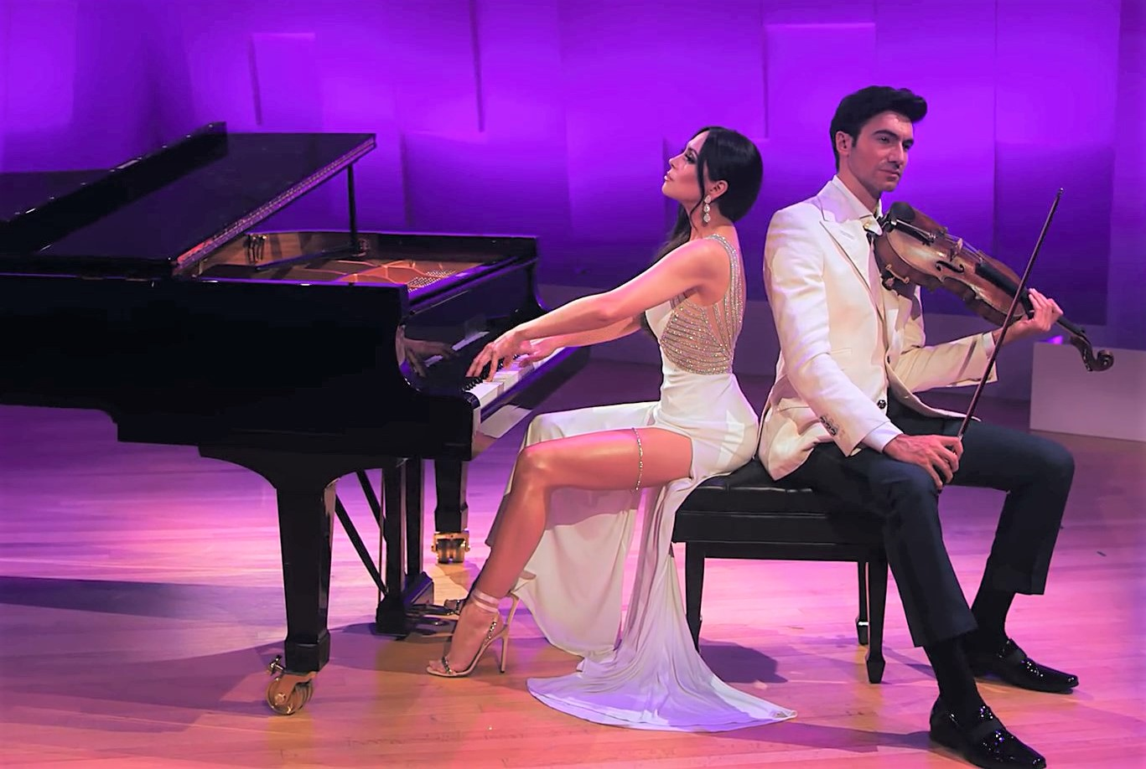




Romantické melodie 3
Elise
Nemesis
The Gods of love
Warriors
Romance
Wind of chance
y@t@t@
Halleluja
www.yatata-blog.eu

