Slide 1
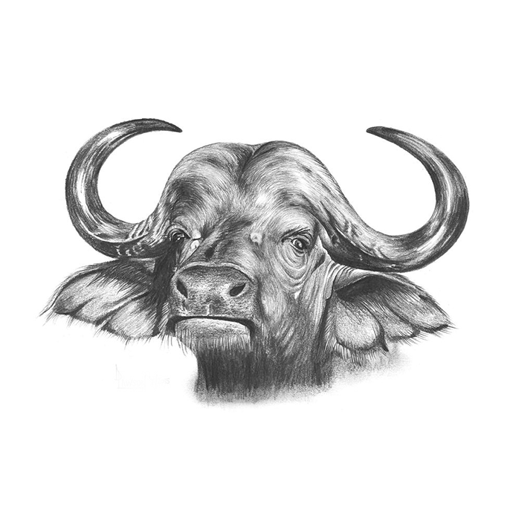

Wildlife
06
Buffalo
Of africa

Slide 2
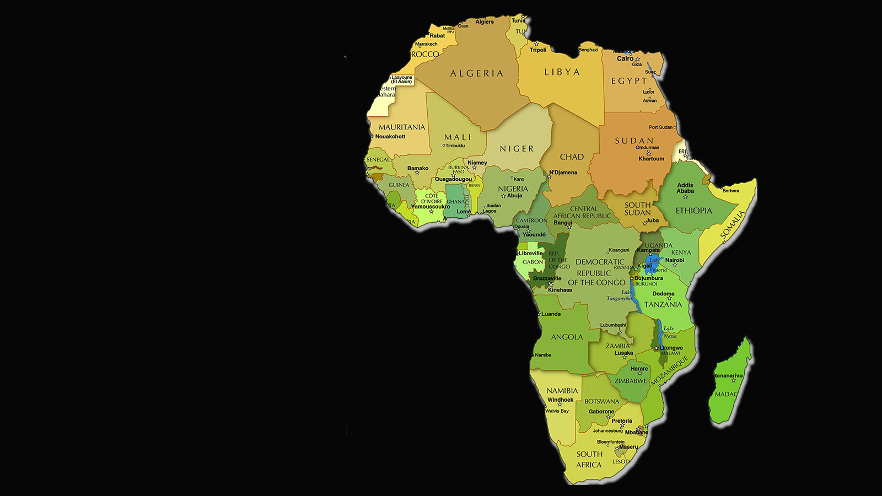

Wildlife
of Africa

Slide 3


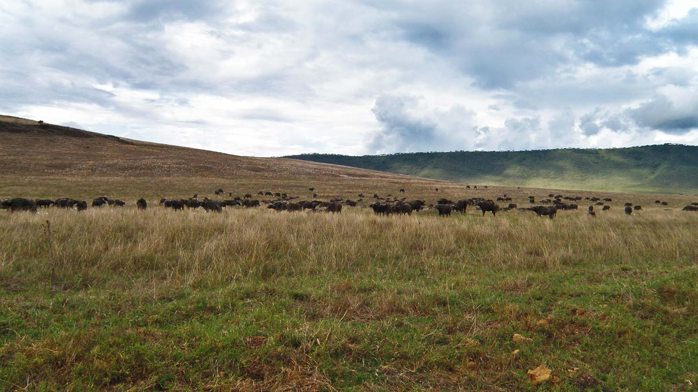
Photo © Hudec Ivan

Slide 4
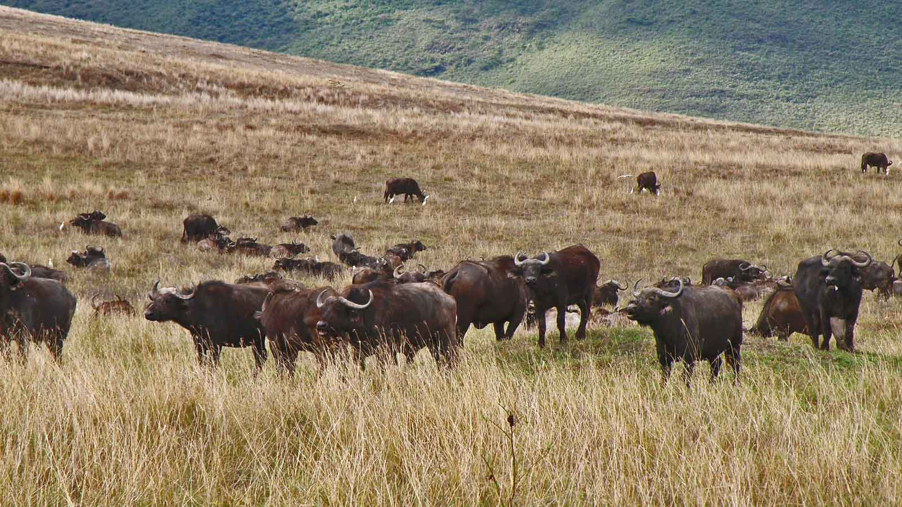
Photo © Hudec Ivan

Slide 5
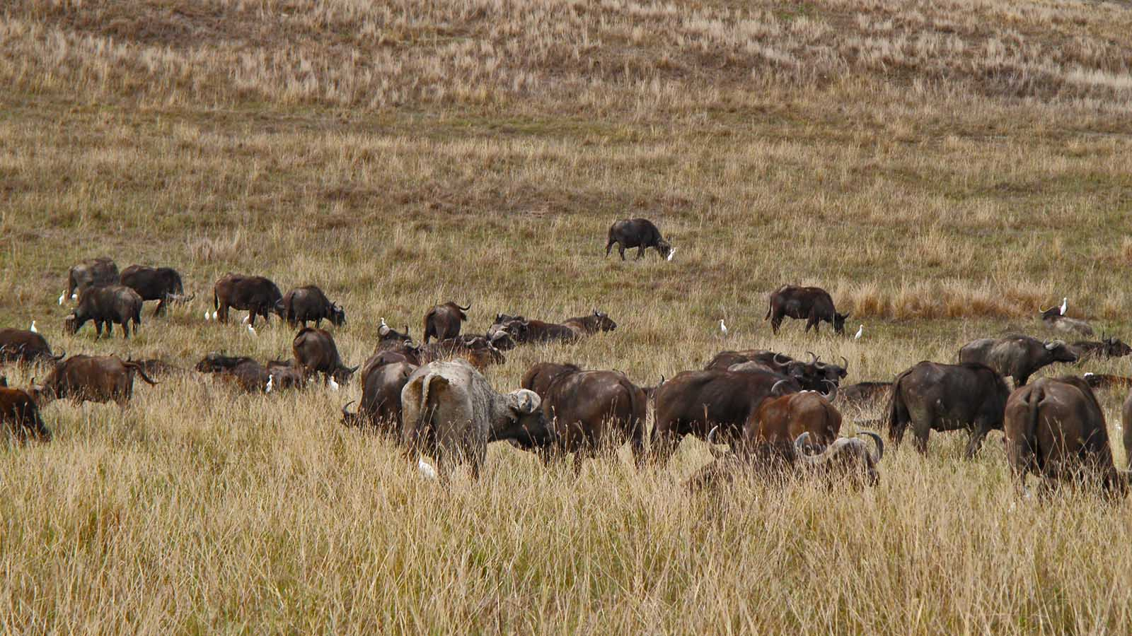
Photo © Hudec Ivan

Slide 6
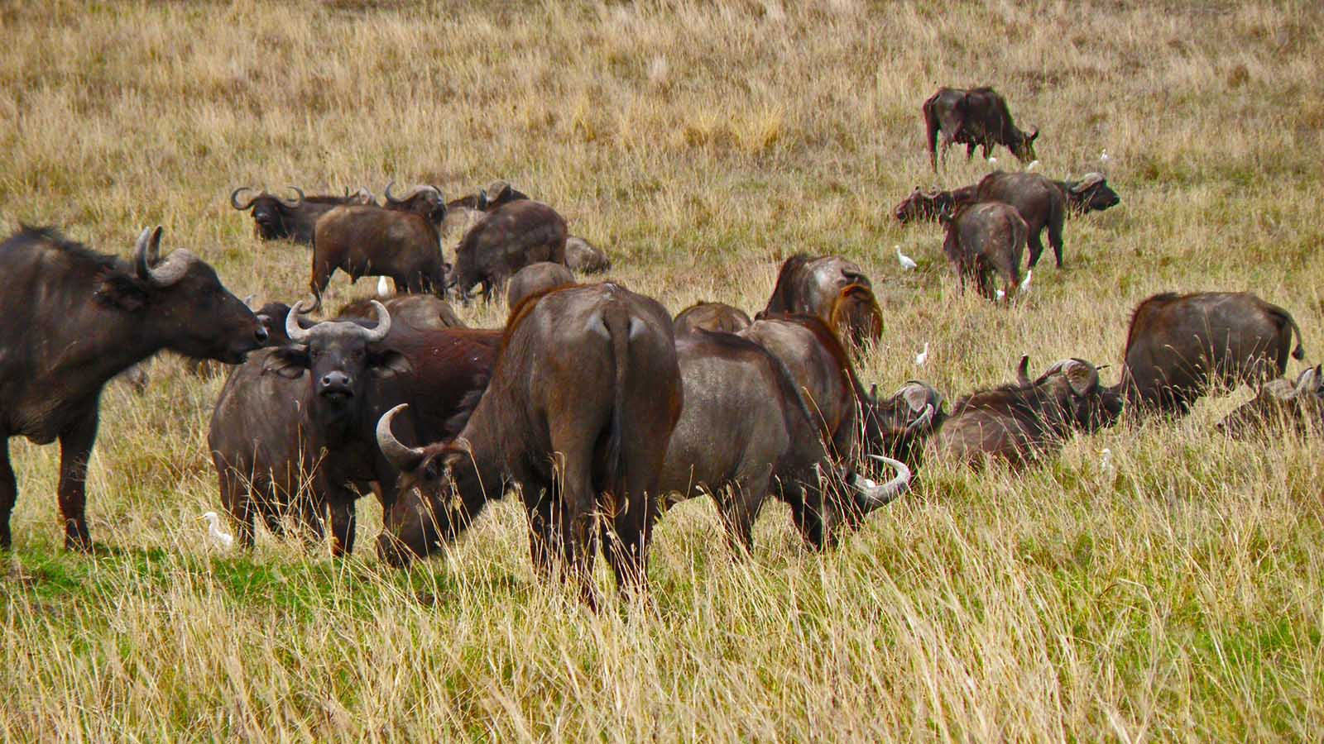
Photo © Hudec Ivan

Slide 7
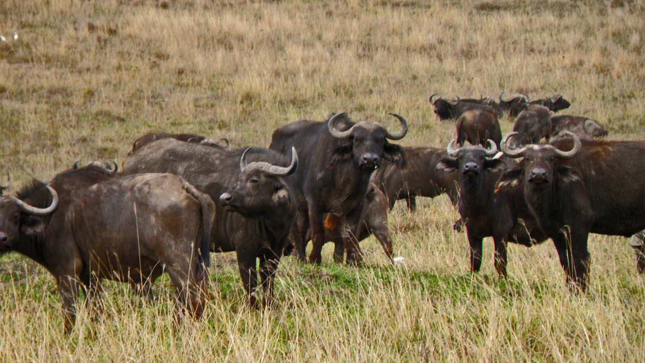
Photo © Hudec Ivan

Slide 8
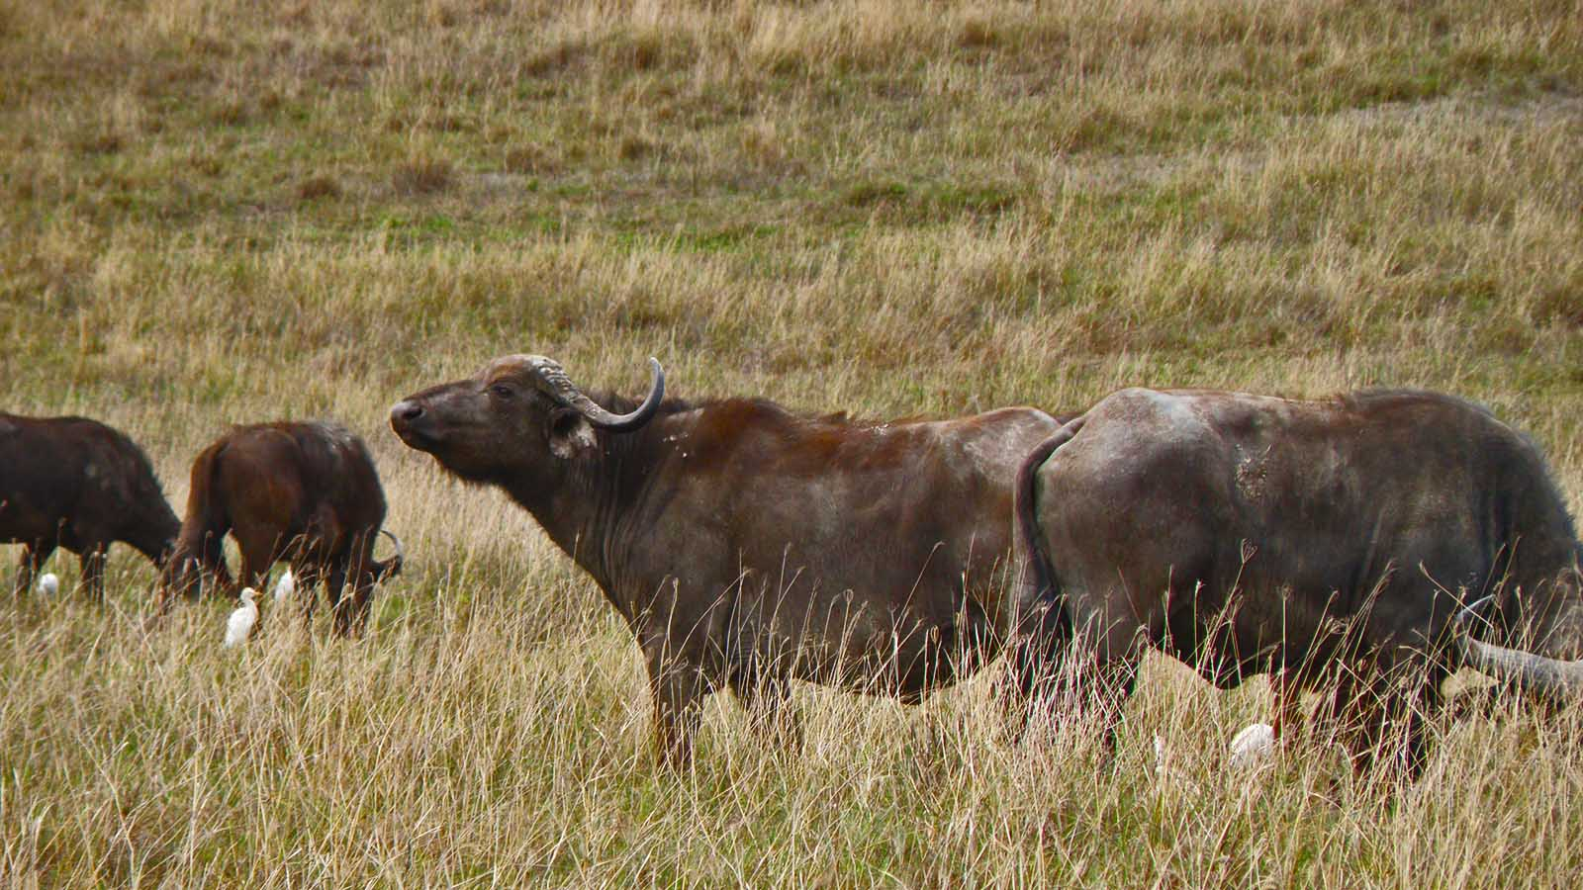
Photo © Hudec Ivan

Slide 9
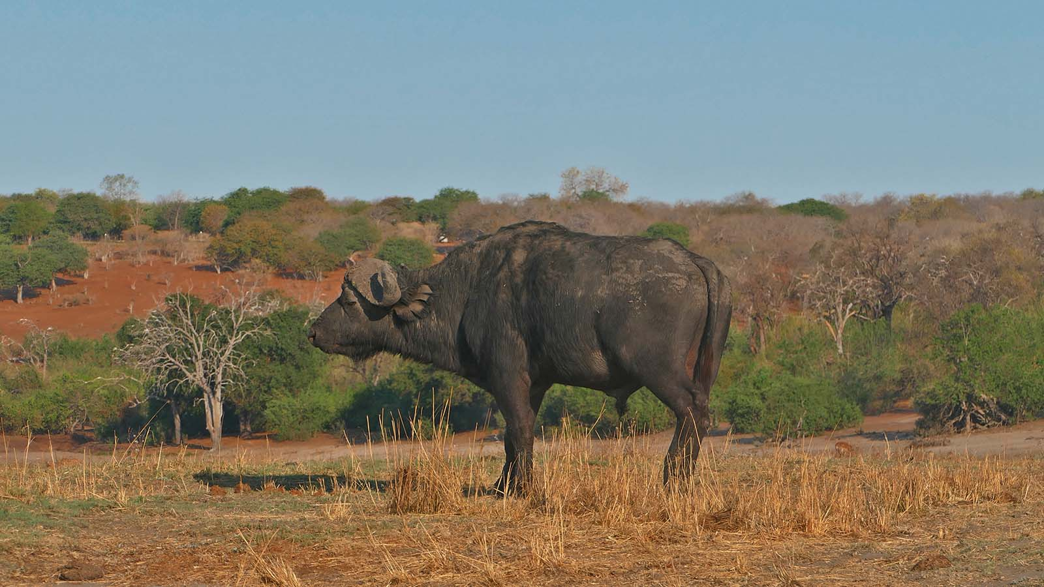
Photo © Sekerka D

Slide 10
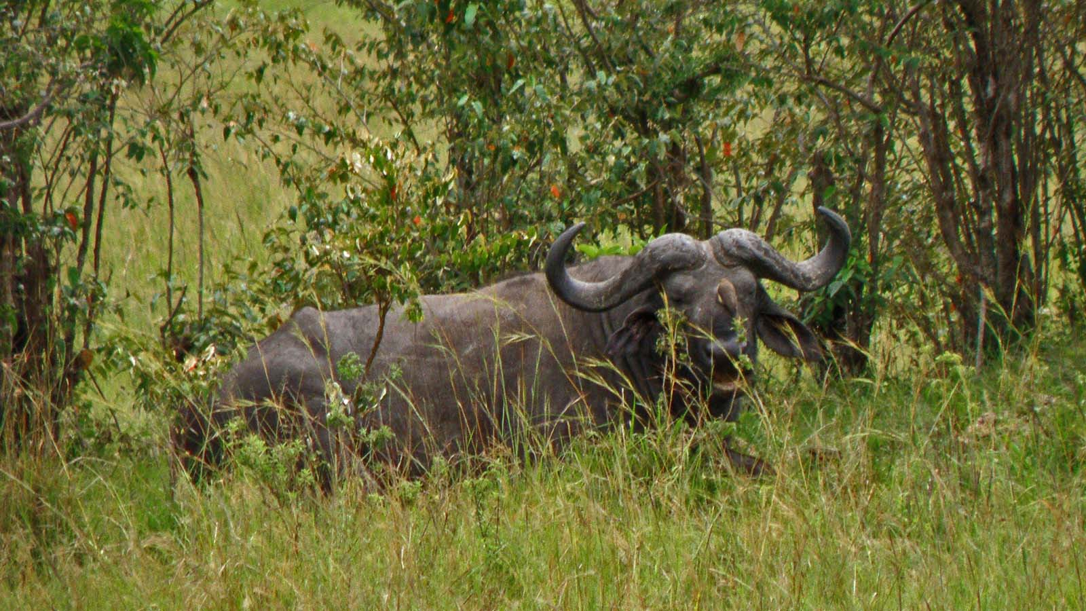
Photo © Hudec Ivan

Slide 11
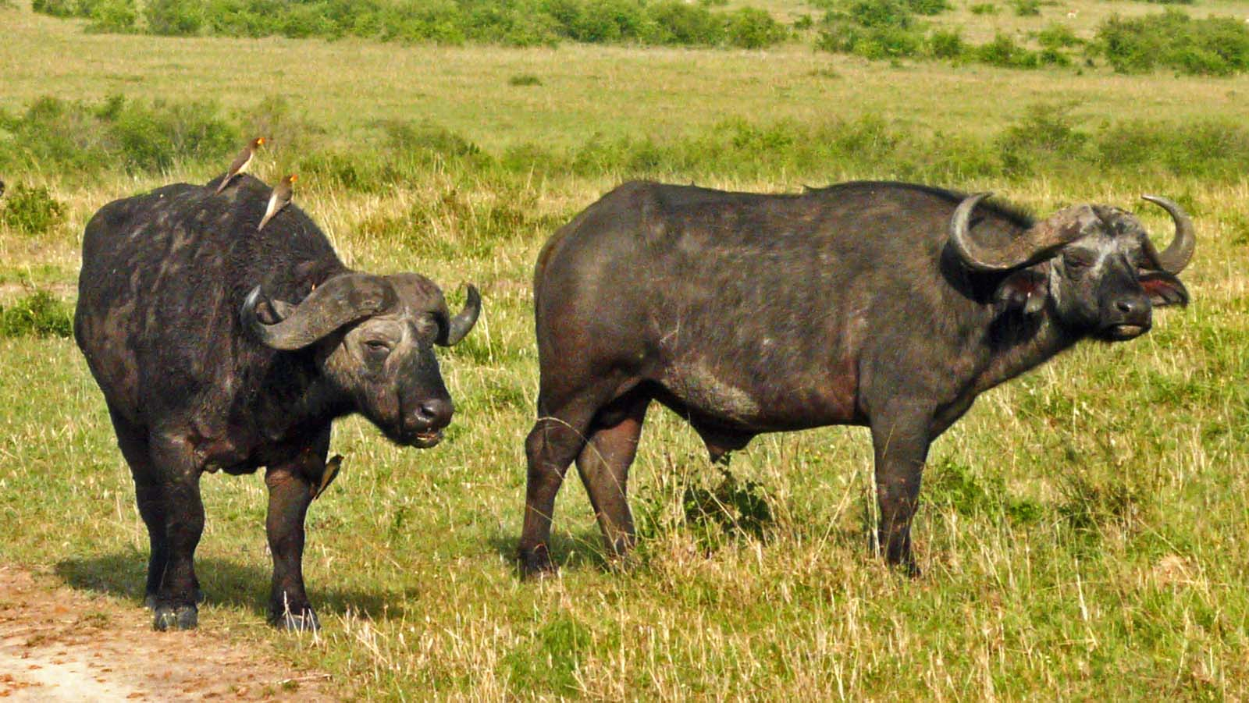
Photo © Nikolai Maksimovitch

Slide 12
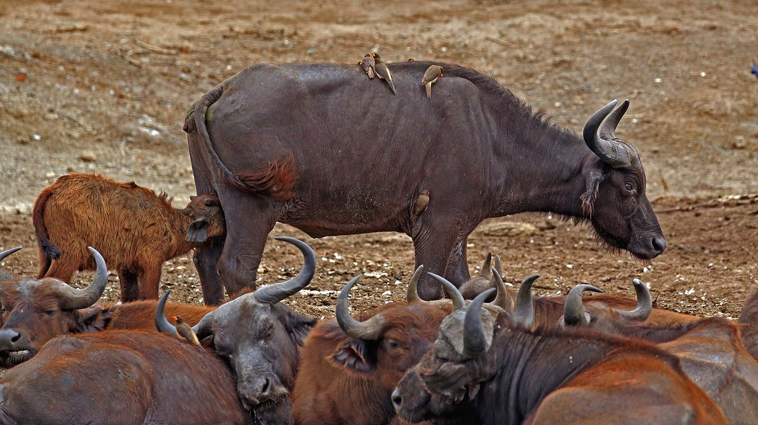
Photo © Charles J.Sharp

Slide 13
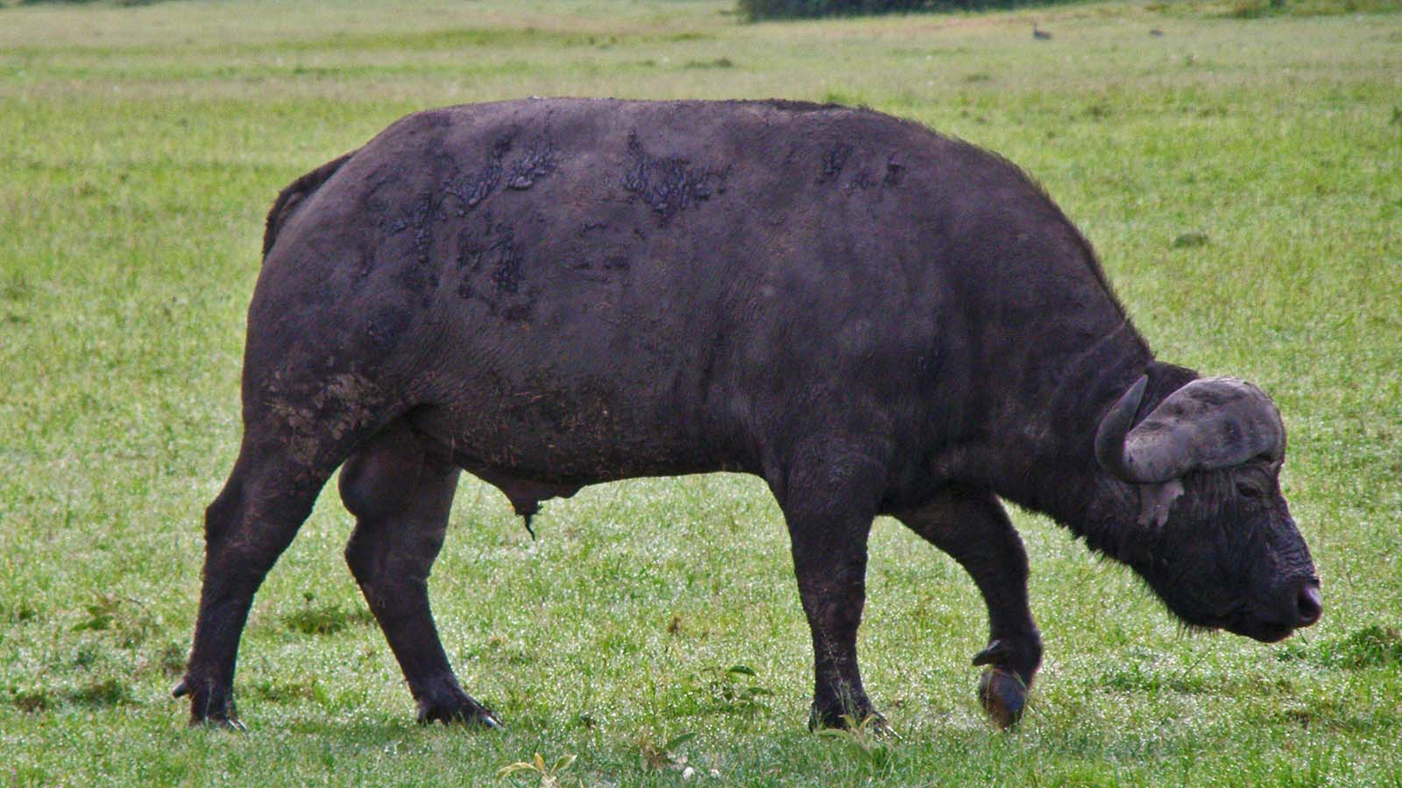
Photo © Hudec Ivan

Slide 14
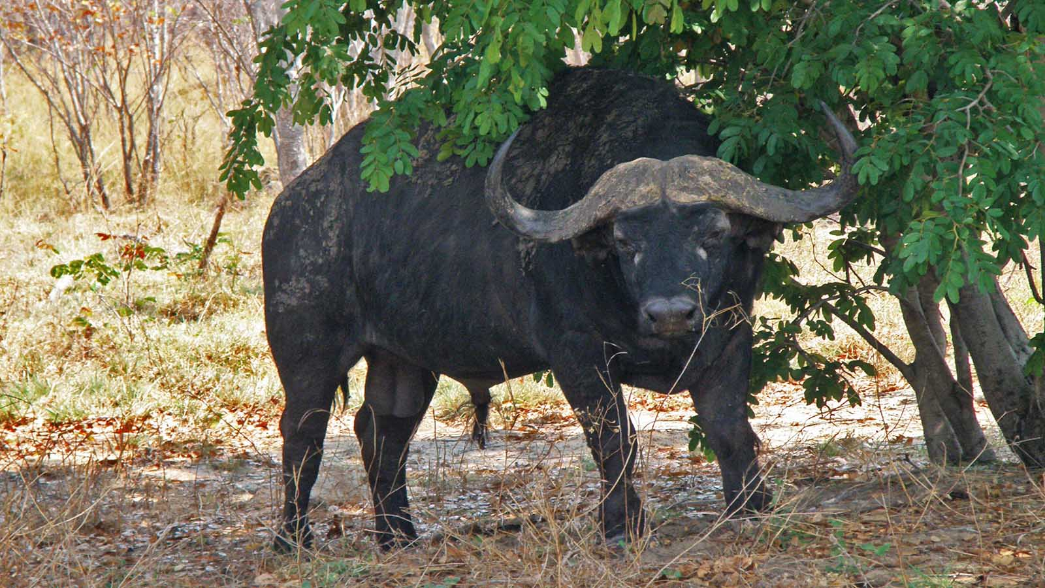
Photo © Hudec Ivan

Slide 15
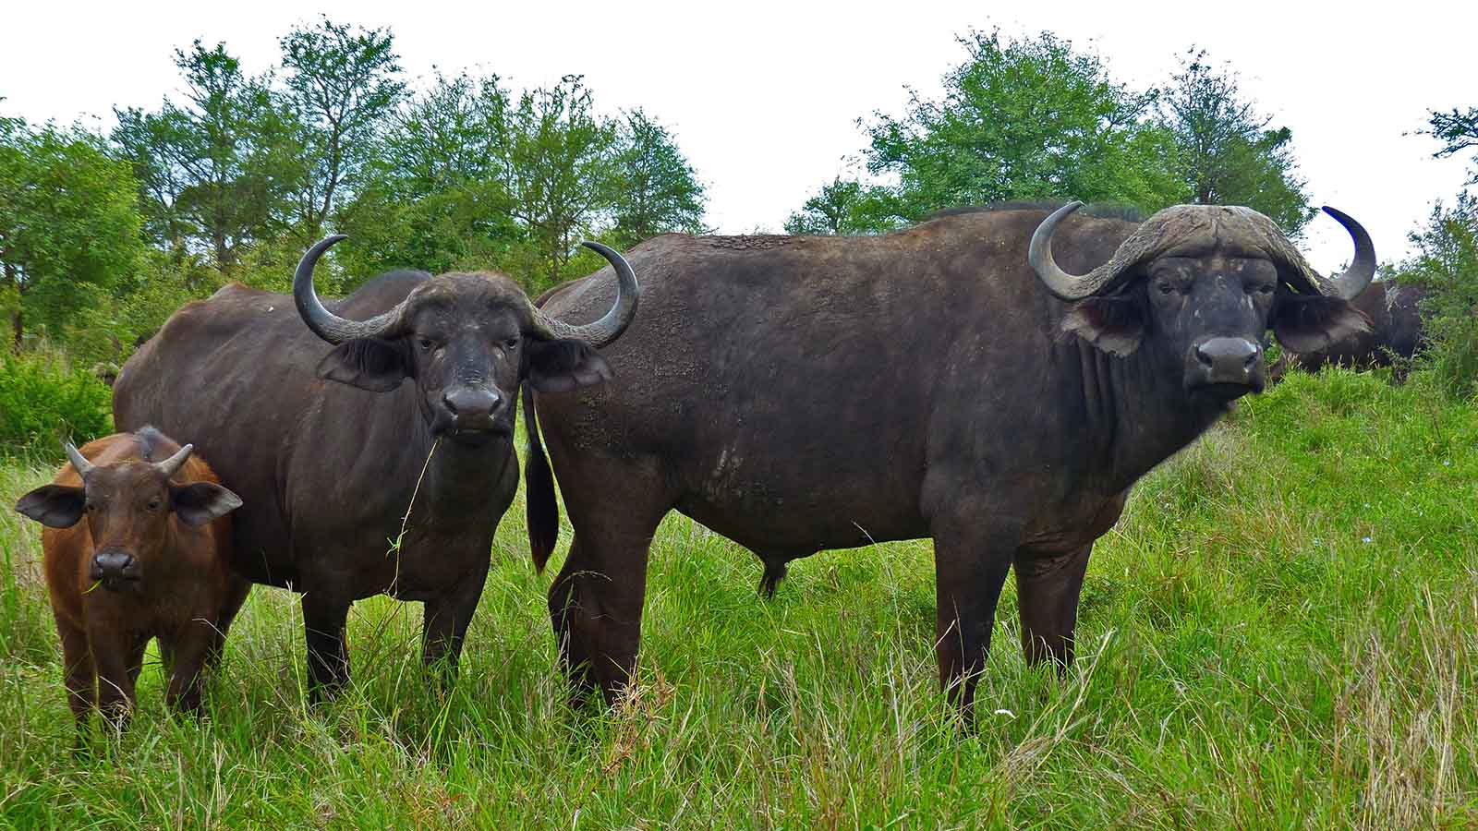
Photo © Bernard Dupont

Slide 16
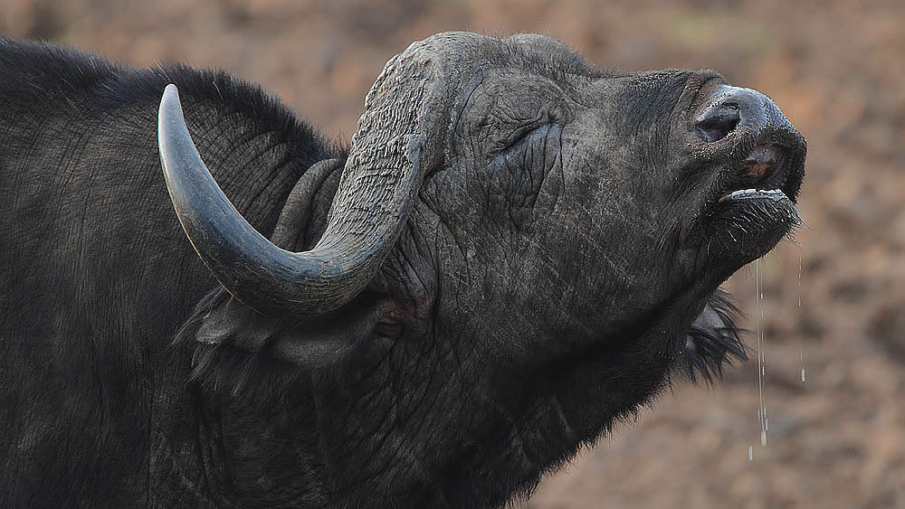
Photo © Steve Garvie

Slide 17
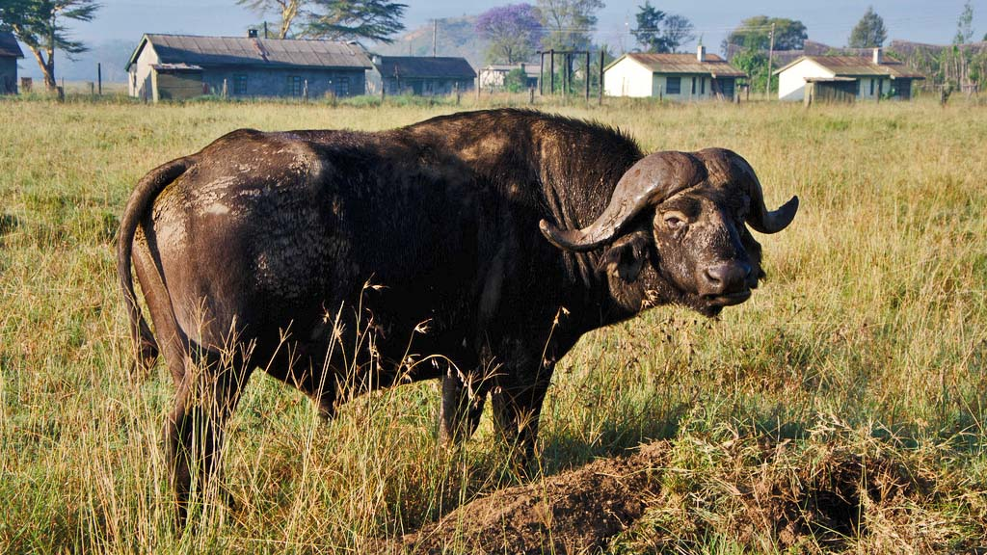
Photo © Daijithegeek

Slide 18
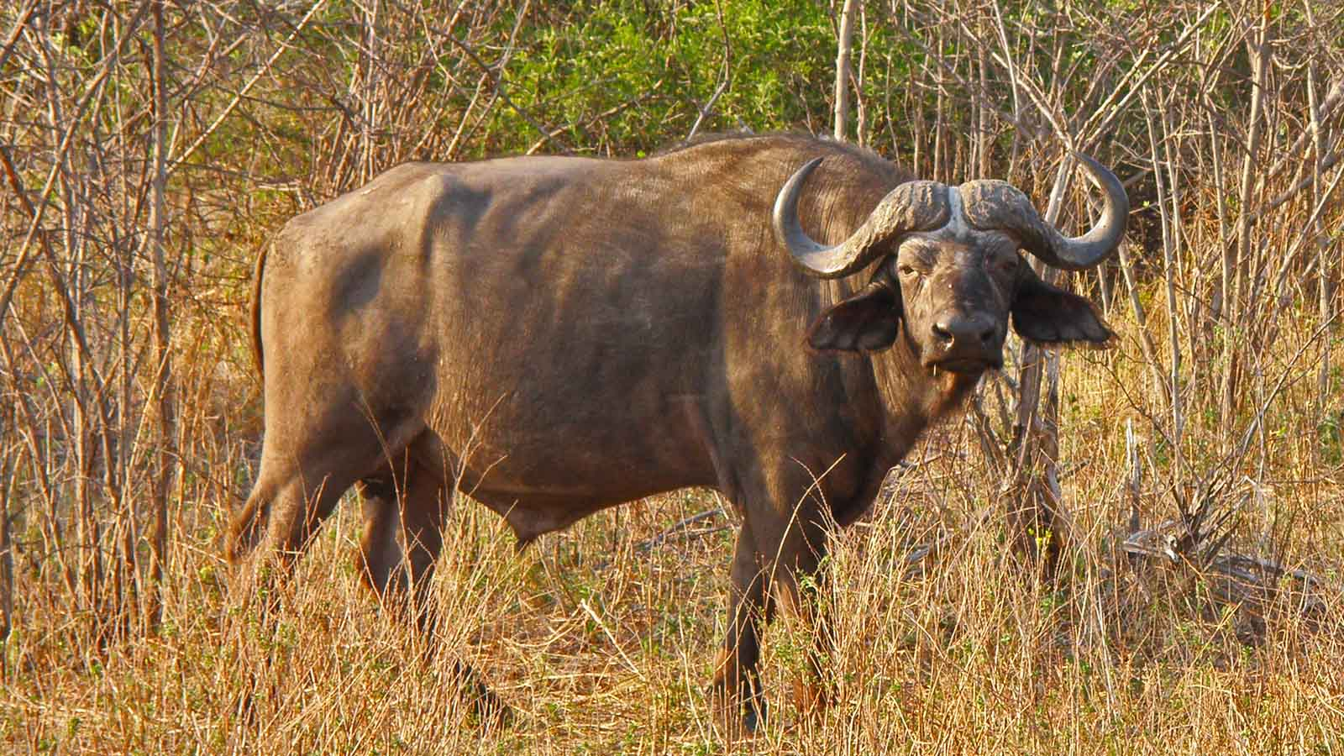
Photo © Hudec Ivan

Slide 19
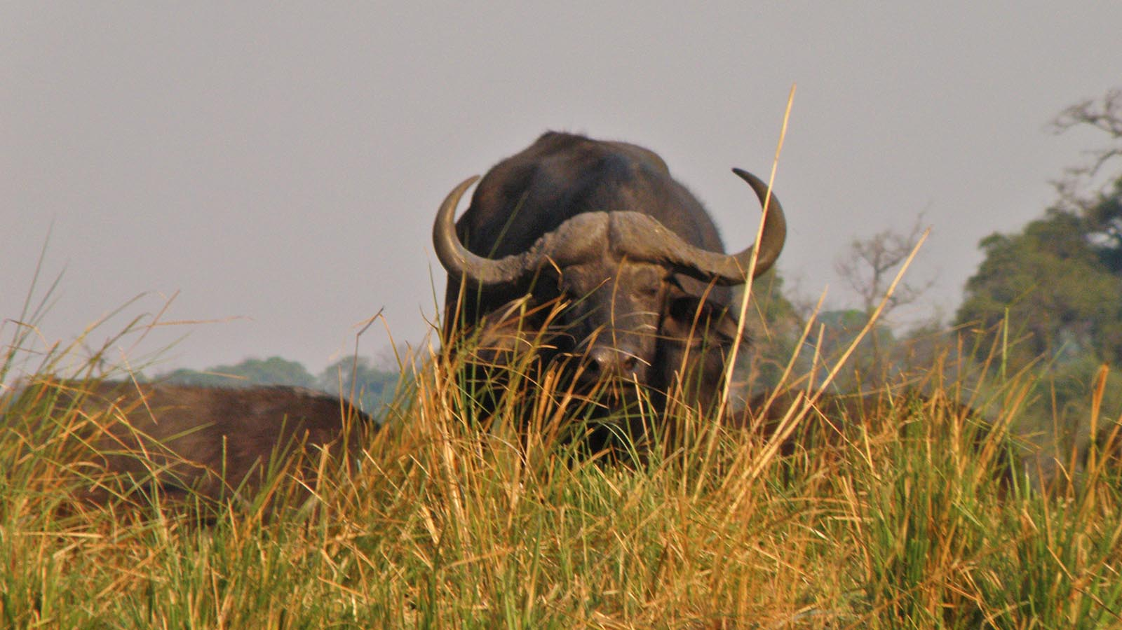
Photo © Hudec Ivan

Slide 20
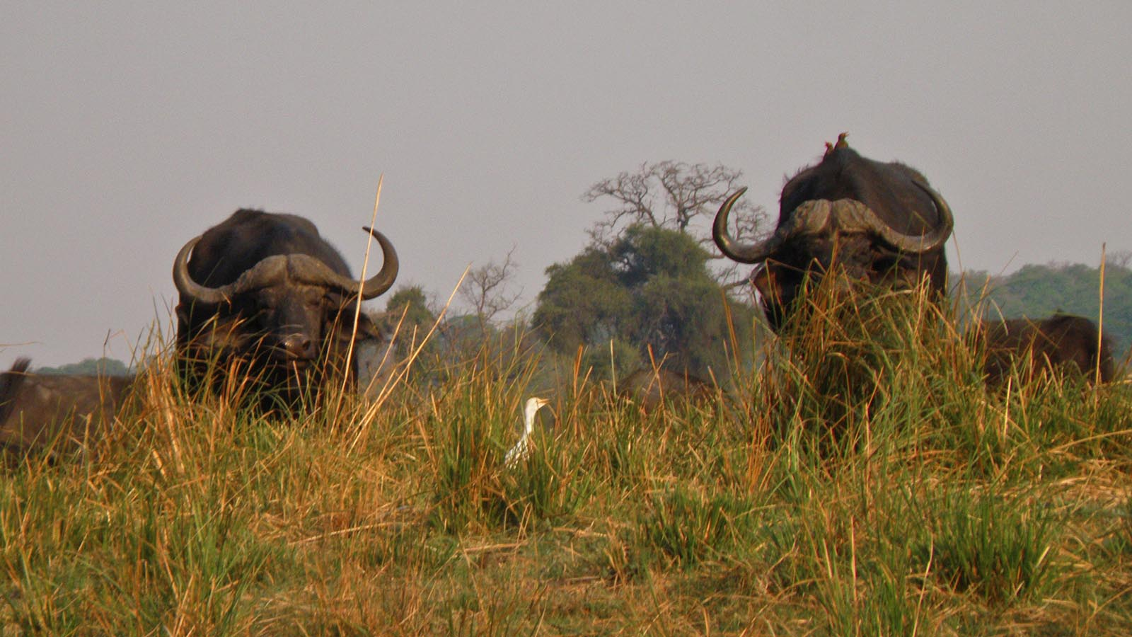
Photo © Hudec Ivan

Slide 21
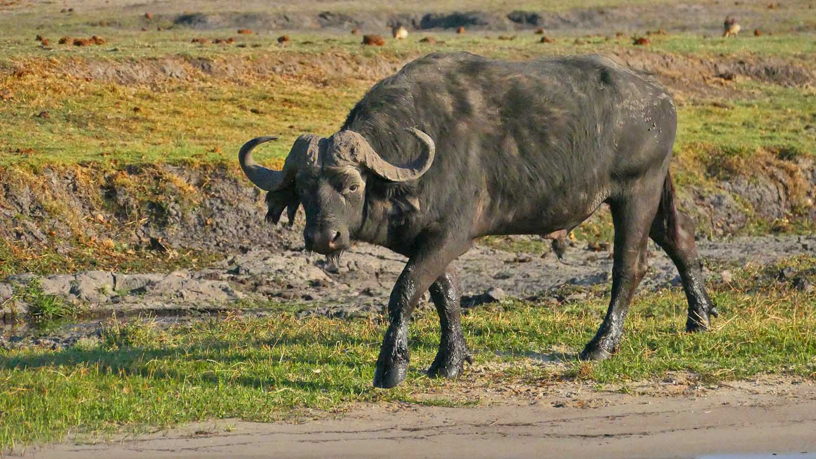
Photo © Sekerka D

Slide 22
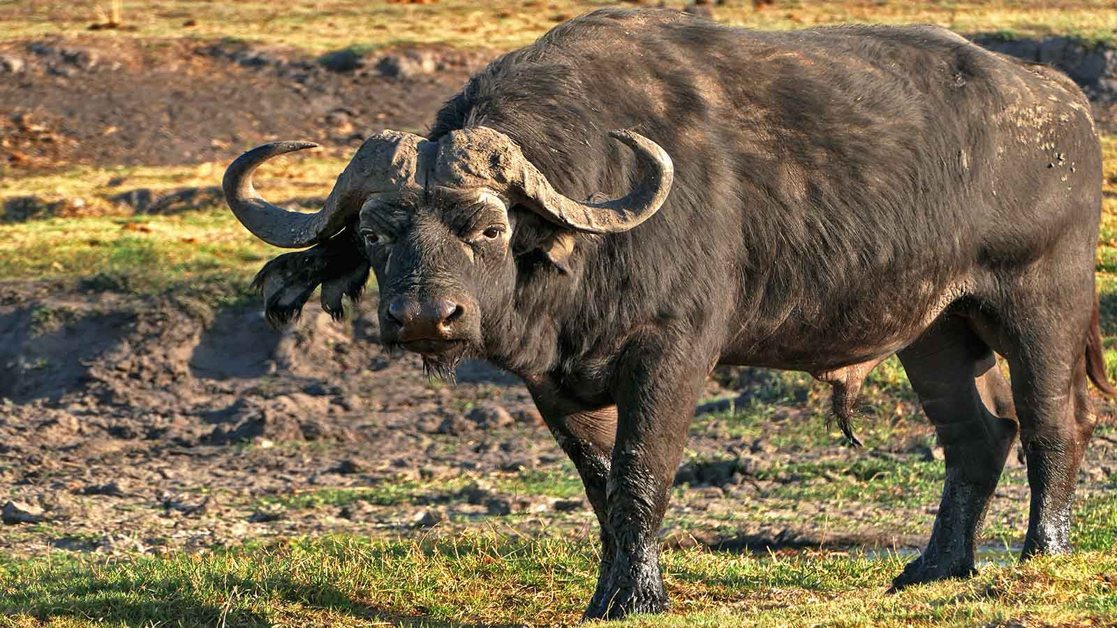
Photo © Sekerka D

Slide 23
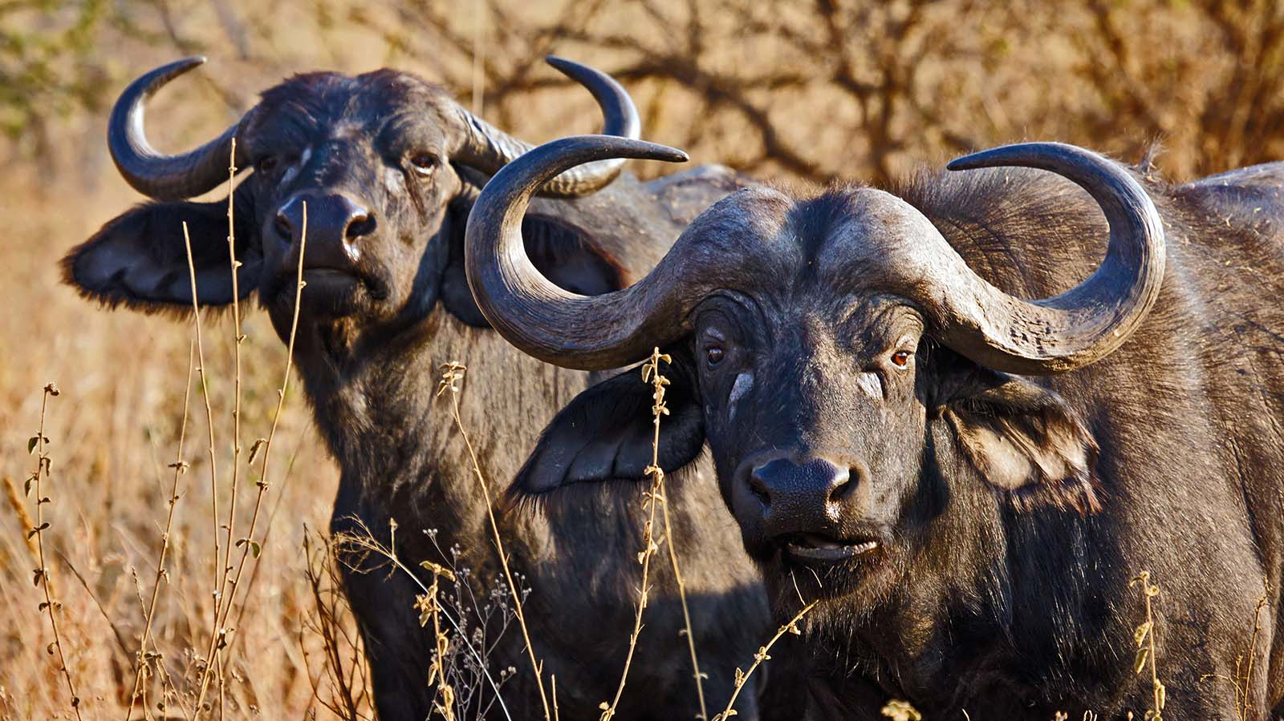
Photo © Ikiwaner

Slide 24
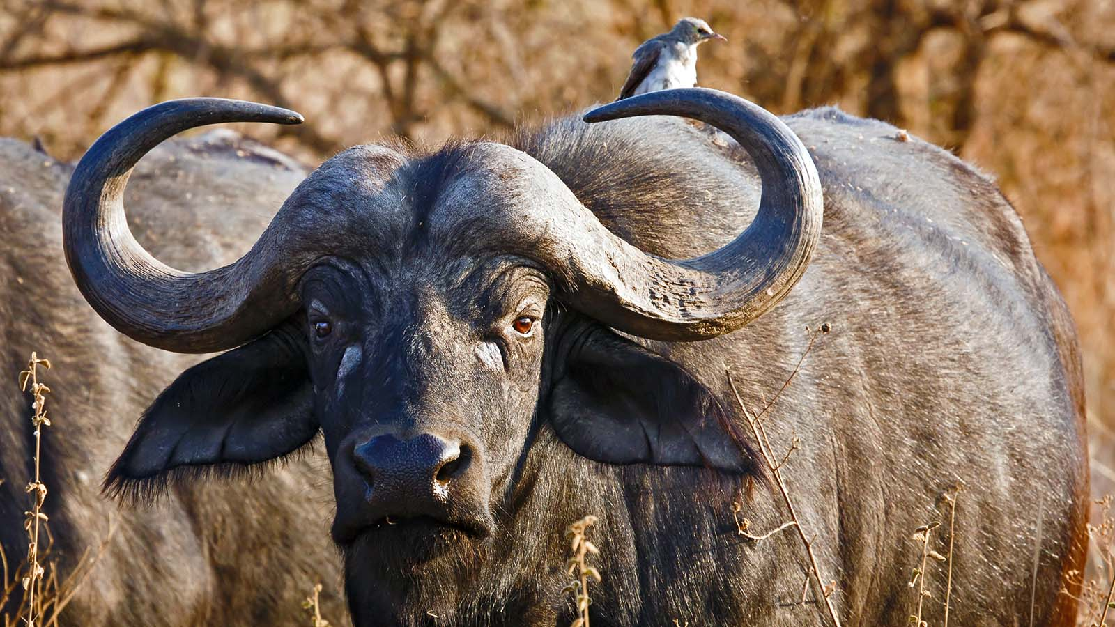
Photo © Ikiwaner

Slide 25
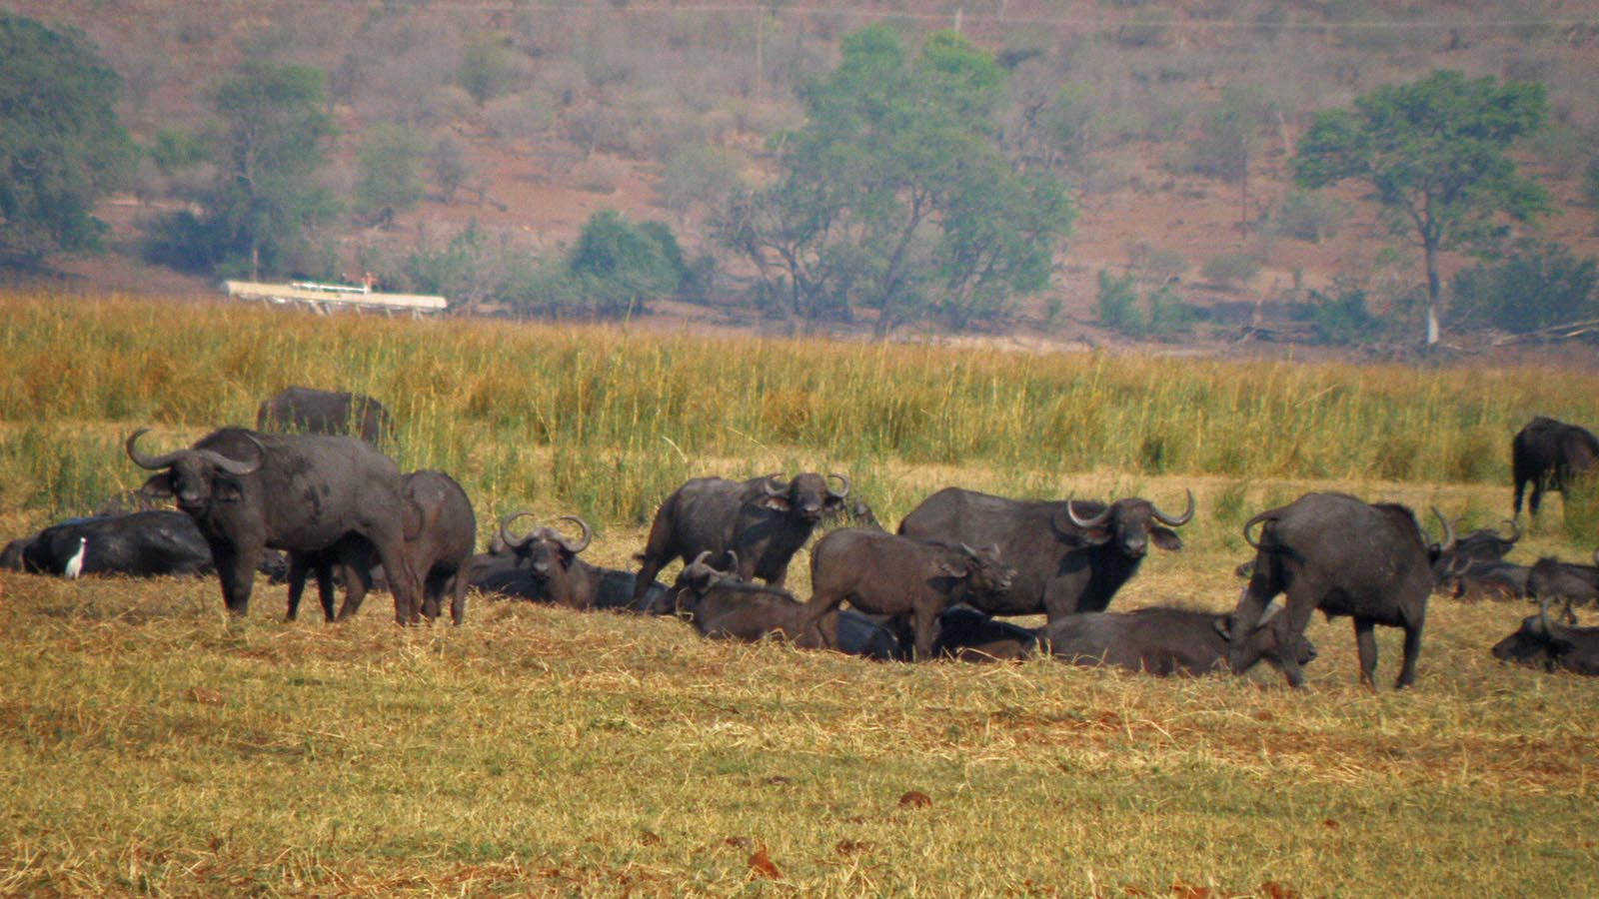
Photo © Hudec Ivan

Slide 26
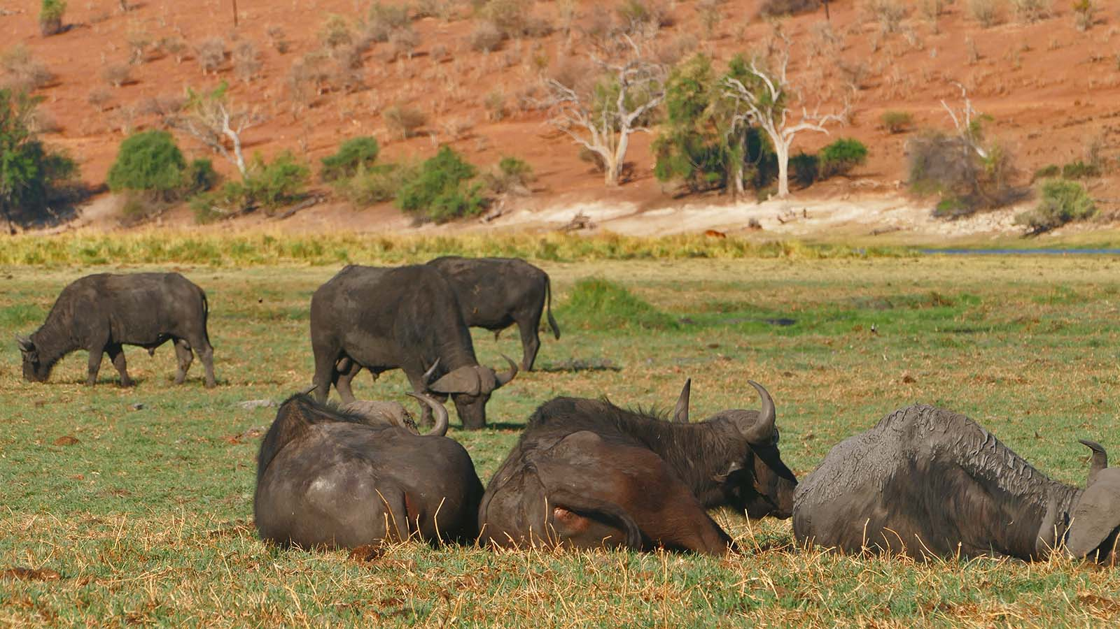
Photo © Sekerka D

Slide 27
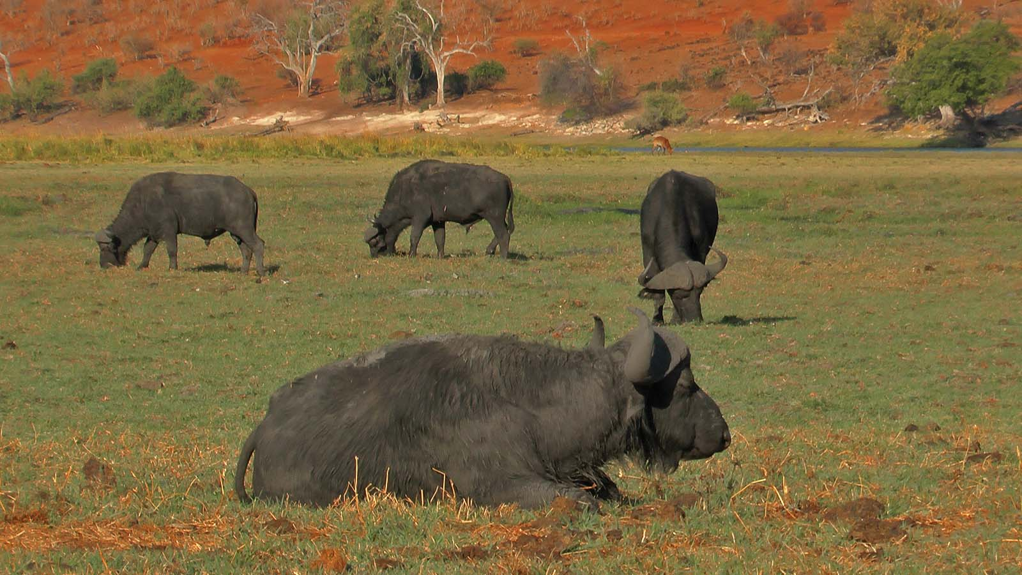
Photo © Sekerka D

Slide 28
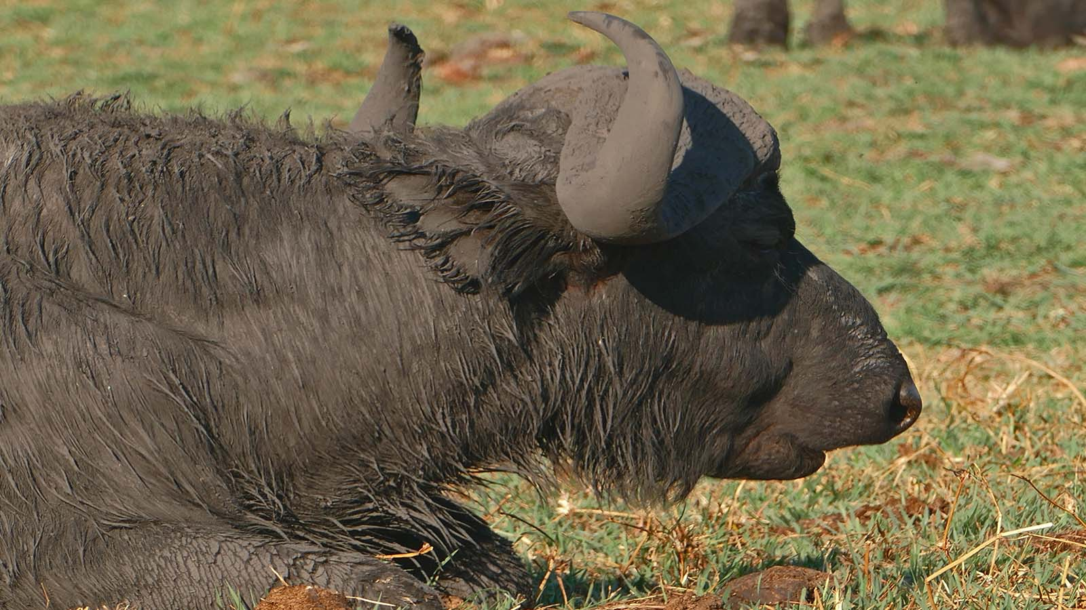
Photo © Sekerka D

Slide 29
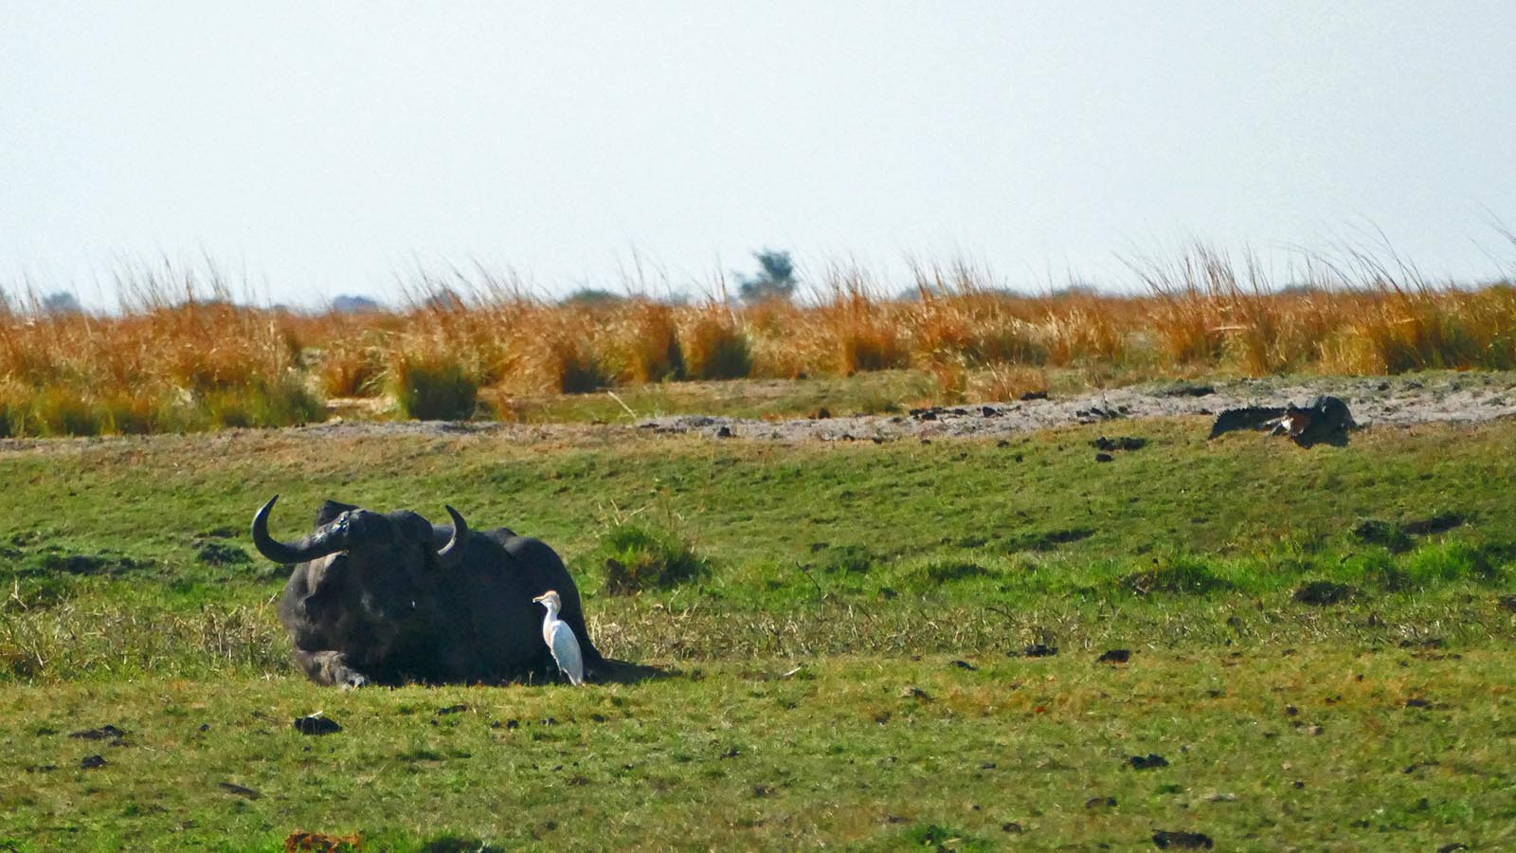
Photo © Sekerka D

Slide 30
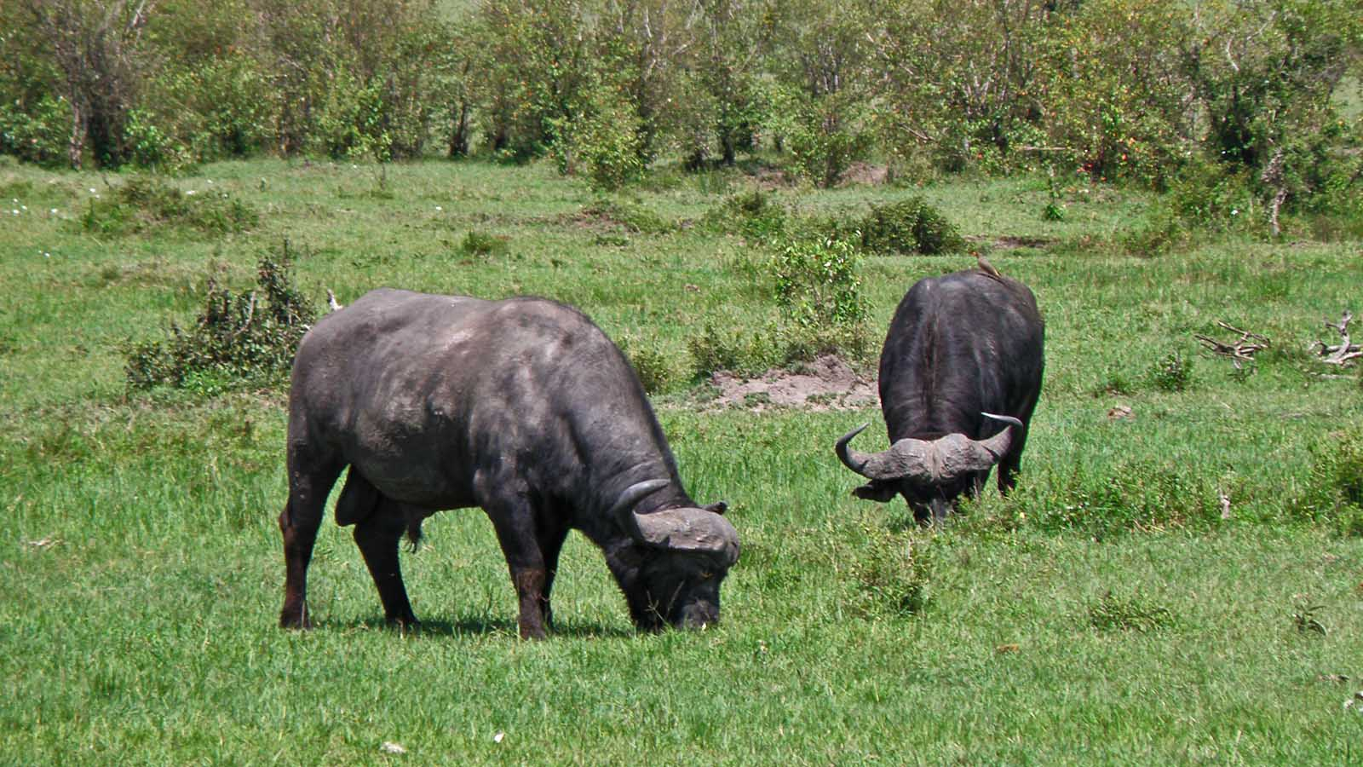
Photo © Hudec Ivan

Slide 31
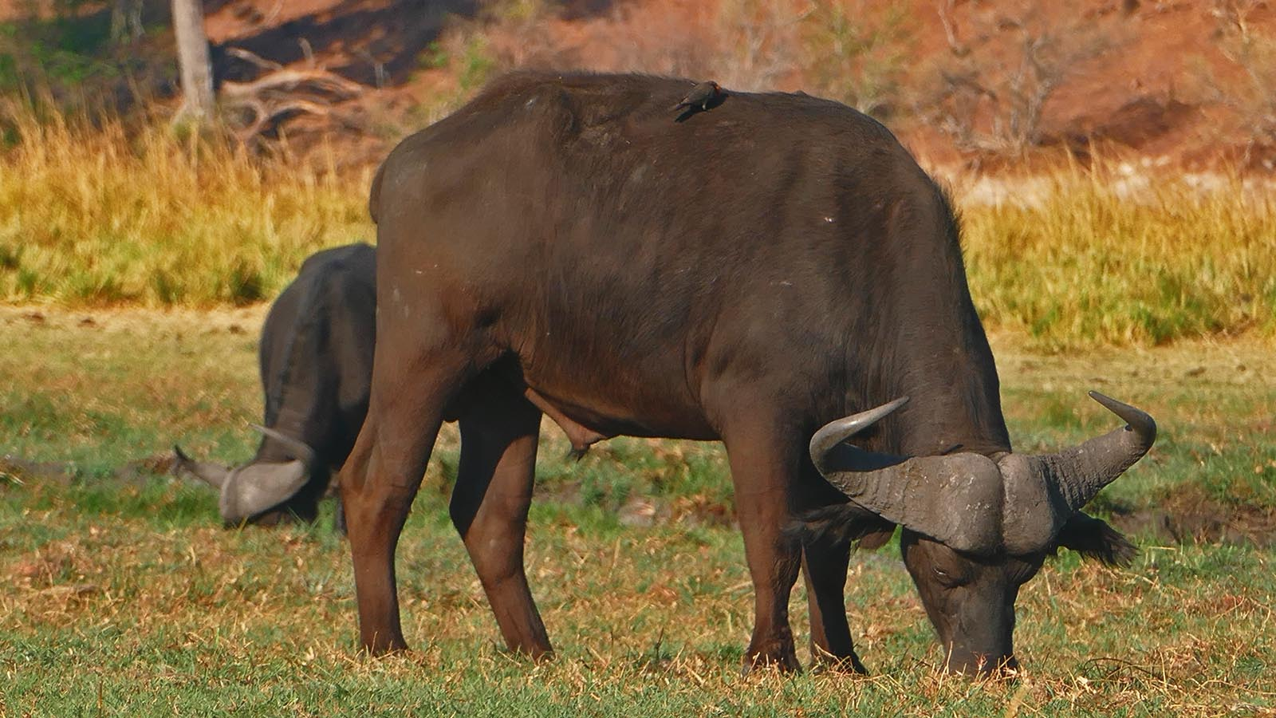
Photo © Sekerka D

Slide 32
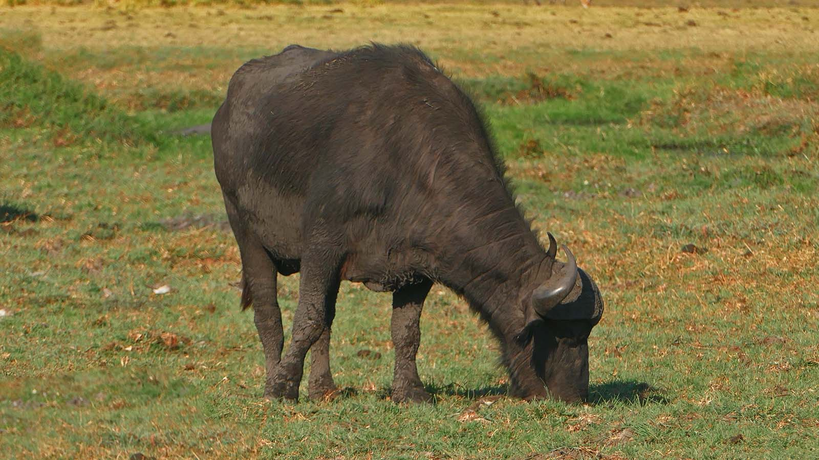
Photo © Sekerka D

Slide 33
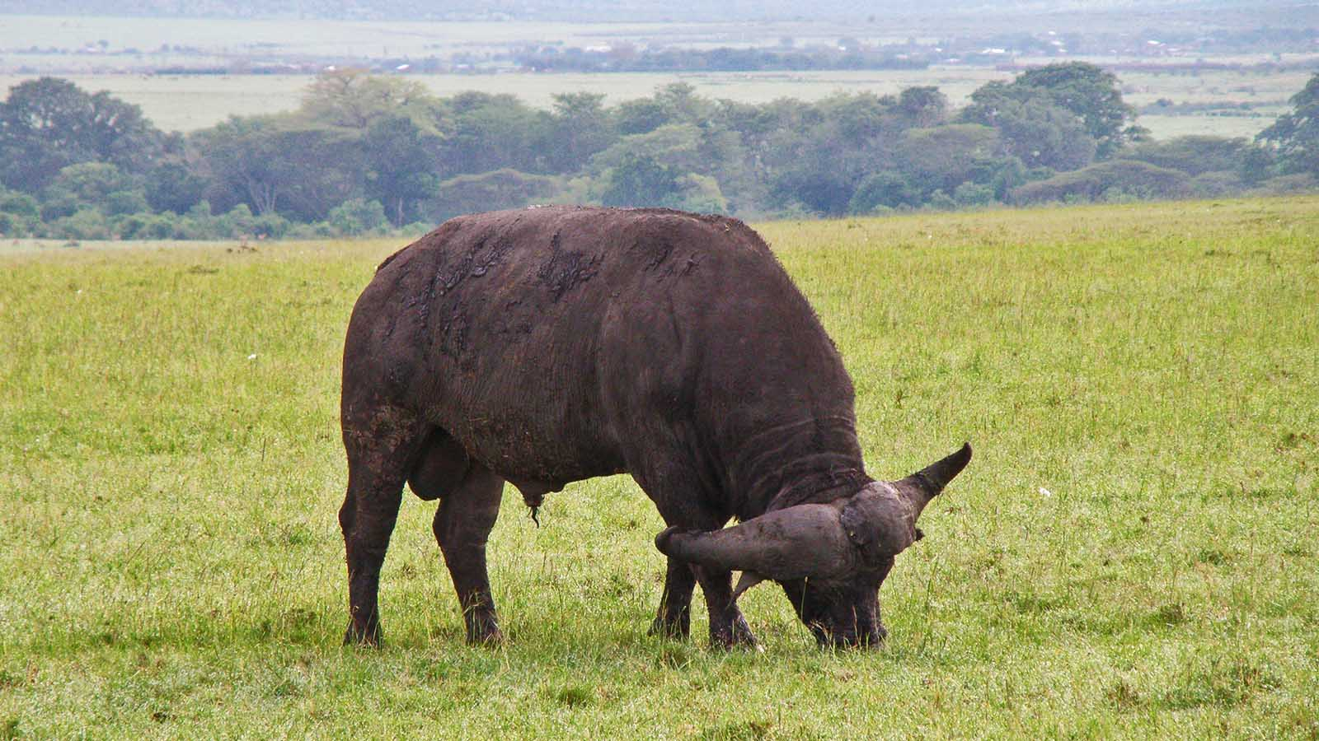
Photo © Hudec Ivan

Slide 34
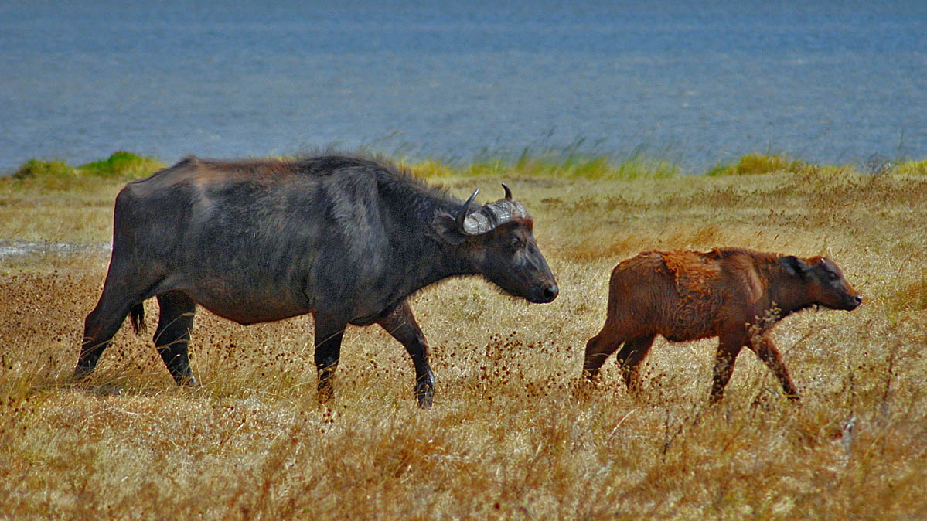
Photo © Pedrito

Slide 35
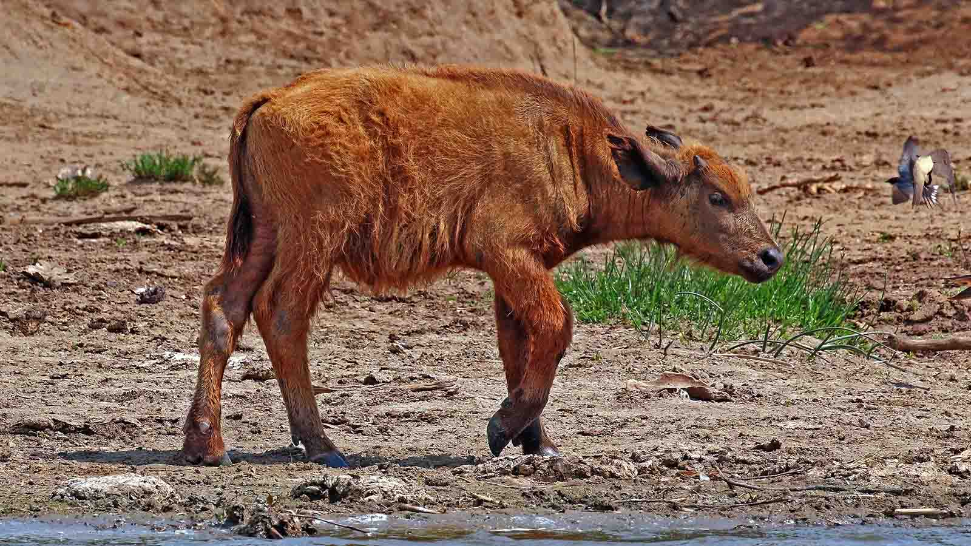
Photo © Charles J.Sharp

Slide 36


2021
Music : Mkhulu Wam
Photos : Sekerka Dušan, Ing. (Slovakia)
Photos : Hudec Ivan (Slovakia)
Photos : Internet (Wikimedia)
Created by : Rumpler Štefan (Slovakia)
Contact : pista2011@gmail.com

Slide 37


Welcome in all languages!
I can translate your mails!
pista2011@gmail.com
CLICK FOR MY TRAVEL VIDEOS
Thank you for your feedback
Steve

