Slide 1
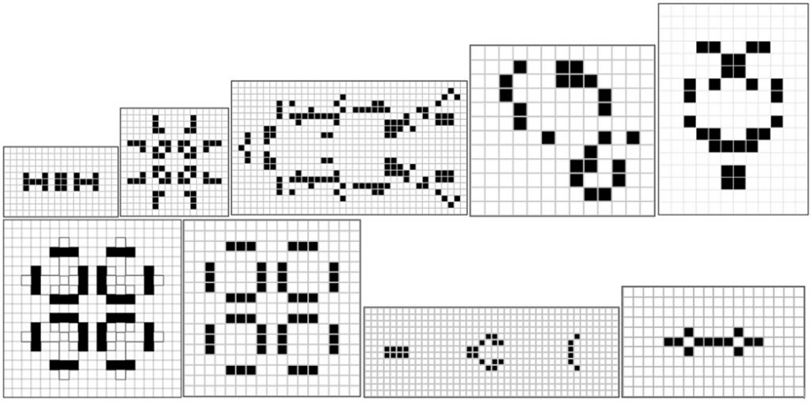
The game of life

Slide 2
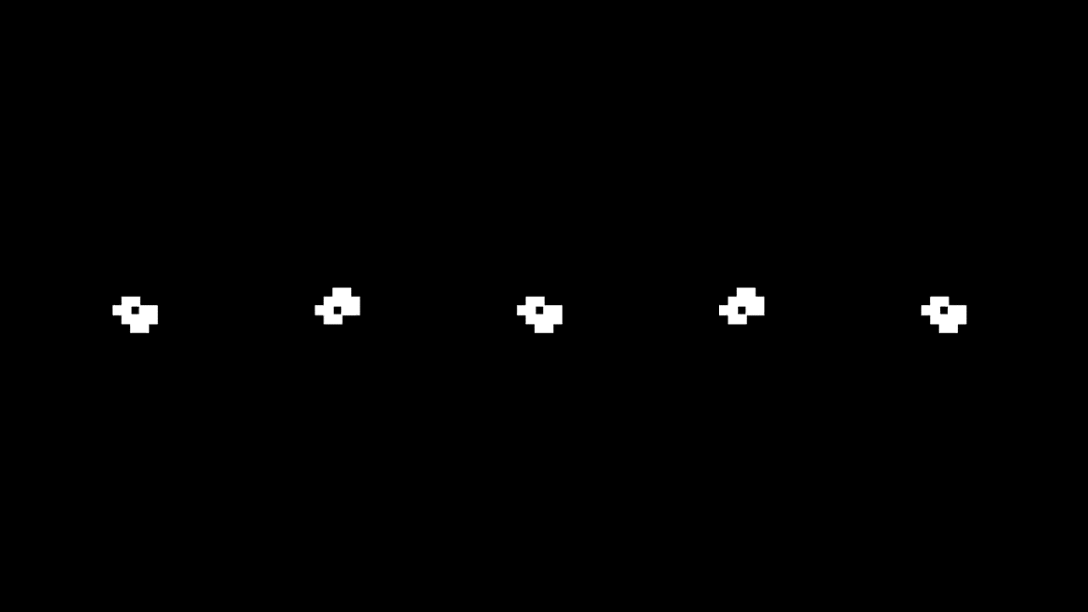

Slide 3
Origins of the game and what is it about

Slide 4
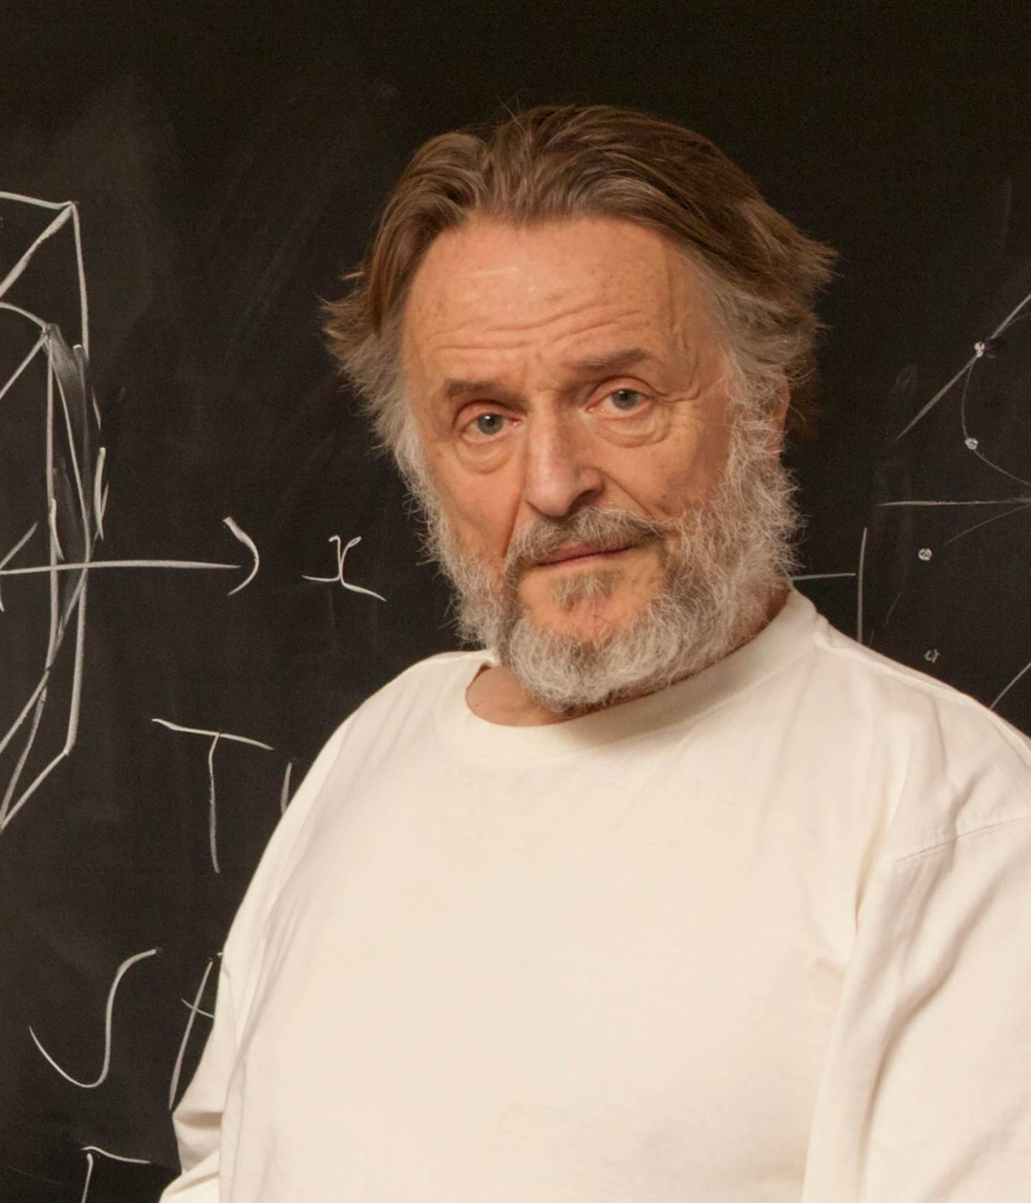
John Conway (1937 – 2020)
British mathematician
Created the game of life in 1970

Slide 5
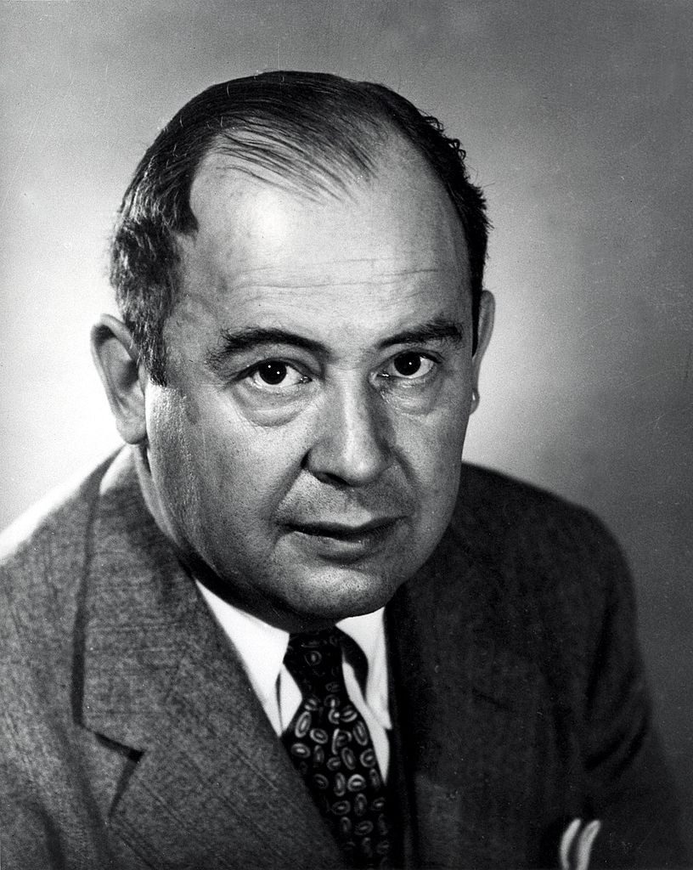
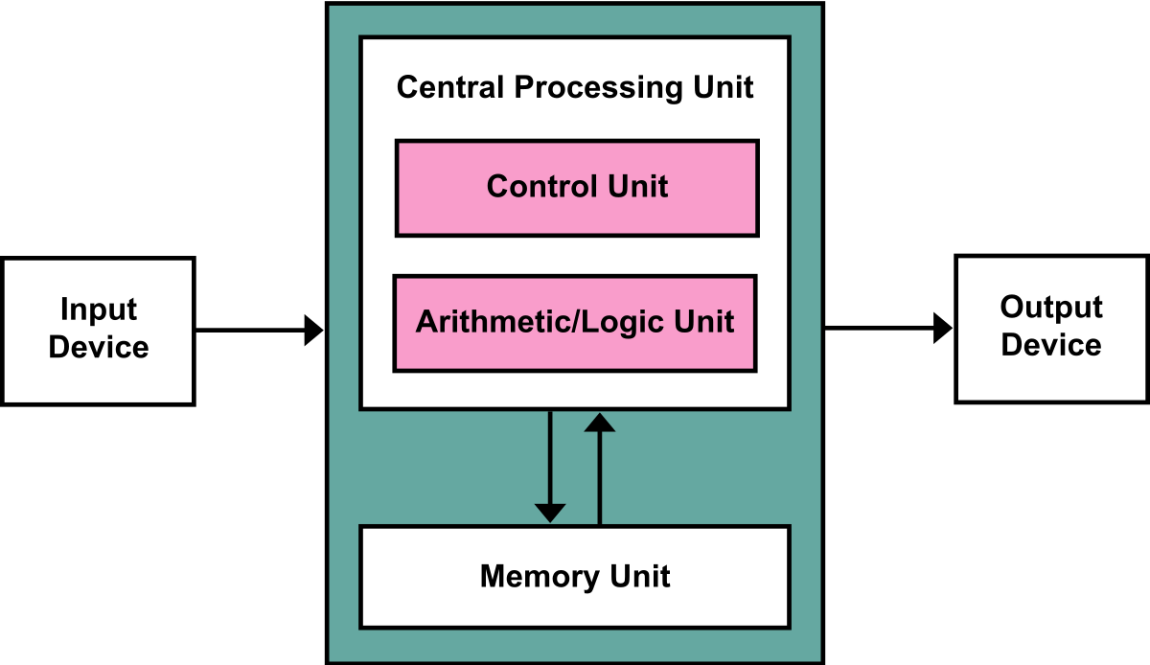
John Von Neumann (1903 – 1957)
Hungarian mathematician
Contributed to computing
Von-Neumann-Architektur

Slide 6
Why was it created

Slide 7
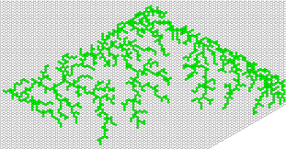
Exemple of cellular automaton

Slide 8
How does it works

Slide 9
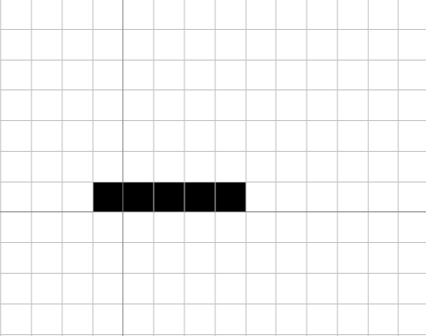

Rules :
If ■ surrounded by 2 or 3 ■ = survive, 4 or more = ☠
If □ surrounded by 3 neighbor = birth of cells

Slide 10
Rules :
If ■ surrounded by 2 or 3 ■ = survive, 4 or more = ☠
If □ surrounded by 3 neighbor = birth of cells
Exemple : 5 cells in a row

Slide 11
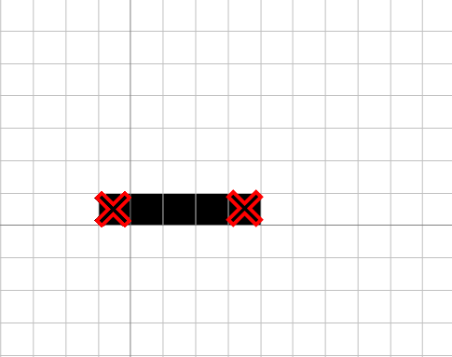
Rules :
If ■ surrounded by 2 or 3 ■ = survive, 4 or more = ☠
If □ surrounded by 3 neighbor = birth of cells
2 cells dies

Slide 12
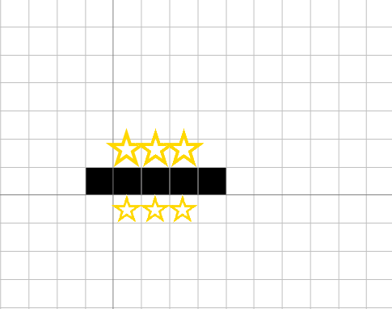
Rules :
If ■ surrounded by 2 or 3 ■ = survive, 4 or more = ☠
If □ surrounded by 3 neighbor = birth of cells
6 cells born

Slide 13
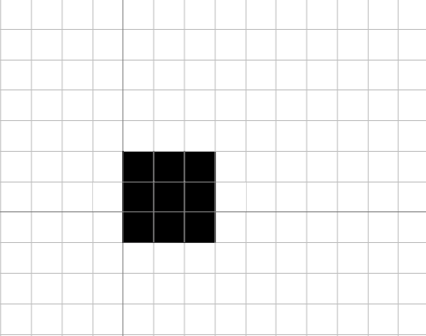
Rules :
If ■ surrounded by 2 or 3 ■ = survive, 4 or more = ☠
If □ surrounded by 3 neighbor = birth of cells
Final result :

Slide 14
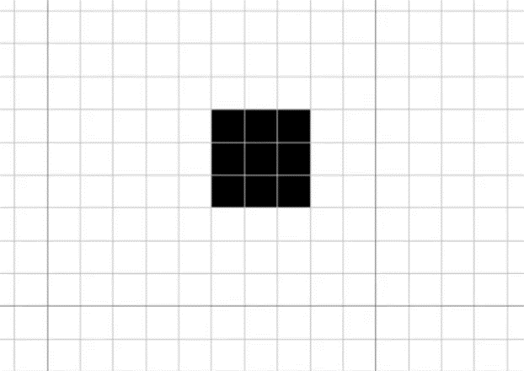
Rules :
If ■ surrounded by 2 or 3 ■ = survive, 4 or more = ☠
If □ surrounded by 3 neighbor = birth of cells
Exemple of a cell evolution

