Slide 1
RNAscope assays for spatial transcriptomic
Next generation in situ hybridization

Slide 2
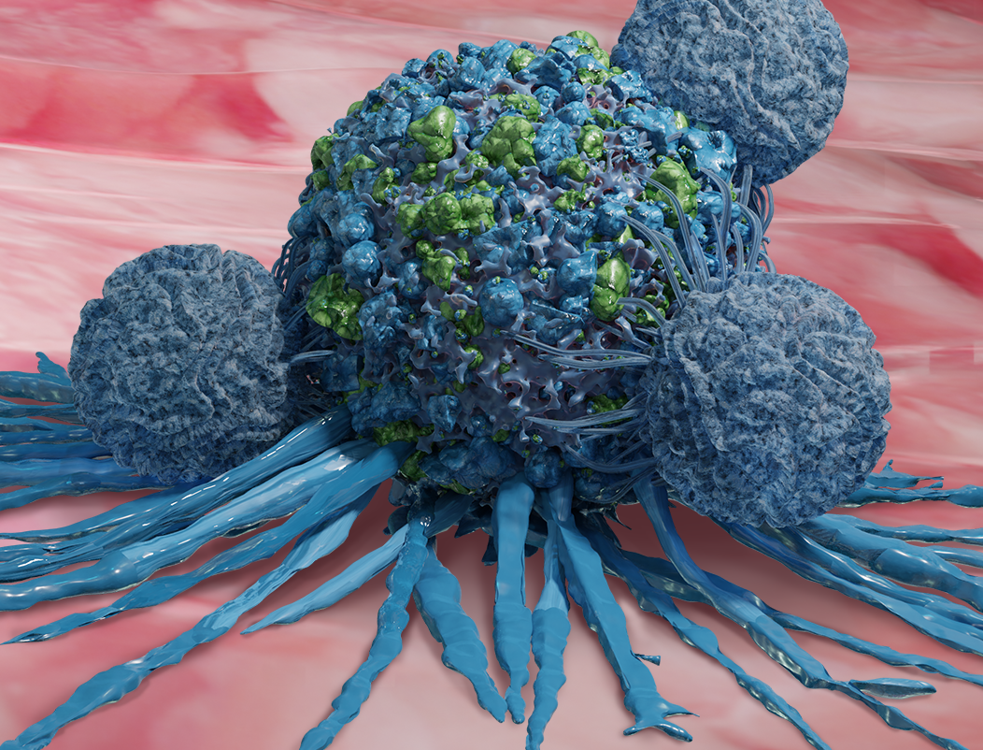
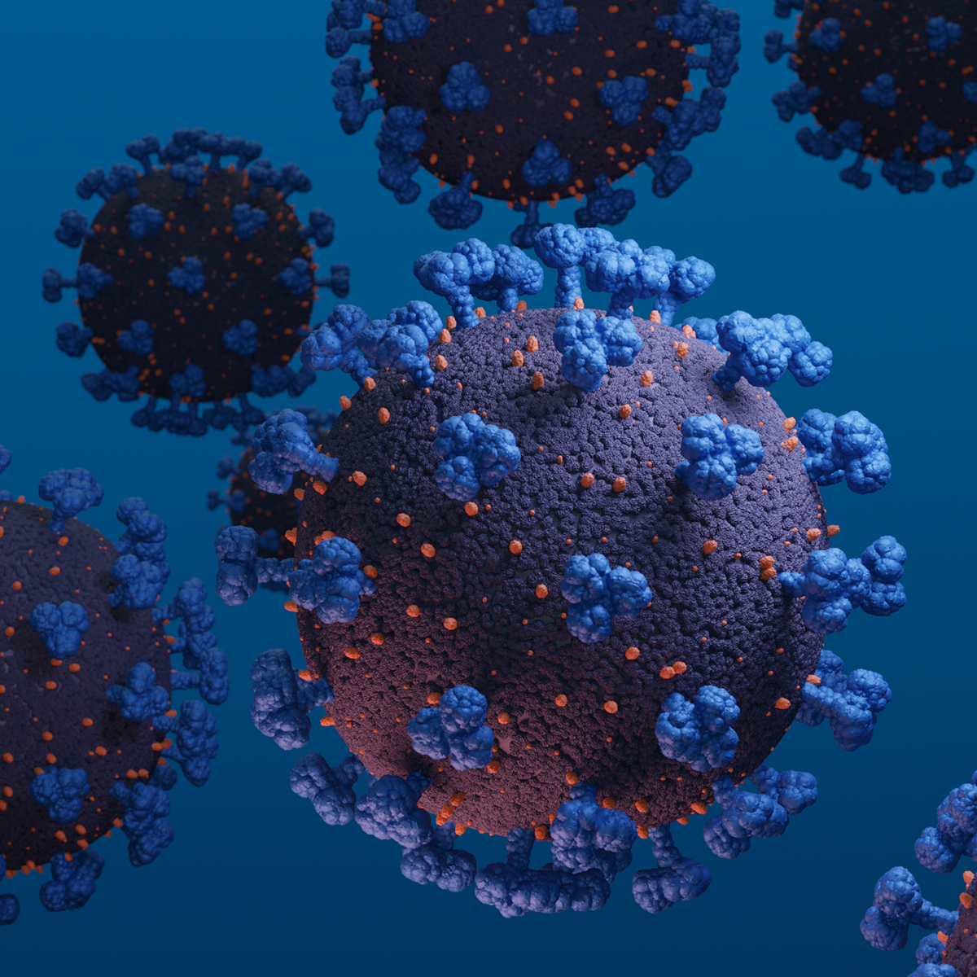
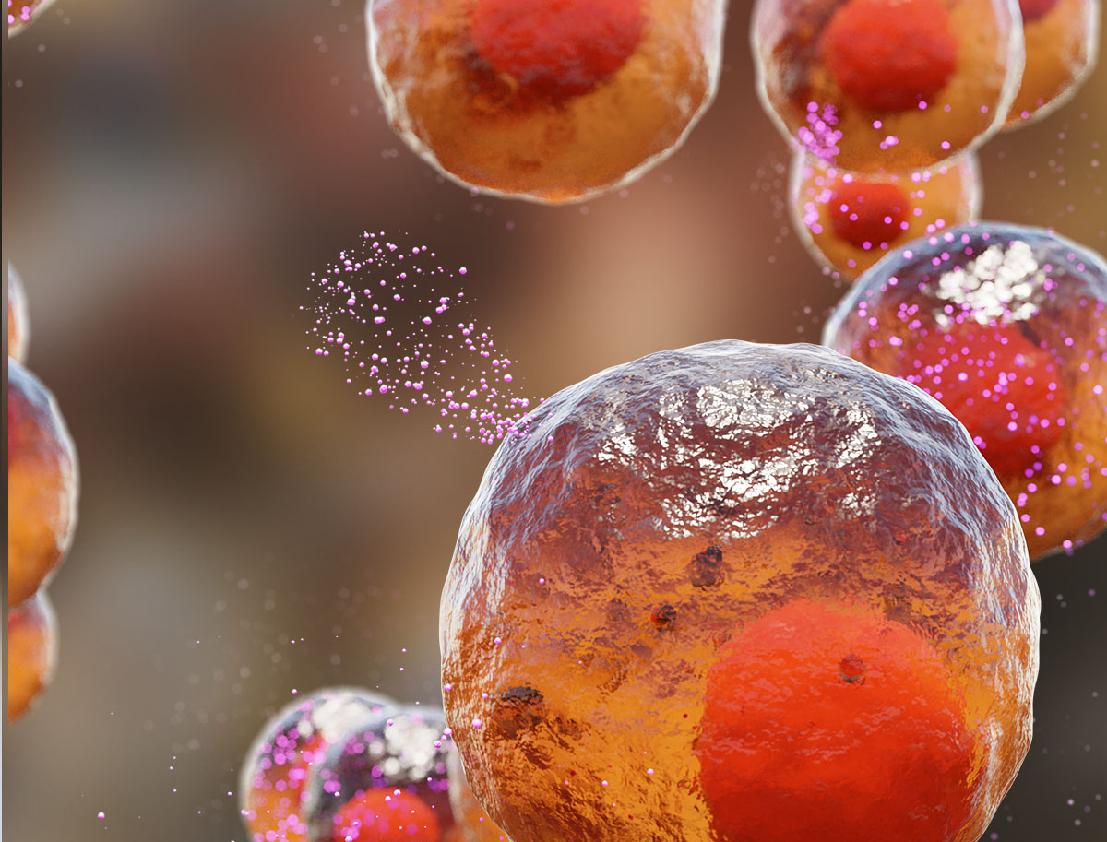
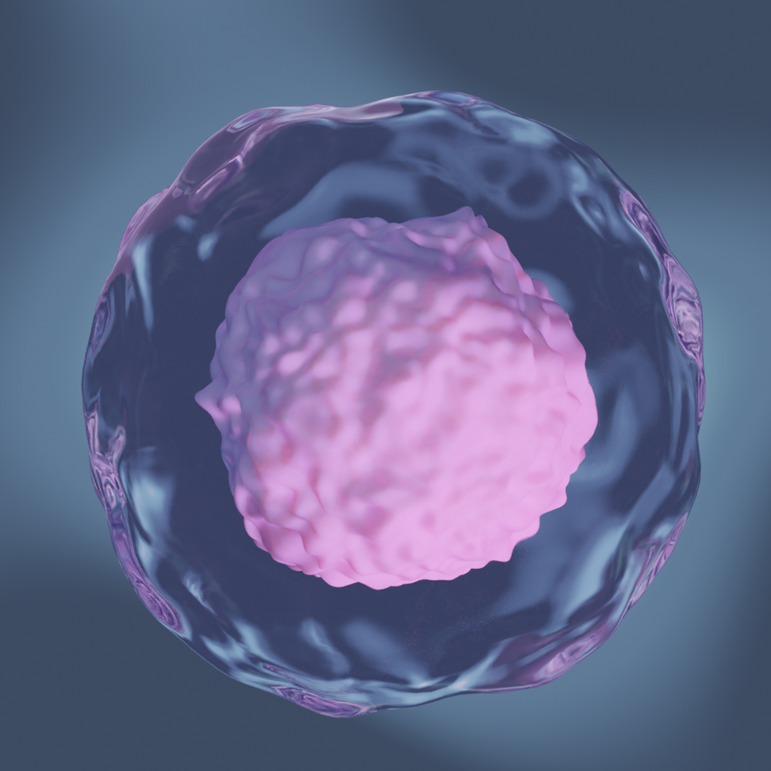

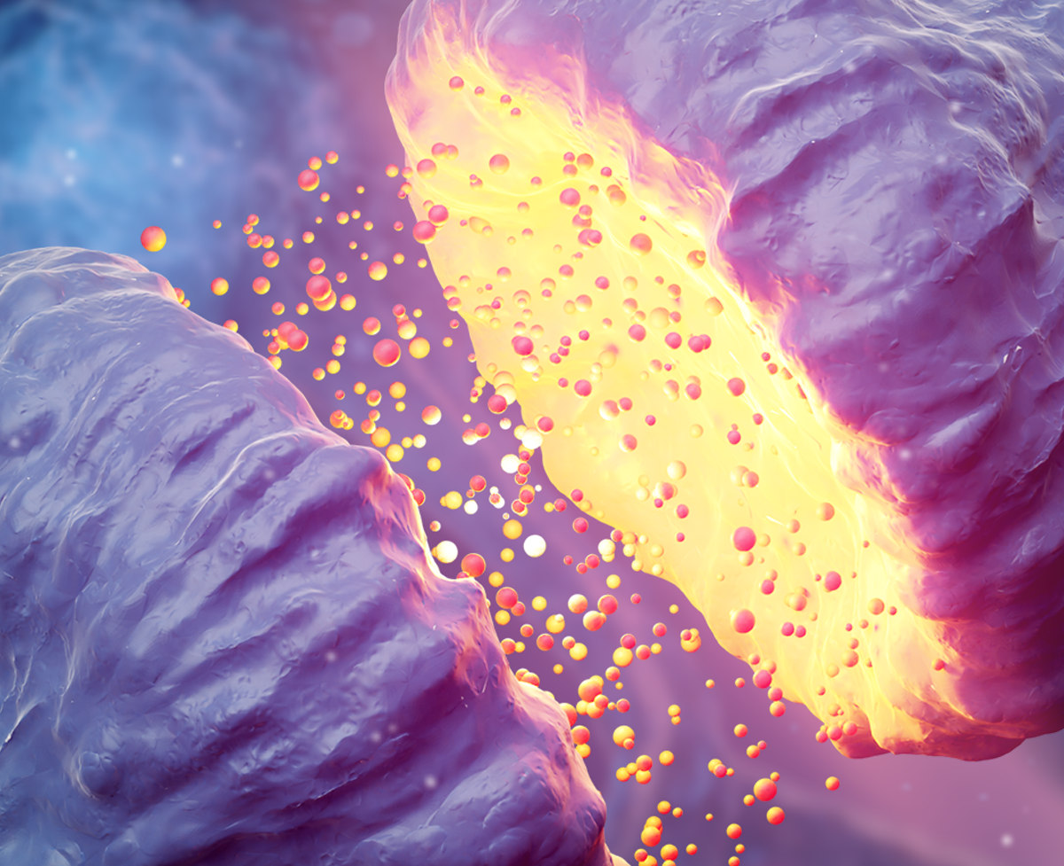

RNAscope, BaseScope, miRNAscope examples
CANCER/IO
INFECTIOUS DISEASE
IMMUNOLOGY/
INFLAMMATION
DEVELOPMENTAL BIOLOGY - stem
organoïds
GENE THERAPY
NEUROSCIENCE
Atypical samples and species (bone, skeletal muscle, embryos)
CELL THERAPY

Slide 3
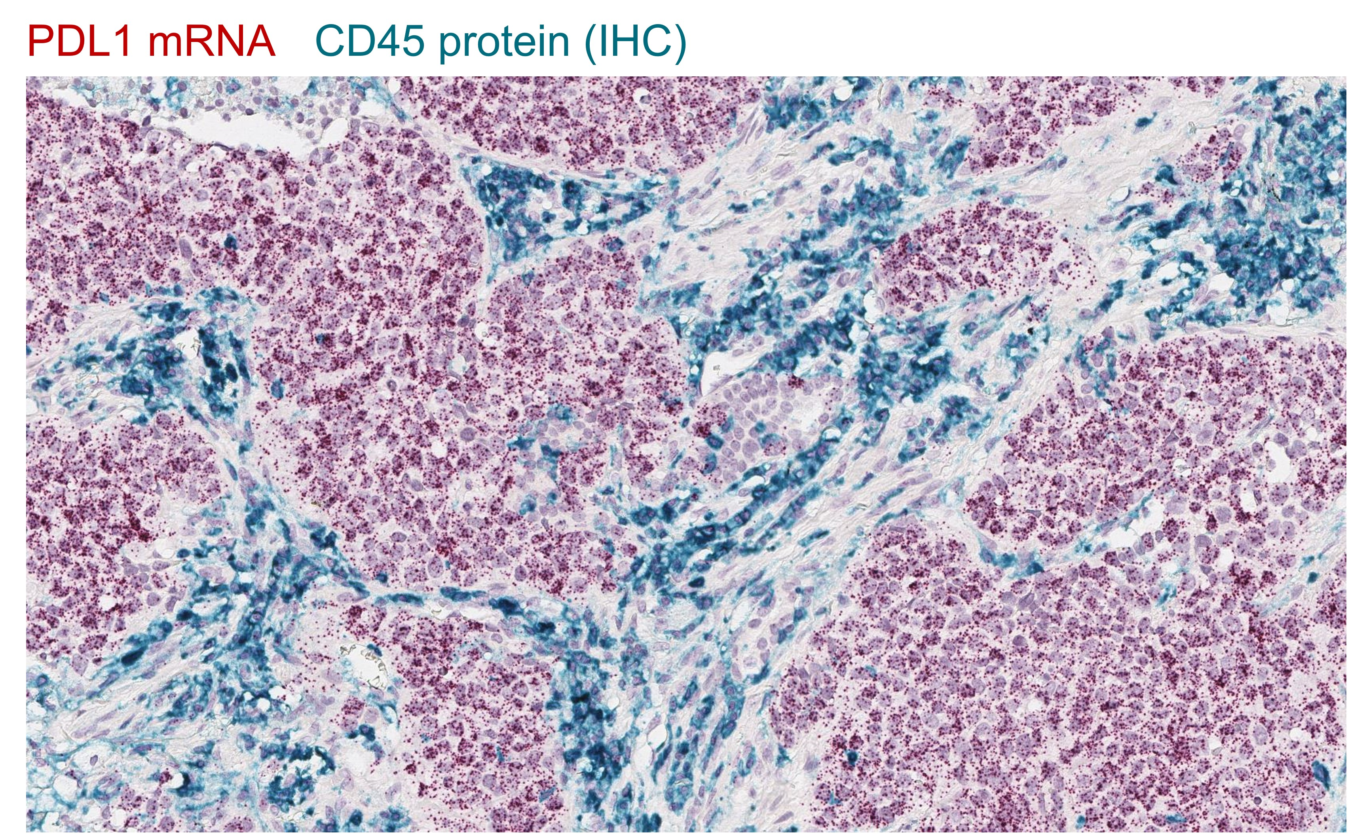
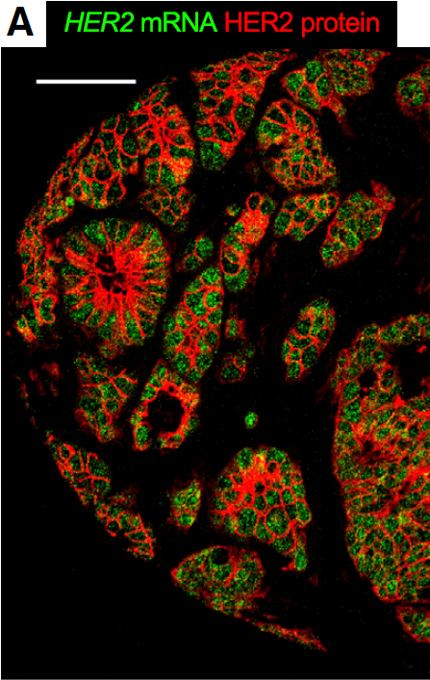
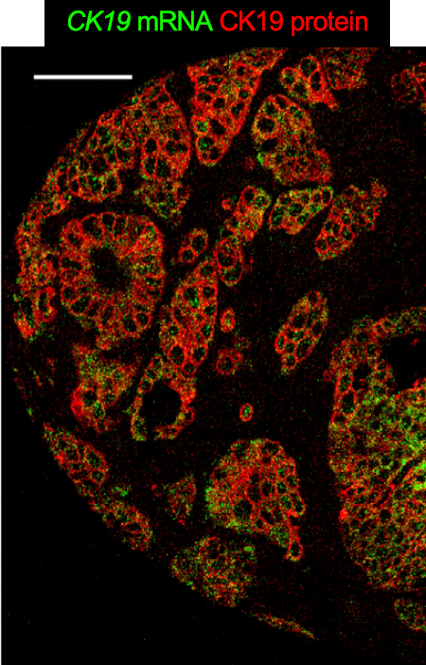
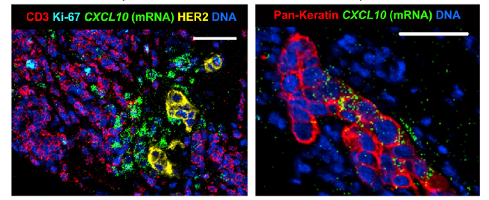
CANCER/IO
mRNA-protein co-detection in tumors

Slide 4
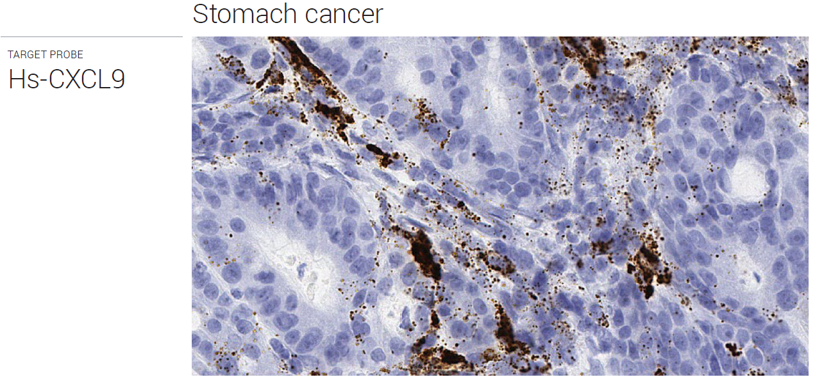
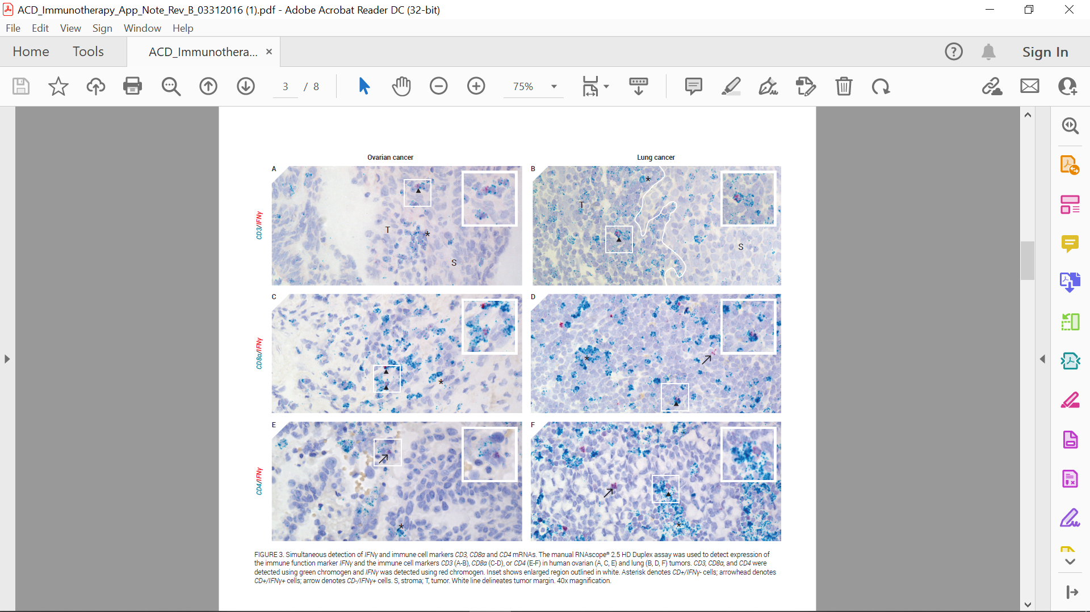
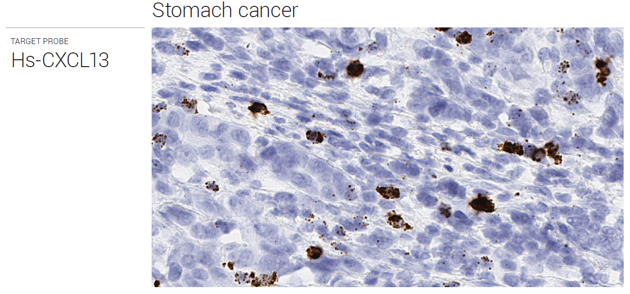
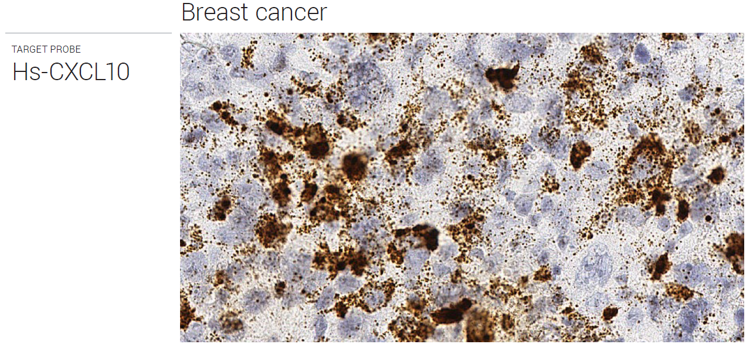
CANCER/IO
Identify the cellular origin of a soluble factor
CD4 m RNA/IFNγ mRNA
CD8a mRNA /IFNγ mRNA

Slide 5
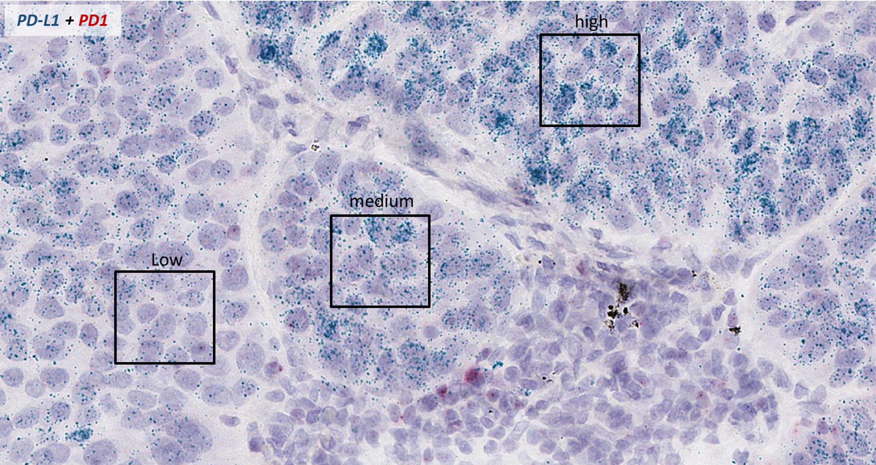
CANCER/IO
Gene expression in a spatial and morphological context
Intratumor heterogeneous expression of PD-L1 in lung tumor

Slide 6
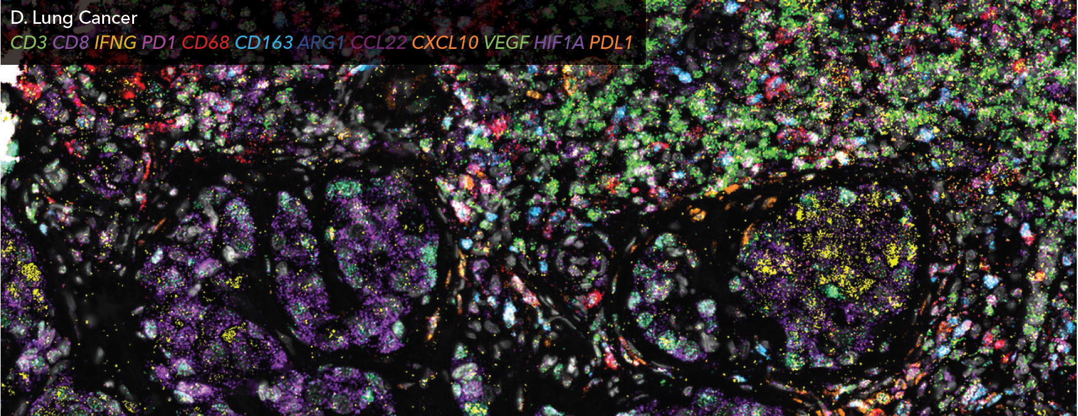
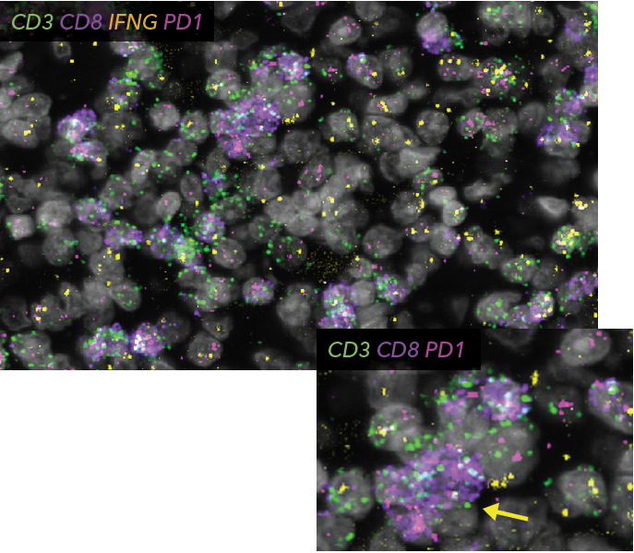
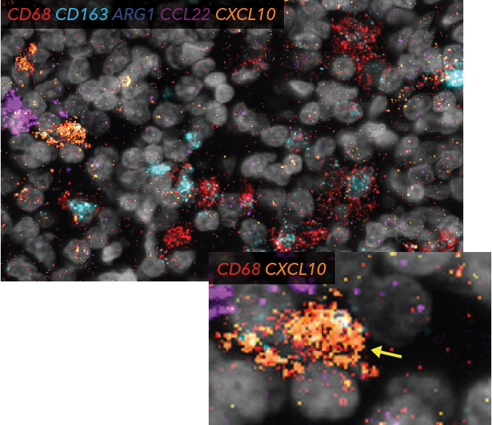
Spatial understanding of the Tumor Micro Environment
CANCER/IO
T cell subsets
within the tumor
Macrophage markers, chemokines within the tumor

Slide 7
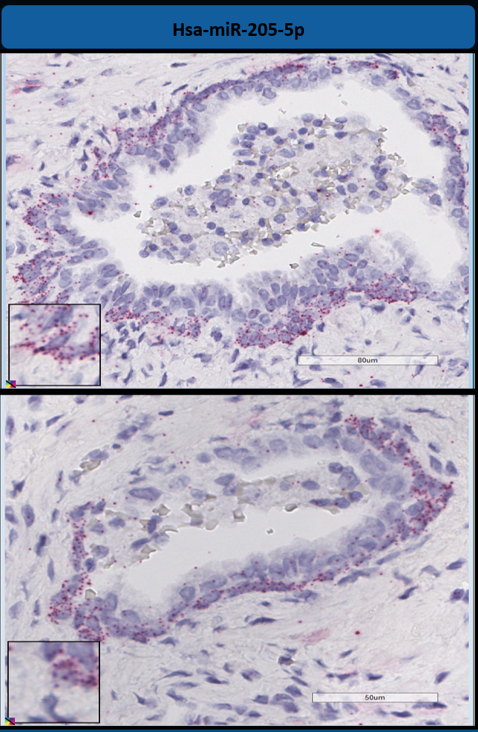
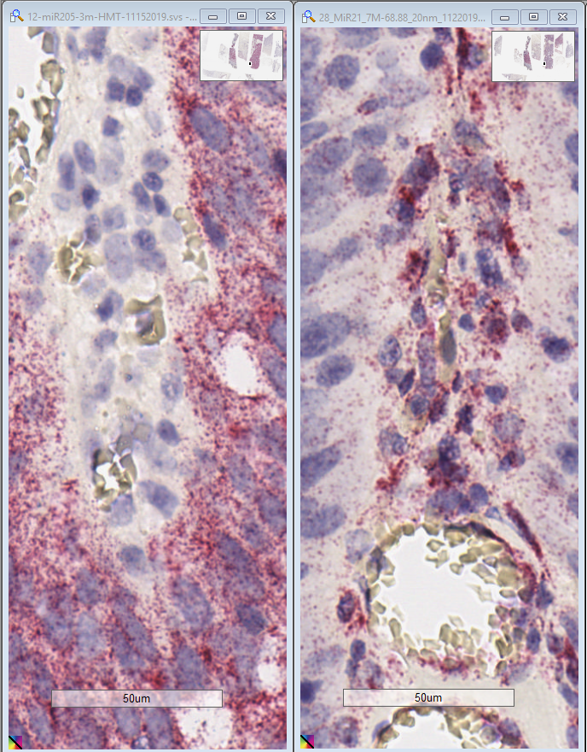
Specific miRNA detection in tumors
CANCER/IO
Lung cancer
Breast cancer
miR-205-5p
miR-21-5p

Slide 8
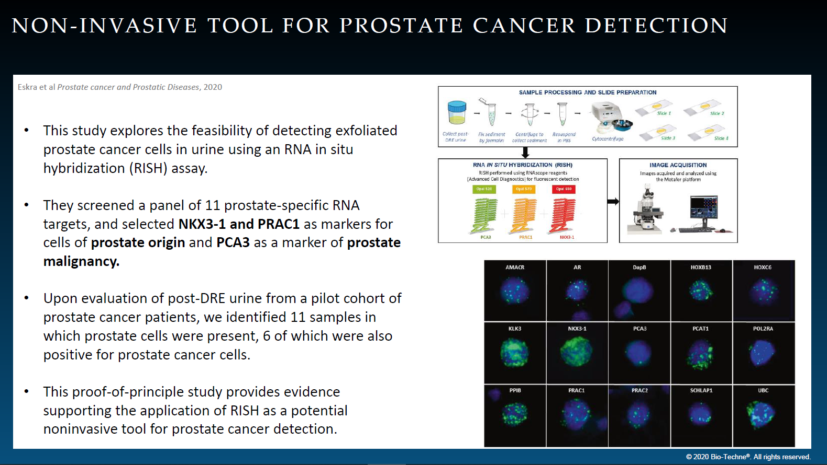
CANCER/IO

Slide 9
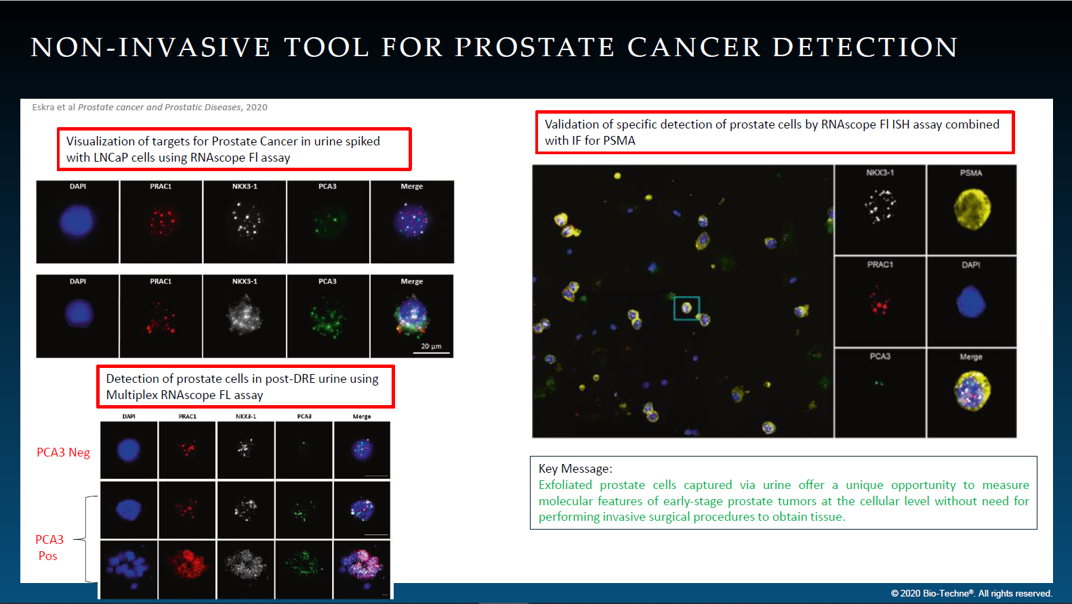

Slide 10
In situ visualization of splice variants (BaseScope assay)
CANCER/IO

Slide 11
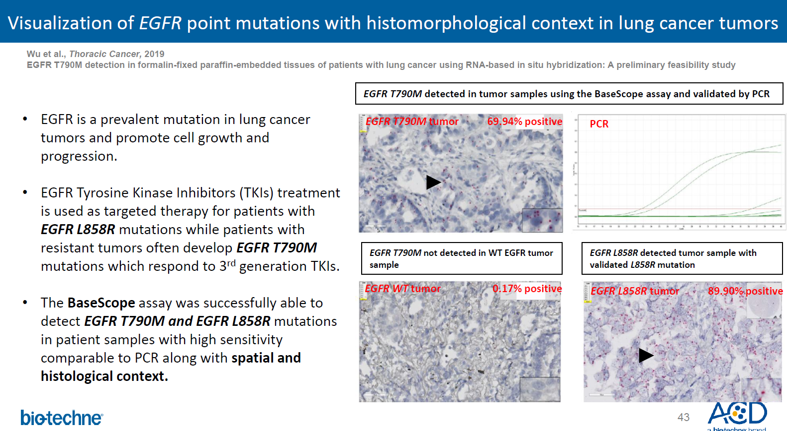

Slide 12
mRNA-protein co-detection in Nervous system
NEUROSCIENCE
IF
RNAscope

Slide 13
RNAscope on whole-mount and thick section
NEUROSCIENCE
Provide a detailed approach to use the fluorescent RNAscope ISH method in the mouse inner ear and thick brain sections and in combination with IHC
Mouse Inner Ear
Mouse Brain Thick Section (200-500μm)
Kersigo et al. Cell Tissue Res, 2018

Slide 14
Detection of targets in the Nervous System when no (reliable) antibodies are available e.g. GPCR
NEUROSCIENCE
Dopamingeric Receptor D1 (Drd1) mRNA
Cannabinoid Receptor 1 (Cnr1) mRNA

Slide 15
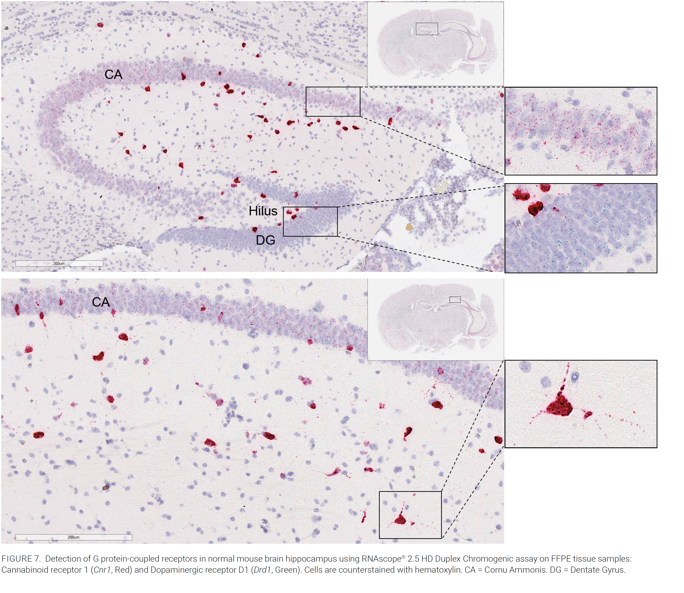
NEUROSCIENCE
Mouse Brain Hippocampus FFPE sample
=> Chromogenic duplex assay
Cannabinoid Receptor 1 (Cnr1) mRNA
Dopamingeric Receptor D1 (Drd1) mRNA
Mouse Brain Striatum FFPE sample
=> Chromogenic duplex assay

Slide 16
Long non-coding mRNA detection in the Nervous System
NEUROSCIENCE
Mouse Brain Hippocampus FFPE sample
=> Multiplex V1 fluo assay
Neat 1 mRNA
Malat 1 mRNA

Slide 17
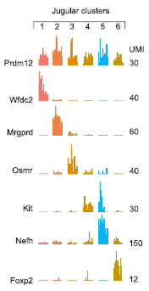
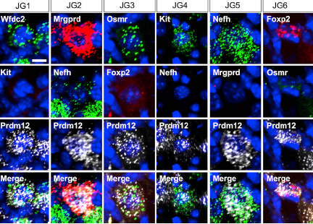
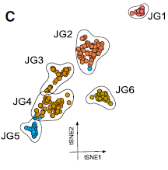
NEUROSCIENCE
scRNAseq validation in the Nervous System
Atlas of Vagal Sensory Jugular Neurons in the Mouse
Kupari et al, Cell Rep, 2019 An Atlas of Vagal Sensory Neurons and Their Molecular Specialization
Expression of genes used for in vivo validation of jugular clusters
6 different neuronal clusters identified as jugular neurons using scRNAseq
In vivo validation of each jugular cluster using RNAscope
Notes:
Key message related to RNAscope: was used to performed to validate single cell RNAseq and for in vivo identification of cells based on their gene expression profiles.
Potential positioning/utility of this paper: ScRNAseq validation and cell type identification
Assay used: Manual Multiplex Fluorescent v1 assay (cat# 320850)
Probes used: Trpa`, Tmem233, Uts2b, Gata3, Slc17a7, Itm2a, Mrgprd, Wfdc2, Osmr, Gpr65, Piezo, Vip, Car8, Rbp4, Gabra1, Kcnq3, Kcna1, Aqp1, Prdm12, Phox2b, Igf1, Foxp2, Kit, Nefh, Meis2
Details on this publication:
Title: An Atlas of Vagal Sensory Neurons and Their Molecular Specialization
Authors: Jussi Kupari, Martin Haring, Eneritz Agirre, Gonc¸alo Castelo-Branco, Patrik Ernfors
Author affiliations:
Department of Medical Biochemistry and Biophysics, Karolinska Institutet, 17177 Stockholm, Sweden
Ming Wai Lau Centre for Reparative Medicine, Stockholm node, Karolinska Institutet, Stockholm, Sweden
Overall Key Findings:
Abstract: Sensory functions of the vagus nerve are critical for conscious perceptions and for monitoring visceral functions in the cardio-pulmonary and gastrointestinal systems. Here, we present a comprehensive identification, classification, and validation of the neuron types in the neural crest (jugular) and placode (nodose) derived vagal ganglia by single-cell RNA sequencing (scRNA-seq) transcriptomic analysis. Our results reveal major differences between neurons derived from different embryonic origins. Jugular neurons exhibit fundamental similarities to the somatosensory spinal neurons, including major types, such as C-low threshold mechanoreceptors (C-LTMRs), A-LTMRs, Ad-nociceptors, and cold-, and mechano-heat C-nociceptors. In contrast, the nodose ganglion contains 18 distinct types dedicated to surveying the physiological state of the internal body. Our results reveal a vast diversity of vagal neuron types, including many previously unanticipated types, as well as proposed types that are consistent with chemoreceptors, nutrient detectors, baroreceptors, and stretch and volume mechanoreceptors of the respiratory, gastrointestinal, and cardiovascular systems.

Slide 18
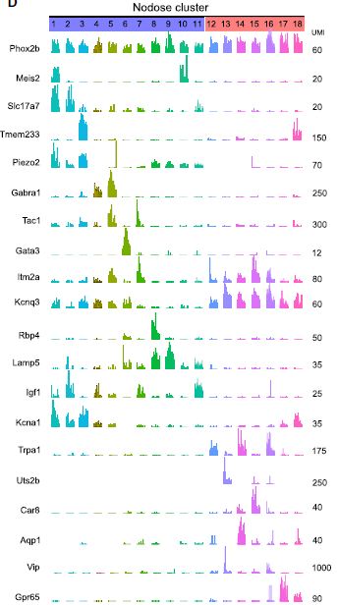
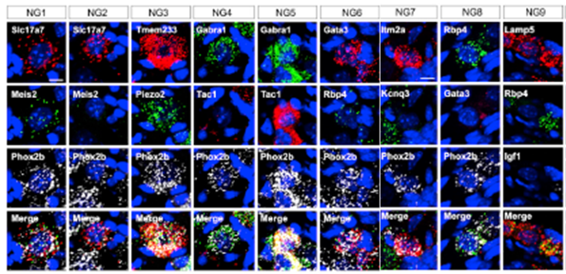
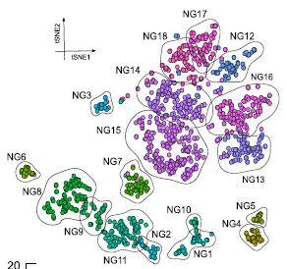
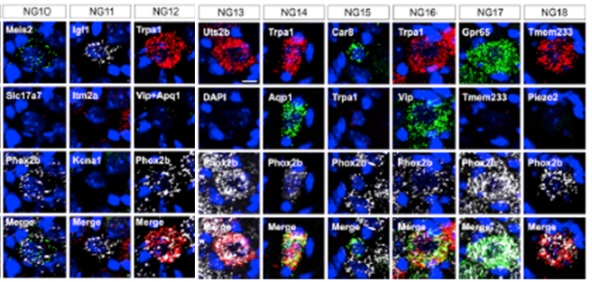
NEUROSCIENCE
scRNAseq validation in the Nervous System
Atlas of Vagal Sensory Nodose Neurons in the Mouse
Kupari et al, Cell Rep, 2019
Expression of genes used for in vivo validation of nodose clusters
In vivo validation of each nodose cluster using RNAscope
18 different neuronal clusters identified as nodose neurons using scRNAseq
Notes:
Key message related to RNAscope: was used to performed to validate single cell RNAseq and for in vivo identification of cells based on their gene expression profiles.
Potential positioning/utility of this paper: ScRNAseq validation and cell type identification
Assay used: Manual Multiplex Fluorescent v1 assay (cat# 320850)
Probes used: Trpa`, Tmem233, Uts2b, Gata3, Slc17a7, Itm2a, Mrgprd, Wfdc2, Osmr, Gpr65, Piezo, Vip, Car8, Rbp4, Gabra1, Kcnq3, Kcna1, Aqp1, Prdm12, Phox2b, Igf1, Foxp2, Kit, Nefh, Meis2
Details on this publication:
Title: An Atlas of Vagal Sensory Neurons and Their Molecular Specialization
Authors: Jussi Kupari, Martin Haring, Eneritz Agirre, Gonc¸alo Castelo-Branco, Patrik Ernfors
Author affiliations:
Department of Medical Biochemistry and Biophysics, Karolinska Institutet, 17177 Stockholm, Sweden
Ming Wai Lau Centre for Reparative Medicine, Stockholm node, Karolinska Institutet, Stockholm, Sweden
Overall Key Findings:
Abstract: Sensory functions of the vagus nerve are critical for conscious perceptions and for monitoring visceral functions in the cardio-pulmonary and gastrointestinal systems. Here, we present a comprehensive identification, classification, and validation of the neuron types in the neural crest (jugular) and placode (nodose) derived vagal ganglia by single-cell RNA sequencing (scRNA-seq) transcriptomic analysis. Our results reveal major differences between neurons derived from different embryonic origins. Jugular neurons exhibit fundamental similarities to the somatosensory spinal neurons, including major types, such as C-low threshold mechanoreceptors (C-LTMRs), A-LTMRs, Ad-nociceptors, and cold-, and mechano-heat C-nociceptors. In contrast, the nodose ganglion contains 18 distinct types dedicated to surveying the physiological state of the internal body. Our results reveal a vast diversity of vagal neuron types, including many previously unanticipated types, as well as proposed types that are consistent with chemoreceptors, nutrient detectors, baroreceptors, and stretch and volume mechanoreceptors of the respiratory, gastrointestinal, and cardiovascular systems.

Slide 19
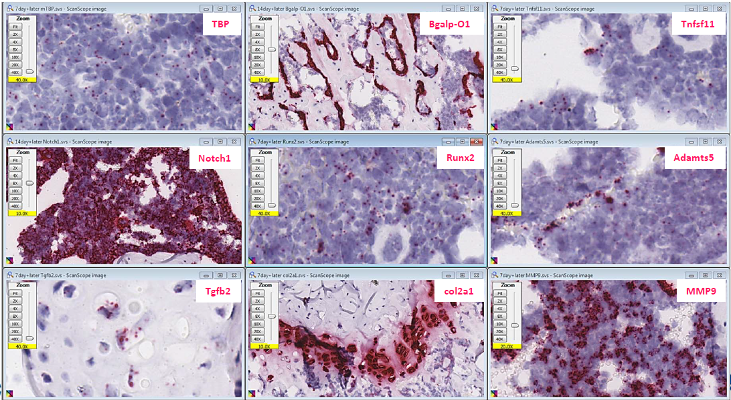
DEVELOPMENTAL BIOLOGY
Detection of mRNA targets on
decalcified mouse bone marrow

Slide 20
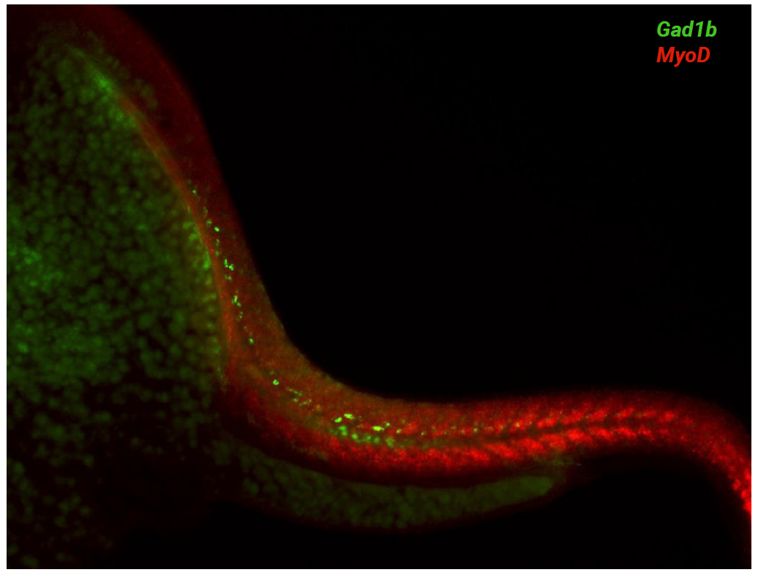
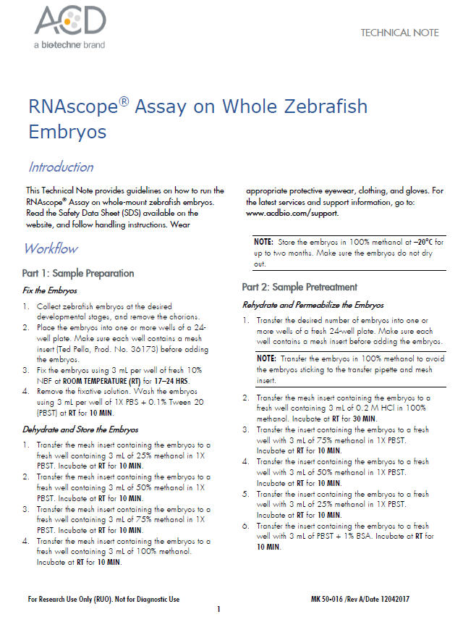
DEVELOPMENTAL BIOLOGY
DEVELOPMENTAL BIOLOGY
RNAscope on whole Zebrafish embryos
Mouse Inner Ear
Gad1b mRNA / MyoD mRNA
in 24 hpf Zebrafish whole mount embryos with the RNAscope multiplex fluorescent V2 assay

Slide 21
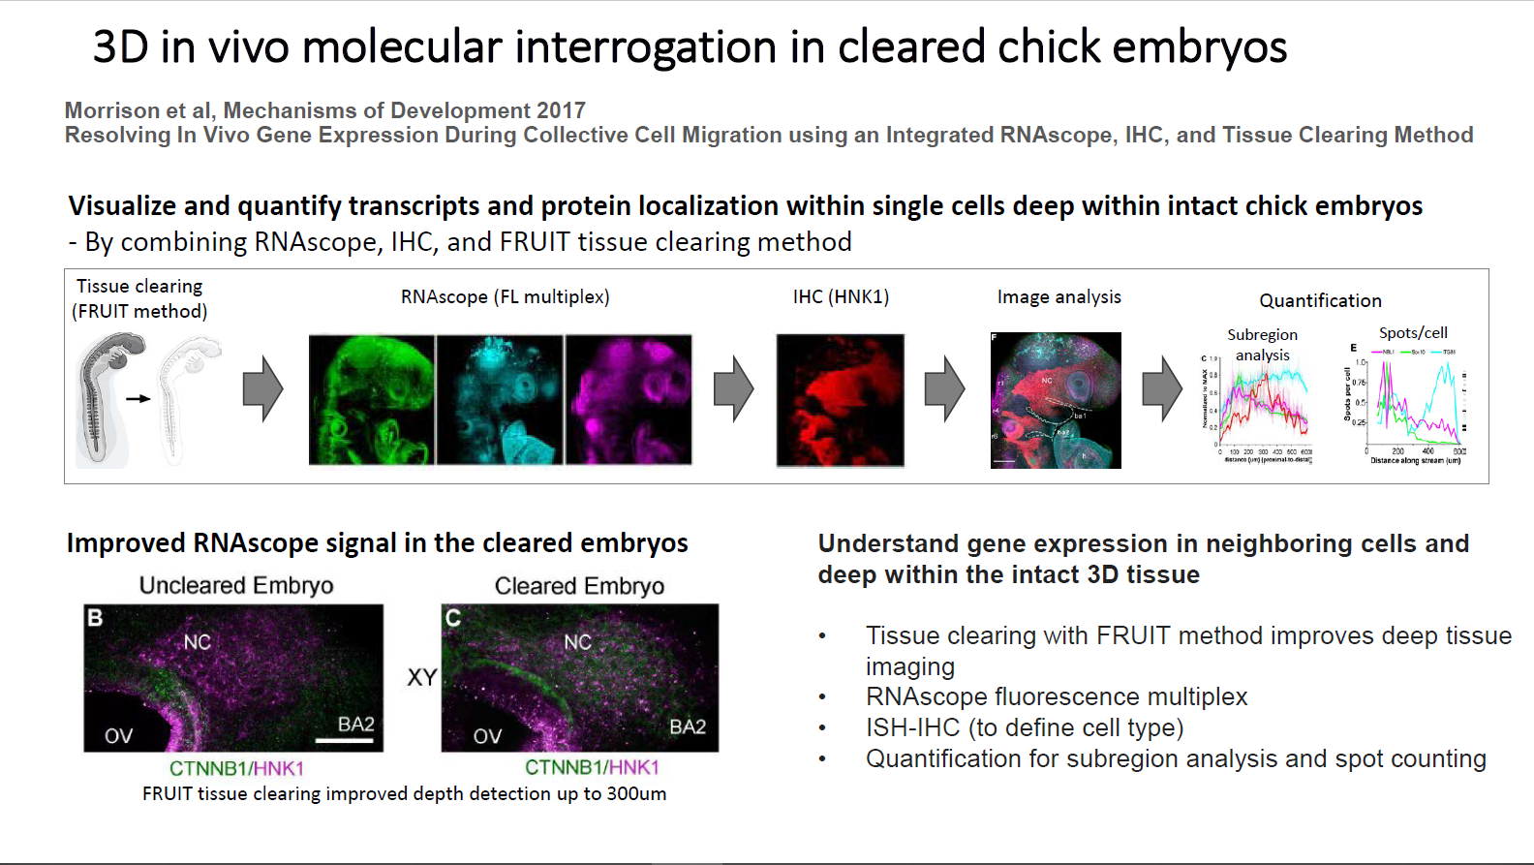
Skeletal muscle
RNAscope Examples

Slide 22
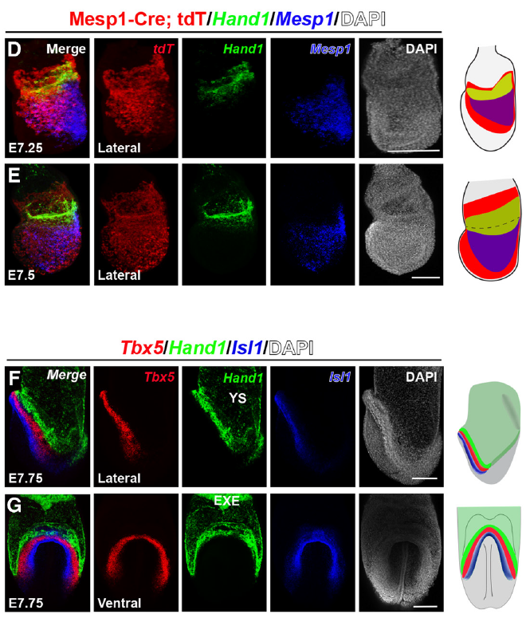
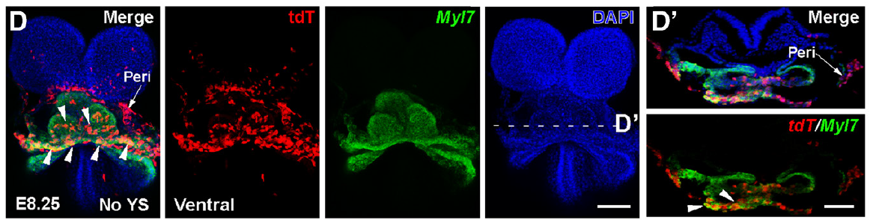
DEVELOPMENTAL BIOLOGY
single cell analysis to study developmental relationships between cardiac cell lineages
Zhang et al. Circulation Research, 2021
This study reveals the location of previously unknown multipotent cardiovascular progenitors at the embryonic/extraembryonic interface.
RNAscope Multiplex Fluorescent v2 was used to confirm the cell fate lineage analysis using transcriptomic profiling by showing distinct cell population location within the heart at various embryonic stages.
Gene signatures of distinct populations of cardiomyocytes with different developmental origins
RNAscope on whole-mount mouse embryo provides spatio-temporal context

Slide 23
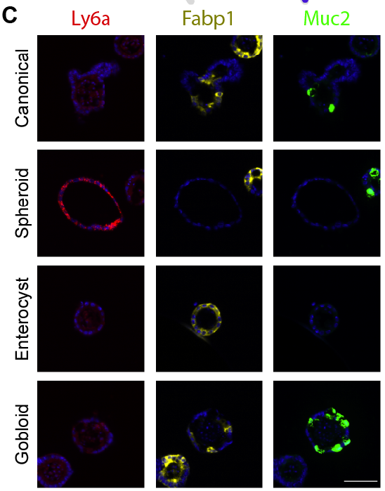
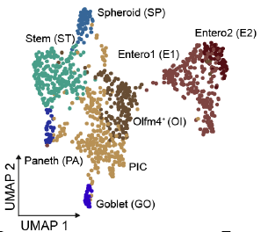
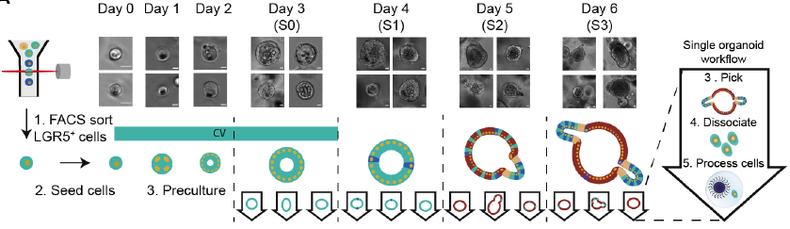
RNAscope validates novel organoid cell types identified by scrnaseq
DEVELOPMENTAL BIOLOGY
Bues et al, BioRxiv 2021
Deterministic scRNA-seq of individual intestinal organoids reveals new subtypes and coexisting distinct stem cell pools
Notes:
While Single-cell RNA-sequencing (scRNA-seq) has transformed our ability to resolve cellular properties across systems, current microfluidics-based scRNA-seq technologies are limited to samples with large amounts of cells (> 1,000 cells).
To overcome these limitations, scientists from EPFL developed a deterministic, mRNA-capture bead and cell co encapsulation dropleting system, DisCo, that enables precise particle and cell positioning and droplet sorting control through combined machine-vision and multilayer microfluidics.
To validate the existence of the uncovered organoid subtypes, we utilized RNAScope to visualize Ly6a, Muc2, Fabp1 expression in organoid sections

Slide 24
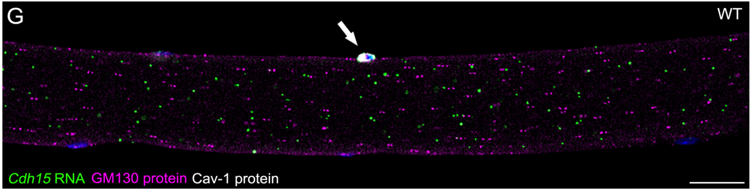
Detection of mRNA targets on whole mount murine myofibers
(Kann et al. 2019)

Slide 25
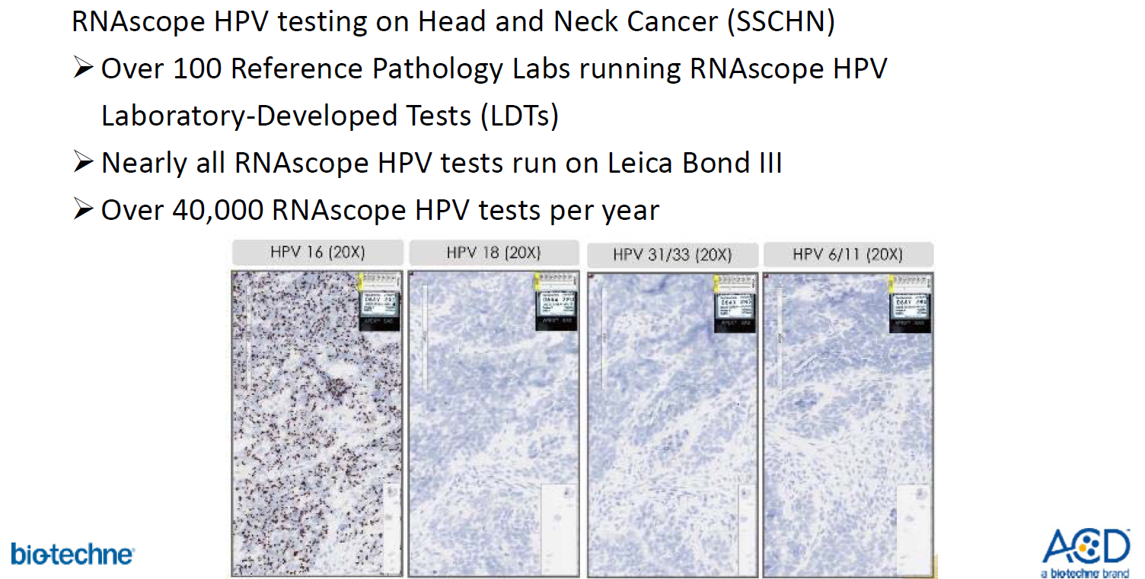
INFECTIOUS DISEASE
RNAscope HPV clinical testing head and neck cancer

Slide 26
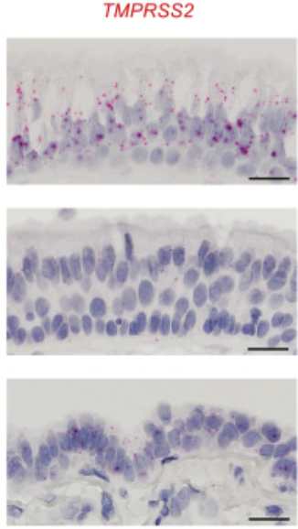
INFECTIOUS DISEASE
SARS-CoV-2 gene expression – viral bio-distribution
Hou et al, used a reverse genetics system to study SARS-CoV-2 growth and pathogenesis.
Using the RNAscope/Cytospin technology they detected ACE2 expression in upper respiratory tract with increased sensitivity and efficacy compared to scRNA-seq.
RNAscope ISH detects ACE2 in Cytospin samples
RNAscope ISH detects ACE2 and TMPRSS2 in normal human airway surface epithelium
KEY MESSAGE
Using the RNAscope assay the researchers established an ACE2 expression gradient and TMPRSS2 detection in the respiratory tract along with the SARS-CoV-2 virus
Notes:
This is a paper that came out of University of North Carolina from the Baric lab.
The mode of acquisition and causes for the variable clinical spectrum of coronavirus disease 2019 (COVID-19) was unknown.
Scientists in this study, used a reverse genetics system to study SARS-CoV-2 growth and pathogenesis
Using the RNAscope/Cytospin technology they revealed ACE2 expression in upper respiratory tract with increased sensitivity and efficacy compared to scRNA-seq,
Additionally, using the RNAscope 2.5 HD Red assay they established an ACE2 expression gradient in the respiratory tract and detected TMPRSS2 in normal human airway surface epithelium.

Slide 27
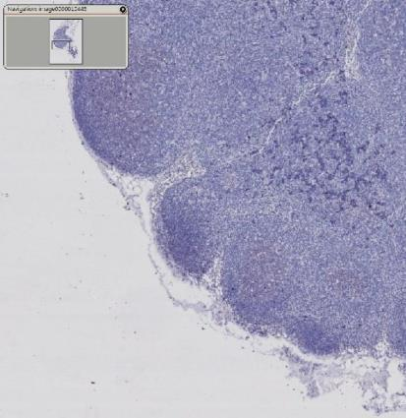
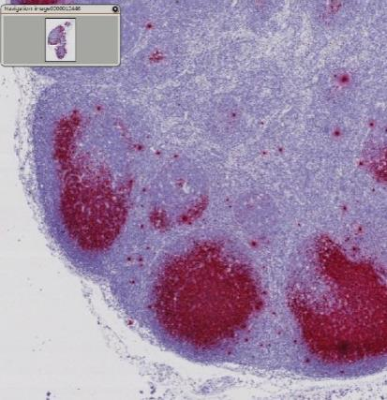
Most Sensitive Method Available for RNA ISH
INFECTIOUS DISEASE
SIV Infection Detection by RNA ISH
HIV Detection by RNAscope
RNAscope
400-times more sensitive
DIG-RNA ISH
“RNAscope of cerebellum in a patient who died with no detectable viral load.”
SL Lamers, et al Journal of NeuroVirology 2015
JD Estes, Retroviral Immunopathology, MD
Frederick National Laboratory for Cancer Research (NCI)

Slide 28
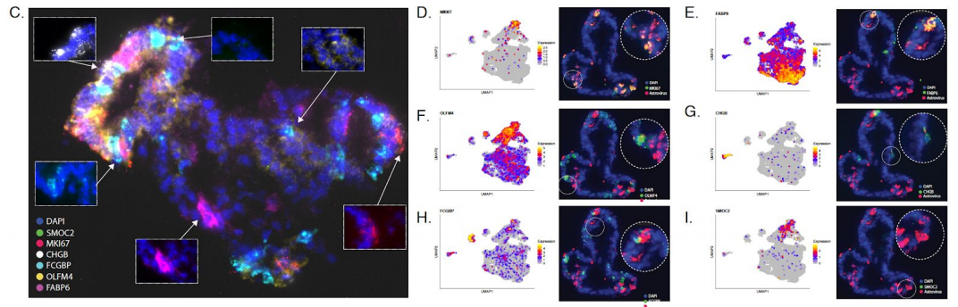
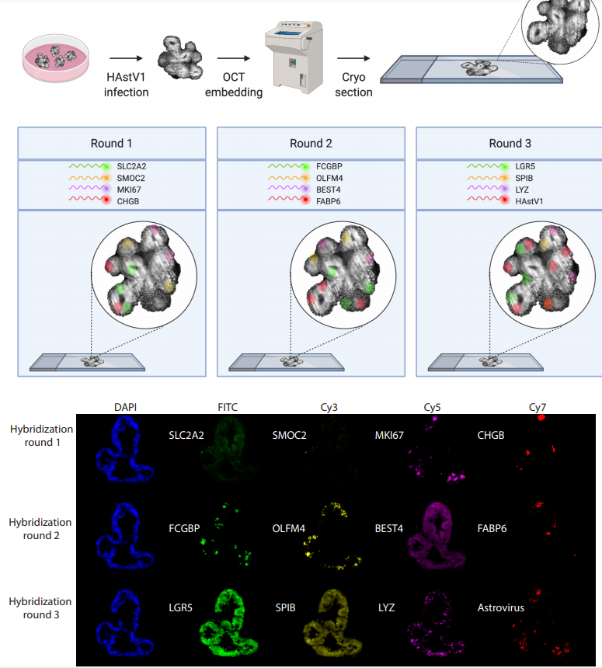
in the human intestinal epithelium, each cell lineage plays a unique role in resolving virus infection
Detection of mRNA targets on organoïds
INFECTIOUS DISEASE
Triana et al, 2021, BioRxiv
Single-cell transcriptomics reveals immune response of intestinal cell types to viral infection
Notes:
EMBL study response to Human astrovirus using RNAseq and HiPlex
On Infection with virus, each intestinal epithelial cell lineage mounted a specific interferon response

Slide 29
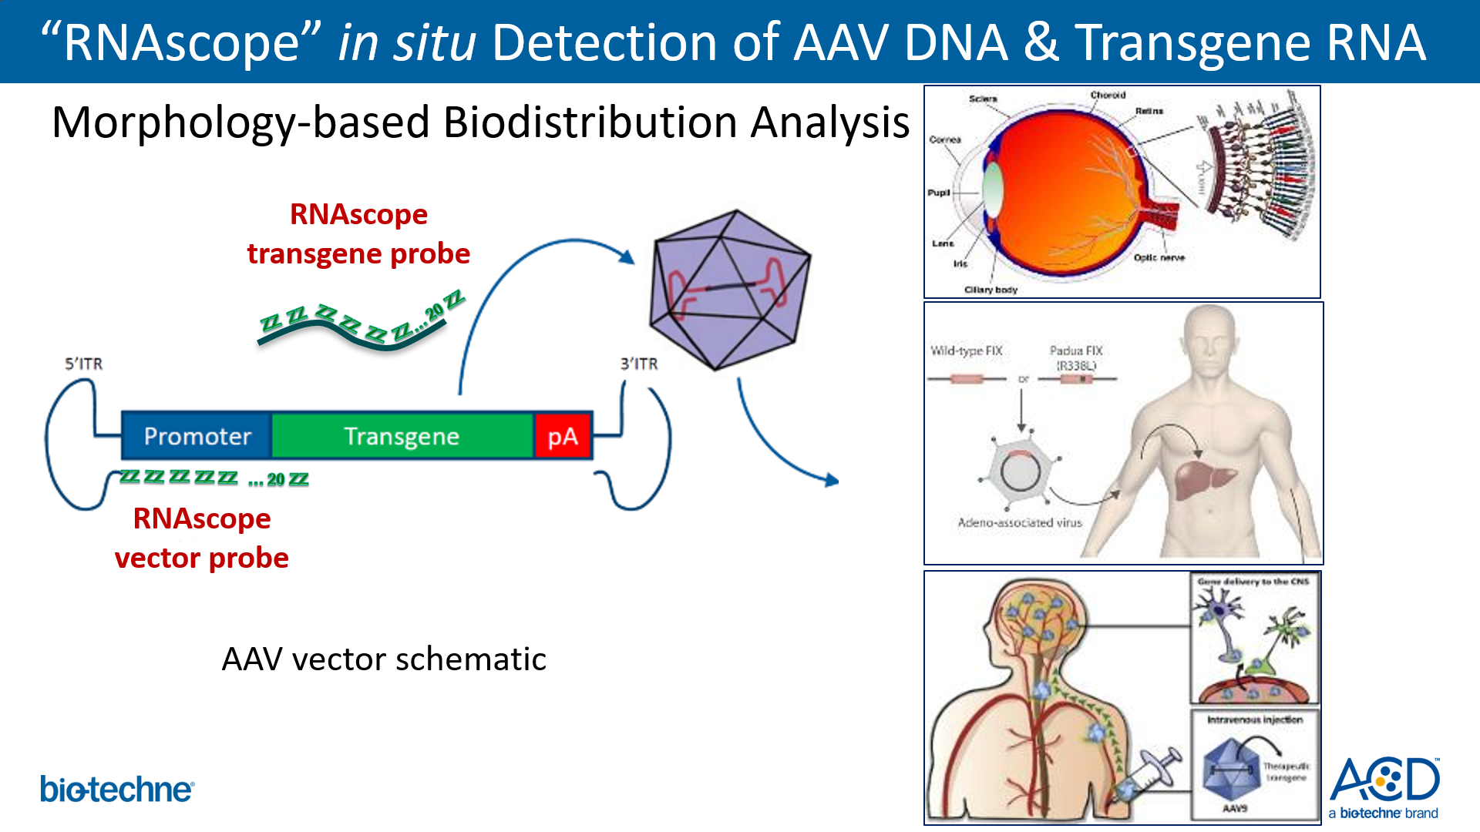
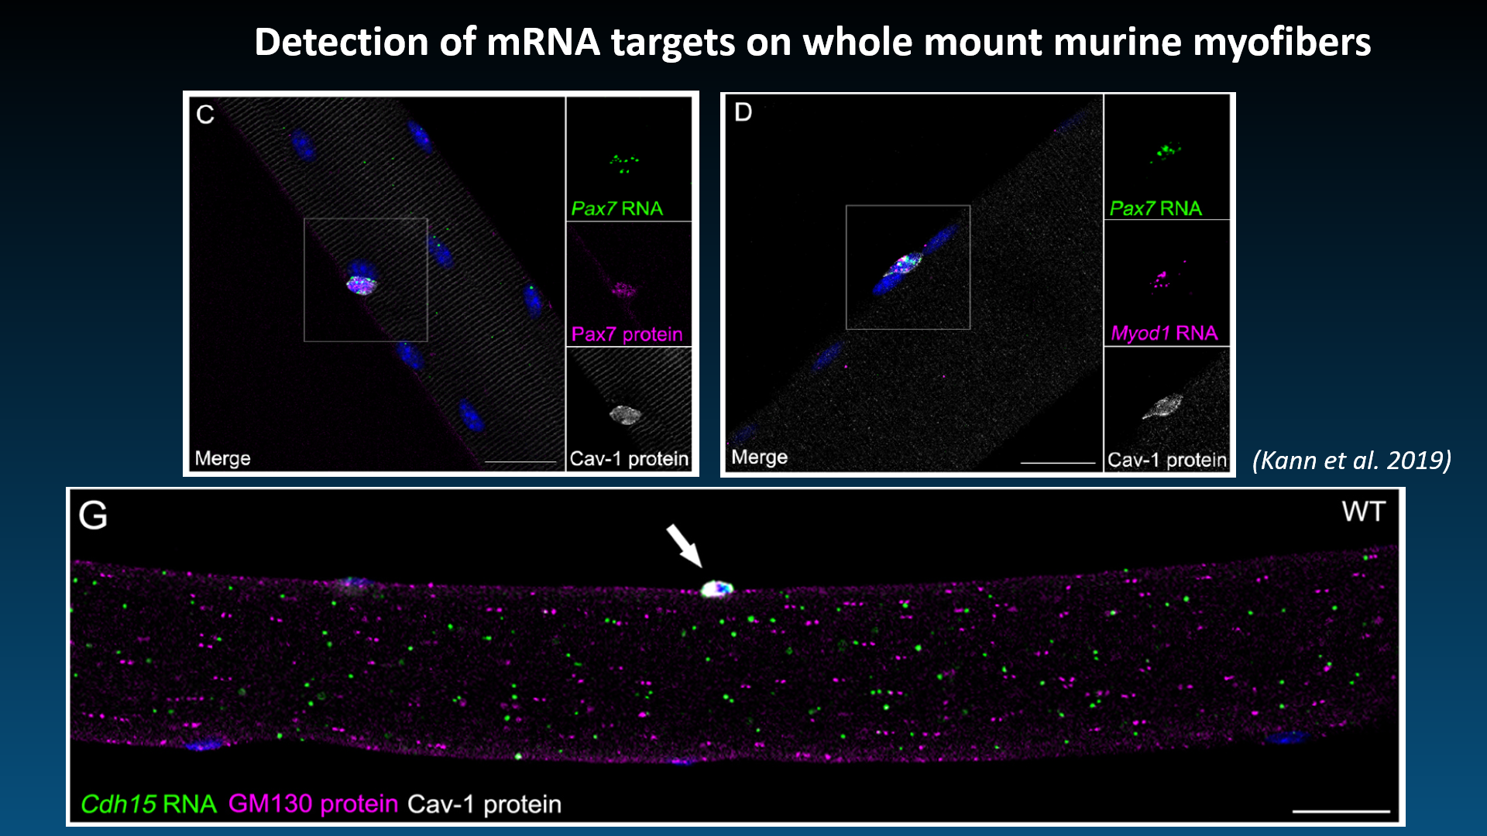
2019
GENE THERAPY

Slide 30

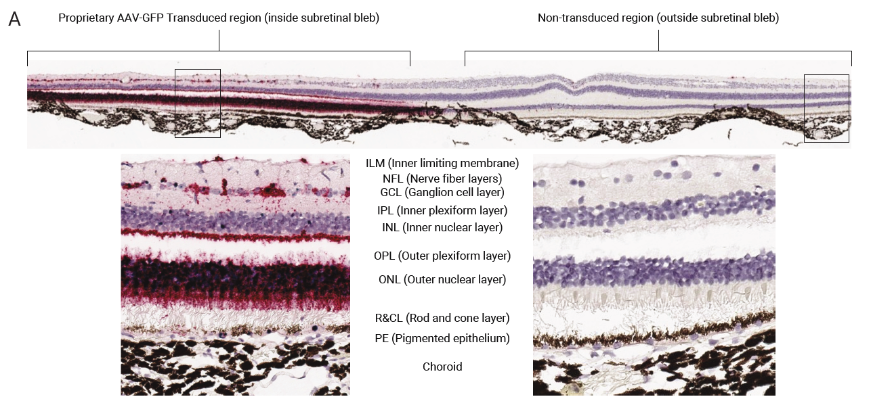
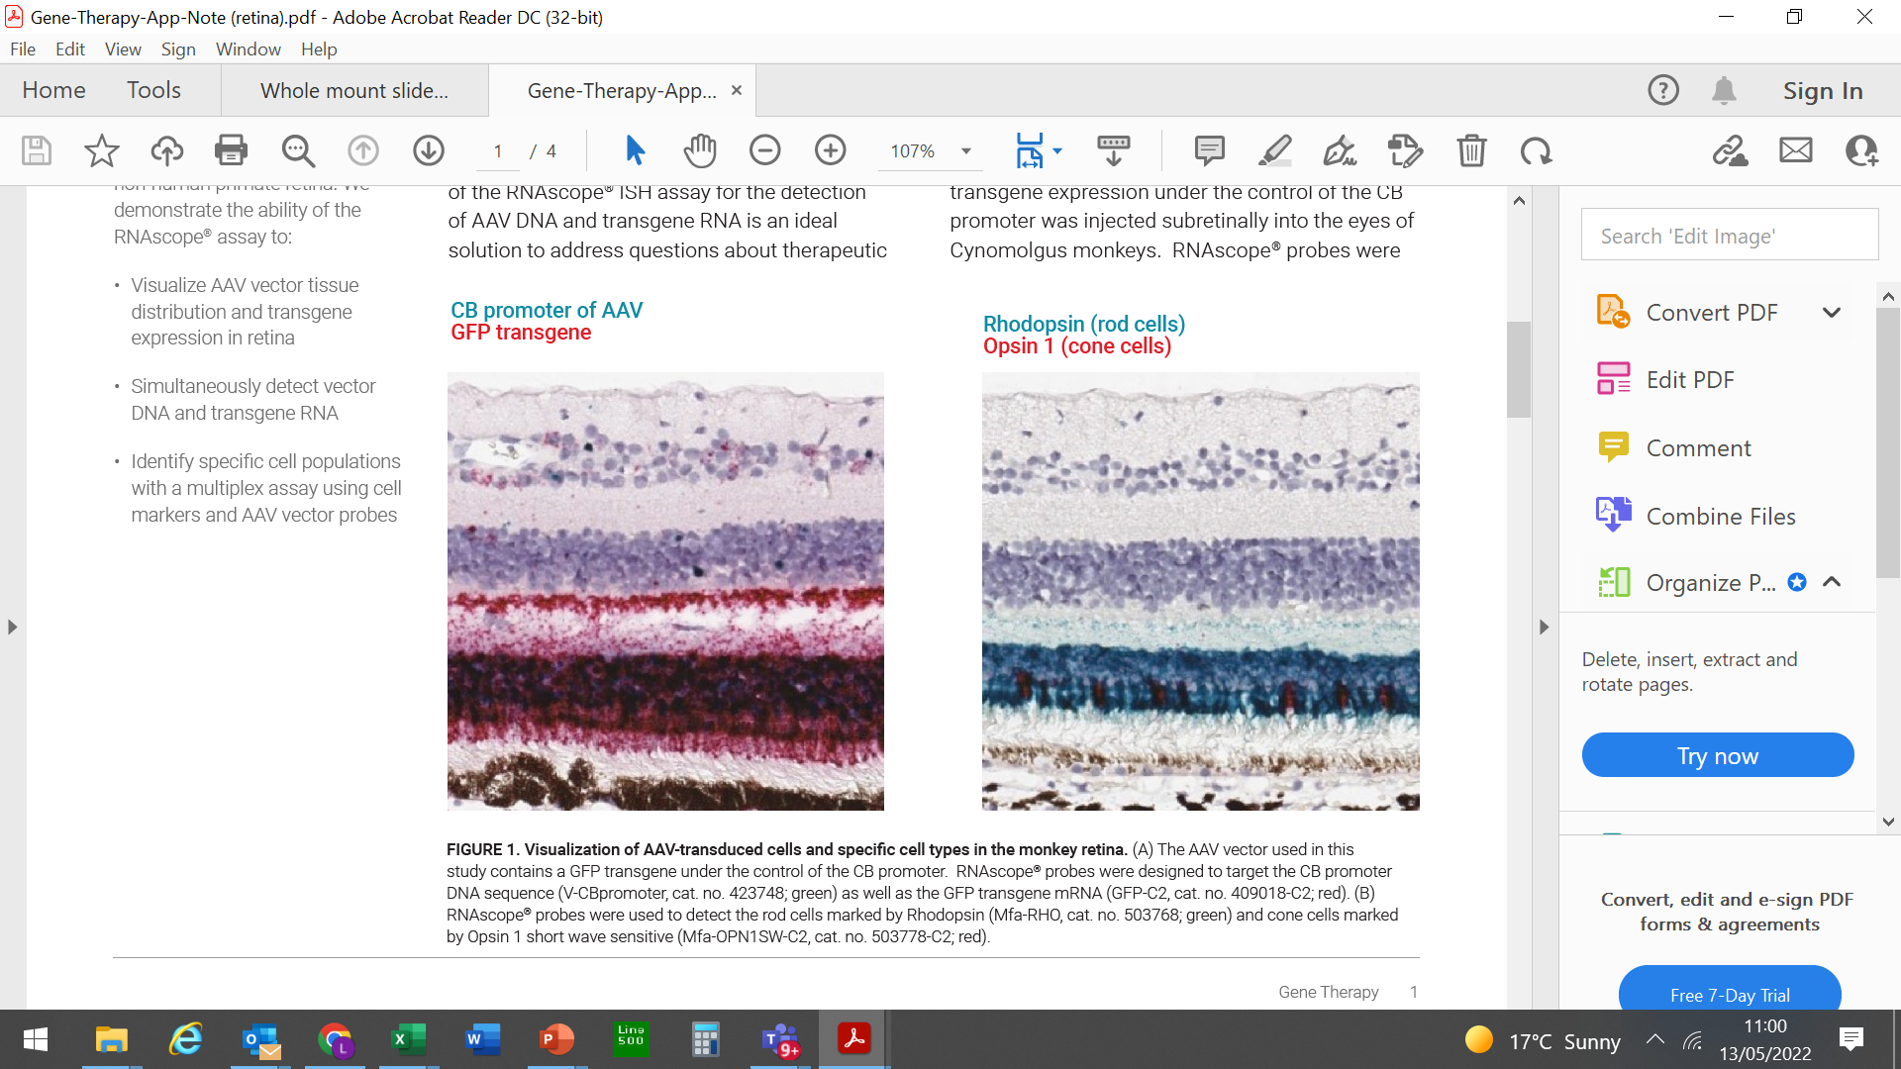

2019
GENE THERAPY

Slide 31


GENE THERAPY
2019

Slide 32












BaseScope Duplex AAV Vector and Transgene Analysis
Visualization and quantification of transgene expression and AAV vector in treated liver
AAV-treated
Vehicle-treated
Transgene mRNA
AAV Vector DNA
Vehicle AAV Treated
AAV Transgene mRNA
AAV Vector genome DNA
GENE THERAPY

Slide 33
Human cells in mouse : CAR-T cells biodistribution and activation (RNAscope assay)
CELL THERAPY
BCMA was only expressed in the BCMA+ xenografted tumor
Anti-BCMA CAR-T cells were active only in the tumor

Slide 34
CELL THERAPY

Slide 35


CRISPR-Cas9 editing validation (BaseScope assay)
WT probe
Edited probe
YES
WT
Edited
49 nt
Vehicle mouse liver
CRISPR/Cas9 liver
WT / Edited
WT / Edited
WT-only hepatocytes
Edited-only hepatocytes (mono-allelic)
Co-expressing hepatocytes (bi-allelic)
Bi-allelic (both copies were edited or not edited) or monoallelic (only one copy was edited)
Notes:
Edited probe for deleted or corrected locus
Bi-allelic (both copies were edited or not edited) or monoallelic (only one copy was edited)

Slide 36
Xenograft : human cells in mouse
Human- and Mouse-Specific RNA Detection in Patient-Derived Xenografts (PDX)
Human-specific TGFb probe
Human-specific FGFR1 probe
Mouse-specific TGFb probe
Mouse-specific Fgfr1 probe

Slide 37











Notes:
More data will be on the landing page. Natural linearity data to come. This is spike linearity data.

