Slide 1
Romantické melodie

Slide 2





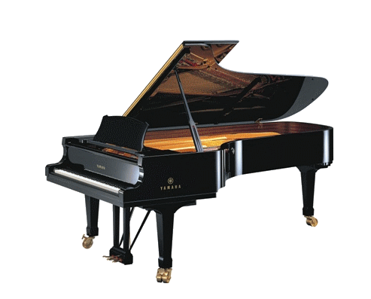


Romantické melodie :
Two candles
A fiesta
Aurora
Eternal love
Fly with me
Forever
Do not
leave me
Autumn rose
Love
A chaing of
the winds
Bertha
Dying of love
God sent me
Dancing on the clouds
Emmanuelle
www.yatata-blog.eu

