Slide 1
Nice melodies
16

Slide 2

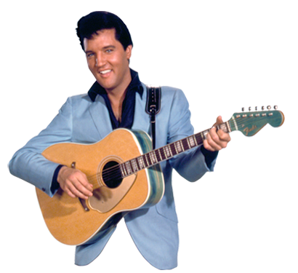






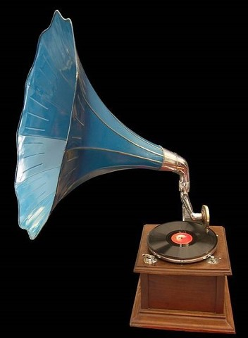
Nice melodies 16
presentation by y@t@t@
Do you love
me
The talk
When
Mandolins
When little
children
Dreaming
www.yatata-blog.eu

