Slide 1
Country music
116

Slide 2
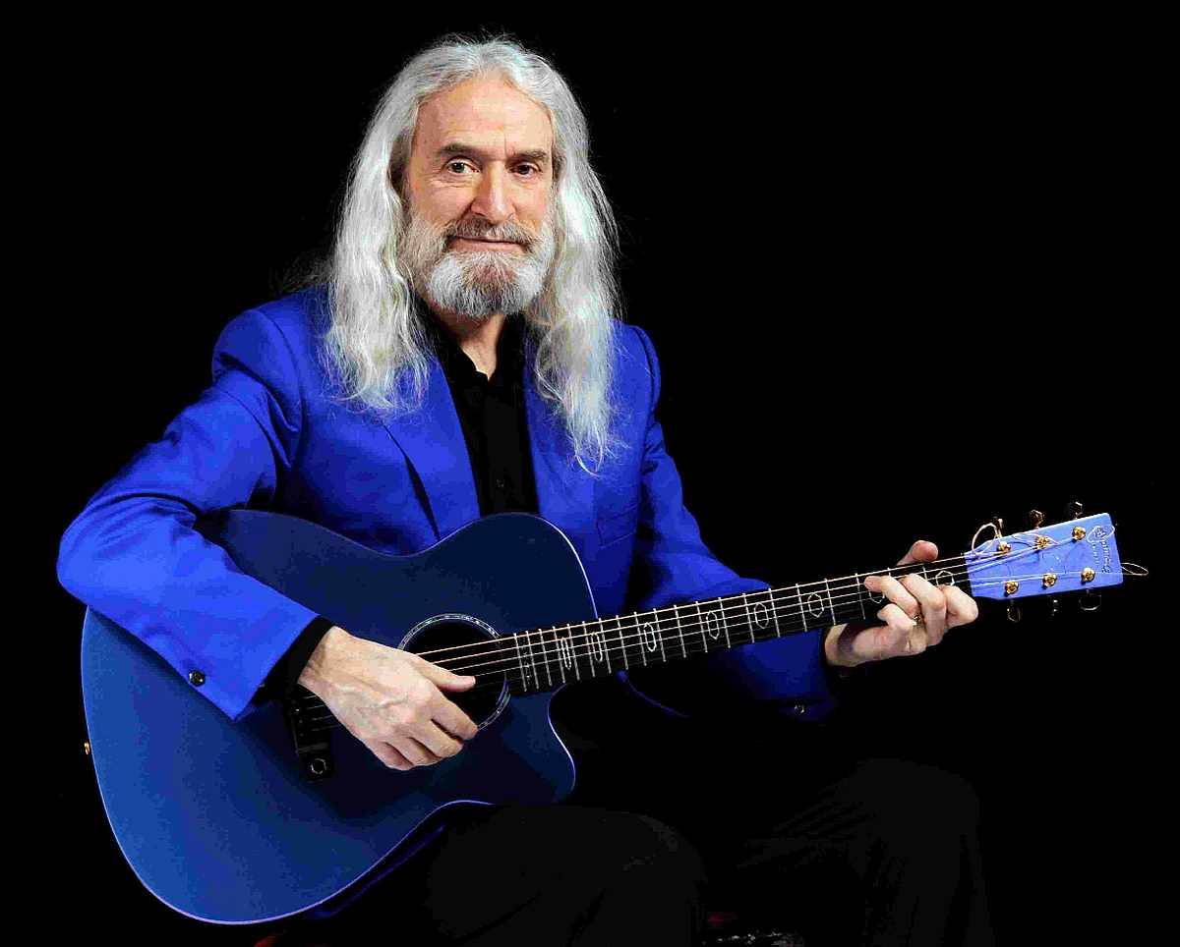






Country music 116
What colour is
the wind
My heart
would know
Angels with
one wings
I wish it
was me
Close your
eyes
I all be
missing you
Part of me
Mountains
Boulder
The green grass
Walking on my
memories
Peace on Earth
www.yatata-blog.eu

