Slide 1
Romantic ballads
Ballades romantiques

Slide 2
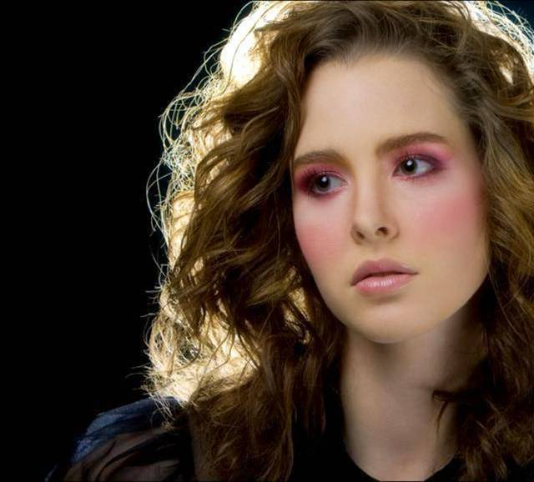



Romantic ballads
Pockets
If this is goodbye
Your memory won‘t die
All the roadrunning
Love and happiness
Wherever I go
Old Pigweed
Brothers in arms
www.yatata-blog.eu

