Slide 1
Roger
Whittaker

Slide 2
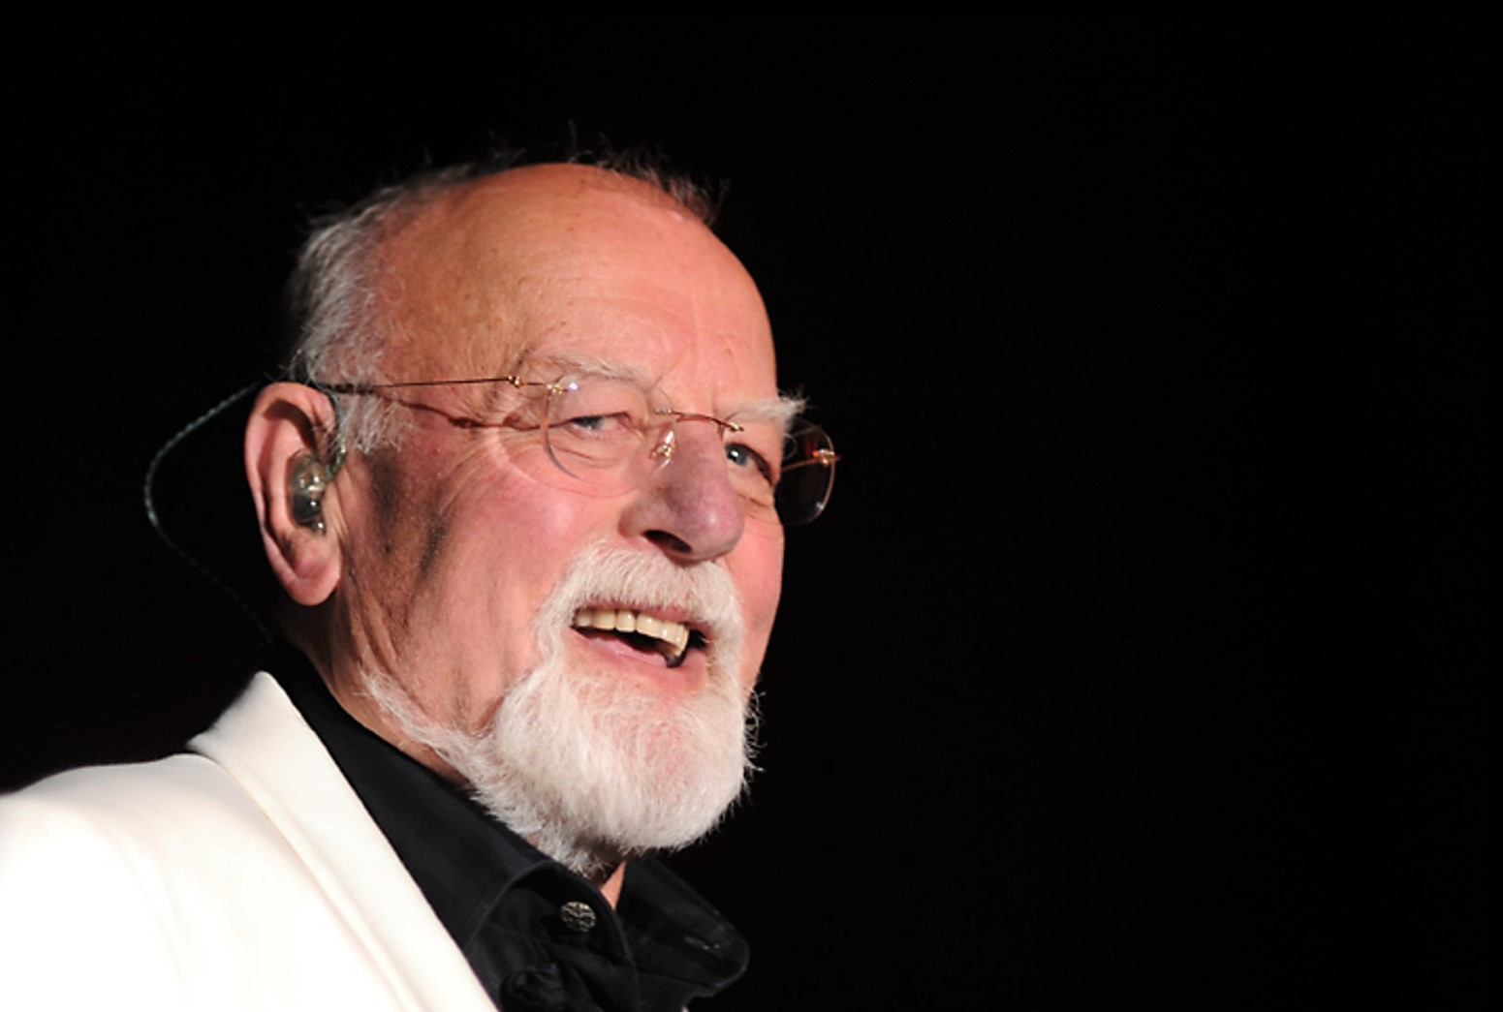


Roger Whittaker
A perfect day
presentation by y@t@t@
Mon pays bleu
Green,green
grass of home
Leben mit dir
Everything I do
Song of goodbye
I will always love you
www.yatata-blog.eu

