Slide 1

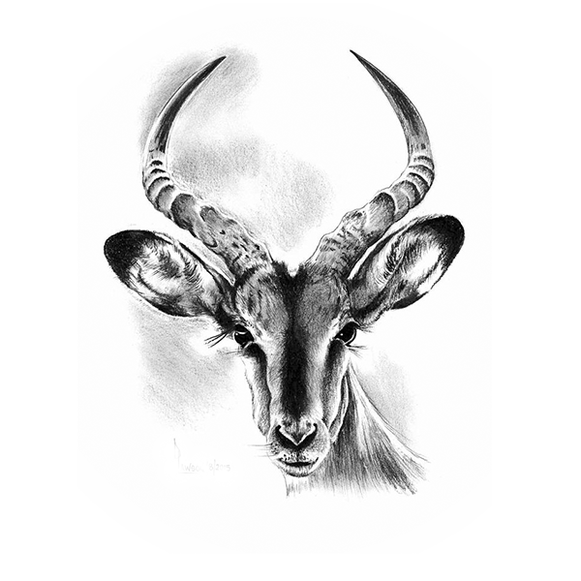

Wildlife
09
Antelope
Of africa

Slide 2
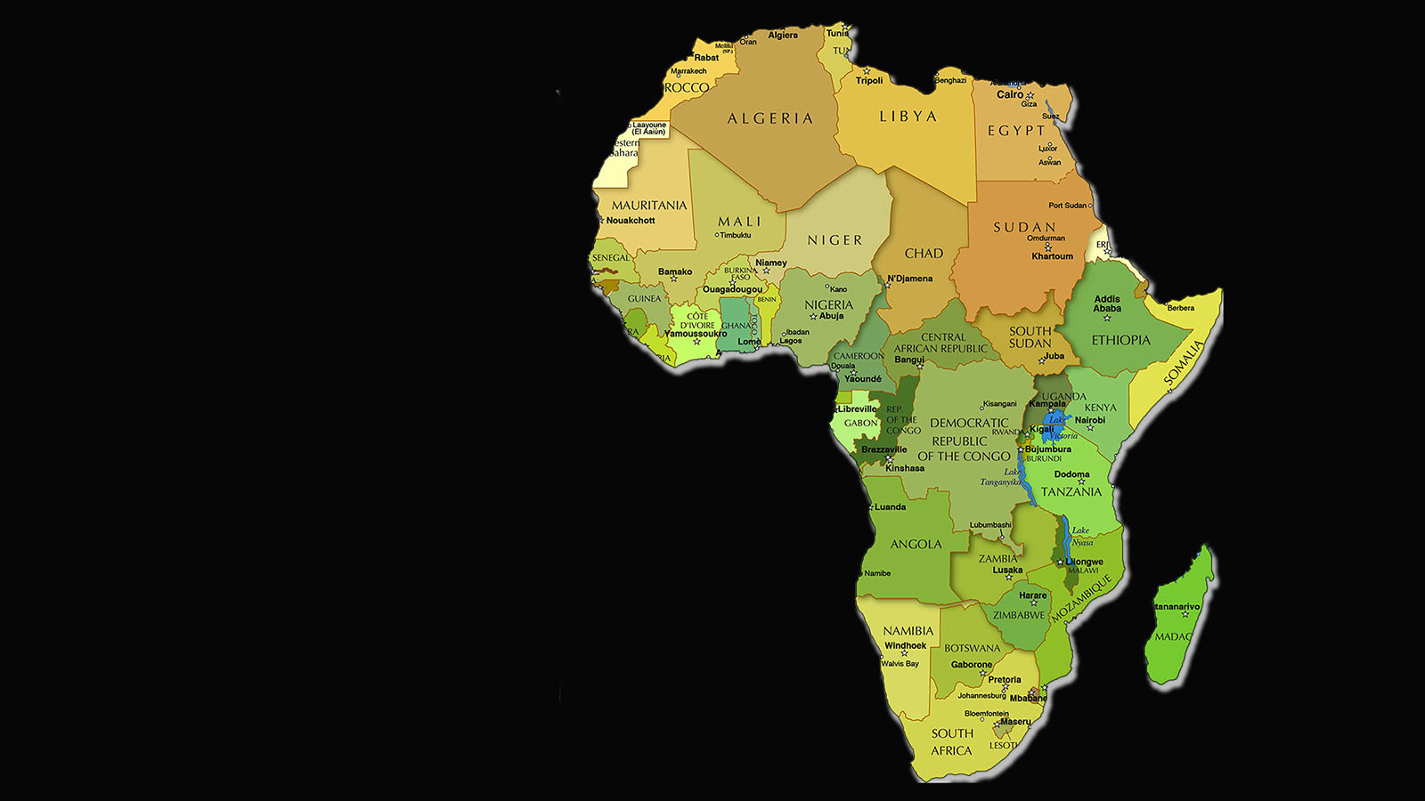

Wildlife
of Africa

Slide 3
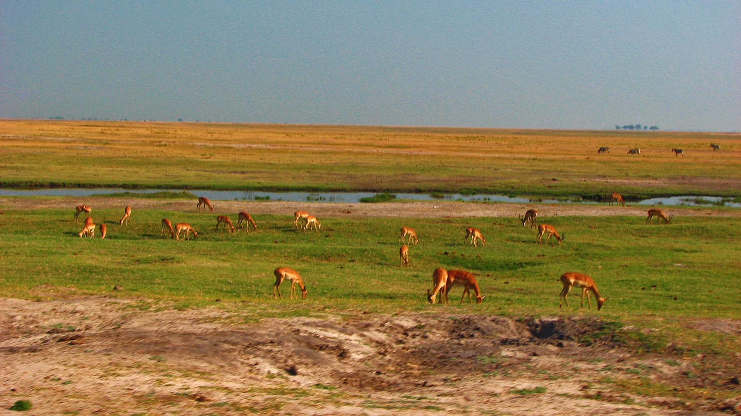

Photo © Hudec Ivan

Slide 4
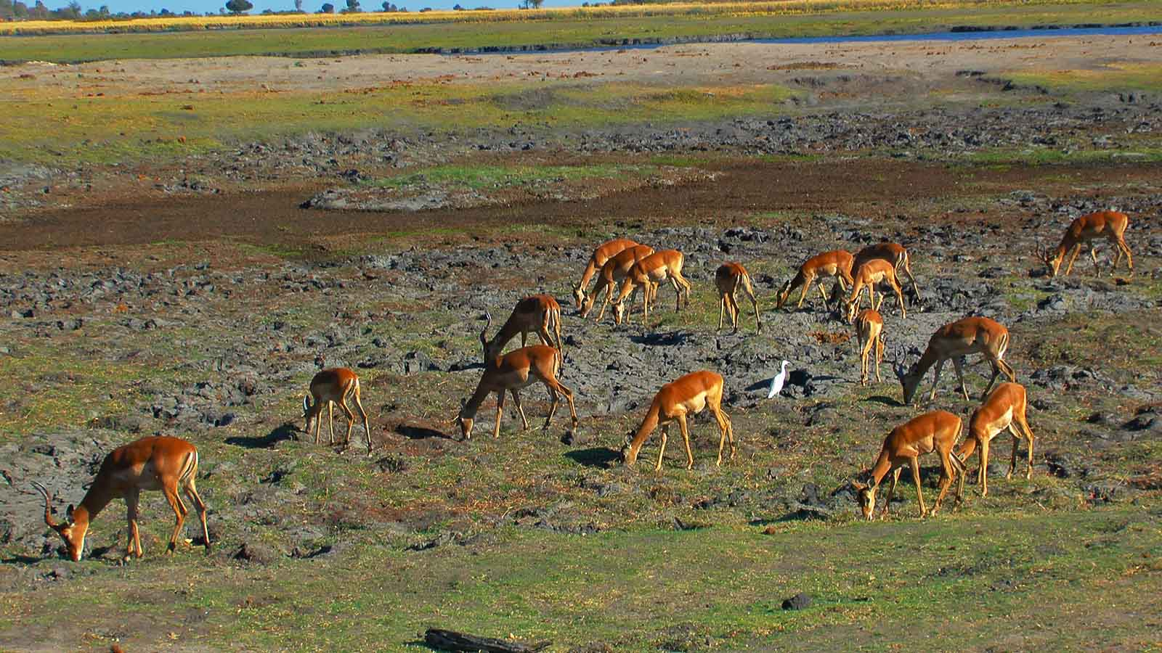
Photo © Sekerka D

Slide 5
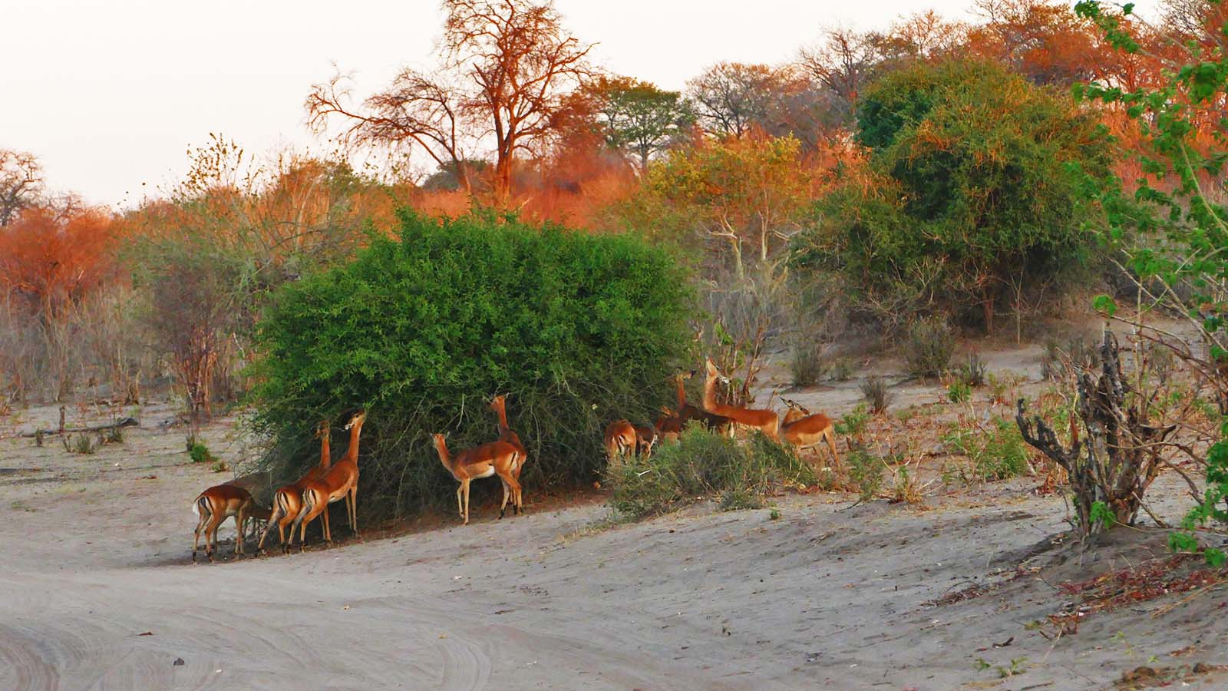
Photo © Sekerka D

Slide 6
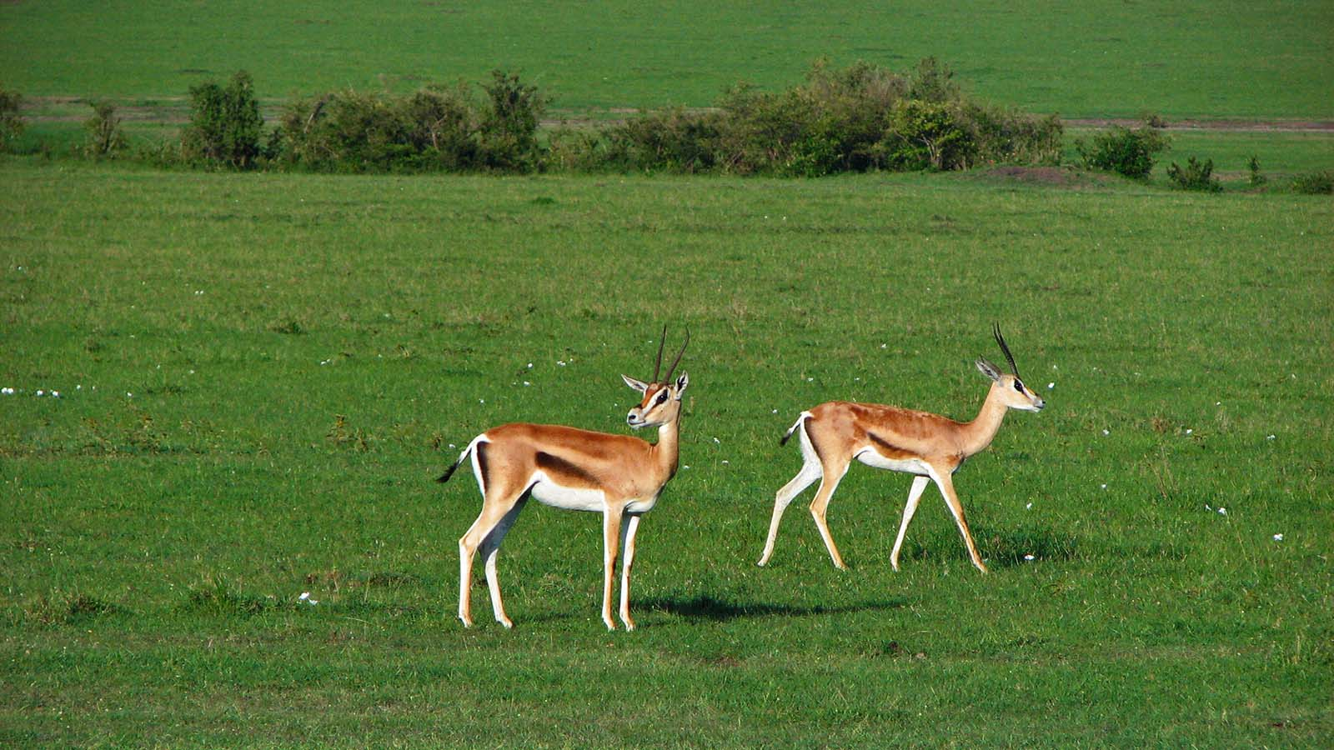
Photo © Hudec Ivan

Slide 7
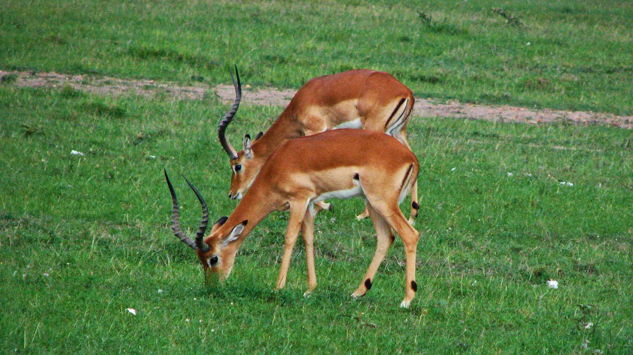
Photo © Hudec Ivan

Slide 8
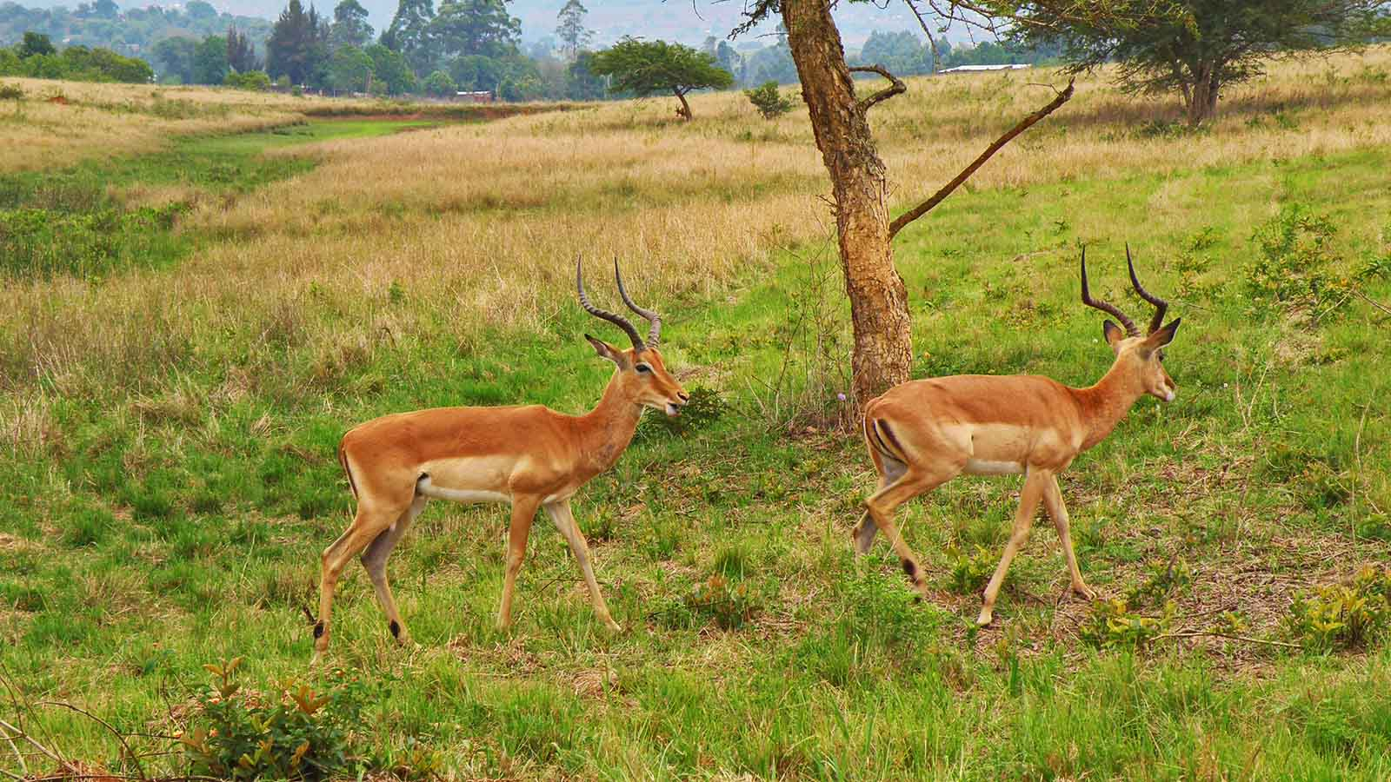
Photo © Hudec Ivan

Slide 9
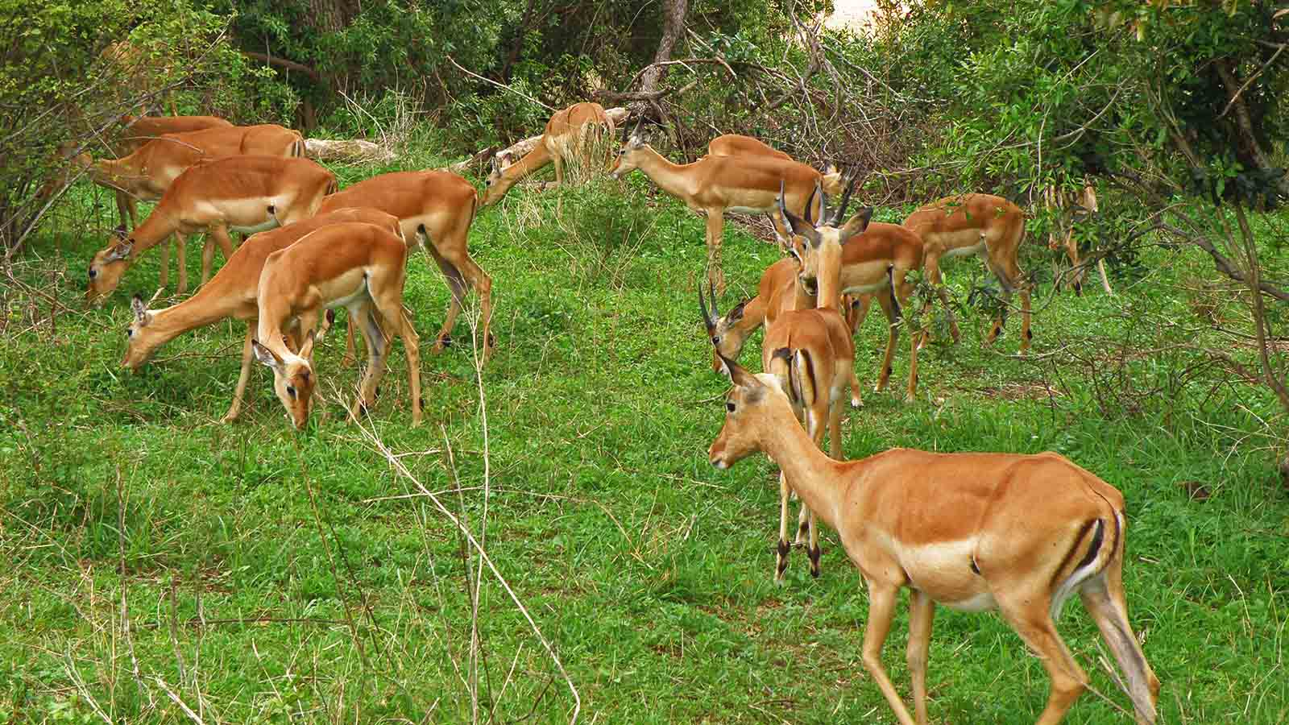
Photo © Hudec Ivan

Slide 10
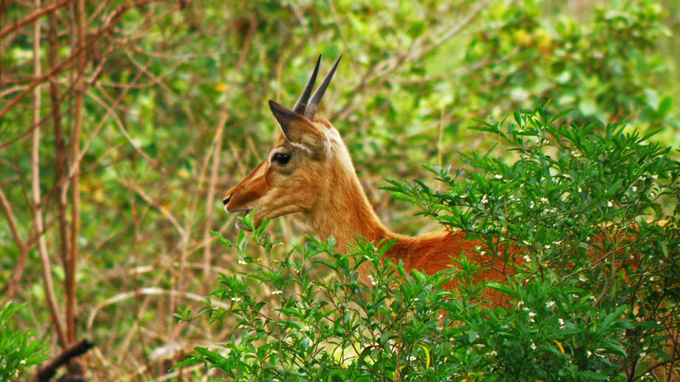
Photo © Hudec Ivan

Slide 11
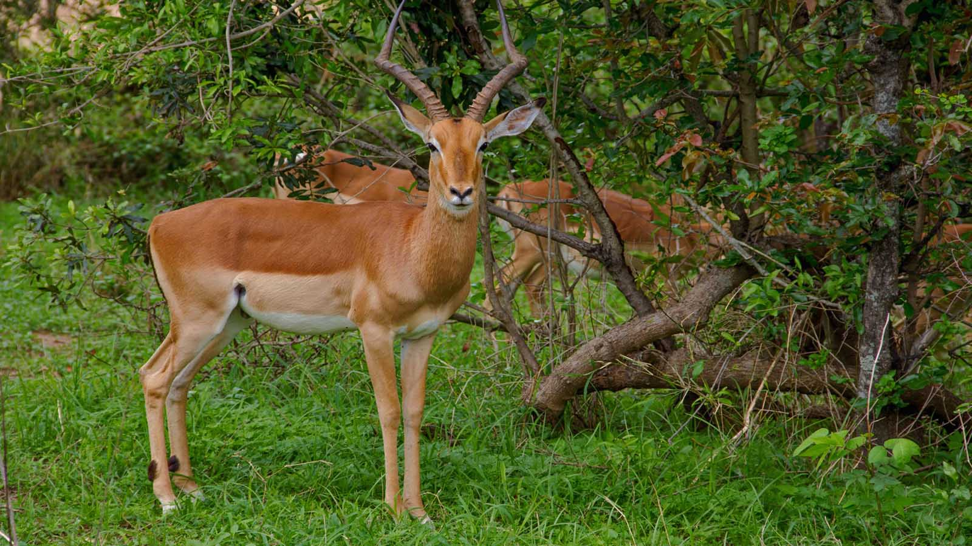
Photo © Hudec Ivan

Slide 12
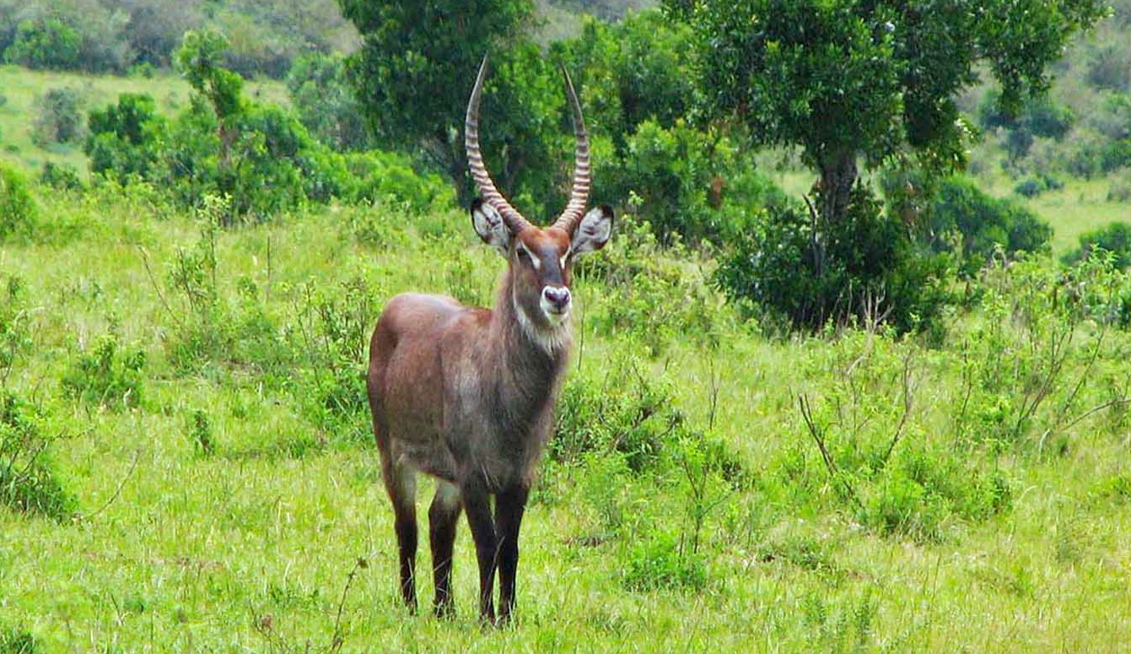
Photo © Hudec Ivan

Slide 13
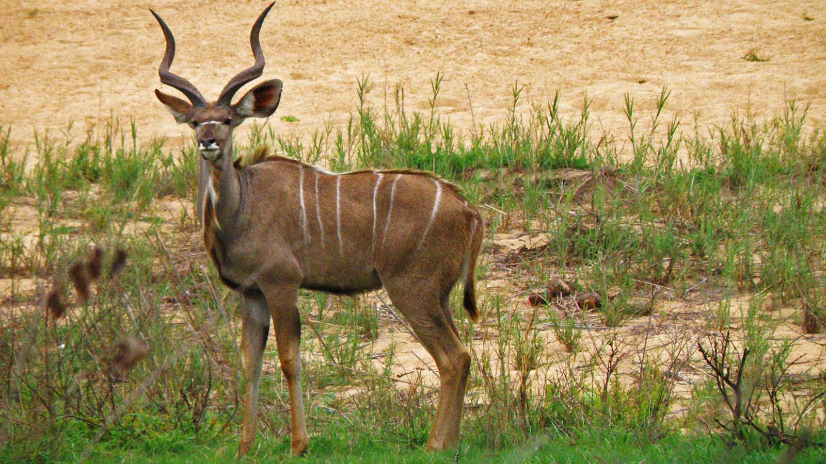
Photo © Hudec Ivan

Slide 14
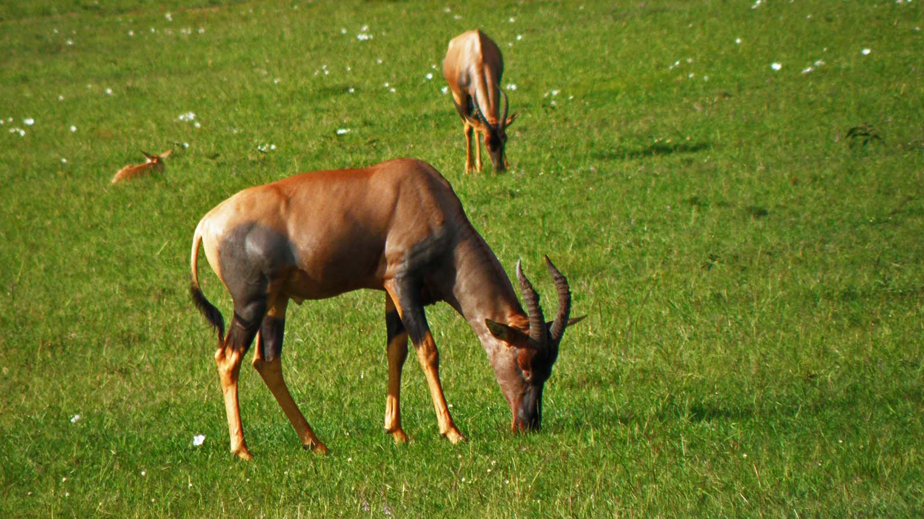
Photo © Hudec Ivan

Slide 15
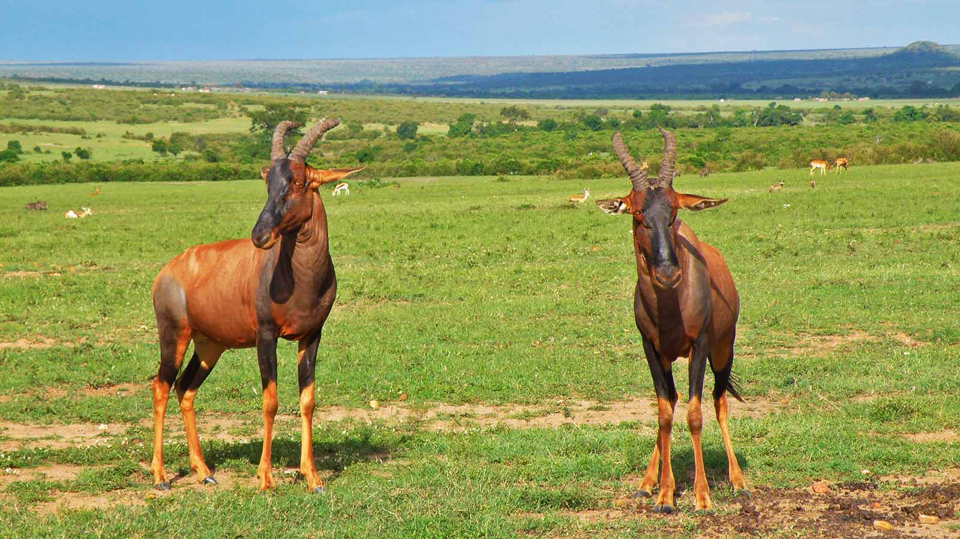
Photo © Hudec Ivan

Slide 16
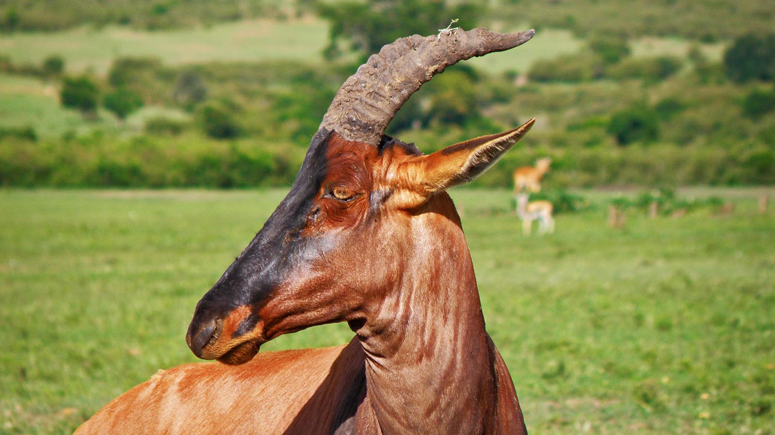
Photo © Hudec Ivan

Slide 17
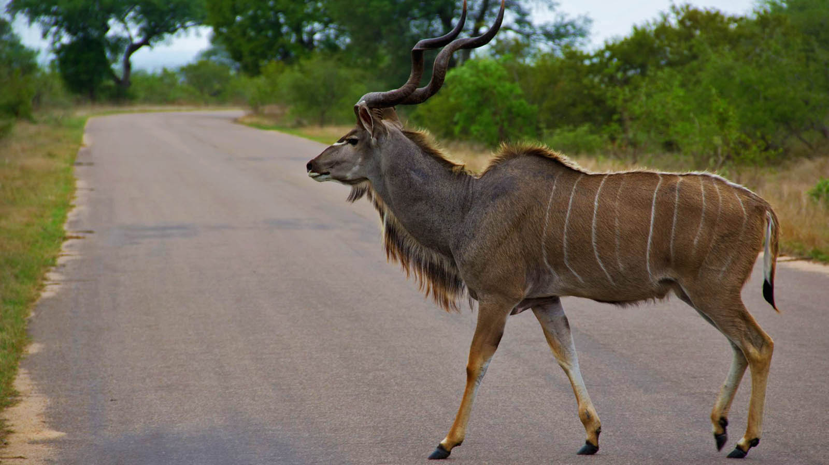
Photo © Hudec Ivan

Slide 18
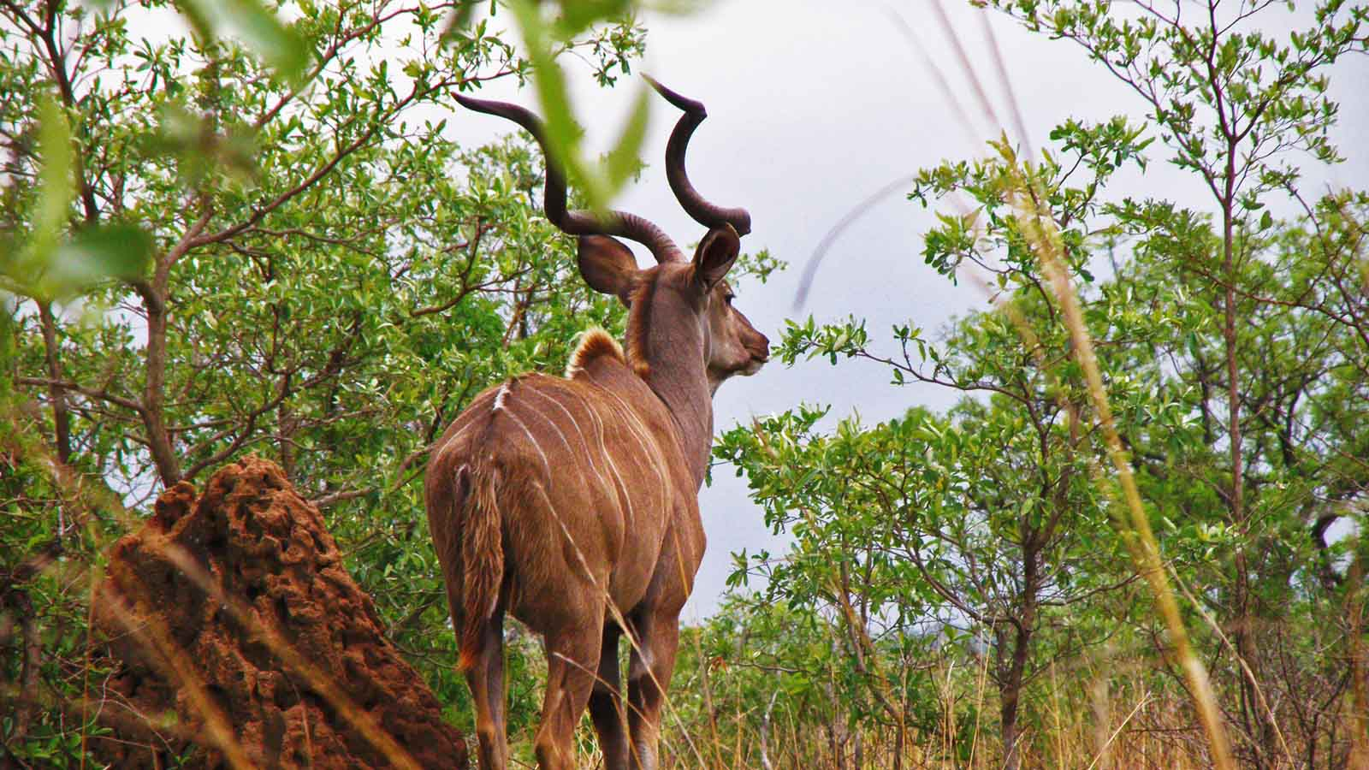
Photo © Hudec Ivan

Slide 19
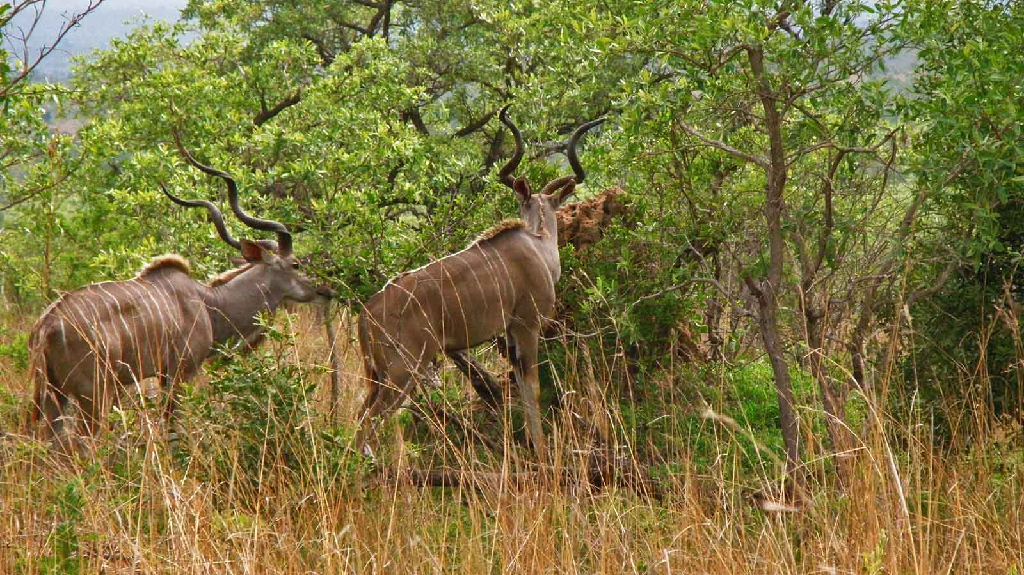
Photo © Hudec Ivan

Slide 20
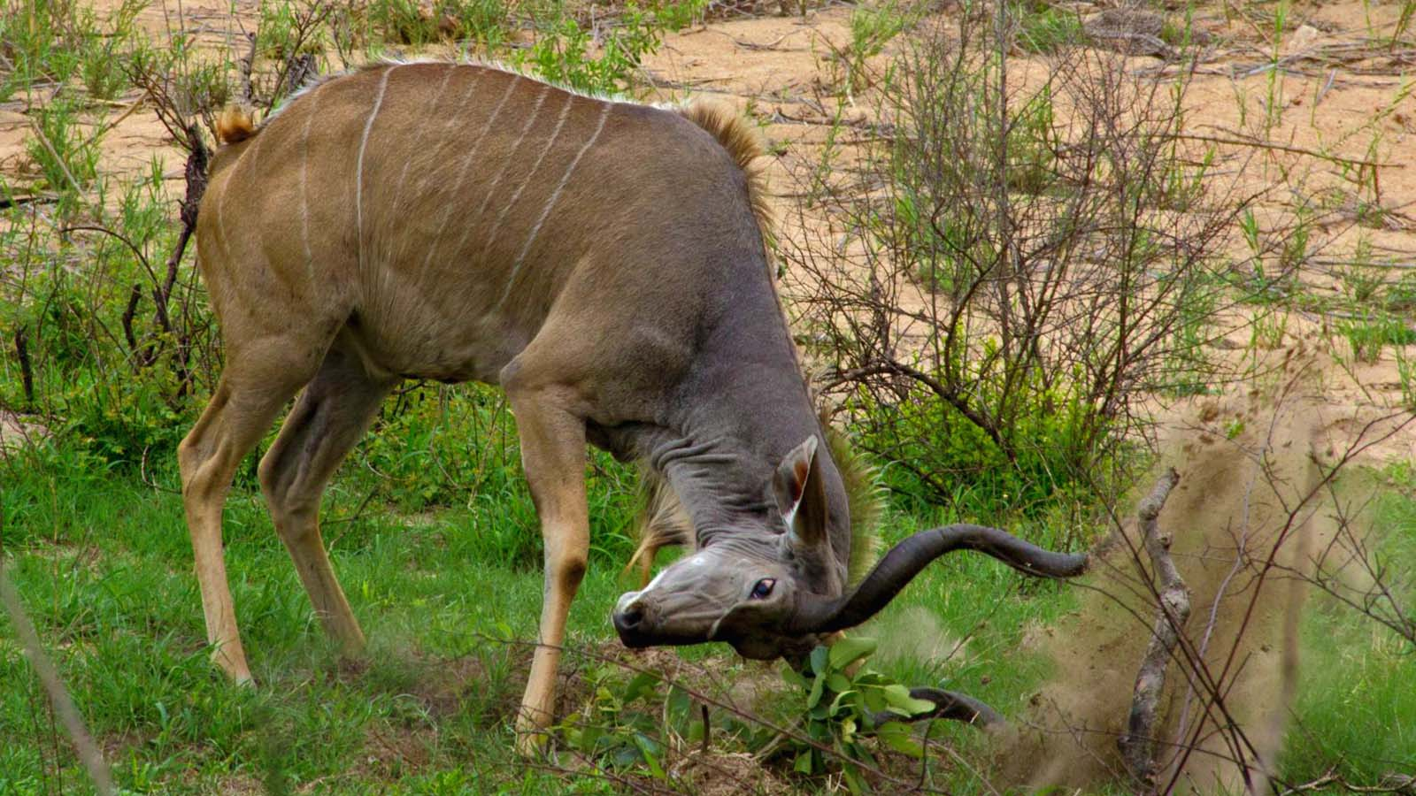
Photo © Hudec Ivan

Slide 21
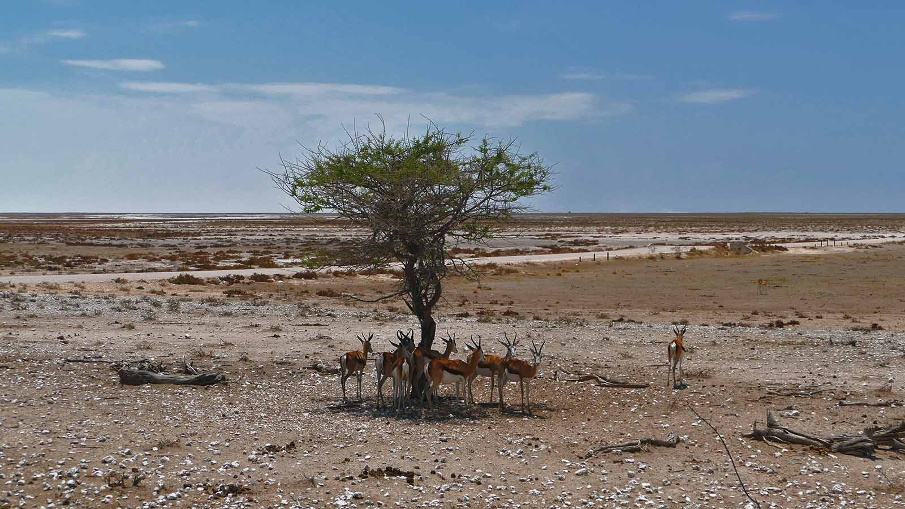
Photo © Sekerka D

Slide 22
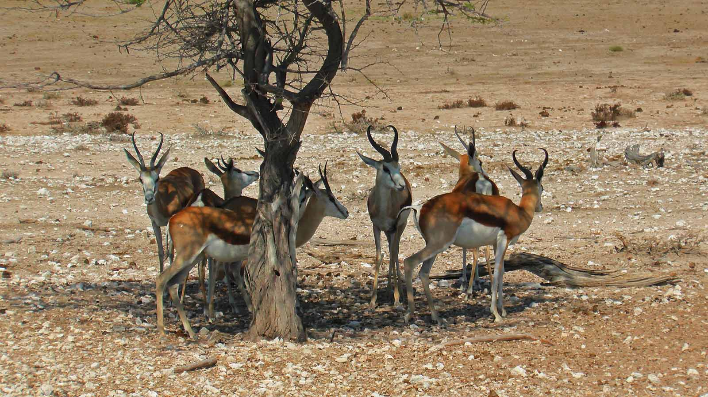
Photo © Sekerka D

Slide 23
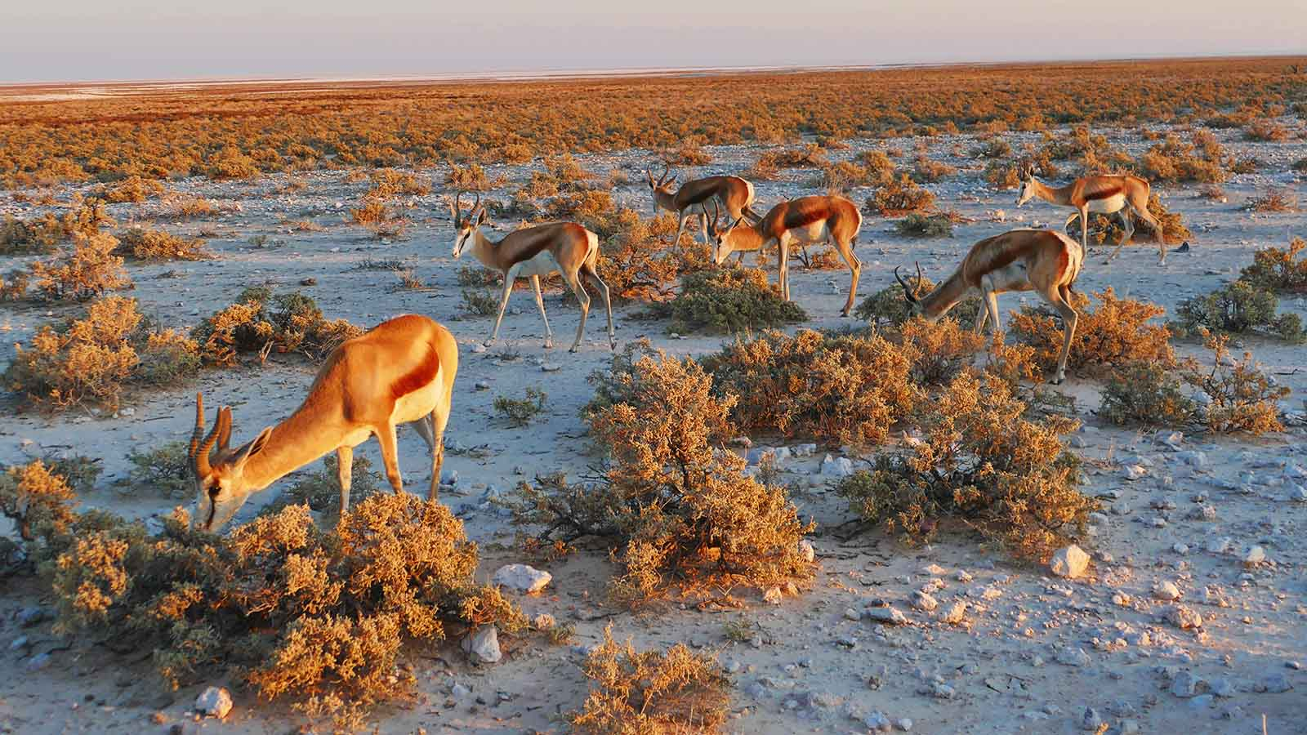
Photo © Sekerka D

Slide 24
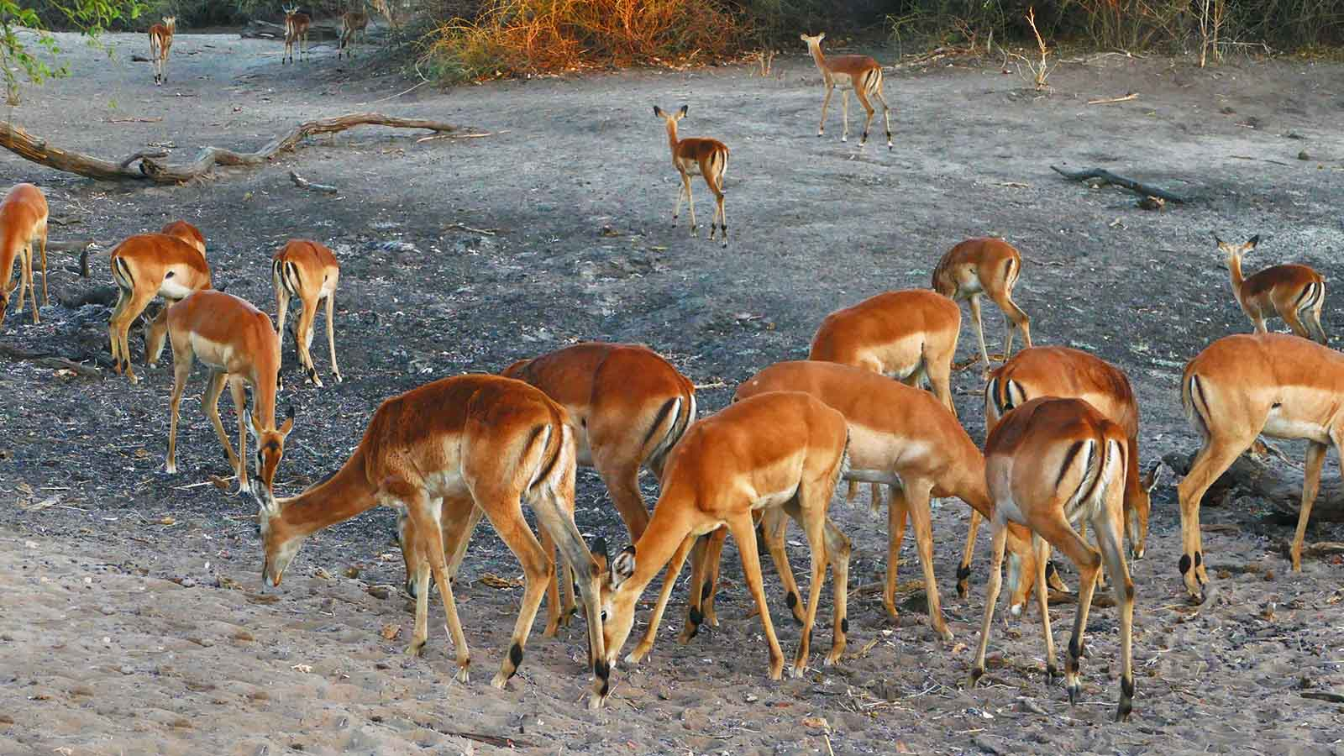
Photo © Sekerka D

Slide 25
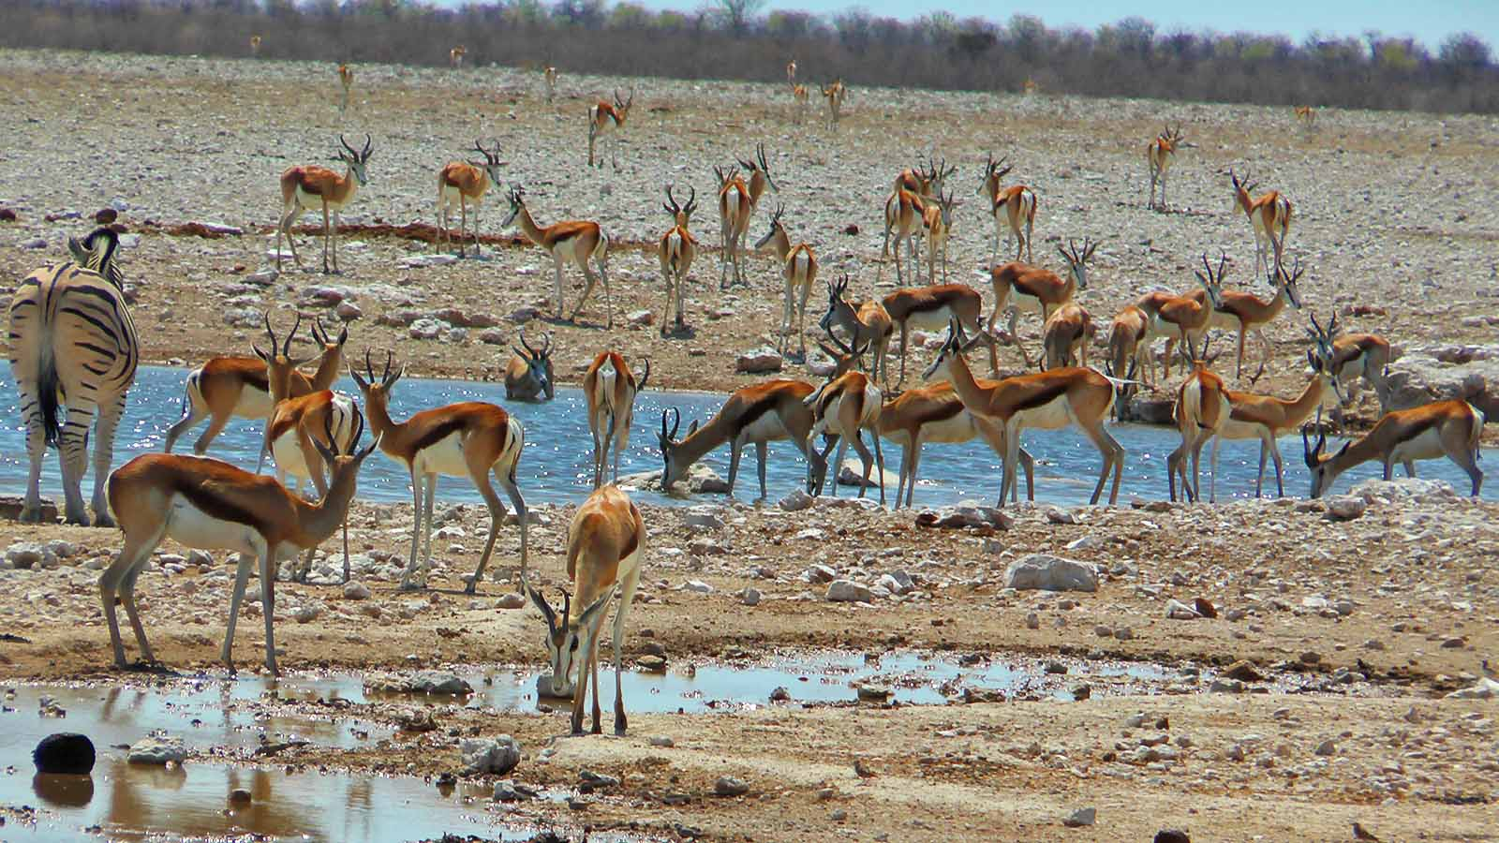
Photo © Sekerka D

Slide 26
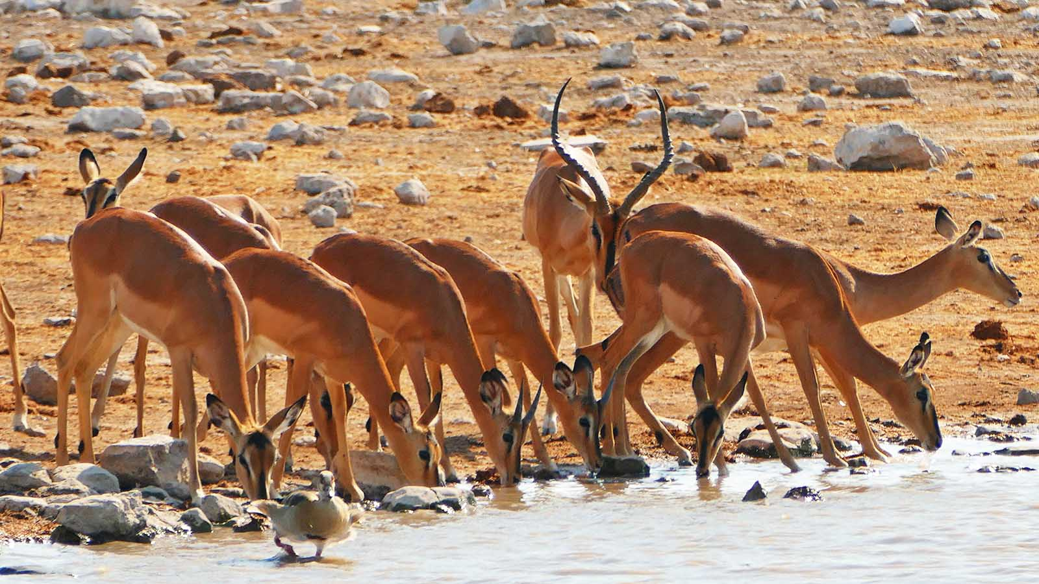
Photo © Sekerka D

Slide 27
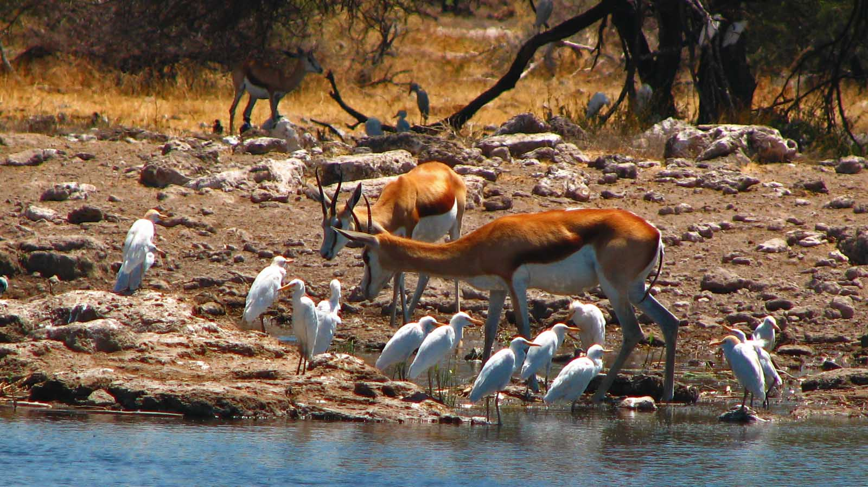
Photo © Hudec Ivan

Slide 28
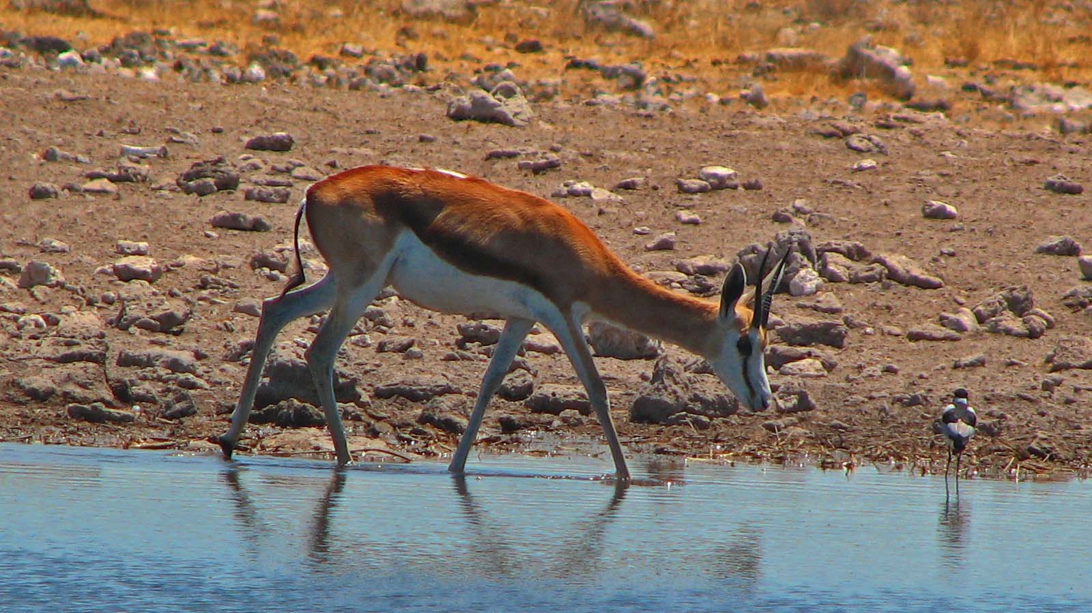
Photo © Hudec Ivan

Slide 29
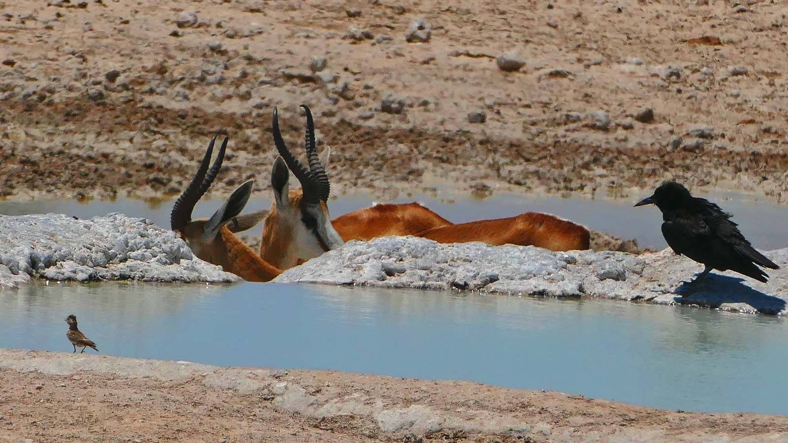
Photo © Sekerka D

Slide 30
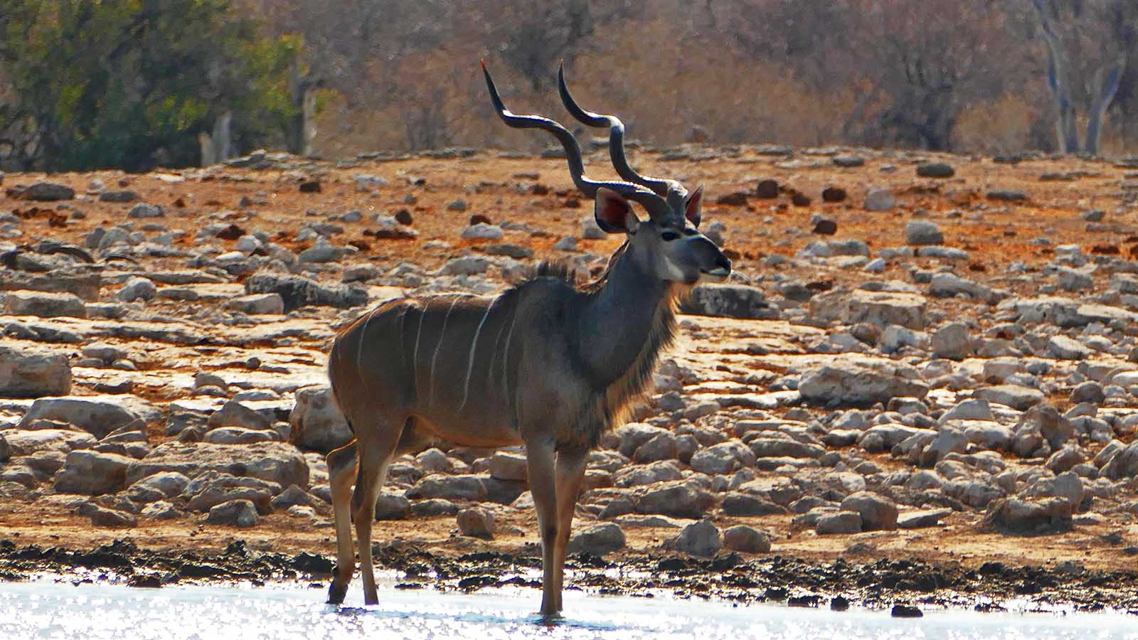
Photo © Sekerka D

Slide 31
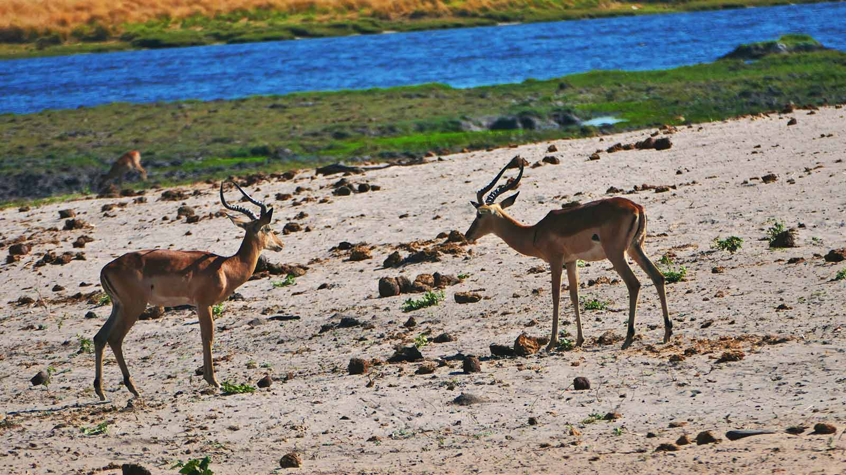
Photo © Sekerka D

Slide 32
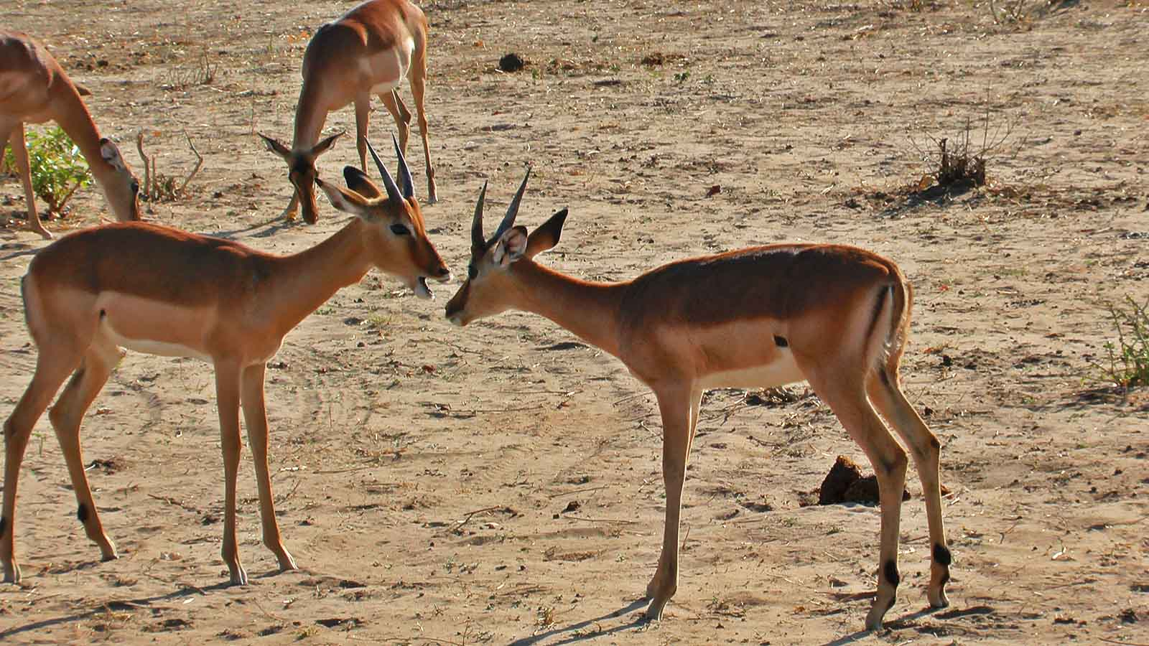
Photo © Sekerka D

Slide 33
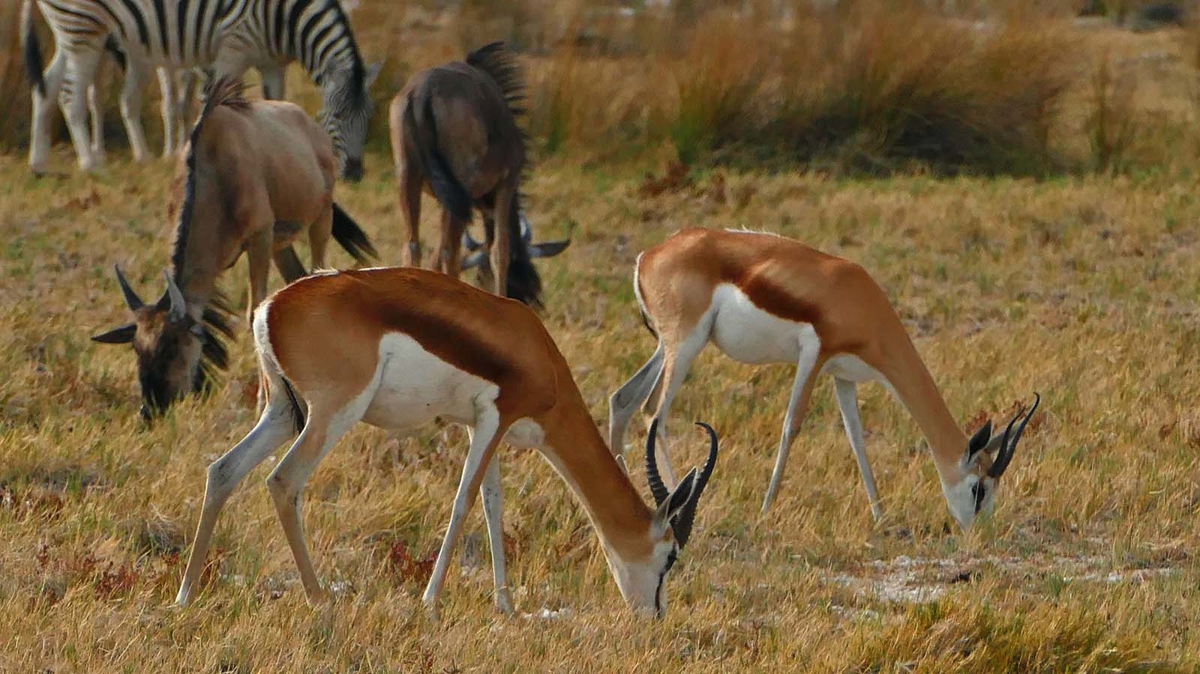
Photo © Sekerka D

Slide 34
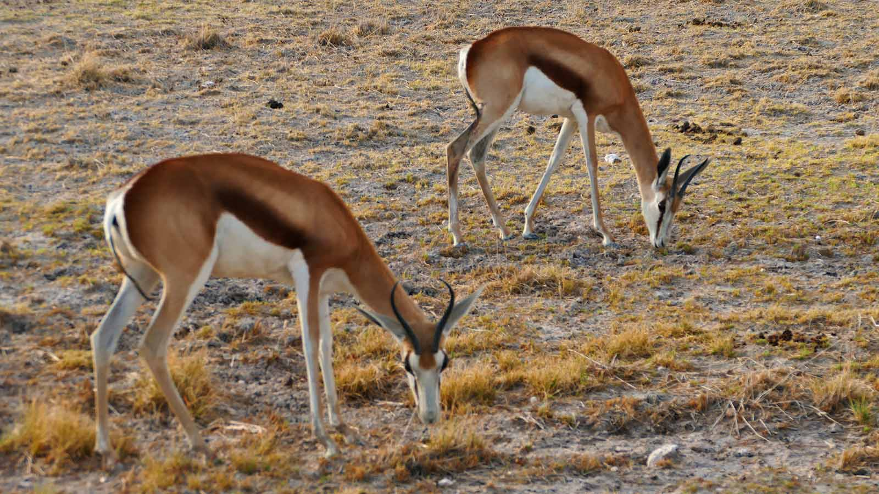
Photo © Sekerka D

Slide 35
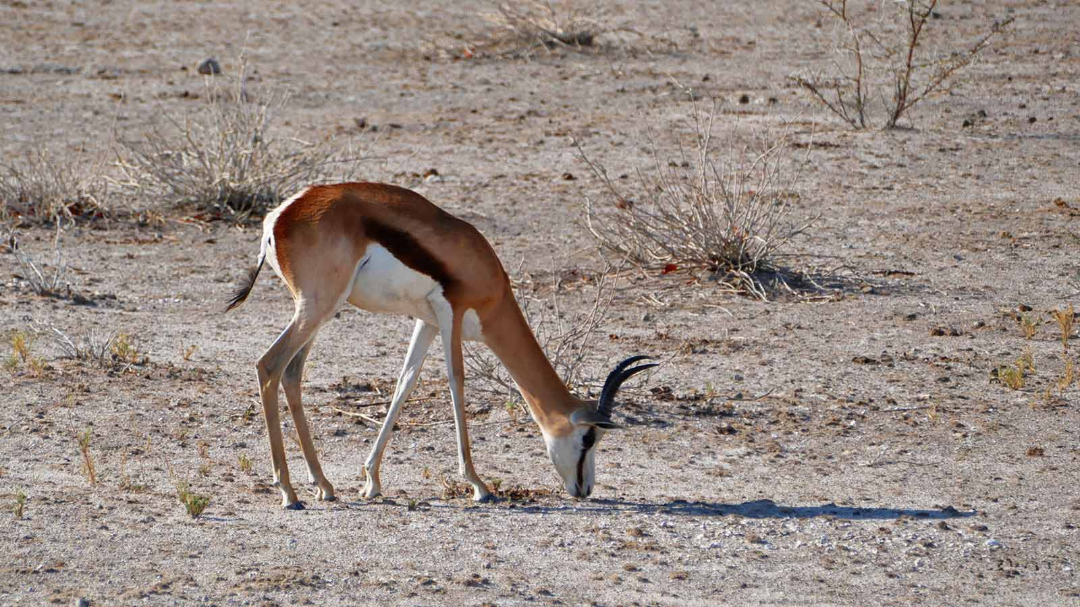
Photo © Sekerka D

Slide 36
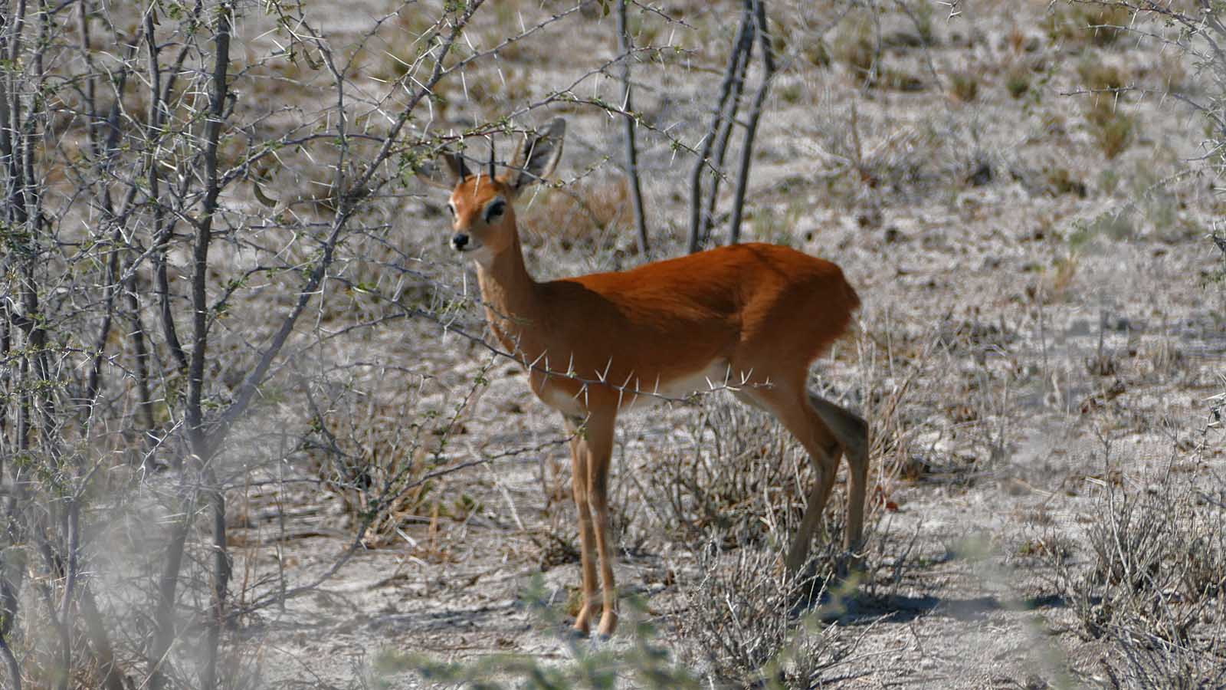
Photo © Sekerka D

Slide 37
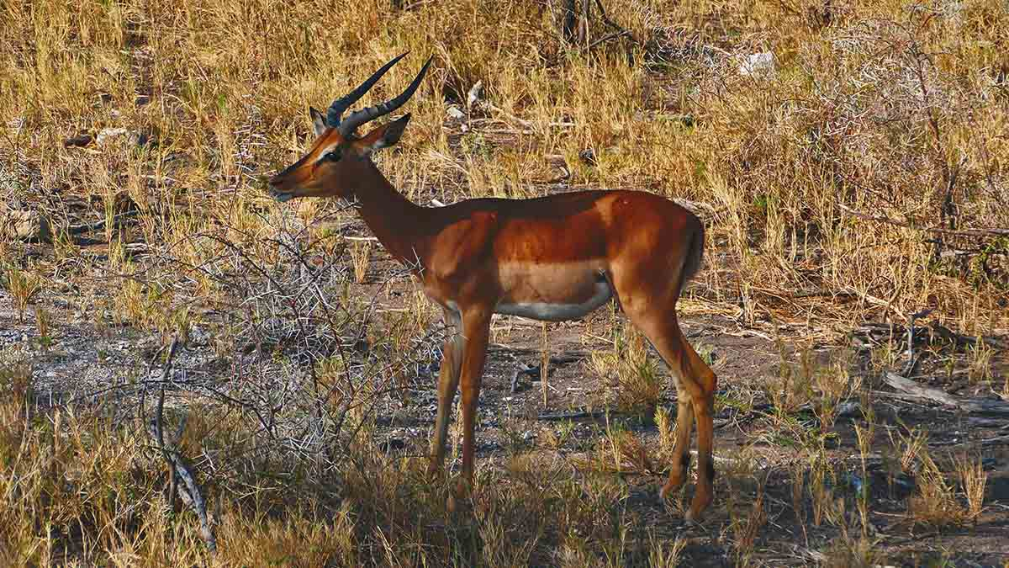
Photo © Sekerka D

Slide 38
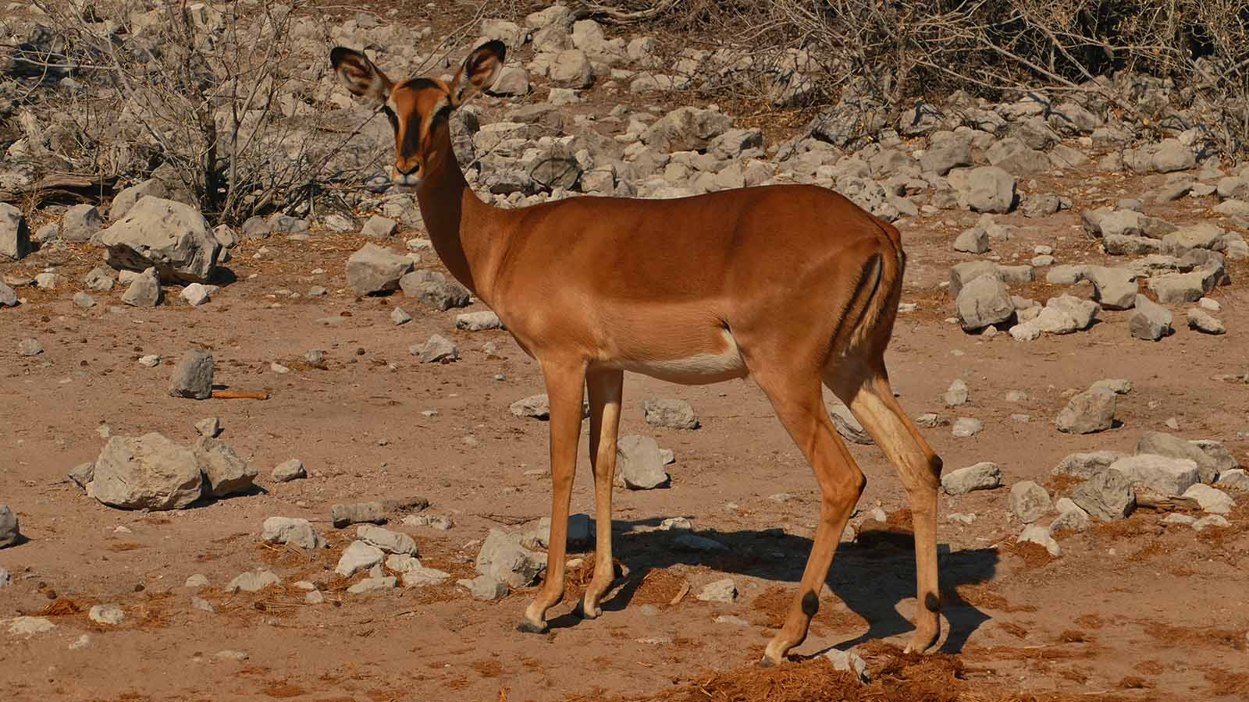
Photo © Sekerka D

Slide 39
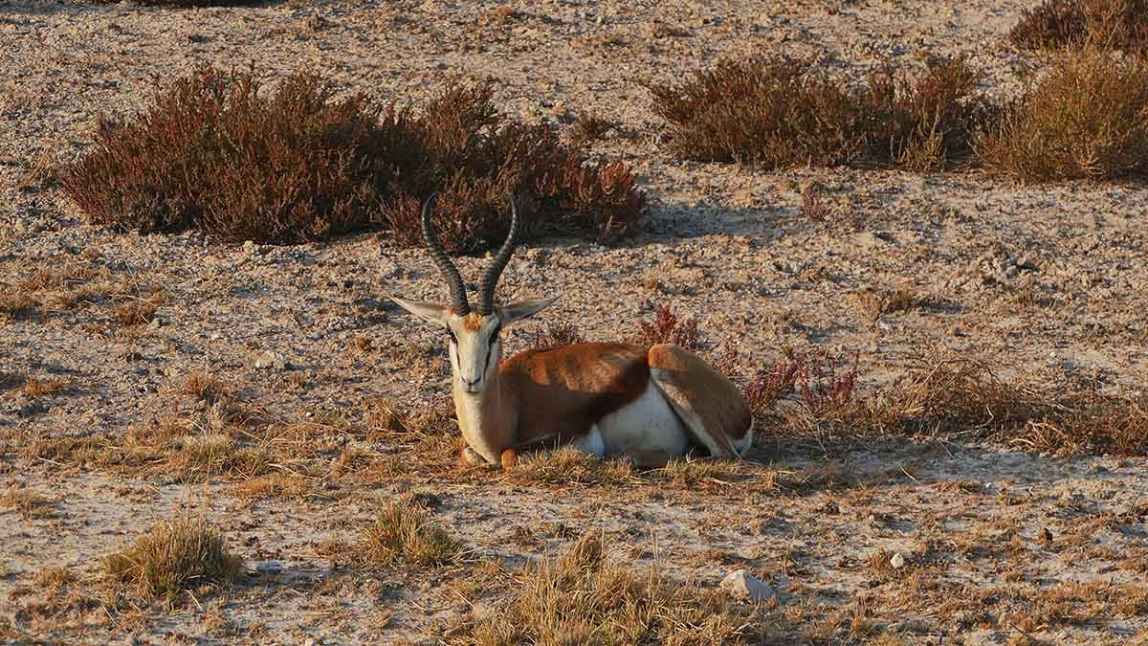
Photo © Sekerka D

Slide 40
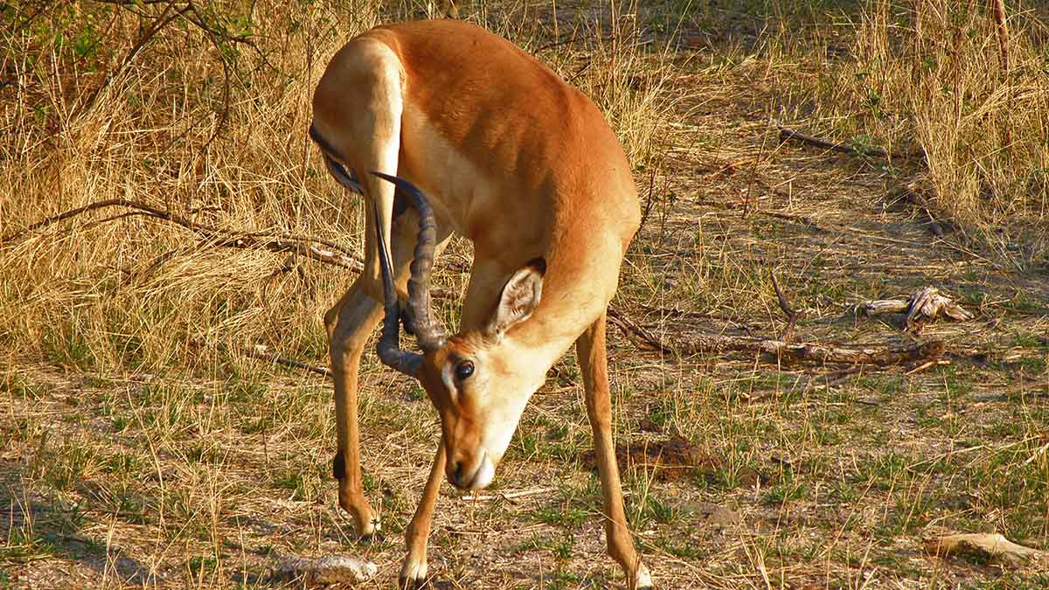
Photo © Hudec Ivan

Slide 41
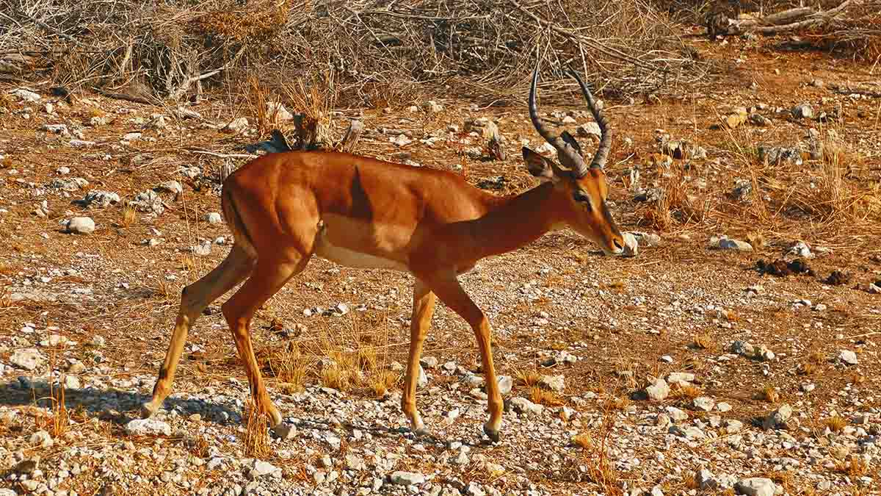
Photo © Sekerka D

Slide 42
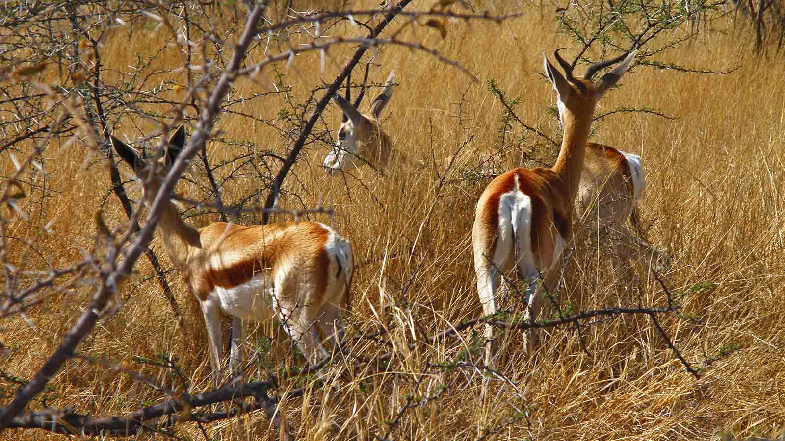
Photo © Hudec Ivan

Slide 43
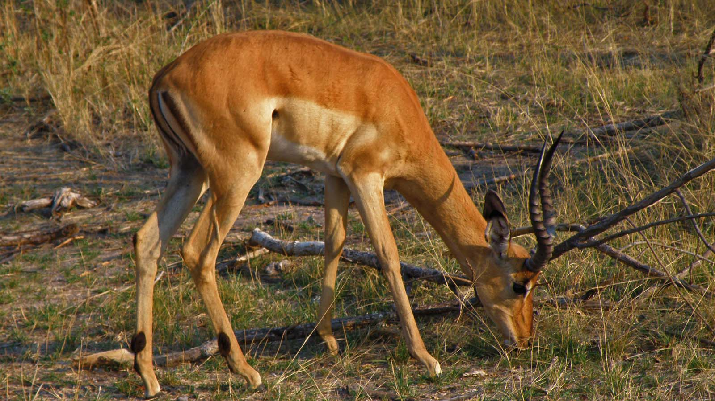
Photo © Hudec Ivan

Slide 44
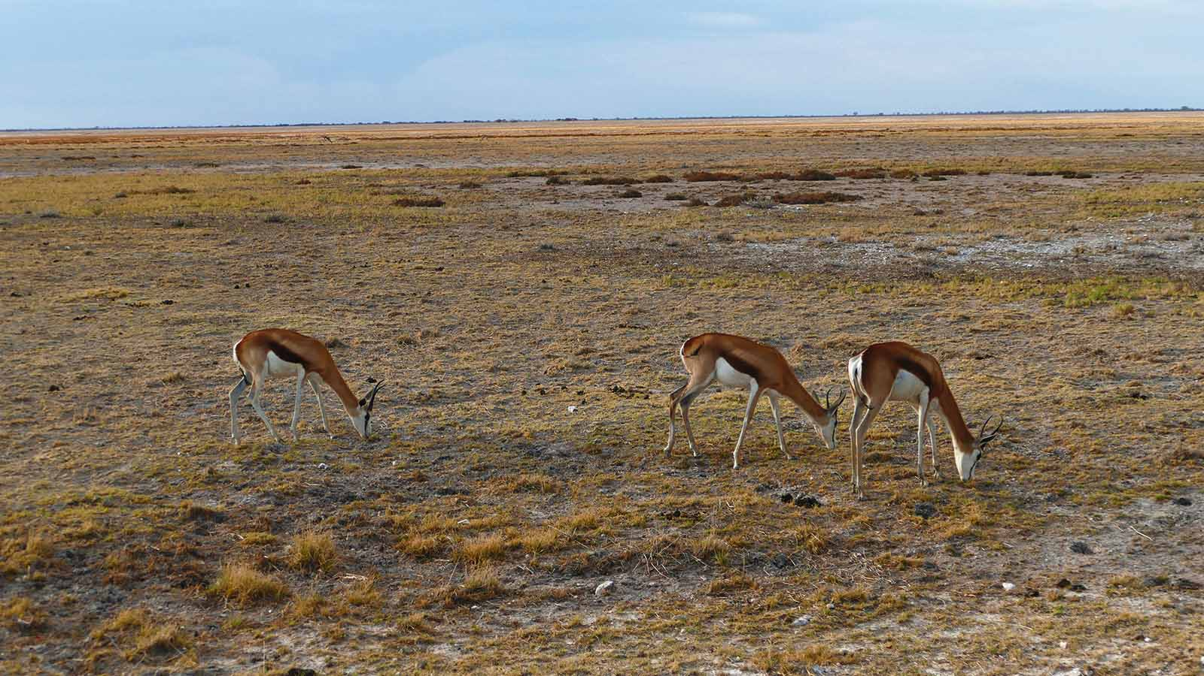
Photo © Sekerka D

Slide 45
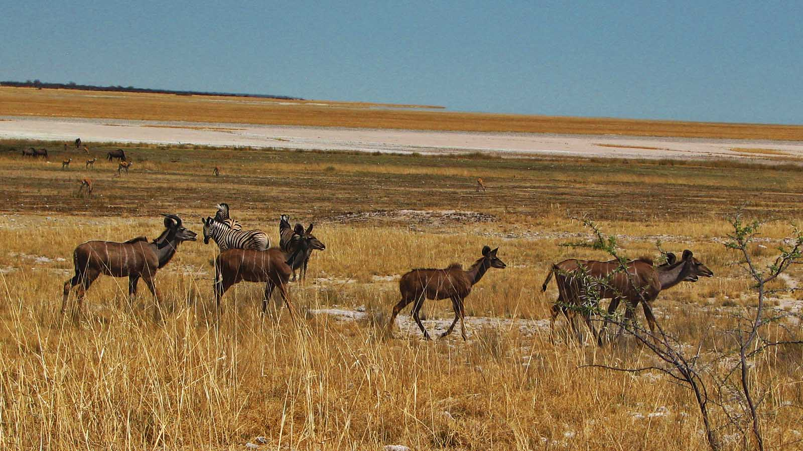
Photo © Hudec Ivan

Slide 46
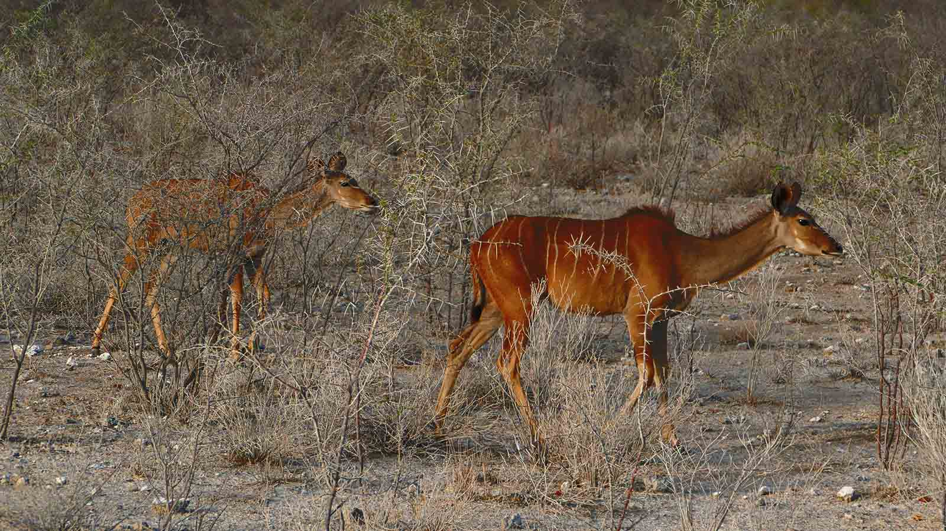
Photo © Sekerka D

Slide 47
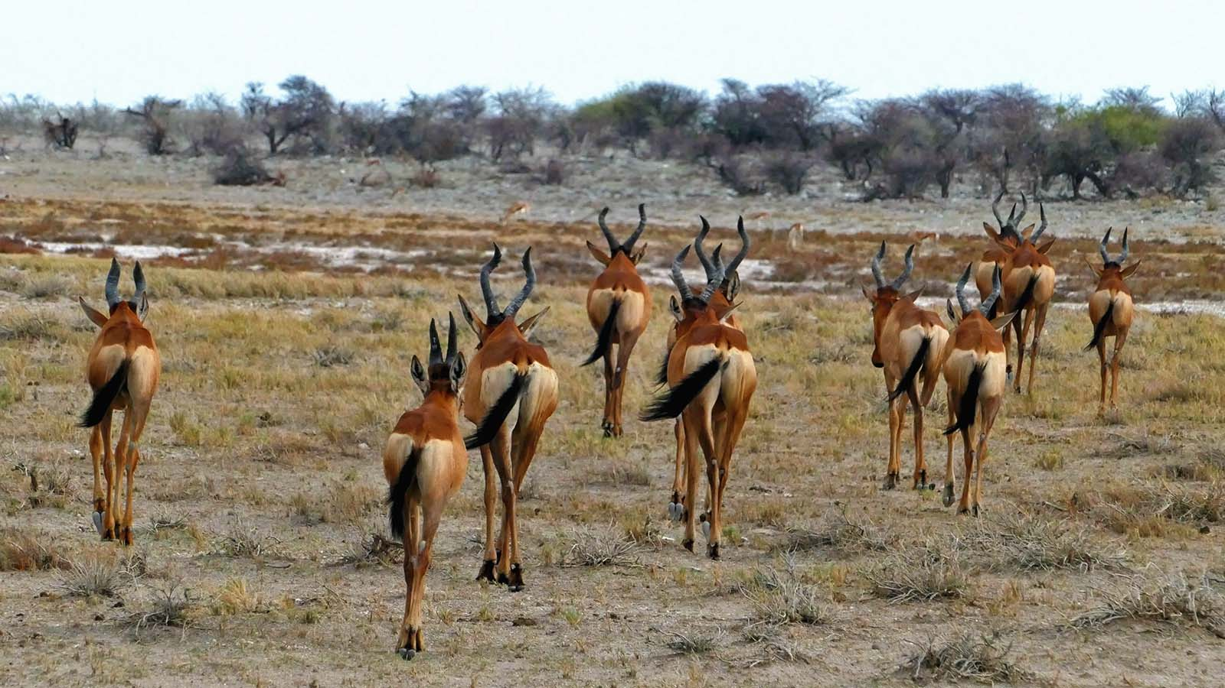
Photo © Sekerka D

Slide 48
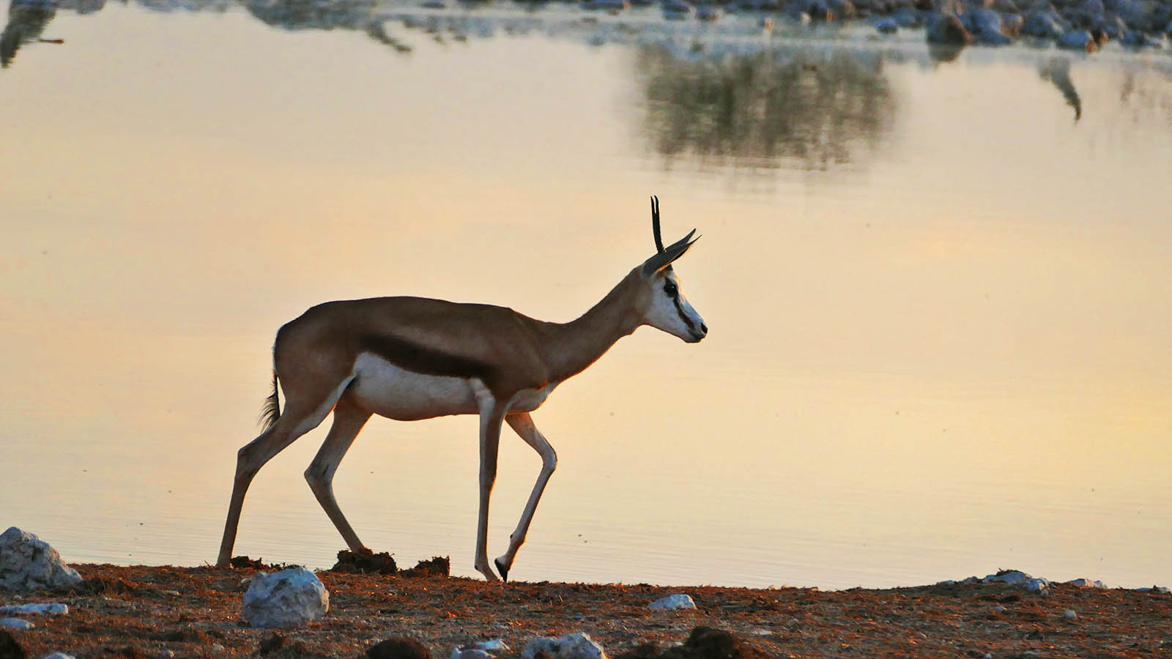
Photo © Sekerka D

Slide 49

2021
Music : Instrumental Music - Heart of Africa
Photos : Sekerka Dušan, Ing. (Slovakia)
Photos : Hudec Ivan (Slovakia)
Created by : Rumpler Štefan (Slovakia)
Contact : pista2011@gmail.com

Slide 50


Welcome in all languages!
I can translate your mails!
pista2011@gmail.com
CLICK for my VIDEOS
CLICK for my PPSX
Thank you for your feedback
Steve

