Slide 2



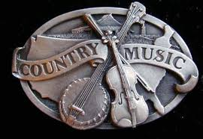

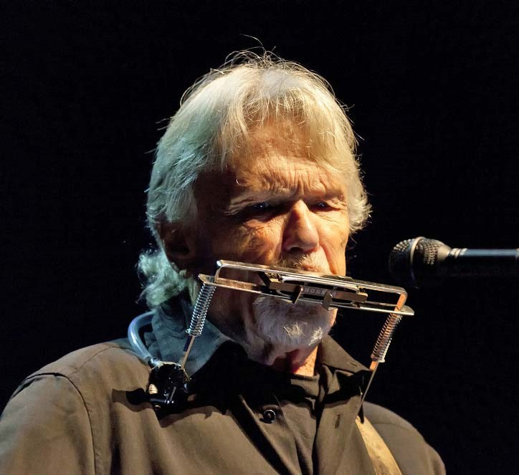

Country Music 95
200 miles
Red river valley
Country
music
My old
home
Darlin‘
Nellie
500 miles from home
Tonight my lady learns to love
Name this song
How can I tell my dreams
Tom Dooley
presentation by y@t@t@
Willow garden
www.yatata-blog.eu

