Slide 1



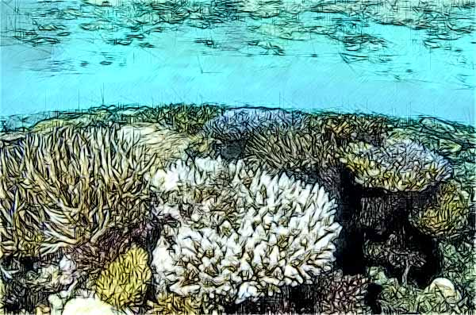
Coral reefs
( 3 )
AUSTRALIA

Slide 2

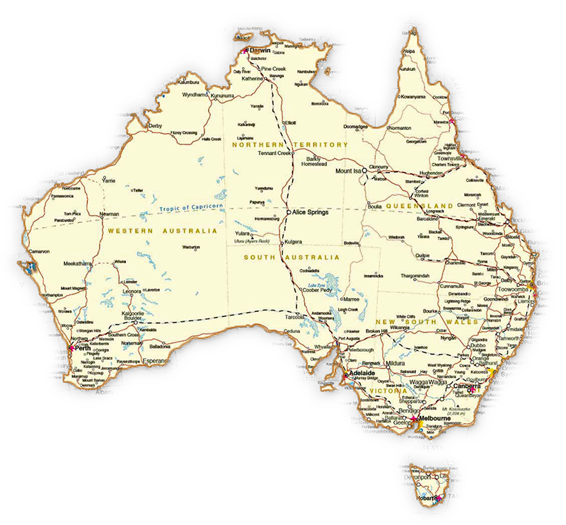
Coral Reefs
Australia

Slide 3
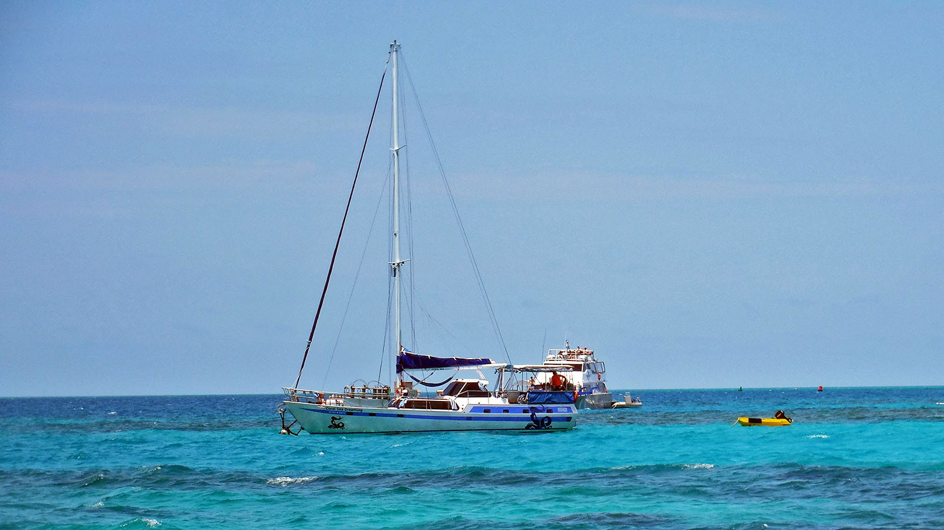
Photo © Hudec Ivan

Slide 4
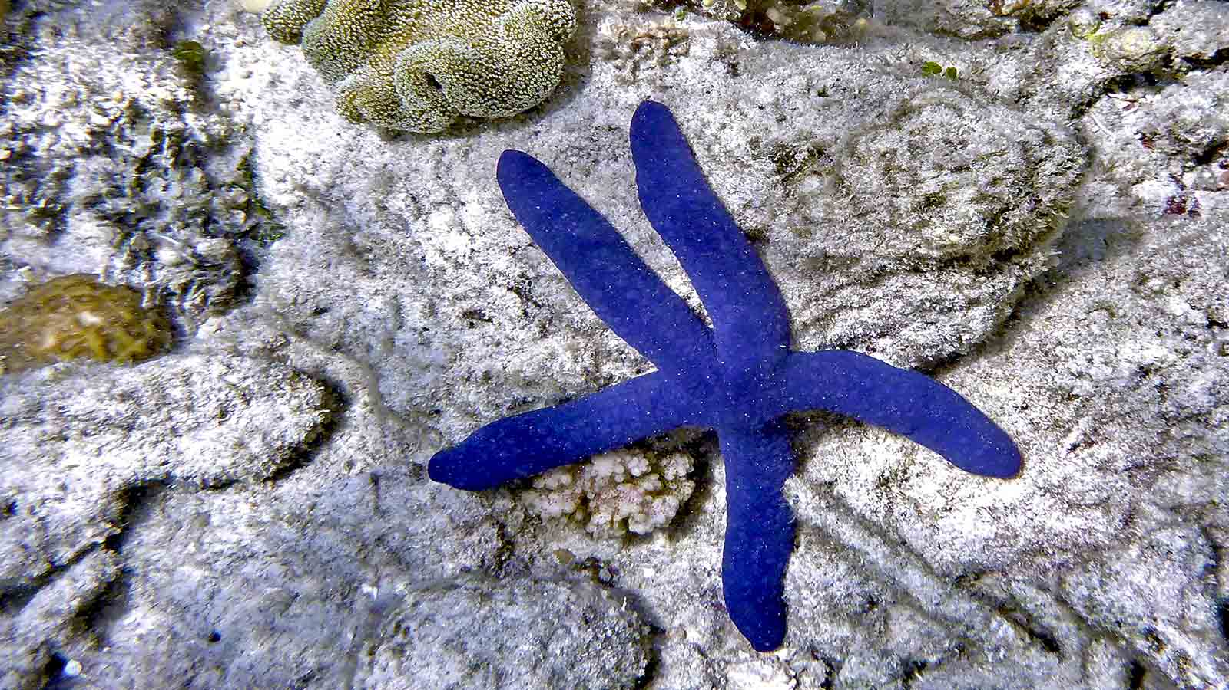
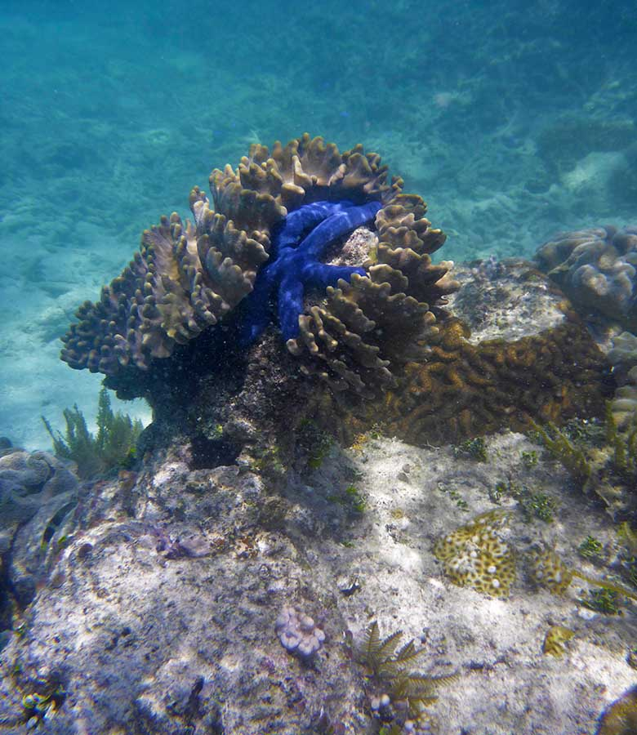
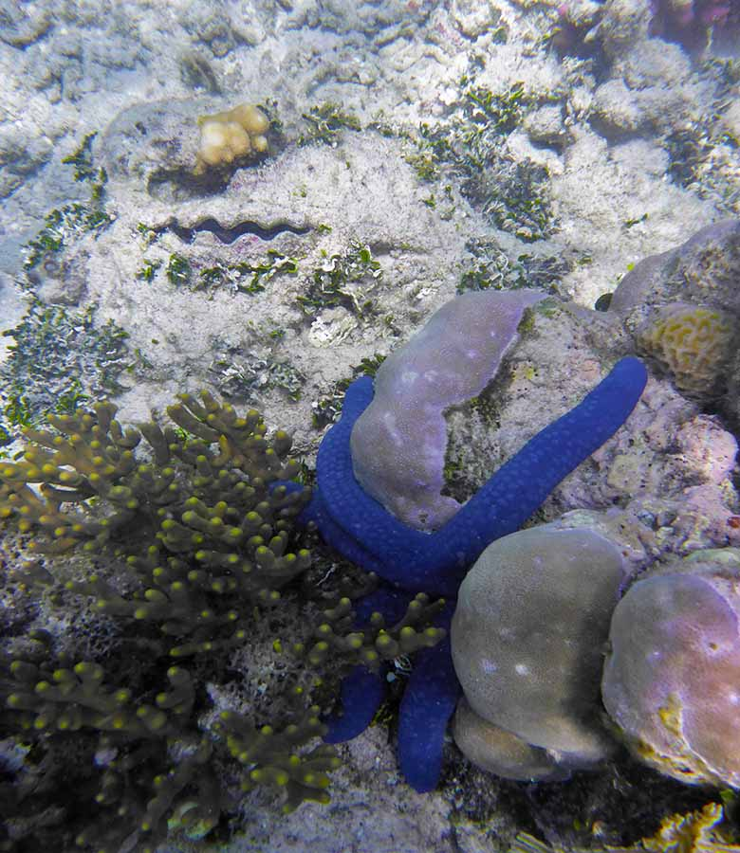
Photo © Hudec Ivan
Photo © Hudec Ivan
Photo © Hudec Ivan

Slide 5
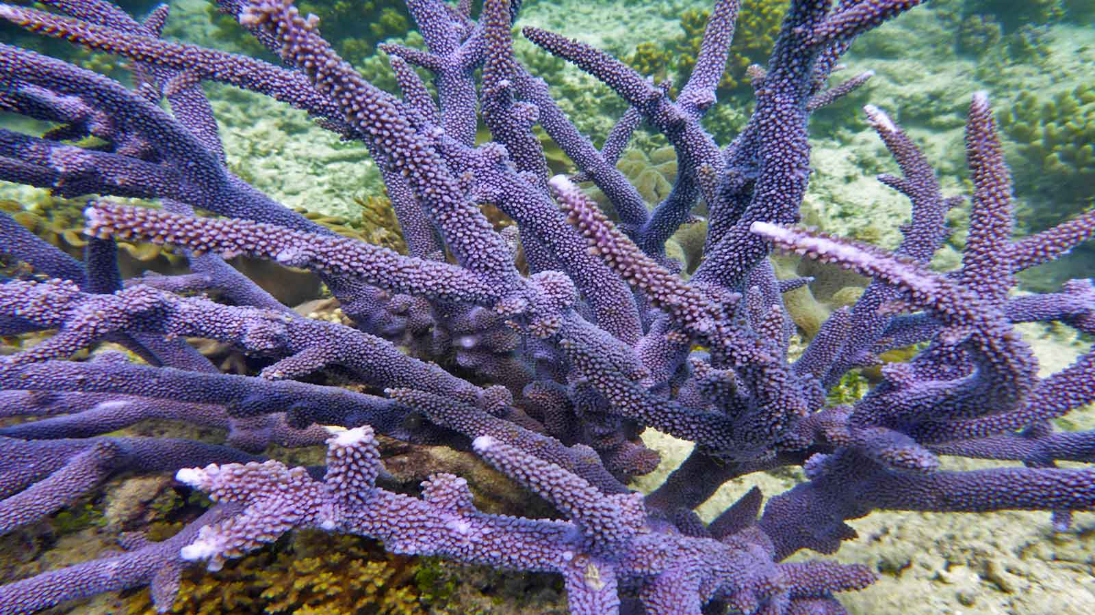
Photo © Hudec Ivan

Slide 6
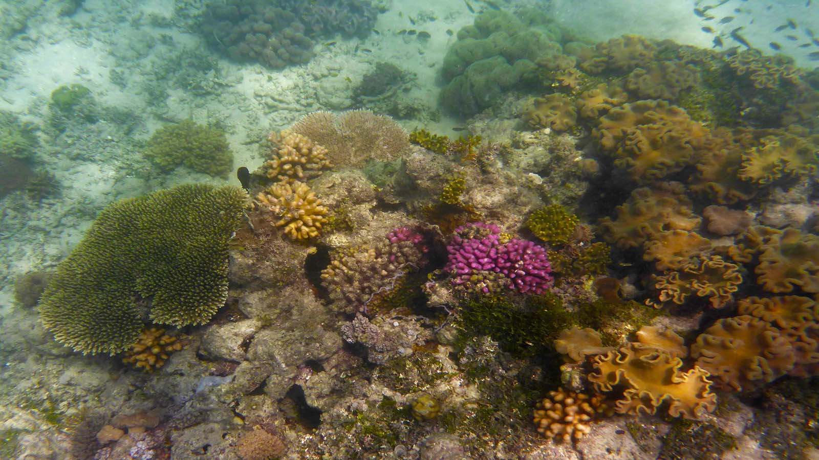
Photo © Hudec Ivan

Slide 7
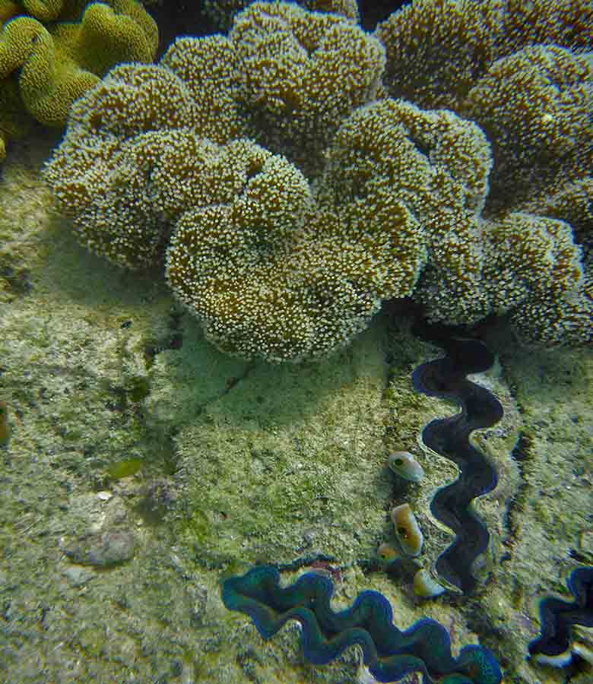
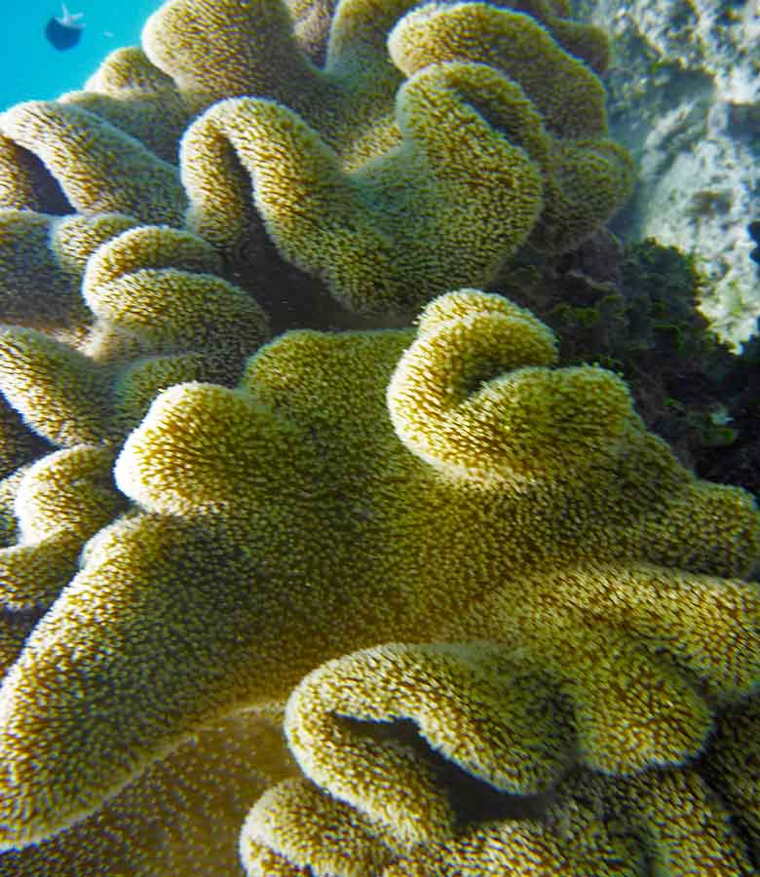
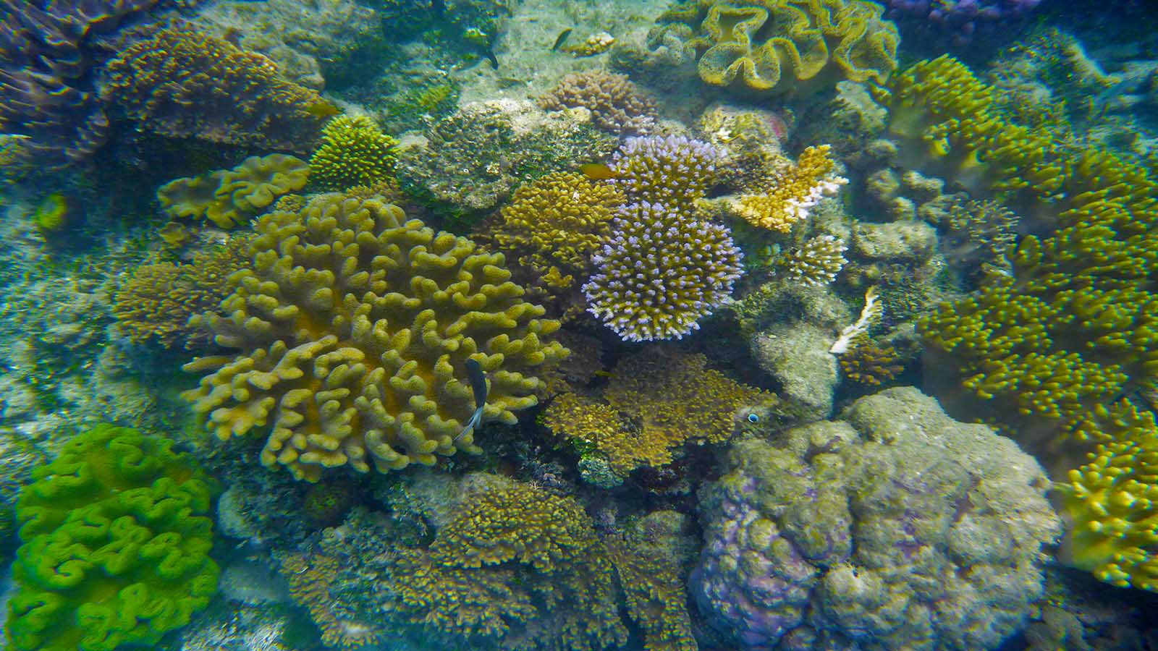
Photo © Hudec Ivan
Photo © Hudec Ivan
Photo © Hudec Ivan

Slide 8
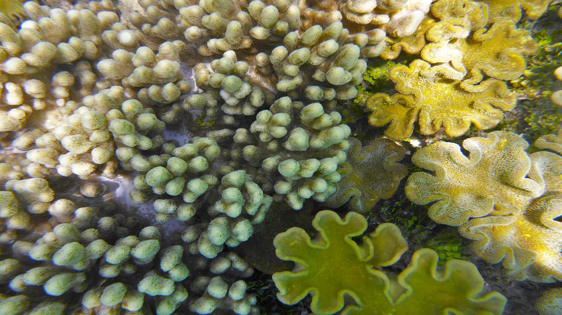
Photo © Hudec Ivan

Slide 9
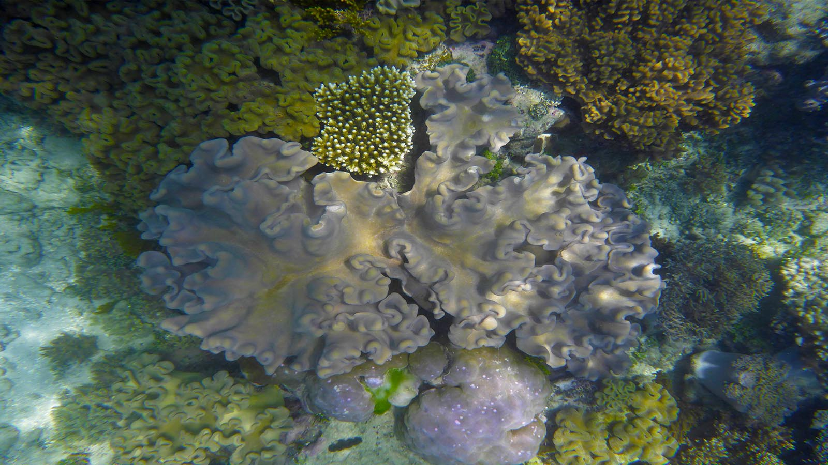
Photo © Hudec Ivan

Slide 10
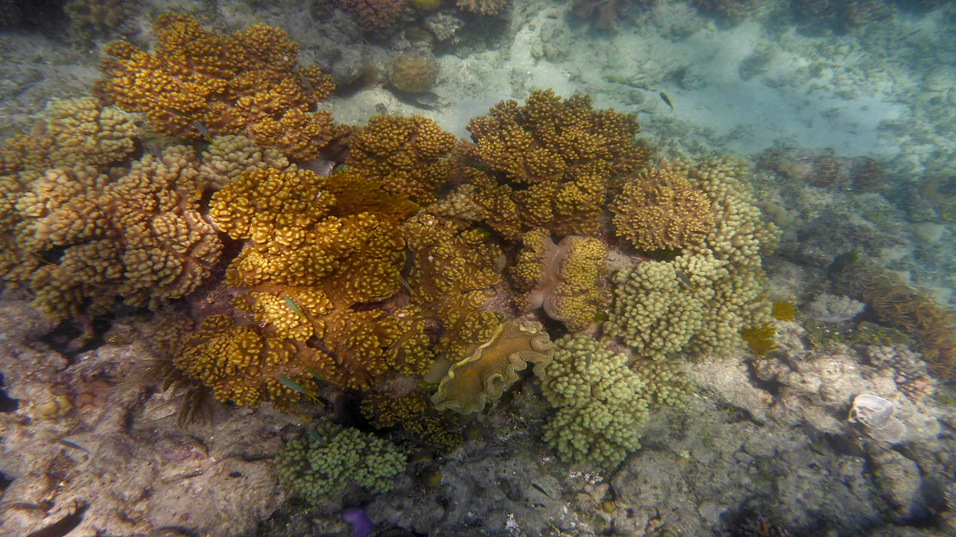
Photo © Hudec Ivan

Slide 11
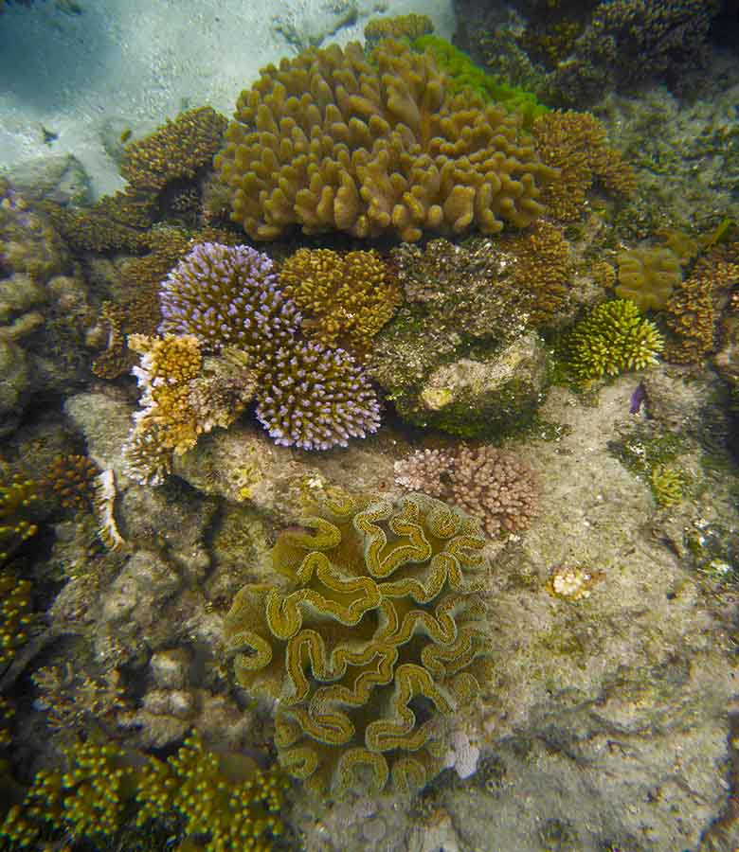
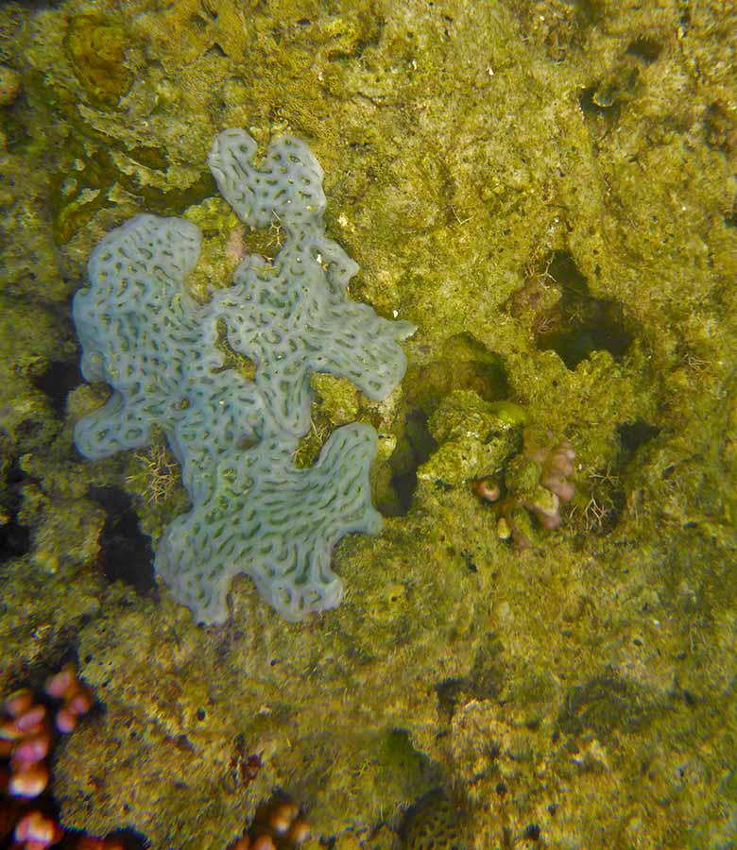
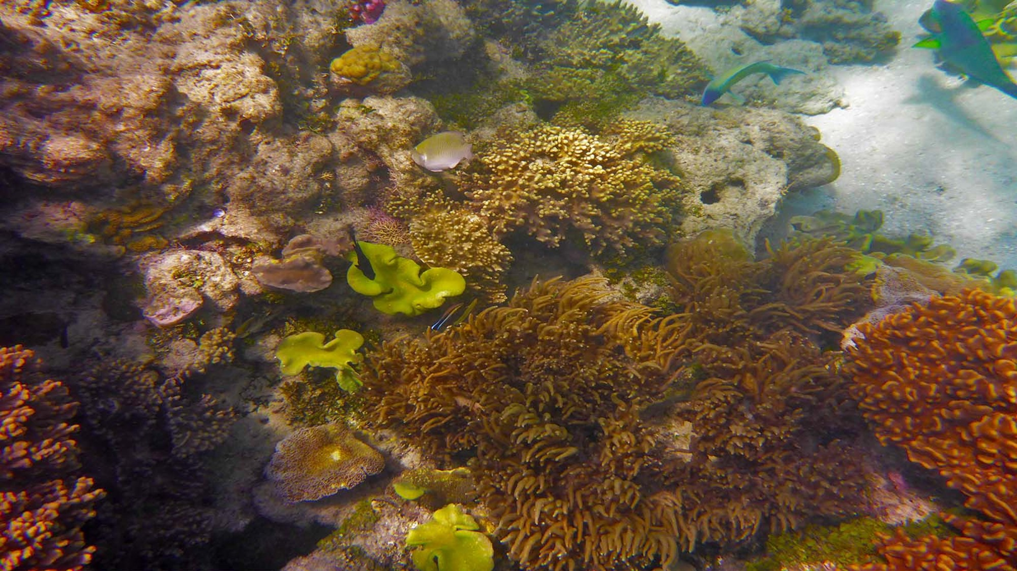
Photo © Hudec Ivan
Photo © Hudec Ivan
Photo © Hudec Ivan

Slide 12
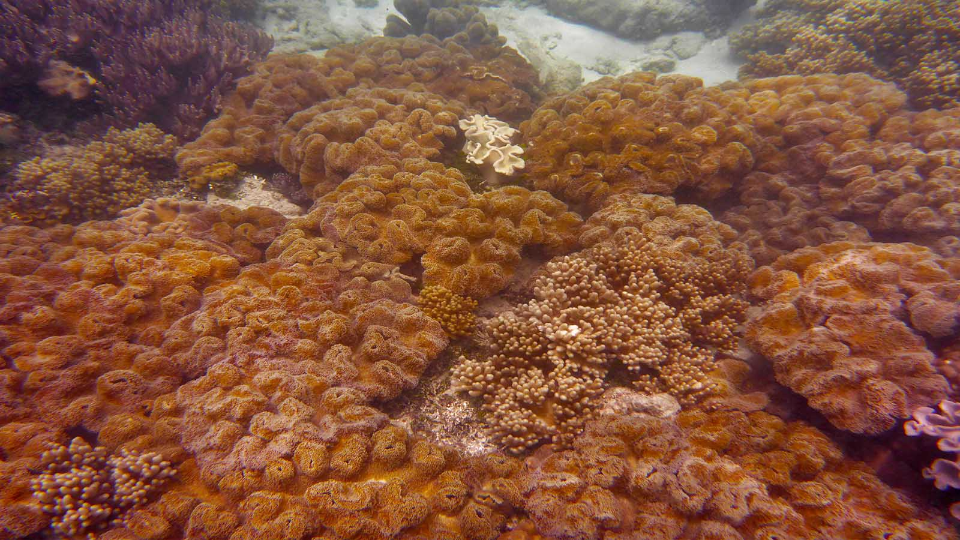
Photo © Hudec Ivan

Slide 13
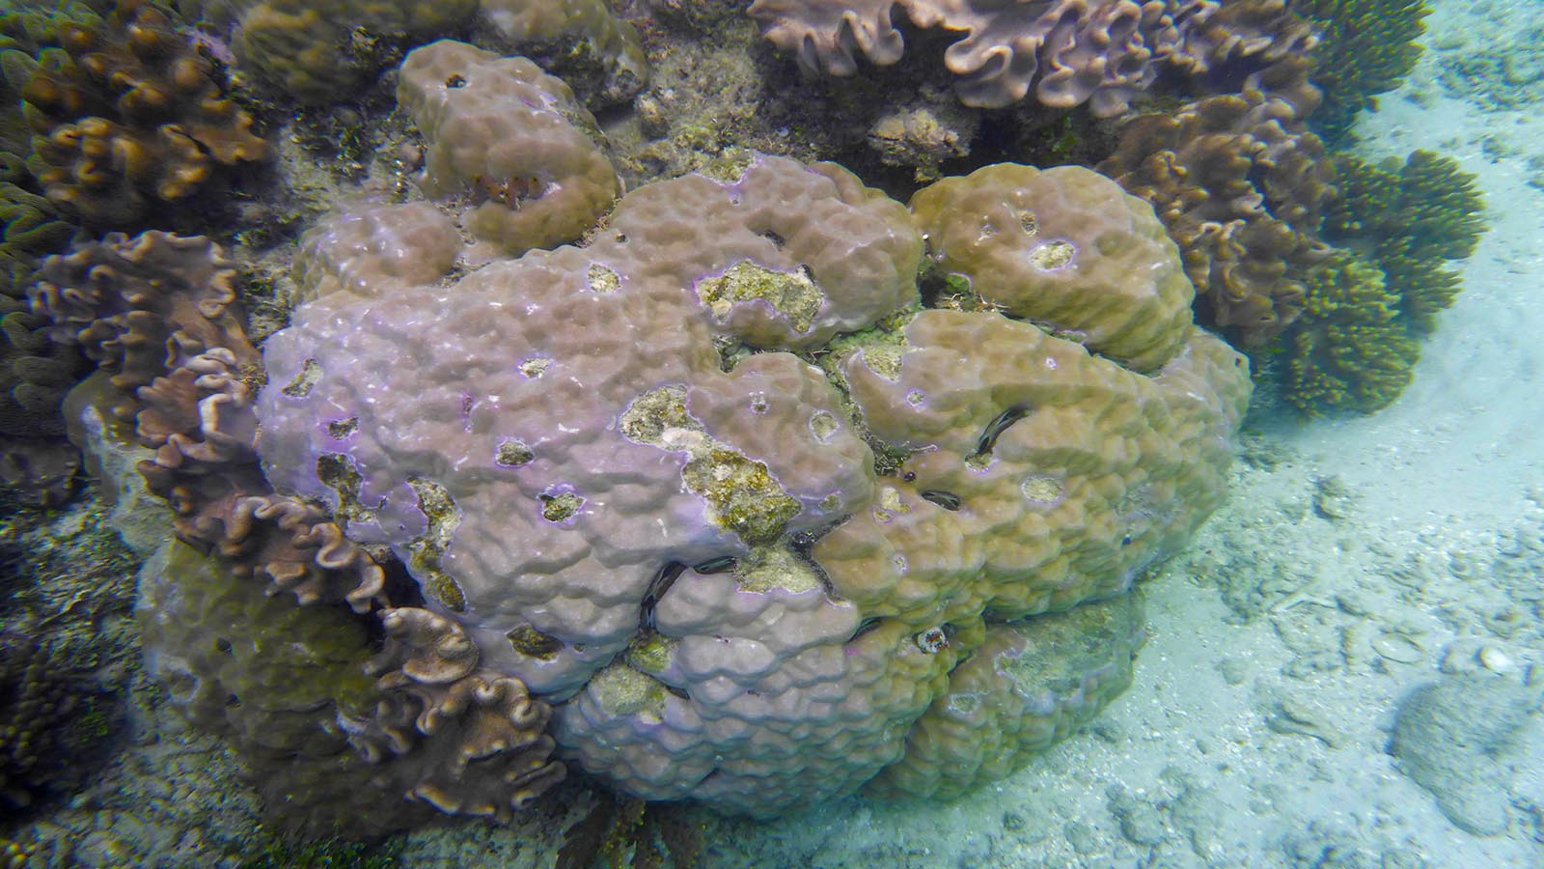
Photo © Hudec Ivan

Slide 14
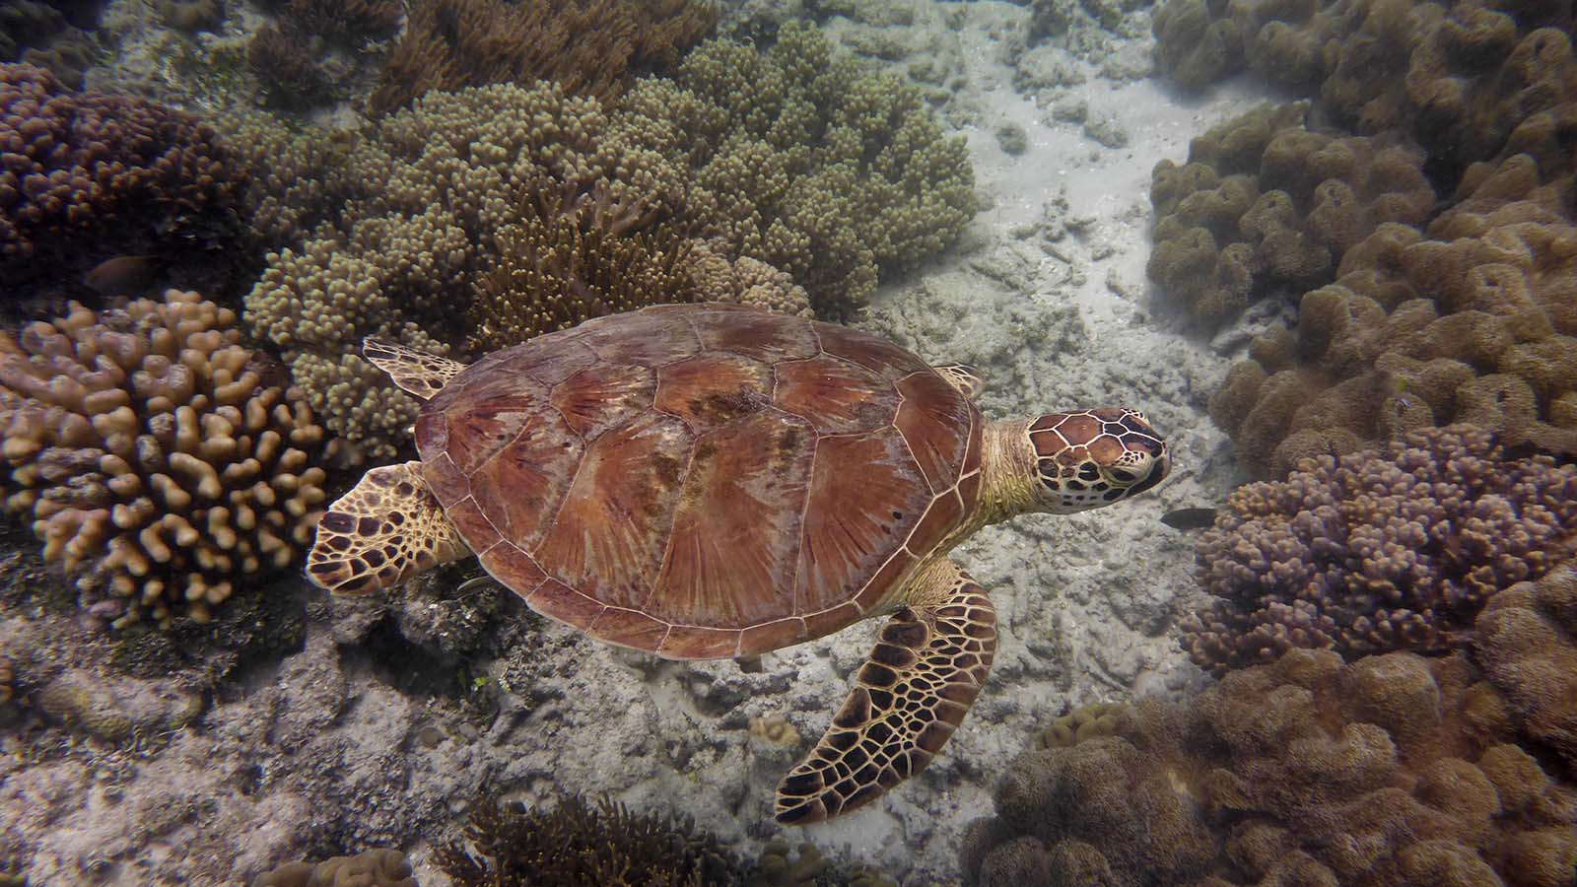
Photo © Hudec Ivan

Slide 15
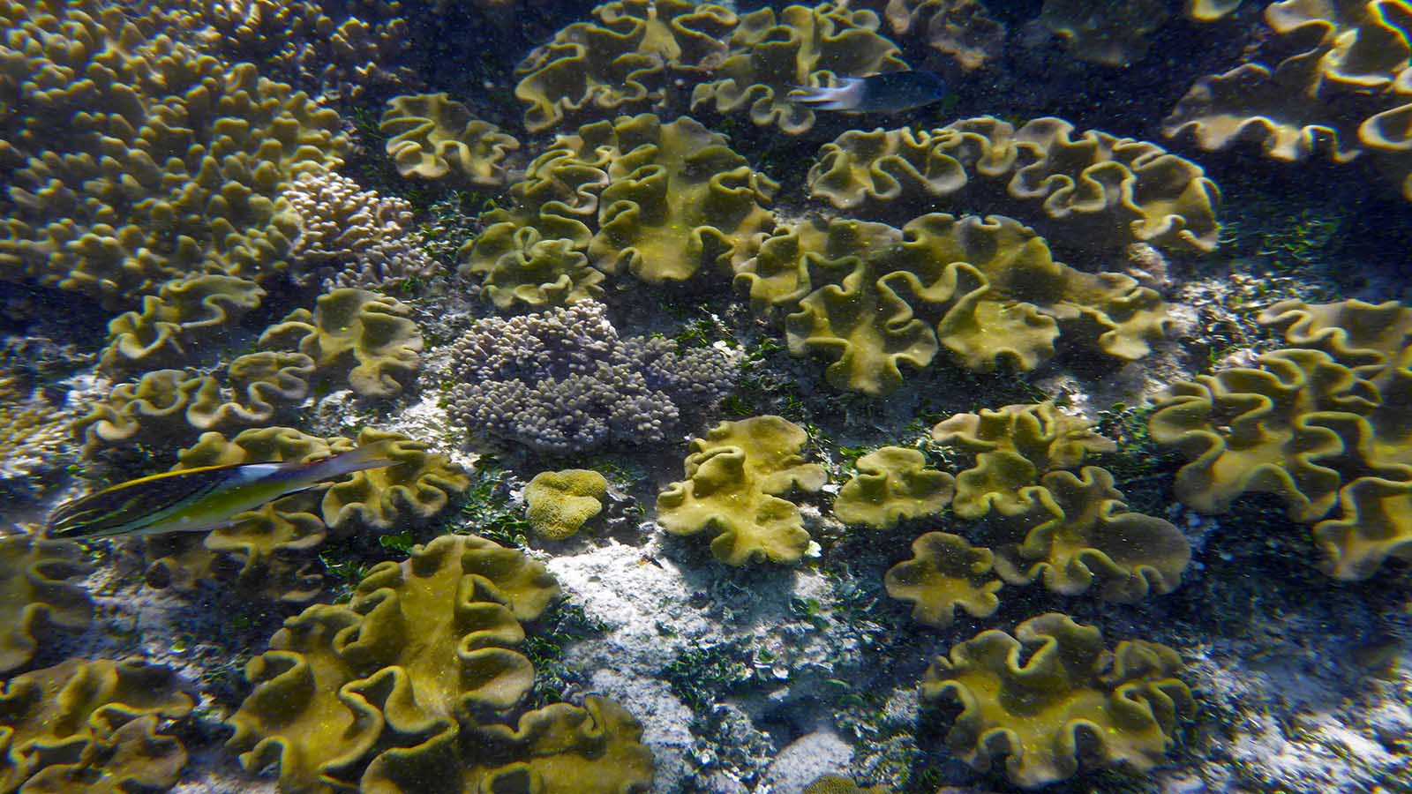
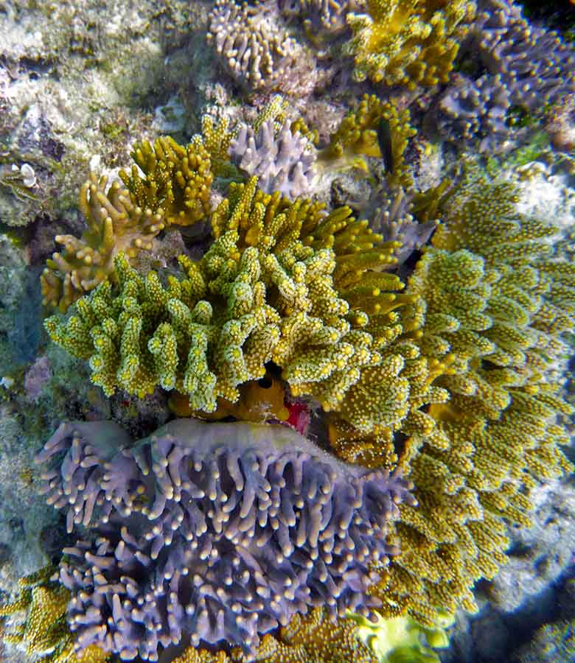
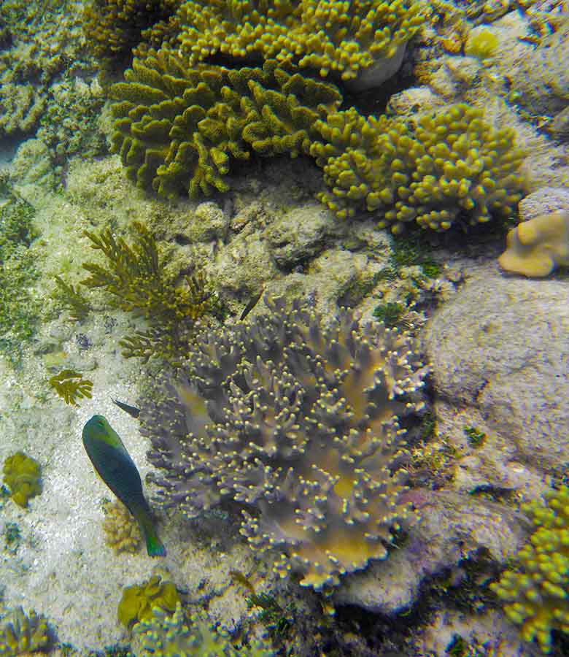
Photo © Hudec Ivan
Photo © Hudec Ivan
Photo © Hudec Ivan

Slide 16
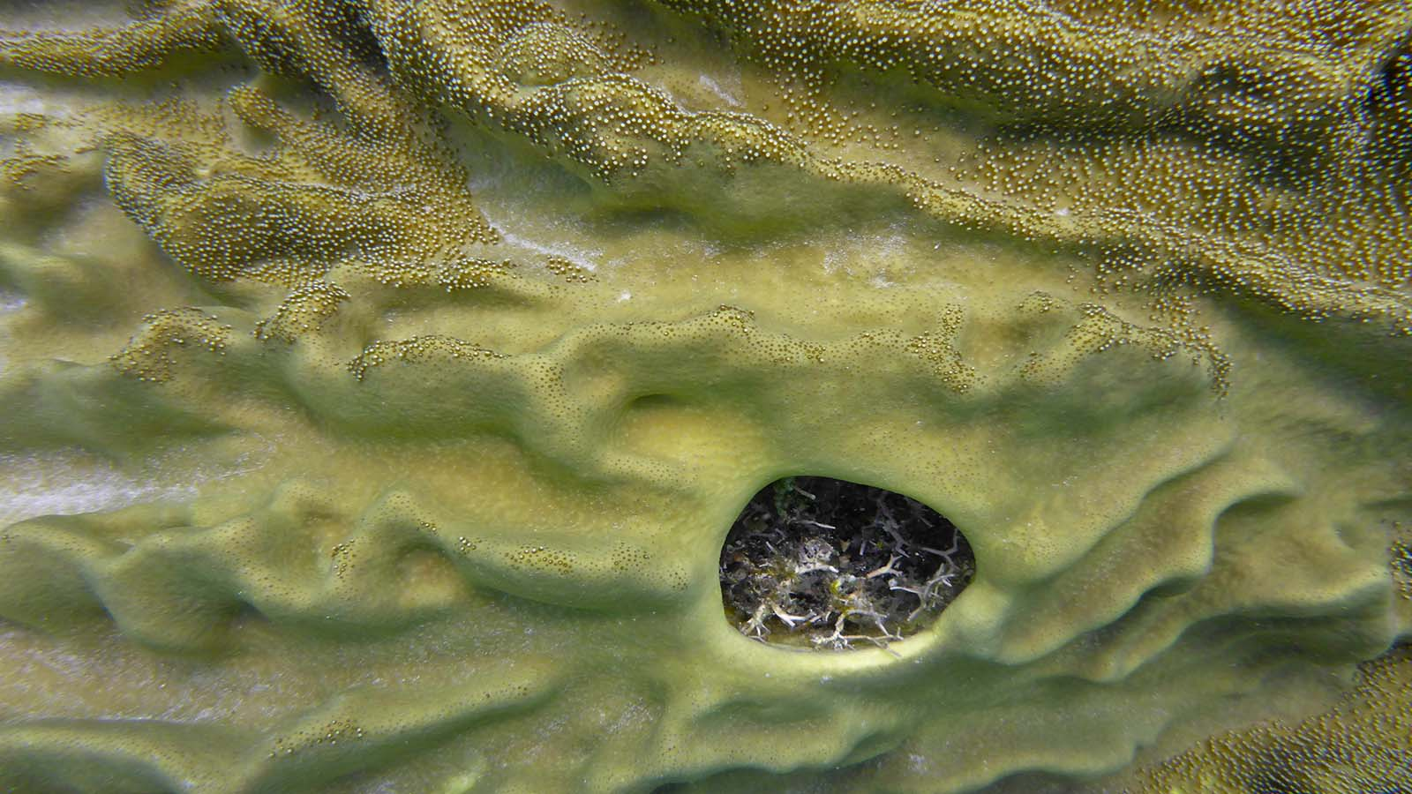
Photo © Hudec Ivan

Slide 17
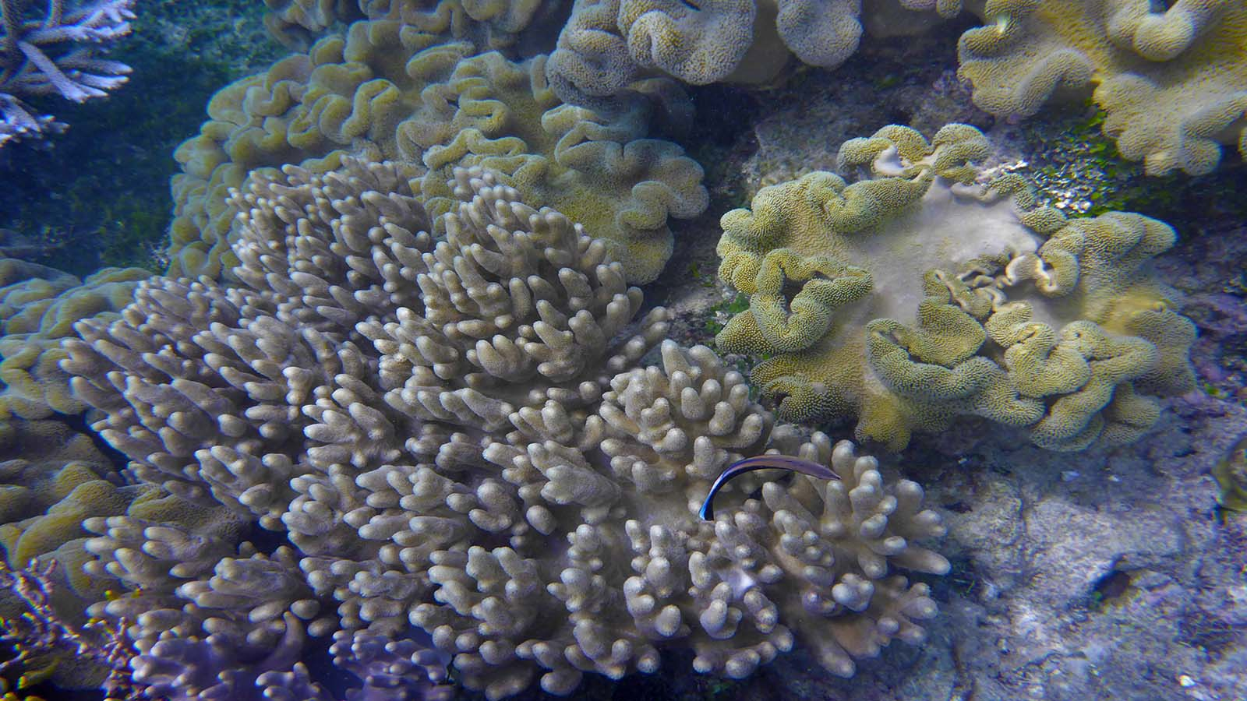
Photo © Hudec Ivan

Slide 18
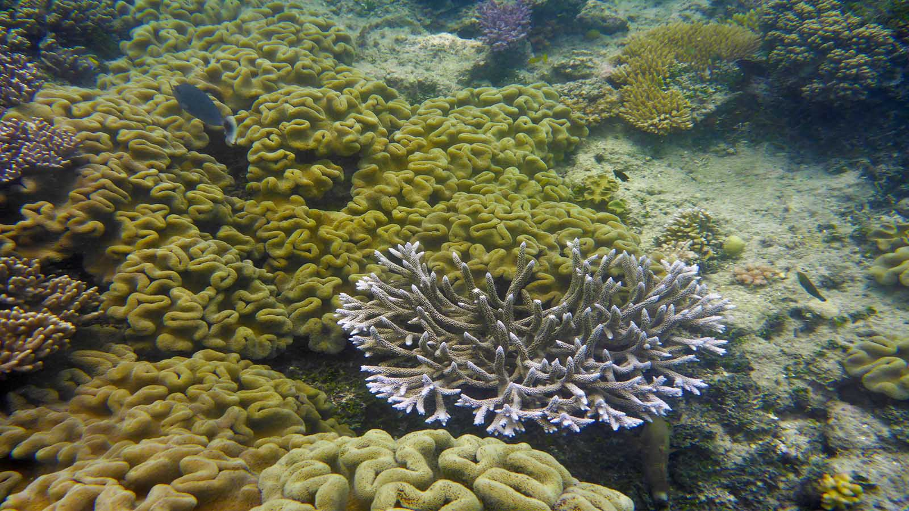
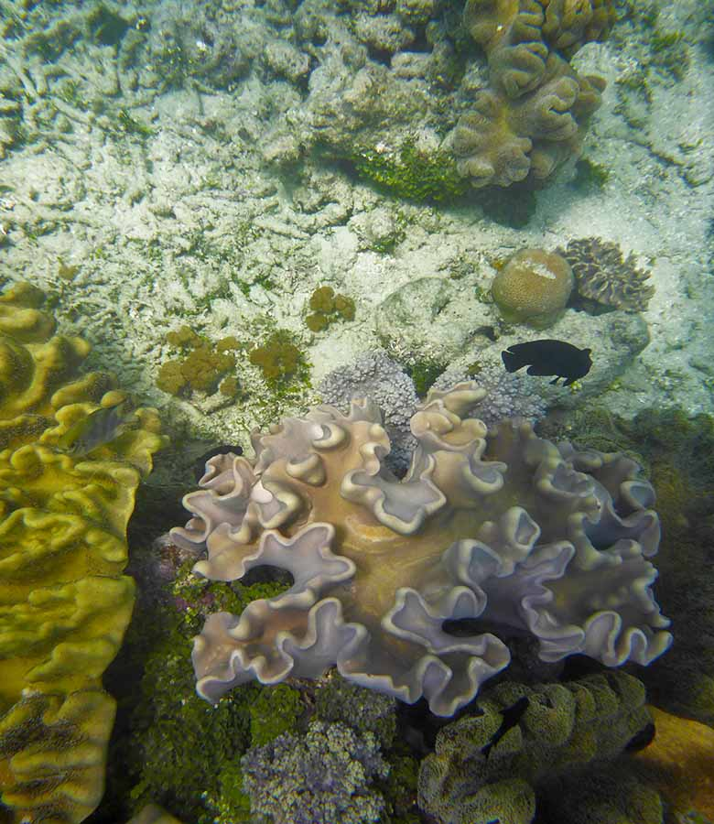
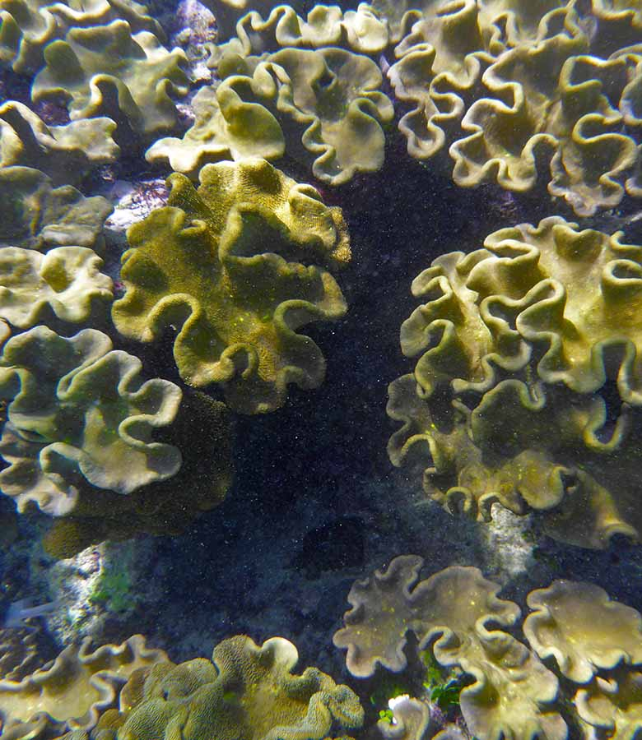
Photo © Hudec Ivan
Photo © Hudec Ivan
Photo © Hudec Ivan

Slide 19
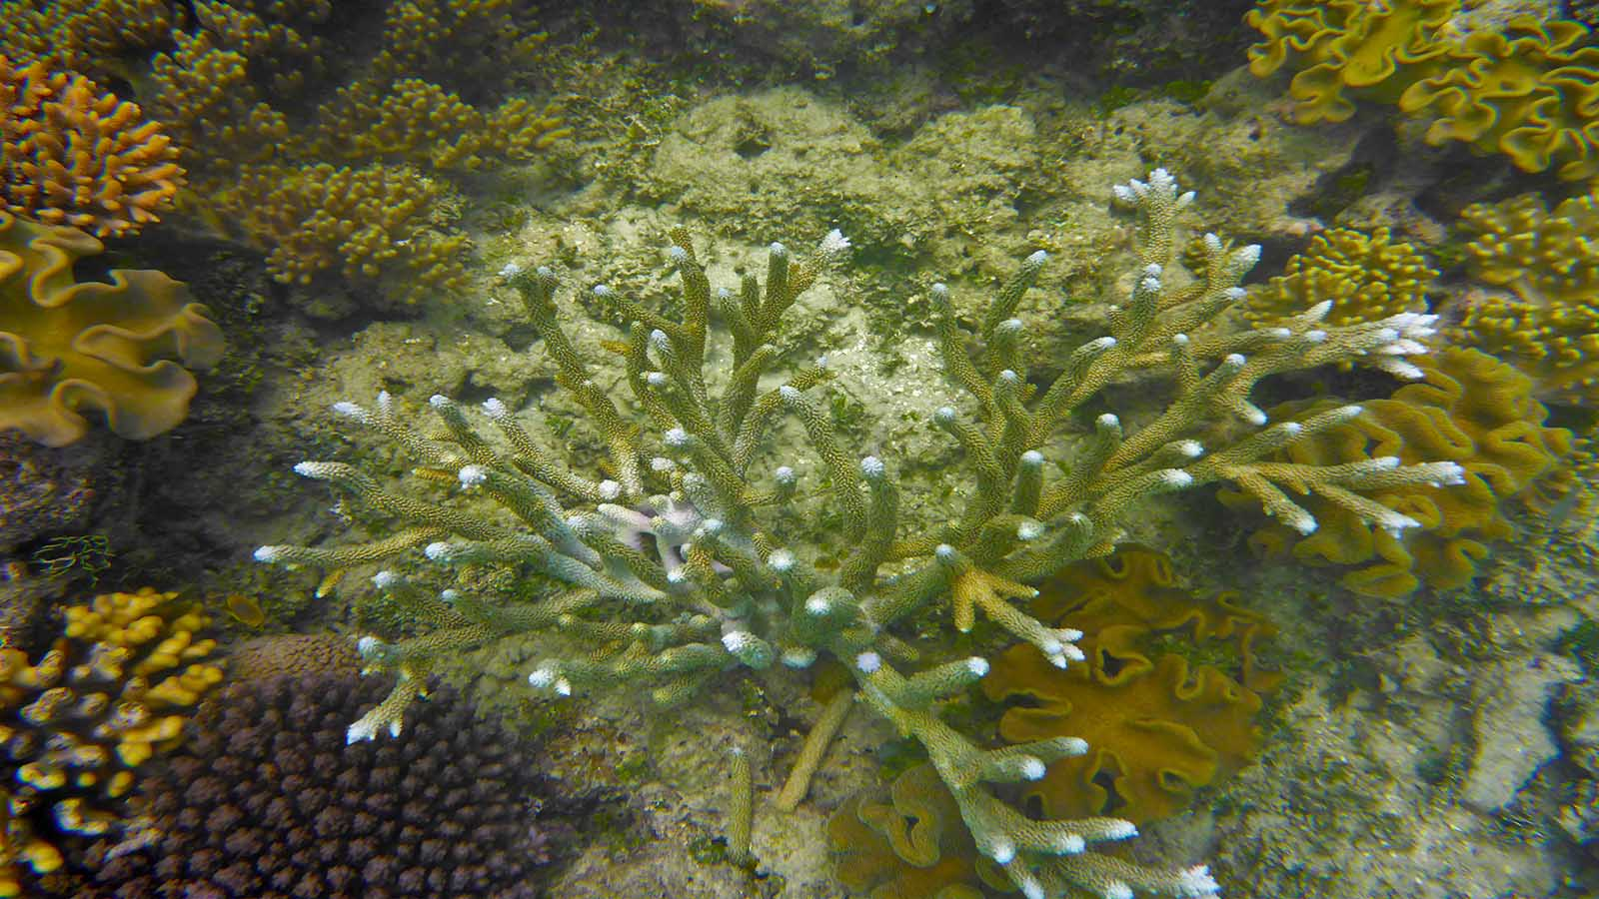
Photo © Hudec Ivan

Slide 20
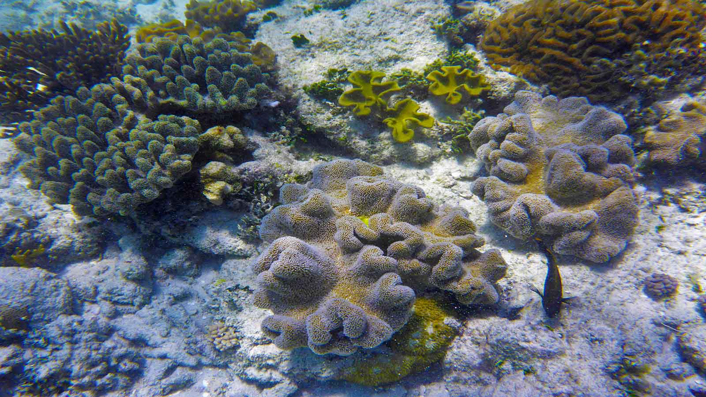
Photo © Hudec Ivan

Slide 21
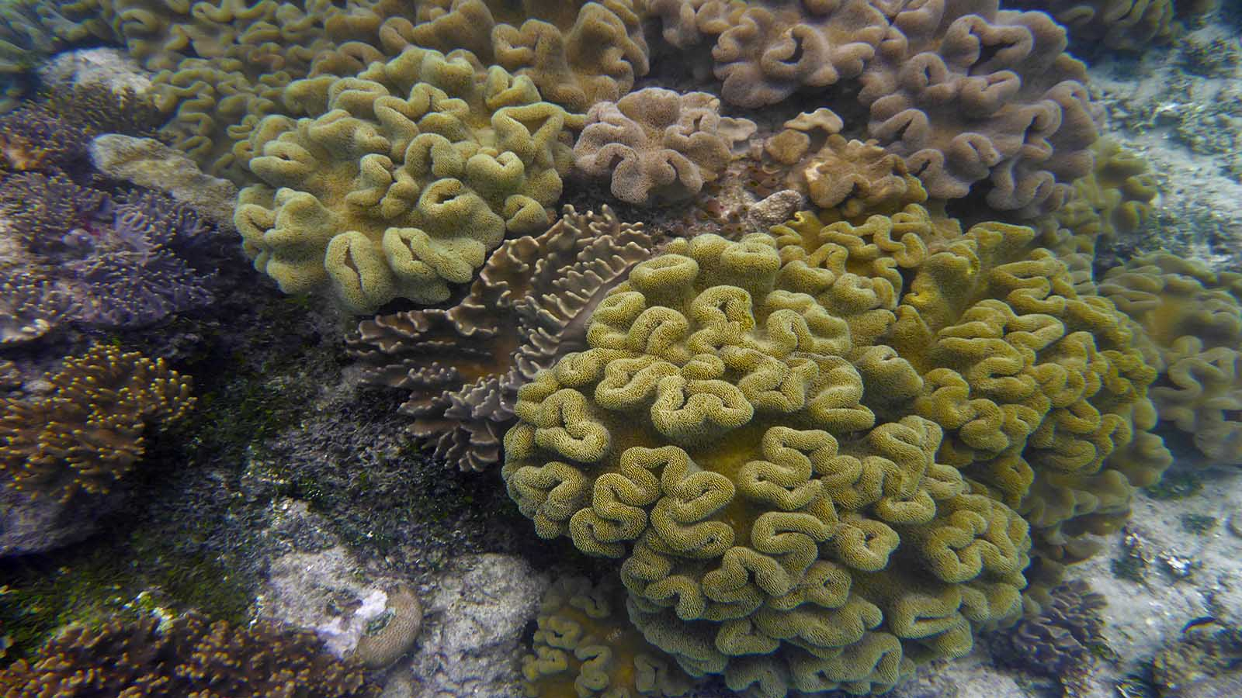
Photo © Hudec Ivan

Slide 22
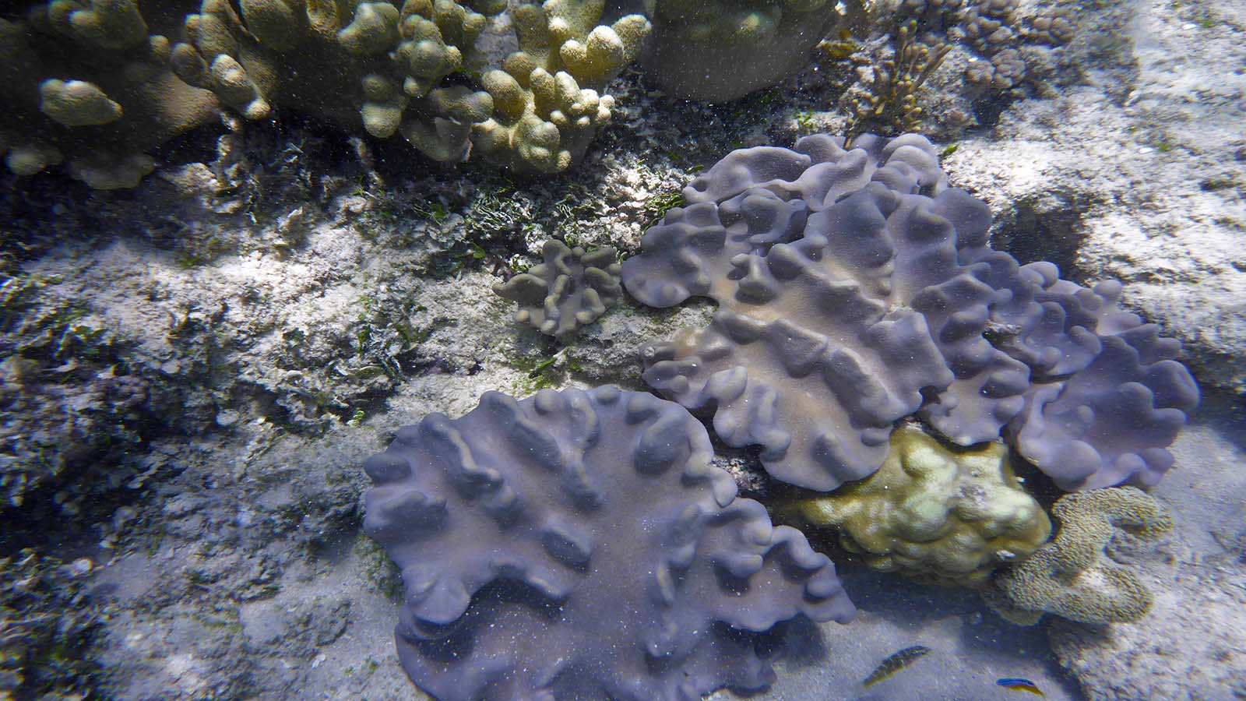
Photo © Hudec Ivan

Slide 23
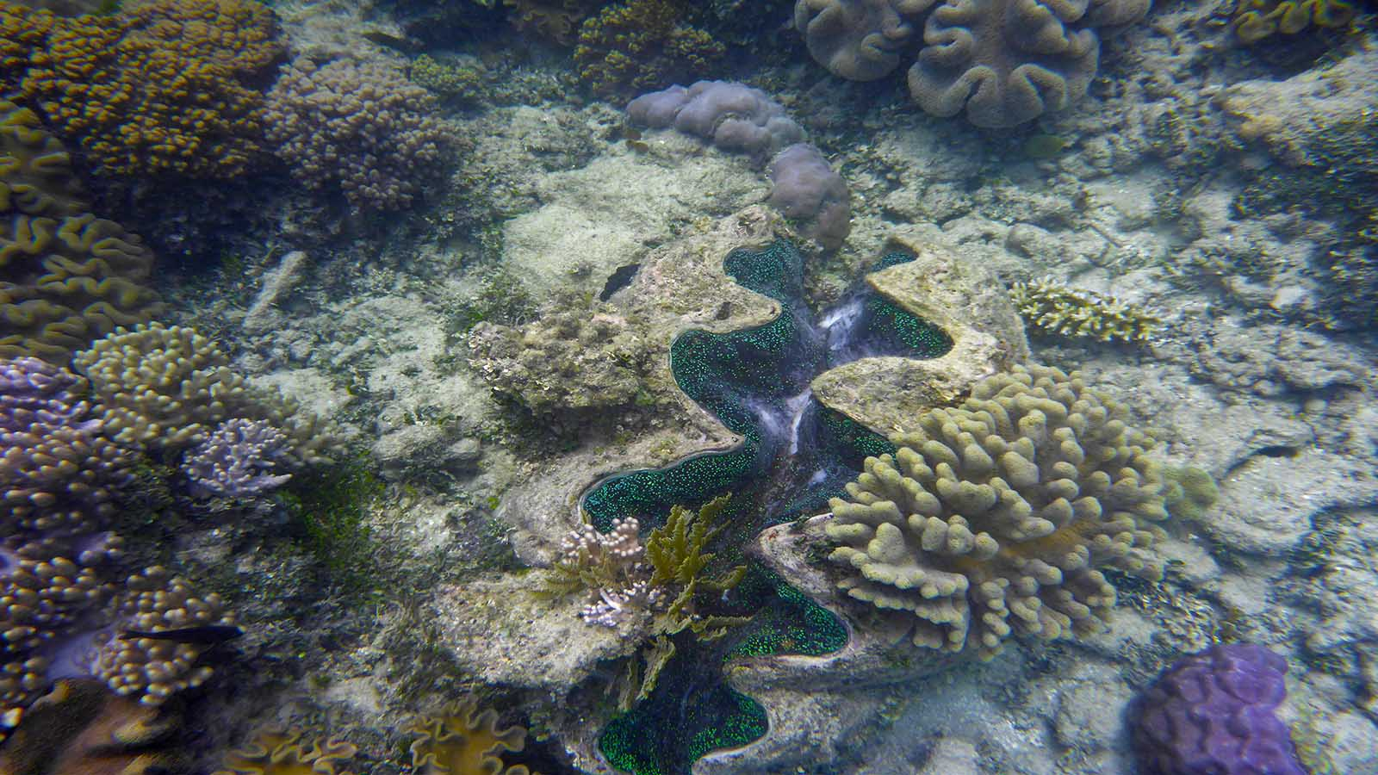
Photo © Hudec Ivan

Slide 24
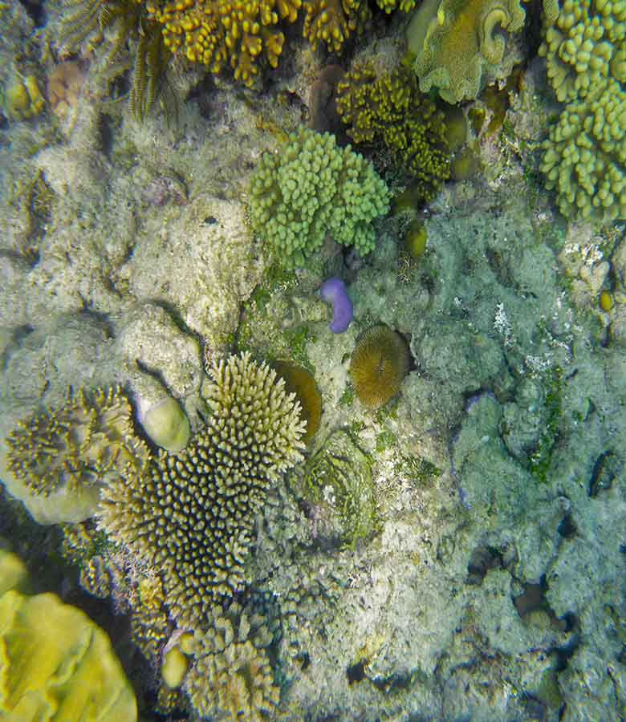
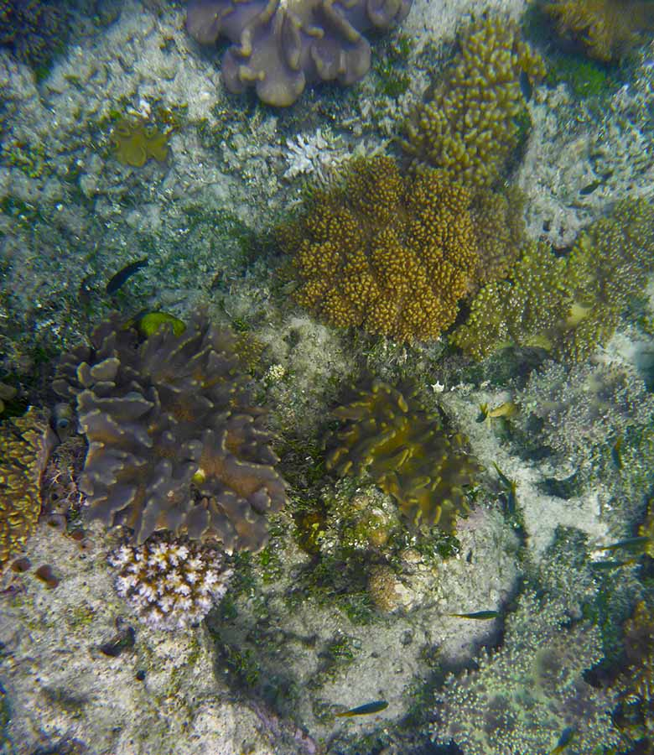
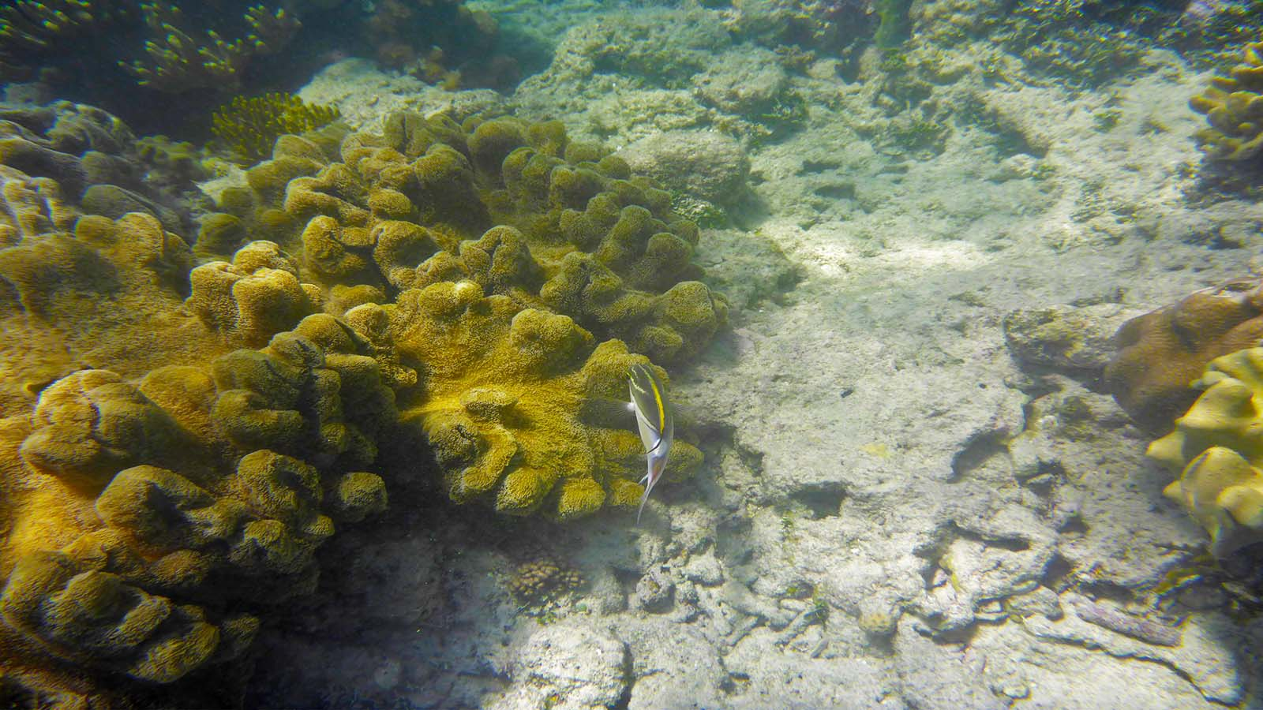
Photo © Hudec Ivan
Photo © Hudec Ivan
Photo © Hudec Ivan

Slide 25
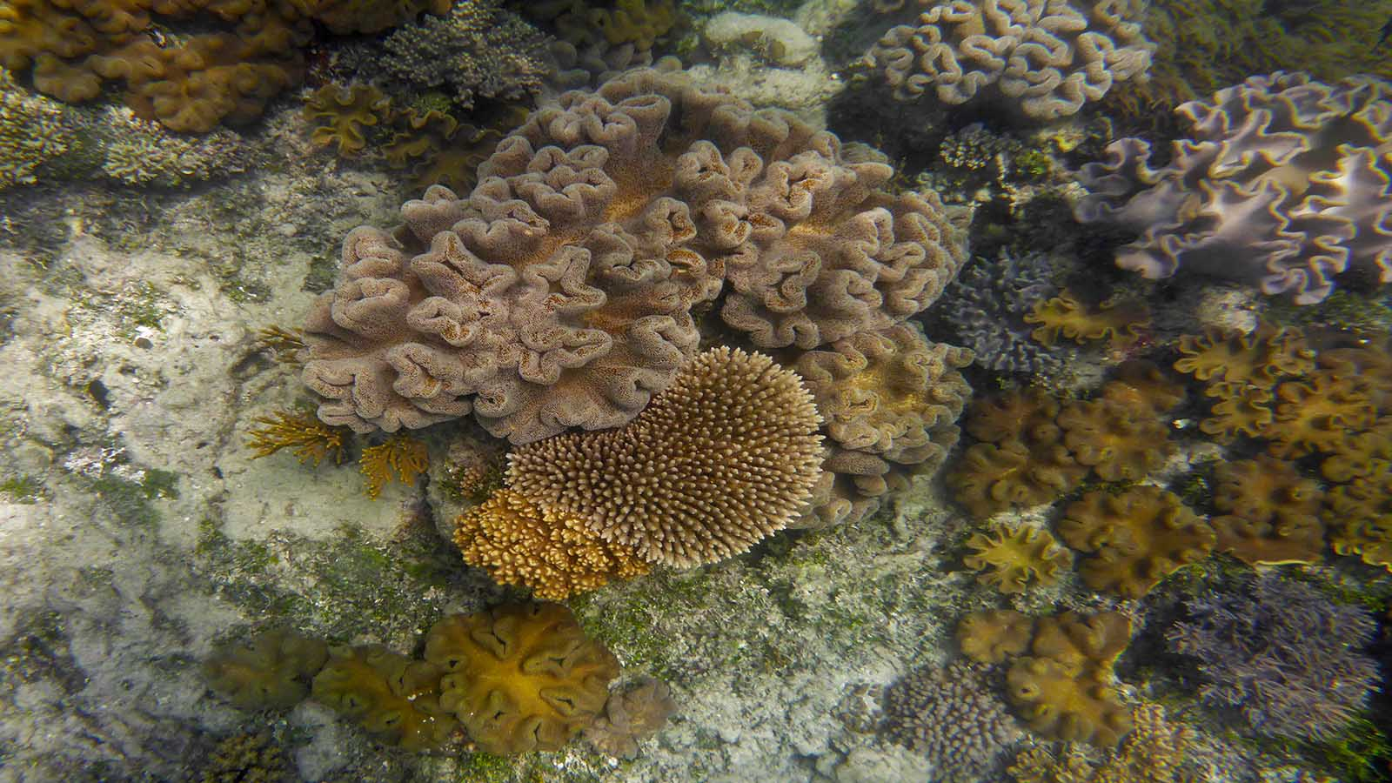
Photo © Hudec Ivan

Slide 26
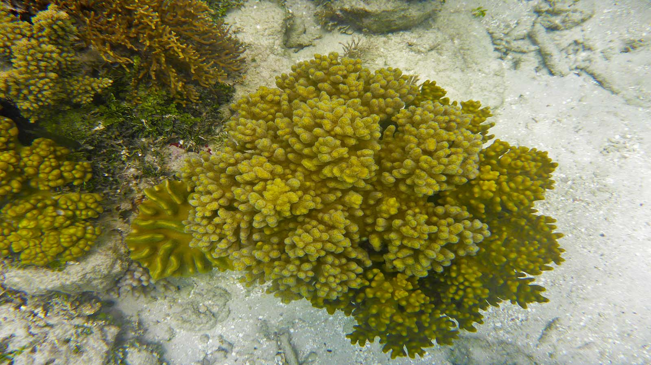
Photo © Hudec Ivan

Slide 27
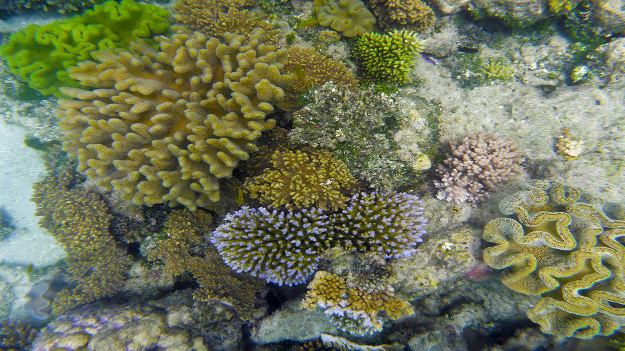
Photo © Hudec Ivan

Slide 28
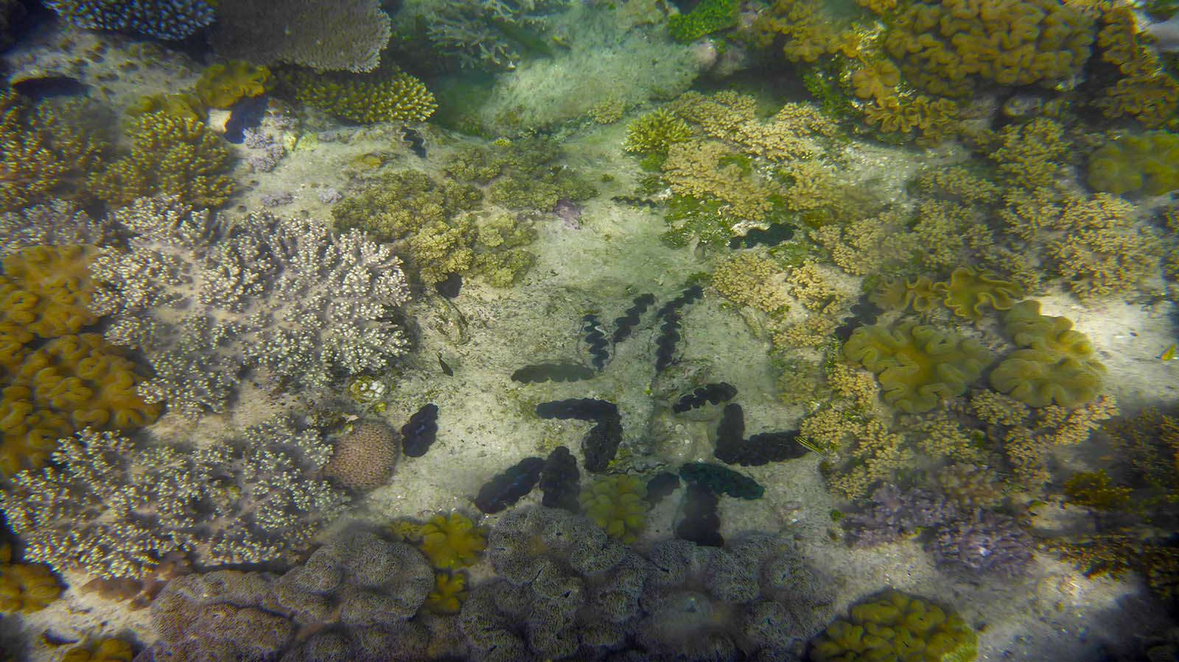
Photo © Hudec Ivan

Slide 29
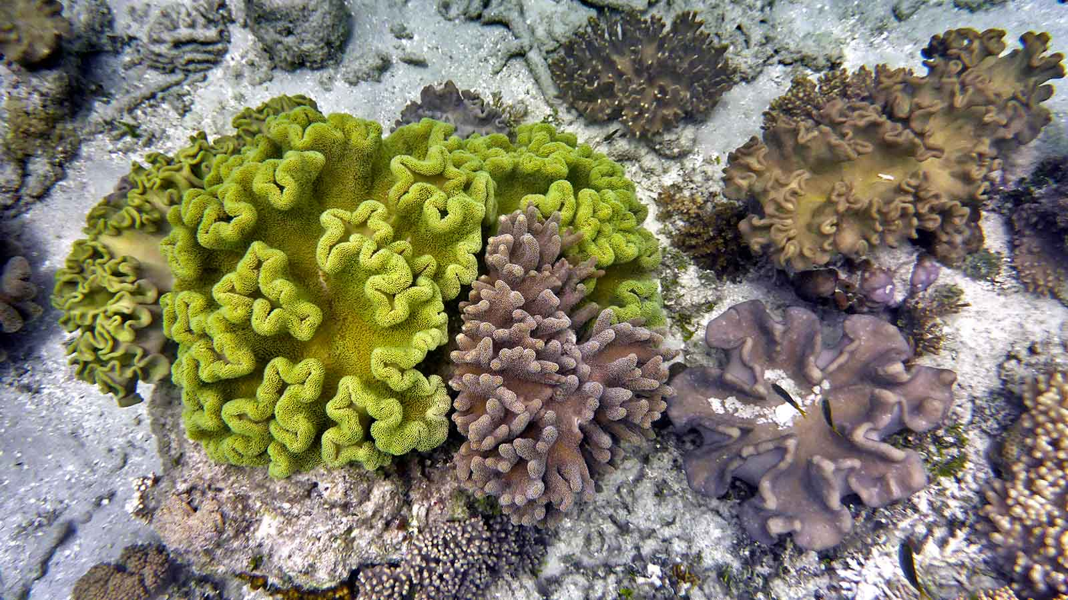
Photo © Hudec Ivan

Slide 30
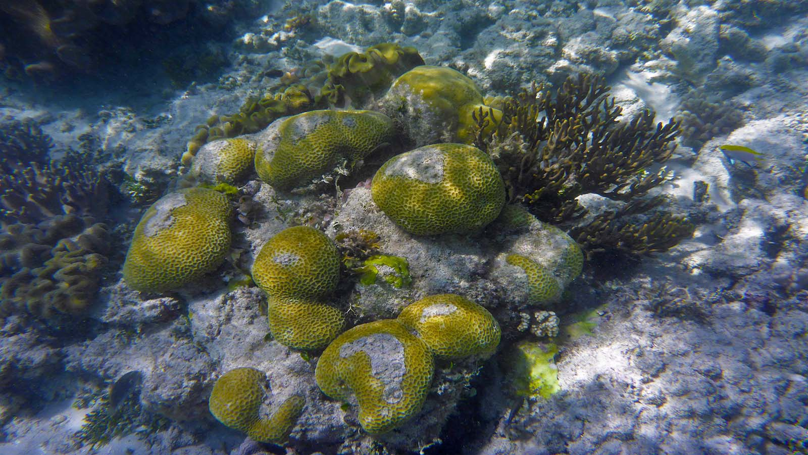
Photo © Hudec Ivan

Slide 31
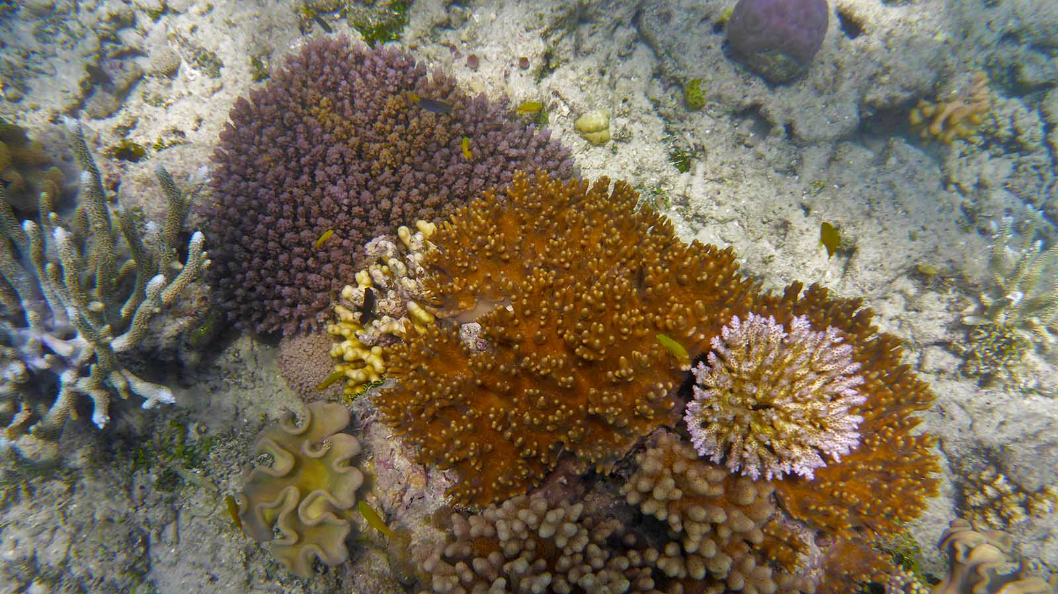
Photo © Hudec Ivan

Slide 32

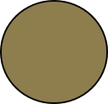


Non-commercial presentation !
Music : Chromatic Player Paul - Blue Bayou
Photos : Hudec Ivan
Compilation : Steve Rumpler
pista2011@gmail.com
Year : 2020
Thank you for watching the presentation.

