Slide 1
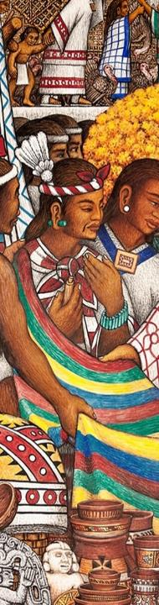
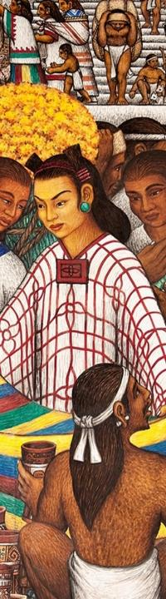
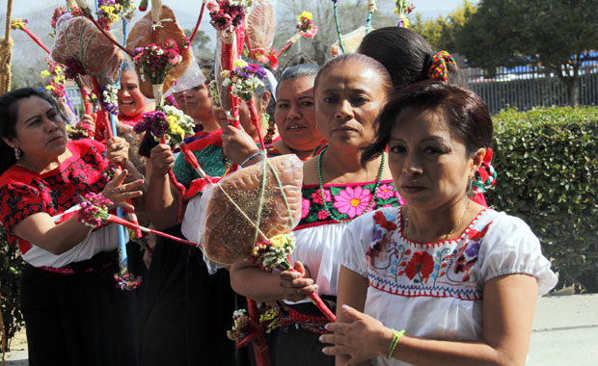
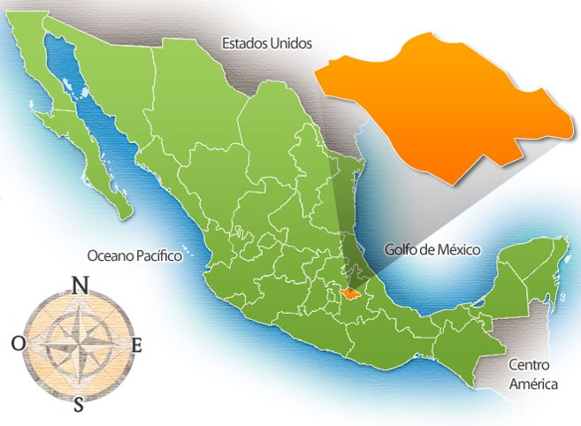
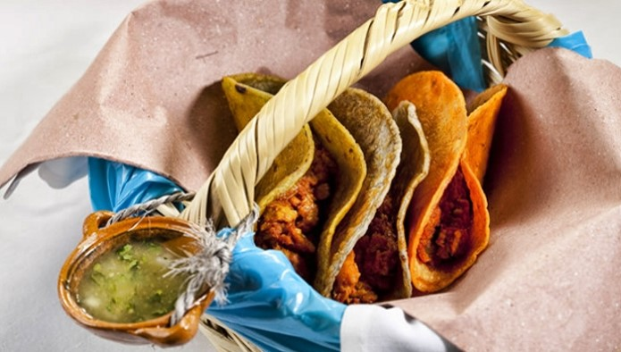
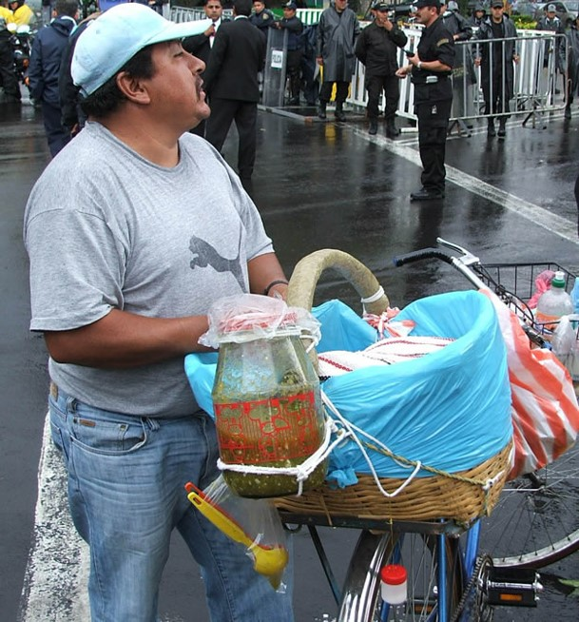
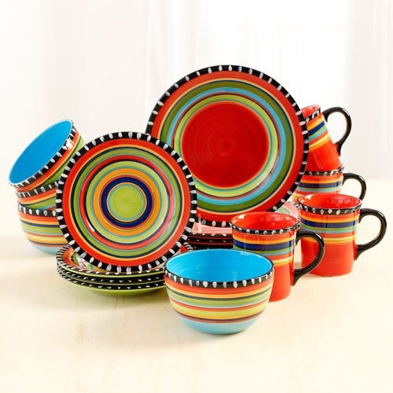
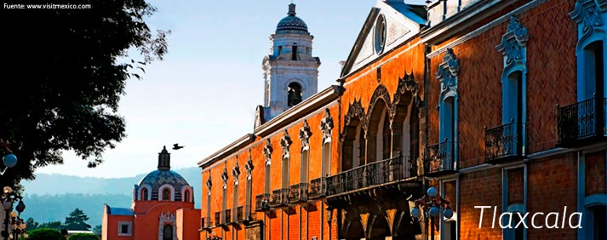
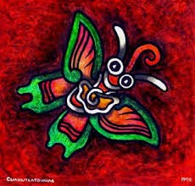
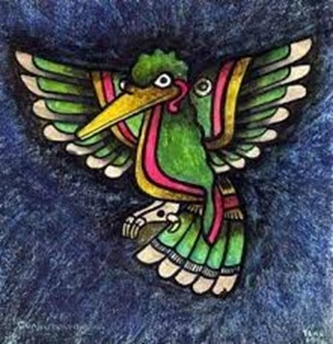
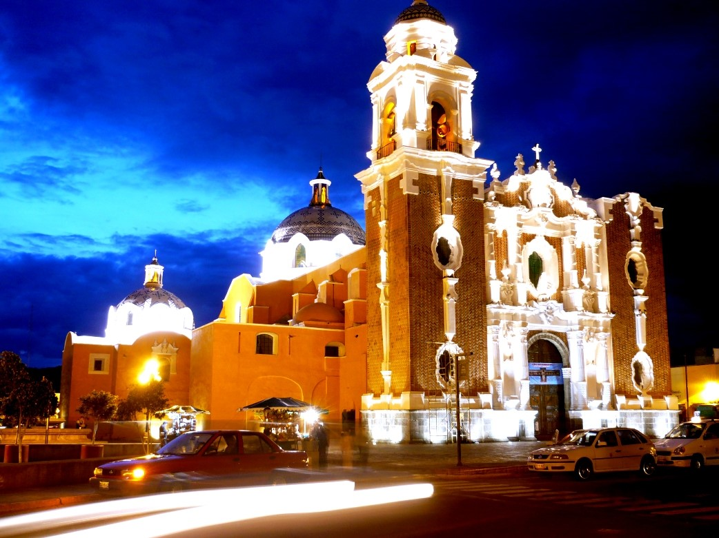
This is
Tlaxcala

Slide 2
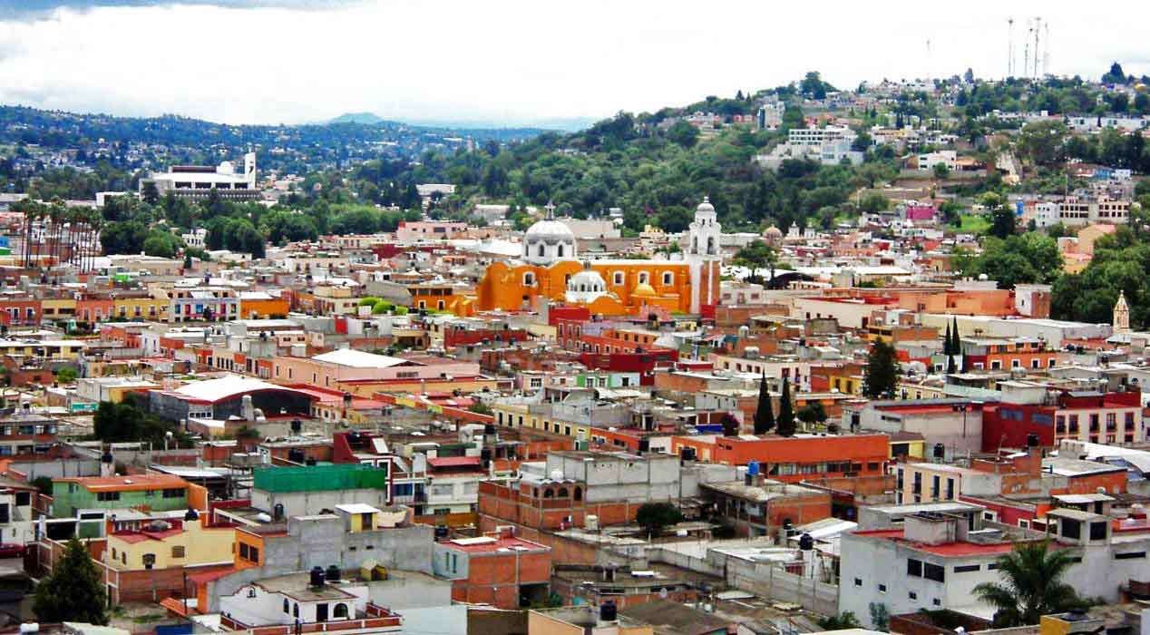
Tlaxcala city
Photography © 2014 por Emmanuel Romero en 500px

Slide 3
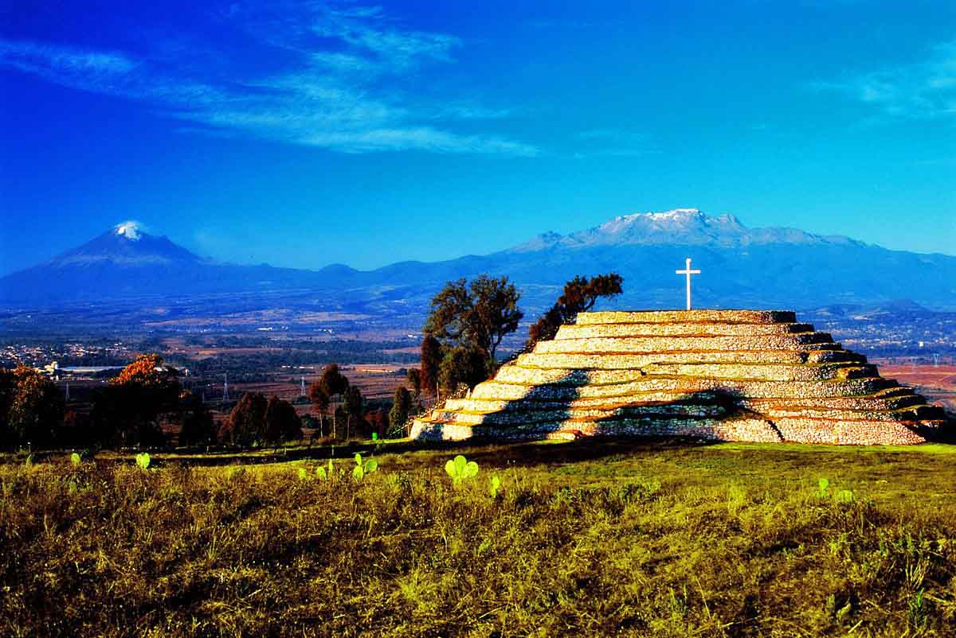

Archaeological site, Xochitécatl - pyramid of the spiral is unique
Copyright © 2014. T Kartodromo - Tlaxcala

Slide 4
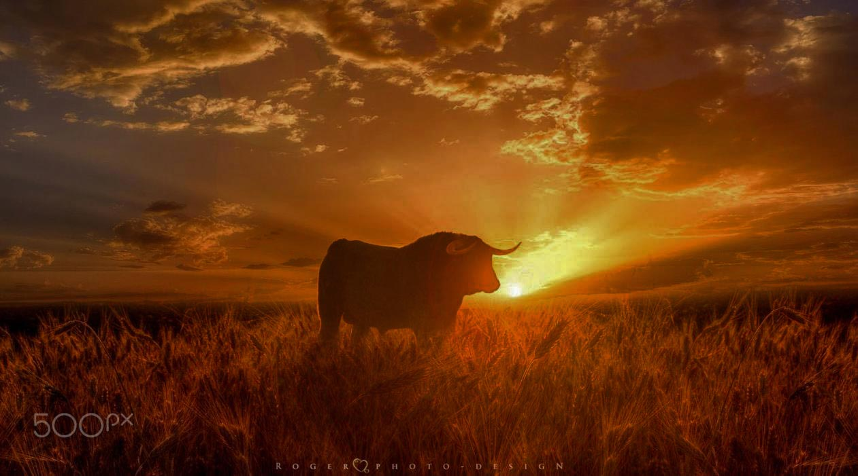
Bull on sunset
Photography © 2016 por Manuel Roger en 500px

Slide 5
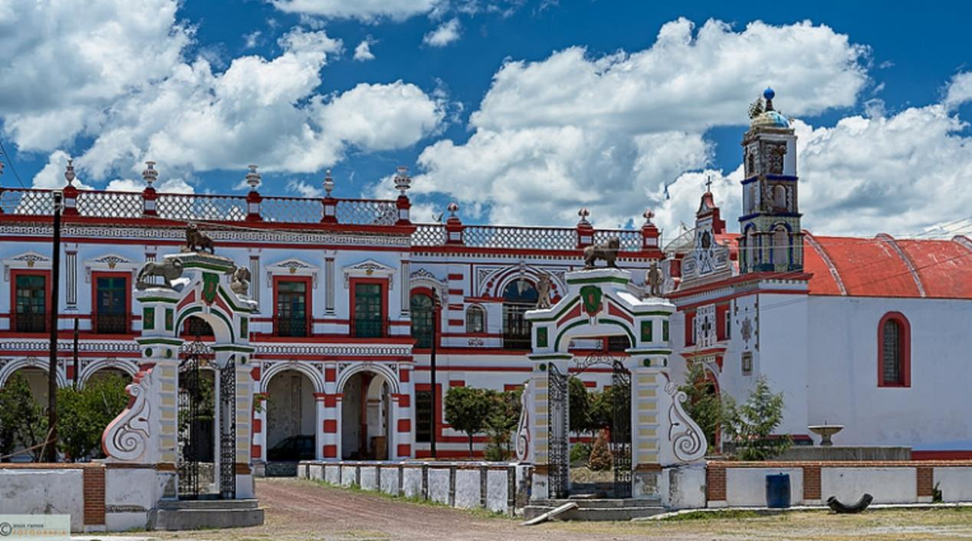
San Bartolomé del Monte - Old Hacienda Pulquera
Photography © 2015 por Jesusito2008

Slide 6
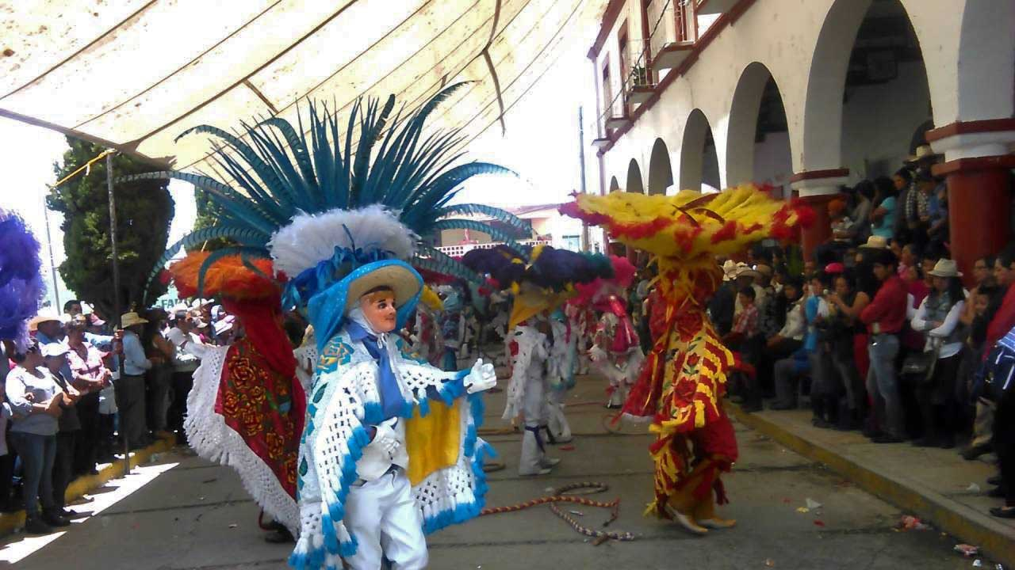
Carnival Acuitlapilco in fair Altzayanca

Slide 7
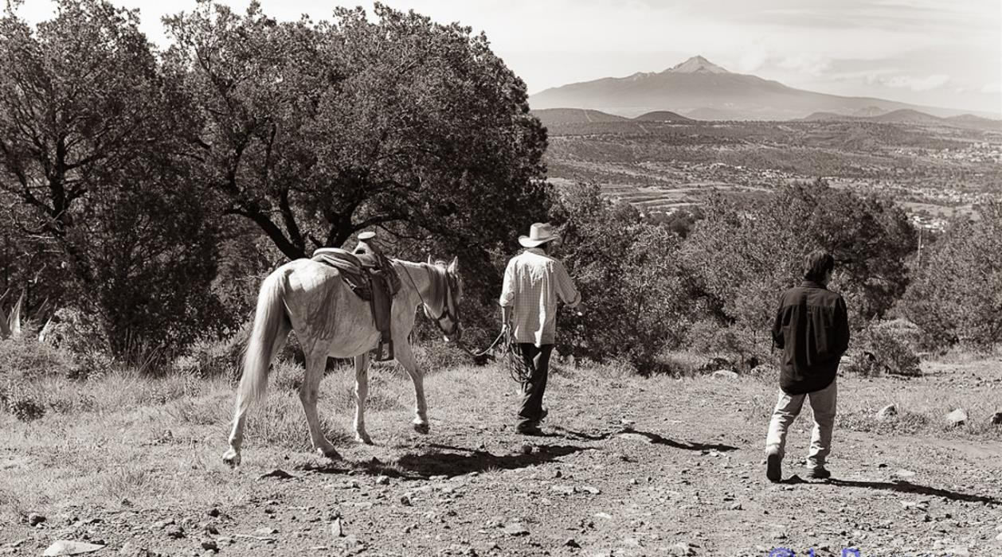
La Malinche

Slide 8
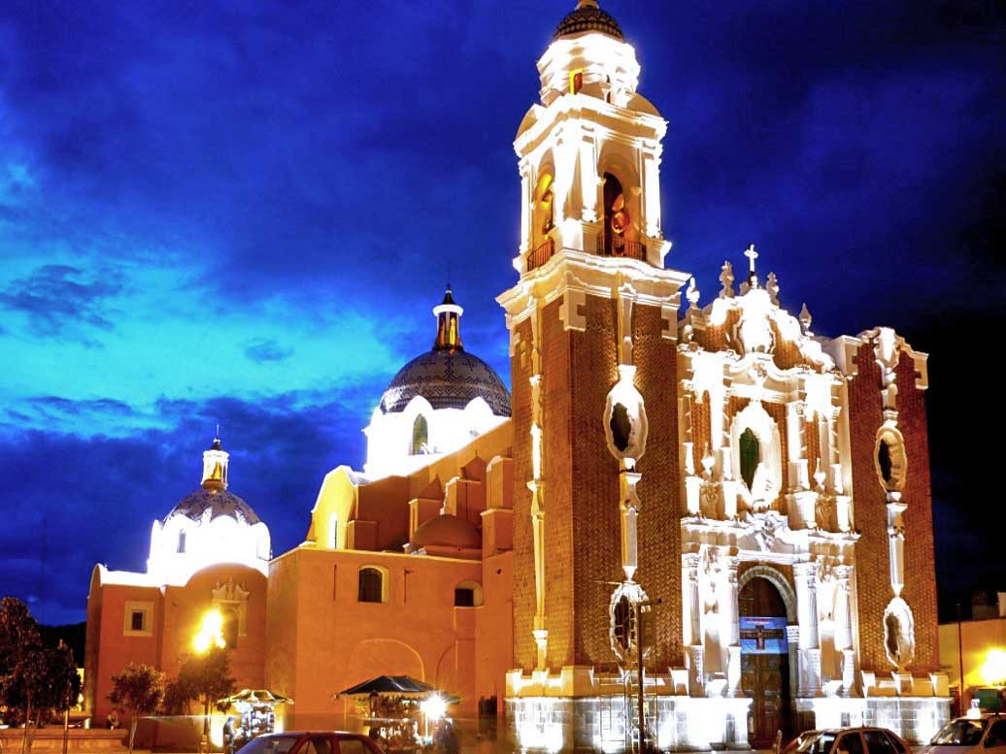

Parish of San José

Slide 9
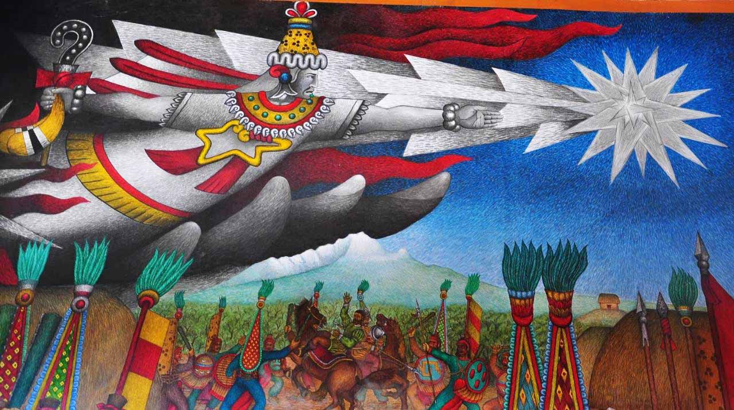
Mural painted by the Master Desiderio Hernandez Xochitiotzin, Tlaxcala

Slide 10
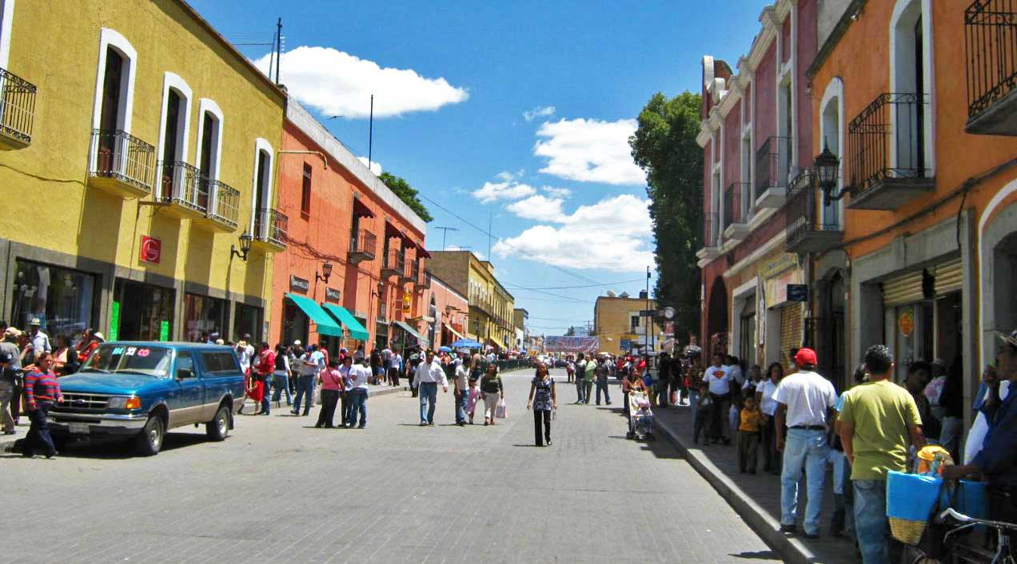
To the Huamantla fair
Photography © 2009 por Compyther Rojas r

Slide 11
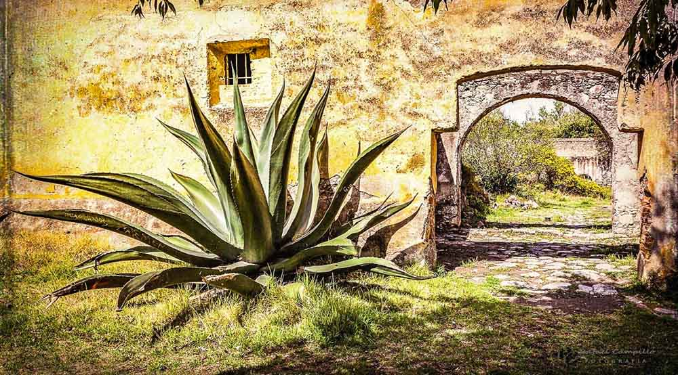
Hacienda Soltepec
Photography © 2016 por Rafael Campillo Rodríguez en 500px

Slide 12
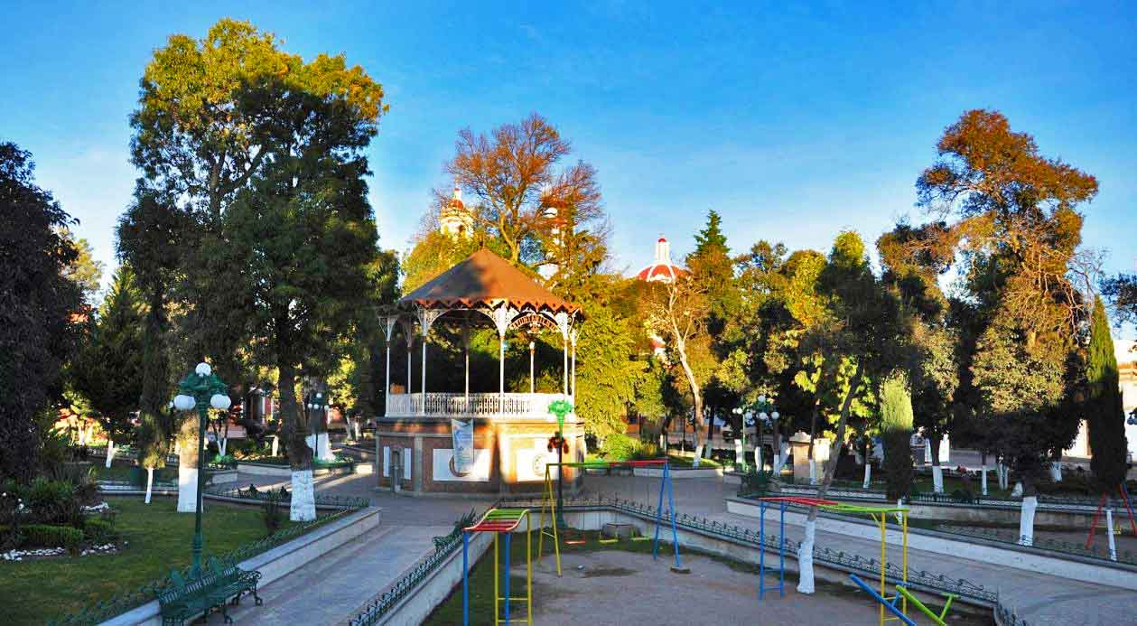

Benito Juárez Square

Slide 13
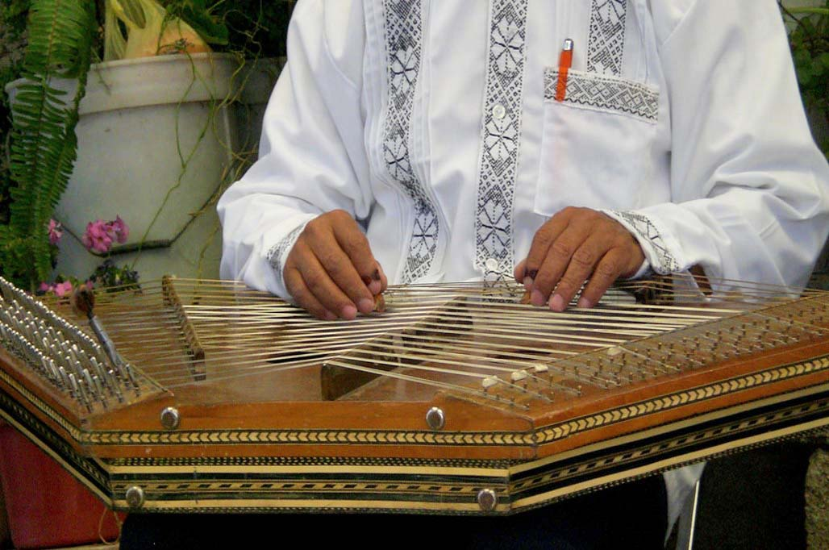
Salterio bajo en Altzayanca Tlaxcala
Photography © 2008 AzulAnalma

Slide 14
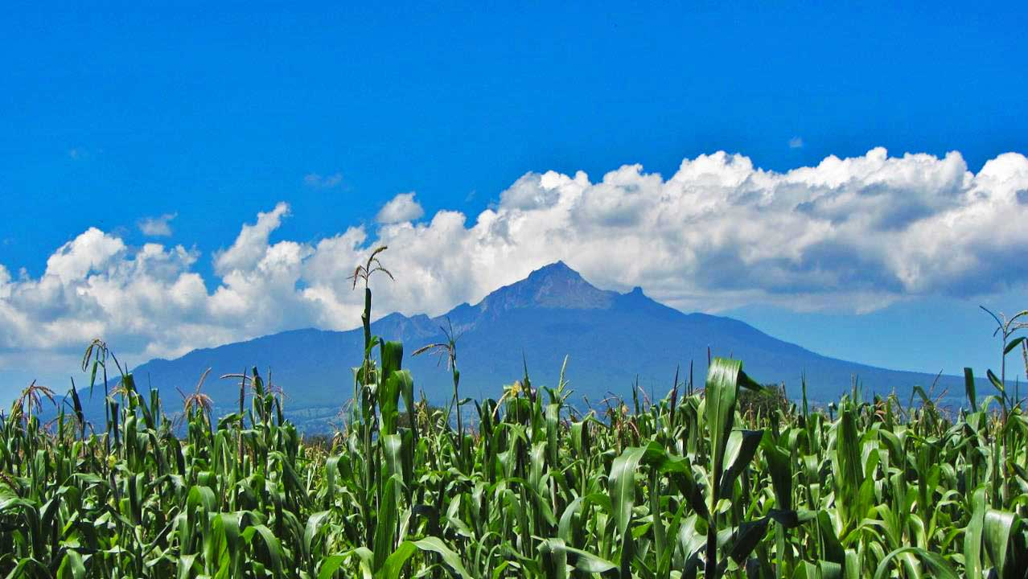
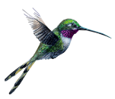
Volcan The Malinche
Photography © 2013 Alyse & Remi

Slide 15
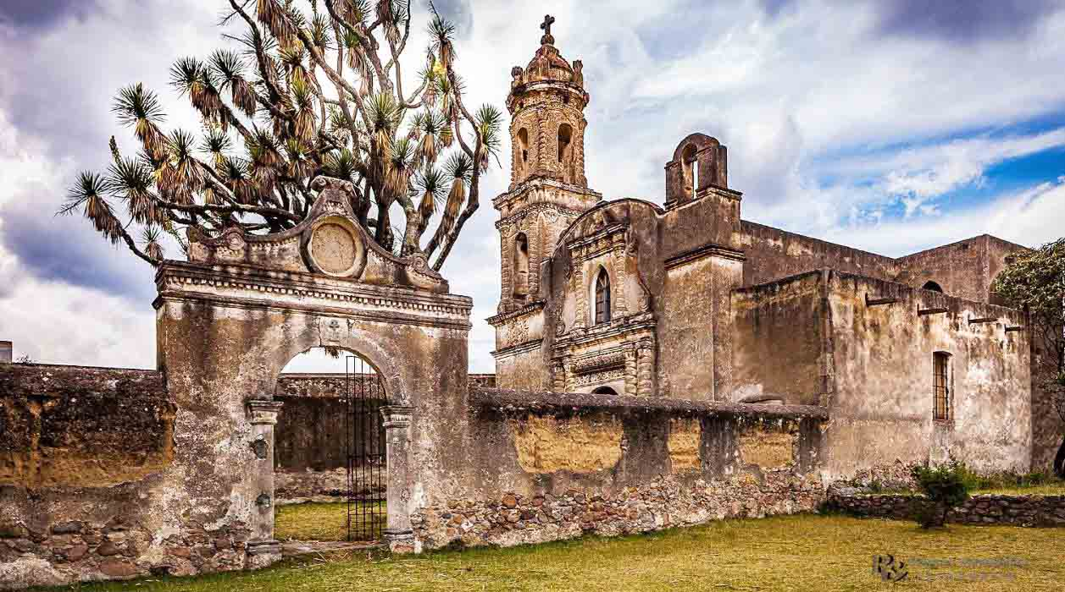
Hacienda Santa Barbara
Photography © 2016 por Rafael Campillo Rodríguez en 500px

Slide 16
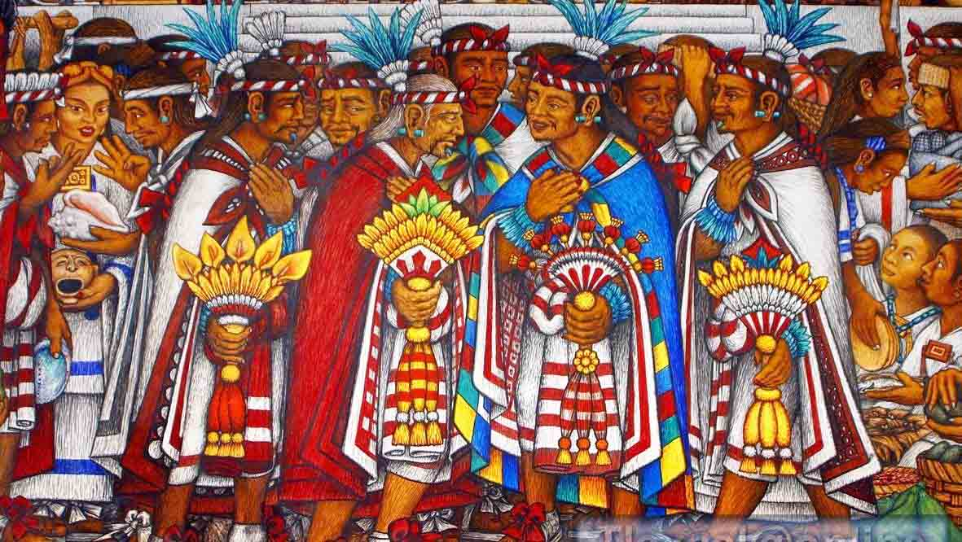
Mural por Desiderio Hernandez Xochitiotzin – The four Lords

Slide 17
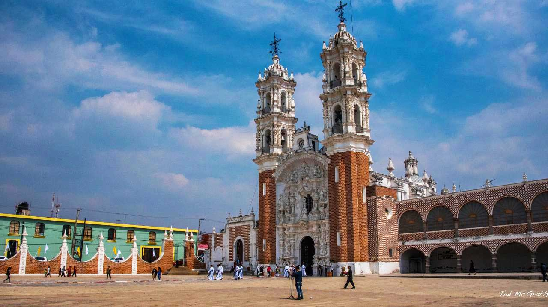
Basílica de Nuestra Senora de Ocotlán, Tlaxcala

Slide 18
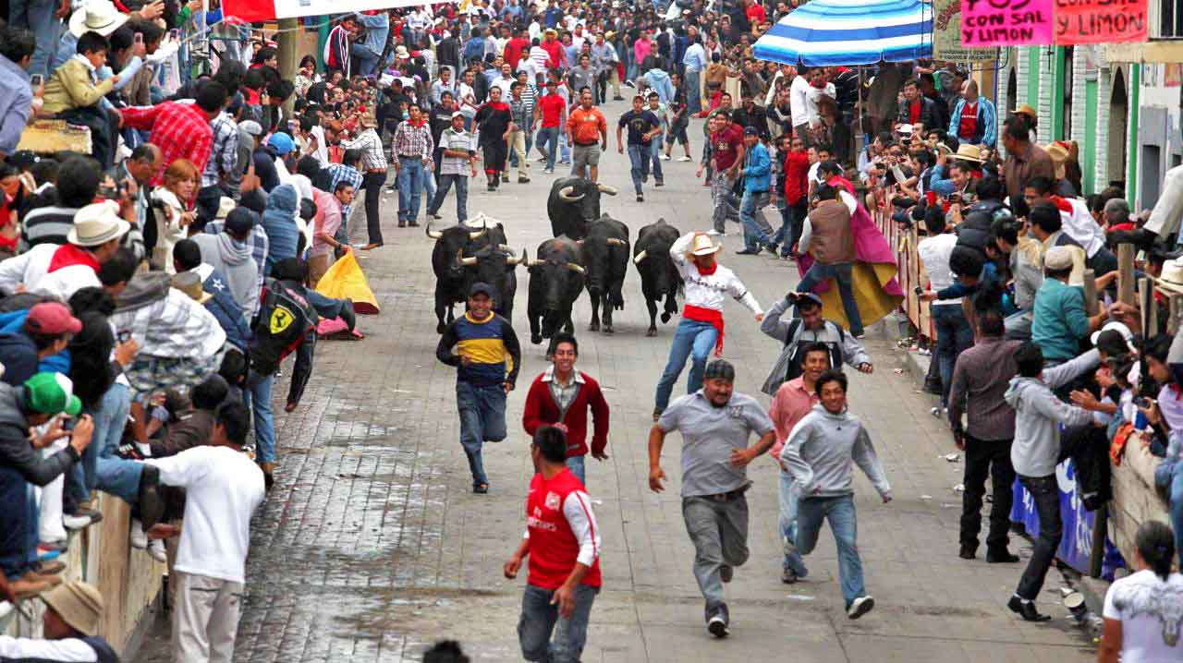
La Huamantlada

Slide 19
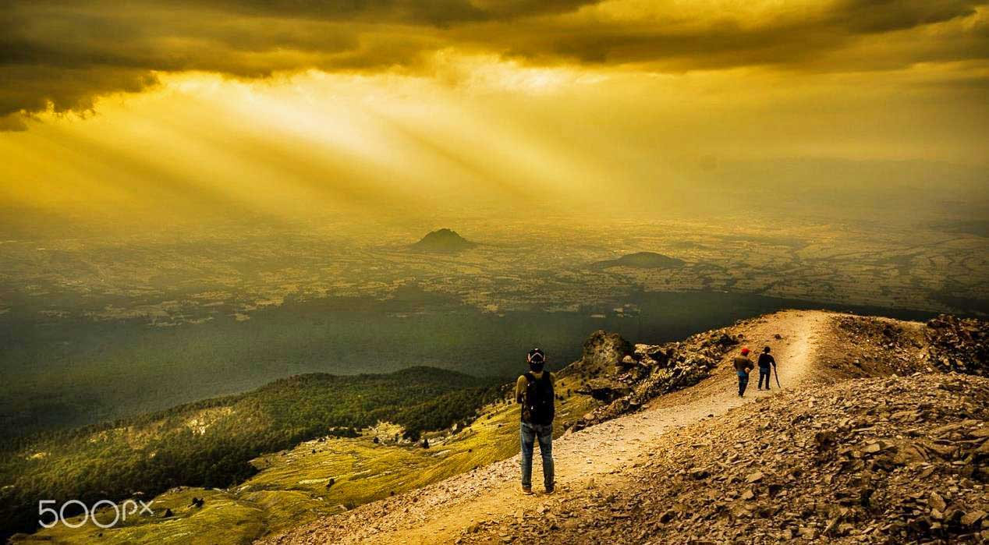
Panoramic view of the Valley of Puebla, Tlaxcala
Photography © 2016 por Israel Espinosa en 500px

Slide 20
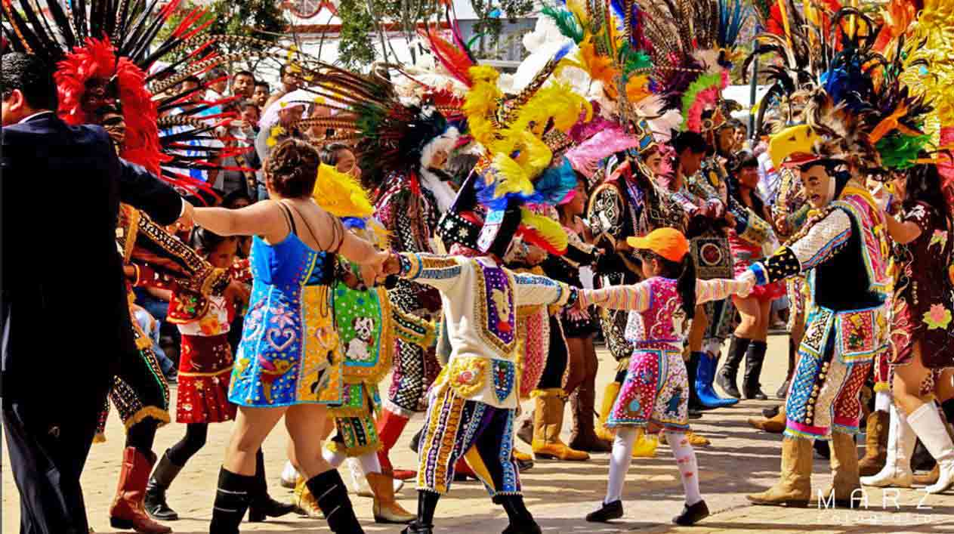
Huehues de Tlaxcala

Slide 21
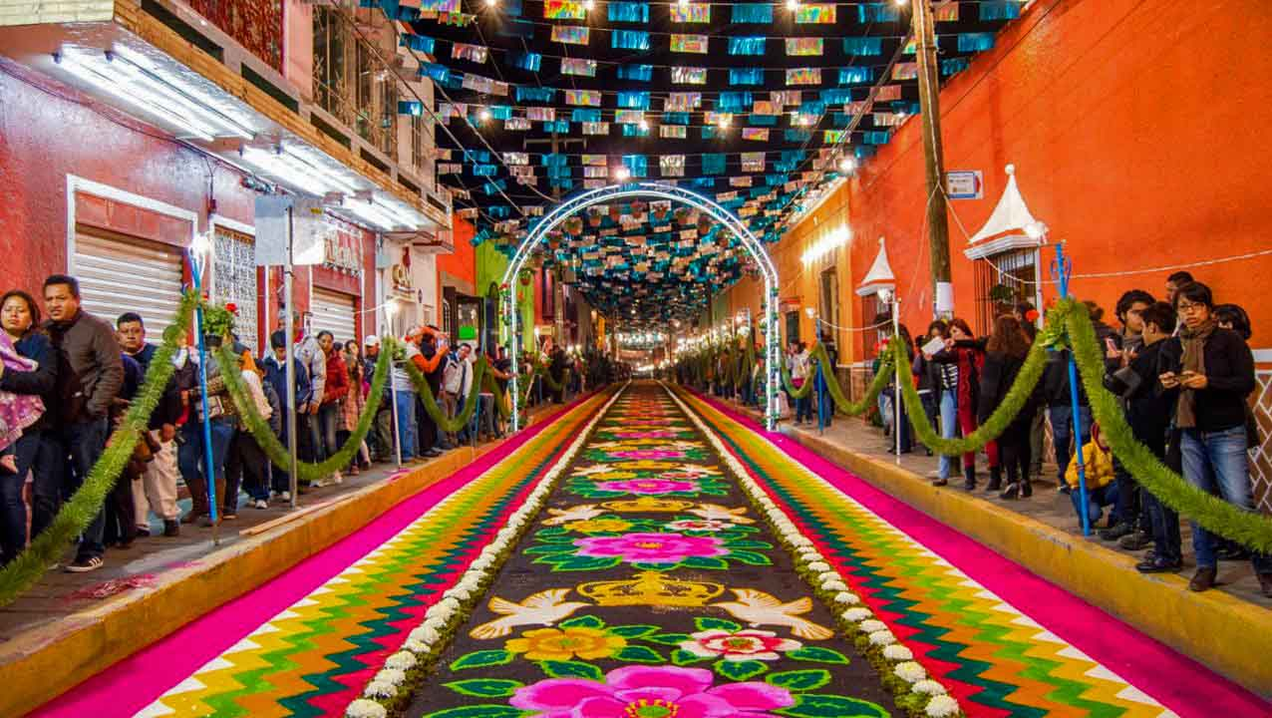

Celebration of the Virgin of charity in Huamantla
Photography © Jesús Reyes en 500px

Slide 22
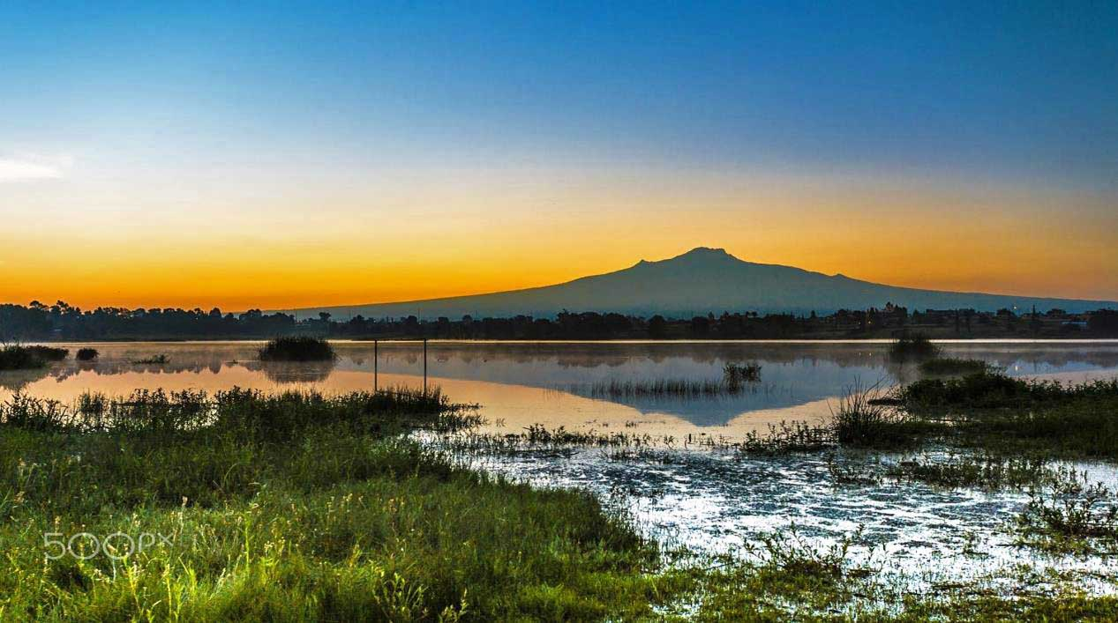

Dawn with La Malinche
Photography © 2016 por Cristobal Garciaferro Rubio en 500px

Slide 23
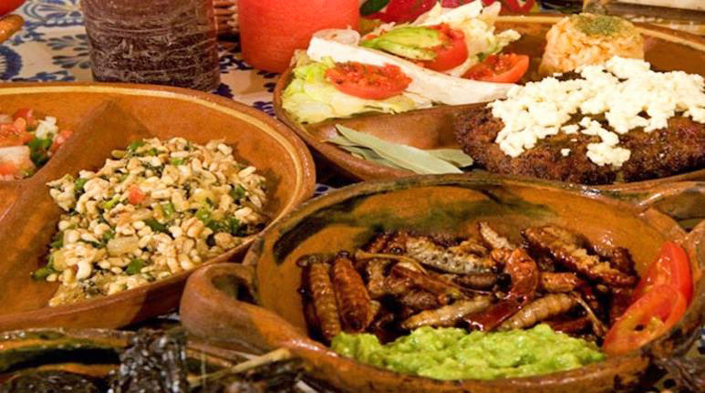
Gastronomy in Tlaxcala

Slide 24
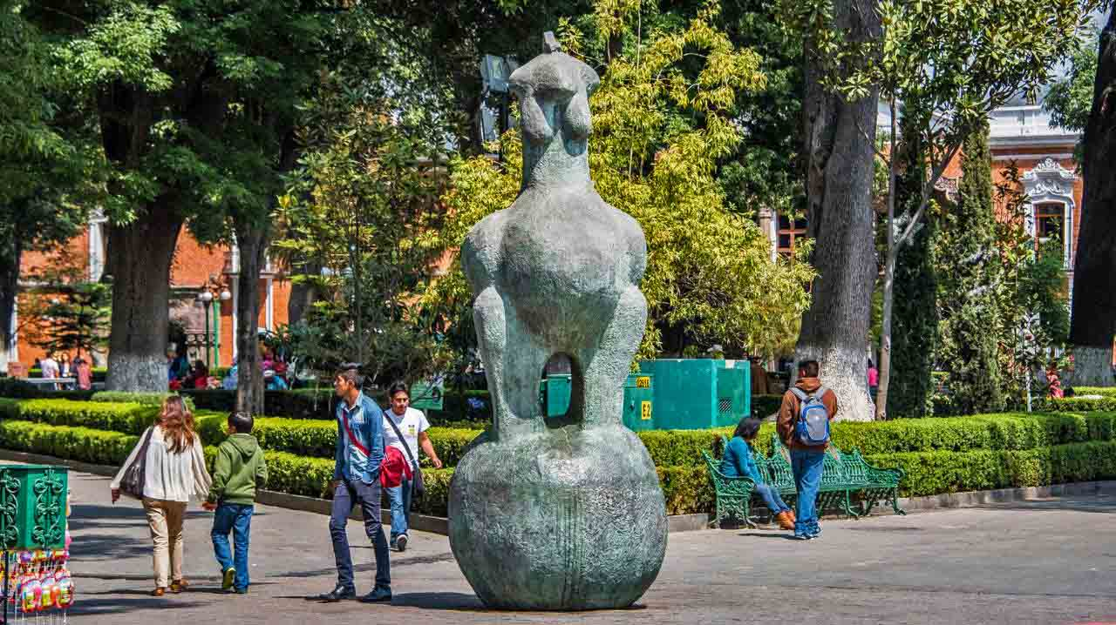
Tlaxcala - the Zocalo (Constitution Square)
Photography © 2016 Ted McGrath

Slide 25
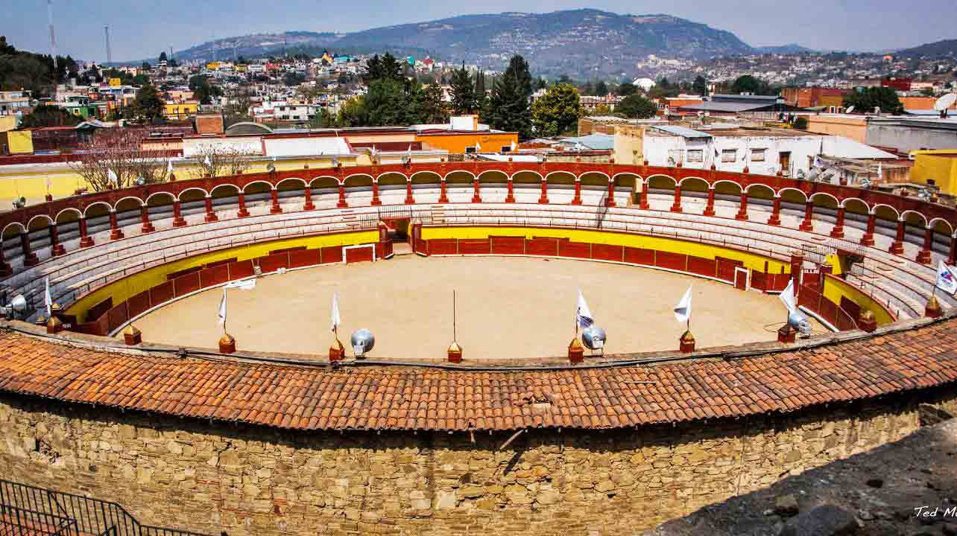
Plaza Jorge "El Ranchero" Aguilar
Photography © 2016 por Ted McGrath

Slide 26
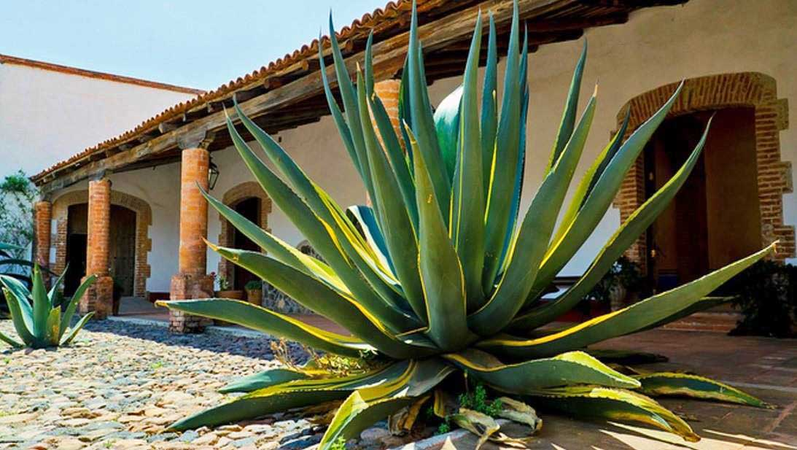
Ex Hacienda Santa María Xalostoc, Tlaxco
Photography © 2014 por Ricardo González

Slide 27
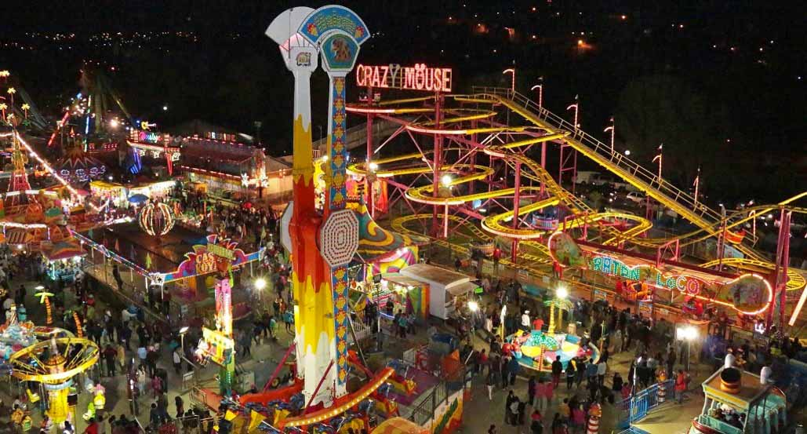
Tlaxcala La Feria

Slide 28
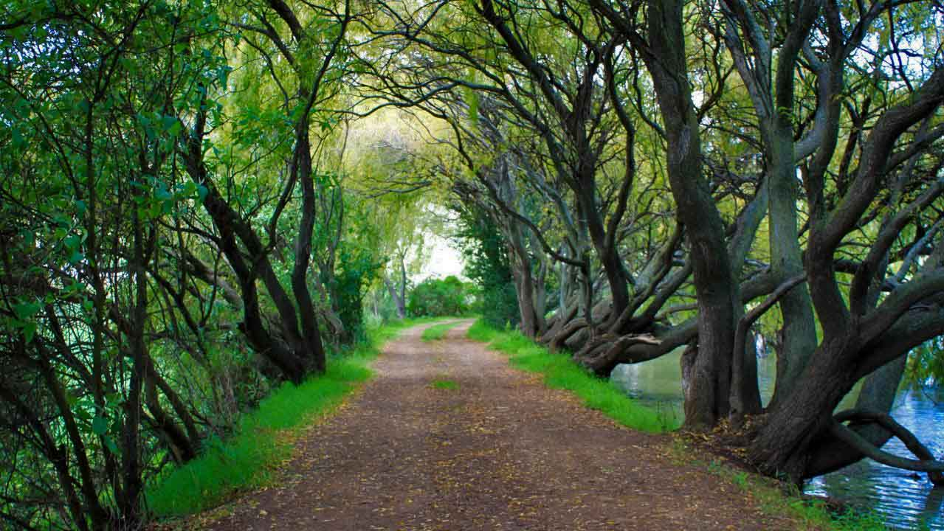
Tlaxco
Photography © 2012 Raúl Jiménez Mora

Slide 29
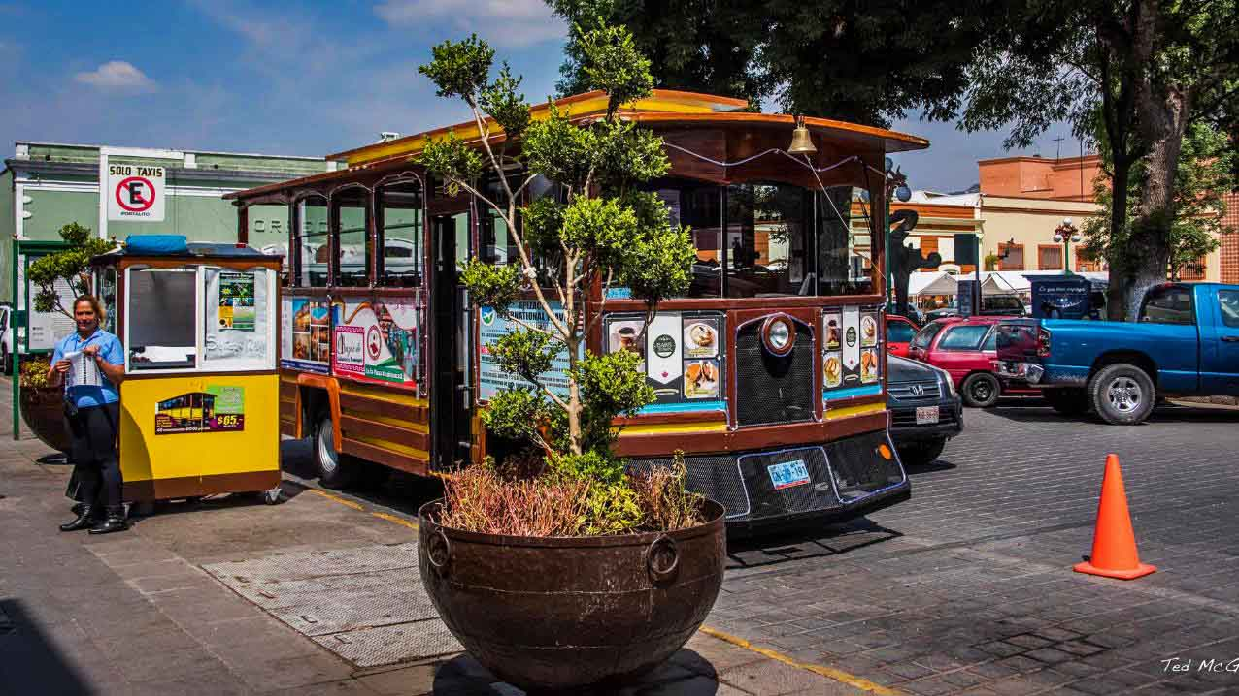
In the Tlaxcala streets
Photography © 2016 por Ted McGrath

Slide 30
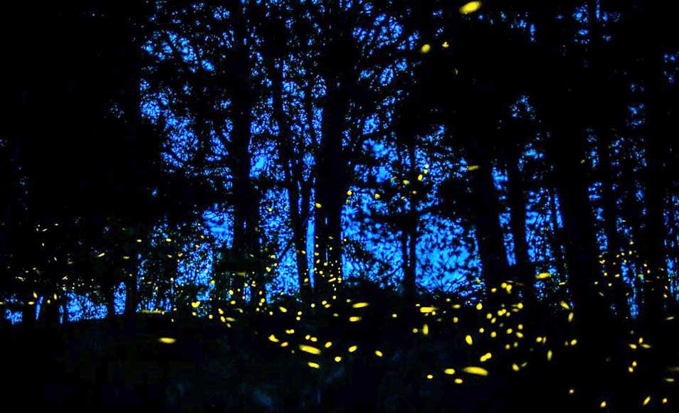
Sanctuary of the fireflies

Slide 31
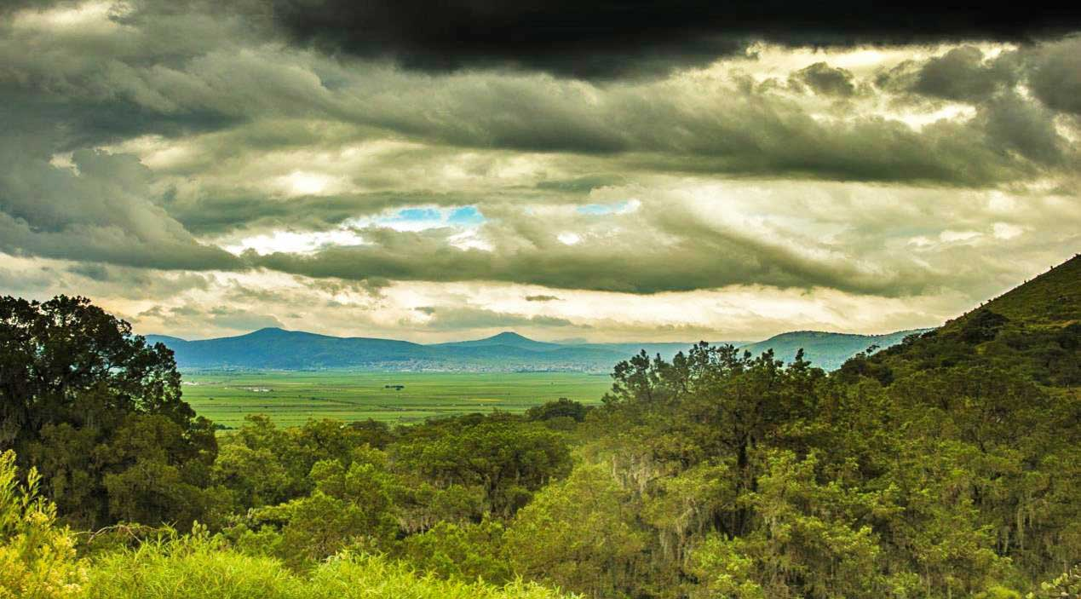

Before the thunderstorm, scenery close to Tlaxcala
Photography © 2016 por Carlos Aguirre en 500px

Slide 32
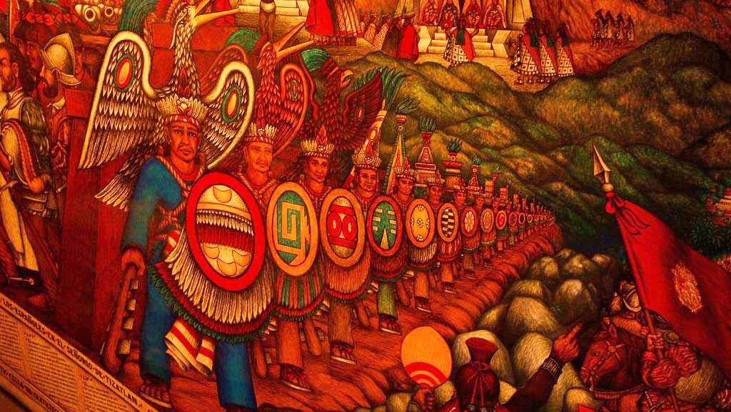
Mural de Desiderio Hernandez Xochitiotzin – The Warriors

Slide 33
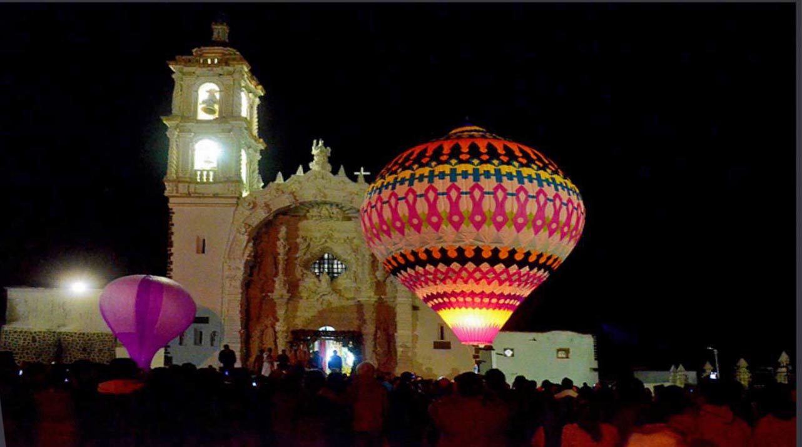
Panotla Tlaxcala
Photography © 2013 por xavo_rob

Slide 34
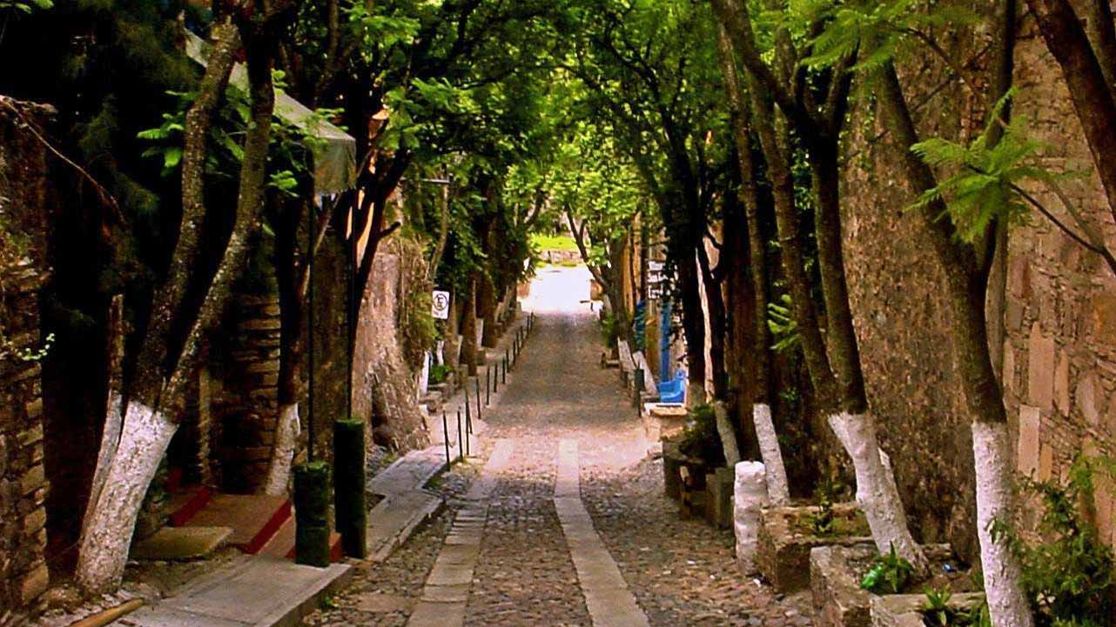
Going down to the garden
Photography © 2016 por Randall Keller en 500px

Slide 35
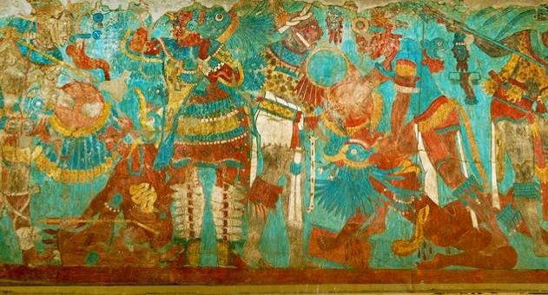
Mural of the battle at Cacaxtla
Photography © 2015 por Christophe Morisset

Slide 36
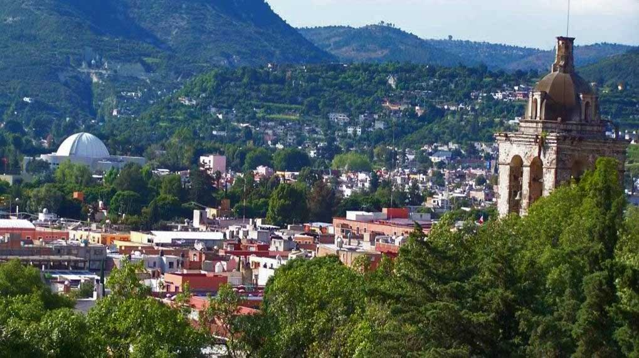
Tlaxcala

Slide 37
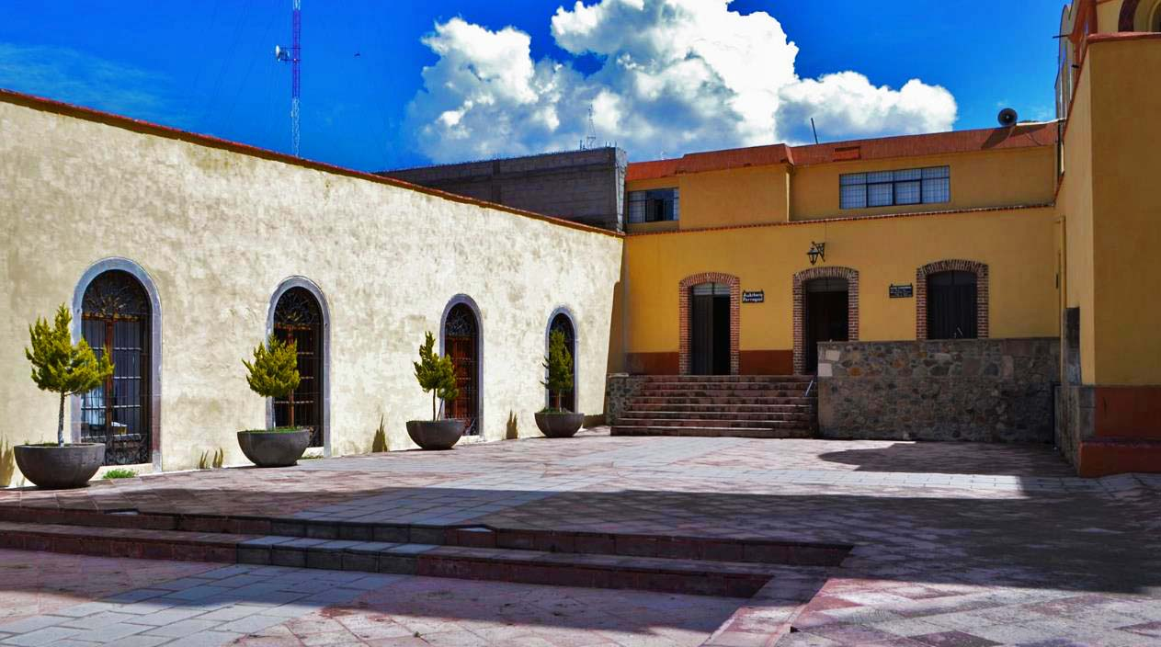
Tlaxco Tlaxcala
Photography © 2015 por José Miguel Escobar Pérez

Slide 38
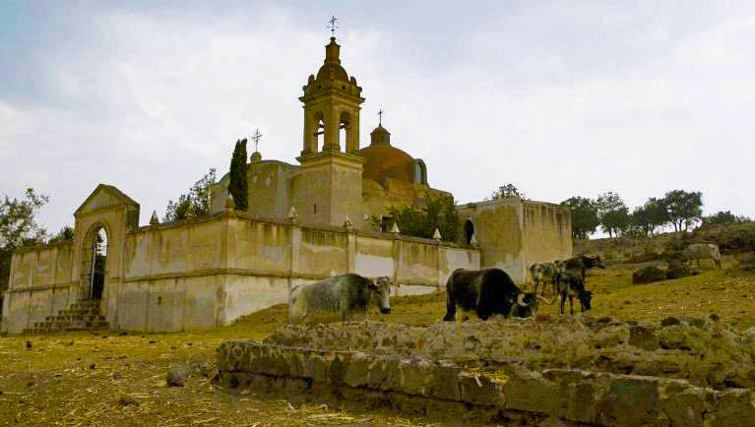

Huamantla haciendas pulqueras

Slide 39
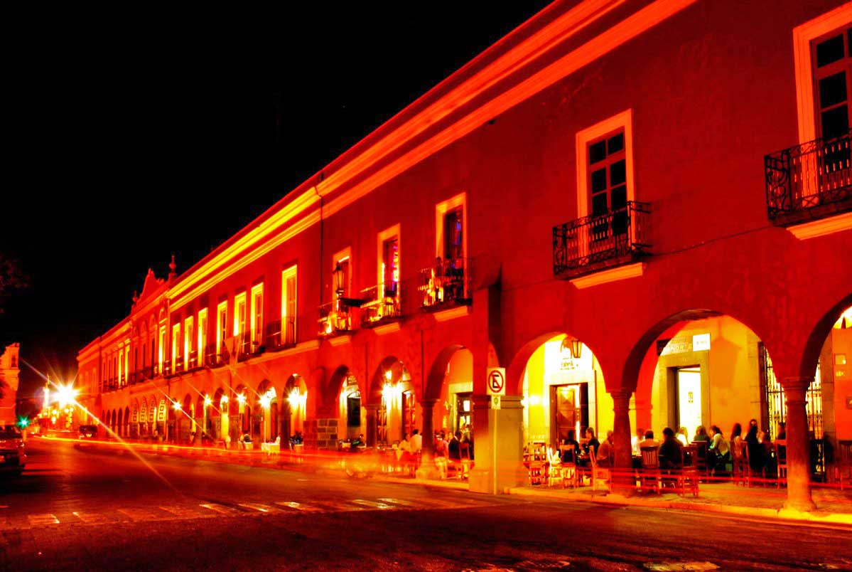
Tlaxcala Portal

Slide 40











Editing and compilation: Eduardo Gutiérrez y Castro
With thanks to the friend Steve Rumpler of Slovakia for his contribution in the elaboration of this presentation.
Avec reconnaissance à l'ami Steve Rumpler de la Slovaquie par sa contribution dans l'élaboration de cette présentation.
México 2017
Images from
the Web
Tlaxcala
lalo2gu@gmail.com
pista2011@gmail.com
Salterio music
Potpurrí Ranchero – Interpreta Salterios de Atltzayanca
E
G
Con el debido respeto y agradecimiento a todas aquellas personas que publican sus maravillosas fotografías e imágenes en la web

