Slide 1

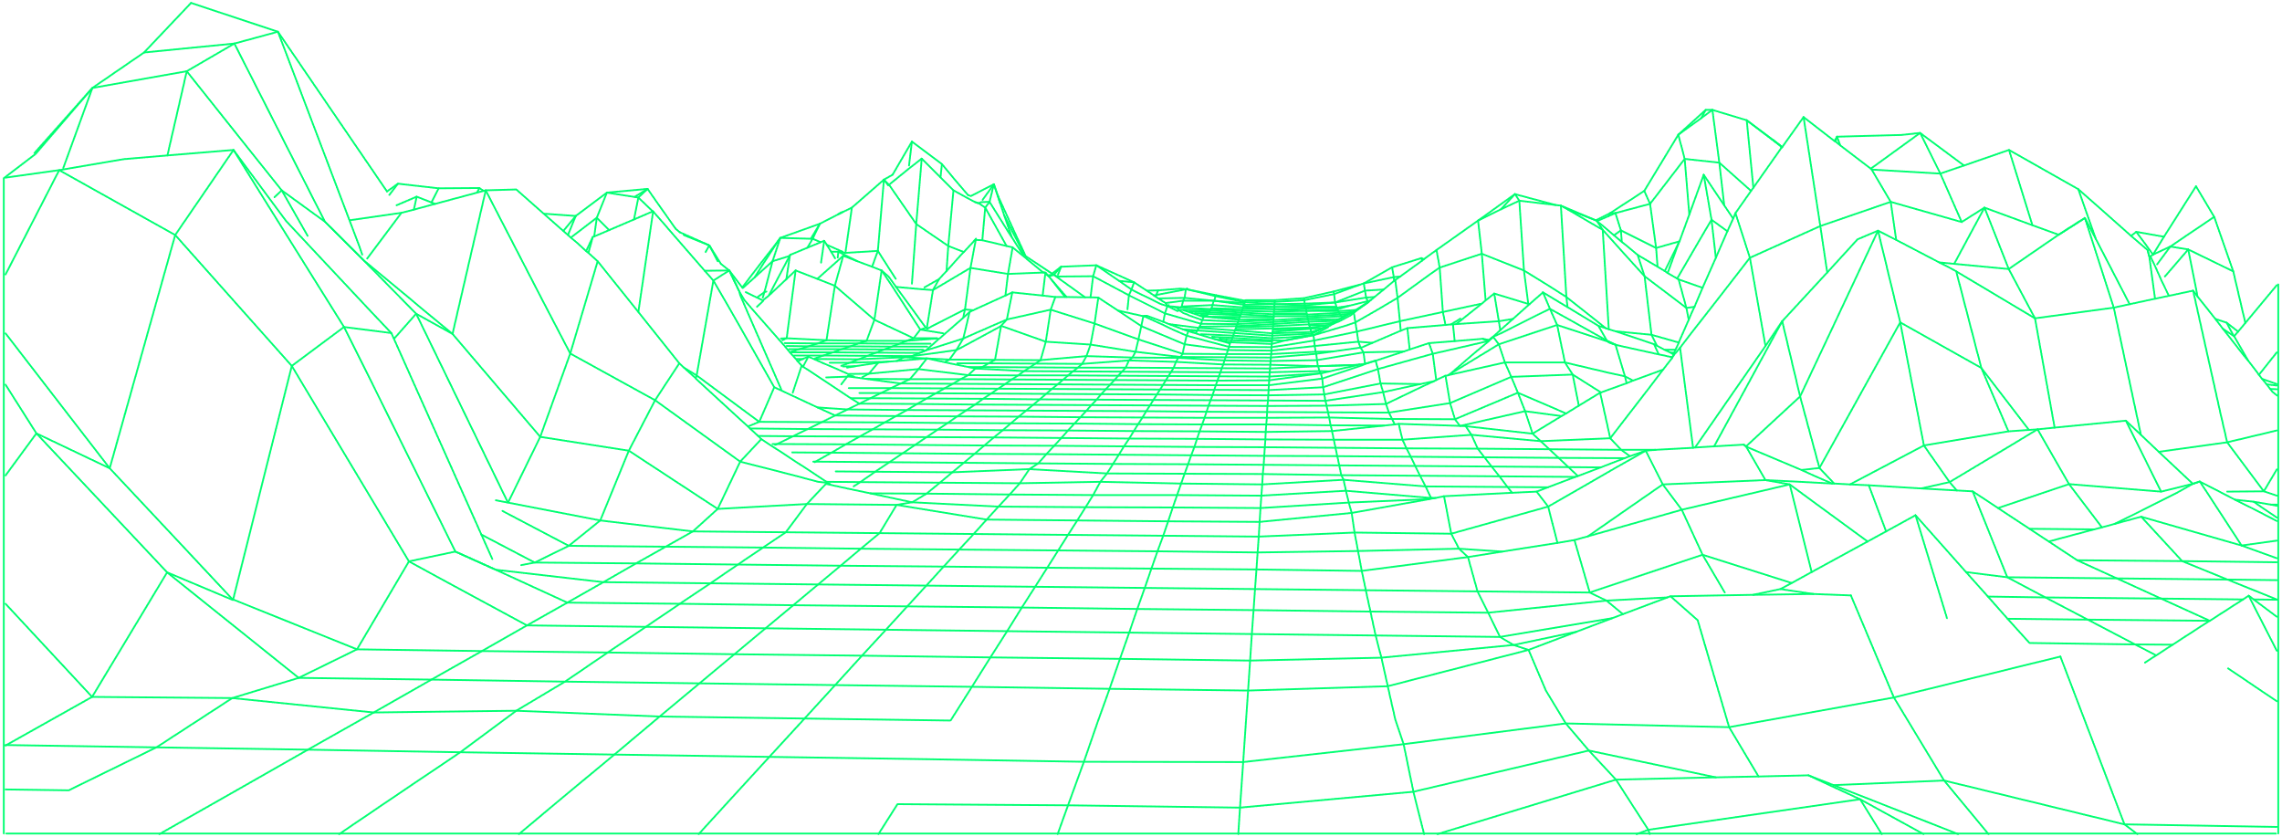
Showcase your life
in your own private
metaverse

Slide 2

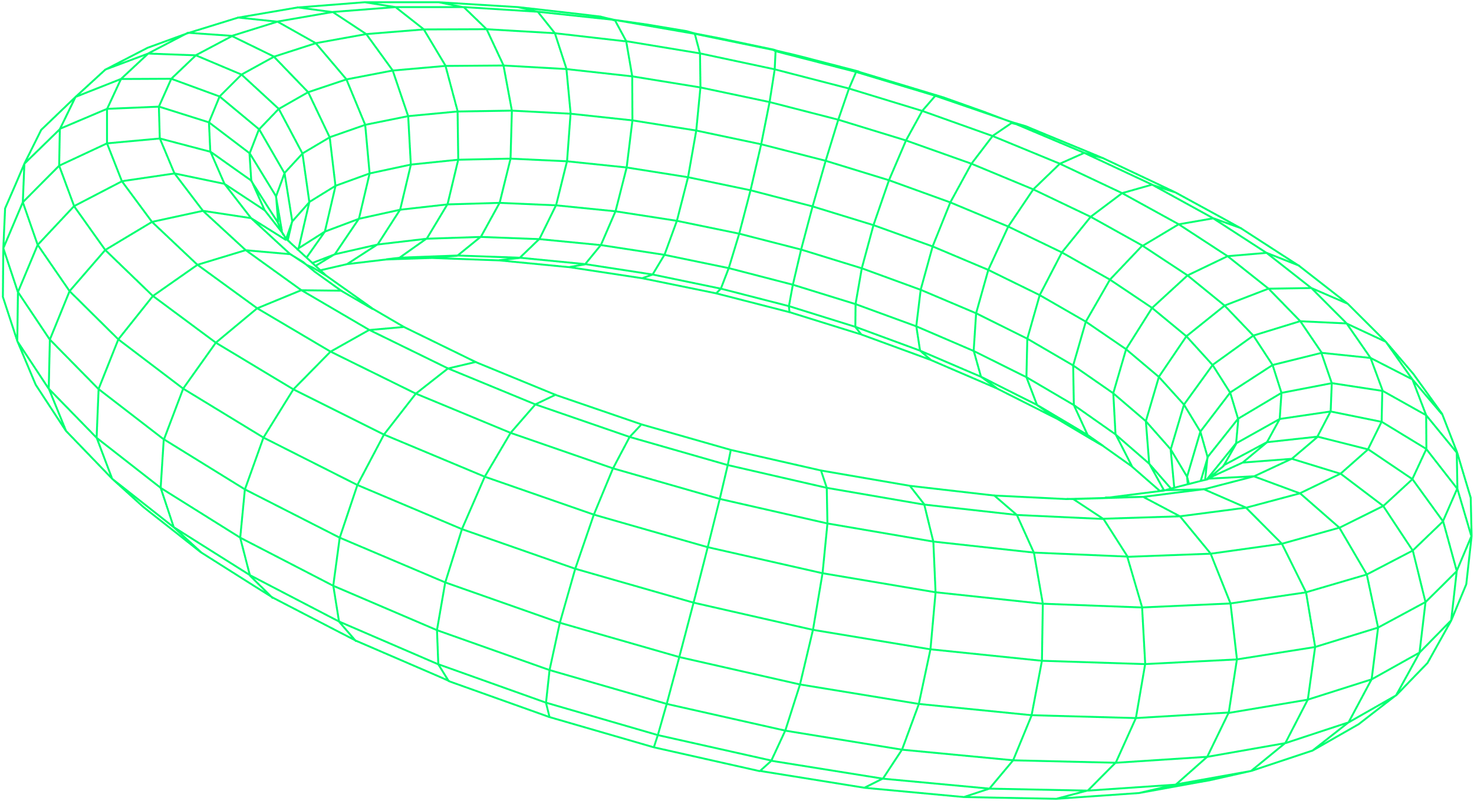
Disclaimer
Please be fully informed of the risks and costs associated with trading assets (digital or otherwise) in the financial markets. ICOs are one of the riskiest forms of investment available. You can potentially lose 100% of your investment. Cryptocurrency trading carries high risk and is not suitable for all investors. Before deciding to trade cryptocurrencies, tokens or any other digital asset, you should carefully consider your investment goals, level of experience and risk appetite.
Please note that we reserve the right to make any changes to the technology mentioned in this White Paper in favor of the overall purpose of the project. For the latest version of the white paper, go to: https://lifestoryapp.com
Life coin
Trading and investing is risky, do it at your own risk, and we advise people never to use more money than they can afford to lose. The cryptocurrency market is a volatile and risky market. Investing in cryptocurrencies may not be suitable for all readers of this Whitepaper.
Anyone looking to invest in cryptocurrencies should consult a fully qualified independent professional financial advisor or do their research.
In addition, an ICO is subject to several regulations that we strive to comply with as much as possible, such as the Prospectus Directive, the Markets in Financial Instruments Directive, the Market Abuse Regulation (MAR), the 6th Directive on the prevention of the use of the financial system for the purpose of money laundering or terrorist financing (AMLD6).
Neither LIFE Company nor any person or entity associated with it, including but not limited to its agents, employees, insurers, attorneys, advisors and assignees, shall be liable, whether in contract, tort (including negligence) or otherwise, for any damage, expense or other loss you may suffer as a result of the use or investment in LIFEcoin.
In addition, consumers (within the meaning of European Directive No. 2011/83/EU), "American persons" (within the meaning of "Regulation S" of the Securities Act 1933 of US law), citizens of Canada and Singapore are excluded from the ICO.
No investment advice
Not all information provided in this White Paper constitutes investment advice, financial advice, trading advice or any other type of advice, and you should neither consider the content of the Website as such.
Accuracy of information
We endeavor to ensure the accuracy of the information contained in this White Paper, but we cannot be held responsible for any missing or erroneous information. You understand that you use all information available here at YOUR OWN RISK.
All investments involve risk
All investments involve risk, and the past performance of cryptocurrencies, the market or financial products does not guarantee future results or returns. Gains made with cryptocurrencies are usually subject to tax, depending on the country in which you reside. We take no responsibility for any loss or damage you have suffered as a result of the investment in the project.

Slide 3
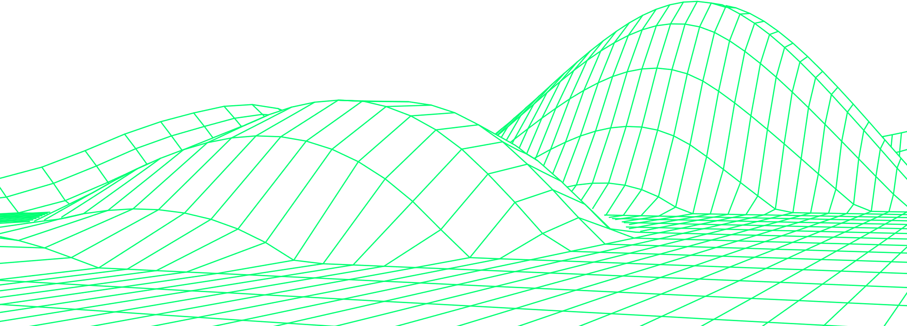
Table of Contents
Disclaimer
Purchase and resale of NFT
Skins
Private collection
Sponsorship
Visualize your life in your private metaverse
Team
Business model
Royalties
Advisors
Application use cases
Brands
The token: LIFC
Usefulness of the token
SmartStaking
Conventional Staking
SmartShare
Smartbacking: Deflationary economy
Abbreviations
Lifestory Ecosystem
Timeline room
Micro-Metaverse
Timelines
Moments
Skins
Contact
Tokenomics
Token distribution/Allocation
Vesting and Cliff periods
Mobile App
Immersive VR universe
Roadmap

Slide 4
Abbreviations
Abréviation
Définition
Abréviation
Définition
Abréviation
Définition
Abréviation
Définition
Abréviation
Définition
Abréviation
Définition
Abréviation
Définition
Abréviation
Définition
Abréviation
Définition
Abréviation
Définition
Abréviation
Définition
Abréviation
Définition
Abréviation
Définition
Abréviation
Définition
Abréviation
Définition
Abréviation
Définition
Abréviation
Définition
Abréviation
Définition
Abréviation
Définition
Abréviation
Définition

Slide 5
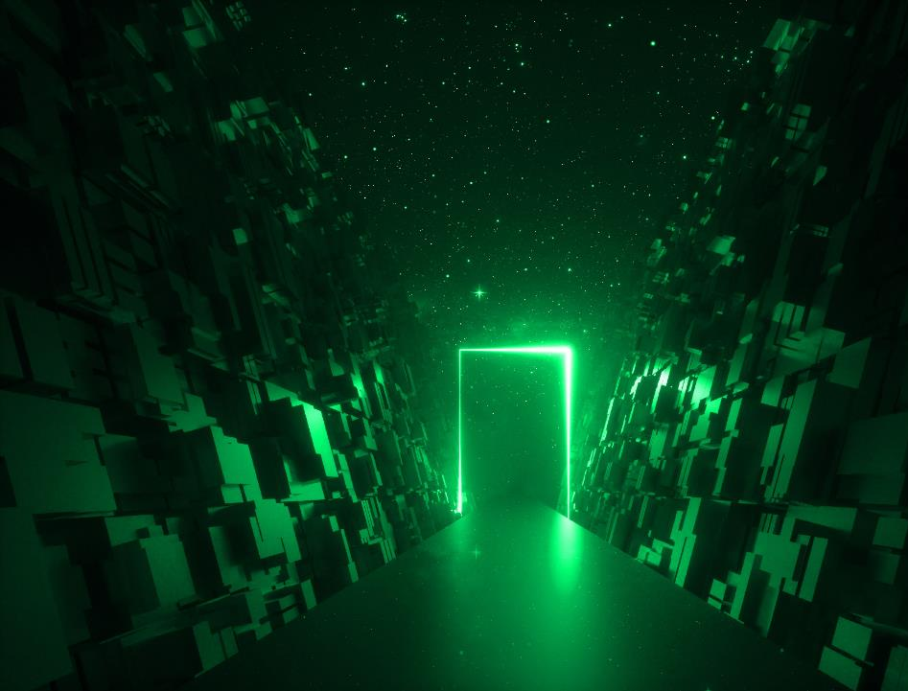
Visualize your life in your private metaverse.
Lifestory allows you to share all your memories thanks to the Blockchain in the form of non-fungible tokens (NFT).
These sharing can be done directly with your community using public or private "Timelines" in your own metaverse.
In each passing day, we experience new things, meet new people and spend unforgettable moments that we want to preserve, relive and share.
Whether alone, with family or friends, these moments from the most memorable to the most innocuous, always hold importance to us or even an inestimable value for others.

Slide 6
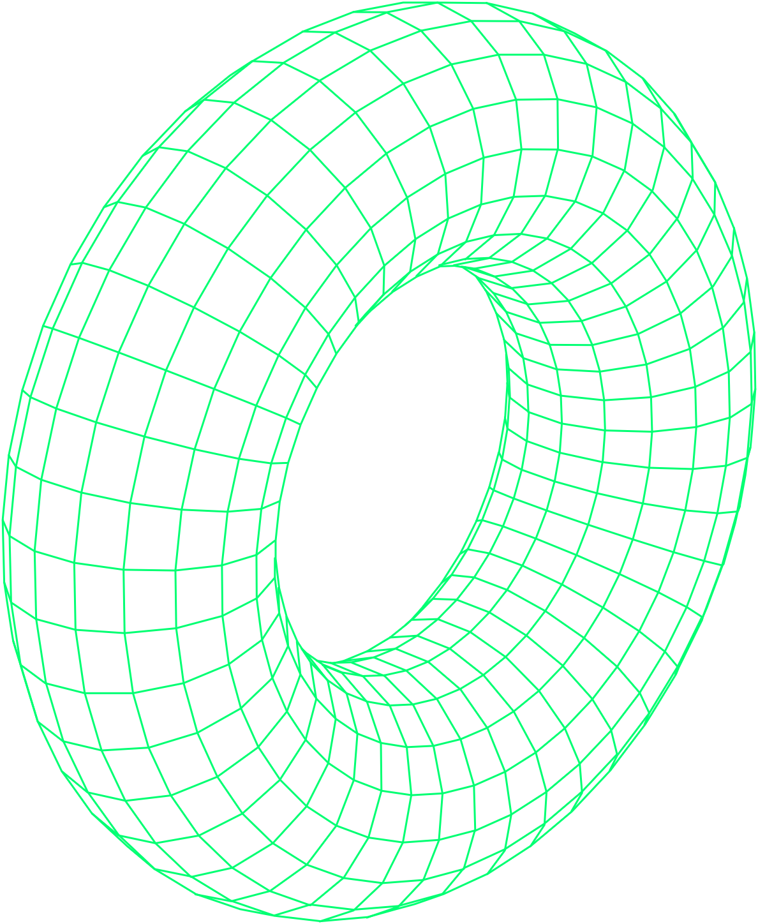
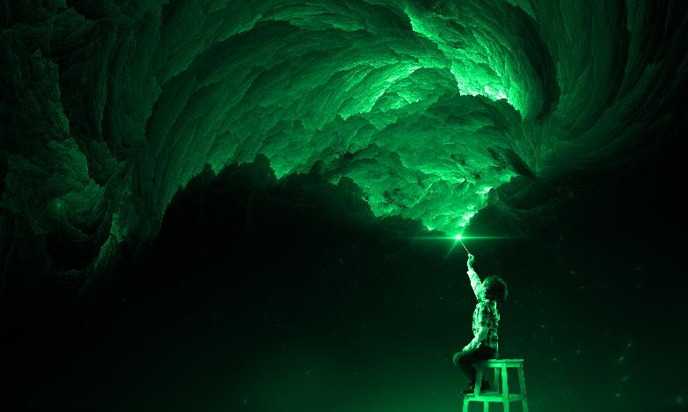


Imagine…
CREATE
a personalized timeline with the most memorable moments of your life.
BE
a celebrity, an influential person, a scientist or artist who would share a love letter from his youth, a note taken in his office that had an impact in an important decision.
SHARE
your story to the rest of humanity in the form of a museum in your metaverse, private, built with your hands, searchable by future generations and likely to inspire them.
Every moment should be considered
as a work of art for someone else or an inheritance to be passed on to future generations, to members of your community.
WRITE
your autobiography in the form of an authentic timeline thanks to the inalterability of blockchain and NFT's.

Slide 7
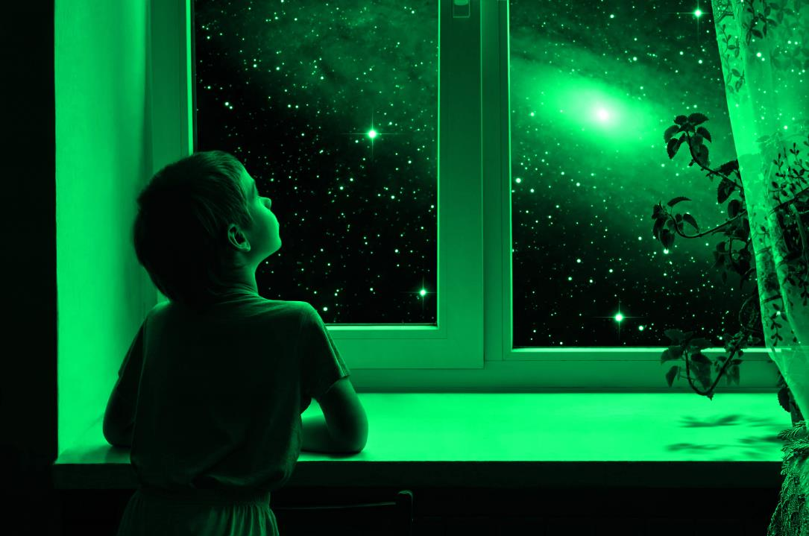
Every second deserves to be preserved and we should have the choice to keep it in order to cherish it forever!
Lifestory makes it all possible.
Record all the important moments of your life by combining the new technologies of blockchain and NFTs with the reflex that we have all already acquired in the digital age.
Where the cloud is the storage, Lifestory is the museum.
Instead of simply storing your data on the cloud or social networks only to lose ownership, Lifestory allows you to create a private metaverse consisting of a private space and a gateway to your timelines to end up in total immersion in your memories.
You can then decide to share your metaverse and decide to monetize those moments with your community.

Slide 8
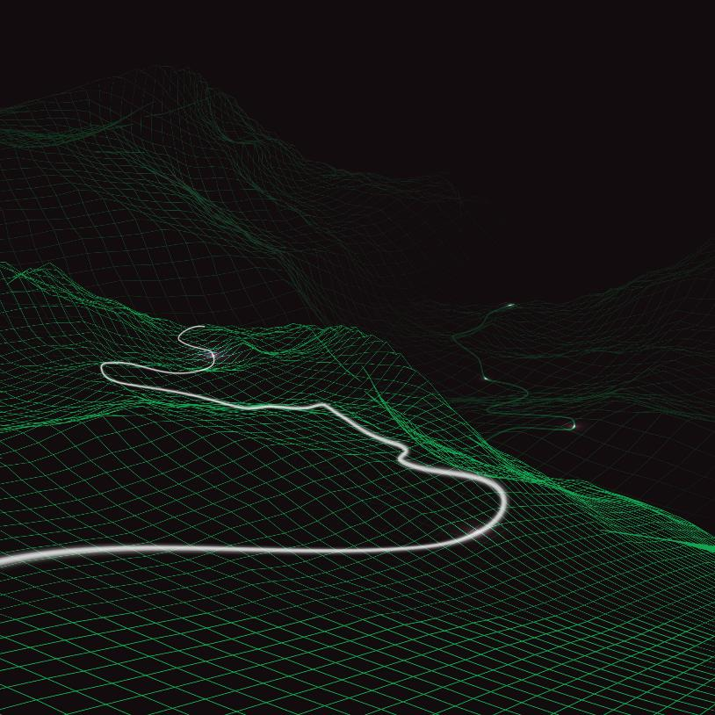






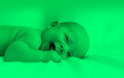

The cases of use for such an application are countless
You have just become a parent, your first child is born and it is an adorable little girl!
You take her for the first time in your arms, and are invaded by emotions, you do not want to lose or forget this moment!
You wish you could have relived this feeling every day if you had the opportunity...
With Lifestory, all you have to do is take your smartphone and film your child in your arms. Then you record this moment on your timeline and decide to add an audio message to it so that you can share it with your daughter when the time comes and make her feel the intensity of your happiness to have welcomed her into your life.
The day you are no longer of this world, she will be able to relive this moment through her timeline that you bequeathed to her before.
Moment 3
Love letter for my daughter
Moment 2
Natalie walks
for the first time
Moment 1
Birth of the love of my life, Natalie
Timeline: Natalie
User 1 : Parent
Notes:
Fond vert case le contraste
bord arrondies detein du reste
carte fonctioon

Slide 9
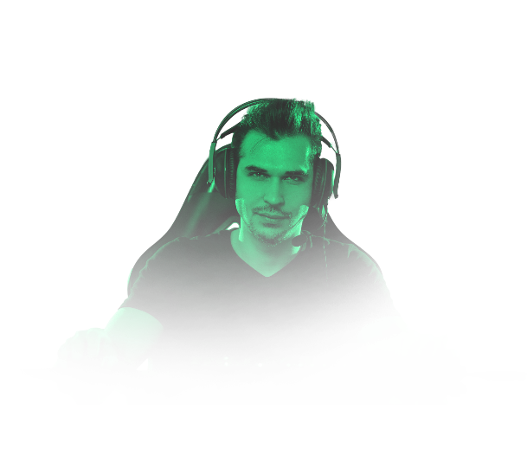






You have an appointment with a person you like.
You imagine yourself together and it's been a little while that you try to convince yourself to take the first step. This step is taken and you want to preserve this moment! You never know, maybe she really is the woman of your life.
You are a professional streamer/player.
You are a professional streamer/player, you play an epic game of your favorite game. Your community followed you live throughout your game. Some moments were incredibly well done. You can take these moments in the app, convert them to NFT and offer them to your community of fans!
Timeline: My couple
User 1
Timeline: Life stream: Counter Strike
Streamer Pro
Moment 1
My first date with Isabelle
Moment 2
Our second date, at the movie
Moment 3
Isabelle introduces me to her parents
Moment 1
Unlikely headshot
Moment 2
Epic stabbing
Moment 3
Three kills with
a single shot
Notes:
Image scene de marriage + supprimer le fond vert
Petite carte même remarque

Slide 10

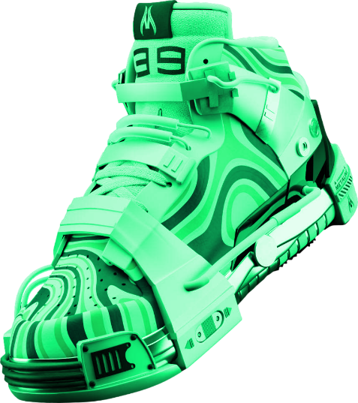
Brands
You own a brand of running shoes with more than 30 years of existence. You present historic performances of a very specific shoe-model with which high-level athletes continue to break records. You want to highlight your story. You want to show when your basketball pair made history.
Timeline: Metalines
Moment 1
Gold medal of the running championship with the athlete *.
Moment 2
New women's running world record with the athlete*.
Moment 3
Olympic medal at the Athens Olympics in 2004.

Slide 11
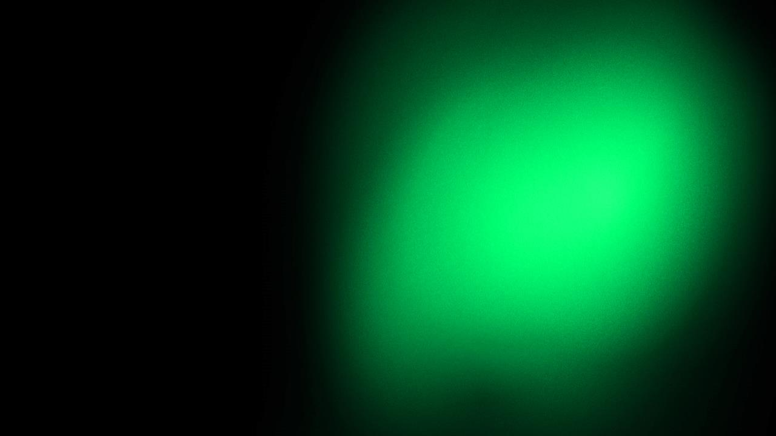
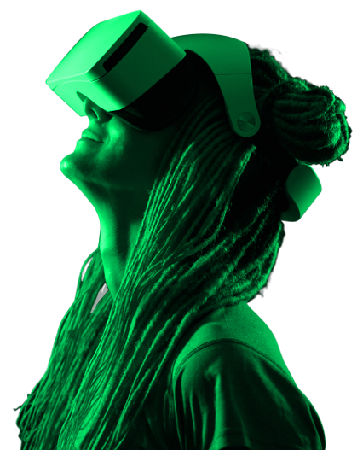
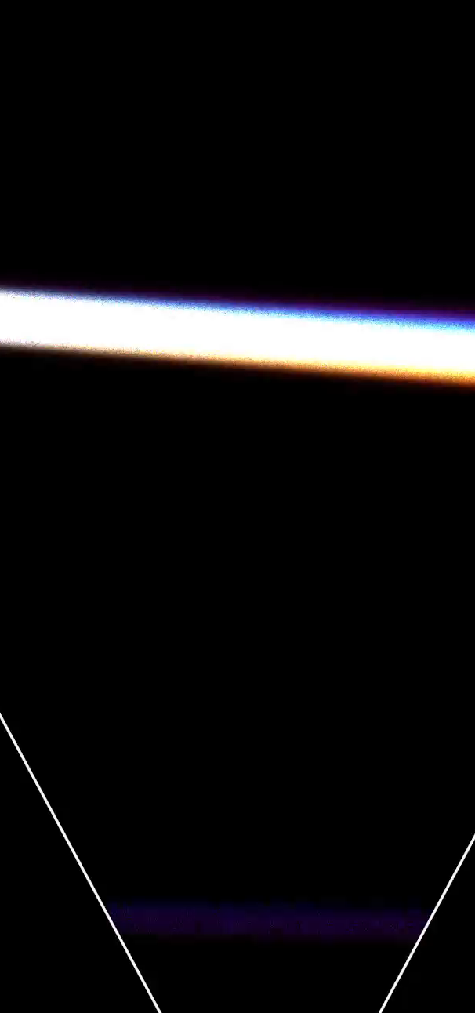
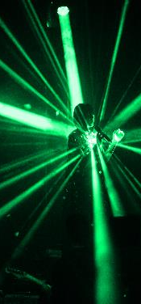
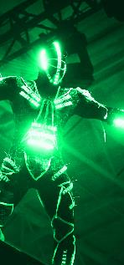
Mobile Application
The mobile application will allow the creation of timelines as well as 2D moments with depth effects.
These moments may contain several distinct elements such as photos, videos, texts and/or audio messages. They will be private by default and shareable with one or more people.
All the moments created and added on mobile will then also be viewable in virtual reality (VR).

Slide 12
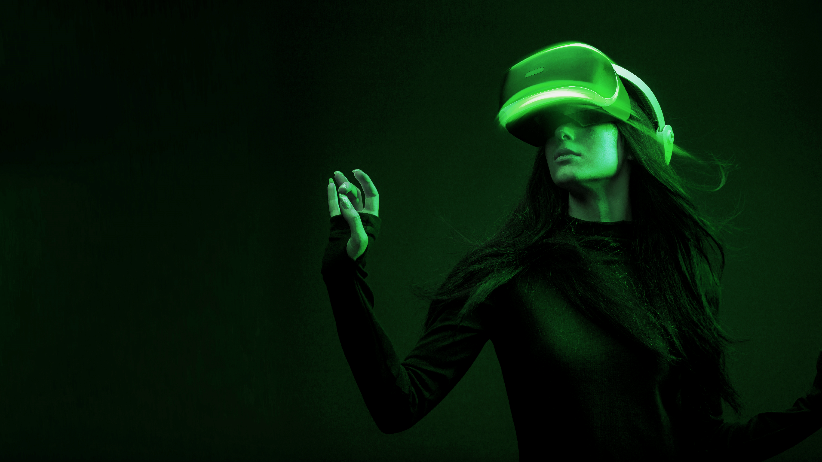
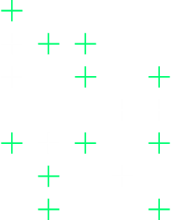
Immersive VR Universe
A micro-metaverse will be a whole universe where it will be possible to exhibit all its moments as we know it in a private museum where any authorized person can bask and admire the representations, "Moments", lived or bought.
All the moments created within the ecosystem will be viewable directly in virtual reality using a VR headset.
This will allow an integral immersive experience and will therefore be able to offer the buyers of moments and their loved ones the opportunity to relive these moments as if they were there.
It will be possible to move within a timeline and go back to a specific moment and relive it as in the early days.

Slide 13



The Lifeverse
The lifeverse is comparable to a universe (Metaverse) in which there will be 5555 planets, satellites and different ships.
01
First collection
It will consist of 5555 planets that will be sold in the form of NFT's and that will allow individuals, brands to be able to create in an almost unlimited way an environment to their image if they choose not to rent out theirs.
Each planet owner will be able to leave a trace of his passage on earth (the real one) by customizing a Liverse’s planet in his own way.
Whether it is a human being or a legal person, each story can be exposed to the taste of the creator through multiple timelines in his outdoor timeline room or in his planetary mansion

Slide 14
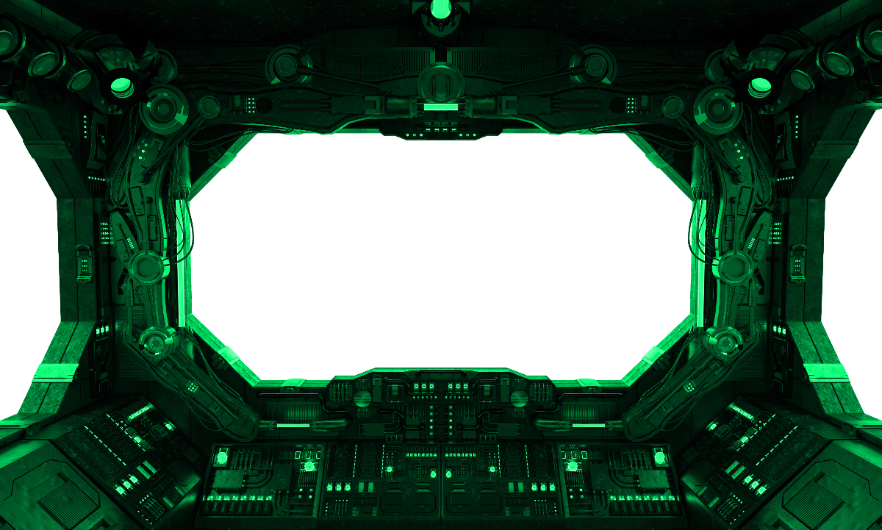
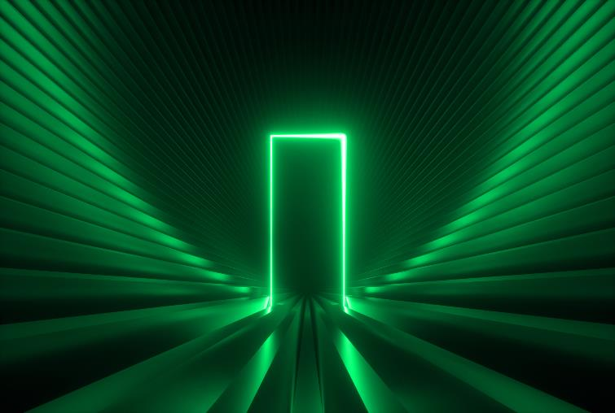
02
Second collection
Unique spaceships allowing the Lifestory app users with a VR headset to be able to have their own exceptional ships in the lifeverse instead of a simple free default ship obtained during registration.
All the ships of the Lifeverse will consist of a cockpit, a lobby, a museum and a timeline room to relive your moments alone, with family, friends or community

Slide 15
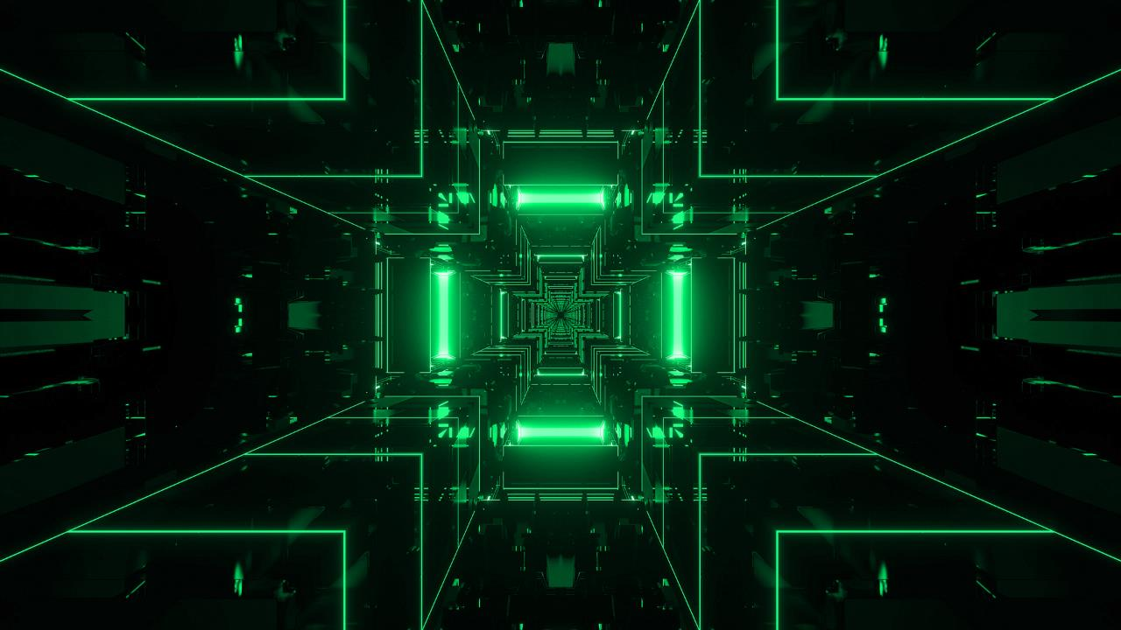
Lifestory Ecosystem
Micro-Metaverse
A micro-metaverse is a private, individualized and customizable universe within the app.
It brings together all the timelines and moments created by the same person. The creator of the micro-metaverse can choose to keep his entire world private or to give access to his community through these timelines.
Notes:
Fond vert case le contraste
bord arrondies detein du reste
carte fonctioon

Slide 16
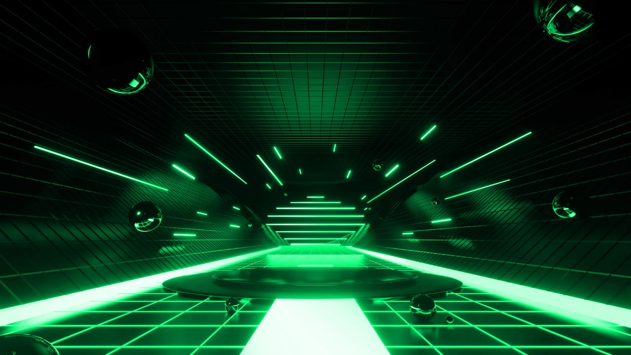
Timelines room
The timeline room is an environment of the micro-metavese in which all the timelines of the users are located.
All timelines appear arranged next to each other
and are selectable to visit them and retrace their moments
Notes:
Fond vert case le contraste
bord arrondies detein du reste
carte fonctioon

Slide 17
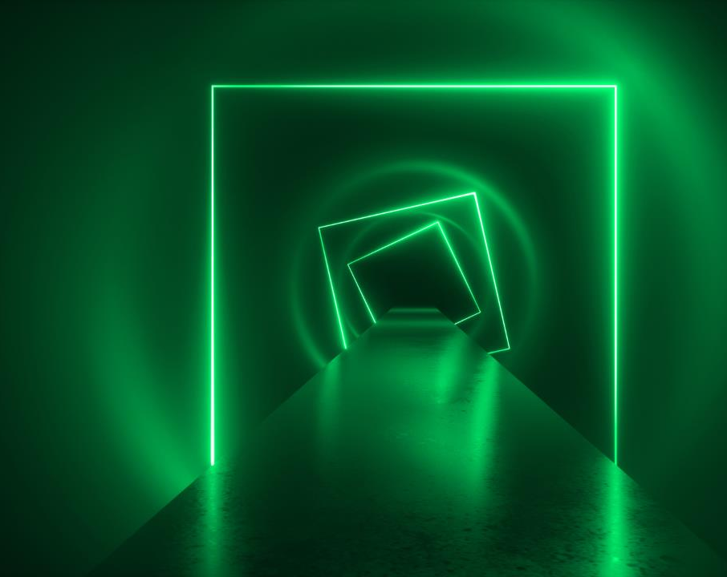
Timelines
Timed timelines are the chronological digital representation of moments in a person's, group's or company's life, whether fictional or real.
FOR EXAMPLE, A TIMELINE:
For privacy
By professional career
For a public career
For each member’s siblings
For each product
of the same brand
Timelines also allow you to create different versions or editions of the same activity.
LIKE WHAT
An international football organization would have different timelines depending on the tournaments it would organize.

Slide 18
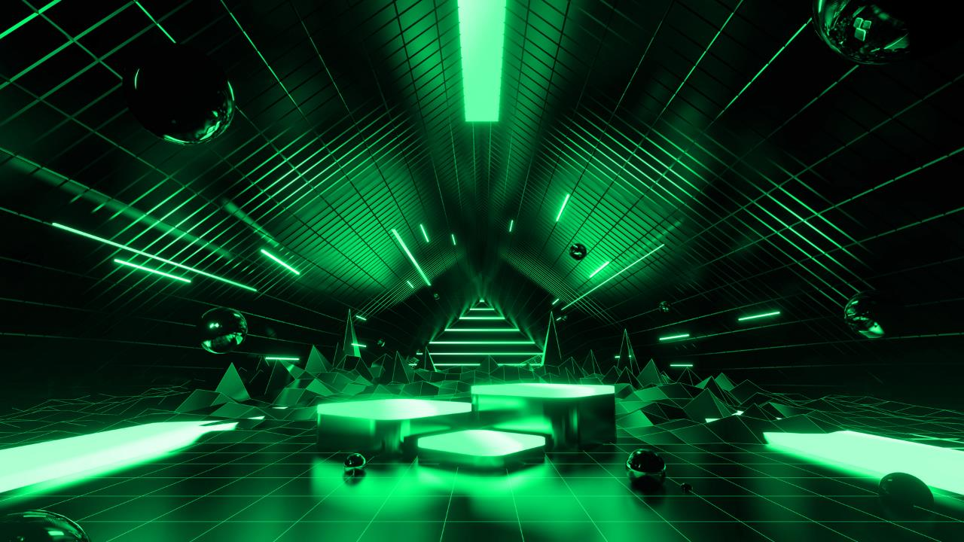
Moments
Moments are digital "anchors" composed of photos, videos, texts and/or audio, downloaded on a timeline.
Moments, fictional or real, can be sold to a group of people through NFT technology. These moments are monetizable in a granular way depending on the number of unique copies created.
Skins
Skins are digital assets for customizing the appearance of timelines and/or their environment to give them a unique look and feel.
These assets can then be sold according to the desires of other users on the integrated marketplace.

Slide 19
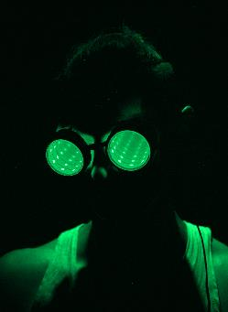

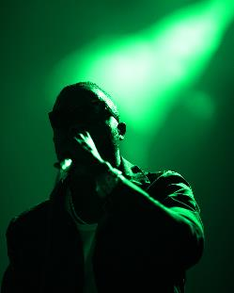
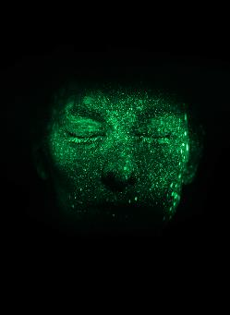
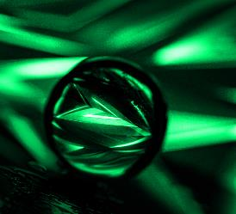
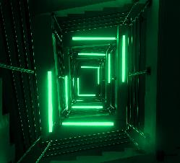
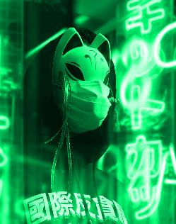


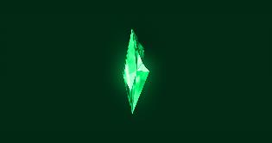
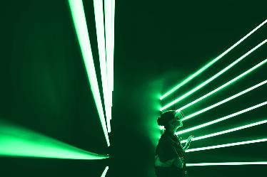
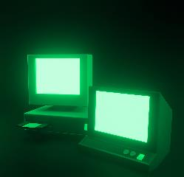
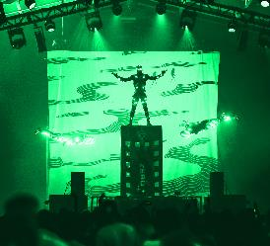
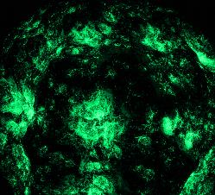
Purchase and
resale of NFT
Every accessible moment on a timeline will be monetizable and anyone with access to a timeline will have the opportunity to acquire one or more of those moments.
Once a moment is purchased, a stamp of ownership will be visible on the Moment, which will make it possible to know who the holder is. It may also be resold.
As for the buyer, all the moments purchased will appear in a personalized space, called "Museum", within his micro-metaverse. He will then have the choice to give access to this space to designated users and thus make it either private or public.
Skins
It will also be possible to buy NFTs to customize your ship, your home, your lobby, your timeline room, your timelines and style the appearance of the moments. These NFTs are more specifically called "SKINS".

Slide 20

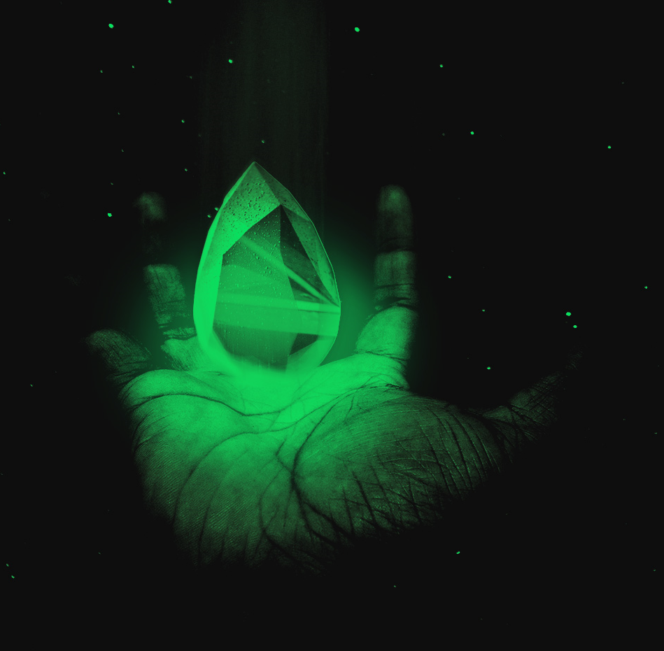


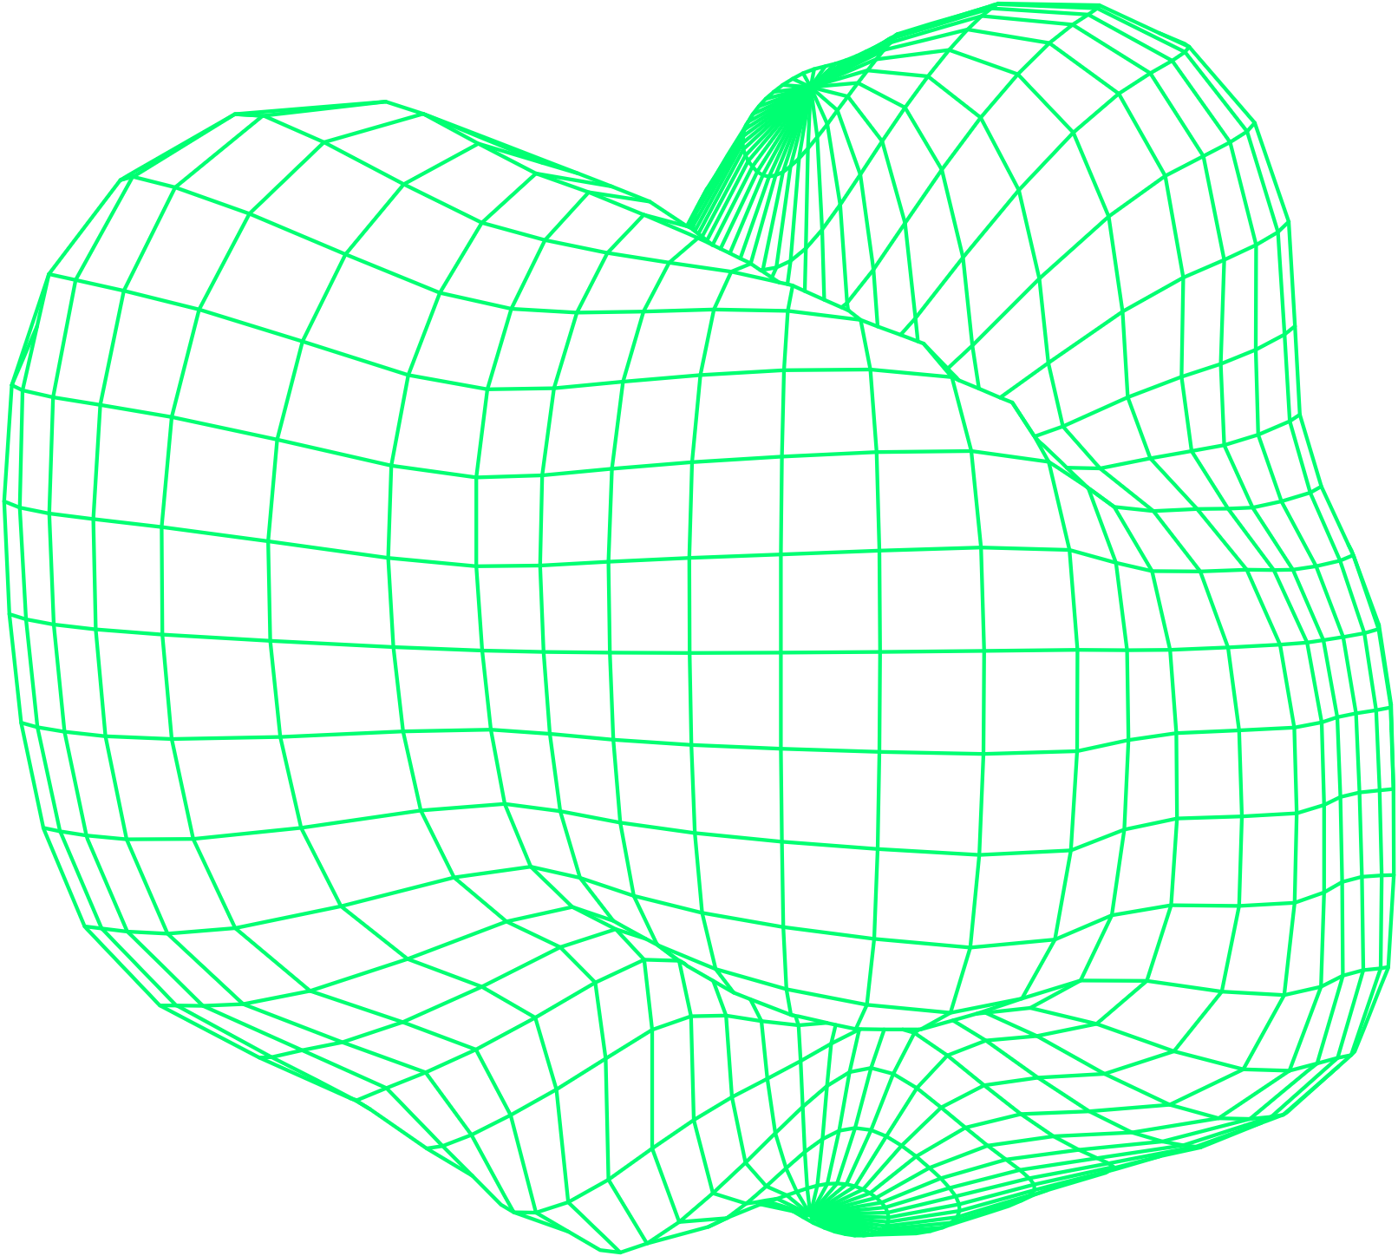
Private Collection
LIFESTORY Private Collection offers exclusive access on the market place to collector's products, rare moments to collect in limited edition or preview.
To become a Private Collector, the user must hold LIFC tokens above the minimum threshold of $20,000 in LIFC in a special section of their in-app wallet, called LIFE Safe.
A second method to access the status of Private Collector is to provide the evidence of receipt of an invitation to become a Private Collector. These invitations can only be sent by existing Private Collectors, and are only valid for access to the Private Collections for a limited period of 30 days.
Private collector users have privileged access to sales of digital or non-digital products in priority depending on the amount of LIFC present in their LIFE Safe.

Slide 21



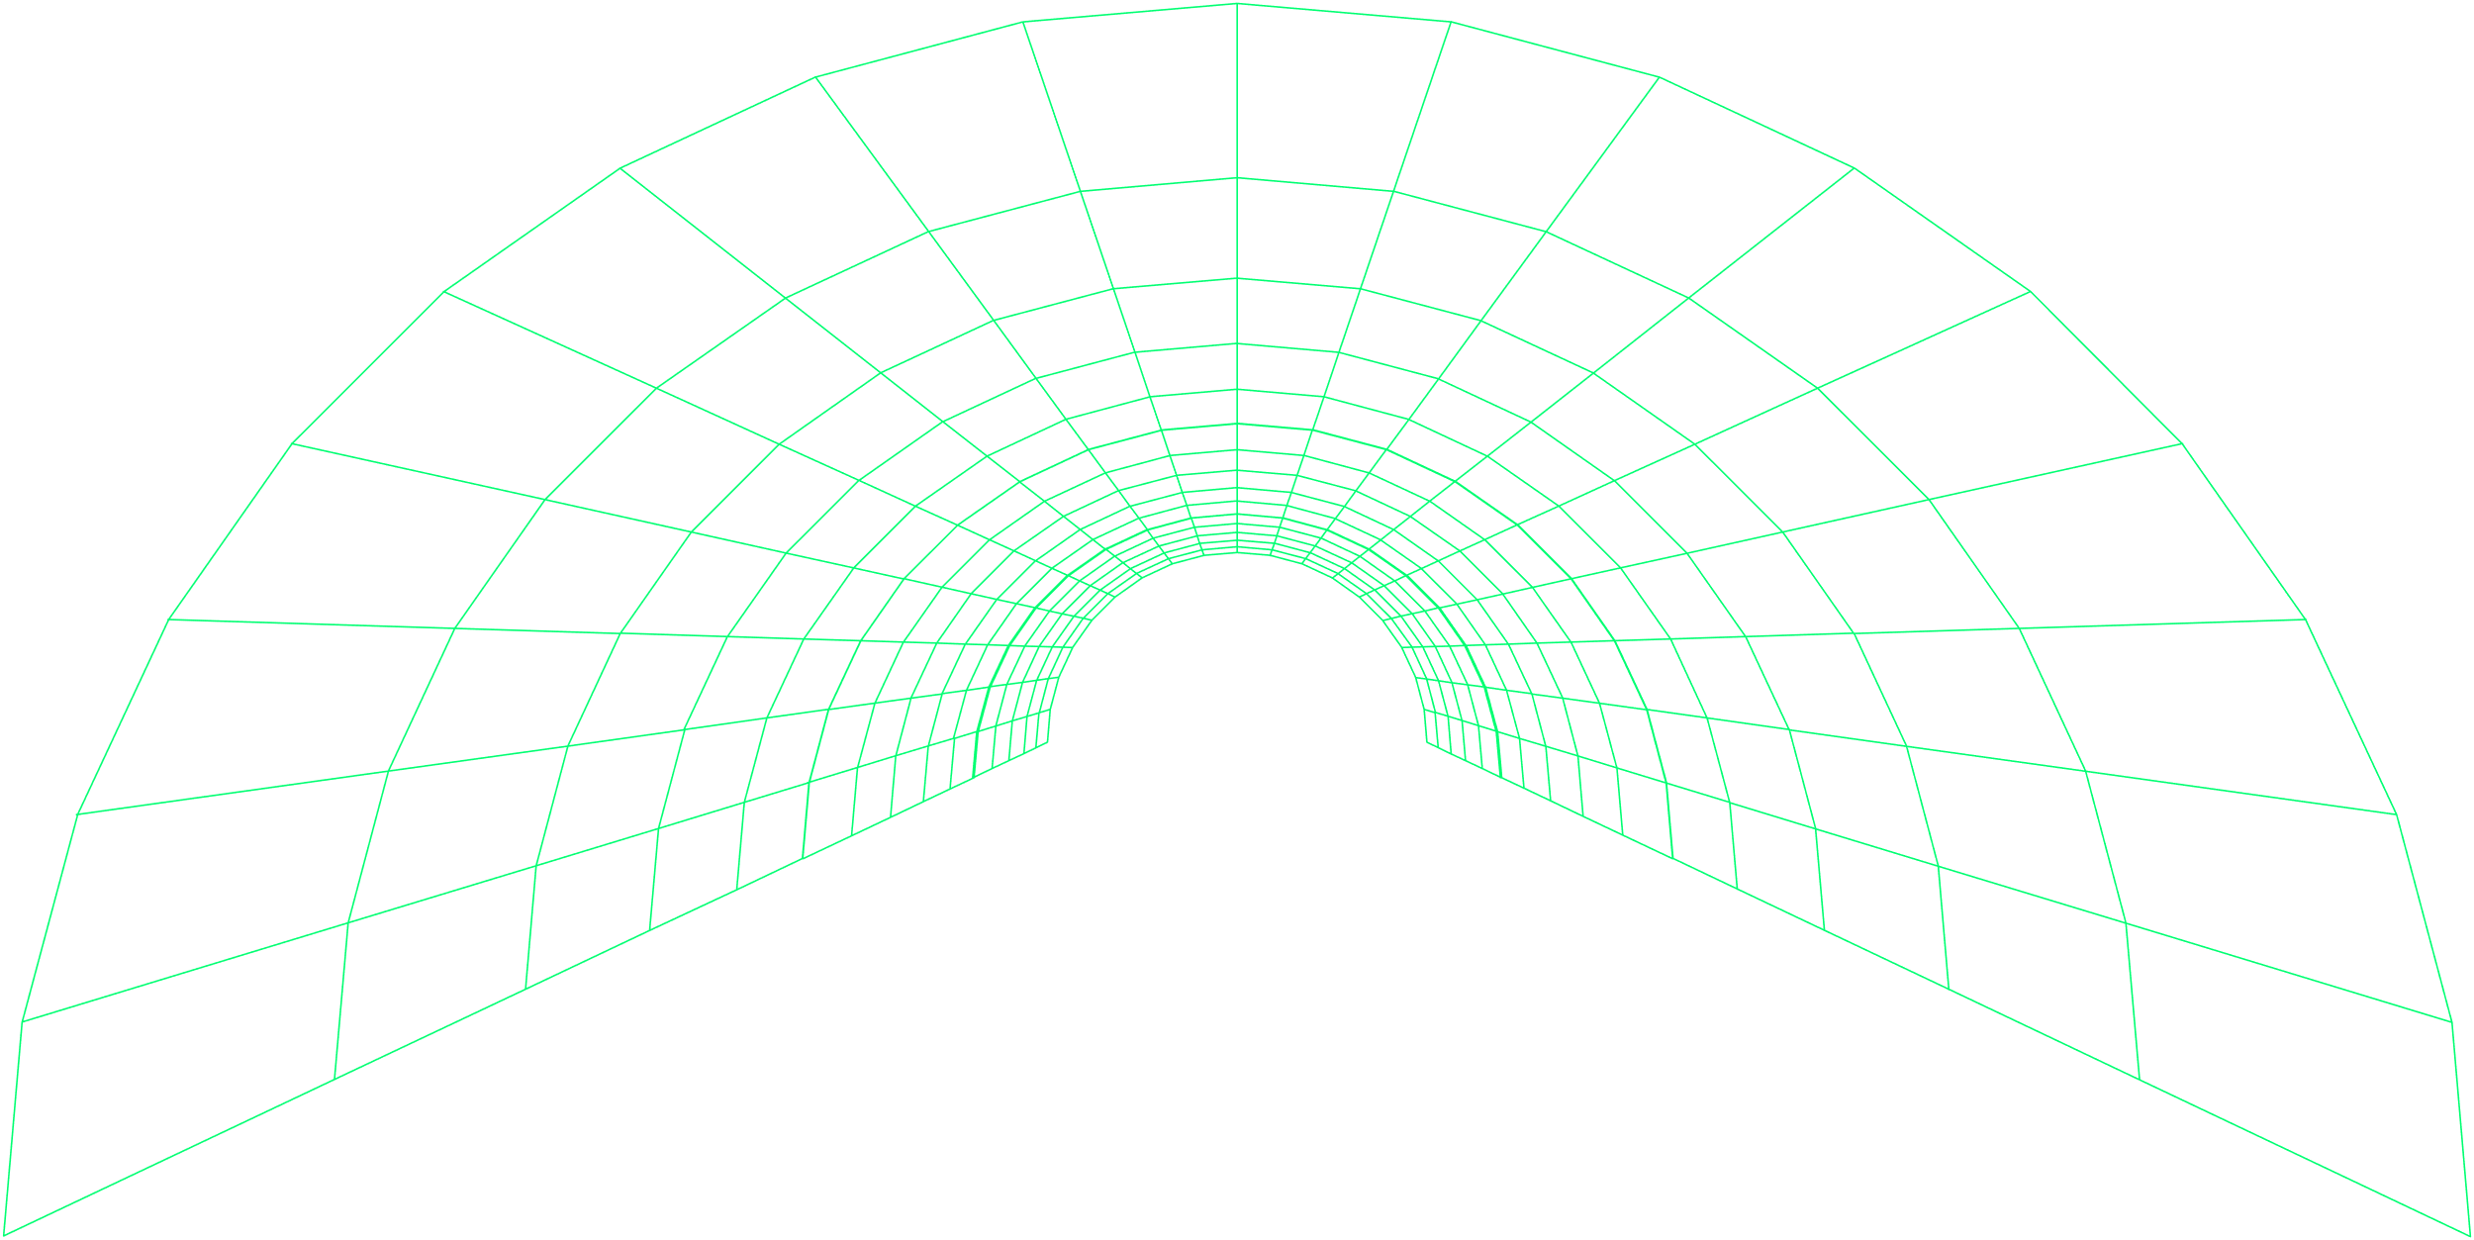


Business model
Lifestory operates on a commission system on transactions taking place on the platform.
The majority of the value created within the platform is therefore redistributed directly to the creators.
Verified Accounts
Standard Sale
SAAS
Accounts verified and validated by Lifestory that have benefited from the intervention of Lifestory's Timeline Manager will be commissioned at 32% on the first sale and 5% on subsequent sales.
All NFTs sold by standard accounts and created by users without Lifestory's intervention will be commissioned
up to 5%.
A monthly subscription will be possible for the creation of NFT and will reduce Lifestory's commission to 1% per transaction.
Royalties
All creators of NFT will be able to choose the amount of Royalties they will receive with a maximum of 15% and without time limit.
They will nevertheless have to define their royalties at the time of the creation of the NFT because these will no longer be modifiable thereafter.
*Managers dedicated to the complete management of timelines and the creation of NFt's of celebrities or brands

Slide 22
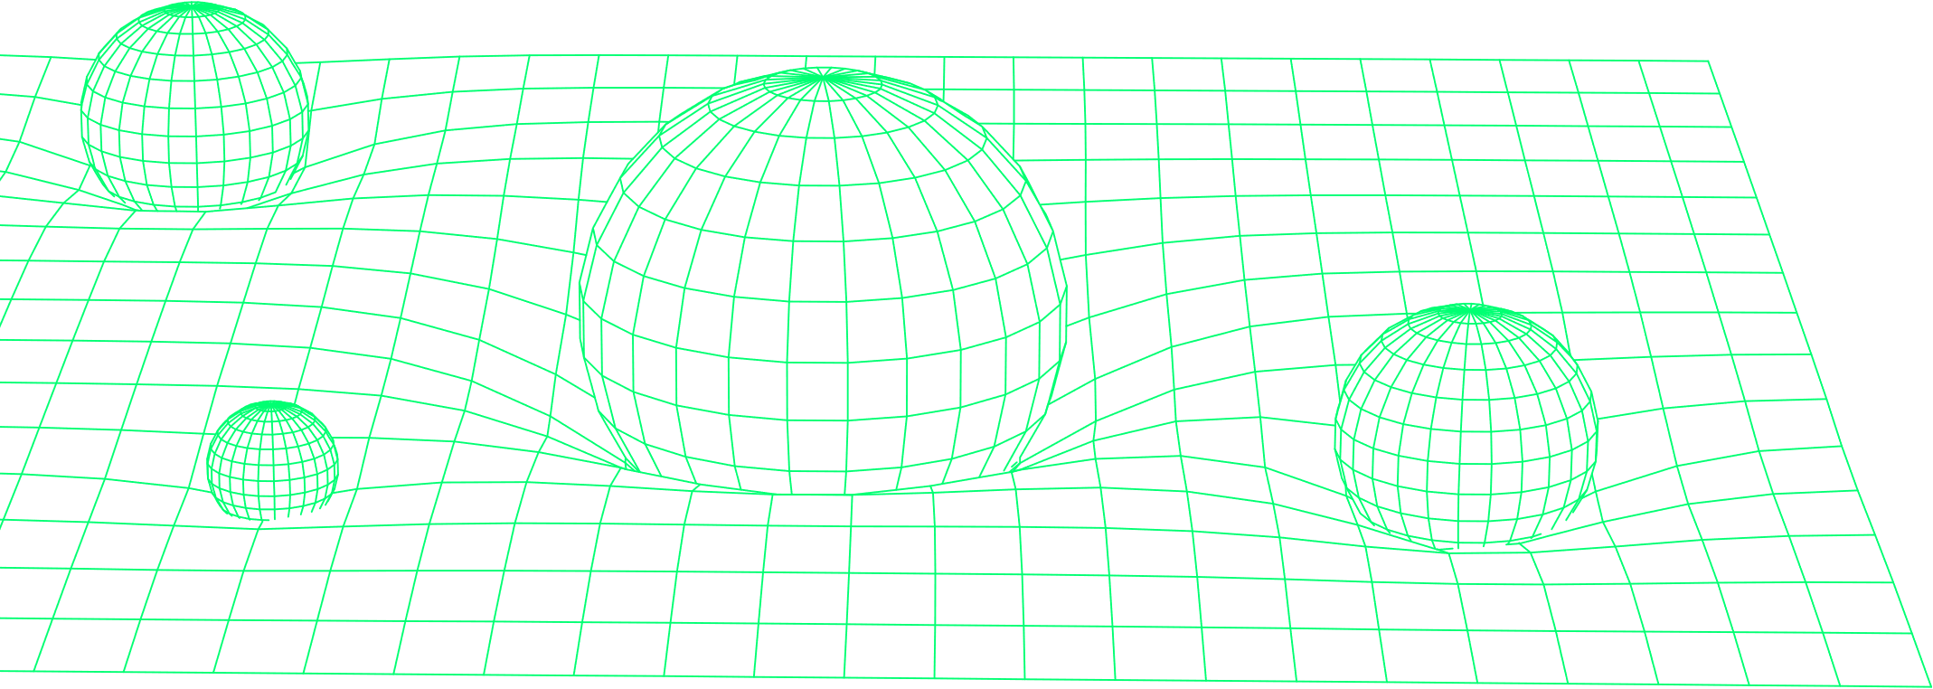
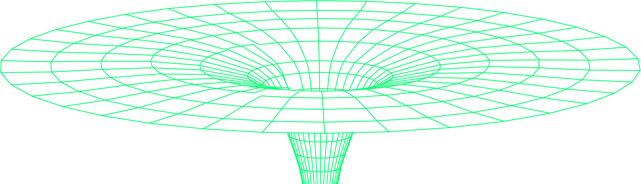
The token: LIFC
Token Utility
LIFC tokens will be created and offered as rewards during the various collection sales of Lifestory to support and fuel all transactions taking place in the Lifestory ecosystem.
The maximum offer is limited
to 1,000,000,000 (One billion)
of LIFC.
The LIFC will serve as a medium of exchange to purchase and resale
NFT's in the Lifestory ecosystem.
It will provide access to:
Discounts on the purchase of Skins depending on the number of tokens staked.
Discounts on the purchase of NFT's compared to the FIAT equivalent.
The private collection for the purchase of exclusive NFT’s.
It will also:
ACCESS TO PASSIVE INCOME IN $LIFC
via the repayment of a percentage of the transaction fees taking place in the Lifestory ecosystem (Smart-stacking program)
SMART-SHARE
Redistribution of value in a possible IPO after the creation of the LIFSTO* security token.
*Security token under study allowing the tokenization of part of the company's capital.

Slide 23

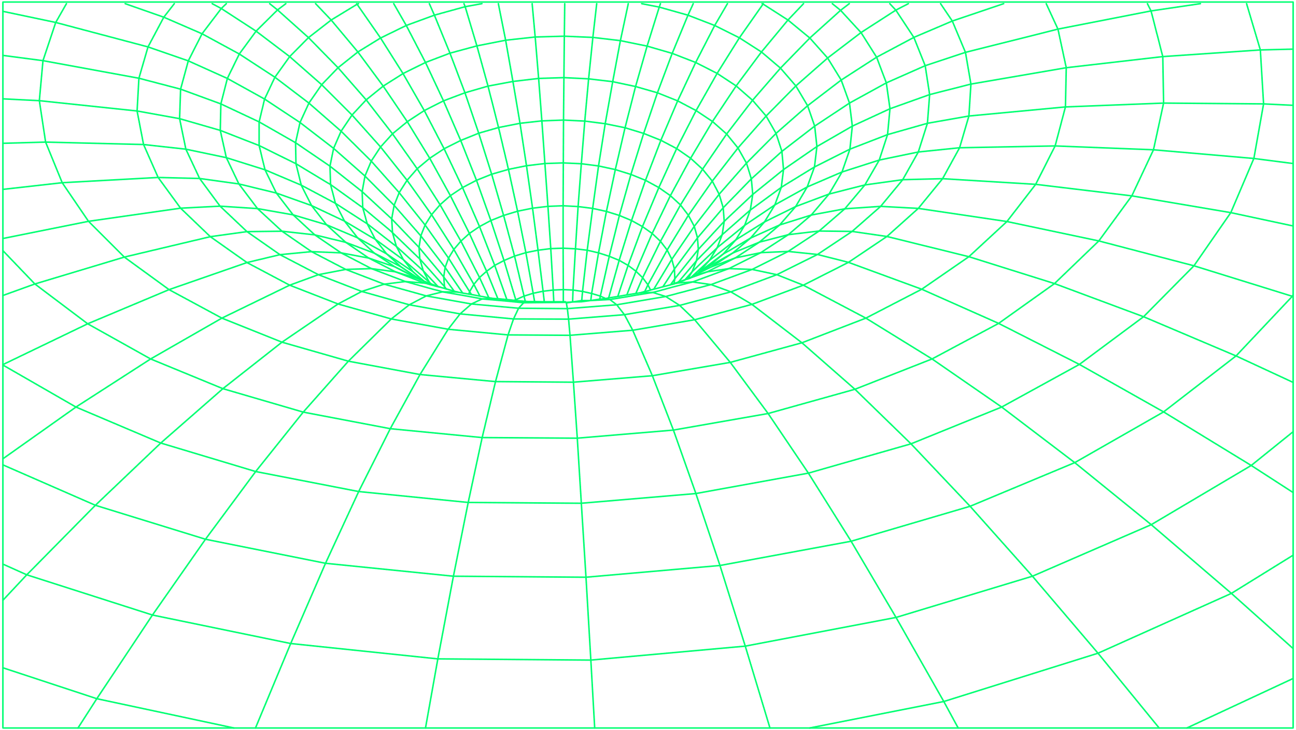
SmartStaking
Each STAKED LIFC token will be multiplied by the corresponding multiplier to determine the pro-rated share. For example:
Smart Staking is a mechanism that allows people who use staking to benefit from 1% of the transaction fee in proportion to $LIFC staked.
In order to encourage staking in the long term, a multiplier will be applied to the different staking pools.
Thus, longer staking periods will give a higher multiplier.
There will be pools of 30 days, 90 days, 180 days, 365 days and 730 days with multipliers of 1X, 1.3X, 1.5X, 1.8X and 2.0X.
If a quarter generates $4,000 in transaction fees
to redistribute and there are 6 portfolios, distribution will be as follows:
WALLET A
WALLET B
WALLET C
WALLET D
WALLET E
WALLET F
100 tokens
325 tokens
200 tokens
150 tokens
250 tokens
370 tokens
Unstaked
Pool staking 30d
Pool staking 90d
Pool staking 180d
Pool staking 365d
Pool staking 730d
MULTIPLIER 1X
MULTIPLIER 1,3X
MULTIPLIER 1,5X
MULTIPLIER 1,8X
MULTIPLIER 2X
NOW THE TOKENS ARE MULTIPLIED BY THE MULTIPLIER TO DETERMINE THE POINTS.
100 x 0
0 points
325 x 1
325 points
200 x 1,3
260 points
150 x 1,5
225 points
250 x 1,8
450 points
370 x 2
740 points
There are 2000 points in total on all wallets and each "point" receives $2 at the end of the month.
Portfolio A receives $0, Portfolio B receives $650,
Portfolio C receives $520, Portfolio D receives $450, Portfolio E receives $900, and Portfolio F receives $1480.
This is because holding more tokens and stacking them for longer, results in a higher amount of transaction fees.

Slide 24



Conventional Staking
Smartbacking:
Deflationary economy
In addition to this advantage, simply staking the LIFC will give a percentage return, an Annual Percentage Return (APR) in LIFC.
There will be a linear* release of LIFC for staking rewards and therefore early stakers will have the advantage of higher rewards.
*chart circulating supply on demand
1% of the transaction fees will be used to buy back, occasionally, the LIFC on the markets to reduce the circulating supply.
SmartShare
Upon the IPO or redemption of Lifestory, LIFSTO will be created and each LIFC holder will be rewarded with an amount corresponding to the height of his tokenship while preserving his tokens.
Thus, the community will be able to benefit from it through a conversion modality.
In addition, these LIFSTO may be converted into fiat currency after the IPO or the purchase of the company.

Slide 25

Tokenomics
Token distribution/allocation
NFT Public Sale
NFT Private Sale
NFT Presale
Team
Marketing
Staking + Liquidity Reserve
Development
Advisors
Airdrop
40%
7%
6%
10%
10%
17%
4%
4%
1%

Slide 26
Vesting and Cliff periods
Phase 1: Private Sale
Phase 3: One-month public sale
4%
of the management team’s, advisors’ and private sales investors’ allocations will be distributed at the TGE.
ROUND 1
10%
Cliff
10% / month
of the pre-sale investors’ allocations will be distributed at the TGE.
No
will be unlocked until all tokens are distributed over a period of 9 months.
96%
of the remaining tokens are subject to a 12-month lock-up period and 3% will be released each month until all tokens are distributed.
ROUND 2
10%
Cliff
10% / month
of the presale investors' allocations will be distributed at the TGE.
No
will be unlocked until all tokens are distributed over a period of 9 months.
Phase 2: Presale
7%
of the investors’ allocations will be distributed at the TGE during the presale.
ROUND 3
10%
Cliff
10% / month
93%
of the pre-sale investors’ allocations will be distributed at the TGE.
No
will be unlocked until all tokens are distributed over a period of 9 months.
of the remaining tokens are subject to a cliff period of 12 months. Finally, 3% will be unlocked each month until all tokens are distributed.

Slide 27
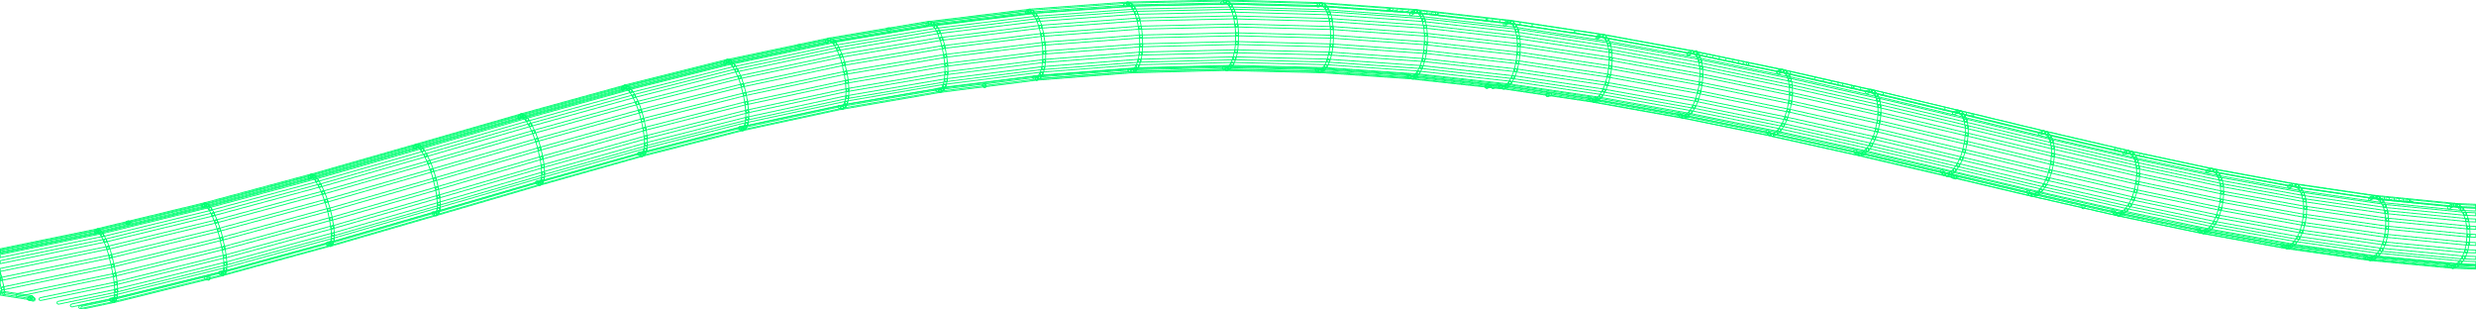
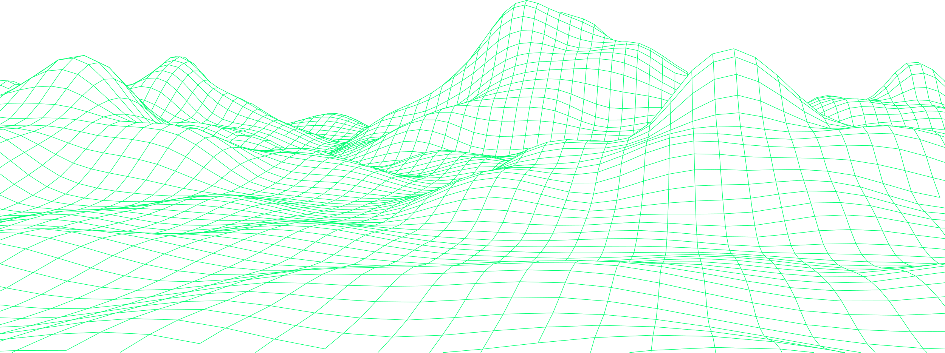
Roadmap
2022
2023
Q3
Launch of second NFT collection - (Spaceships)
Q4
Listing of $LIFC on decentralized exchanges; Uniswap,etc..
Launch of third and last NFT collection - (Satellites)
Lifestory Mobile & Web app v1 release.
ListIng of $LIFC on centralized exchanges; CEX, etc
Q1
The Lifeverse (eco-system) available in Virtual Reality. VR experience through Oculus.
Q2
Launch of first NFT collection
(Micro-Metaverse)

Slide 28
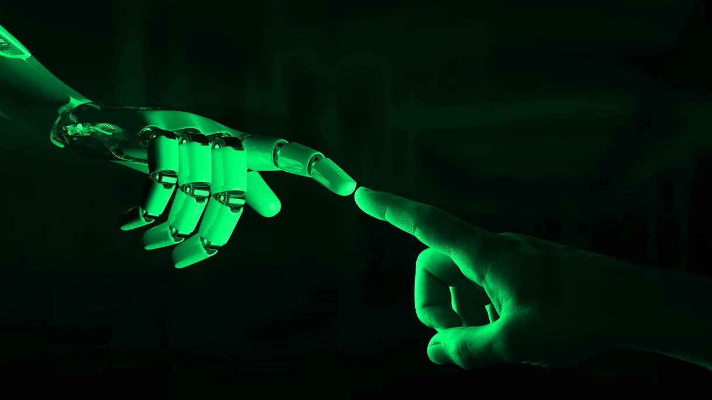
Sponsorship
The sponsorship mechanism ensures the allocation to the sponsor of 5% $LIFC equivalent per planet purchased by his godchildren, as well as an additional 5% to the godson who made a purchase.
The allocation is limited to a level of sponsorship, and the LIFC tokens thus awarded are taken from the reserve of tokens provided for this purpose and in any case within the limit of the tokens available (see tokenomics: Marketing).
Each participant will be assigned a referral code. When making any purchase made by a referral using this referral code, an amount equivalent to 5% of the value of the NFT's purchased will be credited to the referrer's account. Similarly, an additional 5% will be credited to the godson.
Example :
A has a LIFC account. B, godson of A, buys 10000 LIFC → A receives 500 LIFC thanks to B and B receives 500 LIFC as a bonus

Slide 29
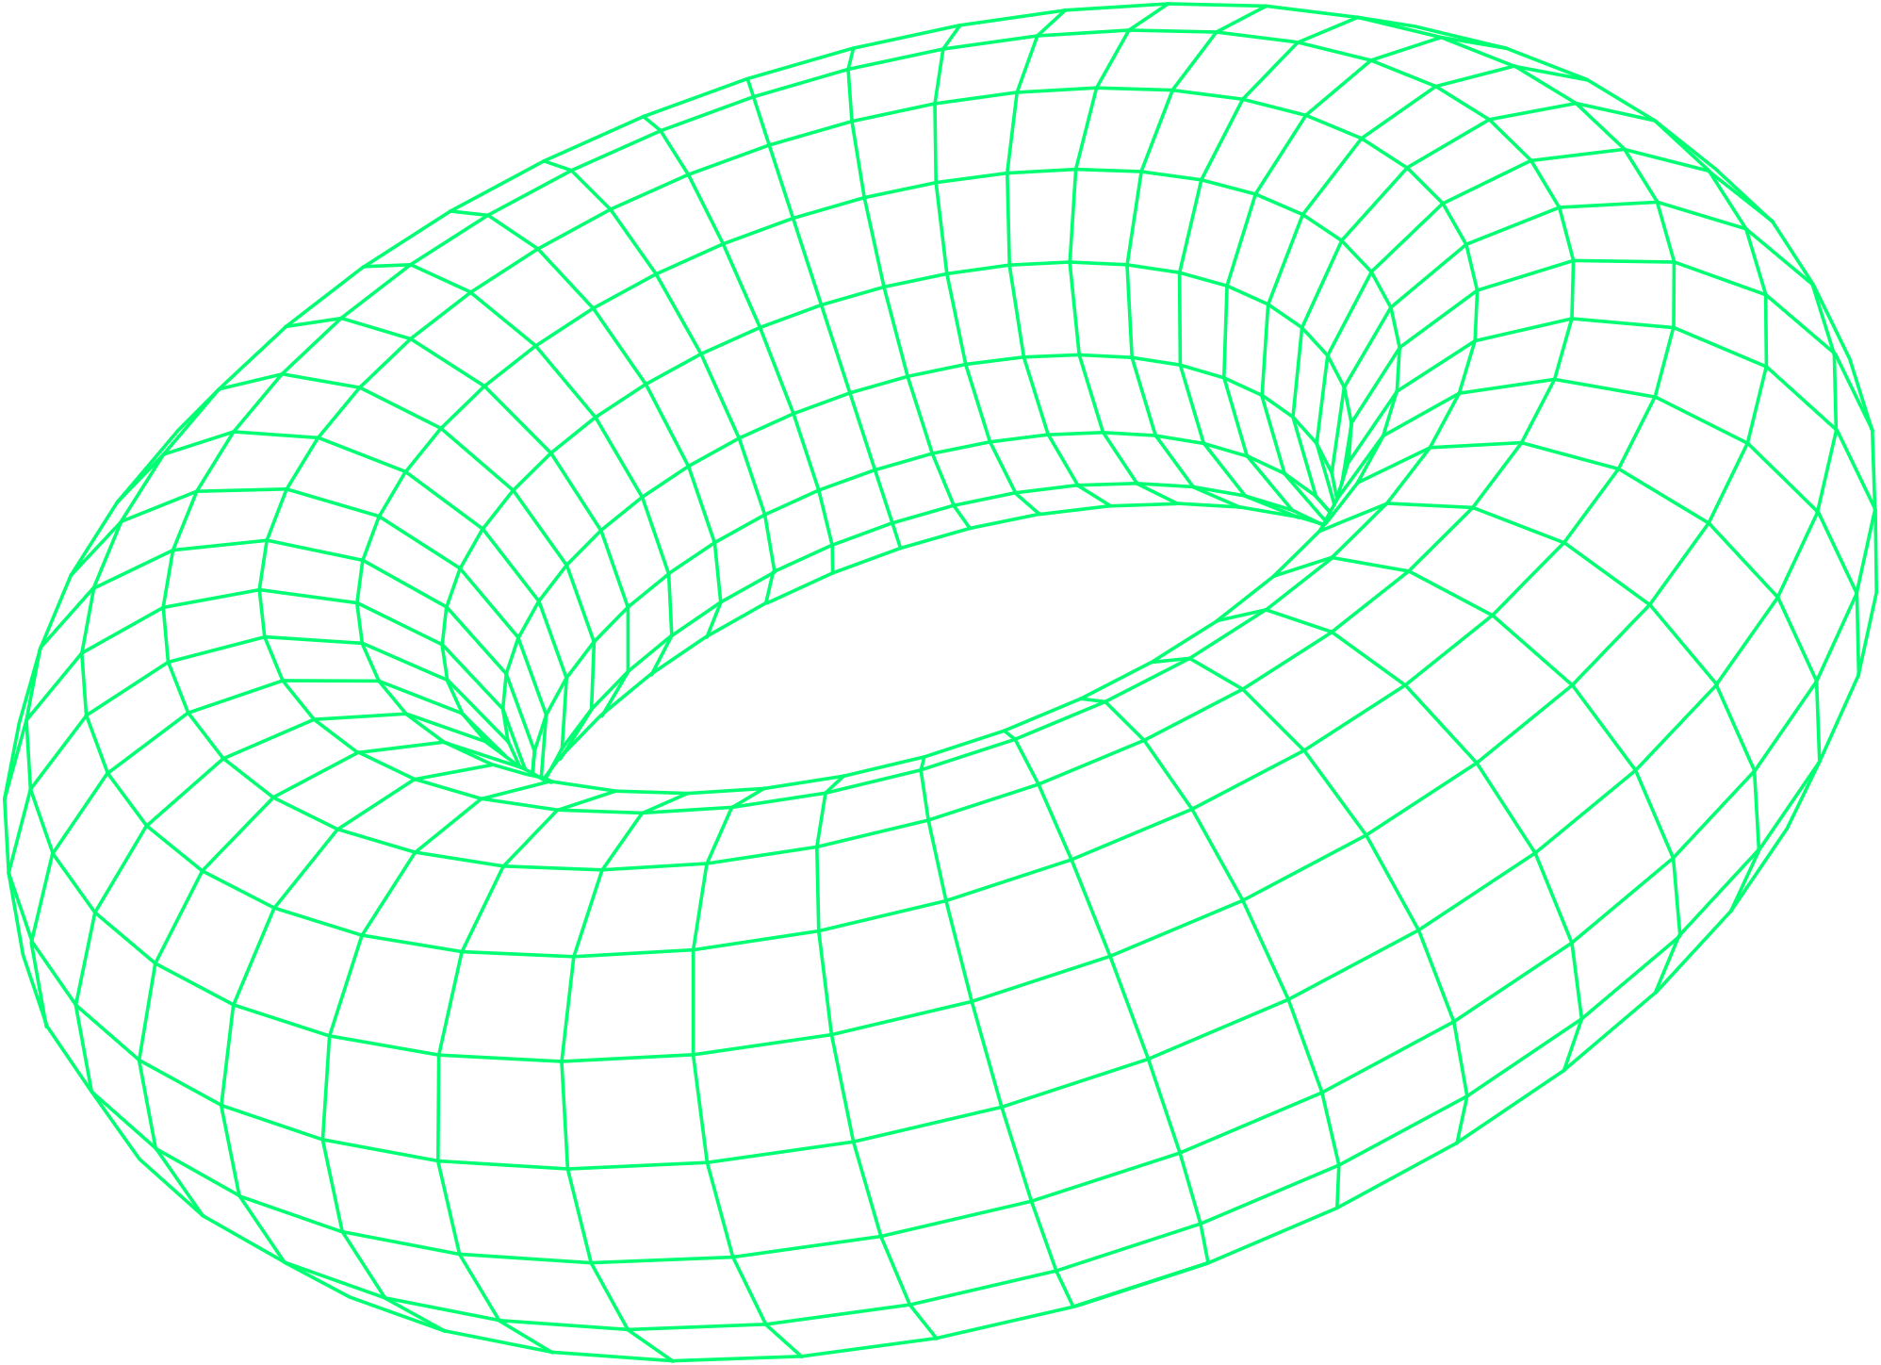
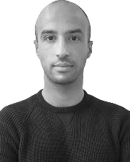





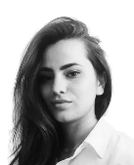



Team
Serge Gourari
Chief Technical Officer
Omar Aftat
Chief Executive Officer
Merouane Saadi
Media Buying Expert
Hamza Chairi
Chief Marketing Officer
Hamza Naqi
Finance Lead
Adel Saadi
Media Buying Expert
Yasmine Syed
Chief Operating Officer
Mohamed Kabbouri
Chief Infrastructure Officer
Shujaat Syed
Chief Commercial Officer
Abderahman Bouali
Principal Developer

Slide 30

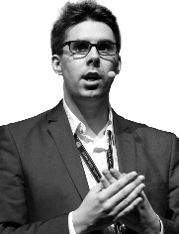





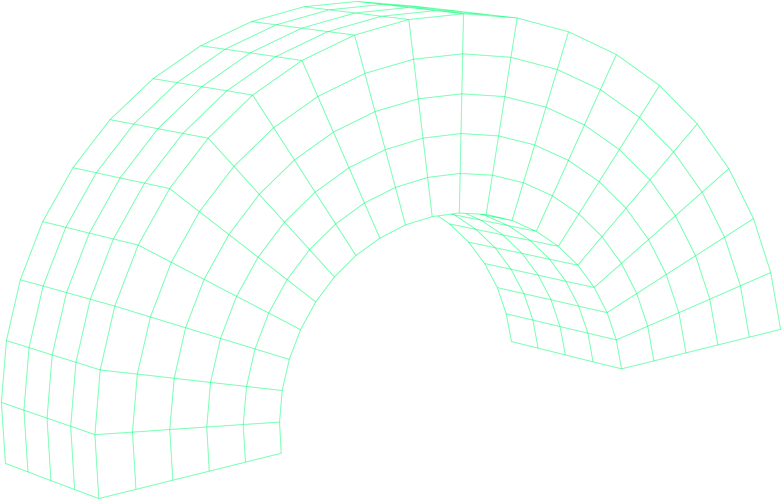
Advisors
Nicolas Anelka
Former International Football Player
Jean-Luc Verhelst
Blockchain author, speaker trainer and advisor
Thibaut Verbiest
Partner Metalaw
Internet, Fintech & Blockchain lawyer
Samy Bessi
President
of Engage Gaming
Marcus Abramovitch
Blockchain consultant
Bertrand Verlaine
Project Manager in IT
& Digital management
Mohamed ElBakkali
Financial & Partnerships Advisor

Slide 31
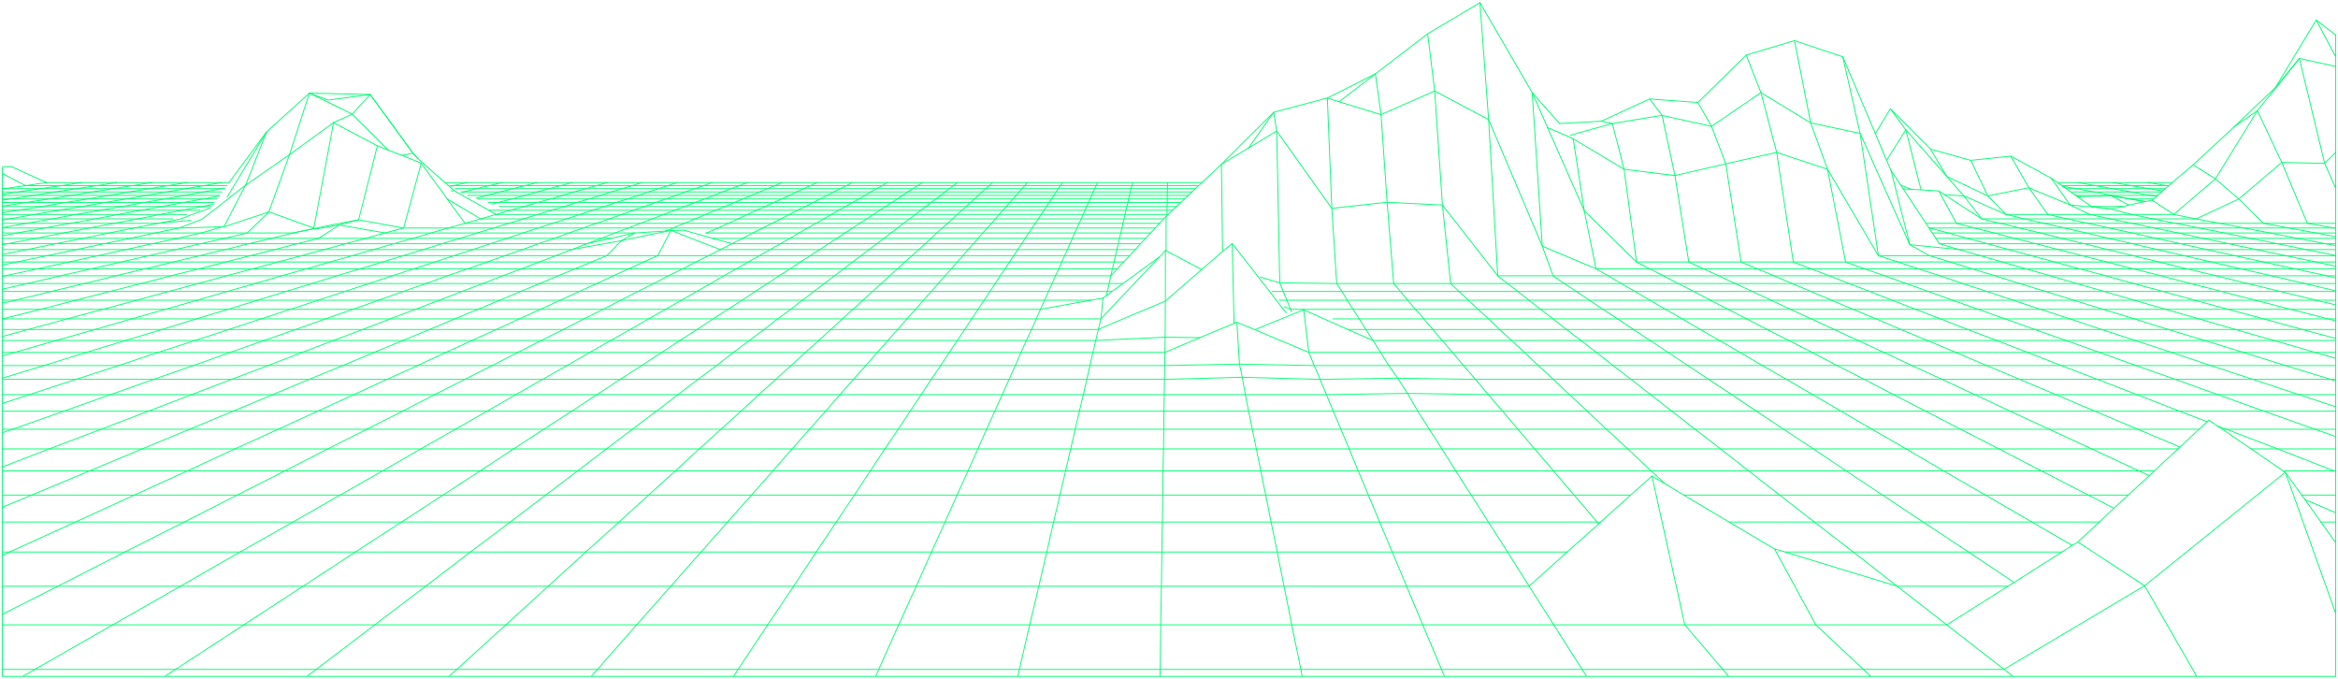
Contact
hi@lifestoryapp.com

