Slide 1




African beaches
Diapositivas : de Internet
Montadas por : Lalo
Cooperacion tecnica : Steve
Música : Oliver Mtukudzi - Dzoka Uyamwe

Slide 2
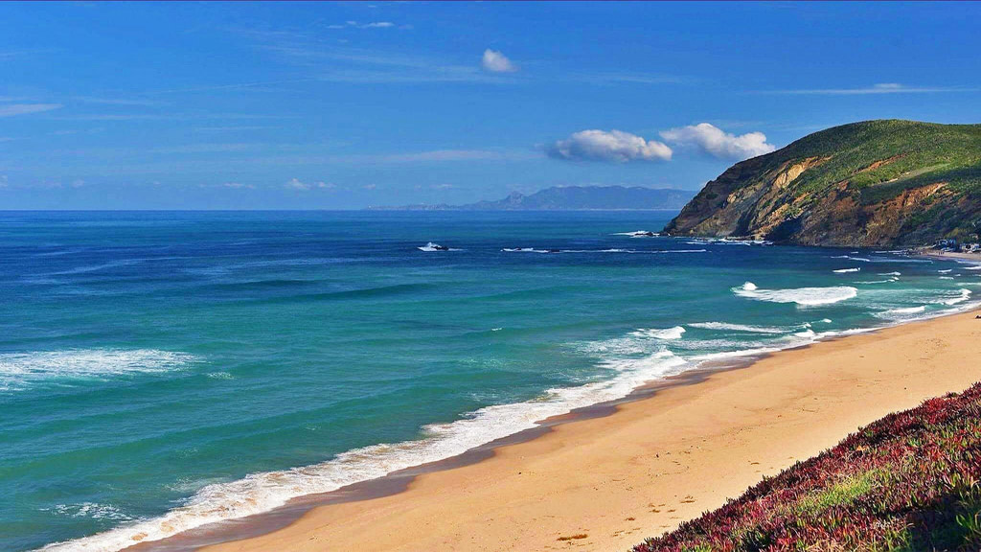
Algeria

Slide 3
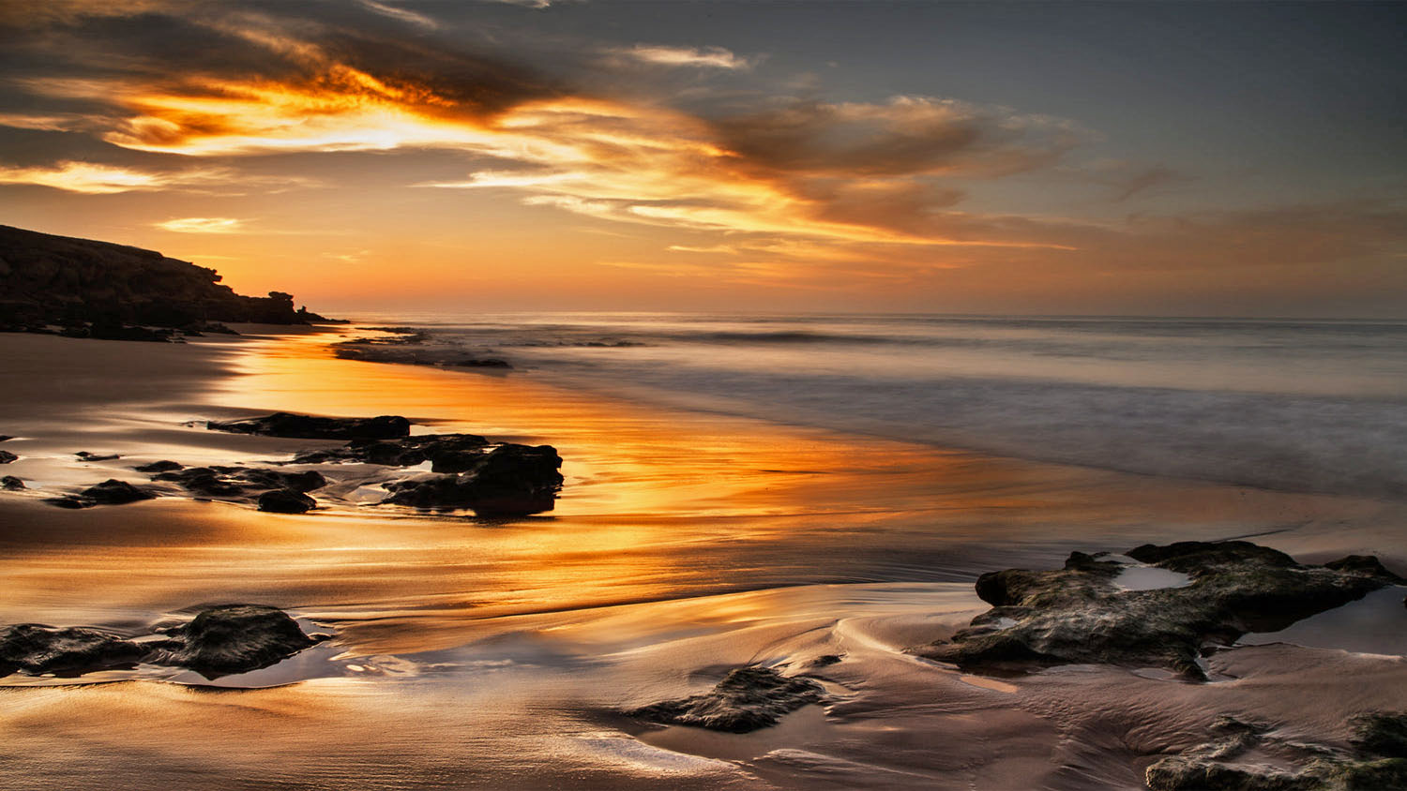
Angola
Golden hour
Photo © André Silva Pinto on 500px

Slide 4
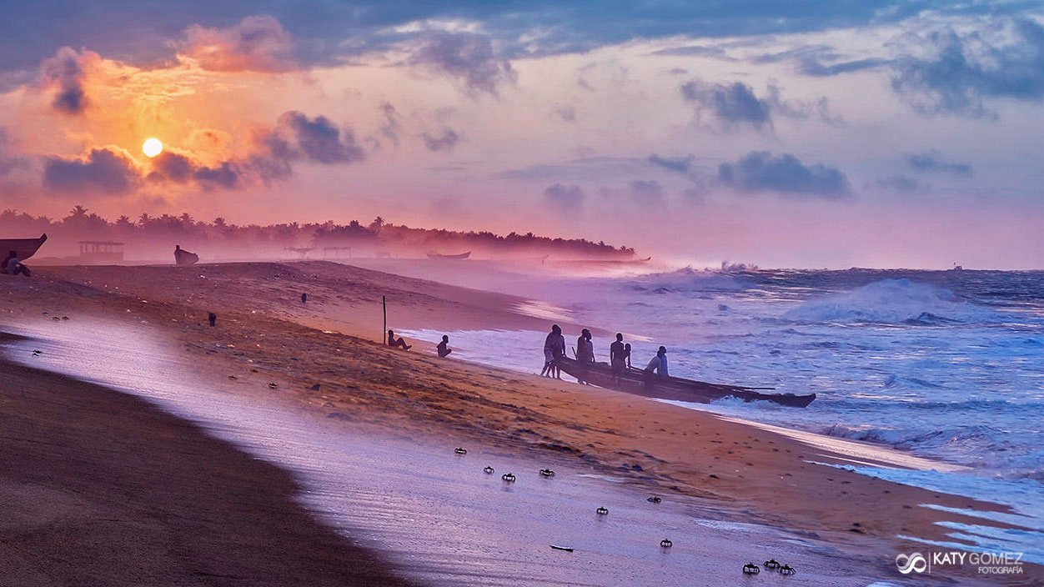
Benin
Hubo un tiempo en el que Benin y este rincón del Golfo de Guinea se convirtieron en uno de los mayores puntos del tráfico de esclavos de toda África. Una paleta cromática infinita para pintar el lienzo de la esclavitud y donde los silencios se hacen estruendosos y sacuden hasta los últimos recovecos del alma. Hoy, las traicioneras aguas del atlántico, enmarcan el duro trabajo de los pescadores de la zona.

Slide 5
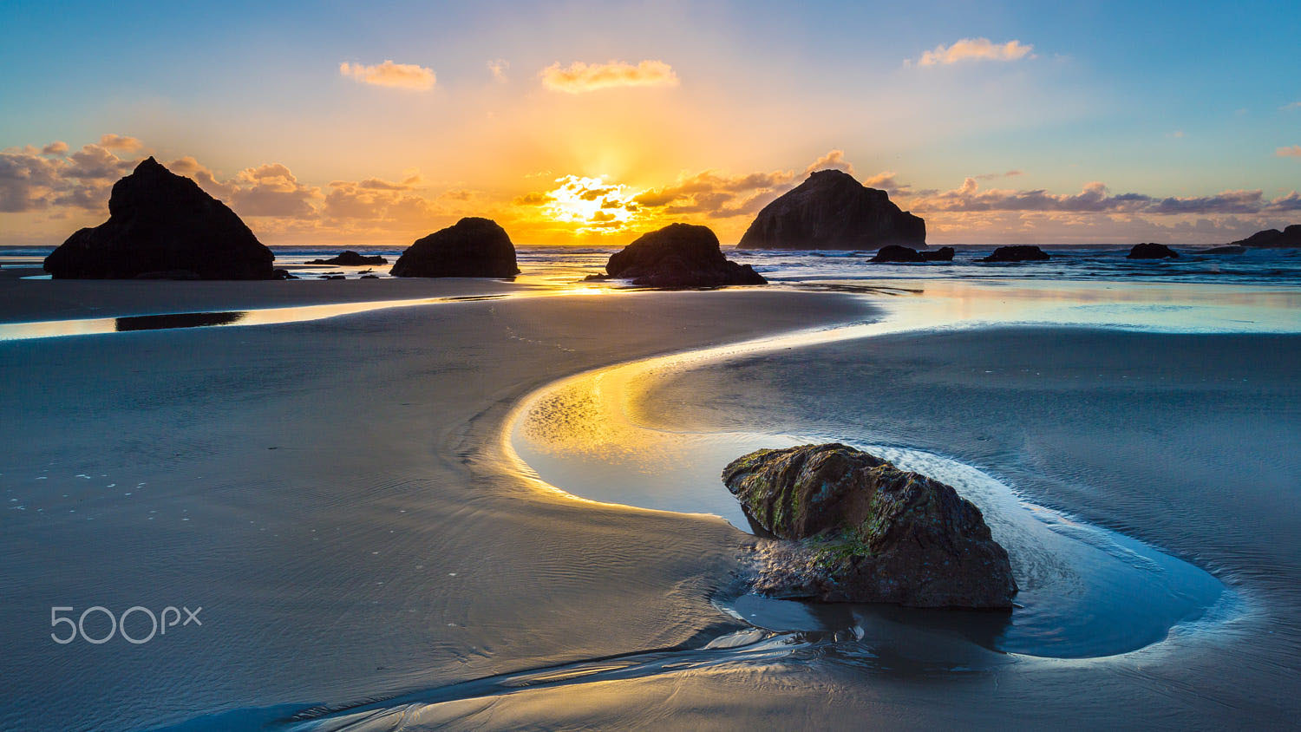
Cameroon
Sunset in Limbé's Volcanic Beach. Dark sand, volcanic rocks, atlantic ocean and a beautiful sunset. That is Limbé!
Photo © by Victor Ndende on 500px

Slide 6
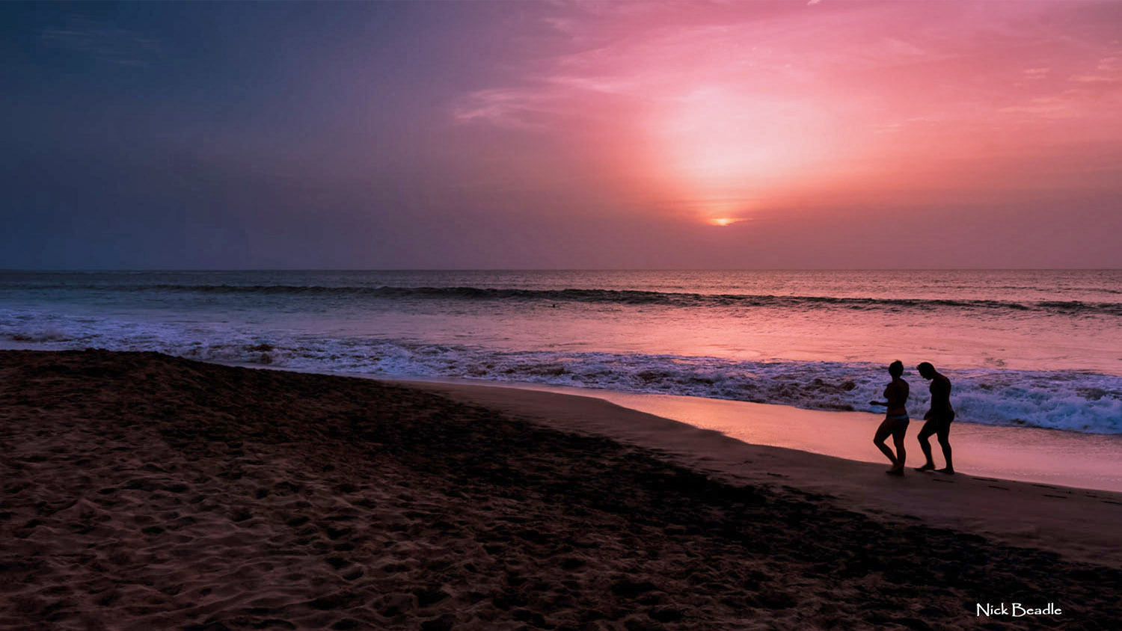
Cape Verde

Slide 7
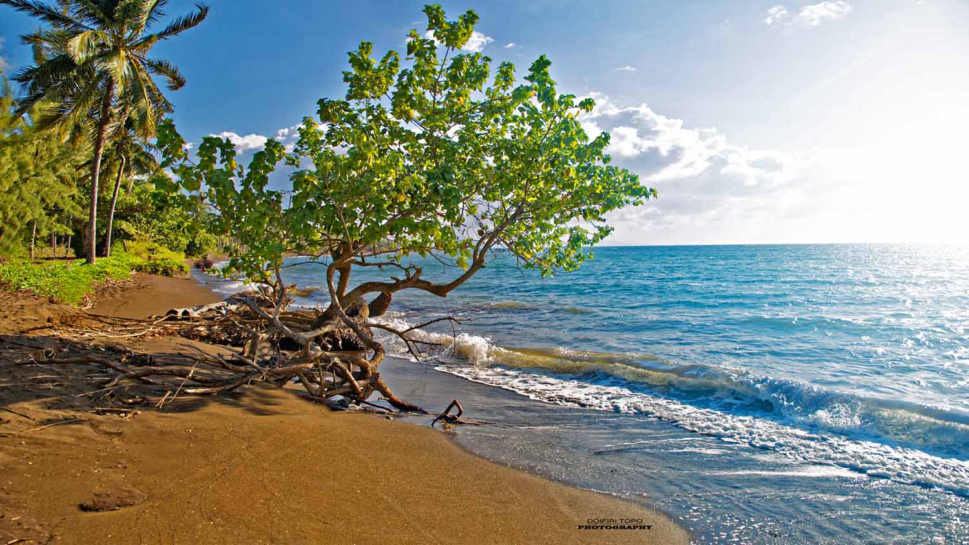
Comoros
Welcome to Comoros islands. Discover the archipelago of perfumed islands. Through its different islands, enjoy a total disorientation with landscapes to cut the breath.

Slide 8
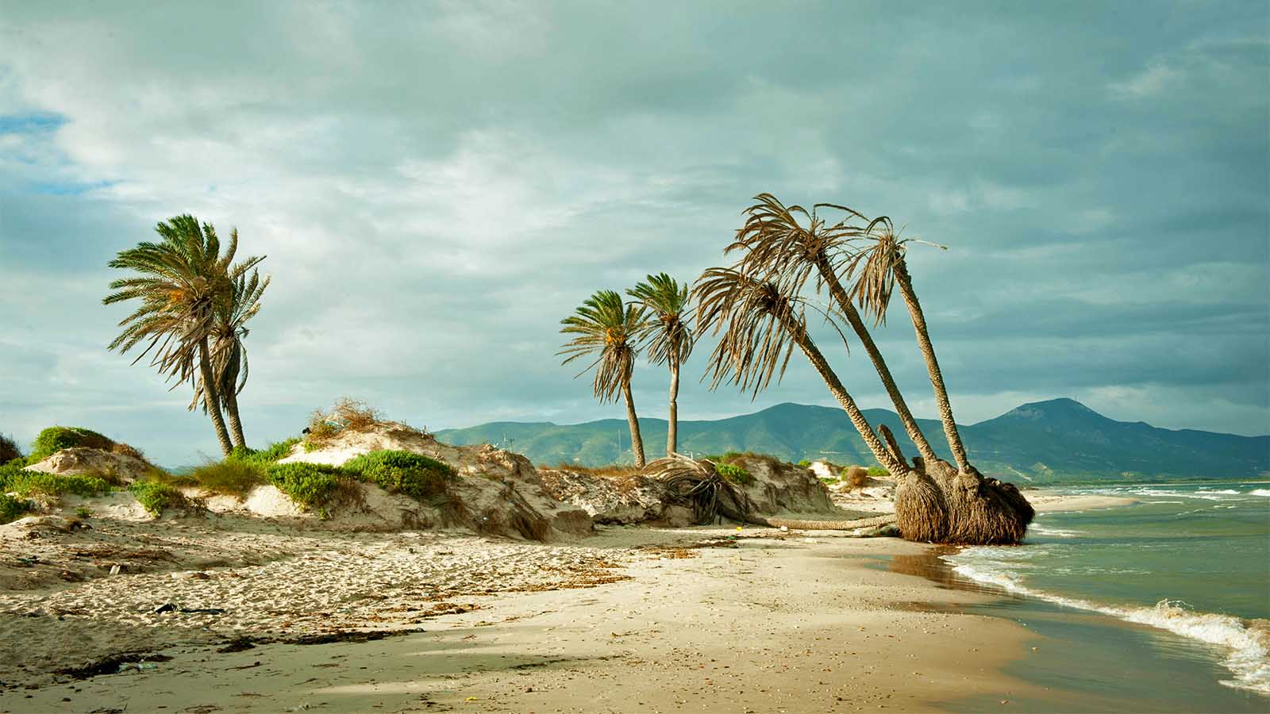
Democratic Rep. of the Congo

Slide 9
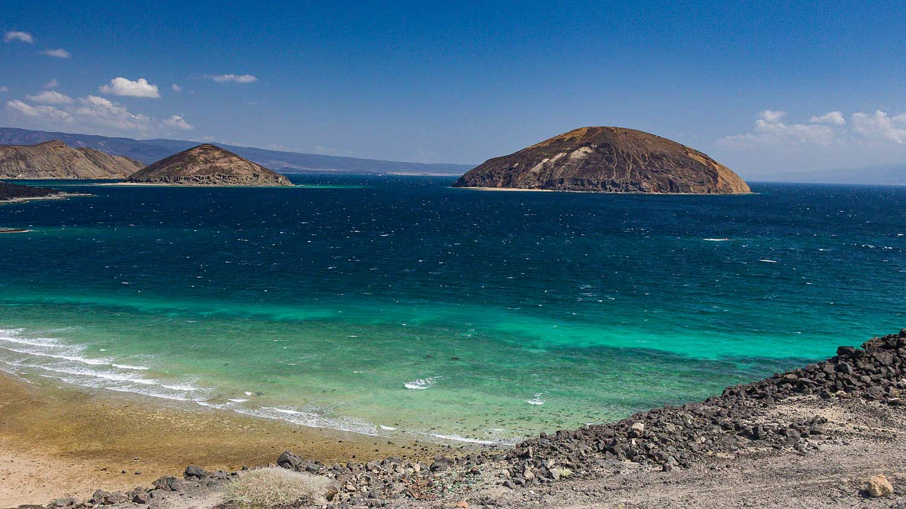
Djibouti
Le Goubet and Gulf of Tadjoura Landscape. View on the Gulf of Tadjoura with Le Goubet the Devils Rock, Djibouti, East Africa
Photo © by Elena and Roland Obermeier on 500px

Slide 10
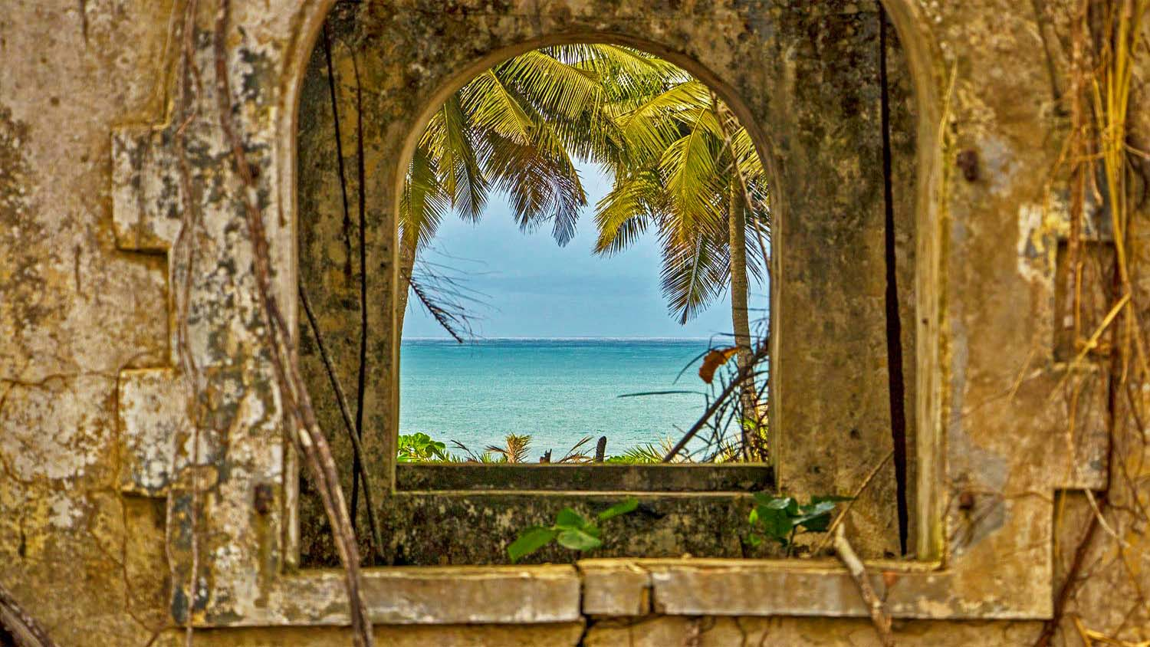
Côte d'Ivoire
La Flotte, Côte d'Ivoire. Fenêtre sur fenêtre sur mer.
Les vestiges de la maison de l'ancien gouverneur de San Pedro. Exhumée de la forêt par un passionné, les ruines sont présent visible.
Photo © by Sid Camelot on 500px

Slide 11
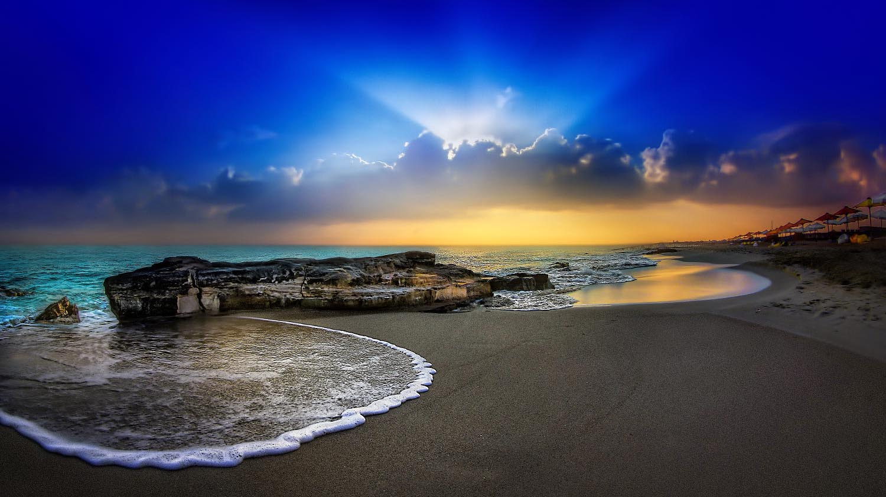
Egypt
Telal sunrise. Telal resort north coast, Egypt
Photo © by Nasser Osman on 500px

Slide 12
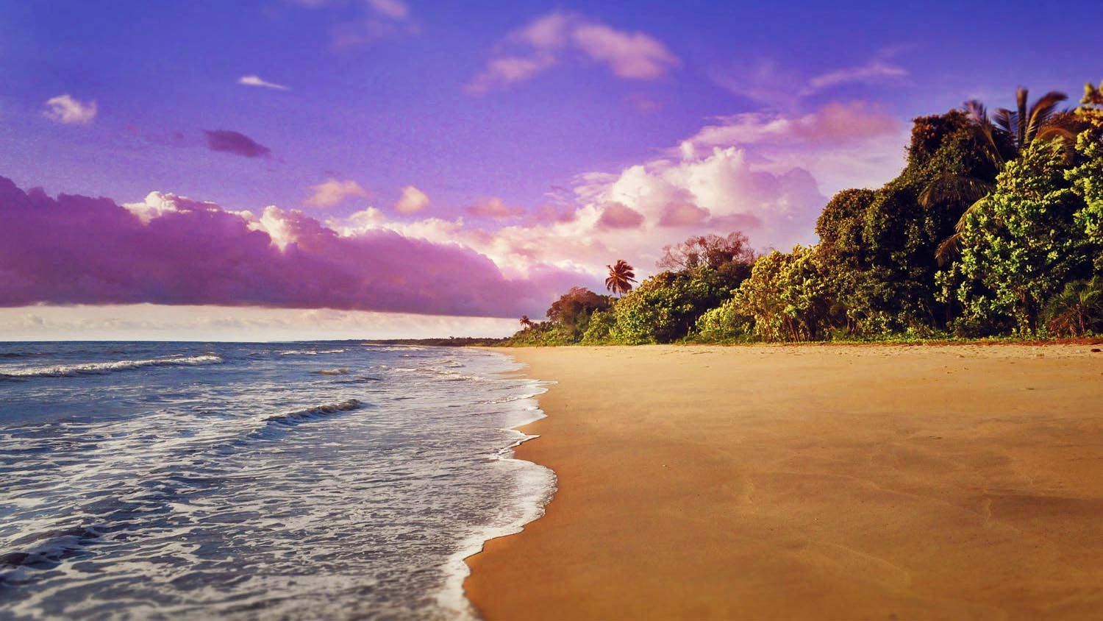
Equatorial Guinea
Bata, sunday on the beach
Photo © by Assaf Golan on 500px

Slide 13
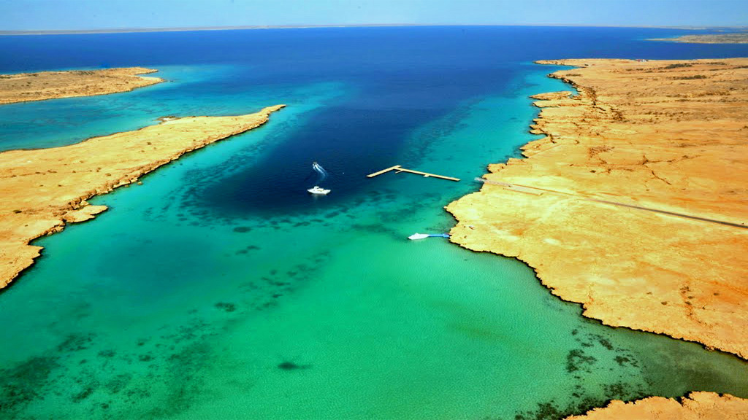
Eritrea

Slide 14
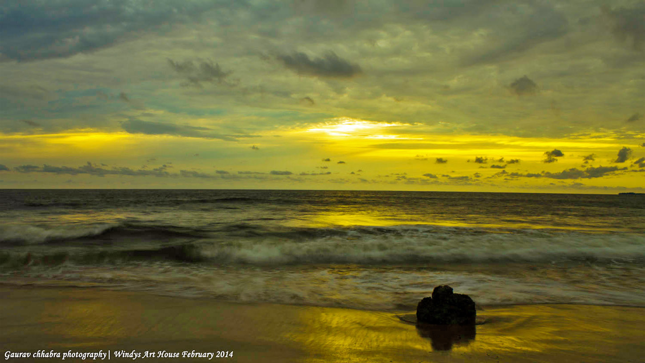
Gabon
Tropicana Beach

Slide 15
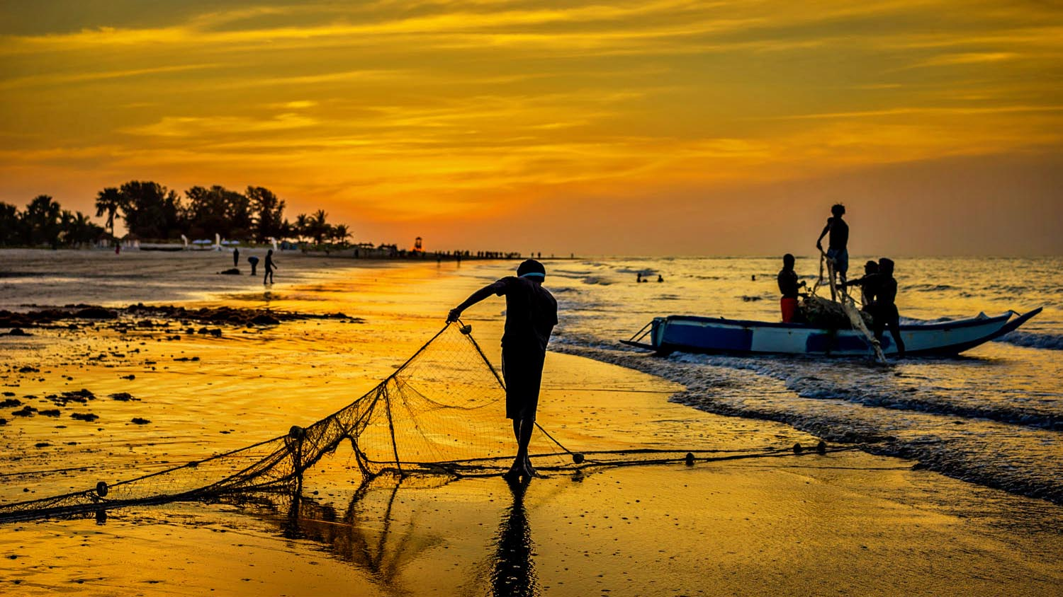
Gambia
Gambian fishermen
Photo © by Steve Baker on 500px

Slide 16
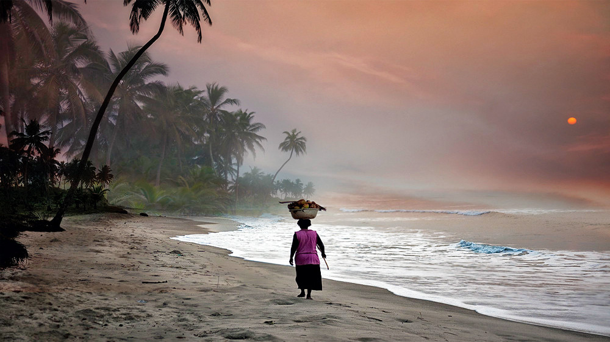
Ghana
Cape Coast, Ghana
Photo © by Salvador Sabater on 500px

Slide 17
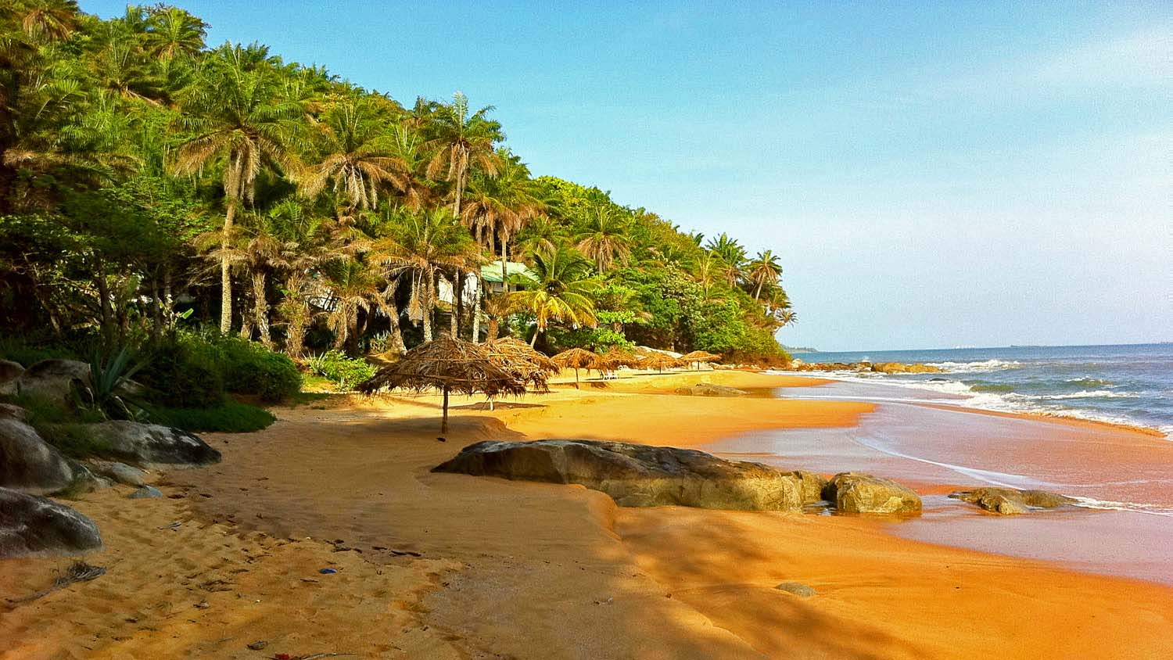
Guinea
Lazy afternoon, Roume, Iles de Los, Conakry
Photo © by John Downey on 500px

Slide 18
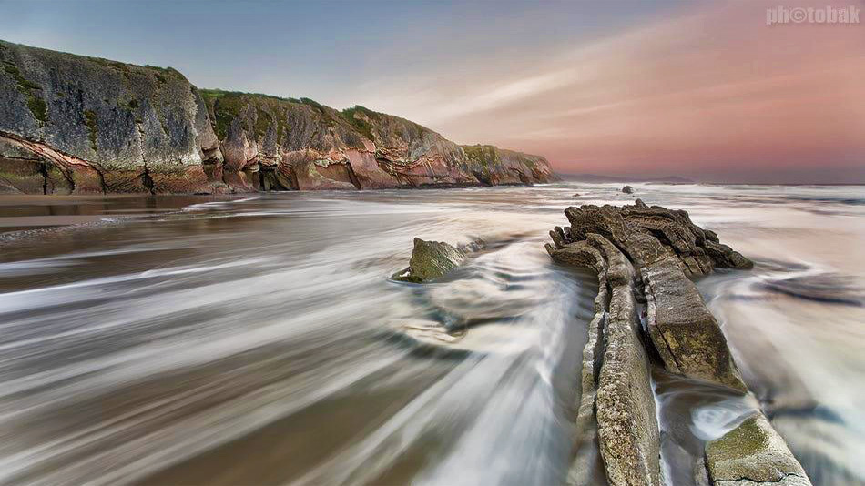
Guinea Bissau
Itzurun Beach
Photo © by Oskar Baglietto on 500px

Slide 19
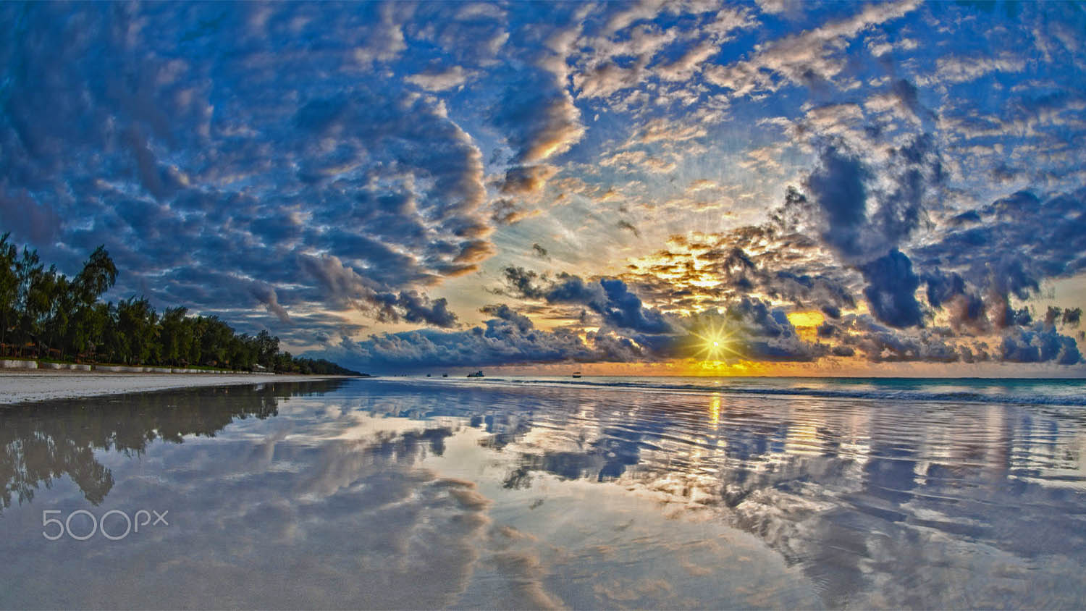
Kenya
Beach Sand Sun
Early morning on the award winning Diani Beach. I have started veering off from my wildlife photography, or rather expanding from it, as I gather more and more inspiration from all the great photos that I see on 500px. Thank you to all who so selflessly share your knowledge and experience so that those of us who wish to can learn so much !!!
Photo © by Ralph Winter on 500px

Slide 20
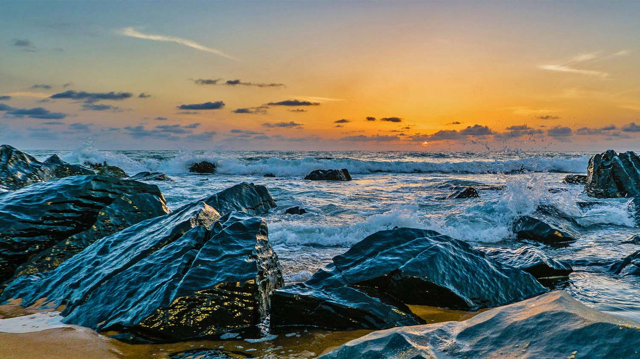
Liberia
Alok Photography
View from Golden Beach, Monrovia, Liberia
Photo © by Alok Puri on 500px

Slide 21
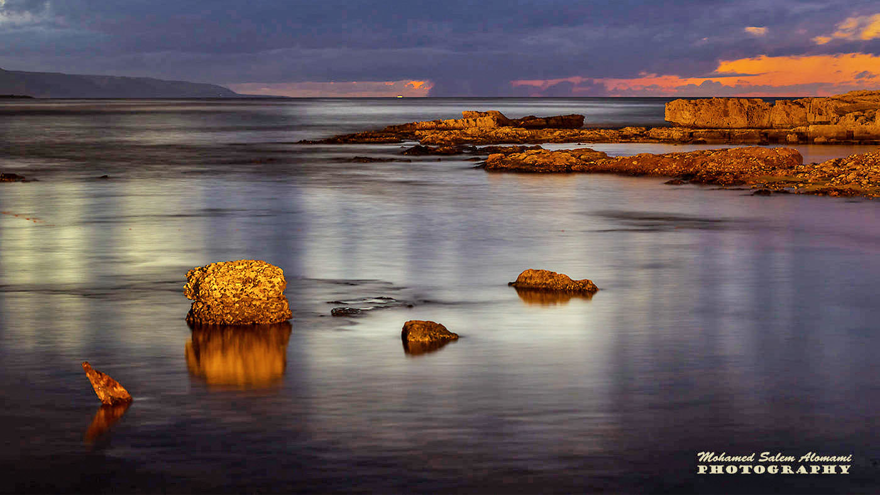
Libya
سوسة = ليبيا by محمد العمامي on 500px

Slide 22
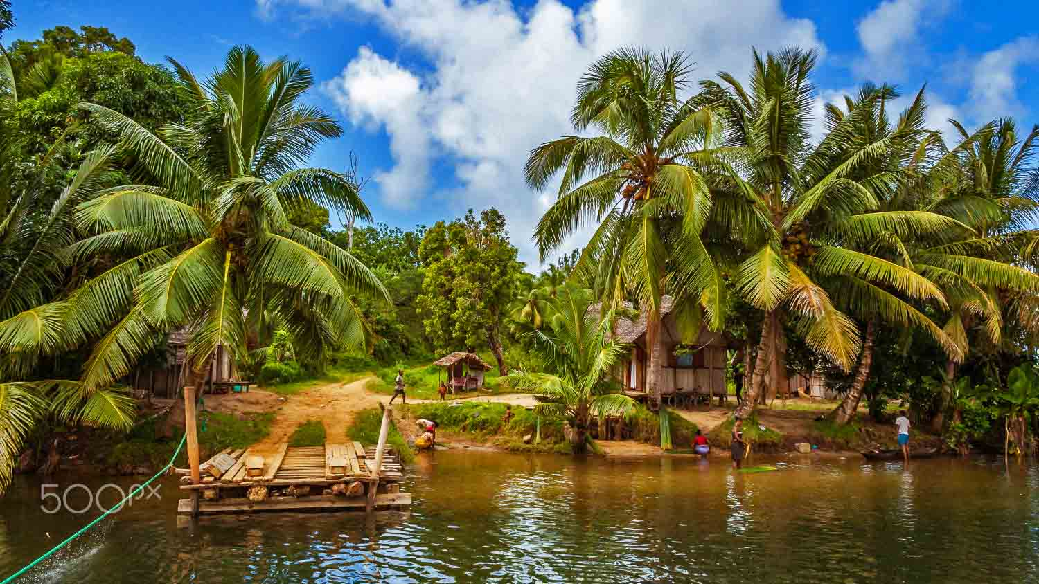
Madagascar
Typical village on the banks of Antongil bay, eastern Madagascar
Photo © by Pierre-Yves Babelon on 500px

Slide 23
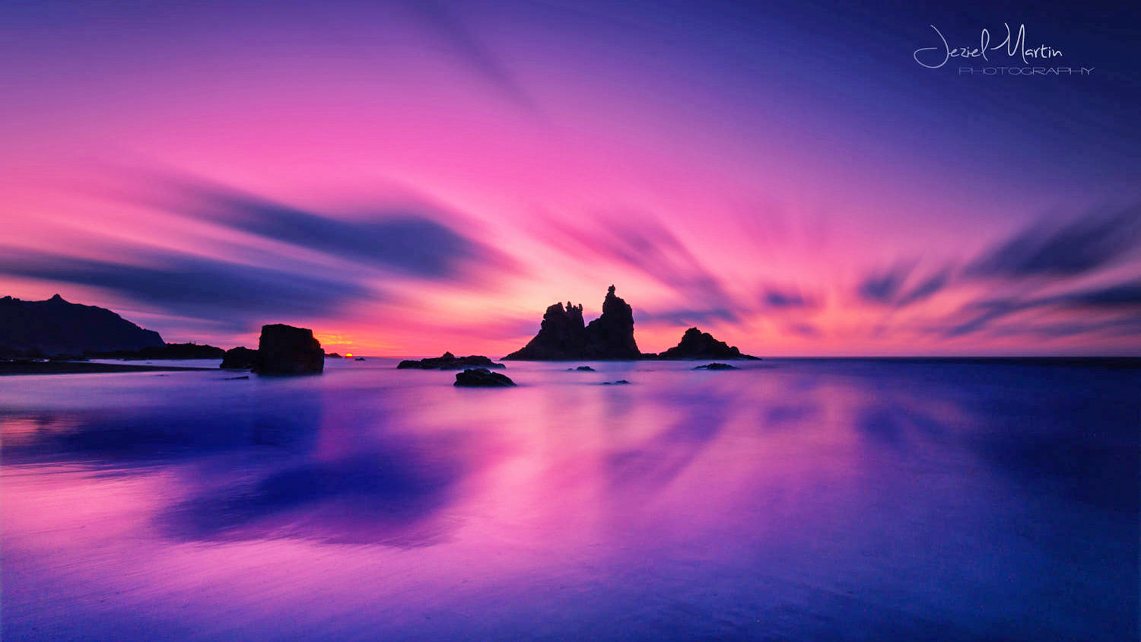
Mauritania
Mauritania, Benijo
Photo © by Jeziel Martín on 500px

Slide 24
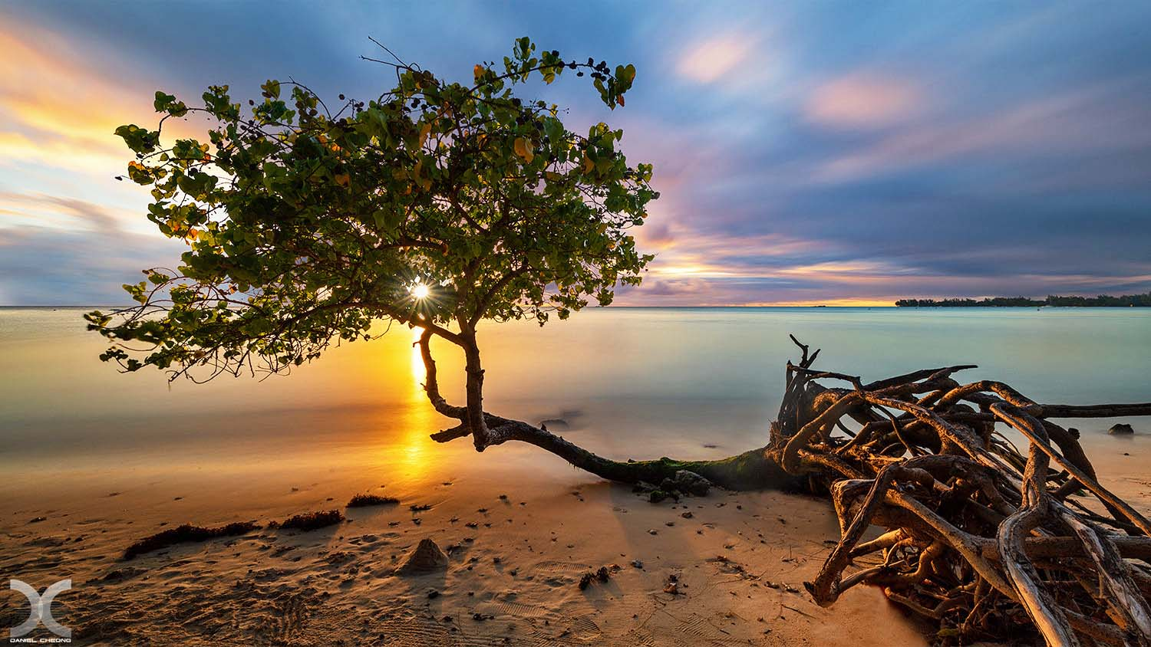
Mauritius
Last Light
Mont Choisy beach, Mauritius.
Grand Baie, Mauritius

Slide 25
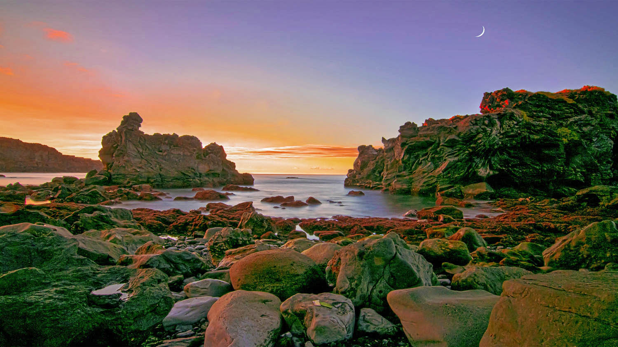
Morocco
Sunset
Photo © by Jay Z on 500px

Slide 26
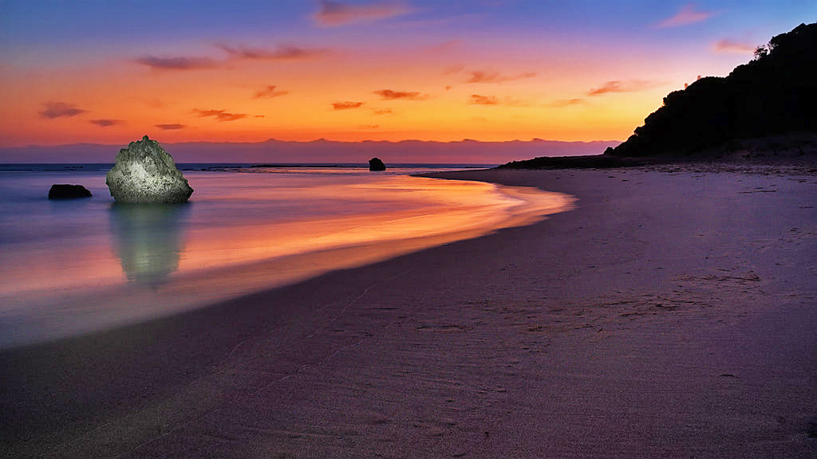
Mozambique
Rock and a point
Taken in Ponta, Mozambique.
Photo © by Gavin Fordham on 500px

Slide 27
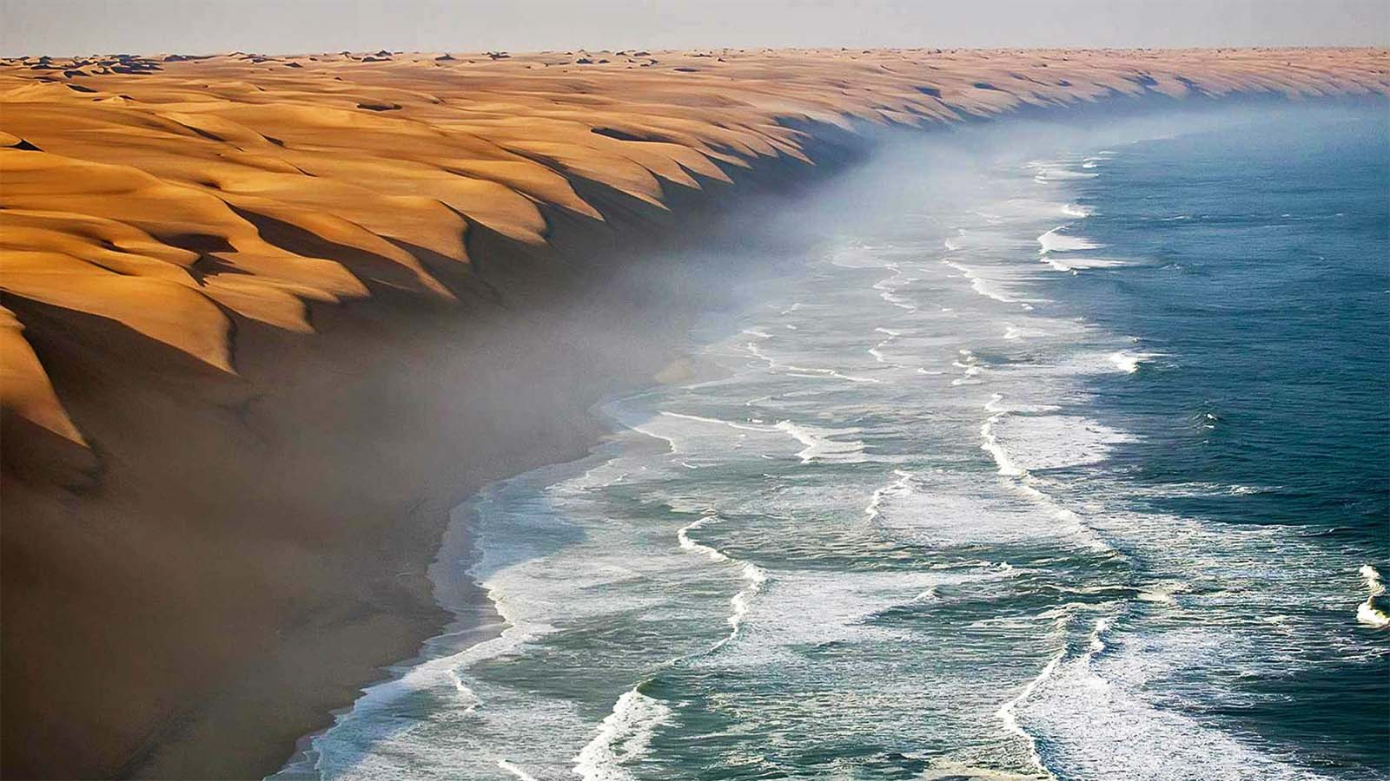
Namibia
Harmony of Nature
This is the fantastic place where the Namib Desert meets the sea.
Photo © by Roberto Sysa Moiola on 500px

Slide 28
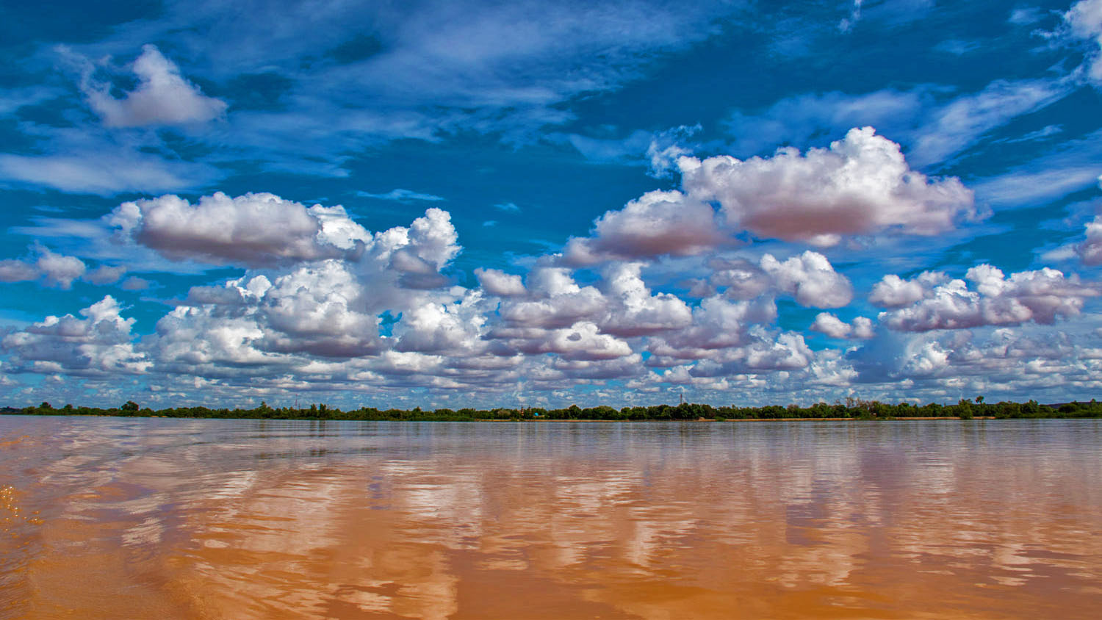
Niger
Niamey, Niger
Clarity on point
Photo © by Ahmet Celtik on 500px

Slide 29
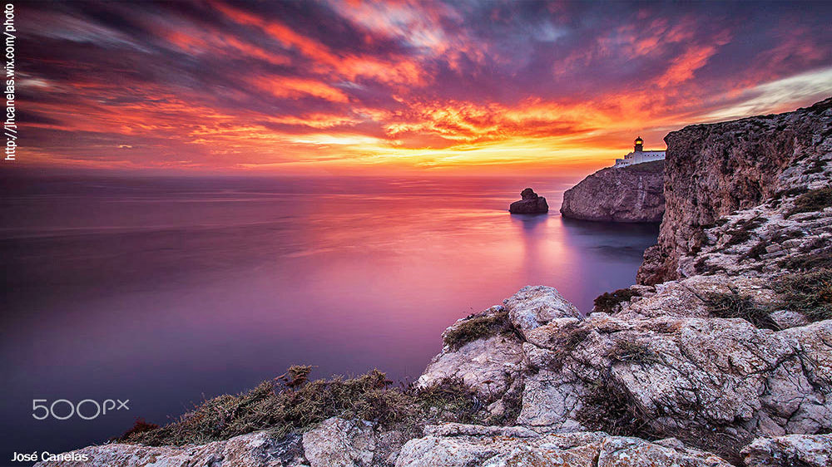
Nigeria

Slide 30
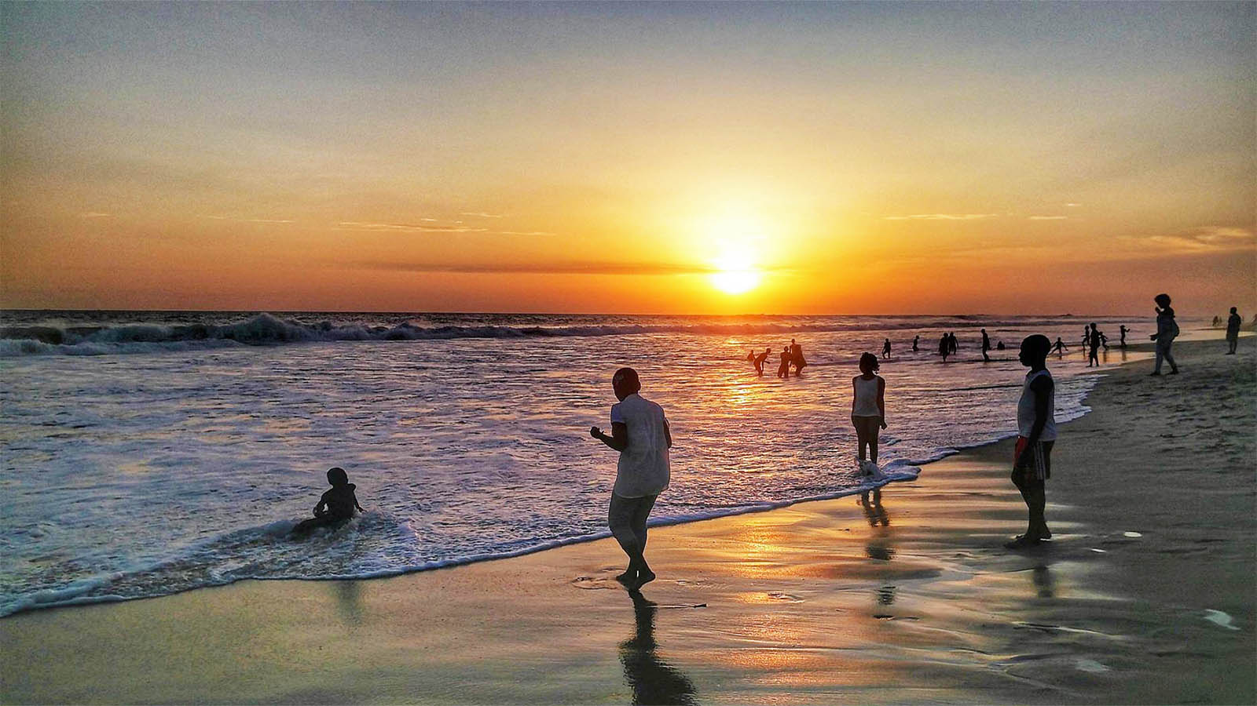
Republic of the Congo
Losange, Pointe-Noire, Kouilou
Photo © 2018 by Rousseaux Cyrille

Slide 31
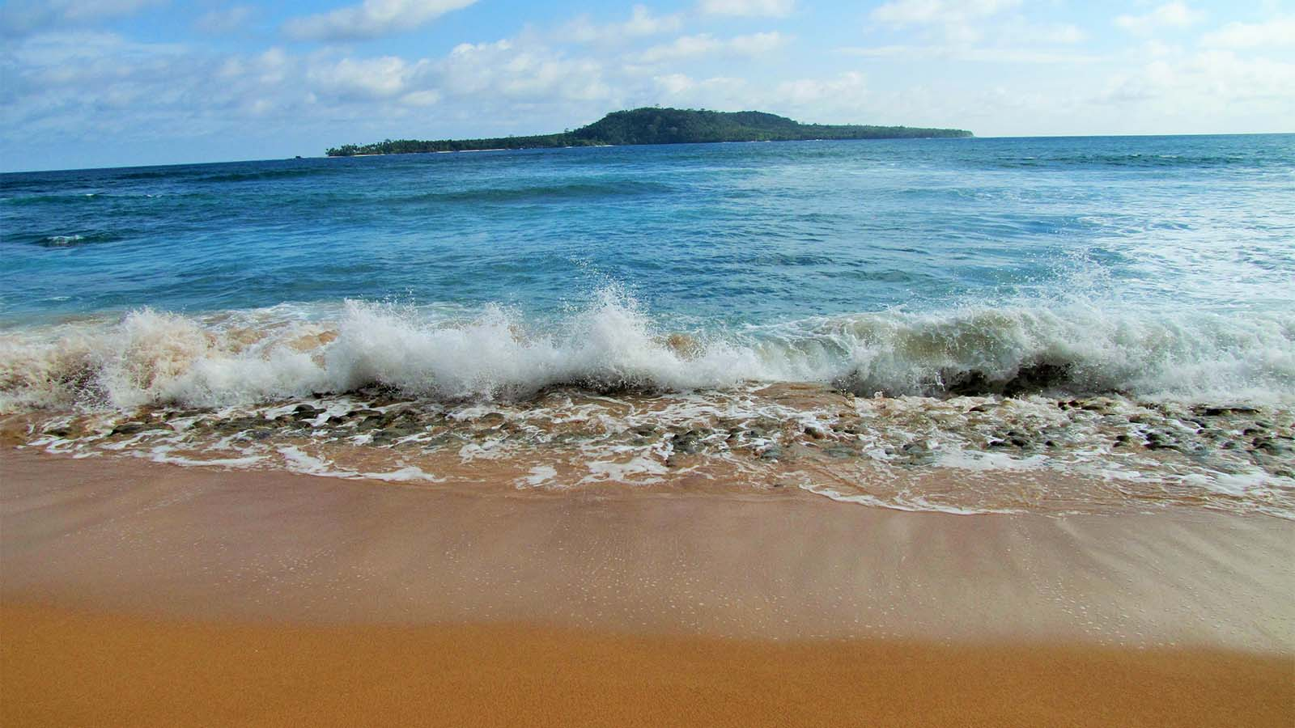
São Tomé and Príncipe

Slide 32
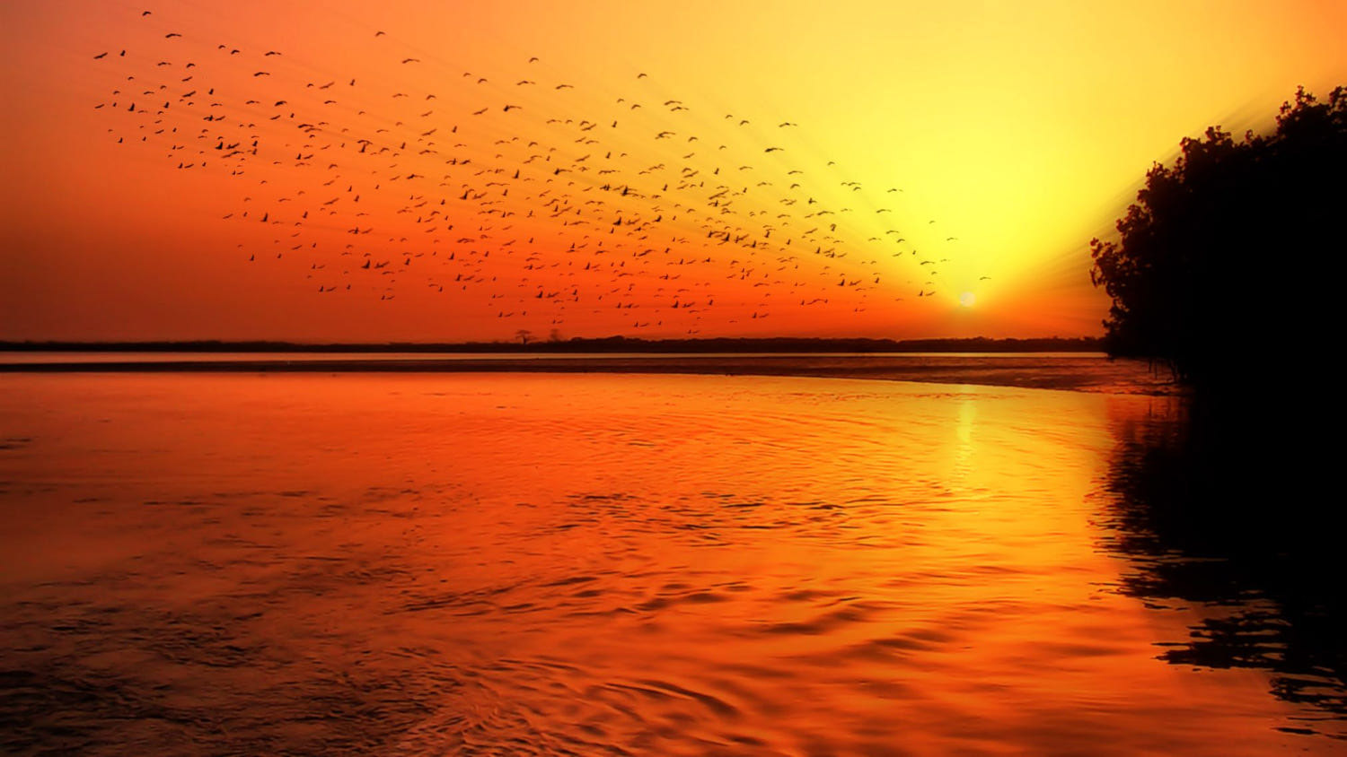
Senegal
It is an absolute human certainty that no one can know his own beauty or perceive a sense of his own worth until it has been reflected back to him in the mirror of another loving, caring human being.
- John Joseph Powell
Photo © by Rose MacAuslan on 500px

Slide 33
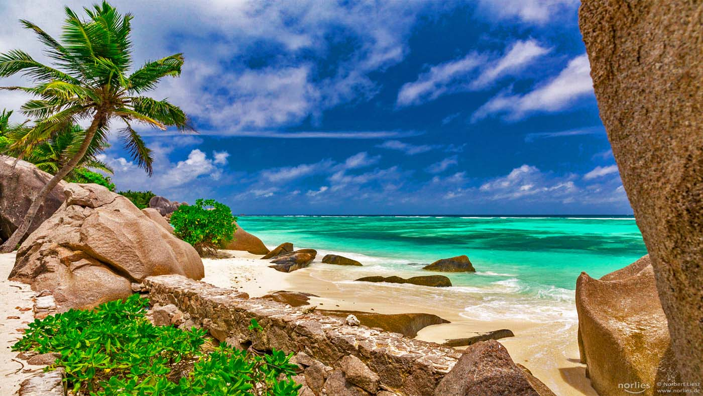
Seychelles
Green and blue
Anse Source D'Argent / La Digue / Seychelles

Slide 34
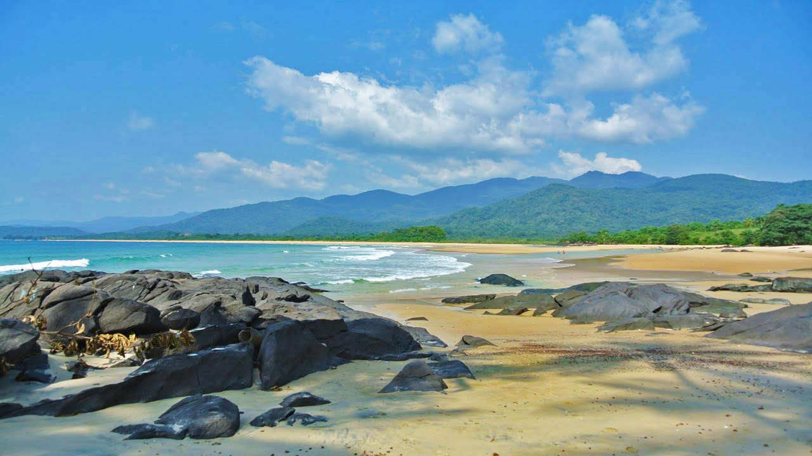
Sierra Leone

Slide 35
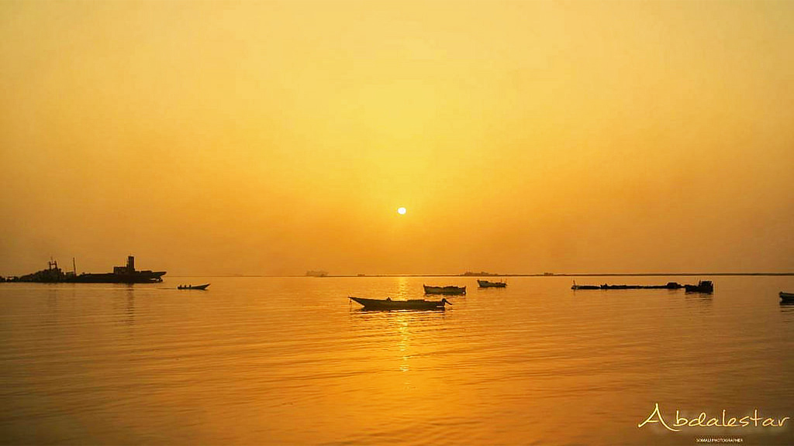
Somalia

Slide 36
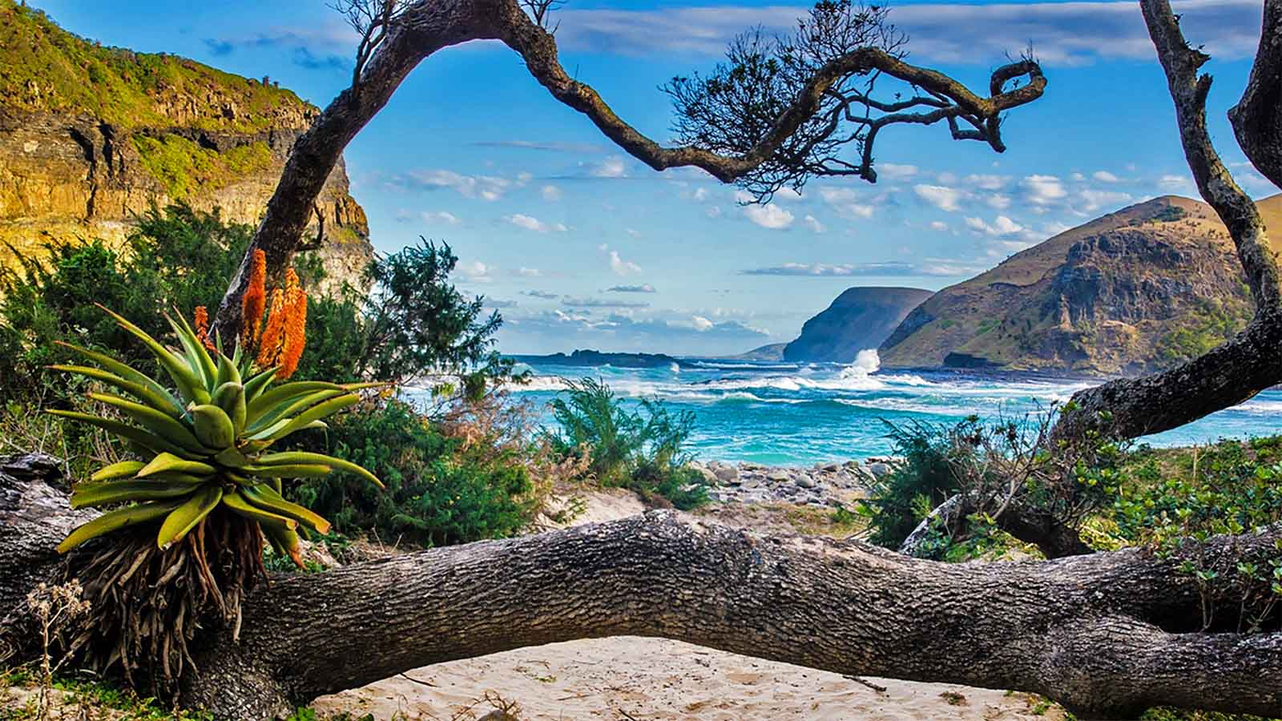
South Africa
Nature around The Hole in the Wall at Coffee Bay in the Wild Coast, South Africa
Windows 10 SpotLight Images © 2018

Slide 37
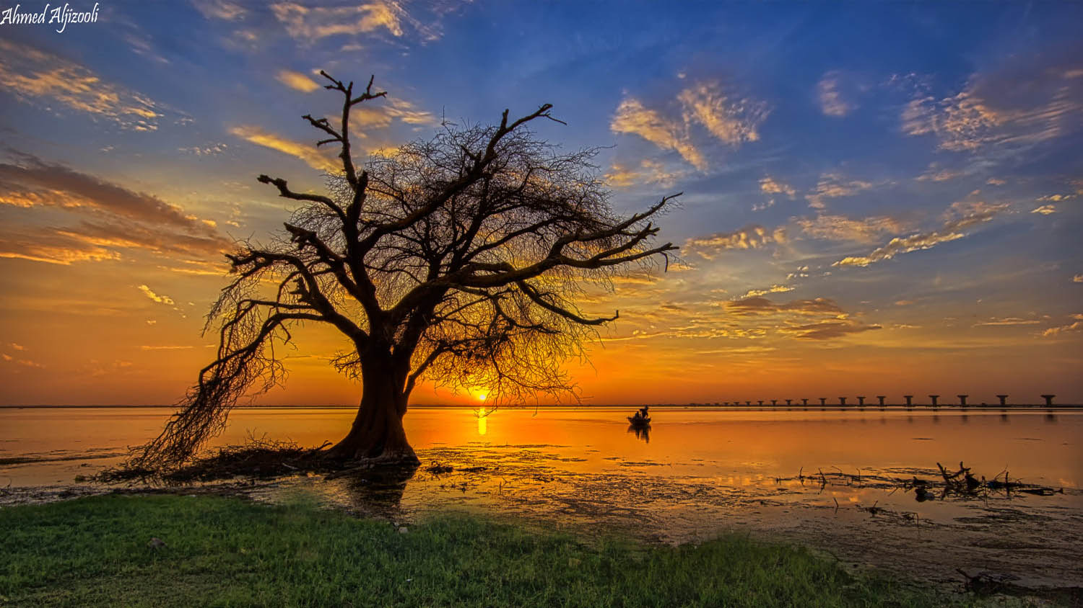
Sudan

Slide 38
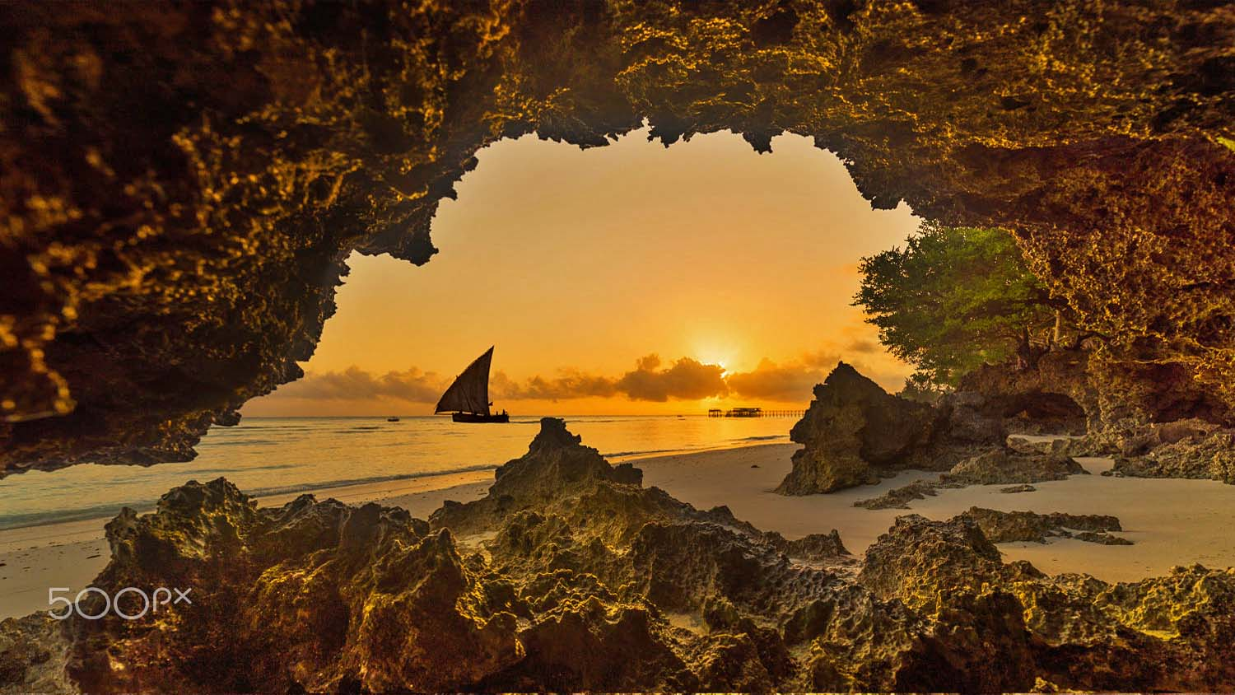
Tanzania
Sailing time
Photo © by Isam Telhami

Slide 39
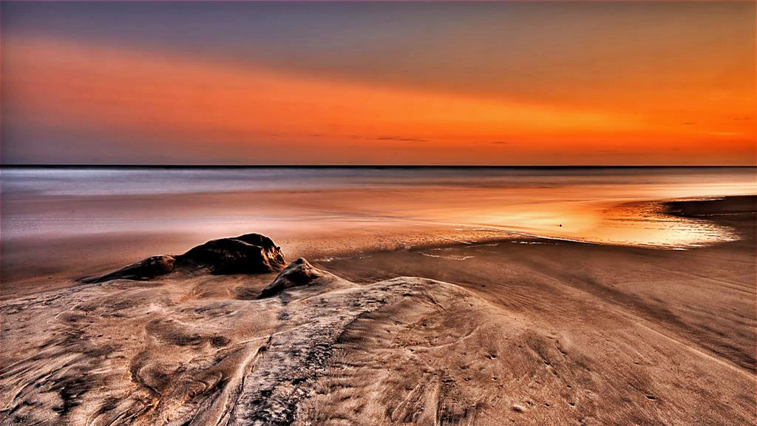
Togo
Sunset (Lome, Togo)
Photo © by Rowan Mark

Slide 40
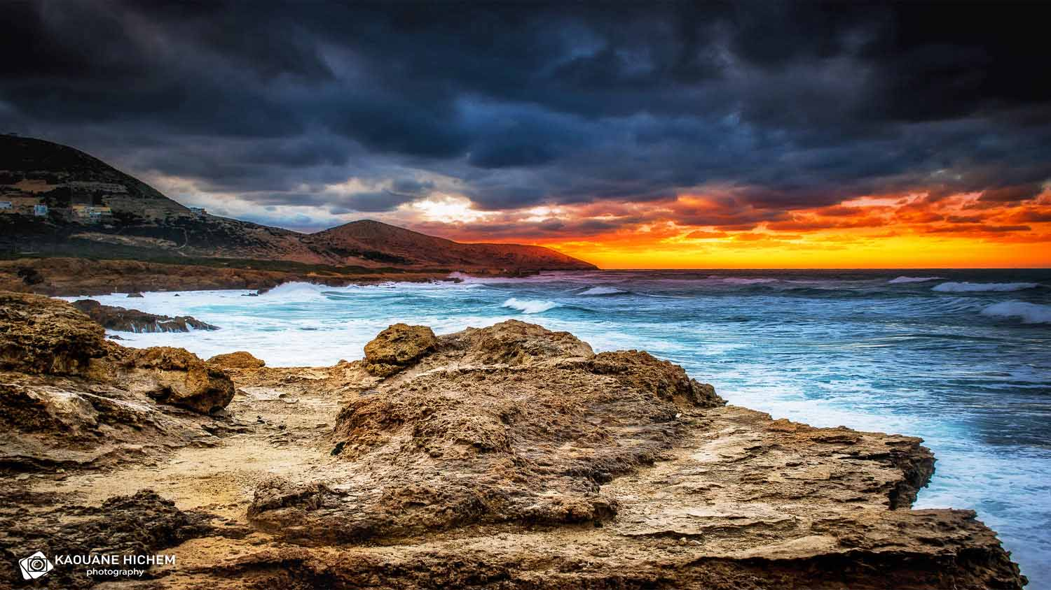




Tunisia
Very bad time
Bizerte - Tunisia

