Slide 1

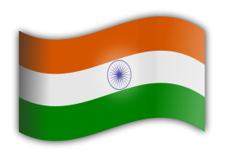
05
INDIA - 3

Slide 2
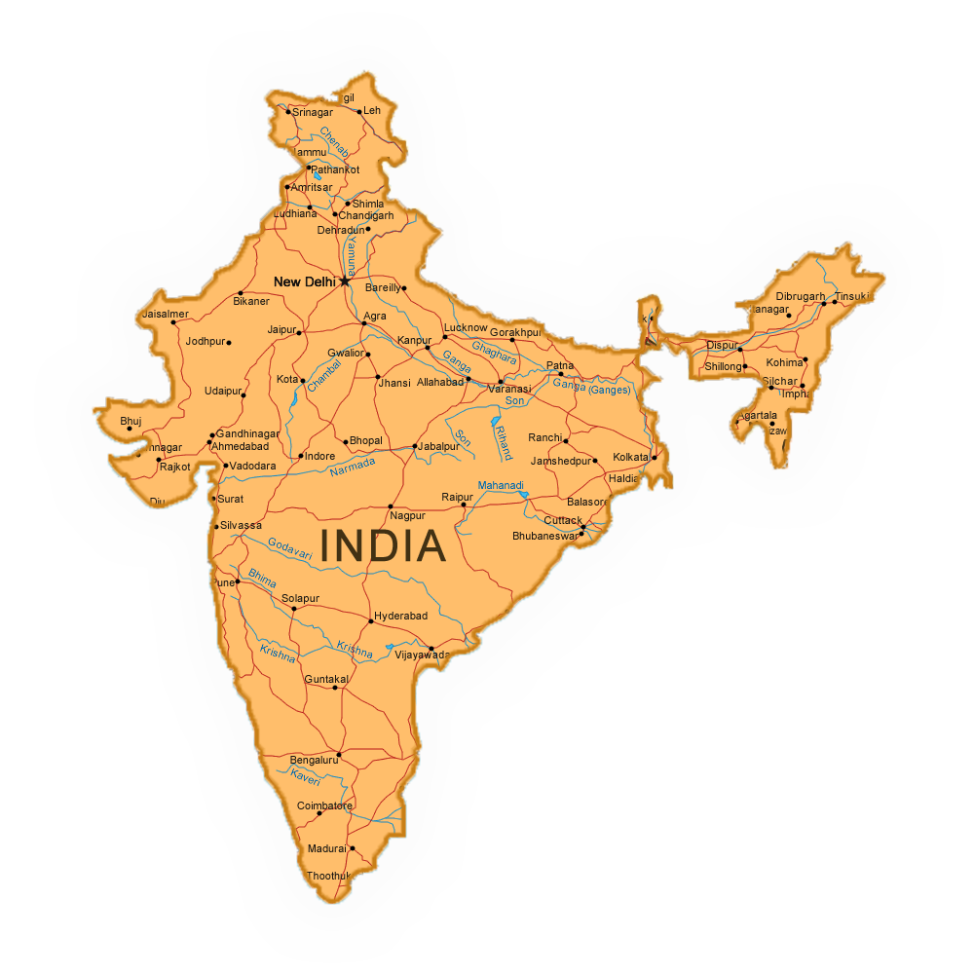

India

Slide 3




India is a country in South Asia. It is the seventh largest country in the world with more than 1.3 billion people. There are 22 official and over 300 spoken languages. No country is as diverse as India. It is home to majestic mountain ranges, pristine lakes, mighty rivers, virgin beaches and lush green forests. The food is as diverse as its weather and art as diverse as its cultures. From the snowbound regions of the north to the bright and cheerful backwaters in the south, from the sandy deserts in the west to the beautiful beaches in the east - simply incredible India...
India es un país en el sur de Asia. Es el séptimo país más grande del mundo con más de 1.300 millones de personas. Hay 22 idiomas oficiales y más de 300 hablados. Ningún país es tan diverso como la India. Es el hogar de majestuosas cadenas montañosas, lagos prístinos, ríos poderosos, playas vírgenes y frondosos bosques verdes. La comida es tan diversa como su clima y el arte tan diverso como sus culturas. Desde las regiones nevadas del norte hasta los remansos brillantes y alegres del sur, desde los desiertos de arena del oeste hasta las hermosas playas del este - simplemente increíble India…
India je krajina v južnej Ázii. Je to siedma najväčšia krajina s viac ako 1,3 miliardy ľudí na svete. V Indii sa používa 22 oficiálnych a viac ako 300 hovorených jazykov. Žiadna krajina nie je taká rôznorodá ako India. Je domovom majestátnych pohorí, nedotknutých jazier, mohutných riek, panenských pláží a bujných zelených lesov. Jedlo je tak rozmanité ako jej počasie a umenie tak rozmanité ako jeho kultúra. Od zasnežených oblastí na severe až po svetlé a veselé stojaté vody na juhu, od piesočnatých púští na západe až po krásne pláže na východe - jednoducho neuveriteľná India...

Slide 4
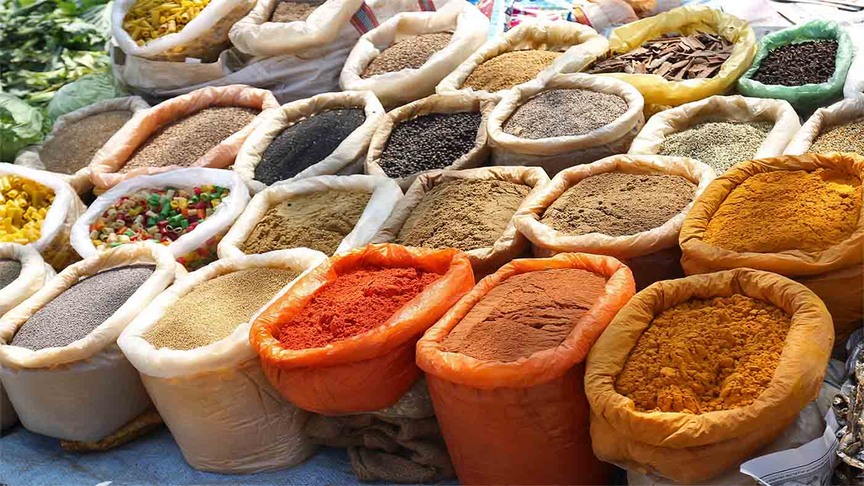

Over 70% of the world’s spices come from India

Slide 5
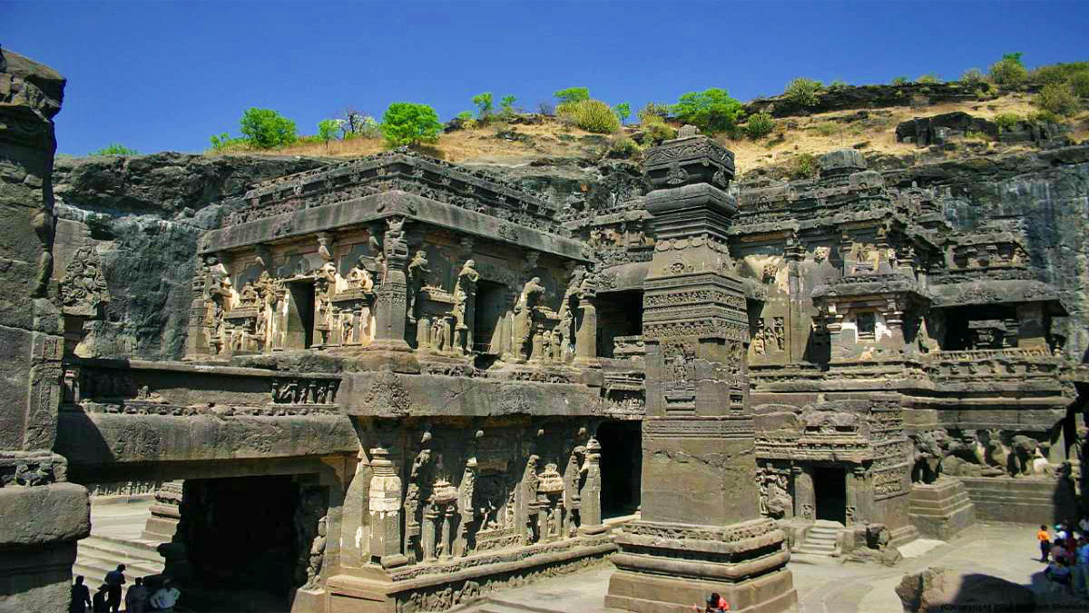
Ellora Caves , Maharashtra

Slide 6
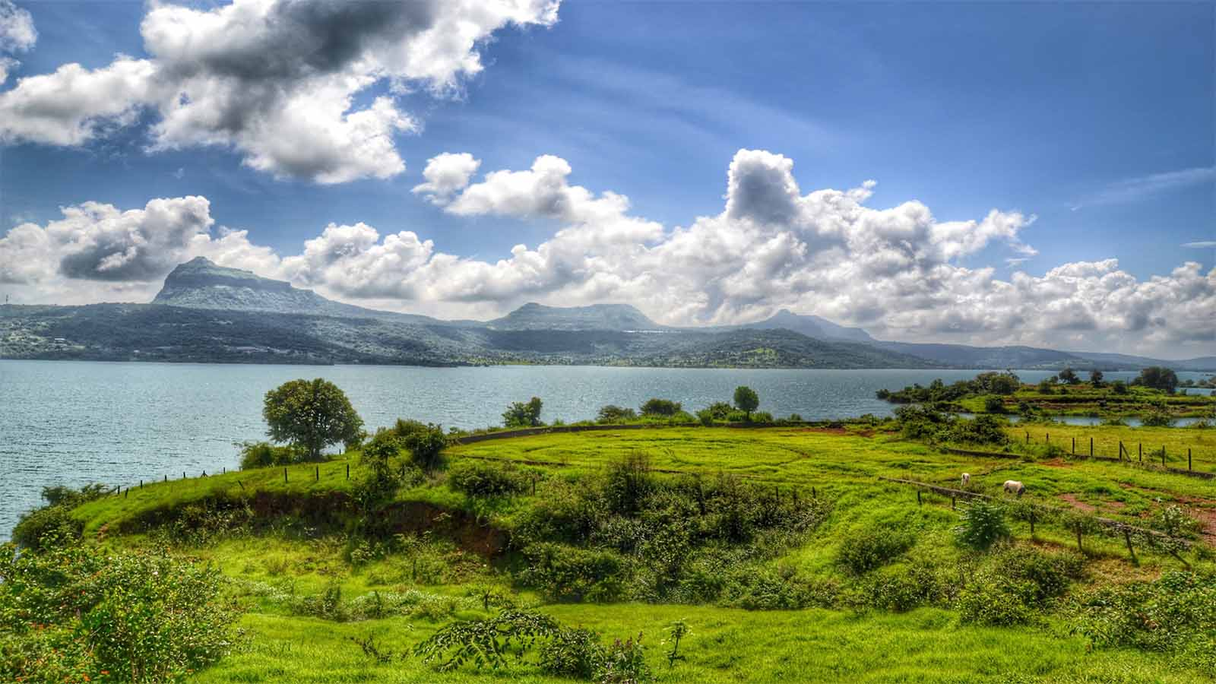
Lonavala, Pune, Maharashtra

Slide 7
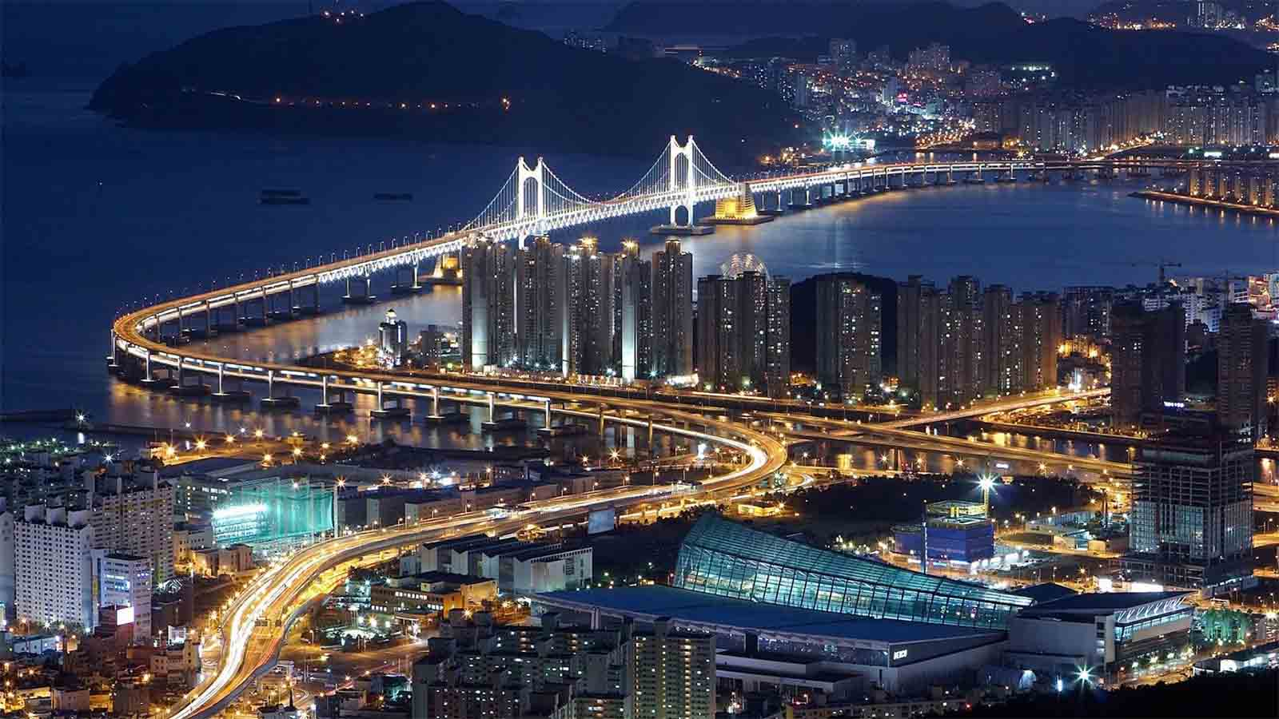
Bandra–Worli Sea Link bridge, Mumbai, Maharashtra

Slide 8
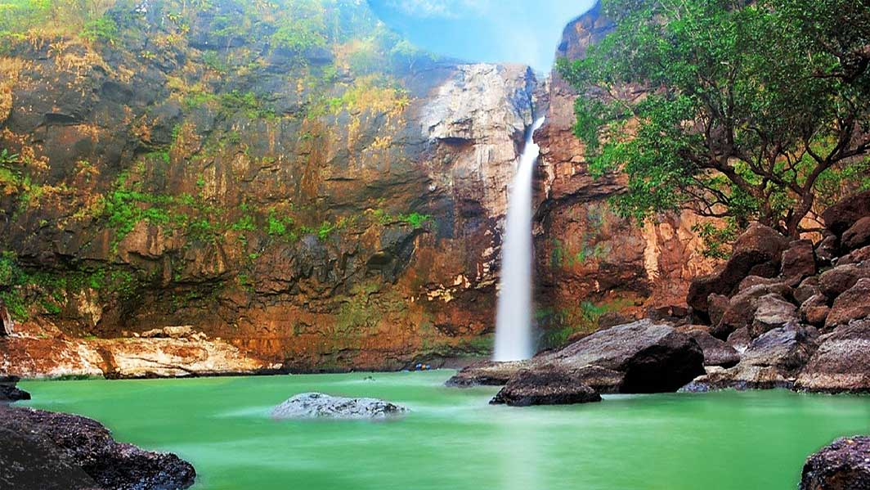
Jawhar, Maharashtra

Slide 9
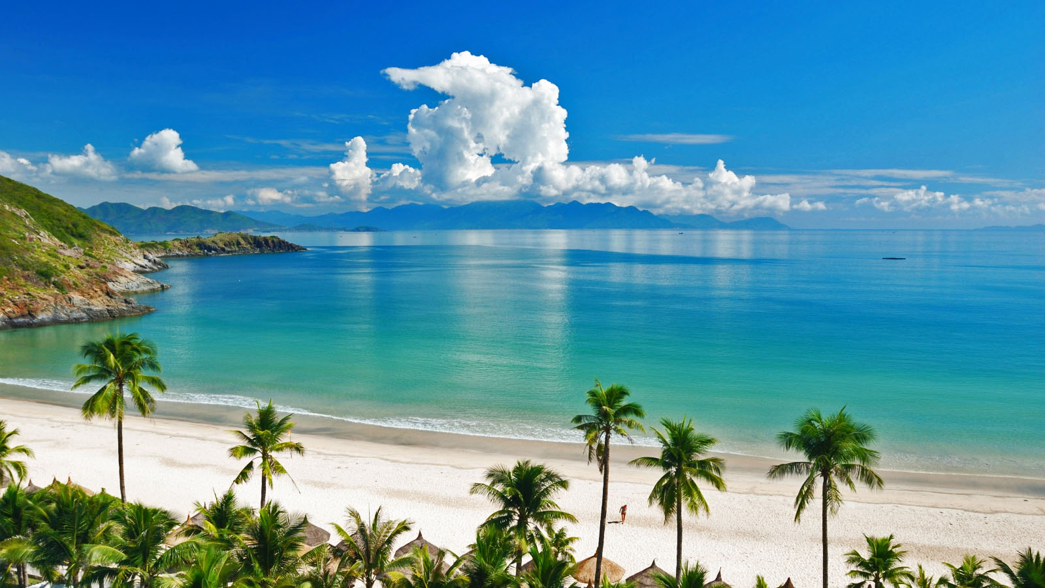
Beaches, Goa

Slide 10
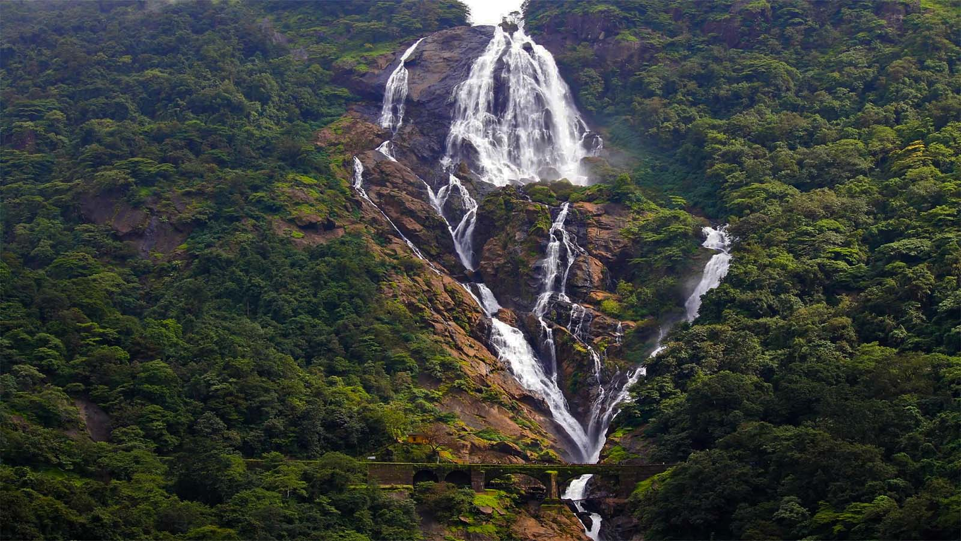
Dudhsagar Falls, Goa

Slide 11
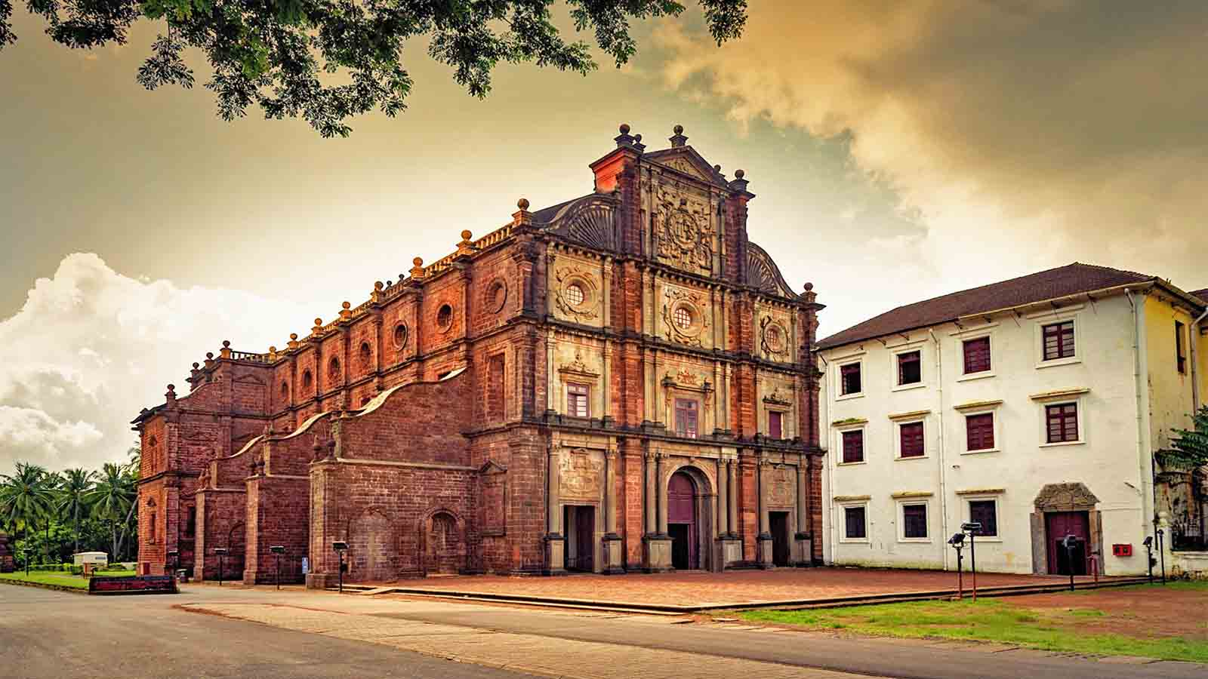
Basilica of Bom Jesus, Goa

Slide 12
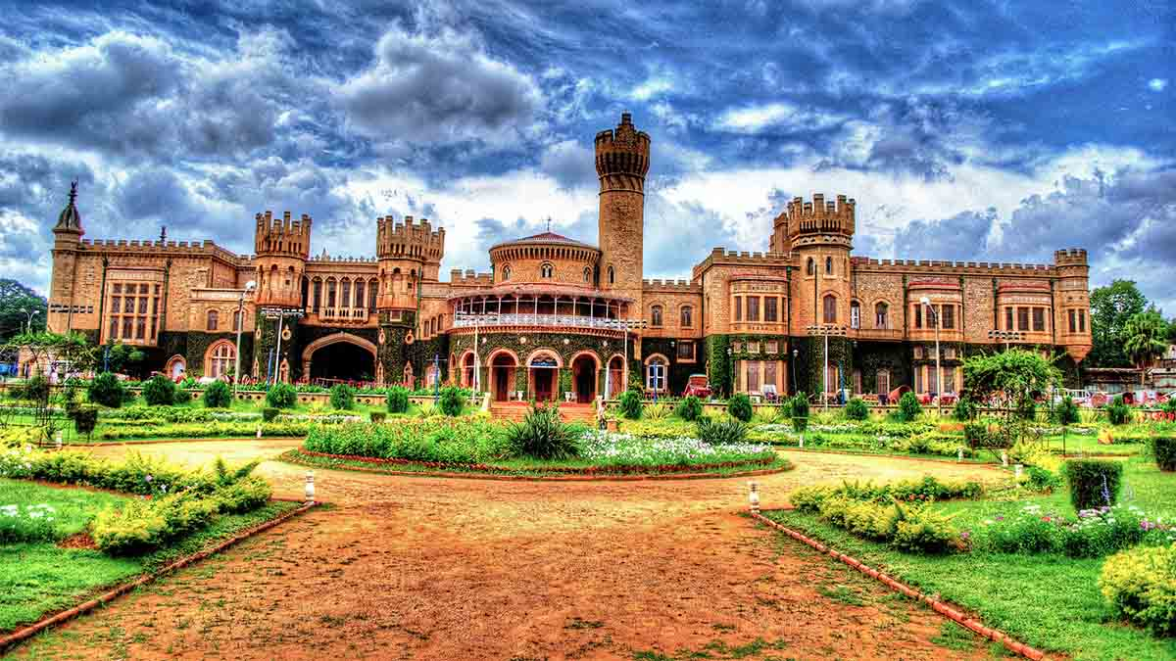
Bangalore Palace, Bangalore, Karnataka

Slide 13
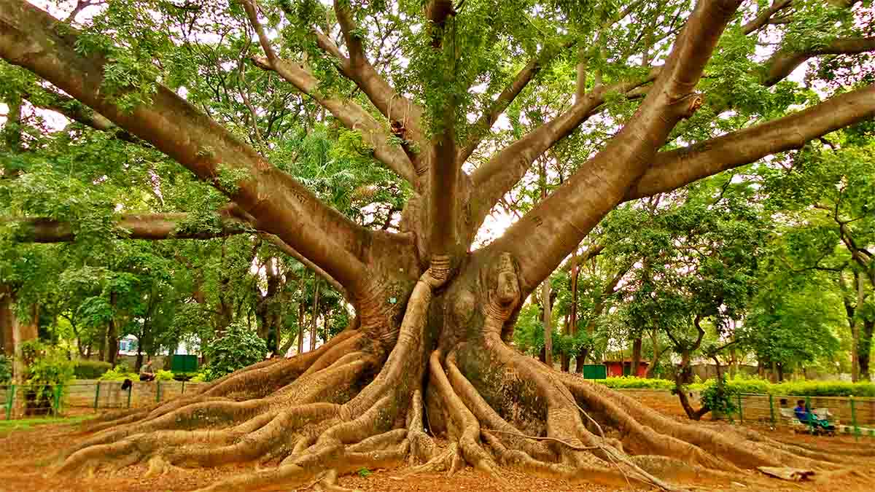
The giant sili cotton tree, Lalbagh Park, Bangalore, Karnataka

Slide 14
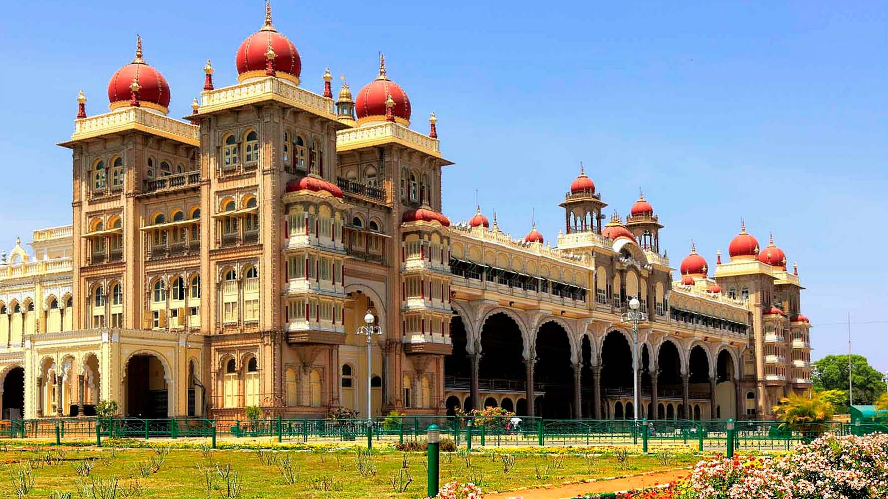
Mysore Palace, Mysore, Karnataka

Slide 15
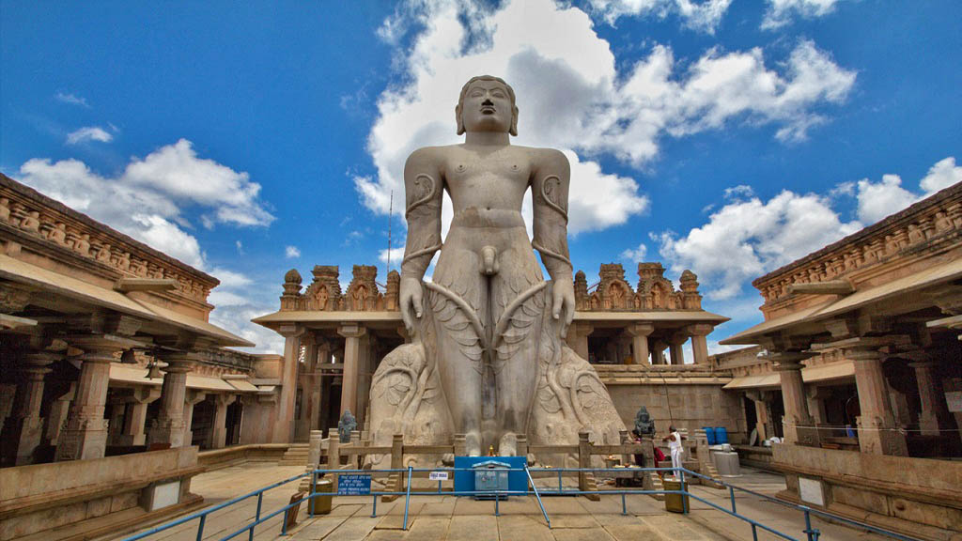
Gomateshwara statue of Bahubali, Shravanabelagola, Karnataka

Slide 16
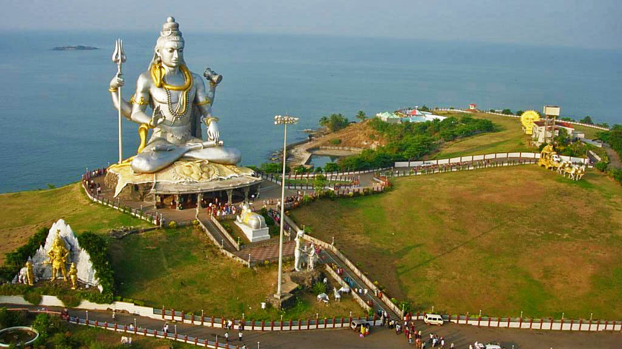
Shiva statue, Murudeshwar, Karnataka

Slide 17
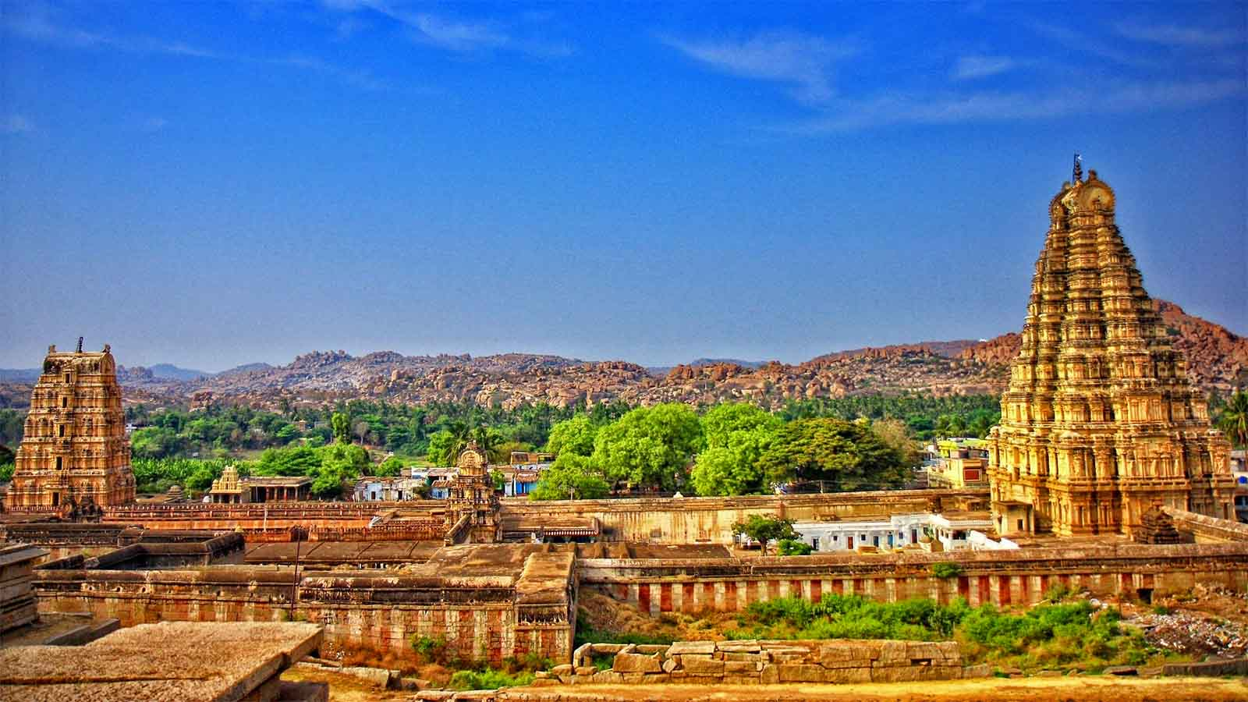
Hampi temple town, Karnataka

Slide 18
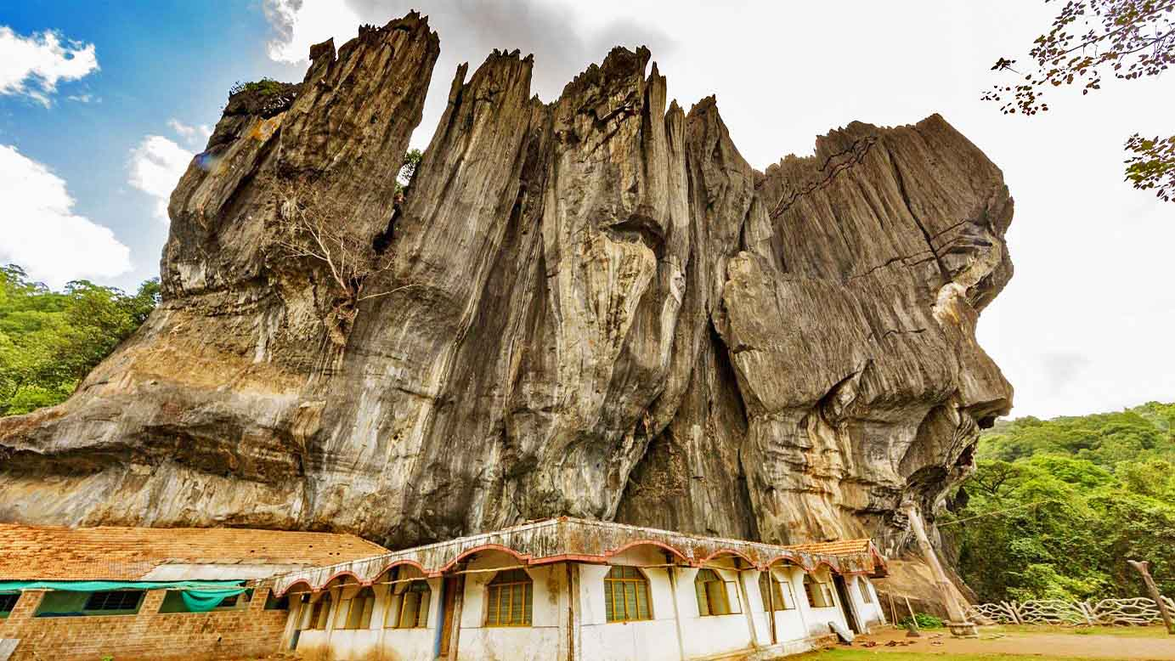
Yana village, Kumta forest, Karnataka

Slide 19
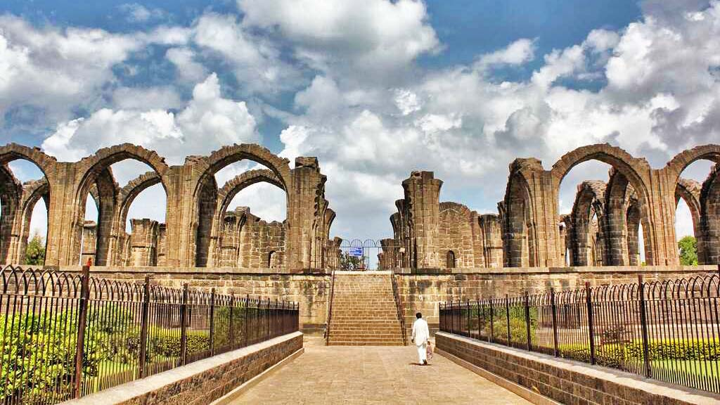
Bara Kaman, mausoleum of Ali Adil Shah II, Bijapur, Karnataka

Slide 20
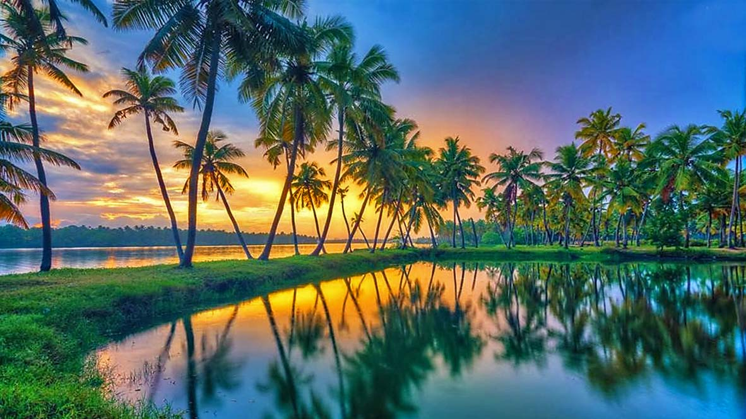
Coconut lined pathways, Kerala

Slide 21
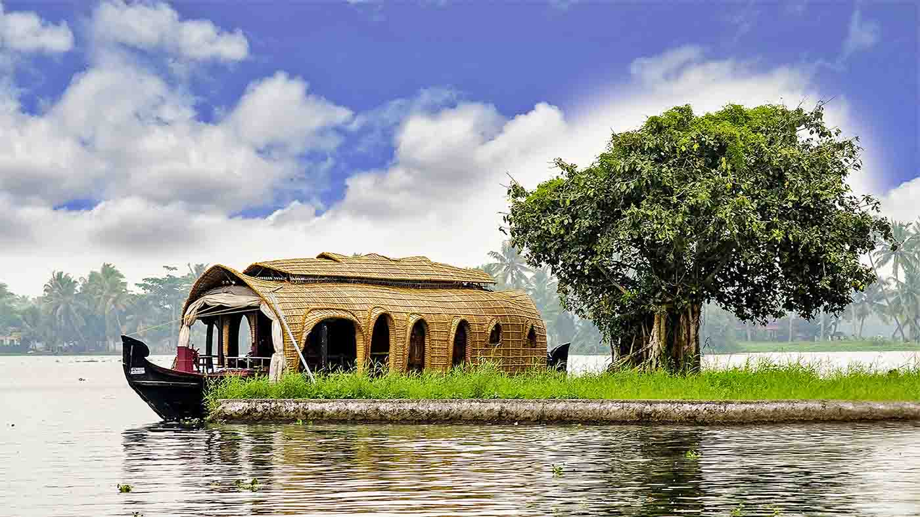
Cruising houseboat, Alleppey, Kerala

Slide 22
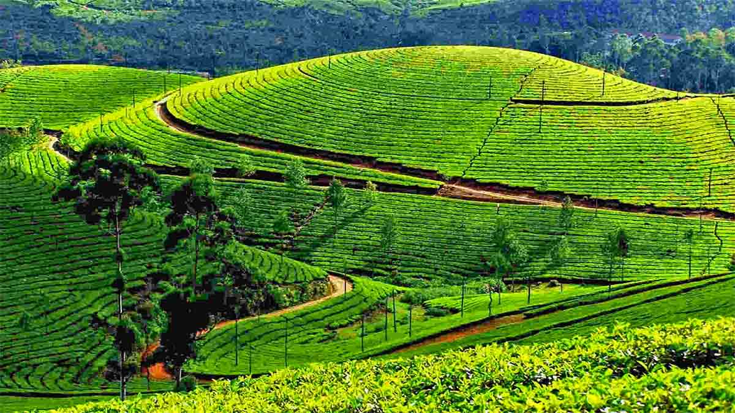
Tea Estates of Munnar, Kerala

Slide 23
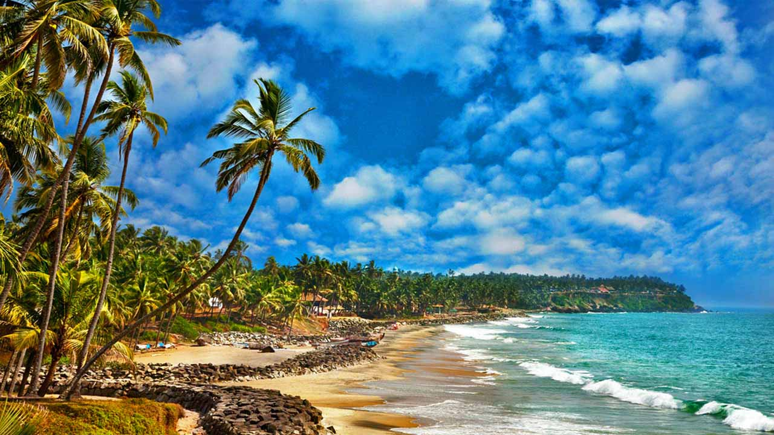
Mararikulam Beach, Kerala

Slide 24
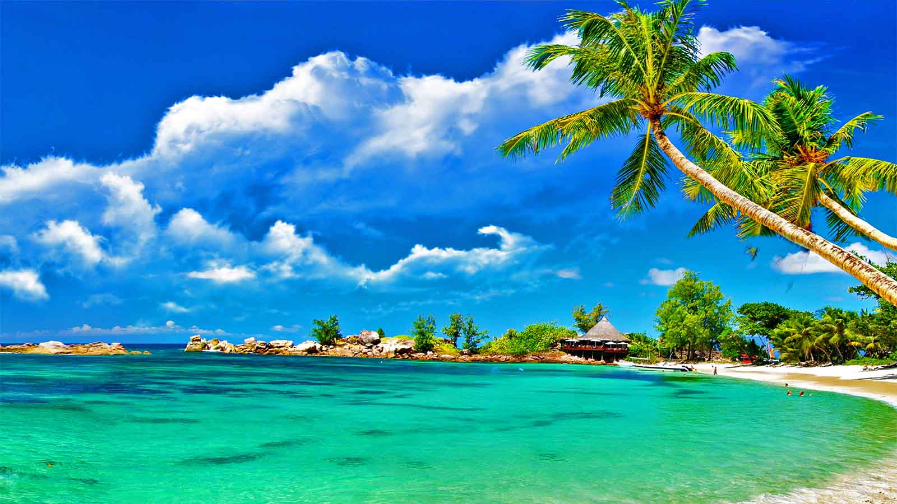
Lakshadweep archipelago, Laccadive Sea, Kerala

Slide 25
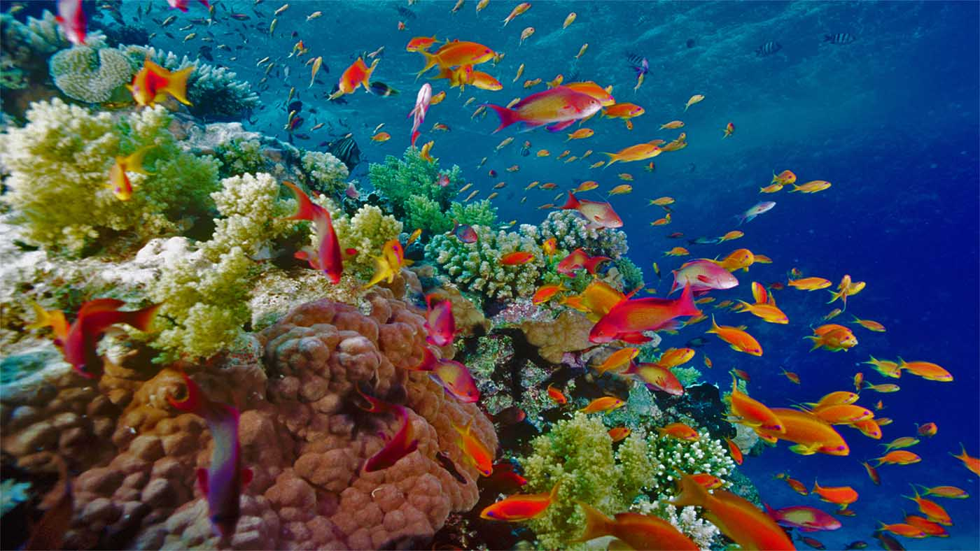
Lakshwadeep Islands coral reefs, Kerala

Slide 26
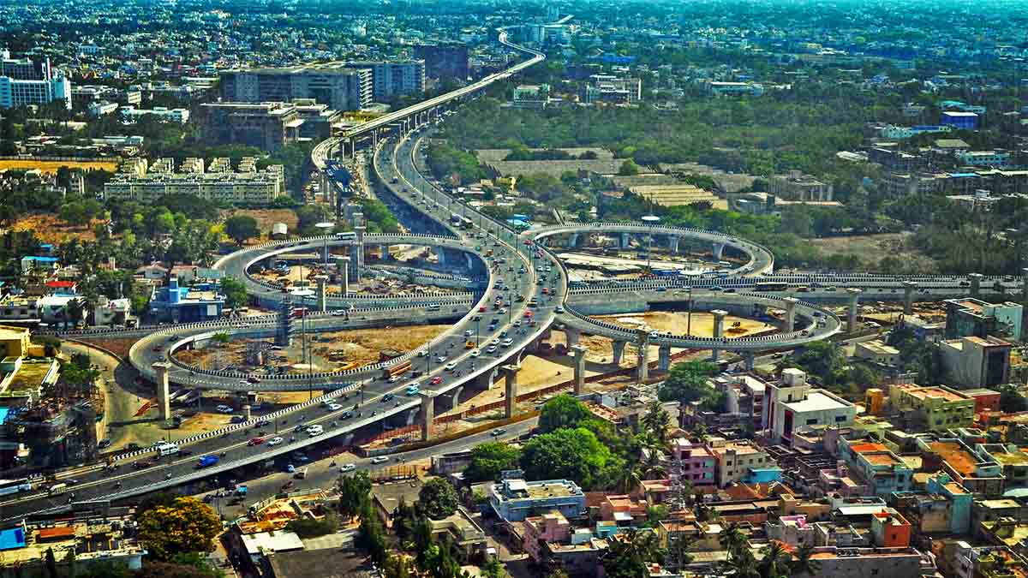
Kathipara Flyover, Chennai City, Tamil Nadu

Slide 27
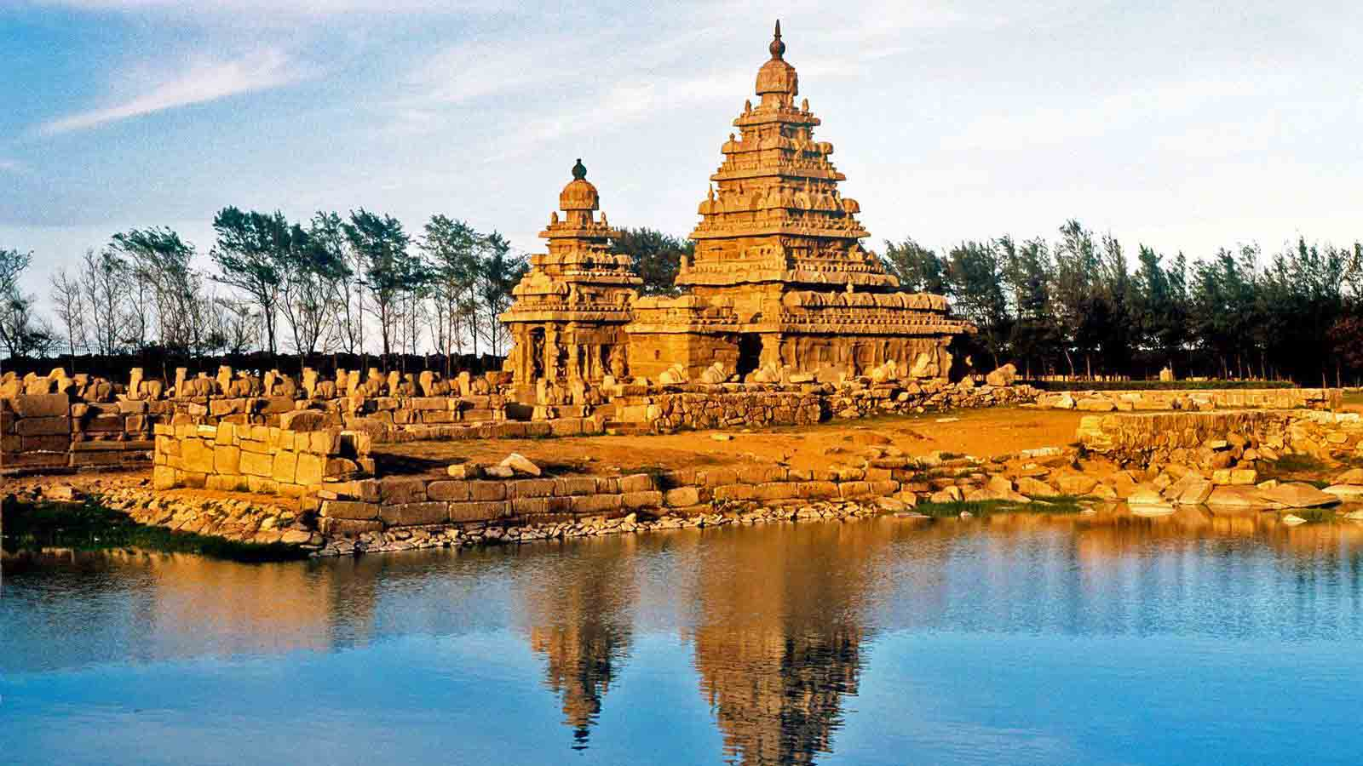
Mahabalipuram Shore Temple, Tamil Nadu

Slide 28
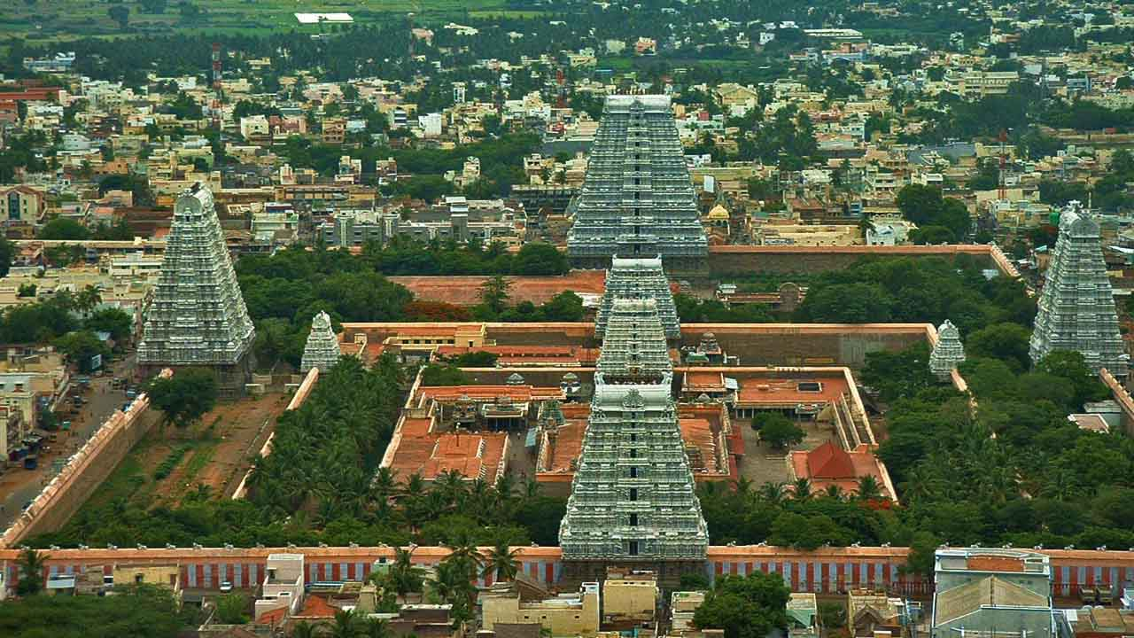
Meenakshi Amman, Temple, Madurai, Tamil Nadu

Slide 29
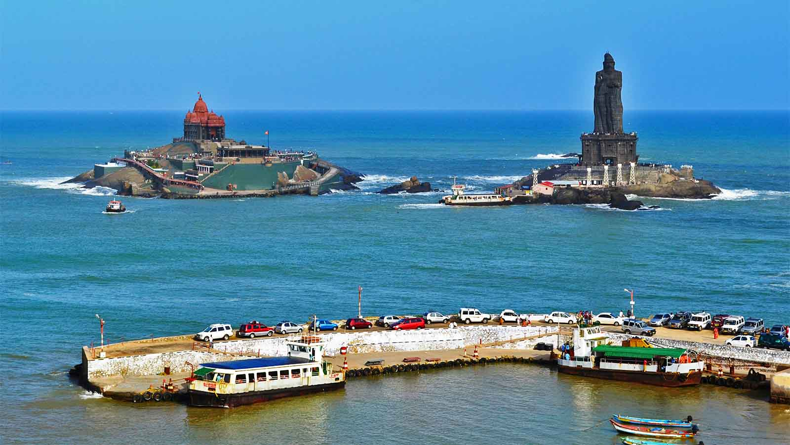
Vivekanada Rock and Thiruvallur Statue, Kanyakumari, Tamil Nadu

Slide 30
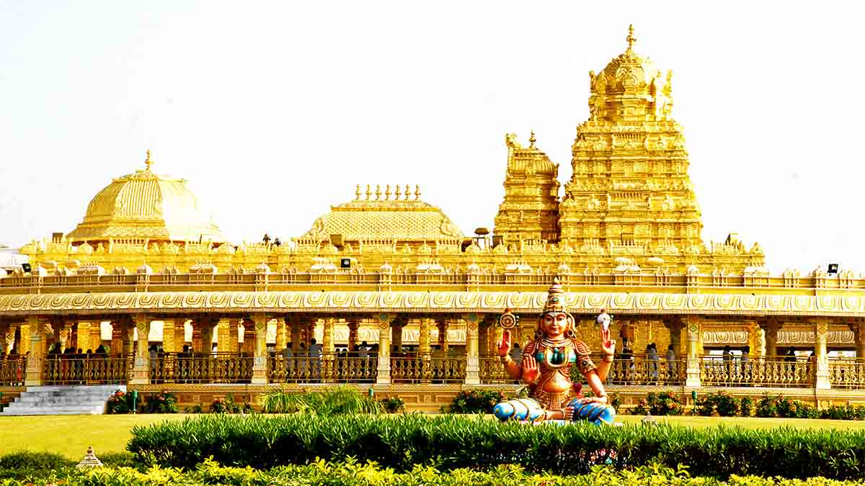
Sripuram Golden Temple, Vellore, Tamil Nadu

Slide 31
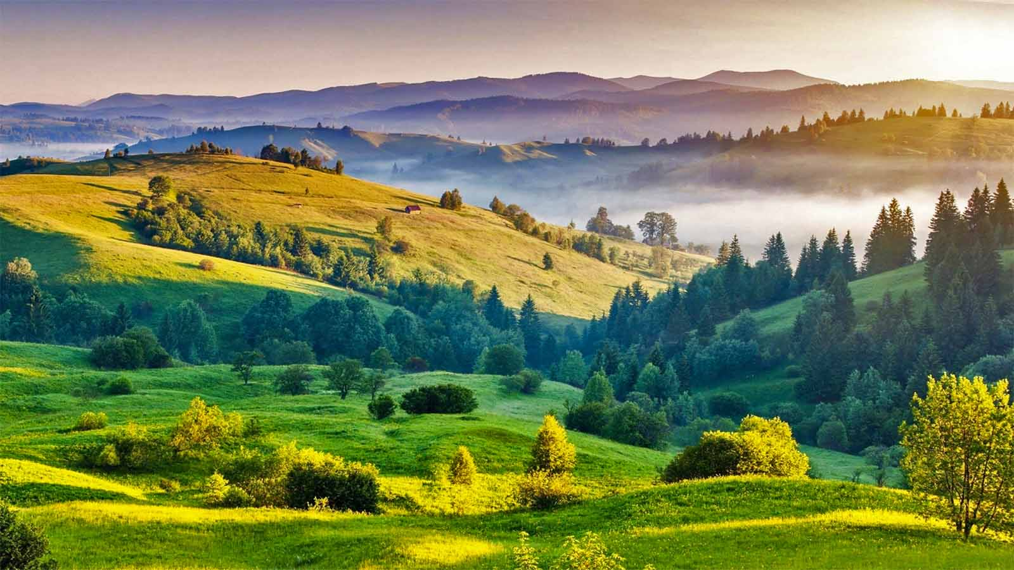
Kodaikanal, Tamil Nadu

Slide 32
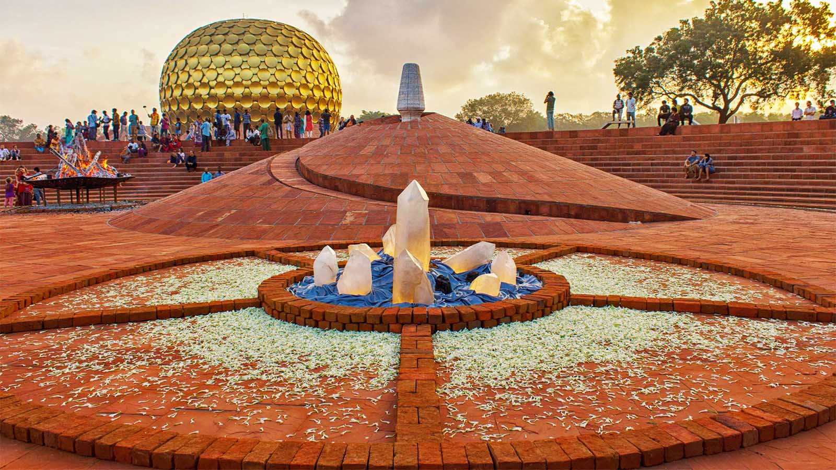
Auroville - experimental world community, Pondicherry, Tamil Nadu

Slide 33
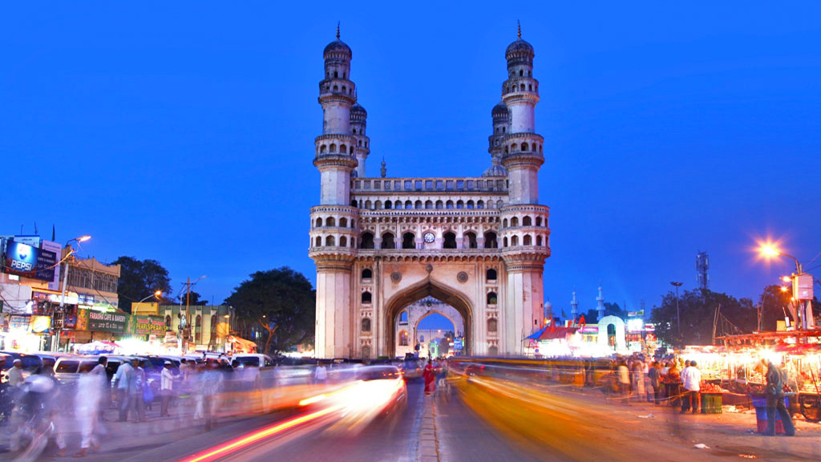
Charminar monument and mosque, Hyderabad, Telengana

Slide 34
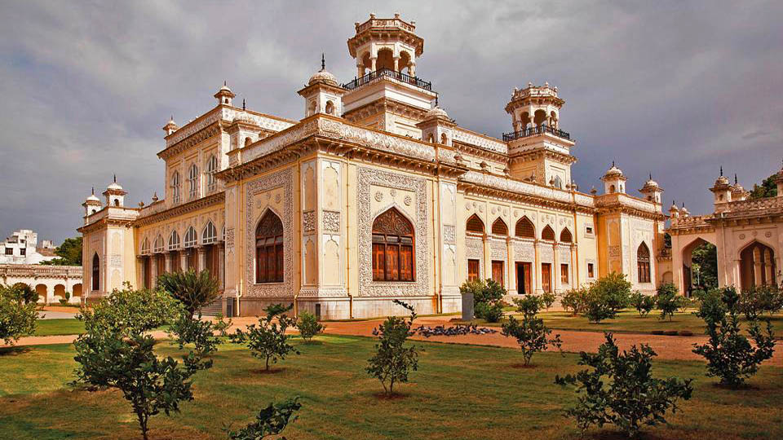
Chowmahalla Palace, Hyderabad, Telengana

Slide 35
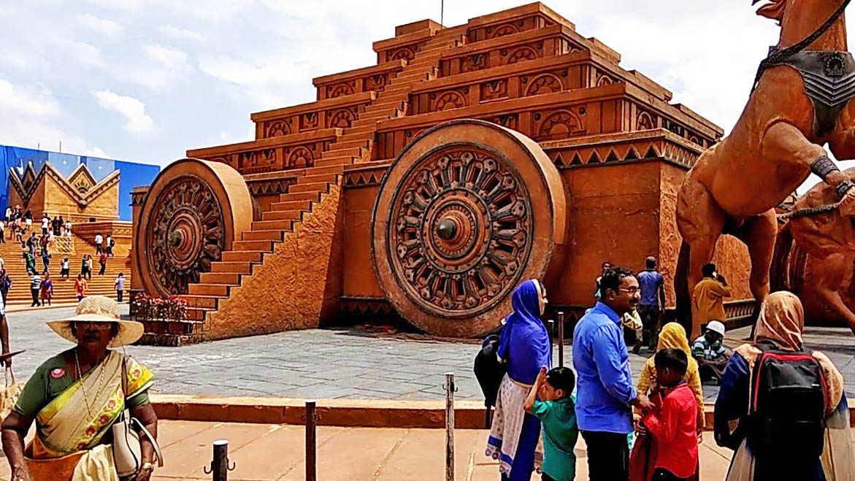
Ramoji Film City, Hyderabad, Telengana

Slide 36
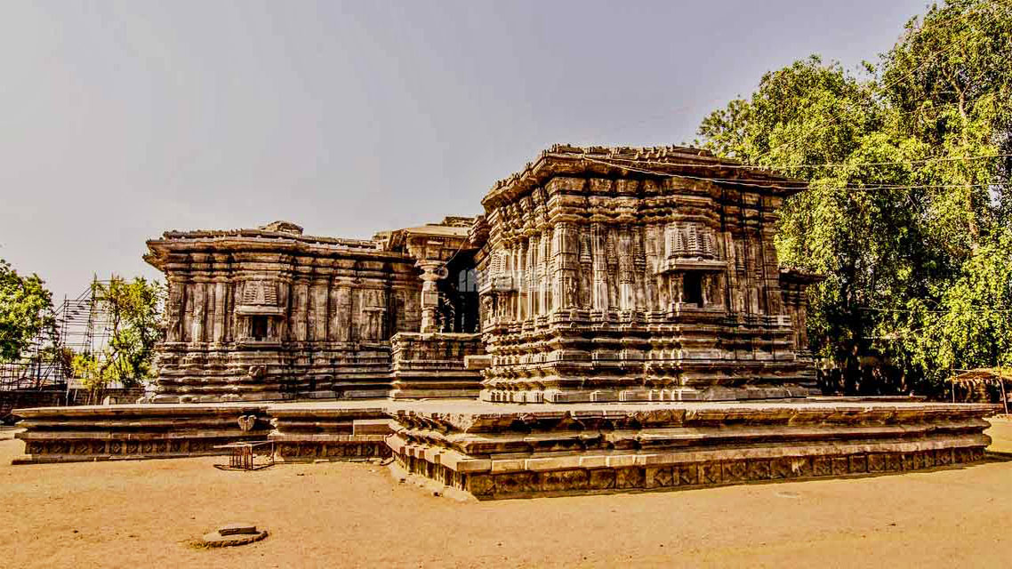
Temple of 1000 Pillars, Warangal, Telengana

Slide 37
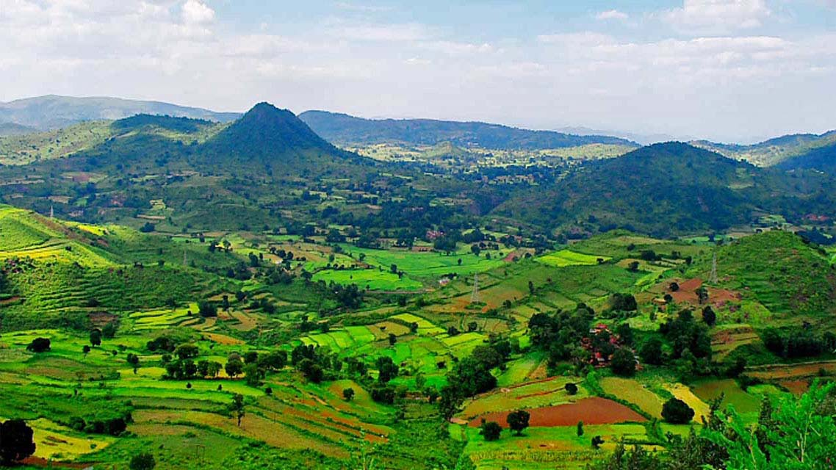
Araku Valley, Andhra Pradesh

Slide 38
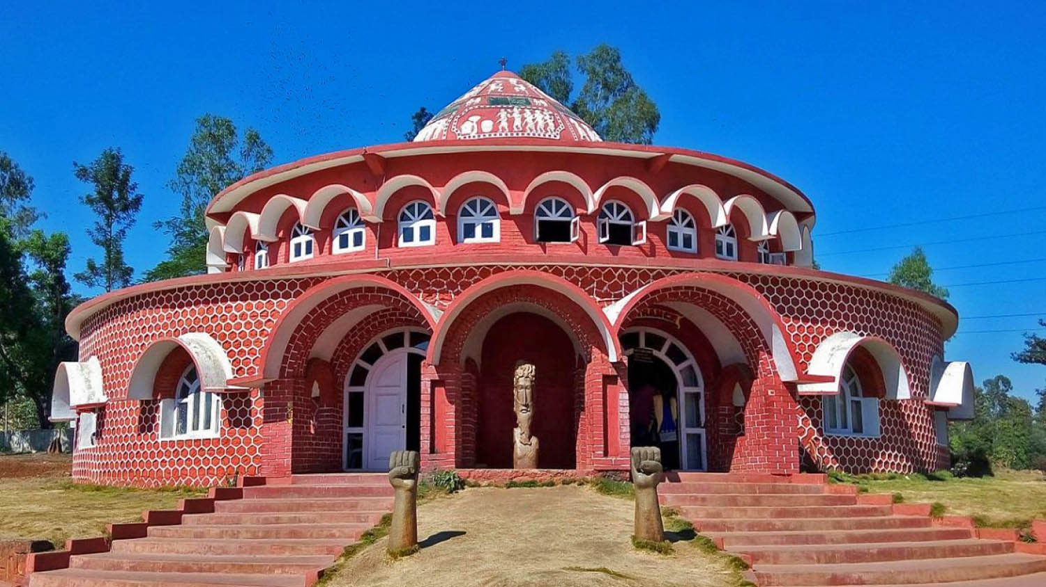
Araku Tribal Museum, Araku valley, Andhra Pradesh

Slide 39
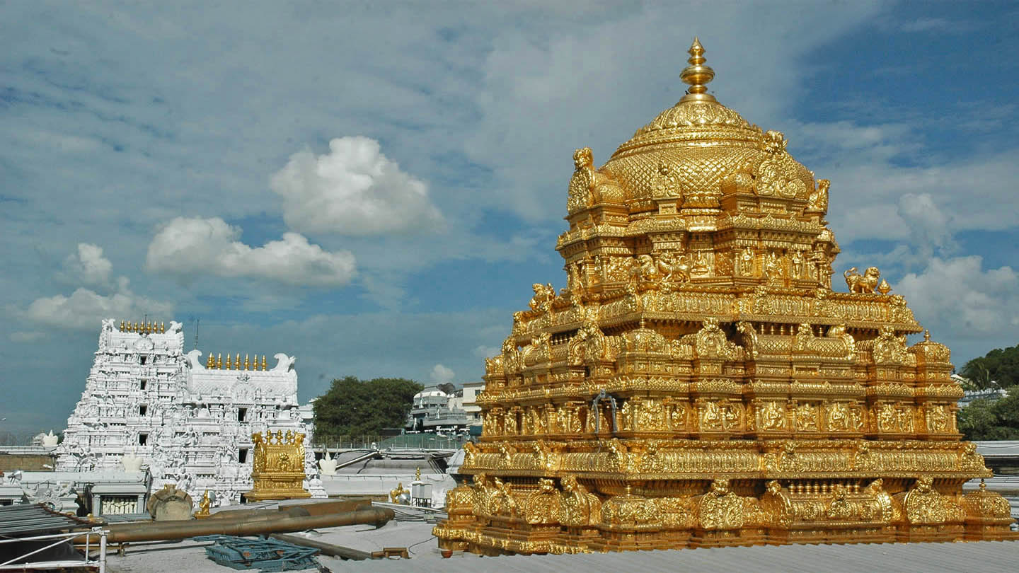
Venkateswara Temple, Tirumala, Andhra Pradesh

Slide 40
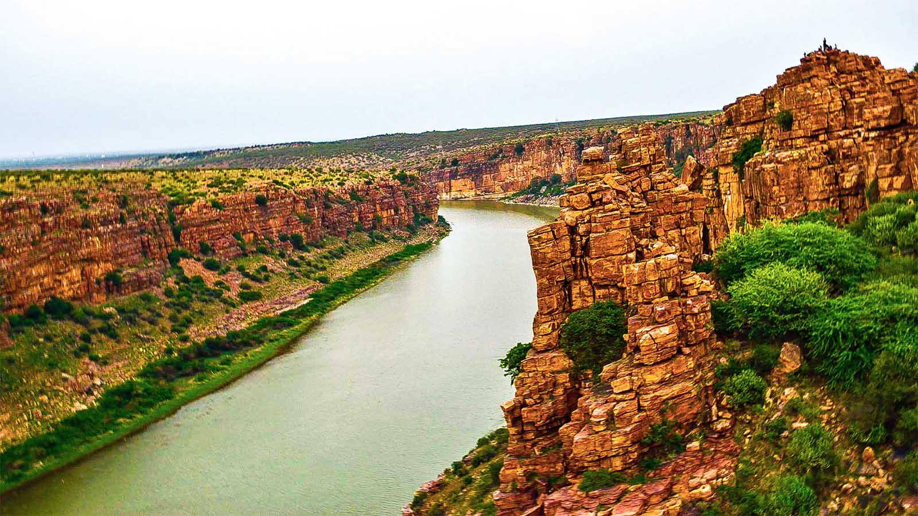
Bank of the river Pennar, Andhra Pradesh

Slide 41
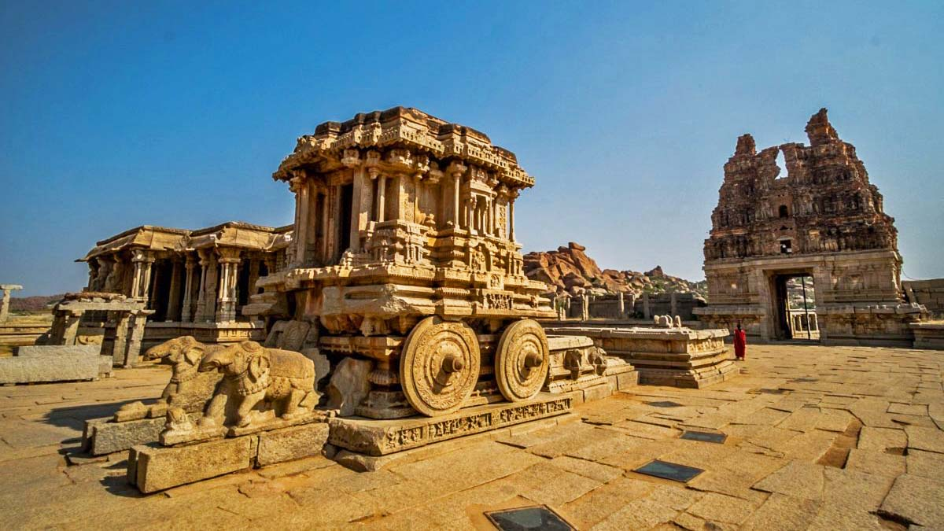
Konark Sun Temple, Konark, Orissa

Slide 42
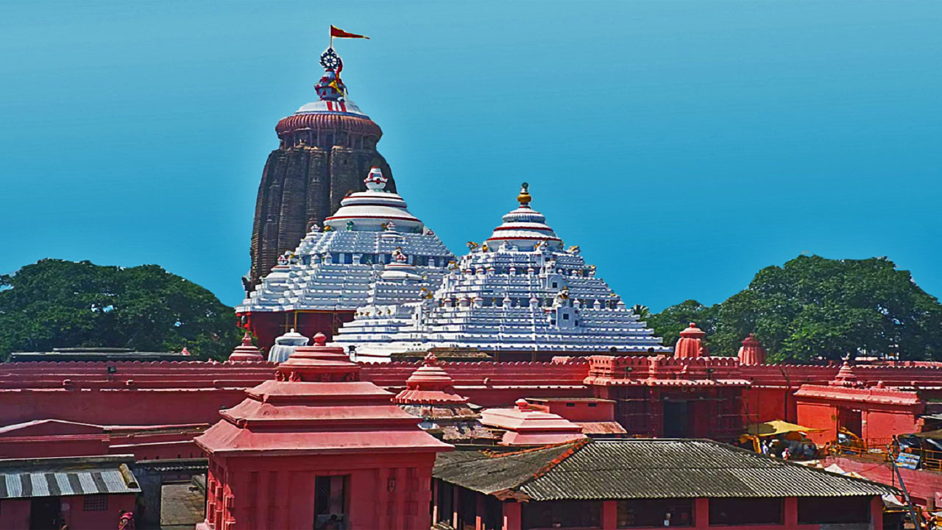
Shri Jagannath Temple, Puri, Orissa

Slide 43
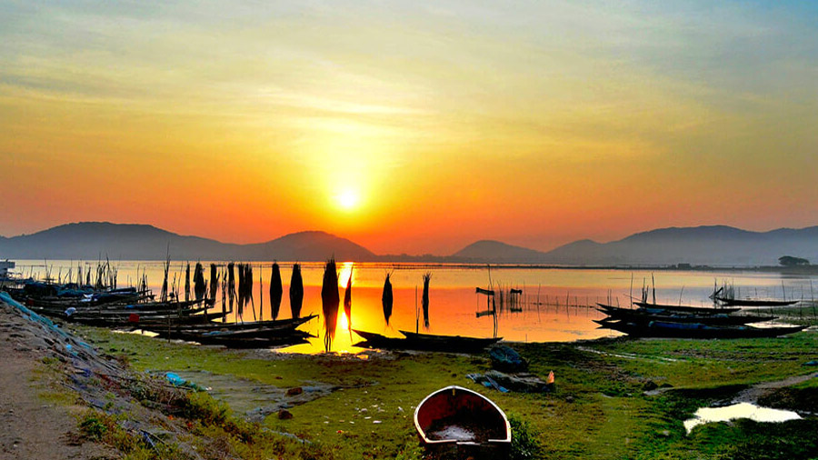
Beacon Island on Chilika Lake, Orissa

Slide 44
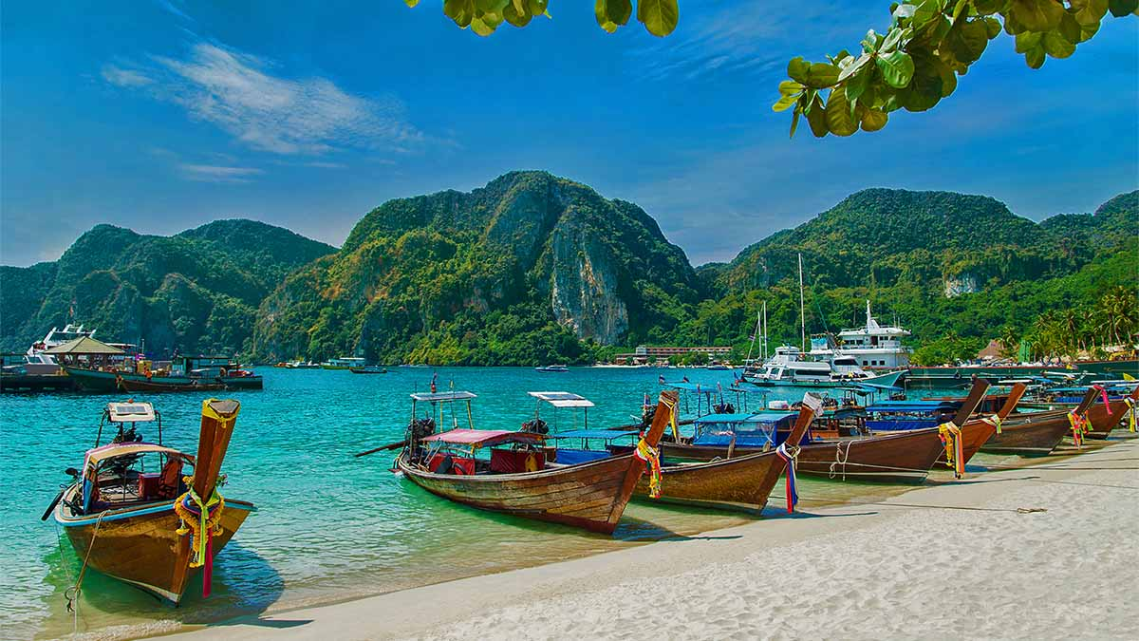
Andaman and Nicobar Islands

Slide 45
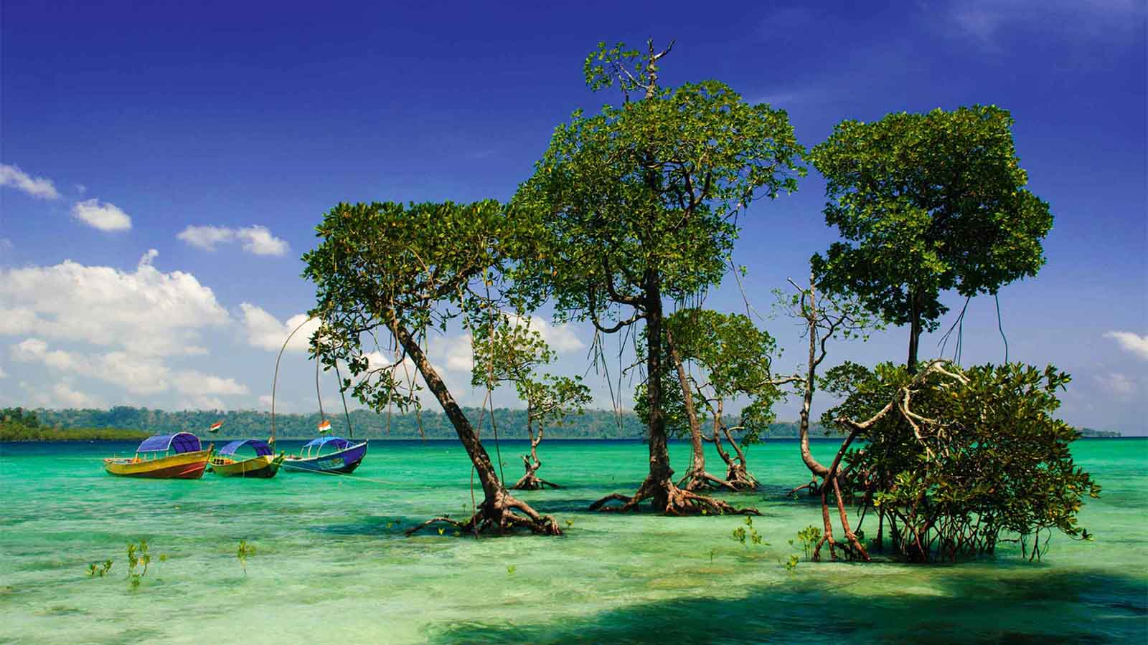
Jolly Buoy Island, Andaman and Nicobar islands

Slide 46
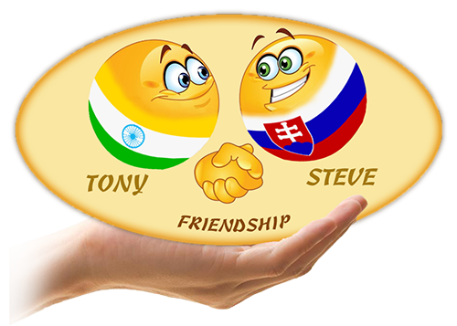



2019
Non-commercial presentation!
Photos : Internet
Music : Stive Morgan - Magic Travel
Compilation : Tony Chacko (India)
tonychacko2000@gmail.com
Technical cooperation: Steve Rumpler (Slovakia)
pista2011@gmail.com
Thank you for watching the presentation...

