Slide 1


Places of Europe
that must be seen
in ones lifetime
2017
2
Compiled by - Tony Chacko and Steve Rumpler

Slide 2
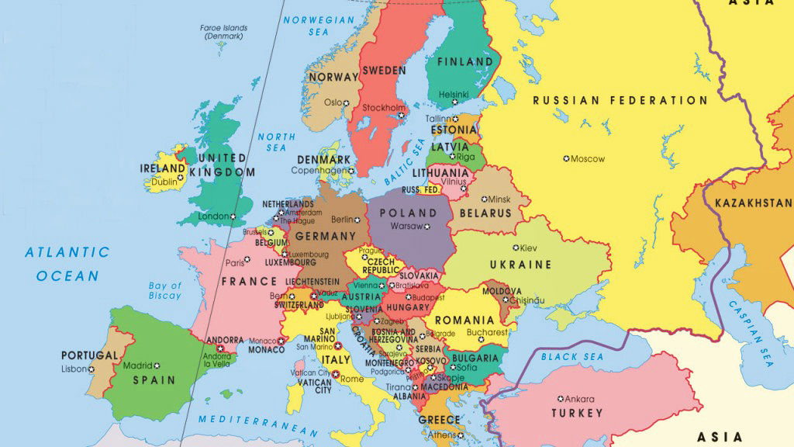

Europe
2017
Compiled by - Tony Chacko and Steve Rumpler

Slide 3
Europe - a concept dating back to classical antiquity - is a continent that comprises the westernmost part of Eurasia. Europe is bordered by the Arctic Ocean to the north, the Atlantic Ocean to the west, and the Mediterranean Sea to the south. Politically, Europe is divided into about 50 nations of which the Russian Federation is the largest, spanning 39% of the continent and comprising 15% of its population. Europe, in particular ancient Greece, was the birthplace of Western civilization. The fall of the Roman Empire, during the migration period, marked the end of ancient history and the beginning of an era known as the Middle Ages. Renaissance humanism, exploration, art, and science led to the modern era. From the Age of Disco-very onwards, Europe played a predominant role in global affairs. Between the 16th and 20th centuries, European powers controlled at various times the Americas, most of Africa, Oceania, and the majority of Asia. The Industrial Revolution, which began in Great Britain at the end of the 18th century, gave rise to radical economic, cultural, and social change in Western Europe, and the wider world. Here is a presentation of great touring places of European countries. Though Turkey is not in the E.U., historically and geographically it had been the cause for some cultural and geographic changes to the European culture and region by it’s past Arab invasions.
Area : 10.18 million km²
Population : 743.1 million (2015)
Languages : English, French, German, Italian, Russian, Spanish; (total about - 225 languages)
Compiled by - Tony Chacko and Steve Rumpler

Slide 4
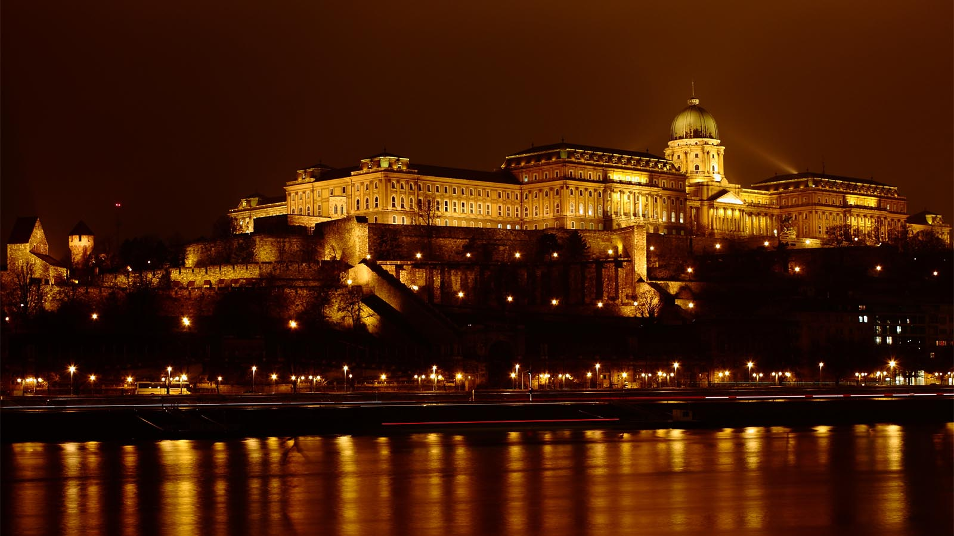

HUNGARY (Castle, Budapest)

Slide 5
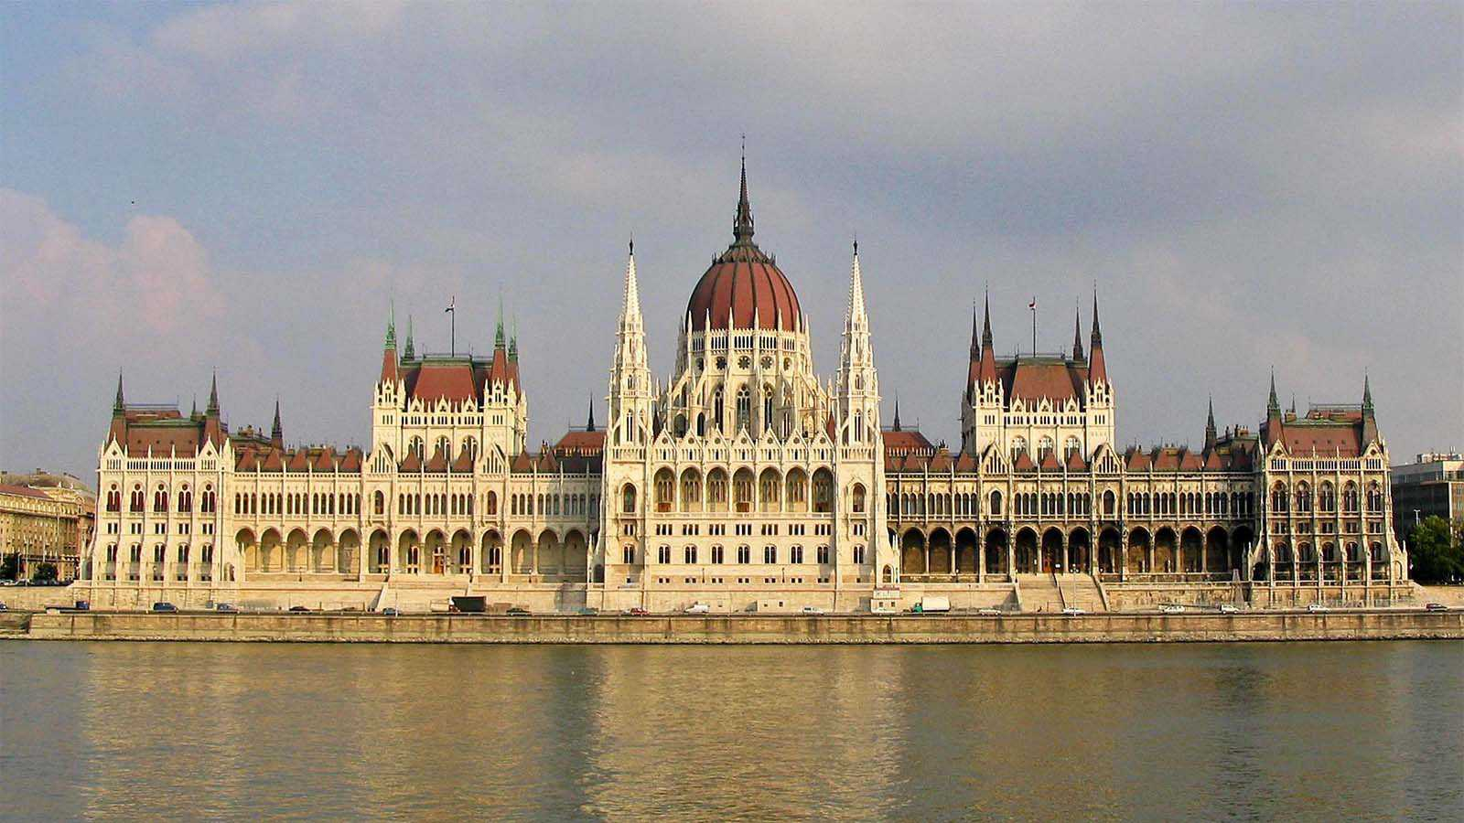
HUNGARY (Parliament House, Budapest)

Slide 6
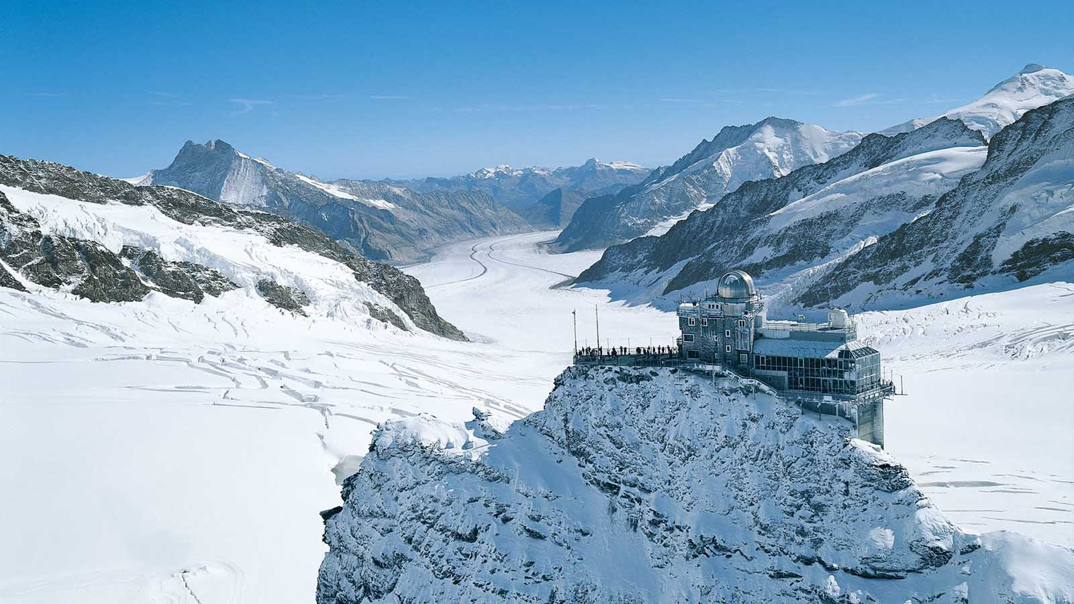
SWITZERLAND (The Sphinx Observatory)

Slide 7
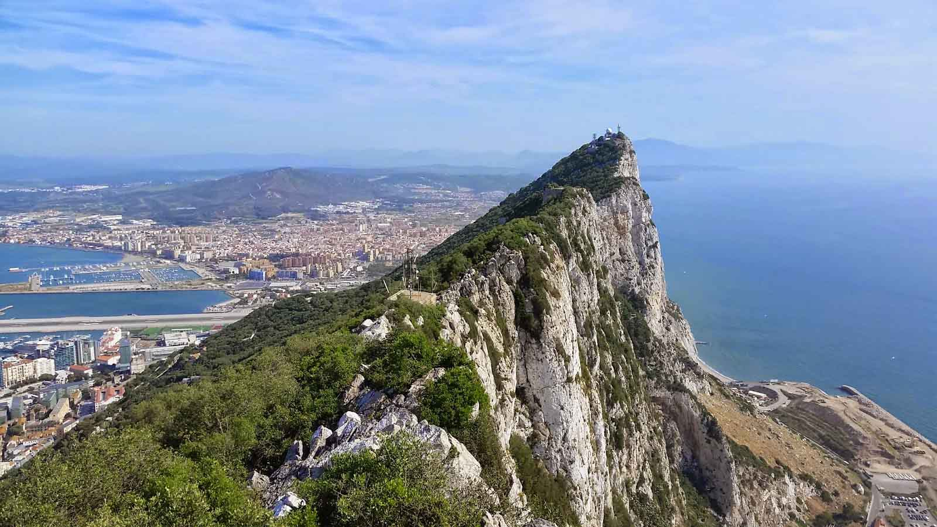
GIBRALTAR (The Rock of Gibraltar)

Slide 8
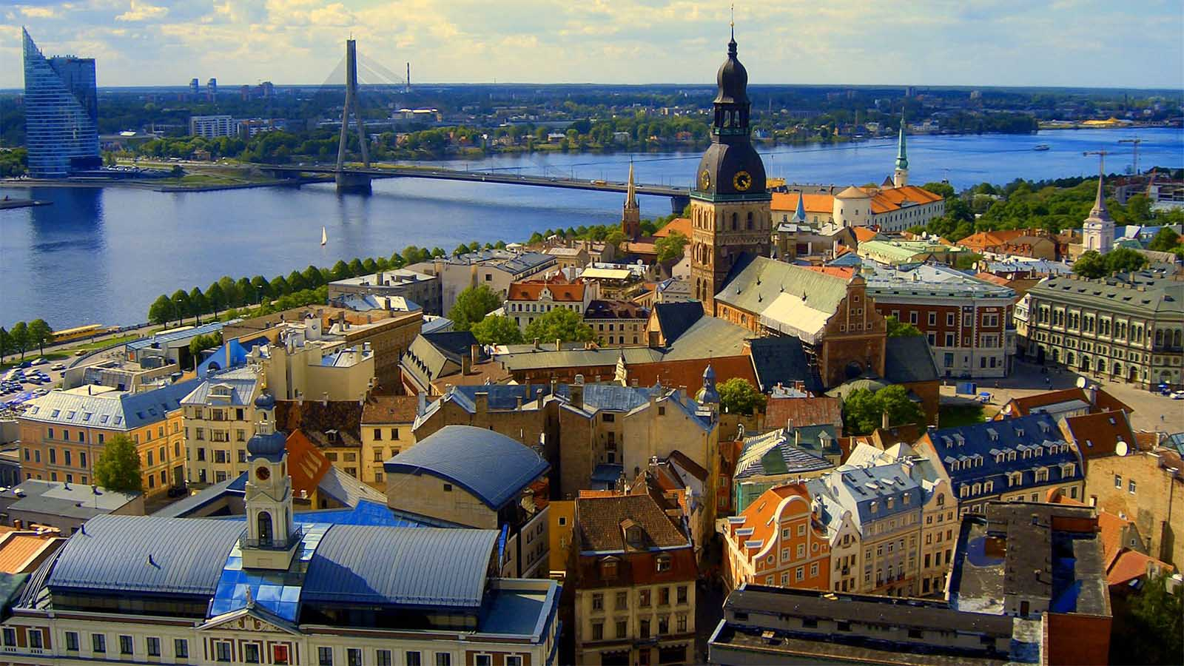
LATVIA (Riga)

Slide 9
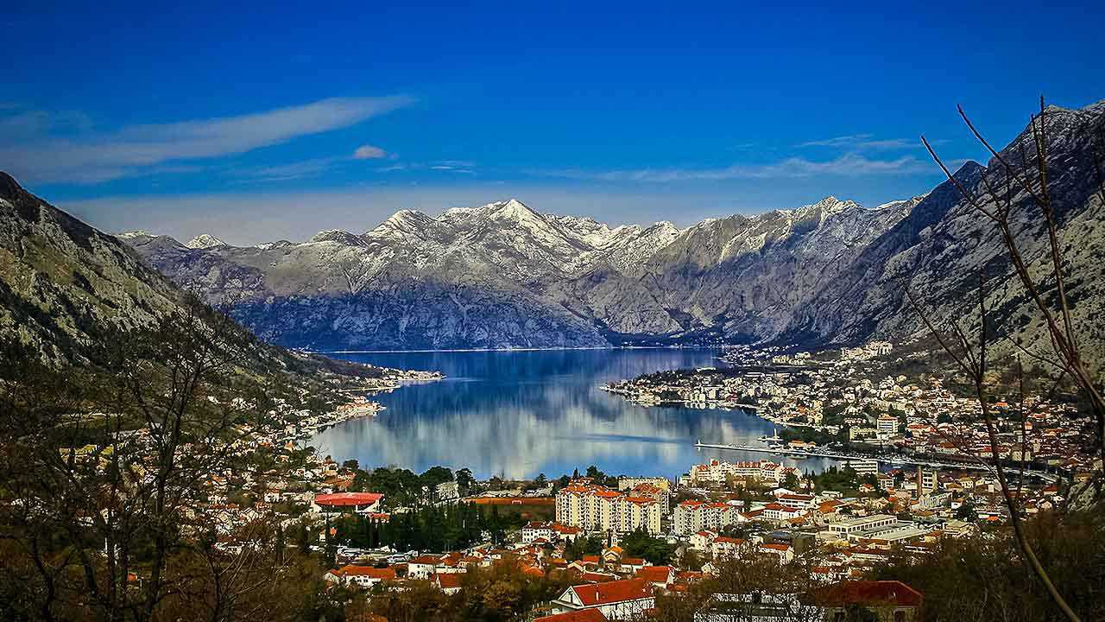
MONTENEGRO (Kotor)

Slide 10
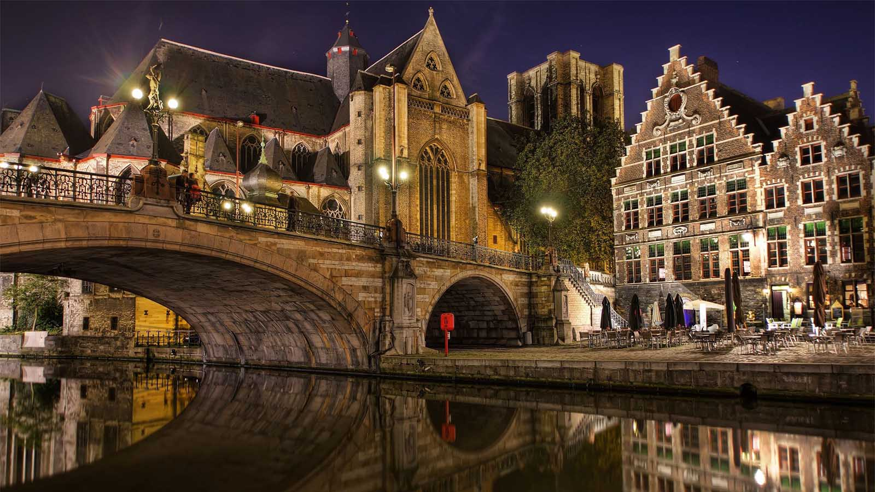
BELGIUM (Ghent)

Slide 11
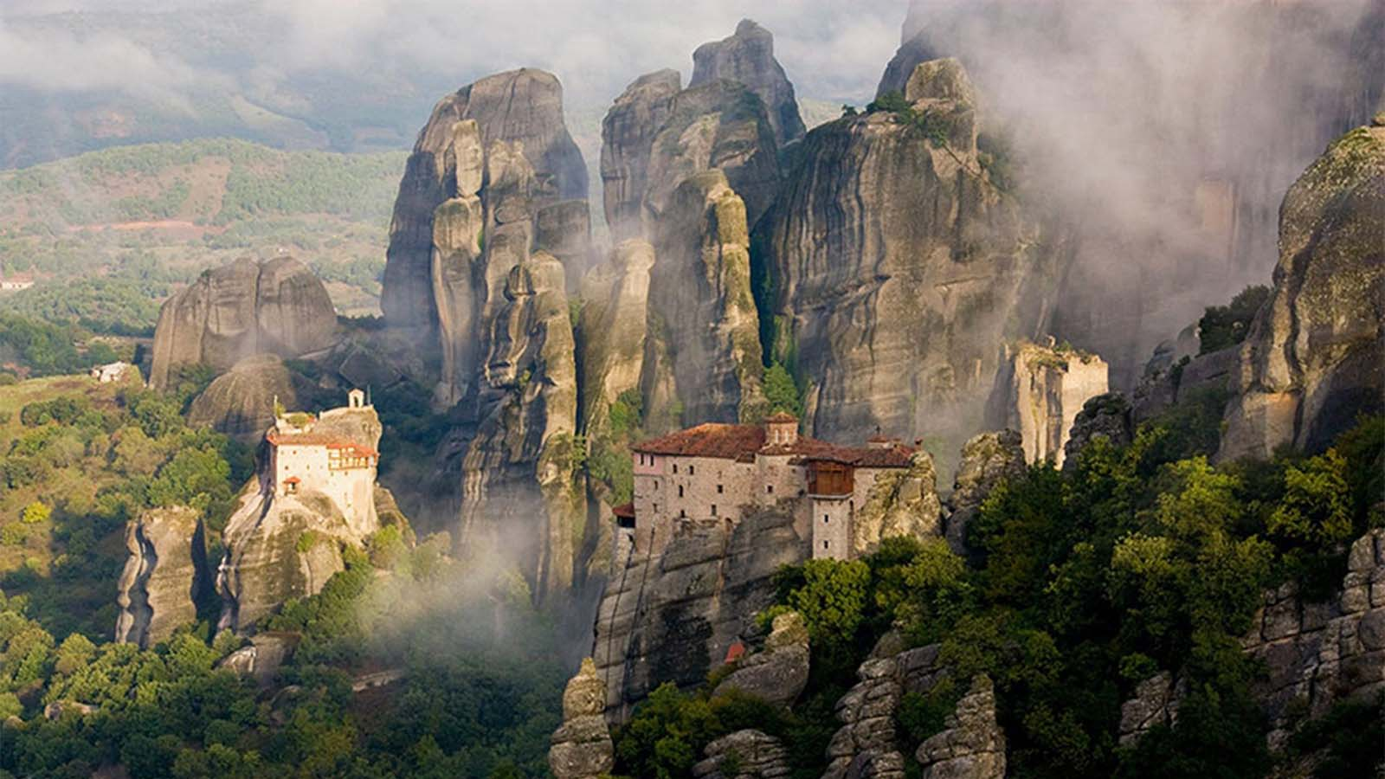
GREECE (Metéora Monasteries)

Slide 12
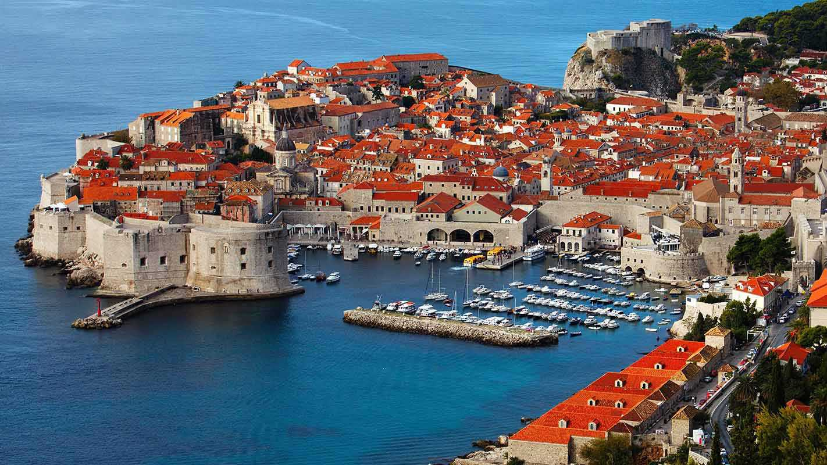
CROATIA (Dubrovnik)

Slide 13
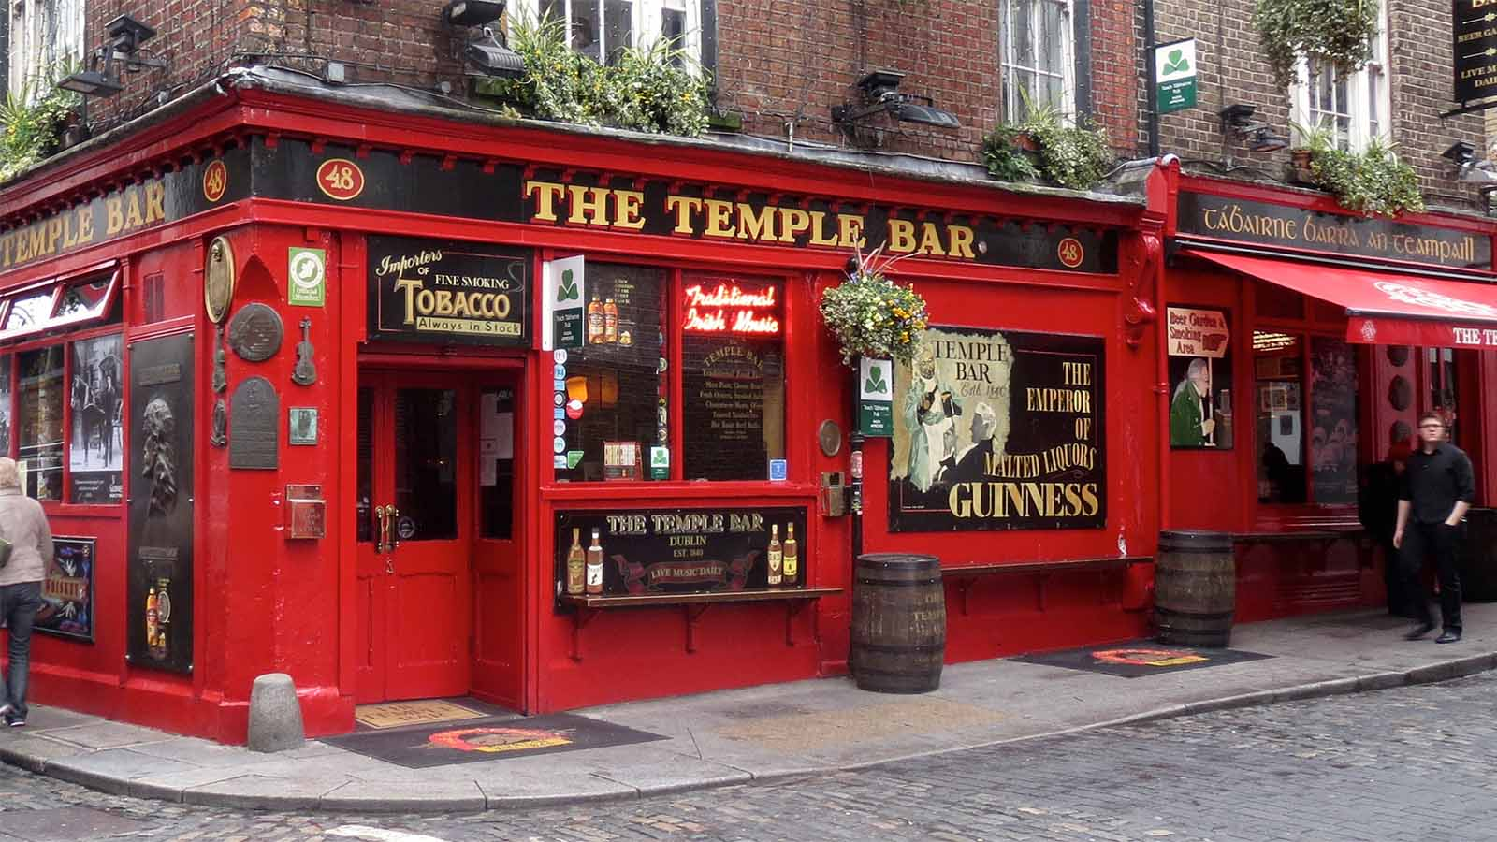
IRELAND (The Temple Bar, Dublin)

Slide 14
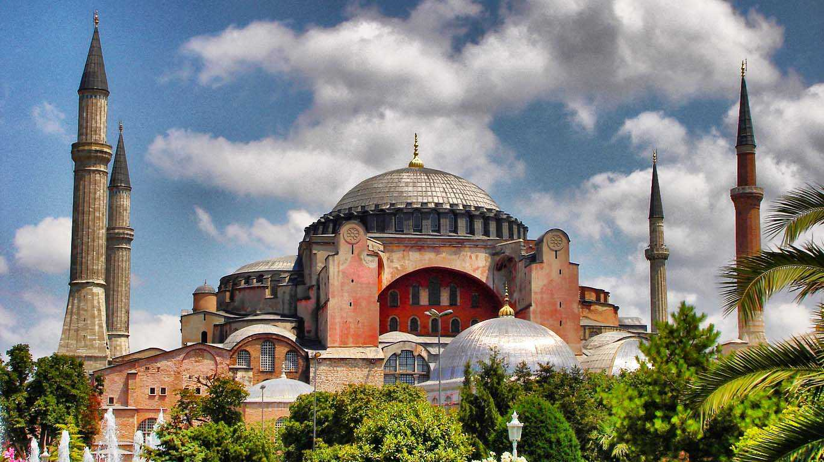
TURKEY (Hagia Sophia, Istanbul)

Slide 15
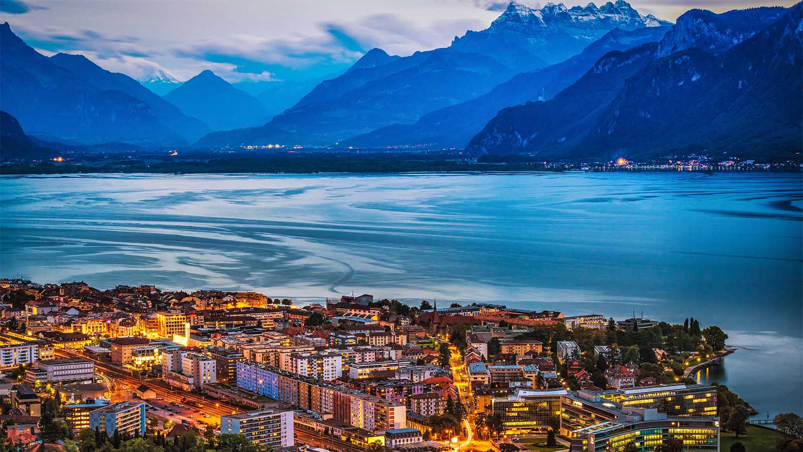
SWITZERLAND (Lake Geneva)

Slide 16
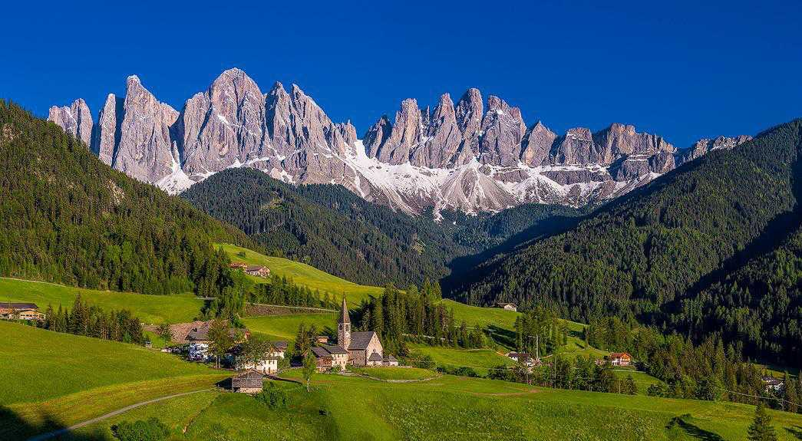
ITALY (Dolomites)

Slide 17
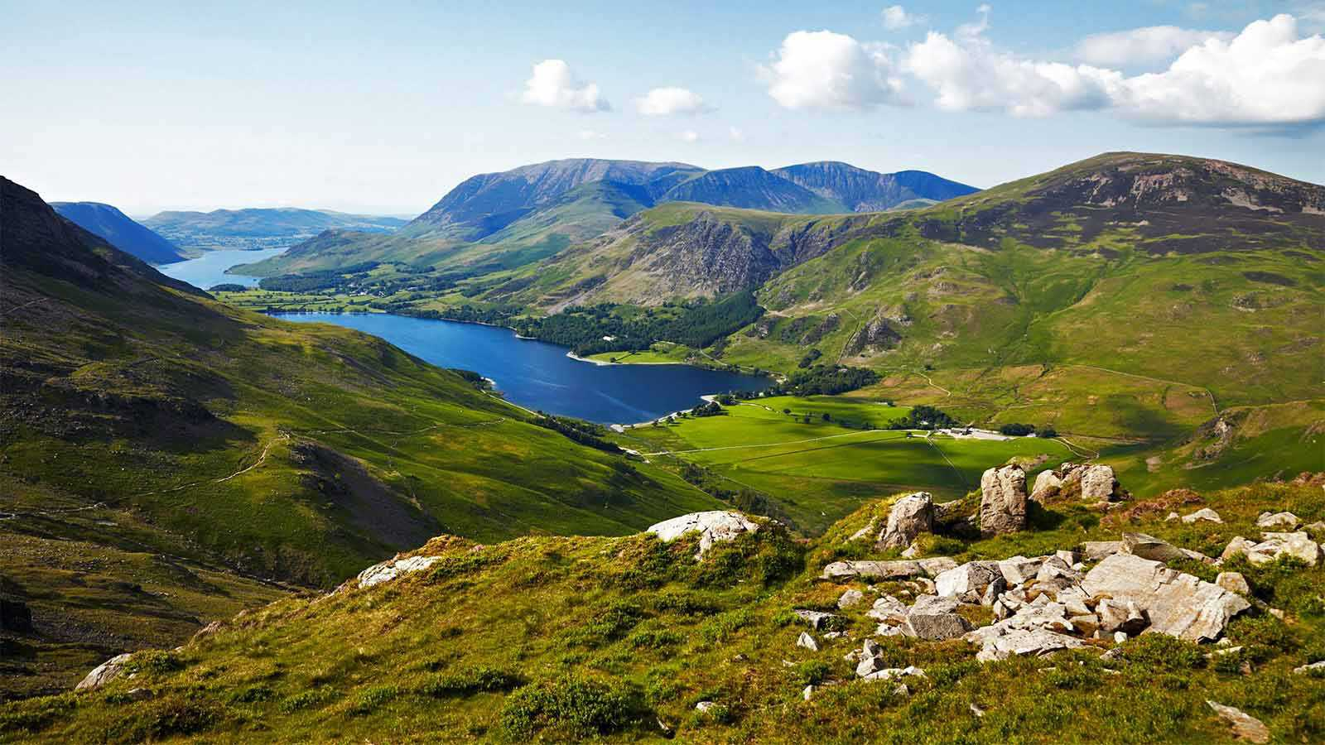
ENGLAND (Lake District)

Slide 18
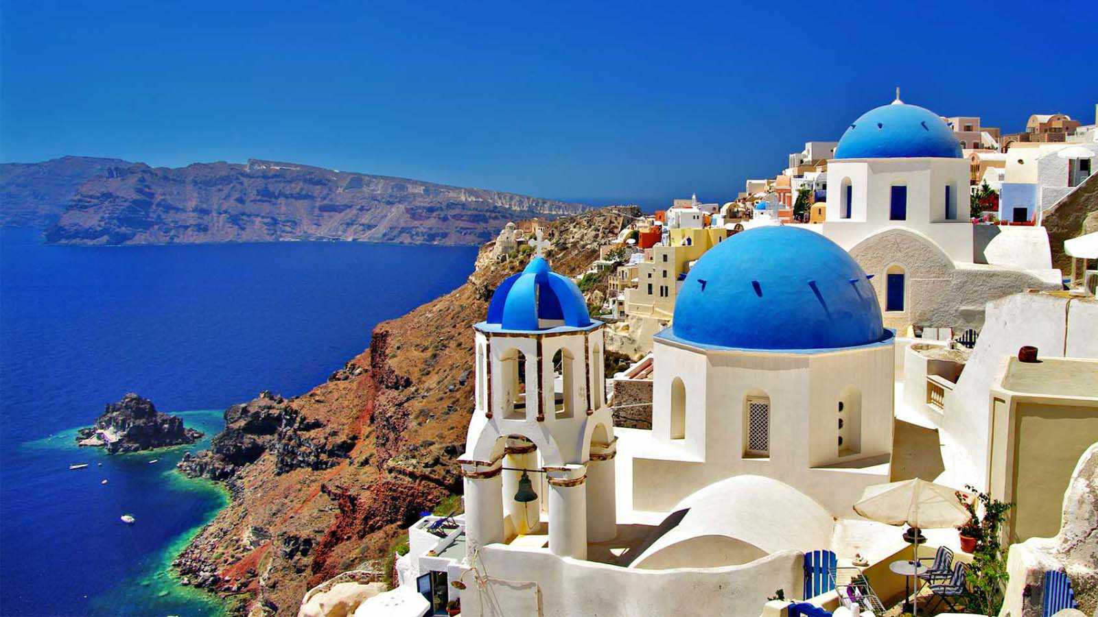
GREECE (Santorini Island)

Slide 19
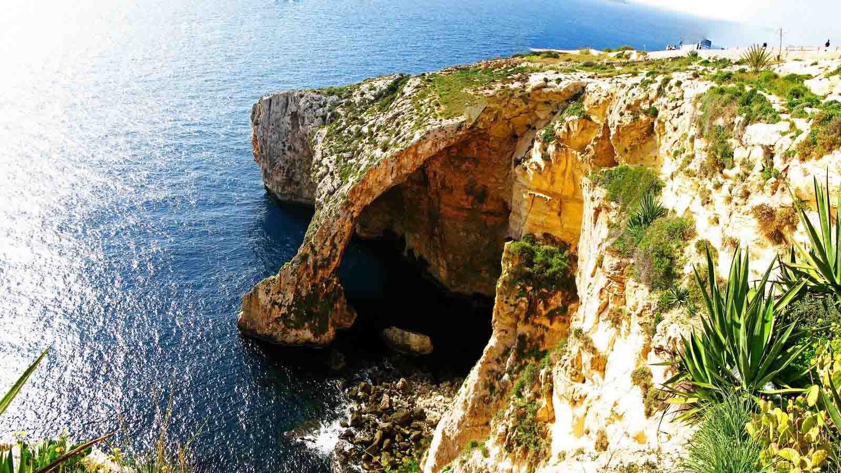
MALTA (Blue Grotto)

Slide 20
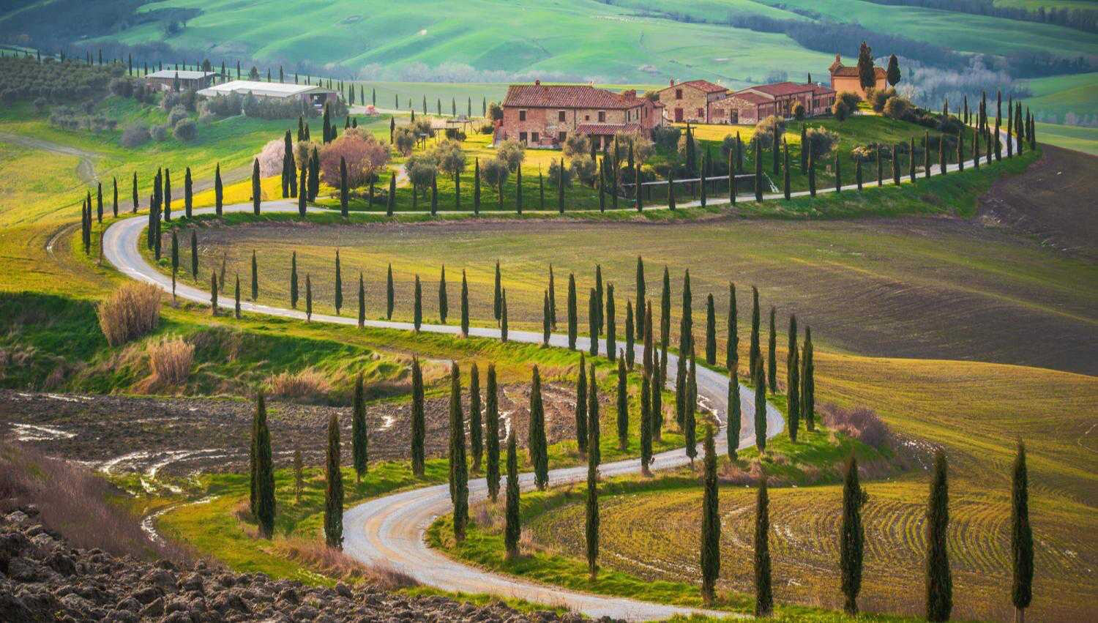
ITALY (Tuscany)

Slide 21
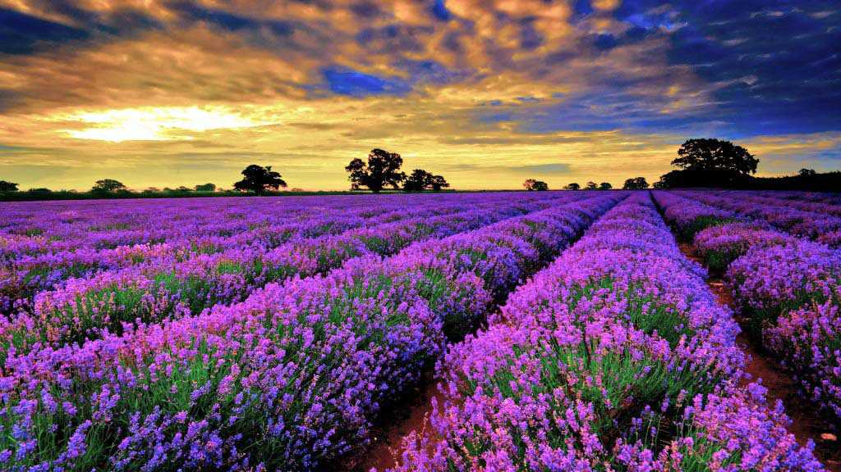
FRANCE (lavender fields, Provence)

Slide 22
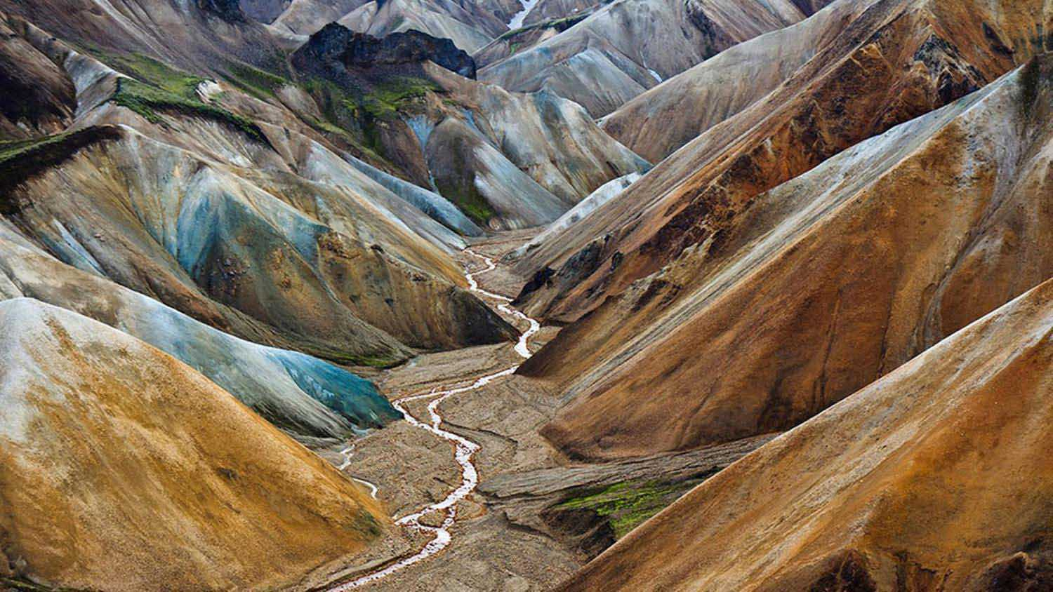
ICELAND (Landmannalaugar)

Slide 23
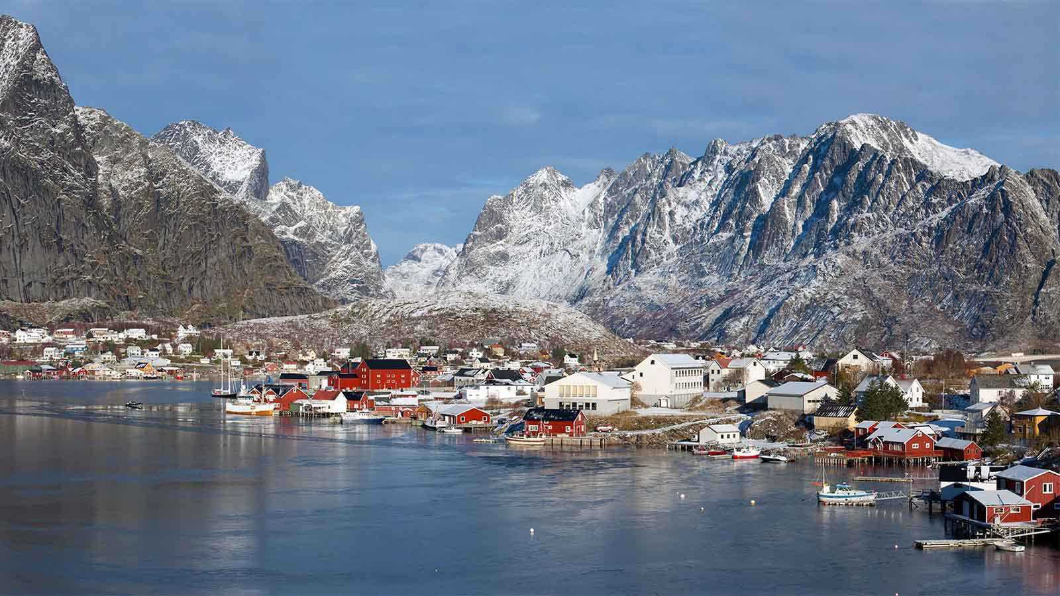
NORWAY (Lofoten)

Slide 24
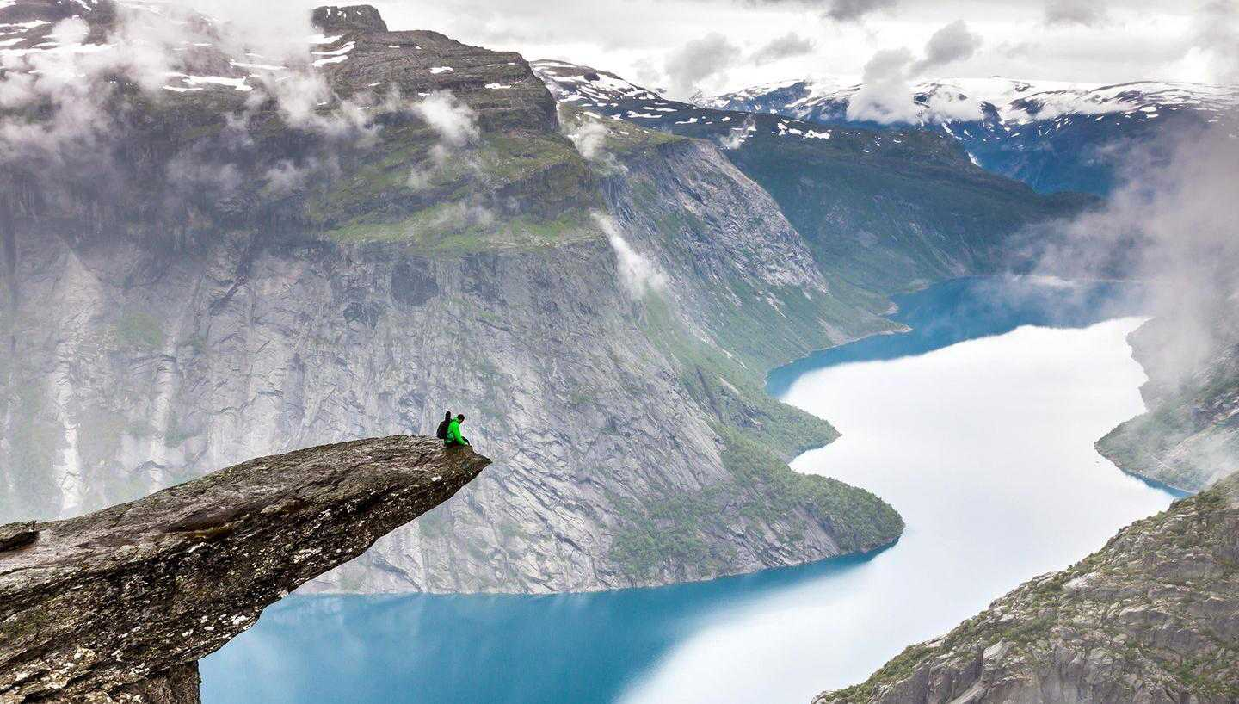
NORWAY (Trolltunga, Hordaland)

Slide 25
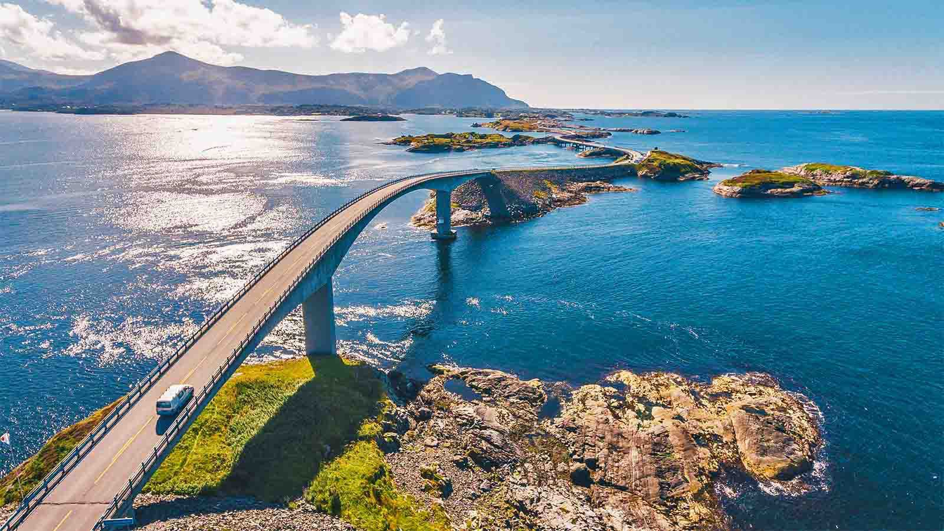
NORWAY (The Atlantic Ocean Road)

Slide 26
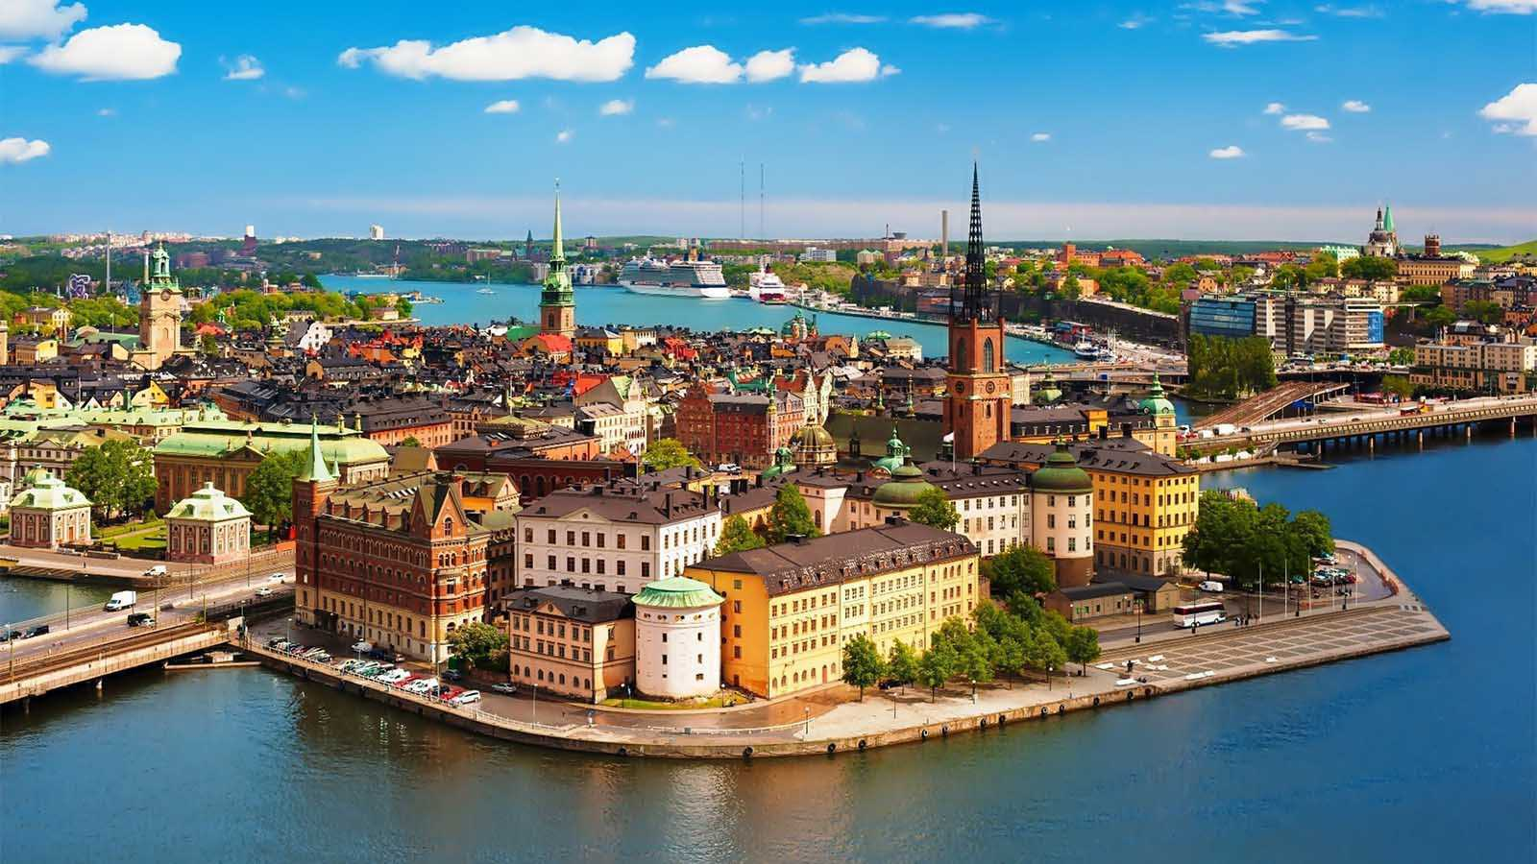
SWEDEN (Stockholm)

Slide 27
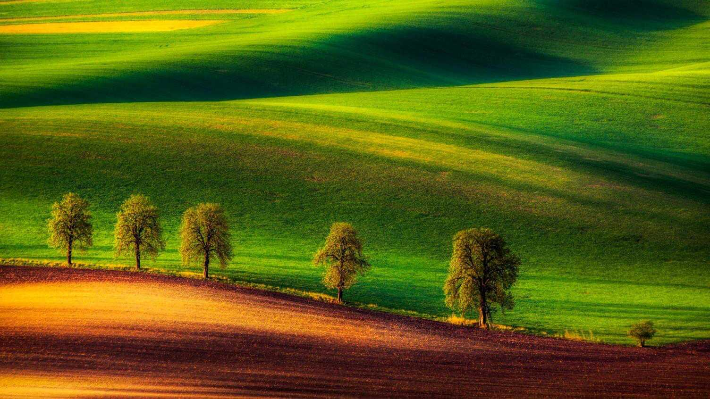
CZECH REPUBLIC (Moravian fields)

Slide 28
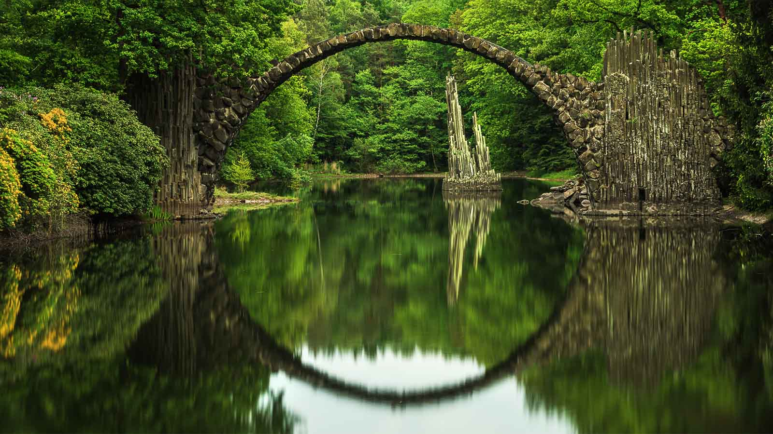
GERMANY (Rakotzbrücke, Kromlau)

Slide 29
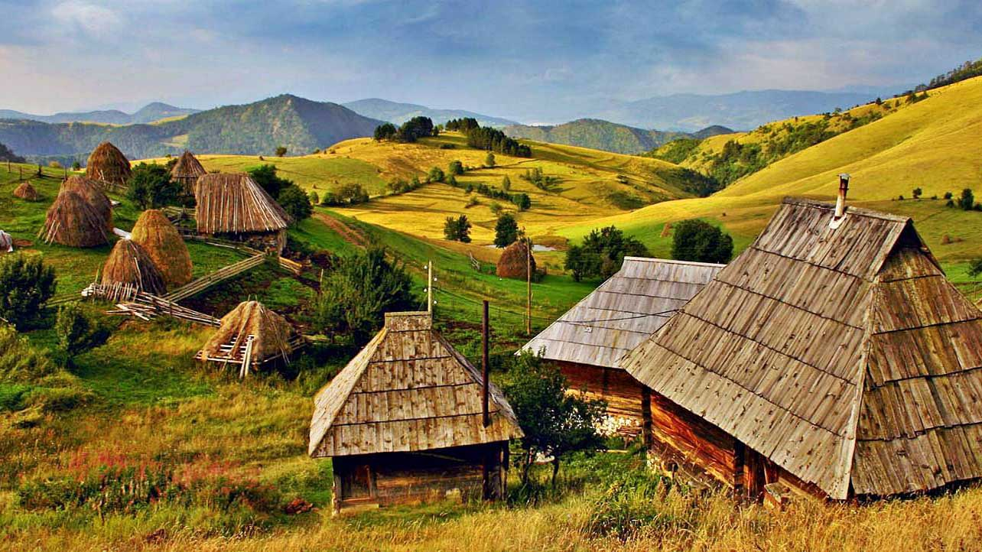
SERBIA (ethno village)

Slide 30
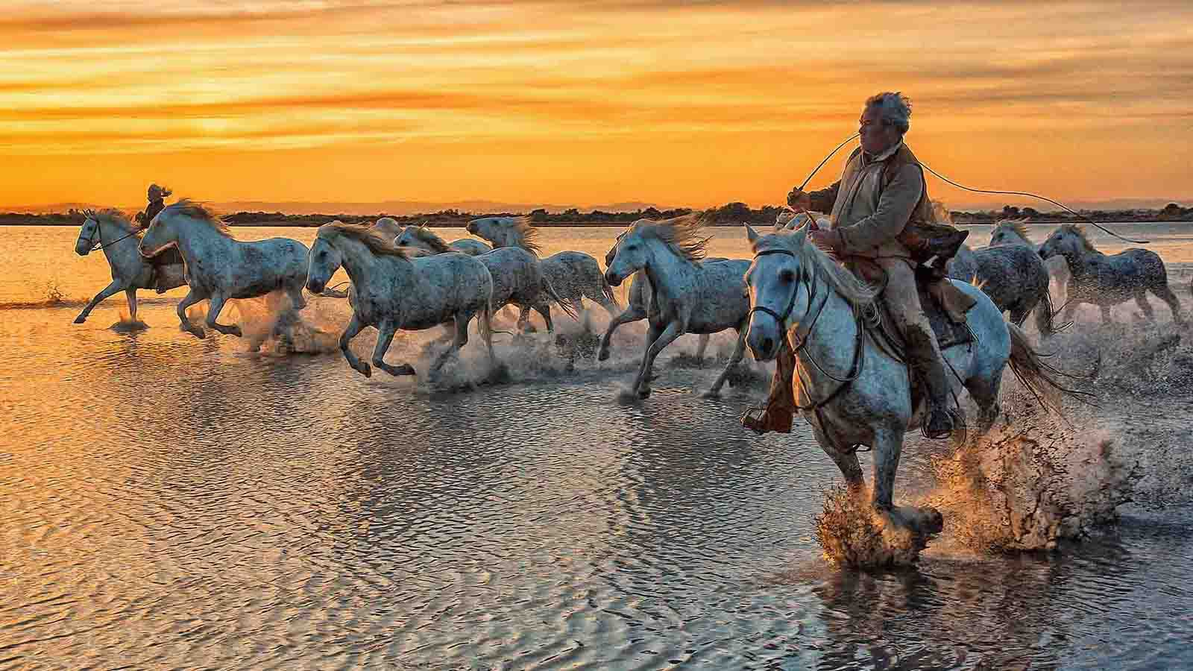
FRANCE (Camargue)

Slide 31
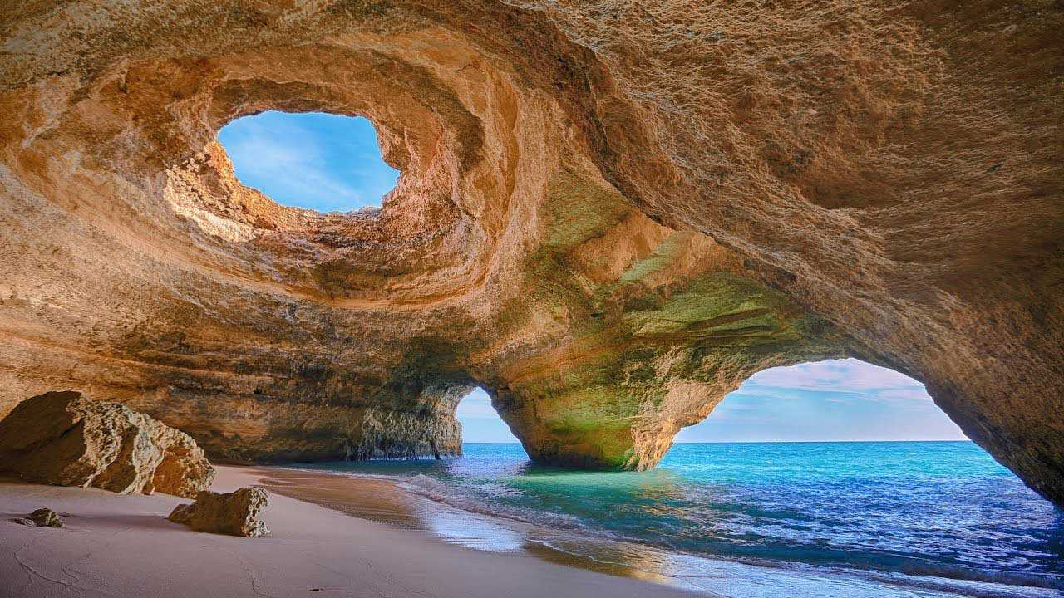
PORTUGAL (Algarve)

Slide 32
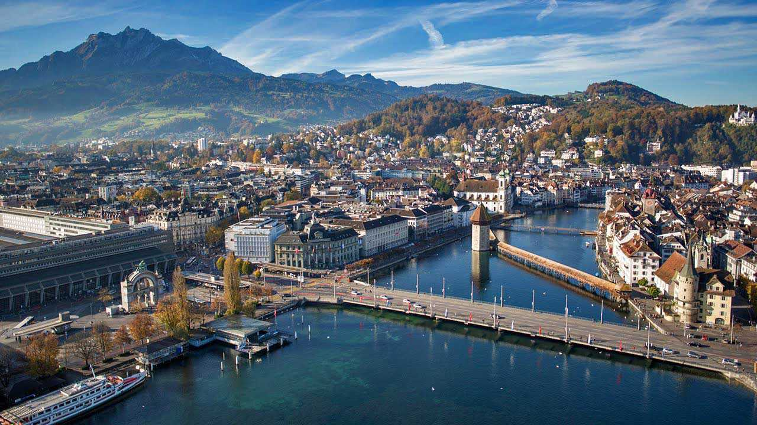
SWITZERLAND (Lucerne)

Slide 33
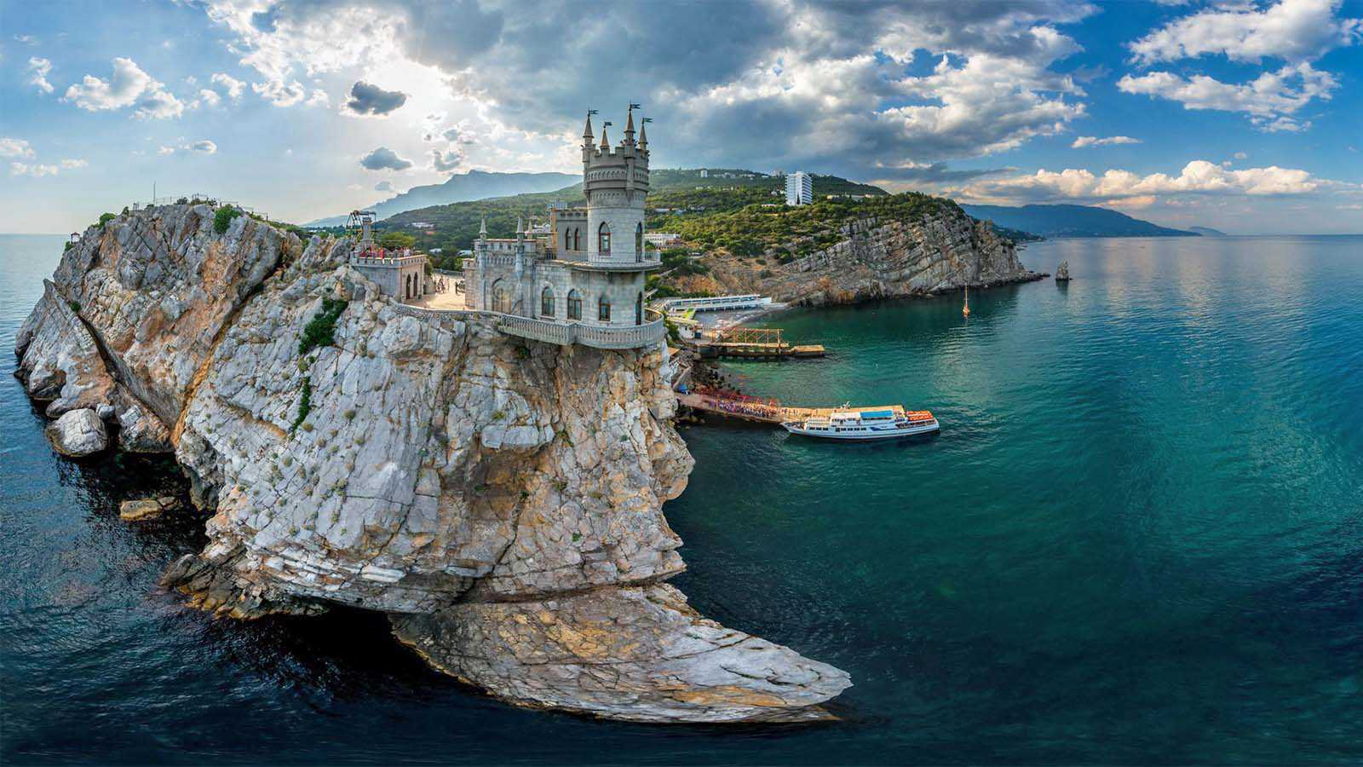
RUSSIA (The Swallow‘s Nest, Crimea)

Slide 34
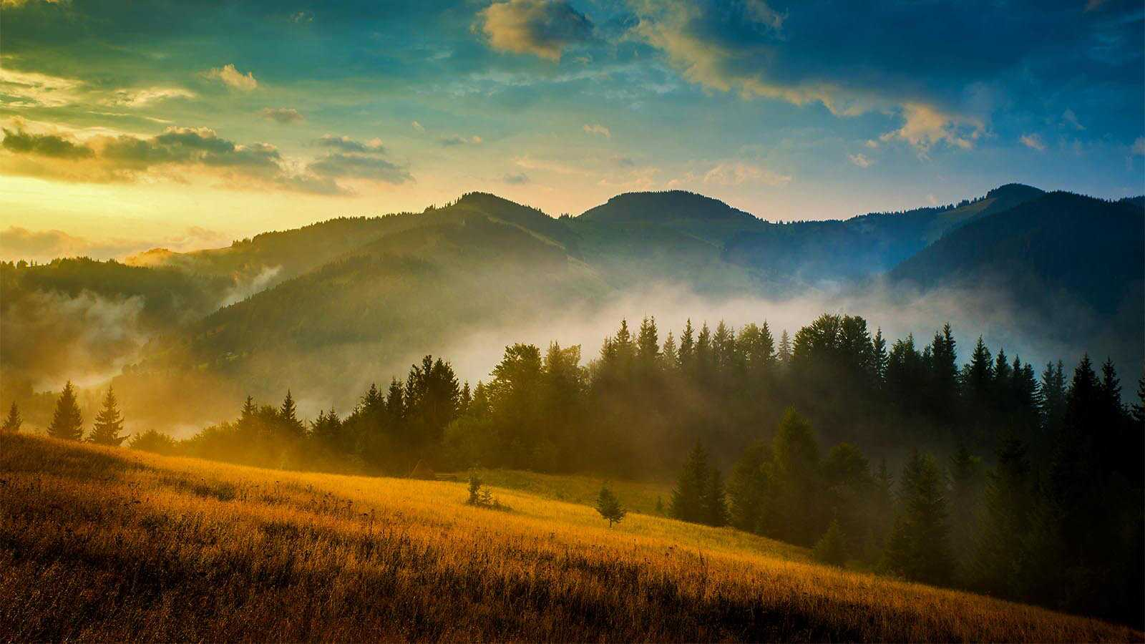
UKRAINE (Carpatian Mountains)

Slide 35
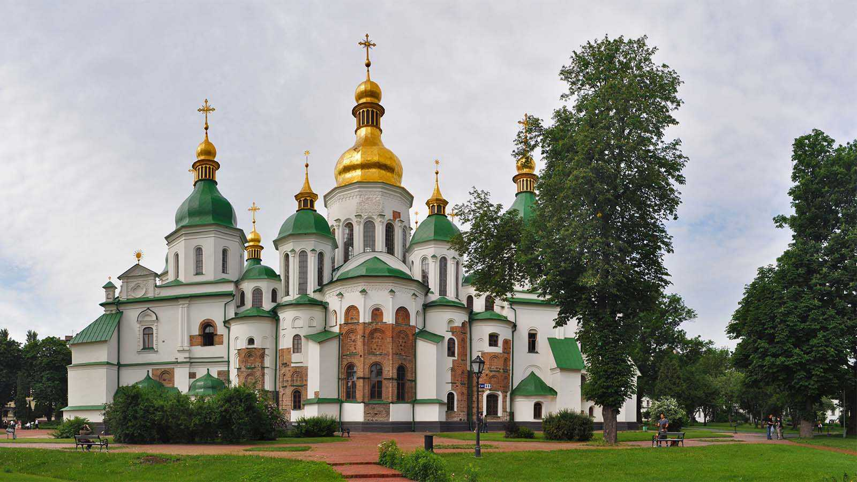
UKRAINE (St.Sophia Cathedral, Kiev)

Slide 36
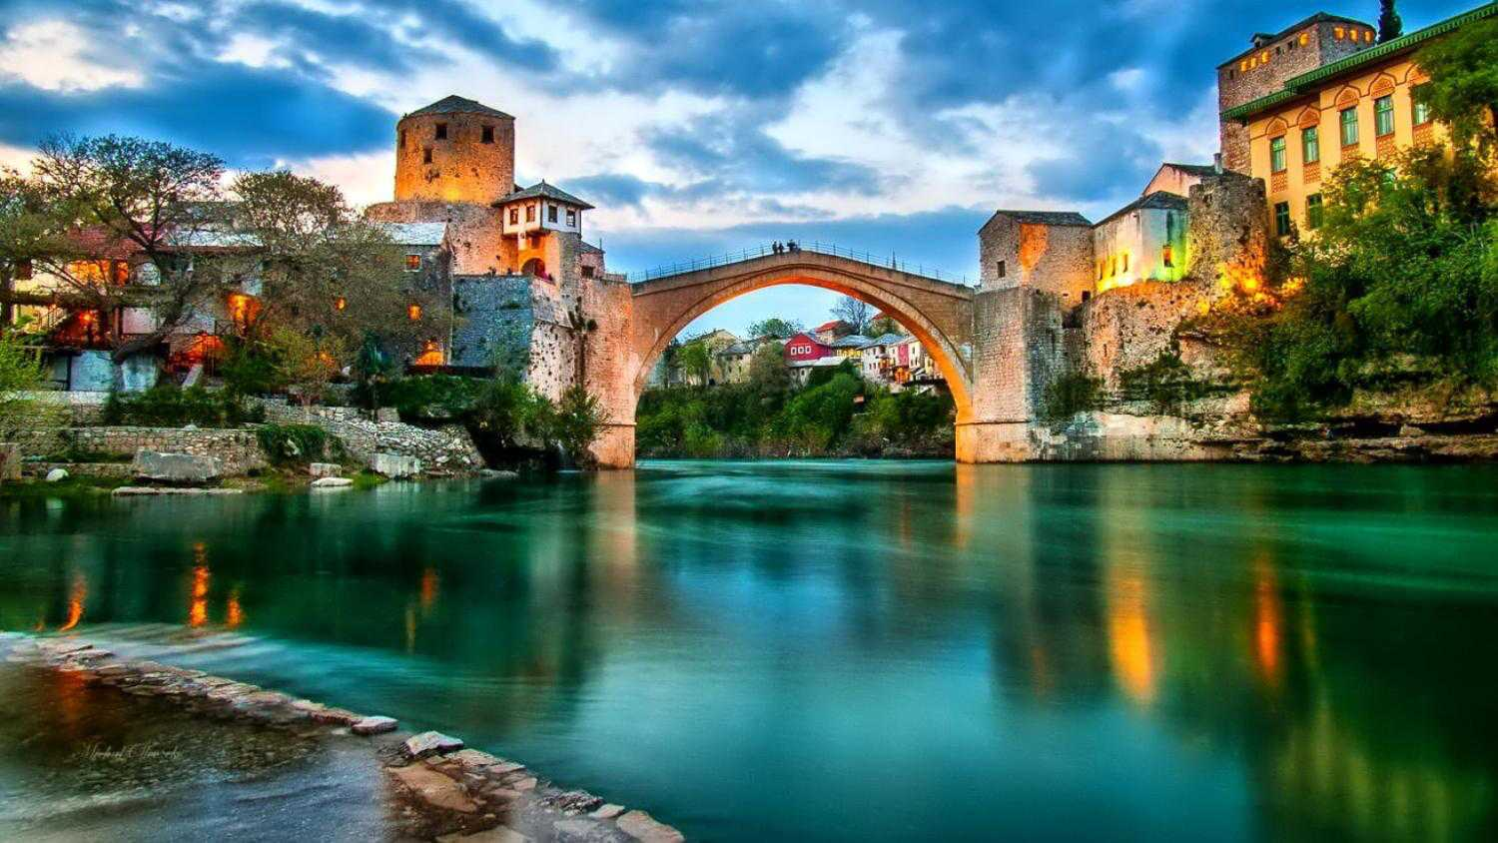
BOSNIA and HERZEGOVINA (Mostar)

Slide 37
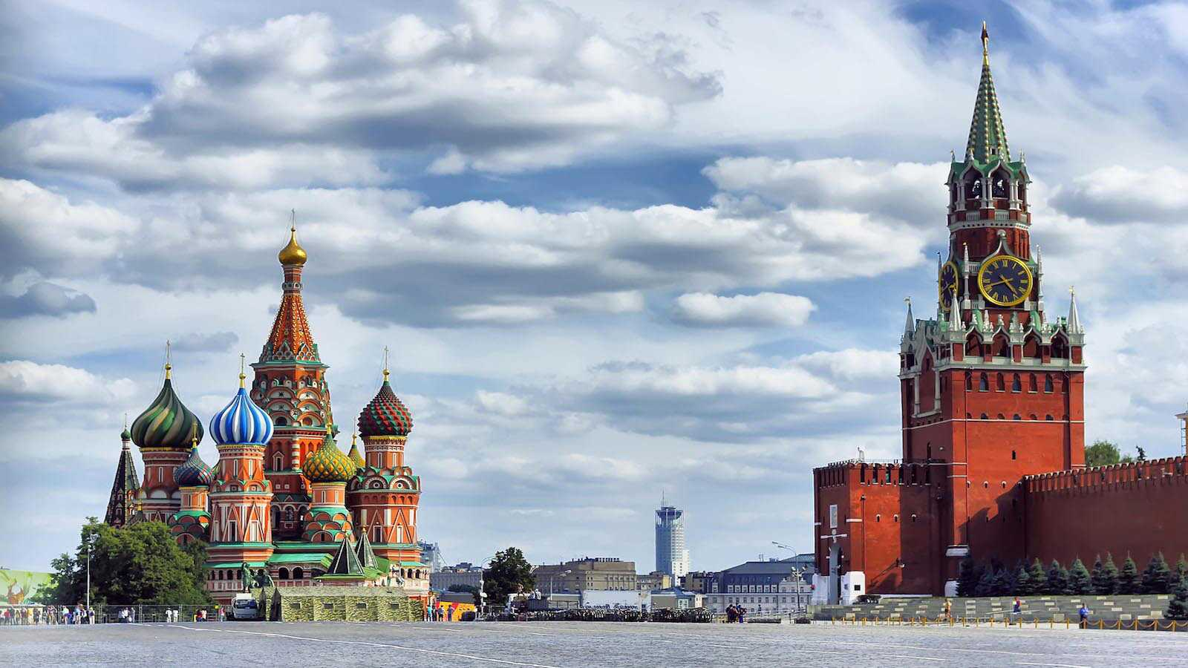
RUSSIA (Red Square, Moscow)

Slide 38
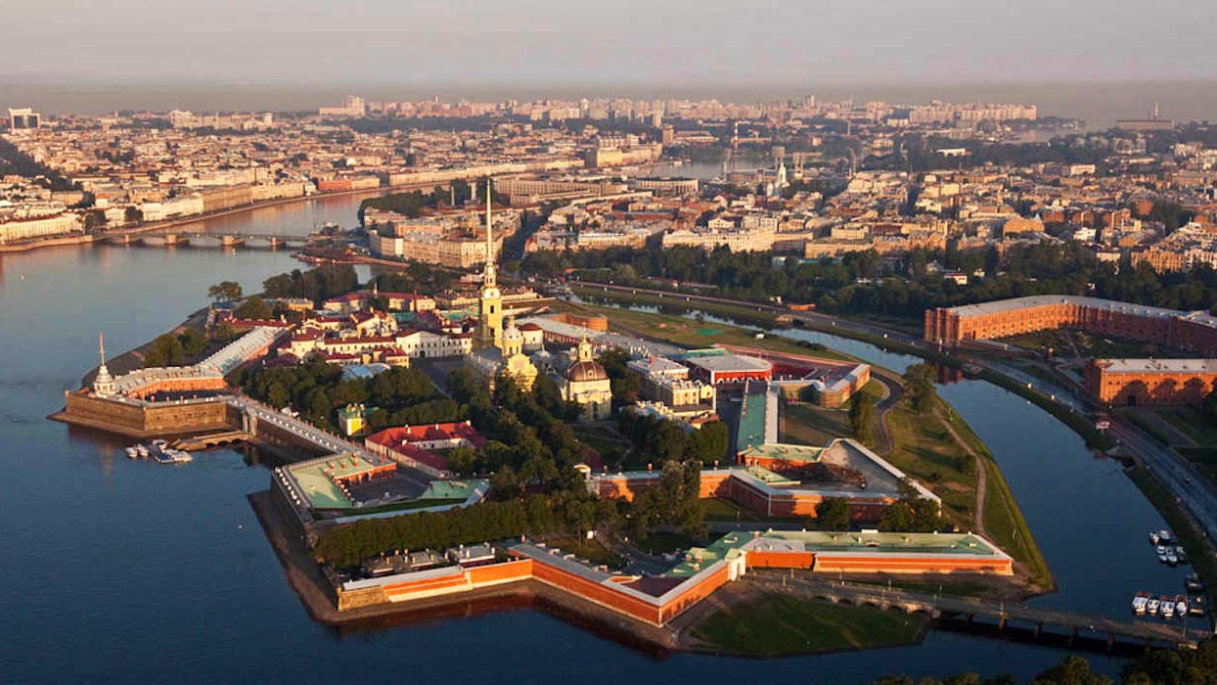
RUSSIA (St.Petersburg)

Slide 39
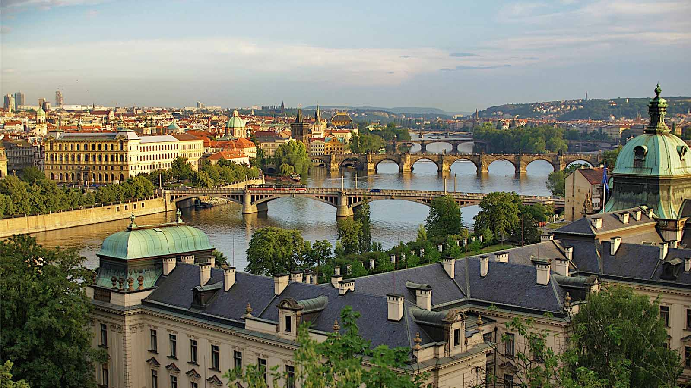
CZECH REPUBLIC (Prague)

Slide 40
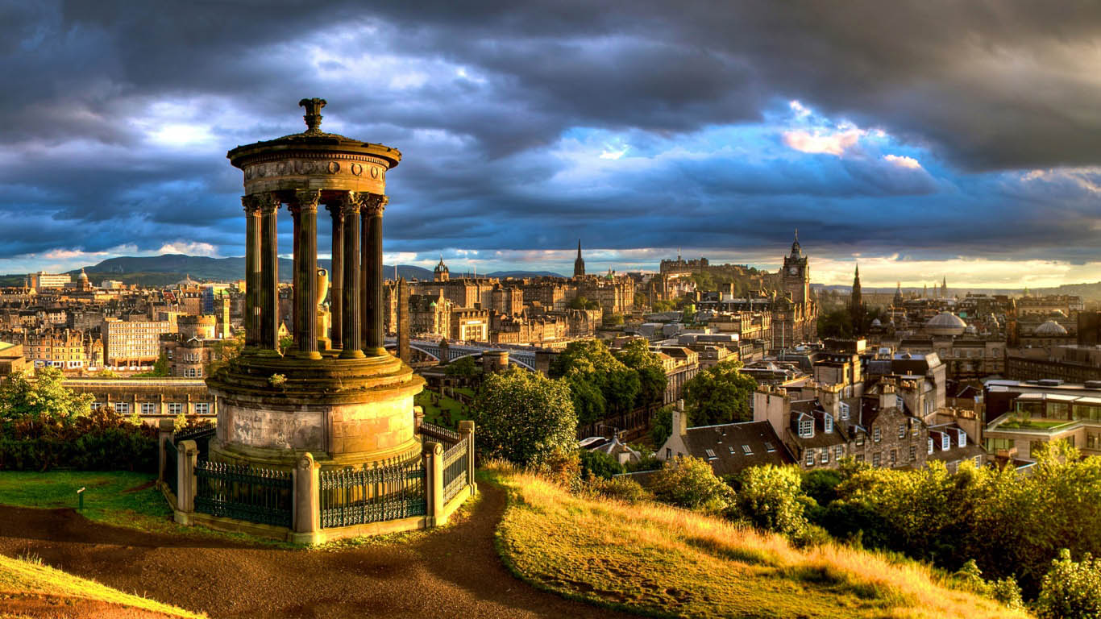
SCOTLAND (Edinburgh)

Slide 41
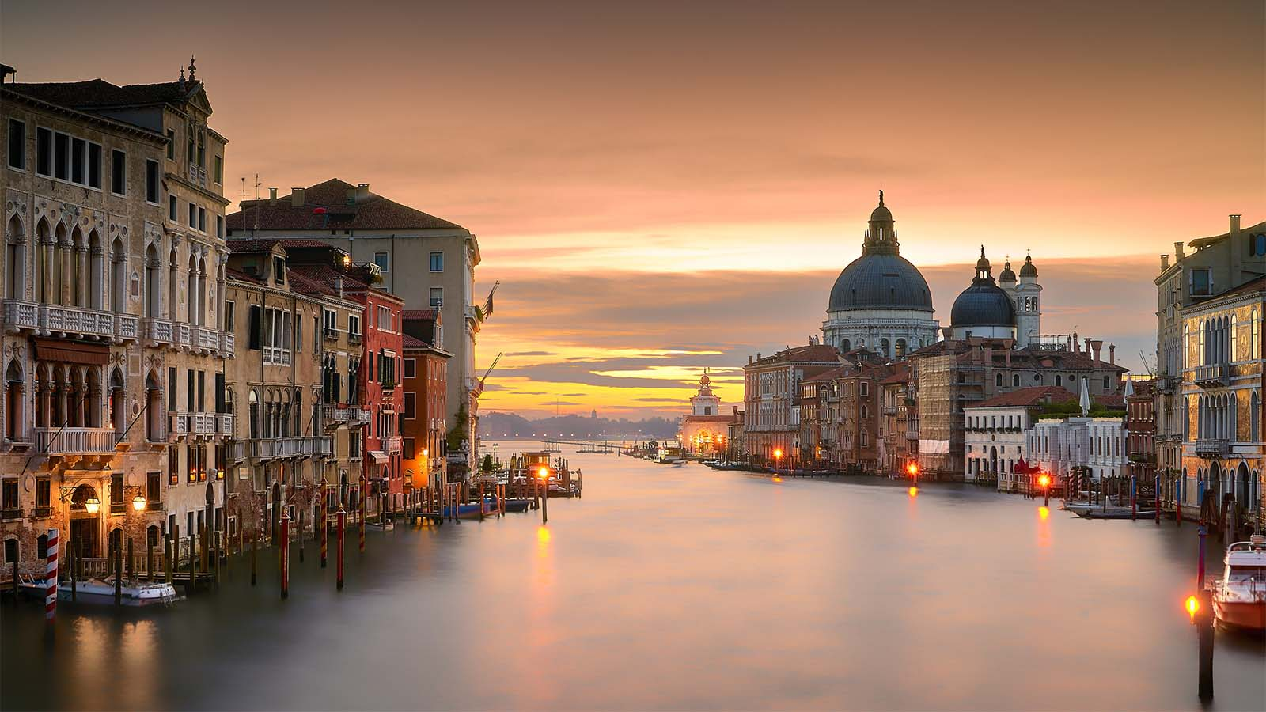
ITALY (Venice)

Slide 42
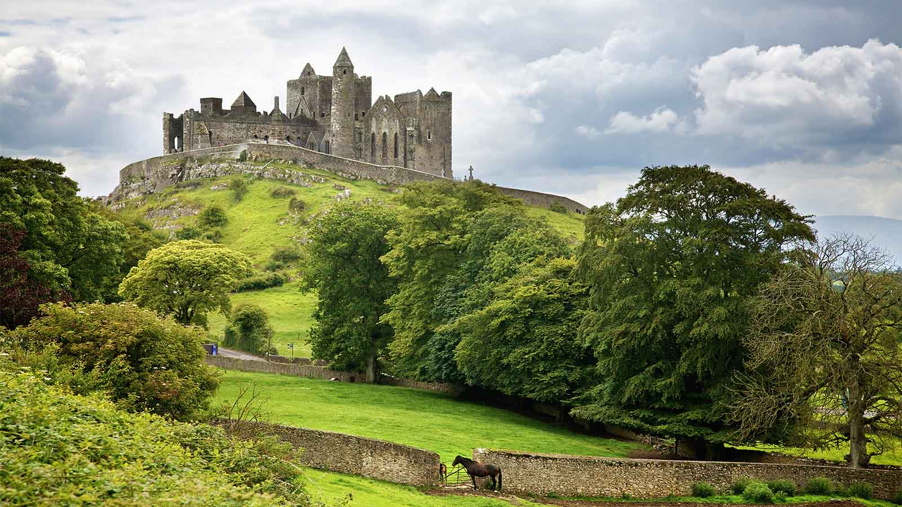
IRELAND (The Rock of Cashel)

Slide 43
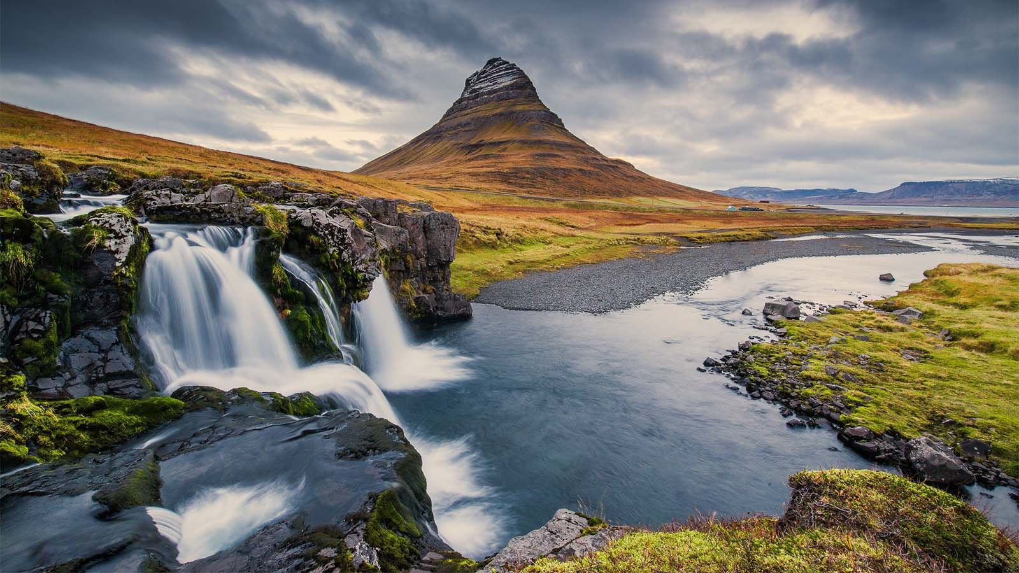
ICELAND (Kirkjufell)

Slide 44
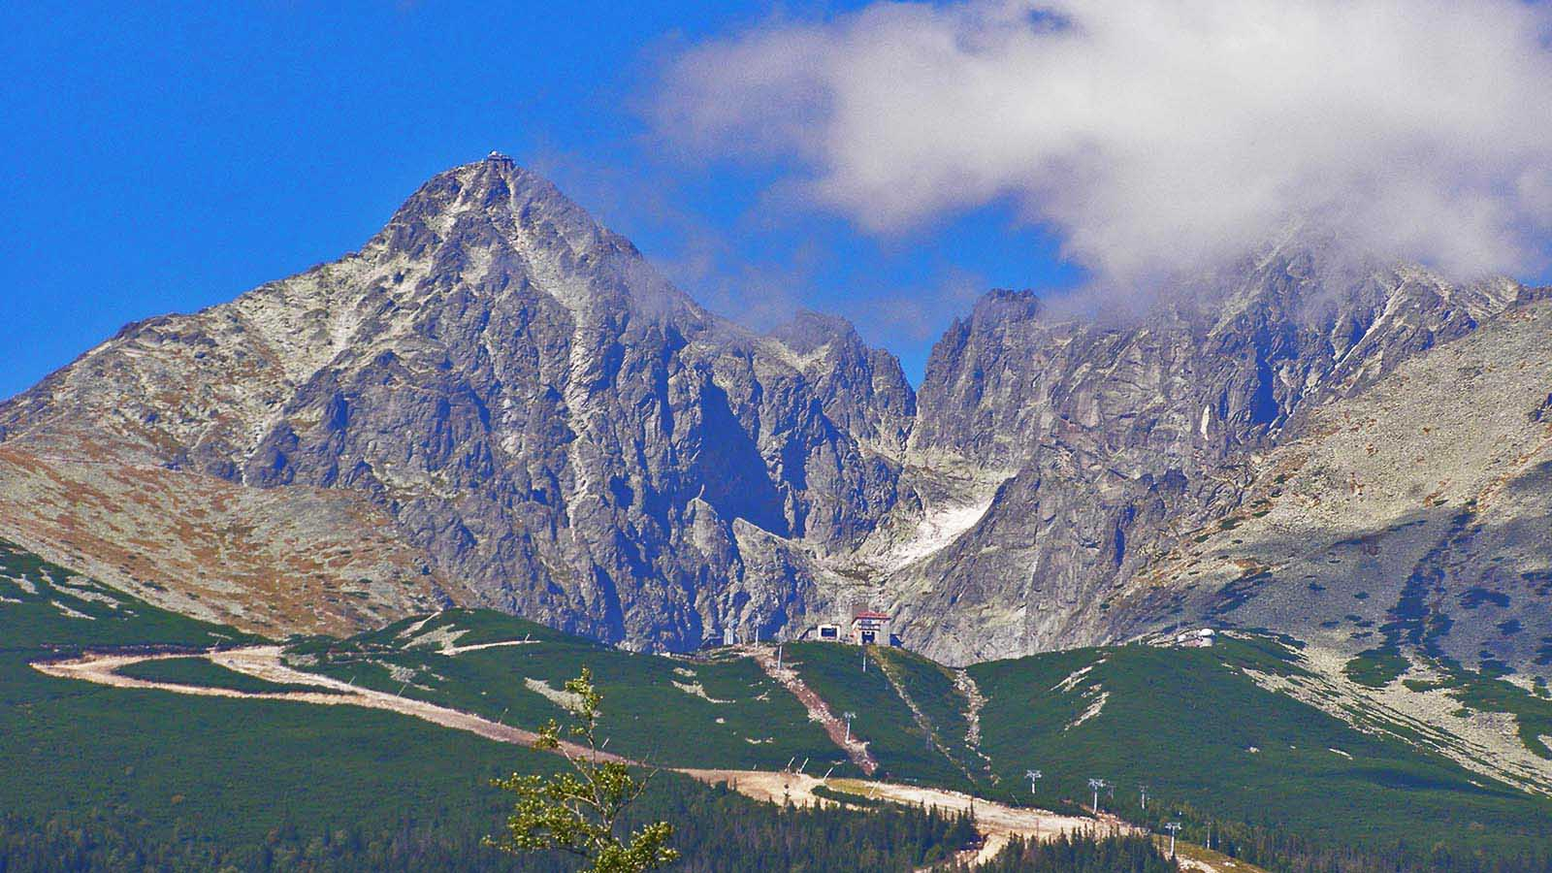
SLOVAKIA (High Tatras)

Slide 45
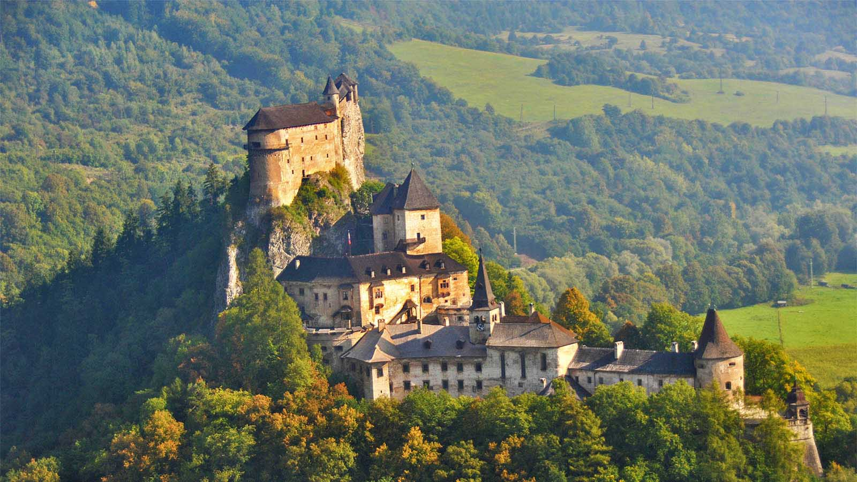
SLOVAKIA (Orava Castle)

Slide 46
Hope you have enjoyed viewing this presentation
Have a nice day
With regards - Tony Chacko and Steve Rumpler
tonychacko2000@gmail.com pista2011@gmail.com
Music: George Zamfir – Let It Be
2017

