Slide 1
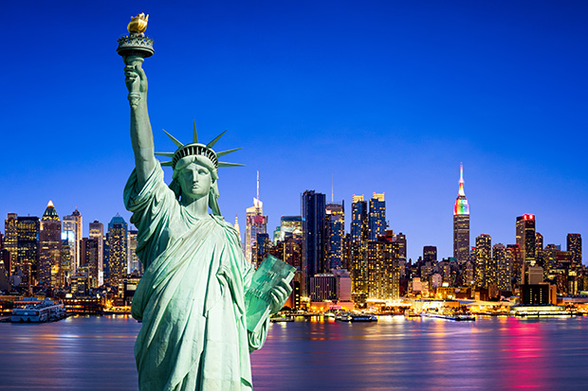

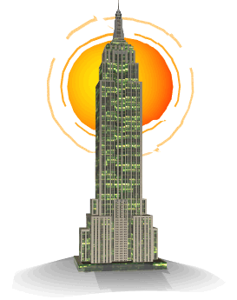
“ NYC Top 10 attractions”
Attraction
Adjective(s)
1
Statue of Liberty
Ultimate (symbol)
2
Times Square
Best (experience)
3
Empire State Building
Unmatched (views)
4
Central Park
Great (urban park)
5
Rockefeller Center
Ama zing
6
Grand Central Terminal
amazing
7
Wall Street
/
8
Greenwich Village
charming
9
Brooklyn Bridge
old
10
Staten Island Ferry
spectacular (views)

