Slide 1


Slide 2

Kidnap & Ransom
Insurance
© Atheapan THAMBU

Slide 3
How do we define kidnapping ?

Slide 4

"The abduction of a person or persons with the intent of their detention in an unknown location until a demand is met."

Slide 5


Summary
Kidnapping
Kidnap and Ransom Insurance
Key numbers...
The contract...

Slide 6
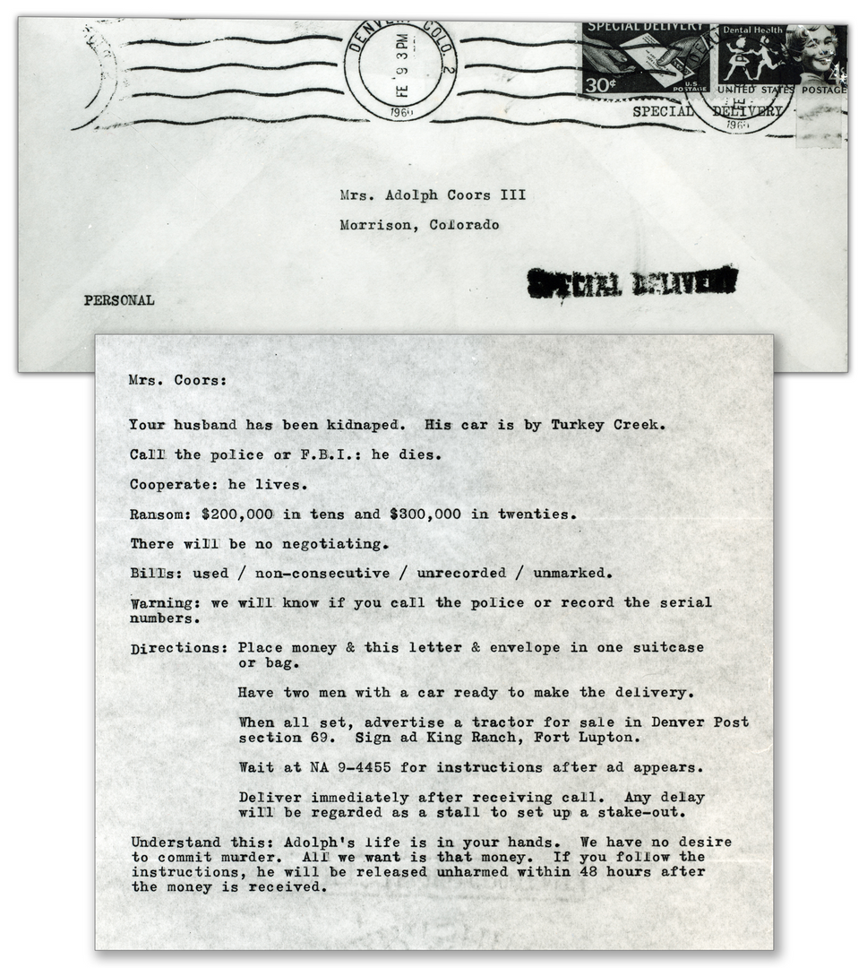
How many kidnaps-for-ransom a year ?

Slide 7
How many kidnaps-for-ransom a year ?
  30,000 cases a year
  73% of those for money

Slide 8
80% of all kidnappings go unreported.

Slide 9

Activity

Slide 10

Top 10 countries for kidnap-for-ransom 2019
Make your list

Slide 11
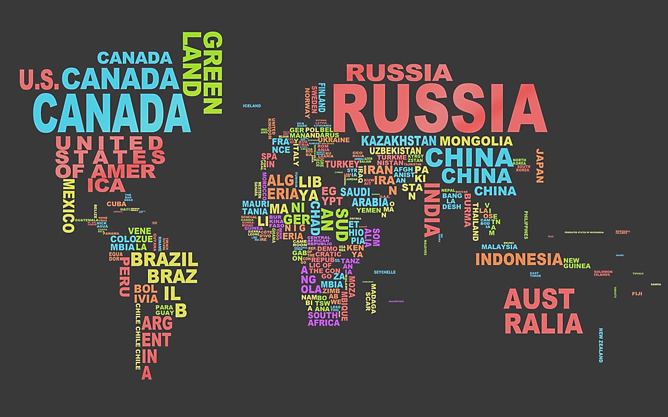

Slide 12
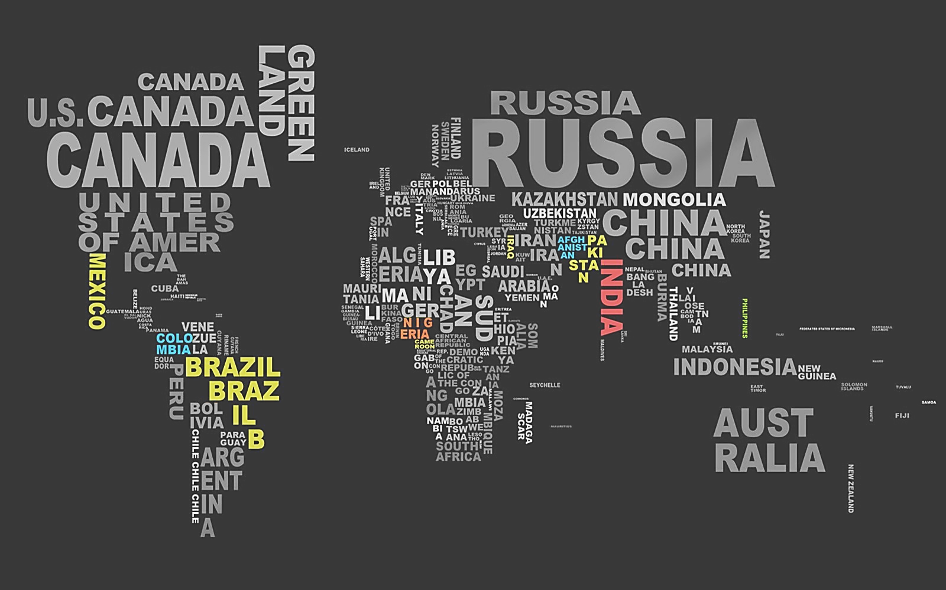

Slide 13
  Mexico
  Nigeria
  India
  Pakistan
  Afghanistan
  Brazil
  Iraq
  Colombia
  Cameroon
  Philippines

Slide 14
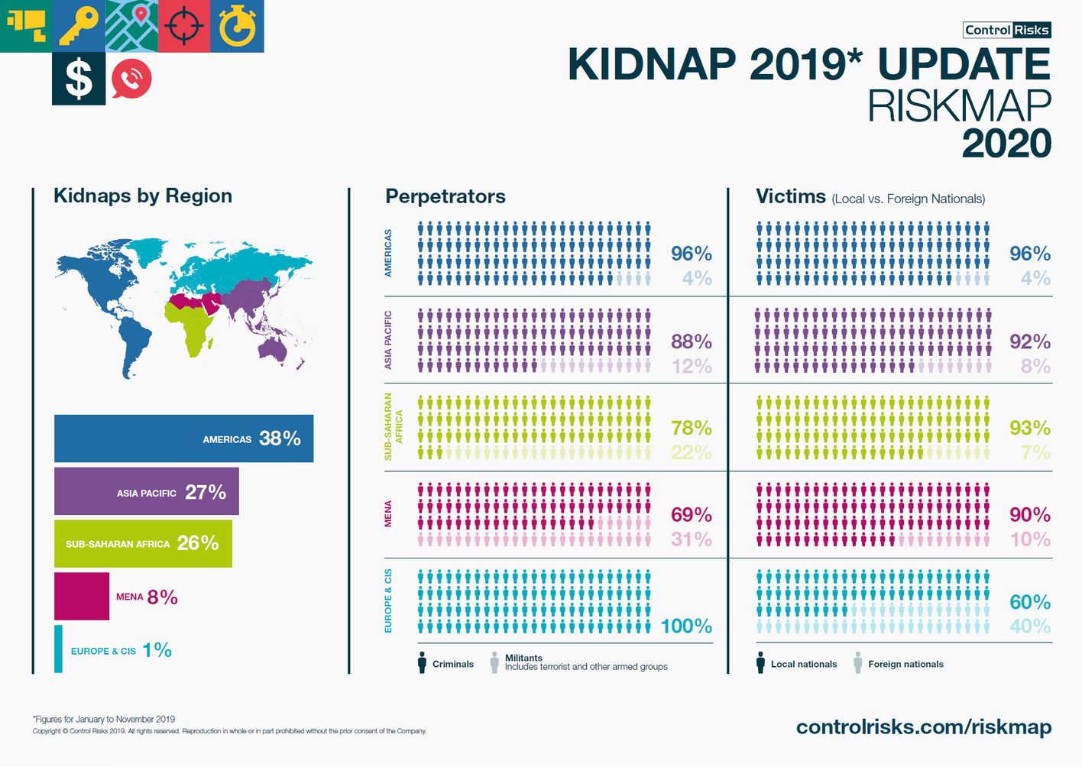

Slide 15
To sum up...
Most affected continent:
Americas (38% of kidnaps)
Most number of militants:
MENA (31% of perpetrators)
Most foreign victims:
Europe & Cis (40% of victims)

Slide 16
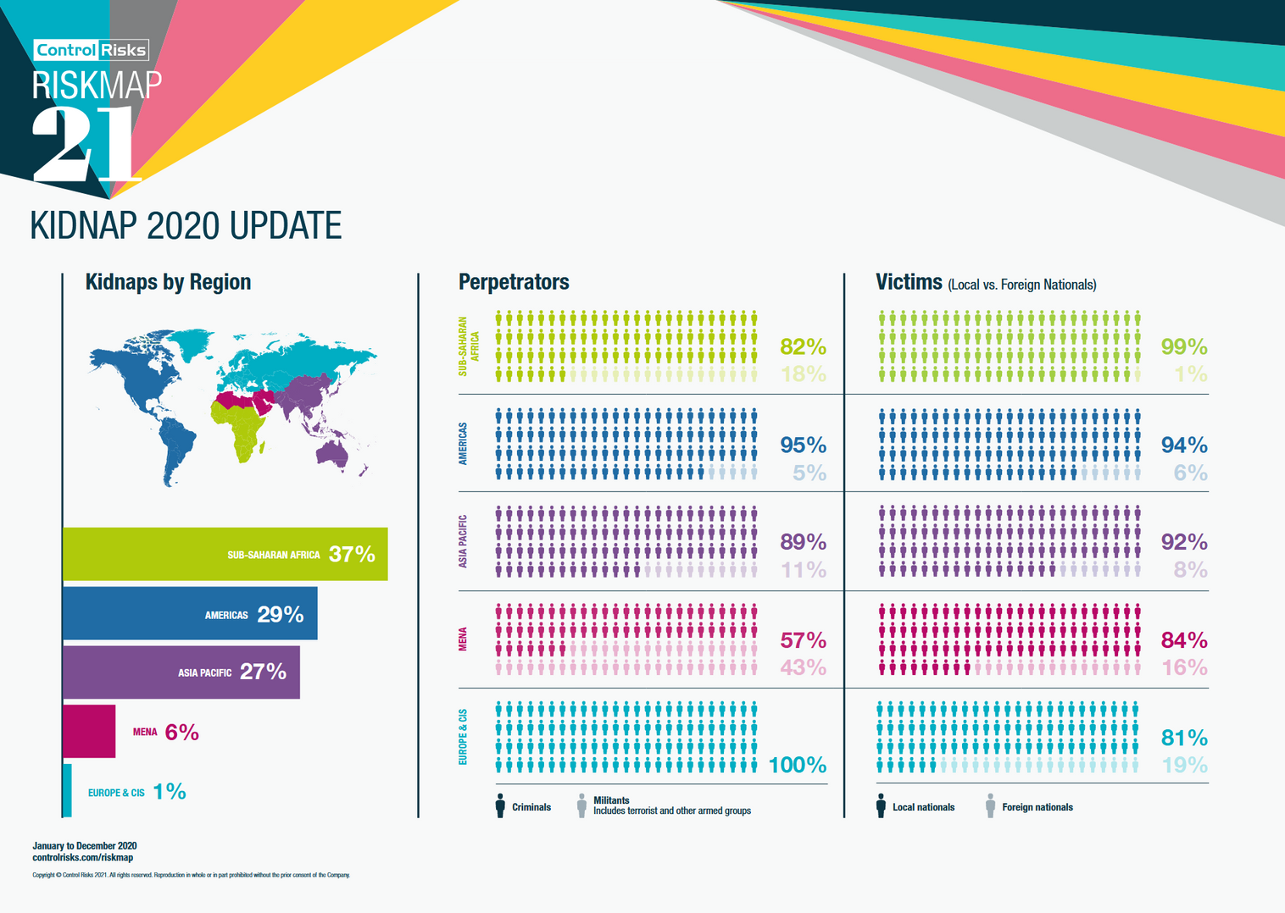
To sum up...
Most affected continent:
Sub-Saharan Africa (37% of kidnaps)
Most number of militants:
MENA (43% of perpetrators)
Most foreign victims:
Europe & Cis (19% of victims)

Slide 17

What does virtual kidnapping mean ?
Is ransomware a form of kidnapping ?
Questions
What is the difference between classic kidnapping and express kidnapping ?
What is tiger kidnapping ?

Slide 18
Transition...
How kidnapping became a big business | The Economist
https://www.youtube.com/watch?v=1AkZMJjI_uM

Slide 19

Kidnap and Ransom Insurance
The need and the purpose

Slide 20
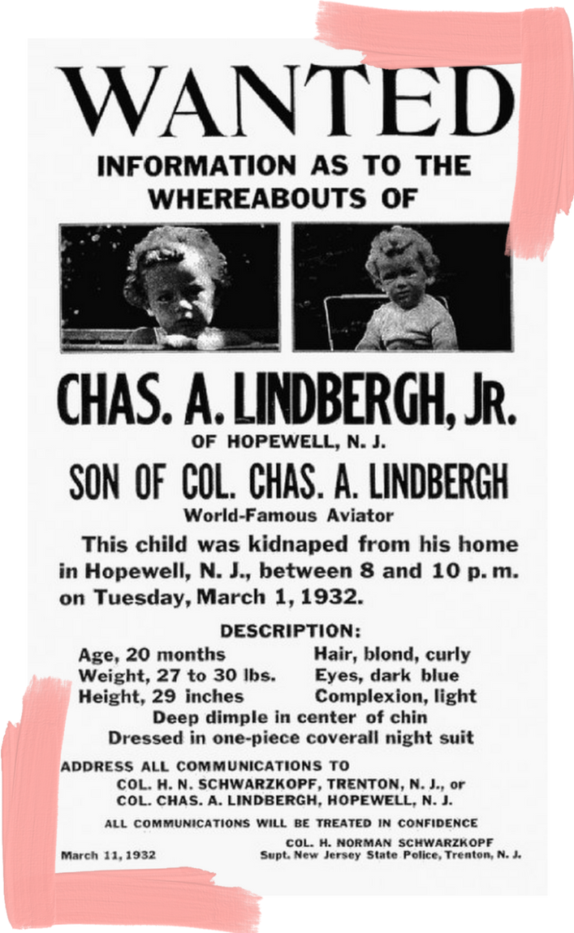
Rewind : The birth of K&R Insurance
  Lloyd's of London created this policy in 1932 post "The Crime of the Century".
CRIME OF THE CENTURY: Lindbergh Kidnapper Brought to Justice | HISTORY
https://www.youtube.com/watch?v=8M6y8vXisiI
  But it only took off from the 1960s, following a series of kidnappings of businessmen and their families in Europe and Latin America.

Slide 21
K&R Insurance Policy
01
02
03
For whom ?
What for ?
How ?
Mostly corporates and high profils
Kidnaps, Extorsions, Hijacks, and many more
Reimbursement of ransoms and expenses for a crisis team

Slide 22
Corporate Policy Form
All officers, directors and employees of the insured
  Large Corporations
  Small and Medium Size Enterprises
Individual/Family Policy Form
For whom ?
Named individuals
  Singles
  Independent Contractors
  Wealthy Families
  Middle Income Families
Definition of covered persons can be tailored to exact need of the policyholder

Slide 23
Activity

Slide 24
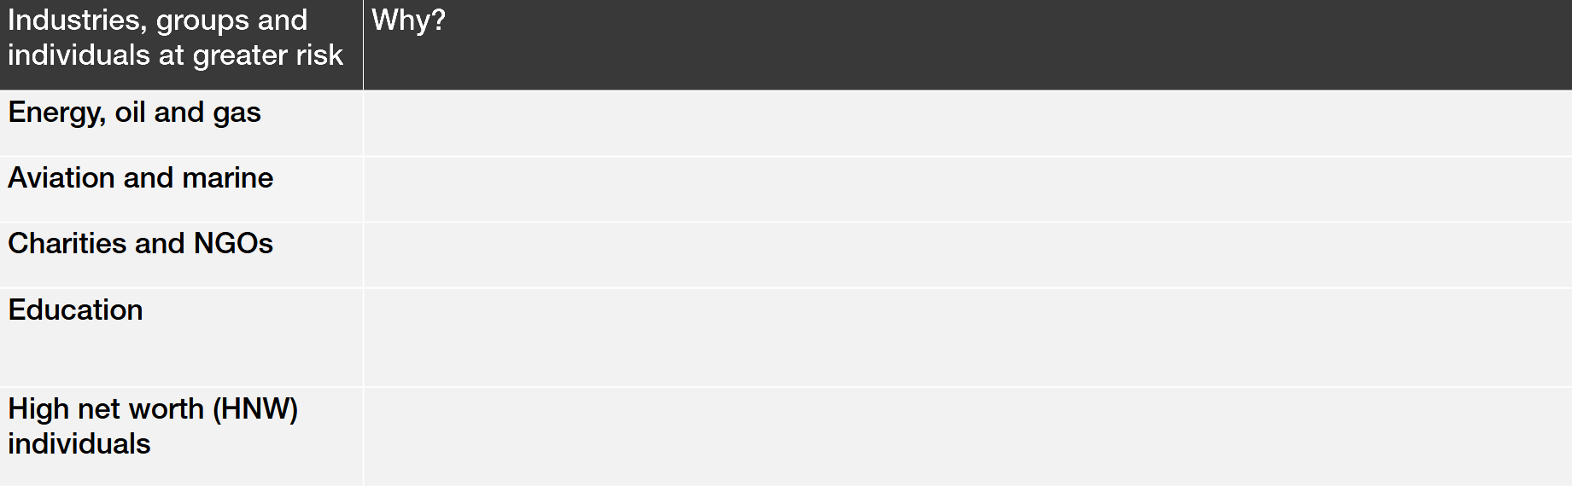
These specific industries tend to be more exposed to kidnapping than others.
Tell me why

Slide 25
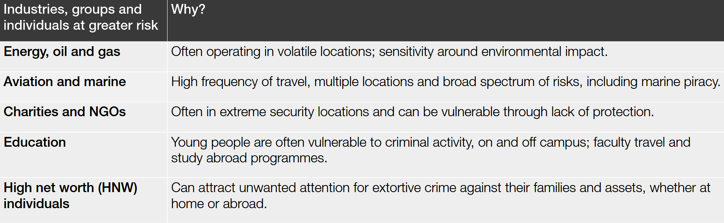
These specific industries tend to be more exposed to kidnapping than others.
That is why

Slide 26
Kidnapping
  Kidnaps-for-ransom
  Express kidnaps
  Virtual kidnaps
Extortion
What for ?
  Threat to life/property
  Cyber-Extorsion
Illegal Detention
Unlawful incarcerations by foreign governments
Hijackings

Slide 27
Reimbursements
Ransom monies – Money paid or lost in transit/delivery
Additional Expenses
  For the crisis team (negotiators, PR consultants, interpreters, forensic analysts, etc)
  Salaries of impacted staff/ family members
  Extensions for post incident expenses (medical expenses)
How ?
All Control Risks' fees and expenses

Slide 28
"Since its foundation in 1975, Control Risks has advised clients on the resolution of thousands of kidnap and extortion cases, worldwide.
They have a dedicated team of specialist consultants, available for immediate deployment in response to a crisis anywhere in the world. Control Risks’ fees and
expenses are covered on an unlimited basis (by the policy, giving the policyholder comfort that they will be supported for as long as it takes).
In the event of an insured incident occurring, a Control Risks consultant will be deployed to provide advice and assistance around the complex and sensitive
issues that need to be addressed to achieve a safe conclusion."
— Control Riks

Slide 29

The Insurance Policy

Slide 30
1er
02
Reimbursement Policy
Cost
You must have the ability to raise ransom payment and then you will be reimbursed by the insurer.
Annual premiums range from $500 to more than $100,000.
Key Points
03
04
Confidentiality
Crisis Management
You cannot make public the existence of the coverage.
Insurer pays unlimited fees and expenses for it.

Slide 31

As per reports, in presence of a crisis management, the hostage was released safely in 90% of cases.

Slide 32

The importance of confidentiality
To avoid fraud
To protect
Faking your own kidnapping to perceive the insurance money.
Publicizing this policy can make you a walking kidnapping target.
Divulging this information voids your insurance.

Slide 33

How is K&R Underwritten ?
(for the Corporate Policy Form)

Slide 34
Industry
Number of insured persons
Location of operations
Business travel
Deployment training
Security measures employed during foreign residency
Net assets of the organization
Prominence of the individual/organization
History of prior threats or incidents

Slide 35
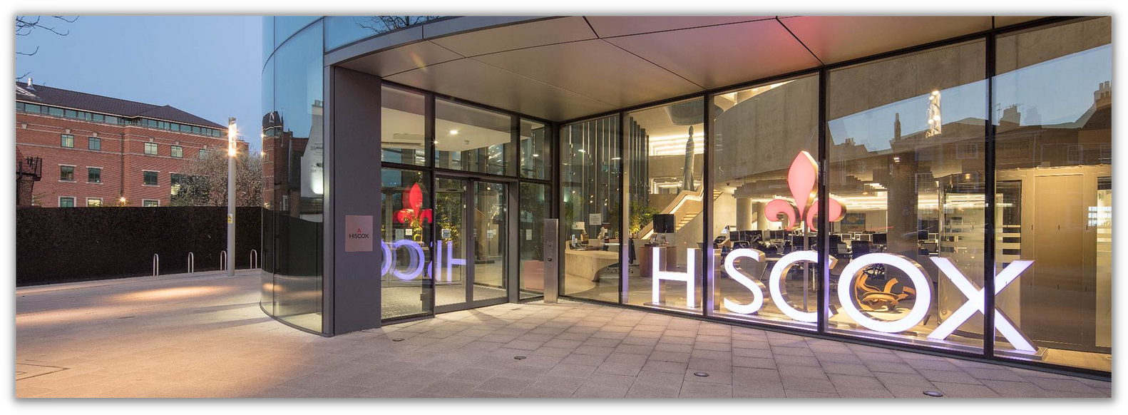



Insurance Companies which propose this policy.

Slide 36

If you are interested...
La Rançon (documentary)
Every year, more than 30,000 people are kidnapped around the world. Behind each kidnapping is a ransom demand. And dealing with each demand, a negotiator. With hostage taking on the rise, a secretive and lucrative shadow industry is prospering. Insurance companies now sell "kidnap and ransom" policies which guarantee the services of a professional negotiator and a refund of the ransom in the event a policy holder is abducted. We gain exclusive access to one of the world’s leading kidnap insurers and the top hostage negotiators he works with and follow several cases from beginning to end. A journey to the heart of a secret world where to save a person’s life, you have to bargain with their kidnappers.
https://boutique.arte.tv/detail/rancon

Slide 37
A quick Recap...
Uncover Kidnap & Ransom Risks | Travelers
https://www.youtube.com/watch?v=nVO0WPvs6vw

Slide 38
Time for a Kahoot !

Slide 39

THANK
YOU
FOR
YOUR
ATTENTION

