Slide 1

Humour Mais tu as
de beaux restes N°5

Slide 2


Slide 3


Slide 4
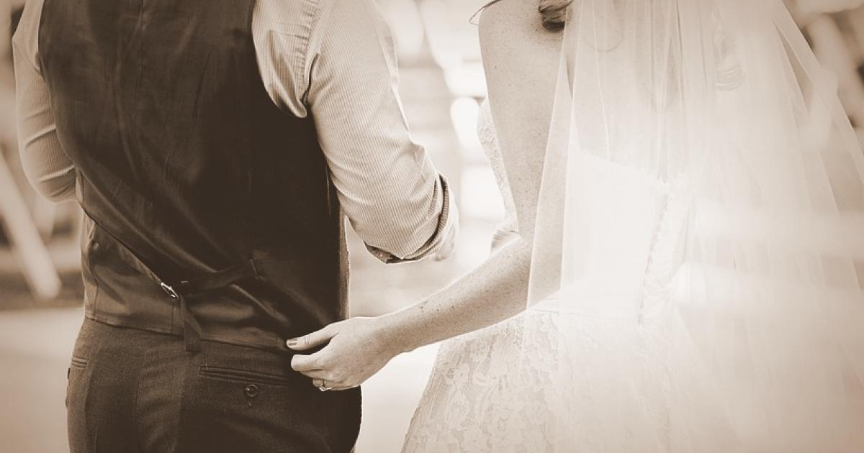
Vieillir ensemble

Slide 5
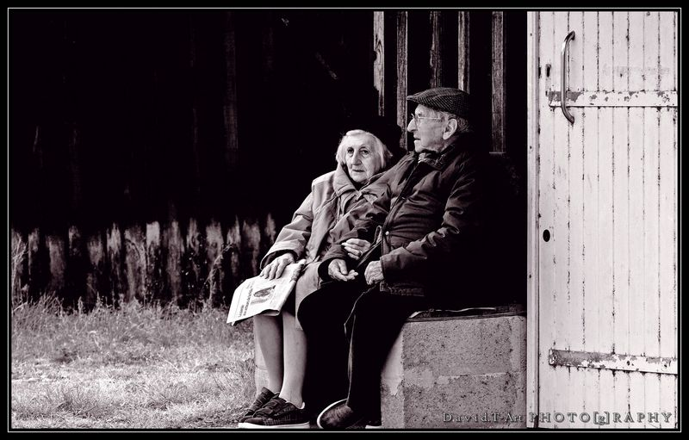

Slide 6
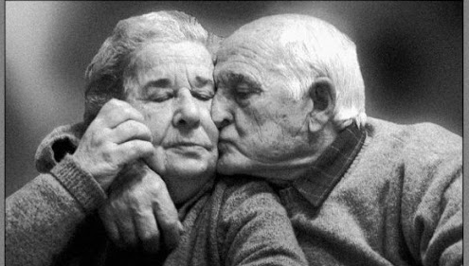

Slide 7



Slide 8


Slide 9


Slide 10


Slide 11


Slide 12



Slide 13
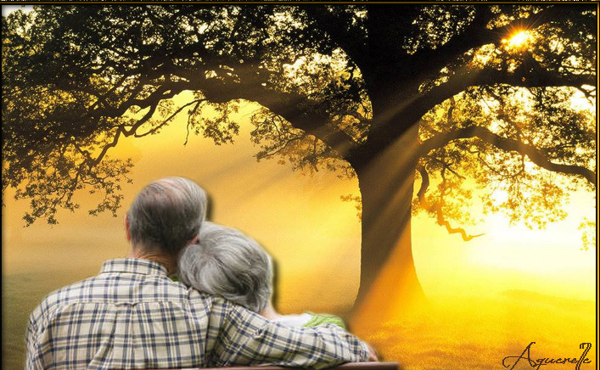


Slide 14
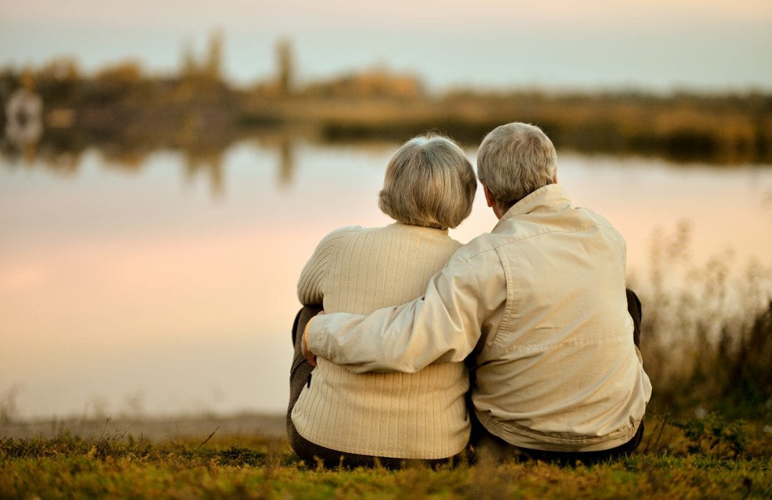

Slide 15
C’était
Humour Mais tu as
de beaux restes

