Slide 1

Humour Mais tu as
de beaux restes N°2

Slide 2


Slide 3


Slide 4


Slide 5
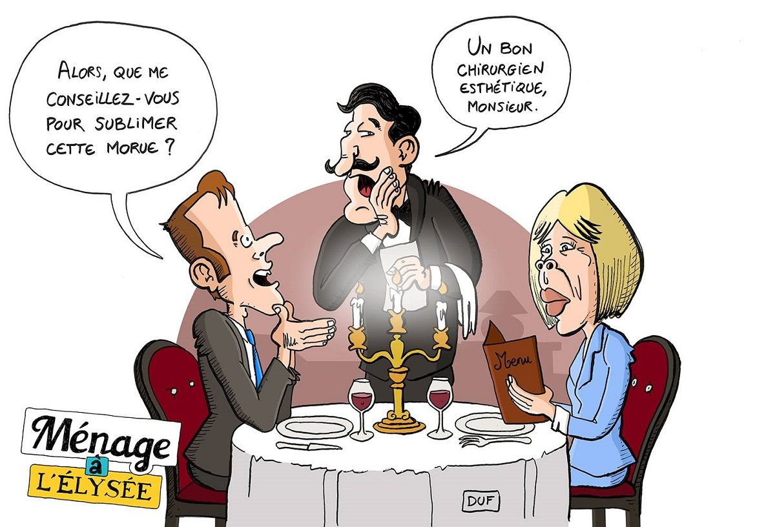

Slide 6


Slide 7
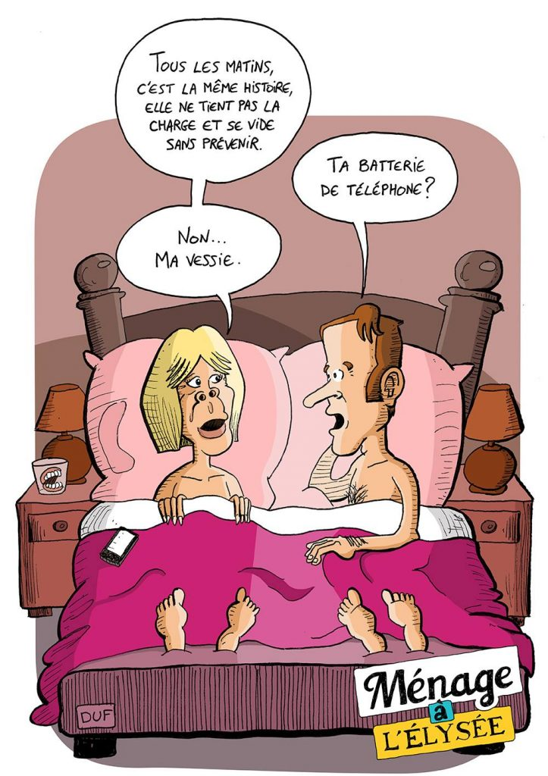

Slide 8
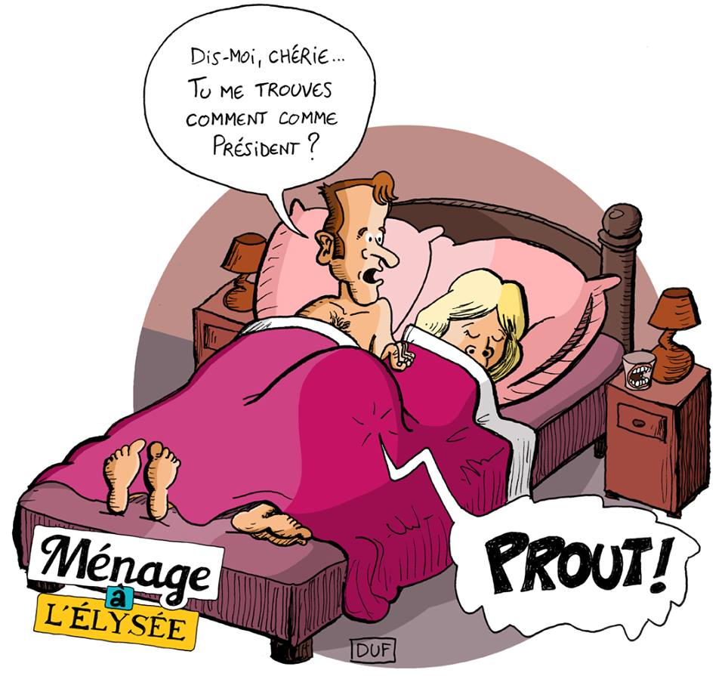

Slide 9
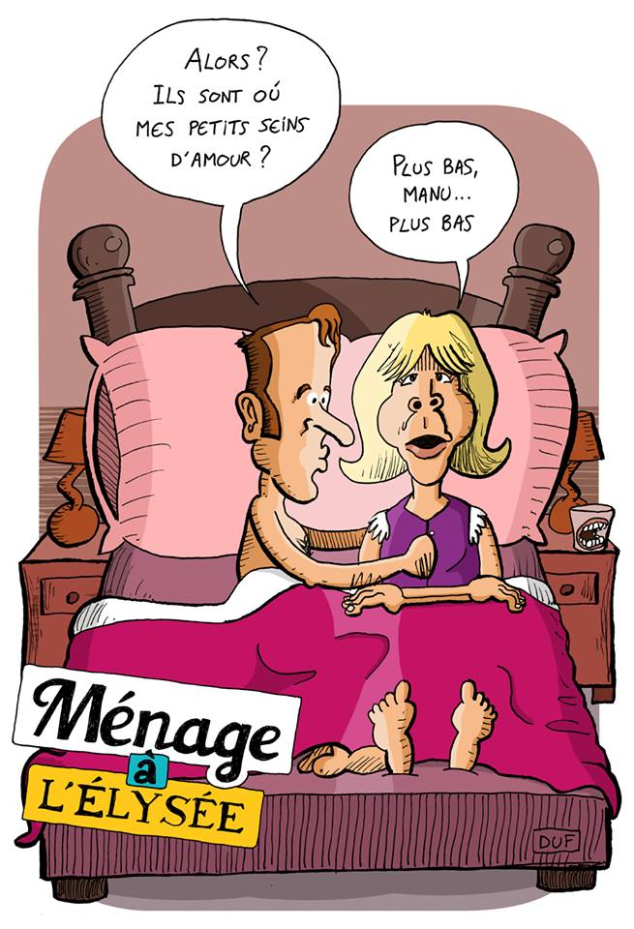

Slide 10
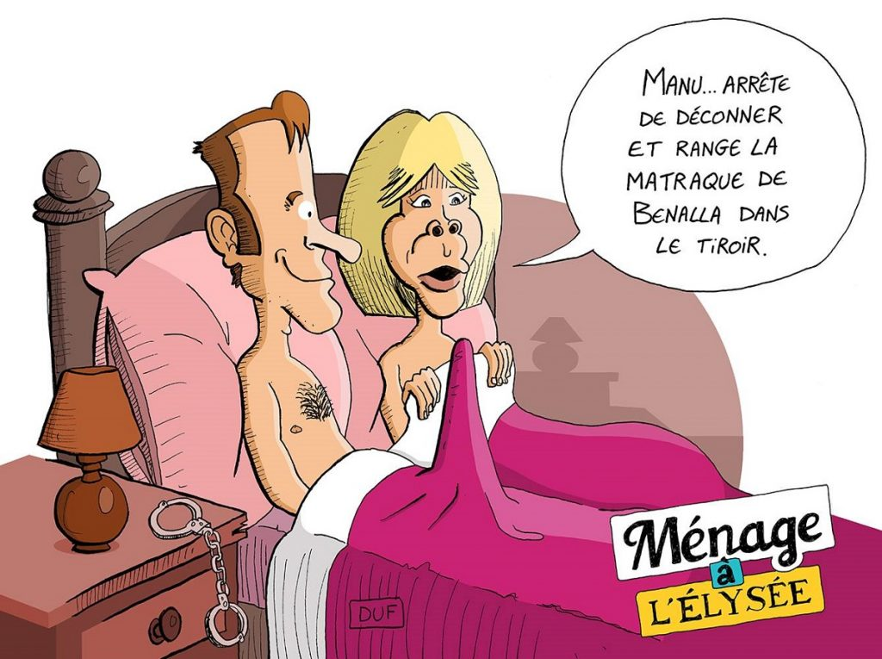

Slide 11
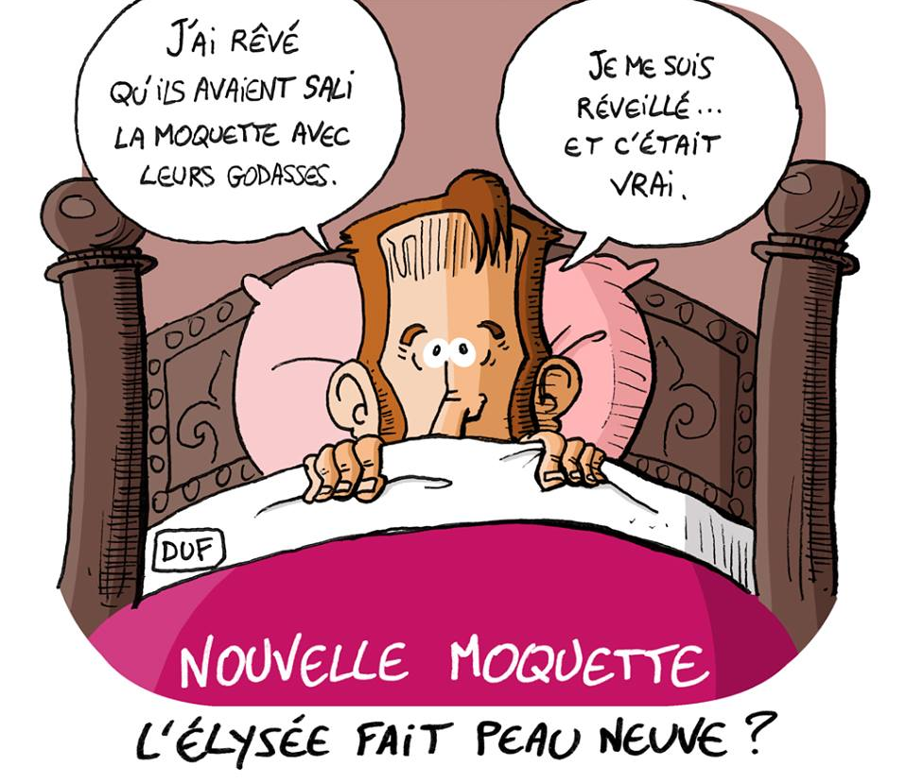

Slide 12
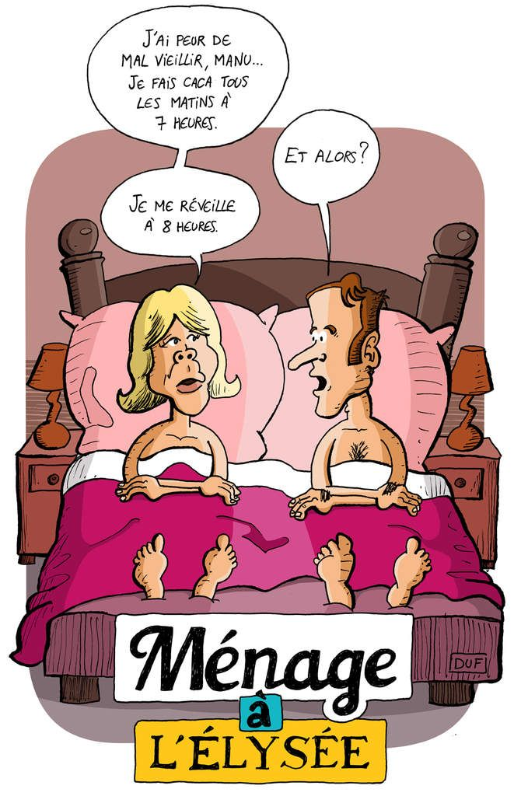

Slide 13


Slide 14
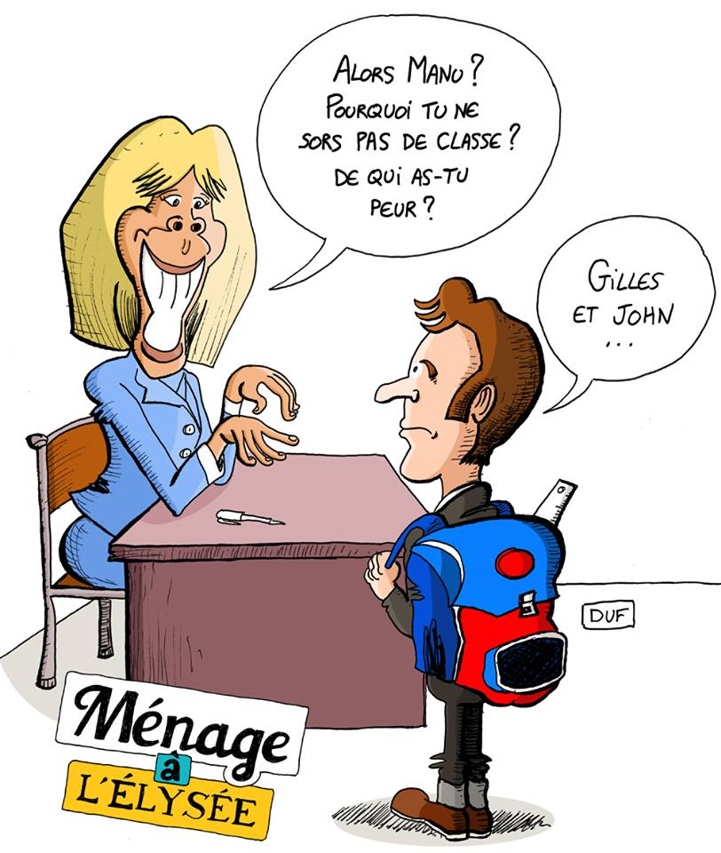

Slide 15
C’était
Humour Mais tu as
de beaux restes

