Slide 1
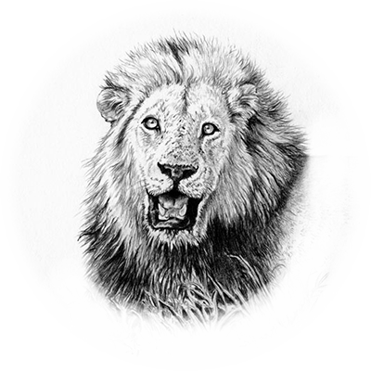

Wildlife
03
Of africa
Lion

Slide 2
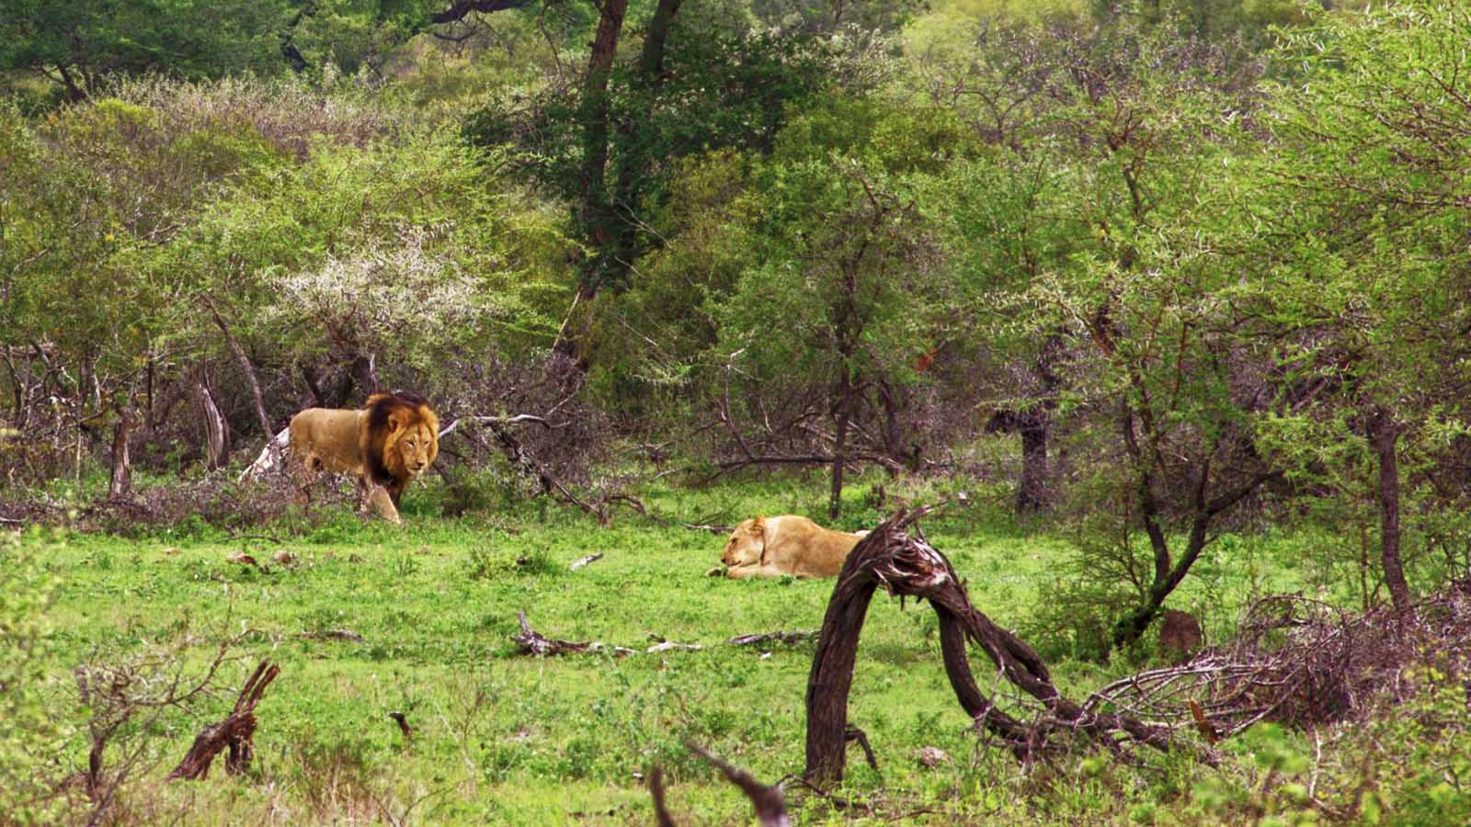

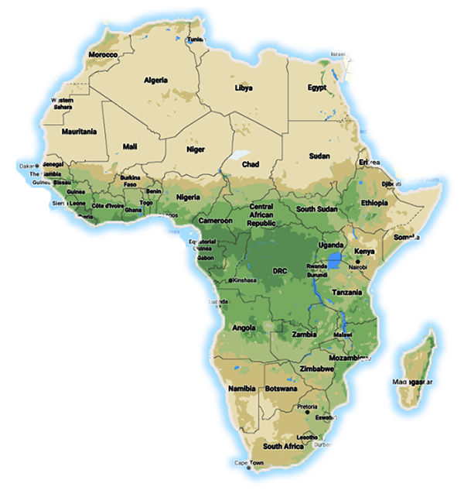

Wildlife
of Africa
Photo © Hudec Ivan

Slide 3
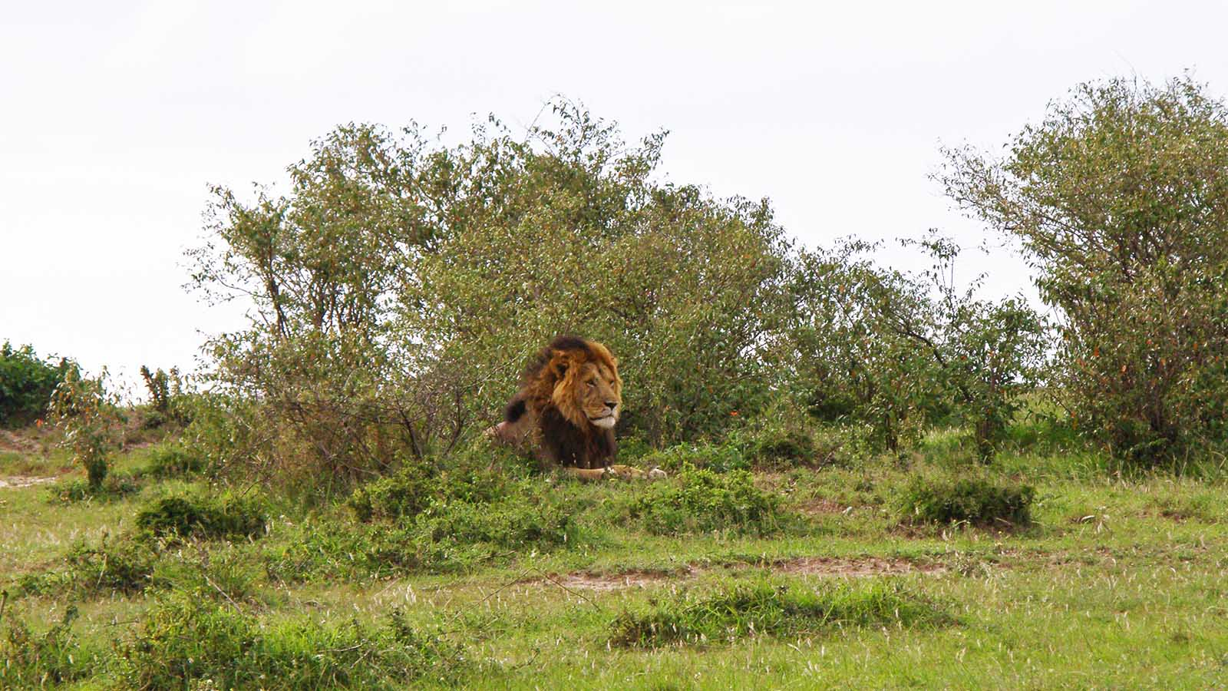
Photo © Hudec Ivan

Slide 4
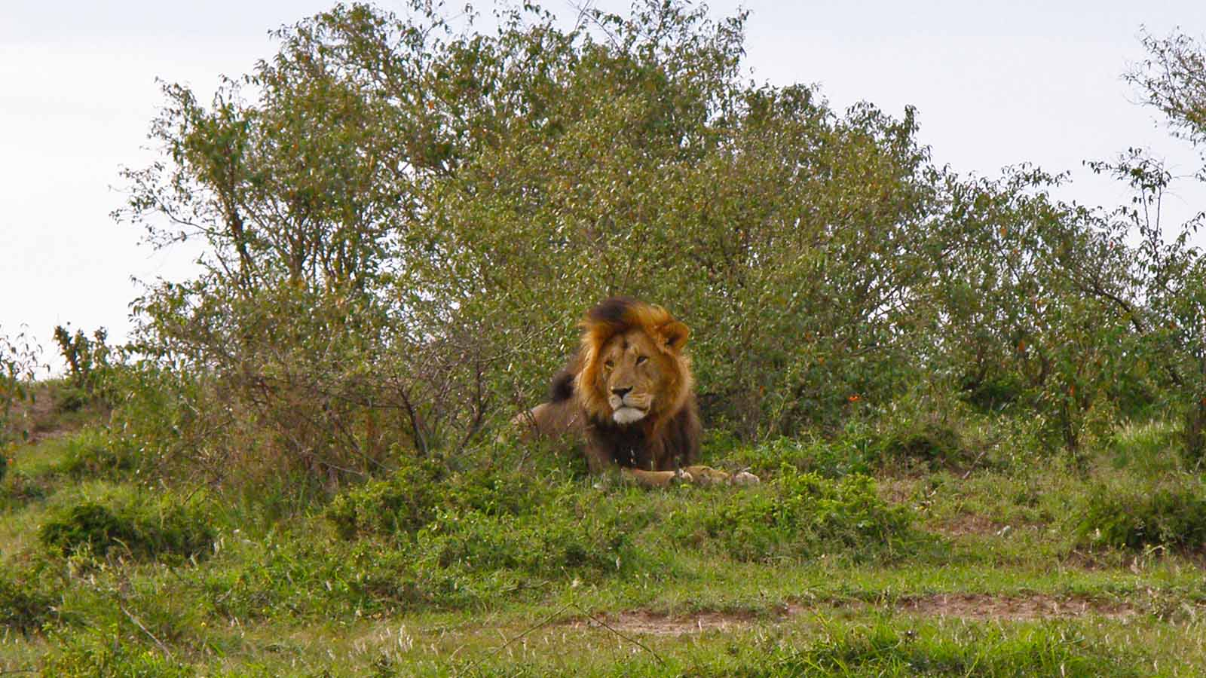
Photo © Hudec Ivan

Slide 5
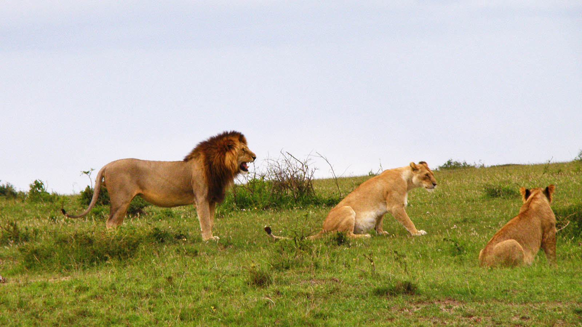
Photo © Hudec Ivan

Slide 6
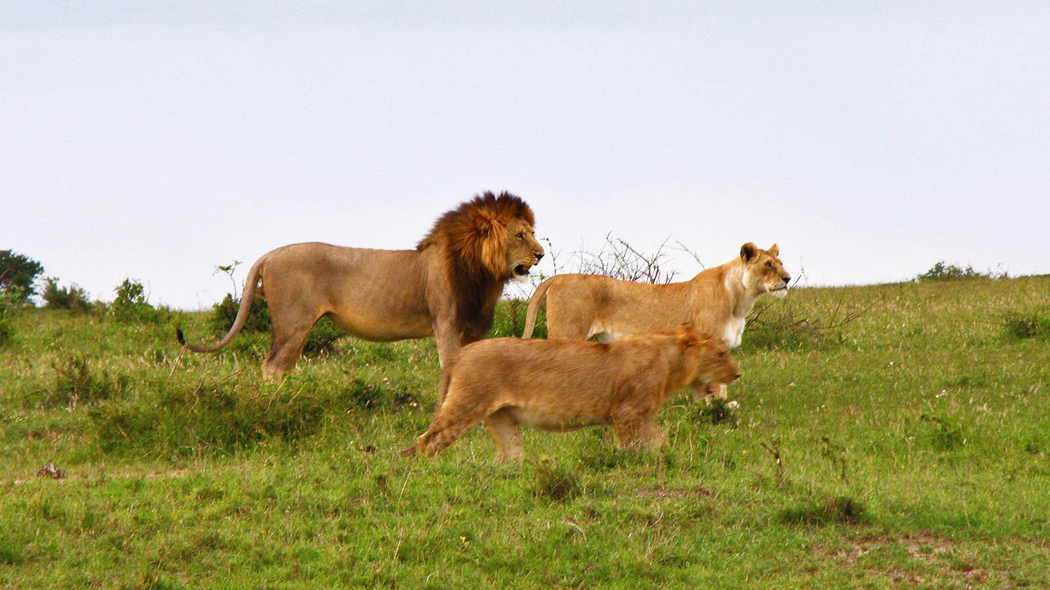
Photo © Hudec Ivan

Slide 7
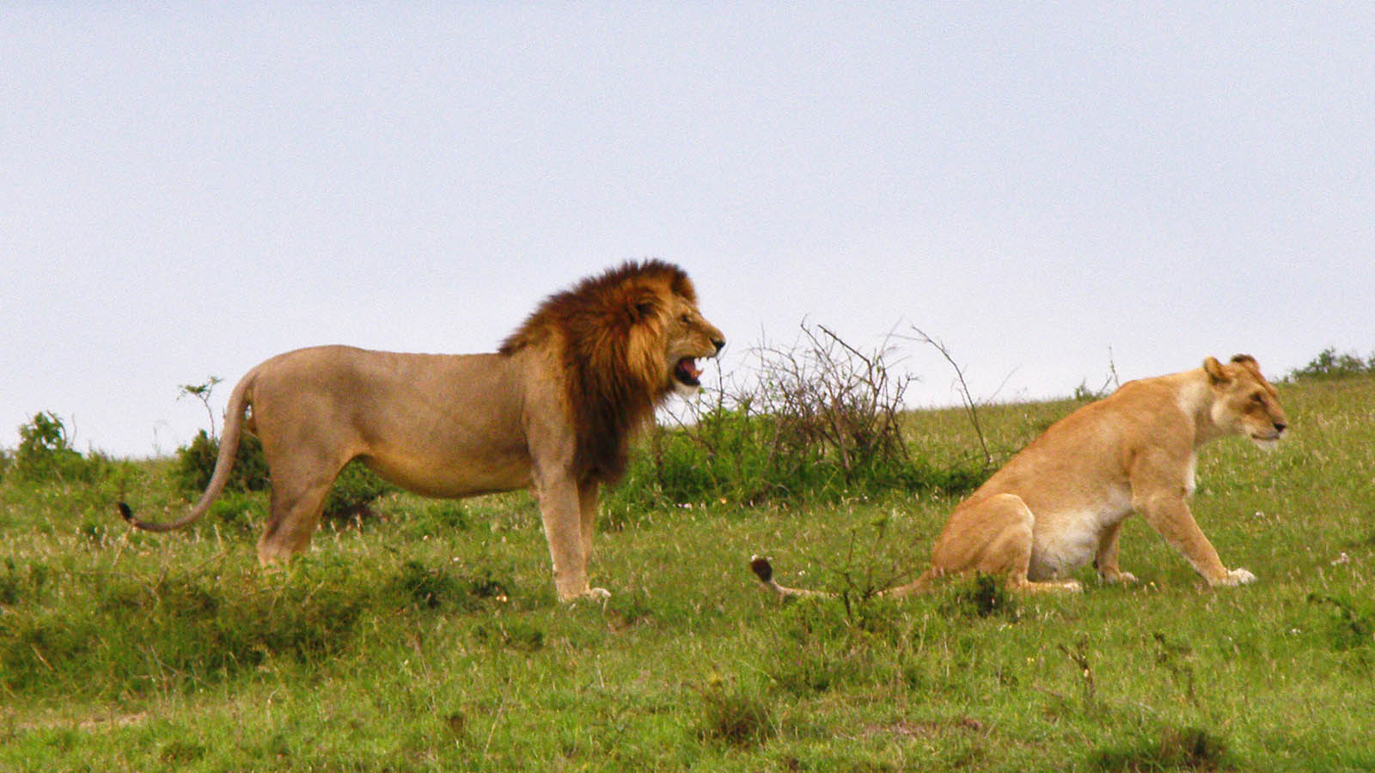
Photo © Hudec Ivan

Slide 8
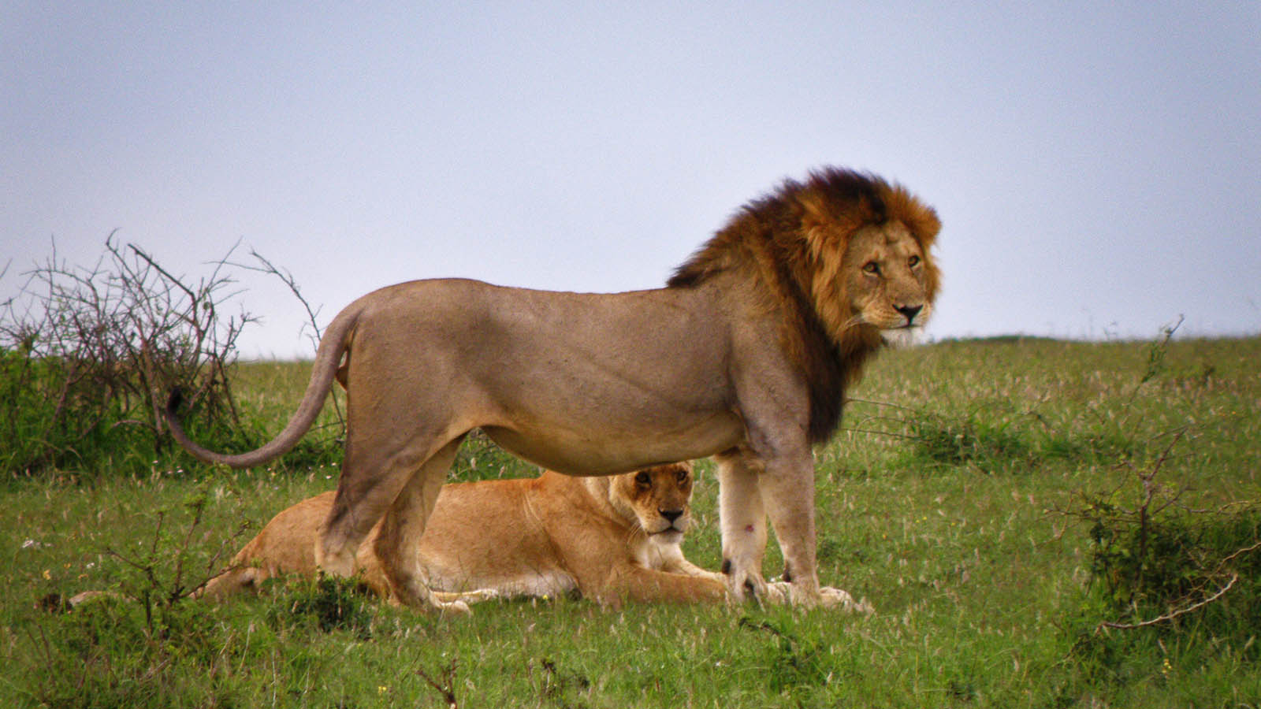
Photo © Hudec Ivan

Slide 9
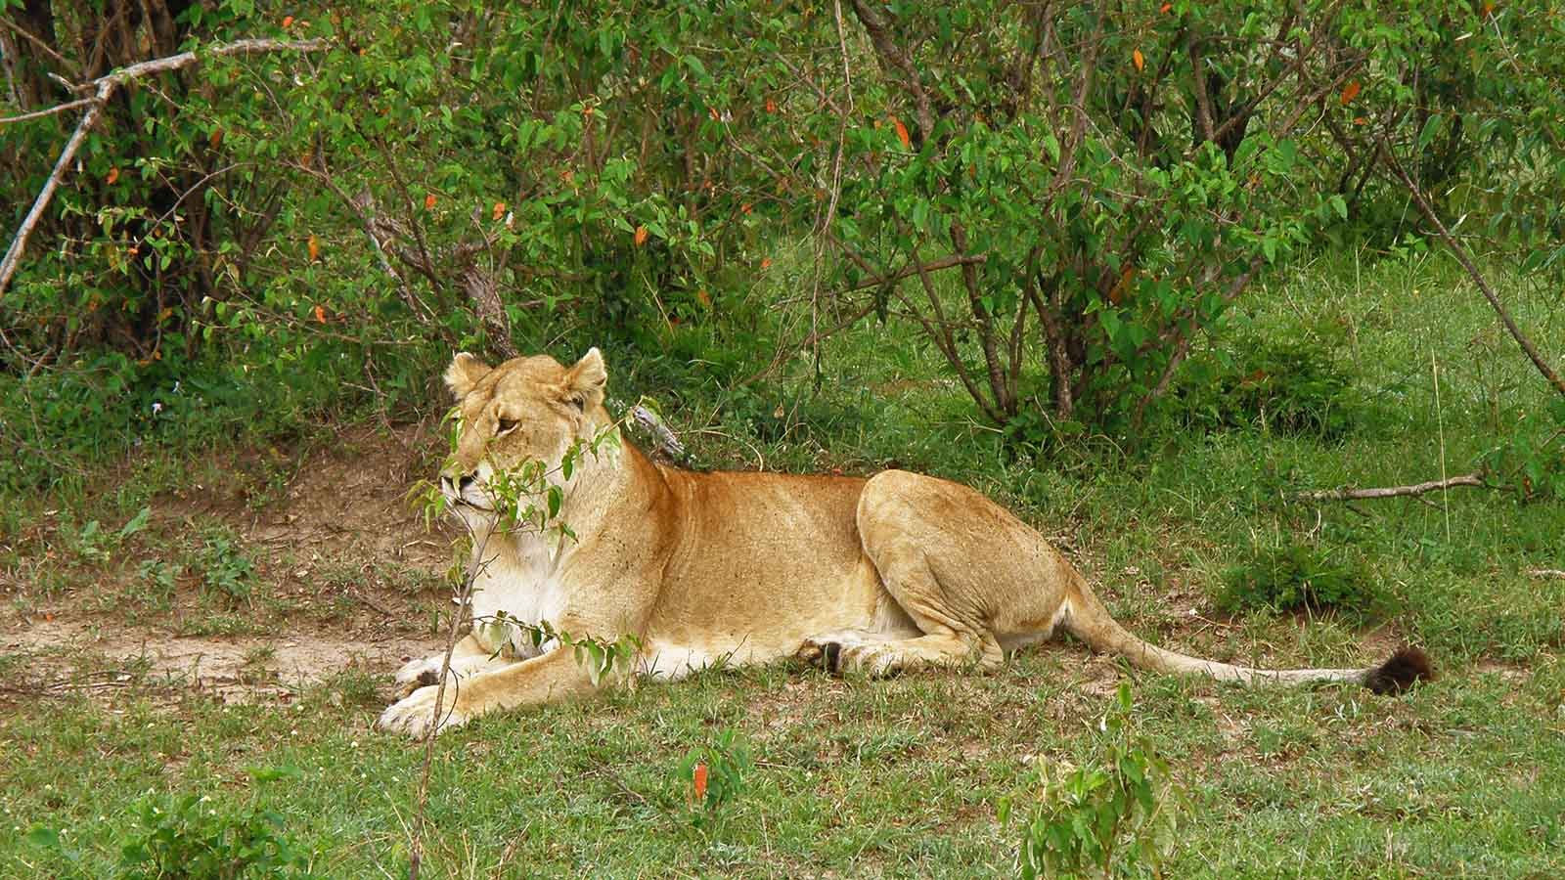
Photo © Hudec Ivan

Slide 10
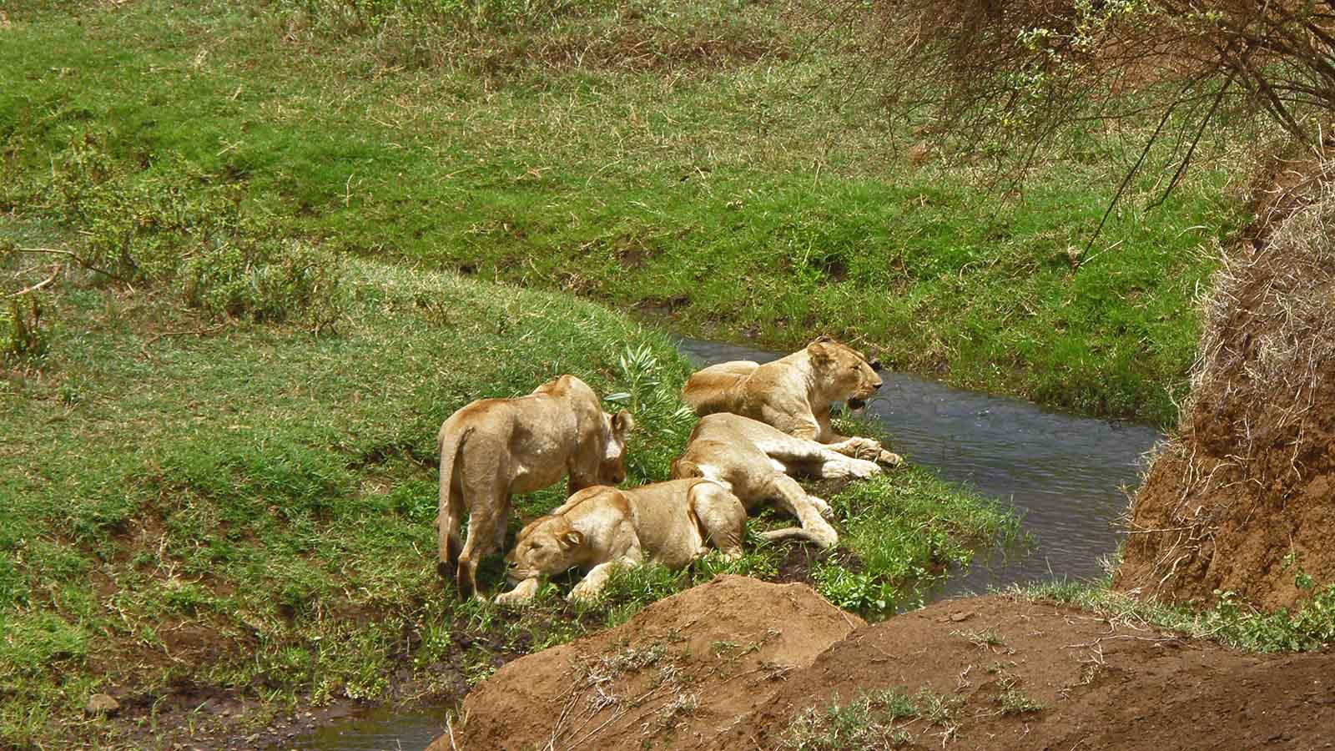
Photo © Hudec Ivan

Slide 11
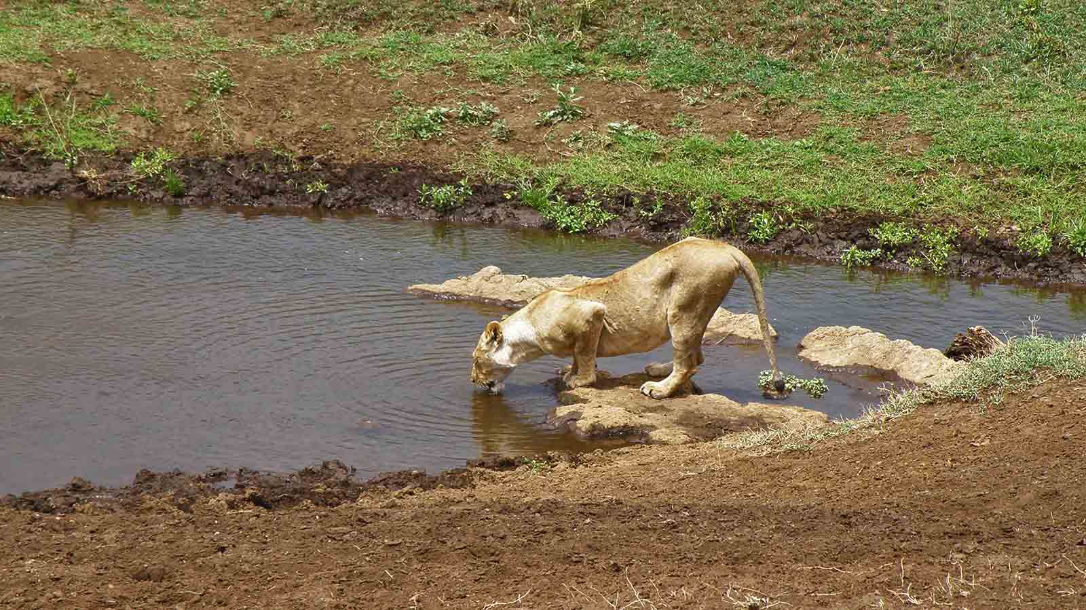
Photo © Hudec Ivan

Slide 12
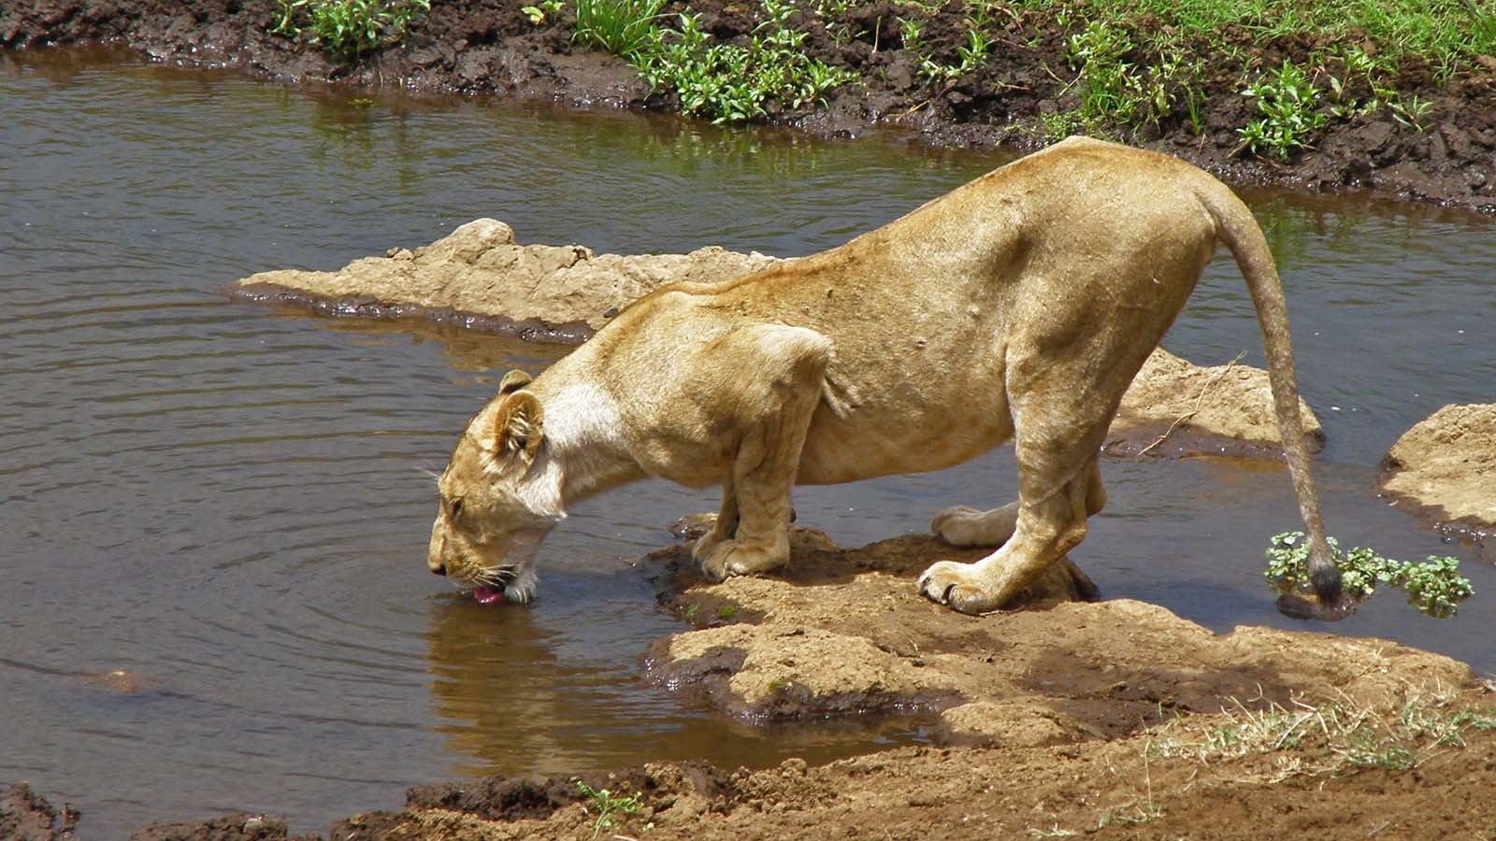
Photo © Hudec Ivan

Slide 13
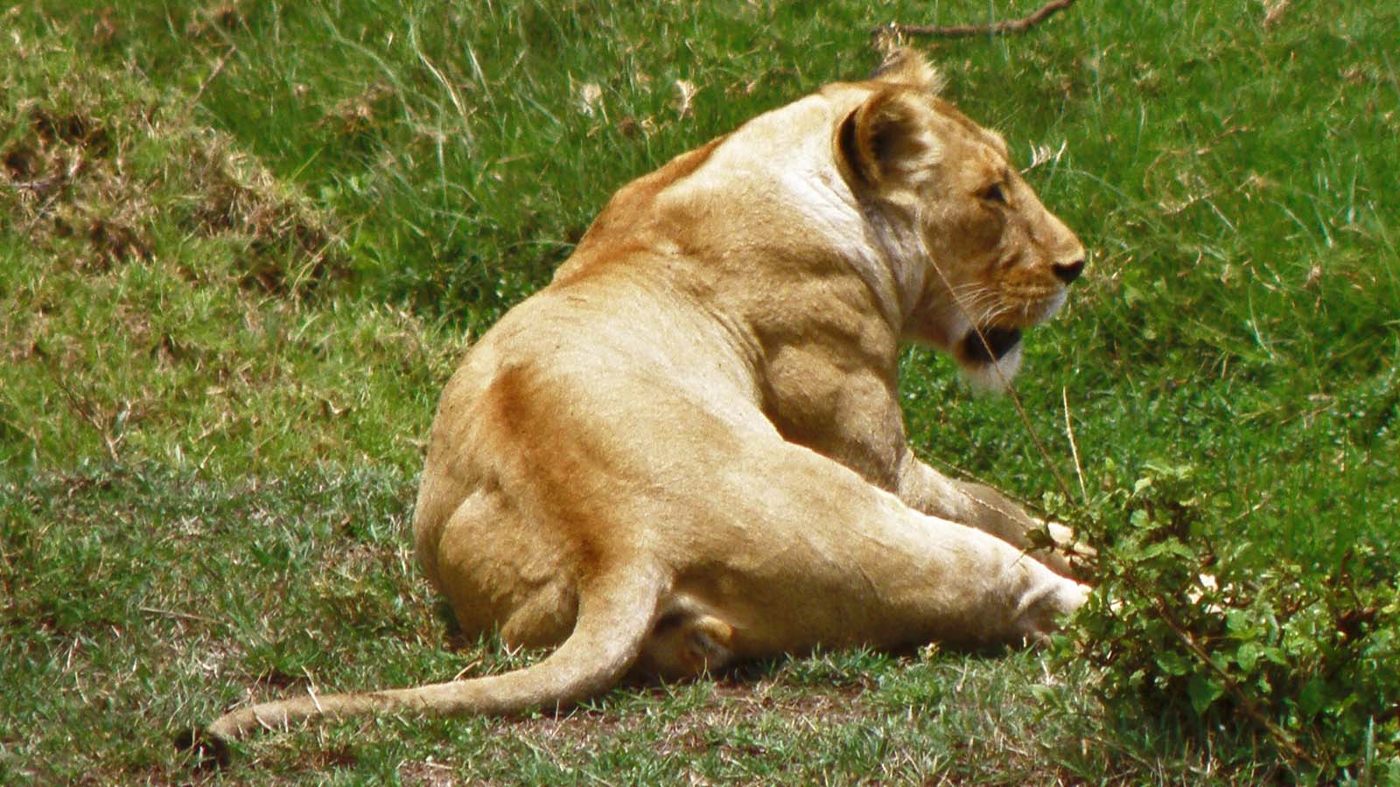
Photo © Hudec Ivan

Slide 14
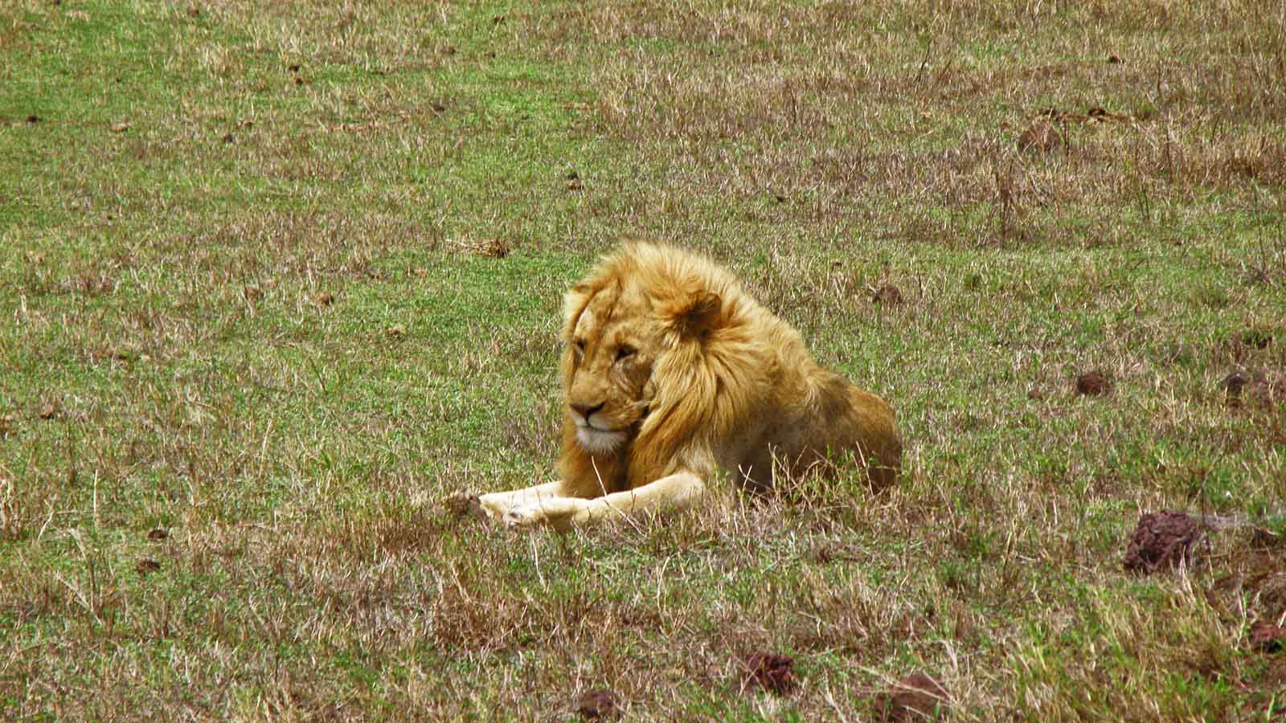
Photo © Hudec Ivan

Slide 15
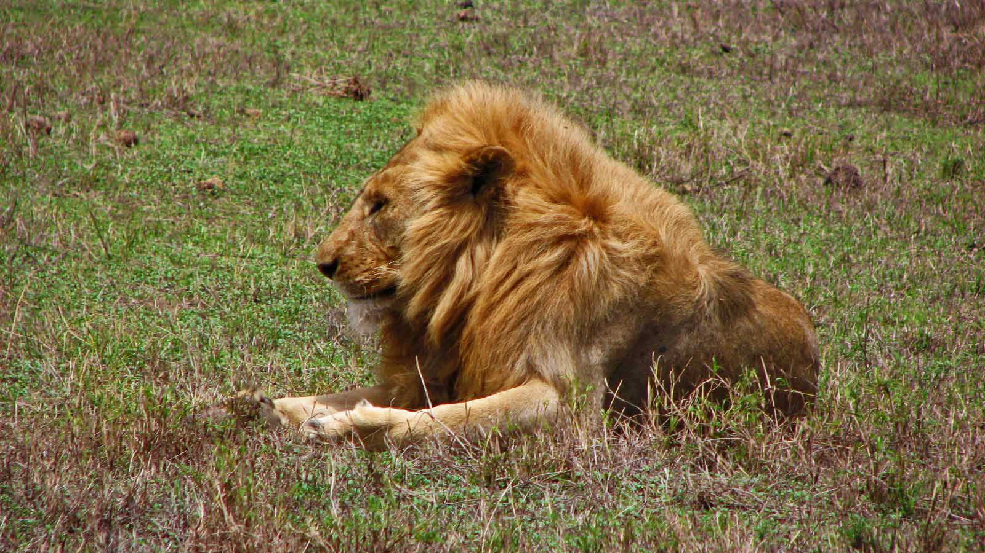
Photo © Hudec Ivan

Slide 16
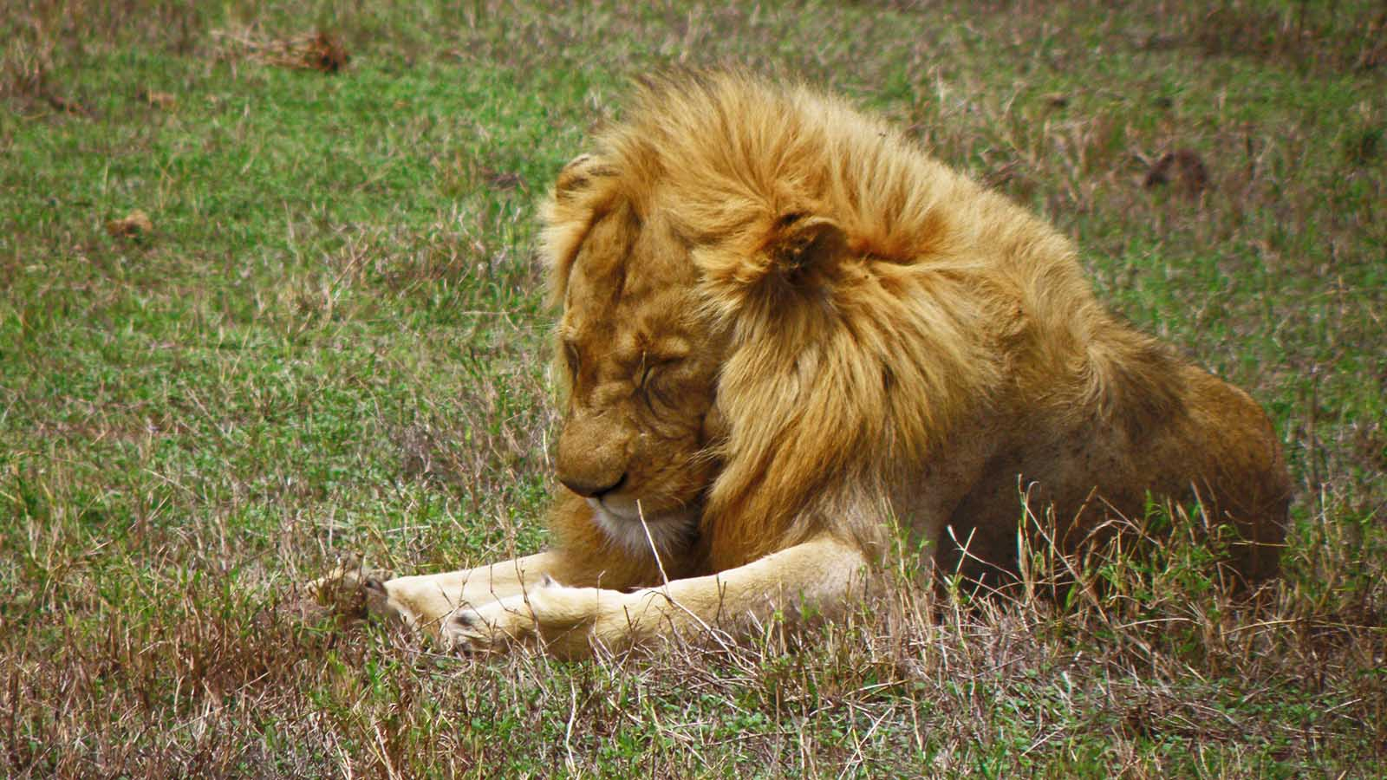
Photo © Hudec Ivan

Slide 17
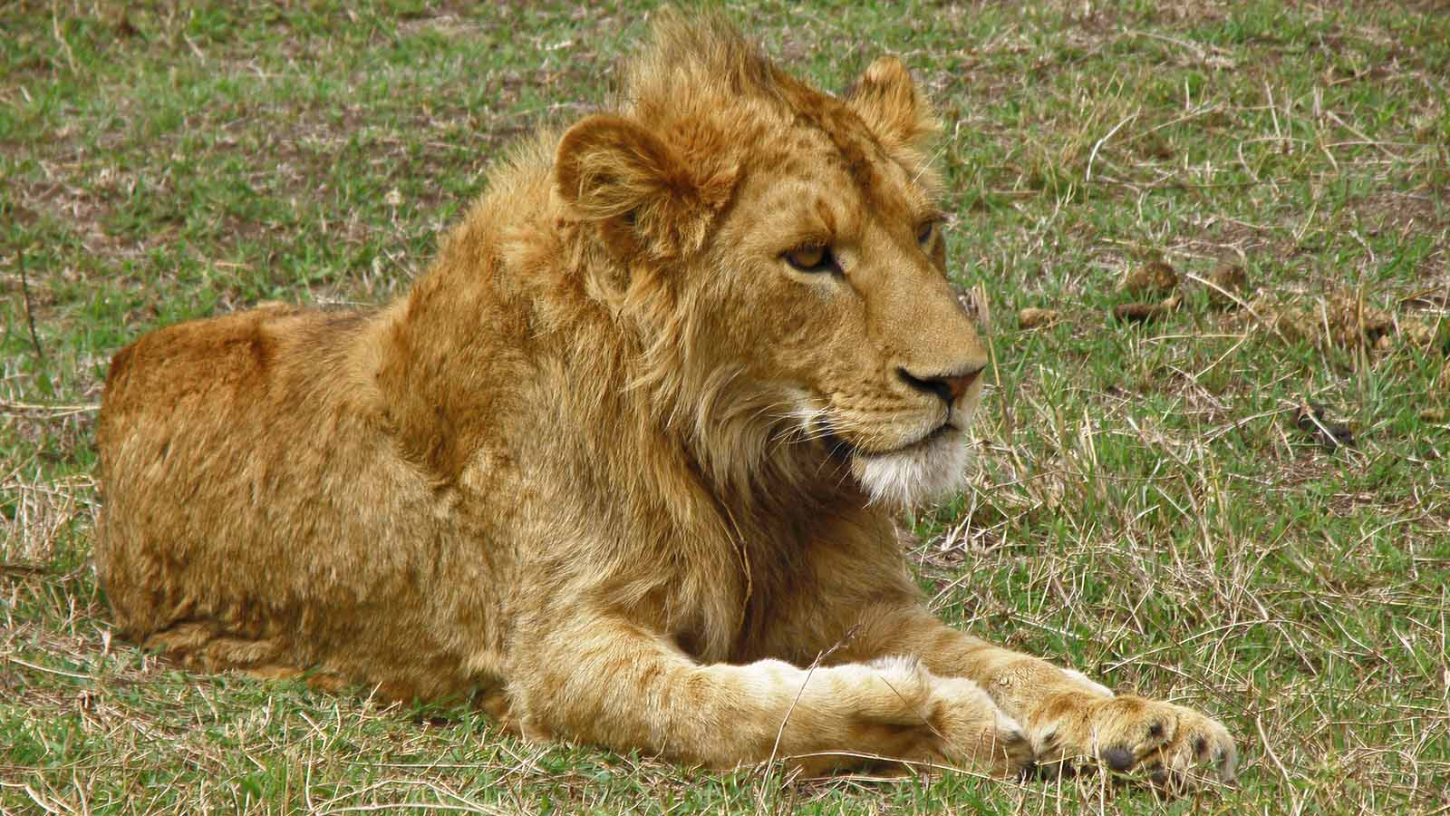
Photo © Hudec Ivan

Slide 18
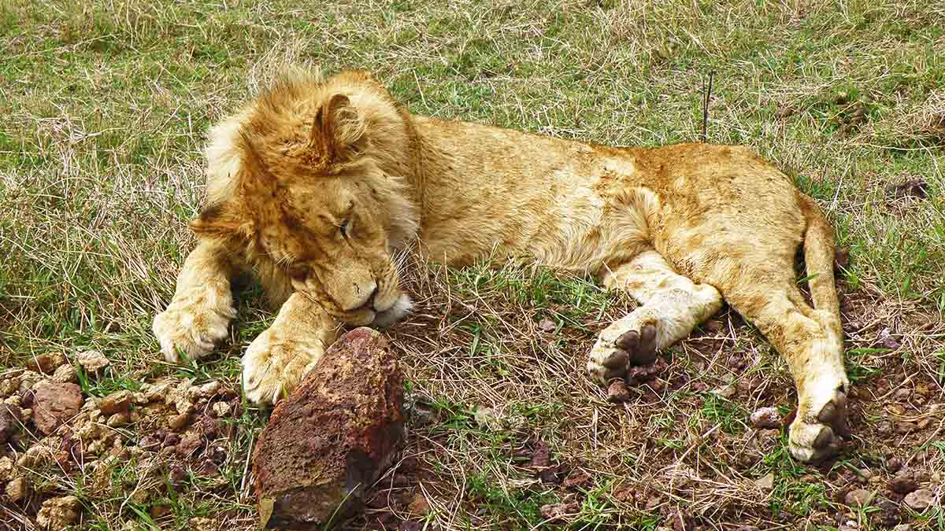
Photo © Hudec Ivan

Slide 19
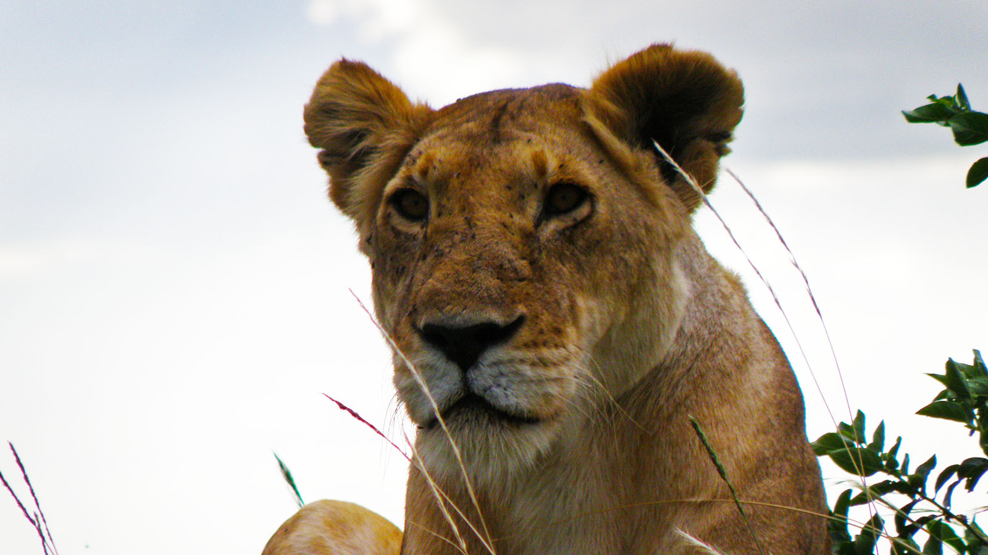
Photo © Hudec Ivan

Slide 20
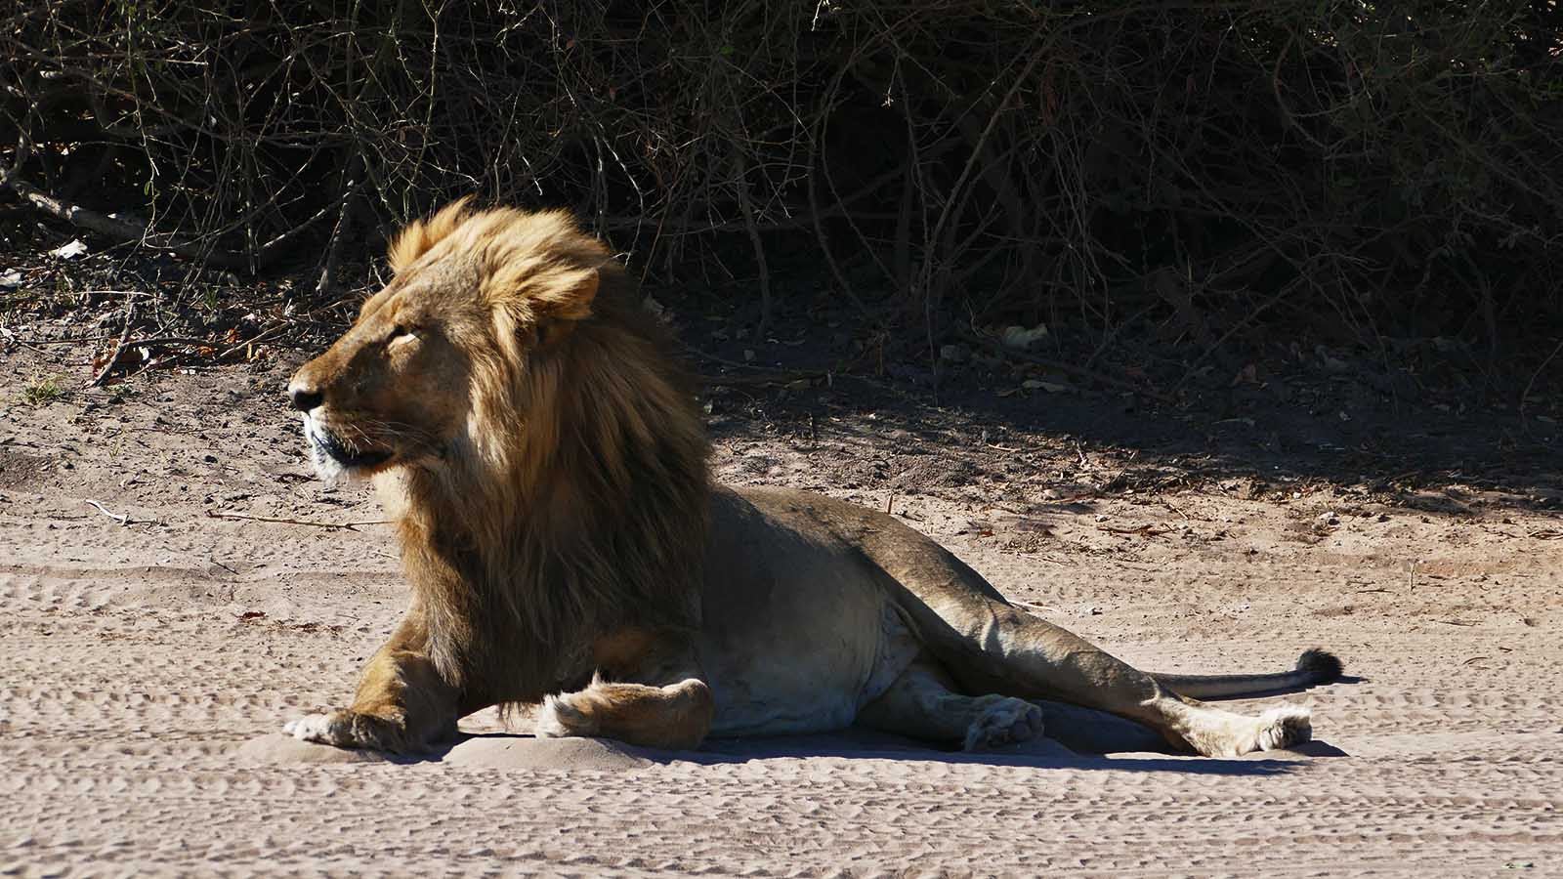
Photo © Sekerka D

Slide 21
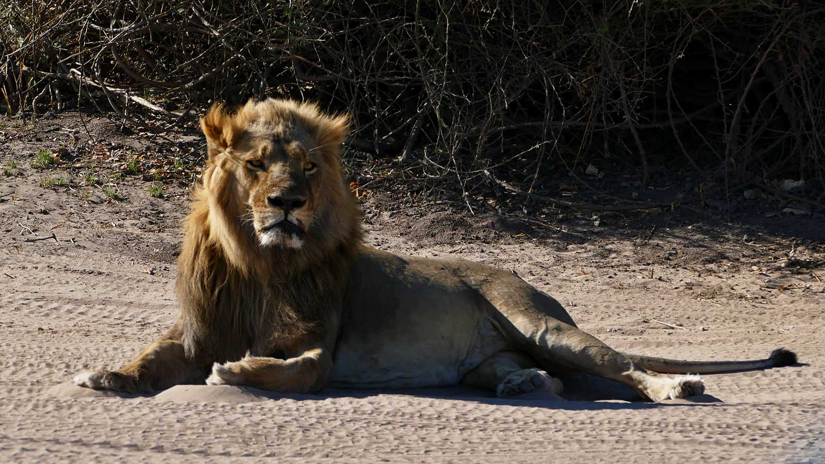
Photo © Sekerka D

Slide 22
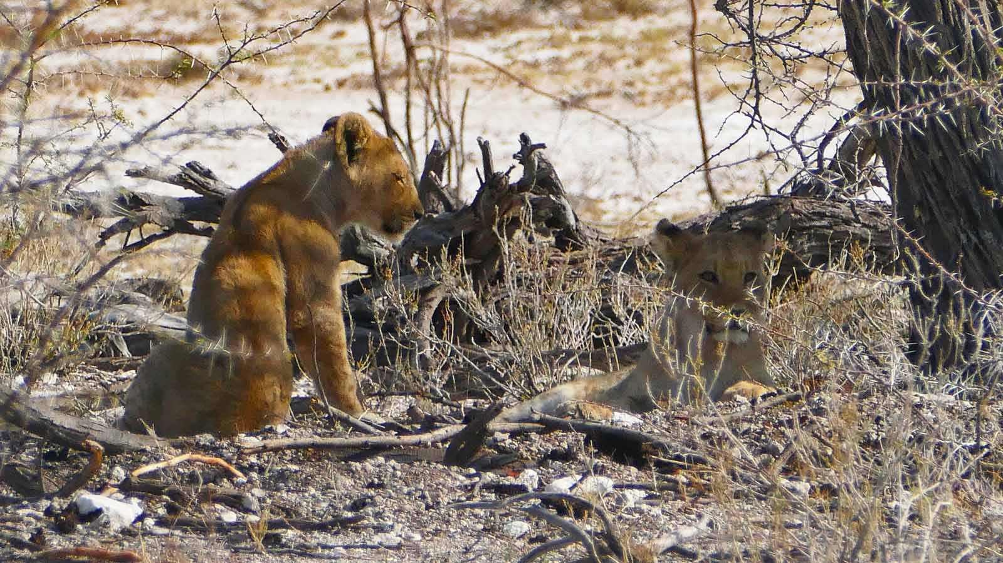
Photo © Sekerka D

Slide 23
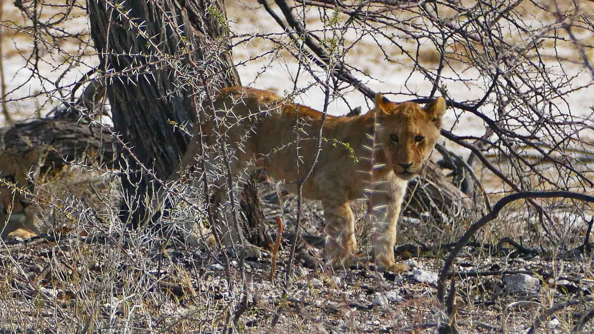
Photo © Sekerka D

Slide 24
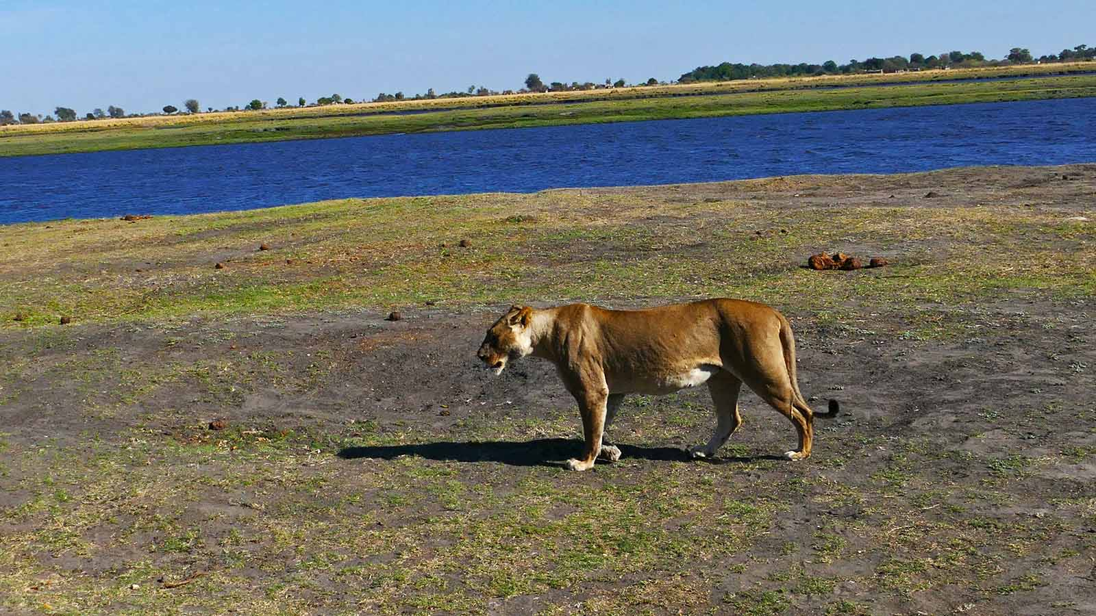
Photo © Sekerka D

Slide 25
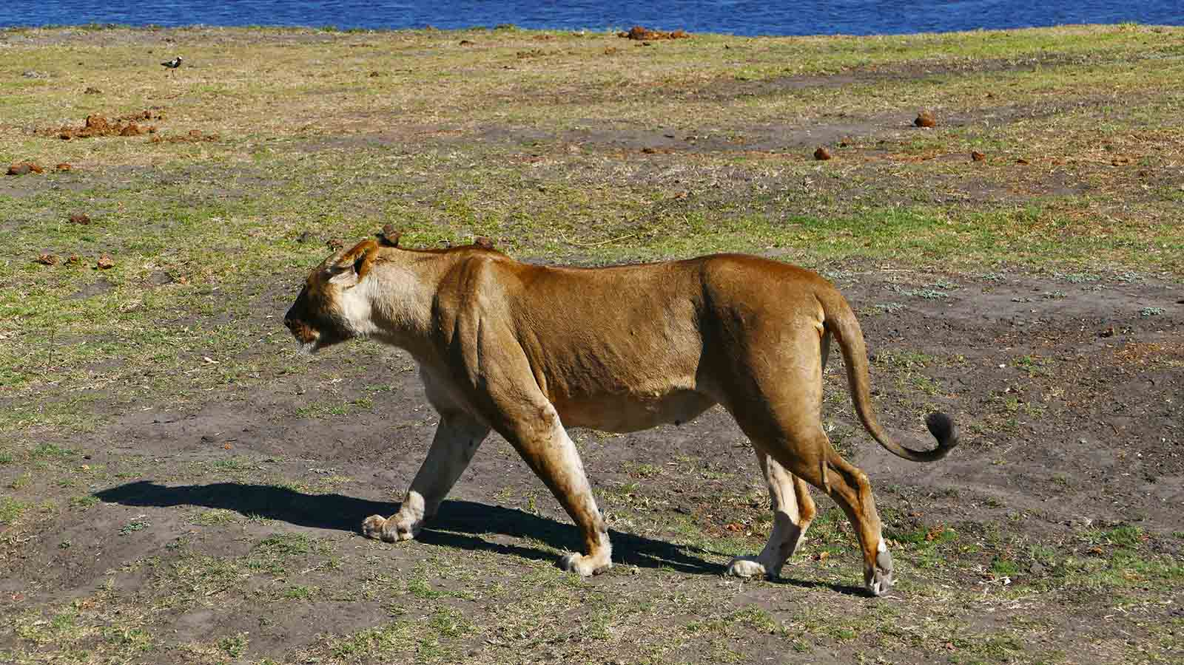
Photo © Sekerka D

Slide 26
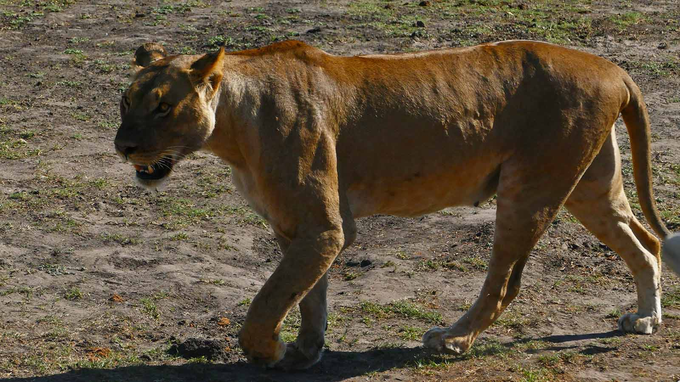
Photo © Sekerka D

Slide 27
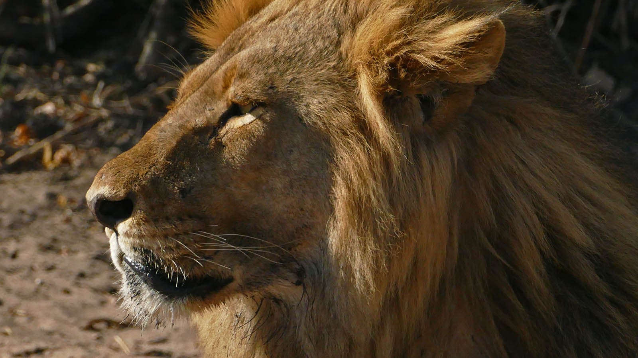
Photo © Sekerka D

Slide 28
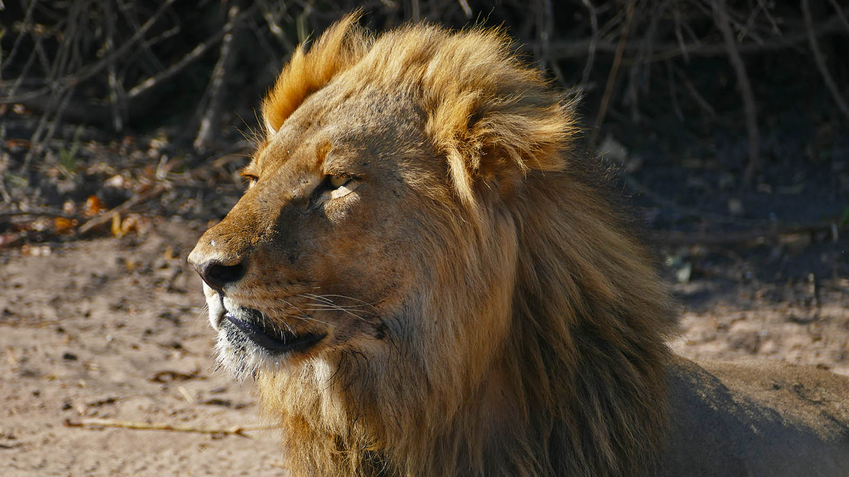
Photo © Sekerka D

Slide 29
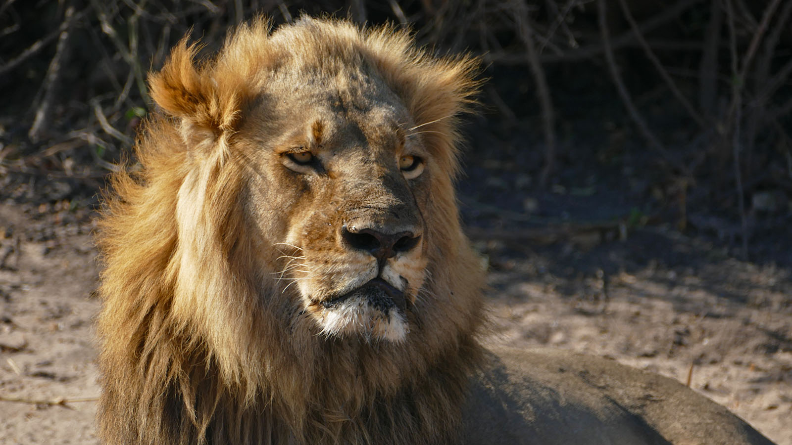
Photo © Sekerka D

Slide 30
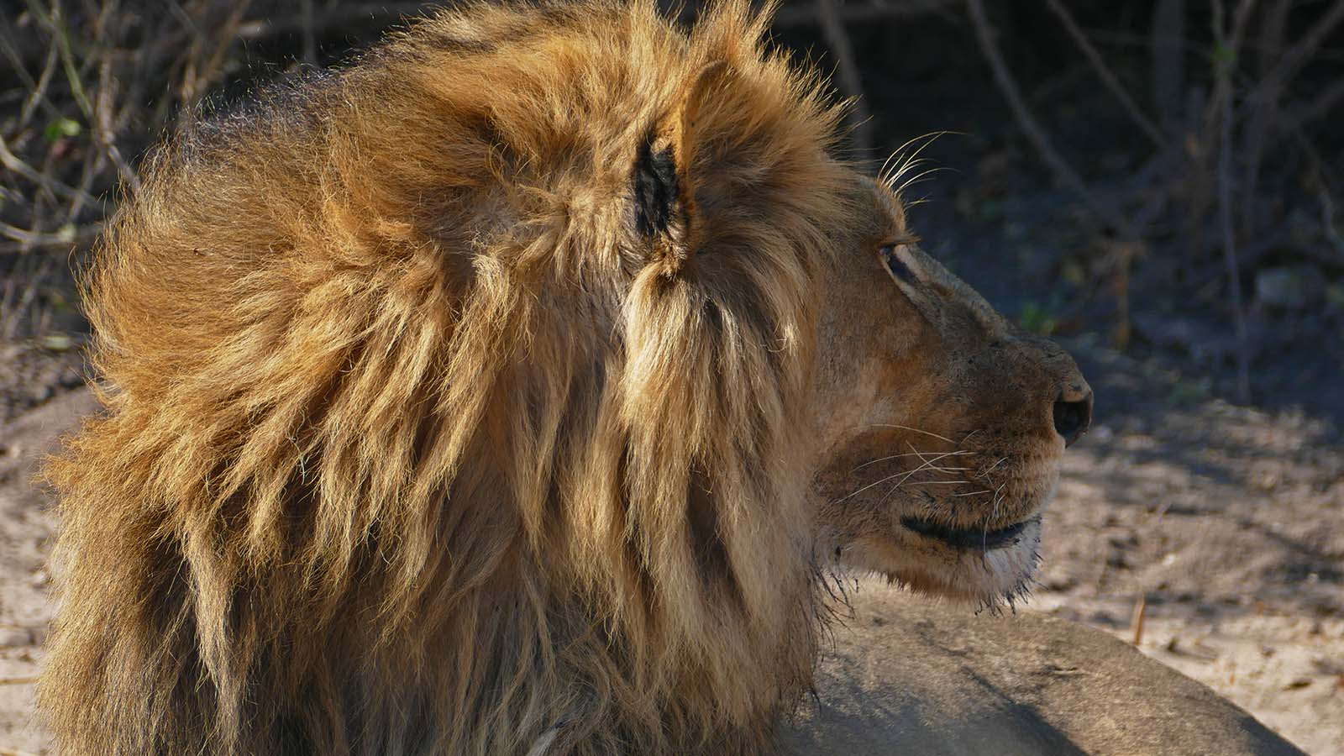
Photo © Sekerka D

Slide 31
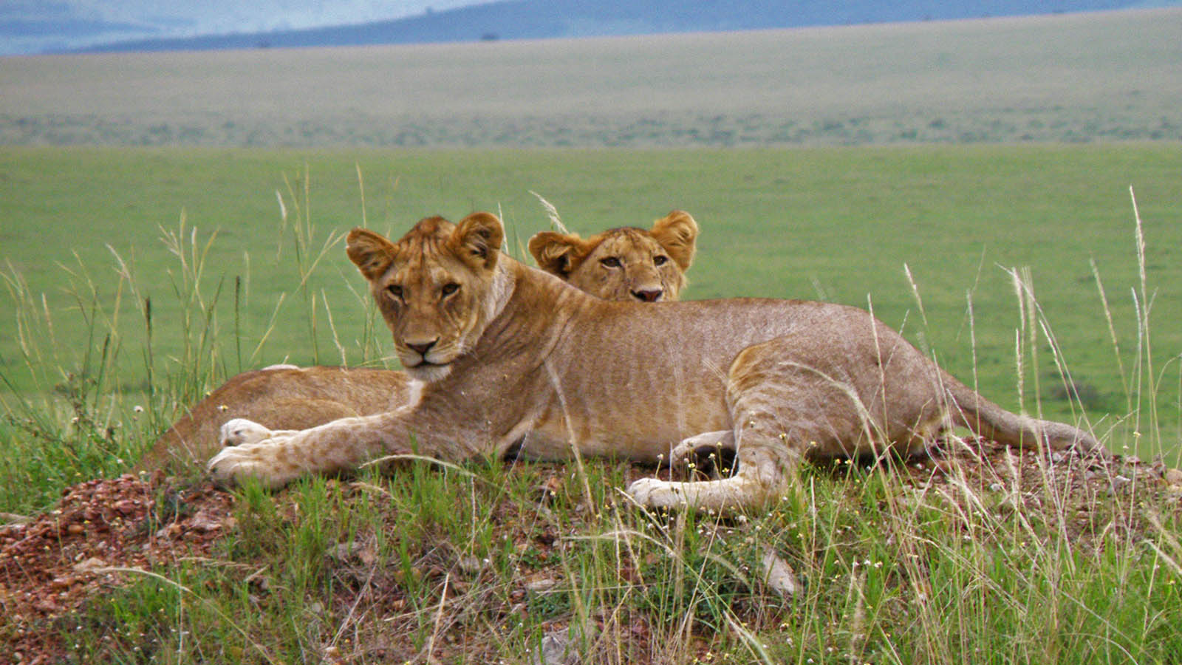
Photo © Hudec Ivan

Slide 32
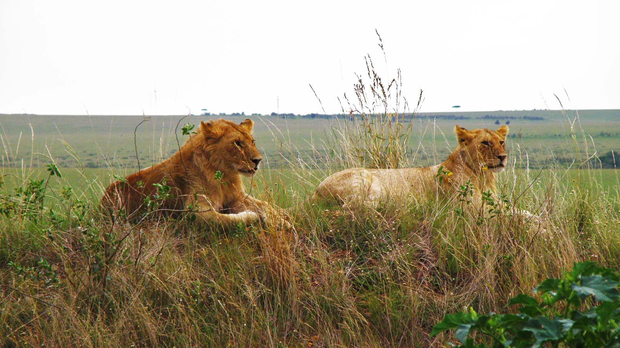
Photo © Hudec Ivan

Slide 33
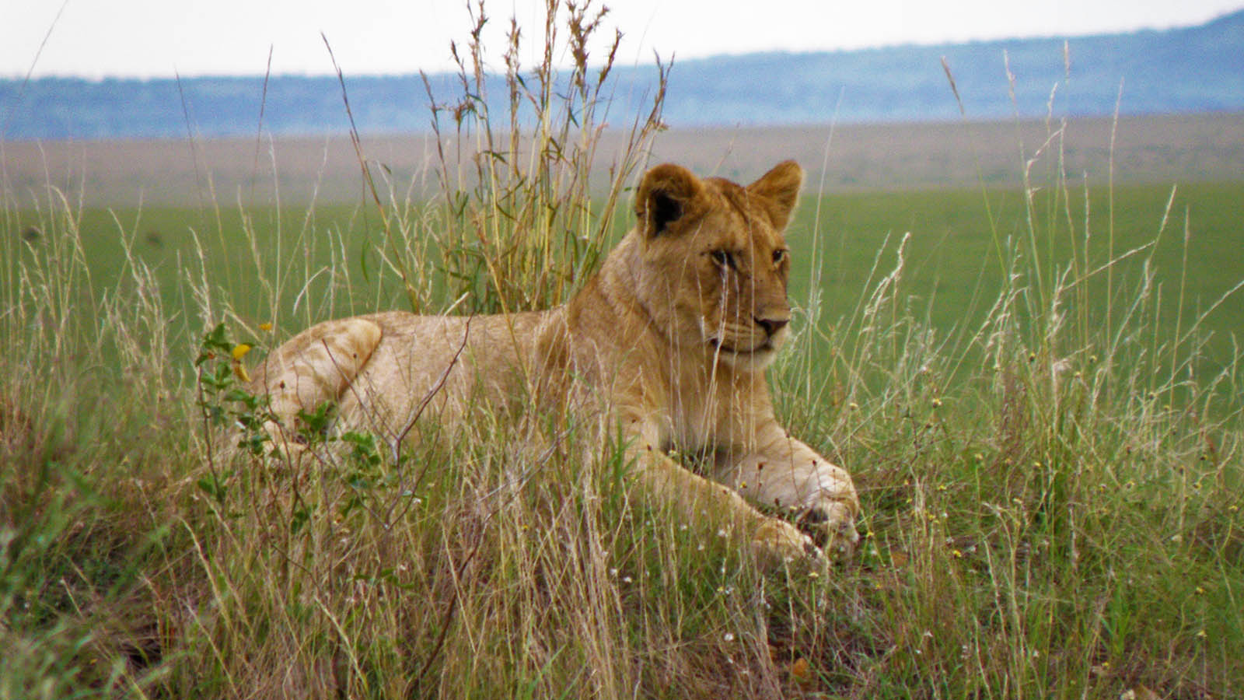
Photo © Hudec Ivan

Slide 34
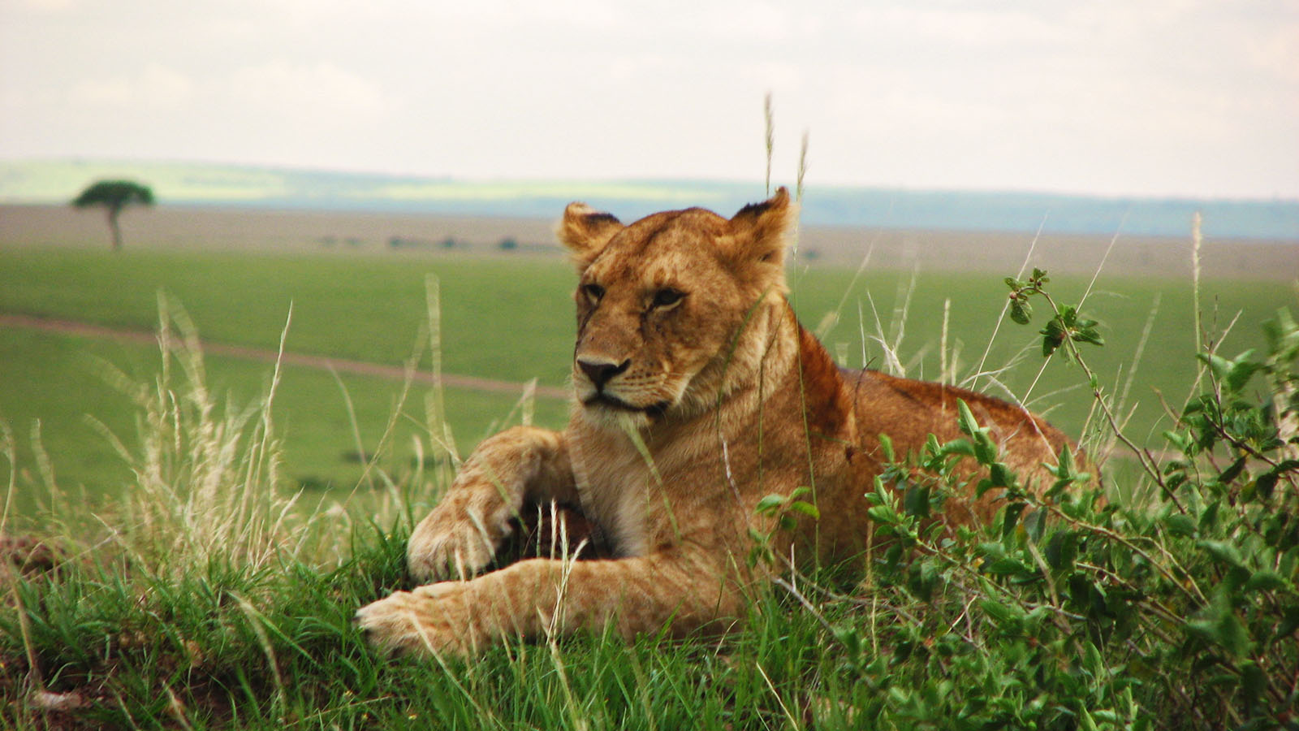
Photo © Hudec Ivan

Slide 35
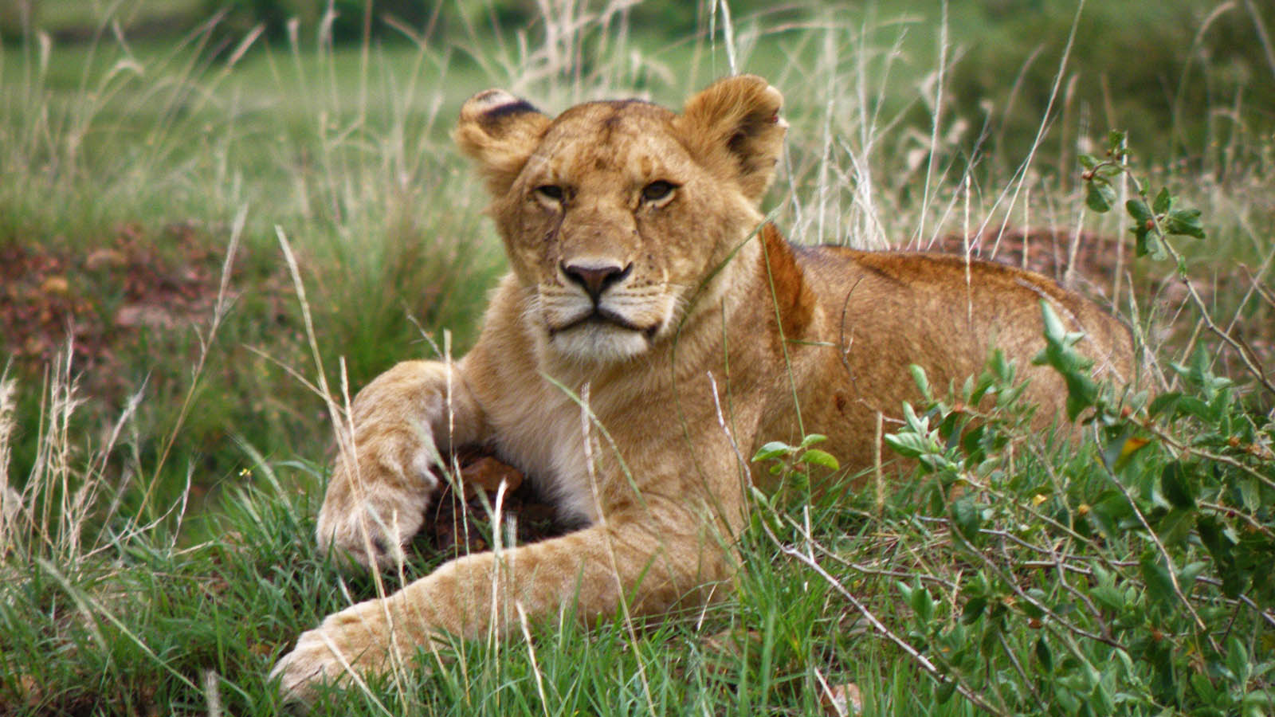
Photo © Hudec Ivan

Slide 36
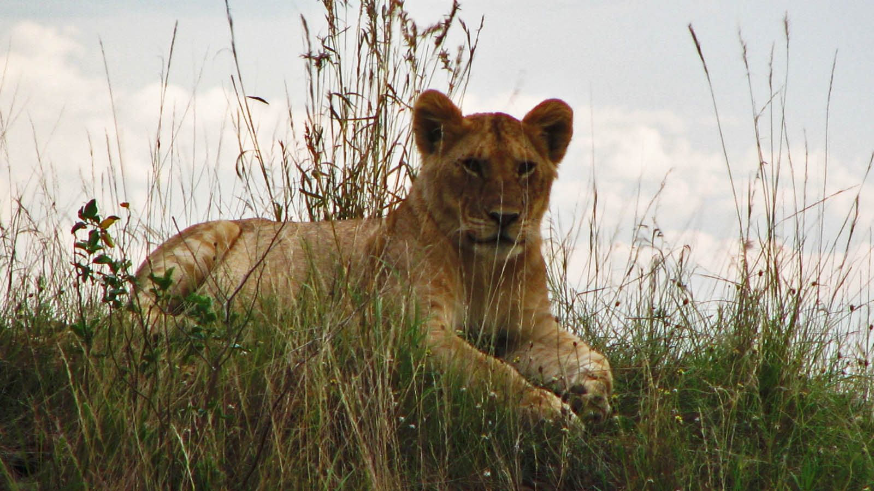
Photo © Hudec Ivan

Slide 37
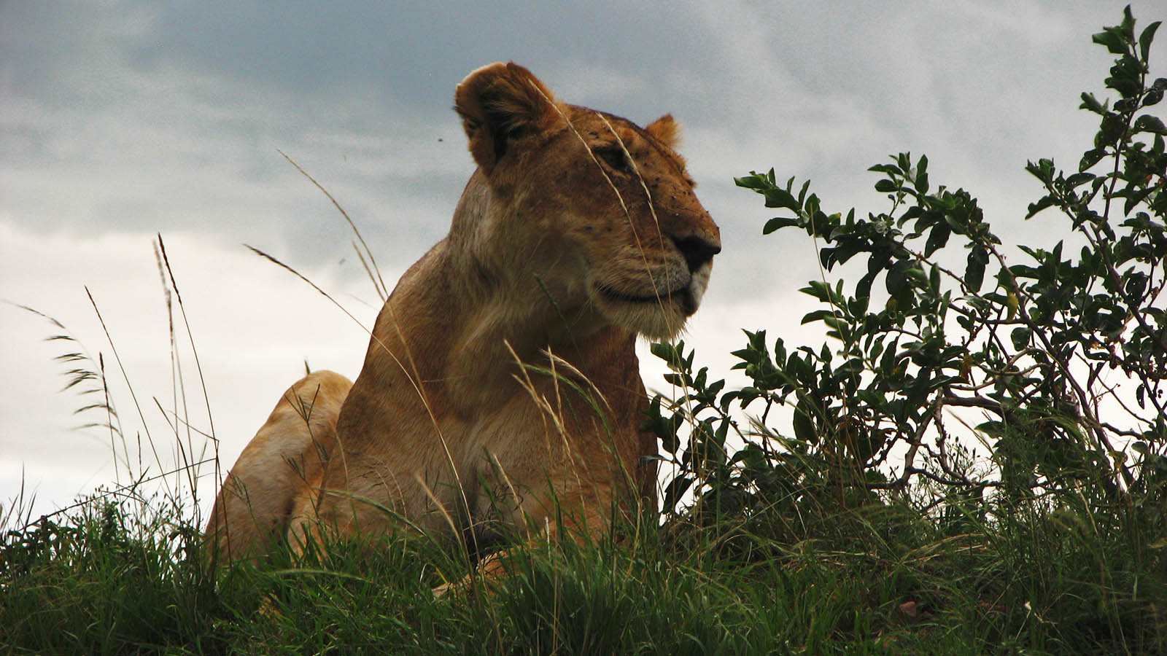
Photo © Hudec Ivan

Slide 38

2020
Music : N'Chant Nguru - Sounds of Africa
Photos : Sekerka Dušan, Ing. (Slovakia)
Photos : Hudec Ivan (Slovakia)
Created by : Rumpler Štefan (Slovakia)
Contact : pista2011@gmail.com

Slide 39

CLICK FOR MY TRAVEL VIDEOS
Thank you for your feedback
Steve

