Slide 1

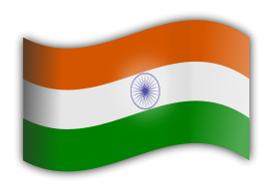
04
INDIA - 2

Slide 2
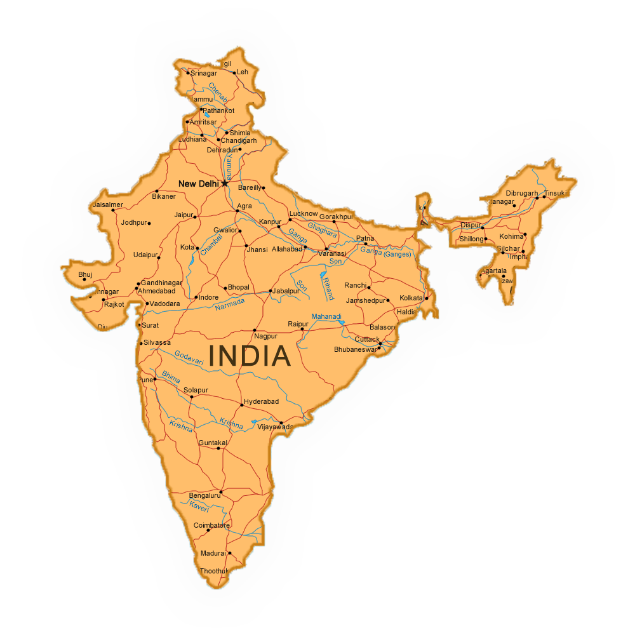

India

Slide 3




India is a country in South Asia. It is the seventh largest country in the world with more than 1.3 billion people. There are 22 official and over 300 spoken languages. No country is as diverse as India. It is home to majestic mountain ranges, pristine lakes, mighty rivers, virgin beaches and lush green forests. The food is as diverse as its weather and art as diverse as its cultures. From the snowbound regions of the north to the bright and cheerful backwaters in the south, from the sandy deserts in the west to the beautiful beaches in the east - simply incredible India...
India es un país en el sur de Asia. Es el séptimo país más grande del mundo con más de 1.300 millones de personas. Hay 22 idiomas oficiales y más de 300 hablados. Ningún país es tan diverso como la India. Es el hogar de majestuosas cadenas montañosas, lagos prístinos, ríos poderosos, playas vírgenes y frondosos bosques verdes. La comida es tan diversa como su clima y el arte tan diverso como sus culturas. Desde las regiones nevadas del norte hasta los remansos brillantes y alegres del sur, desde los desiertos de arena del oeste hasta las hermosas playas del este - simplemente increíble India…
India je krajina v južnej Ázii. Je to siedma najväčšia krajina s viac ako 1,3 miliardy ľudí na svete. V Indii sa používa 22 oficiálnych a viac ako 300 hovorených jazykov. Žiadna krajina nie je taká rôznorodá ako India. Je domovom majestátnych pohorí, nedotknutých jazier, mohutných riek, panenských pláží a bujných zelených lesov. Jedlo je tak rozmanité ako jej počasie a umenie tak rozmanité ako jeho kultúra. Od zasnežených oblastí na severe až po svetlé a veselé stojaté vody na juhu, od piesočnatých púští na západe až po krásne pláže na východe - jednoducho neuveriteľná India...

Slide 4

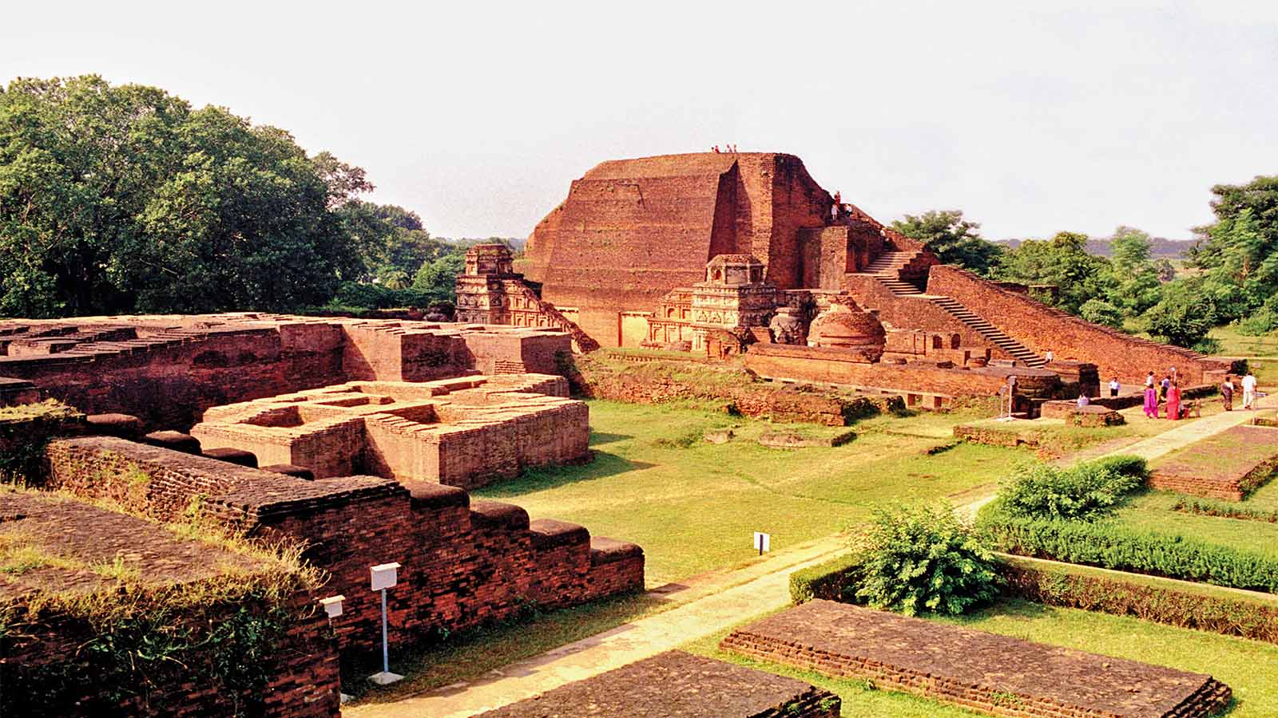
Nalanda Buddhist Monastery, Bihar

Slide 5
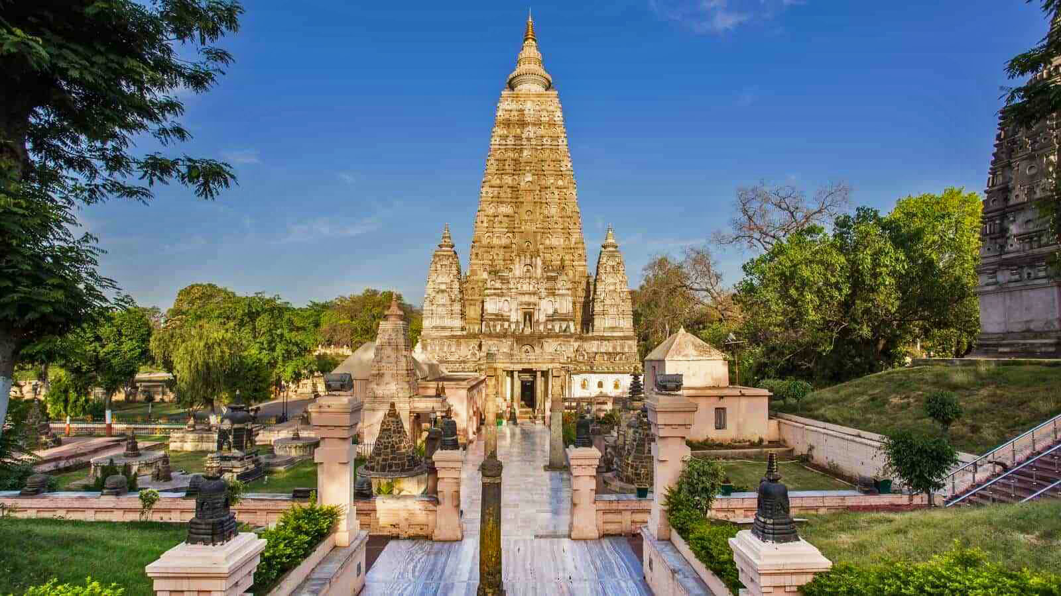
Mahabodhi Temple, Bihar

Slide 6
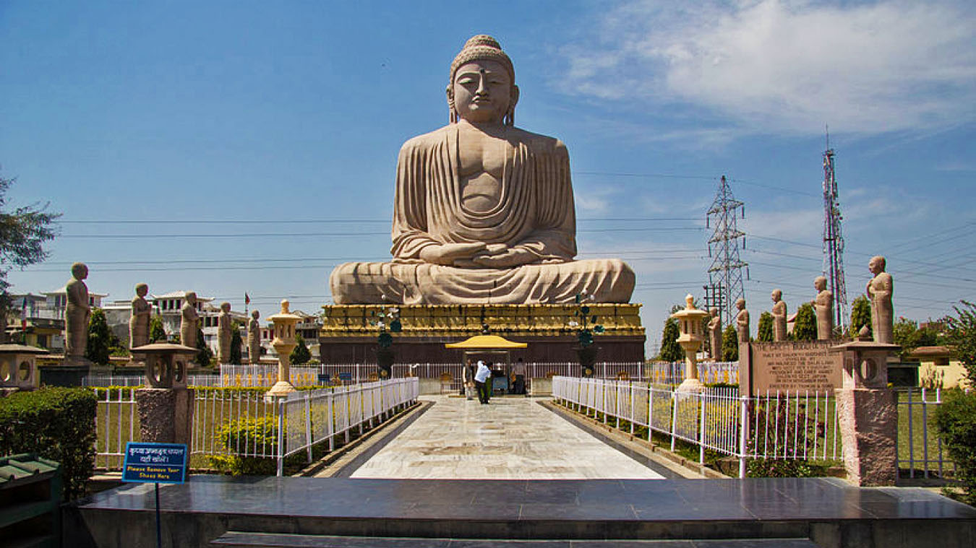
Great Buddha Statue, Bodh, Bihar

Slide 7
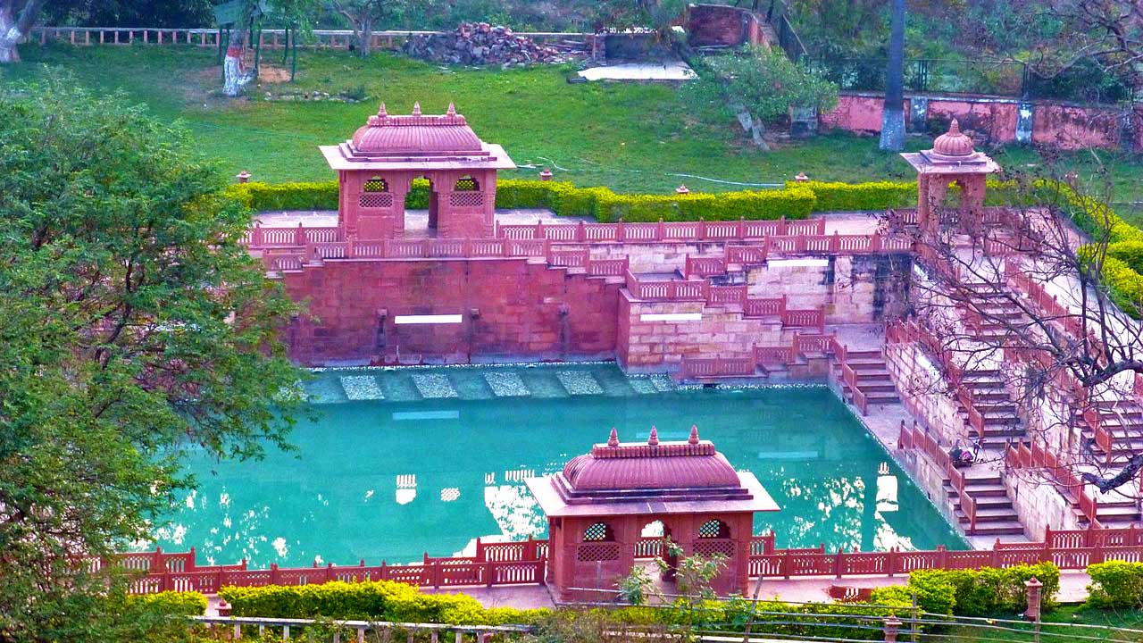
Brahma Kund hot springs, Rajgir, Bihar

Slide 8
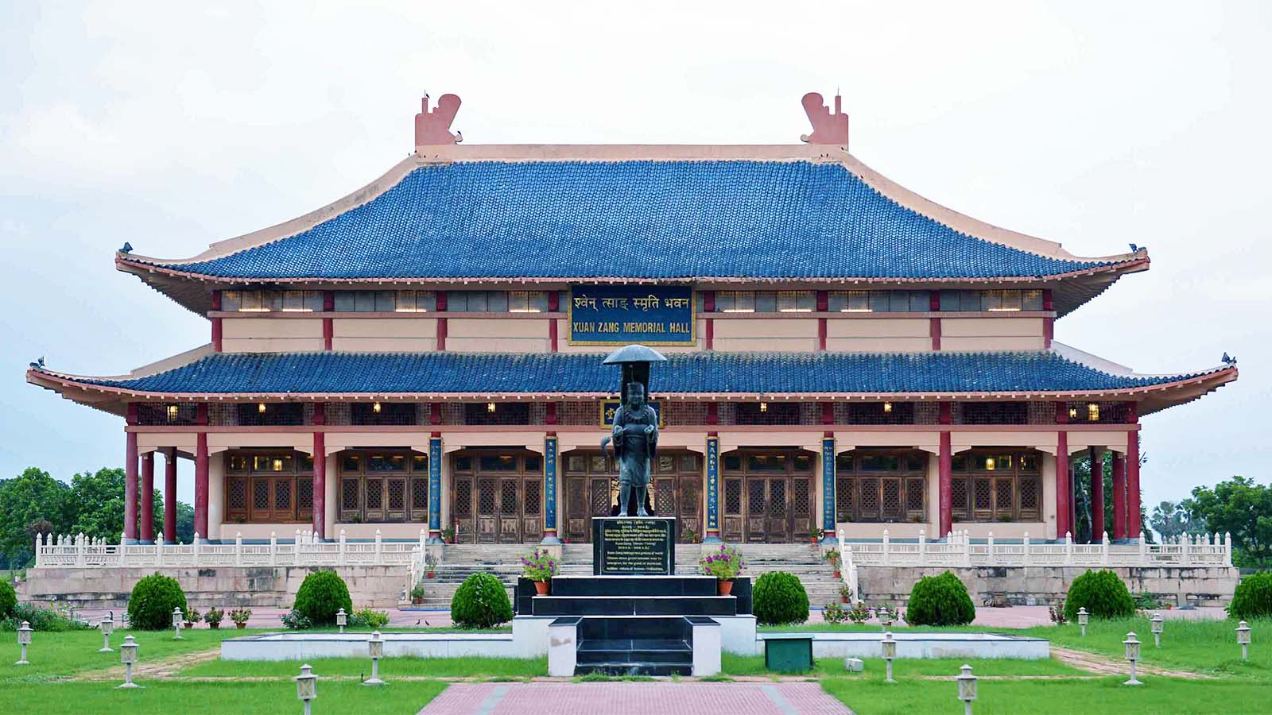
Hieun Tsang Memorial Hall, Nalanda, Bihar

Slide 9
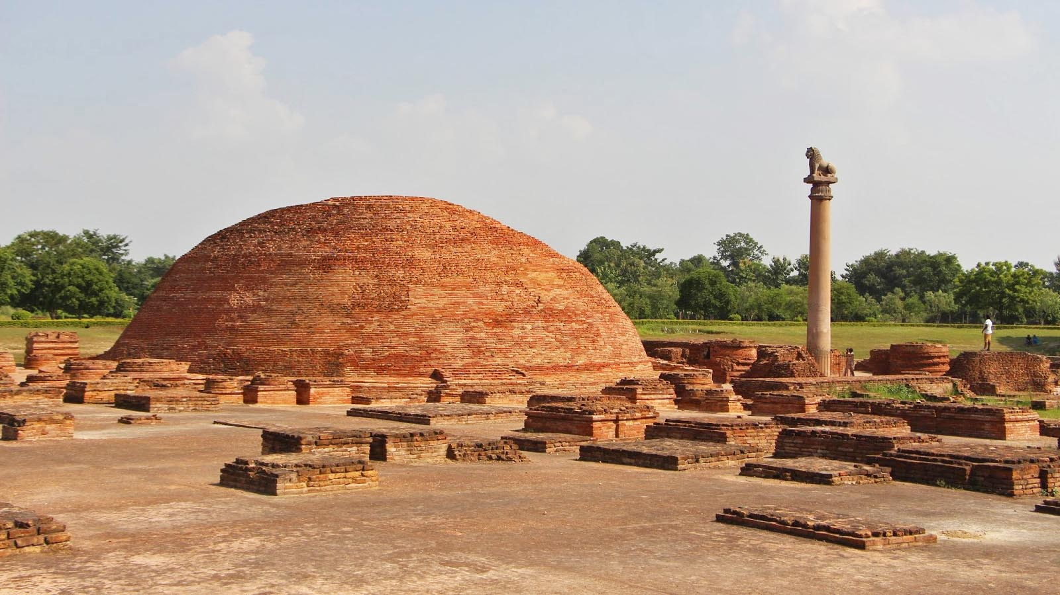
Vaishali, Nalanda, Bihar

Slide 10
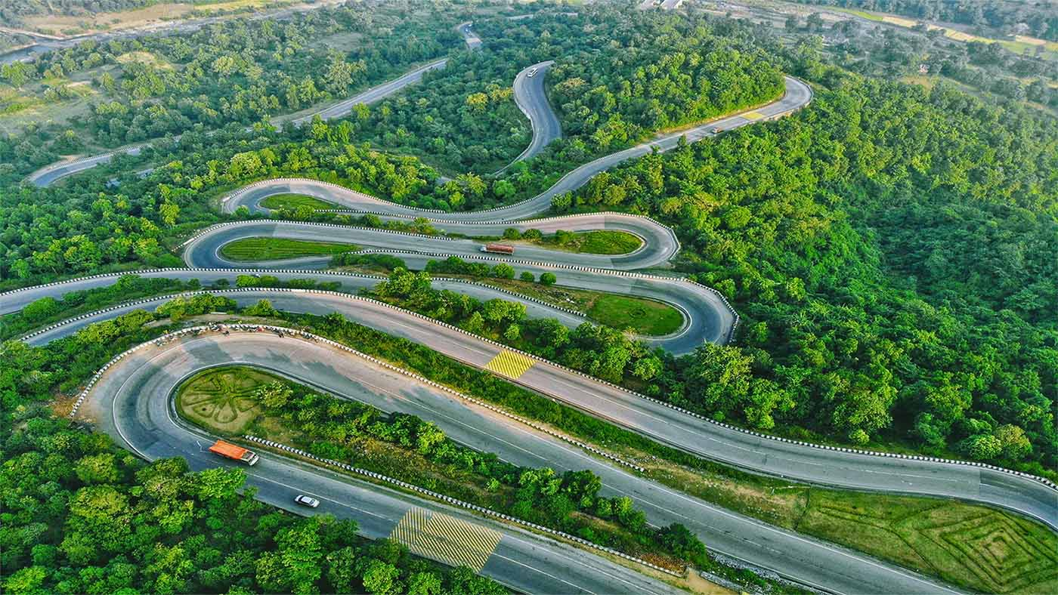
Patratu Valley from Ranchi Hill, Jharkhand

Slide 11
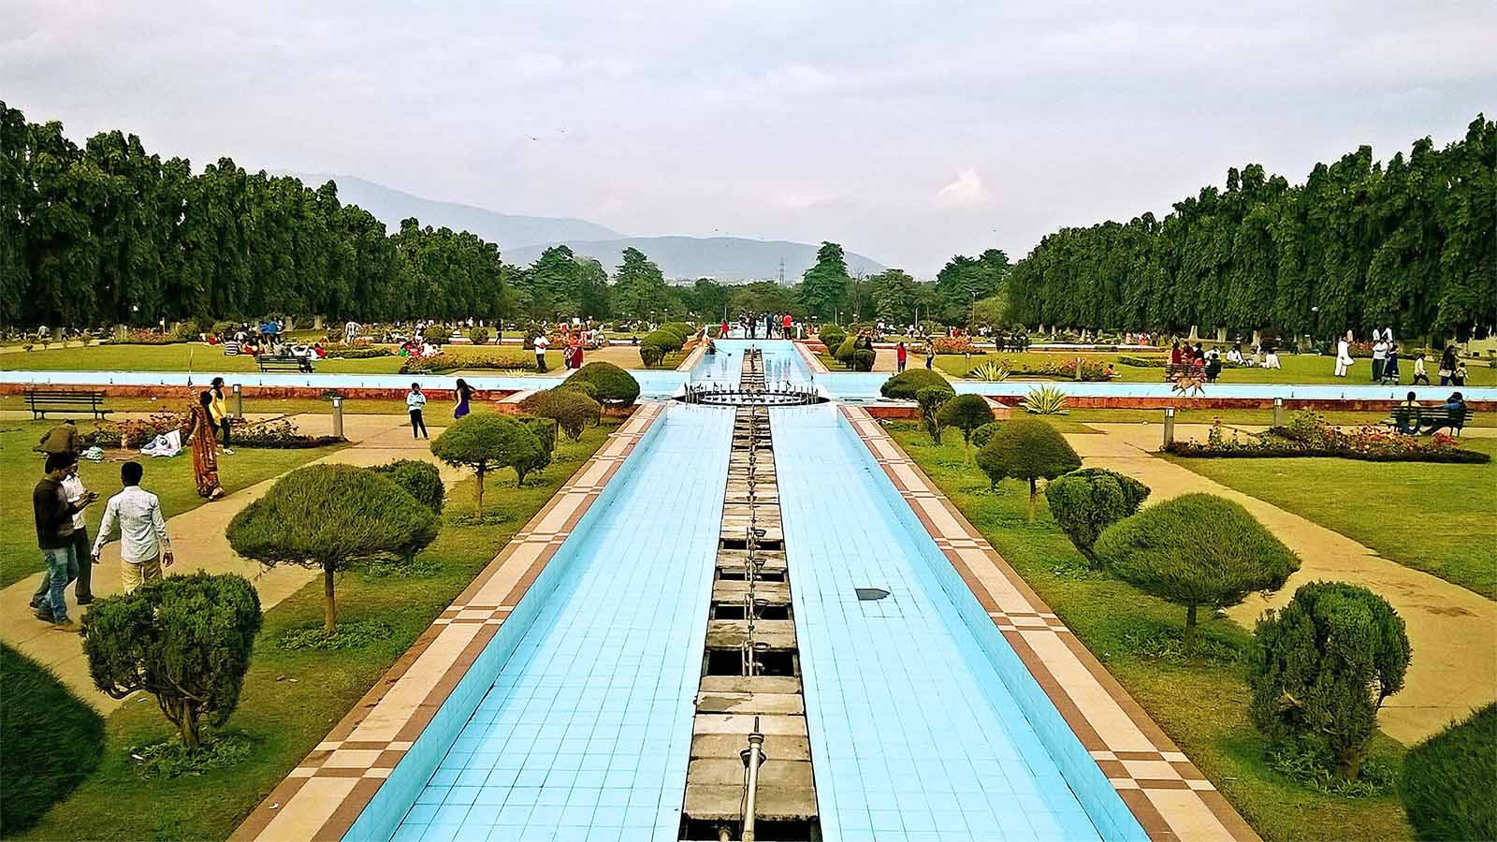
Tata Steel Park, Jamshedpur, Jharkhand

Slide 12
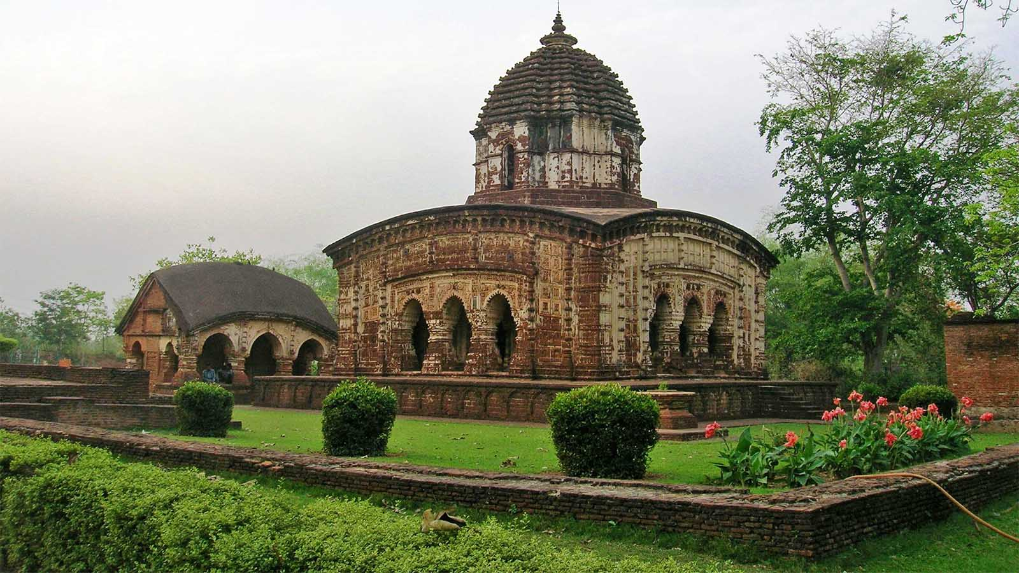
Radhamadhab Temple, Bishnupur, West Bengal

Slide 13
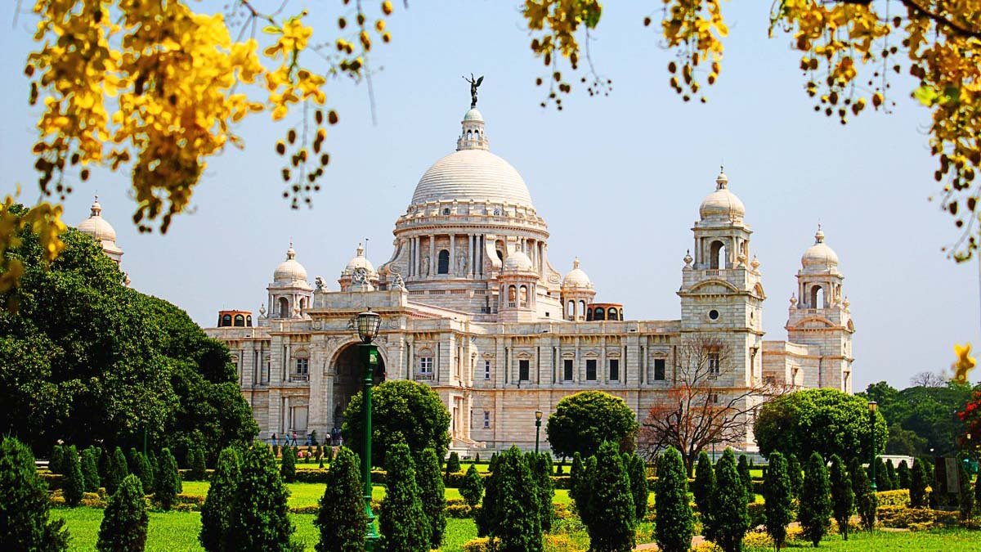
Victoria Memorial, Kolkata, West Bengal

Slide 14
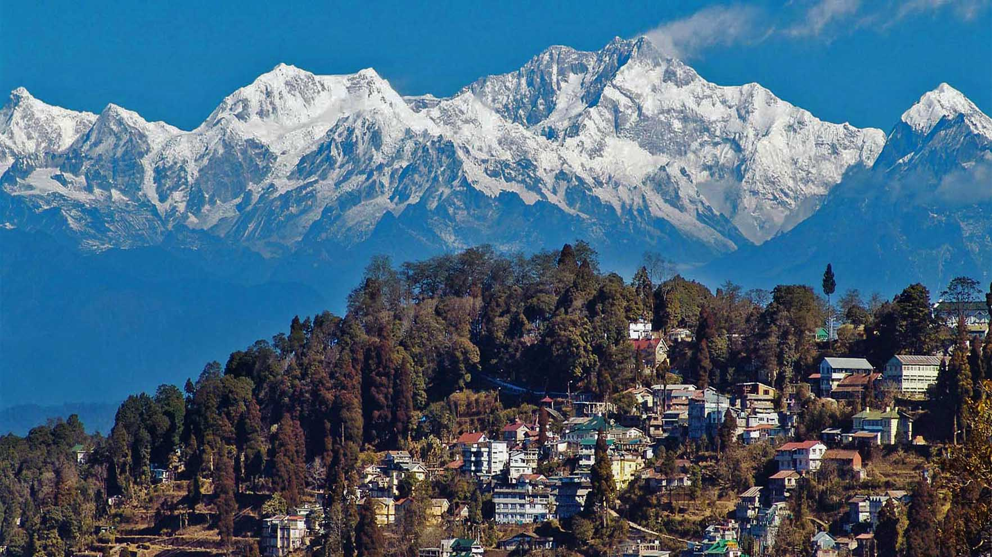
Tiger Hill (with Mt Everest and Mt Kangchenjunga), West Bengal

Slide 15
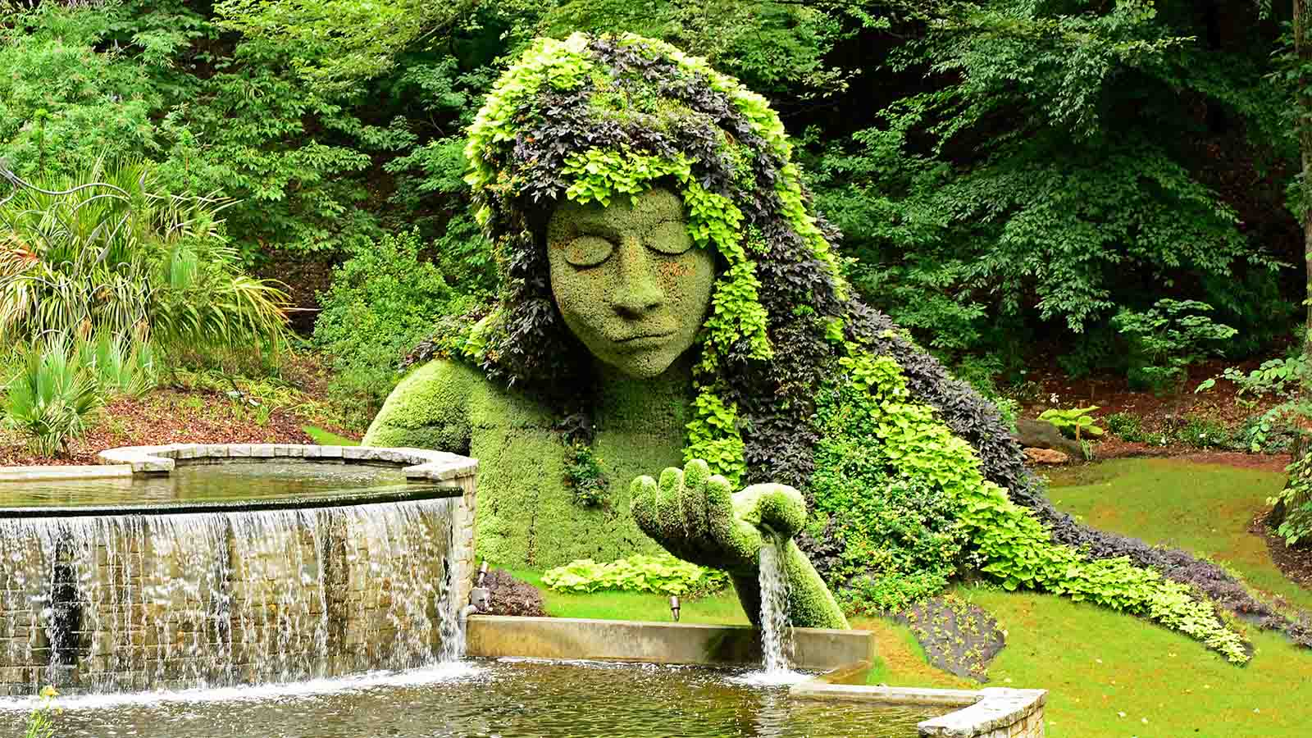
Botanical Garden, Shibpur, Kolkata

Slide 16
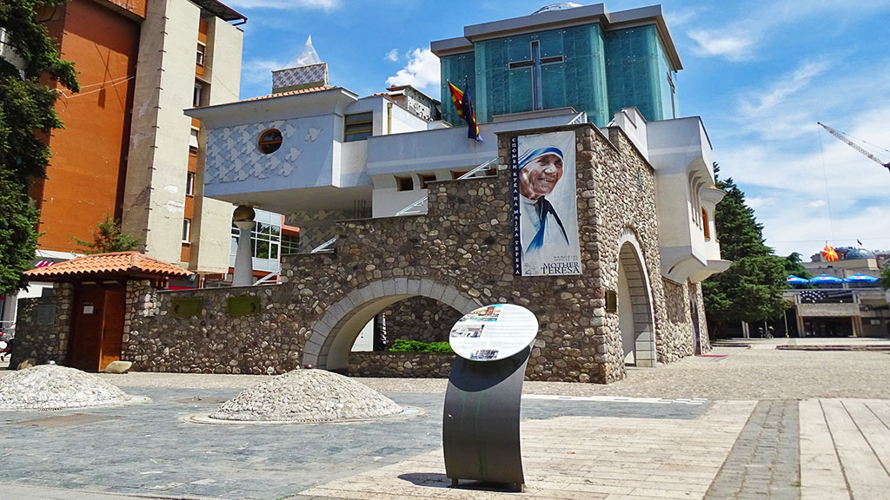
Mother House established by Mother Teresa, Kolkata

Slide 17
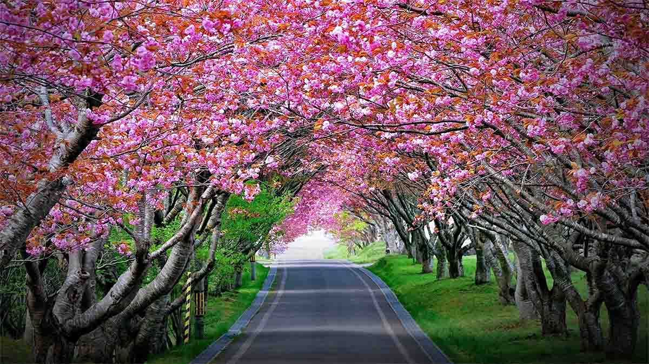
Cherry blossom tree tunnel, Shillong, Meghalaya

Slide 18
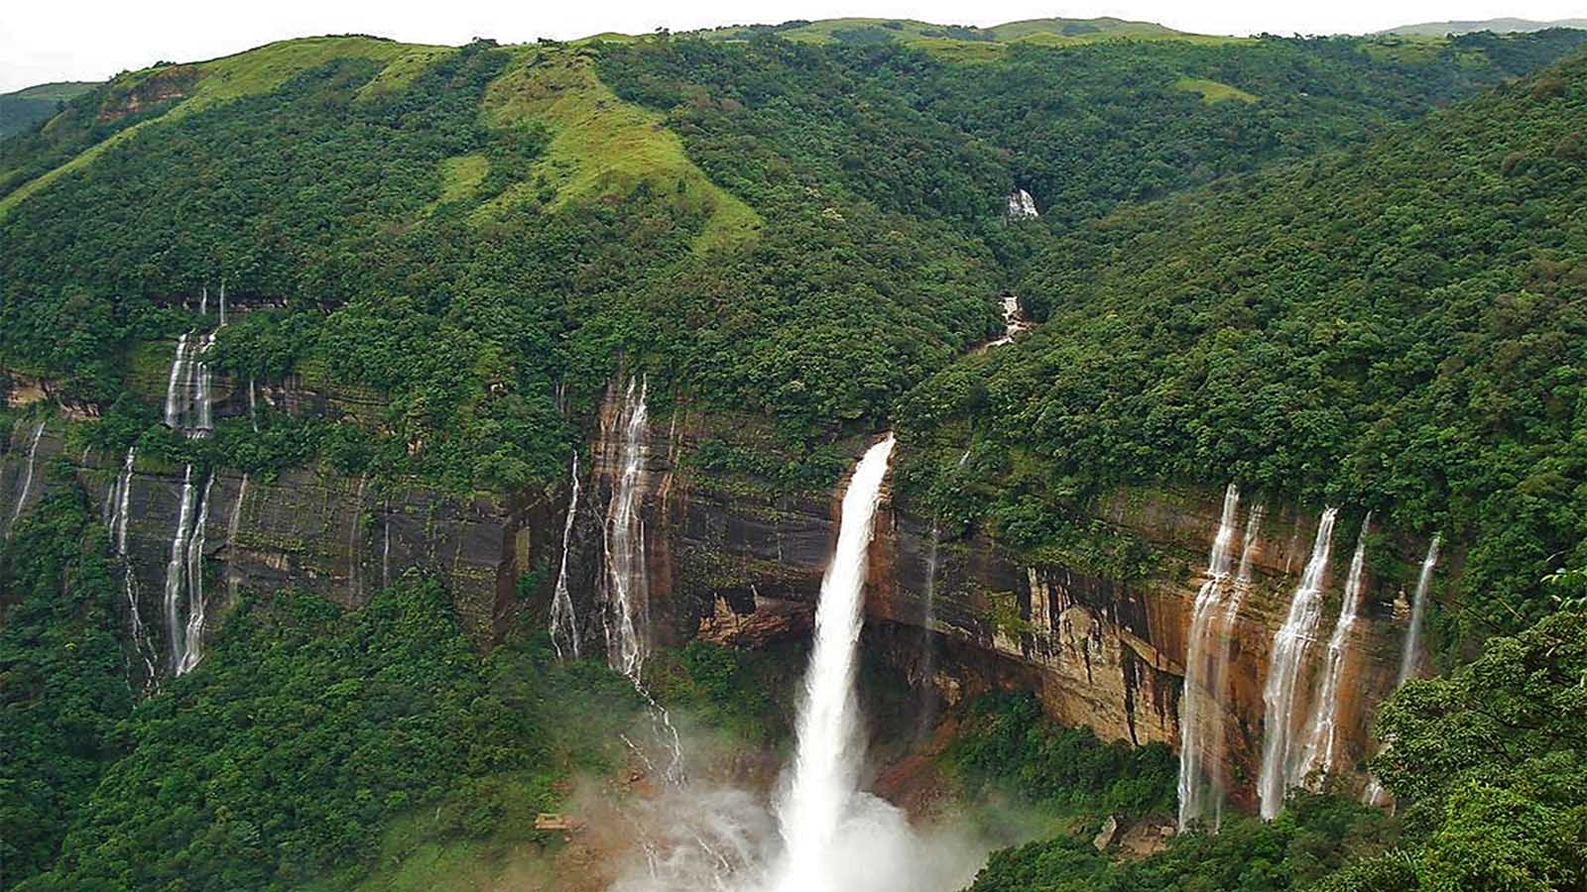
Nohsngithiang Falls, Meghalaya

Slide 19
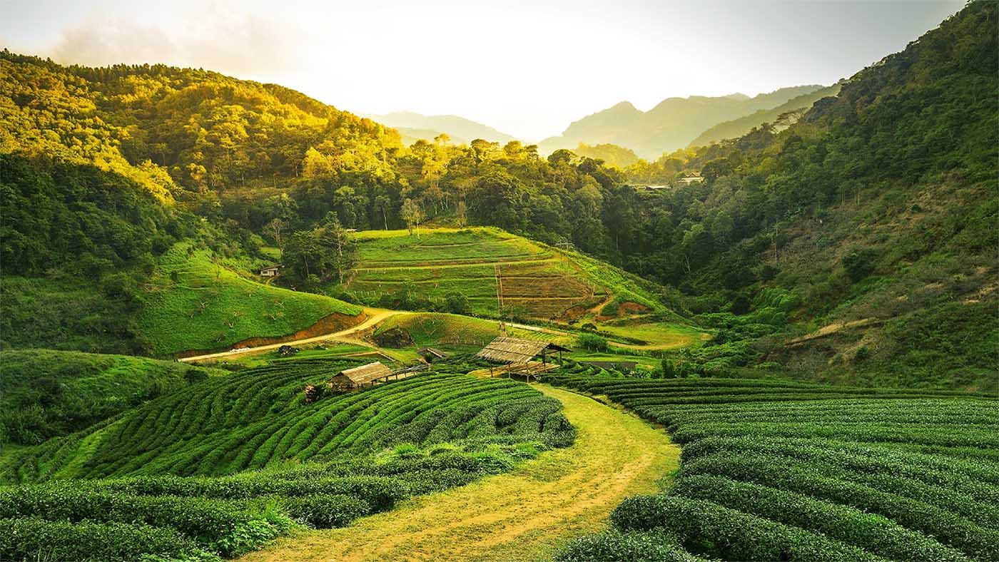
Tea plantations, Assam

Slide 20
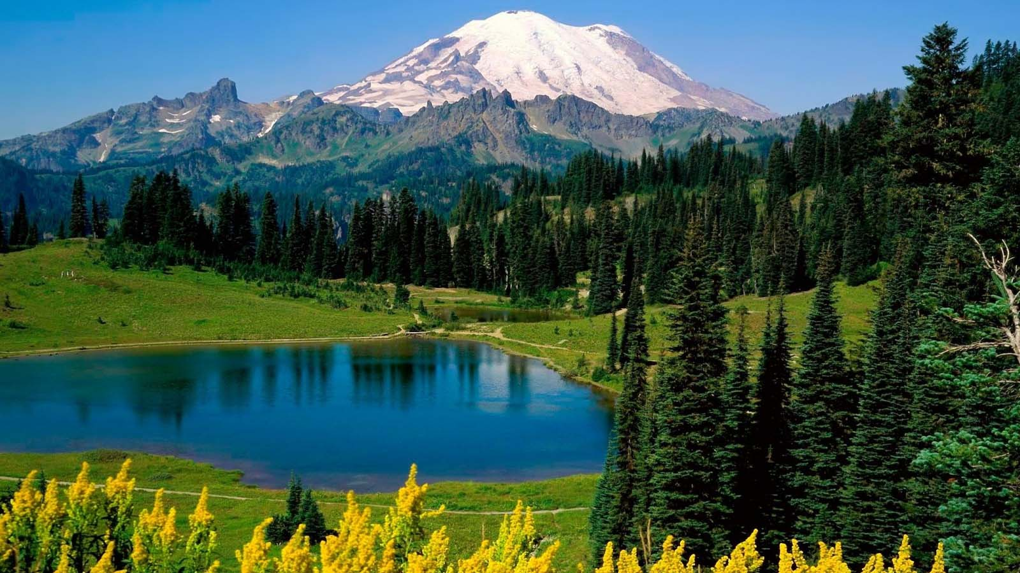
Haflong Lake, Assam

Slide 21
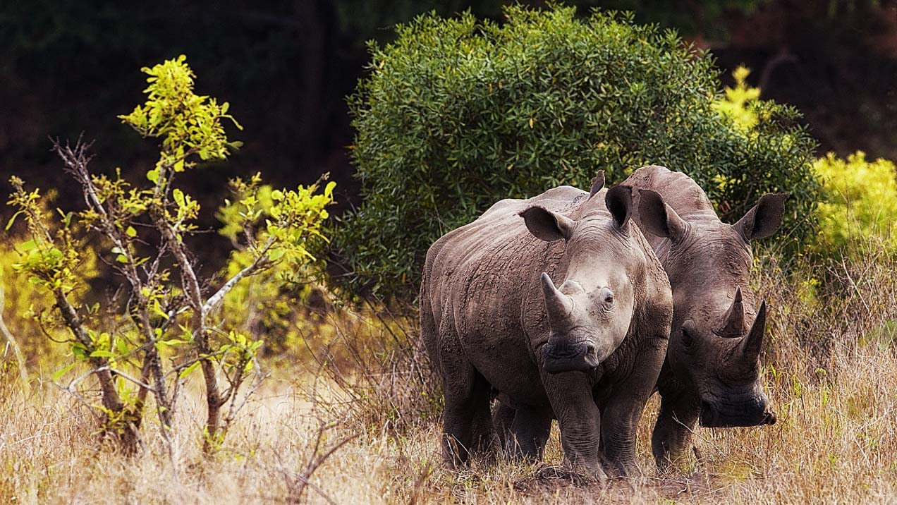
Kaziranga National Wildlife Park, Assam

Slide 22
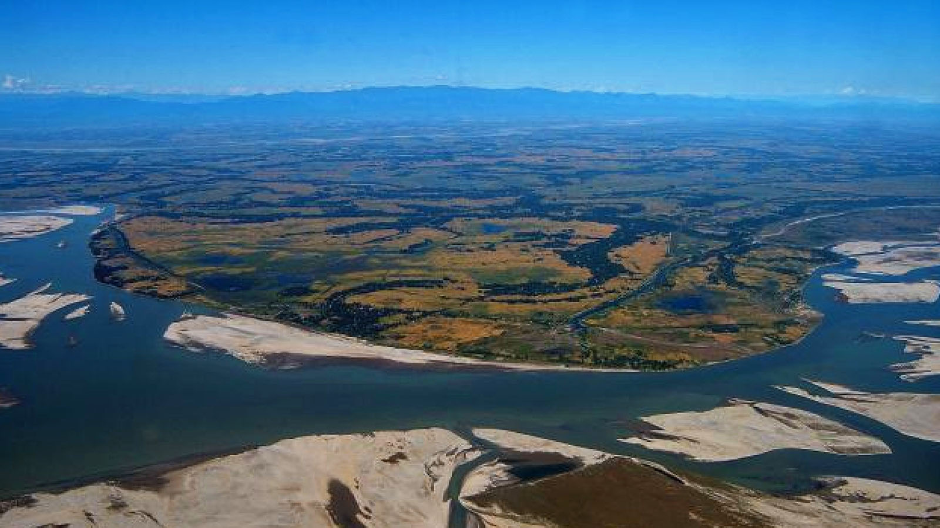
Mājuli river island in the Brahmaputra River, Assam

Slide 23
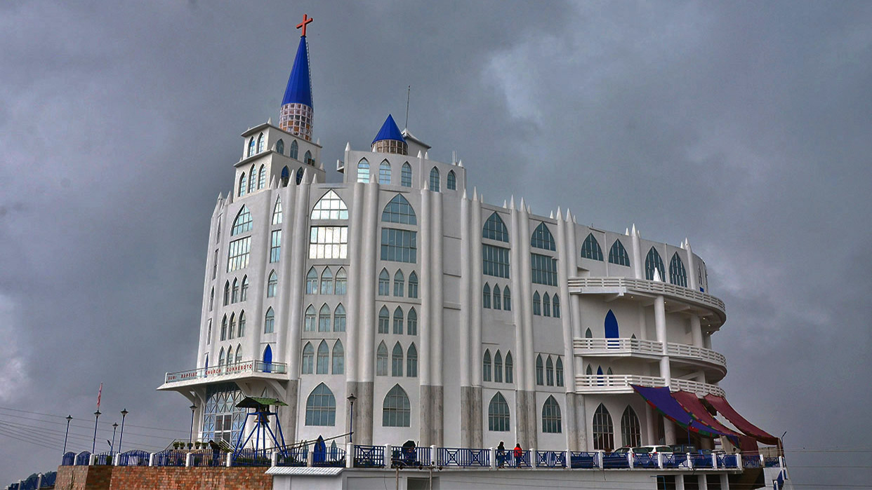
Sumi Baptist Church, Nagaland

Slide 24
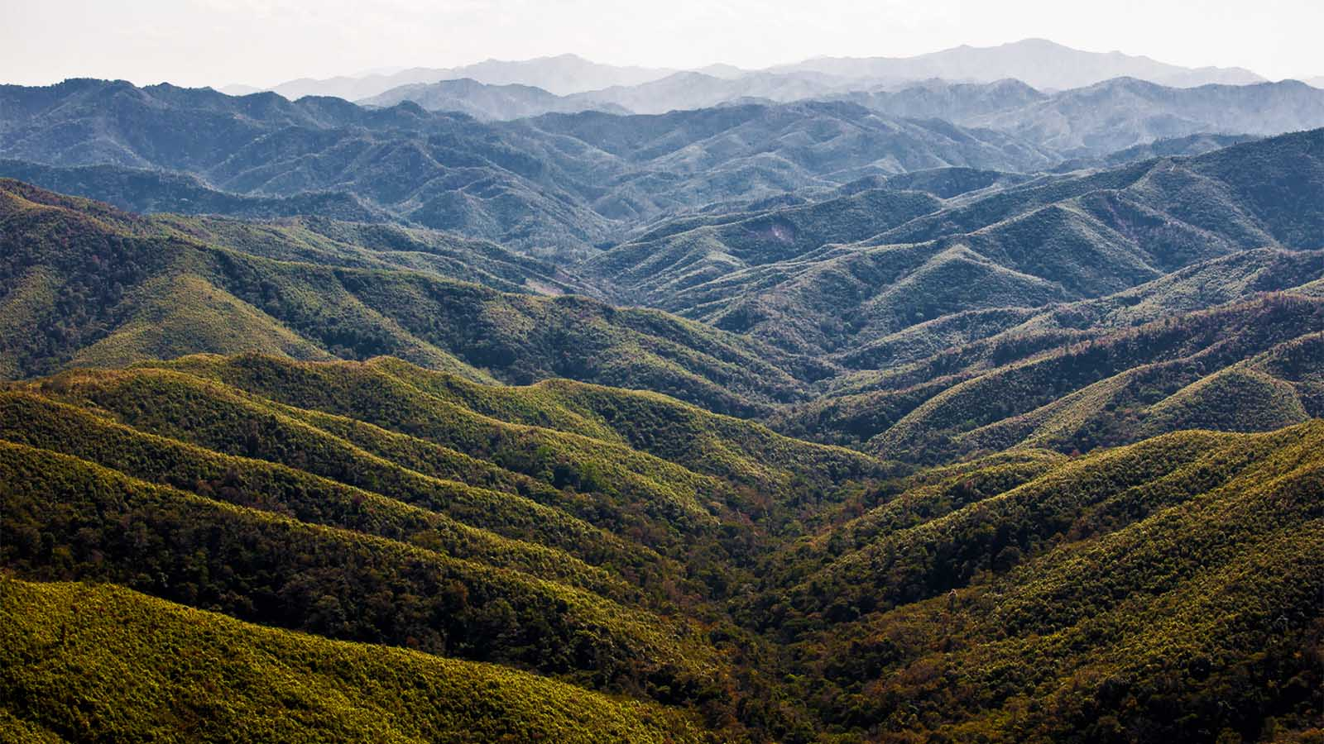
Landscape, Manipur

Slide 25
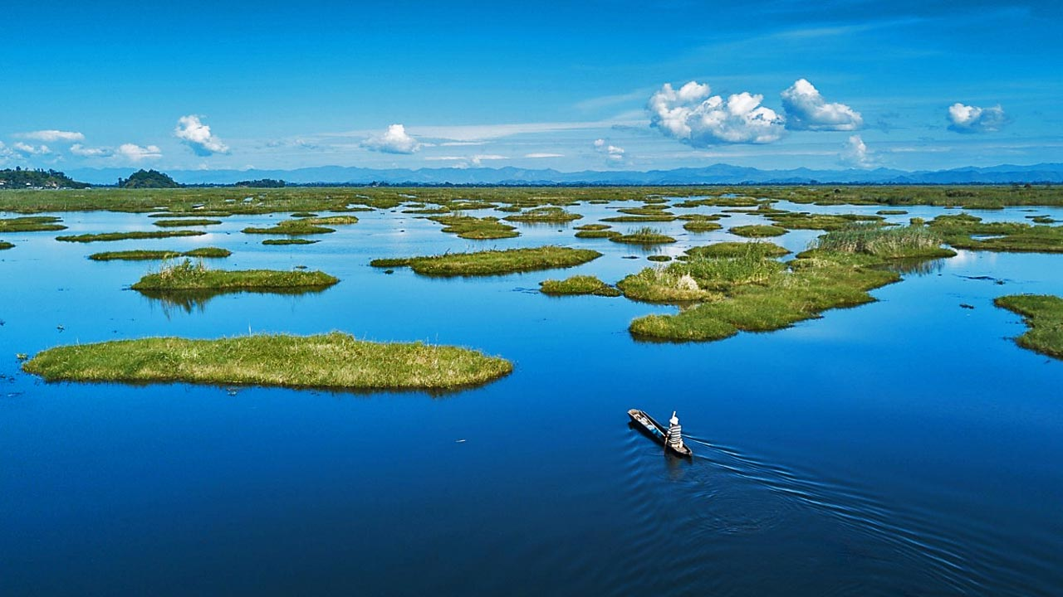
Loktak lake, Moirang, Manipur

Slide 26
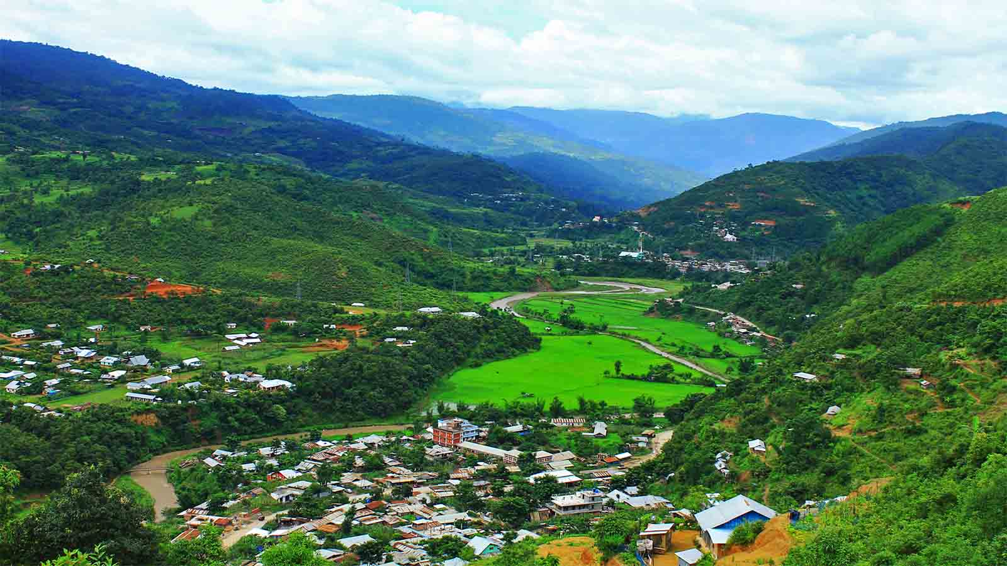
Karong Village, Manipur

Slide 27
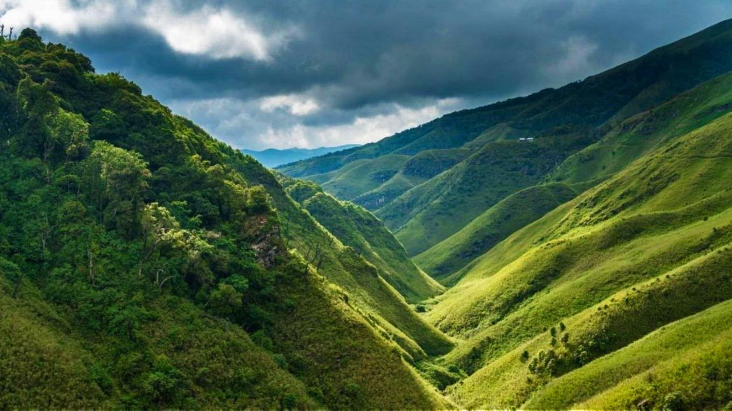
Dzukou Valley, Manipur

Slide 28
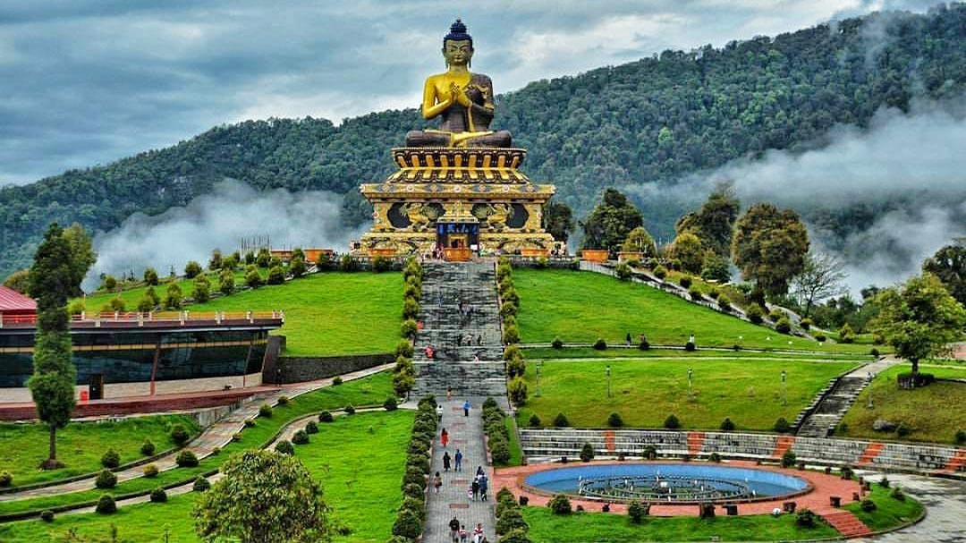
Buddha Park of Ravangla, Sikkim

Slide 29
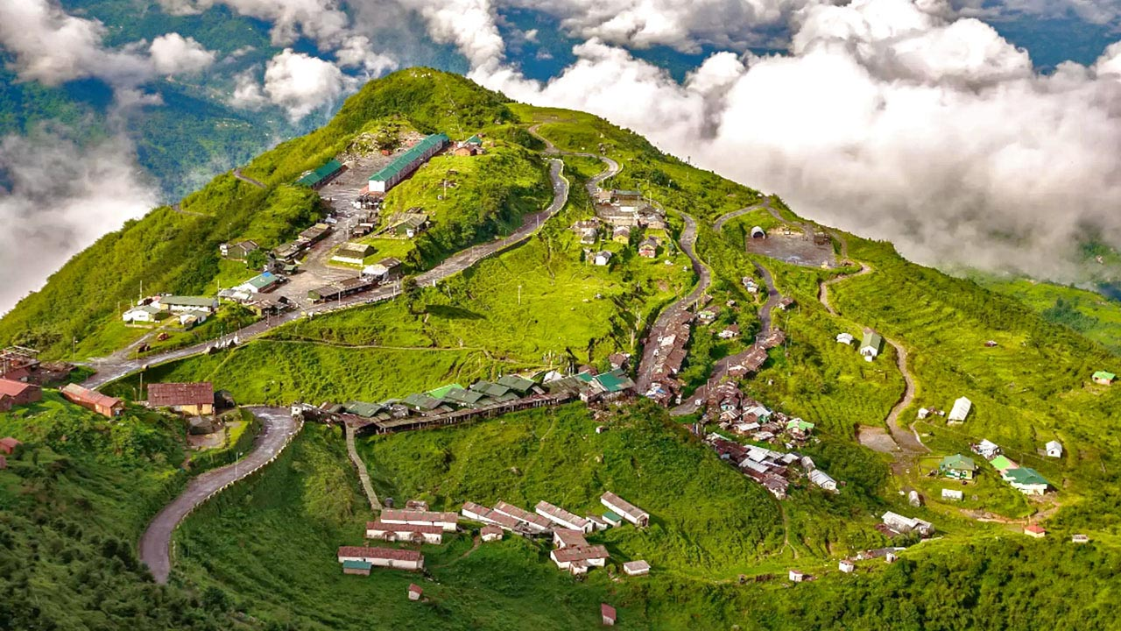
Zuluk Village, Sikkim

Slide 30
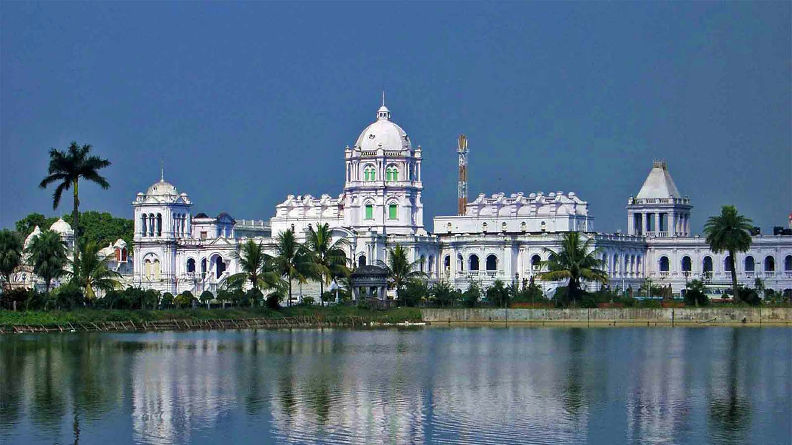
Ujjayanta Palace, Agartala, Tripura

Slide 31
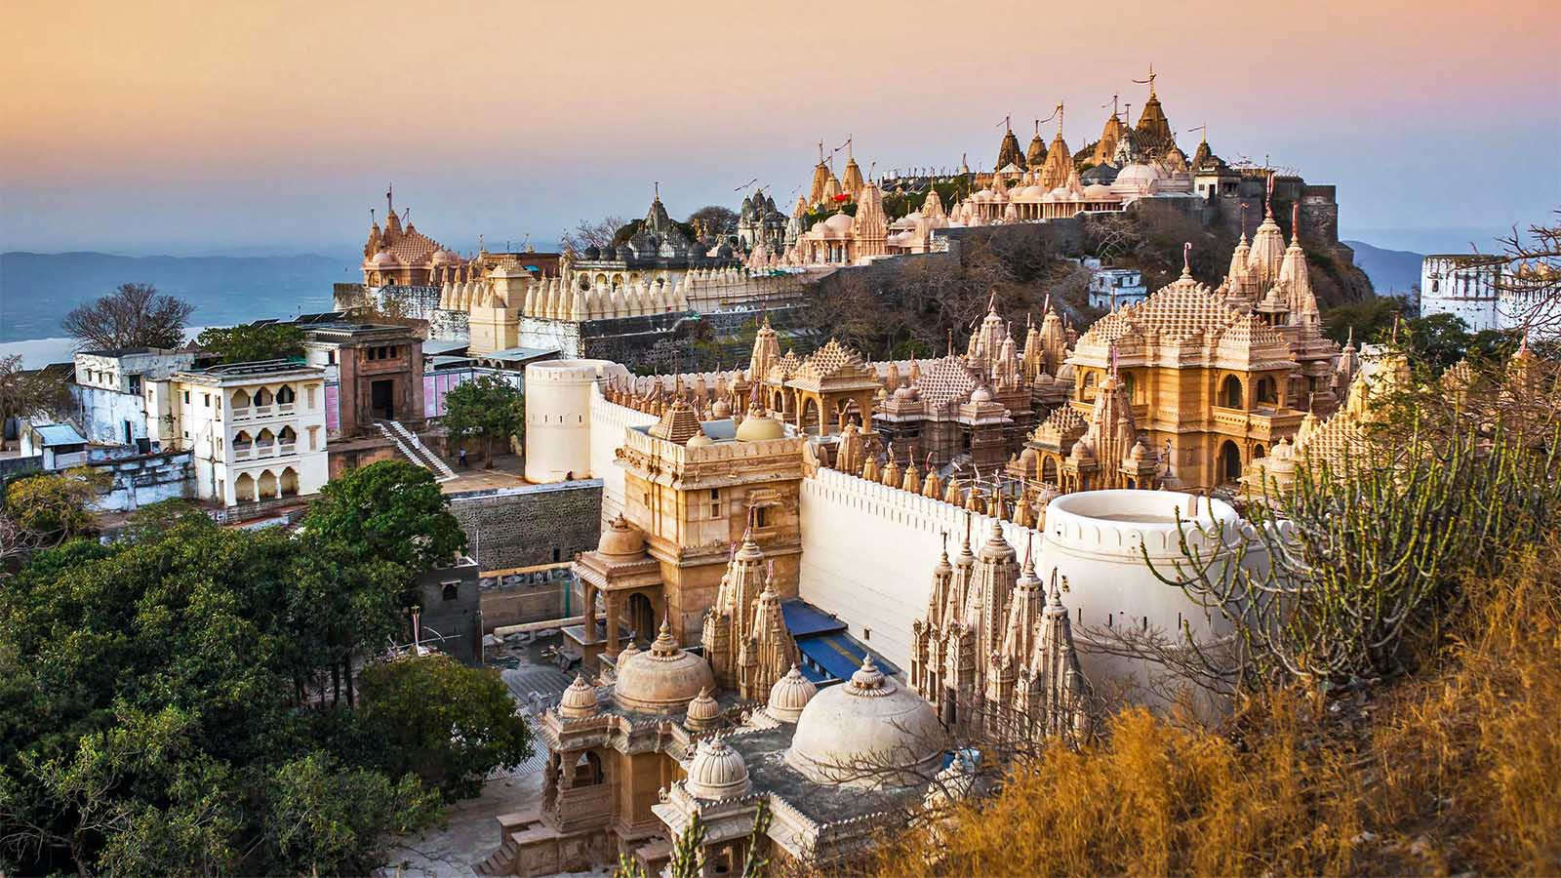
Jain Temples on Shatrunjaya Hill, Gujarat

Slide 32
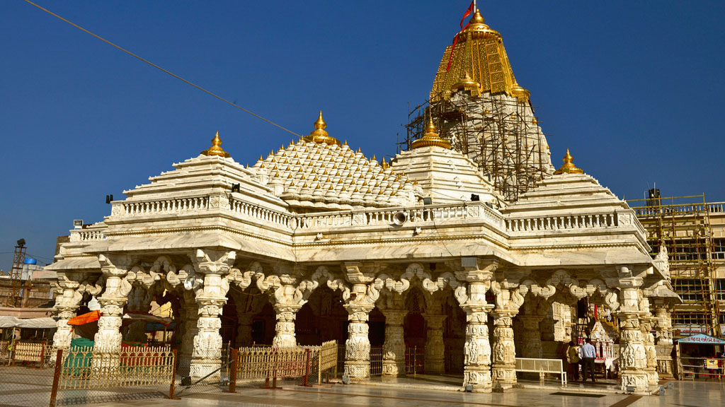
Ambaji Temple, Gujarat

Slide 33
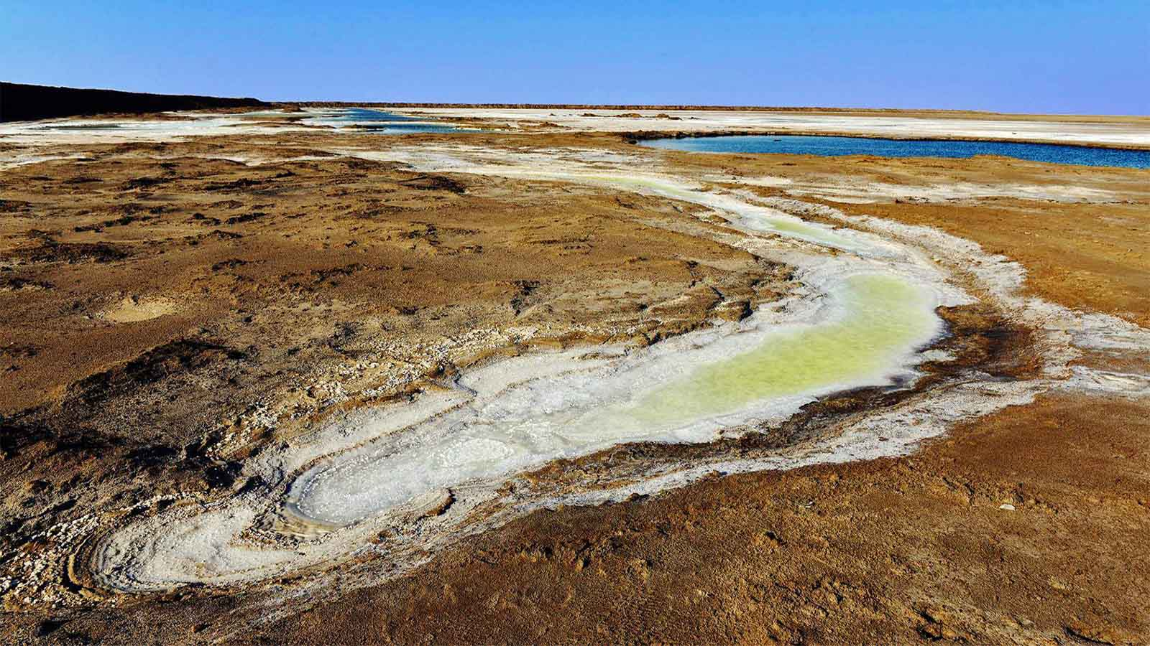
Great Rann of Kutch, Thar Desert, Gujarat

Slide 34
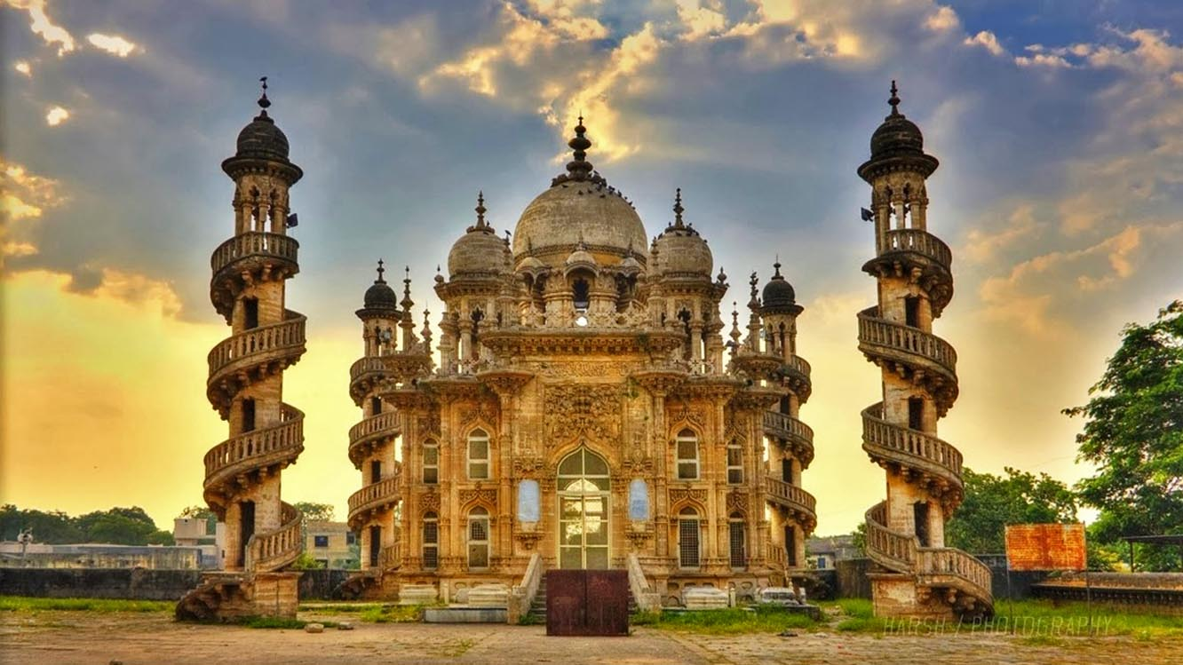
Mahabat Maqbara complex, Junagadh City, Gujarat

Slide 35
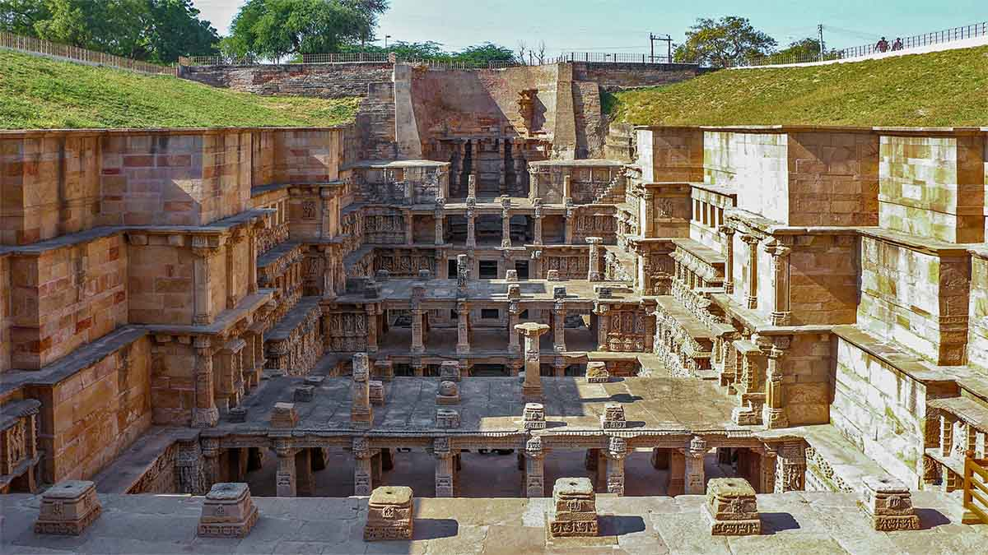
Rani Ki Vav, Patan, Gujarat

Slide 36
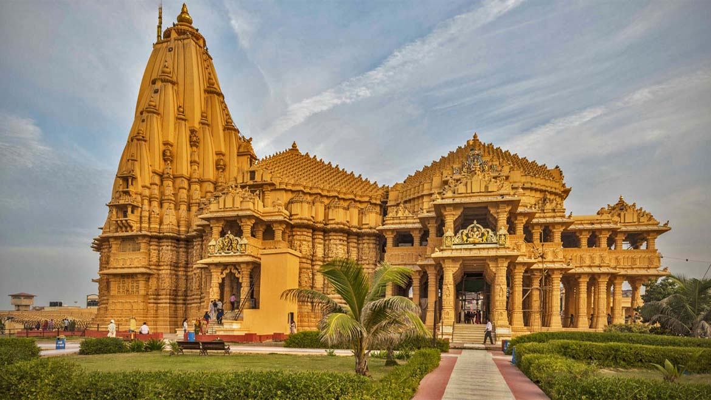
Somnath Temple, Gujarat

Slide 37
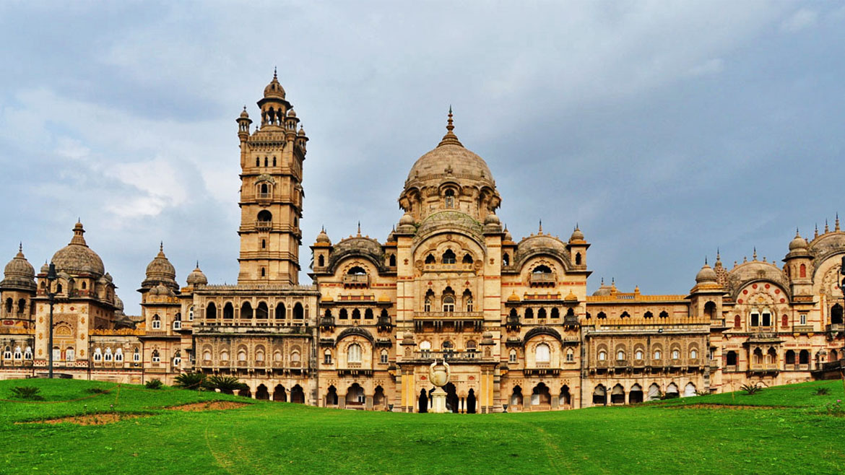
Laxmi Vilas Palace, Gujarat

Slide 38
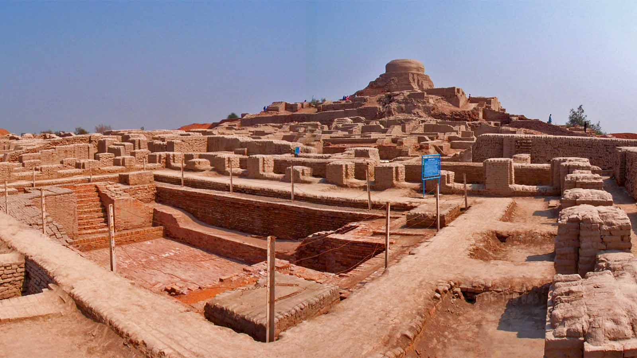
Lothal and Dholavira, Kutch Wildlife Sactuary, Gujarat

Slide 39
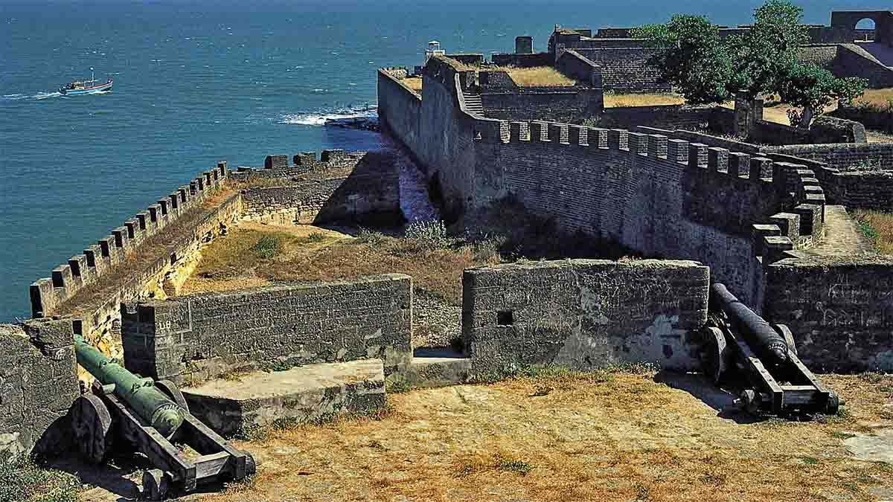
Panikota Fort, Daman and Diu Island

Slide 40
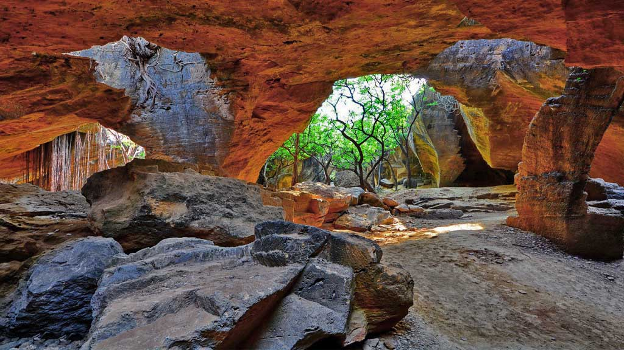
Naida Caves, Daman and Diu Island

Slide 41
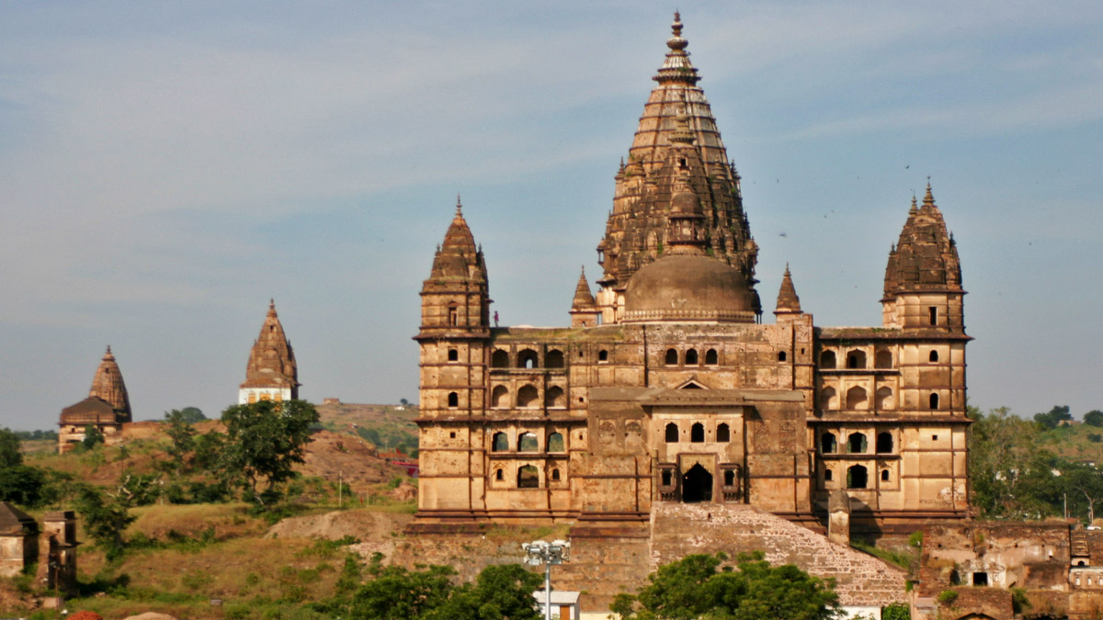
Ram Raja Temple, Orchha

Slide 42
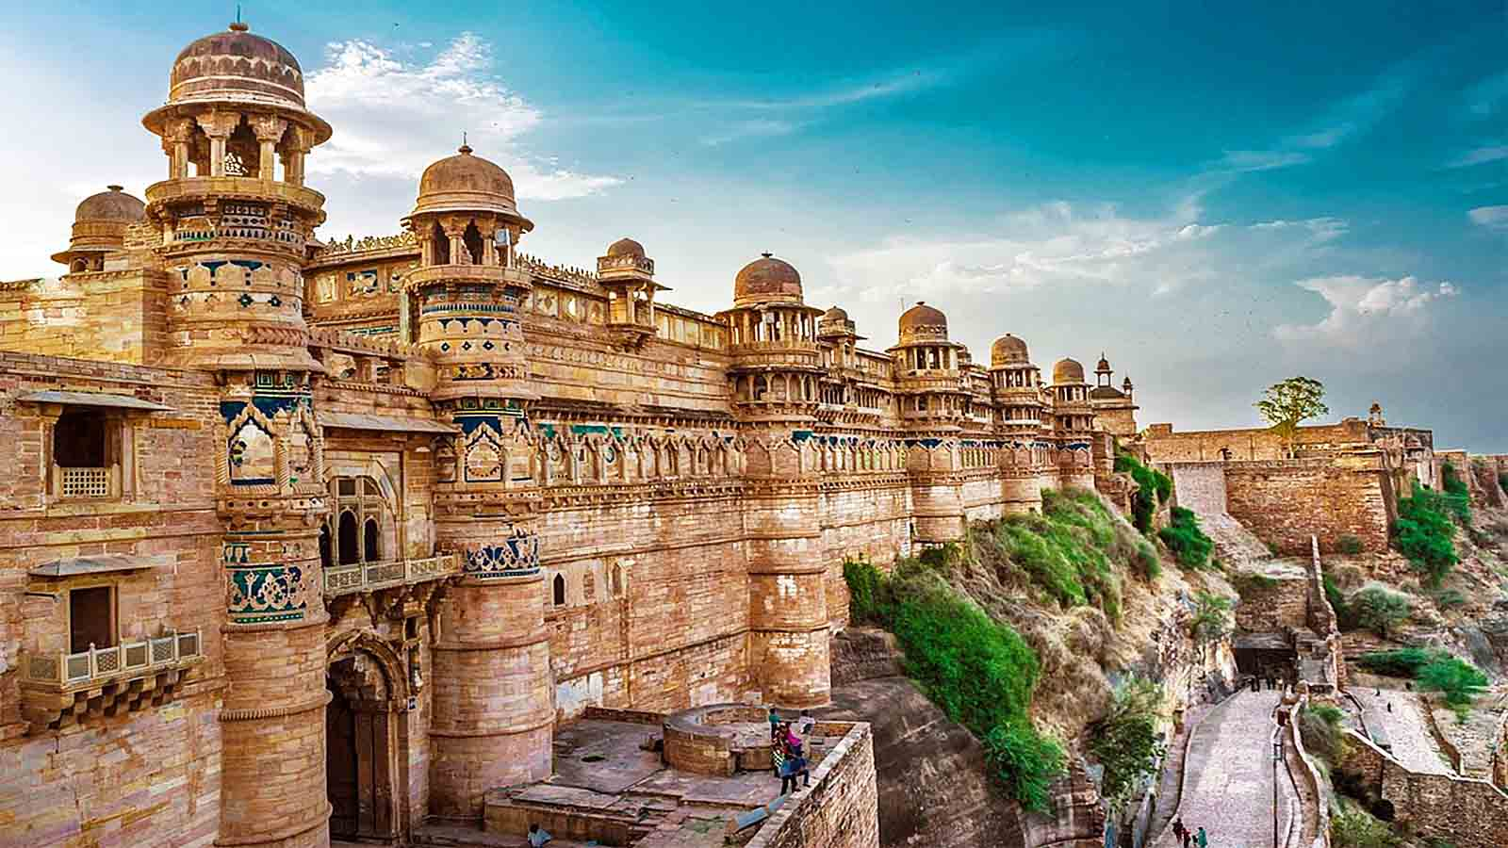
Gwalior Fort, Gwalior City, Madhya Pradesh

Slide 43
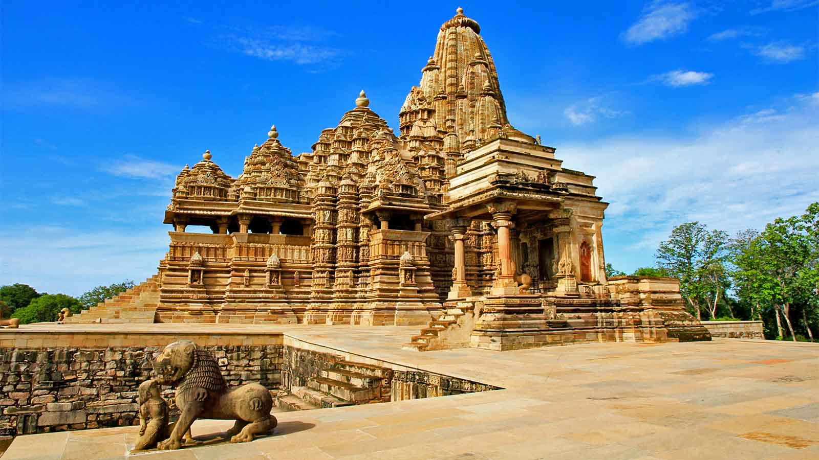
Khajuraho Group of Monuments, Madhya Pradesh

Slide 44
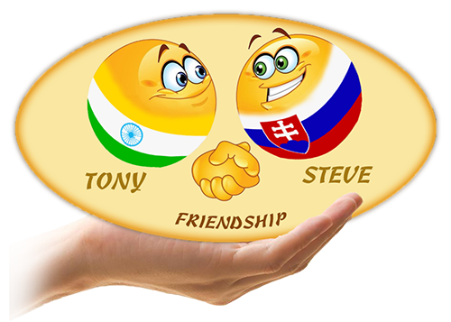



2019
Non-commercial presentation!
Photos : Internet
Music : Bally Sagoo - Aap Ki Nazron
Compilation : Tony Chacko (India)
tonychacko2000@gmail.com
Technical cooperation: Steve Rumpler (Slovakia)
pista2011@gmail.com
Thank you for watching the presentation...

