Slide 1


KEUKENHOF GARDENS & FLOWERLANDS OF NETHERLANDS
The history of Keukenhof dates back to the 15th century. Countess Jacoba van Beieren [Jacqueline of Bavaria] (1401-1436) gathered fruit and vegetables from the Keukenduin for the kitchen of Teylingen Castle. Keukenhof Castle was built in 1641 and the estate grew to encompass an area of over 200 hectares.
Landscape architects Jan David Zocher and his son Louis Paul Zocher, who also designed Amsterdam's Vondelpark, redesigned the castle gardens in 1857. That park was made in the English landscape style constitutes the basis of the Keukenhof Gardens.
In 1949 a group of 20 leading flower bulb growers and exporters came up with the plan to use the estate to exhibit spring-flowering bulbs, signaling the birth of Keukenhof as a spring park. The park opened its gates to the public in 1950 and was an instant success, with 236,000 visitors in the first year alone. 2019 will be the 70th edition of Keukenhof, with Flower Power as its theme. During the past 69 years Keukenhof has developed into a world-famous attraction.
Keukenhof is located in South Holland, south of Haarlem and 41 km southwest of Amsterdam. It is accessible by bus from the train stations of Haarlem, Leiden and Schiphol. It is located in an area called the "Dune and Bulb Region"
Contact
Telephone +31 (0)252 465 555 (business enquiries only) Email: info@keukenhof.nl
The flower fields of Lisse are never as crowded as Keukenhof, but they’ve become more popular in recent years. I’d recommend arriving before 10:00am to experience them without crowds.
Renting a bike –You can rent bikes from the main parking lot at the Keukenhof gardens. They will provide you with a map of the area and there is an option to add a basket or child seat to your bike. This is a great option if the weather is nice and you want the full experience. Plan to spend at least a couple hours biking if you want to visit a few flower fields, as most are spread out.
Renting a car – for more flexibility, consider renting a car before you head to Lisse, so you can drive to different flower fields. Once there, you’ll be able to park on the street or in a nearby town to visit the fields.
Enjoy this internet tour of the best spring-flower garden of the world. - A special presentation by TONY CHACKO
T.C.

Slide 2

Keukenhof Garden Maps
The layout of Keukenhof Gardens changes a bit over time, but the major features stay the same. Most visitors only want to see the garden, but there is more to Keukenhof to see including the nearly 400 year old Kasteel Keukenhof (The Steel Windmill).
Willem-Alexander Pavilion
The Willem-Alexander Pavilion is tulip heaven. What most people don’t realize is that it is also a Lily heaven in the last 10 days or so of each season. With over 15,000 lilies comprising 300 varieties, this little known part of Keukenhof is worth seeing if you happened to missed the tulip season.
Oranje-Nassau Pavilion
Oranje-Nassau offers a new flower show each week. This is where the best come to be judged with different type of flower displays every week. It is located at the heart of the 32 hectare springtime garden. The shows in the other flower pavilions have a more permanent year round exhibit.
Beatrix Pavilion
The Beatrix Pavilion is filled with Orchids with possibly the best orchid display in all of Europe. The walk from Beatrix to the Windmill includes a hidden Japanese garden. Have a tea by the greenhouses or grab some poffertjes, small bite sized pancakes from the cart near the playground.
Julianna Pavilion
The Julianna Pavilion teaches visitors about the history of the tulip. From the earliest trading of tulips to 17th Century tulip mania and economic bubble and the role of the tulip today as an icon of Holland and spring. You can learn more about the origin of the tulip in the historic garden.
Wilhamena Pavilion
If you want to sit down and eat in a food court like atmosphere, then Wilhamena Pavilion is the place to do so. Not really much else to see or do here.
Irene Pavilion
This was the old entrance to Keukenhof. Now it is being developed to be part of the garden and its role will be defined over the coming years. Perhaps it will be for a special annual display or yet another exhibit.
Keukenhofmolen
Molen means windmill in Dutch, so Keukenhofmolen is simply the big windmill in the garden. This place can get really crowded as everyone fights for the perfect picture or selfie. Try to reach the windmill in the morning or before the park closes in order to get some time for your series of Windmill photos.
T.C.

Slide 3
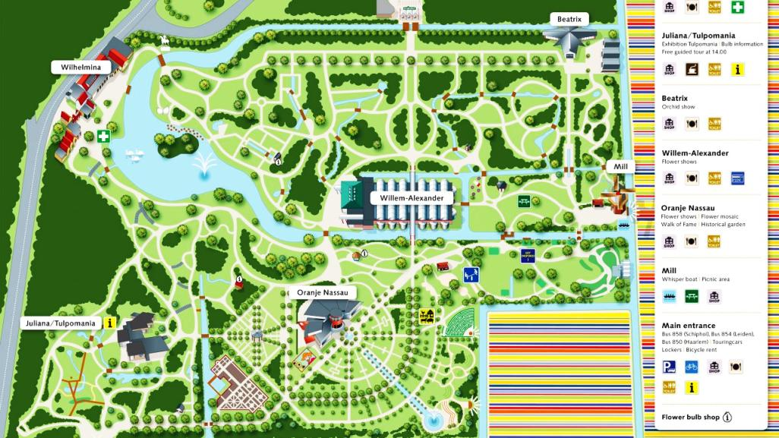
Map Of Keukenhof Gardens

Slide 4
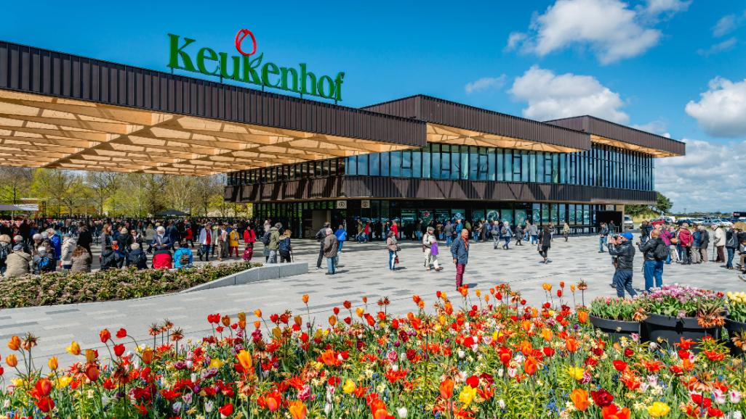
Entrance to the Keukenhof Gardens at Lisse, Netherlands

Slide 5
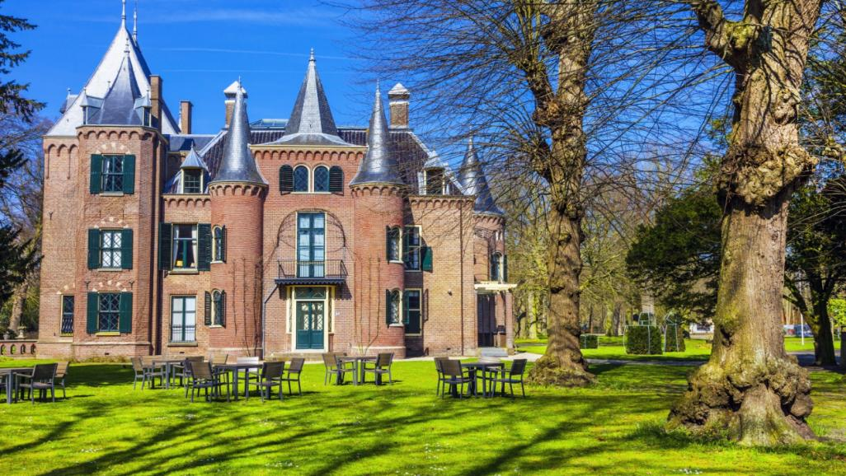
Keukenhof Castle in Lisse was originally built in 1642 as a classicist country house by Adriaen Maertensz. Block , a former commander of the VOC in the Moluccas. Castle Keukenhof reopened at the end of 2012 after a restoration of almost two years. It can be viewed at set times through guided tours. It is an official wedding location of the Municipality of Lisse and in use for (cultural) events.

Slide 6
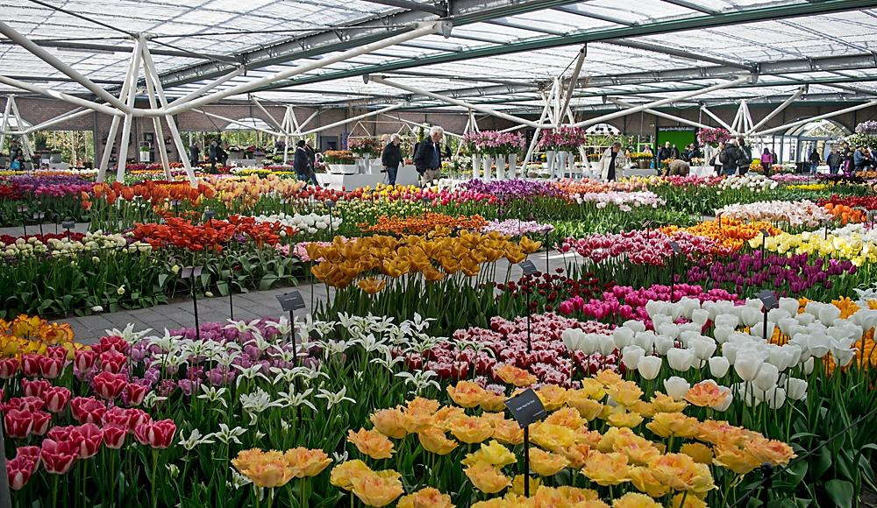
The William Alexander Pavilion of Keukenhof

Slide 7
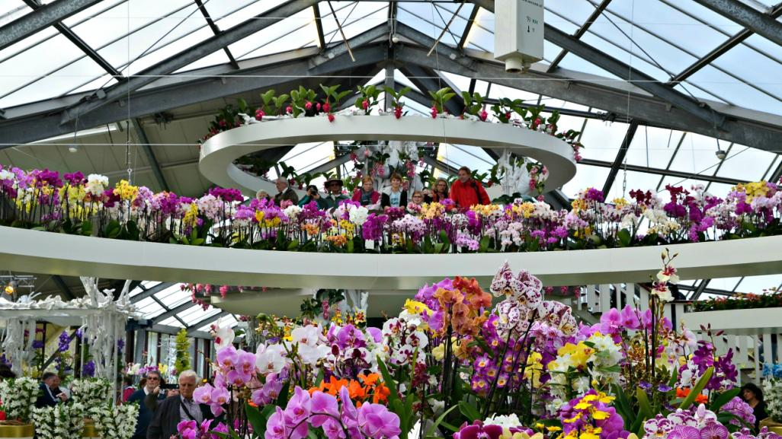
The Beatrix Pavilion is a heaven of orchid flowers.

Slide 8
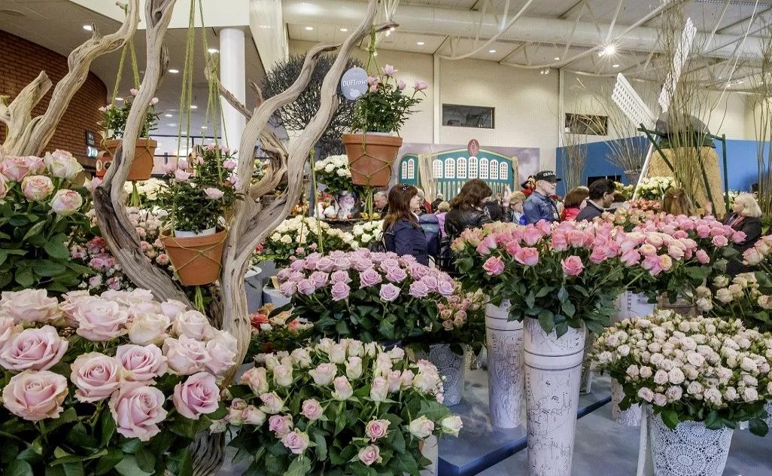
Orange-Nassau Pavilion

Slide 9
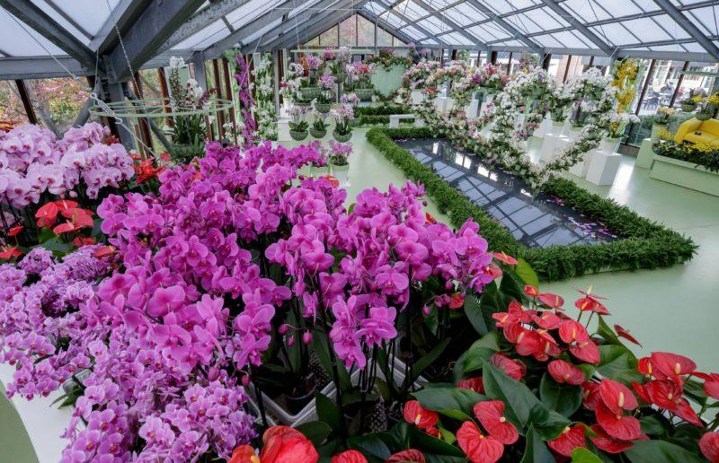
Juliana Pavilion with it’s fabulous display of Orchids and Anthuriums

Slide 10
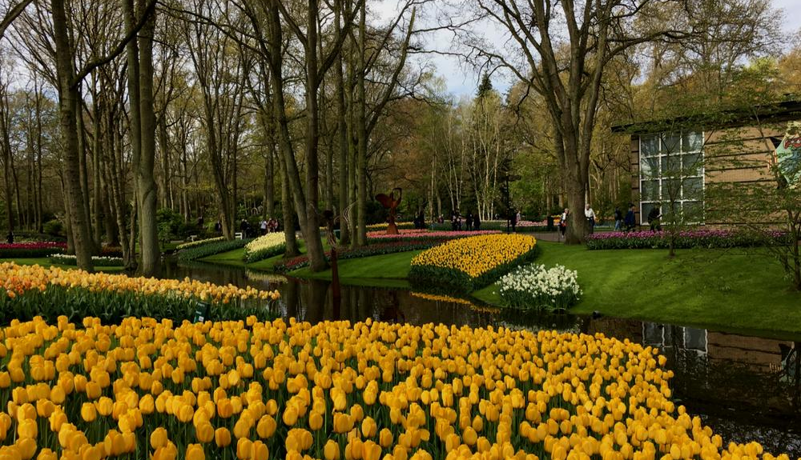

T.C.
Landscaped garden of Tulips outside the Julianna Pavilion of Keukenhof

Slide 11
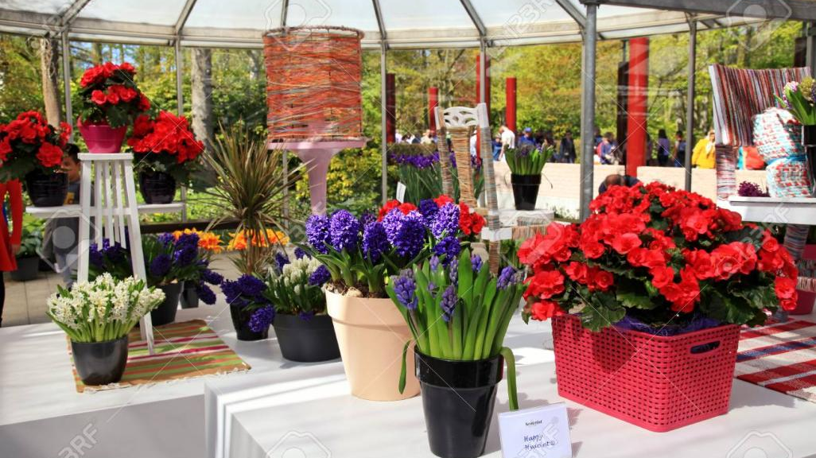
In-house Flower Display at Keukenhof Garden

Slide 12
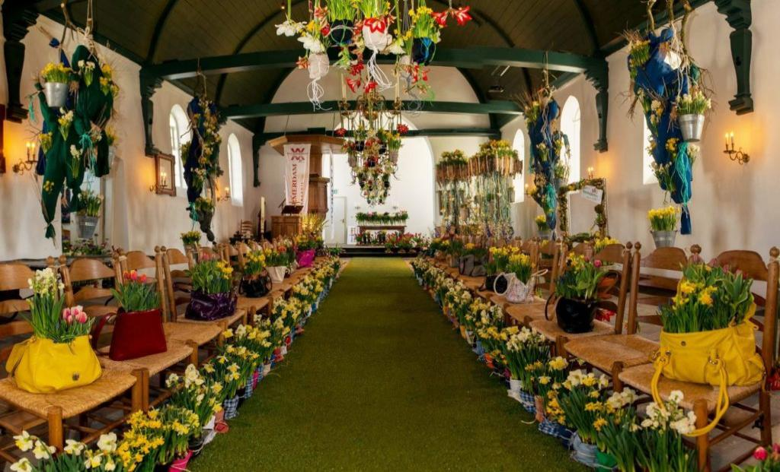

Slide 13
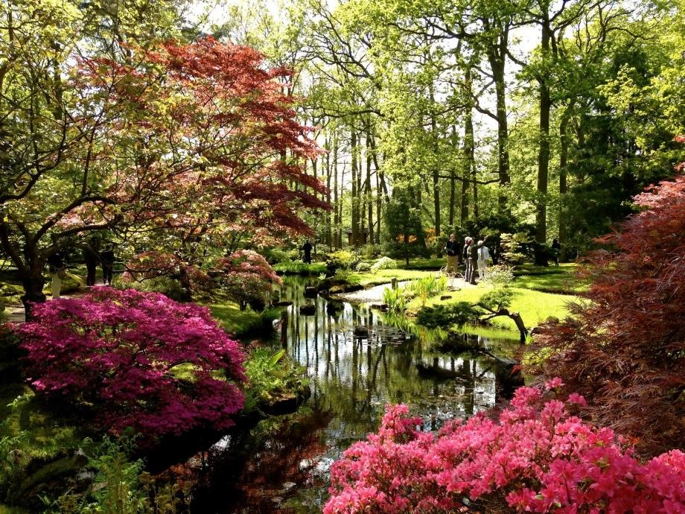
The best Japanese Garden of Europe is also in Netherlands at the Hague.

Slide 14
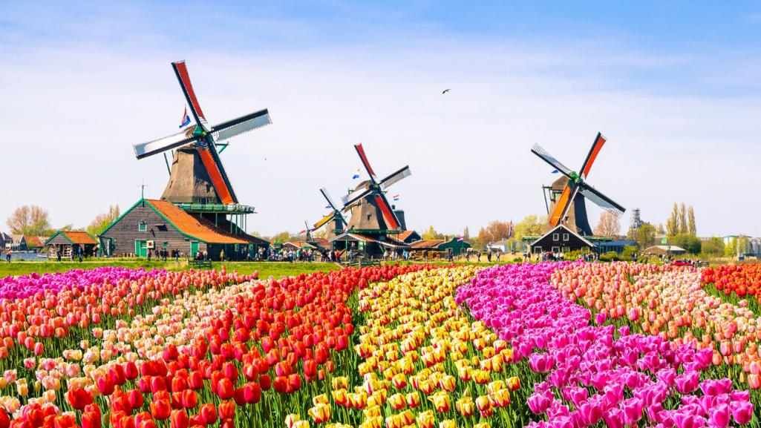

Slide 15
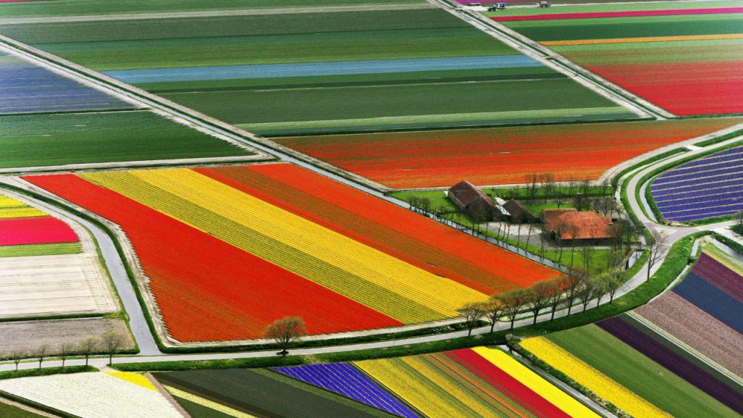

Slide 16
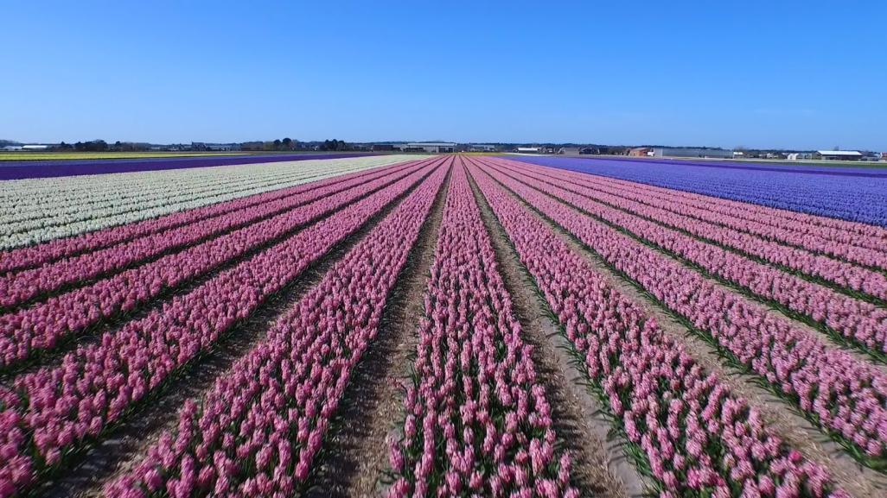

Slide 17
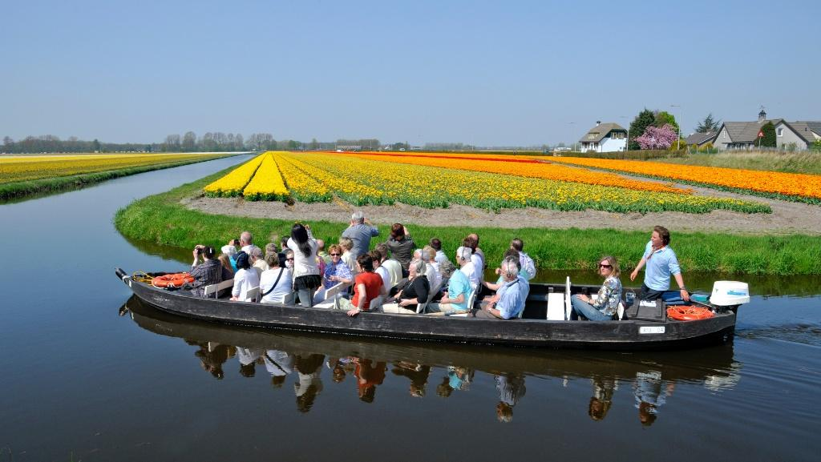
Boat cruising around the tulip fields of Keukenhof

Slide 18
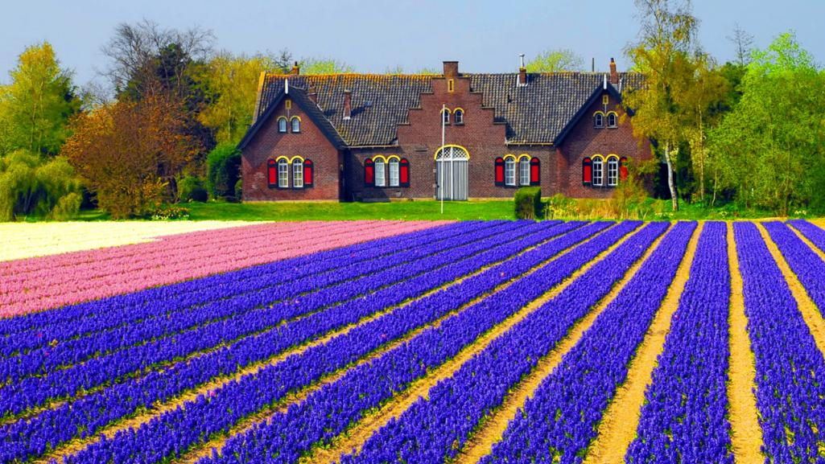

Slide 19
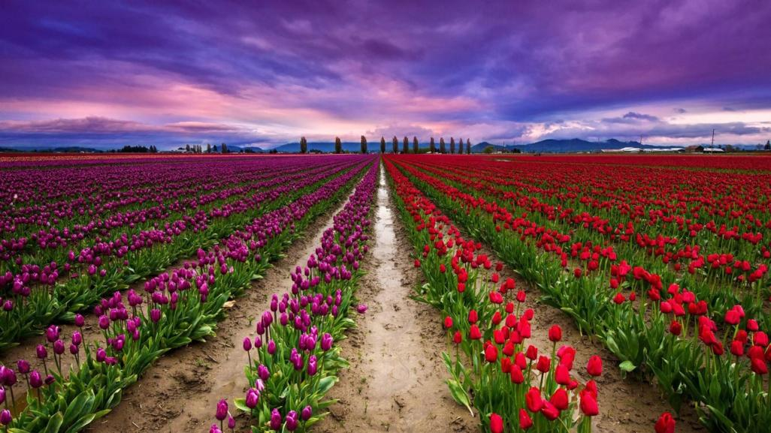

T.C.

Slide 20
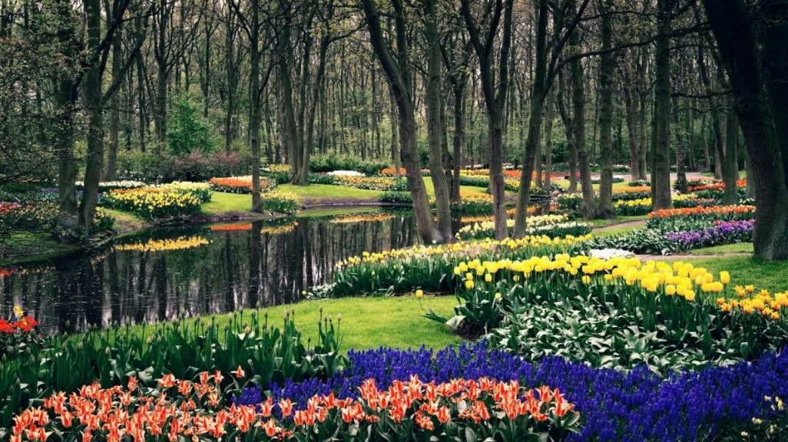

Slide 21
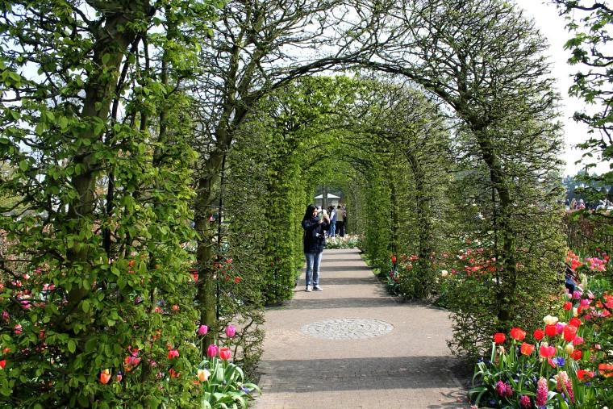
Beautiful Green Arched Vines walkways

Slide 22
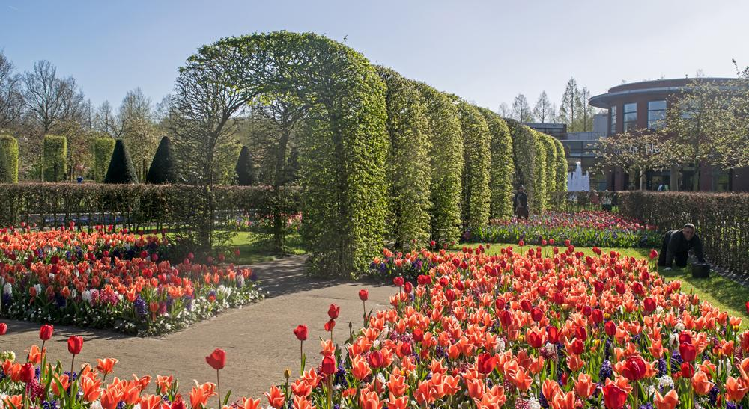

Slide 23
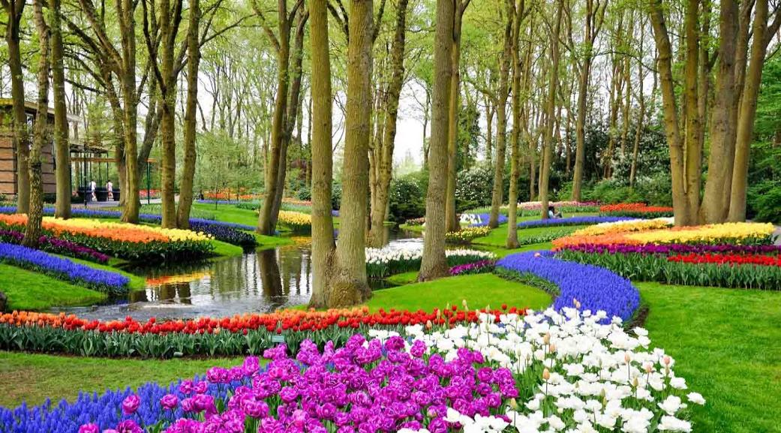

Slide 24
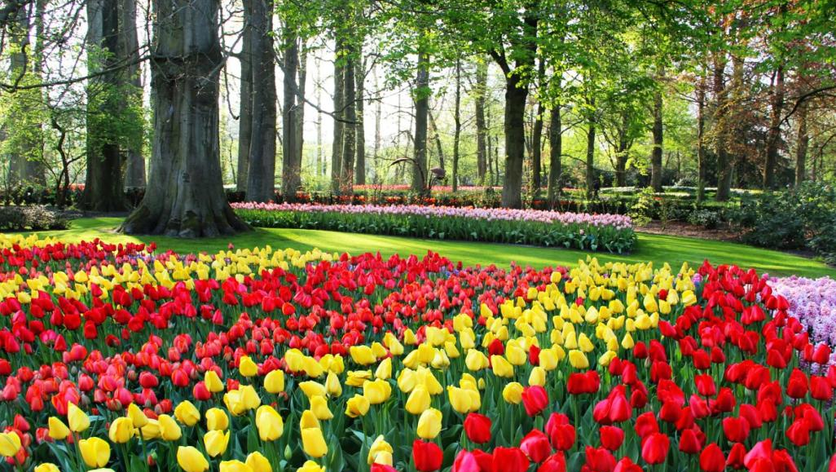

Slide 25
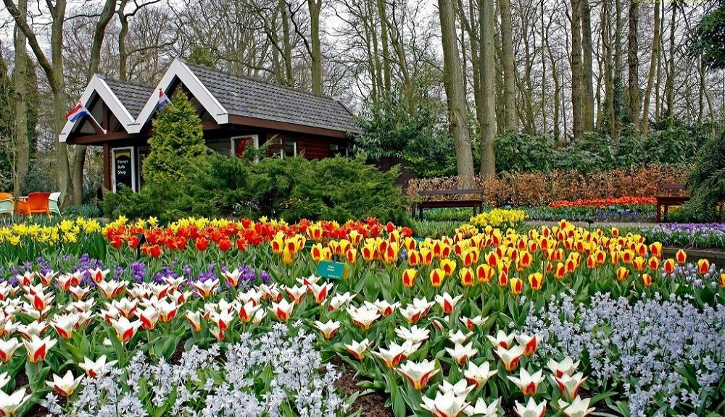

Slide 26
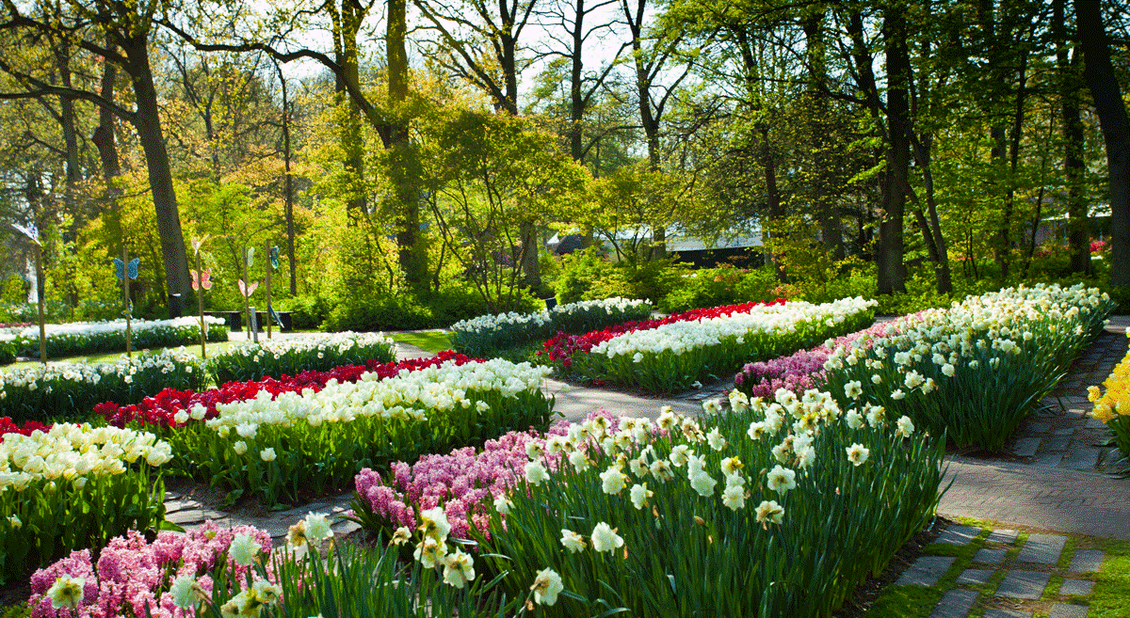

Slide 27
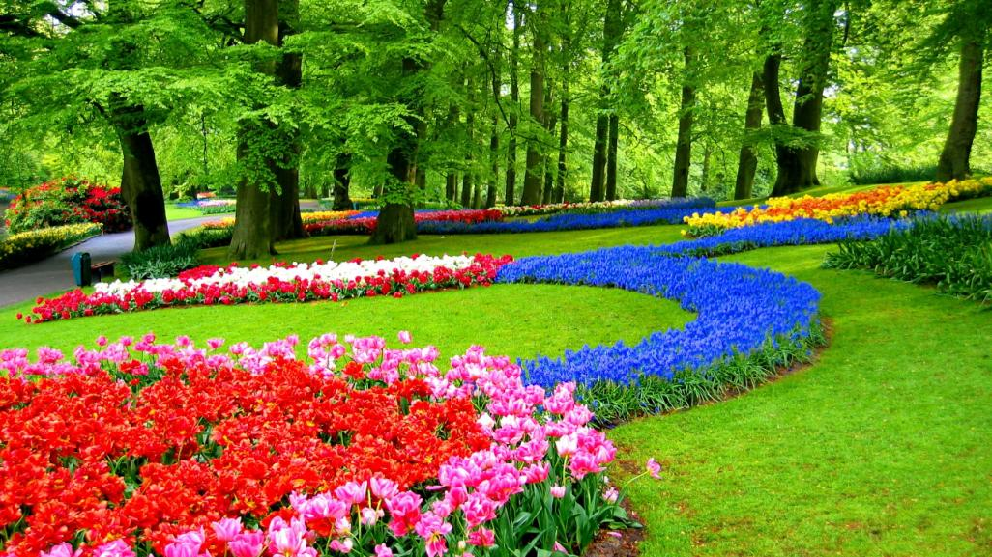

Slide 28
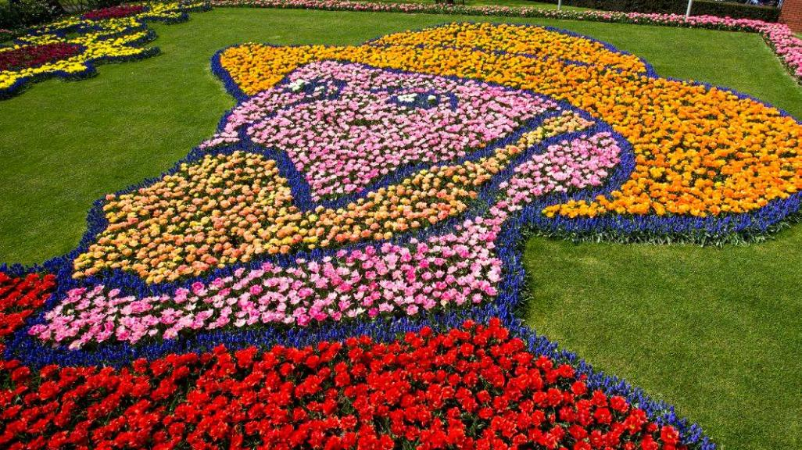
Tulips planted creatively which shows the picture of Holland’s most famous artist - Vincent Van Gogh

Slide 29
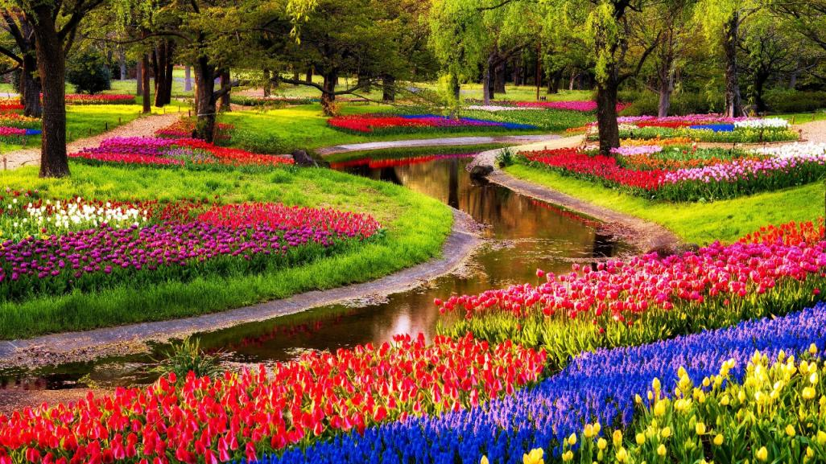

Slide 30
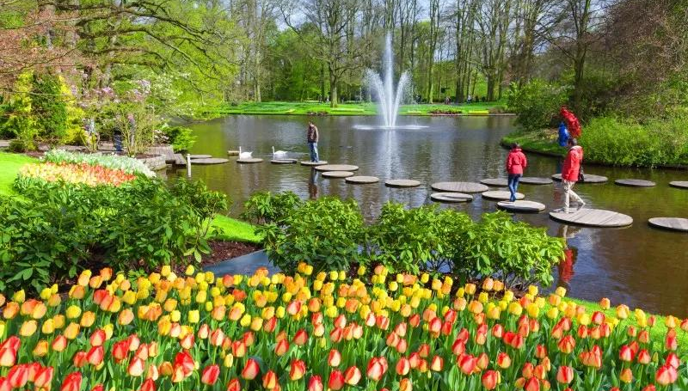

Slide 31
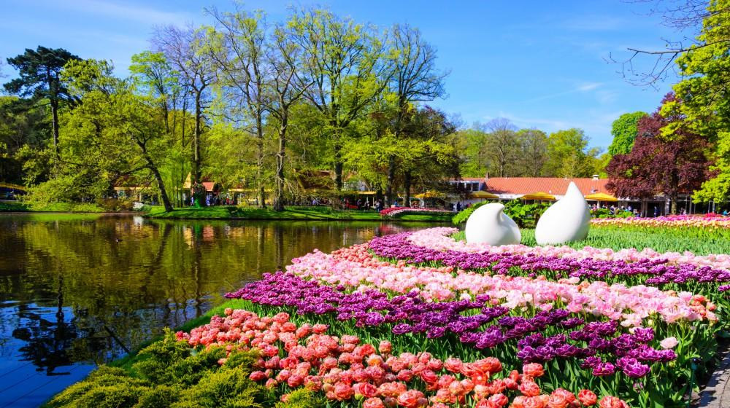

Slide 32
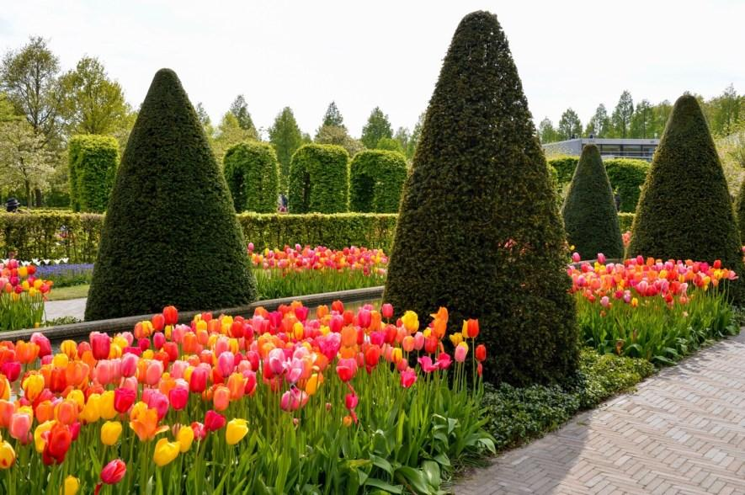

Slide 33
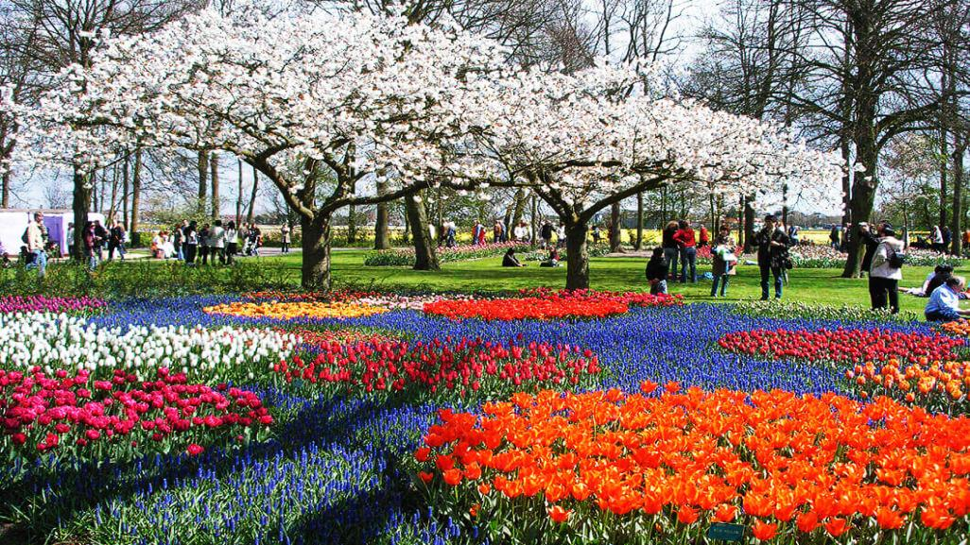

Slide 34
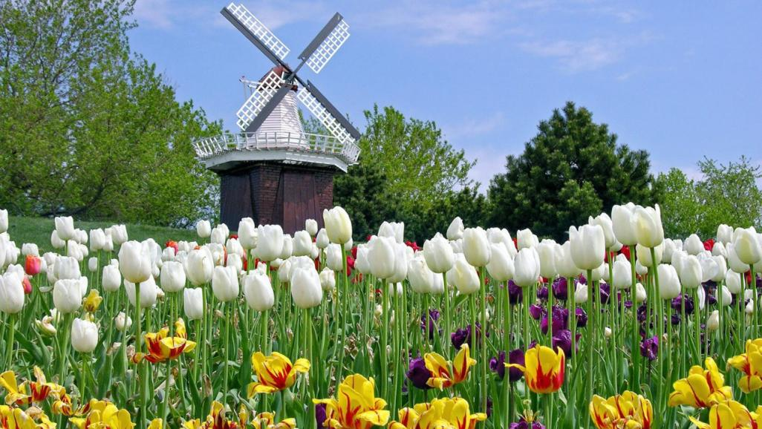
The Keukenhof Molen

Slide 35
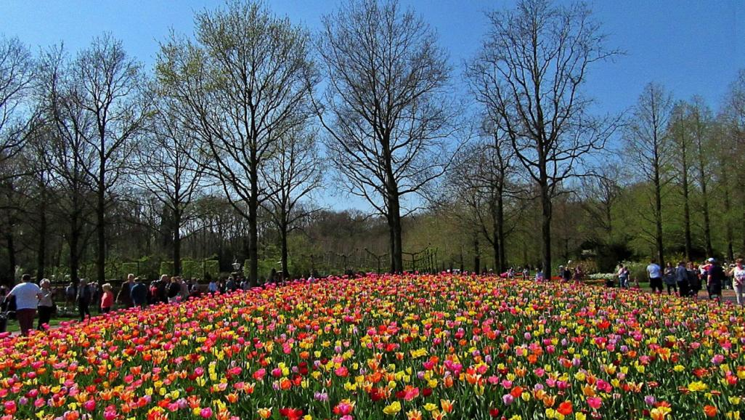
T.C.

Slide 36
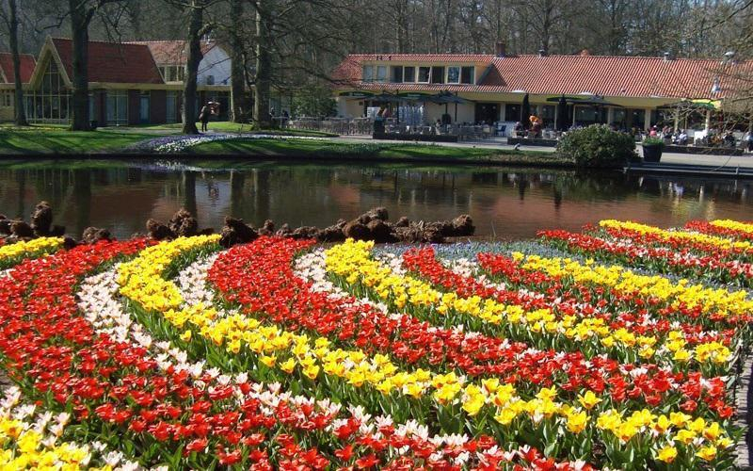

Slide 37
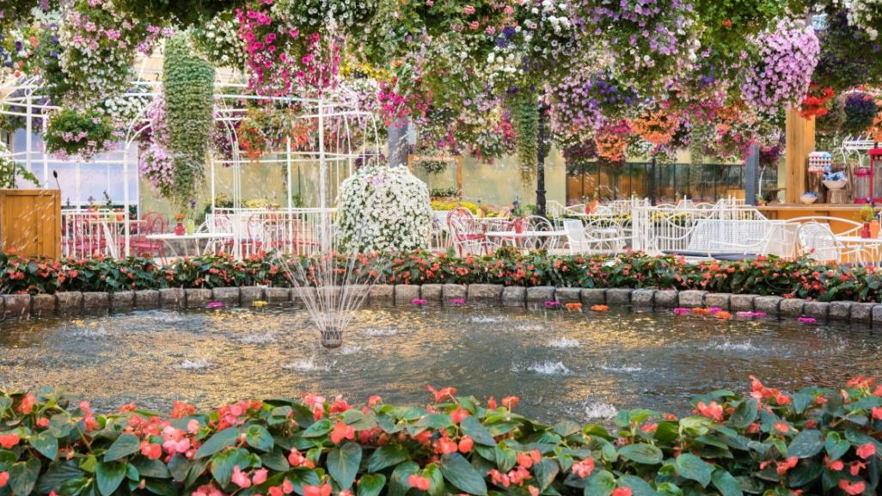
Flevoland near Lisse with one of its manicured gardens

Slide 38
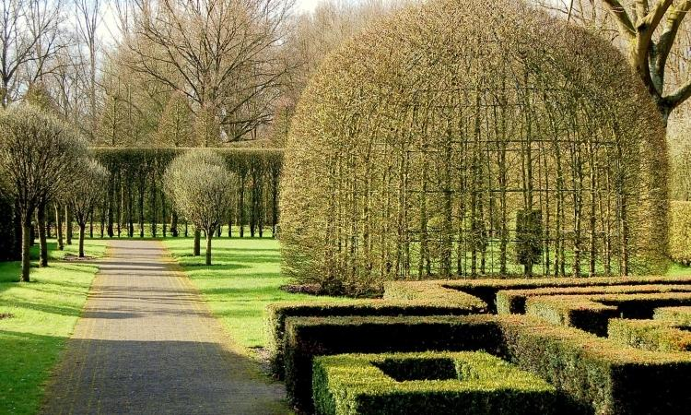
The Amstel Park near Amsterdam with some splendid manicured greenery

Slide 39
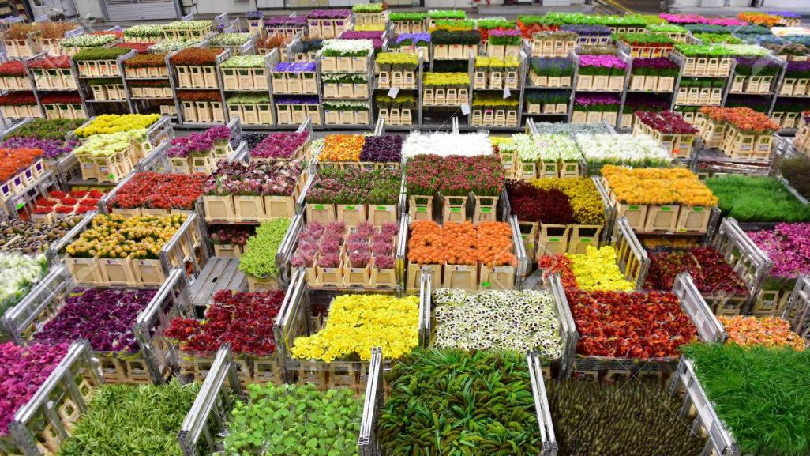
The North Holland town of Aalsmeer is located 13km southwest of Amsterdam and has been dubbed the flower capital of the world, because the largest flower auction on earth is in Aalsmeer.

Slide 40
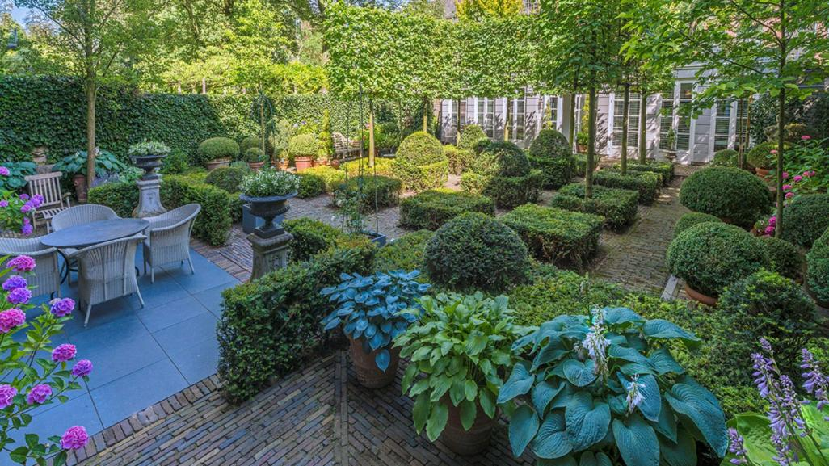
An open manicured garden near Amsterdam

Slide 41
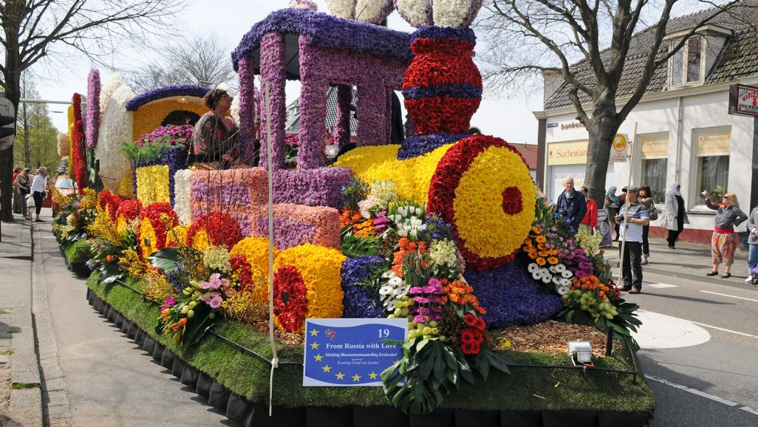
The Keukenhof Flower Float Parade and Shows

Slide 42
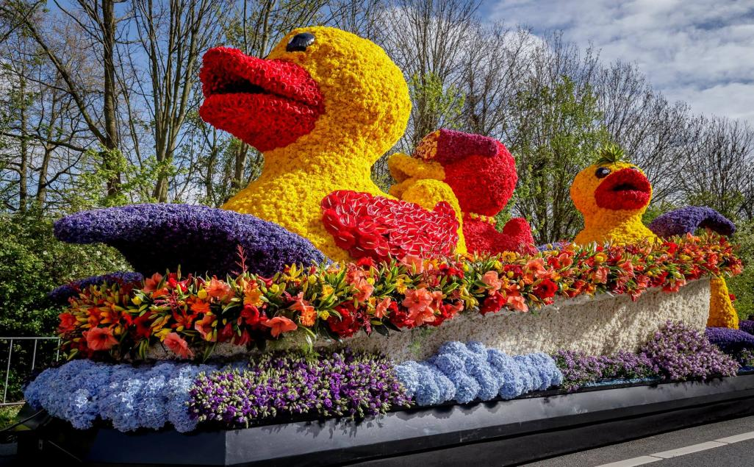

Slide 43
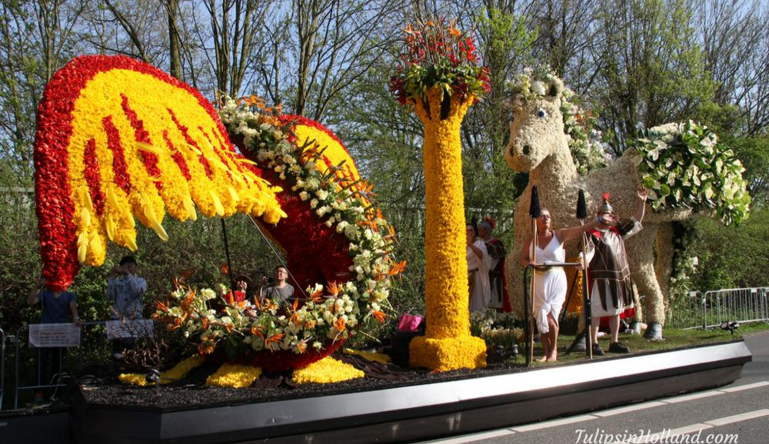

Slide 44
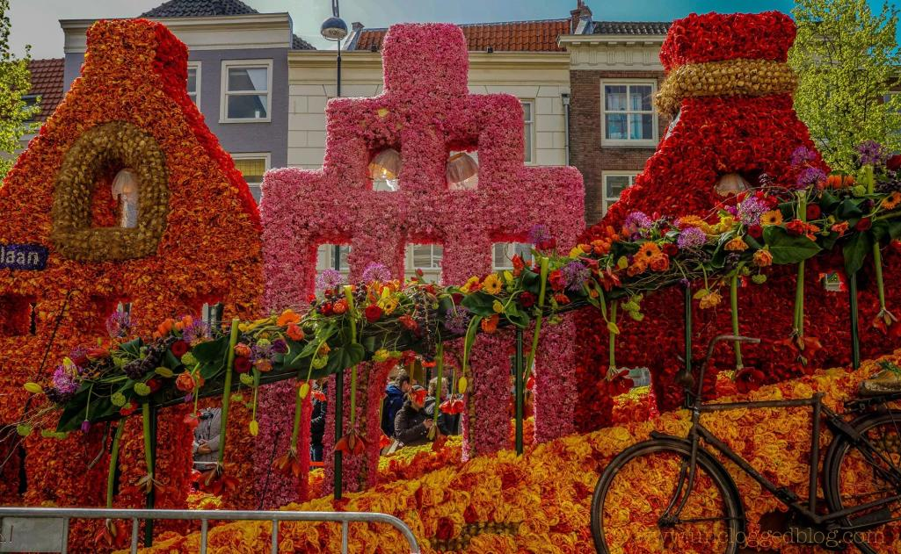

Slide 45
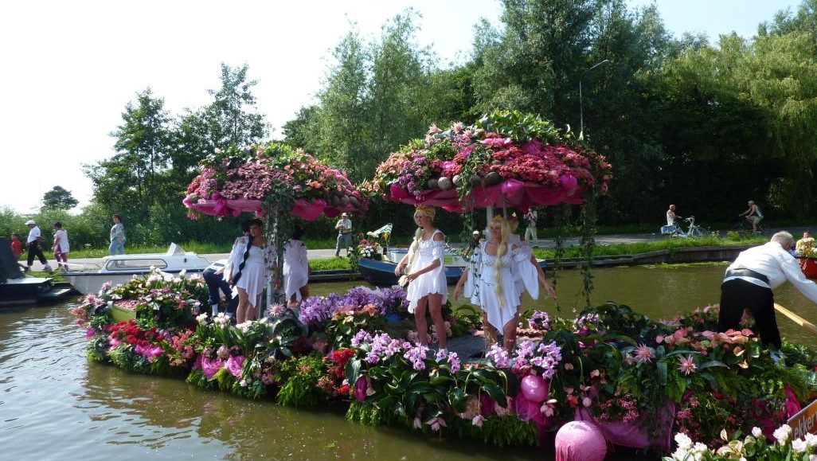
One of the greatest events in Holland, Varend Corso Westland, is a floating parade of boats decorated with fresh fruits, vegetables, colorful flowers and plants from the greenhouses in Westland, Holland

Slide 46
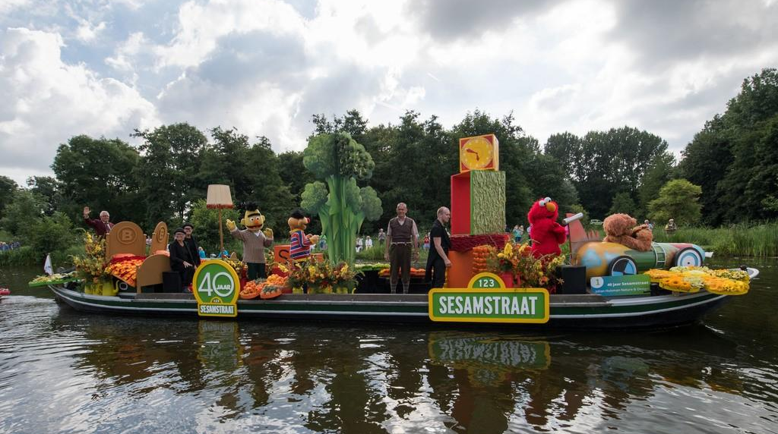
The Westland Boat Parade features dozens of boats decorated with flowers and vegetables. The floating parade sails through the Westland region over a period of 3 days and draws in over half a million visitors every year. The region is famous for its glasshouse horticulture, with millions of vegetables, fruits, plants and flowers. The parade passes through historical cities of The Hague, Delft, Naaldwijk and Maasluis.

Slide 47
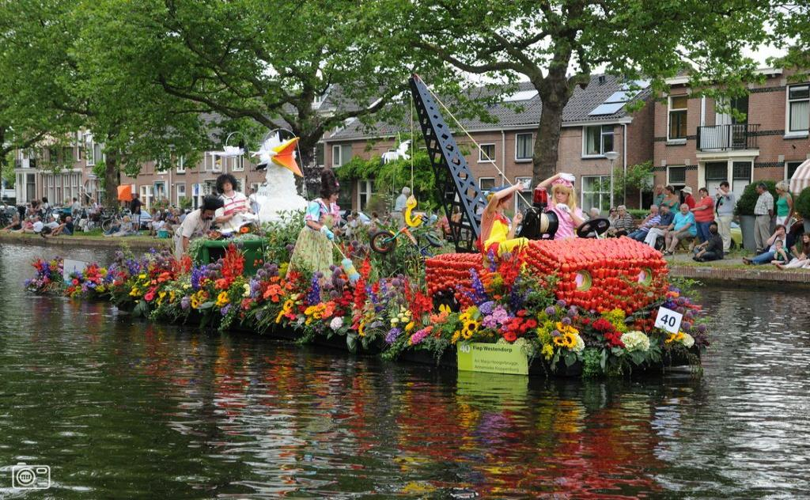
Varend Corso Westland Boat Parade

Slide 48
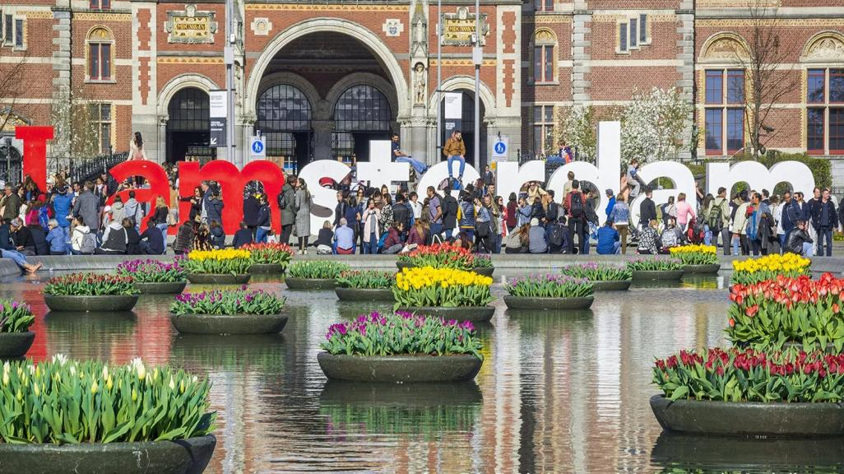

T.C.
The Amsterdam Tulip Festival

Slide 49

T.C.
Hope you have enjoyed viewing this Slideshow.
With the best of regards
TONY CHACKO
(tonychacko2000@gmail.com)

