Slide 1
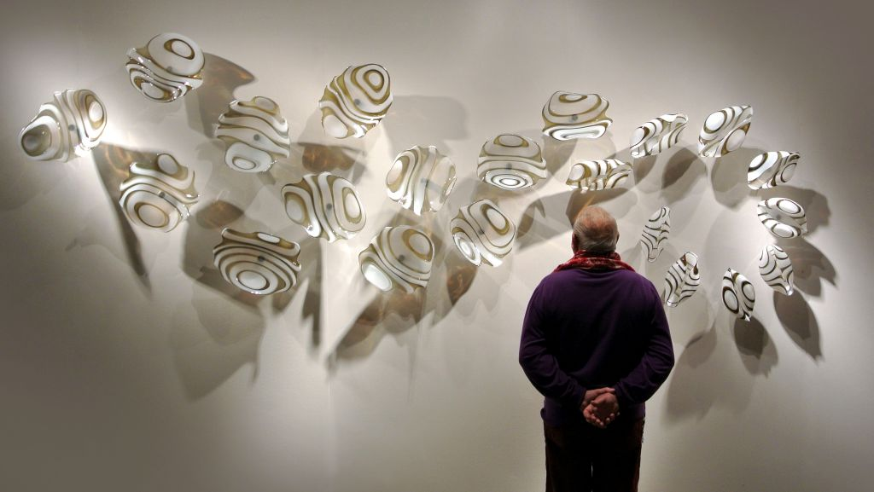
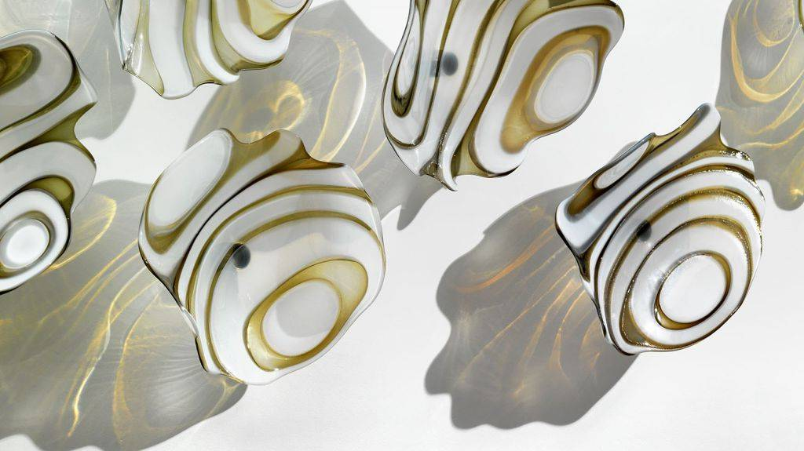
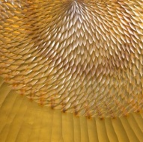


Lino
Tagliapietra
2
Notes:
Metamorphosis
Maestro Lino Tagliapietra at Schantz Galleries
Lino Tagliapietra’s career is defined by a dedication to workmanship, innovation, and collaboration. Born in 1934 on the renowned glass-blowing island of Murano, Italy, Tagliapietra began his apprenticeship at age 11 with Muranese master Archimede Seguso from whom Tagliapietra achieved the status of Maestro Vetraio by the age of 21. For over forty-two years, Lino worked in various for-profit Murano factories including Vetreria Galliano Ferro, Venini & Co., and finally as the Artistic and Technical Director of Effetre International (1976-1989). Tagliapietra has been an independent artist since 1989, exhibiting in museums around the globe, receiving countless honors, openly sharing his far-reaching knowledge of the medium and his skill as one of its finest practitioners, and helping to create a new renaissance in studio glassmaking. As James Yood, adjunct professor of art history at the School of the Art Institute of Chicago and regular contributor to GLASS magazine wrote, “there are probably no two words more respected and honored in the history of modern sculpture in glass than ‘Lino Tagliapietra’; he is the living bridge, the crucial link between the august history of Venetian glass and the ceaseless wonders of what today we call the modern Studio Glass Movement”, (to read more of this essay, refer to Dalle Mani del Maestro, Lino Tagliapietra.)
Lino Tagliapietra has been featured in numerous solo exhibitions and is represented in a global assortment of museums and art institutions, including: Bellevue Art Museum, Bellevue, WA; Bergstrom-Mahler Museum of Glass, Neenah, WI: Venice Biennale, Italy; Carnegie Museum of Art, Pittsburgh, PA; Chrysler Museum; Norfolk, VA; Colby Museum of Art, Waterville, ME; Corning Museum of Glass, NY; The Danish Royal Museum, Copenhagen, Denmark; Glasmuseum, Ebeltoft, Denmark; Hokkaido Museum of Modern Art, Sapporo, Japan; M.H. de Young Memorial Museum, San Francisco, CA; The Metropolitan Museum of Art, New York, NY: Mint Museum of Craft and Design, Charlotte, NC; Musée des Arts Décoratifs, Losanna, Switzerland; Musée des Arts Décoratifs, Paris, France; Museo del Vidrio, Monterrey, Mexico; Museum of Arts and Design, New York, NY; Museum Boymans, Rotterdam, The Netherlands; Museum of Glass, Tacoma, WA; Museum Het Paleis, The Hague, Netherlands; National Museum of Ceramic Art and Glass, Baltimore, MD; Orlando Museum, FL; Palazzo Franchetti, Venice, Italy; Palazzo Grassi, Venice, Italy; Palm Springs Art Museum, CA; Renwick Gallery of the Smithsonian American Art Museum, Washington, D.C.; Seattle Art Museum, WA; Shanghai Museum of Glass, China; Stanford University, Palo Alto, CA; Tokyo National Modern Art Museum, Japan; and the Victoria and Albert Museum, London, UK.

Slide 2
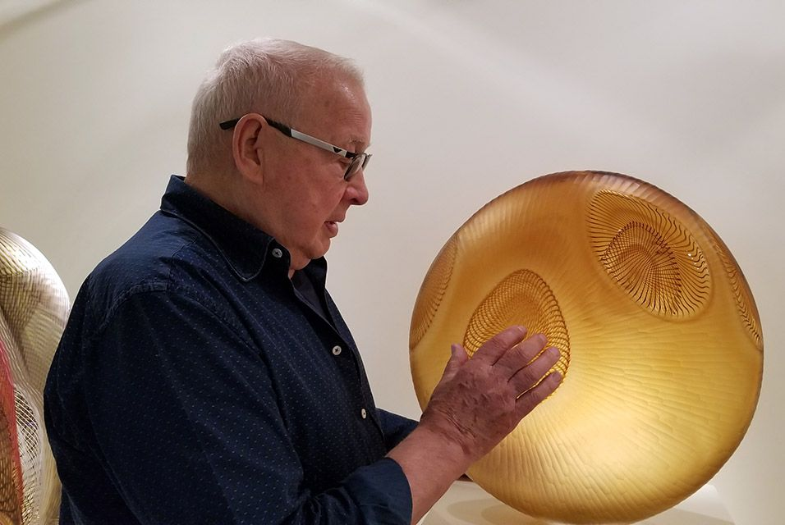
Lino Tagliapietra (born 1934) is a Venetian glass artist who has also worked extensively in the United States. As a teacher and mentor, he has played a key role in the international exchange of glassblowing processes and techniques between the principal American centers and his native Murano, "but his influence is also apparent in China, Japan, and Australia—and filters far beyond any political or geographic boundaries.“
Notes:
Maestro Lino Tagliapietra at Schantz Galleries
He is the recipient of countless awards and recognitions, including: Borsella d’Oro (1968; Murano); Rakow Commission for Excellence in Glass award (1996; Corning Museum); Glass Art Society Lifetime Achievement Award (1997); Urkunde Gold Medal (1997; Germany); Libensky Award (1998; Chateau Ste. Michelle Vineyards and Winery and Pilchuck Glass School); Honorary Doctorate (2004; Centre College, KY); The President’s Distinguished Artist Award (2004; University of the Arts, Philadelphia, PA); Distinguished Educator Award (2006; James Renwick Alliance); Cristal Award (2007; Museo del Vidrio, Monterrey, Mexico); Foreign Honorary Member, American Academy of Arts and Sciences (2007; Cambridge, MA); IIC Lifetime Achievement Award (2009; Istituto Italiano di Cultural, Los Angeles, CA); Honorary Doctorate of Fine Arts (2011; Ohio State University, Columbus, OH).

Slide 3
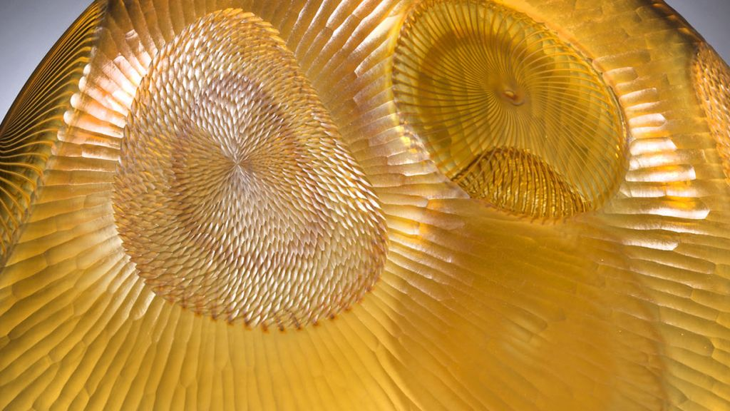
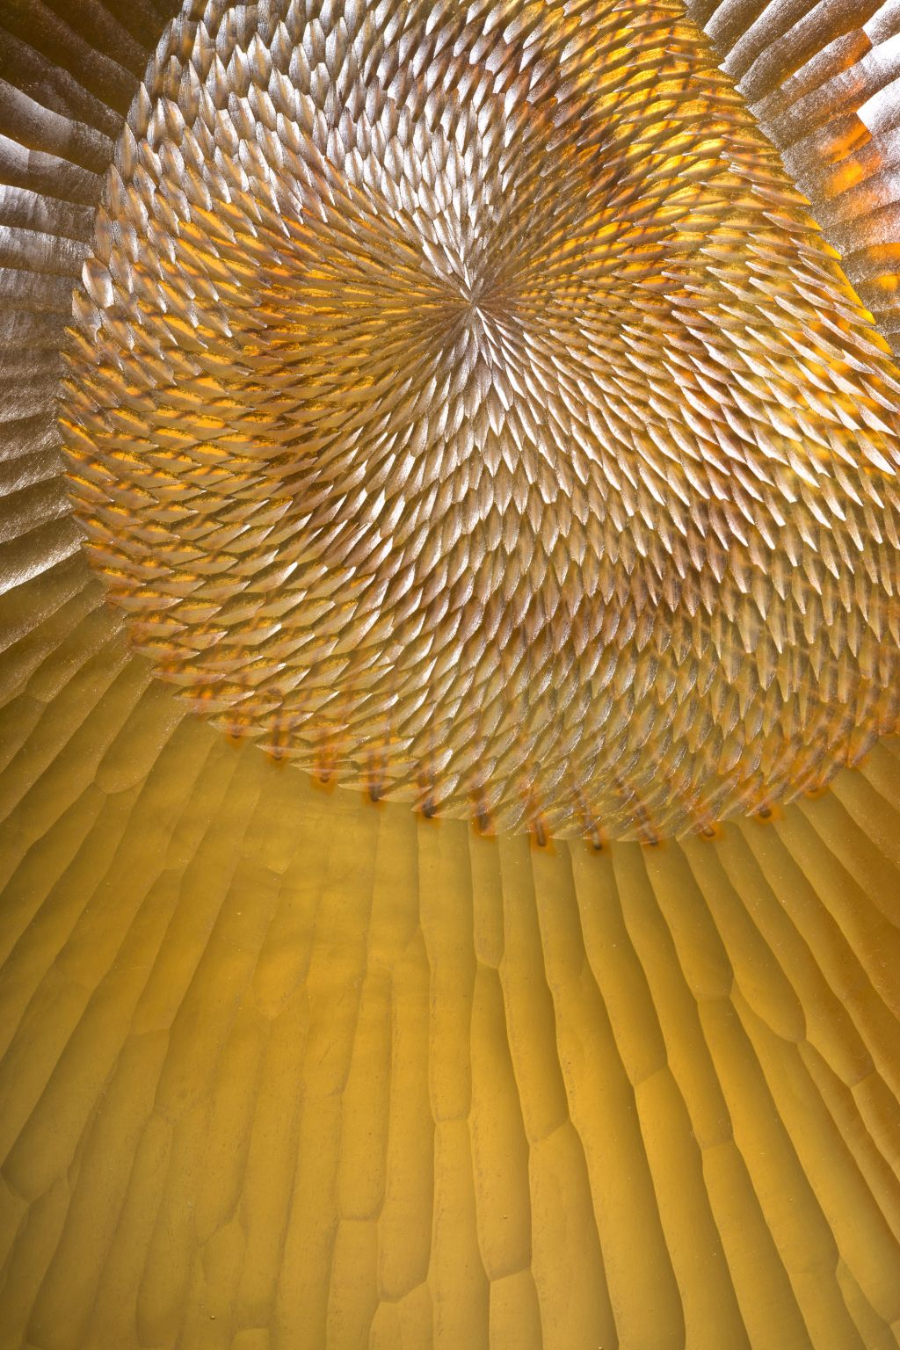
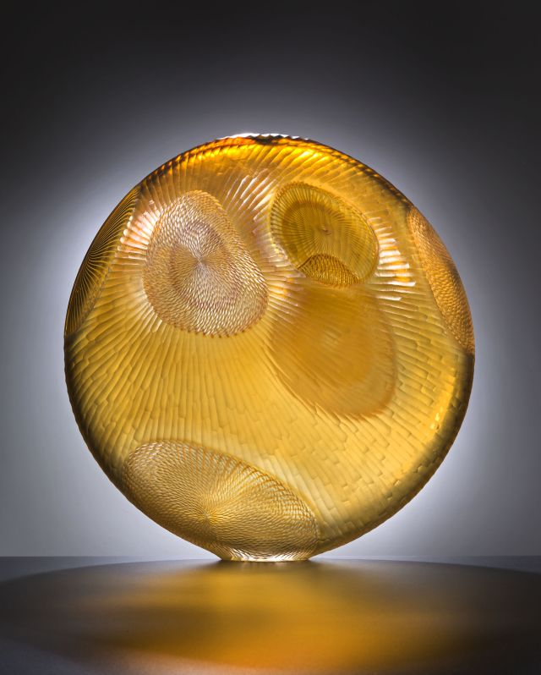
Medusa 2006

Slide 4
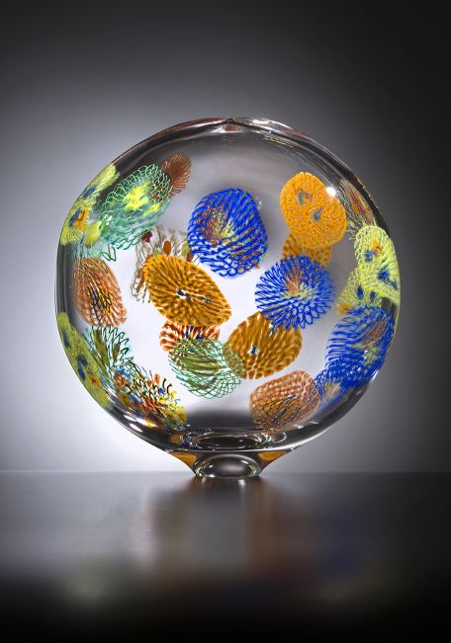
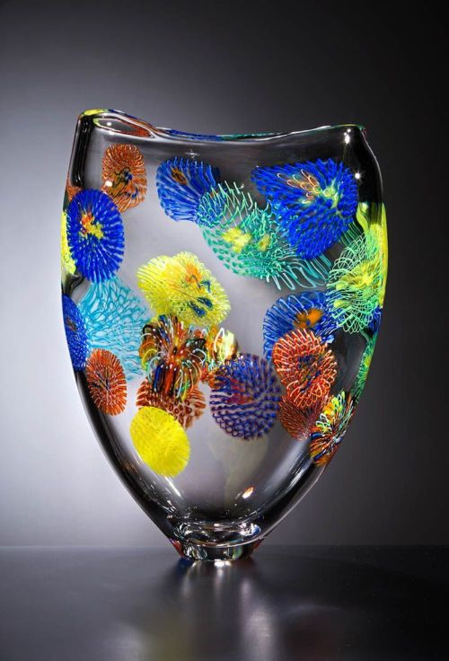
Medusa 2015

Slide 5
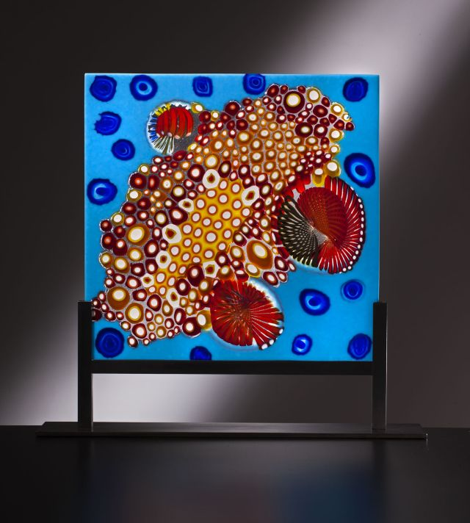
Meduse 2013

Slide 6
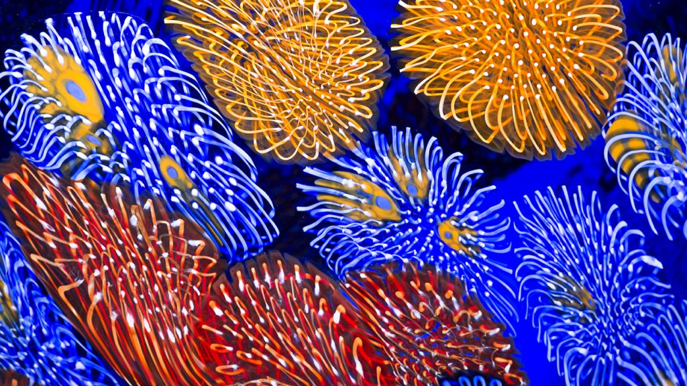

Slide 7
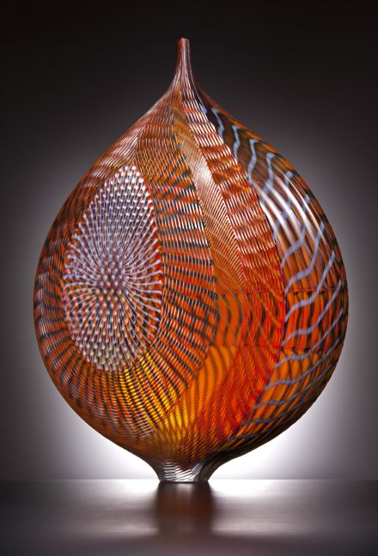
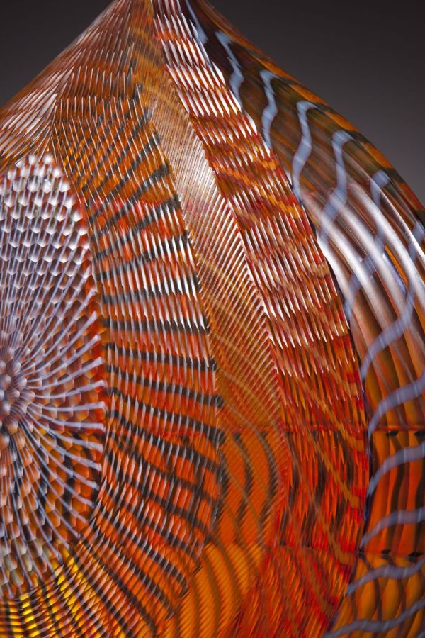
Mandara 2005

Slide 8
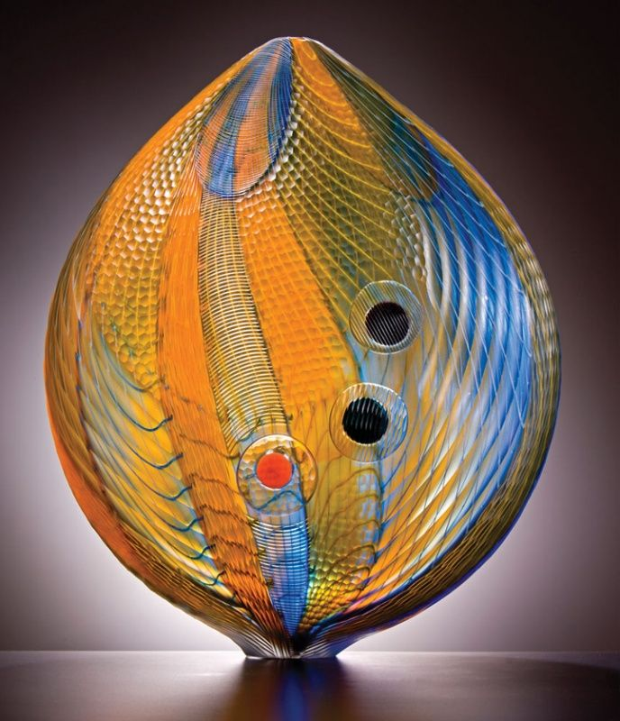
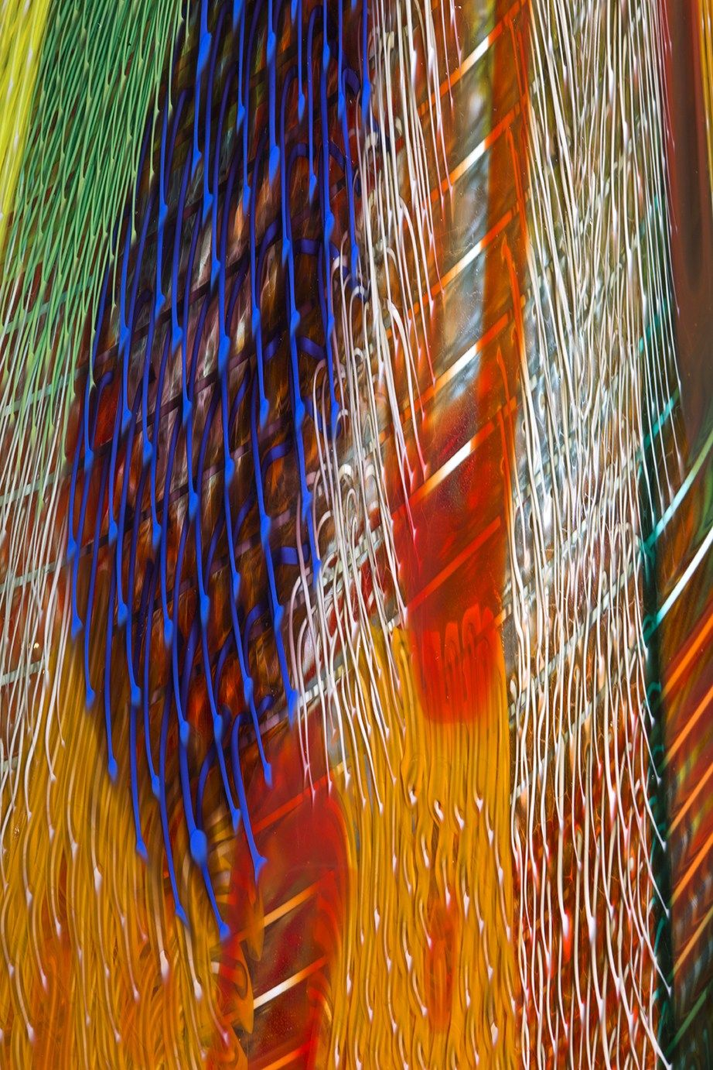
Mandara 2005
Detail

Slide 9
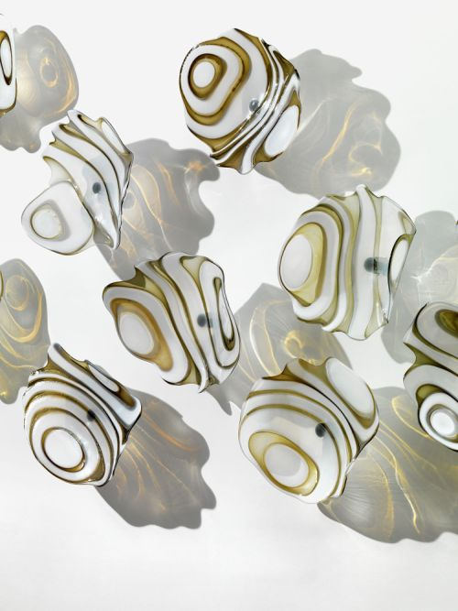
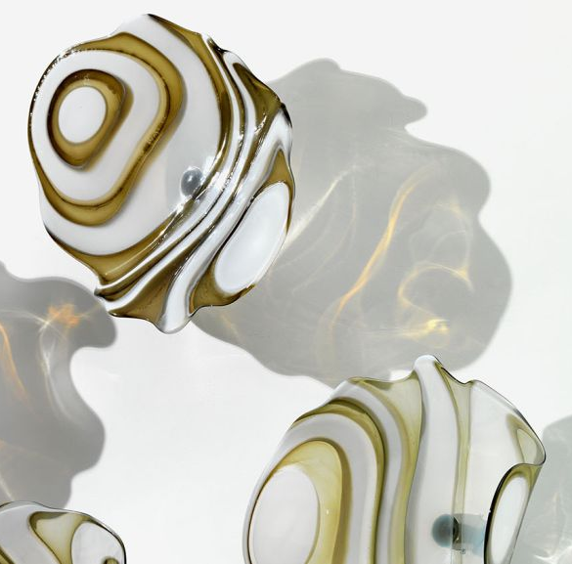
Metamorphosis 2014 - details

Slide 10
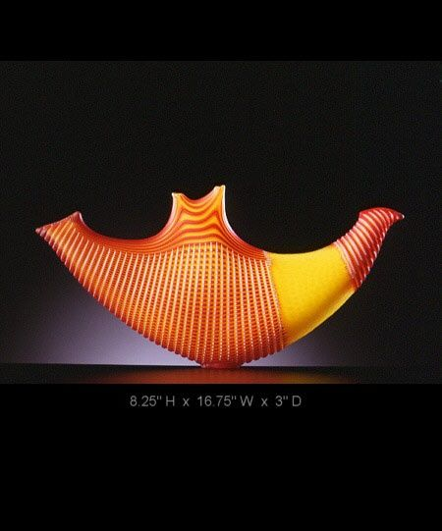
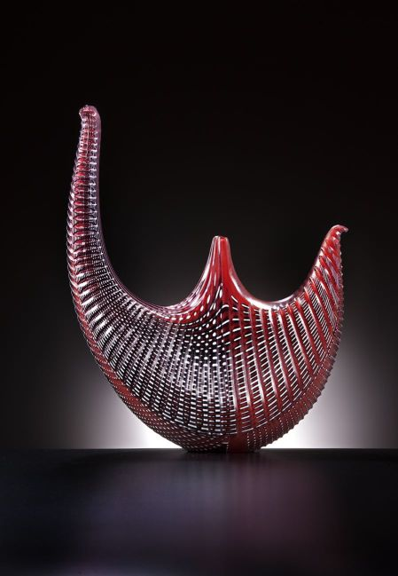
Batman Series

Slide 11
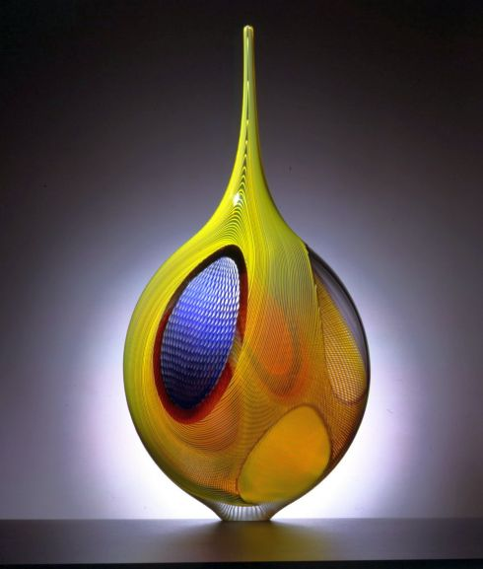
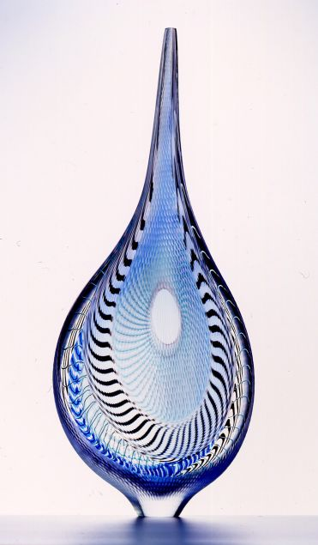
Bilbao
Bilbao 2002

Slide 12
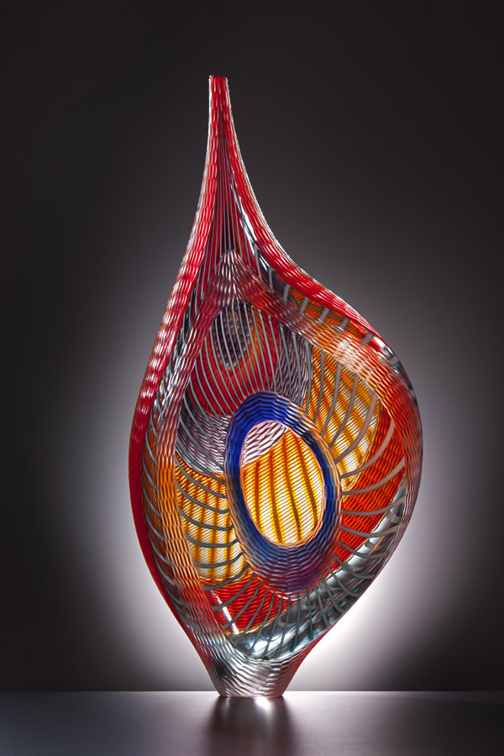
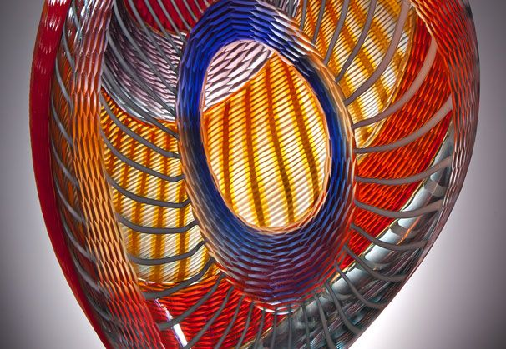
Bilbao 2005

Slide 13
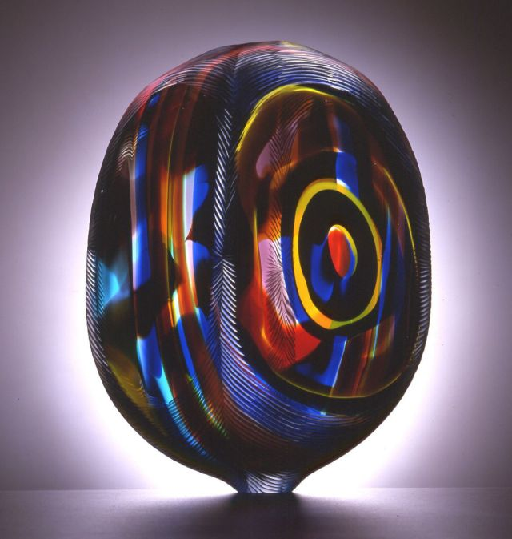
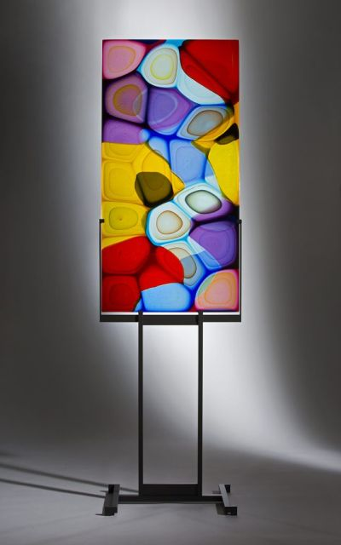
Bilbao 2001
Monterey

Slide 14
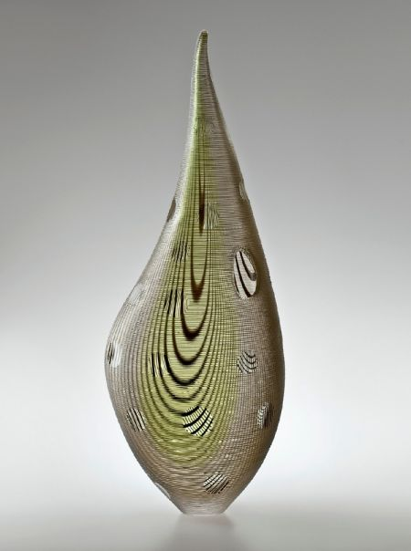
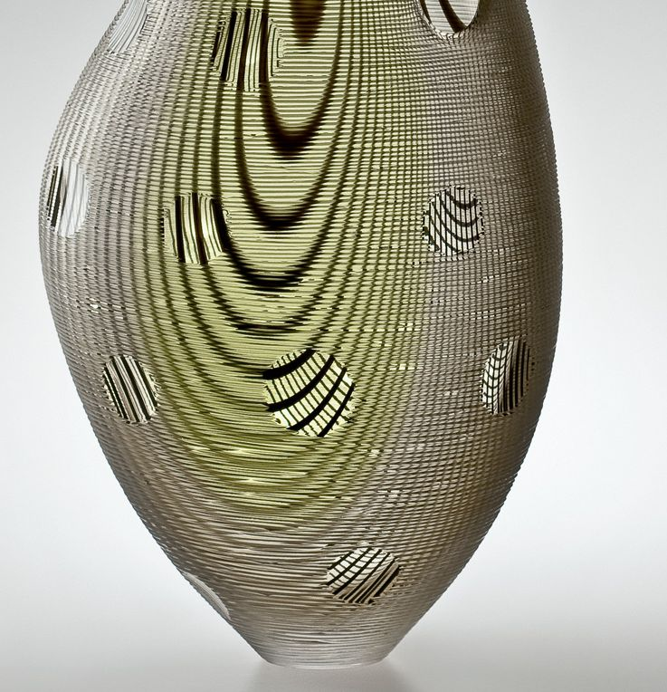
2011

Slide 15
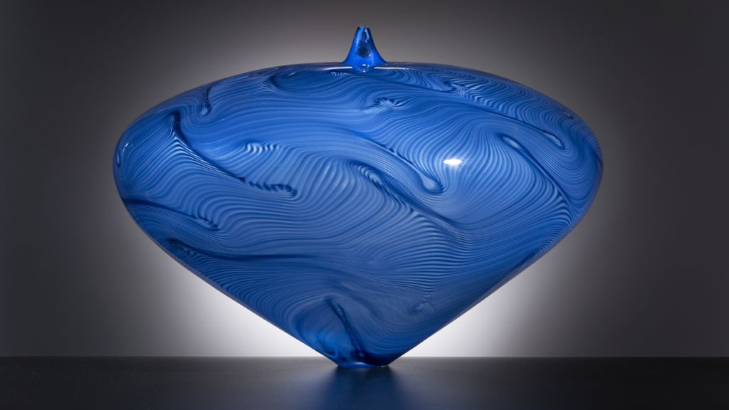
Hopi

Slide 16
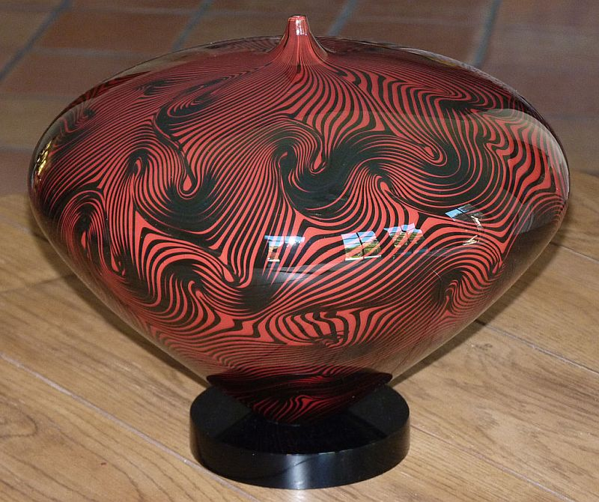
Hopi vase

Slide 17
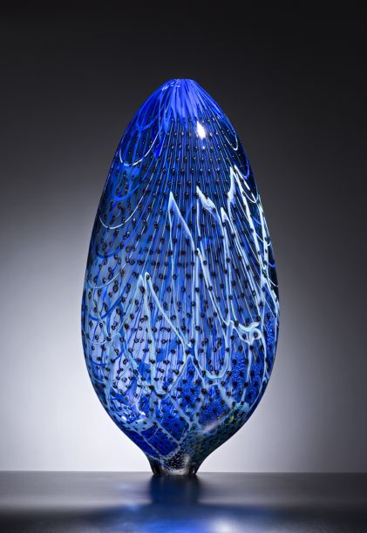
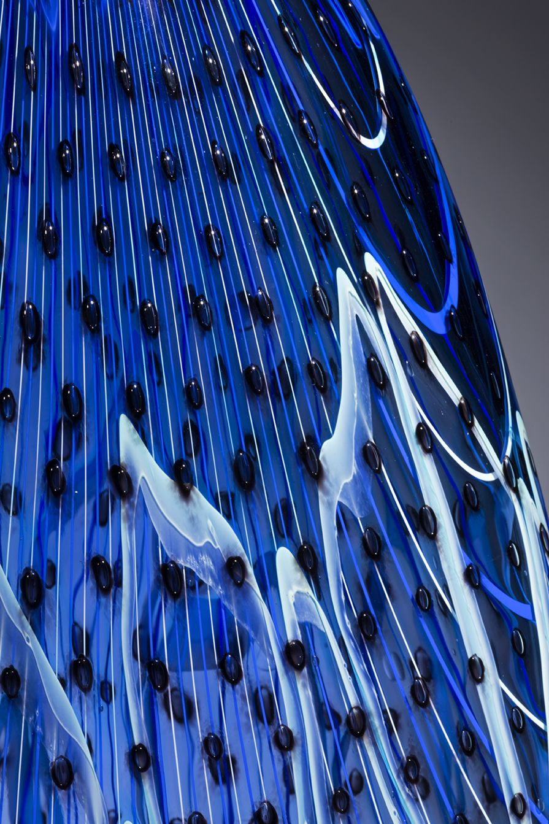
London

Slide 18
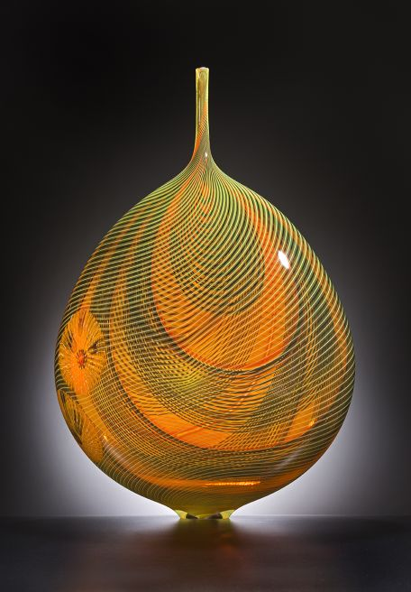
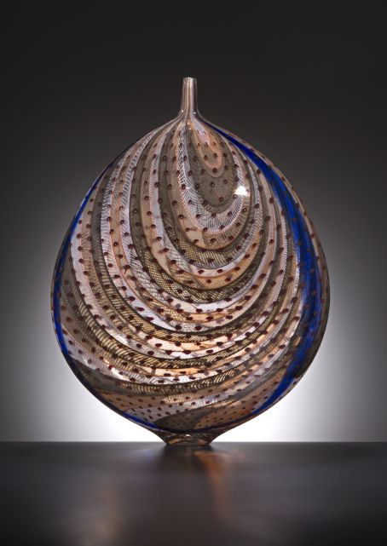
Saba 2016
Sahara 2013

Slide 19
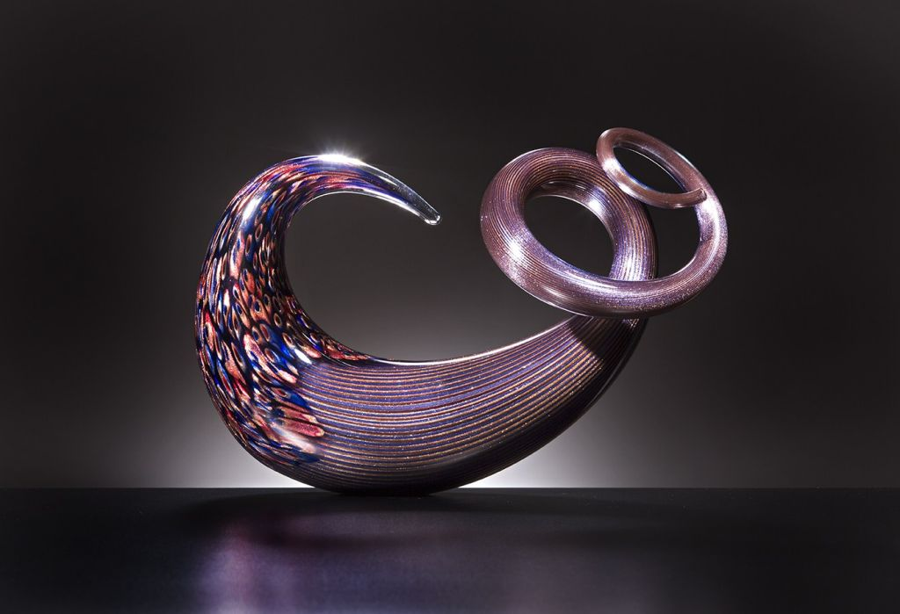

Slide 20
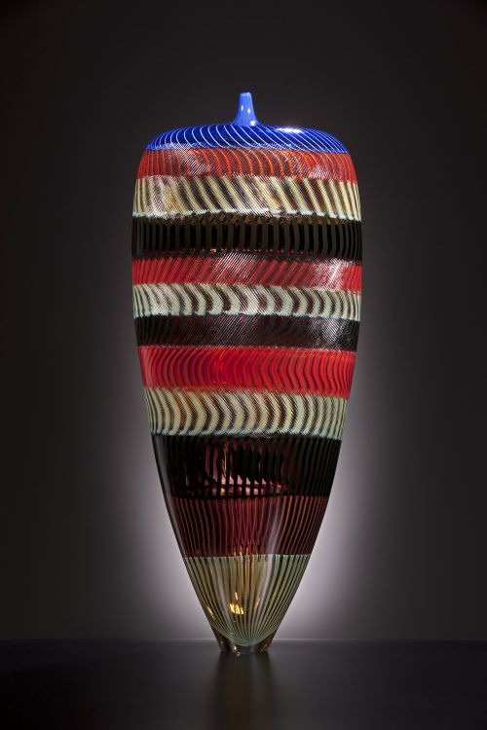
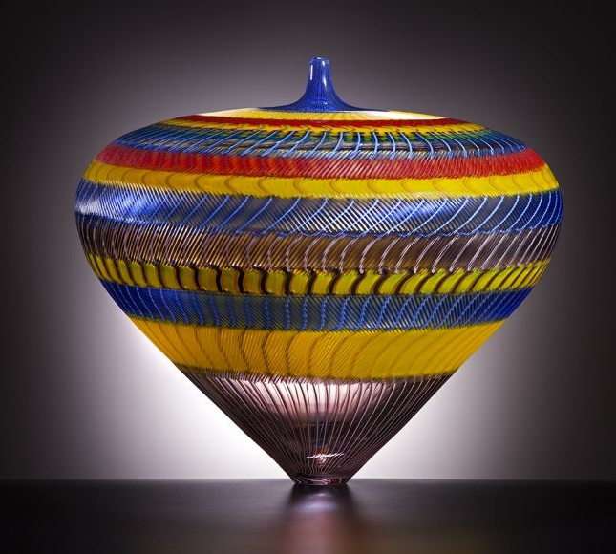
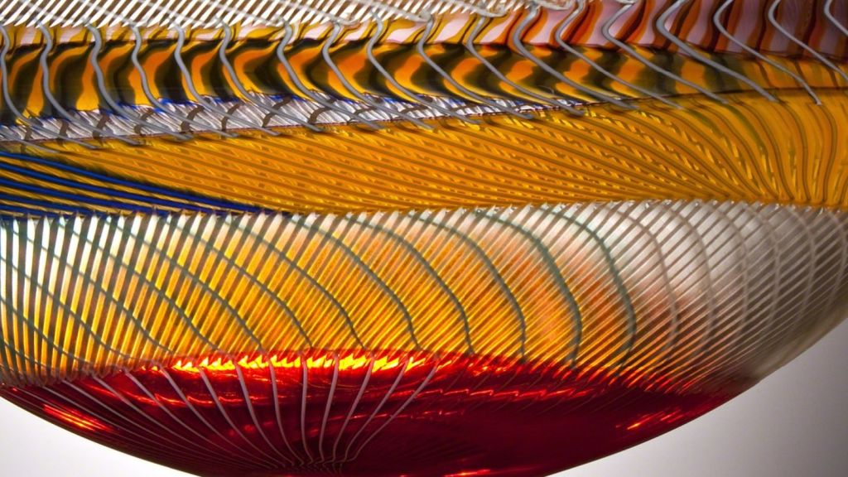
Piccadilly

Slide 21
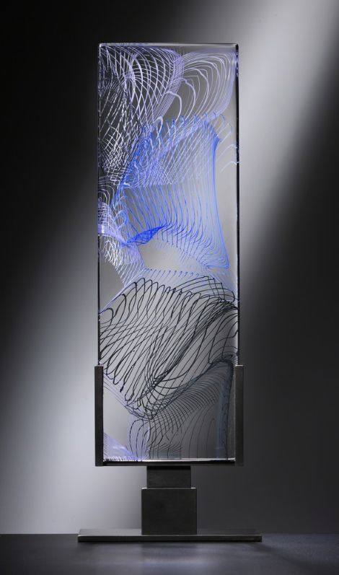
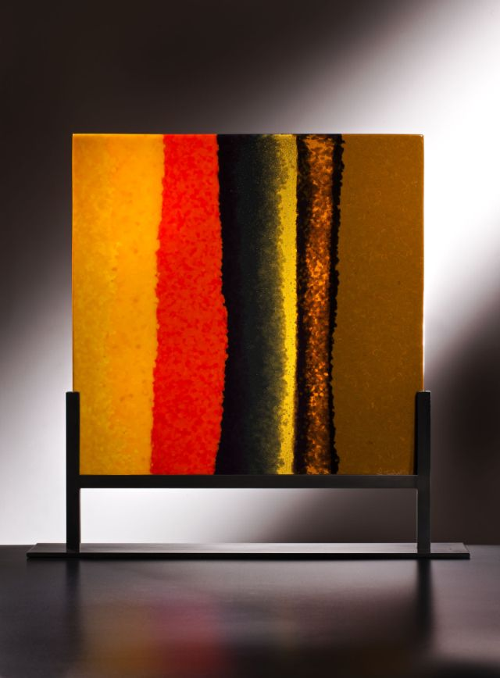
Vertical tornado
Lipari 2013

Slide 22
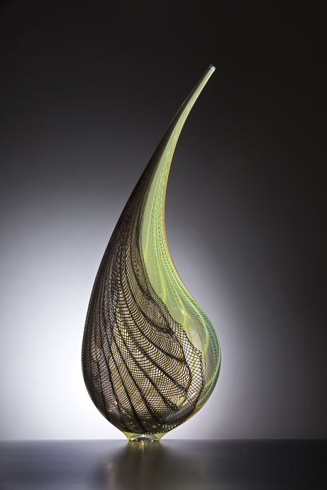
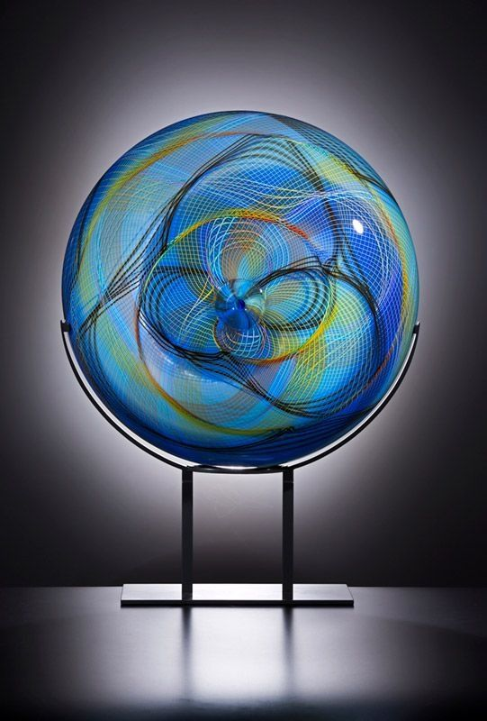
Piccadilly
Piccadilly

Slide 23
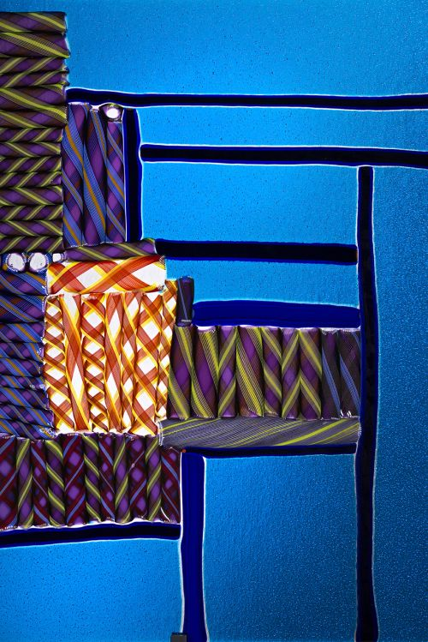
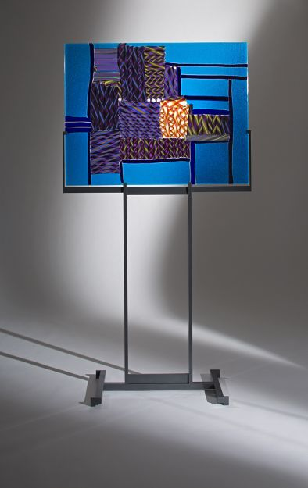
Panel Chicago 2015

Slide 24
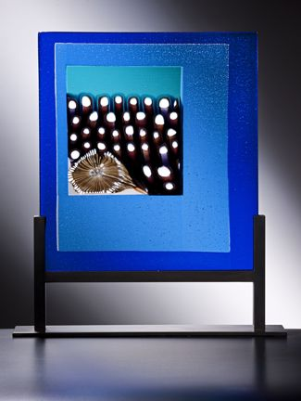
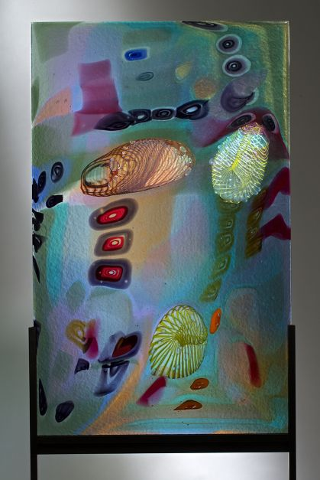
Fiori e Canneto, 2012
Campo delle Ciacole 2013

Slide 25
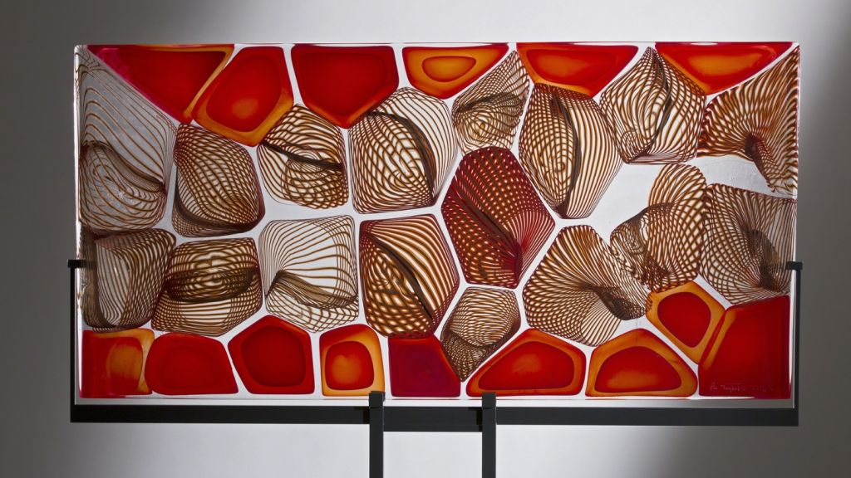
Coral panel

Slide 26
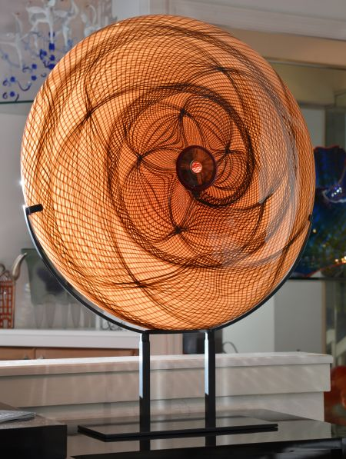
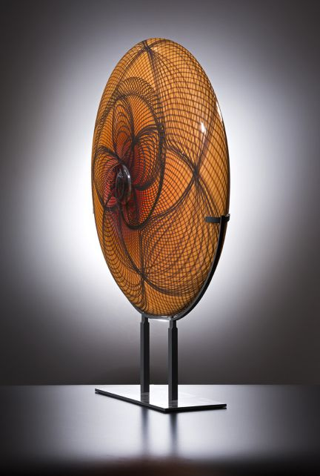
Ombelico Del Mondo

Slide 27
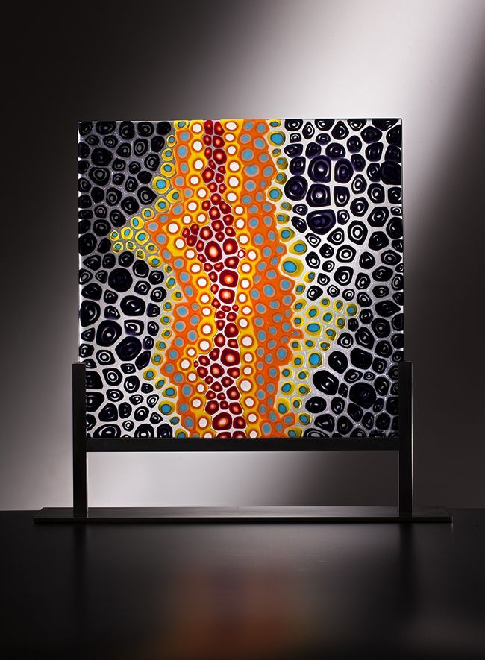
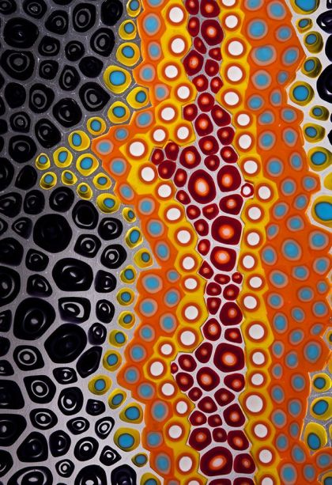
Emozioni

Slide 28


Niomea 2016
Borneo

Slide 29



Niomea

Slide 30



Niomea

Slide 31

Niomea

Slide 32

Poccolo panel, 2015

Slide 33

Puget sound, 2015

Slide 34



Kira

Slide 35


Slide 36


Juno
La mano 2012

Slide 37


Juno
Maui 2010

Slide 38

Maui 2010 detail

Slide 39


Slide 40


Saturno

Slide 41



Ombellico del Mondo 2015

Slide 42

Petra 2012

Slide 43

Tasmania 2013

Slide 44



Saturno Chandelier 2010
Spirale 2016

Slide 45



Oca 2003
Oca 2016
Oca 2002

Slide 46


Oca 2004

Slide 47

Lino Tagliapietra has been featured in numerous solo exhibitions and is represented in a global assortment of museums and art institutions.
He is the recipient of countless awards and recognitions, including: Borsella d’Oro (1968; Murano); Rakow Commission for Excellence in Glass award (1996; Corning Museum); Glass Art Society Lifetime Achievement Award (1997); Urkunde Gold Medal (1997; Germany); Honorary Doctorate of Fine Arts (2011; Ohio State University, Columbus, OH)

Slide 48


Masai 2012
Masai 2014

Slide 49

Masai d’oro 2011 Installation

Slide 50


Contarini
Fireworks

Slide 51



Fenice 2017
Fenice 2011
Fenice 2017

Slide 52


Fenice 2014
Fenice 2017

Slide 53



Fenice
Fenice 2017
Fenice

Slide 54




Endeavor Installation

Slide 55

Endeavor

Slide 56

Endeavor 2005

Slide 57

Endeavor installation

Slide 58


Gioiello, 2016

Slide 59


Angel Tear 2017
Notes:
Maestro Lino Tagliapietra is the recipient of countless awards and recognitions, including: Borsella d’Oro (1968; Murano); Rakow Commission for Excellence in Glass award (1996; Corning Museum); Glass Art Society Lifetime Achievement Award (1997); Urkunde Gold Medal (1997; Germany); Libensky Award (1998; Chateau Ste. Michelle Vineyards and Winery and Pilchuck Glass School); Honorary Doctorate (2004; Centre College, KY); The President’s Distinguished Artist Award (2004; University of the Arts, Philadelphia, PA); Distinguished Educator Award (2006; James Renwick Alliance); Cristal Award (2007; Museo del Vidrio, Monterrey, Mexico); Foreign Honorary Member, American Academy of Arts and Sciences (2007; Cambridge, MA); IIC Lifetime Achievement Award (2009; Istituto Italiano di Cultural, Los Angeles, CA); Honorary Doctorate of Fine Arts (2011; Ohio State University, Columbus, OH).

Slide 60




Angel Tears

Slide 61



Angel Tears

Slide 62

Angel Tear detail

Slide 63



Angel Tears

Slide 64

Angel Tear detail

Slide 65

Shanghai
China,
August 30,
2017

Slide 66

Shanghai
China,
August 30,
2017

Slide 67

Shanghai
China,
August 30,
2017

Slide 68

Shanghai
China,
August 30,
2017

Slide 69



Text and pictures: Internet
All copyrights belong to their respective owners
Presentation: Sanda Foişoreanu
https://plus.google.com/+SandaMichaela
2018
Sound: Canzonetta semplice - Dmitri Hvorostovsky & Sumi Jo
Notes:
Africa detail

