Slide 1

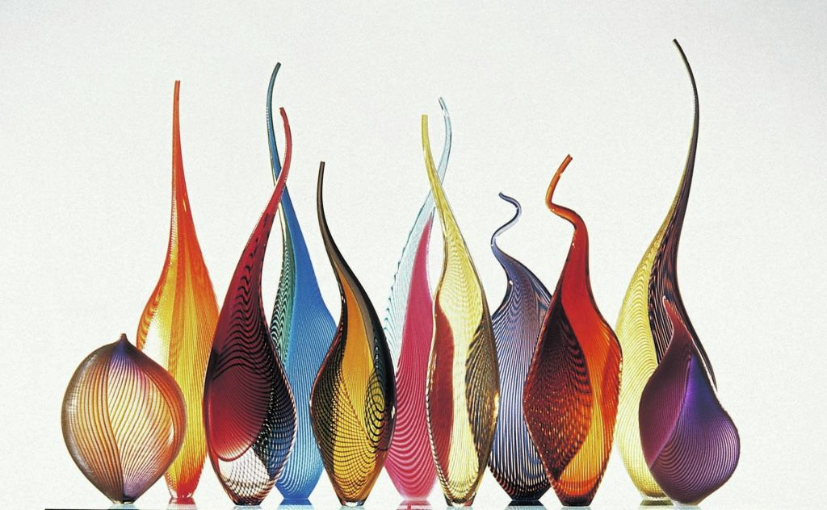
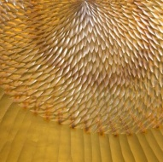

Lino
Tagliapietra
1
Notes:
SAMBA-DO-BRASIL
Maestro Lino Tagliapietra at Schantz Galleries
Lino Tagliapietra’s career is defined by a dedication to workmanship, innovation, and collaboration. Born in 1934 on the renowned glass-blowing island of Murano, Italy, Tagliapietra began his apprenticeship at age 11 with Muranese master Archimede Seguso from whom Tagliapietra achieved the status of Maestro Vetraio by the age of 21. For over forty-two years, Lino worked in various for-profit Murano factories including Vetreria Galliano Ferro, Venini & Co., and finally as the Artistic and Technical Director of Effetre International (1976-1989). Tagliapietra has been an independent artist since 1989, exhibiting in museums around the globe, receiving countless honors, openly sharing his far-reaching knowledge of the medium and his skill as one of its finest practitioners, and helping to create a new renaissance in studio glassmaking. As James Yood, adjunct professor of art history at the School of the Art Institute of Chicago and regular contributor to GLASS magazine wrote, “there are probably no two words more respected and honored in the history of modern sculpture in glass than ‘Lino Tagliapietra’; he is the living bridge, the crucial link between the august history of Venetian glass and the ceaseless wonders of what today we call the modern Studio Glass Movement”, (to read more of this essay, refer to Dalle Mani del Maestro, Lino Tagliapietra.)
Lino Tagliapietra has been featured in numerous solo exhibitions and is represented in a global assortment of museums and art institutions, including: Bellevue Art Museum, Bellevue, WA; Bergstrom-Mahler Museum of Glass, Neenah, WI: Venice Biennale, Italy; Carnegie Museum of Art, Pittsburgh, PA; Chrysler Museum; Norfolk, VA; Colby Museum of Art, Waterville, ME; Corning Museum of Glass, NY; The Danish Royal Museum, Copenhagen, Denmark; Glasmuseum, Ebeltoft, Denmark; Hokkaido Museum of Modern Art, Sapporo, Japan; M.H. de Young Memorial Museum, San Francisco, CA; The Metropolitan Museum of Art, New York, NY: Mint Museum of Craft and Design, Charlotte, NC; Musée des Arts Décoratifs, Losanna, Switzerland; Musée des Arts Décoratifs, Paris, France; Museo del Vidrio, Monterrey, Mexico; Museum of Arts and Design, New York, NY; Museum Boymans, Rotterdam, The Netherlands; Museum of Glass, Tacoma, WA; Museum Het Paleis, The Hague, Netherlands; National Museum of Ceramic Art and Glass, Baltimore, MD; Orlando Museum, FL; Palazzo Franchetti, Venice, Italy; Palazzo Grassi, Venice, Italy; Palm Springs Art Museum, CA; Renwick Gallery of the Smithsonian American Art Museum, Washington, D.C.; Seattle Art Museum, WA; Shanghai Museum of Glass, China; Stanford University, Palo Alto, CA; Tokyo National Modern Art Museum, Japan; and the Victoria and Albert Museum, London, UK.

Slide 2
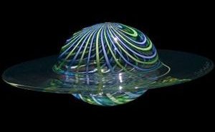
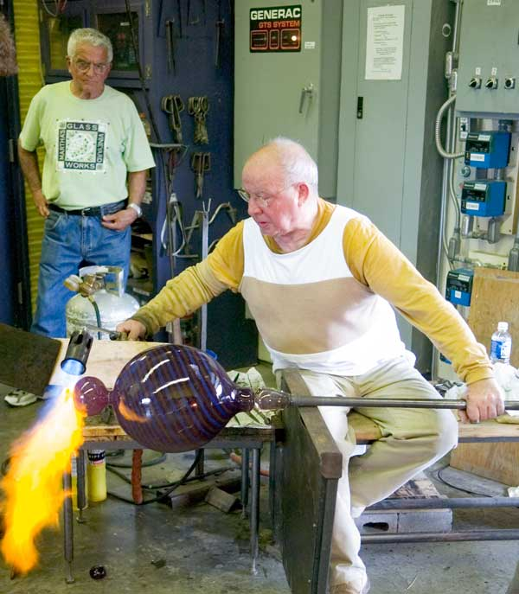
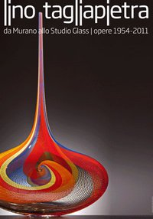

1
Lino Tagliapietra (born 1934) is a Venetian glass artist who has also worked extensively in the United States. As a teacher and mentor, he has played a key role in the international exchange of glassblowing processes and techniques between the principal American centers and his native Murano, "but his influence is also apparent in China, Japan, and Australia—and filters far beyond any political or geographic boundaries.“
He is the recipient of countless awards and recognitions, including: Borsella d’Oro (1968; Murano); Glass Art Society Lifetime Achievement Award (1997); Honorary Doctorate (2004; Centre College, KY); IIC Lifetime Achievement Award (2009; Istituto Italiano di Cultural, Los Angeles, CA); Honorary Doctorate of Fine Arts (2011; Ohio State University, Columbus, OH)
Notes:
Maestro Lino Tagliapietra at Schantz Galleries
He is the recipient of countless awards and recognitions, including: Borsella d’Oro (1968; Murano); Rakow Commission for Excellence in Glass award (1996; Corning Museum); Glass Art Society Lifetime Achievement Award (1997); Urkunde Gold Medal (1997; Germany); Libensky Award (1998; Chateau Ste. Michelle Vineyards and Winery and Pilchuck Glass School); Honorary Doctorate (2004; Centre College, KY); The President’s Distinguished Artist Award (2004; University of the Arts, Philadelphia, PA); Distinguished Educator Award (2006; James Renwick Alliance); Cristal Award (2007; Museo del Vidrio, Monterrey, Mexico); Foreign Honorary Member, American Academy of Arts and Sciences (2007; Cambridge, MA); IIC Lifetime Achievement Award (2009; Istituto Italiano di Cultural, Los Angeles, CA); Honorary Doctorate of Fine Arts (2011; Ohio State University, Columbus, OH).

Slide 3
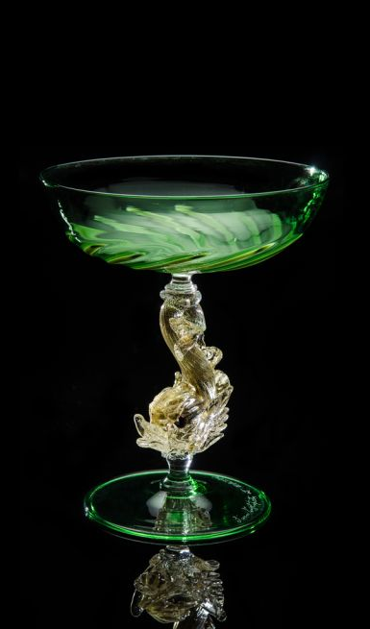
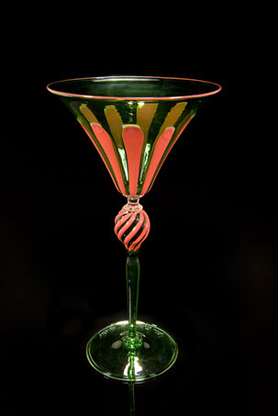
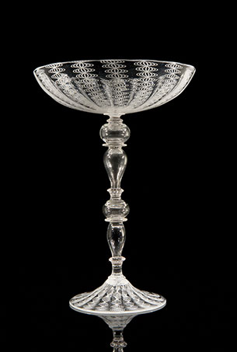

Slide 4
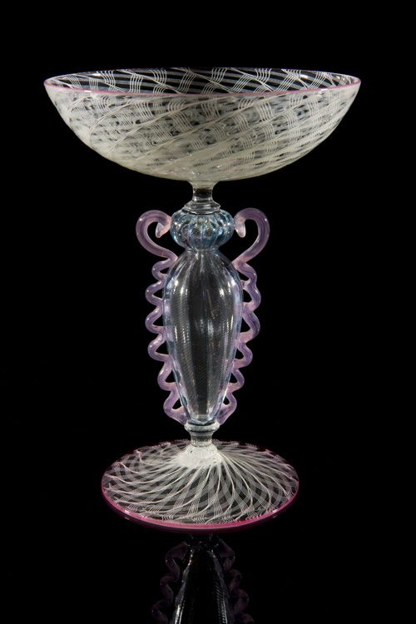
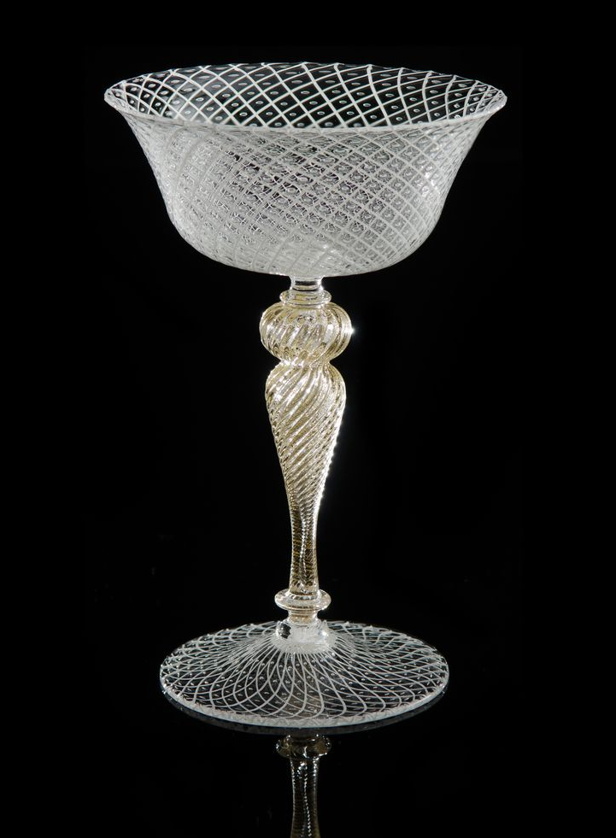

Slide 5
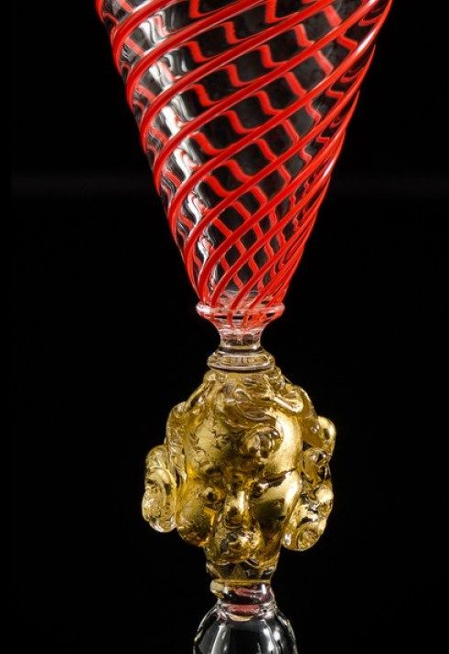
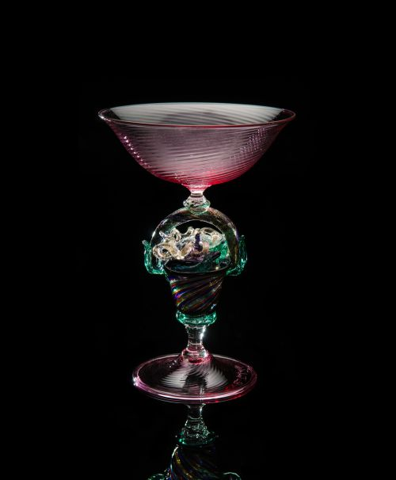

Slide 6
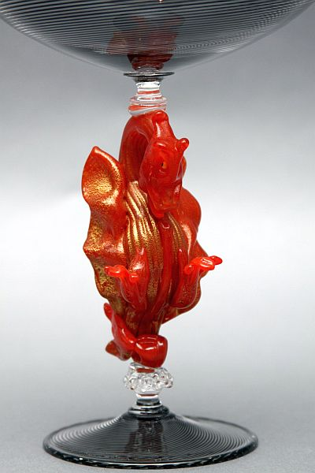
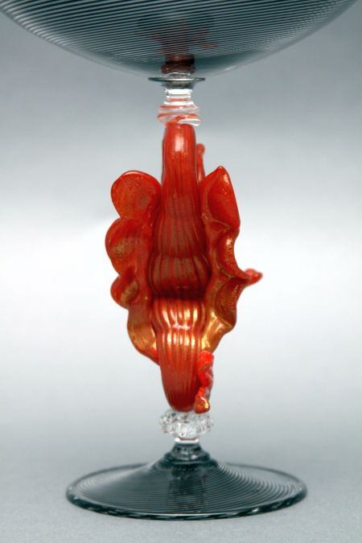
Tazza Dragon Goblet

Slide 7
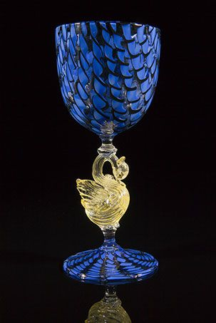
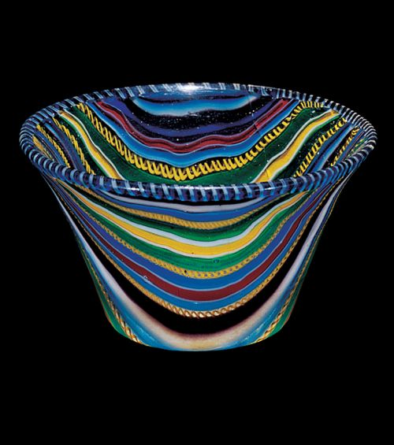

Slide 8
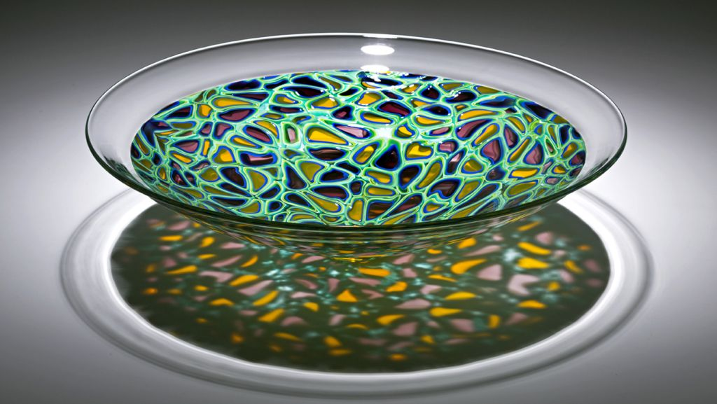
Florencia 2018

Slide 9
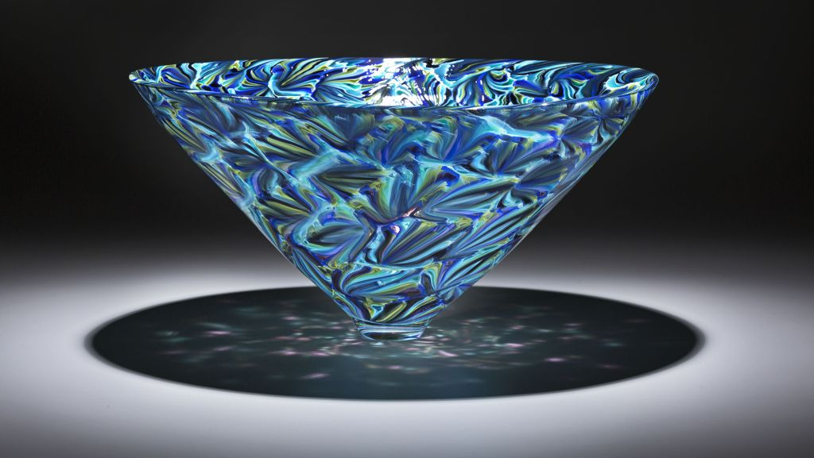
Florencia 2018

Slide 10
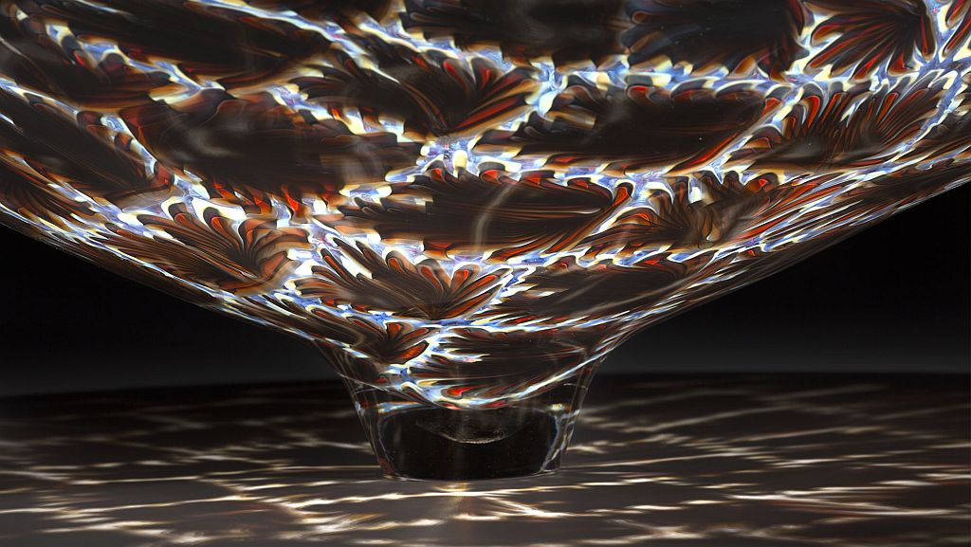
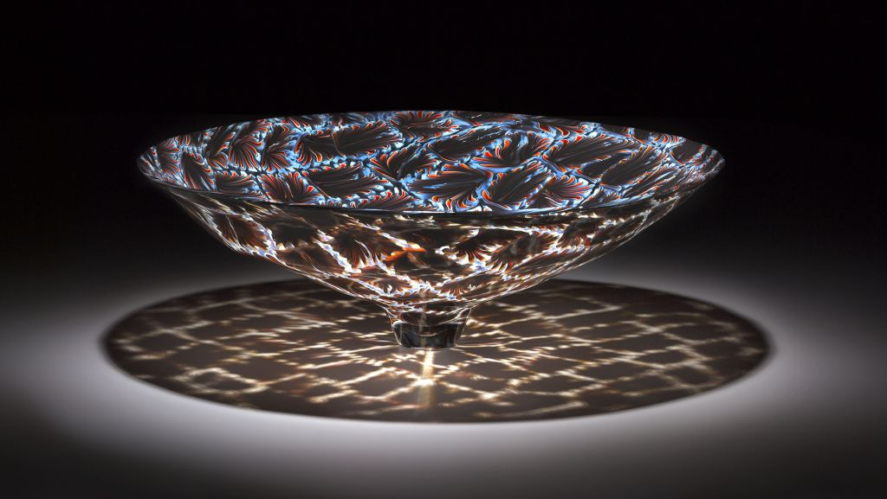
Florencia 2018

Slide 11
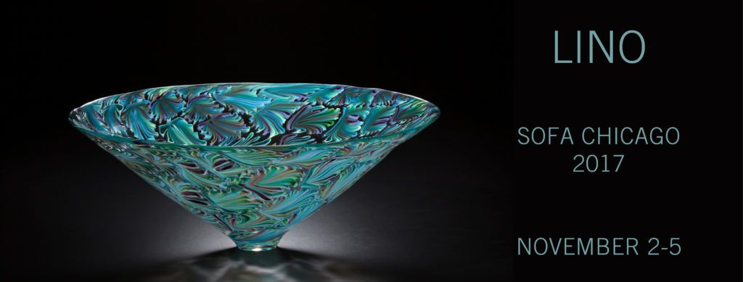

Slide 12
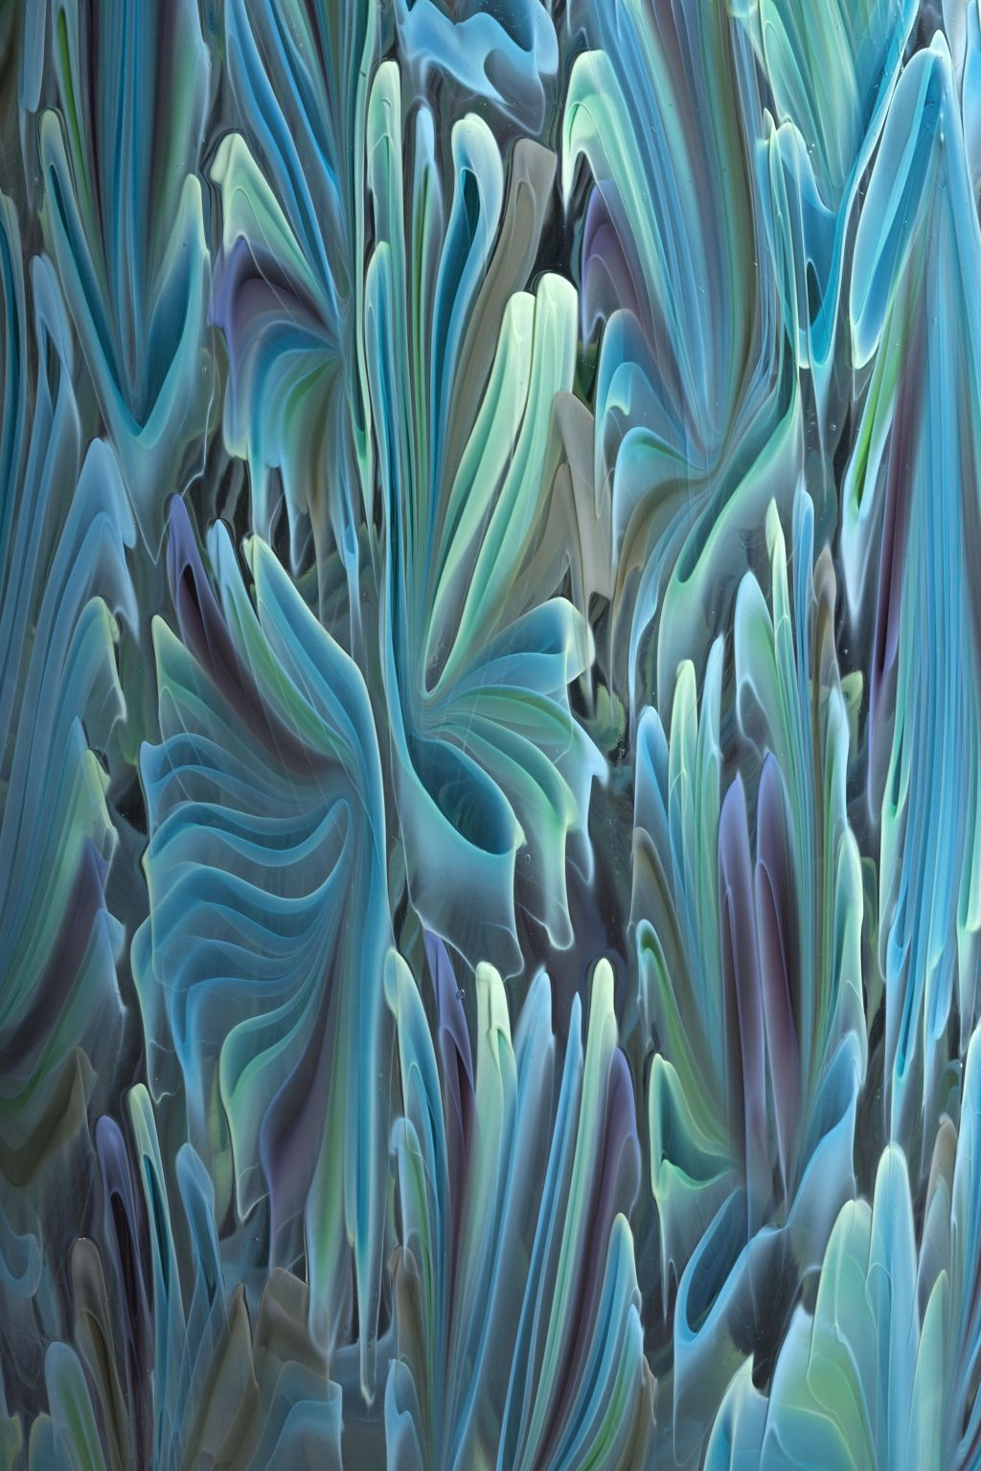
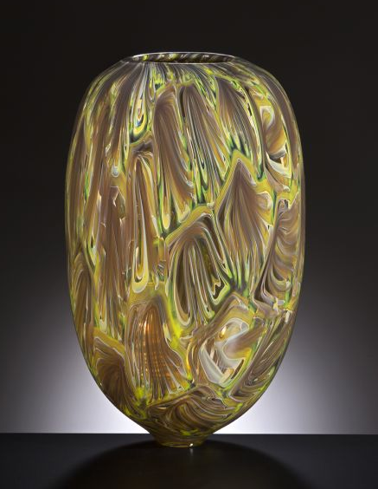
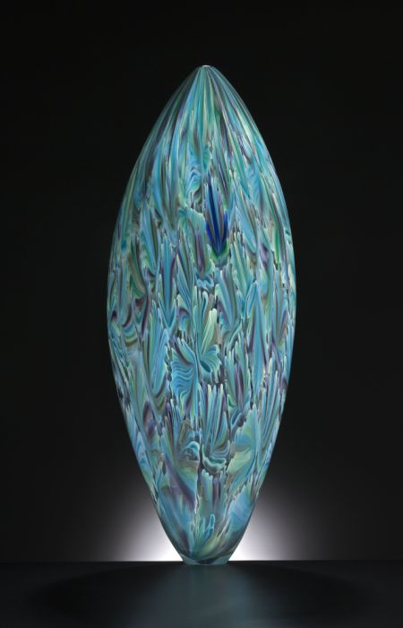
Florencia 2017
Florencia 2017

Slide 13
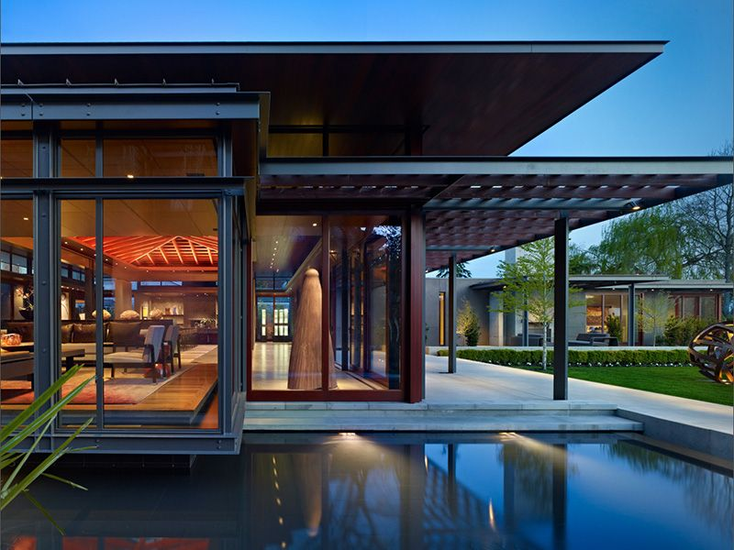
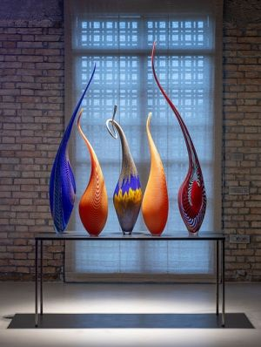
Lake Washington Art house

Slide 14
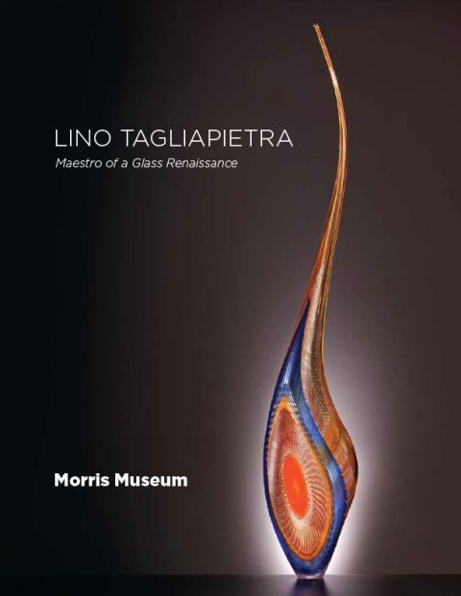
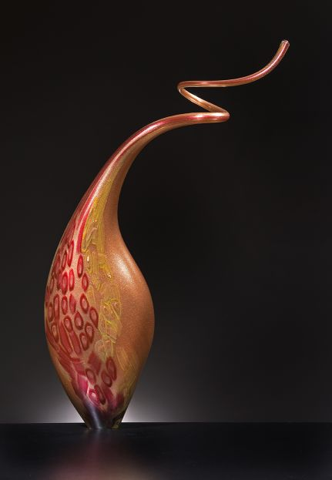
Dinosaur 2004
Dinosaur 2016

Slide 15
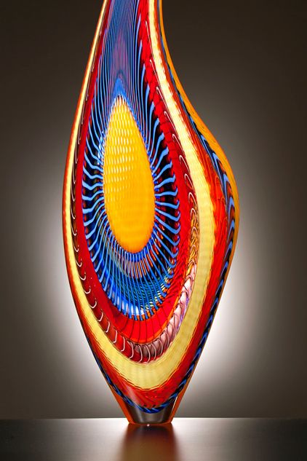
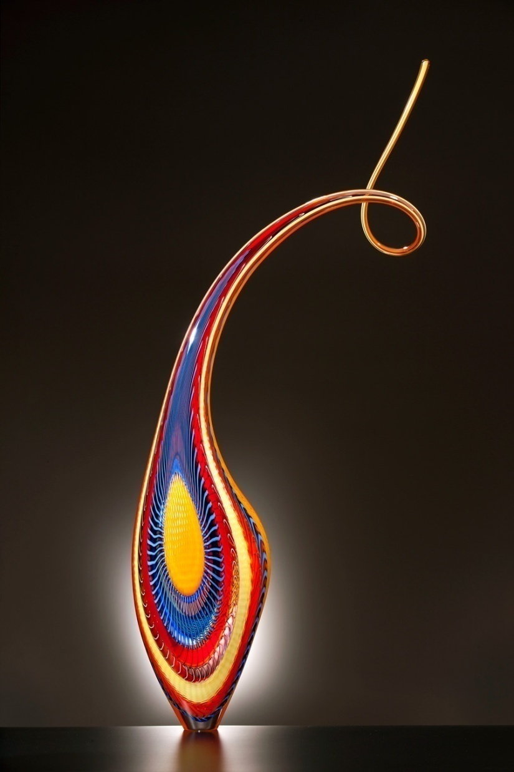
Dinosaur

Slide 16
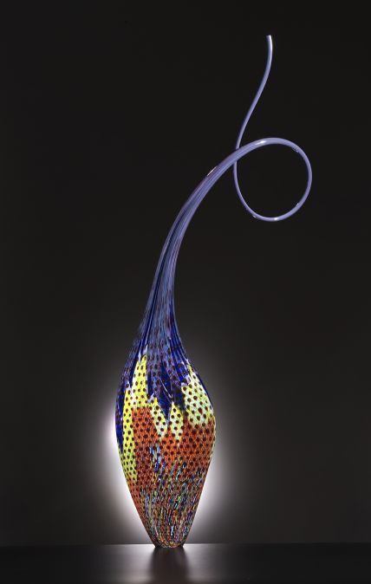
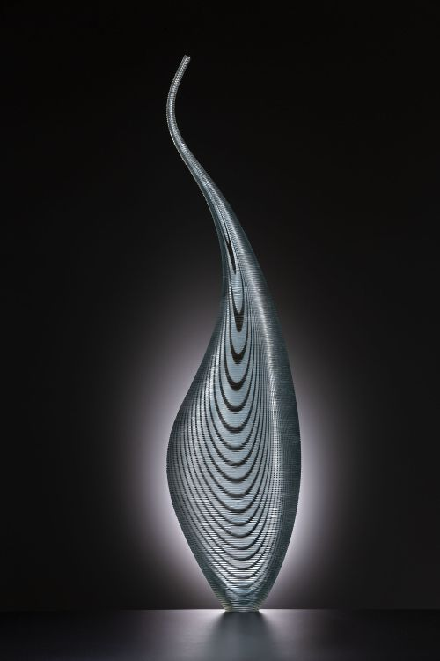
Dinosaur 2017
Dinosaur 1999

Slide 17
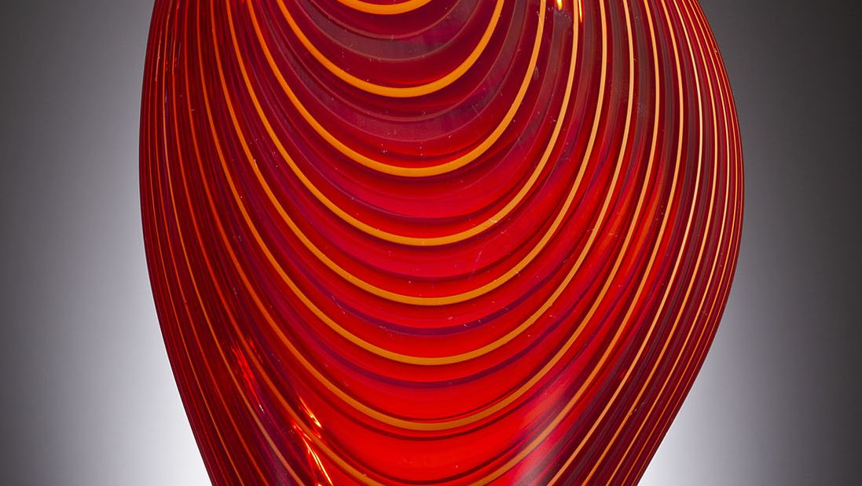
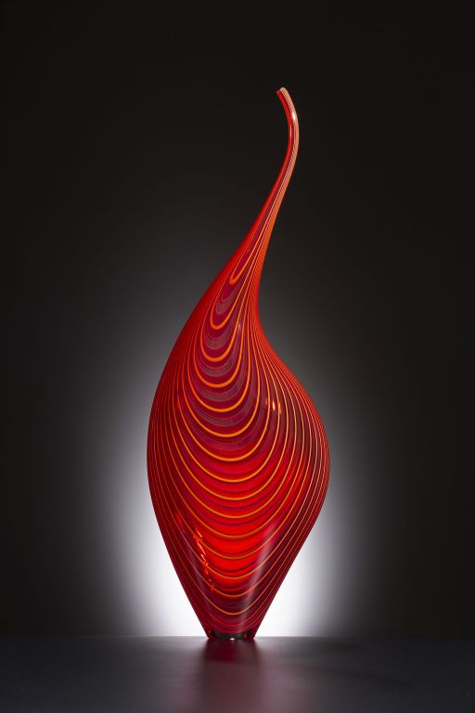
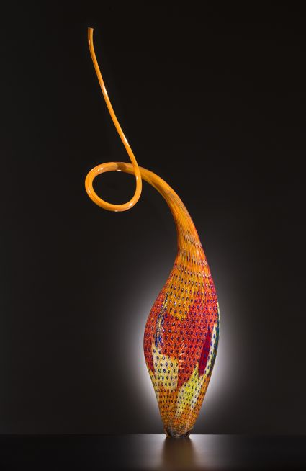
Dinosaur 2009
Dinosaur 2017

Slide 18
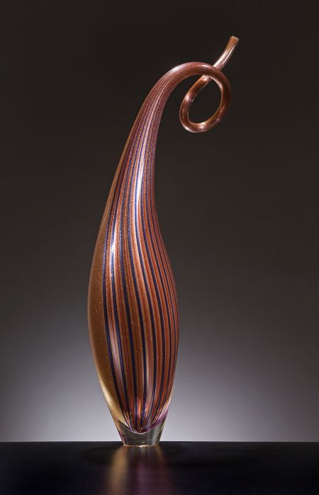
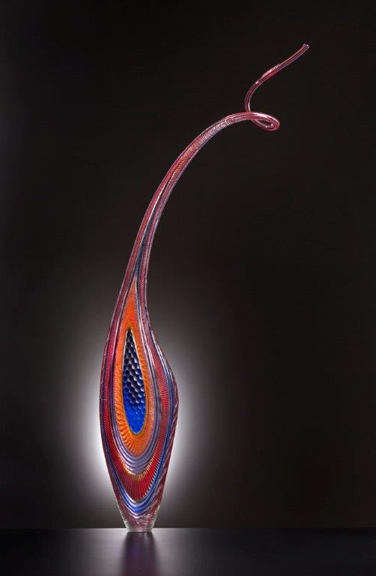
Dinosaur 2015

Slide 19
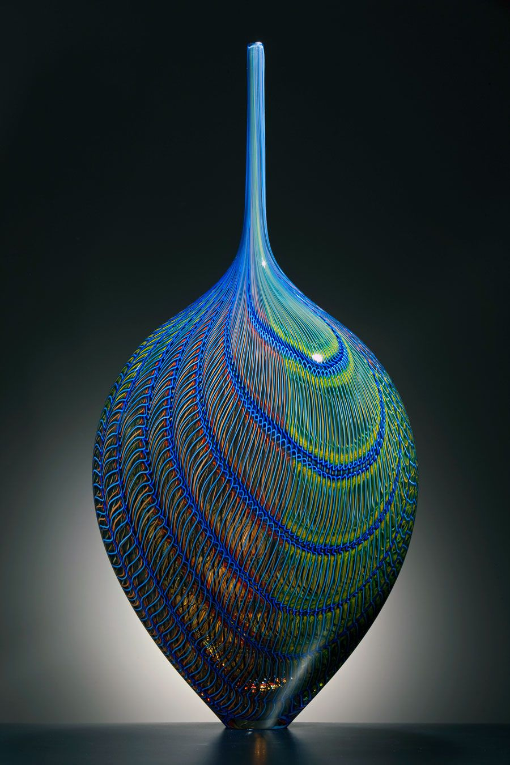
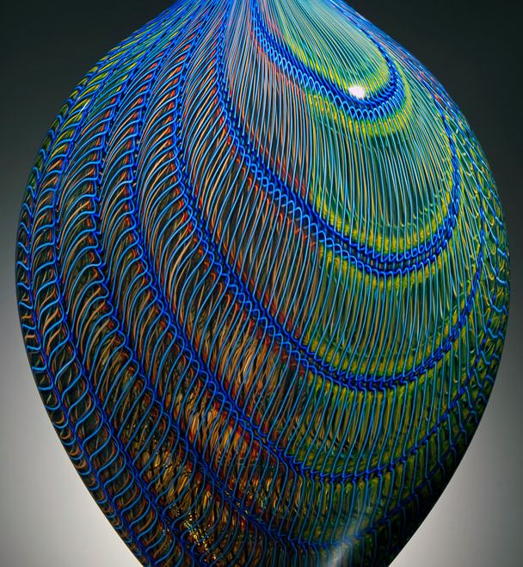
Tatoosh

Slide 20
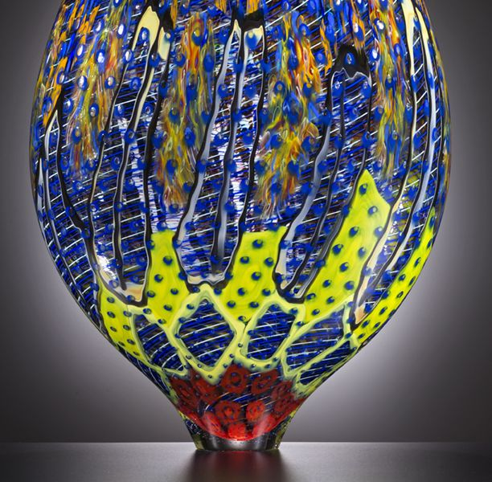
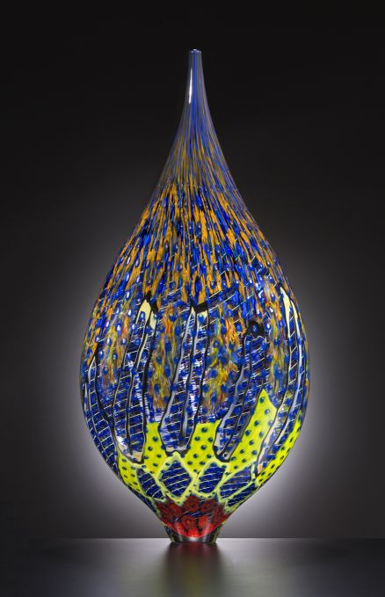
Thaos 2017

Slide 21
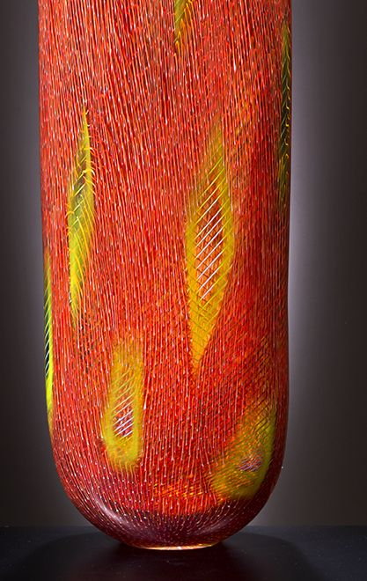
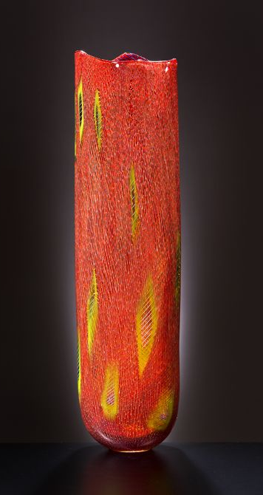
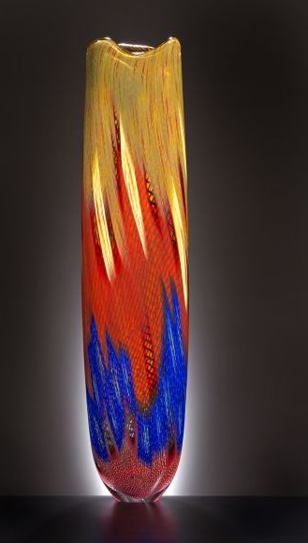
Stromboli 2015
Stromboli 2016

Slide 22
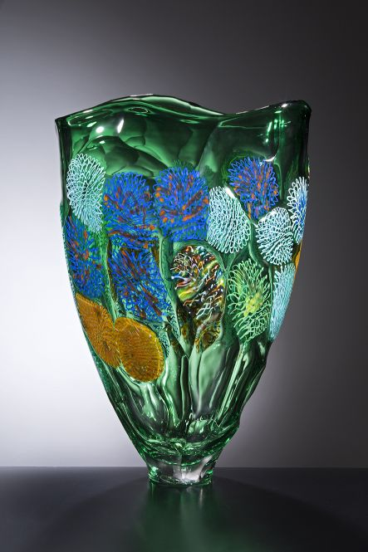
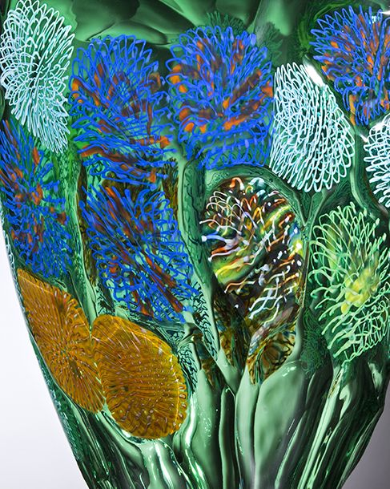
Stromboli 2016

Slide 23
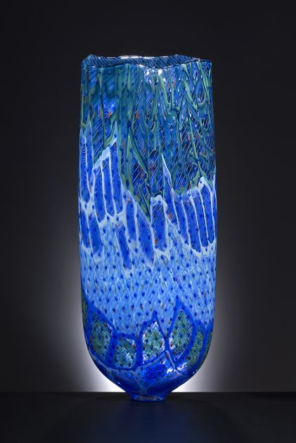
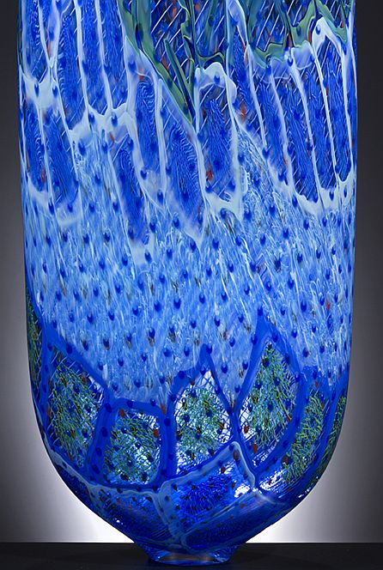
Stromboli 2017

Slide 24
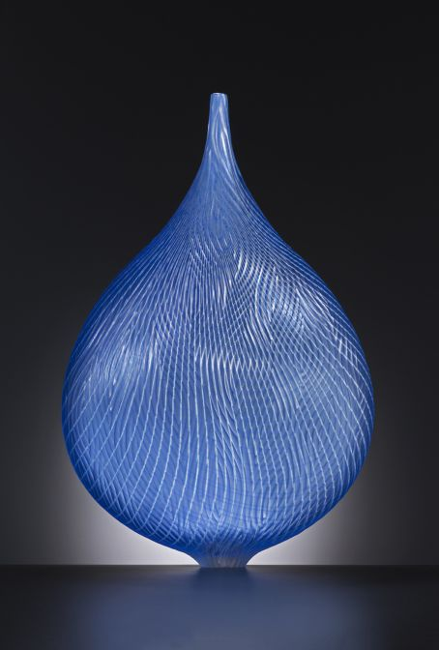
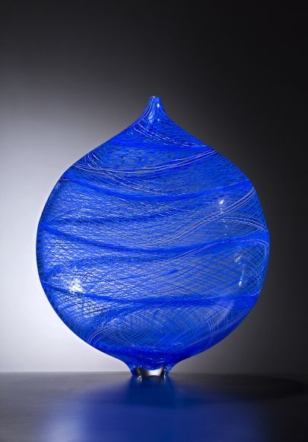
Travertino 2011
Poesia 2015

Slide 25

Africa

Slide 26

Africa 2017

Slide 27


Africa 2013

Slide 28

Africa

Slide 29


Avventura, 2018

Slide 30


Borboleta
Etna 2015

Slide 31


Ostuni

Slide 32


Opera

Slide 33

Lino Tagliapietra has been featured in numerous solo exhibitions and is represented in a global assortment of museums and art institutions

Slide 34



Slide 35

Celtica 2018

Slide 36



Osaka 2011

Slide 37


Fuji 2005
Fuji 2013

Slide 38

Fuji 2013

Slide 39


Fuji 2005
Fuji, 2011 Museum of Glass, Tacoma, WA

Slide 40


Fuji 2015
Fuji 2011

Slide 41


Fuji
Fuji 2015

Slide 42


Fuji
Fuji

Slide 43


Fuji 2011

Slide 44


Kookaburra 2013
Kookaburra

Slide 45



Thor, 2017
Makah

Slide 46


Contarini 2016
Contarini

Slide 47


Contarini

Slide 48


Slide 49


Details
Contarin

Slide 50

Viola 2017

Slide 51


Concerto di Primavera 2000

Slide 52

Ala 2013

Slide 53

Ala 2013

Slide 54

Ala 2013

Slide 55

Ala 2013

Slide 56

Ala 2013

Slide 57

Ala 2013

Slide 58

Ala 2013

Slide 59

Ala 2013

Slide 60

Ala 2013

Slide 61



Text and pictures: Internet
All copyrights belong to their respective owners
Presentation: Sanda Foişoreanu
https://plus.google.com/+SandaMichaela
2018
Sound: Aida Garifullina & Dmitri Hvorostovsky - Deja Vu (Igor Krutoy)

