Slide 1
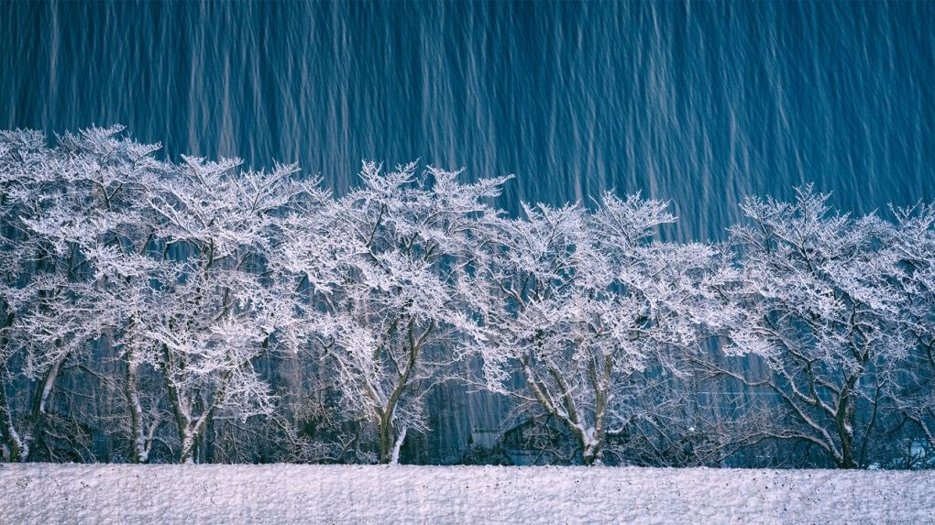
Nikon Photo Contest 2016-2017 – Highlighted Entries (7)
雪嵐の夜に © 秦 由香

Slide 2
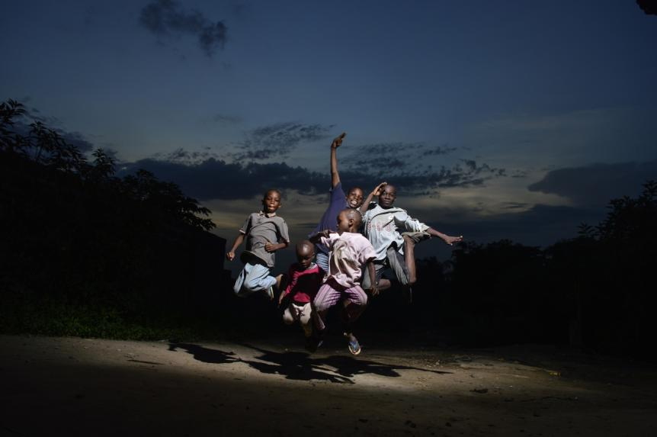
The young energy © Paul Iwuoha

Slide 3
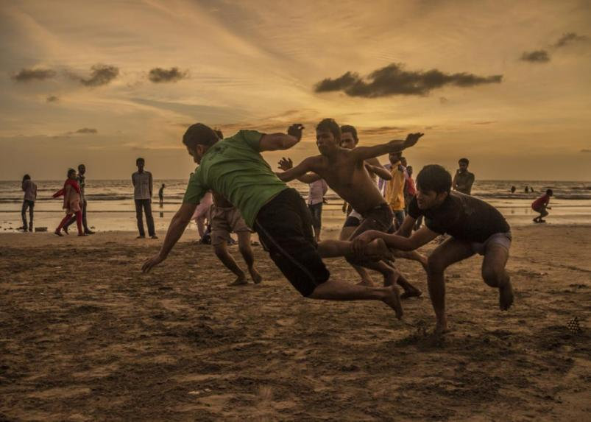
Game of kabaddi being played. © Sagar Shiriskar

Slide 4
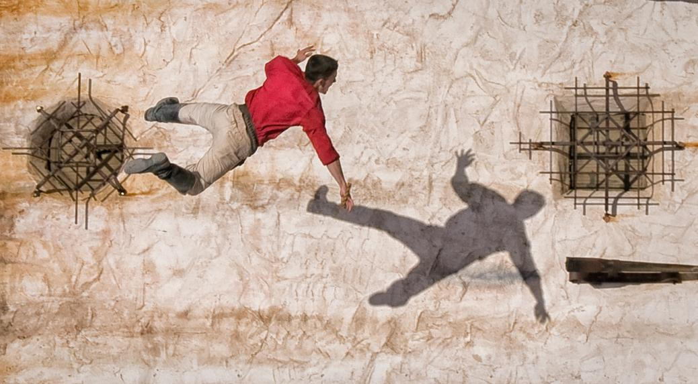
I Hope This is a Dream! © Richard Sereque

Slide 5
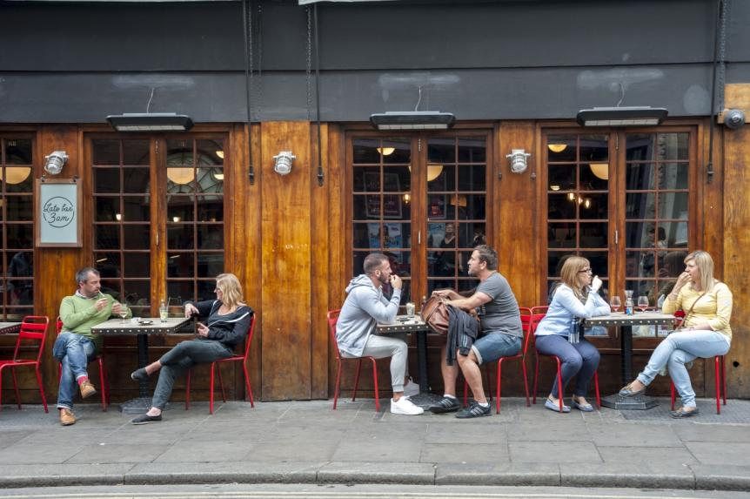
Afternoon Drinks © Tomer Gat

Slide 6
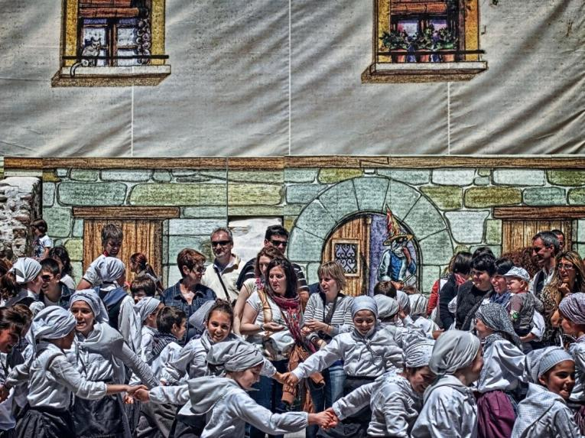
la calle © Angel Benito Zapata

Slide 7
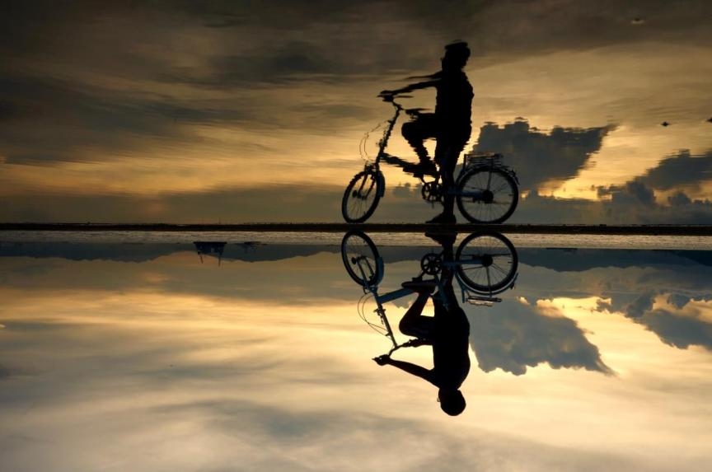
The promise © Belinda Jiao

Slide 8
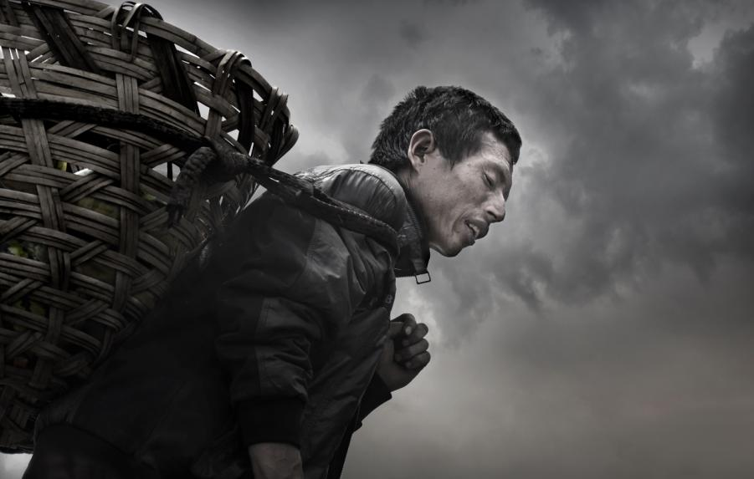
生活 © 兰 利军

Slide 9
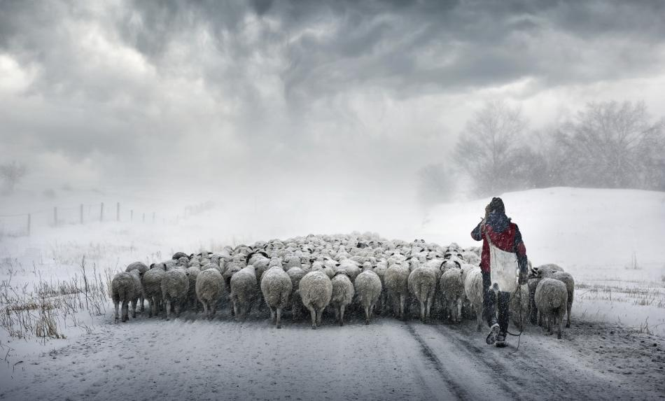
牧归风雪中 © 兰 利军

Slide 10
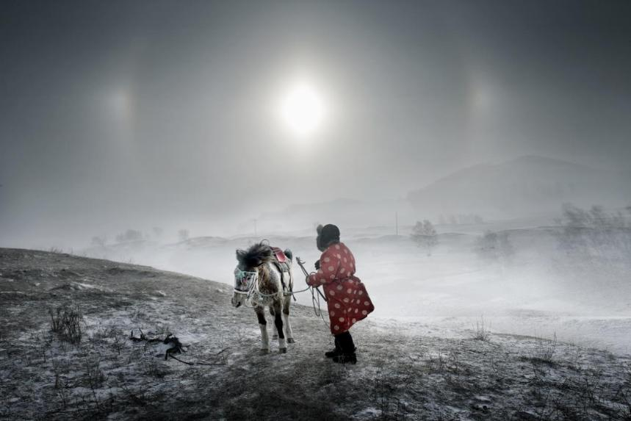
冬日 © 兰 利军

Slide 11
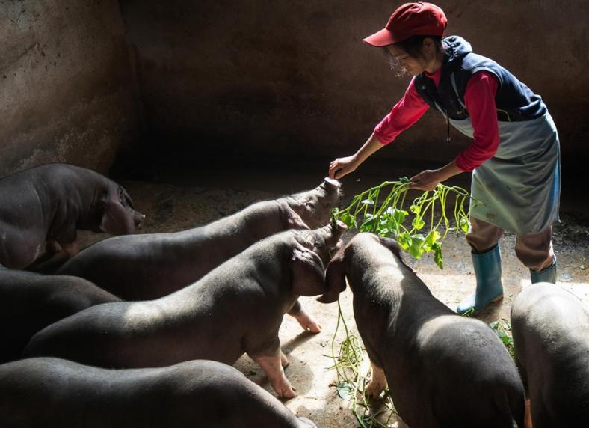
小猪乖乖 © 初 爱民

Slide 12
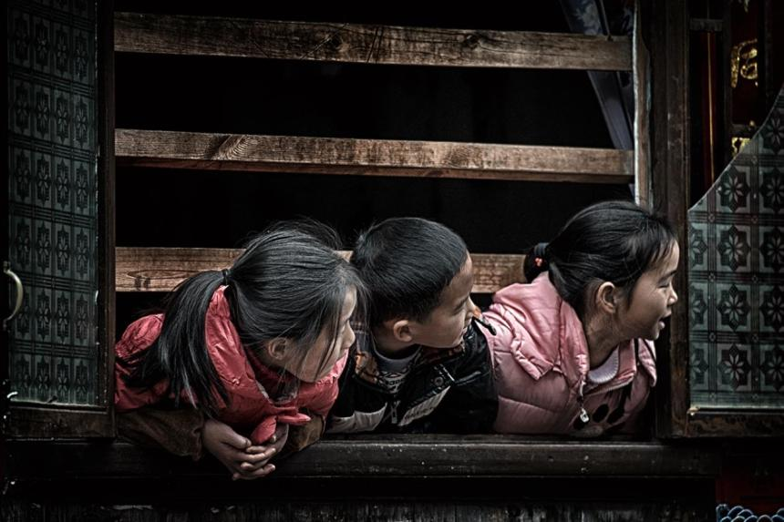
外面的世界 © 陈 强

Slide 13
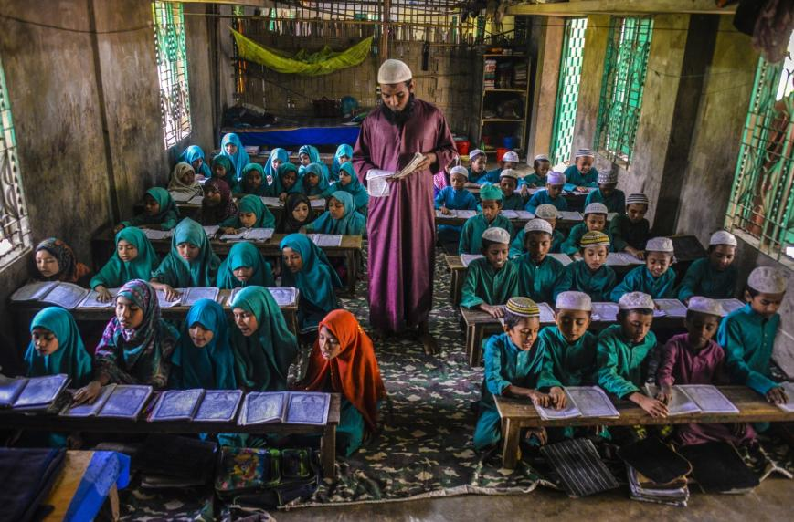
Creating the Future © mohammad uddin

Slide 14
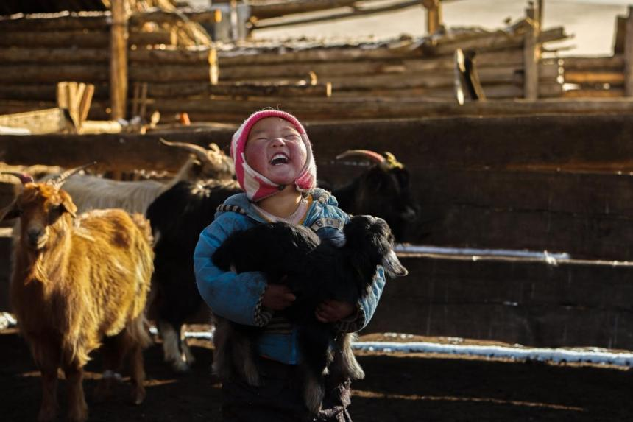
A nomadic kid © BATZORIG Badarch

Slide 15
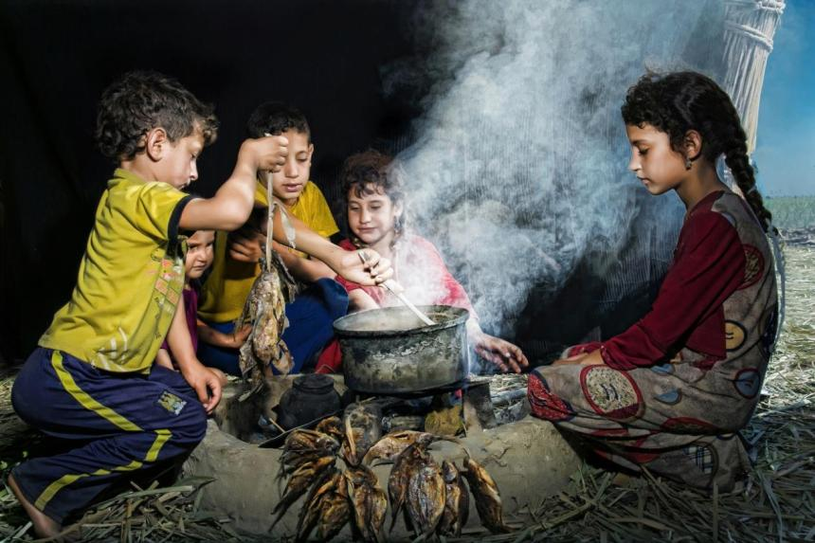
The challenge of living © taisir ktheir

Slide 16
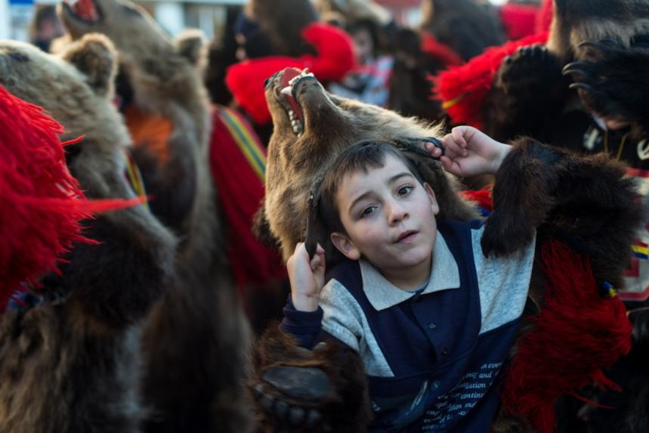
Bear dancer © Corneliu Cazacu

Slide 17
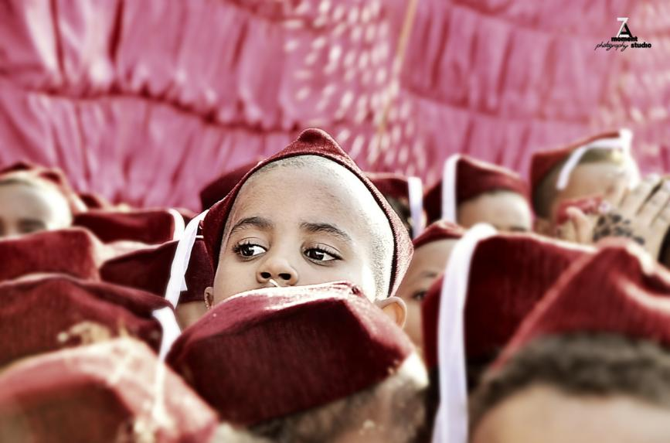
Curiosity © Elhassan Hassan

Slide 18
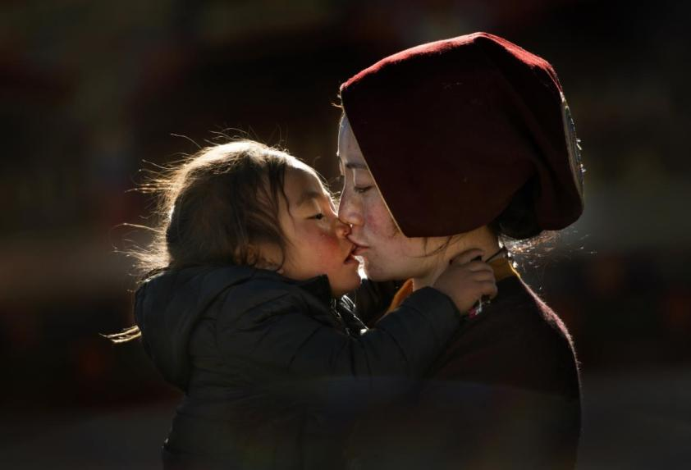
妈妈的吻 © 黄 恒日

Slide 19
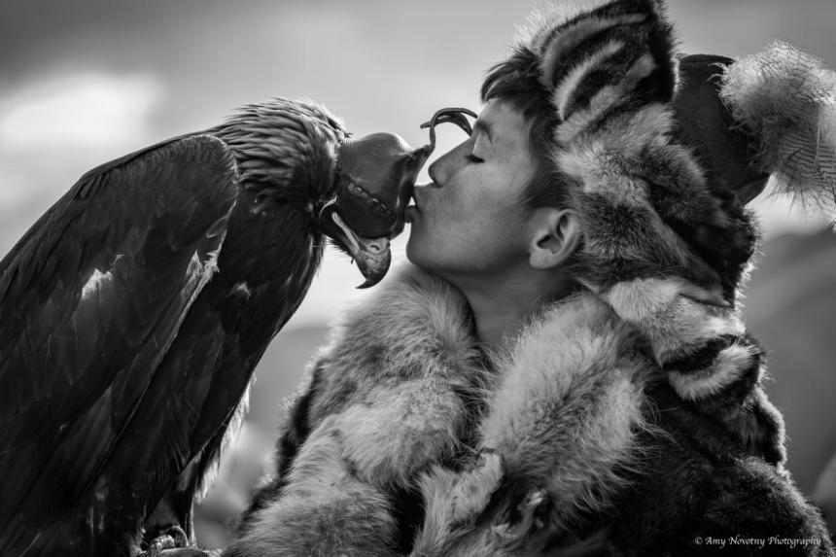
Celebrate with a Kiss © Amy Novotny

Slide 20
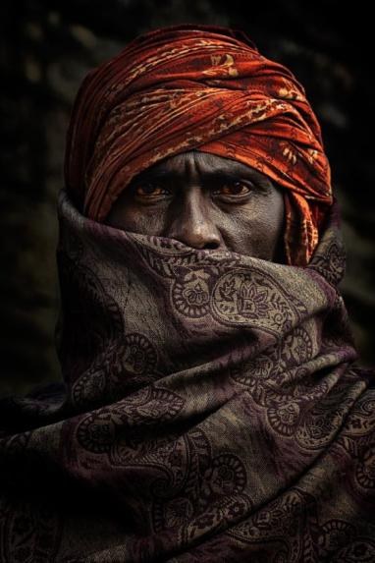
The red eyes © Shibasish Saha

Slide 21
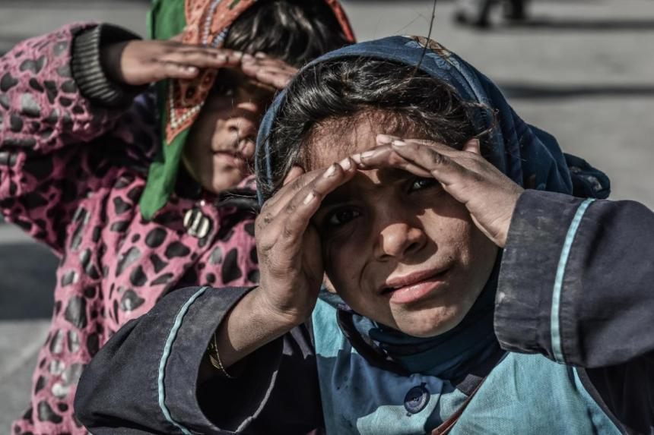
labour children © seyed Mohammad golshahri

Slide 22
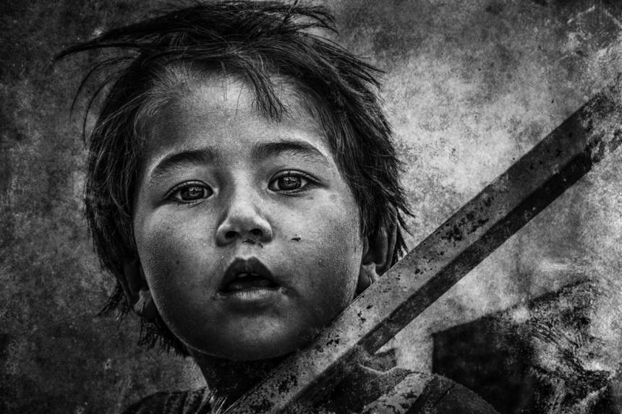
Mystery © ali vajdi

Slide 23
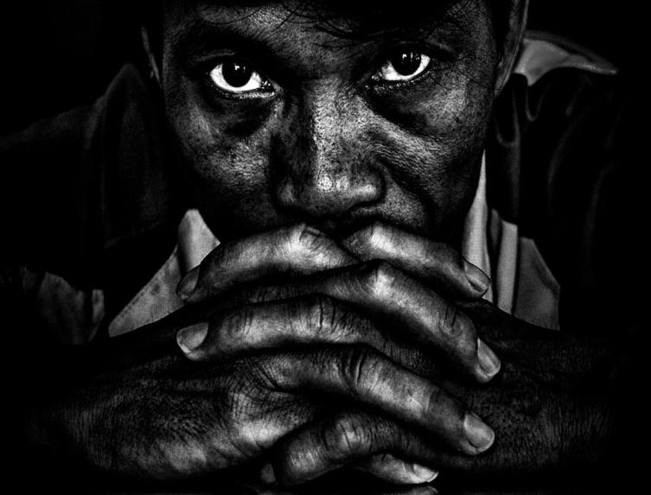
My anniversary © NGUYEN XUAN HUU TAM

Slide 24
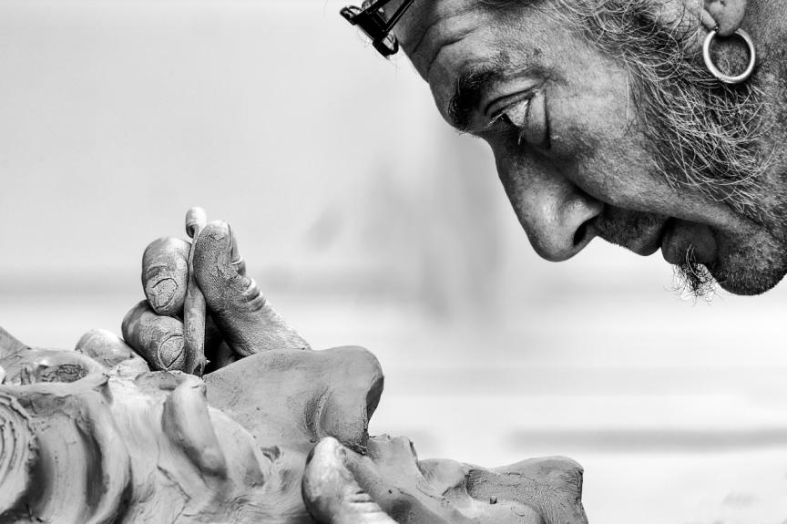
Nascent © Zoltán Nemes

Slide 25
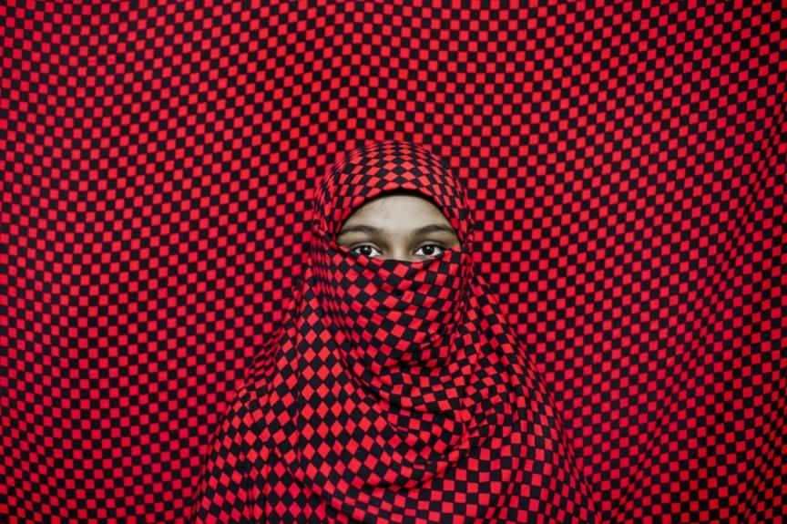
Hijabi Girl © K Asad

Slide 26
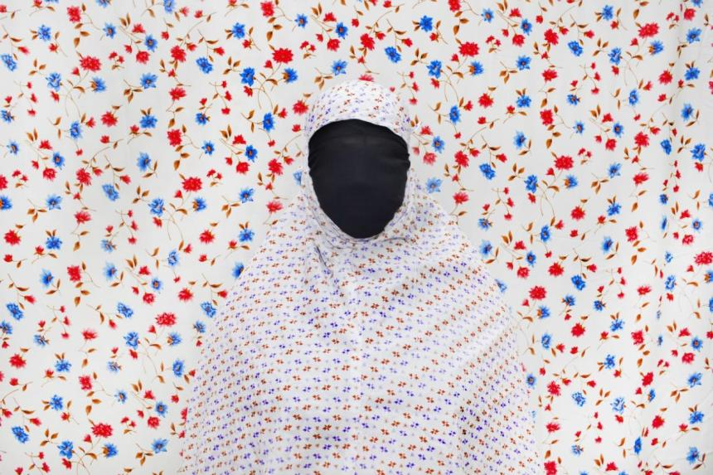
Hijabi woman © K Asad

Slide 27
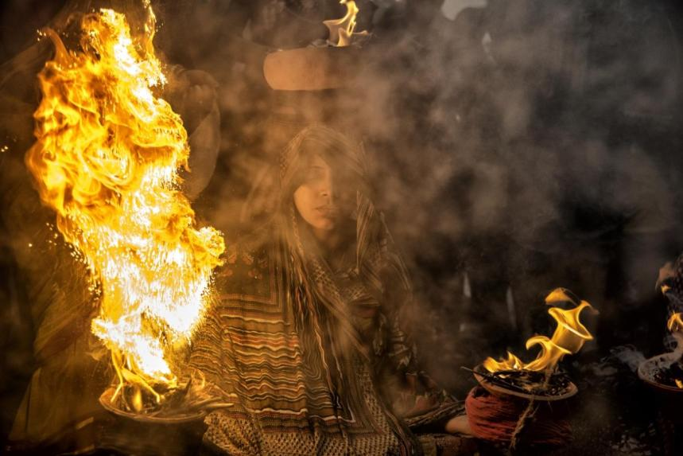
Fire Women © Abir Chaudhury

Slide 28
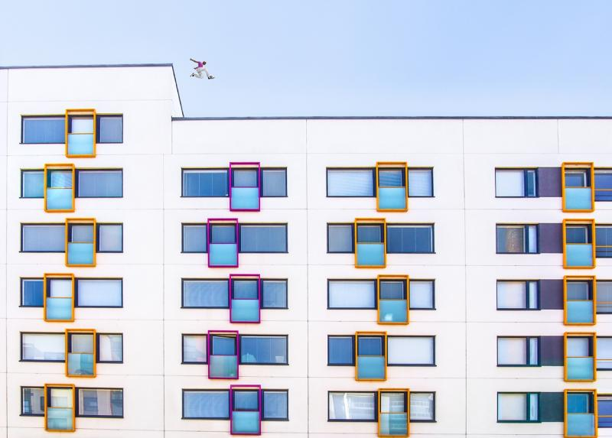
Jump! © Virve Nyyssönen

Slide 29
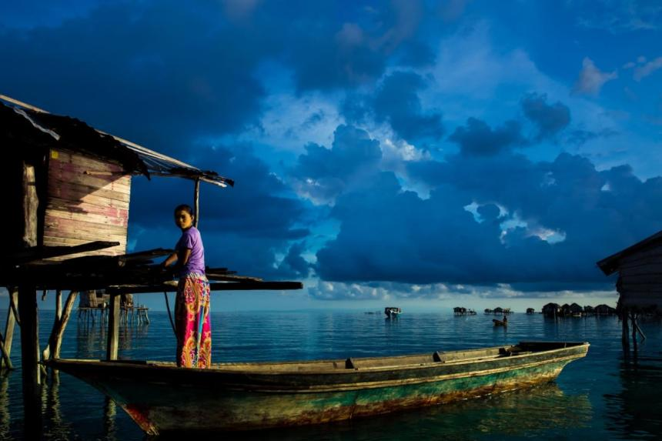
巴瑶族的女人 © 毕 辉

Slide 30
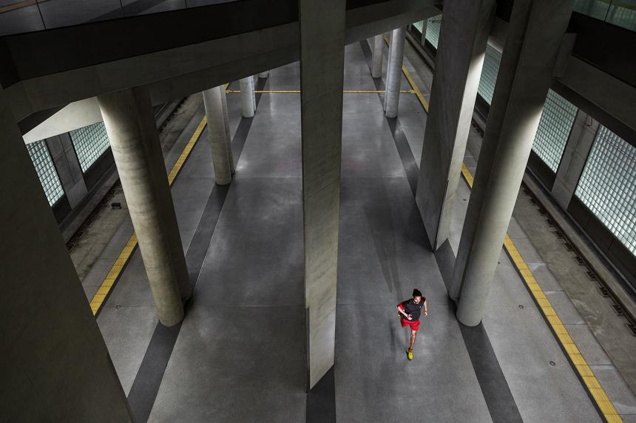
urban running © Jan Fassbender

Slide 31
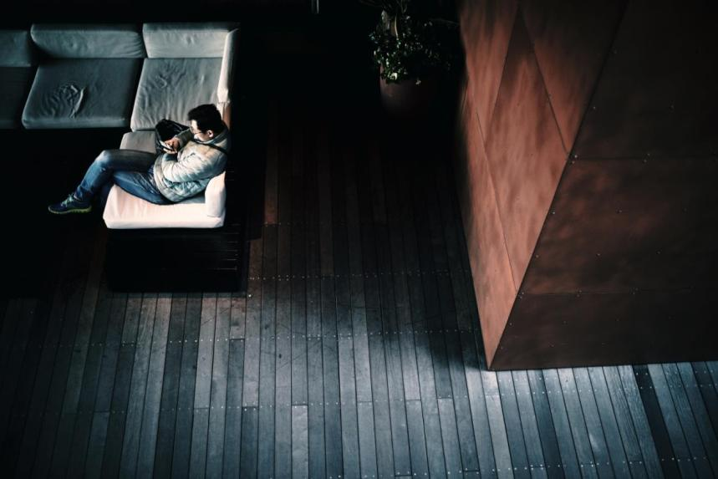
No Mobile, No Life © 布川 正浩

Slide 32
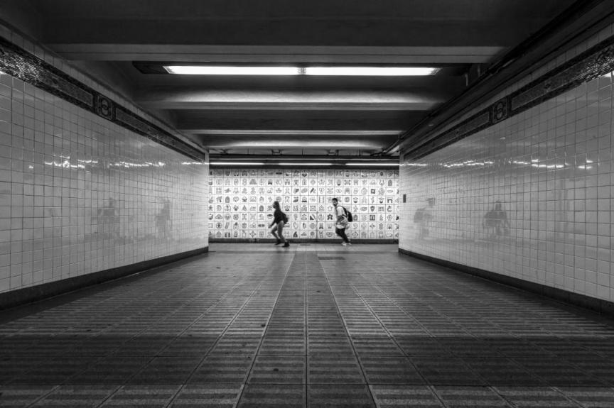
Running through time © Chen Jianfeng

Slide 33
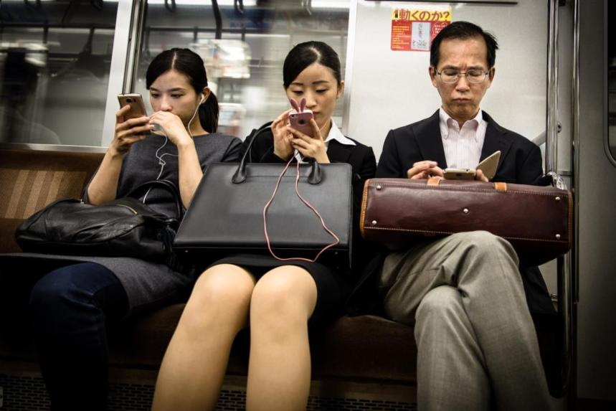
Plugged In © Antoine Bruneau

Slide 34
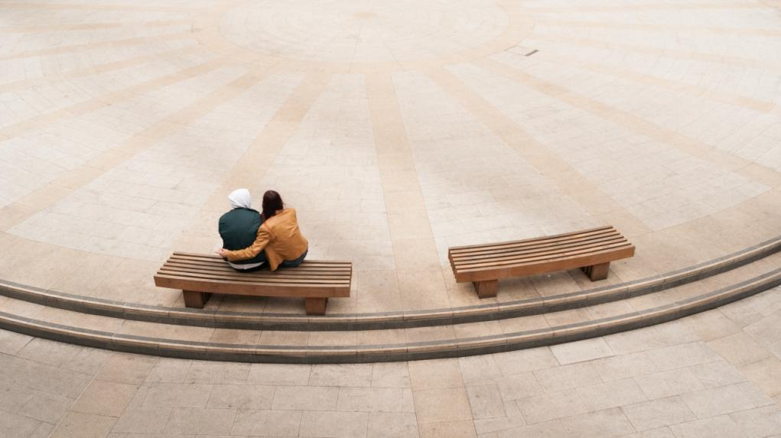
The World is Our Oyster © peter murrell

Slide 35
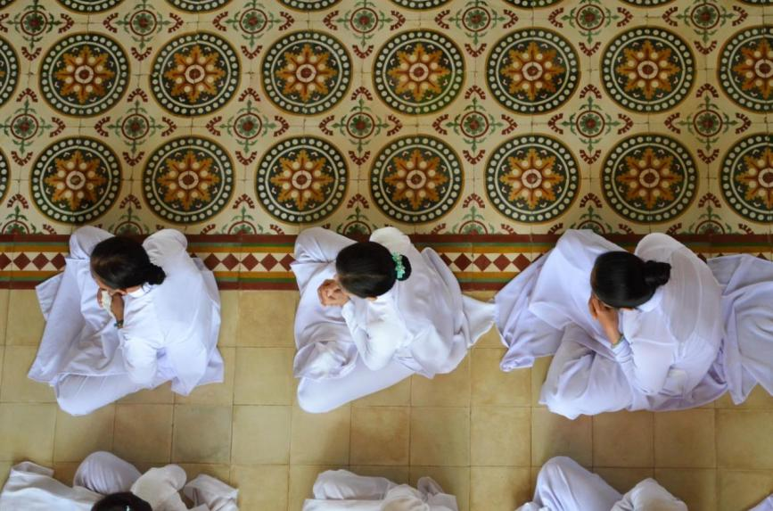
Celebration in Cao Dai Temple
© MONICA GOTTA

Slide 36
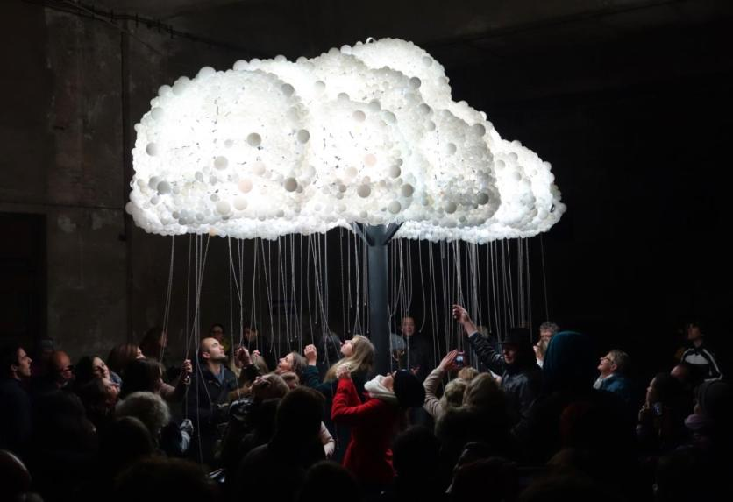
First Contact Fantasy © Ronald Jongeneel

Slide 37
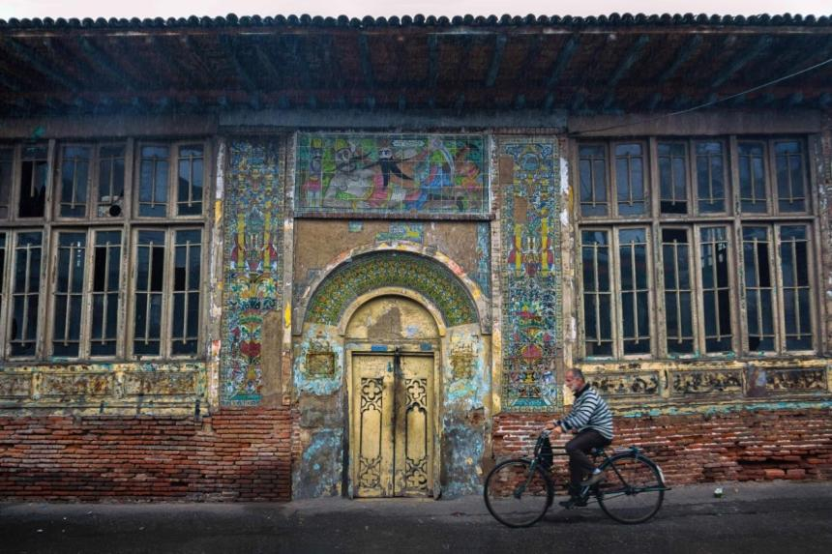
Pass © Nazi Mortazkhoo

Slide 38
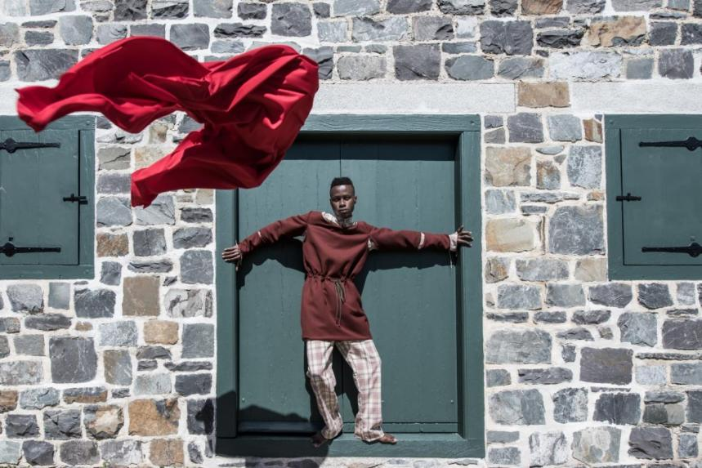
Pembera (celebration) © Micha Serraf

Slide 39
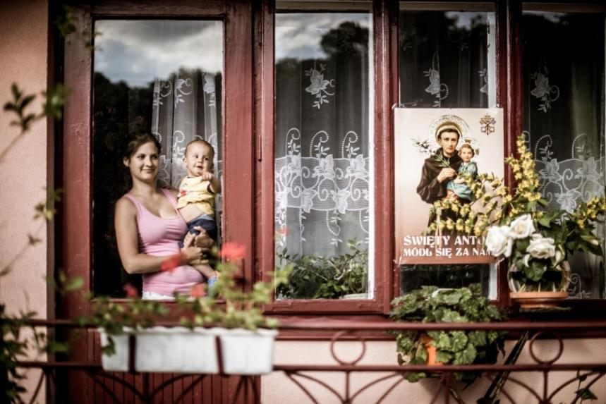
Sw. Antoni © Andrzej Mikulski

Slide 40
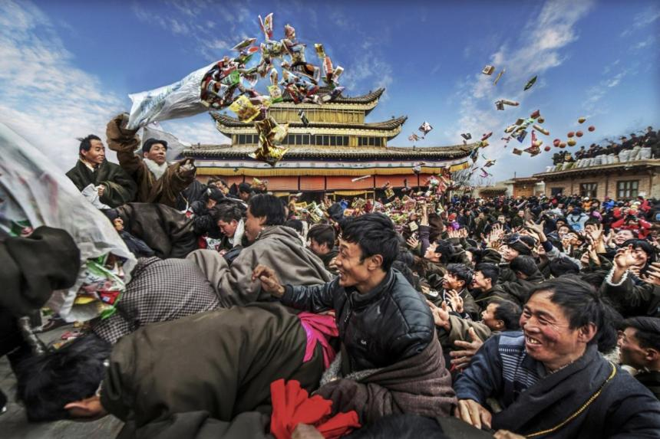
欢庆新年 © 黄 德文

Slide 41
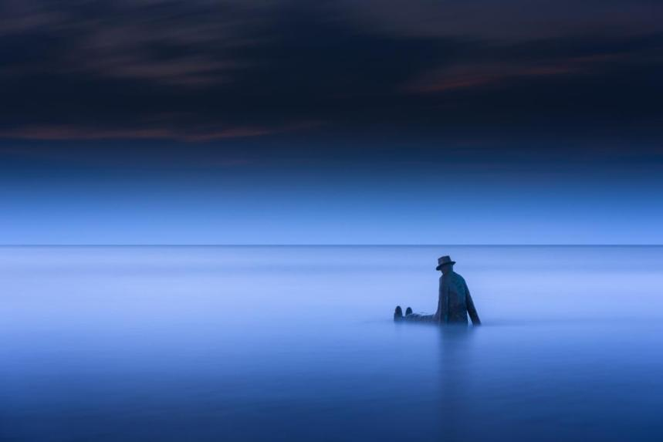
The Sea, the great sculptor © Daniel Vanlandschoot

Slide 42
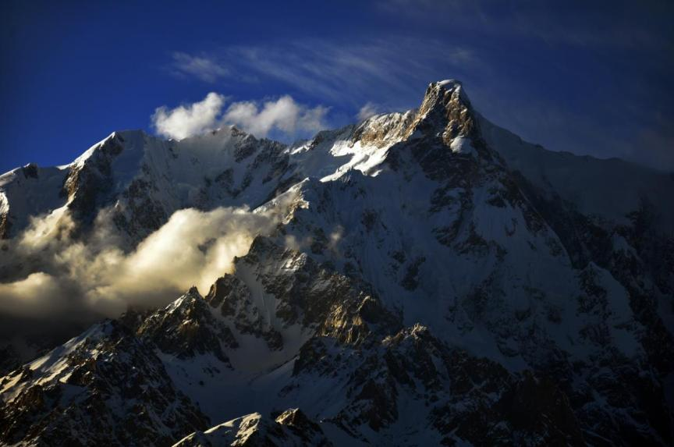
Majestic view of Shaltar peak © Furqan LW

Slide 43
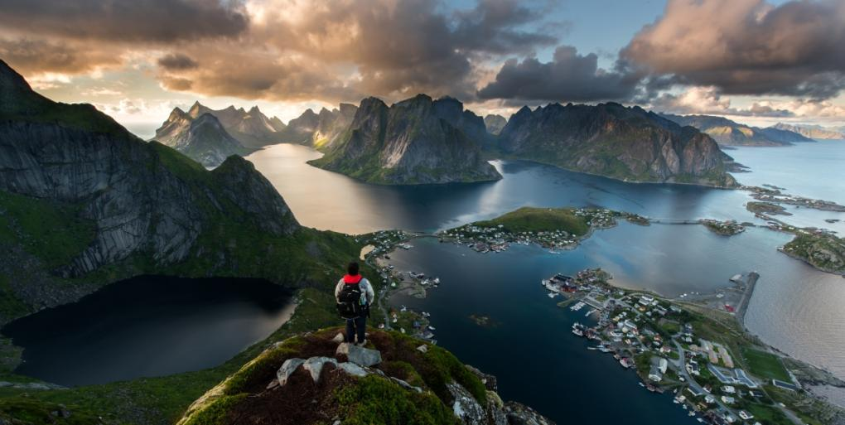
众神之巅 © 雷 雨尧

Slide 44
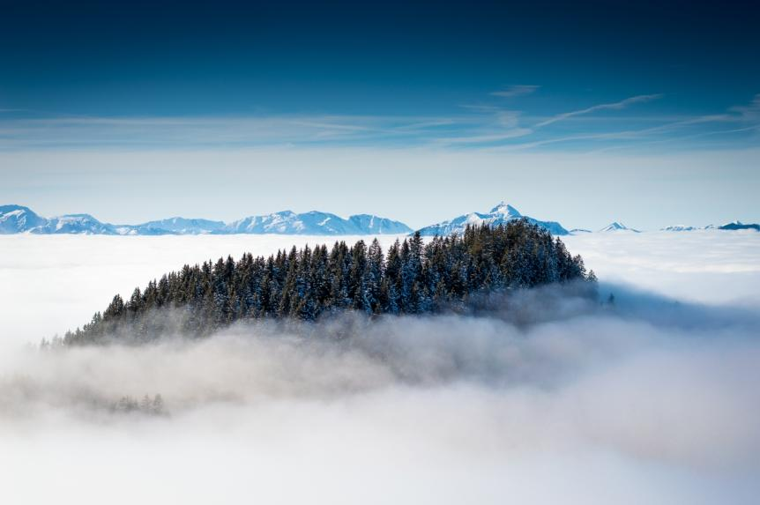
Floating Island © Koen Rijn

Slide 45
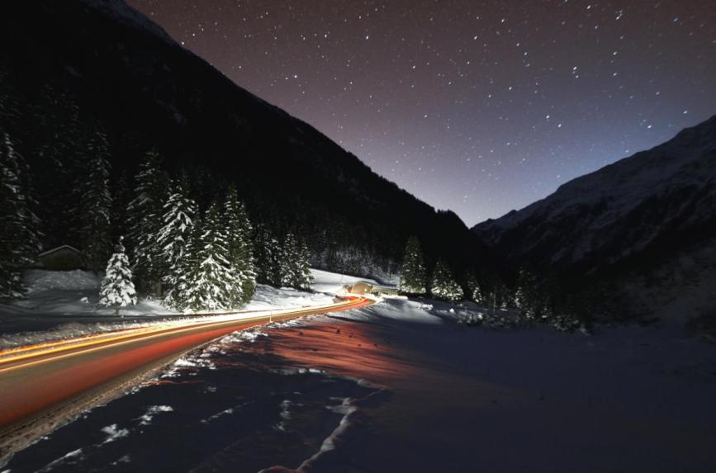
Starry night © Florian Steiner

Slide 46
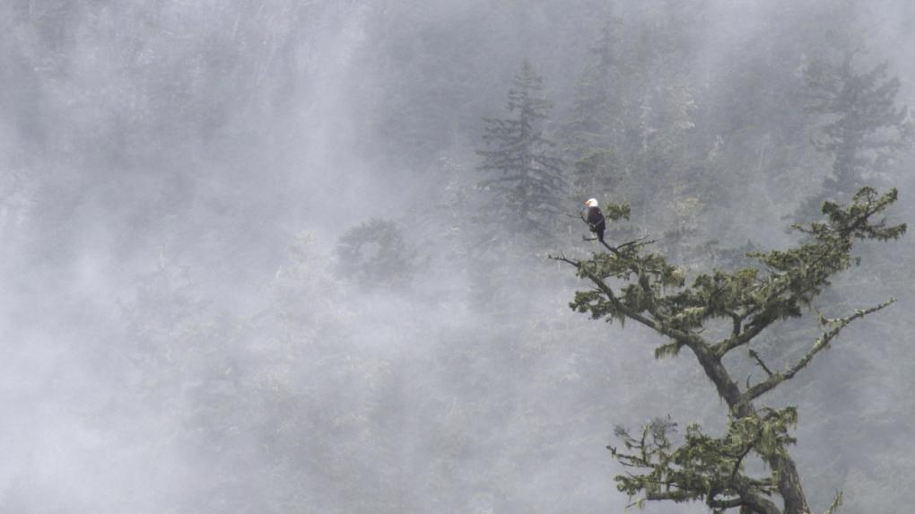
Águila en la bruma © Gerardo Adame

Slide 47
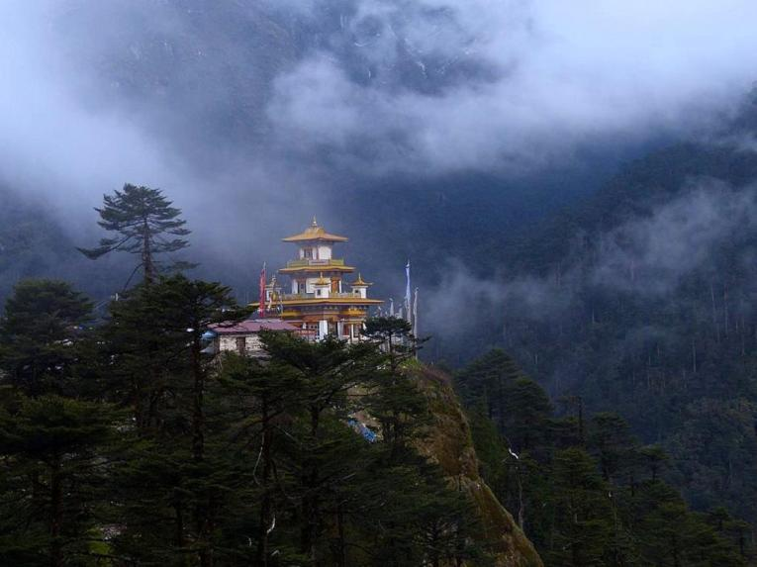
Blue Mountains © Omkar Vats

Slide 48
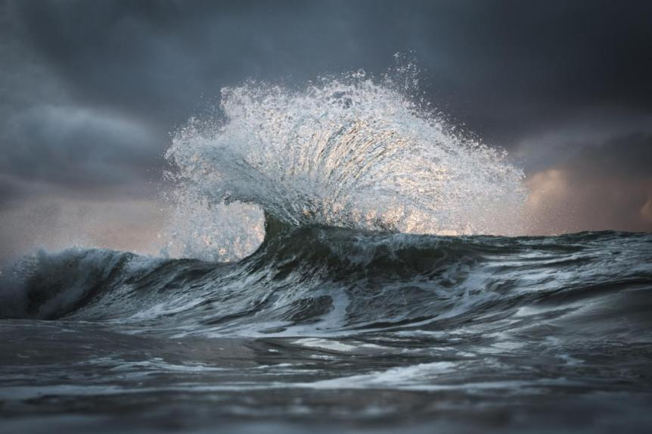
Medusa © Jack Davis

Slide 49
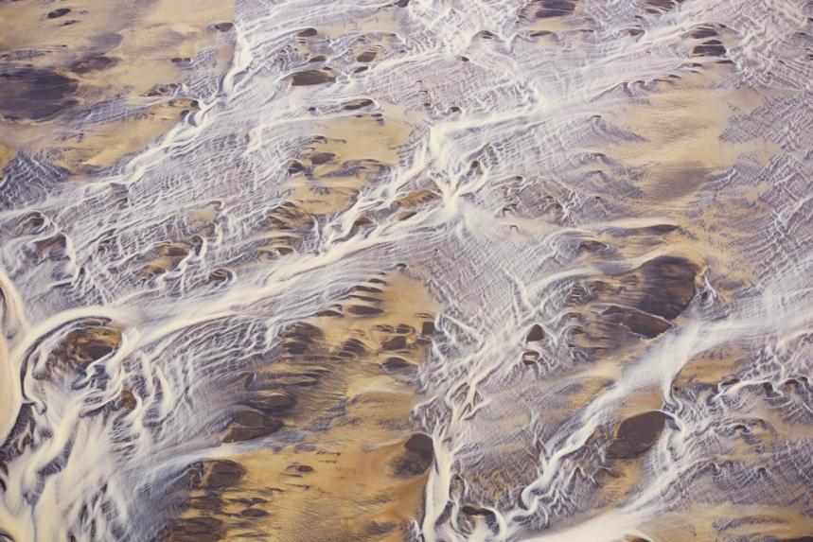
Earth's patterns and colors © Jassen Todorov

Slide 50
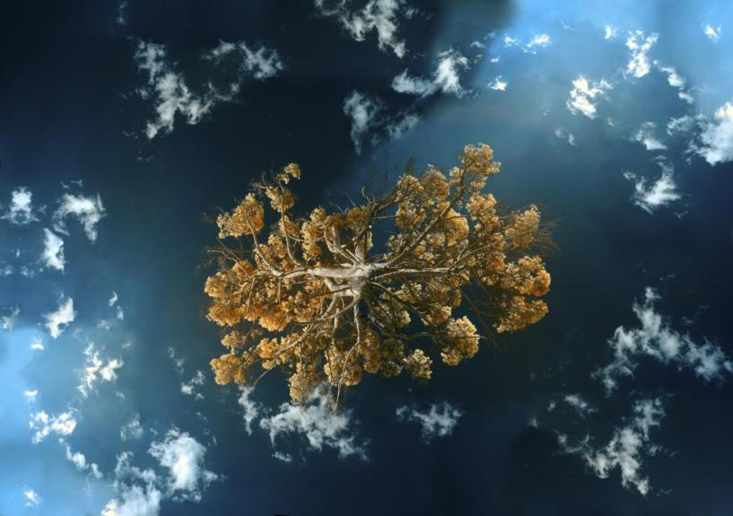
Sky © simone Pollastrini

Slide 51

Nika © Yuri Pritisk

Slide 52

氷壁 © 亀崎 良平

Slide 53

cloud © 坂井 英明

Slide 54

港都之美 © 東河 王

Slide 55

Training Racehorses © fiqman sunandar

Slide 56

動物之間的愛 © 陳 浡濬

Slide 57

Dancing in the last light © David Vuong

Slide 58

Female Horsefly © Radford Geraint

Slide 59

Grass moss © Toan Thanh

Slide 60

June 11, 2017 王文堯 Kaohsiung Taiwan R.O.C
All photos were taken from NIKON.
Sound : Kenny Rogers-Twenty Years Ago
Stokkness © Thomas Siegenthaler
THE END

