Slide 1
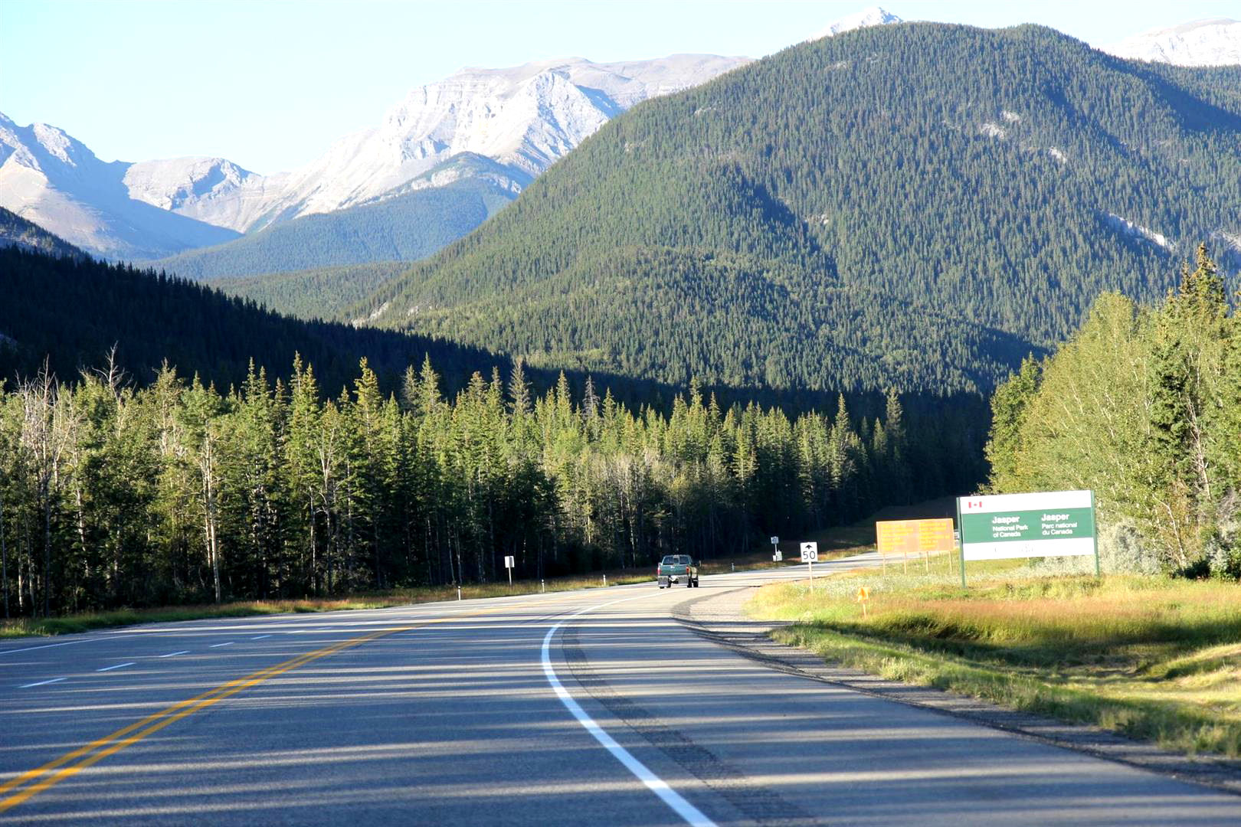
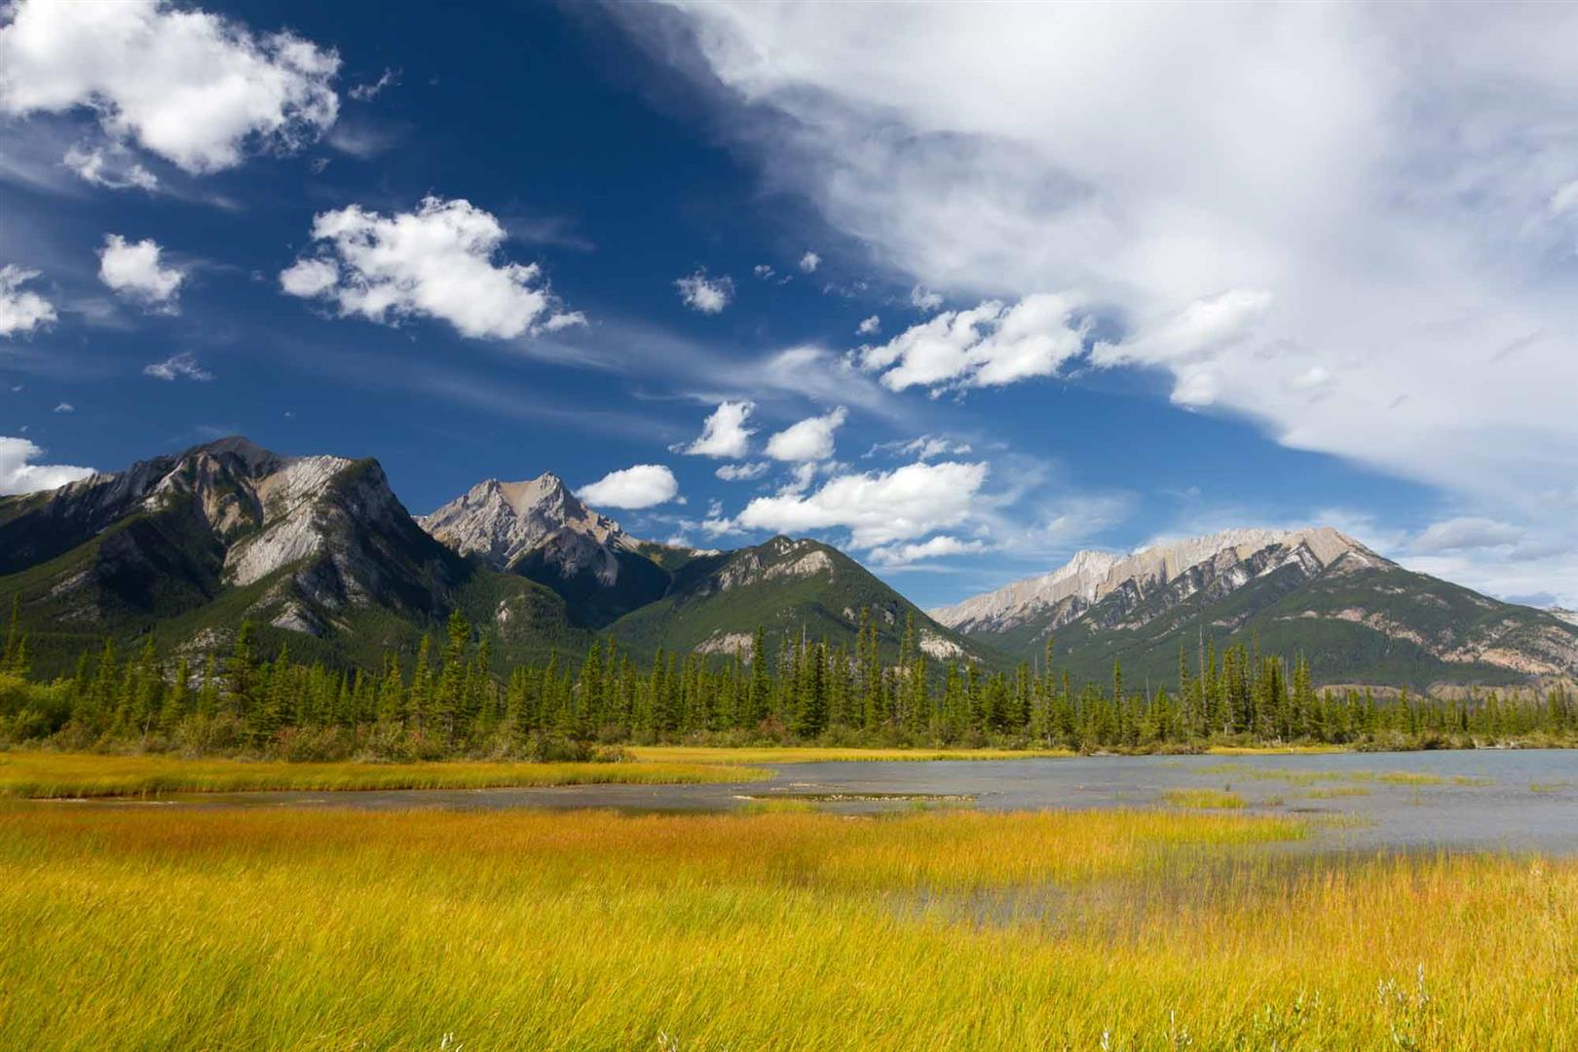
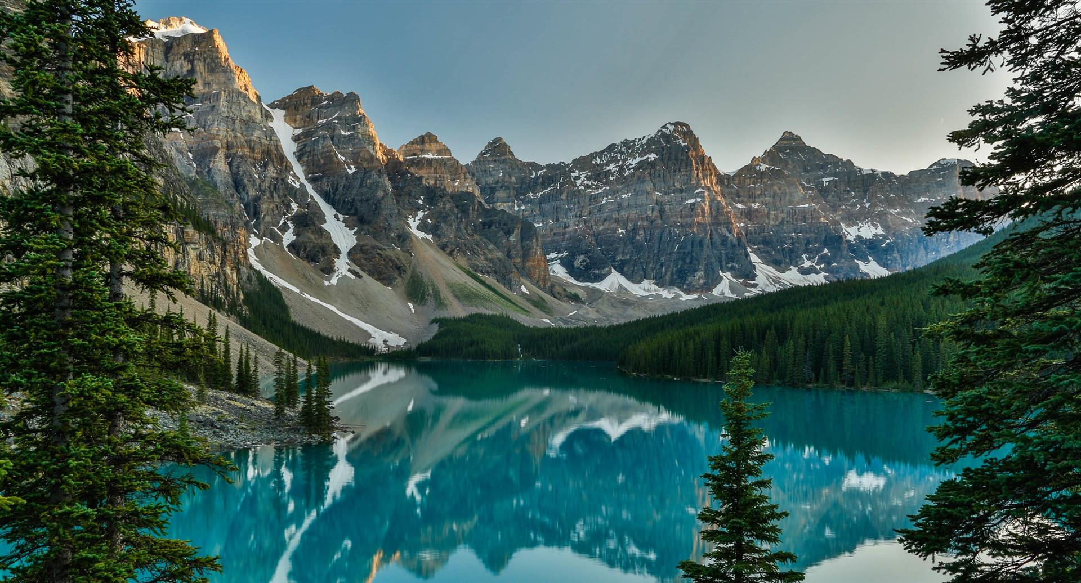
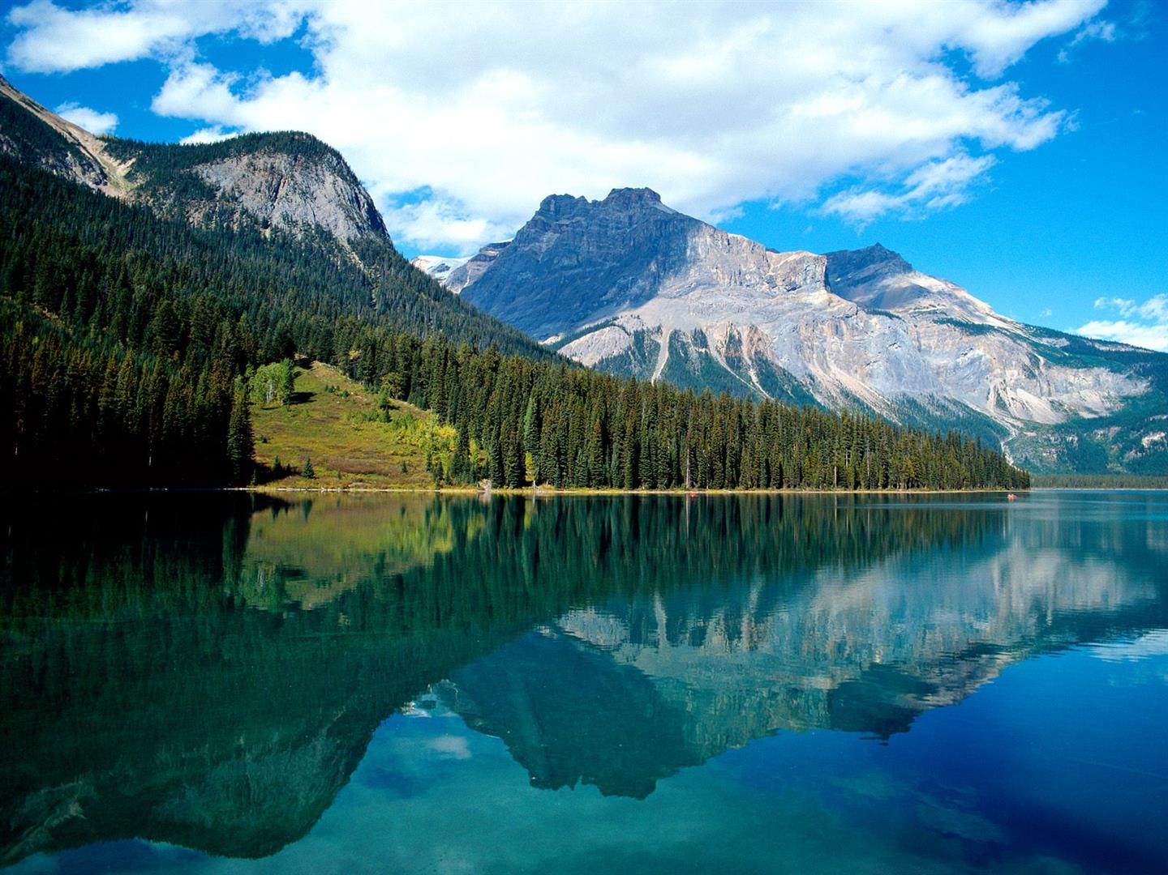

Jasper
National Park
Canada
In the Province
Of Alberta

Slide 2
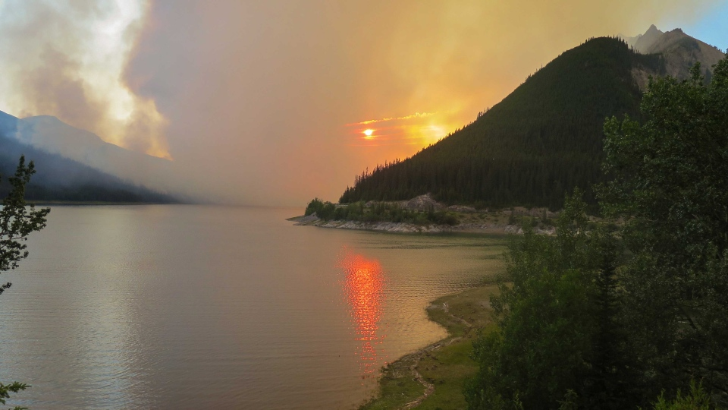
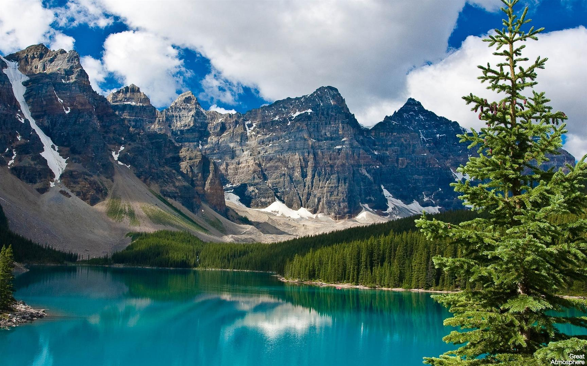
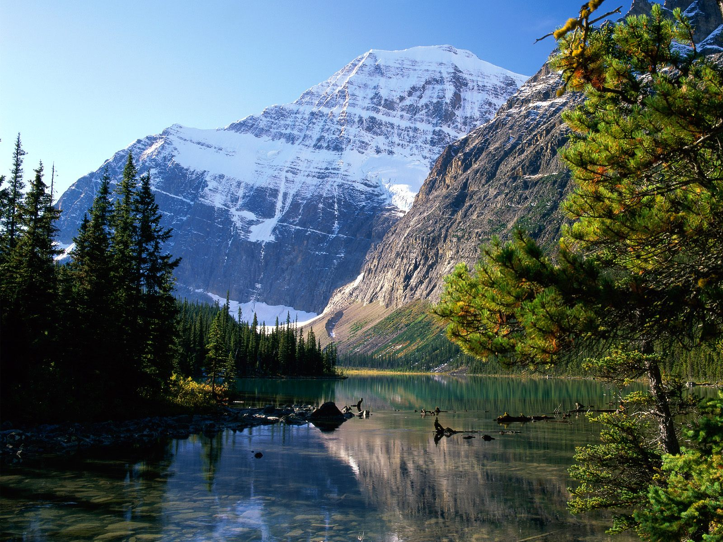

Slide 3
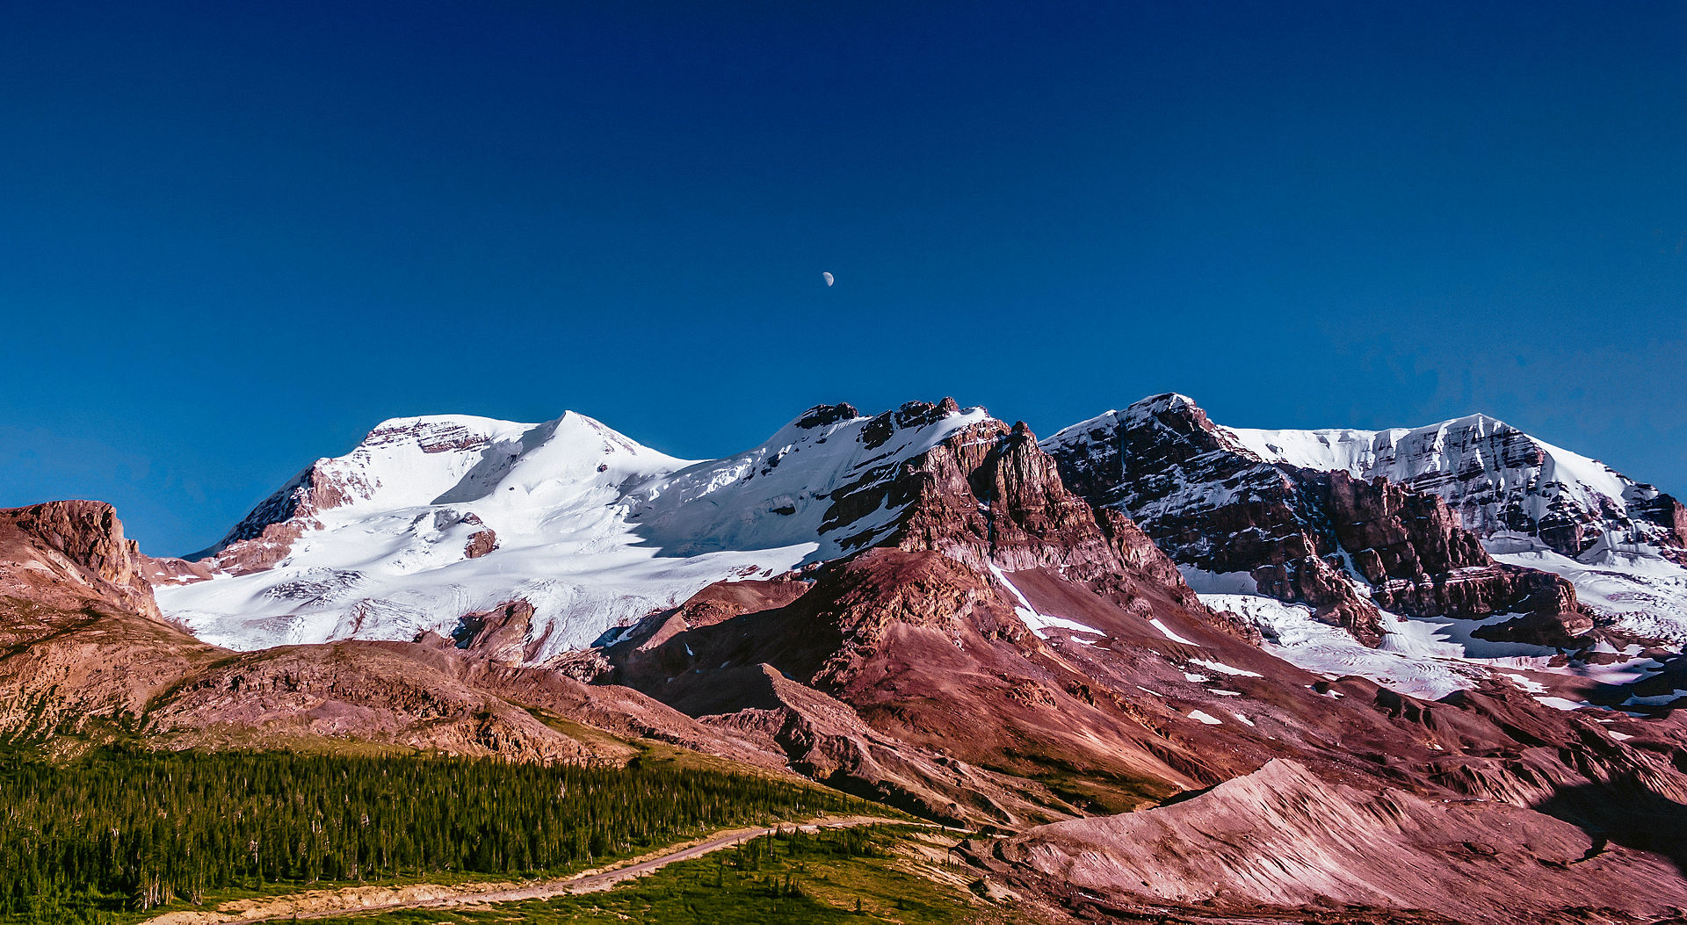
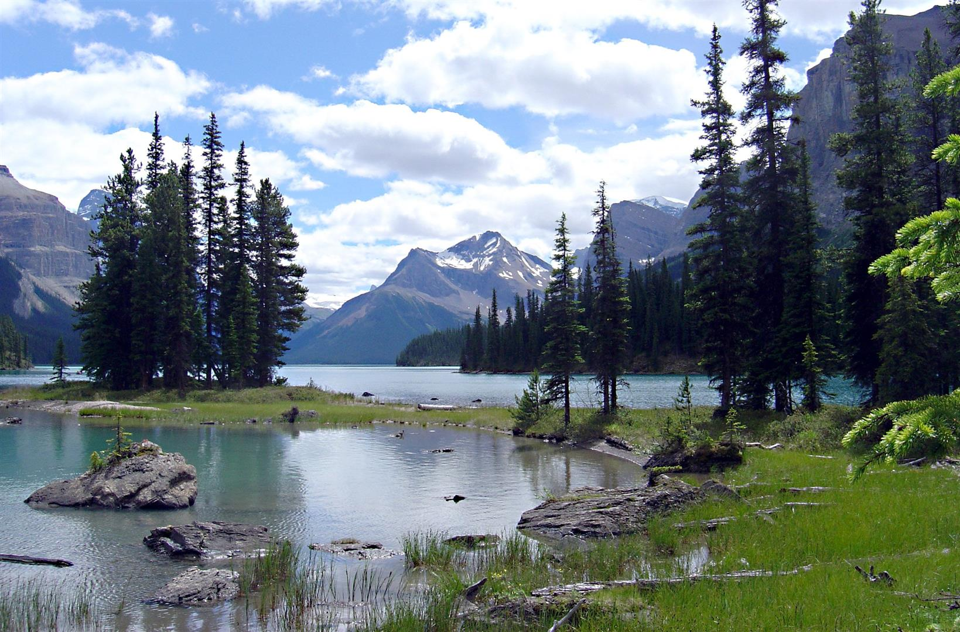
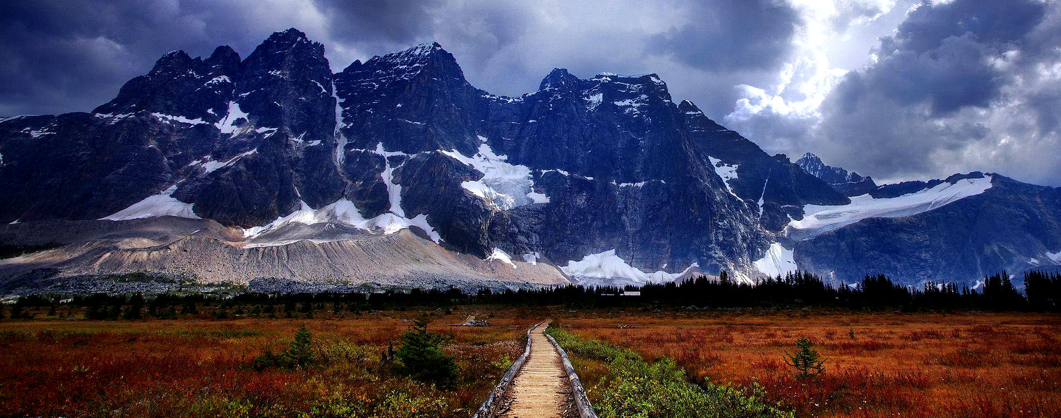
Jasper National Park is the largest National Park in the Canadian Rockies,
Spanning 10,878 km² (4,200 sq mi).
It is located in the province of Alberta, north of Banff National Park and west of Edmonton
The park includes
the Glaciers of the Columbia Ice fields, Hot Springs, Lakes, Waterfalls and Mountains.

Slide 4
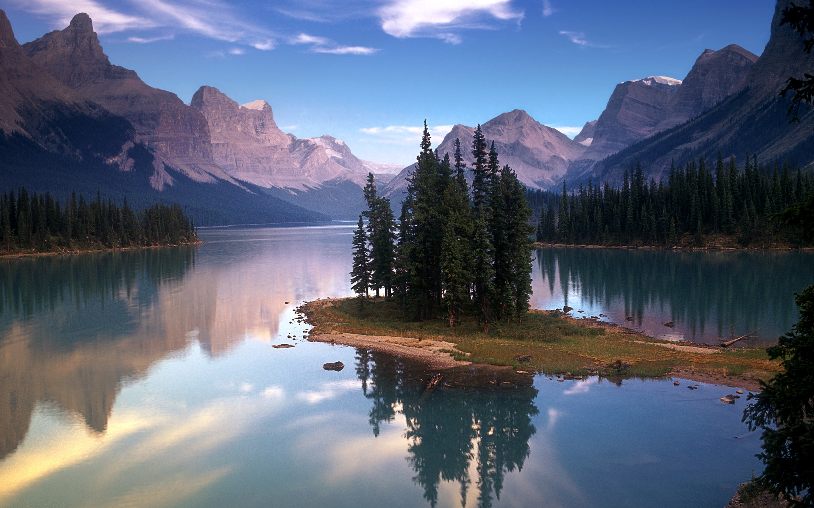
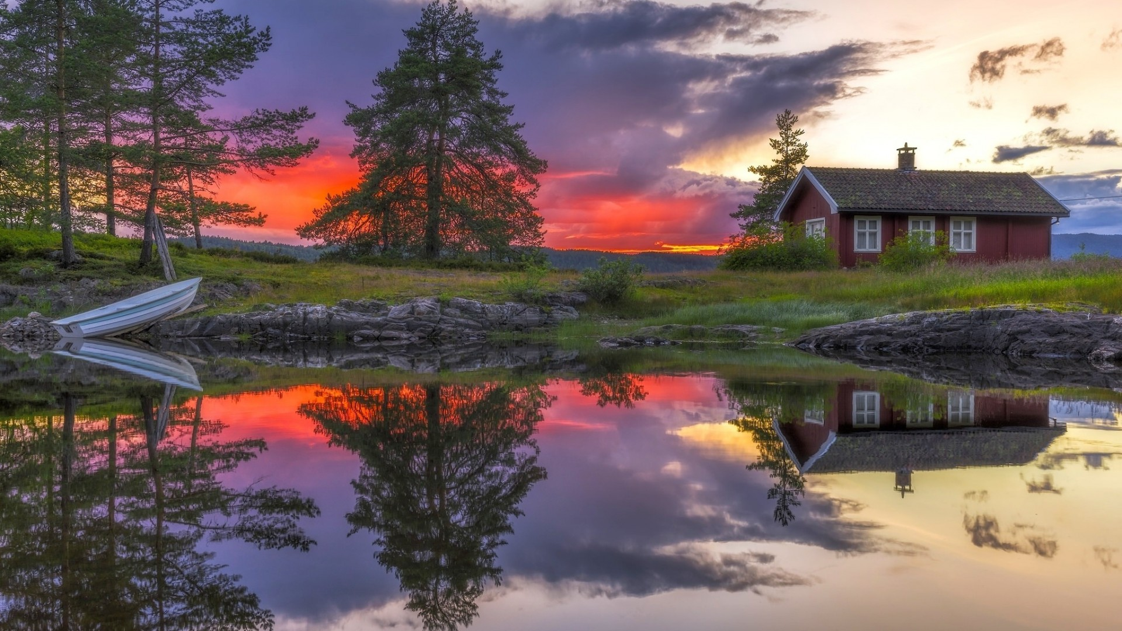
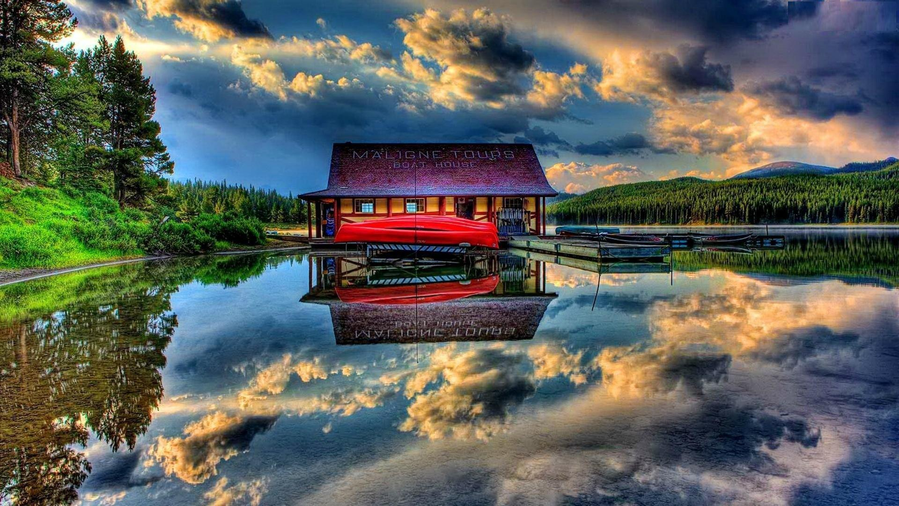

Slide 5
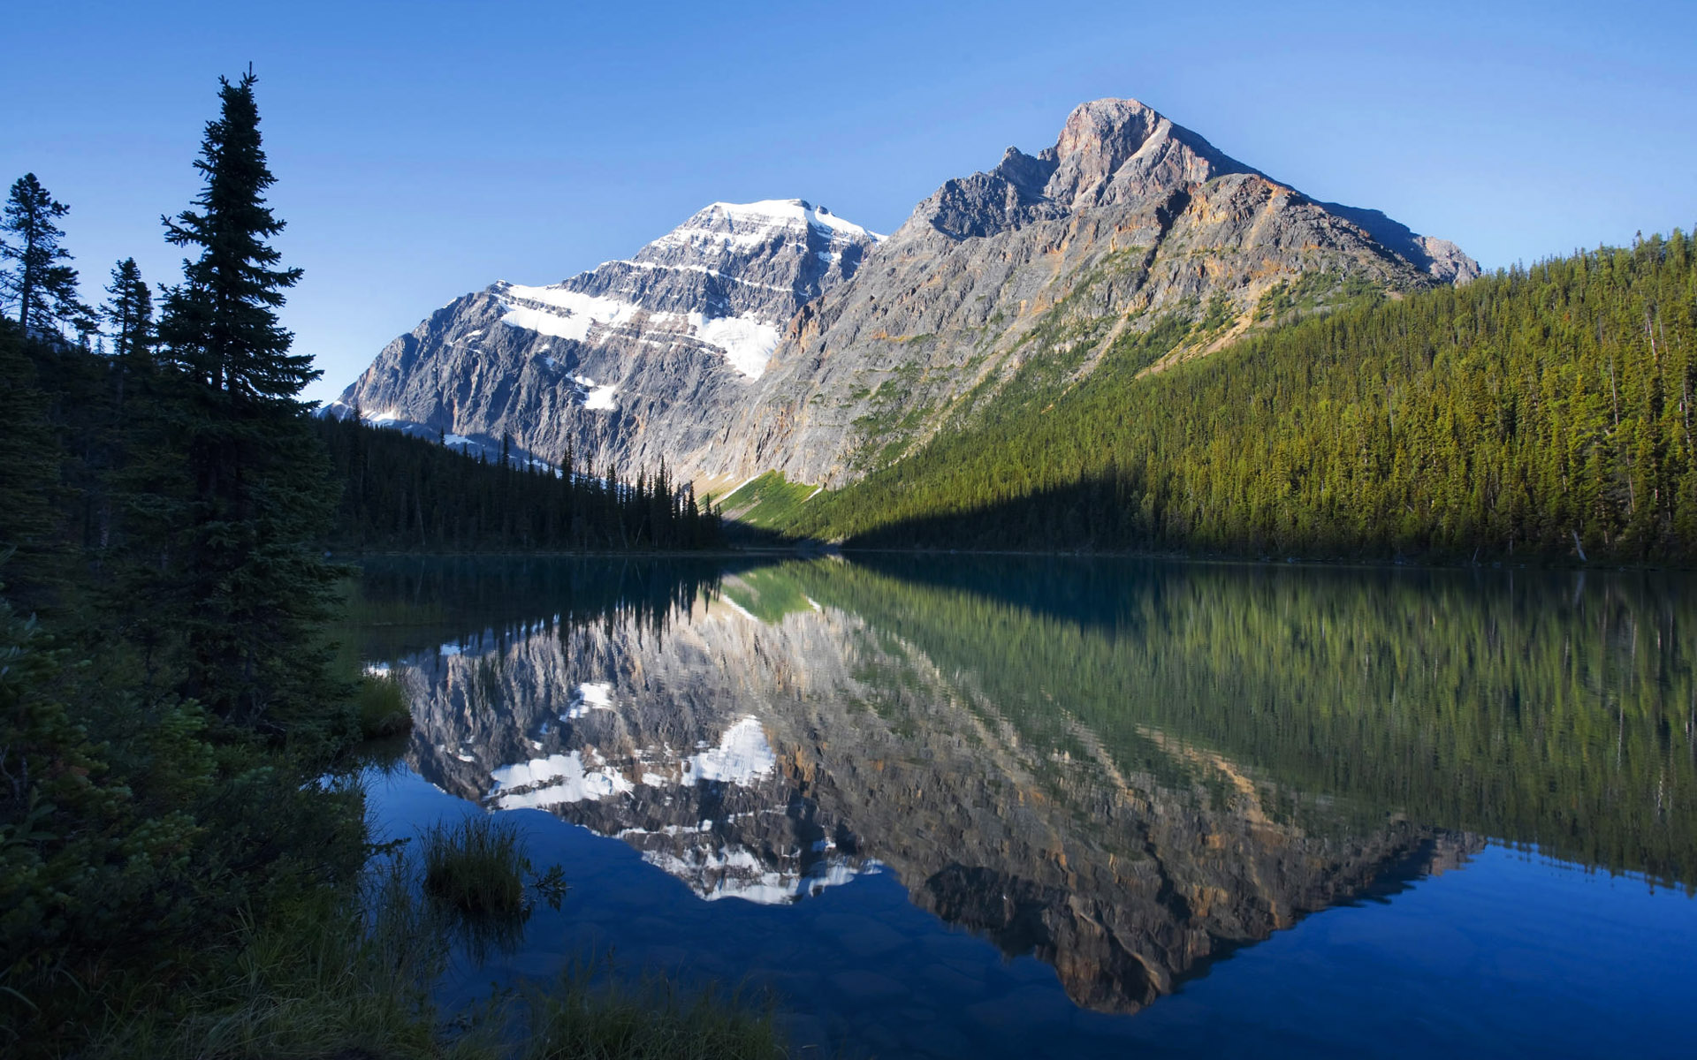
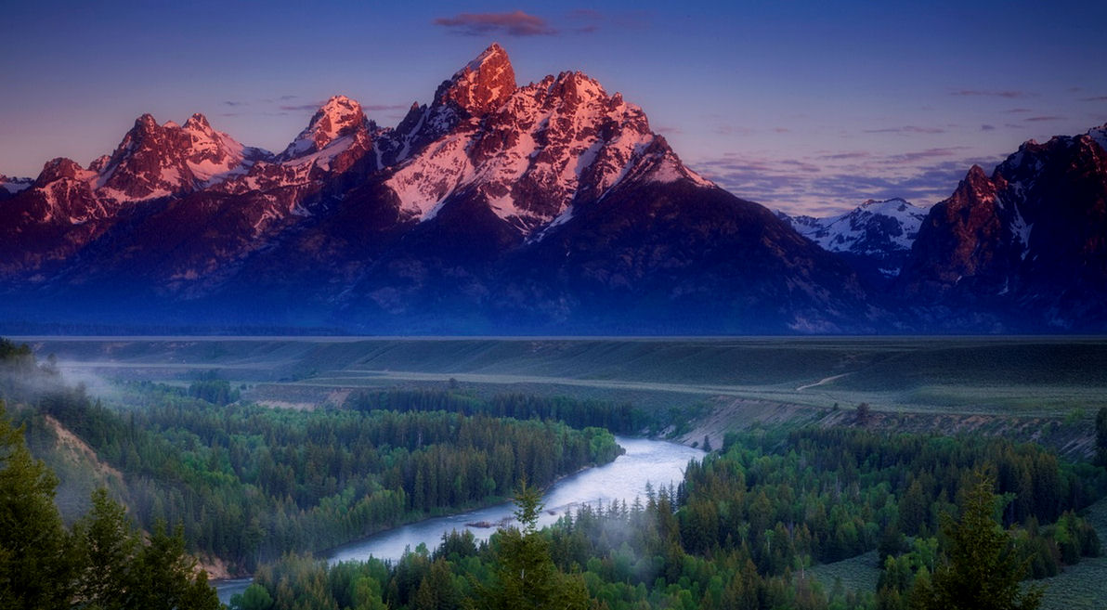
. The park was established on September 14, 1907 as Jasper Forest Park,
and was granted National Park status in 1930.
In 2013 Jasper National Park had 2,022,878 visitors.[

Slide 6
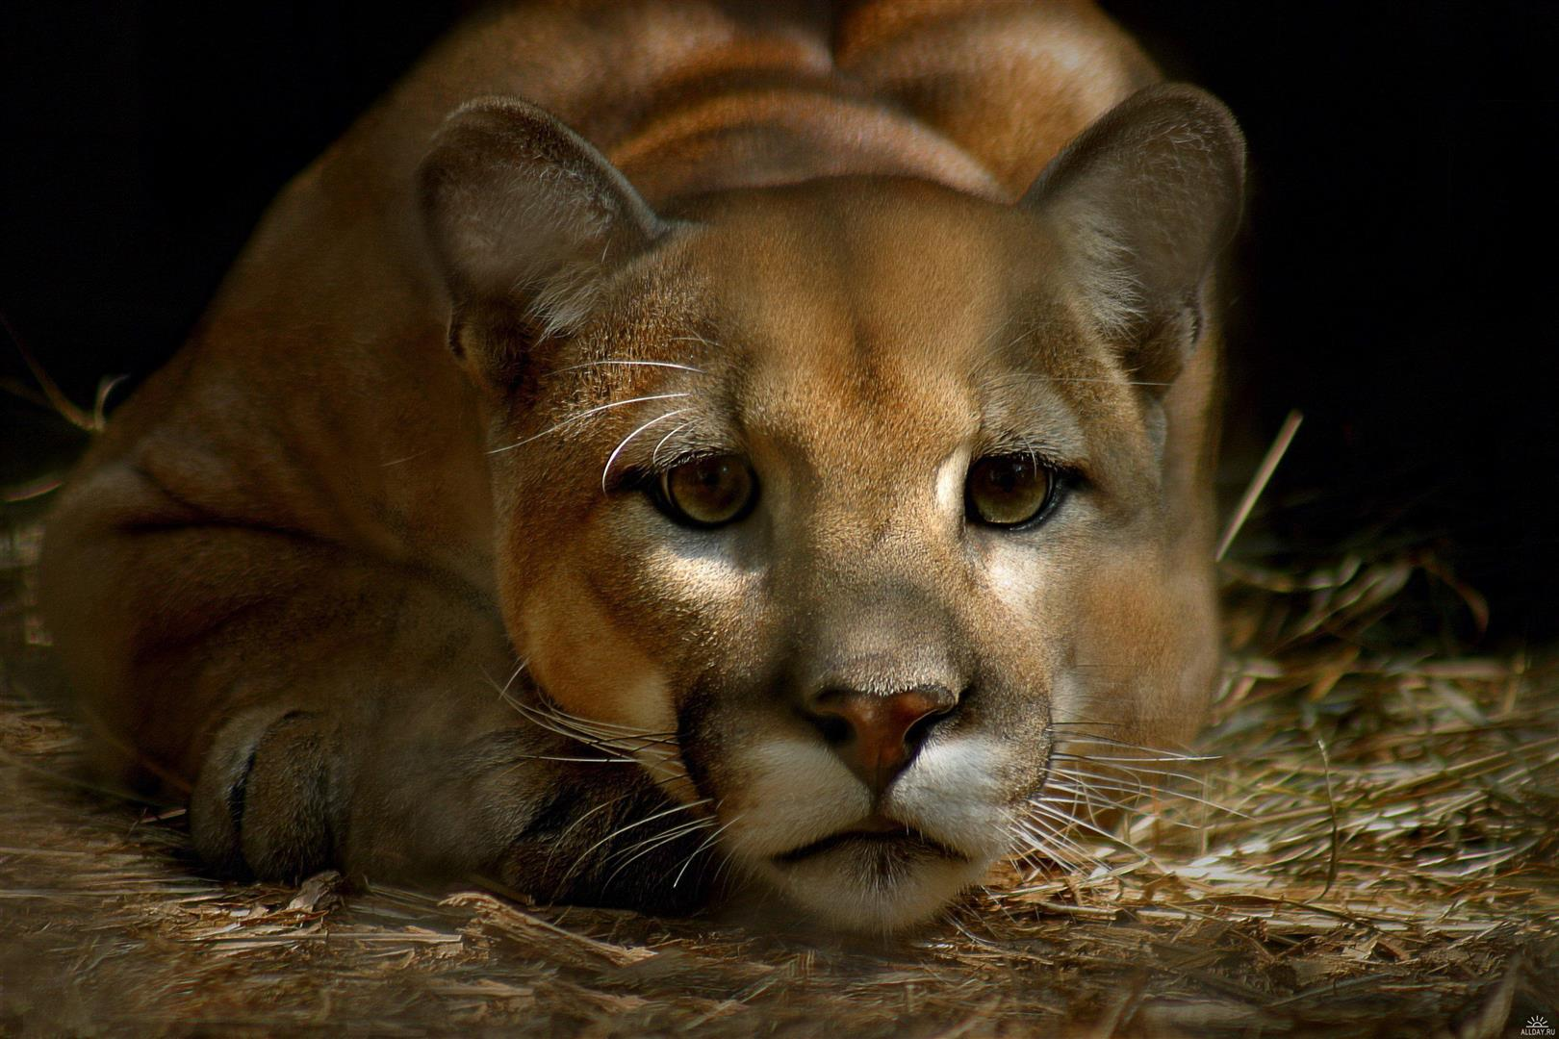
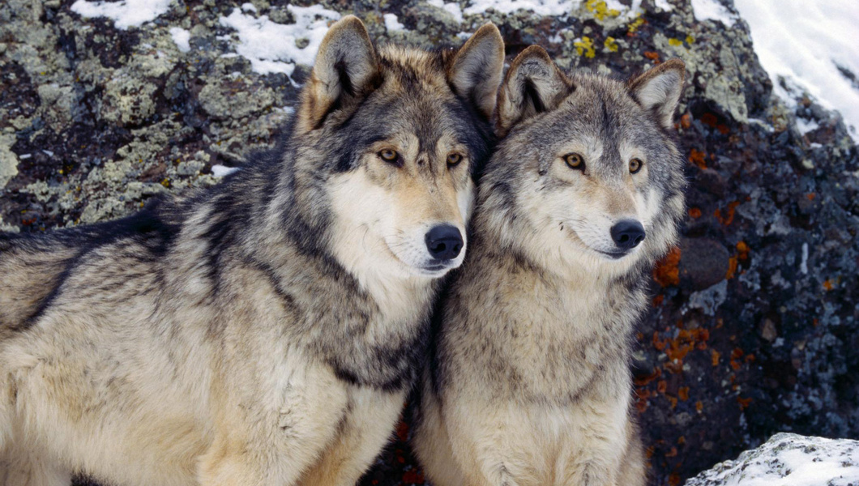
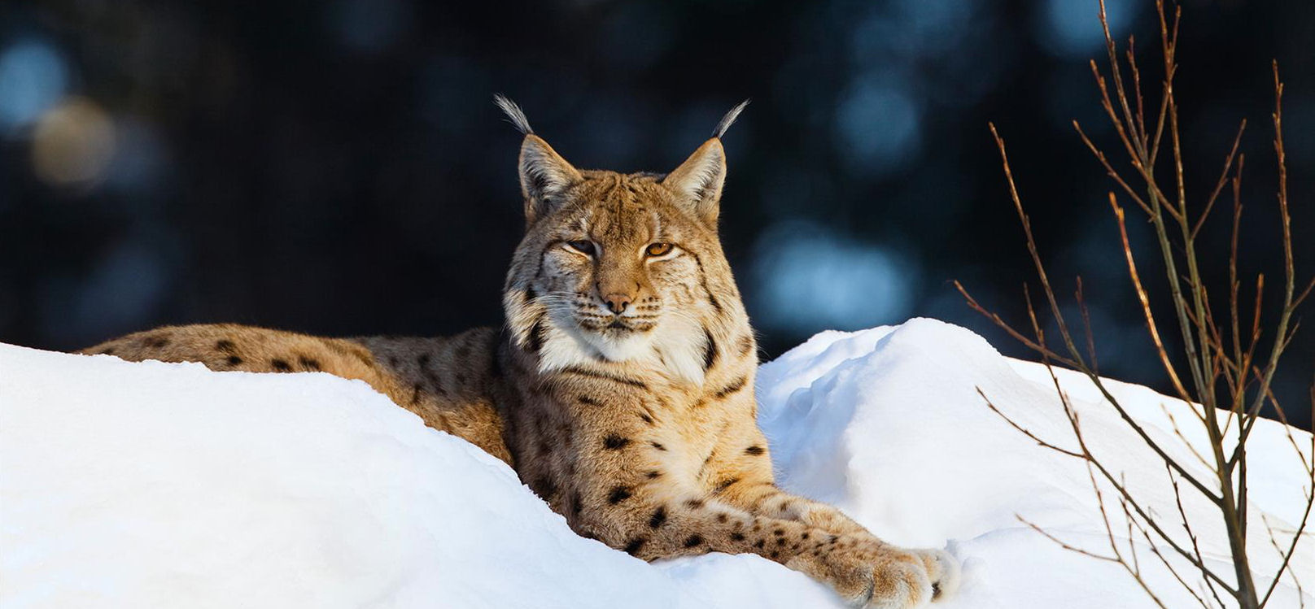
Animals that roam in this park are …
Elk, Caribou, Moose
Lynx
Big Horn Sheep, Grizzly Bears
Coyotes, Beavers, Marmots, Wolves , Cougars
Great horned owls,
Bald Eagles

Slide 7
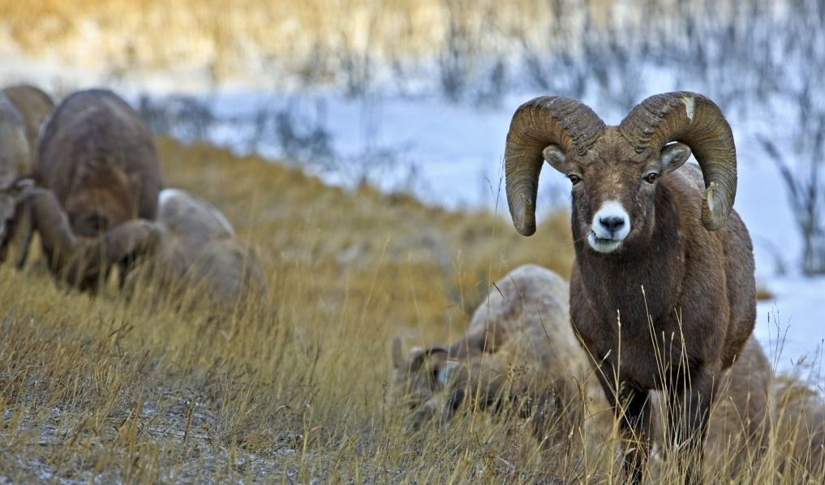
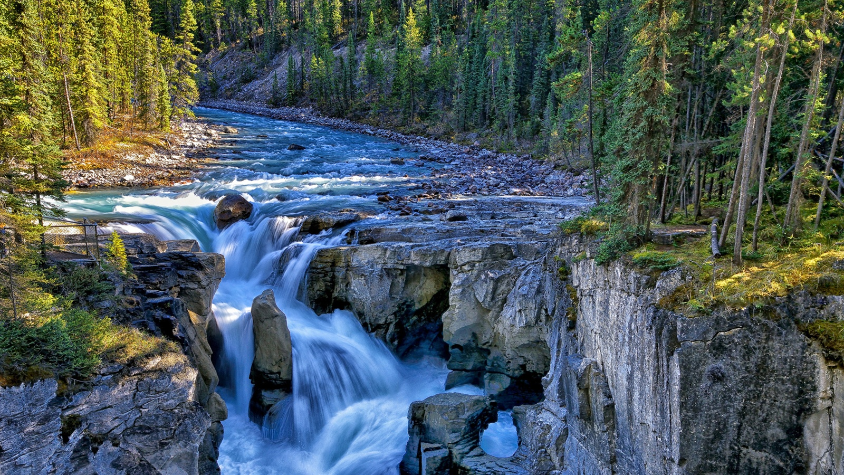
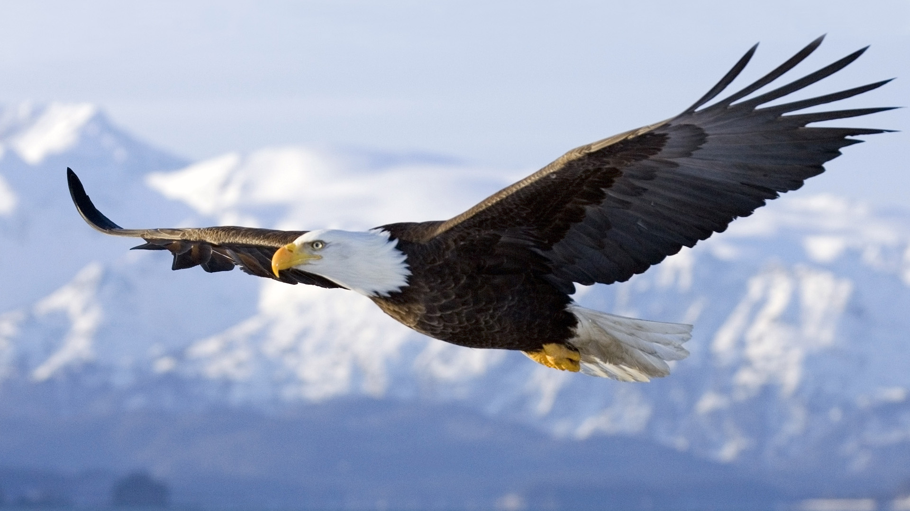
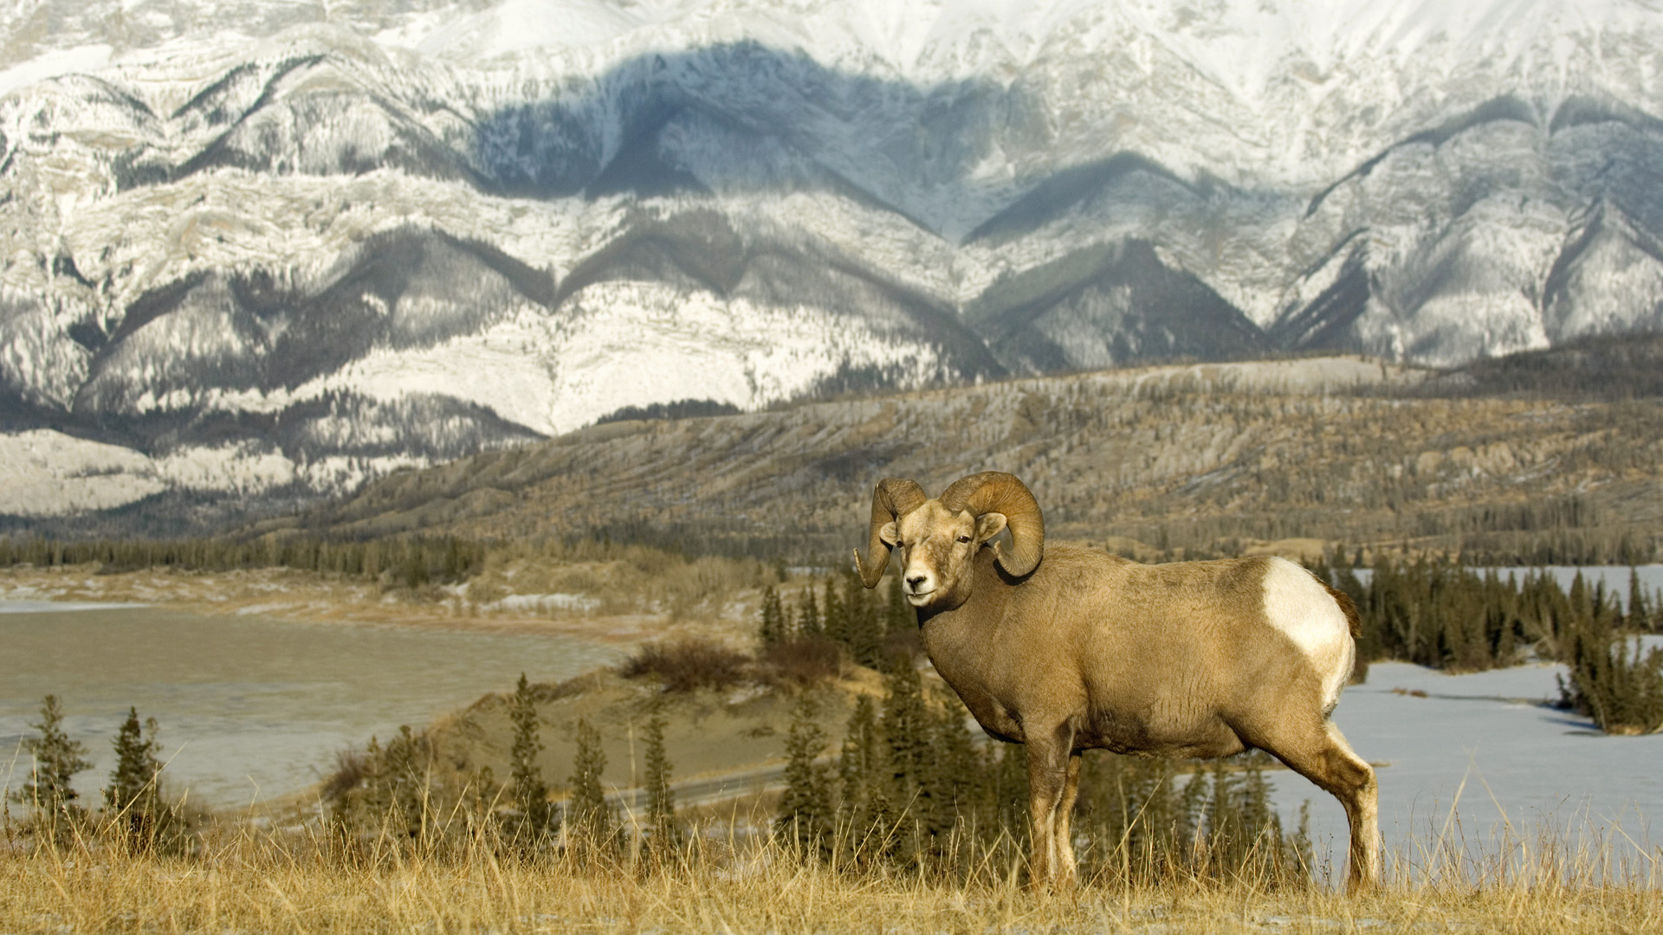
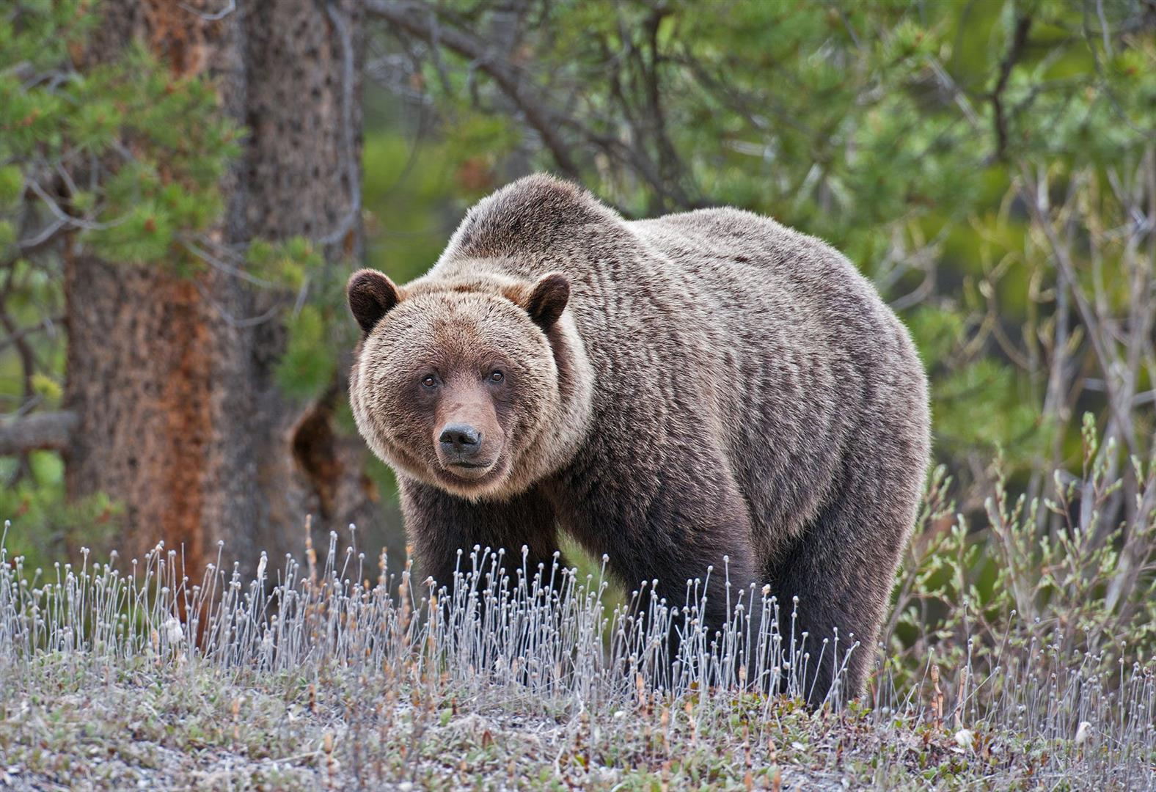

Slide 8
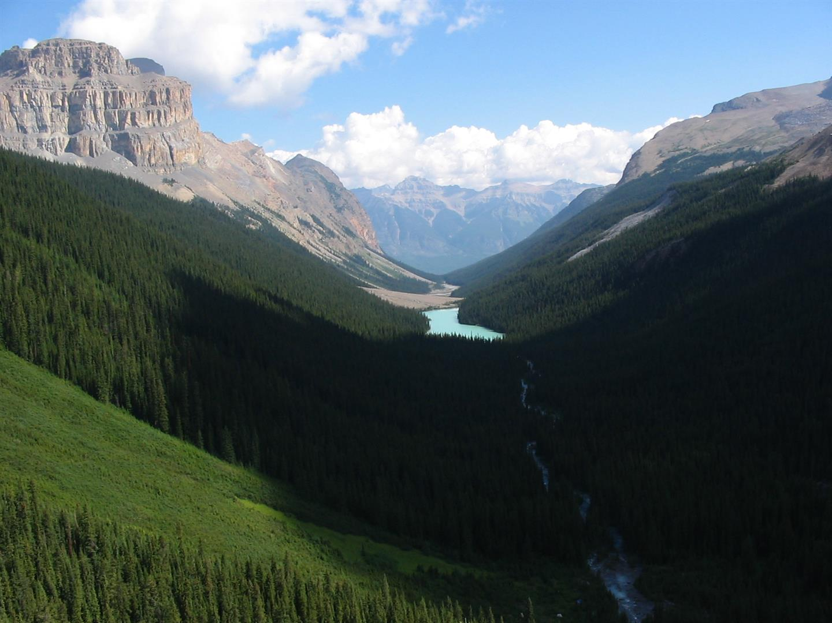
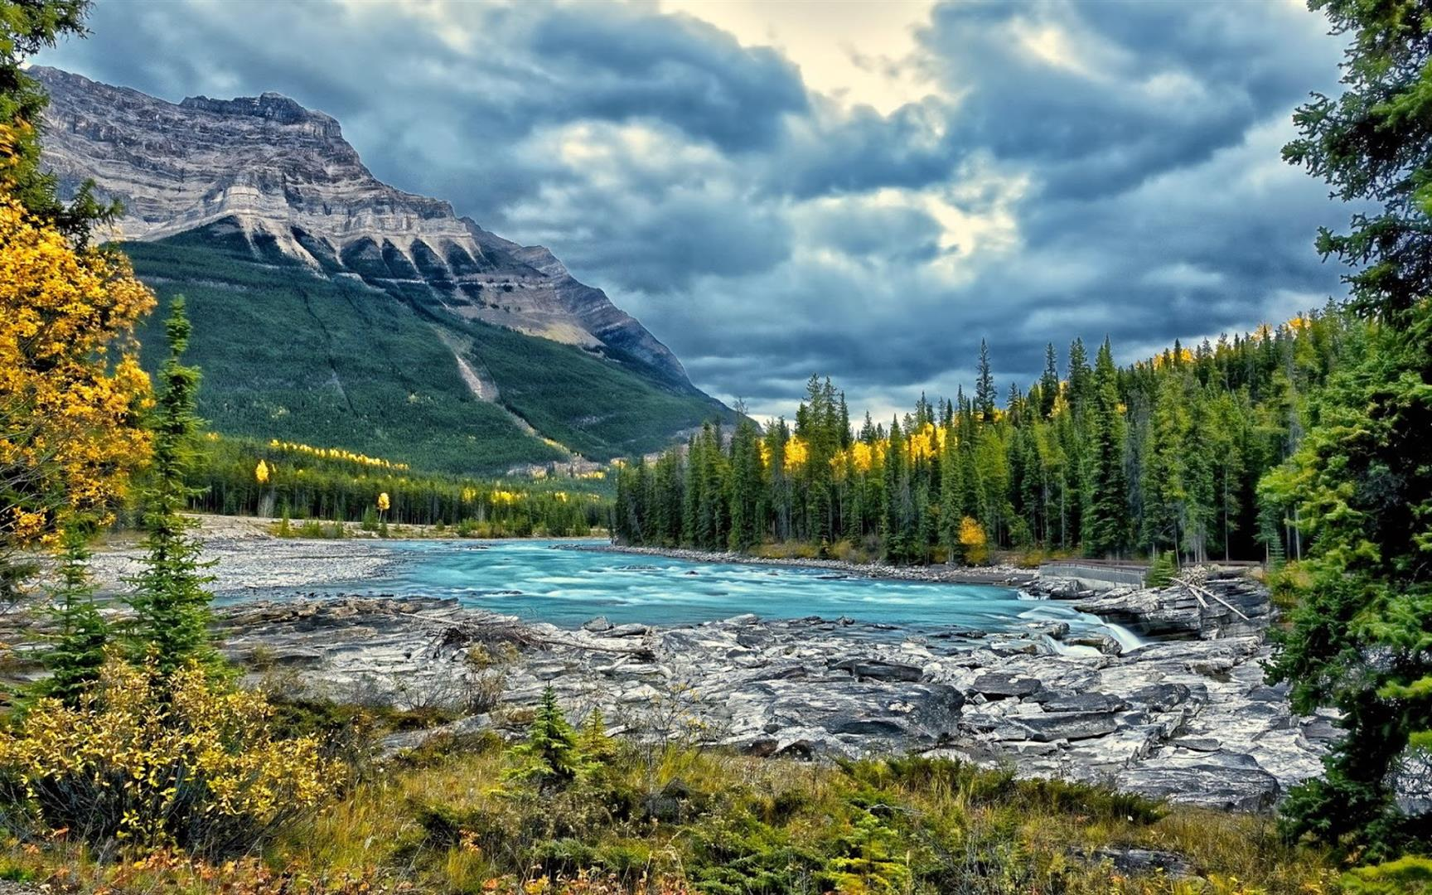

Slide 9


