Slide 1
Papua New Guinea
Part 1 (of 3):
The Huli People
Photographed and presented by Jair (Yair) Moreshet, 2009 ©
( Website: www.Jair-Moreshet.com Email: Jair.Moreshet@gmail.com )
Authentic sound recorded in parallel by Wayne Trudeau

Slide 2
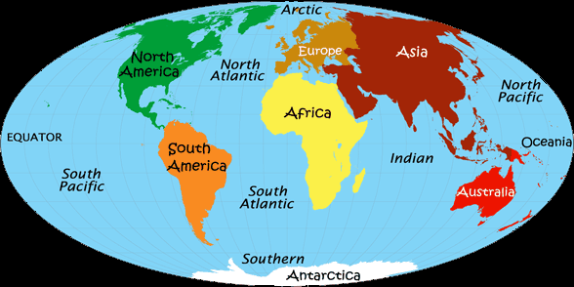
The island of New Guinea is the second largest in the world (Greenland is the first). It is located in the southwestern Pacific Ocean, in the region of Melanesia. The independent state of Papua New Guinea is occupying the eastern half of the island (the western part belongs to Indonesia), plus numerous offshore smaller islands.

Slide 3
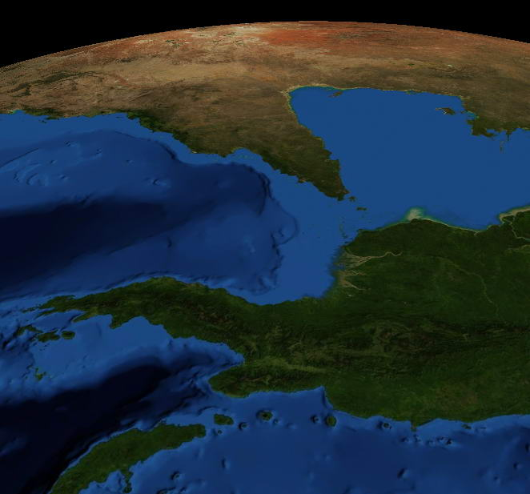
Papua New Guinea is mostly mountainous and covered with tropical rainforest, as well as large flood-plains surrounding the major tropical rivers - Fly and Sepik.
Highlands
- When watched from a satellite (facing southward) it makes it look green in a stark contrast to the nearby desert of Australia.
Sepik Basin

Slide 4
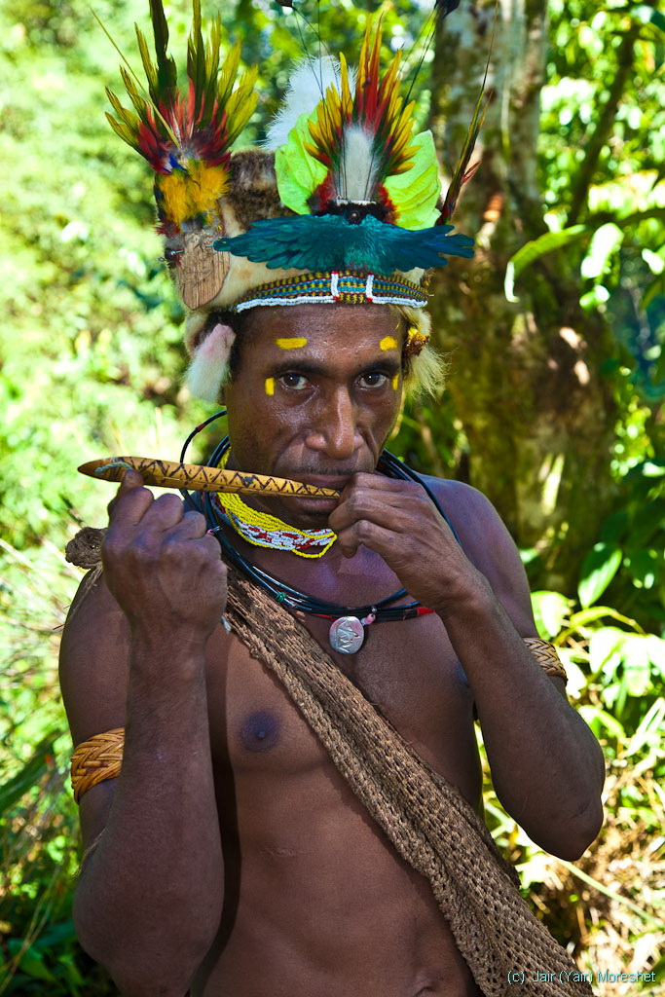
Papua New Guinea is one of the most diverse countries on Earth, with over 850 languages (out of a population of 6 million). The country is one of the world's least explored, both culturally (people) and geographically.
The rugged terrain makes it difficult to penetrate. Most of the access today is by light aircrafts operating off unpaved (and un-manned) airstrips.
The Huli people live in the Highlands and is one of the last discovered peoples on the face of the earth. They have been discovered just in 1936 by Australians who were searching for gold and they were colonized in 1951.

Slide 5
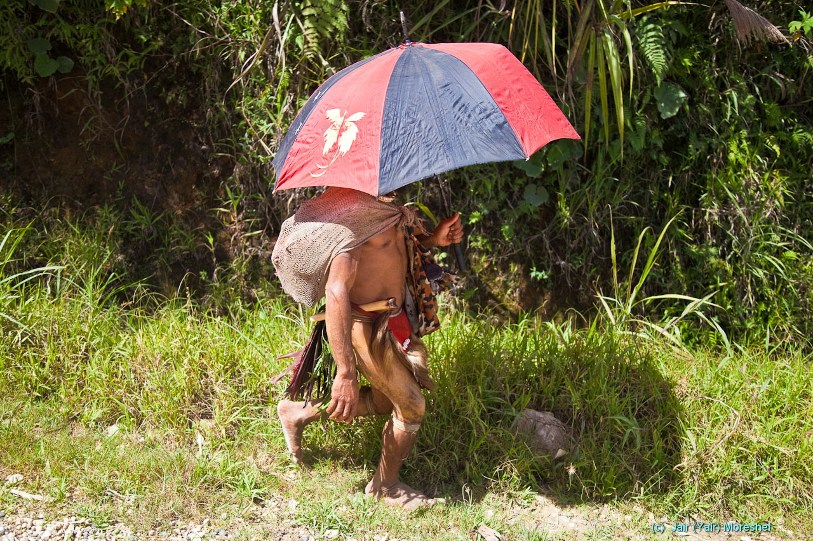
A Huli man on the local road in an everyday casual-traditional dress. In his belt – a knife made of bone. The use of umbrella, though not terribly traditional, is very common.

Slide 6
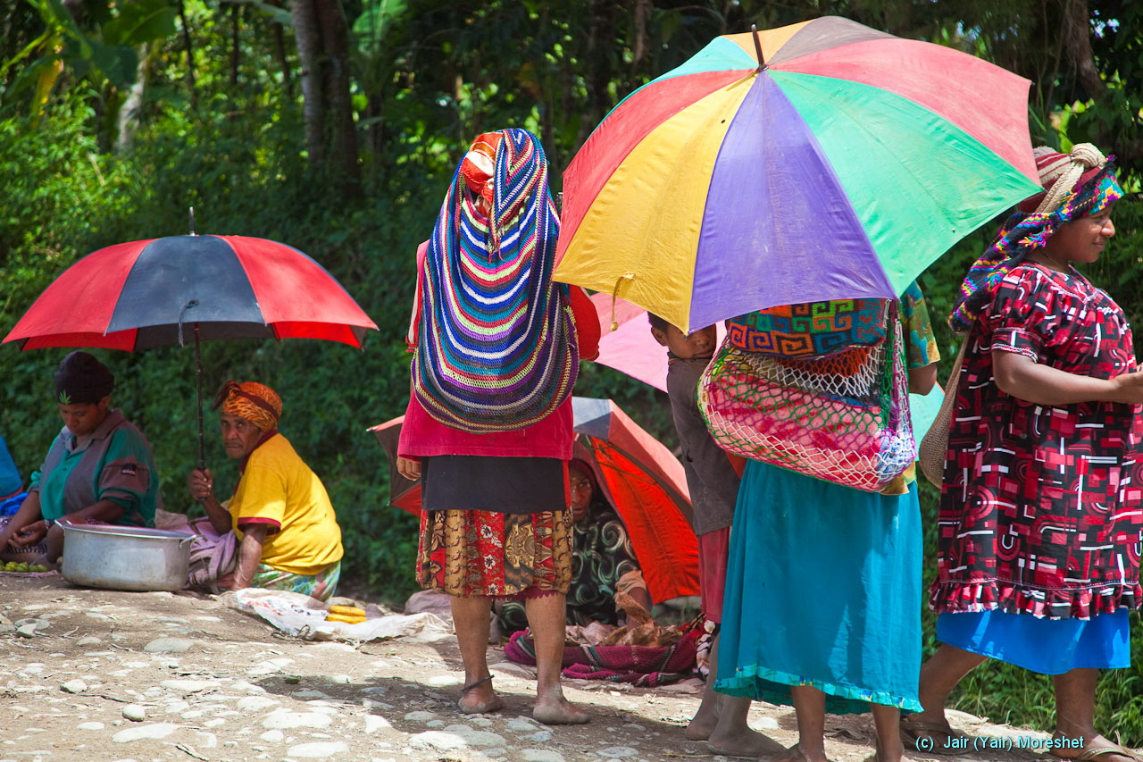
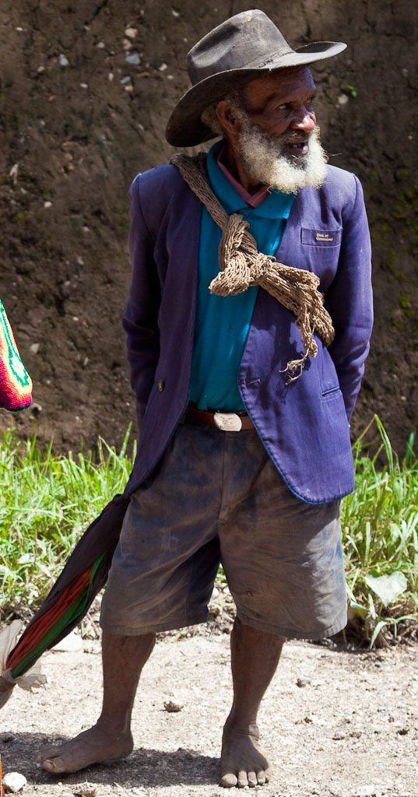
Huli people on the local road in modern-inclined dress for the weekend market.

Slide 7
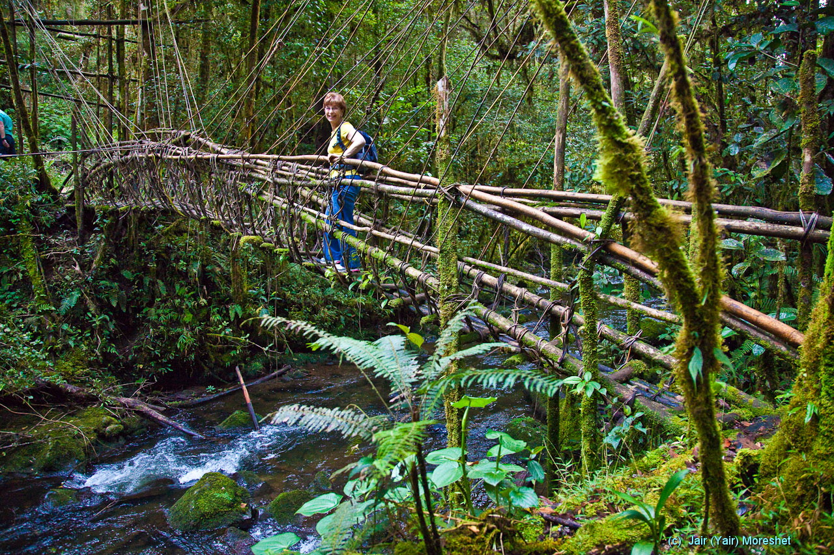
A vine bridge in the Highlands rainforest.

Slide 8
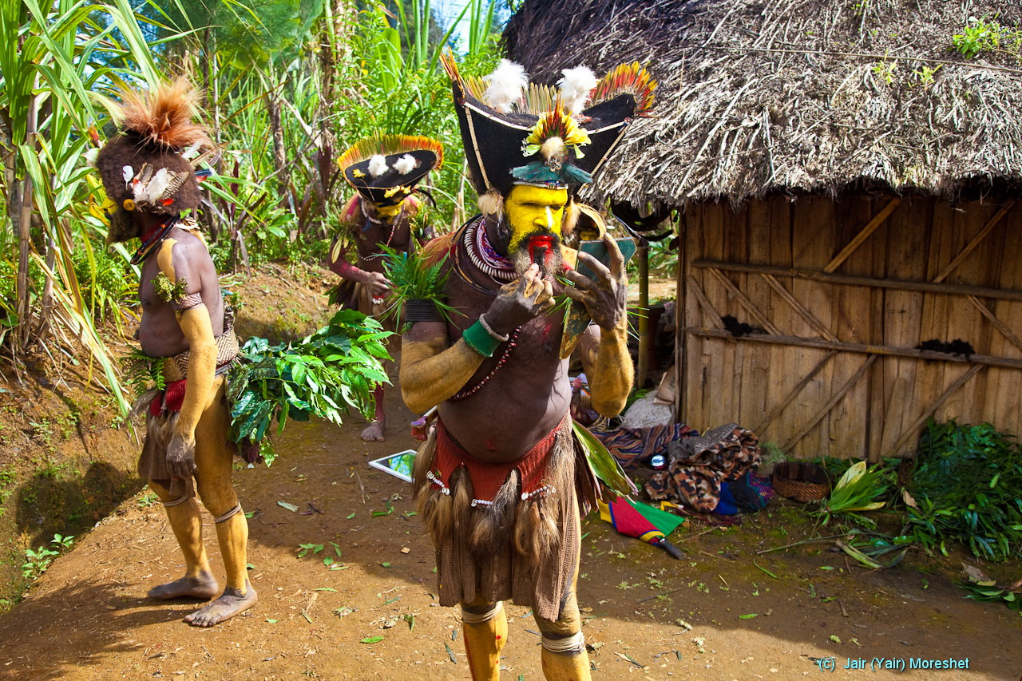
Huli men in full ceremonial-traditional dress in a final touch to their body decoration in preparation to their traditional ceremonial dance .

Slide 9
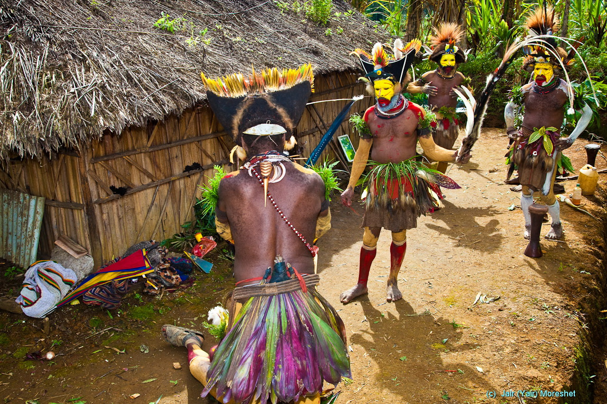

Slide 10
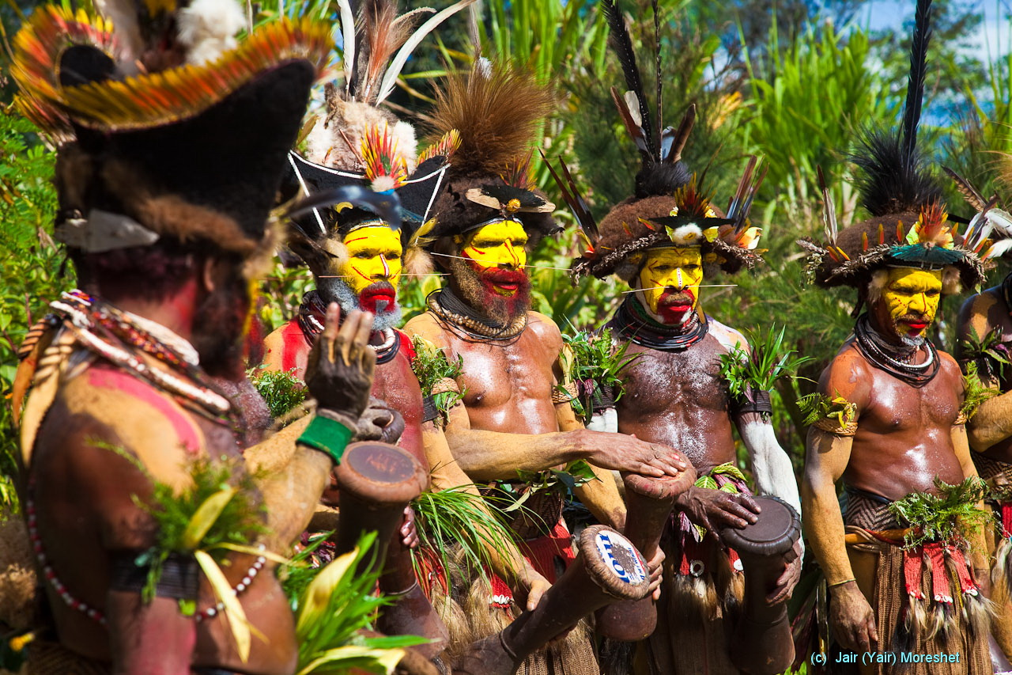
Huli men in traditional ceremonial dance . Both their dress/decoration and the “choreography” mimic the revered Bird Of Paradise. The dance is held on a victory in tribal warfare, which is still common.

Slide 11
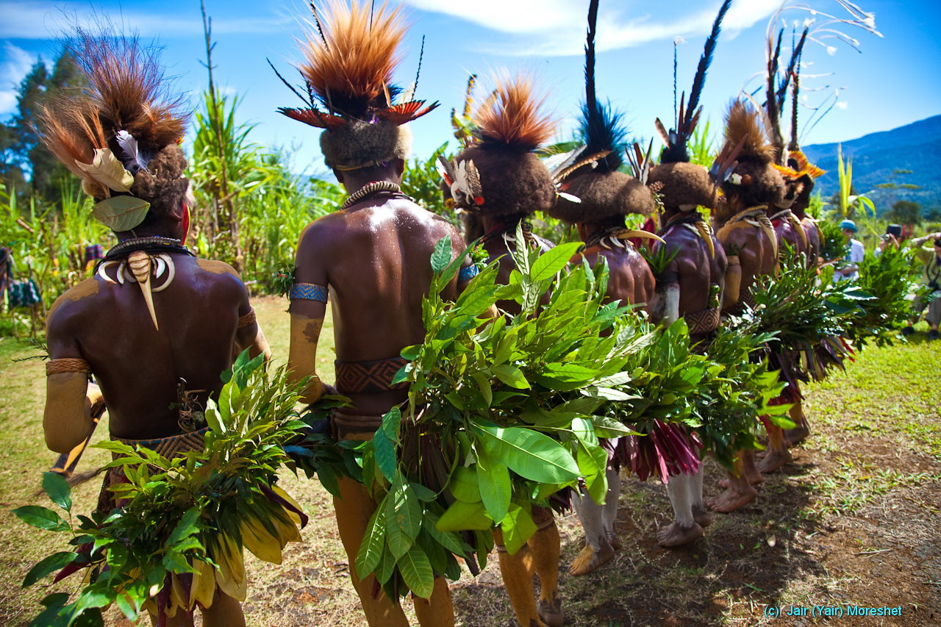

Slide 12
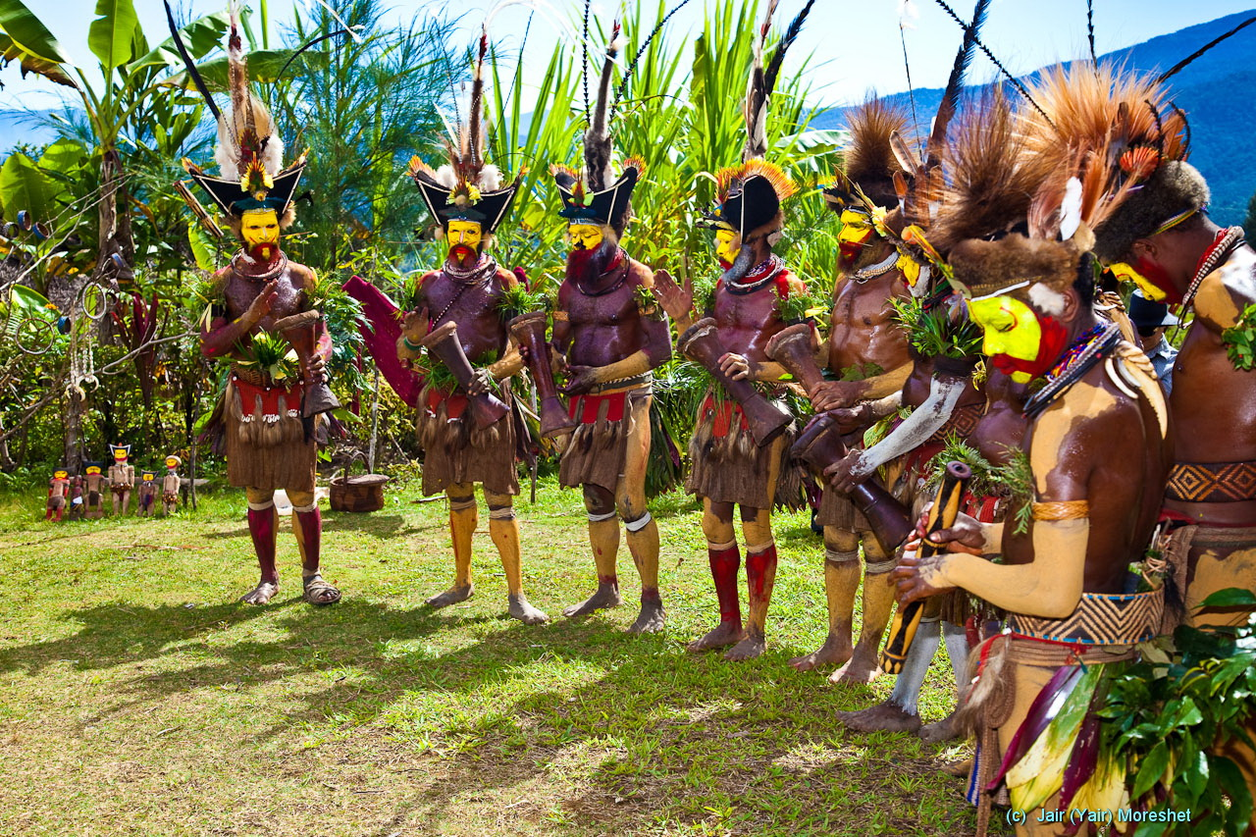

Slide 13
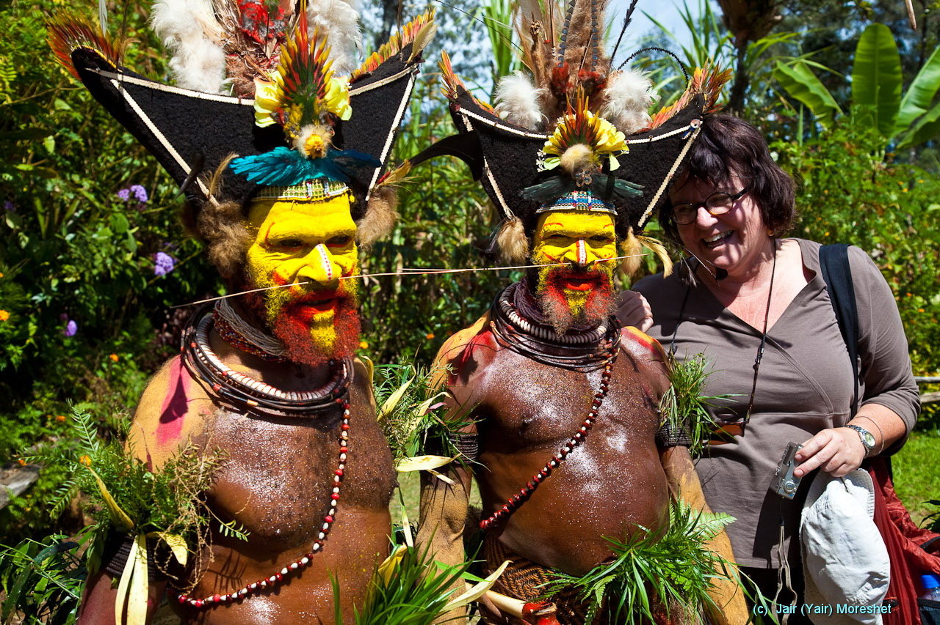

Slide 14
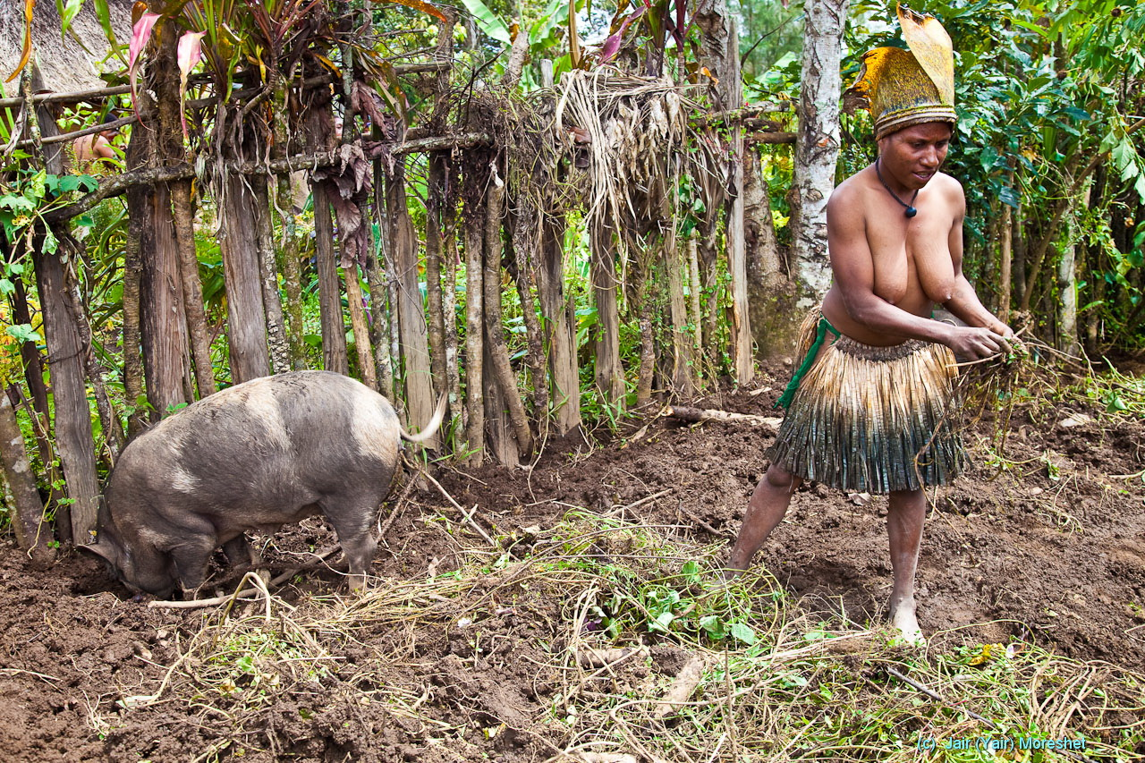
Whereas Huli men in everyday life take care practically just of the warfare, women do the subsistence agriculture, growing vegetables and pigs.

Slide 15
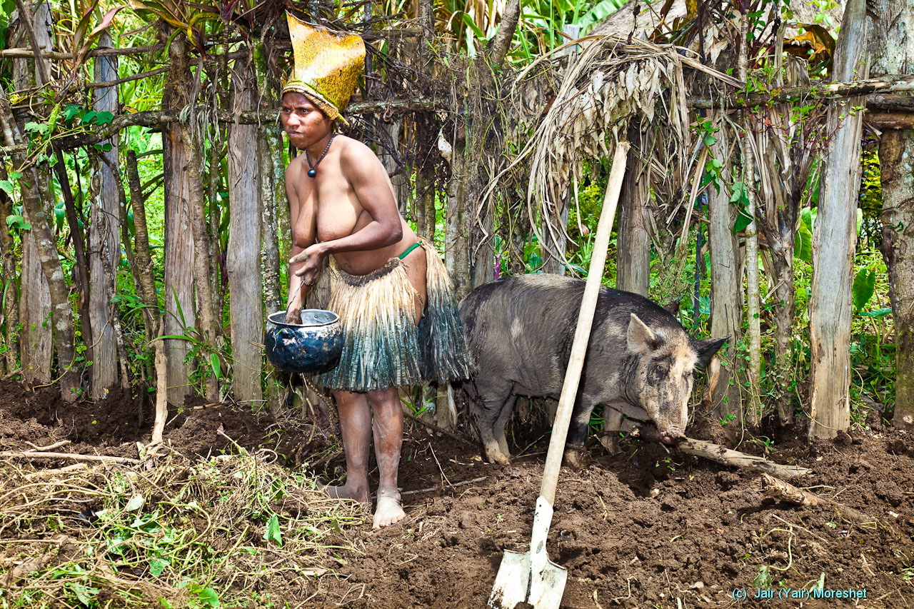

Slide 16
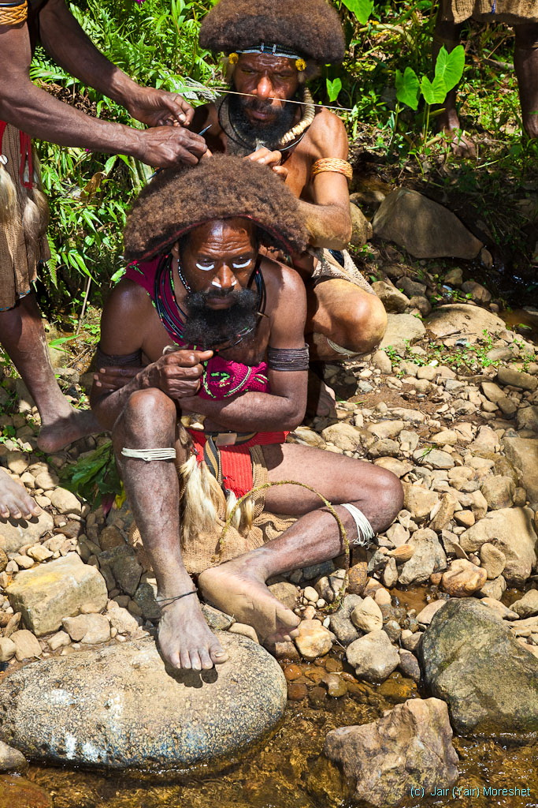
The headdress used by the Huli men as a bed for further decoration with feathers is a wig made of human hair.
The wigs are grown and shaped on actual heads of young poor men who don’t have the means for buying a bride. They cut and sell them eventually for use by others.
These poor men dedicate their life to the process for up to three years, away from women. They spend these years in a group here in the “school” for wigs, which carries the expertise through generations.

Slide 17
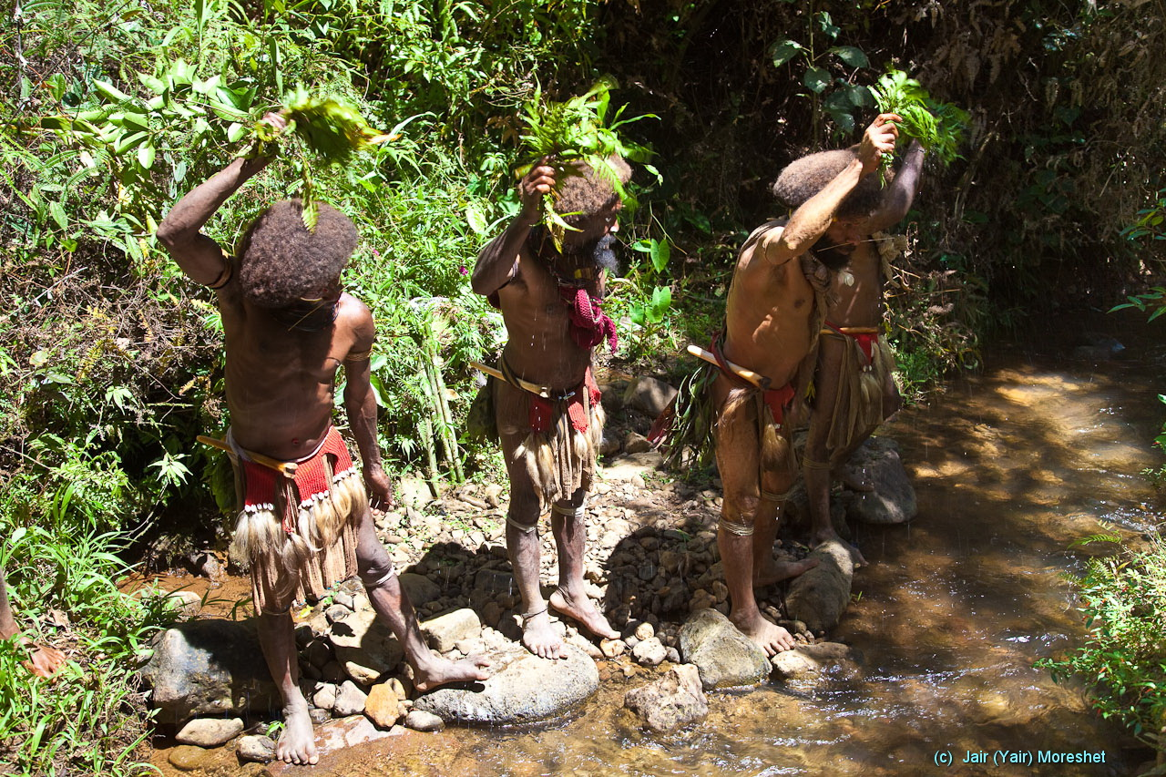
Here in the “school” for wigs, applying the right bunch of leaves, magic spells, and fresh brook water as a part of the process.

Slide 18
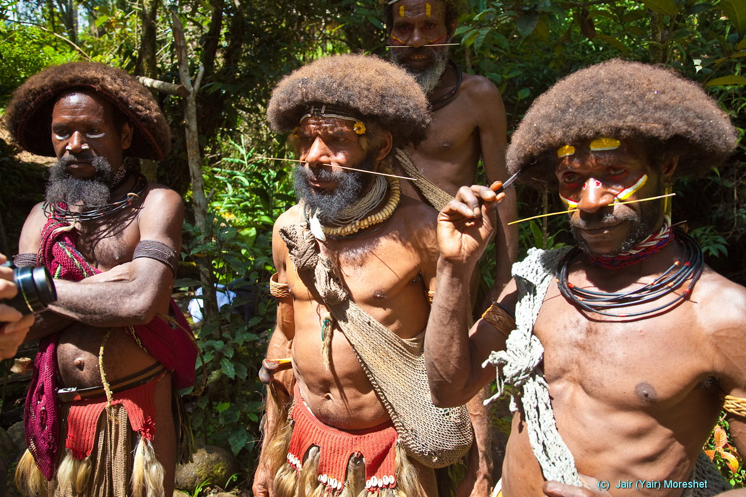

Slide 19
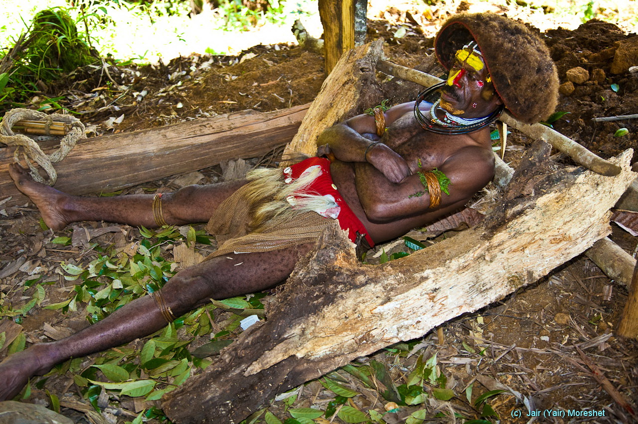
In order to protect the shape of the growing wig they sleep at night with their head supported by this special construction.

Slide 20
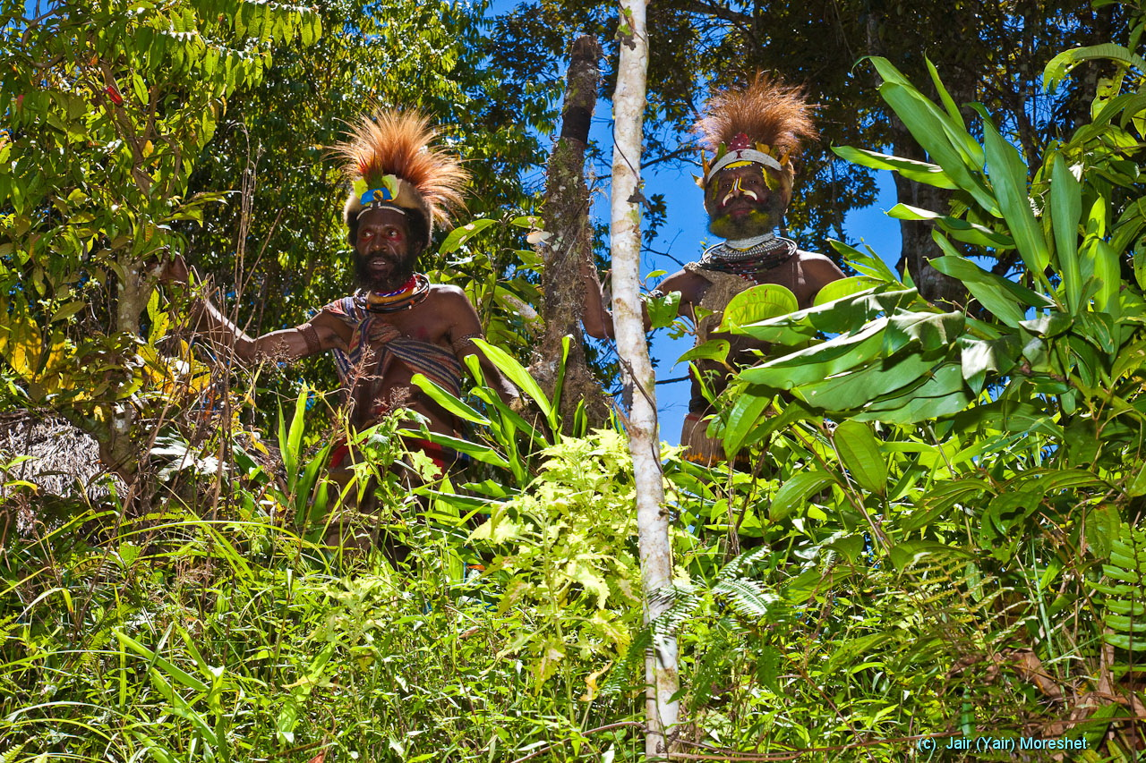

Slide 21
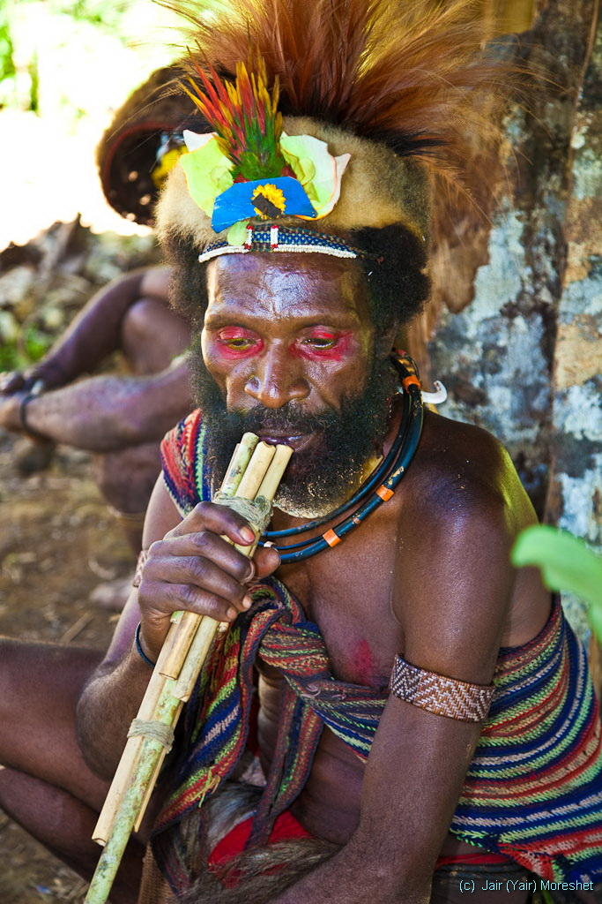

Slide 22
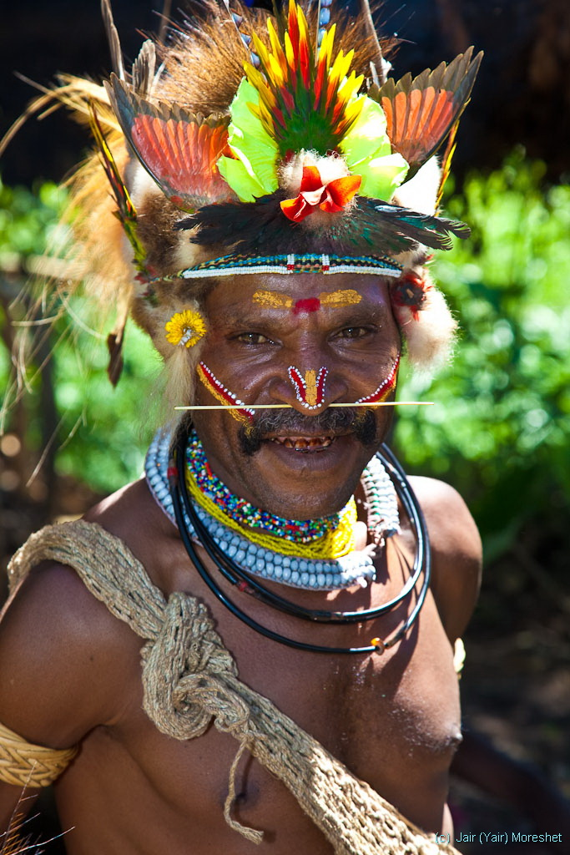
(The red teeth is common and is the result of chewing the Betel Nut which has the effect of a mild stimulant.)

Slide 23
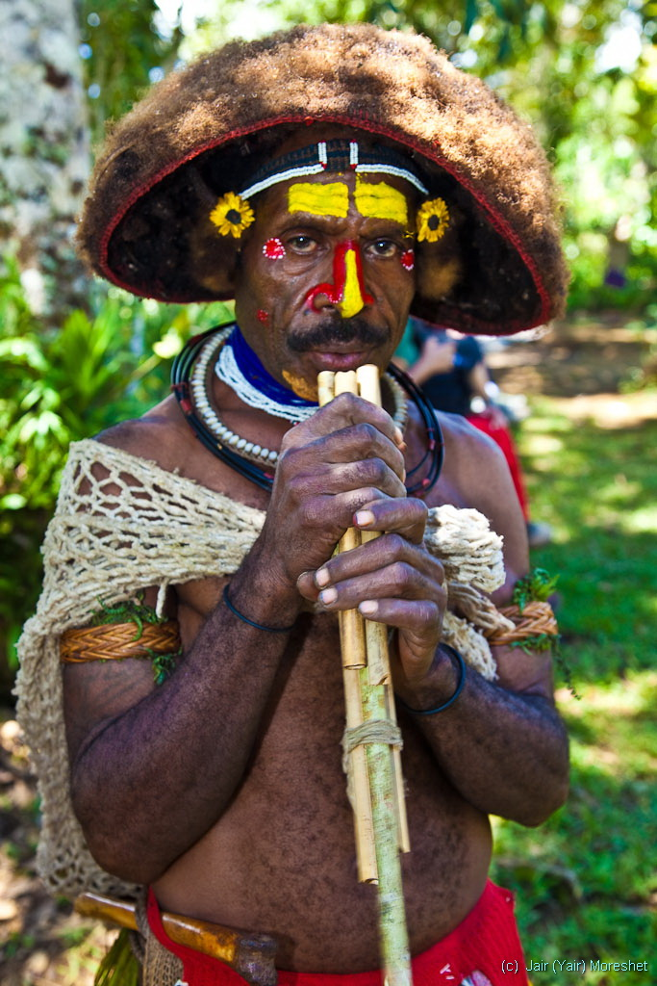

Slide 24
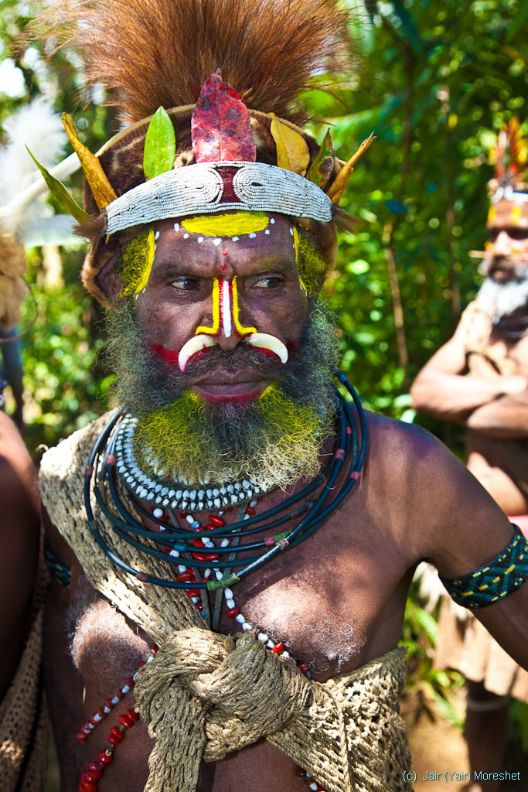

Slide 25
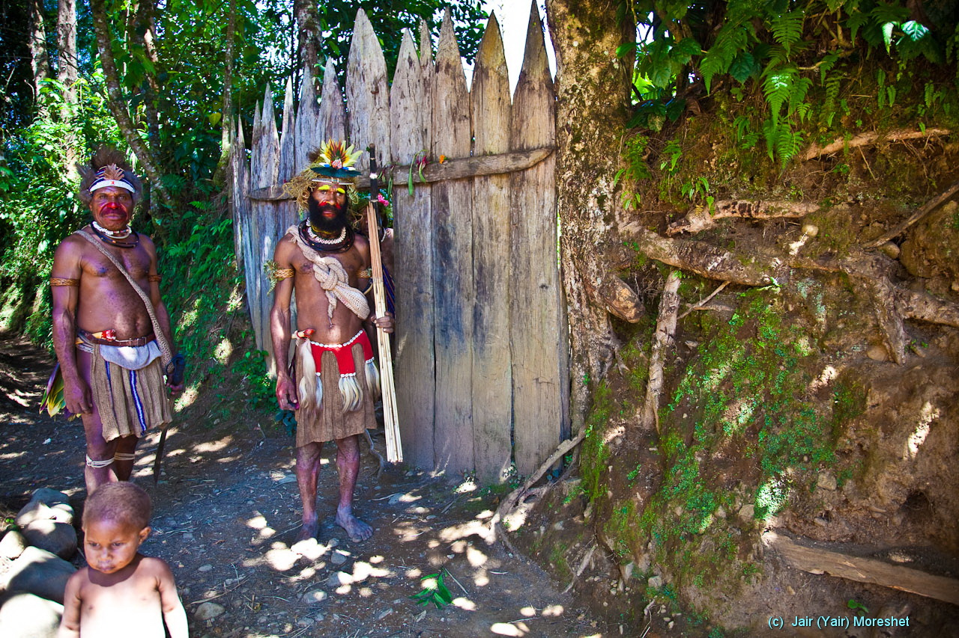
Huli’s basic social structure is the clan (“hamula” in Mediterranean terms) who hold to a piece of land, typically delineated and defended by a mud wall (here) and/or by a “moat” (a ditch carrying water).

Slide 26
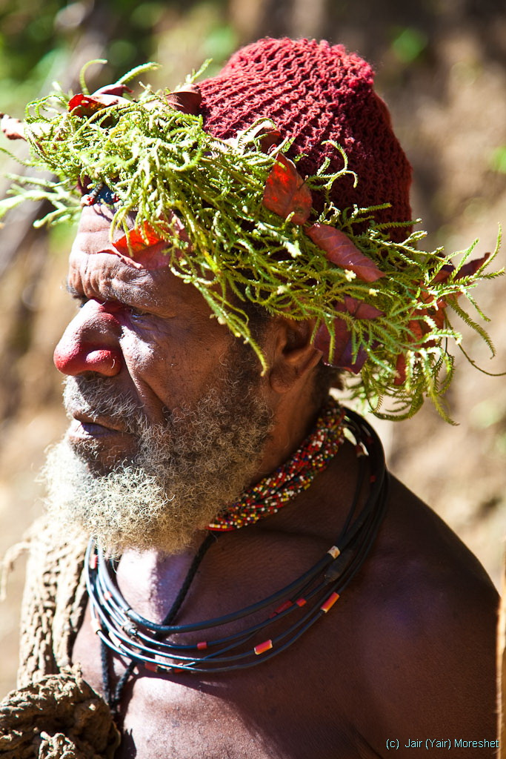

Slide 27
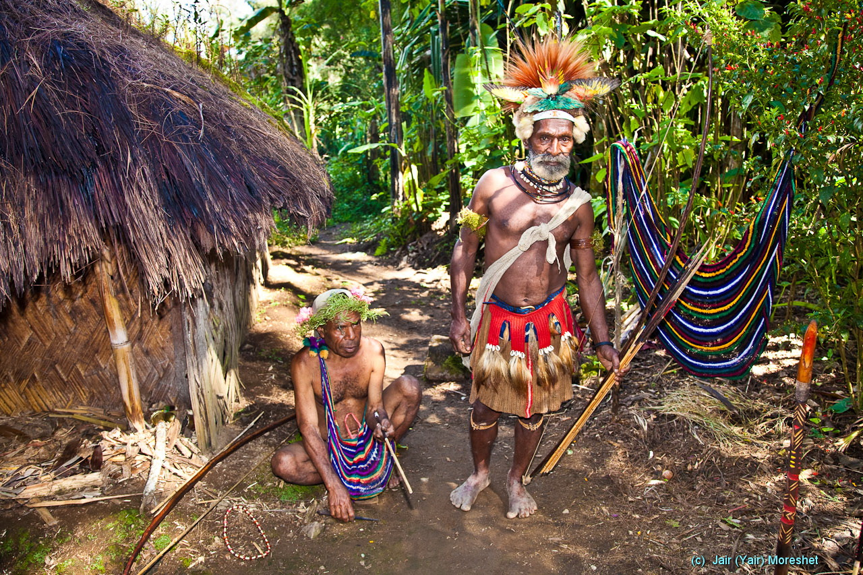

Slide 28
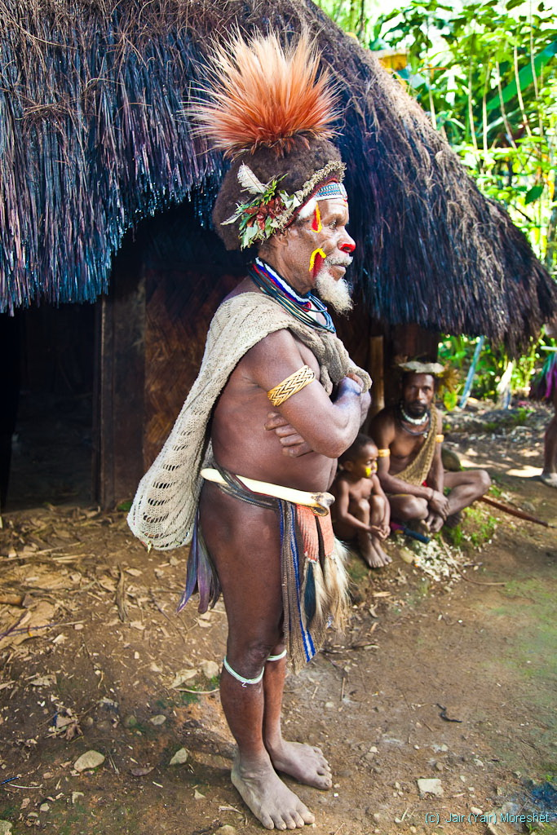
The head of a clan in front of the men’s house.
The women are considered dangerous for men and therefore live in a separate house that they share with the pigs.
They meet basically just once a month to copulate (typically outdoors, daytime).

Slide 29
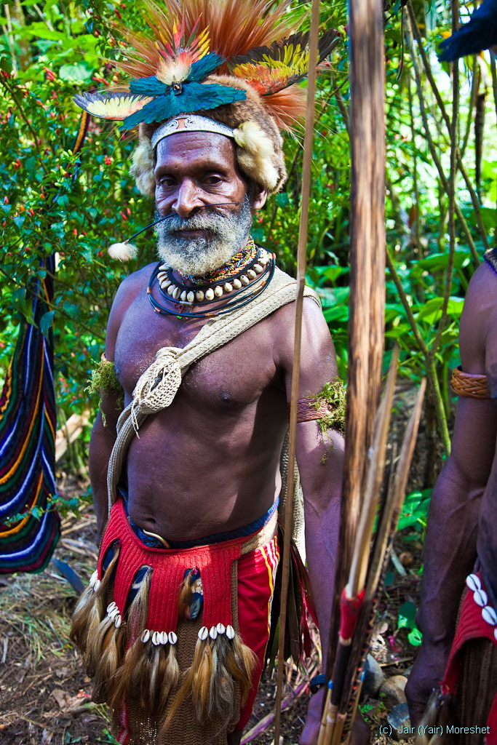

Slide 30
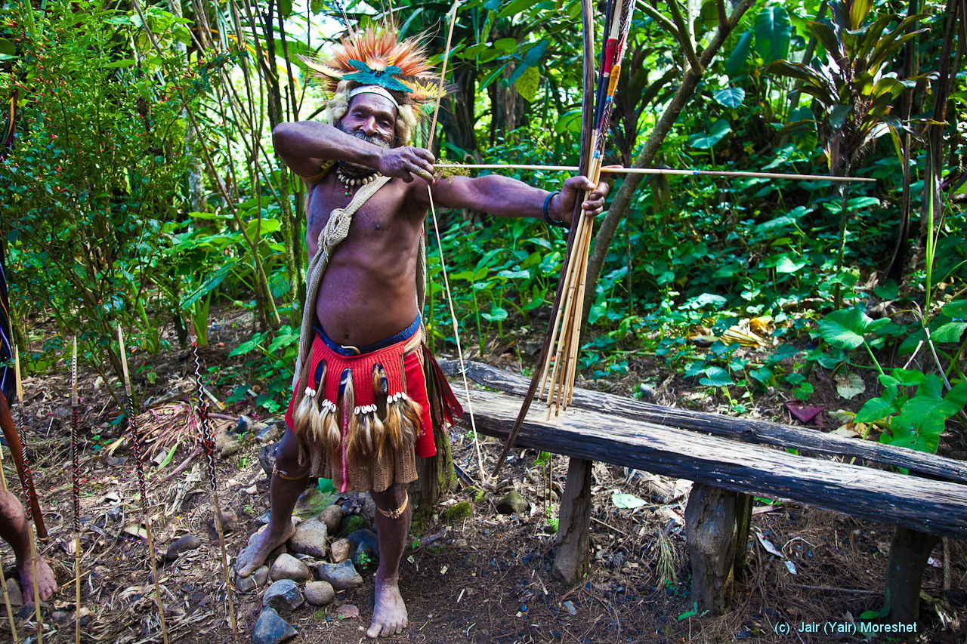

Slide 31
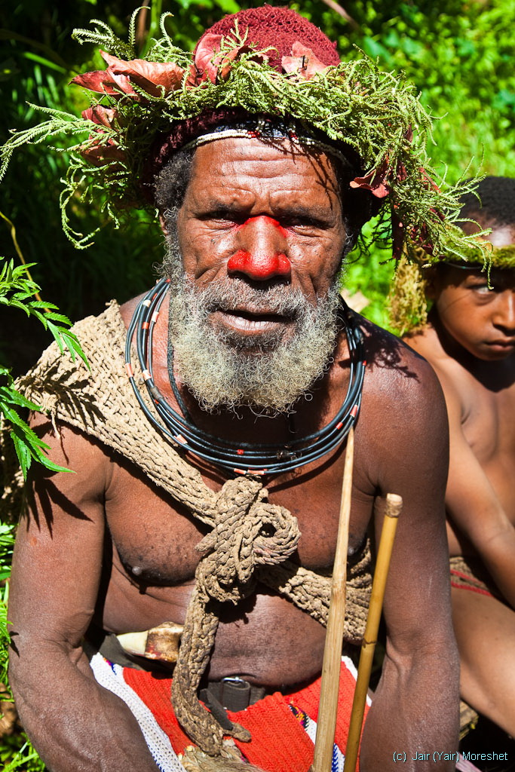

Slide 32
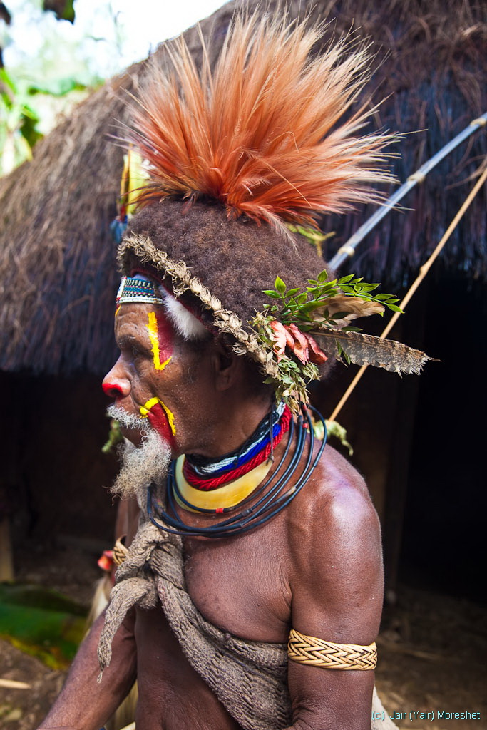

Slide 33
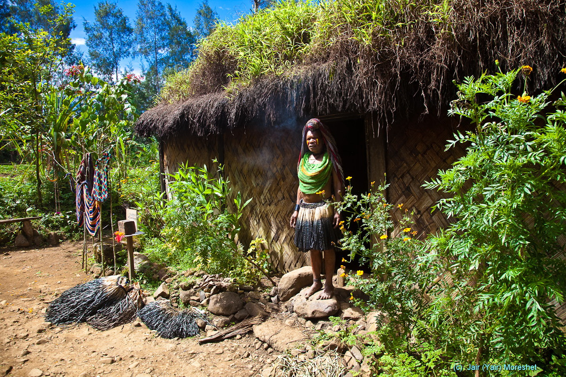
A woman in front of her house that she shares with the pigs.

Slide 34
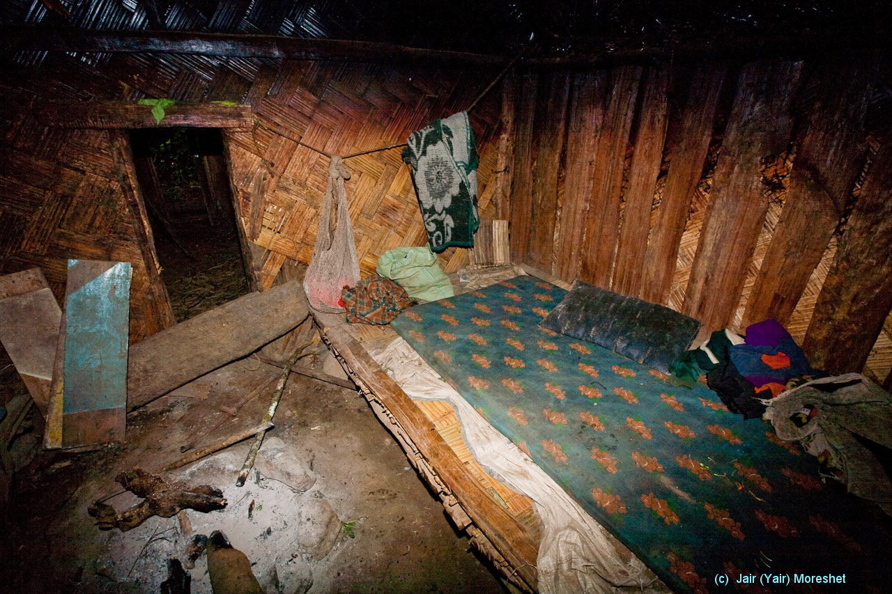
The woman’s house. The pigs’ room is ahead on the left, open fireplace in the middle (notice the burnt walls).

Slide 35
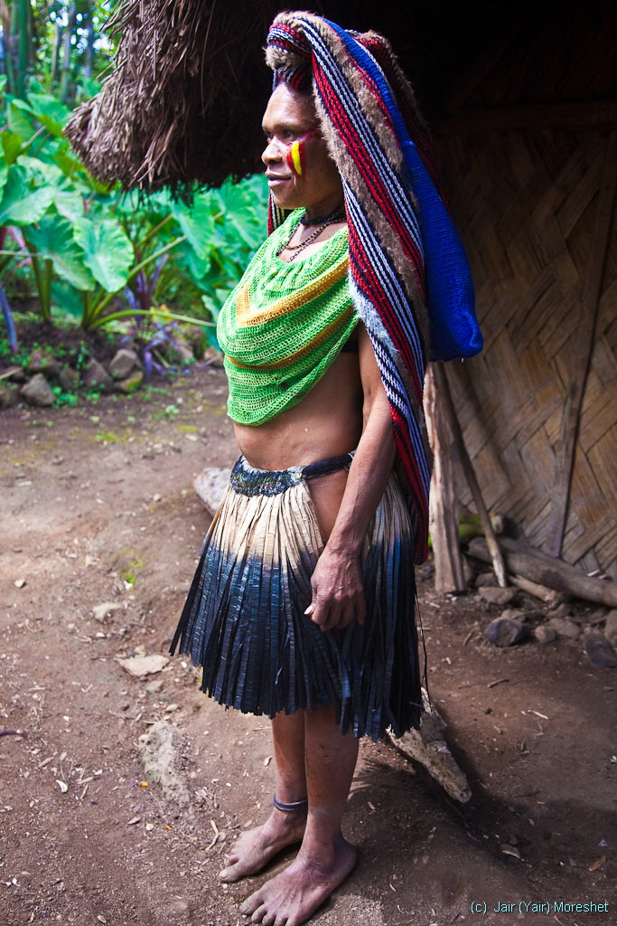
Women’s typical attire. It includes a bag (“bilum”), carried by head.

Slide 36
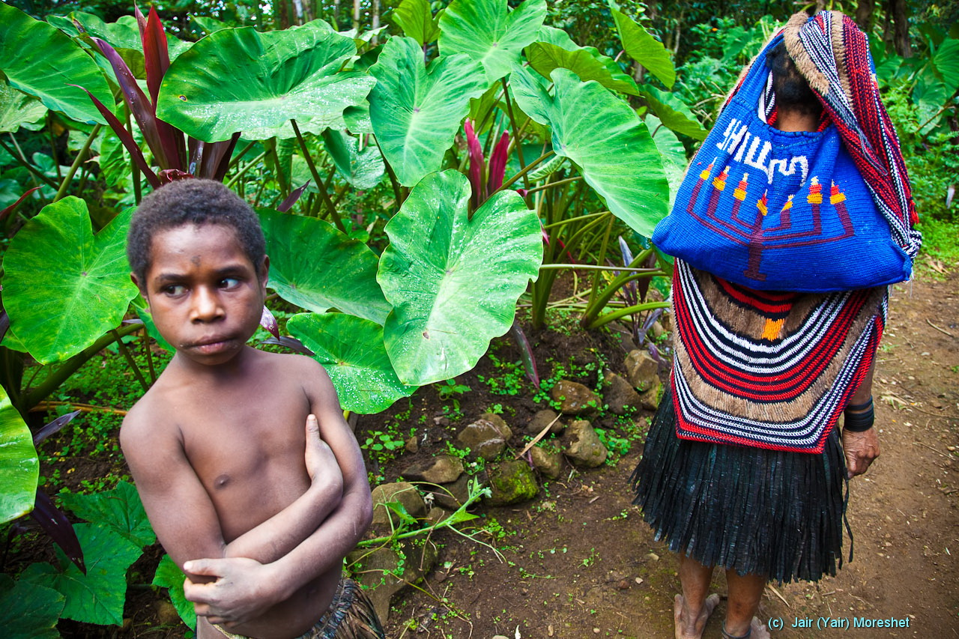
The mysterious Israeli connection: The locally hand-made “bilum” bag of this woman surprisingly includes an Israeli/Jewish Menorah and the Hebrew word SHALOM (peace).

Slide 37
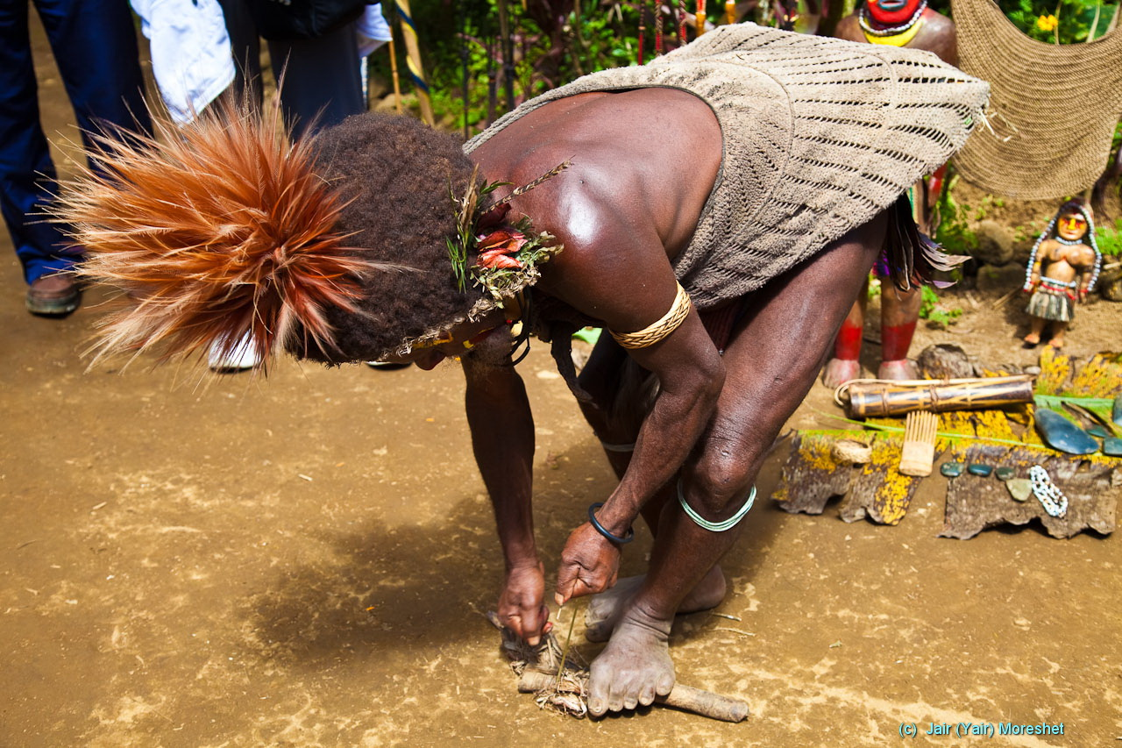
The old way of producing fire by friction.

Slide 38
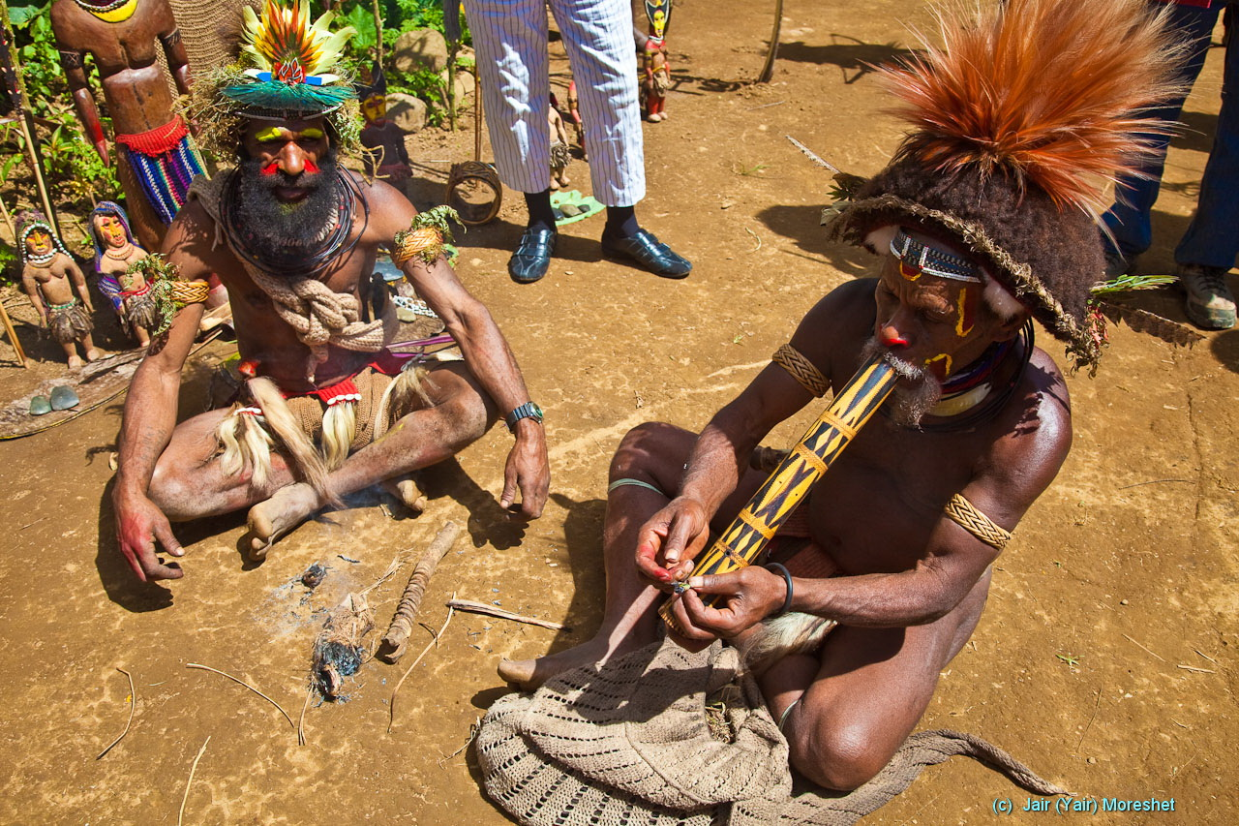
…and using the fire for smoking.

Slide 39
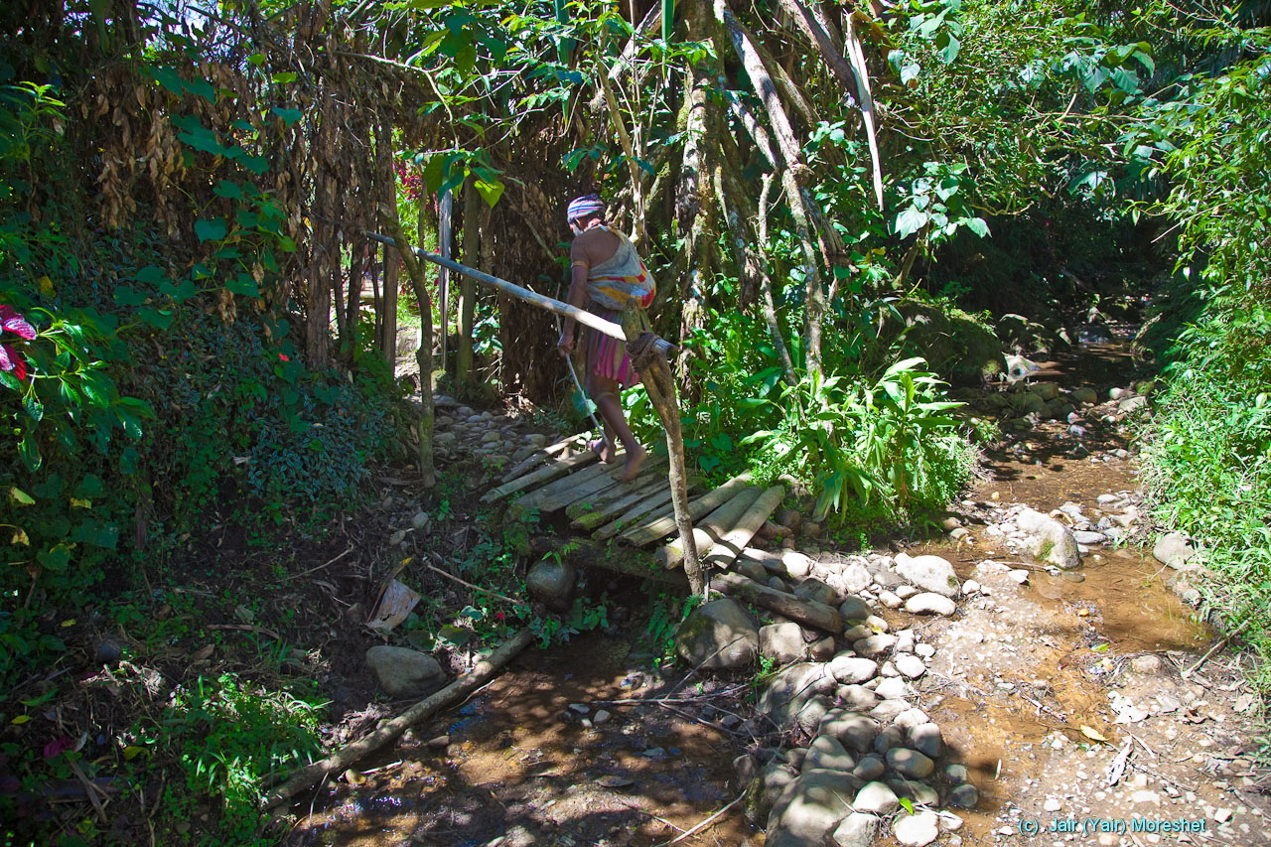
The entrance to the land of another Huli clan over a typical “moat”.

Slide 40
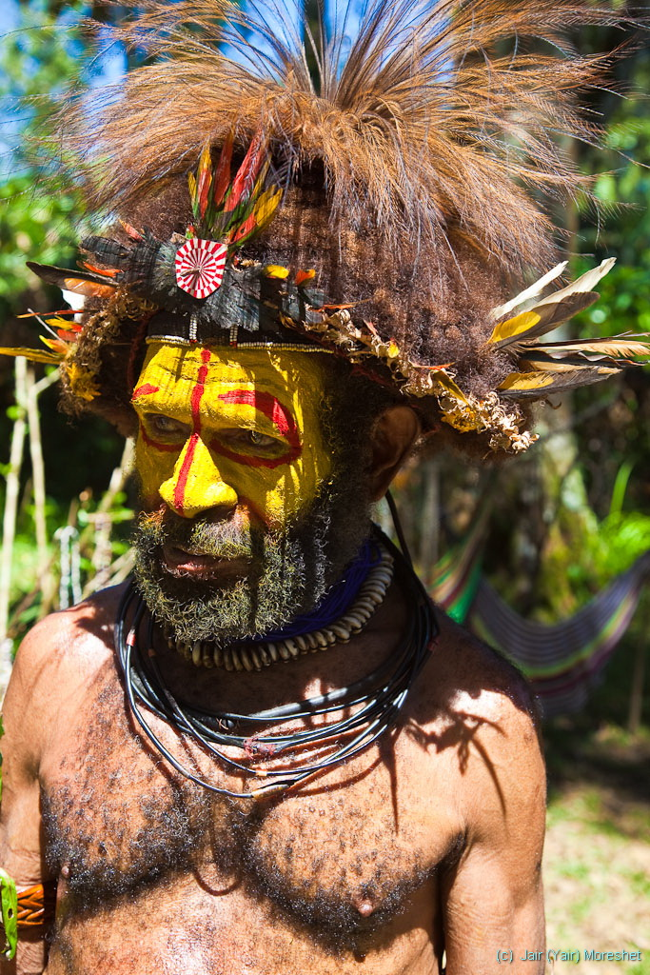

Slide 41
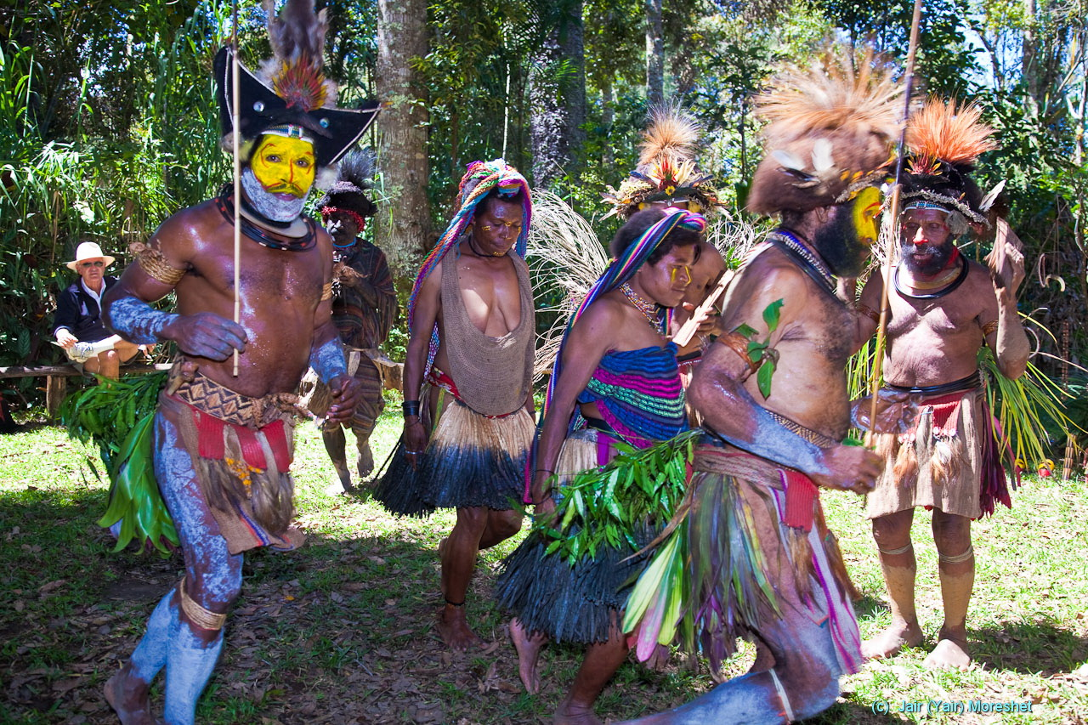
This “sun dance” is performed for the sake of good luck and bounty. -This clan specializes in it and provide it as a service to other clans.

Slide 42
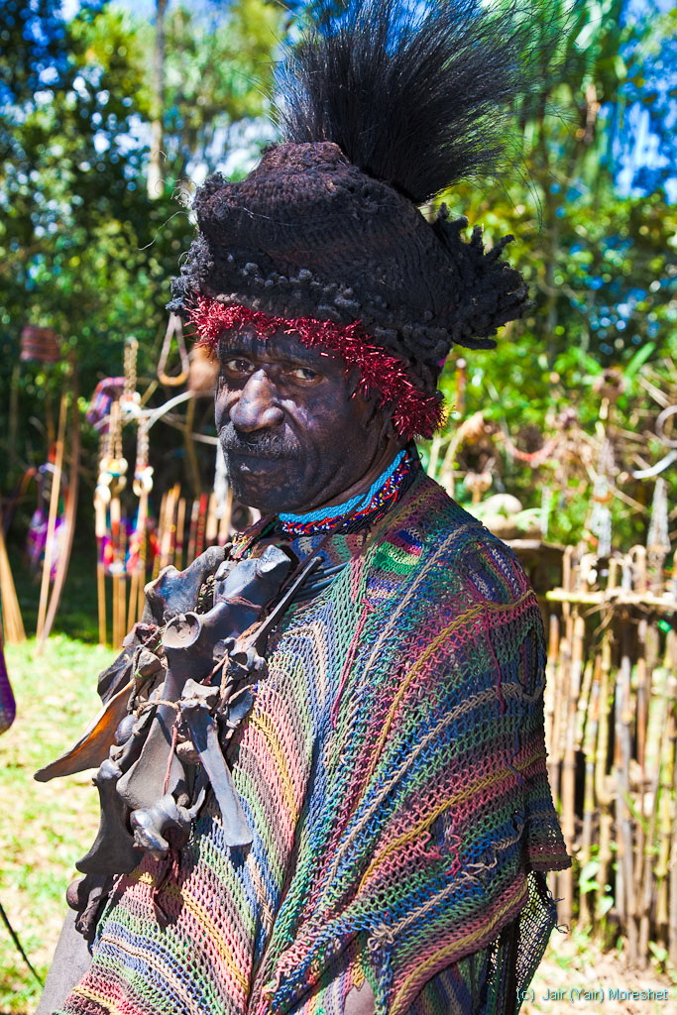
The one in the group representing “the evil”.

Slide 43
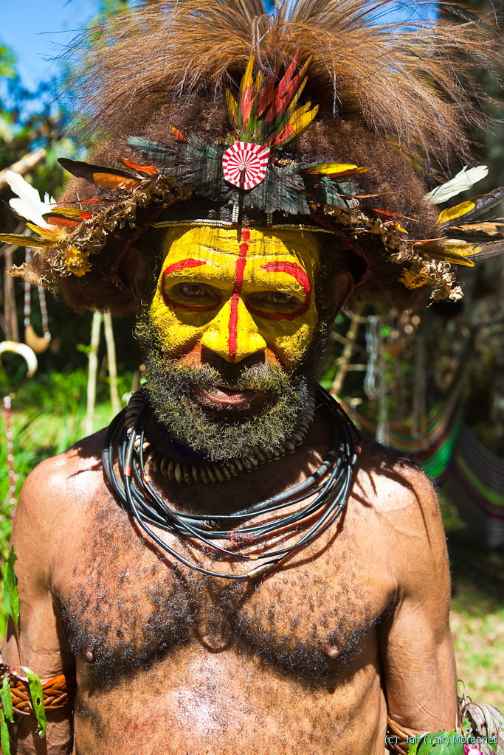

Slide 44
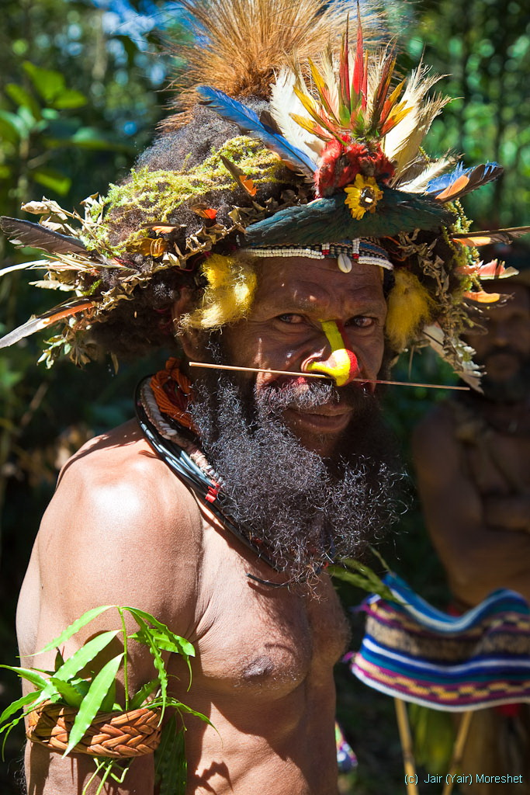

Slide 45
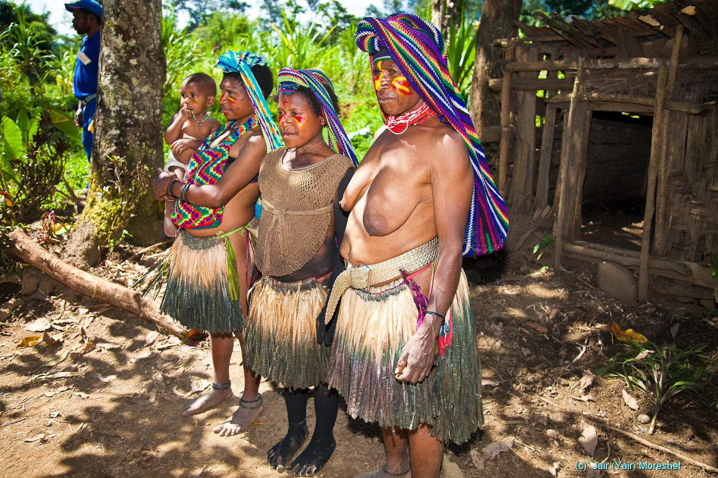
Huli wedding: The bride is the girl in the middle, 14 of age. The wedding is basically about negotiating her price. Her tough grandmother (foremost) is the negotiator on this side.

Slide 46
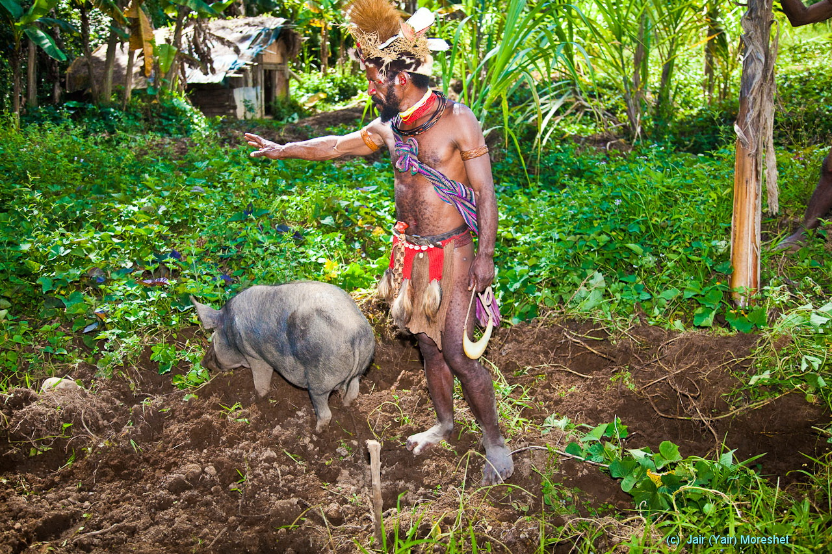
Huli wedding: Here is the experienced groom, negotiating for his side. The basic currency is pigs. In the course of negotiation the tough grandmother hit him by a stick.

Slide 47
Papua New Guinea
Part 2 (of 3):
The Sepik River
Photographed and presented by Jair (Yair) Moreshet, 2009 ©
( Website: www.Jair-Moreshet.com Email: Jair.Moreshet@gmail.com )

Slide 48
The island of New Guinea is the second largest in the world (Greenland is the first). It is located in the southwestern Pacific Ocean, in the region of Melanesia. The independent state of Papua New Guinea is occupying the eastern half of the island (the western part belongs to Indonesia), plus numerous offshore smaller islands.

Slide 49
Papua New Guinea is mostly mountainous and covered with tropical rainforest, as well as large flood-plains surrounding the major tropical rivers - Fly and Sepik.
Highlands
- When watched from a satellite (facing southward) it makes it look green in a stark contrast to the nearby desert of Australia.
Sepik Basin

Slide 50
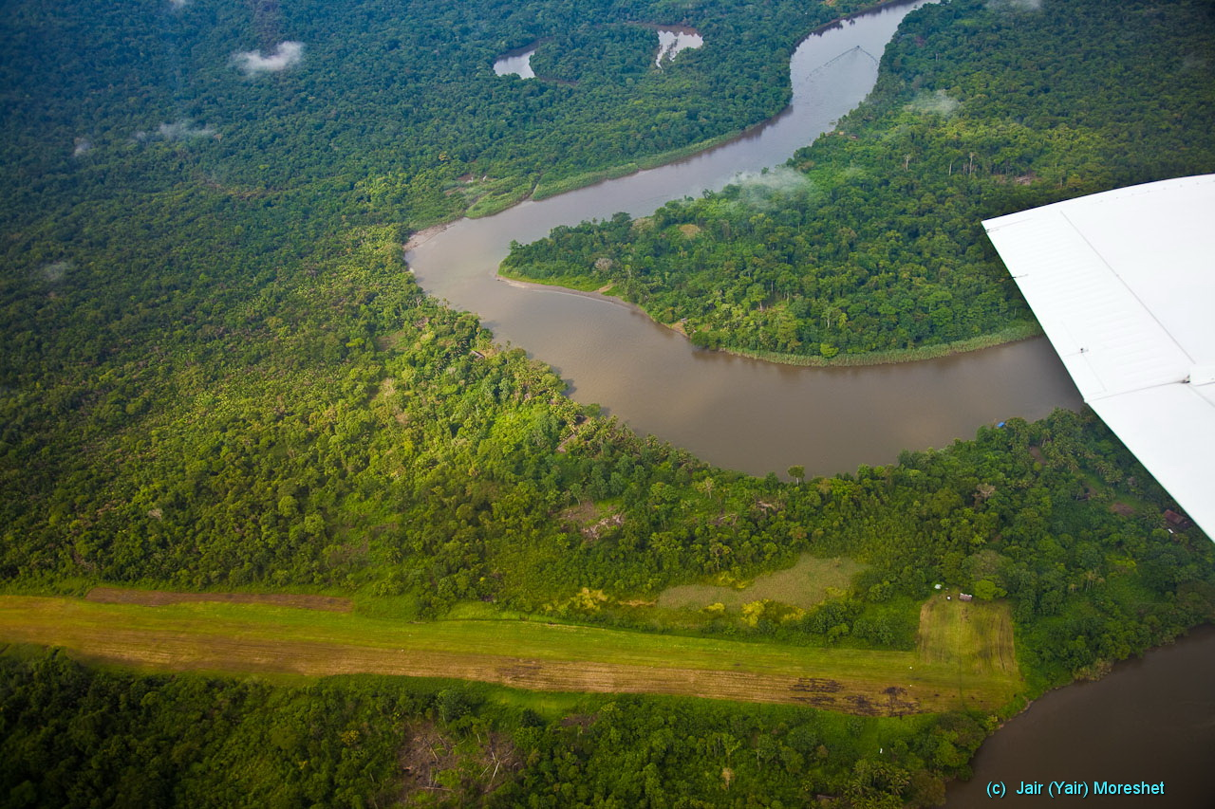
Most of the access in PNG is by light aircrafts operating off unpaved airstrips. Here in the Sepik River basin (which is equivalent to the Amazon), approaching to landing by a small aircraft. In the photo - the serpentine Karawari River, - a tributary of the Sepik, and the local airstrip.

Slide 51
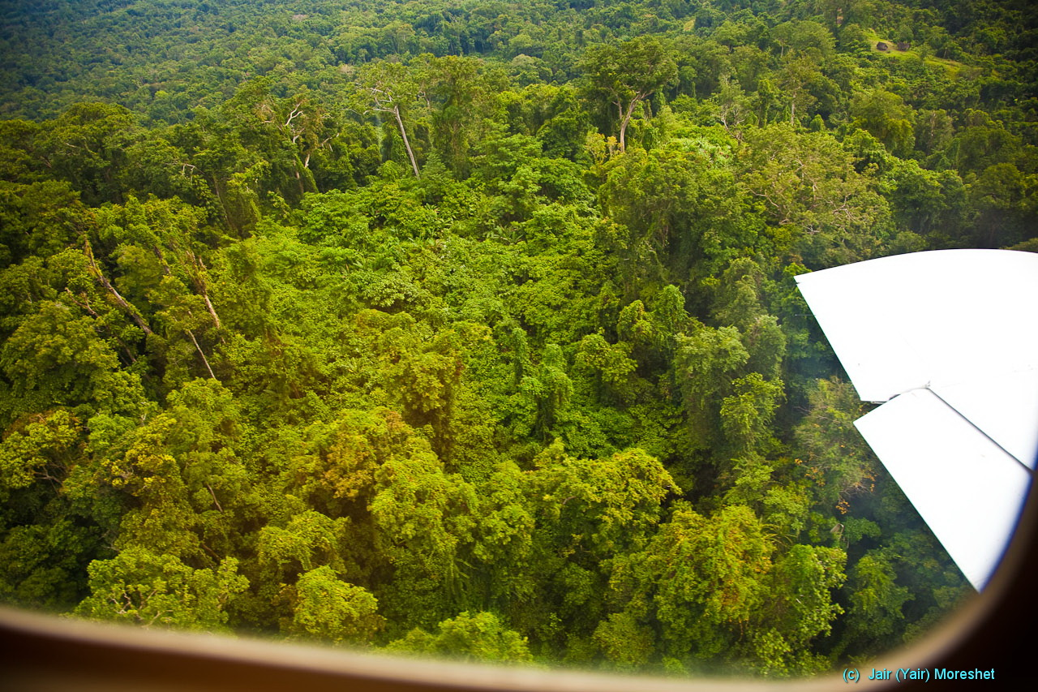

Slide 52
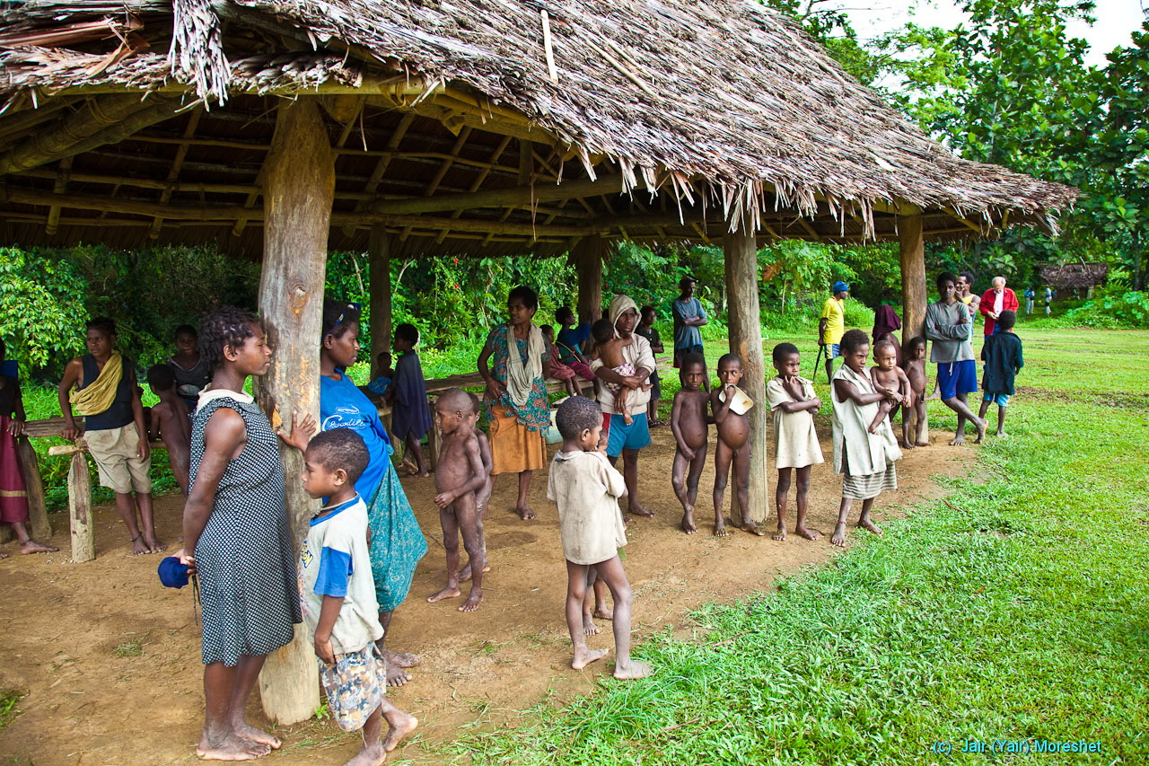
The local airstrip “terminal” with casual local “welcoming” people. Watching man-made birds carrying strange people is apparently a good way of spending time.

Slide 53
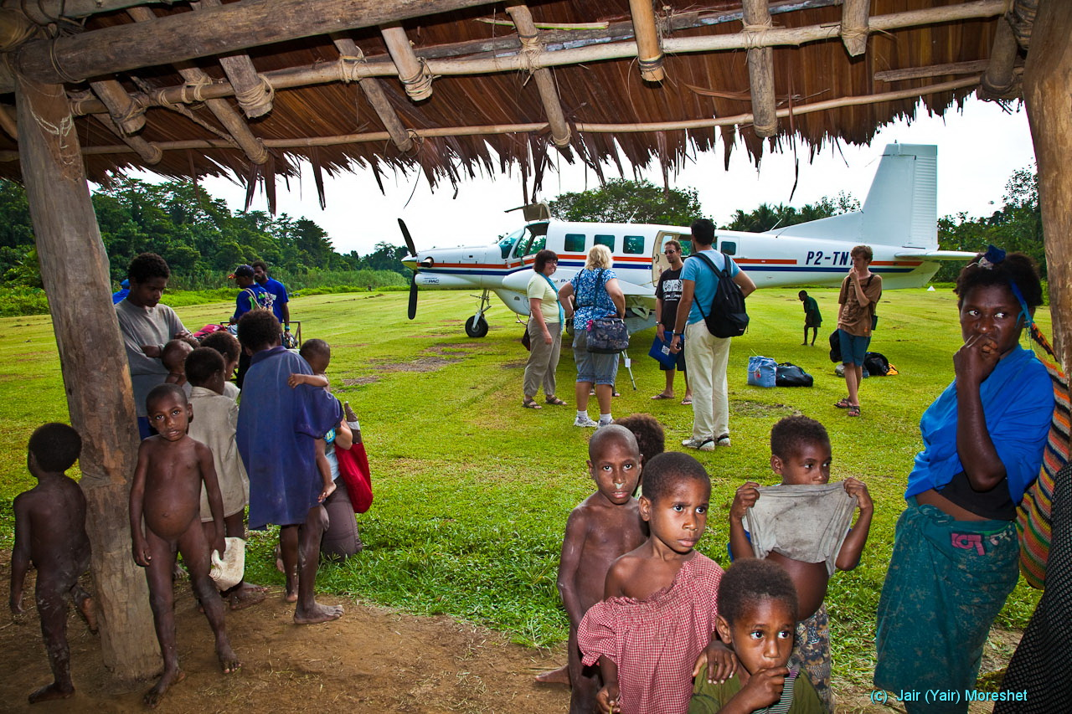

Slide 54

Leaving the airstrip by foot on the way to the water highway system -- the Sepik River and its tributary rivers.

Slide 55


Slide 56

The Karawari River area at sunset.

Slide 57

The Kundiman II Village on the Karawari River (the Yokoim Tribe). Notice the boys in the tiny canoe boat returning from their day at school (which we have just visited).

Slide 58


Slide 59

Sago is a starch extracted from the stem of the Sago palm tree. It is a major staple food for the people here. As a part of the process it is washed by river water.

Slide 60


Slide 61

Houses are big and elevated on stilts as the water level keep changing in a wide range. Notice the girl working on her makeup, though body decoration is not as elaborate as with the Huli people.

Slide 62

Separate kitchens are common.

Slide 63

The interior of a floating lodge (slow), from which we launched our small boat visits to the various villages. - An Australian entrepreneurship decorated by local art and operated by local man-power.

Slide 64


Slide 65

The Konmei Village on the Konmei River (the Yokoim Tribe)

Slide 66


Slide 67

The Konmei Village – a welcome performance

Slide 68


Slide 69

Youth “initiation” by scarring the skin in the shape of a crocodile is very common. It is mostly applied to boys, though.
People believe that they are descendants of a primeval crocodile.

Slide 70


Slide 71


Slide 72

Going hunting for wild pigs.

Slide 73

The Manjami Village on the Karawari River (the Yokoim Tribe)

Slide 74


Slide 75


Slide 76


Slide 77

The Momeri Village on the Krosmeri River.

Slide 78

A household farming of crocodiles, caught in the river.

Slide 79


Slide 80

The local guide explains that HIS people in this area are NOT cannibals, but rather HEAD-HUNTERS.

Slide 81

“Black Water Lakes” is an area covered by swamp-lakes surrounding the river. The level of the muddy shallow water and their reach keep changing all the time, even during a single day.

Slide 82

The Kabriman Village in the Black Water Lakes (the Kabriman Tribe).

Slide 83

The big Spirit House of the Kabriman Village – a house of warship to the ancestral spirits.

Slide 84

The big Spirit House of the Kabriman Village: Hunted (human) heads used to be suspended here by this big column.
The Spirit House is still in use, but they don’t hunt for heads any more. -Not that much because of the theoretical government law which doesn’t reach here, but apparently under the influence of the Christian Mission.

Slide 85

The chief

Slide 86

The big Spirit House.

Slide 87


Slide 88

The Kabriman Village – a welcoming dance.

Slide 89

The ever changing waters of the “Black Water Lakes”.

Slide 90

The Mindimbit I Village on the Krosmeri River.
The villages in the area specialize in “Ancestral Art” – an amazing array of carvings including masks and statues (the ones I brought home combine beautifully into my collection…)

Slide 91


Slide 92


Slide 93

The Tambunan Village on the Sepik River.

Slide 94


Slide 95


Slide 96
Papua New Guinea
Part 3 (of 3):
The Mt. Hagen Show
Photographed and presented by Jair (Yair) Moreshet, 2009 ©
( Website: www.Jair-Moreshet.com Email: Jair.Moreshet@gmail.com )
Authentic sound recorded in parallel by Wayne Trudeau

Slide 97
The island of New Guinea is the second largest in the world (Greenland is the first). It is located in the southwestern Pacific Ocean, in the region of Melanesia. The independent state of Papua New Guinea is occupying the eastern half of the island (the western part belongs to Indonesia), plus numerous offshore smaller islands.

Slide 98
Papua New Guinea is mostly mountainous and covered with tropical rainforest, as well as large flood-plains surrounding the major tropical rivers - Fly and Sepik.
Highlands
- When watched from a satellite (facing southward) it makes it look green in a stark contrast to the nearby desert of Australia.
Sepik Basin

Slide 99

Papua New Guinea is one of the most diverse countries on Earth, with over 850 languages (out of a population of 6 million). The country is one of the world's least explored, both culturally (people) and geographically.
The state of Papua New Guinea encourages the active preservation of the immense culture diversity. The annual Mt. Hagen Cultural Show in the Highlands is a part of it. Various regional, provincial, even national tribal dance groups gather to celebrate their cultural heritage in the form of "Sing-sing". It is hoped that the element of competition among the different groups will substitute for the traditional endless tribal warfare.

Slide 100

Our visit to the Mt. Hagen Show in the Highlands began on an airstrip by the Sepik River.

Slide 101

The organizing committee.

Slide 102

Day one (of two) – the opening parade.

Slide 103


Slide 104


Slide 105


Slide 106


Slide 107


Slide 108

A ceremonial part with the Governor participation.

Slide 109


Slide 110


Slide 111


Slide 112


Slide 113


Slide 114


Slide 115


Slide 116


Slide 117


Slide 118


Slide 119


Slide 120


Slide 121


Slide 122


Slide 123


Slide 124


Slide 125


Slide 126


Slide 127


Slide 128

Day two begins with makeup, having spent overnight on the show grounds.

Slide 129


Slide 130


Slide 131


Slide 132


Slide 133


Slide 134


Slide 135


Slide 136


Slide 137


Slide 138


Slide 139


Slide 140


Slide 141


Slide 142


Slide 143


Slide 144


Slide 145


Slide 146


