Slide 1
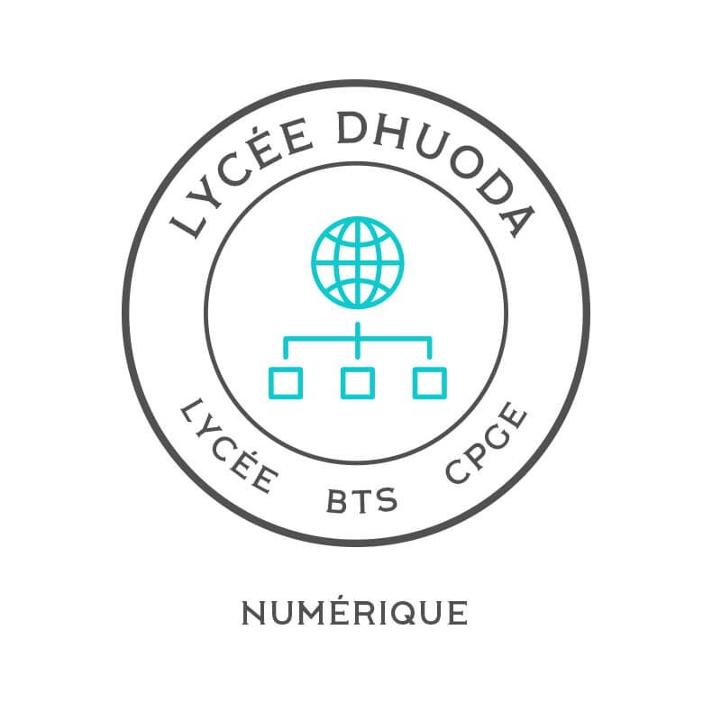
Internship Report
Manufacture of Metal Structures
Eric Fuchs
2020
Dhuoda college

Slide 2
Internship Report
Manufacture of Metal Structures
Eric Fuchs
2020
Dhuoda college
Notes:
Internship Report
GABAREL Damien
Internship from 27/05 to 10/06
Within the company SUD INOX
In Nîmes
Manufacture of Metal Structures
Under the direction of Éric Fuchs Factory Manager
Within the framework of the BTS SNIR internship
Year 2020
Dhuoda college

Slide 3
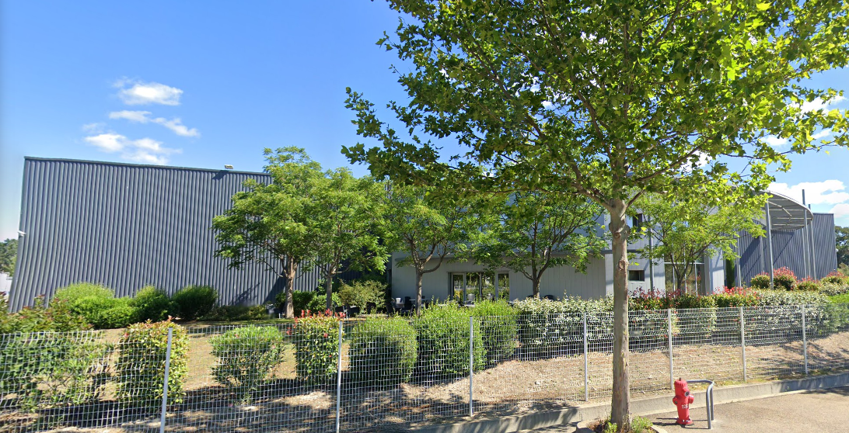
SUD INOX
Notes:
I found SUD INOX Company while prospecting in Grezan industrial zone by going to see the companies one by one and then offering them my services.
The company is called SUD INOX because it is located in Nîmes (in the "south/SUD") and makes stainless steel/INOX kitchen materials.

Slide 4
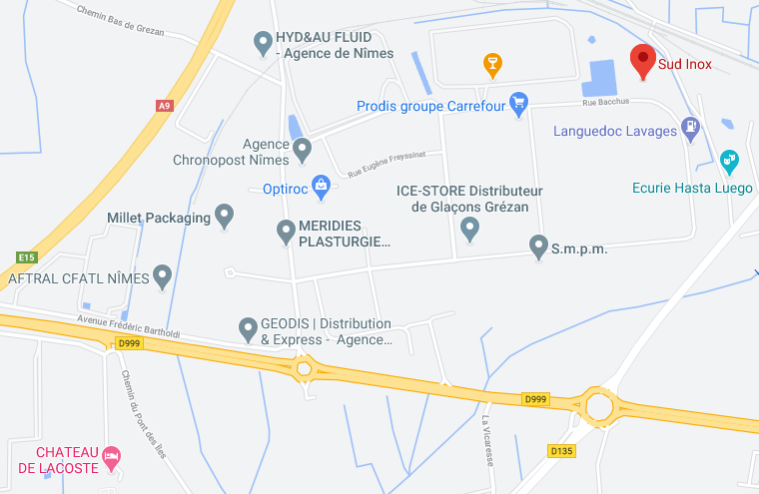
LOCATION
Notes:
SUD INOX is located in I.Z of Grezan at 561 Bacchus Street, 30000 NÎMES and employs 34 employees.
I did my internship from 27/05 (May) to 10/06 (June) (7 weeks)
Mr. Fuchs Éric Factory Manager is my placement supervisor.
I had to work 9 hours with a 10 minute break at 10:00 & the lunch break from noon to 1:00.
I was not paid for this work but my transportation was reimbursed.
My task in this company was to unwrap and ship.
It consists in removing the plastic wrap with a cutter on one of the edges of the part and then manually pulling the remaining surface.

Slide 5
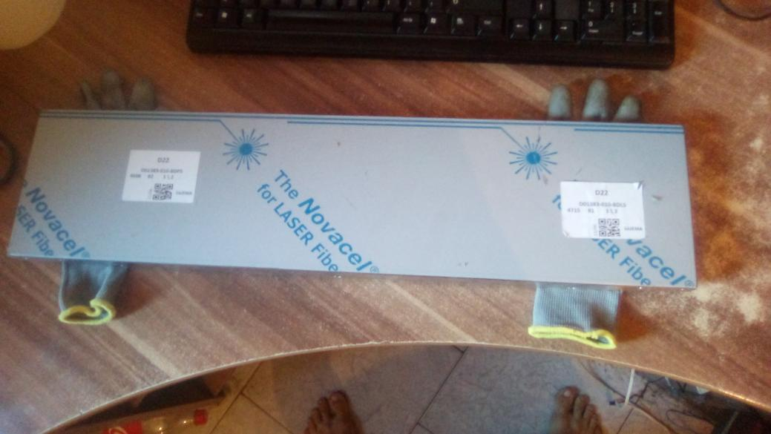
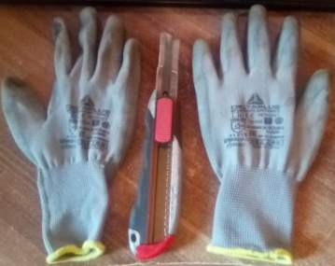
Defilming
Notes:
My first mission was to unwrapping the kitchen pieces by taking them out of the roles, removing the film and putting them back in, allowing the assembler to do their job properly, this mission took well 60% of my time.
Unwrapping of stainless steel parts (from fine sheet metal work) which consists in the removal of a thin plastic wrap placed by the Spinner on the stainless steel plates.
The removal is done with a cutter on one of the edges of the part and then the whole surface is removed manually.
Why does the filming machine put on film if it is to be removed afterwards?
Because the entire film is not removed, the parts are left uncovered to prevent scratching during transport.

Slide 6
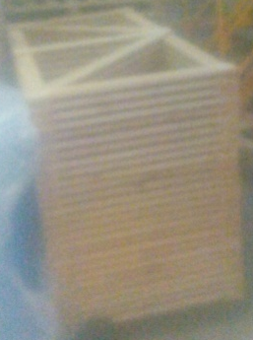
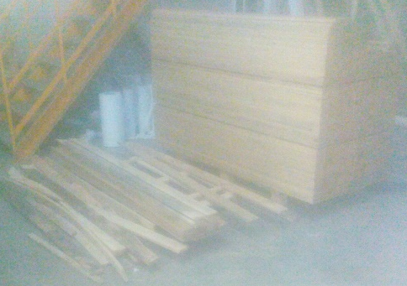
Shippment
backsplashes
boards
Notes:
Construction of boxes until they are shipped
The boxes had to be custom-made by hand to carry the packages:
General rule
Horizontal pallet, perpendicular backsplash, one board on each side and then staple it all together with the industrial stapler.

Slide 7
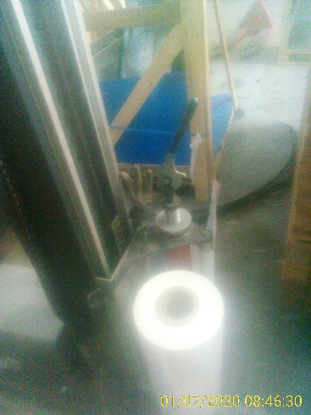
Filming machine
Notes:
The box is then placed on the filming machine (machine allowing to unwrap), this machine requires a learning of the grip because directing the film (white here) during the automatic process is not easy especially according to the parts.
In short: the more parts there are, the easier it is to wrap them.
During this training course, I was able to consolidate already acquired skills such as punctuality, follow-up of instructions, ergonomics.
I encountered difficulties during my internship. Some of the workers taught me how to optimize the tasks assigned to me to save my fatigue and make the work less difficult and less strenuous, mainly in terms of handling.
//A COMPLETER (DEFILMING) //
I encountered much more difficulties in defilming job compared with the shipping because a handling employee (Kévin) help me a lot to permit me to learn quickly. The most difficult part was to learn how to use the machine.
//What was the positive aspects of this placement? //
The positive aspects of this internship were
-friendliness of the hierarchy
-Camaraderie (both with employees and superiors)
-paid to do sports
-Work that is not mentally tiring
-Auxiliary reflection possible during work
-Unconscious learning of gestures
//what was the negative aspect? //
But their negative aspect was:
-Trying & complex adaptability (personal).
-over time destroys health (back, bones and brain by this increased non-reflection)
//Would you like to work in the future in the same company? Explain why or why not? //

Slide 8

What is Ubuntu ?
Notes:
What is Ubuntu?
Ubuntu is a complete Linux distribution (operating system made from a software collection that is based upon the Linux kernel and, often, a package management system) based on Debian who’s a FOSS /*1*/ /*2*/. This is in contrast to proprietary software, where the software is under restrictive copyright licensing and the source code is usually hidden from the users available with both community and professional support. The Ubuntu objective is : /*3*/
that software should be available free of charge & is no extra fee for the “enterprise edition”.
that software tools should be usable by people in despite any disabilities
-and that people should have the freedom to customize and alter their software in whatever way they see fit.
Ubuntu includes the very best in translations and accessibility infrastructure that the Free Software community has to offer, to make Ubuntu usable by as many people as possible.
Ubuntu is shipped in stable and regular release cycles; a new release will be shipped every six months. Every two even years an Ubuntu long term support (LTS) release will become available, that is supported for 5 years. The Ubuntu releases in between (known as development or non-LTS releases) are supported for 9 month each.
Ubuntu is entirely committed to the principles of open source software development; we encourage people to use open source software, improve it and pass it on.
Ubuntu includes thousands of pieces of software, starting with the Linux kernel version 5.4 and GNOME 3.28, and covering every standard desktop application from word processing and spreadsheet applications to internet access applications, web server software, email software, programming languages and tools and of course several games.
Sponsorship by Canonical
The Ubuntu Project is sponsored by Canonical Ltd. Canonical will not charge licence fees for Ubuntu, now or at any stage in the future. Canonical’s business model is to provide technical support and professional services related to Ubuntu. We encourage more companies also to offer support for Ubuntu, and will list those that do on the Support pages of this web site.

Slide 9

Ubuntu, une distribution Linux, c'est-à-dire un système d'exploitation, destinée aux ordinateurs personnels.

Slide 10


Slide 11
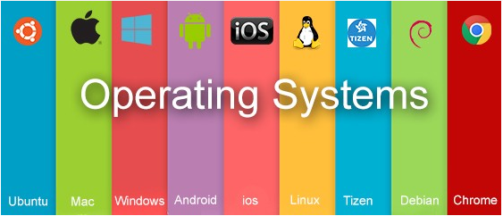

Slide 12
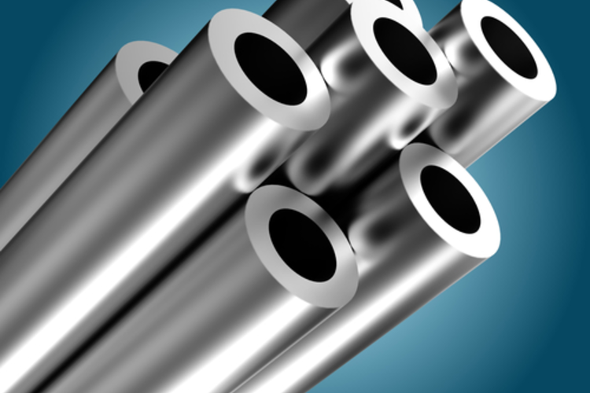
Notes:
The Stainless-Steel Family
A short description of the various grades of stainless steel and how they fit into distinct metallurgical families. It has been written primarily from a European perspective and may not fully reflect the practice in other regions. Stainless steel is the term used to describe an extremely versatile family of engineering materials, which are selected primarily for their corrosion and heat resistant properties. All stainless steels contain principally iron and a minimum of 10.5% chromium. At this level, chromium reacts with and moisture in the environment to form a protective, adherent and coherent, oxide film that envelops the entire surface of the material. This oxide film (known as the or layer) very thin (2-3 manometers). [1nanometre = 10-9 m]. The passive layer on stainless steels exhibits a truly remarkable property: when damaged (e.g. abraded), itself-repairs as chromium in the steel reacts with oxygen and moisture in the environment to reform the oxide layer. Increasing the chromium content beyond the minimum of 10.5% confers still greater corrosion resistance. Corrosion resistance may be further improved, and a wide range of properties provided, by the addition of 8% or more nickel. The addition of molybdenum further increases corrosion resistance (in particular, resistance to pitting corrosion), while nitrogen increases mechanical strength and enhances resistance to pitting.
Categories of Stainless Steels
The stainless-steel family tree has several branches, which may be differentiated in a variety of ways e.g. in terms of their areas of application, by the alloying elements used in their production, or, perhaps the most accurate way, by the metallurgical phases present in their microscopic structures:
Ferritic
Martensitic (including precipitation hardening steels)
Austenitic
Duplex steels (consisting of mixture of ferrite and austenite)
Within each of these groups, there are several “grades” of stainless steel defined according to their compositional ranges. These compositional ranges are defined in European (and other e.g. USA) standards, and within the specified range, the stainless-steel grade will exhibit all of the desired properties (e.g. corrosion resistance and/or heat resistance and/or machineability). More detail on standards and grades is given below.)

Slide 13
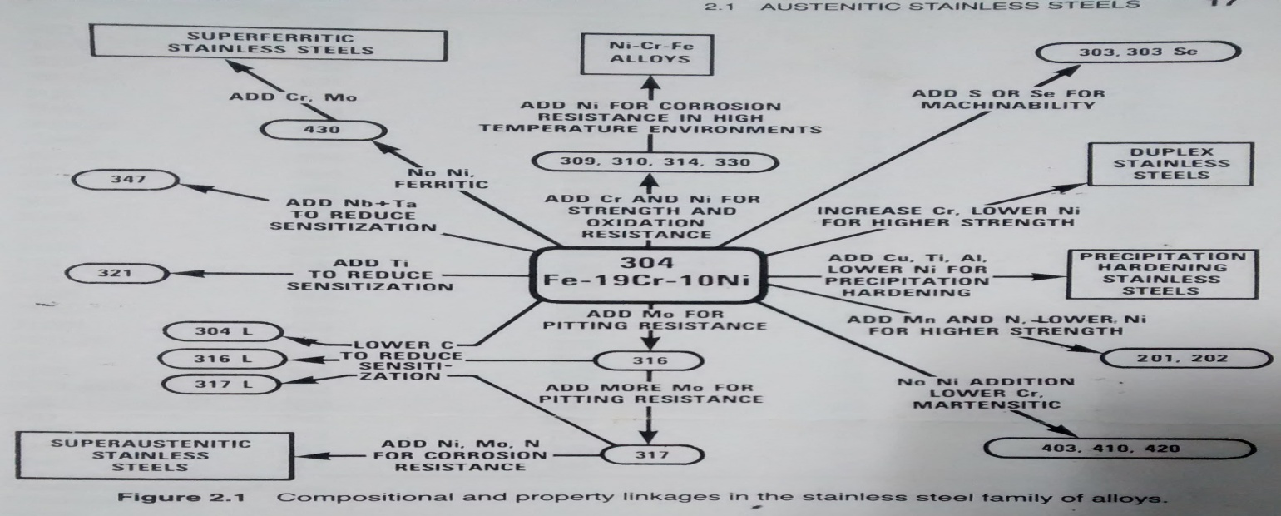

Slide 14
Notes:
Nickel recycling
Recycling metals such as nickel creates win-win scenarios for both the environment and industry. It is an integral part of the metals industry; metals are recycled because of their value and because most can be recycled without loss of quality. This is particularly true of non-ferrous metals such as nickel.
As recyclable metals are valued, there is an infrastructure for gathering and processing them. Although society is now likely to perceive metal recycling as an environmental activity, it has existed as a profitable economic sector in its own right for thousands of years. In most countries, the economics of gathering, sorting, preparing, transporting and using scrap metal employs more people and is of greater economic importance than the mining and refining of ores.
Nickel and nickel-containing alloys can be returned to their original state or converted to a different, but still valuable, form. Examples are nickel-containing stainless-steel scrap being turned into new stainless steel, or nickel from recycled batteries being used for nickel-containing stainless steel.
The efficiency of nickel recycling is one of the highest
Around 68% of all nickel available from consumer products is recycled and begins a new life cycle (reference year 2010); another 15% enters the carbon steel loop. However, around 17% still ends up in landfill, mainly in metal goods and in waste electrical and electronic equipment.
Recycling is an important factor in nickel's life cycle and an important contributor to global sustainability. Nickel-containing products, such as stainless steel, are durable and are designed for long-term use. Demand for recycled nickel is growing; it is part of the solution as a complement to primary production.
"In 2006, the metals industry published a declaration on recycling principles. The declaration, which was signed by 18 metal commodity associations including the Nickel Institute, aims at encouraging policy-makers, designers and manufacturers to adopt life cycle thinking when developing metals recycling policies.
Many metals can be recycled infinitely without any loss of properties. To date, the levels of recycled metals and alloys in products are used as a driver for increasing recycling rates and as an indicator of environmental performance. However, such an approach could encourage inefficiency in the production and use of recycled metals; the declaration shows that the recycled material content of a product fails to take account of the environmental costs and benefits associated with achieving this goal.
Using the recycled content approach may increase overall economic and environmental costs, as metal available for recycling is diverted to manufacturing a specific product rather than to where the recycling loop is more economically or environmentally efficient. The objective should be to promote eco-efficiency in metals use while maximizing the economic benefits to society.
A life cycle approach that considers the material flows at the end of the product life is preferable; this enables the most accurate assessment of the environmental and economic implications aimed at increasing recycling. Such an approach allows decision-makers to identify inefficiencies and associated environmental impacts as well as to optimize product recovery and material recyclability."
The concept of a circular economy is generally understood to be "a regenerative system in which resource input and waste, emission, and energy leakage are minimized by slowing, closing, and narrowing energy and material loops. This can be achieved through long lasting design, maintenance, repair, reuse, remanufacturing, refurbishing, and recycling1. This is in contrast to a linear economy which is a 'take, make, dispose' model of production2.
Given its outstanding properties and high recycling efficiency, nickel, as well as nickel-containing stainless steel, demonstrates how primary materials can contribute to a circular economy. As nickel improves corrosion resistance, it makes the product longer-lasting with lower maintenance. Its high value makes repairing and reusing nickel-containing products economically attractive. The high recycling efficiency ensures that nickel re-enters the economy following the end of life of nickel-containing products.
//mettre pourcentage de nickel dans l’acier inoxydable

