Slide 1
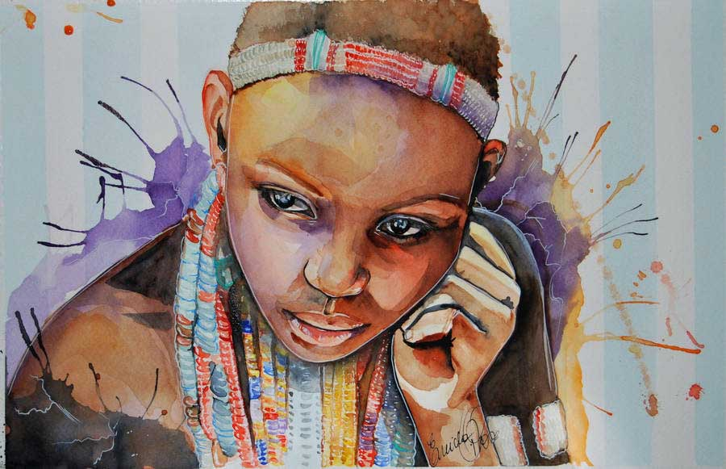



Children
of
Africa
Ebore Girl by fairies and dreams

Slide 3
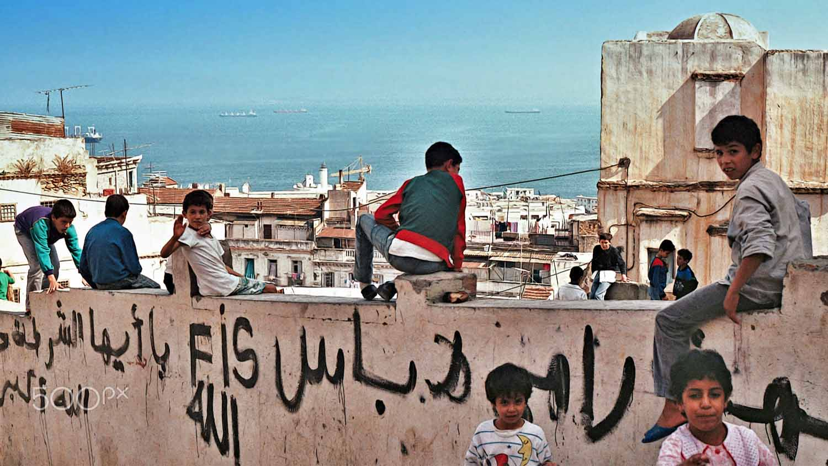
Algeria
Children in Kasba
Photography © by Jarda Novák on 500px

Slide 4
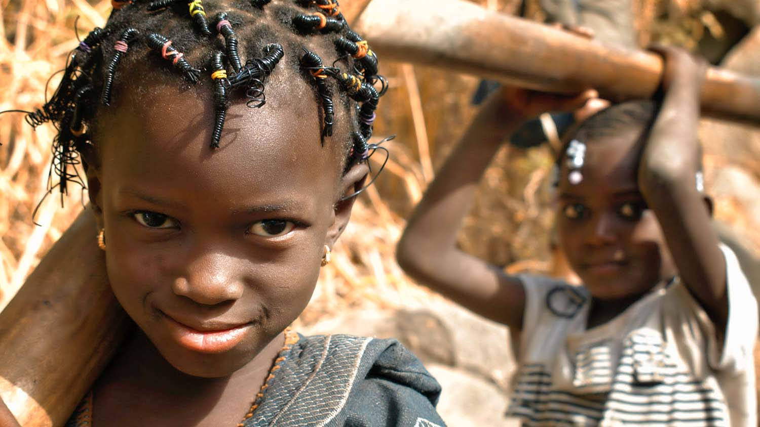
Burkina Faso
Young girls walking together in a small village near Bobo-Dioulasso, Burkina Faso, West Africa
Photography © by Benoit Demers on 500px

Slide 5
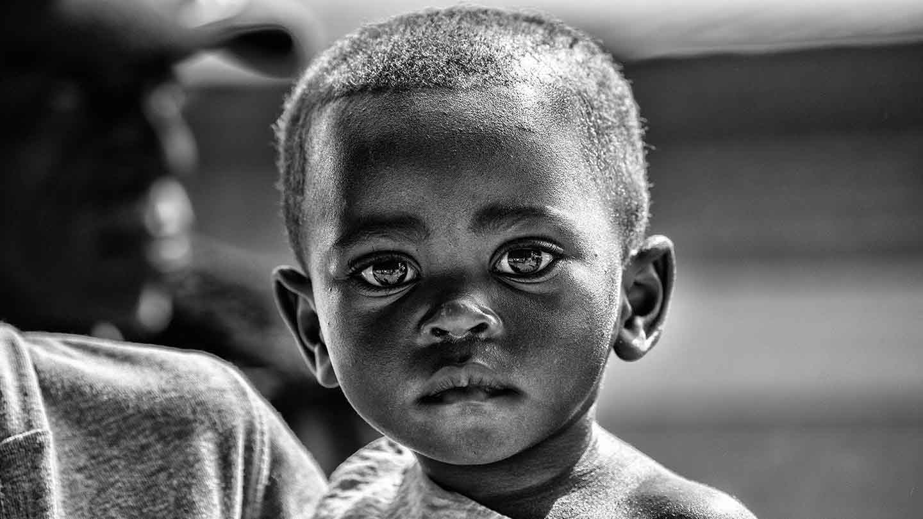
Burundi
Child from Burundi
Photography © by Kurt Drubbel on 500px

Slide 6
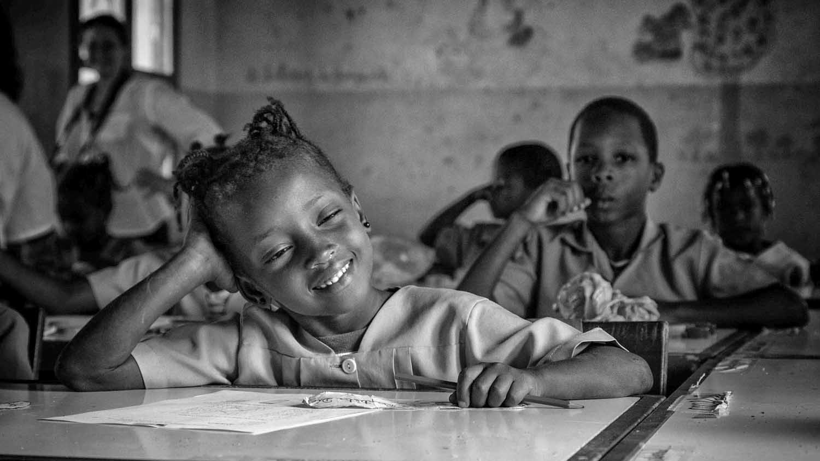
Cape Verde
Daydreaming
Photography © by Piotr Kutolowski on 500px

Slide 7
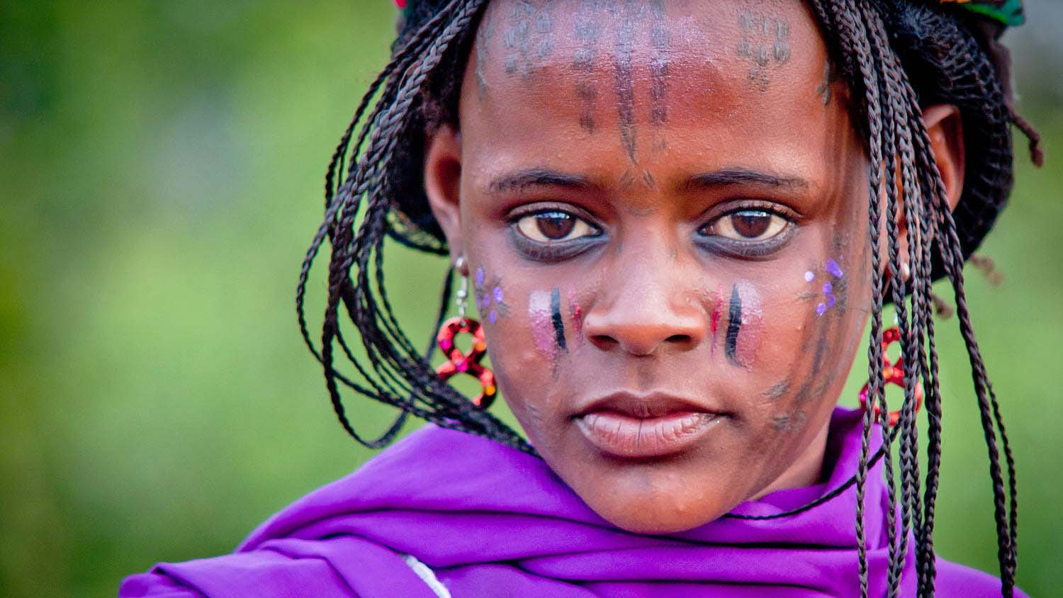
Cameroon
Mbororo
Photography © by Alfons Casalé on 500px

Slide 8
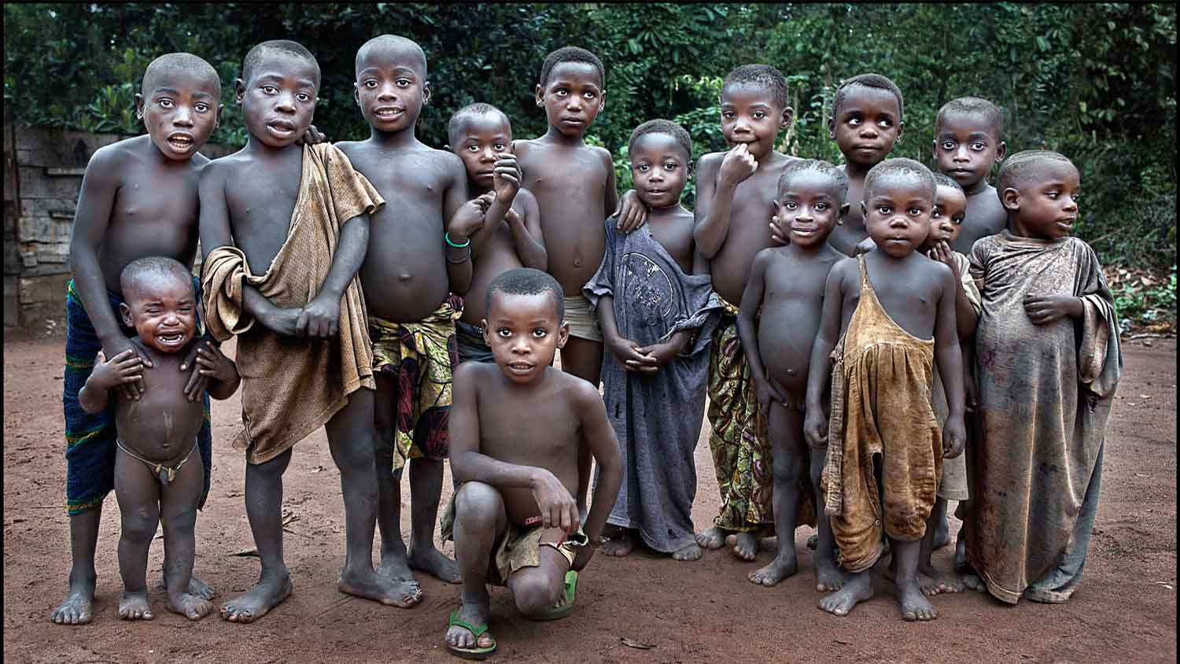
Central African Rep.
Los pigmeos Baka
Photography © by Ana Robles on 500px

Slide 9
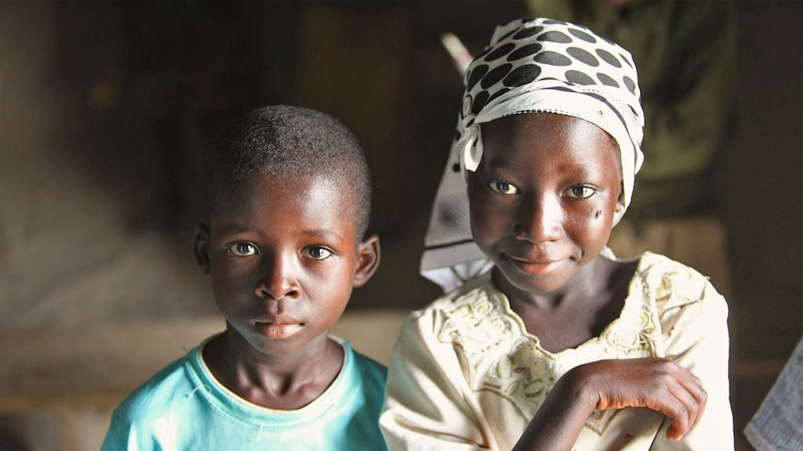
Chad
Children at a school in N'goury
Photography © by James Lane

Slide 10
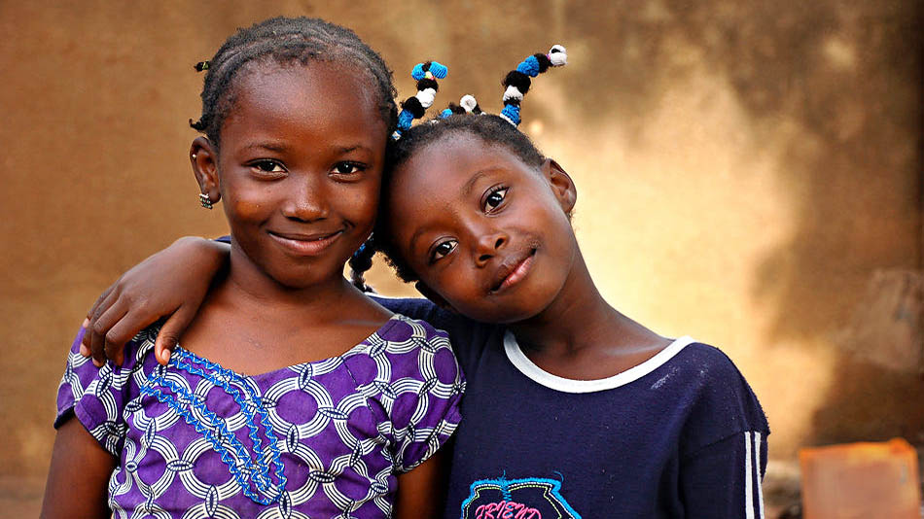
Cote d'Ivoire
Friends, taken at Bouake, Cote d"Ivoire
Photography © by Rajesh Bhattacharjee on 500px

Slide 11
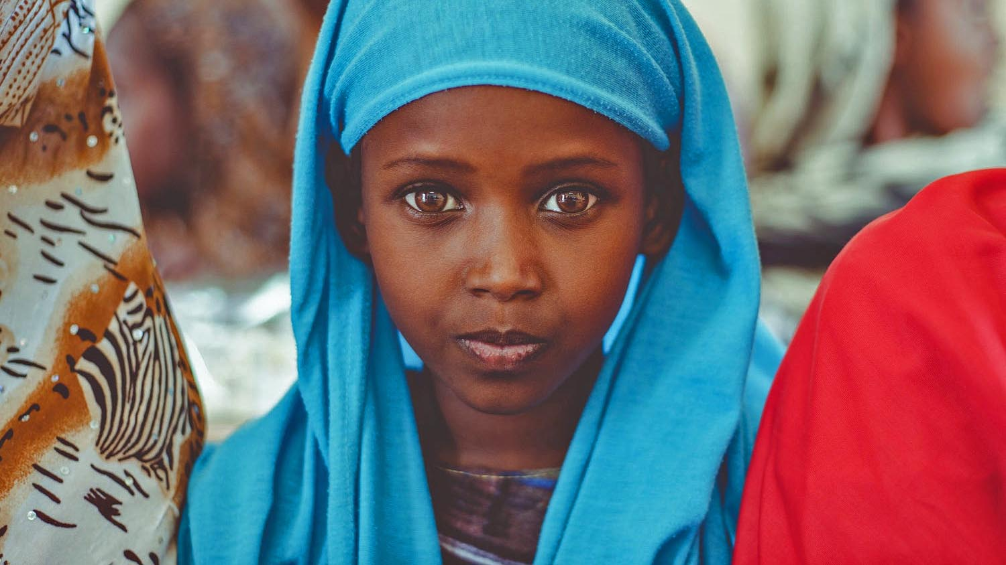
Djibouti
The girl with the blue scarf in one of Djibouti schools
Photography © by Muhammad Alemadi on 500px

Slide 12
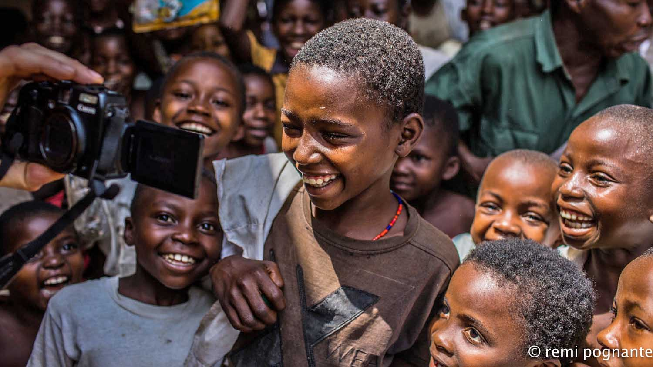
Dem.Rep. of the Congo
They see their faces in the camera, Congo-Kinshasa
Photography © by remi pognante on 500px

Slide 13
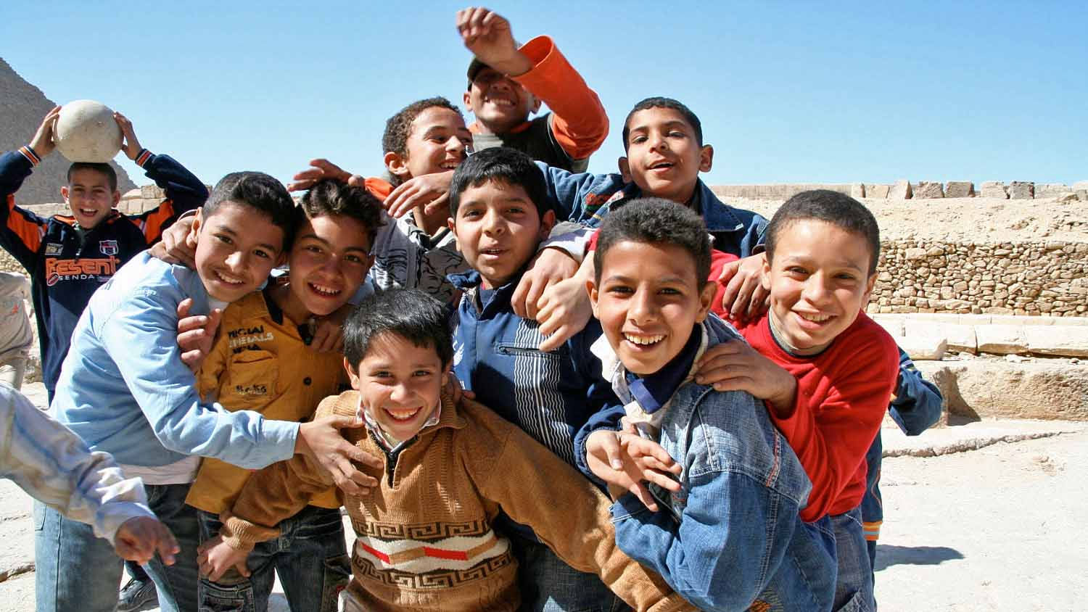
Egypt
We have a lot to learn from children, to be happy to meet new people, Cairo, Egypt
Photography © by Svetlana Povarova Ree on 500px

Slide 14
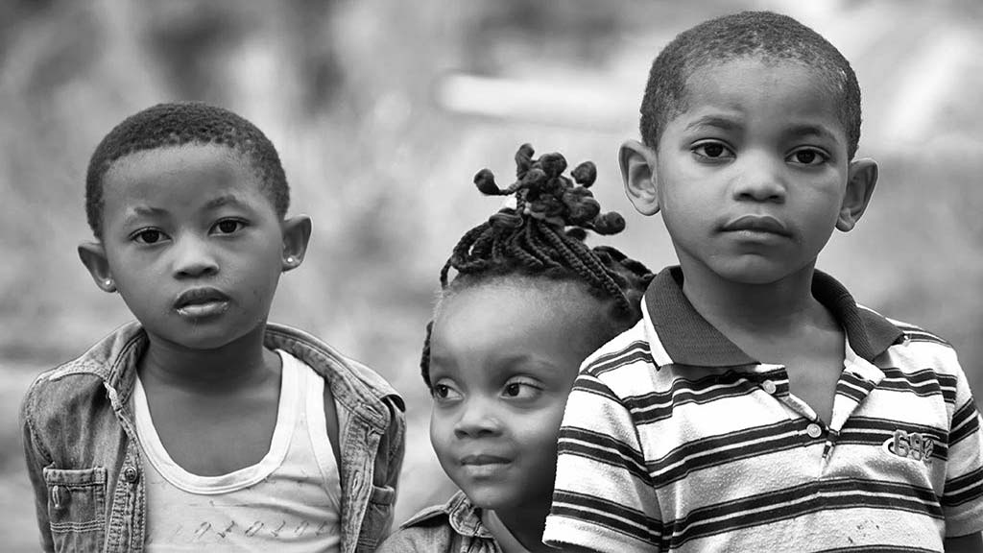
Equatorial Guinea
Children from Moka
Photography © by Félix Corral on 500px

Slide 15
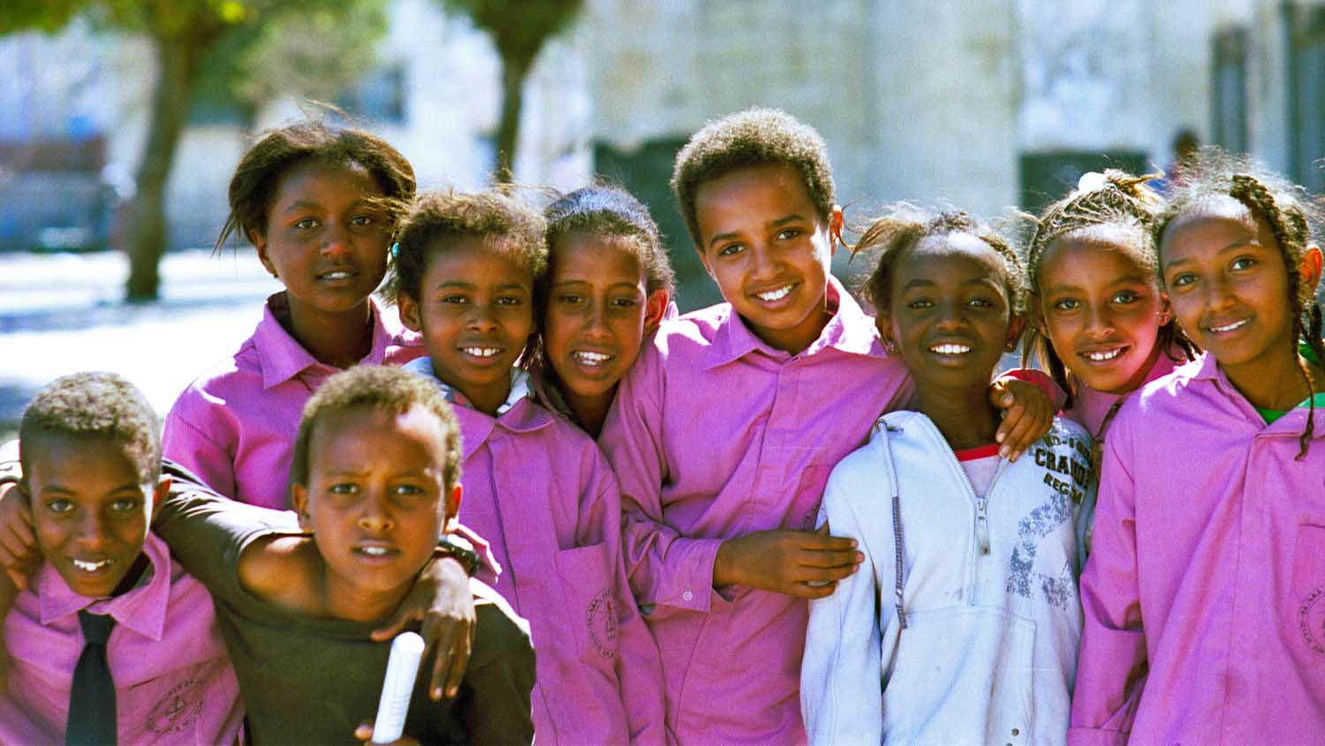
Eritrea
Happy schoolkids
Photography © by Joris Heus on 500px

Slide 16
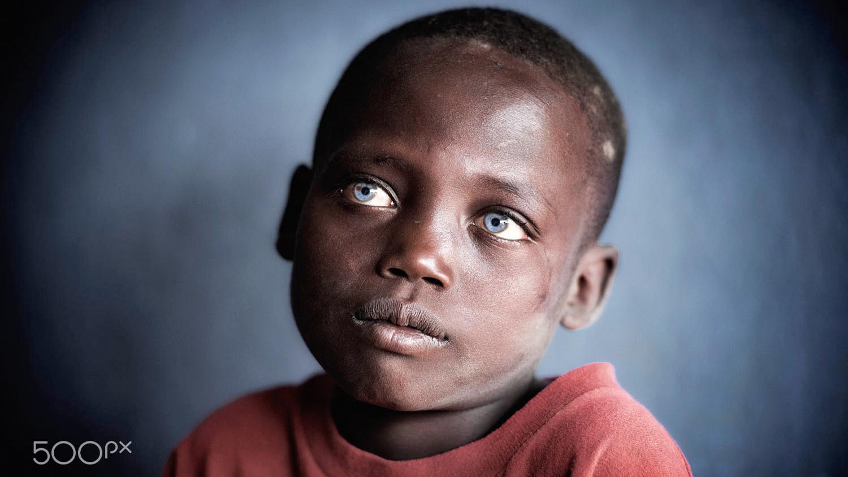
Ethiopia
Windows to the soul, a kid with startling blue eyes.
Photography © by Trevor Cole on 500px

Slide 17
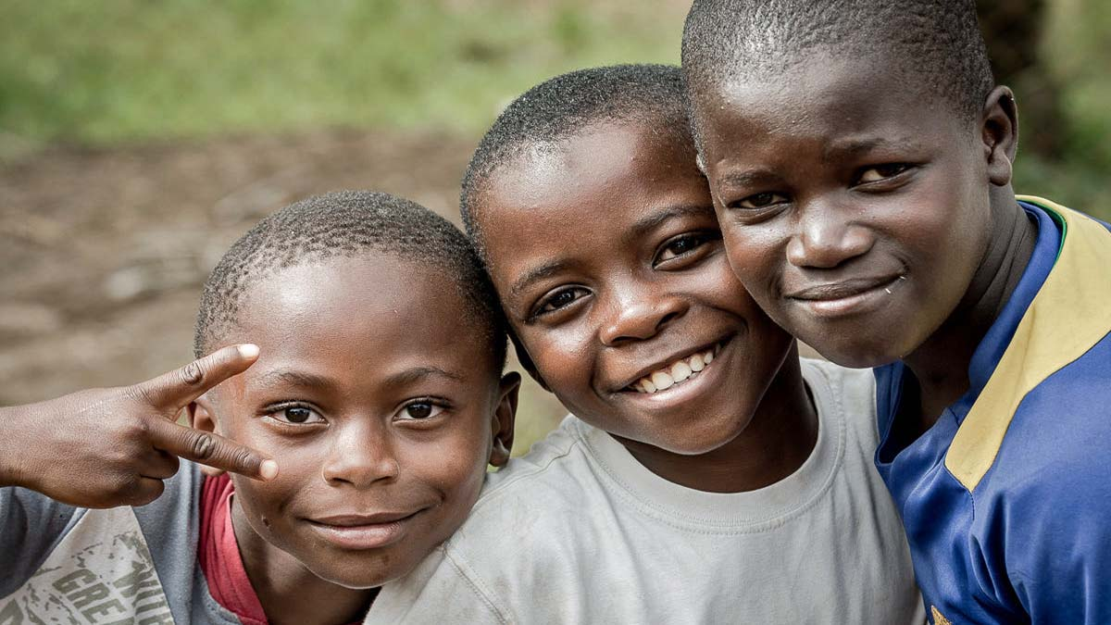
Gabon
Young boys outside the school
Photography © by Alessio Carelli on 500px

Slide 18
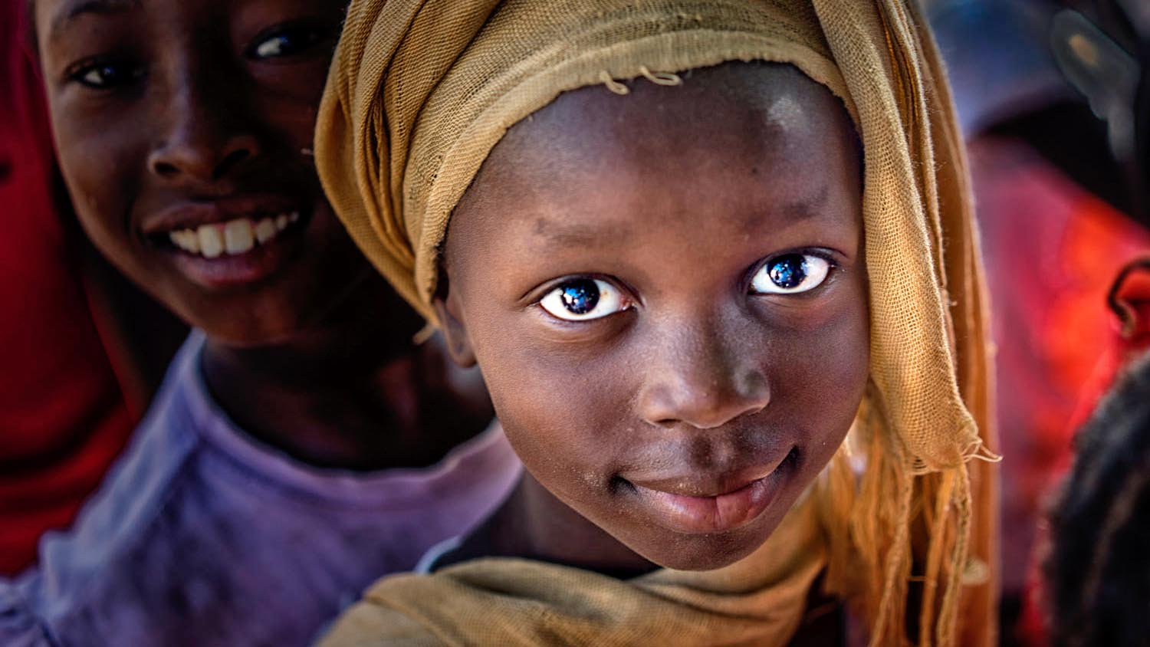
Gambia
Gambian villagers
Photography © by Steve Baker on 500px

Slide 19
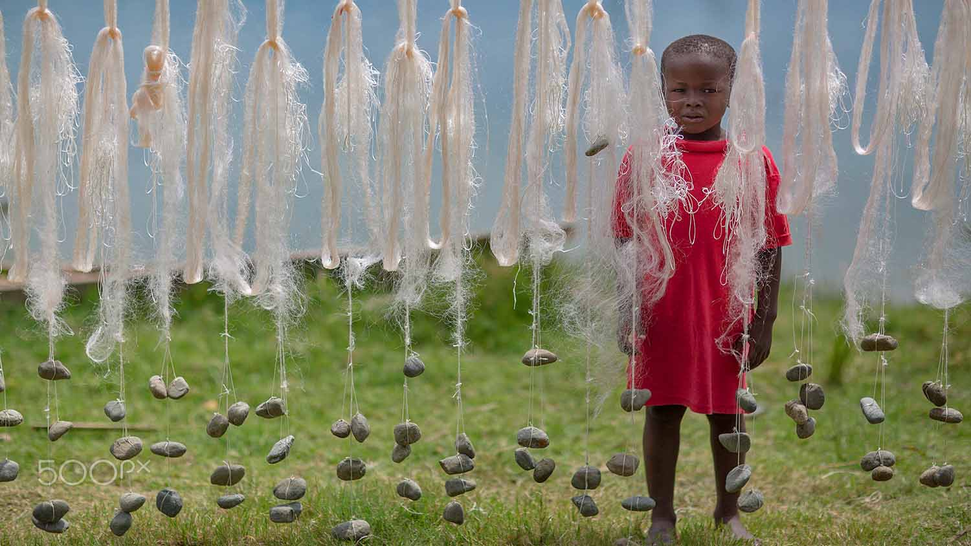
Ghana
He looked at me when I kept photographing the hanging fishing nets. Lake Bosumtwi
Photography © by Bob Pixel on 500px

Slide 20
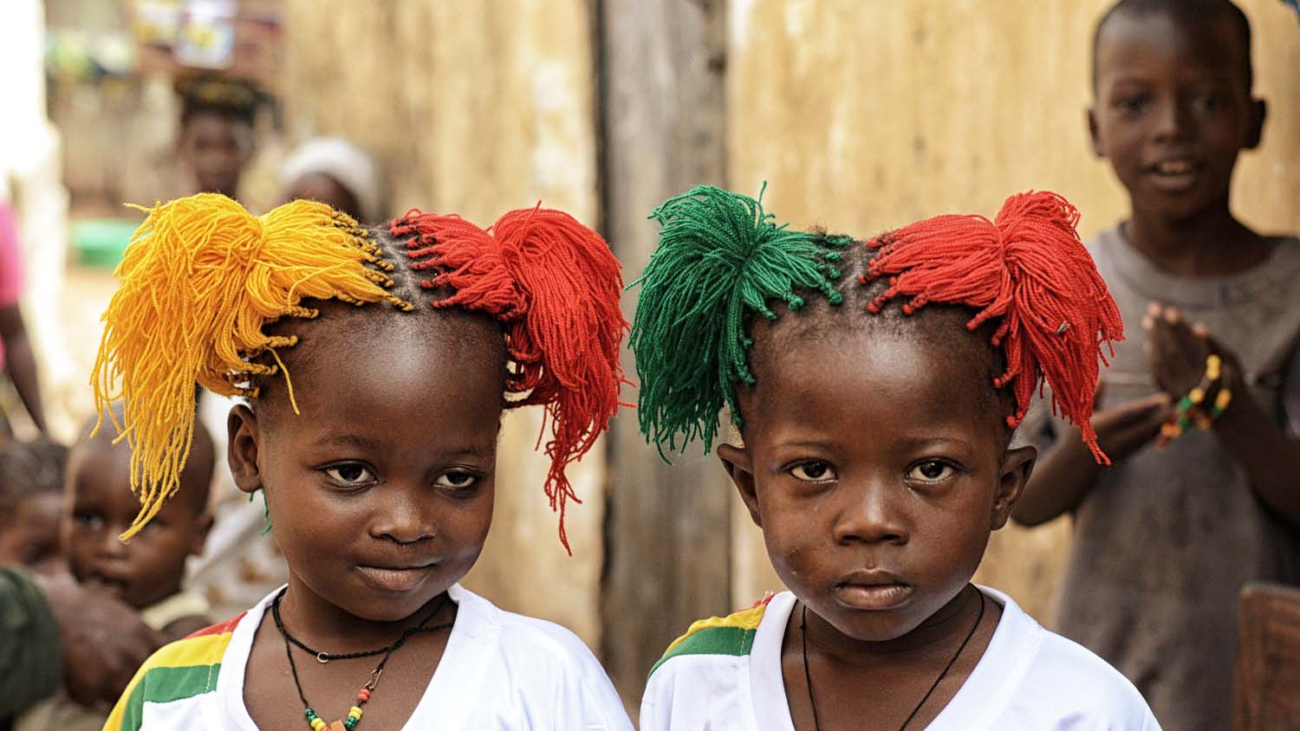
Guinea
Guinean supporters
Photography © by Vincenzo Vitale on 500px

Slide 21
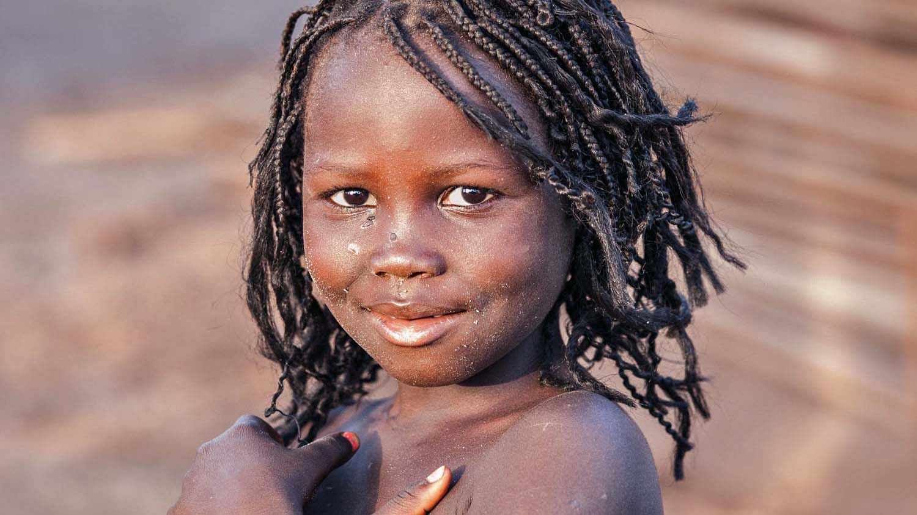
Guinea Bissau
Portrait of a child from Bijagós.
Photography © by Baldomero Coelho on 500px

Slide 22
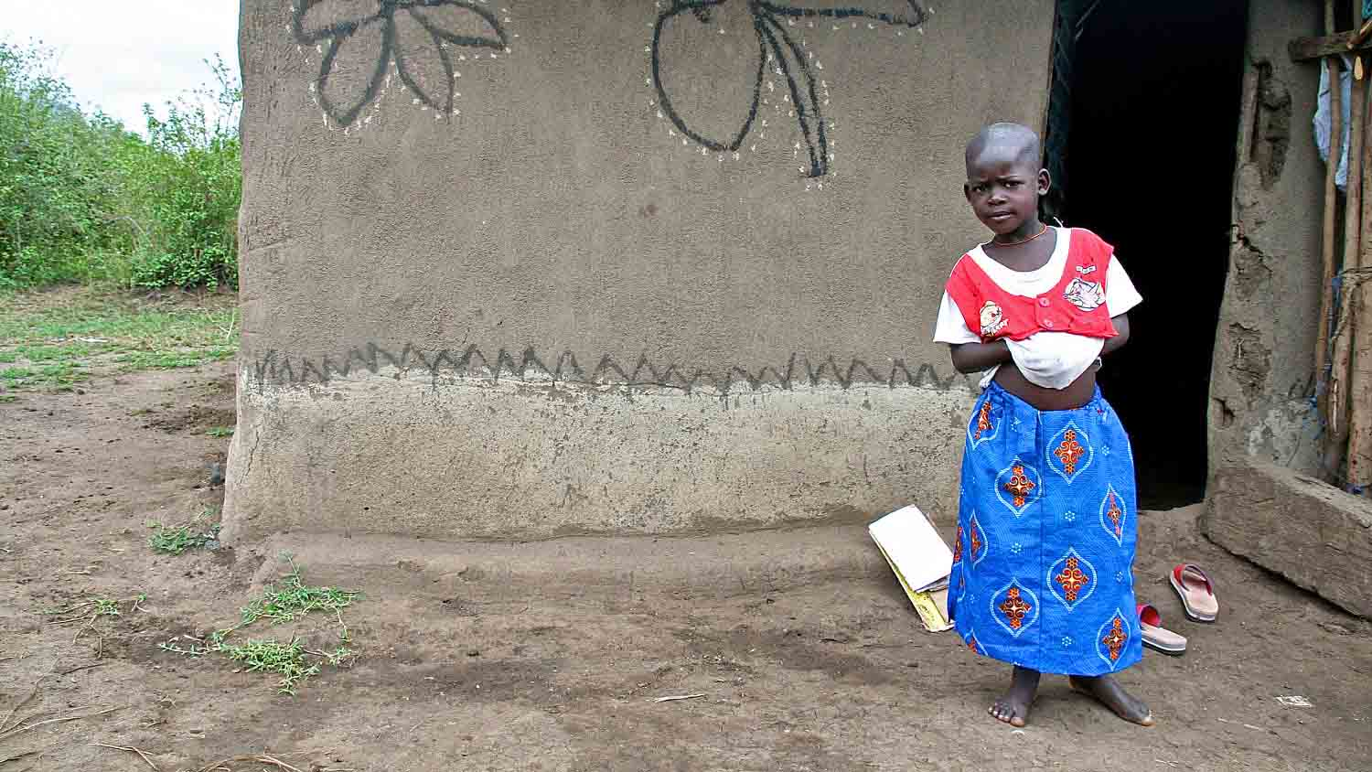
Kenya
Lucies told me that these flowers drew herself. Homa Lime, Kenya
Photography © by Svetlana Povarova Ree on 500px

Slide 23
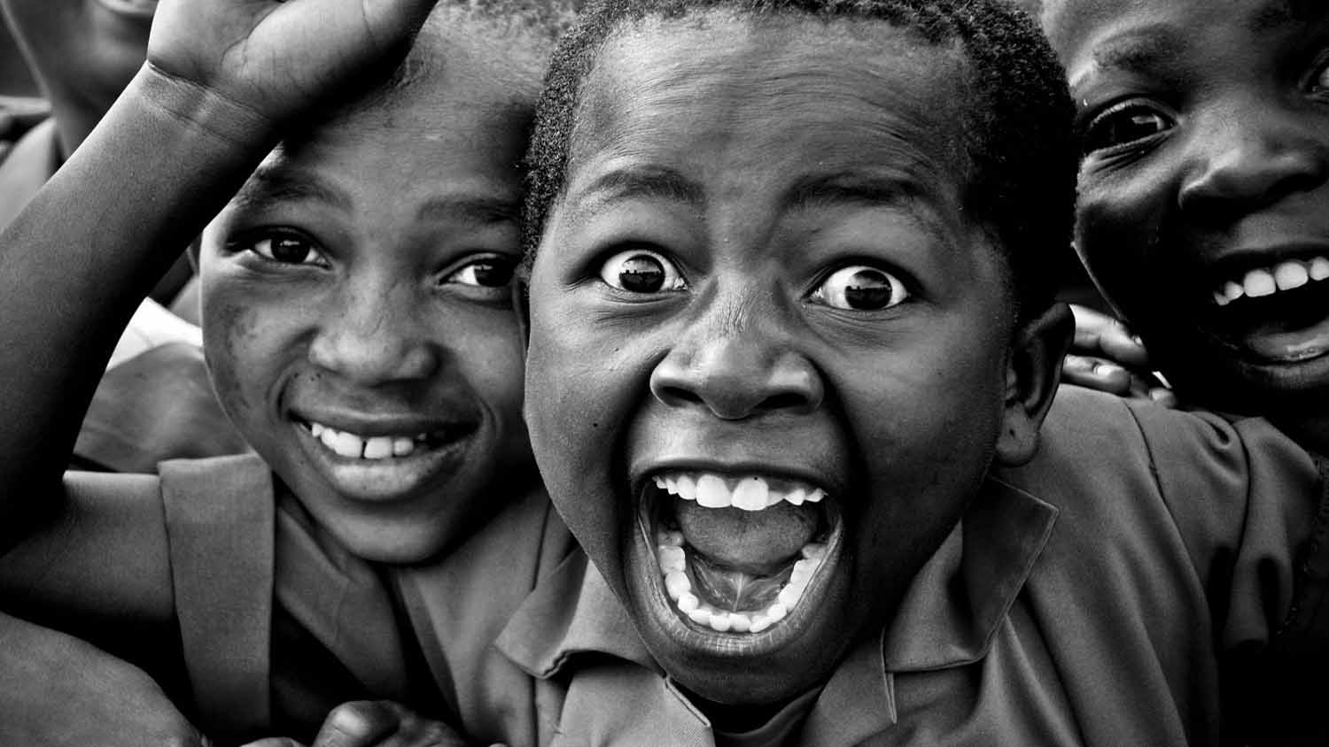
Lesotho
Smile
Photography © by Tsjikatilo on 500px

Slide 24
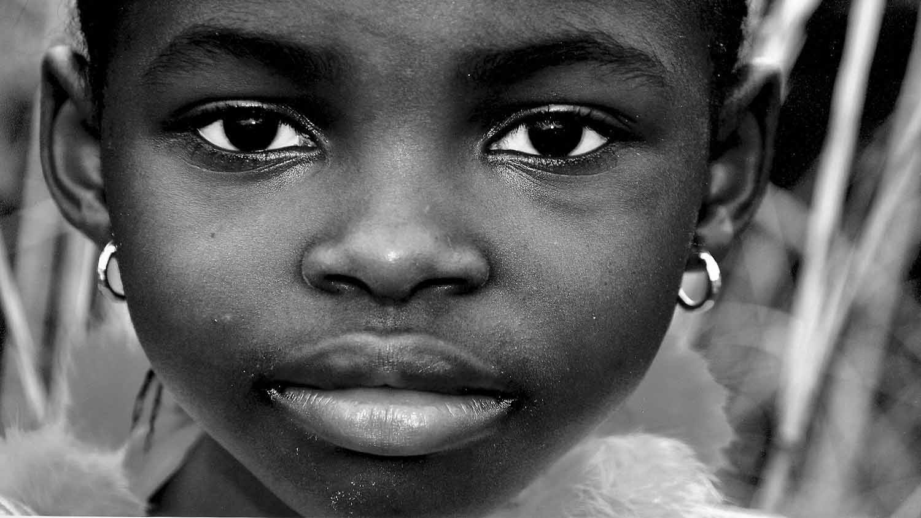
Liberia
The girl who experience war in Liberia.
Photography © by Svetlana Povarova Ree on 500px

Slide 25
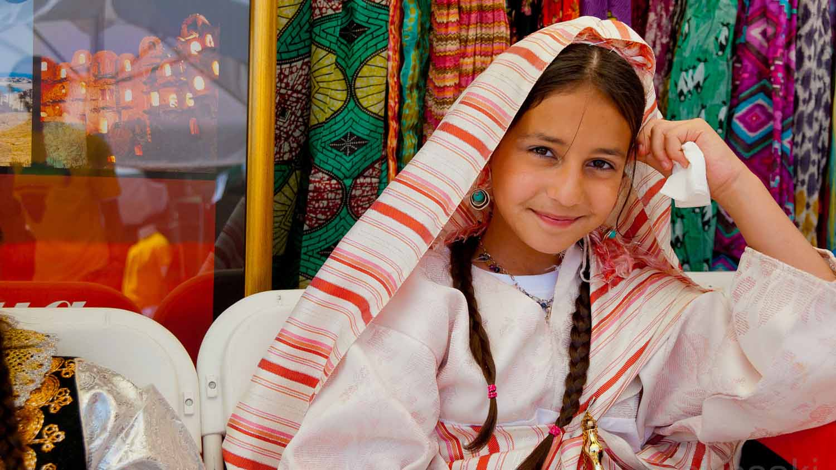
Libya
A little girl wearing traditional clothing.
Photography © by thanasaki on 500px

Slide 26
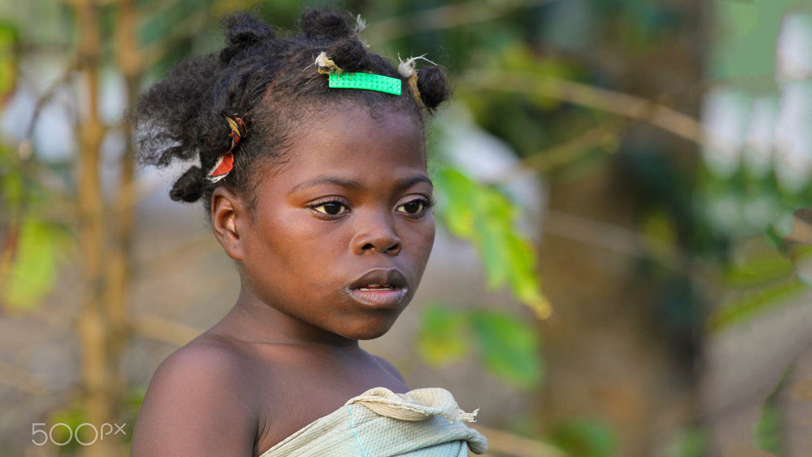
Madagascar
Little Malagasy girl along the famous Canal des Palanganes, near the town of Manakar.
Photography © by Olivier Schram on 500px

Slide 27
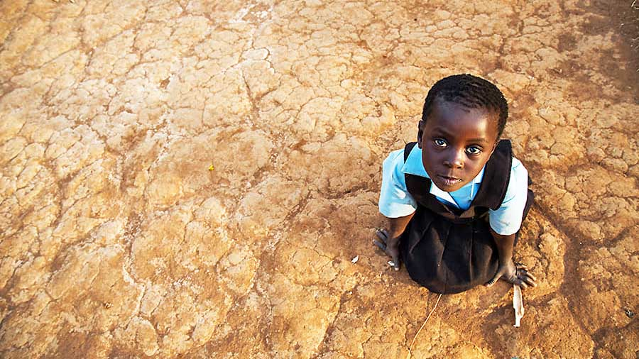
Malawi
You don't necessarily have to go to heaven to meet the Angels.

Slide 28
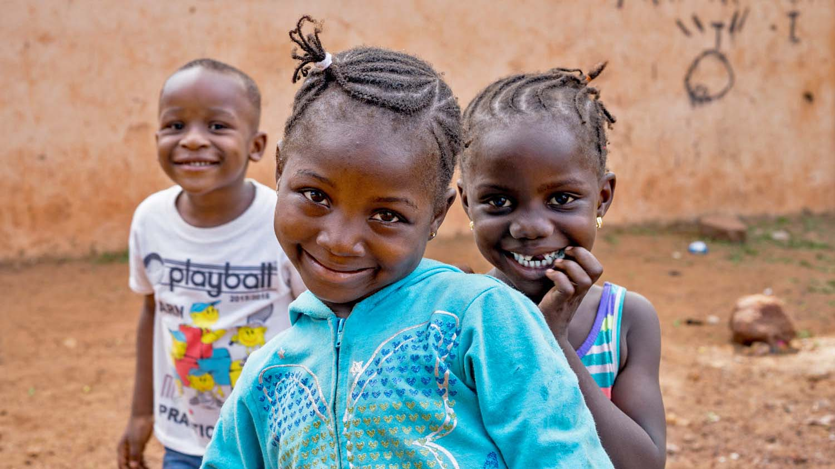
Mali
A trio of kids smile for the camera in the neighborhood of Bamako, Mali.
Photography © by Mark Fischer on 500px

Slide 29
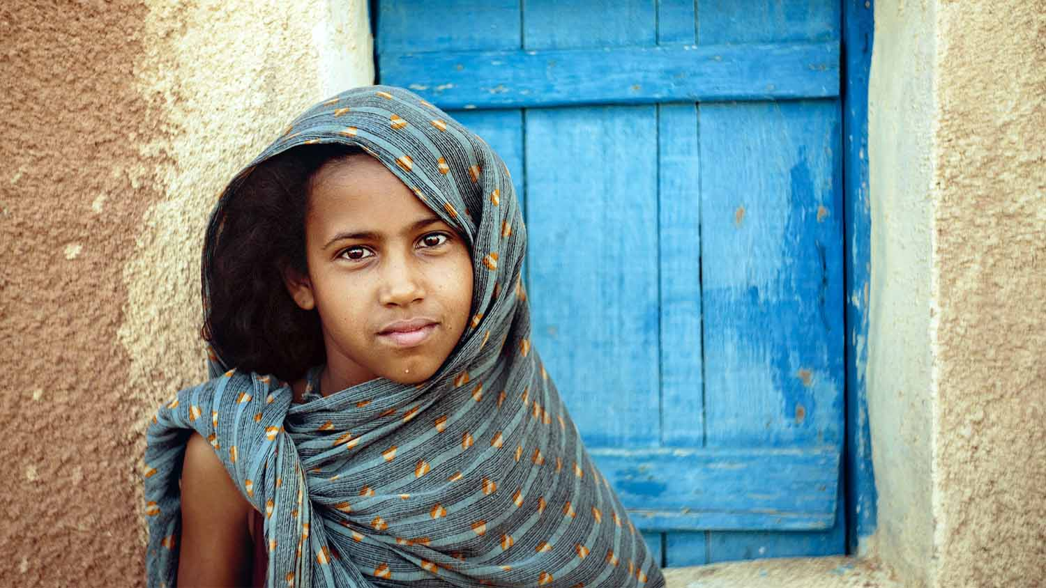
Mauritania
The youth of a family
Photography © by Adro Hacherre on 500px

Slide 30
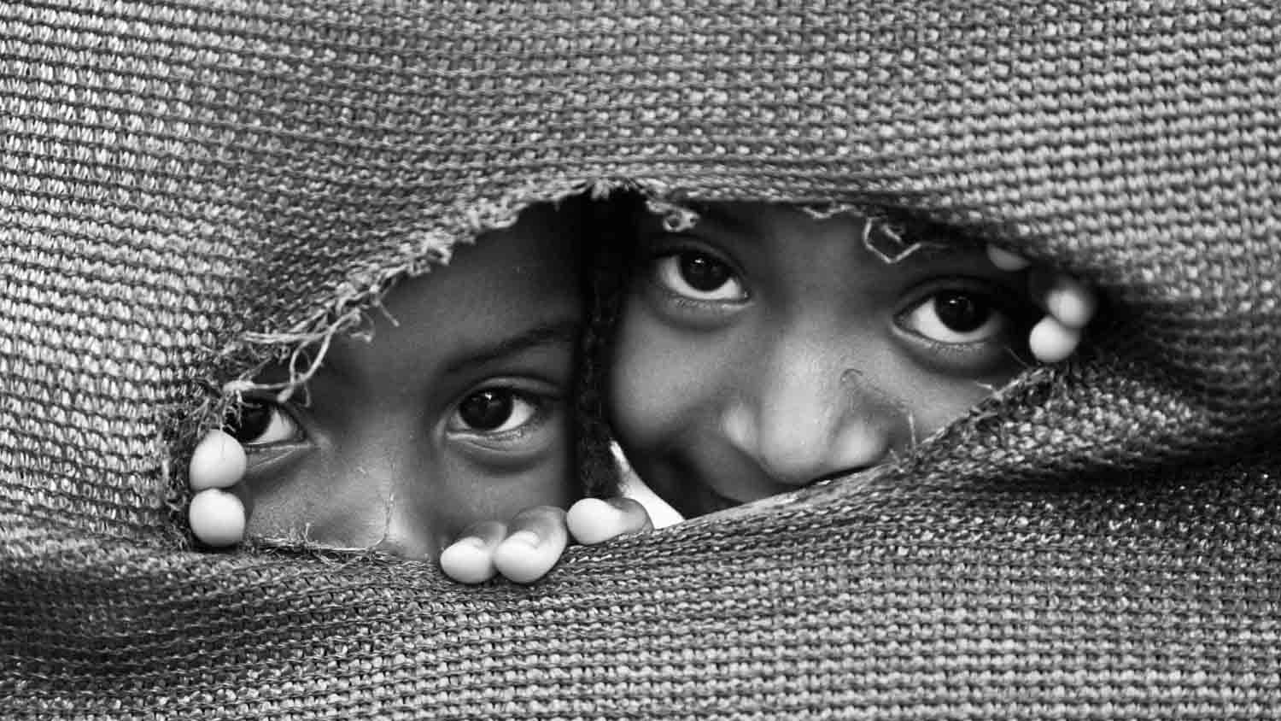
Mauritius
Photo taken at Le Morne Village, Mauritius
Photography © by Prashant Ramlall on 500px

Slide 31
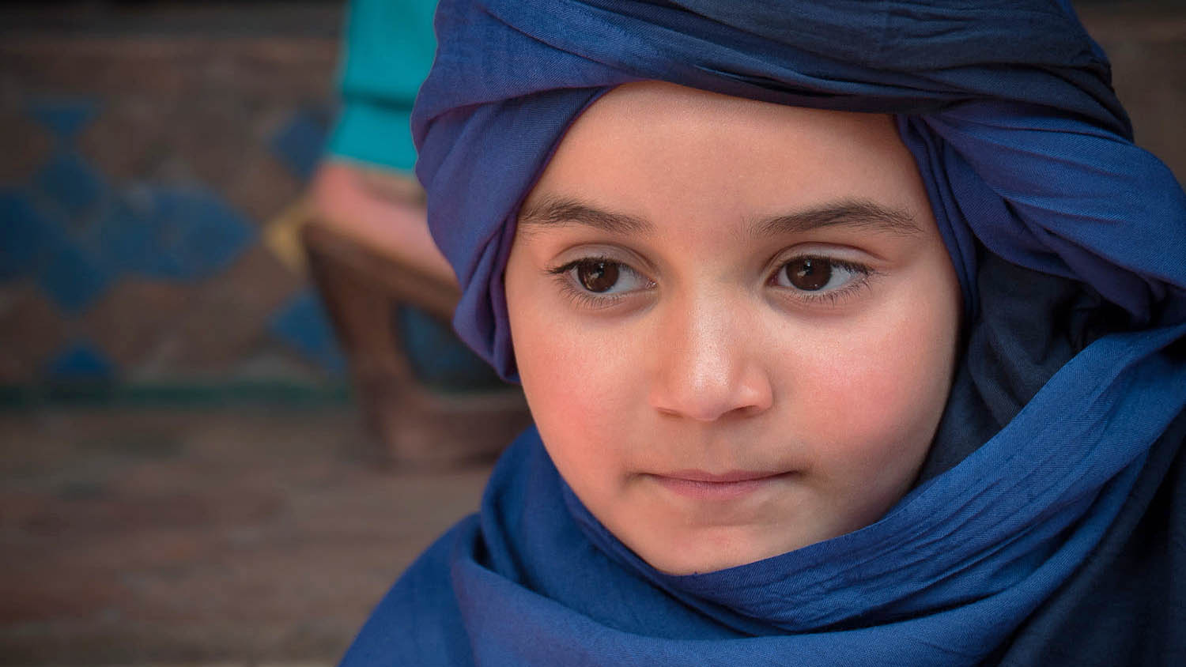
Morocco
Jade - an idea behind the head. Marrakesh, Morocco
Photography © by Amine Fassi on 500px

Slide 32
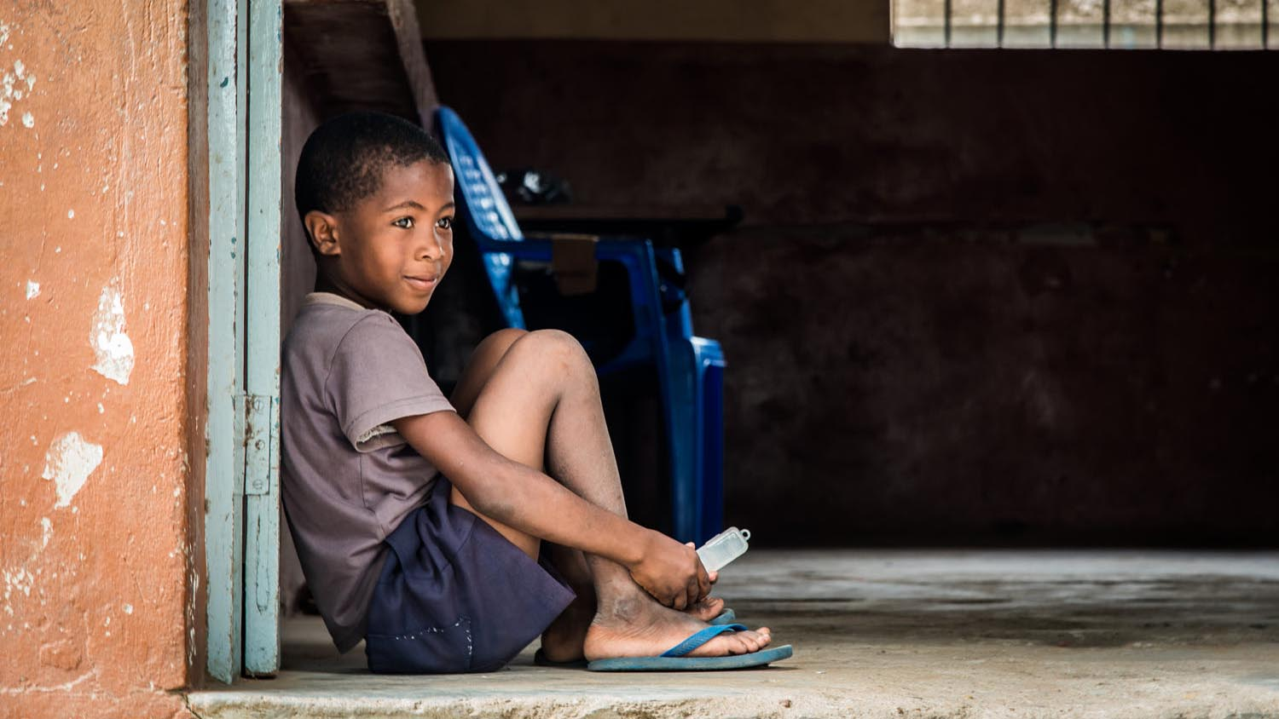
Mozambique
Thinking about the future Maputo, Mozambique.
Photography © by Gian Paolo Russo on 500px

Slide 33
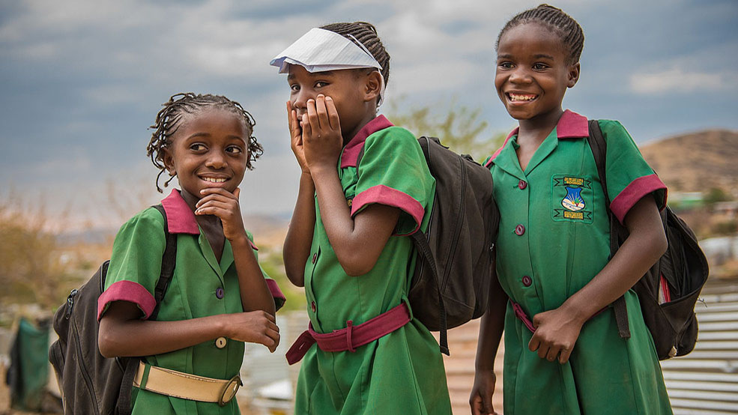
Namibia
Shy girls, Kattura in Windhoek, Namibia
Photography © by云儿gzy on 500px

Slide 34
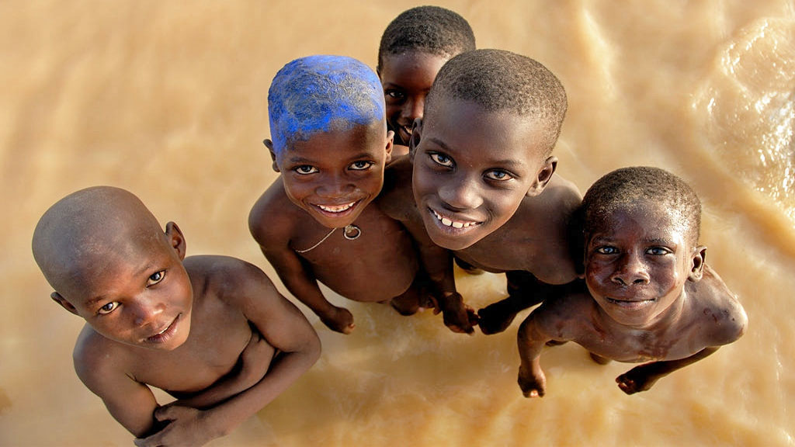
Niger
Rio Niger. Mali
Photography © by Gustavo Rodríguez on 500px

Slide 35
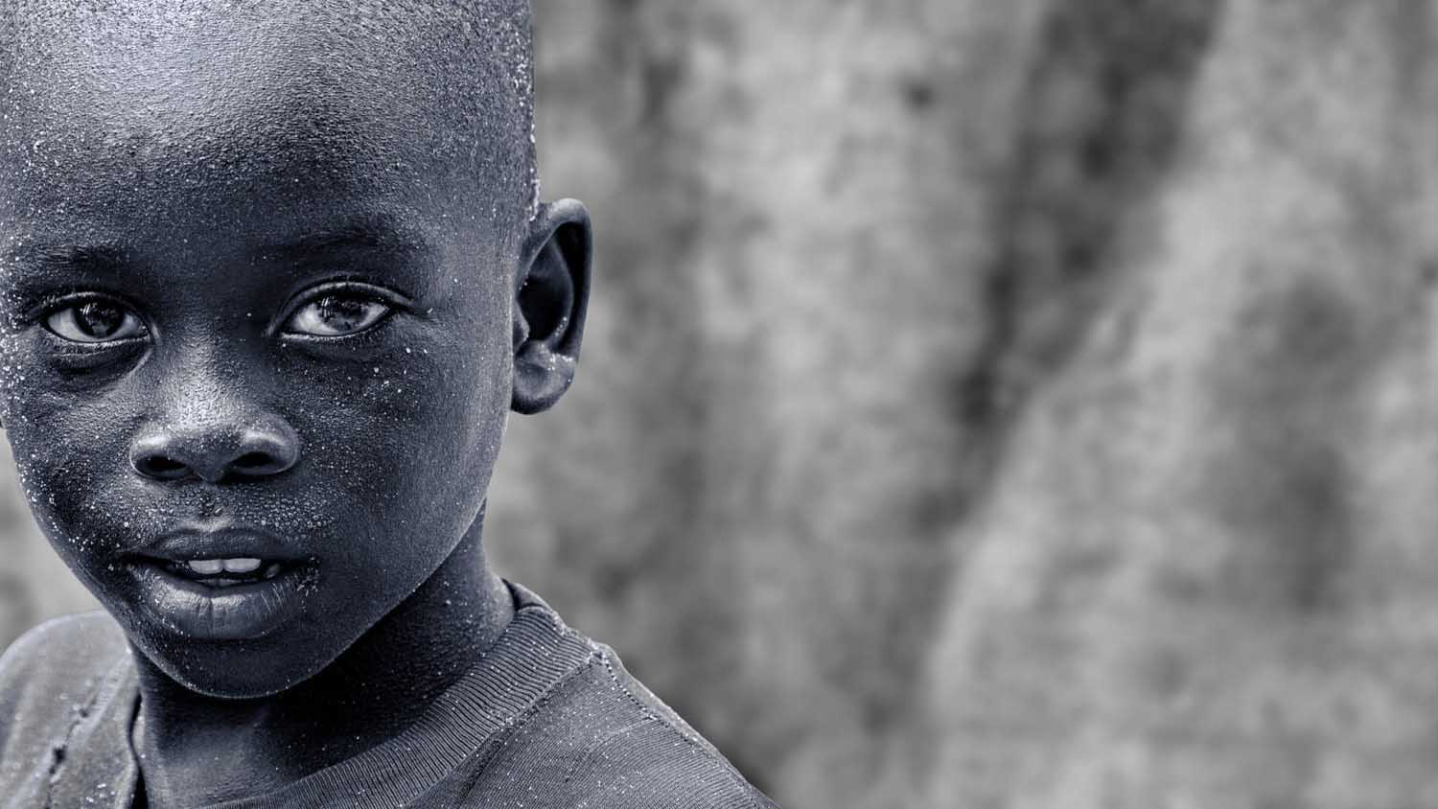
Nigeria
Face on the street
Photography © by Ram Iyer on 500px

Slide 36
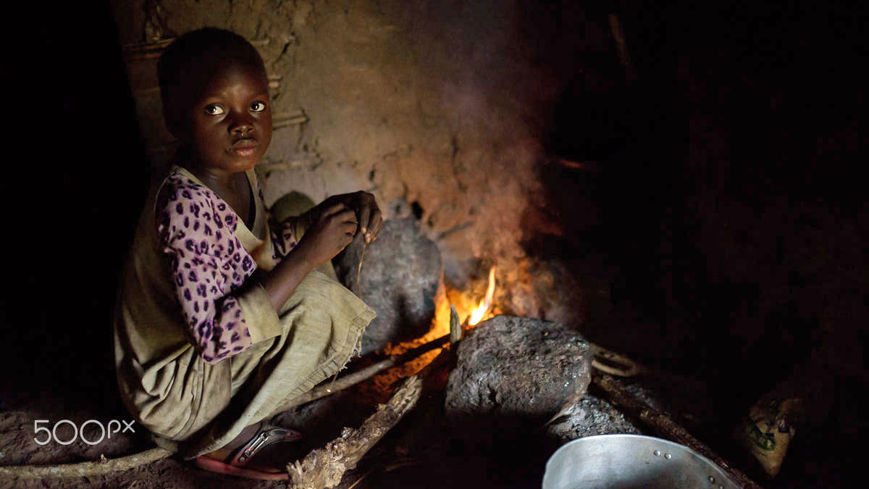
Republic of the Congo
Light a fire for breakfast
Photography © by Andrea Tabaro on 500px

Slide 37
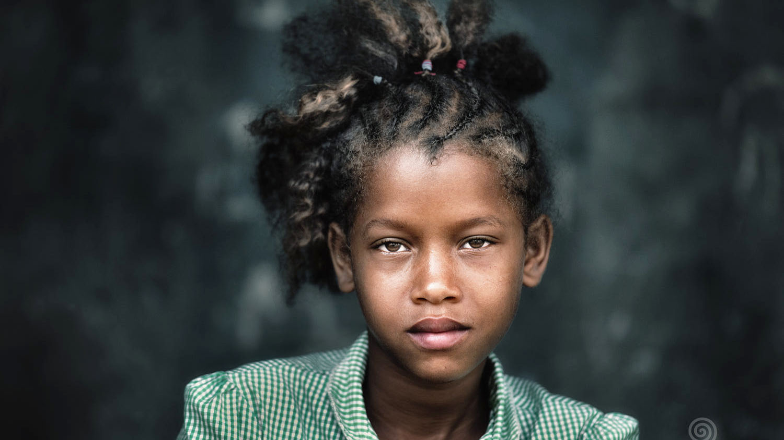
SAo Tomé and Príncipe
Beauty in Ponta Figo, Sao Tome in the Gulf of Guinea
Photography © by Trevor Cole on 500px

Slide 38
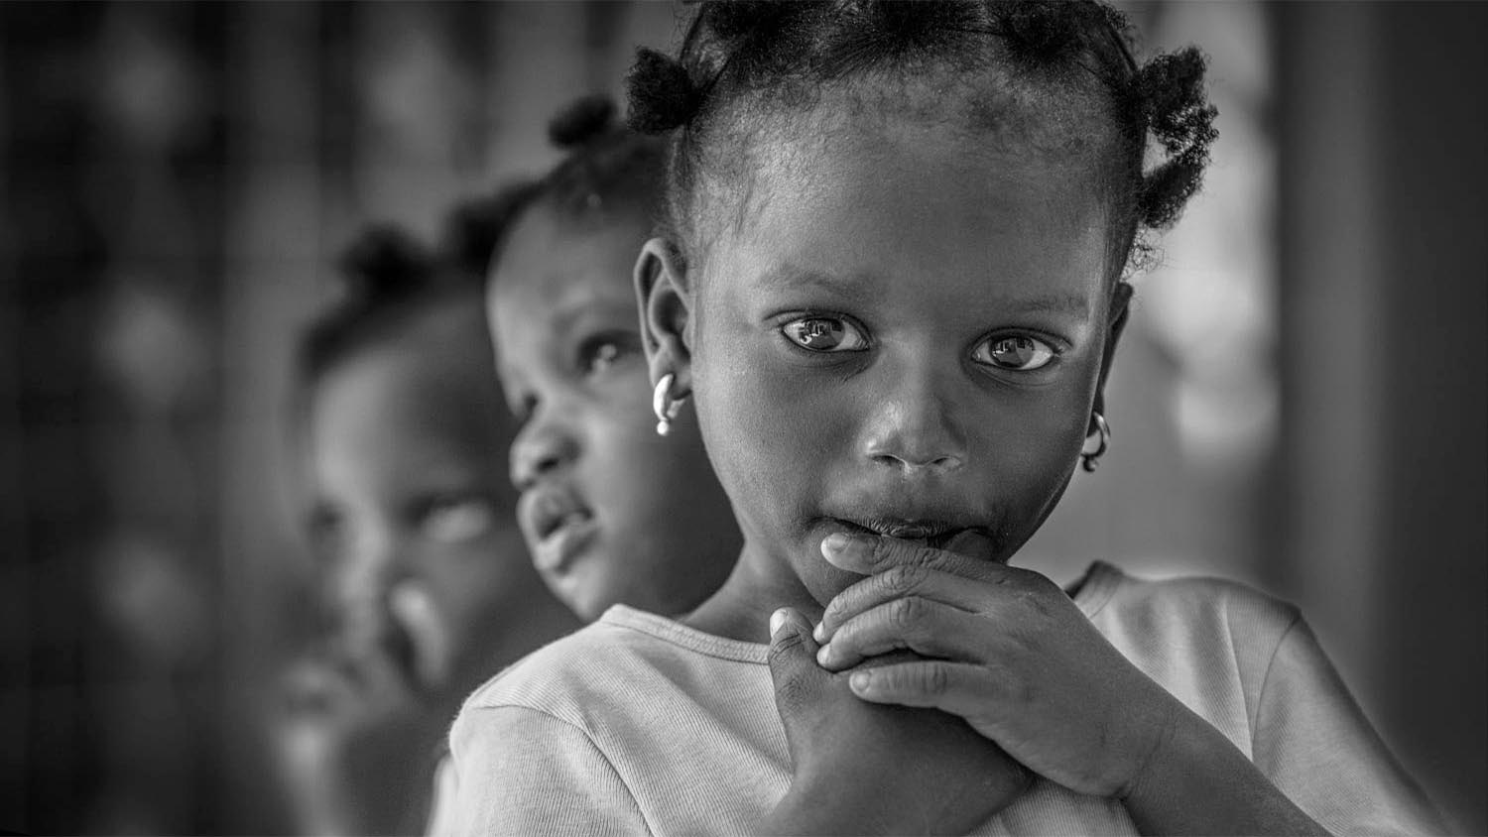
Senegal
M'bour, Senegal
Photography © by Joachim Bergauer on 500px

Slide 39
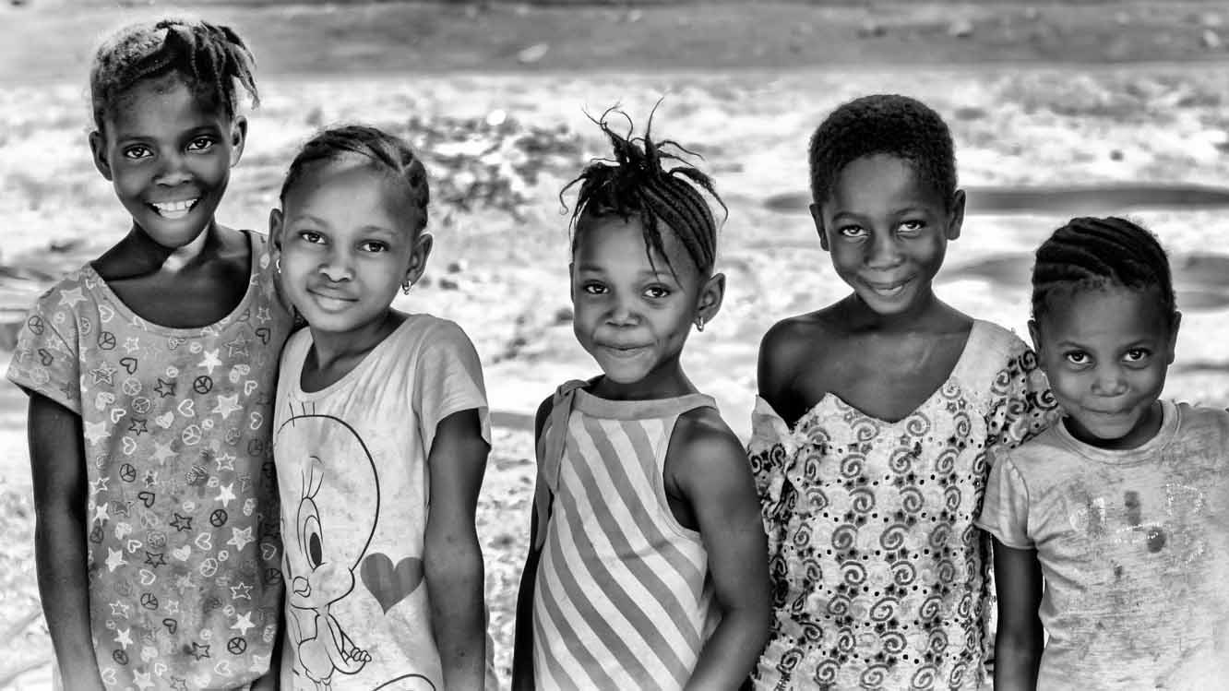
Sierra Leone
Sierra Leone girls
Photography © by Graham Coates on 500px

Slide 40
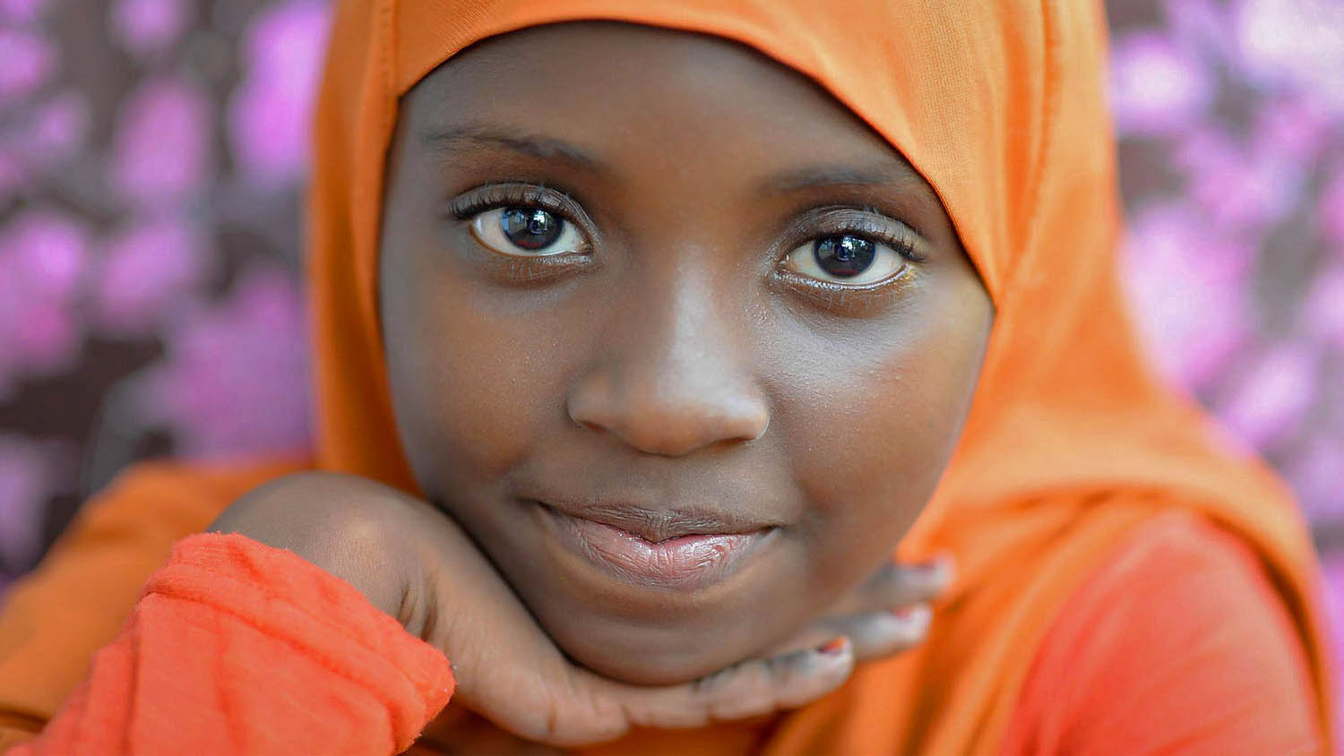
Somalia
Somalian Girl
Photography © by Amy Kiley on 500px

Slide 41
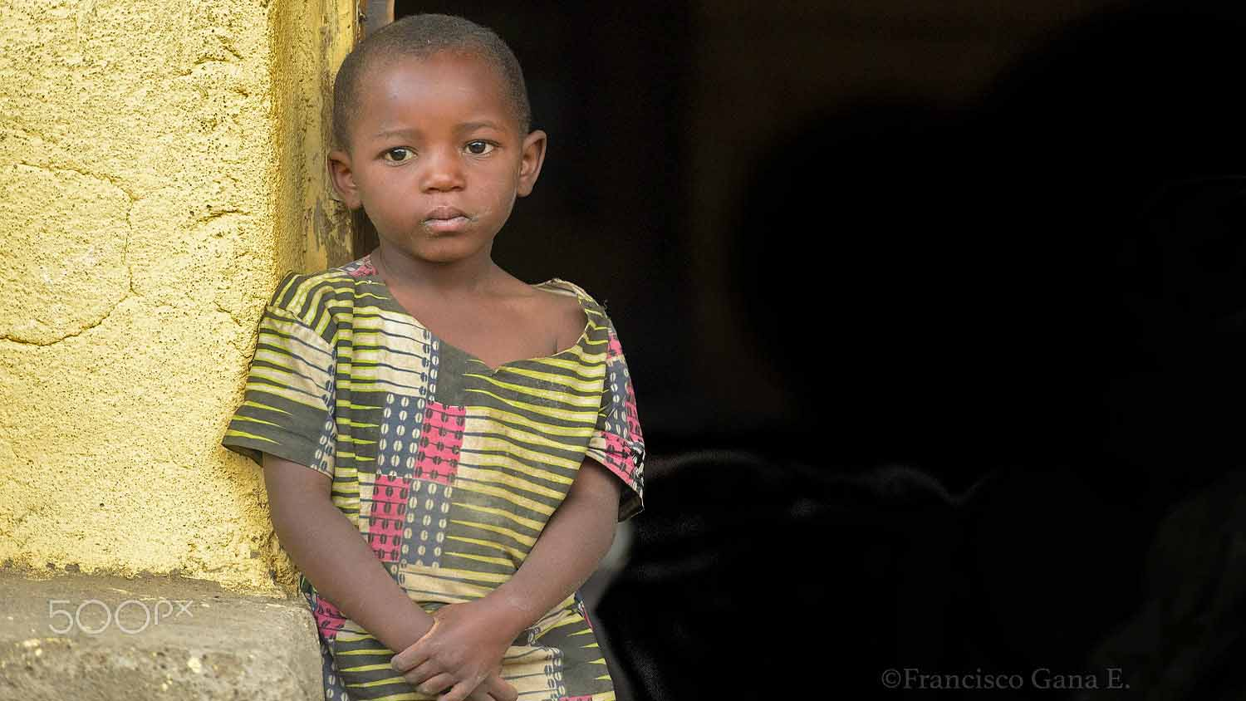
South Africa

Slide 42
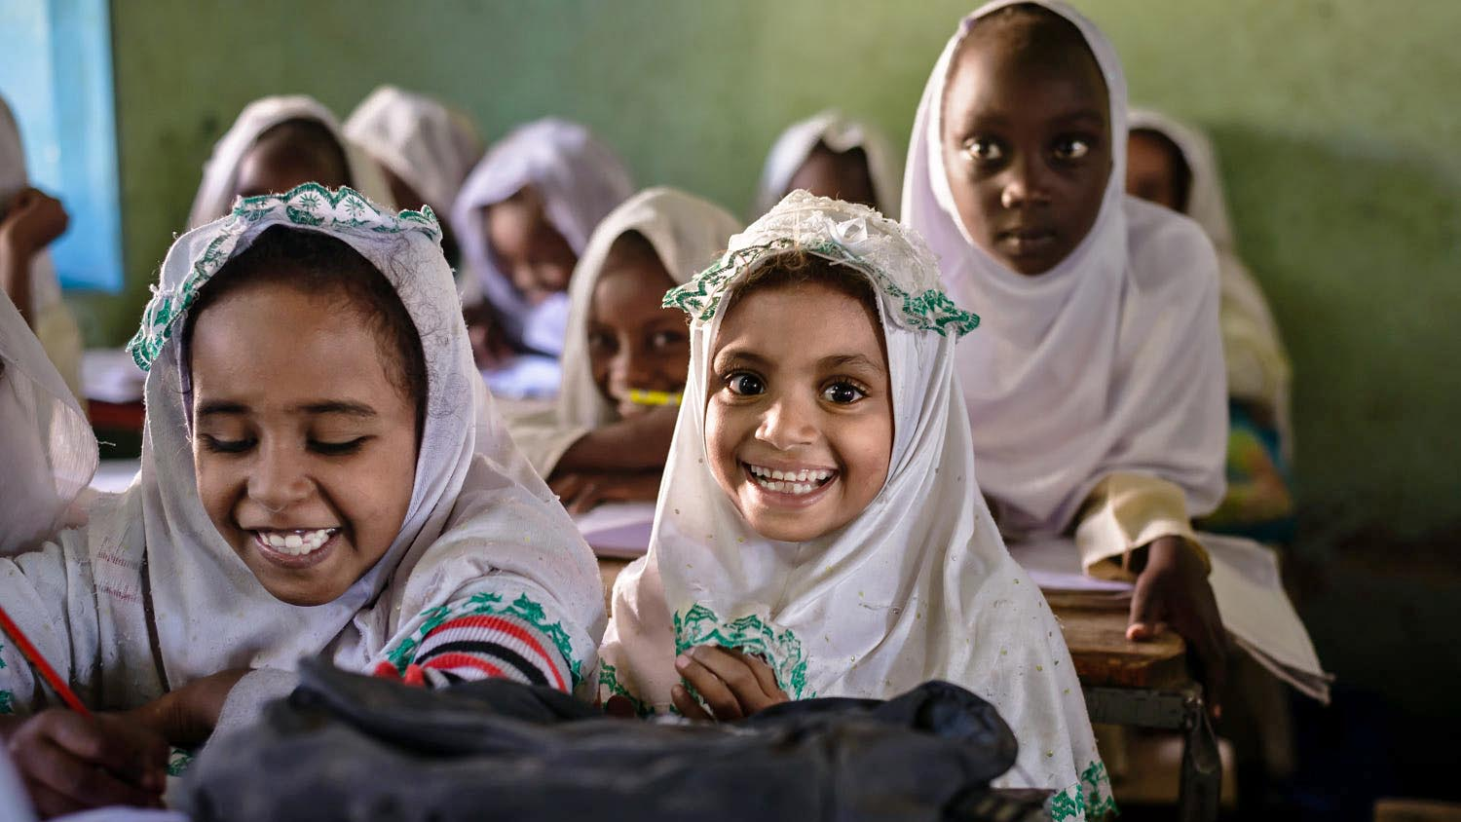
South Sudan
At the school

Slide 43
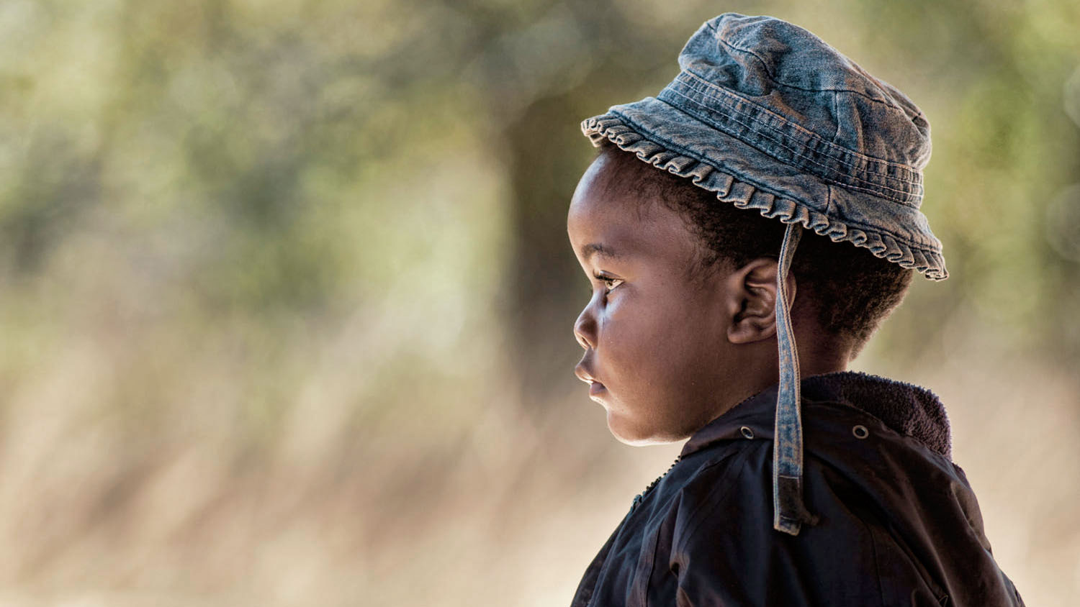
Swaziland
A young boy in Swaziland, Africa wearing his favorite hat.
Photography © by Ben North on 500px

Slide 44
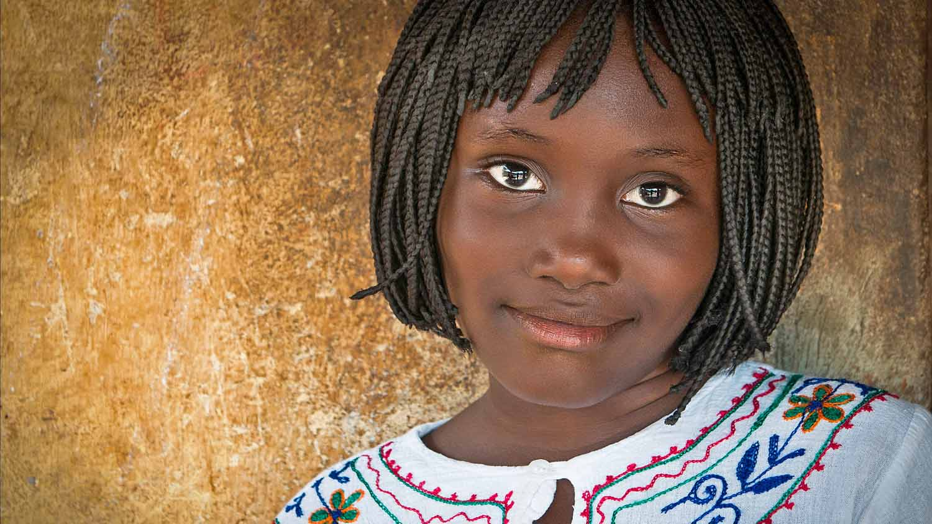
Togo
Shot this sweet girl in Togo.
Photography © by majed AL Zaabi on 500px

Slide 45
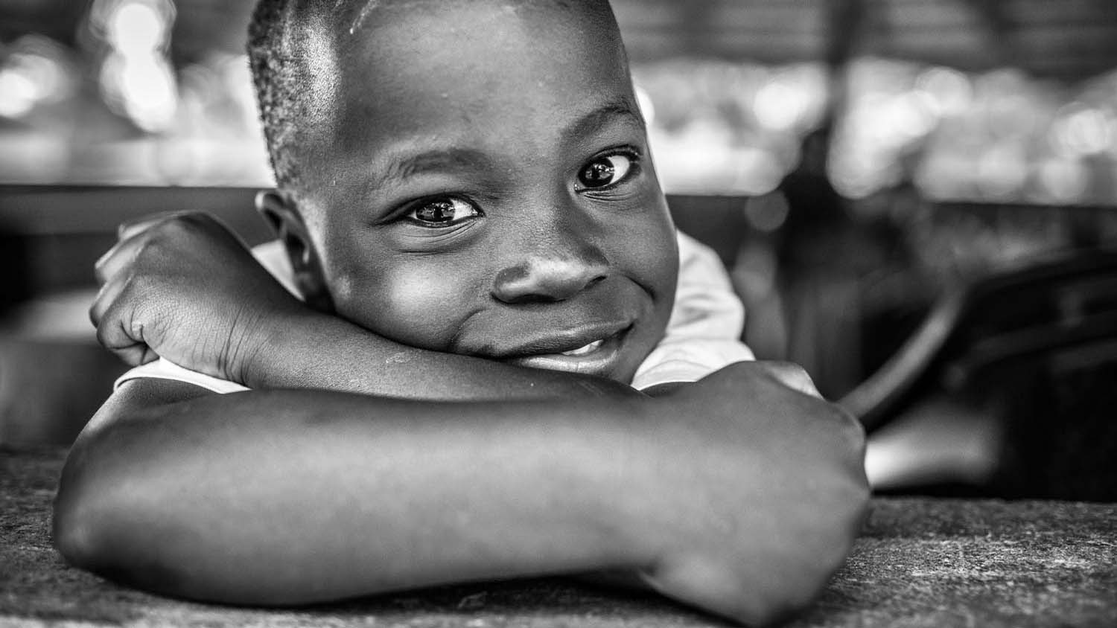
Uganda
Uganda, love the people over there.
Photography © by Tomislav Moze on 500px

Slide 46
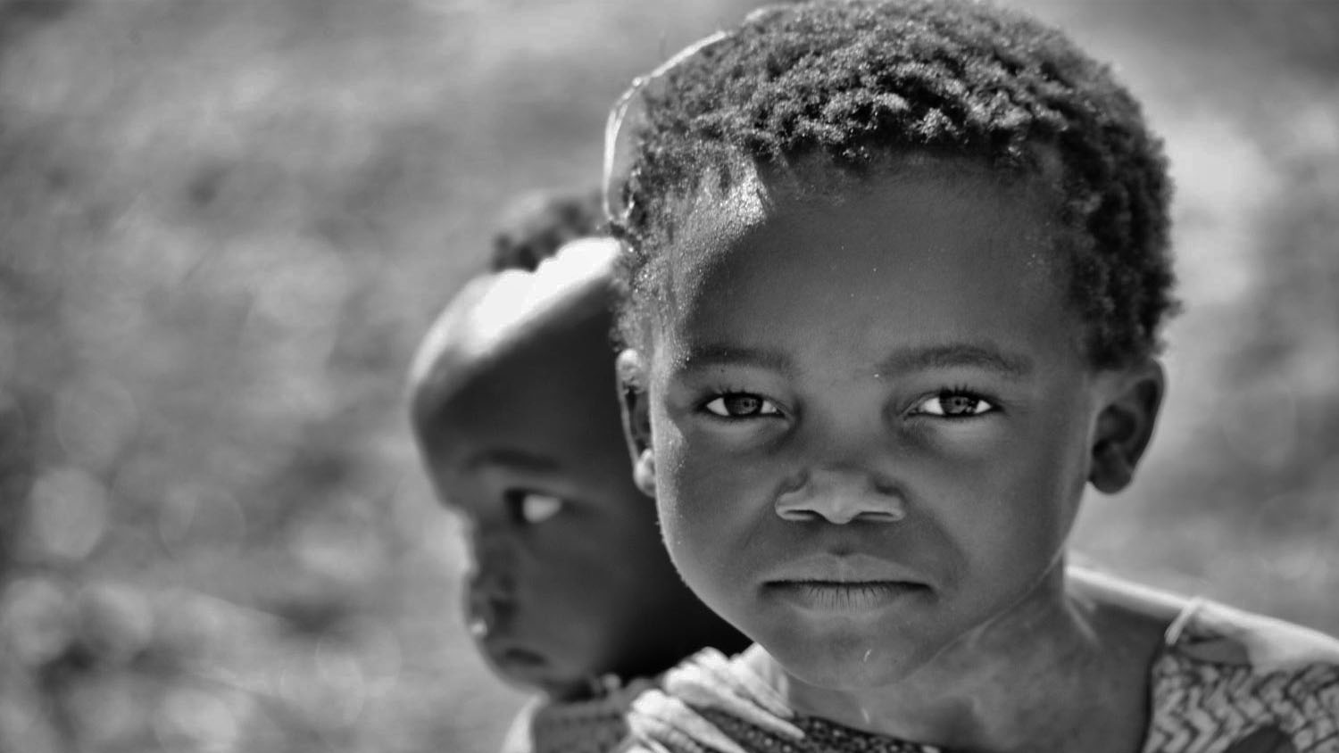
Zambia
Many kids mainly girls have to stay at home from school to take care of the smaller ones.
Photography © by Nicole Cambré on 500px

Slide 47
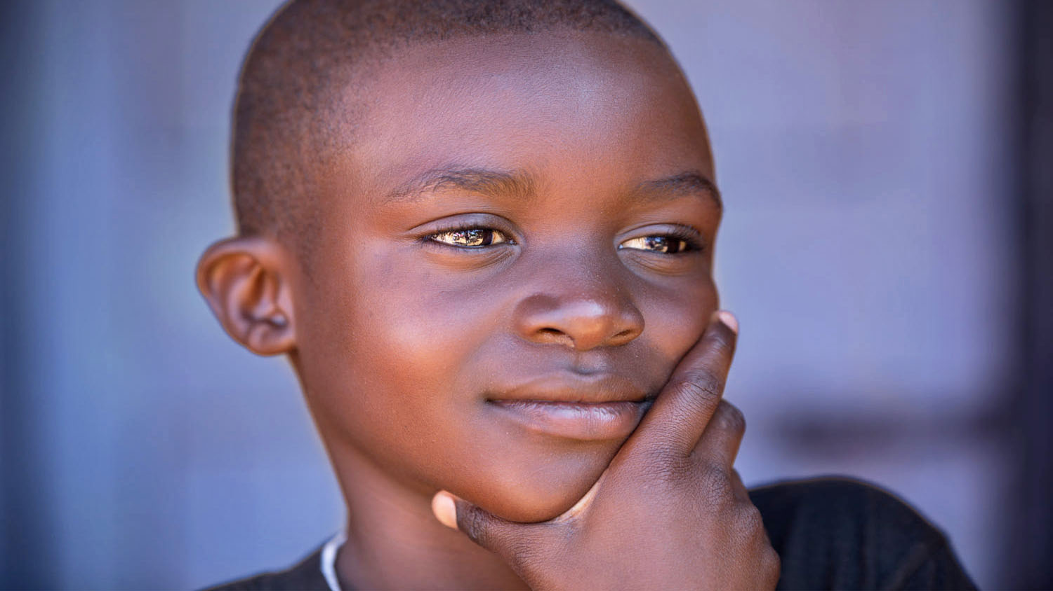
Zimbabwe
A friend's son striking a serious pose.
Photography © by Doug Dicker on 500px

Slide 48




2019
SEE YOU NEXT TIME
The End
Compilation : Lalo (Mexico)
(contact) lalo2gu@gmail.com
Technical cooperation : Steve (Slovakia)
(contact) pista2011@gmail.com
Not for commercial use! / Photos from internet / Music : Vocal Sisters - Thula Mama

