Slide 1


Places of Europe
that must be seen
in ones lifetime
2017
1
Compiled by - Tony Chacko and Steve Rumpler

Slide 2
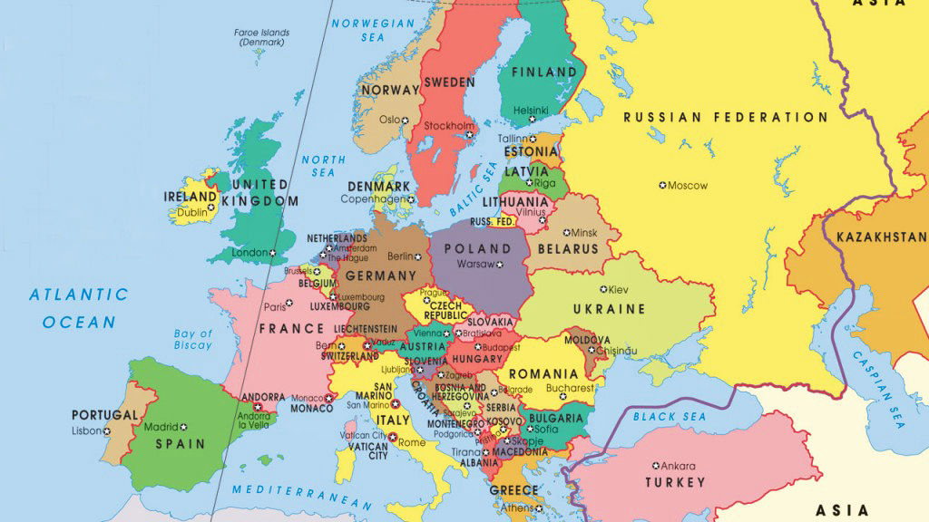

Europe
2017
Compiled by - Tony Chacko and Steve Rumpler

Slide 3
Europe - a concept dating back to classical antiquity - is a continent that comprises the westernmost part of Eurasia. Europe is bordered by the Arctic Ocean to the north, the Atlantic Ocean to the west, and the Mediterranean Sea to the south. Politically, Europe is divided into about 50 nations of which the Russian Federation is the largest, spanning 39% of the continent and comprising 15% of its population. Europe, in particular ancient Greece, was the birthplace of Western civilization. The fall of the Roman Empire, during the migration period, marked the end of ancient history and the beginning of an era known as the Middle Ages. Renaissance humanism, exploration, art, and science led to the modern era. From the Age of Disco-very onwards, Europe played a predominant role in global affairs. Between the 16th and 20th centuries, European powers controlled at various times the Americas, most of Africa, Oceania, and the majority of Asia. The Industrial Revolution, which began in Great Britain at the end of the 18th century, gave rise to radical economic, cultural, and social change in Western Europe, and the wider world. Here is a presentation of great touring places of European countries. Though Turkey is not in the E.U., historically and geographically it had been the cause for some cultural and geographic changes to the European culture and region by it’s past Arab invasions.
Area : 10.18 million km²
Population : 743.1 million (2015)
Languages : English, French, German, Italian, Russian, Spanish; (total about - 225 languages)
Compiled by - Tony Chacko and Steve Rumpler

Slide 4
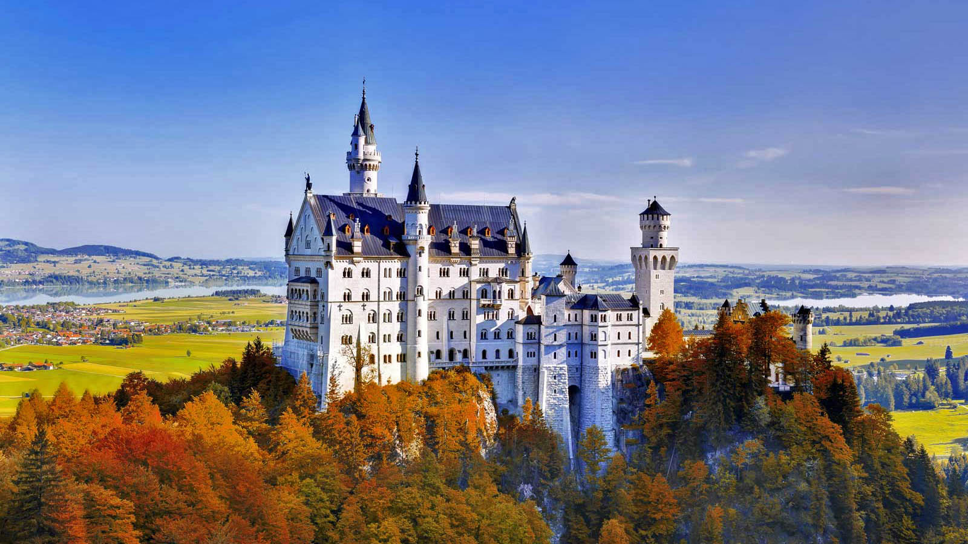

GERMANY (Neuschwanstein Castle)

Slide 5
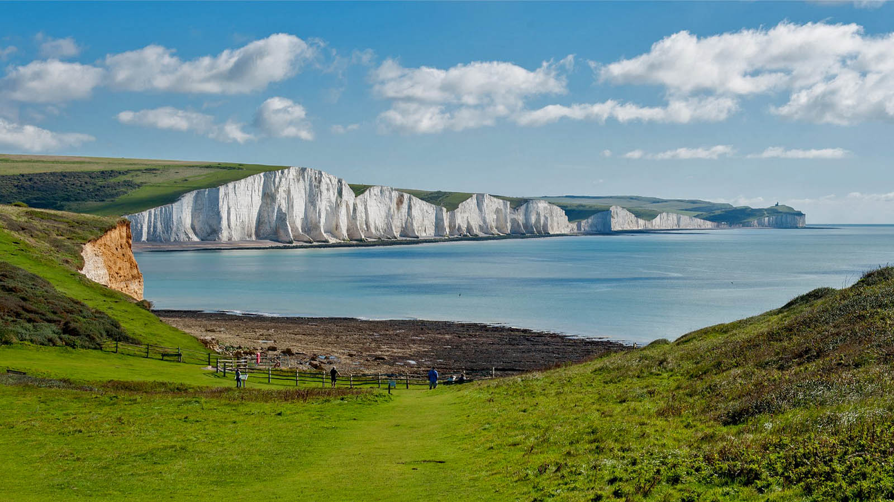
ENGLAND (White Cliffs, Dower)

Slide 6
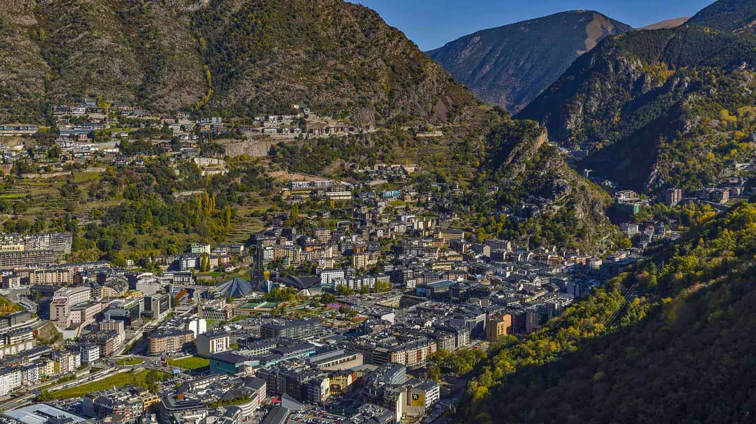
ANDORRA (Andorra la Vella)

Slide 7
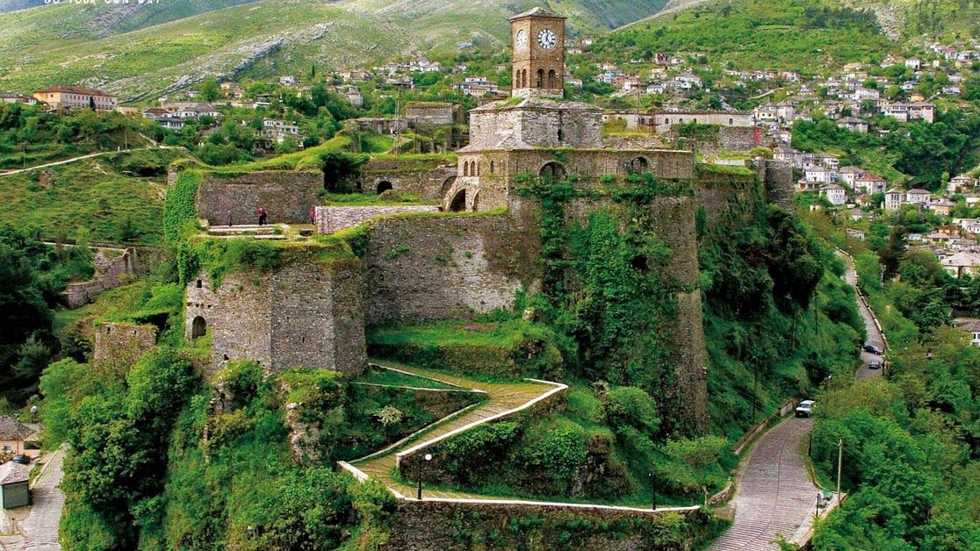
ALBANIA (Gjirocastra)

Slide 8
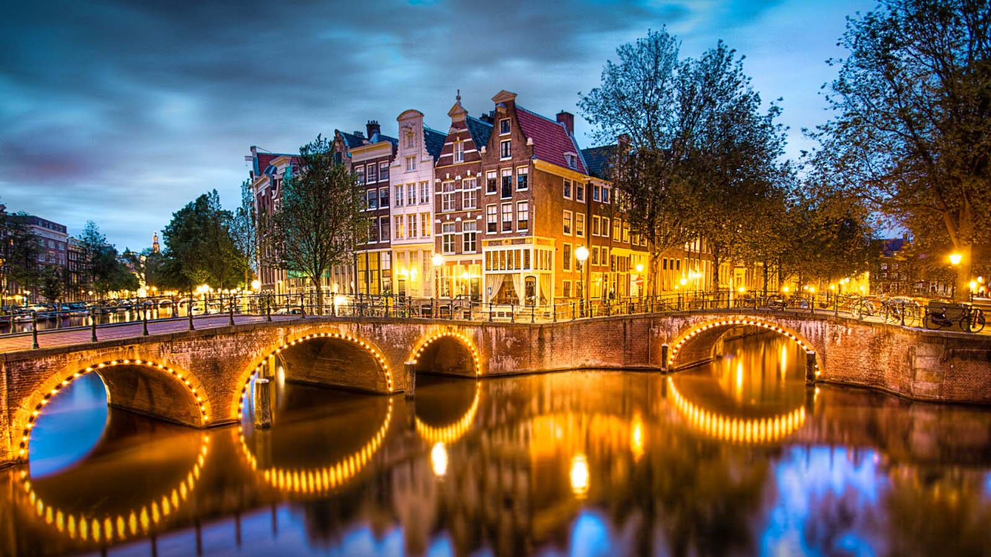
HOLLAND (Amsterdam)

Slide 9
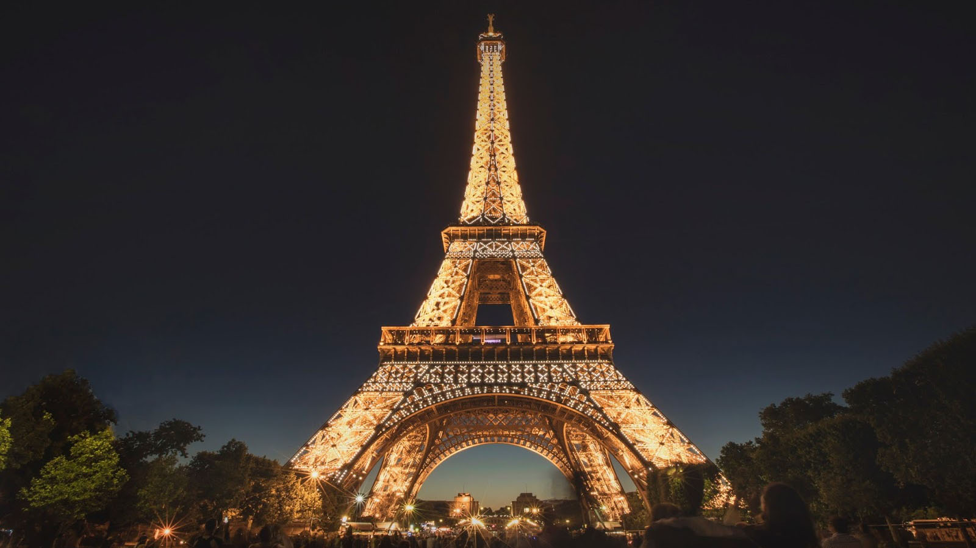
FRANCE (Eiffel Tower, Paris)

Slide 10
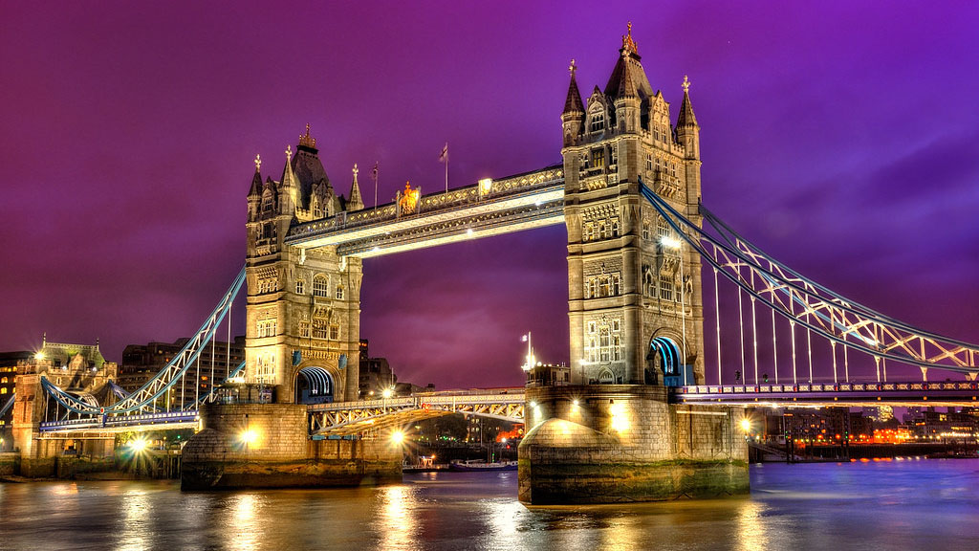
ENGLAND (Tower Bridge, London)

Slide 11
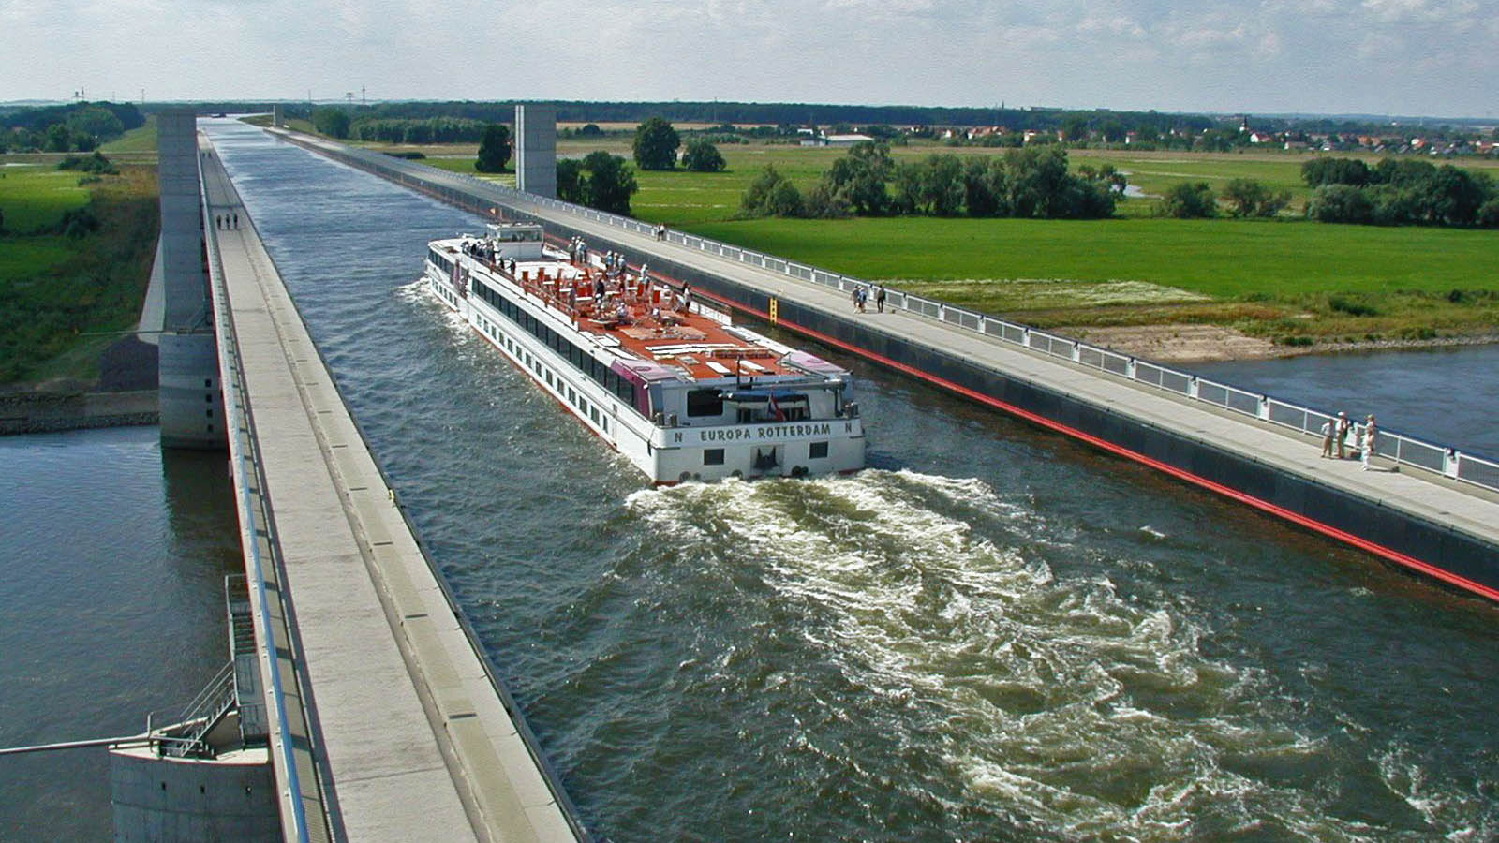
GERMANY (Water Bridge, Magdeburg)

Slide 12
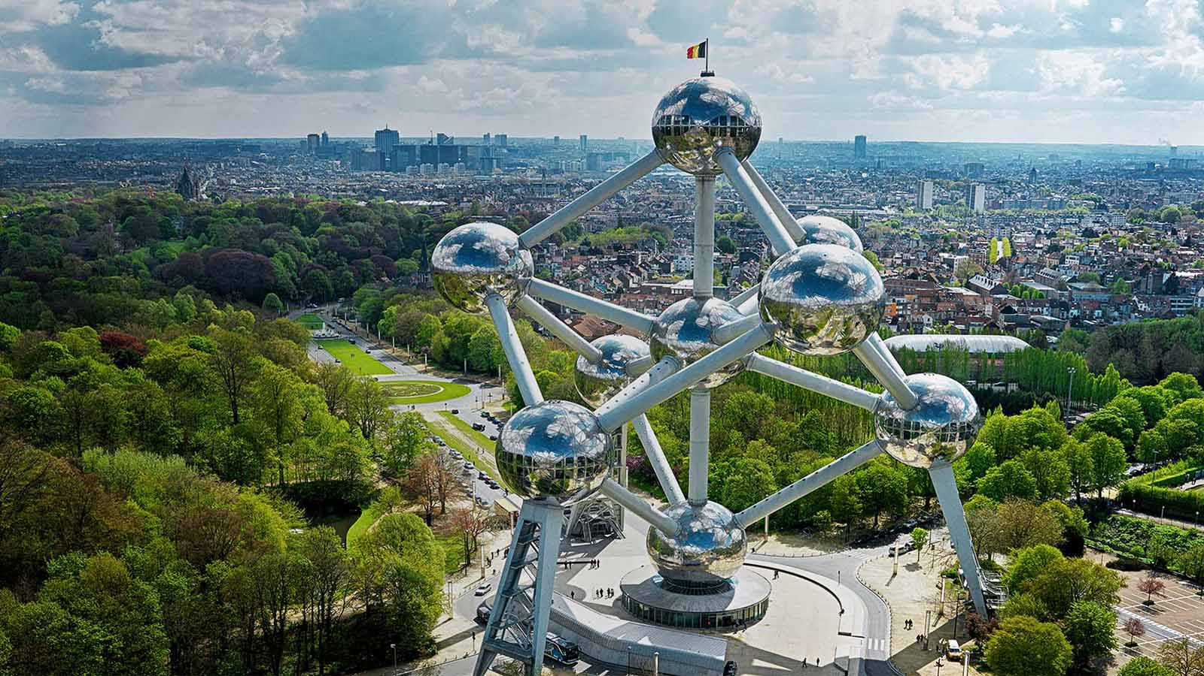
BELGIUM (Atomium, Brussels)

Slide 13
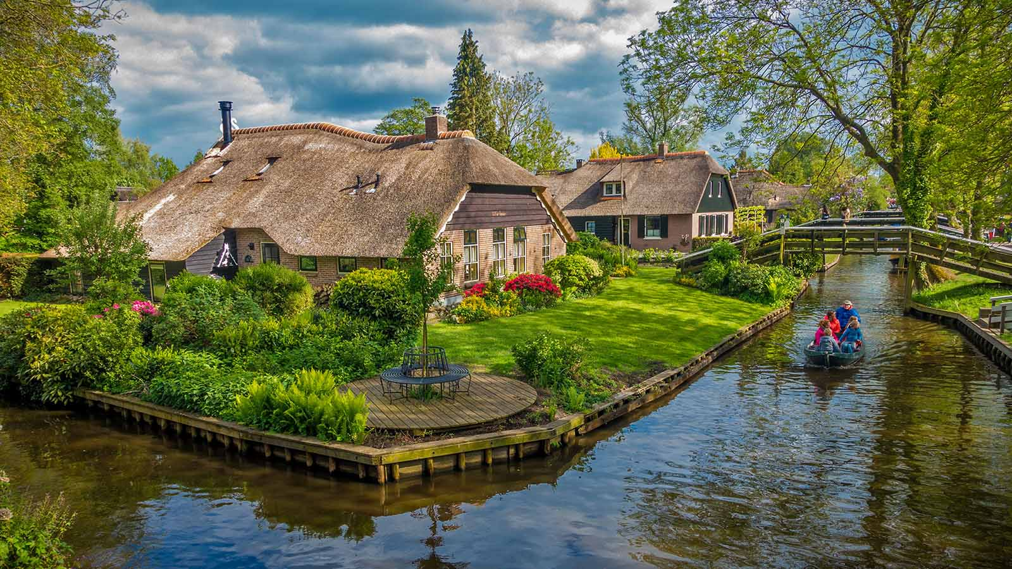
HOLLAND (Giethoorn)

Slide 14
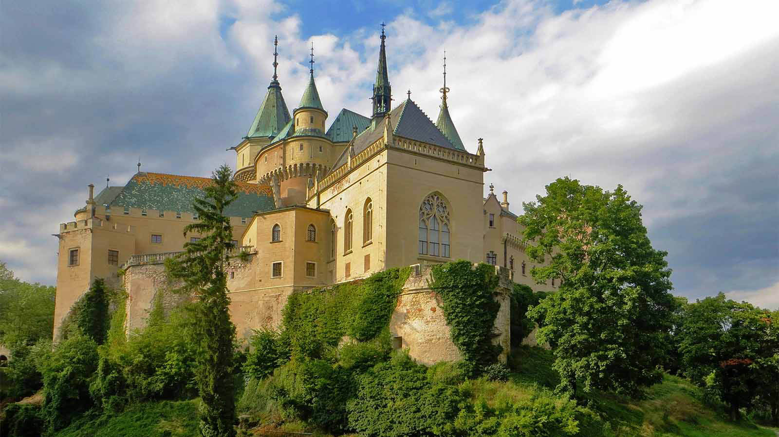
SLOVAKIA (Bojnice Castle)

Slide 15
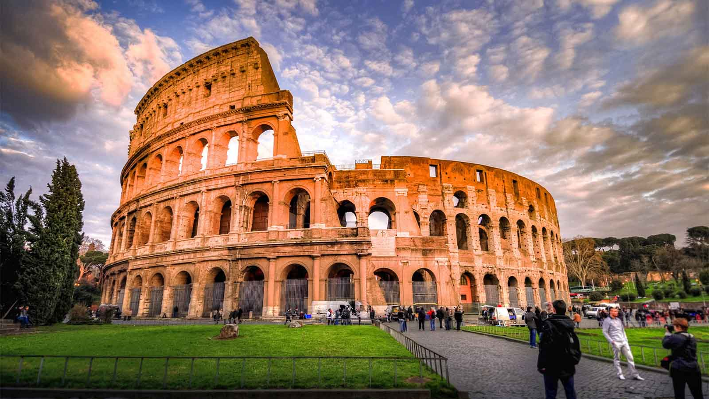
ITALY (Colosseum, Rome)

Slide 16
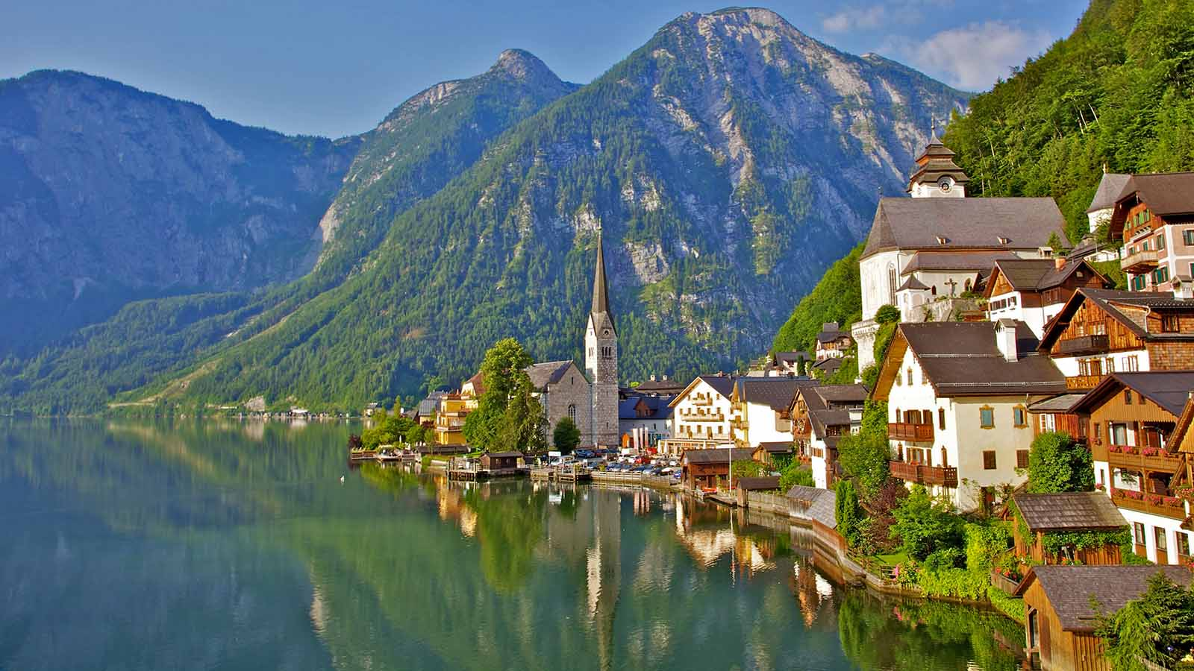
AUSTRIA (Hallstatt)

Slide 17
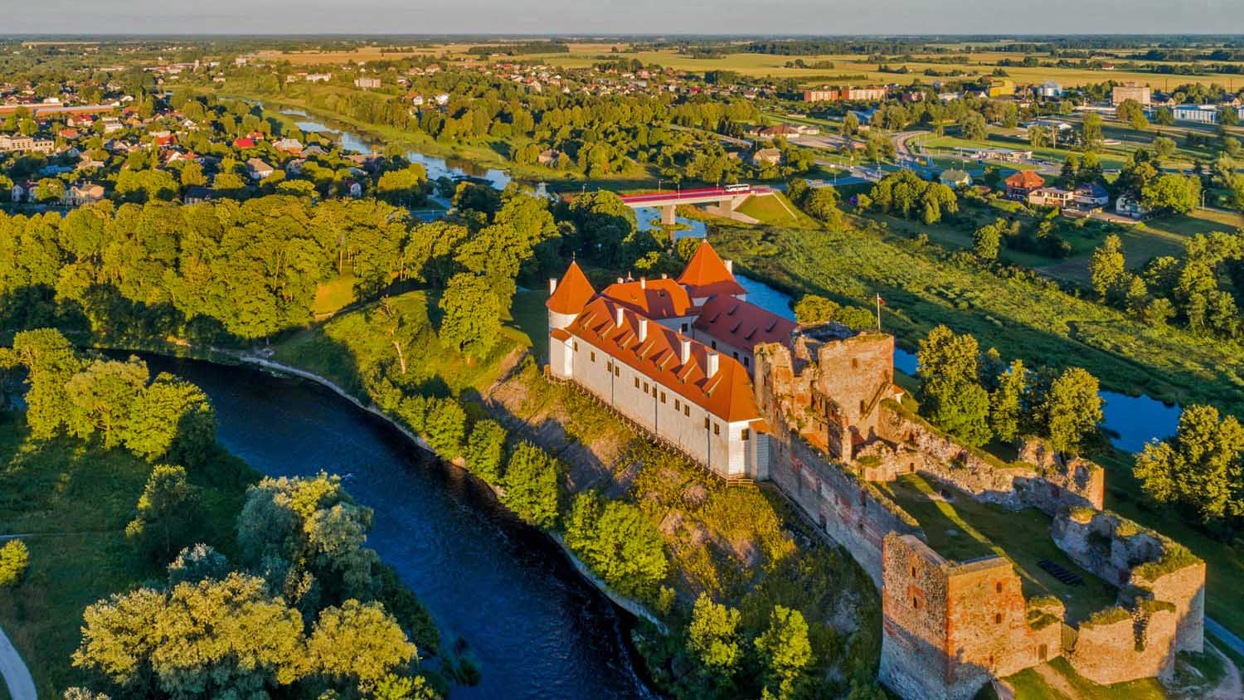
LATVIA (Bauska Cestle, Riga)

Slide 18
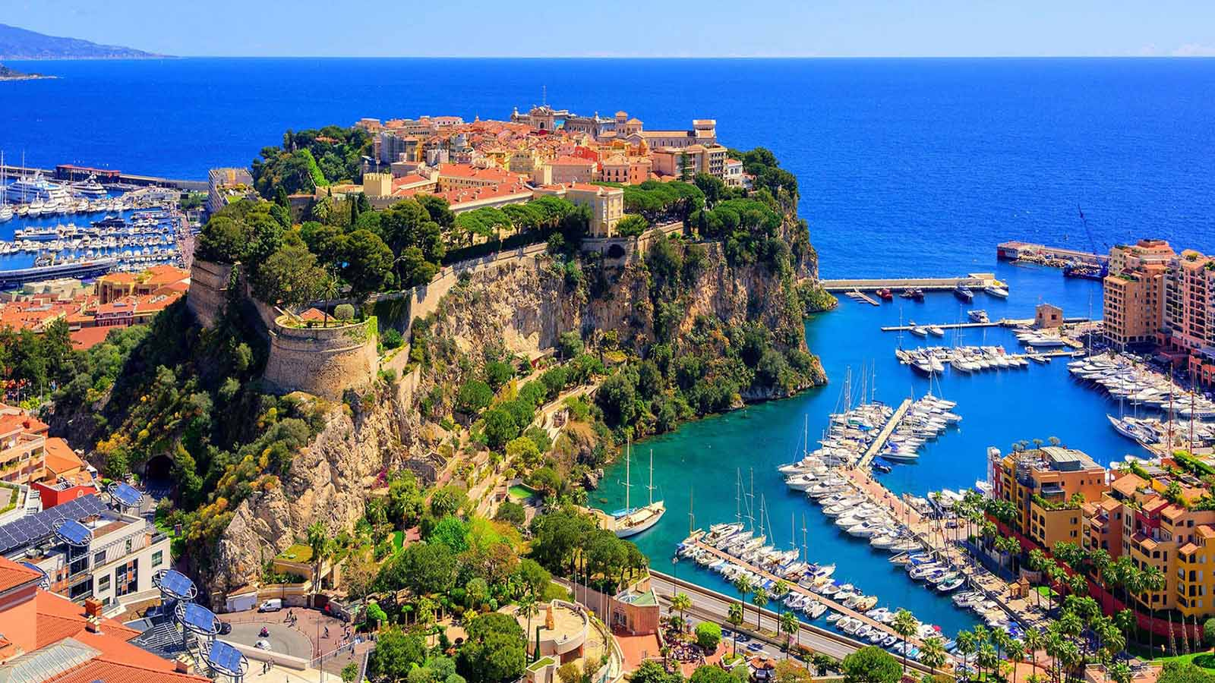
MONACO (Monte Carlo)

Slide 19
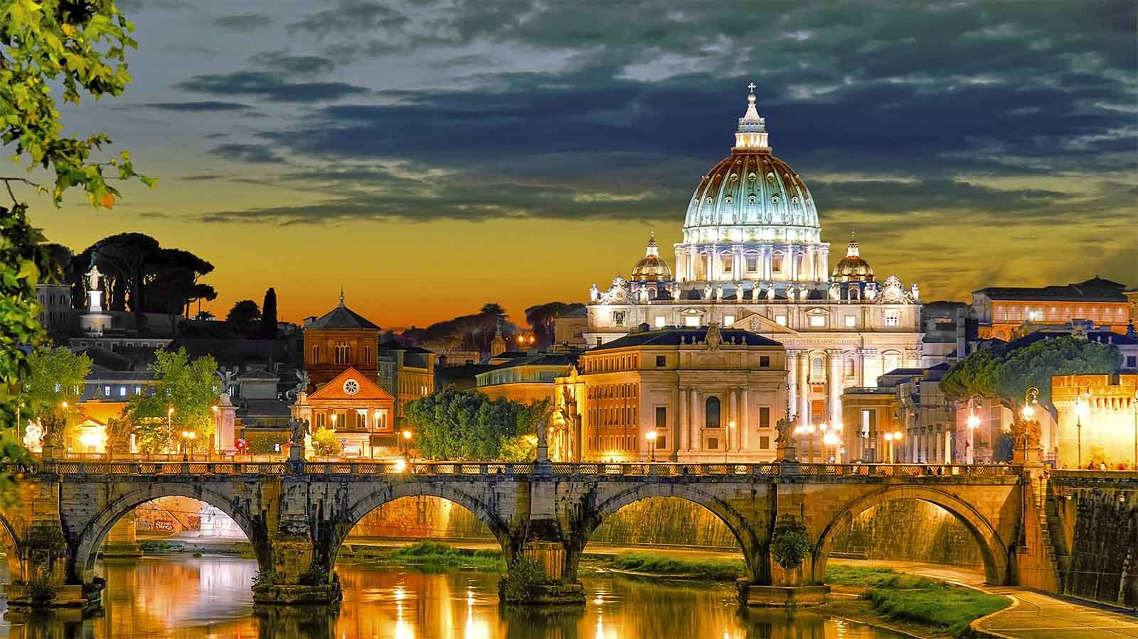
VATICAN (Vatican City)

Slide 20
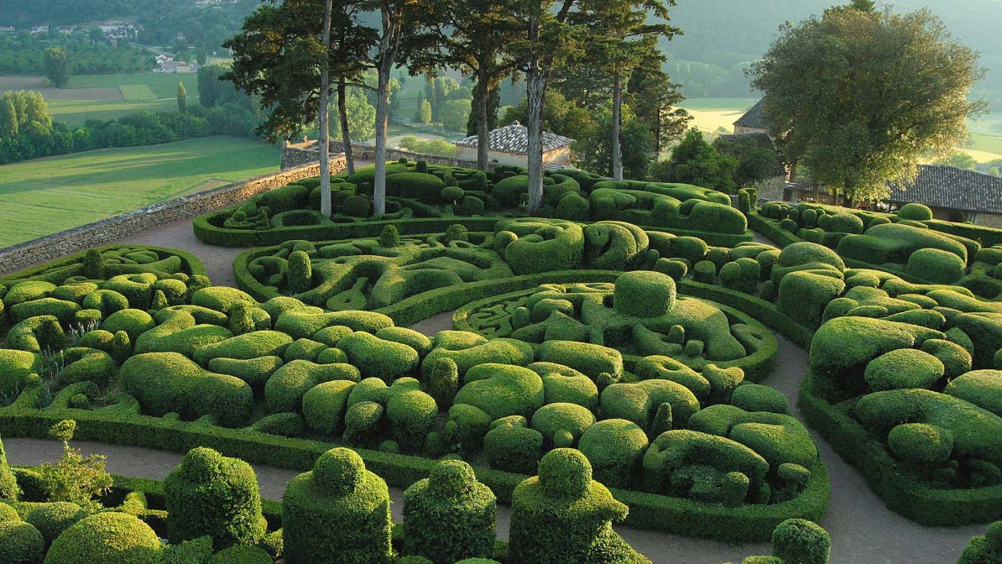
FRANCE (Jardins de Marqueyssac)

Slide 21
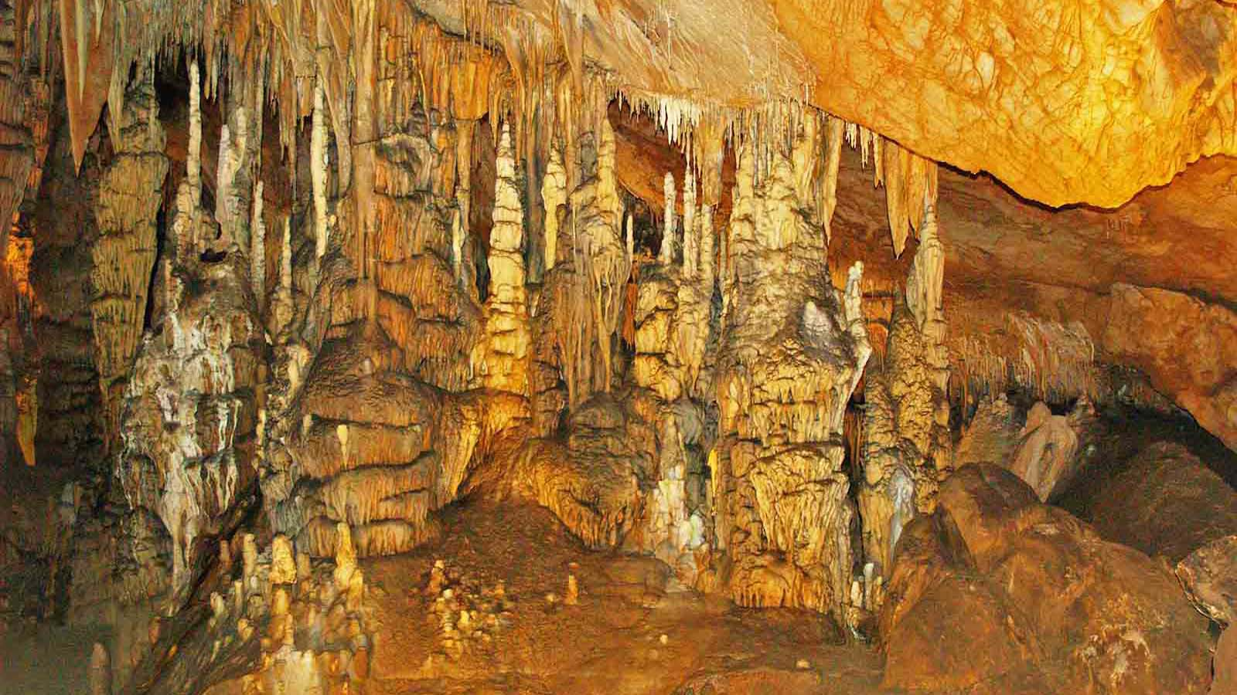
SLOVAKIA (Domica Cave)

Slide 22
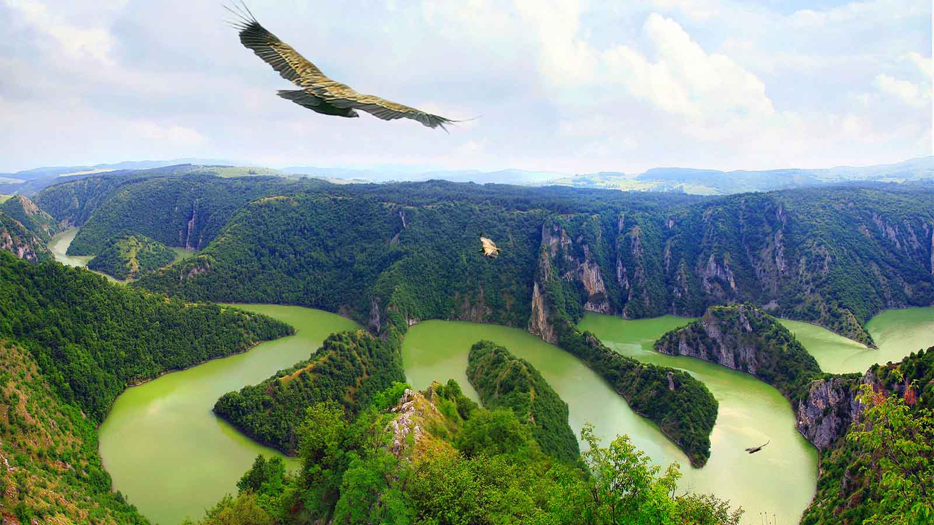
SERBIA (Uvac River Gorge)

Slide 23
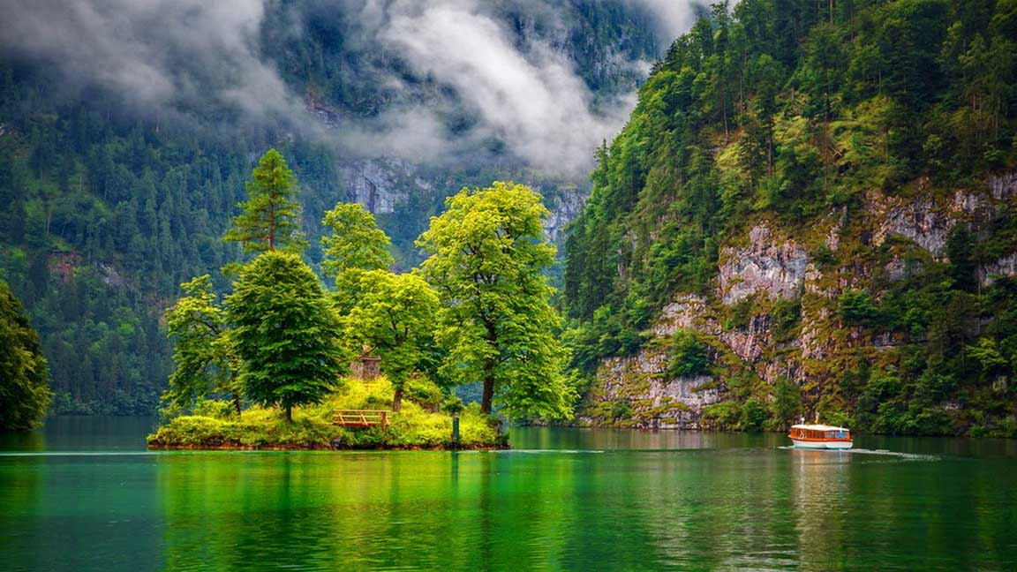
GERMANY (Königsee)

Slide 24
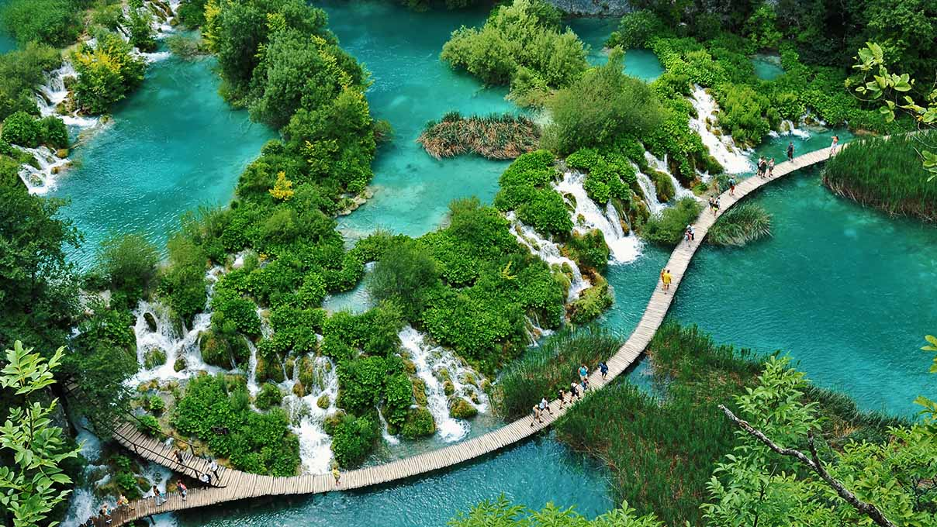
CROATIA (Plitvice)

Slide 25
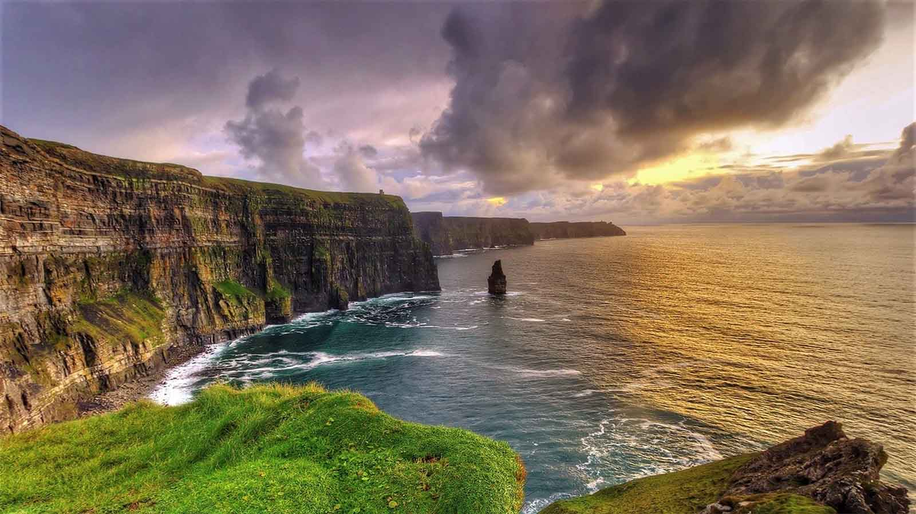
IRELAND (Cliffs of Moher)

Slide 26
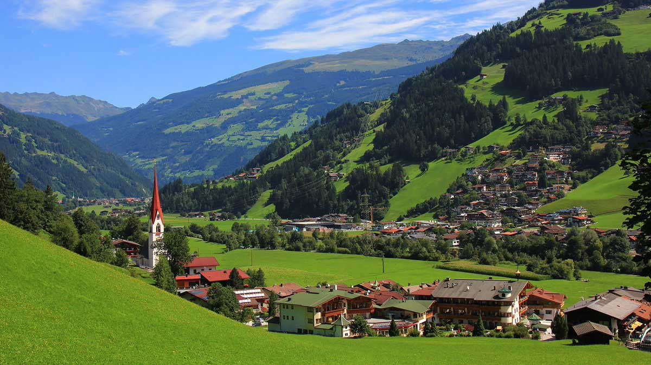
AUSTRIA (Alpine village, Zillertal)

Slide 27
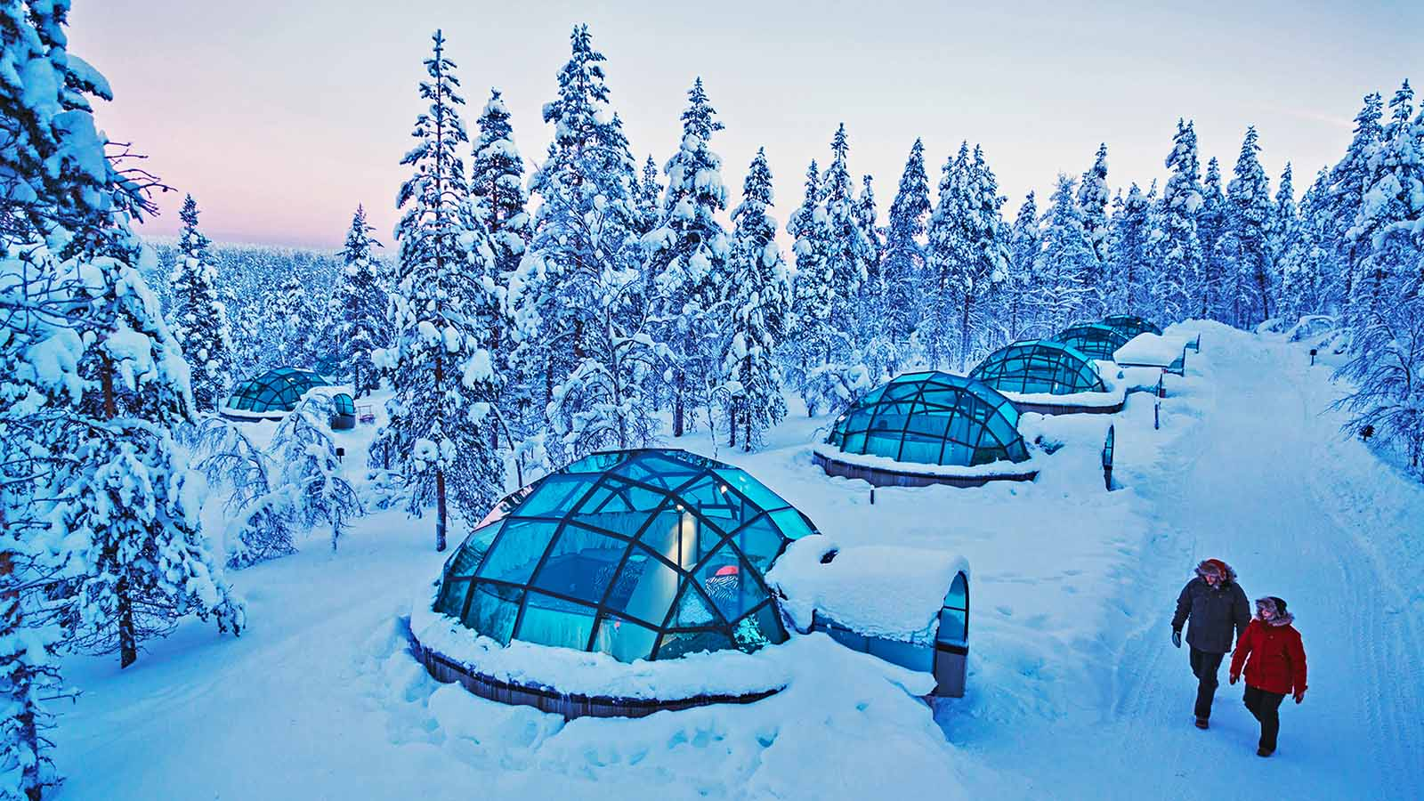
FINLAND (Kakslauttanen Resort)

Slide 28
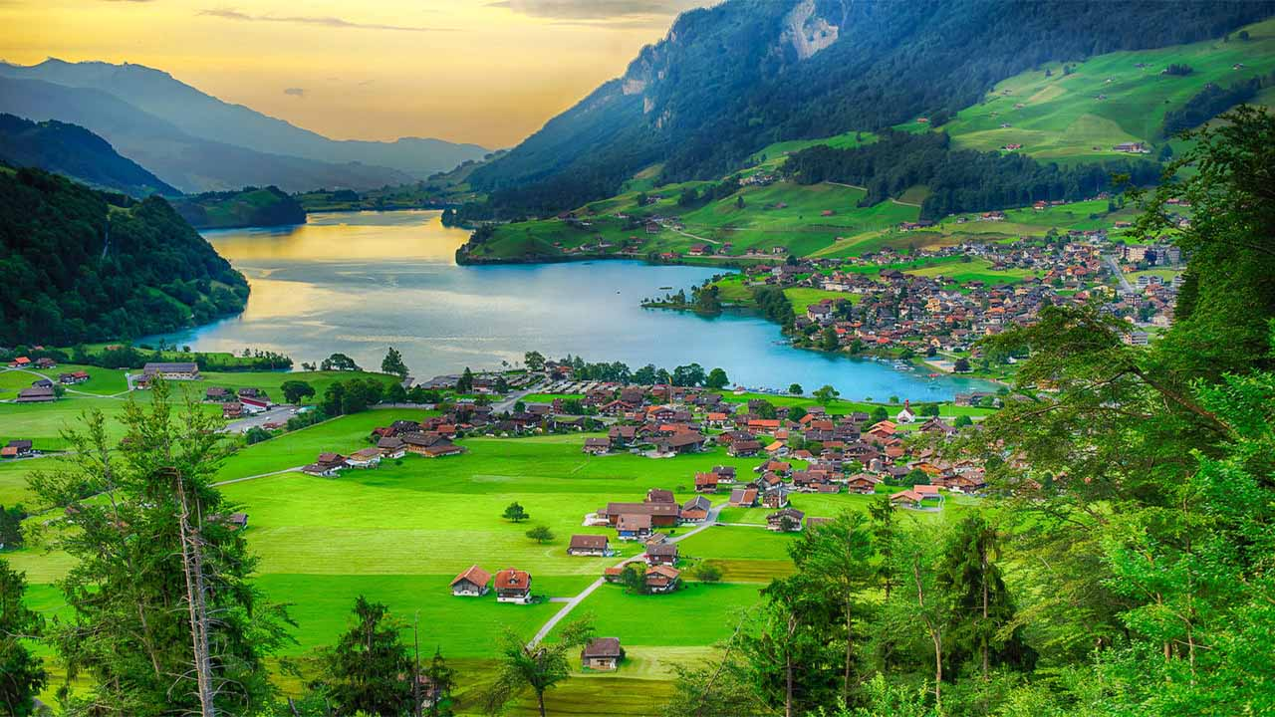
SWITZERLAND (the countryside)

Slide 29
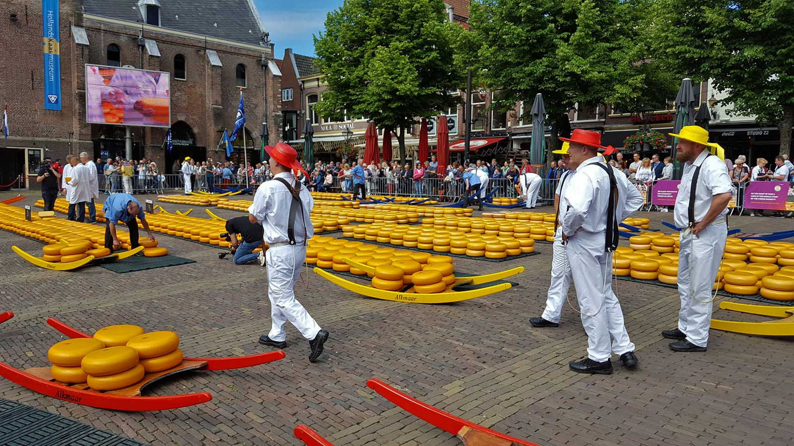
HOLLAND (Alkmaar)

Slide 30
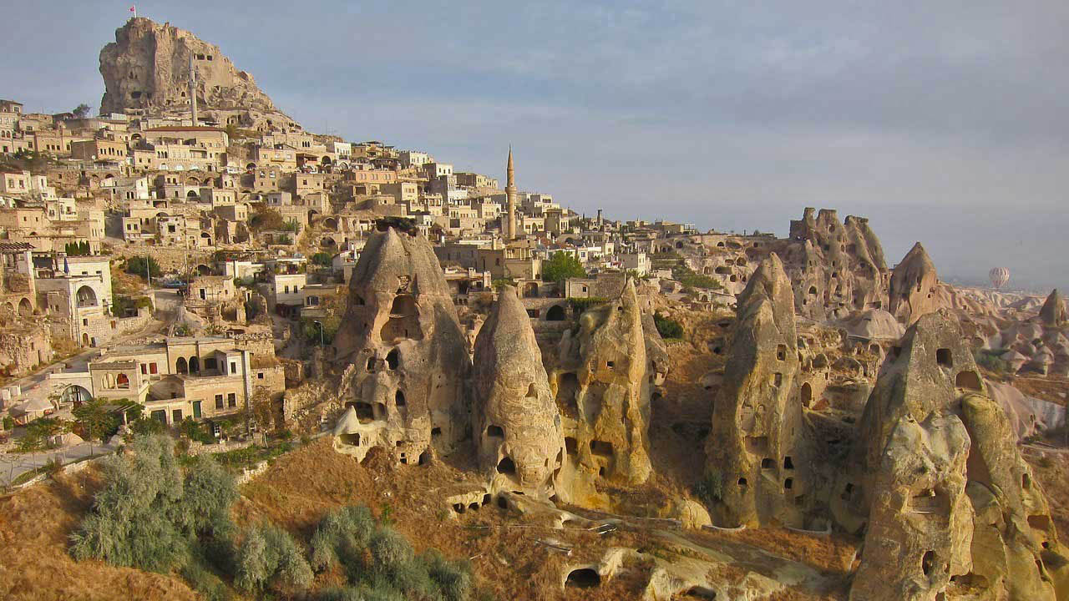
TURKEY (Cappadocia)

Slide 31
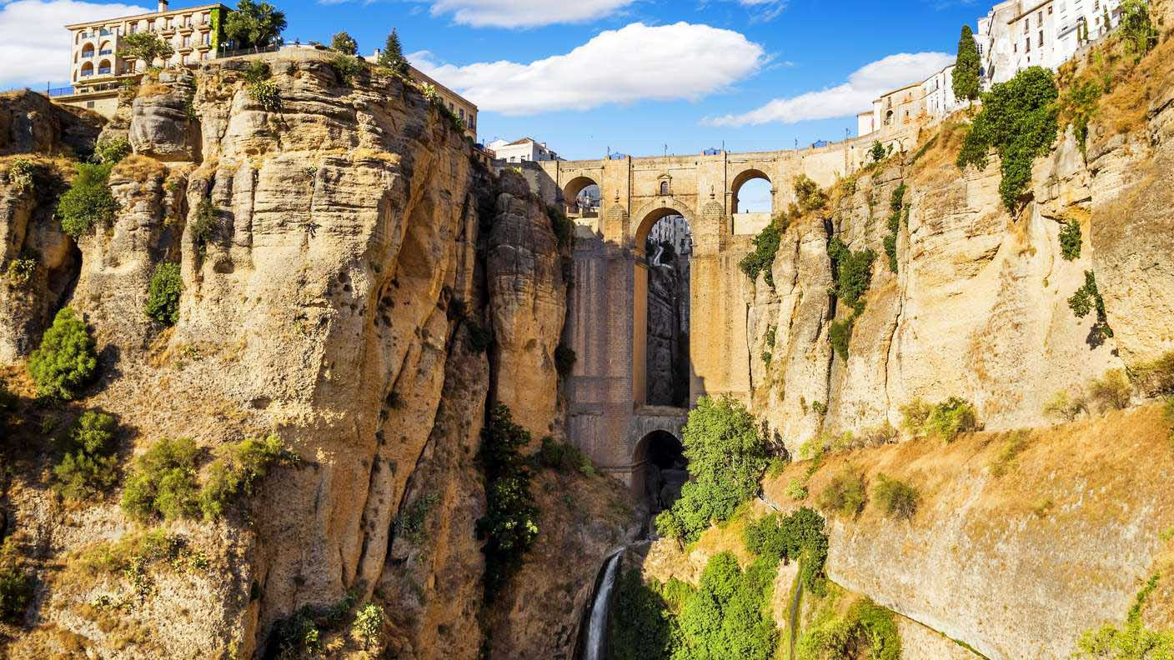
SPAIN (Ronda)

Slide 32
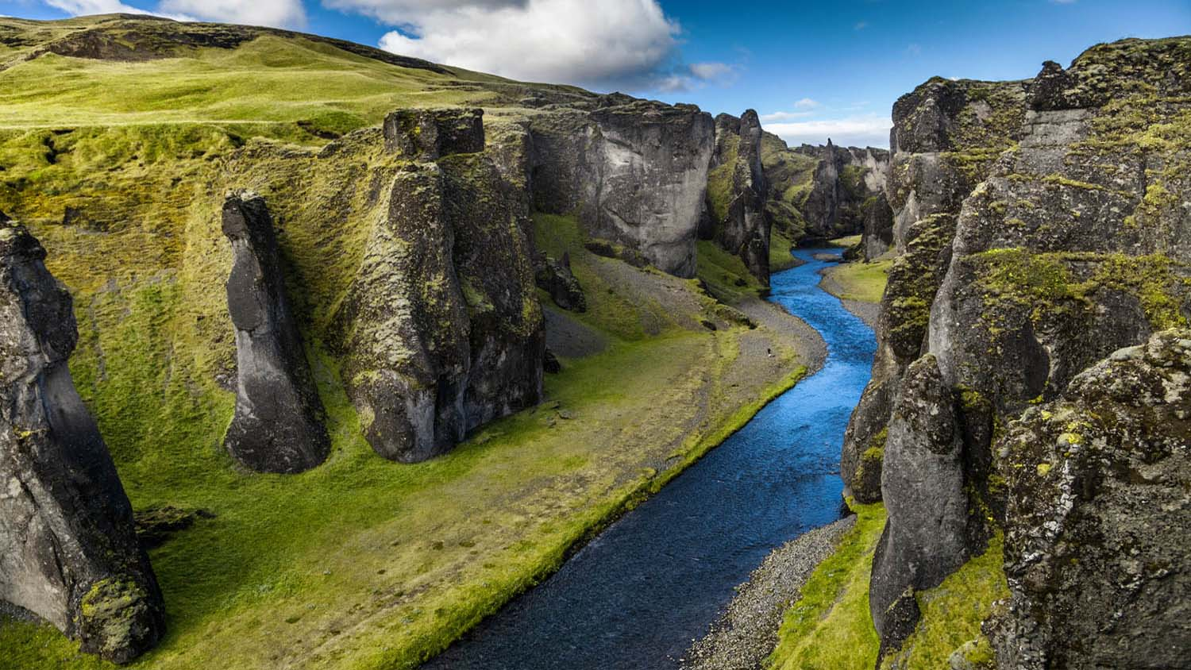
ICELAND (Fjadrargljufur Canyon)

Slide 33
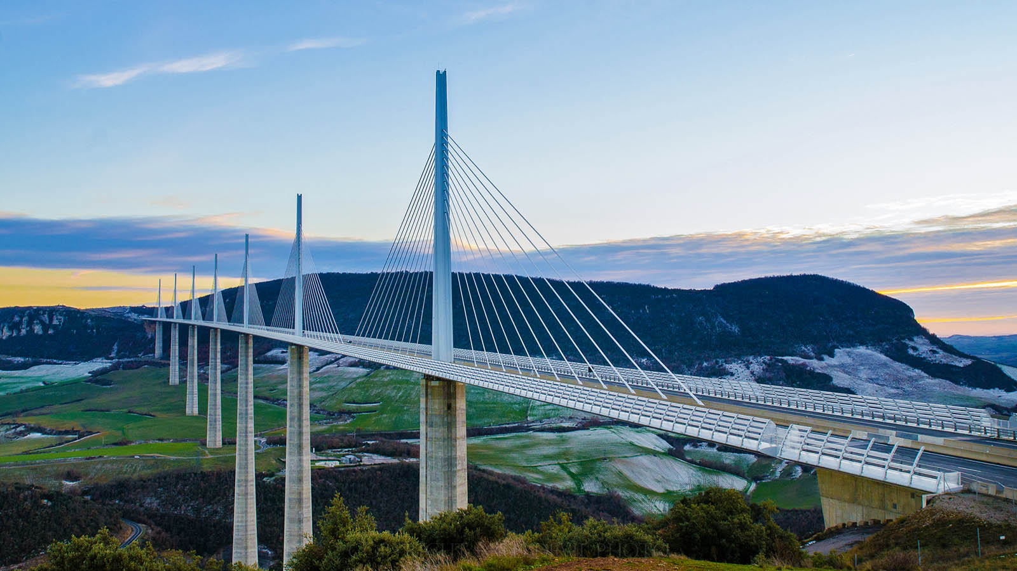
FRANCE (Millau Viaduct)

Slide 34
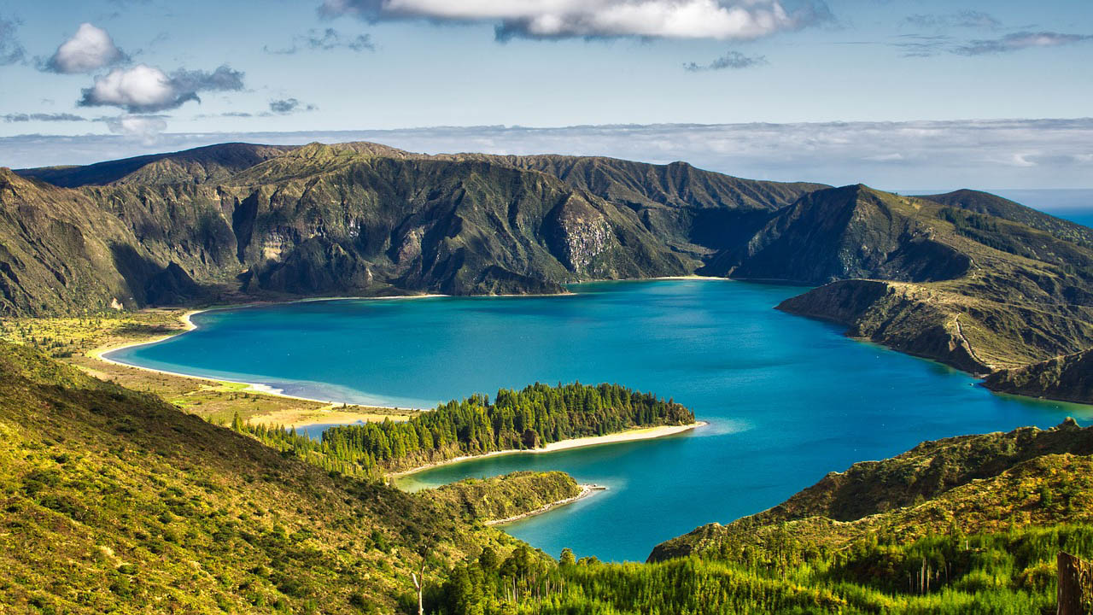
PORTUGAL (São Miguel, Azores)

Slide 35
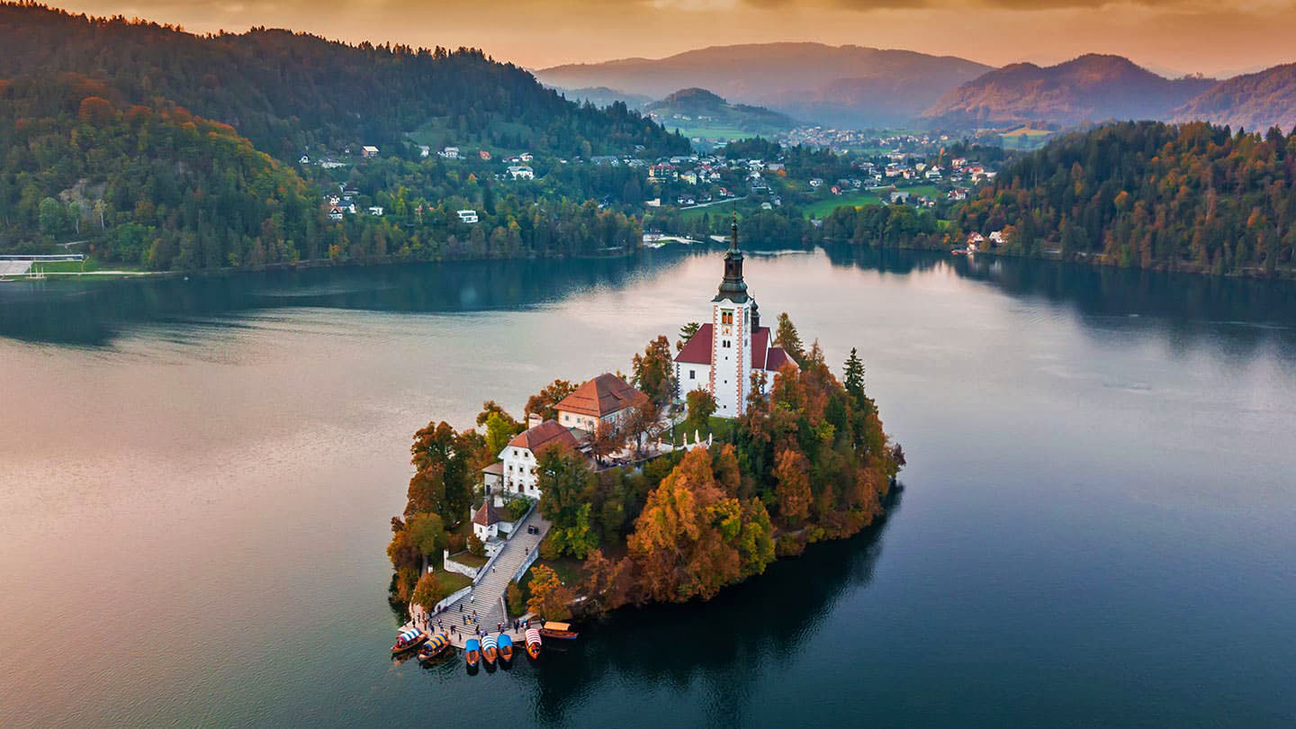
SLOVENIA (Lake Bled)

Slide 36
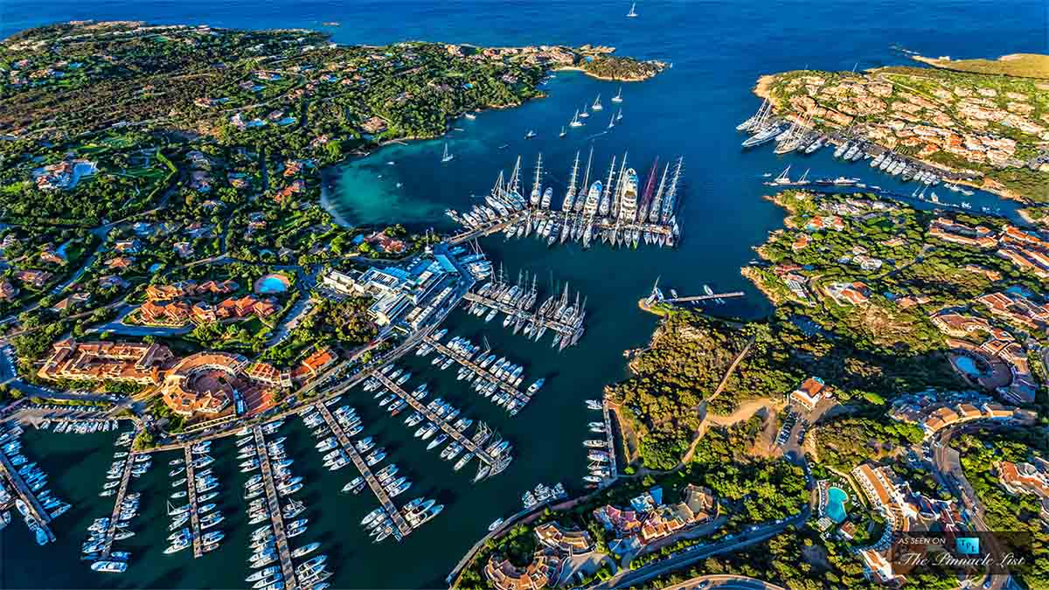
ITALY (Porto Cervo, Sardinia)

Slide 37
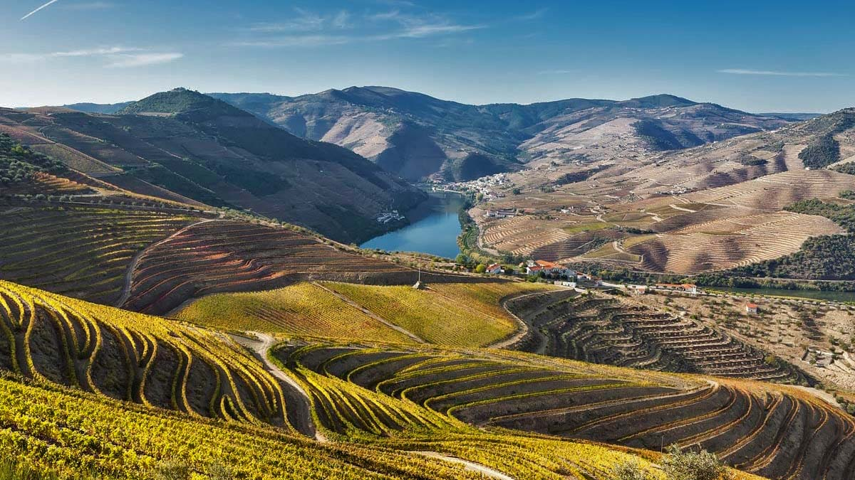
PORTUGAL (Douro Valley)

Slide 38
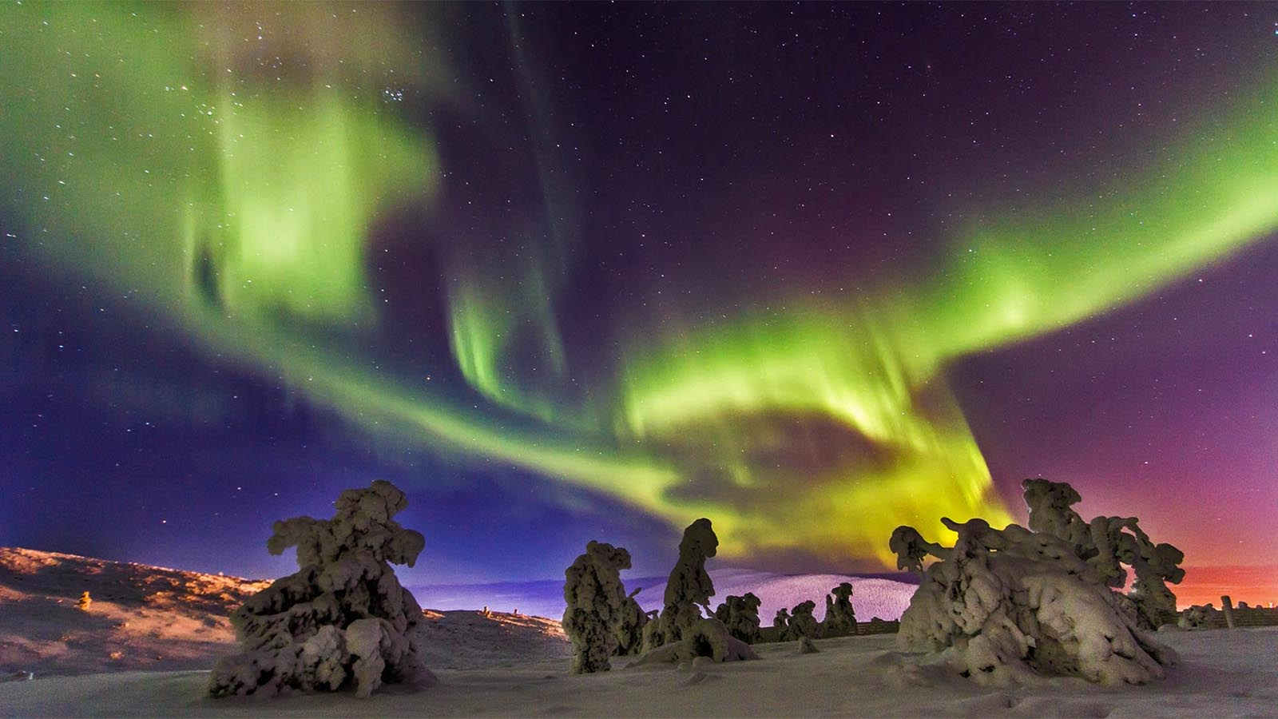
FINLAND (Lapland)

Slide 39
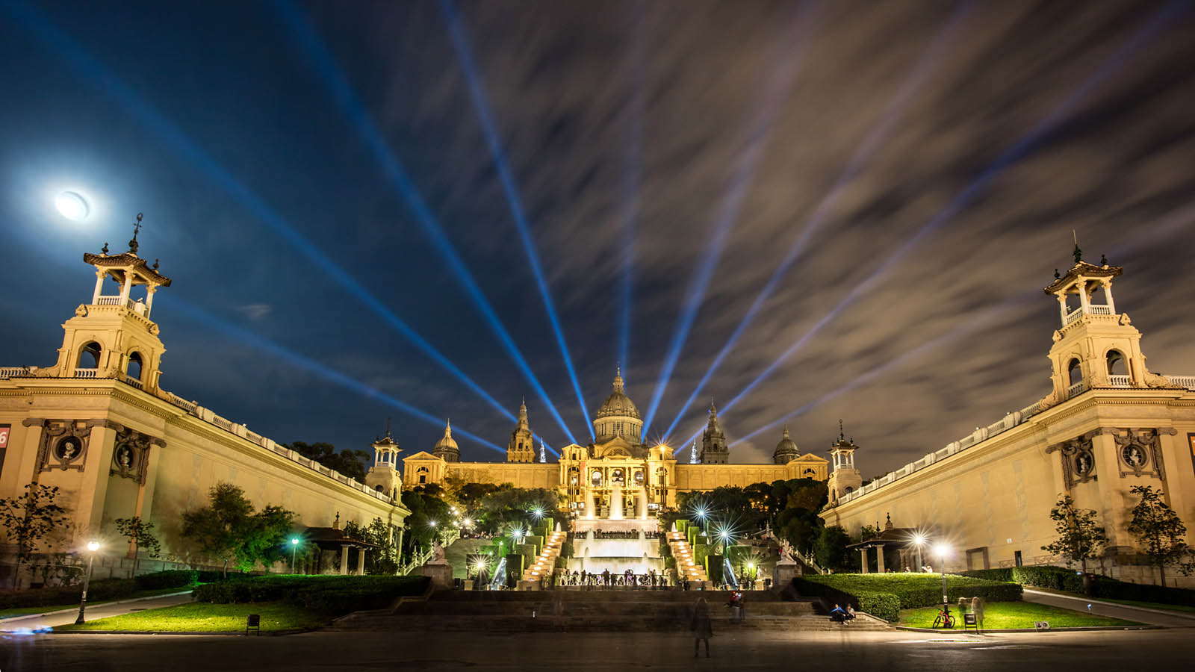
SPAIN (Museu Nacional d'Art de Catalunya, Barcelona)

Slide 40
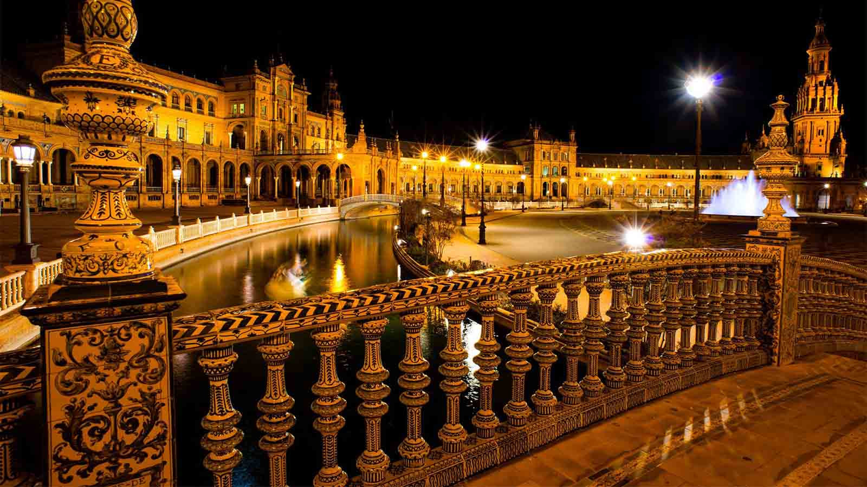
SPAIN (Plaza de España, Seville)

Slide 41
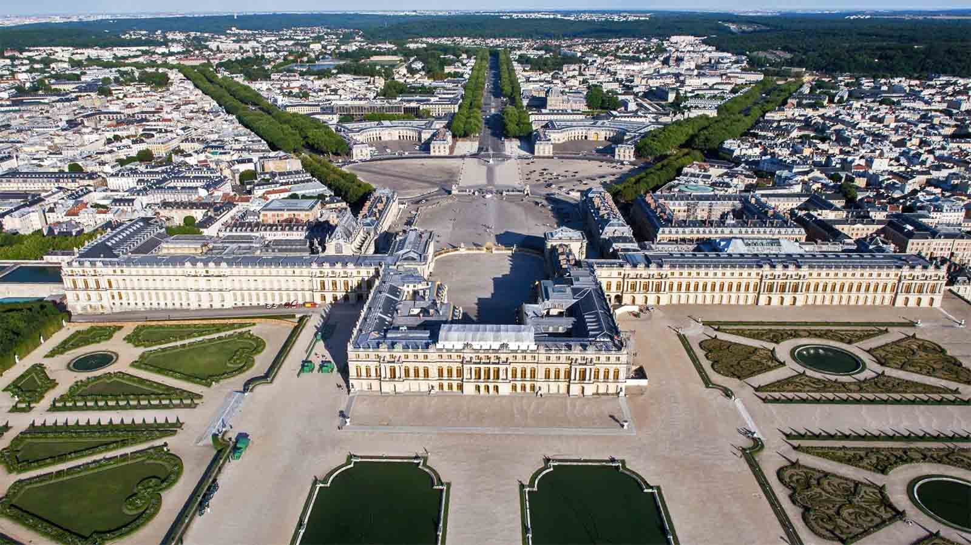
FRANCE (Versailles)

Slide 42
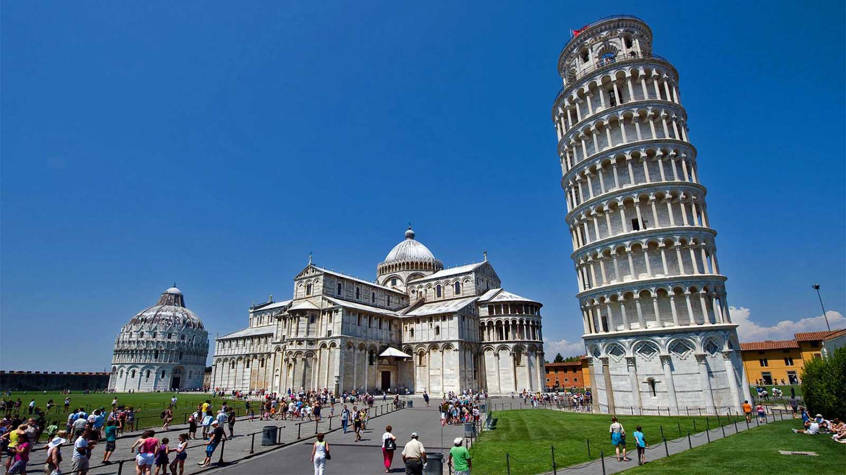
ITALY (Pisa)

Slide 43
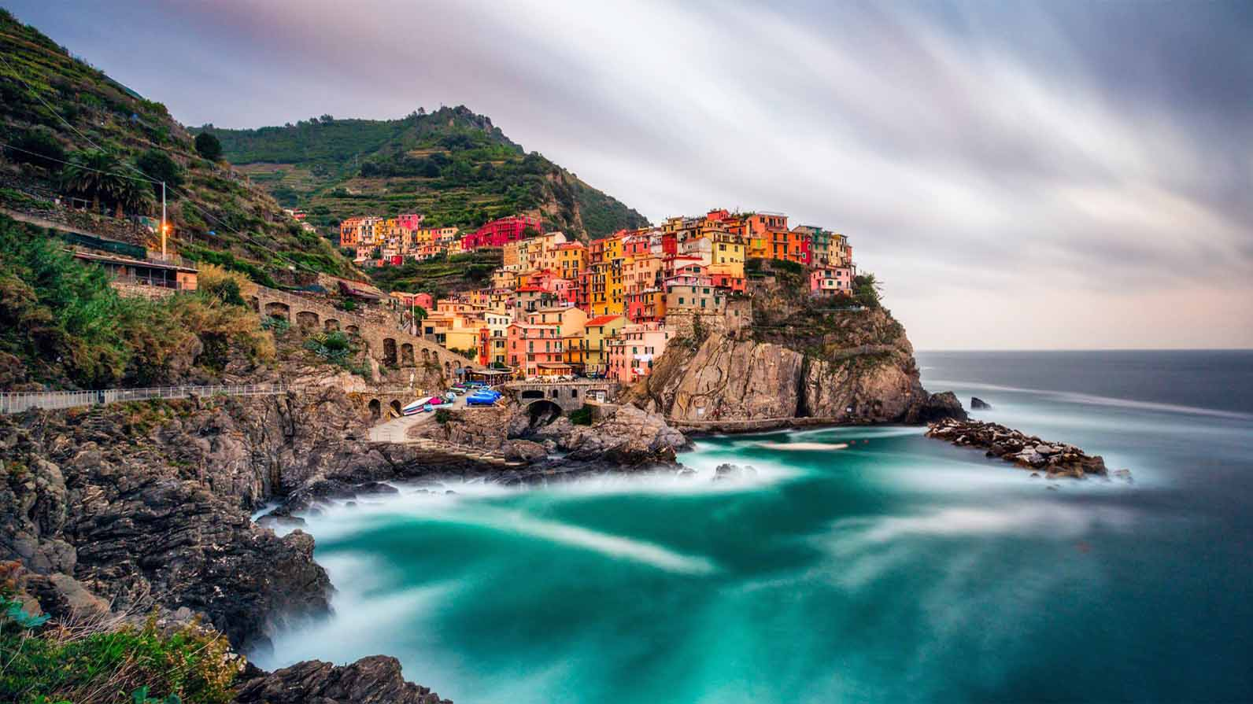
ITALY (Cinque Terre)

Slide 44
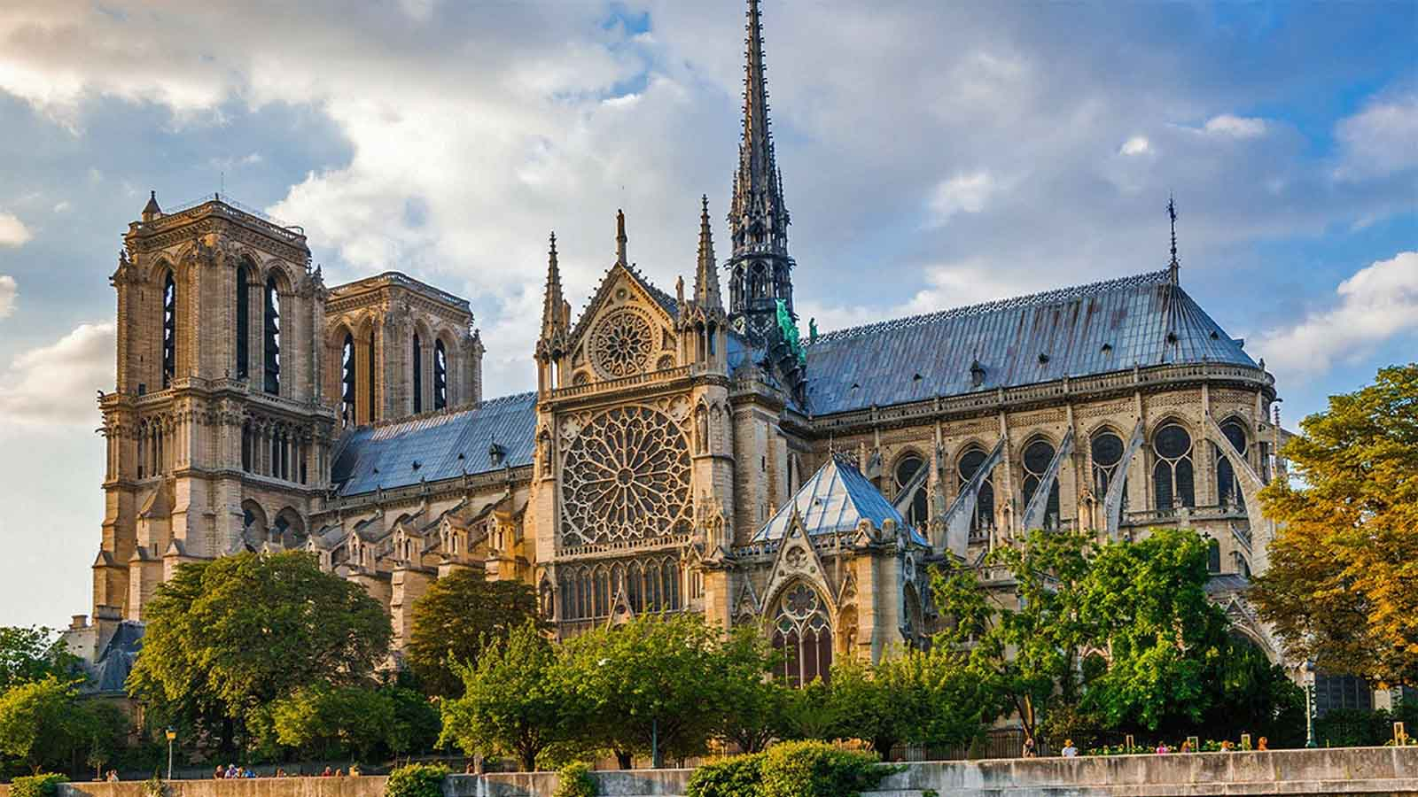
FRANCE (Notre-Dame, Paris)

Slide 45
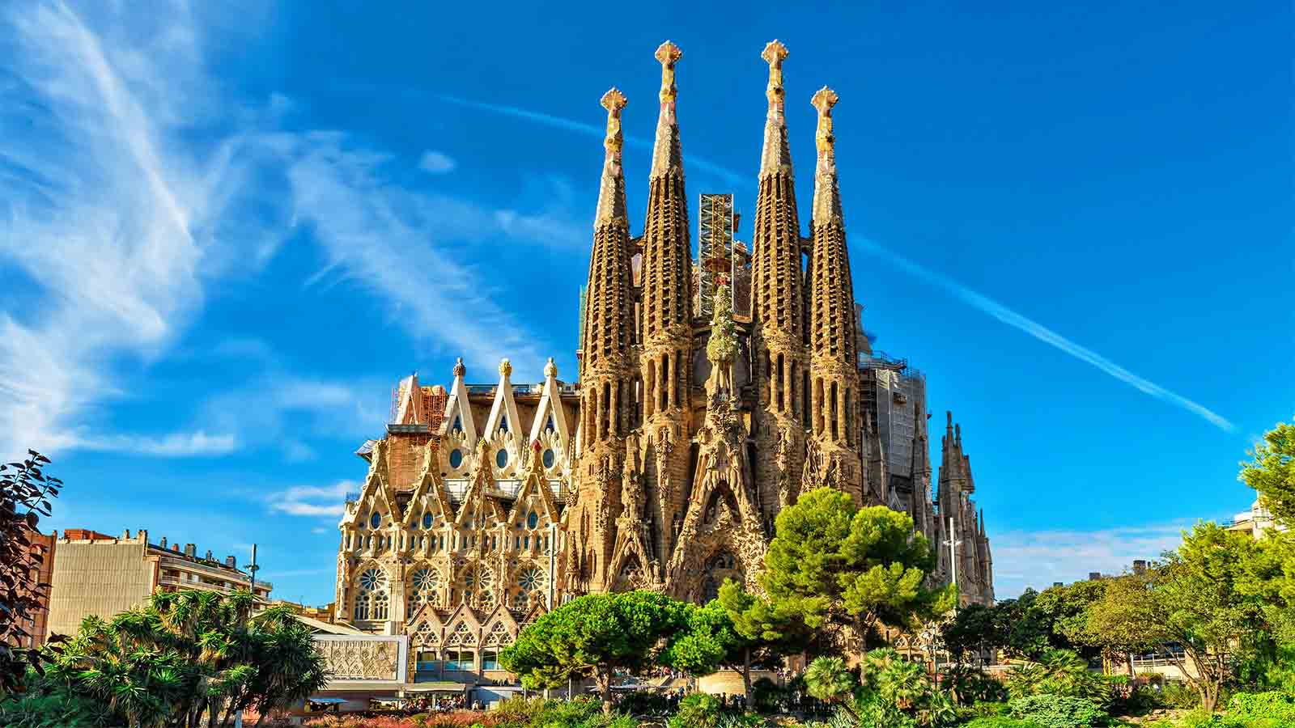
SPAIN (Sagrada Familia, Barcelona)

Slide 46
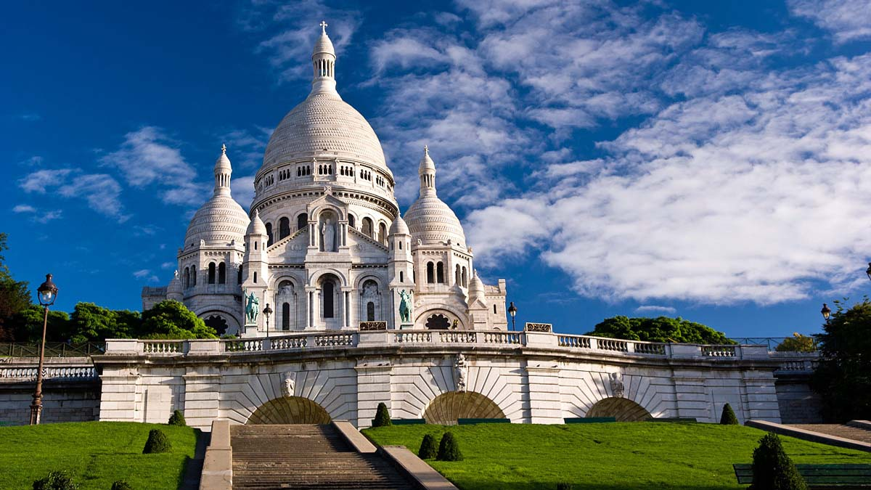
FRANCE (Basilica Sacré-Cœur, Paris)

Slide 47
Hope you have enjoyed viewing this presentation
Have a nice day
With regards - Tony Chacko and Steve Rumpler
tonychacko2000@gmail.com pista2011@gmail.com
Music: Paul Taylor - Exotica
2017

