Slide 1

HOW WE WIN IN 2021 WITH

Slide 2
WHERE ?

Slide 3

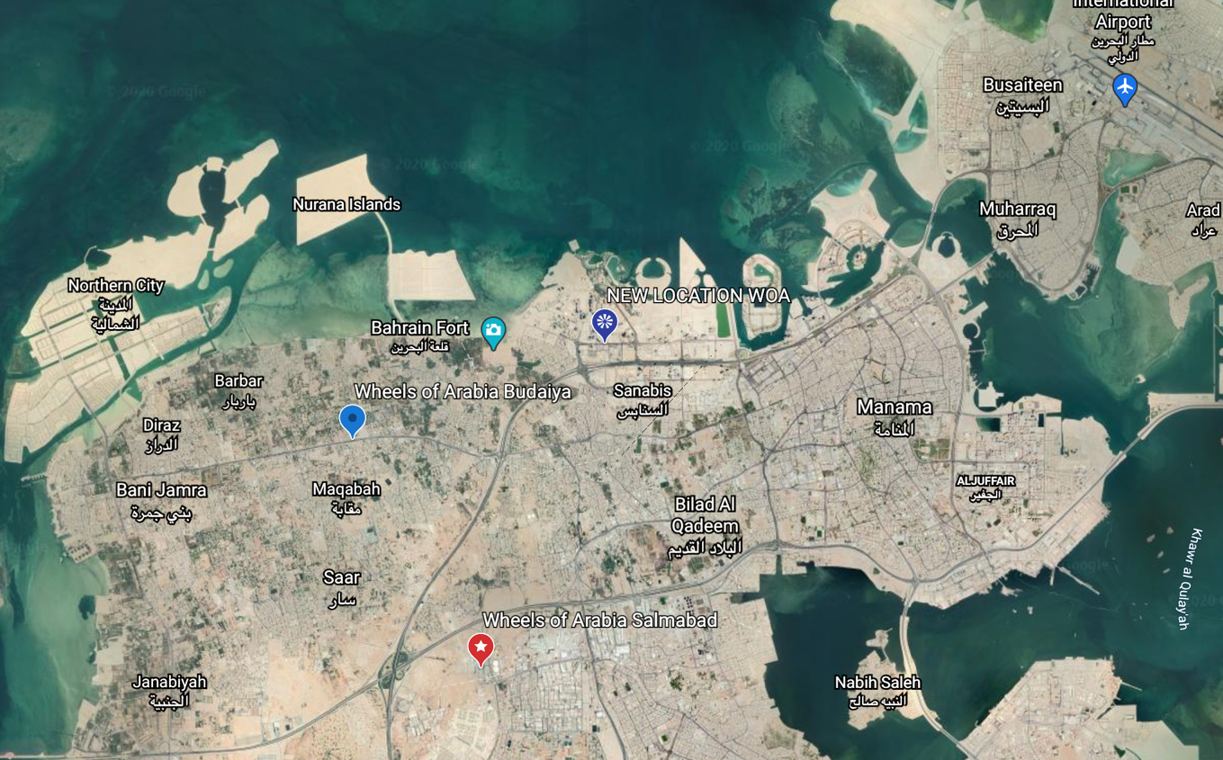
Current operation
Wheels of Arabia Bahrain operate currently in two location. Our first show room located in a compound next to a petrol station. We are representing in this show room, Ducati, Vespa, Piaggio and MV Agusta, Energica (Electric motorcycle as motorcycles brands

Slide 4
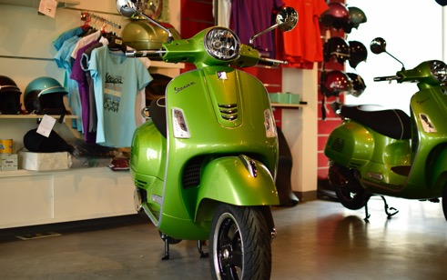
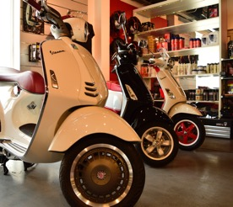
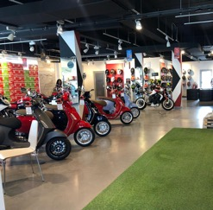
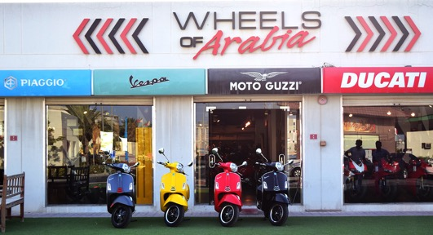
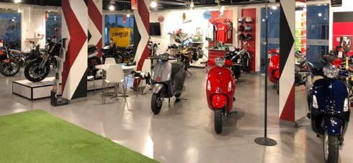
Current operation (Salmabad)

Slide 5
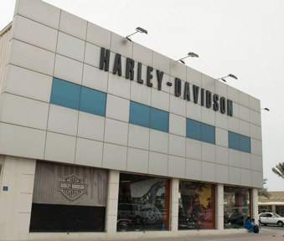
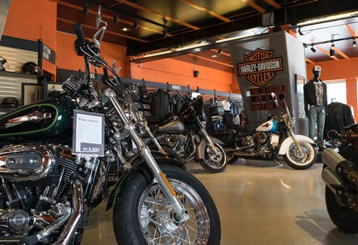
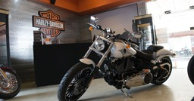
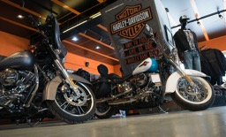
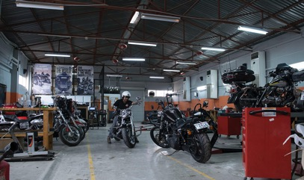
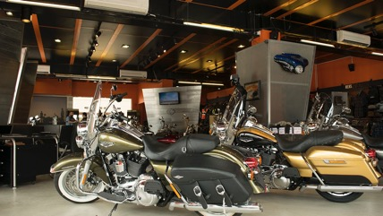
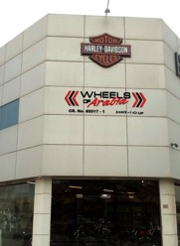
Current operation (Budaiya)

Slide 6
NEW

Slide 7
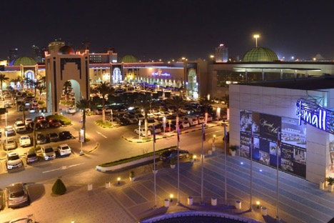
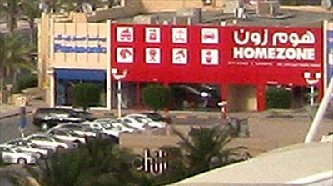

New operation
Wheels of Arabia would like to regroup all our companies under one roof. During the Pandemic time we have the opportunity to get prime location for an affordable price. Our choice and after selected several options, we have now secured the following.
Seef Mall is the second largest mall in the Kingdom of Bahrain. The mall is located in the Seef district of the capital city, Manama It attracts an average of 25,000 visitors a day (Before pandemic).
WOA new show room will be located inside the mall parking next to “Toys R us” shop.
The show room and service combined size is 2330 sqm.
Our idea is to switch all our brands under one roof in this very attractive and popular area. Another advantage which the district enjoys because of its location is its proximity to the other vital areas of Manama. This includes the man-made Reef Island, the Diplomatic Area, which can be easily reached through Shaikh Khalifa bin Salman Highway that borders Seef from the south.

Slide 8
TRY ME

Slide 9
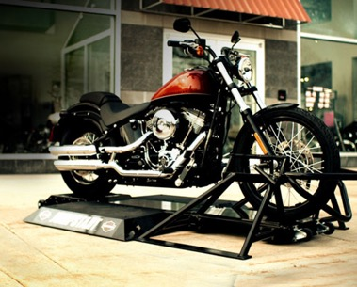

It's your first step to feeling true freedom.
So what is it, you ask?
JL and the rest of the crew here at Wheels of Arabia Bahrain decided it was time to get one of these bad boys to give non-riders and new riders a new outlook on riding a Indian Motorcycle Riding on two wheels can be a little nerve-racking, especially if you've never done it before, and this is the first step to kicking those feelings to the curb.
We attach an Indian Motorcycle to this machine (Indian SCOUT) and line up the back wheels with two rollers. We make sure it's secured and guess what...you're ready to take your first "ride". No, you don't need your license, permit, or any experience. The Indian Motorcycle simulator is a machine that allows the rider to shift through the gears and back down again to get a feel for riding. Only the back wheel spins, allowing the bike to go up to 65 miles per hour.
And after doing it a few times, you'll be hooked! (We promise!)
Now, remember: Indian Motorcycle - in "no way" - replaces a certified riding course and is not to be considered a "training device". It's just to help you get the feel for shifting through the gears and just begin to understand what riding is all about. You won't have to hold the bike up, worry about other vehicles, or be afraid of your neighbor's dog running out in front of you. You can finally start to understand why your sister, brother, best friend, co-worker, mom, dad, and grandparents love to ride.
Stop in anytime at Indian Motorcycle Bahrain - Wheels of Arabia is waiting for you!
You may have heard people say that there's nothing like being on a Motorcycle. Now, you can find out for yourself - even if you have no previous experience with motorcycles.
Motorcycle will not tip over No knowledge or previous motorcycle experience necessary
You'll mount the bike, set your boots on the foot pegs and fire up the engine under the watchful eye of trained personnel. Give the throttle a twist and hear that unforgettable Indian Motorcycle experience. Sitting comfortably on the bike, you'll continue to shift through the gears - all safely and securely attached to the platform.
All your impressions will be share on all our social media platforms (FB, Instagram & Snapchat)

Slide 10
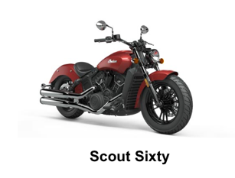
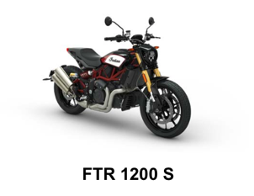
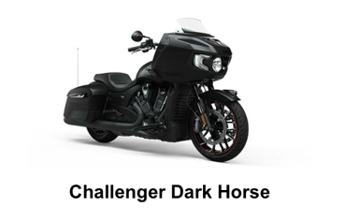
Book your test ride
You're only 3 simple steps away from booking a free, no obligation test ride on the of your dreams.
We'll then be in touch to confirm your booking.
COVID-19: In these challenging times, there may be a delay in our dealers responding to your request. Sit tight though, as they will get in touch as soon as they possibly can.
1
2
3
Choose your ride
Select your dealer
Enter your details

Slide 11
WWW

Slide 12
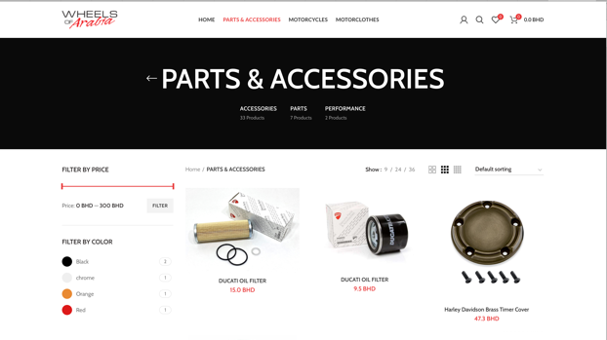
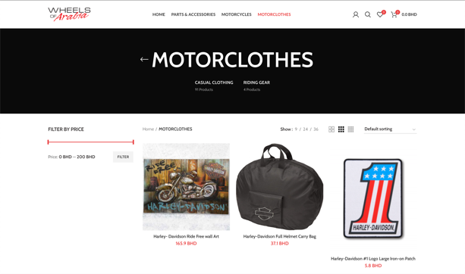
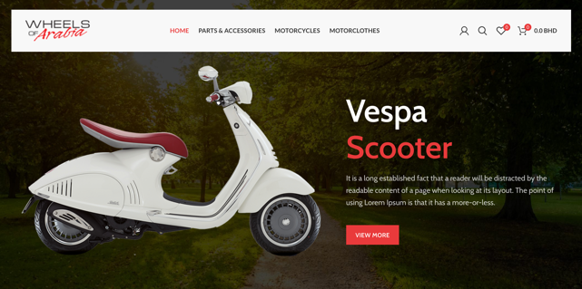
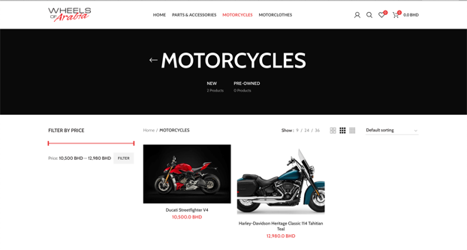
WOA directly notice the importance to have an E-commerce website to be able to sell online and to please our customer with an easy shopping system.
The Pandemic helped us to re-design our business vision and to develop new ideas to maintain our numbers.
We are planing to launch our New E-Commerce in February and add more product with delivery in all Bahrain.

Slide 13
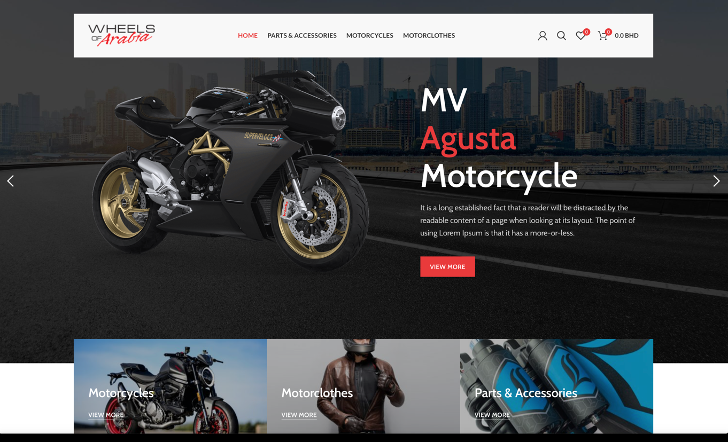
E-COMMERCE WOA
https://shop.wheelsofarabia.com

Slide 14
LOOK @ ME

Slide 15

We believe in Indian Motorcycle and we believe that we will achieve a great 2021 year.
Our first operational year for Indian Motorcycle and POLARIS in the Kingdom of Bahrain will be a year of introduction and seduction. We are already working in our database or existing HD customers but also targeting new riders generation. Until now we have already convince more than 12 friends and clients to buy Indian Motorcycle.
The numbers are feasible and we will do everything to fulfill this amazing challenge. After few month of operation when our cash flow will be stabilized we will develop the trade IN policy and make special events to boost the sales.
We are working also in a Motorcycle loan for new riders and make a special package including the purchase of motorcycle, training & fees, License fees, Insurance so a FULL PACKAGE.
Having our own training system helped us to keep our trainees as customers.
We will also offer Indian Motorcycle as Police or Royal Escort and try to make a fleet deal with Bahraini government.

Slide 16
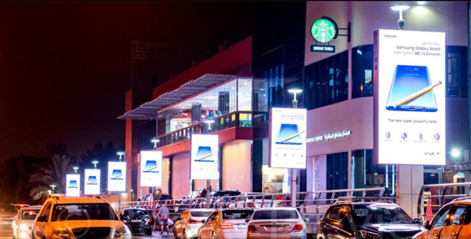
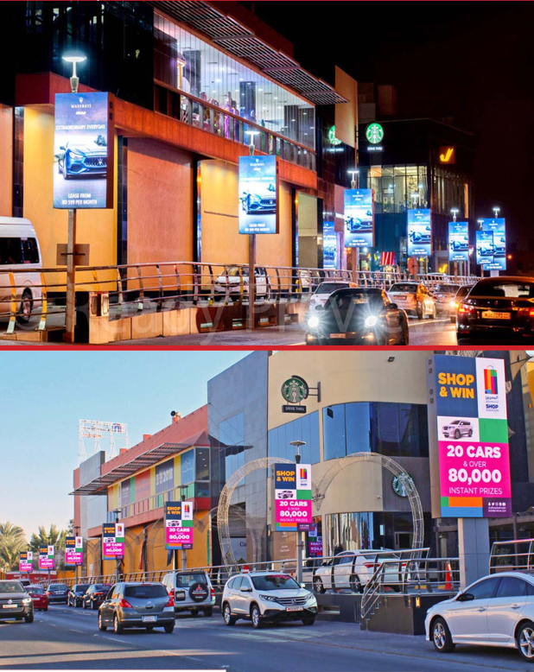
Part of our vision for Indian Motorcycle but also for all the Polaris products we must been see. “Look at me” is the key of the success.
We already book several strategic location of digital lamppost all around Bahrain.
Our Policy will be to have an affordable price to attract a lot of customers.

Slide 17
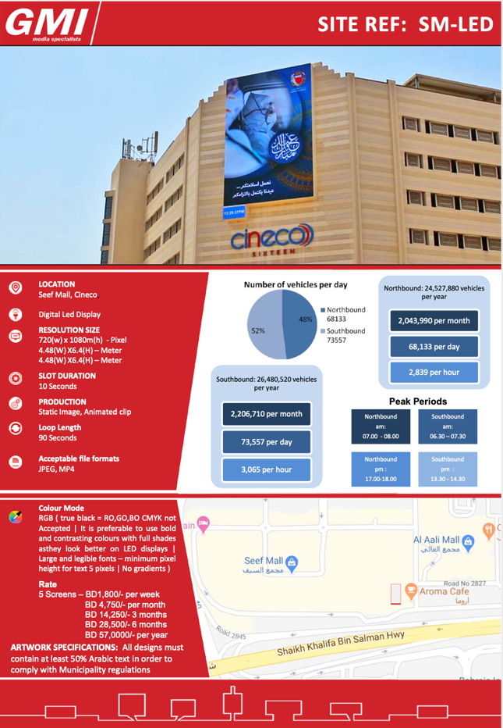
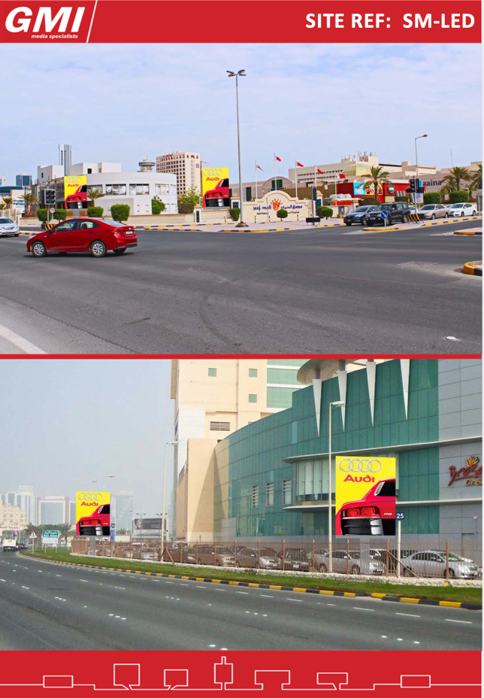

Slide 18
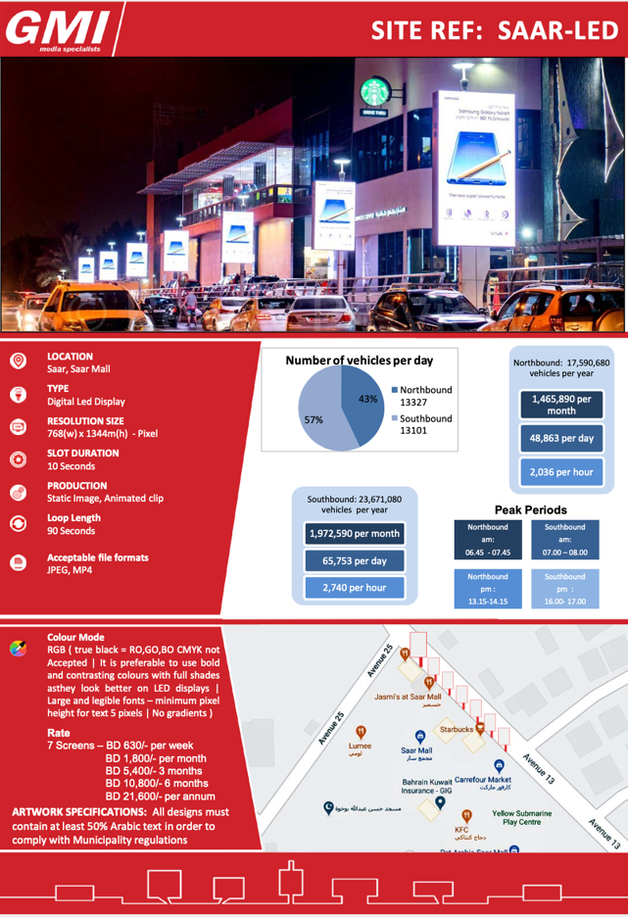
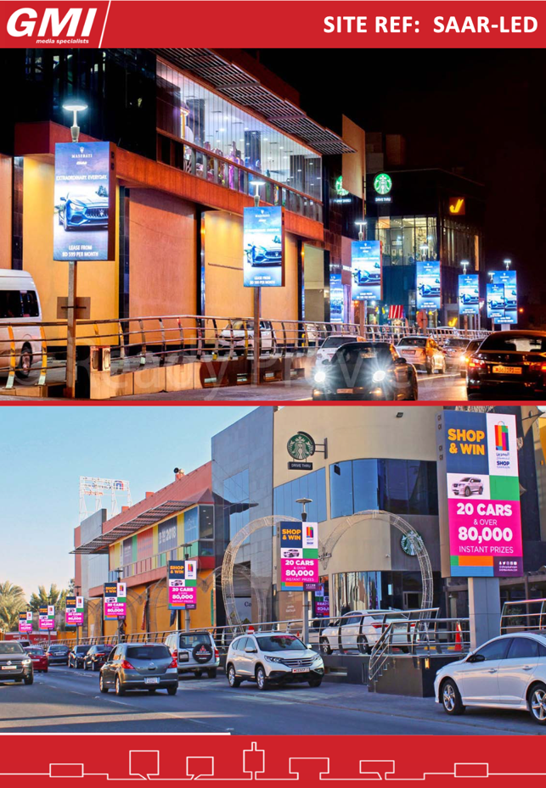

Slide 19
IT’S HAPPENING

Slide 20
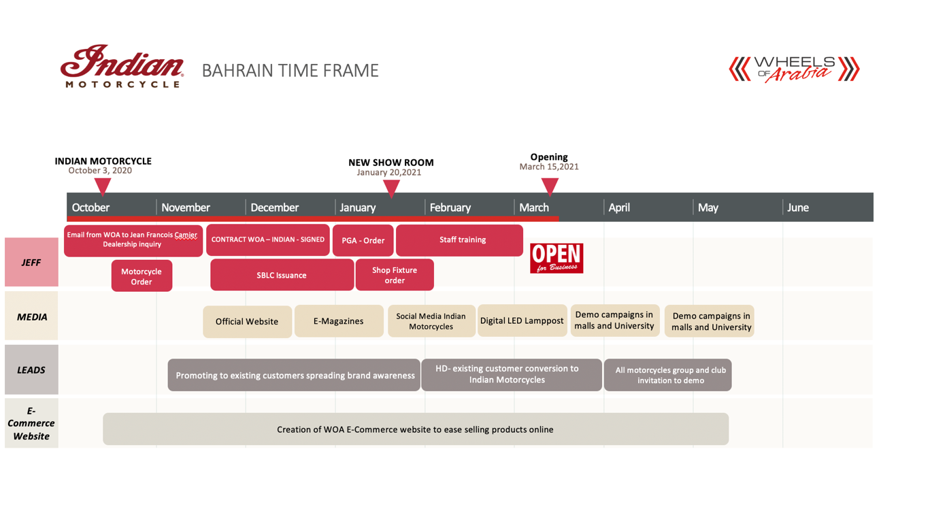
After the signature of the contract with Polaris - Indian we worked to establish several strategies.
Convert H-D customers in Indian Motorcycle using brand awareness. Trying to explain the legacy of Indian motorcycles, the quality & power before the first Indian Motorcycles reach Bahrain.
We are working actually to attract new customers in cooperation with several University (American University of Bahrain) to promote the use of Indian Motorcycle for the students. We are also finalizing a cooperation with a Bank to give a special loan for young and student for the purchase of Indian Motorcycle.
We are making a package that will include the following:
1- Indian Motorcycle Simulator Experience 2- Motorcycle training (Scout) 3- Motorcycle driving license and test Fees. 4- Indian Motorcycle any choice. 5- Third Party Insurance. 6- Licensing and registration.

Slide 21
FAMILY

Slide 22
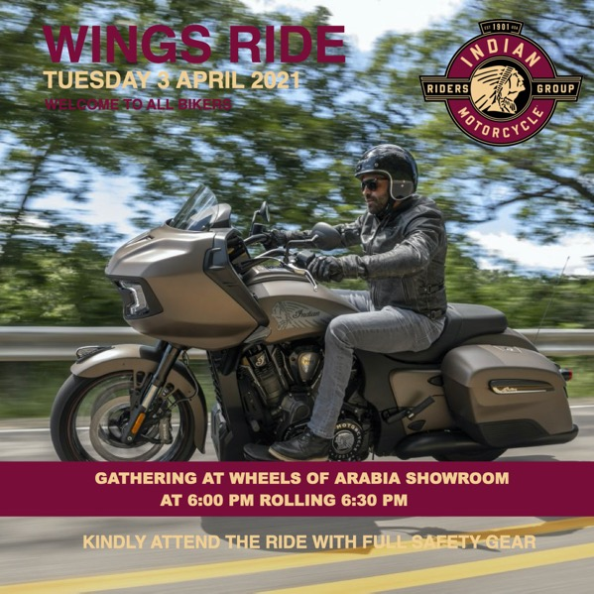
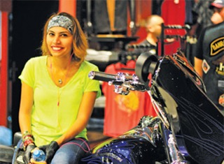
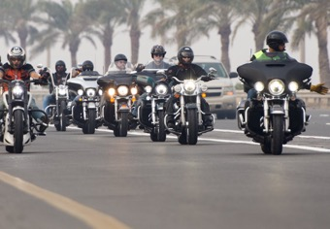
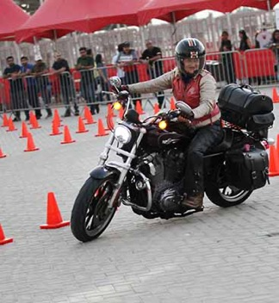
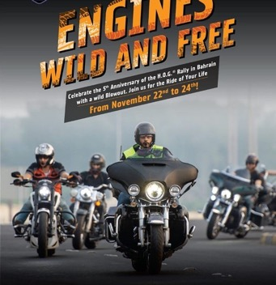
We believe that Indian Motorcycle Riders Group must start the first year by several members that will be our first customers, the need to make them part of a brand and family is essential. We will create a group that is part of the dealership life and share and support our events. We will create a yearly activities calendar mixing riding and social events like BBQ, Bowling, sport activities, Family event, International ride if permitted. Our aim will be to create a big Motorcycle Rally for all Gulf and Middle East countries to gather and share our passion but also to boost and keep Indian Motorcycle growing in the region.

Slide 23
THE DAY

Slide 24
Bahrain riders are very excited about have a legendary brand like Indian Motorcycle opening in their Kingdom. WOA will put all efforts to keep the legacy very high and we will do our best to show to our customers that Indian Motorcycle is a unique brand. We will also attract new customers to discover the 2021 models in our show room.
In our open house we will have live rock music, demos, Simulator and many activities to attract customers to discover all new models. We will also invite all motorcycle club and group in Bahrain to join us for this historical event.
We will let our customer try the Indian Motorcycle (Demos) but also for non riders our simulator. The Indian Motorcycle simulator will be under a photo booth where customer experience will be catch by photographer and directly send to all our Social media platforms, we will also get all impressions of our new riders about the experience trying an Indian Motorcycle for the first time. Every one will get a certificate with his name and date for trying and Indian Motorcycle.

Slide 25
THE YEAR

Slide 26
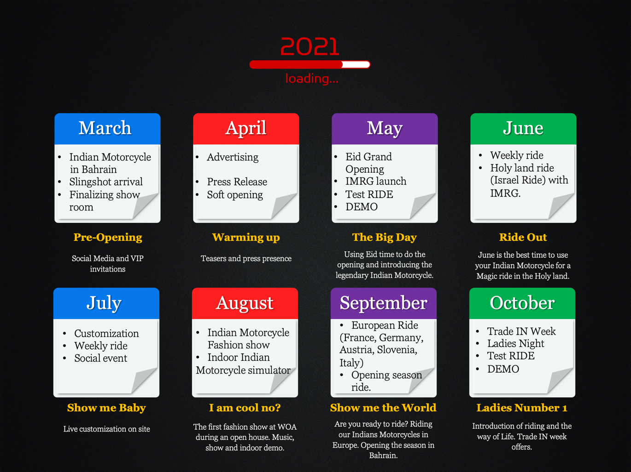

Slide 27
$$$

Slide 28
INDIAN MOTORCYCLES
 | Year 1 (full year) |  | Year 2 |  | Year 3
Sales forecast | 50 Bikes |  | 70 Bikes |  | 100 Bikes
Revenues
New Bikes | 307,366.216 | 74% | 419,685.000 | 71% | 585,106.383 | 71%
Pre-Owned | - |  | 27,500.000 | 5% | 38,297.872 | 5%
Finance & Insurance | - |  | - |  |  | 0%
Service (Labor) | 48,648.649 | 12% | 63,000.000 | 11% | 84,255.319 | 10%
Spare Parts | 16,216.216 | 4% | 22,000.000 | 4% | 30,851.064 | 4%
Accessories | 24,324.324 | 6% | 33,000.000 | 6% | 44,680.851 | 5%
Apparel & Merchandising | 20,270.270 | 5% | 27,500.000 | 5% | 38,297.872 | 5%
Total Revenues | 416,825.676 |  | 592,685.000 |  | 821,489.362
COGS | -
New Bikes | 240,259.797 | 22% | 328,094.583 | 22% | 457,446.809
Pre-Owned |  |  | 24,750.000 | 10% | 34,468.085 | 22%
Finance & Insurance | - |  |  |  |  | 10%
Service (Labor) | - |  | - |  | -
Spare Parts | 9,729.730 | 40% | 13,208.333 | 40% | 18,510.638
Accessories | 14,594.595 | 40% | 19,791.667 | 40% | 26,808.511 | 40%
Apparel & Merchandising | 12,162.162 | 40% | 16,500.000 | 40% | 22,978.723 | 40%
Total Cogs | 276,746.284 |  | 402,344.583 |  | 560,212.766 | 40%
Gross profit | 140,079.392 |  | 190,340.417 |  | 261,276.596
Other costs | -
Personnel | 71,756.757 | 17% | 88,500.000 | 15% | 119,148.936 | 15%
General and administrative costs | 16,891.892 | 4% | 20,833.333 | 4% | 28,723.404 | 3%
Showroom and service rent | 33,783.784 | 8% | 41,666.667 | 7% | 53,191.489 | 6%
Amortization | 4,343.649 | 1% | 5,357.167 | 1% | 6,838.936 | 1%
Adv & Mktg | 4,324.324 | 1% | 5,916.667 | 1% | 8,191.489 | 1%
Total Operating Expenses | 131,100.405 | 31% | 162,273.833 | 27% | 216,094.255
EBIT | 8,978.986 | 2% | 28,066.583 | 5% | 45,182.340 | 6%
Interest Payments | 4,504.865 |  | 6,151.750 |  | 8,577.128
EBT | 4,474.122 | 1% | 21,914.833 | 4% | 36,605.213 | 4%

Slide 29
We believe in Indian Motorcycle and we believe that we will achieve a great 2021 year.
Our first operational year for Indian Motorcycle and POLARIS in the Kingdom of Bahrain will be a year of introduction and seduction. We are already working in our database or existing HD customers but also targeting new riders generation. Until now we have already convince more than 12 friends and clients to buy Indian Motorcycle.
The numbers are feasible and we will do everything to fulfill this amazing challenge. After few month of operation when our cash flow will be stabilized we will develop the trade IN policy and make special events to boost the sales.
We are working also in a Motorcycle loan for new riders and make a special package including the purchase of motorcycle, training & fees, License fees, Insurance so a FULL PACKAGE.
Having our own training system helped us to keep our trainees as customers.
We will also offer Indian Motorcycle as Police or Royal Escort and try to make a fleet deal with Bahraini government.
BHD 99.00

Slide 30
Costing

Slide 31
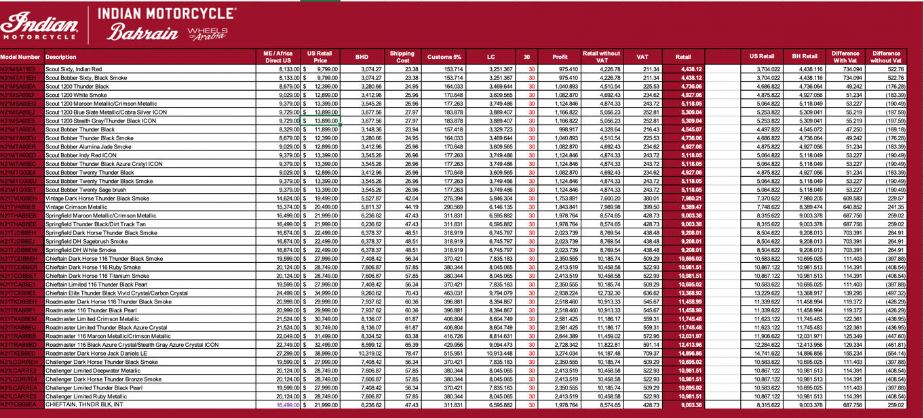
Pricing is the key of the success, and we will always try to be very competitive. We should have an MSRP for gulf and MENA Regions so all dealers will be same pricing. Middle East and Gulf regions love to bargain and it is in the culture, we should be little bit flexible to avoid loosing a deal. Our policy pay back and we always help customers to fulfill their dreams. With an easy access of internet everyone can see worldwide pricing so let’s keep our prices not too far from US prices. Our prices difference between US and Bahrain are not too high compare to the prices of HD previously.
We will also have a Full package that include Training fees, License fees, Insurance, Motorcycle licensing & registration fees.

Slide 32
PGA

Slide 33
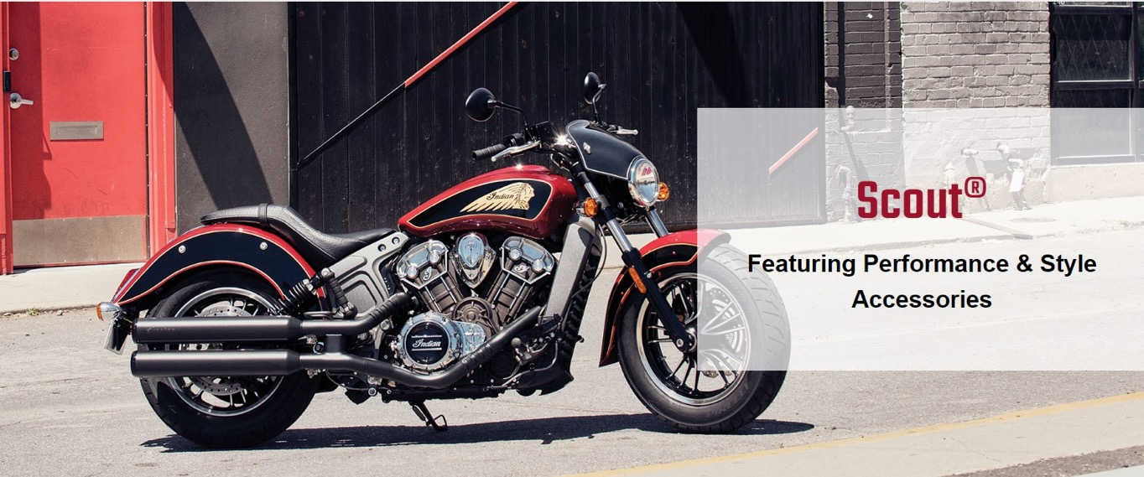
We will dedicate 1 Display wall per family for accessories as we believe we must show and introduce to our existing customer the Indian Motorcycle accessory line properly. We will create accessories package ( Jad already working on it) and adapt this package to the local taste. We will create service package. We will use our social media but also our E-commerce to help customers in purchasing. We will do a weekly session using our social media showing the installation of the accessories illustrating the use, benefits and the style of each items. We will also focus on the performance parts which is a big seller in the region and in Bahrain. ( We already have in line 2 stage III upgrades for 2 Challengers). We will have in stock parts for Stage I for easiness to sell them. (Promoting them via our demo bikes) .
Our demo bikes will be customized with Stage I and minor customization such as grips, floorboards, pegs.
We will create a 100 Horsepower club (patches and pins) so every owners can joined if their motorcycle is over 100hp then we will do a top 20 of the most powerful Indians in Bahrain then in the region.

Slide 34
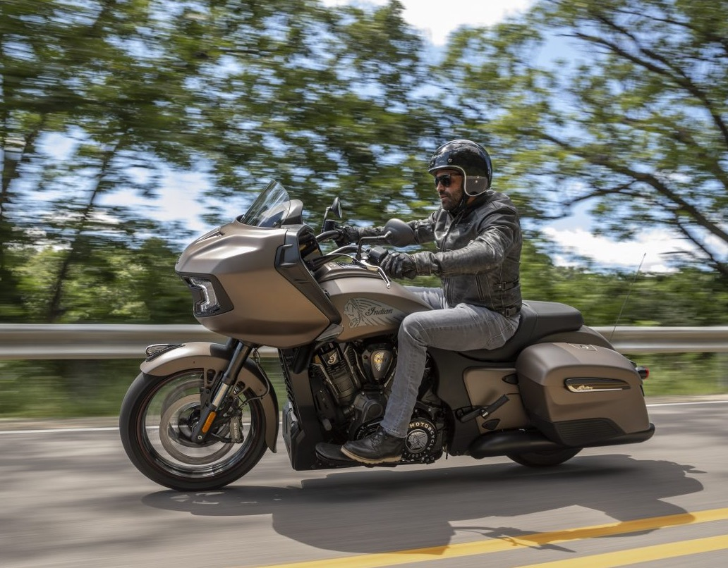

CERTIFICATE
INDIAN MOTORCYCLE BAHRAIN
Jean François Camier
PRESENTED TO
Challenger Dark Horse
122 HP - 128 lbs-ft of torque.
BIKE MODEL
HORSEPOWER

