Slide 1
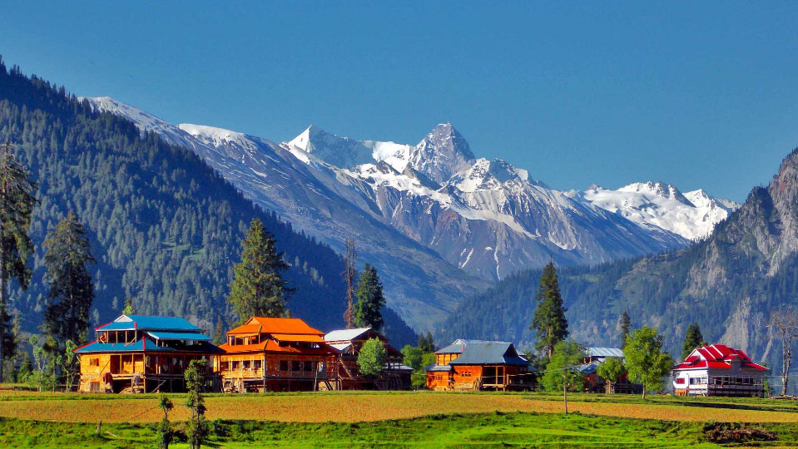


Most Beautiful Gardens Around the World
For a solid portion of human history, people have been cultivating flora in gardens for both practical and aesthetic use. But we’re not just talking about tiny plots in your backyard where you grow tomatoes. Gardening is an art form, from the Zen-like gardens of the eastern tradition, to perfectly manicured Western sanctuaries. "When you see a garden, you see a culture," and "Through the formality or informality (of the landscaping), or the plants a country has chosen to import and show off, you see how it wants to be seen." "Gardens are such a wonderful refuge, and more and more, people are looking for a haven from the stress of modern life,". This craving for green, blossoming sanctuaries is the verdant serenity and happiness of mind that every human would hope for. Here, we take a look at the most beautiful gardens from across the globe.
A special compilation by
Tony Chacko and Steve Rumpler
tonychacko2000@gmail.com pista2011@gmai.com

Slide 2
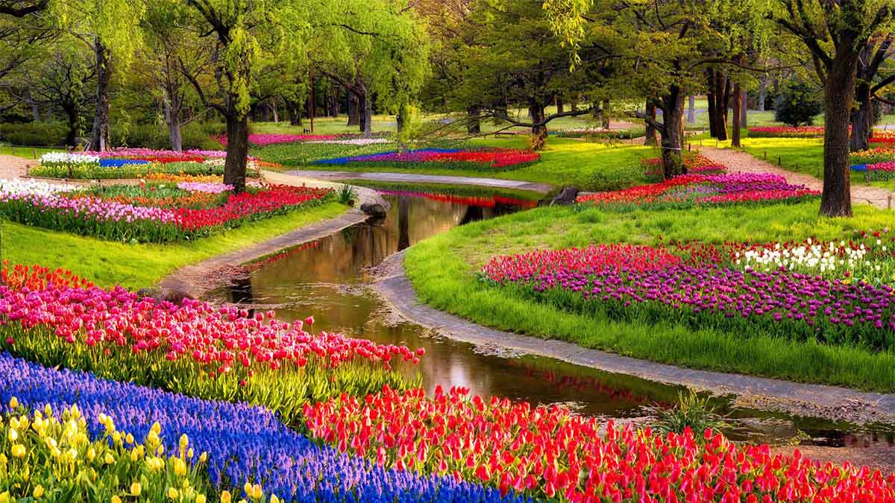

The Keukenhoff Garden, Amsterdam, Netherlands

Slide 3
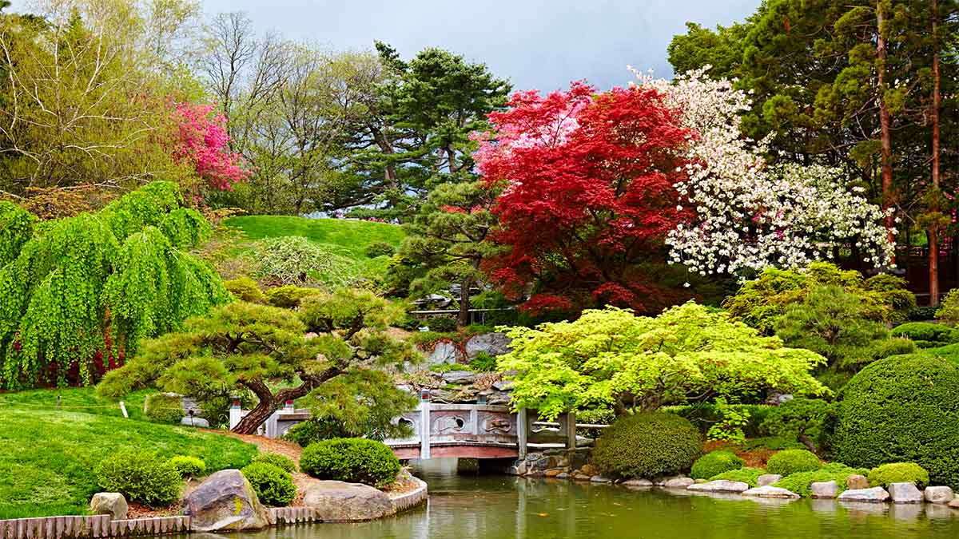
Brooklyn Botanical Garden, USA

Slide 4
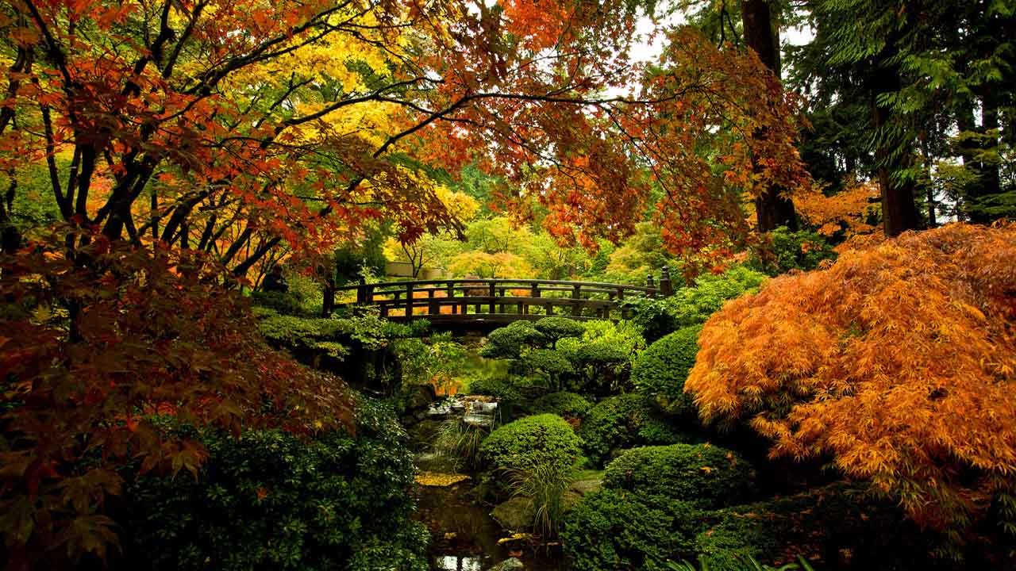
Japanese Garden, Portland, USA

Slide 5
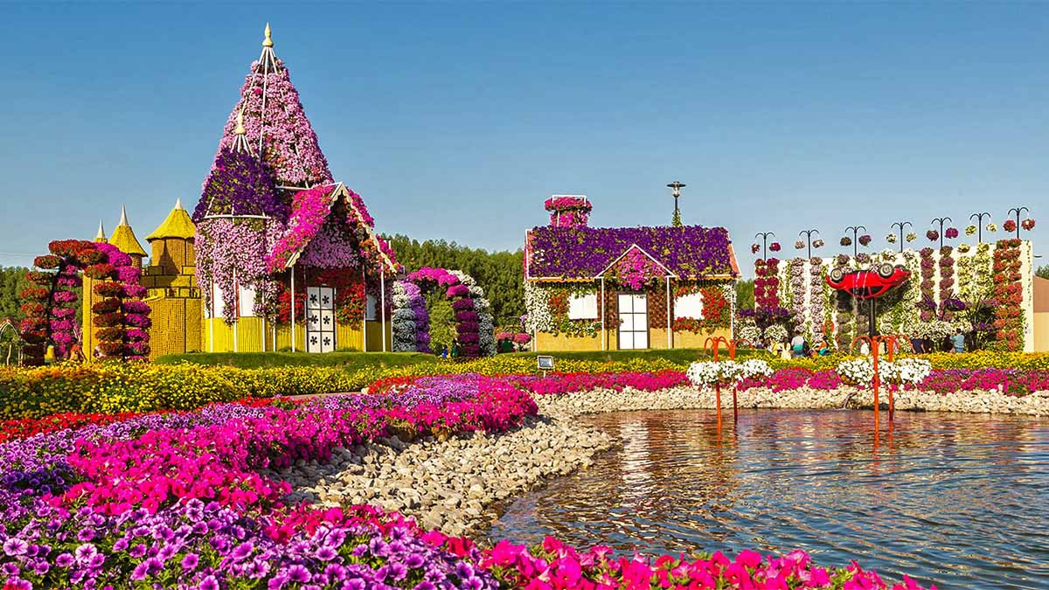
Dubai Miracle Garden, UAE

Slide 6
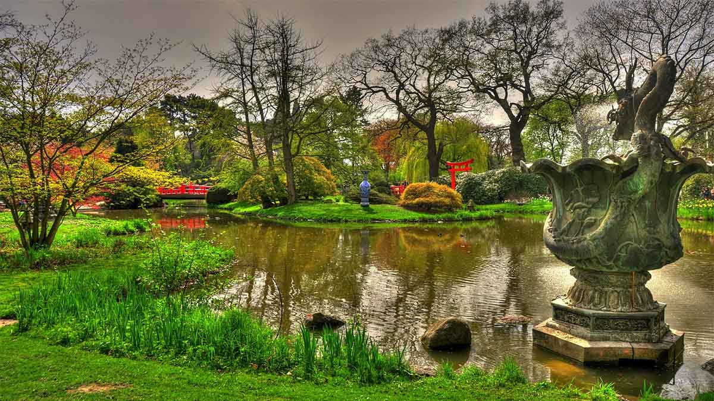
Japanese Garden, Hamburg, Germany

Slide 7
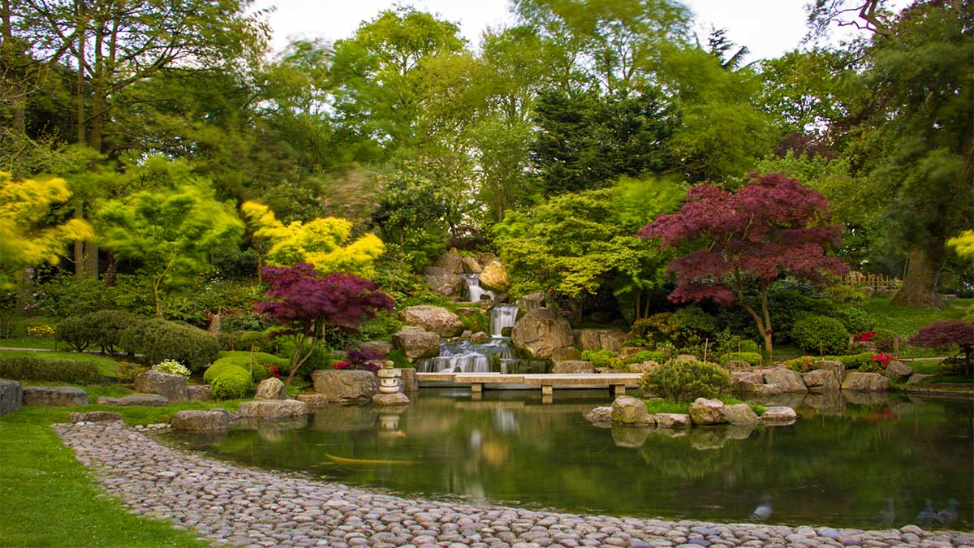
Holland Park, London, England

Slide 8
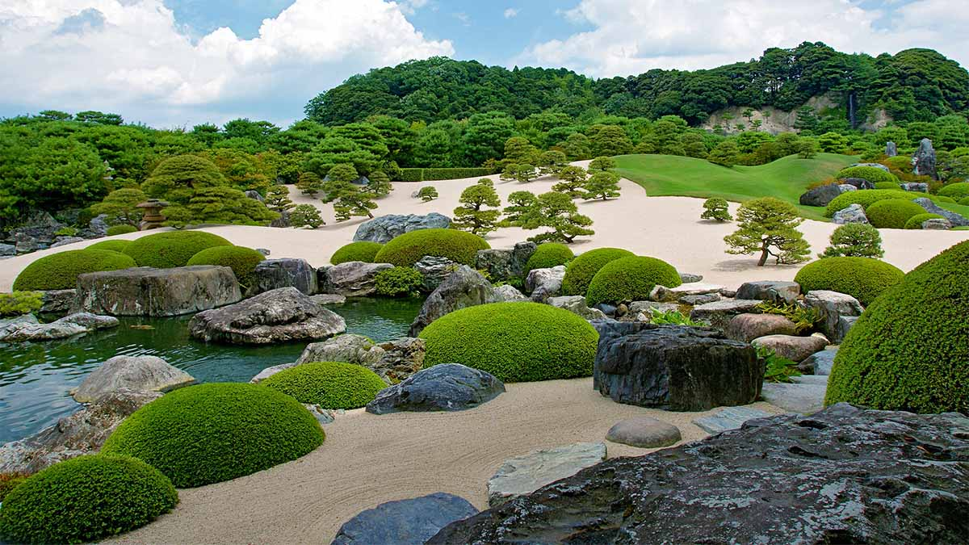
Japanese rock garden, Adachi Museum of Art, Japan

Slide 9
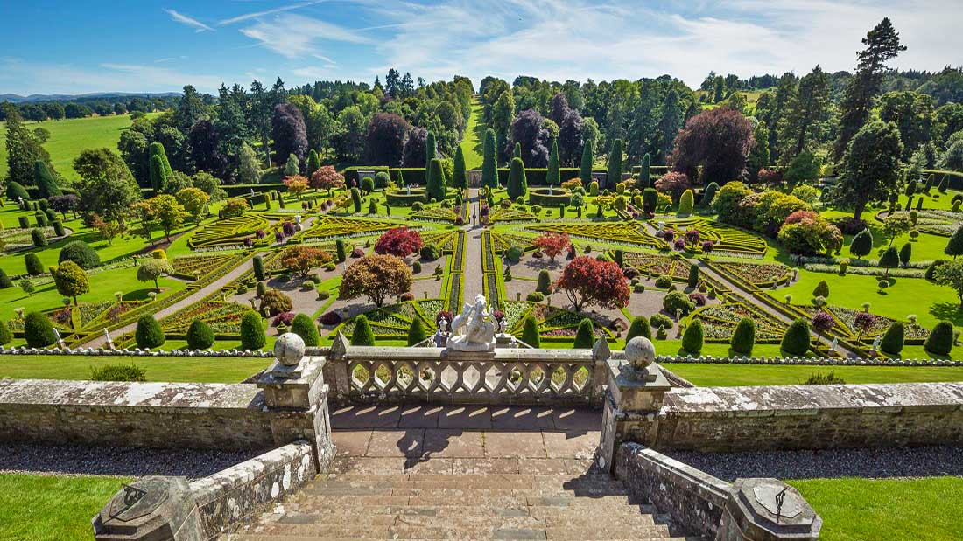
Drummond Castle Garden, Perthshire, Scotland

Slide 10
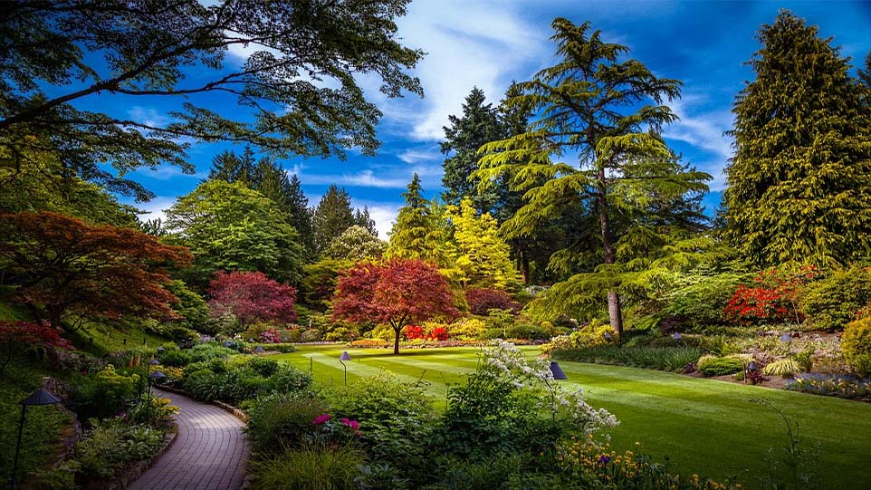
Butchart Gardens, British Columbia, Canada

Slide 11
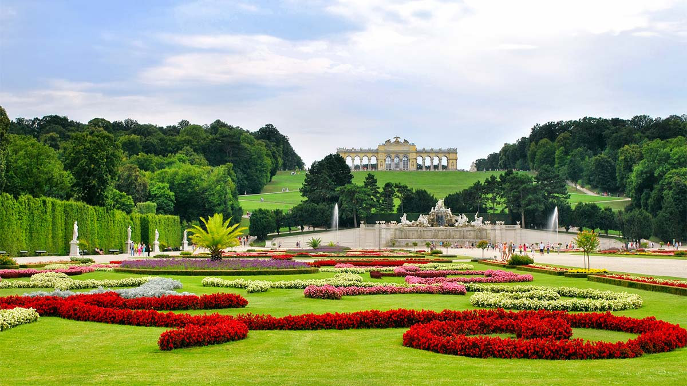
Schönbrunn Palace Gardens, Vienna, Austria

Slide 12
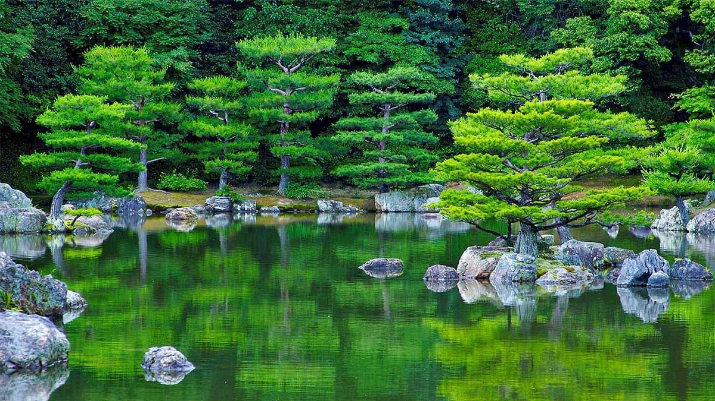
Ryoan-ji Zen Garden, Kyoto, Japan

Slide 13
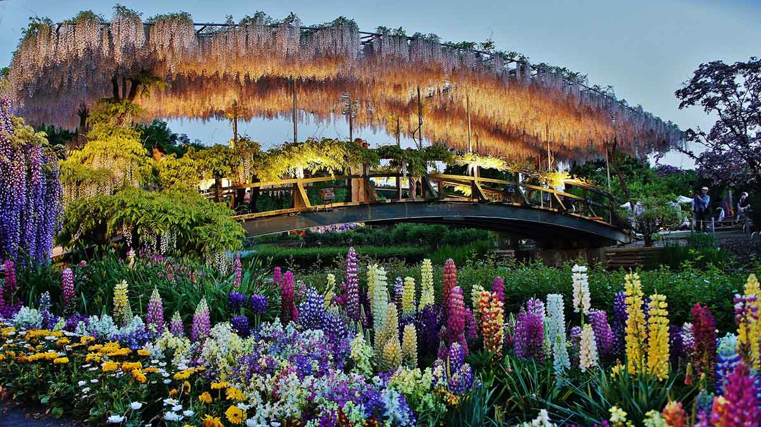
Ashikaga Flower Park, Kyoto, Japan

Slide 14
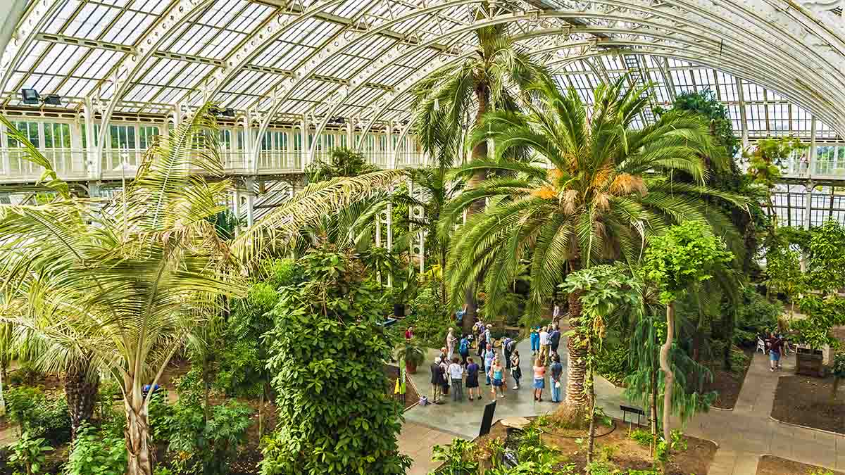
Kew Botanical Gardens, London, U.K.

Slide 15
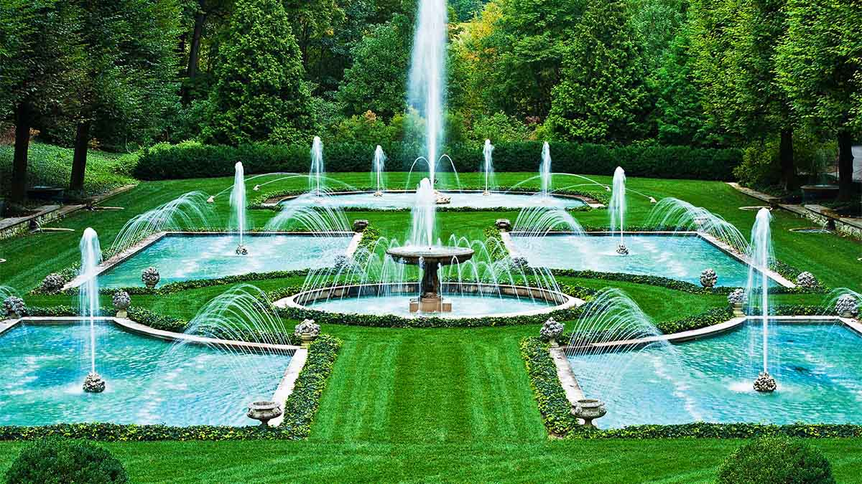
The Longwood Garden, Kennett Square, Pennsylvania, USA

Slide 16
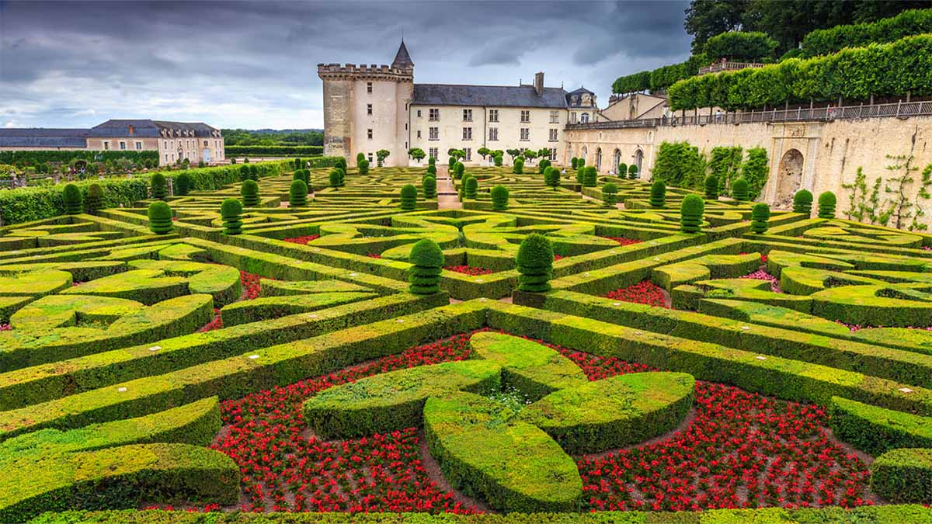
Gardens of Chateau Villandry, Loire Valley, France

Slide 17
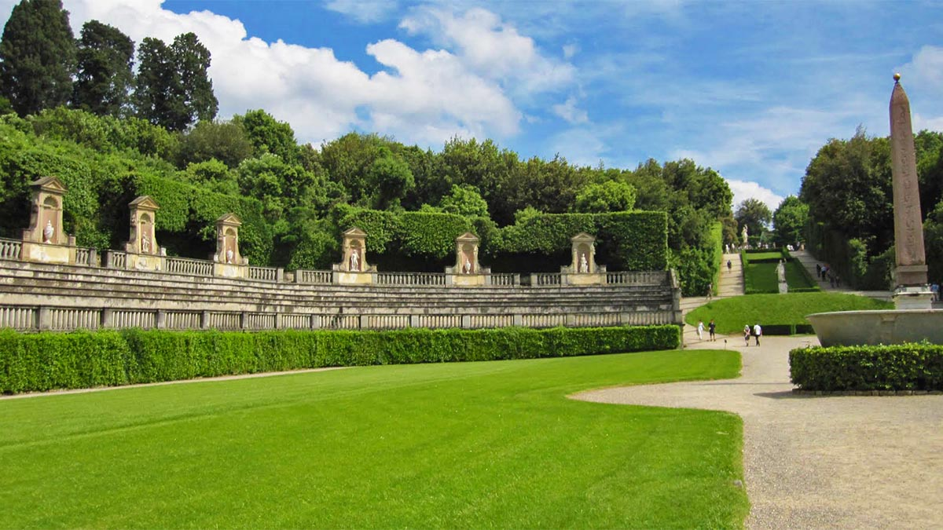
Boboli Renaissance Garden, Florence, Italy

Slide 18
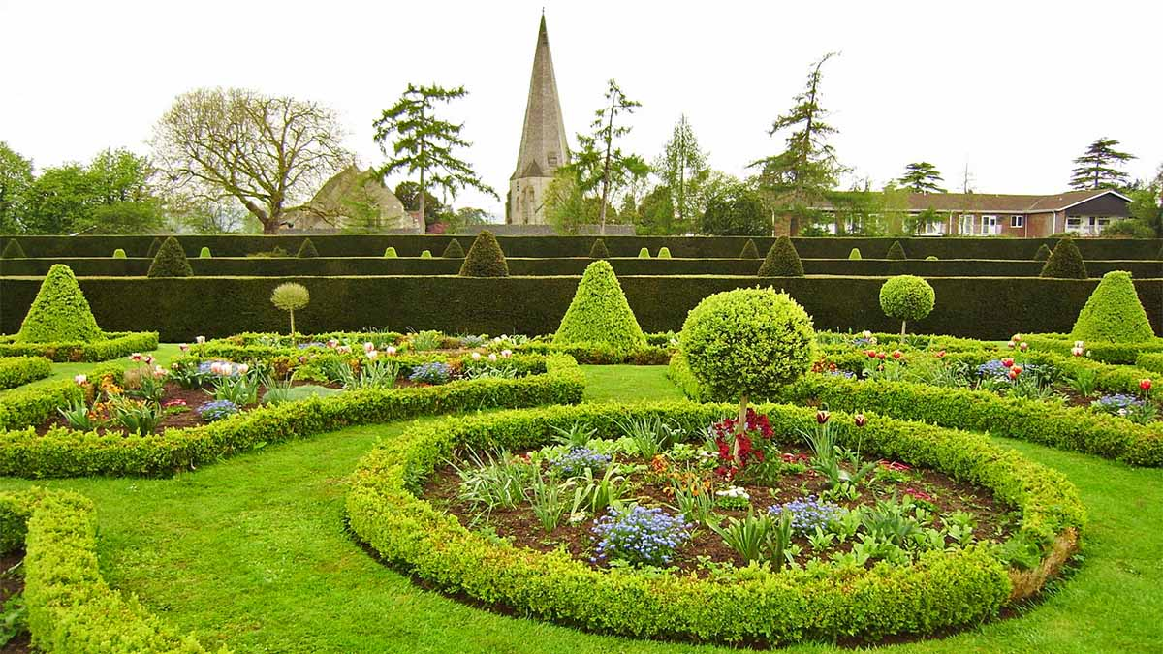
Westbury Court, Gloucester, U.K.

Slide 19
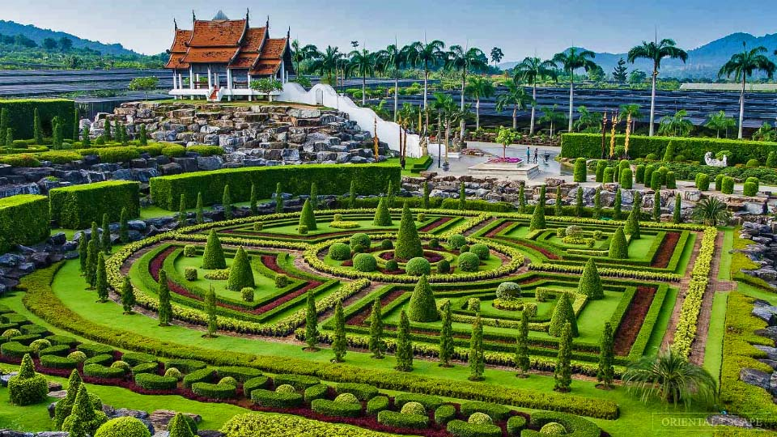
The Noong Nooch Tropical Gardens, Chonbury, Thailand

Slide 20
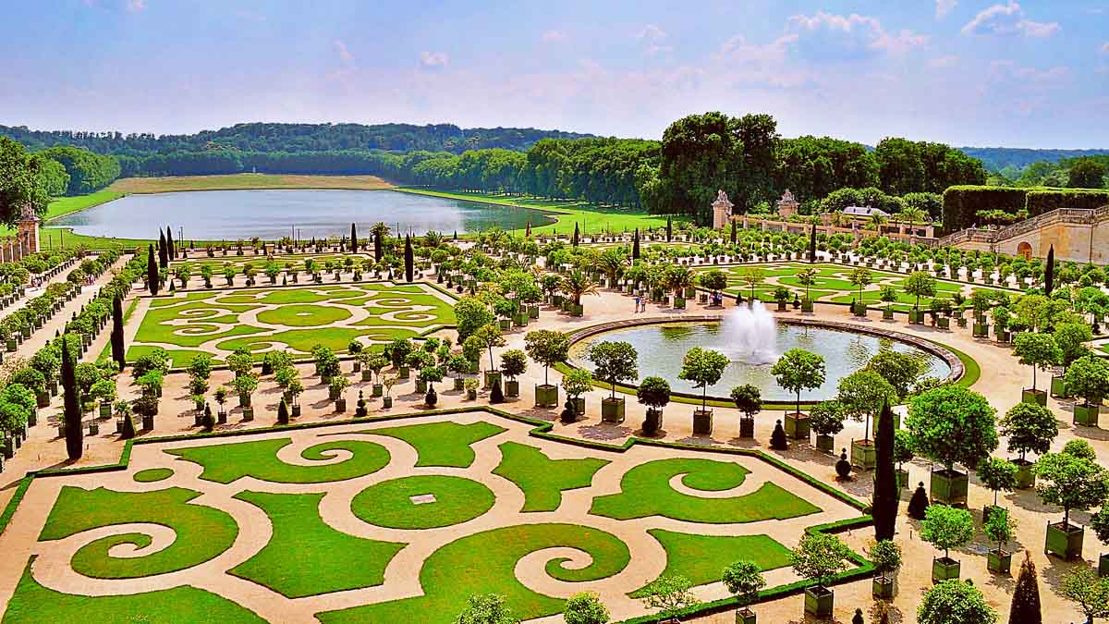
Garden of Palace Versailles, France

Slide 21
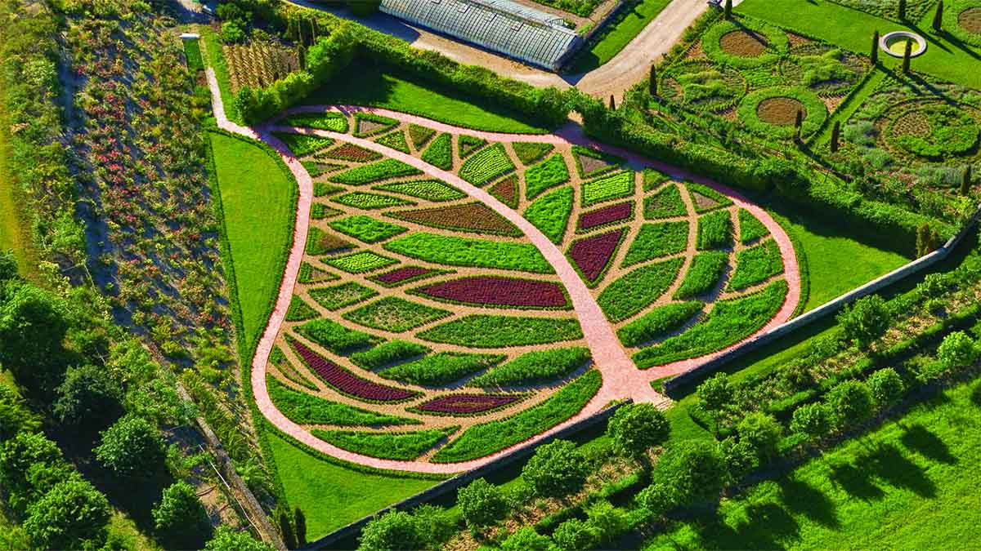
Garden of Abundance of la Chatonniere, France

Slide 22
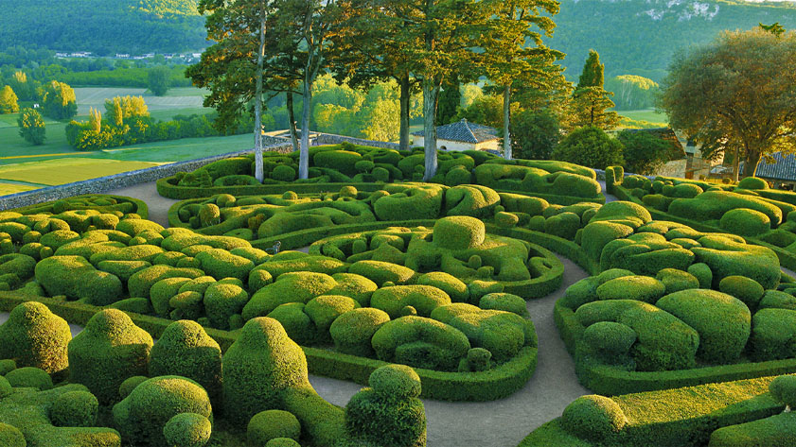
Marqueyssac Gardens, Vezac, France

Slide 23
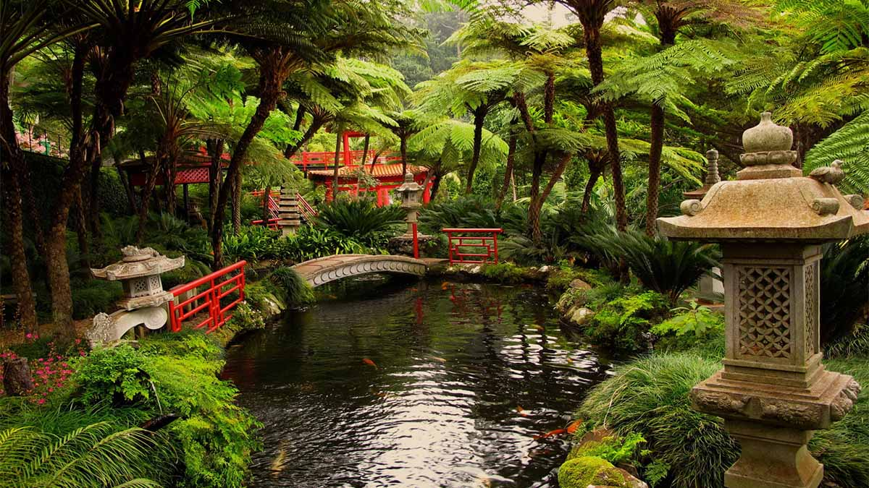
A tropical garden, Funchal, Madeira, Portugal

Slide 24
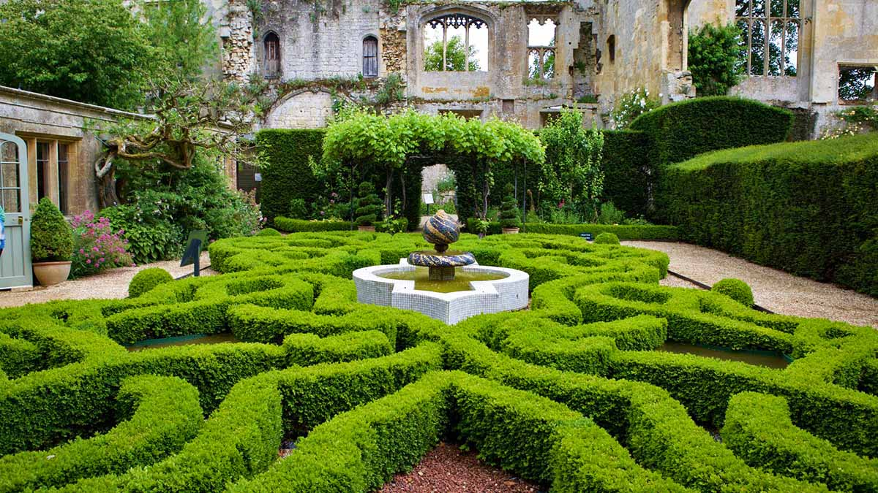
Sudeley Castle Garden, Gloucestershire, England

Slide 25
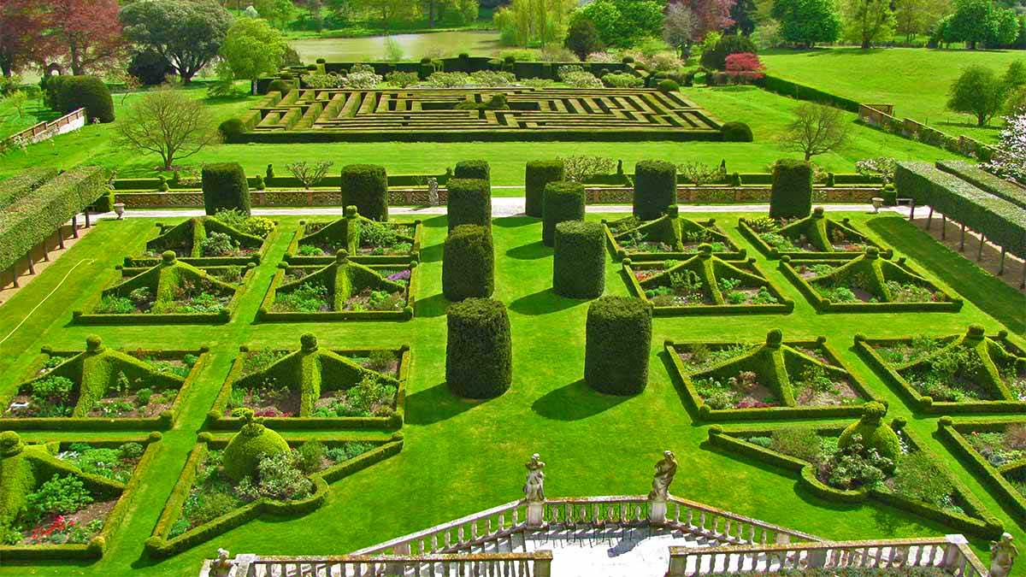
Hatfield House Garden, Hertfordshire, England

Slide 26
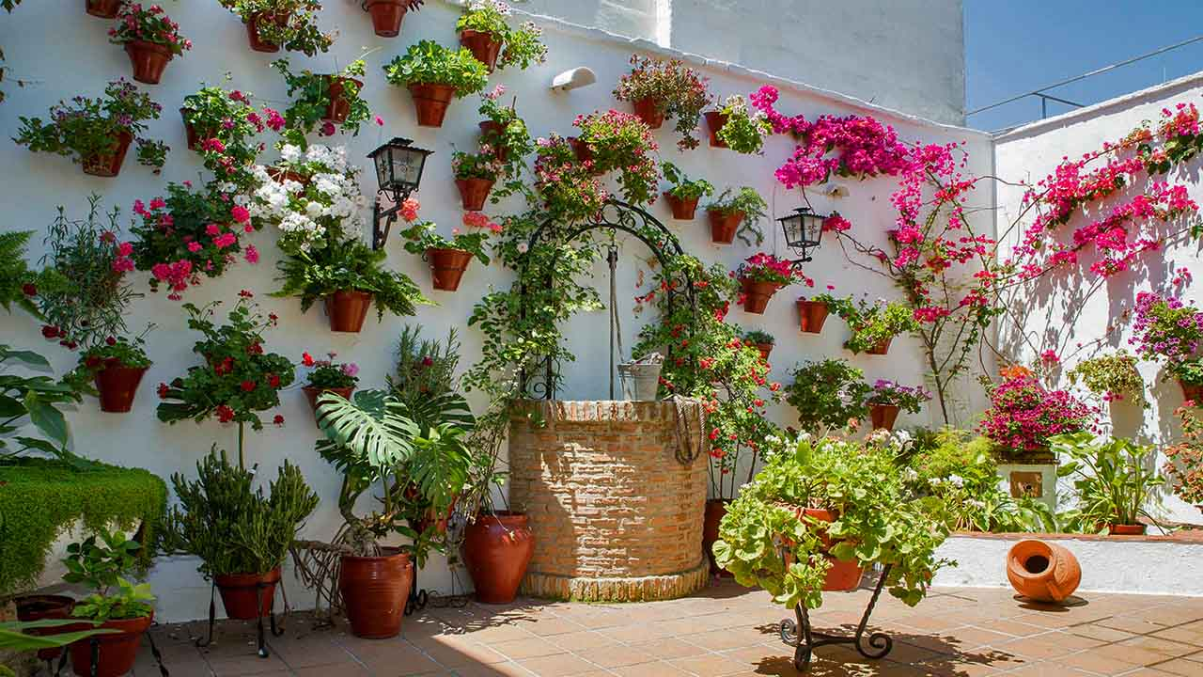
House Wall Affixed Potted Flowers, Cordoba, Spain

Slide 27
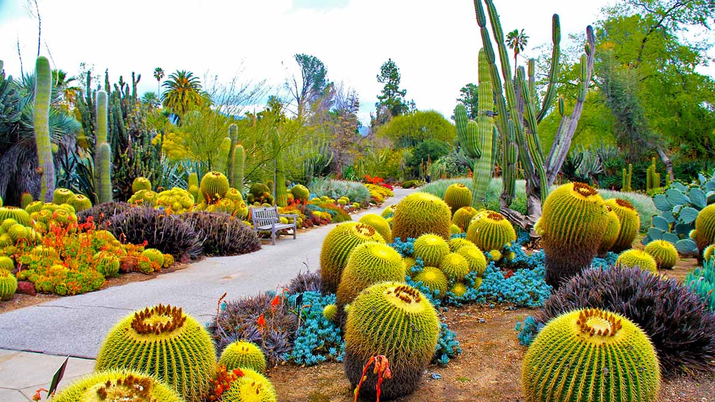
San Marino Gardens, California, USA

Slide 28
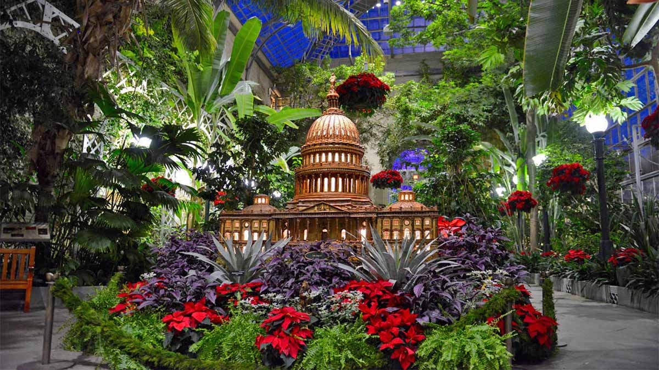
The U.S. Botanic Garden, Washington, USA

Slide 29
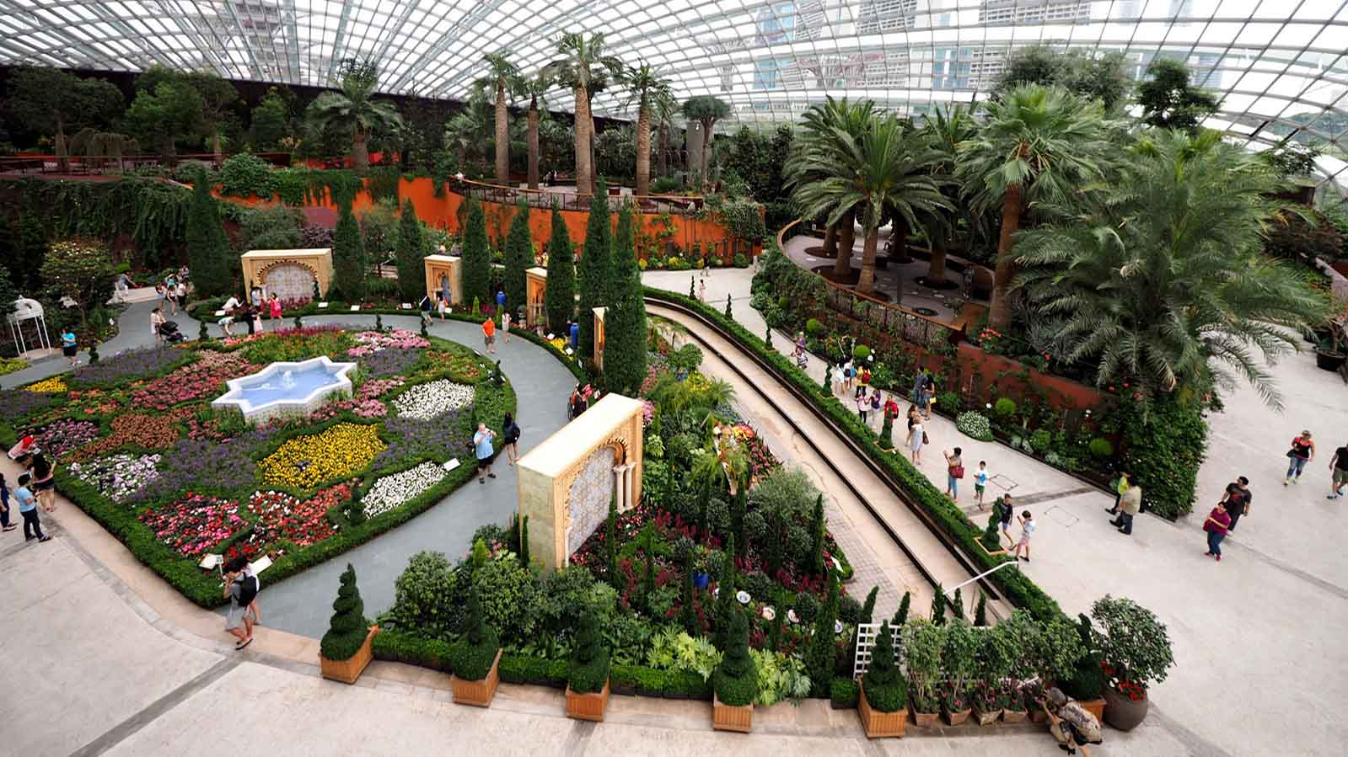
Garden by the Bay, Singapore

Slide 30
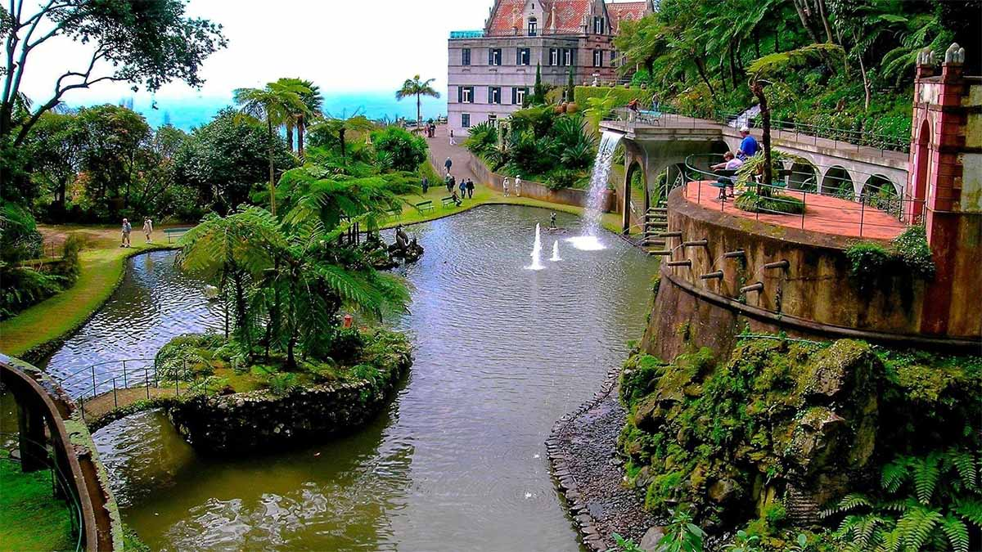
Monte Palace Tropical Garden, Madeira, Portugal

Slide 31
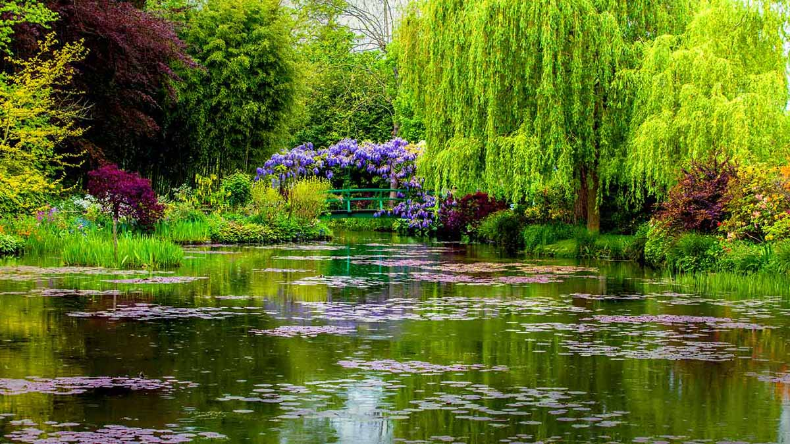
Claude Monet’s natural watergarden, Giverny, France

Slide 32
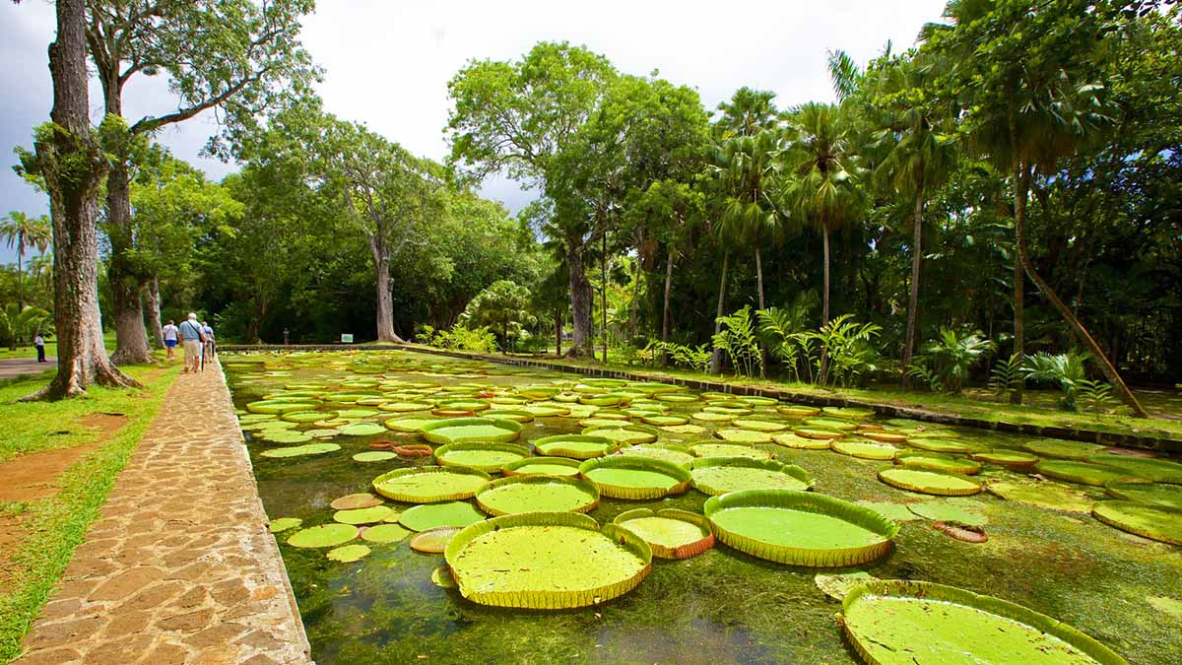
The Sir Seewoosagur Ramgoolam Botanical Garden, Mauritius

Slide 33
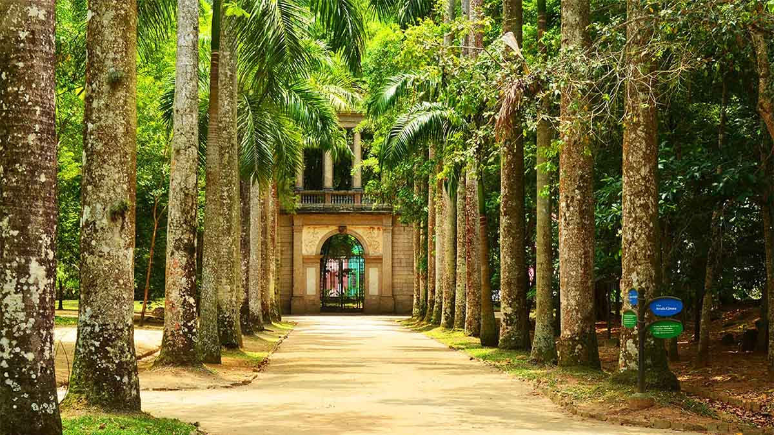
Jardim Botânico, Rio de Janeiro, Brazil

Slide 34

Giant cactusgarden, Phoenix, Arizona, USA

Slide 35
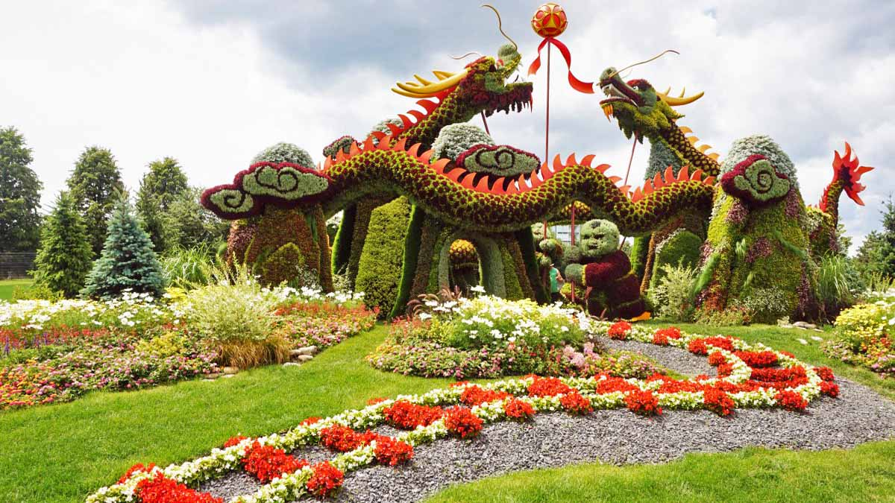
Ottawa Gardens, Canada

Slide 36
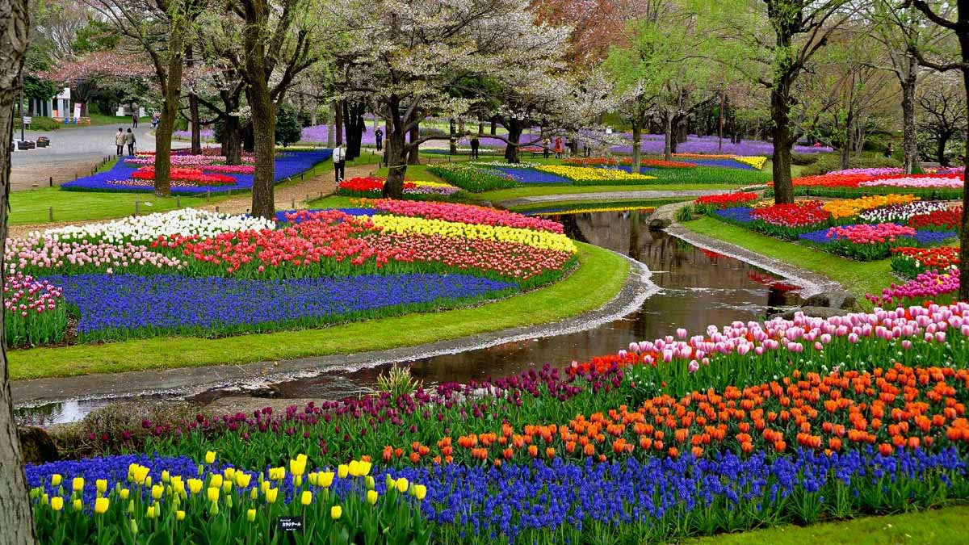
Showa Memorial Park, Tokyo, Japan

Slide 37
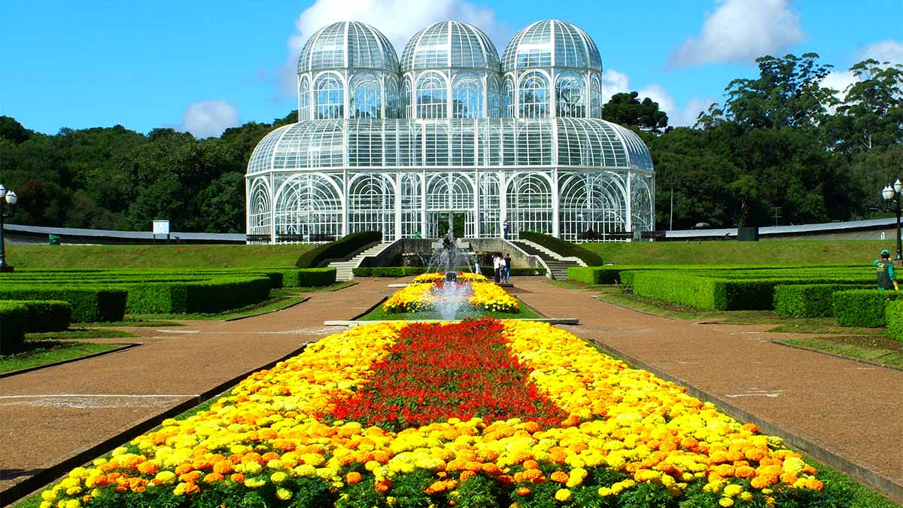
Jardim Botânico de Curitiba, Paraná, Brazil

Slide 38
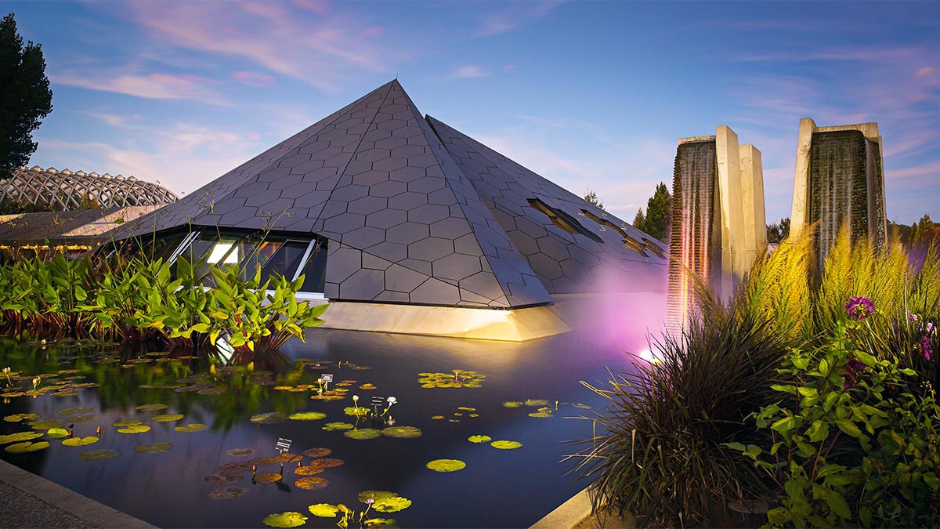
Denver Botanic Gardens, Colorado, USA

Slide 39
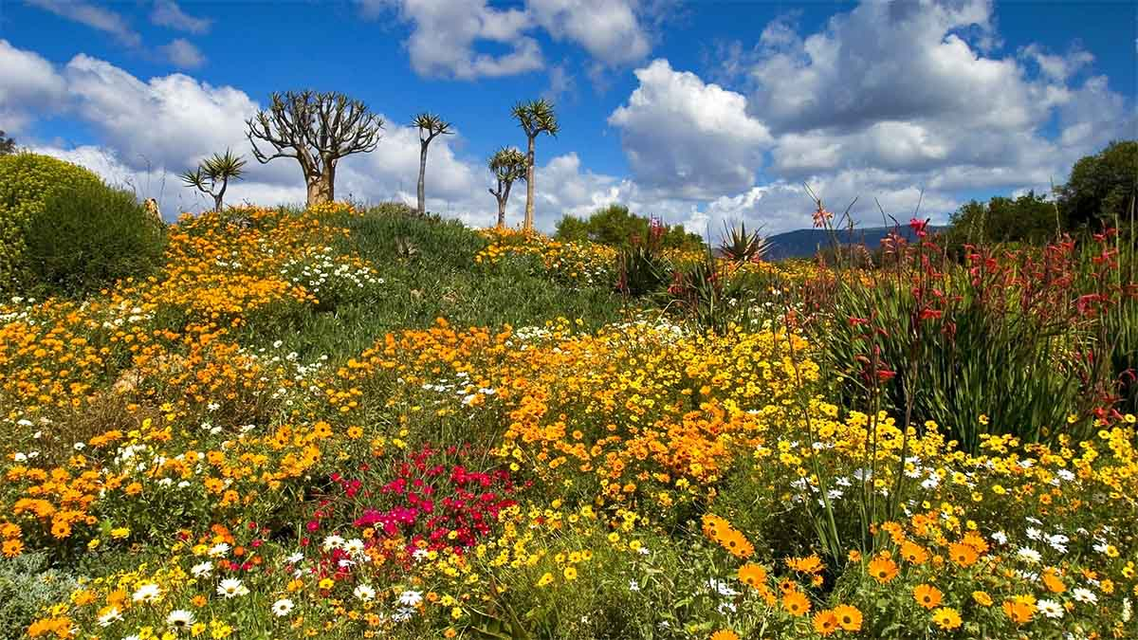
West Coast National Park, South Africa

Slide 40
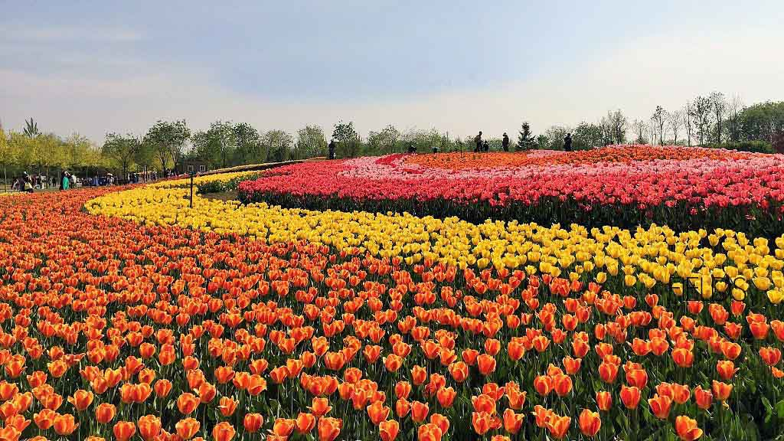
Shunyi Tulip Gardens, Beijing, China

Slide 41
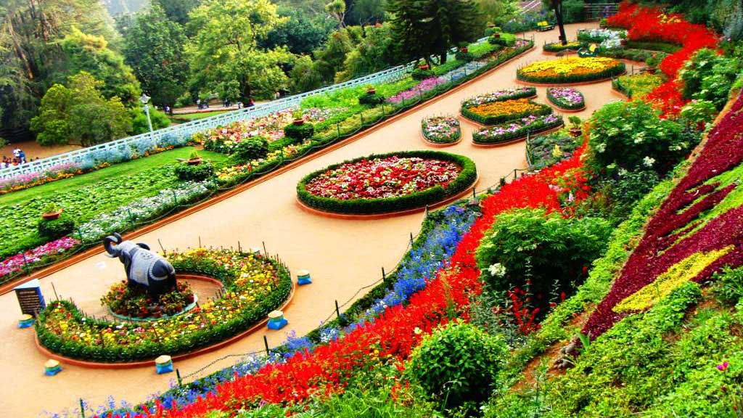
Ooty Botanical Garden, Tamil Nadu, India

Slide 42
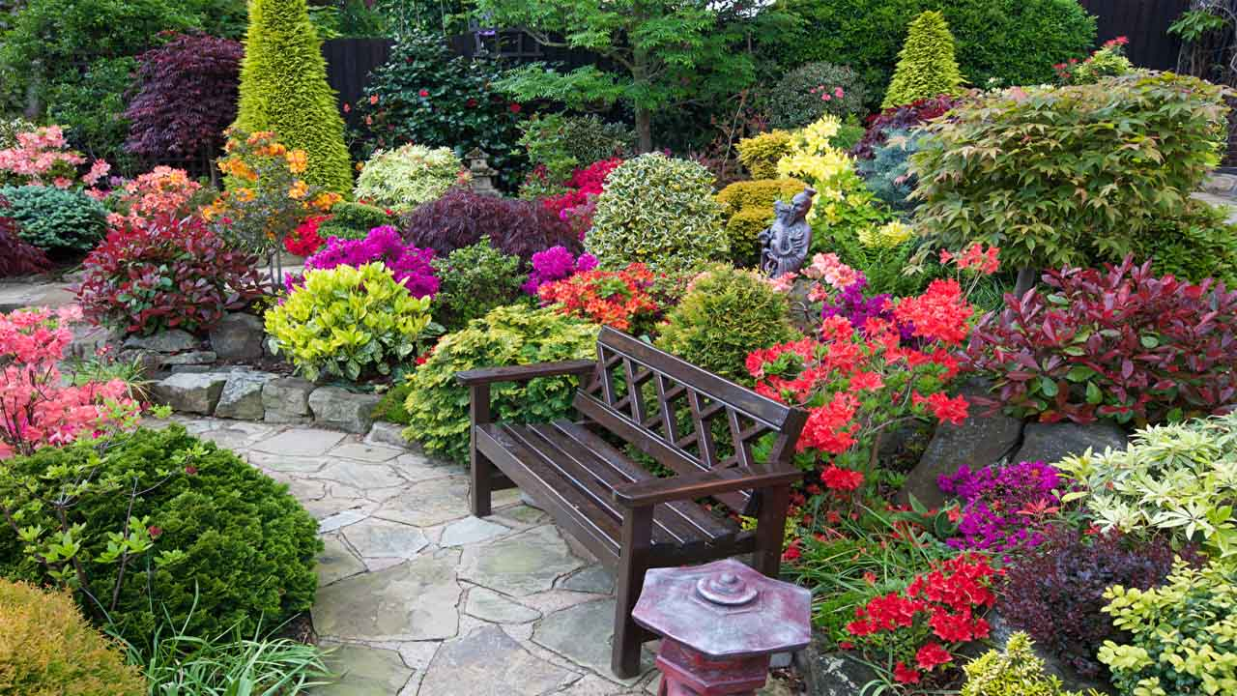
A beautiful private manicured garden, Walsall, England

Slide 43
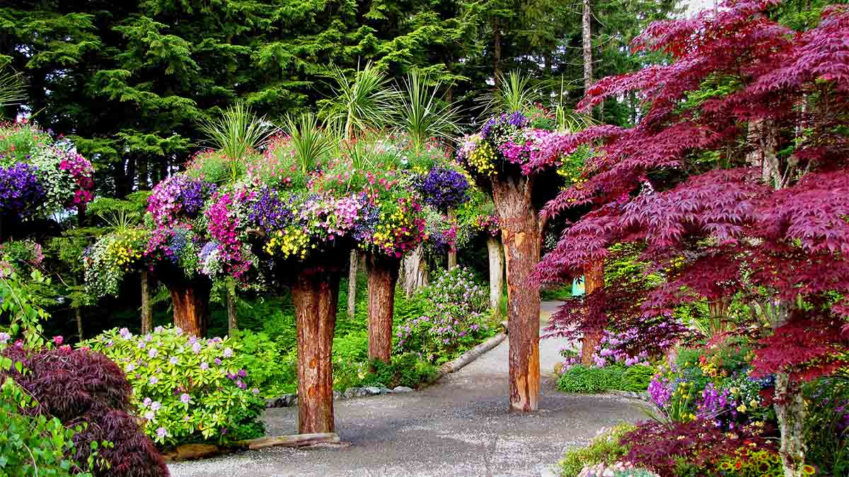
Glacier Gardens, Juneau, Alaska, USA

Slide 44
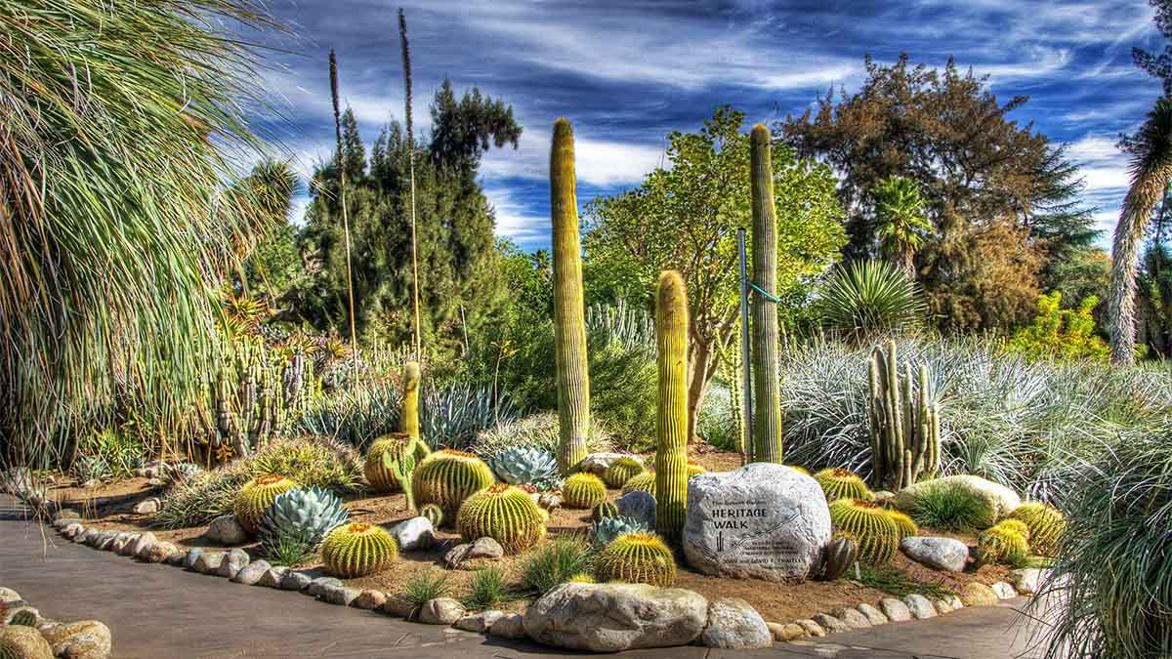
The Huntington Cactus Garden, Los Angeles, USA

Slide 45
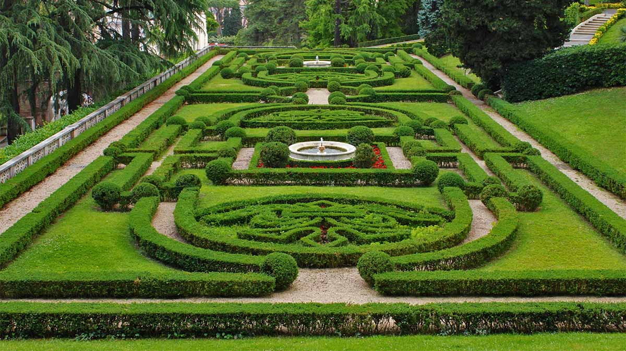
The Vatican's Manicured Garden, Rome

Slide 46

Walt Disney World Resort, Bay Lake, Florida, USA

Slide 47
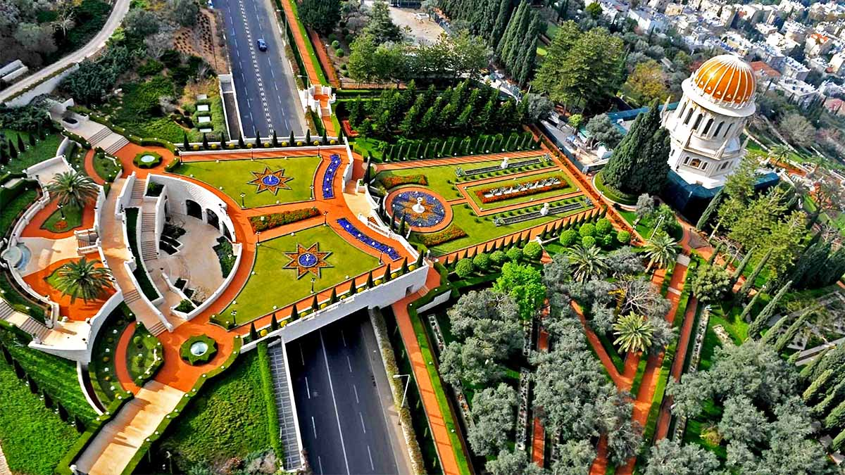
Bahaii Gardens at Haifa, Israel

Slide 48
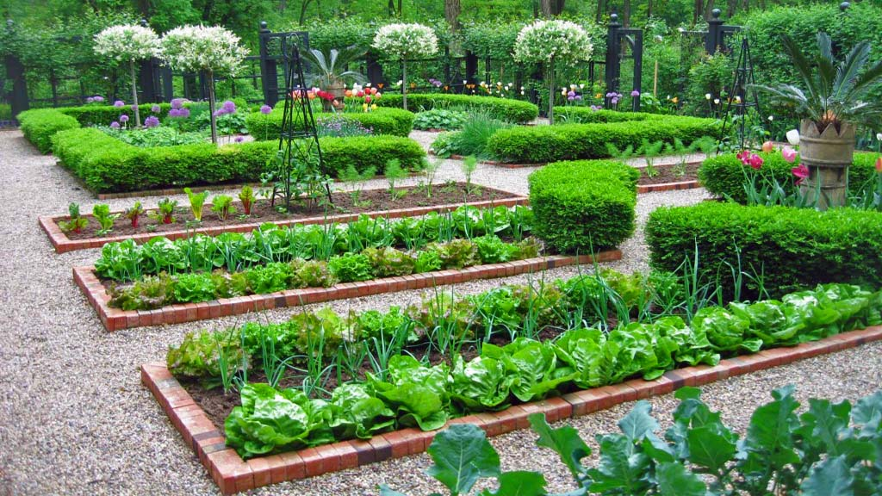
Hope you have enjoyed viewing this presentation
Have a nice day
With regards - Tony Chacko and Steve Rumpler
(tonychacko2000@gmail.com / pista2011@gmail.com)
2017
Music : Govi - Lovers Moon
The Ideal Kitchen Garden

