Slide 1
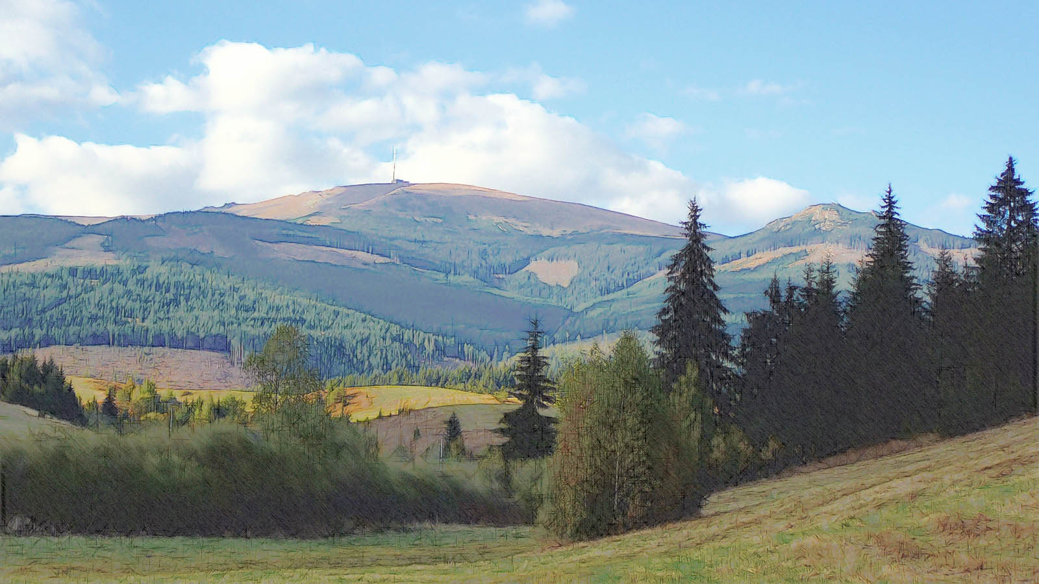


SLOVAKIA
folk costumes
Šumiac (Horehronie)

Slide 2



SLOVAKIA
GPS N 48°50‘24‘‘ E 20°07‘47‘‘
Šumiac
Šumiac (Horehronie)

Slide 3
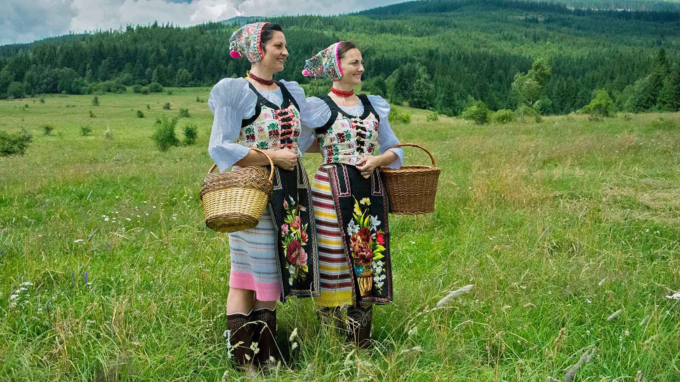
Photo © Hudec Ivan

Slide 4
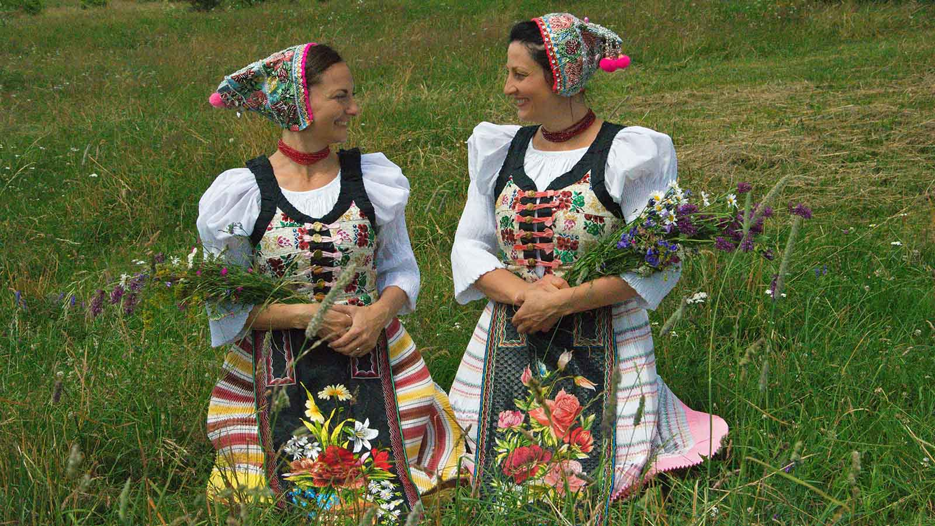
Photo © Hudec Ivan

Slide 5
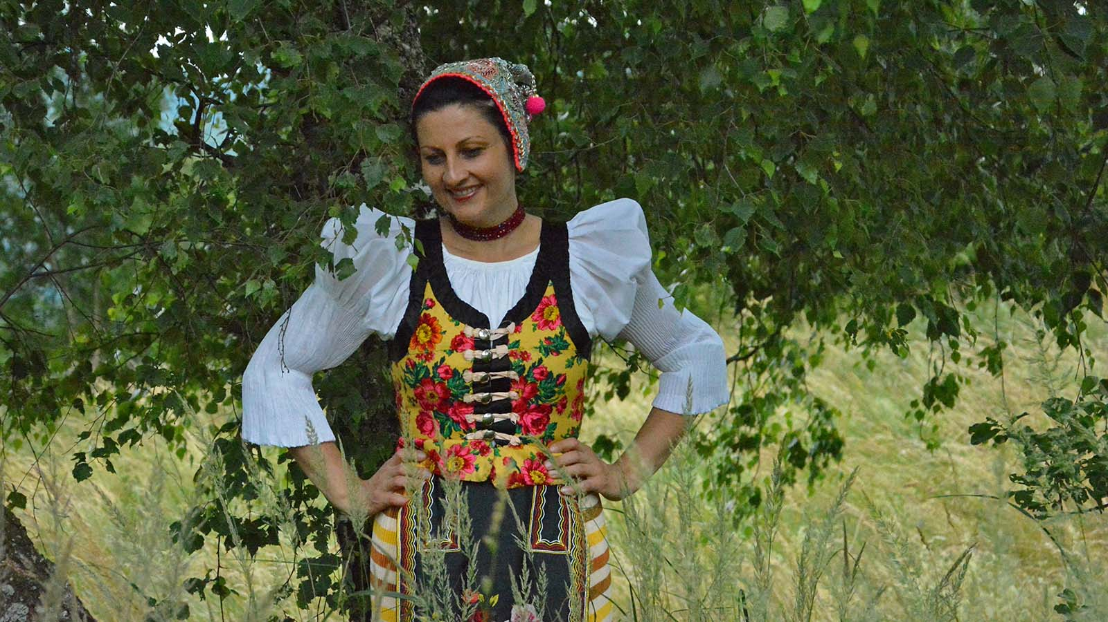
Photo © Hudec Ivan

Slide 6
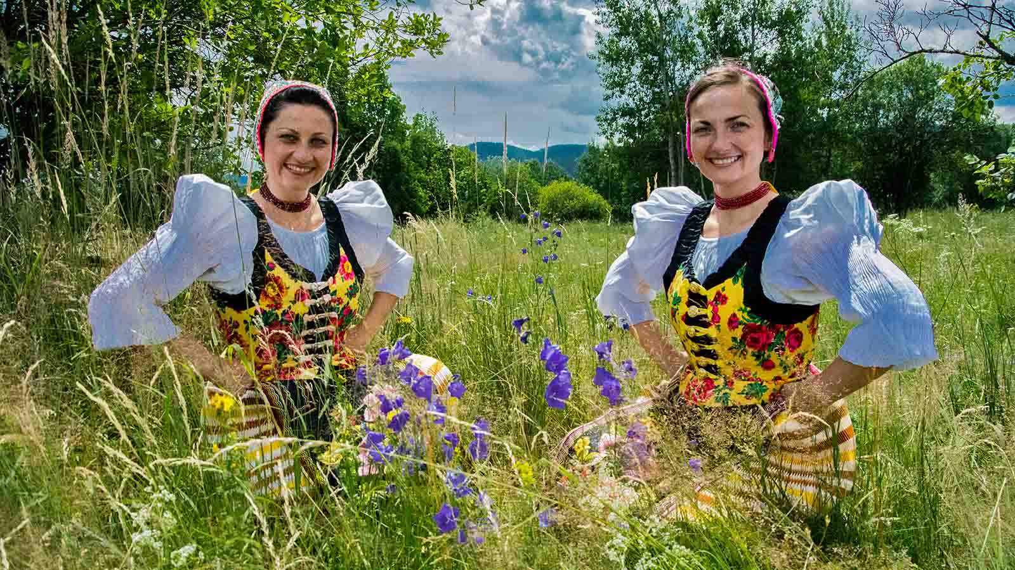
Photo © Hudec Ivan

Slide 7
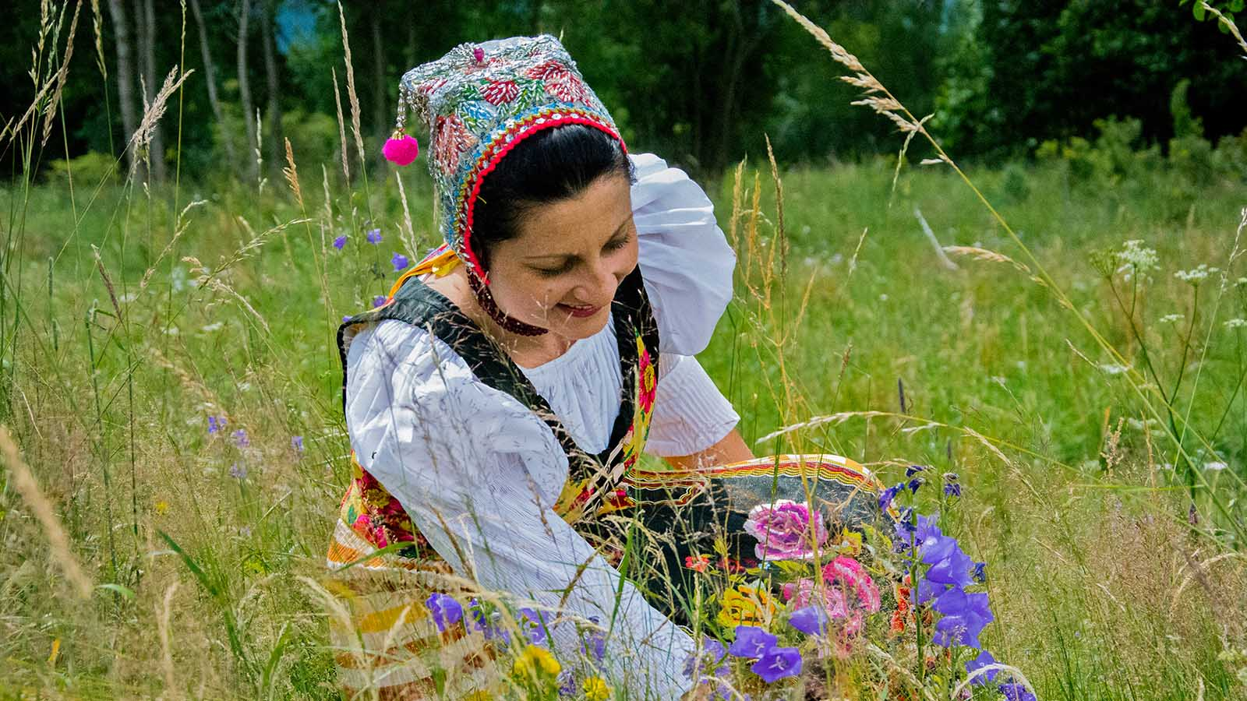
Photo © Hudec Ivan

Slide 8
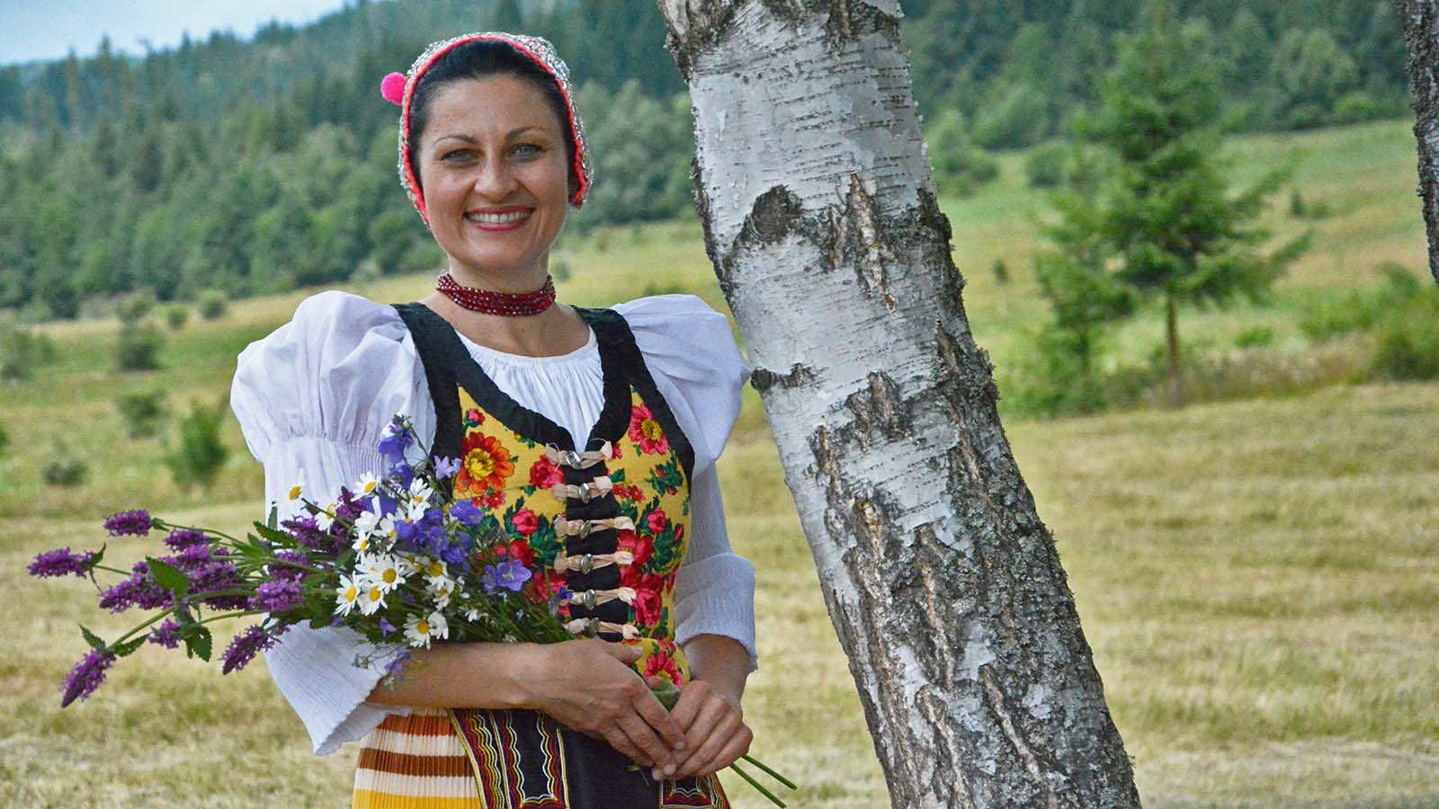
Photo © Hudec Ivan

Slide 9
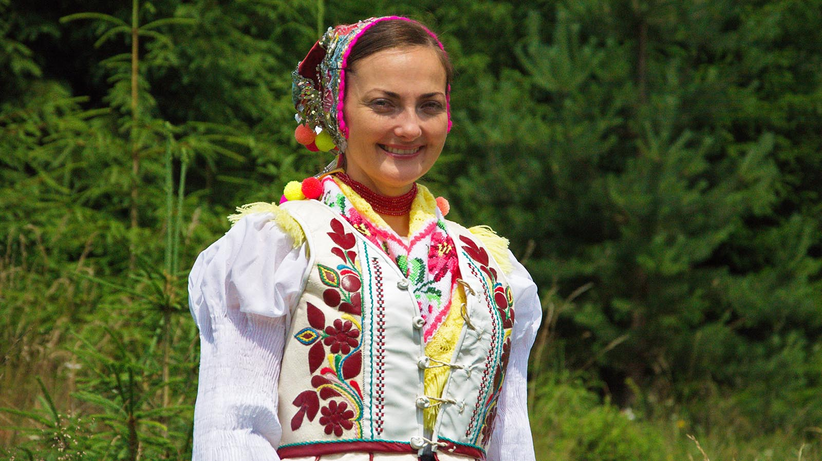
Photo © Hudec Ivan

Slide 10
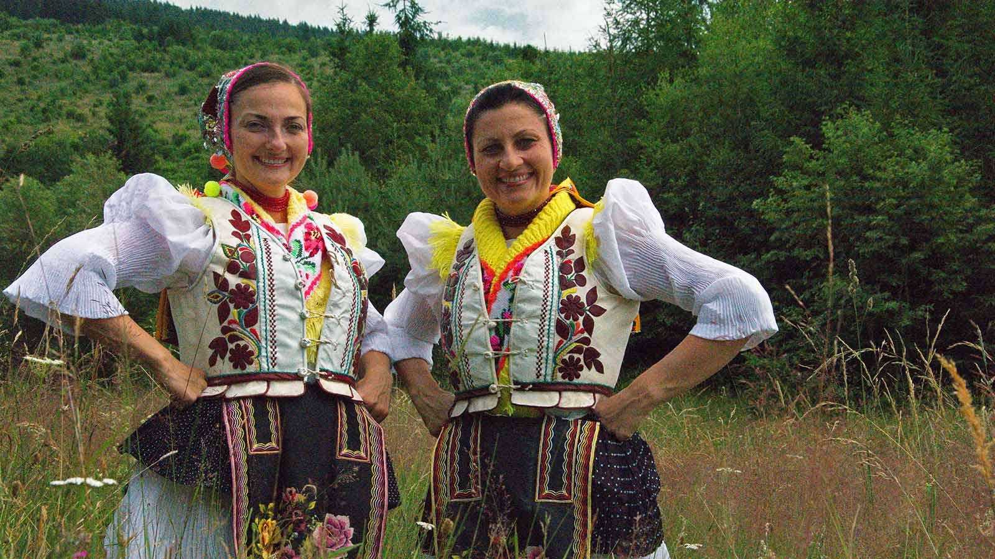
Photo © Hudec Ivan

Slide 11
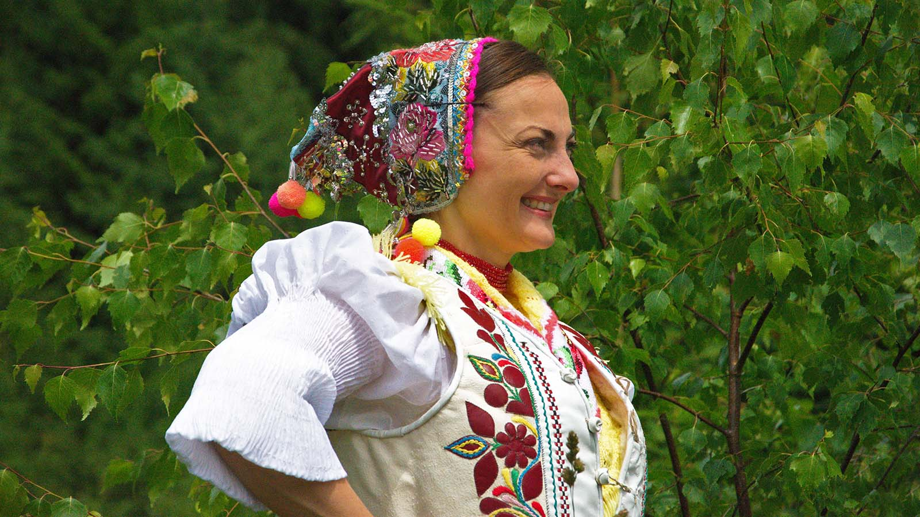
Photo © Hudec Ivan

Slide 12
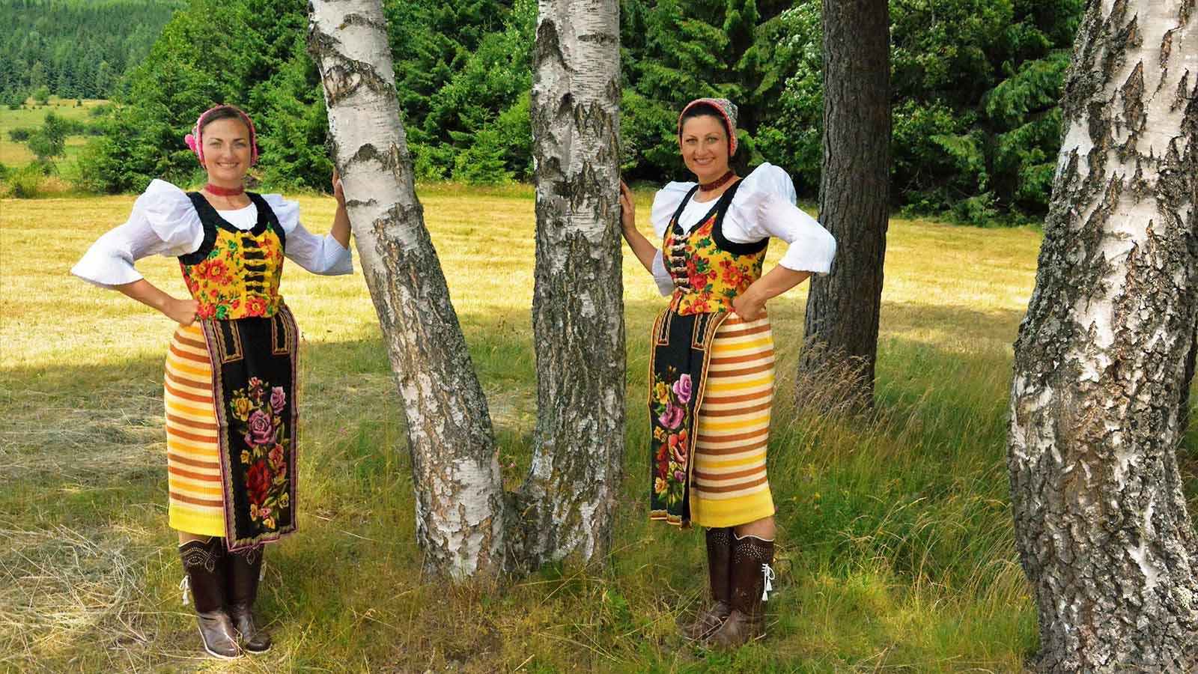
Photo © Hudec Ivan

Slide 13
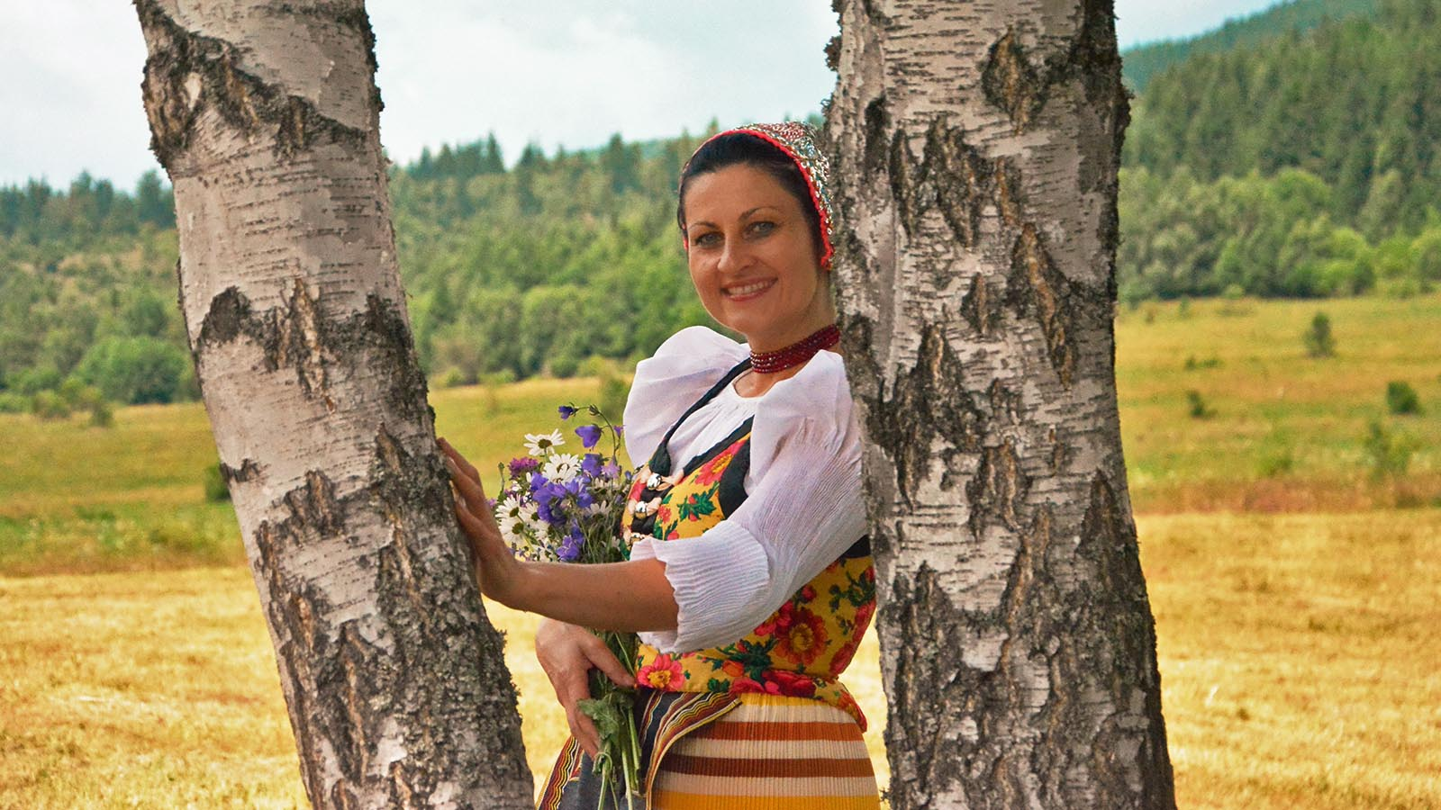
Photo © Hudec Ivan

Slide 14
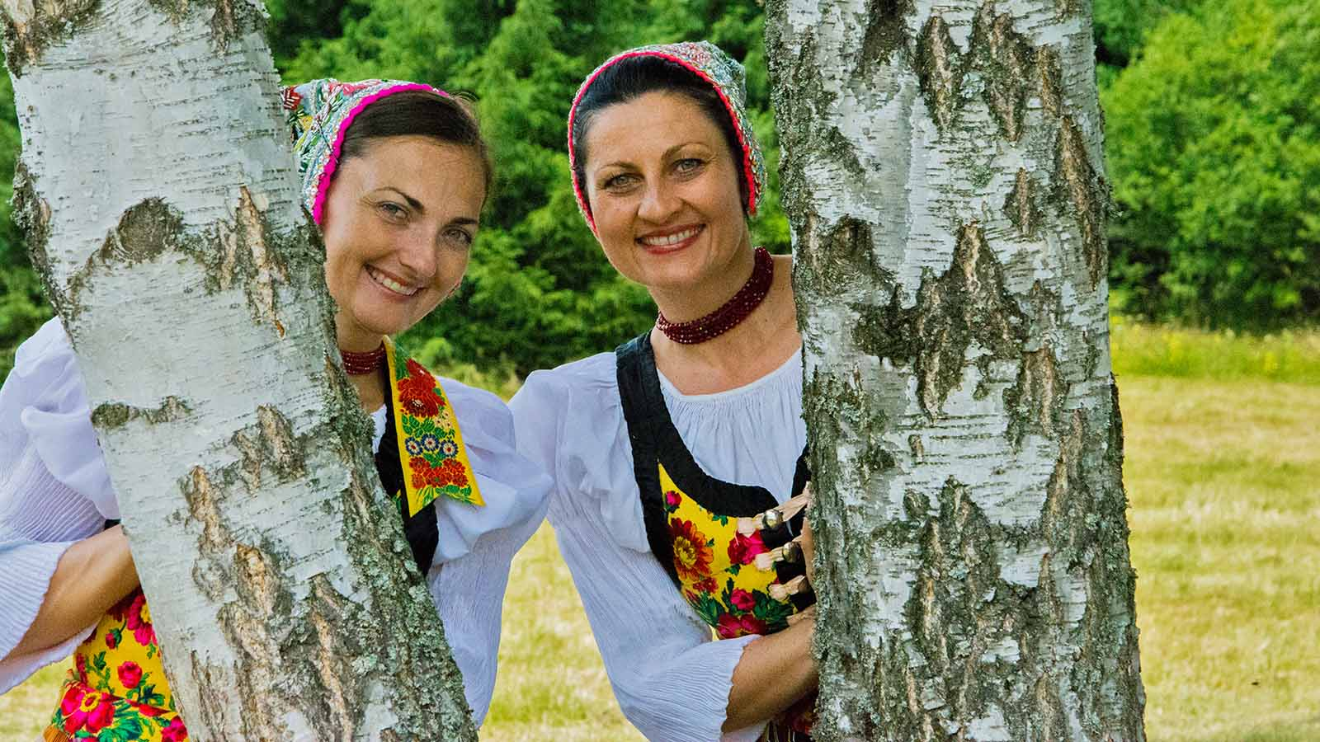
Photo © Hudec Ivan

Slide 15
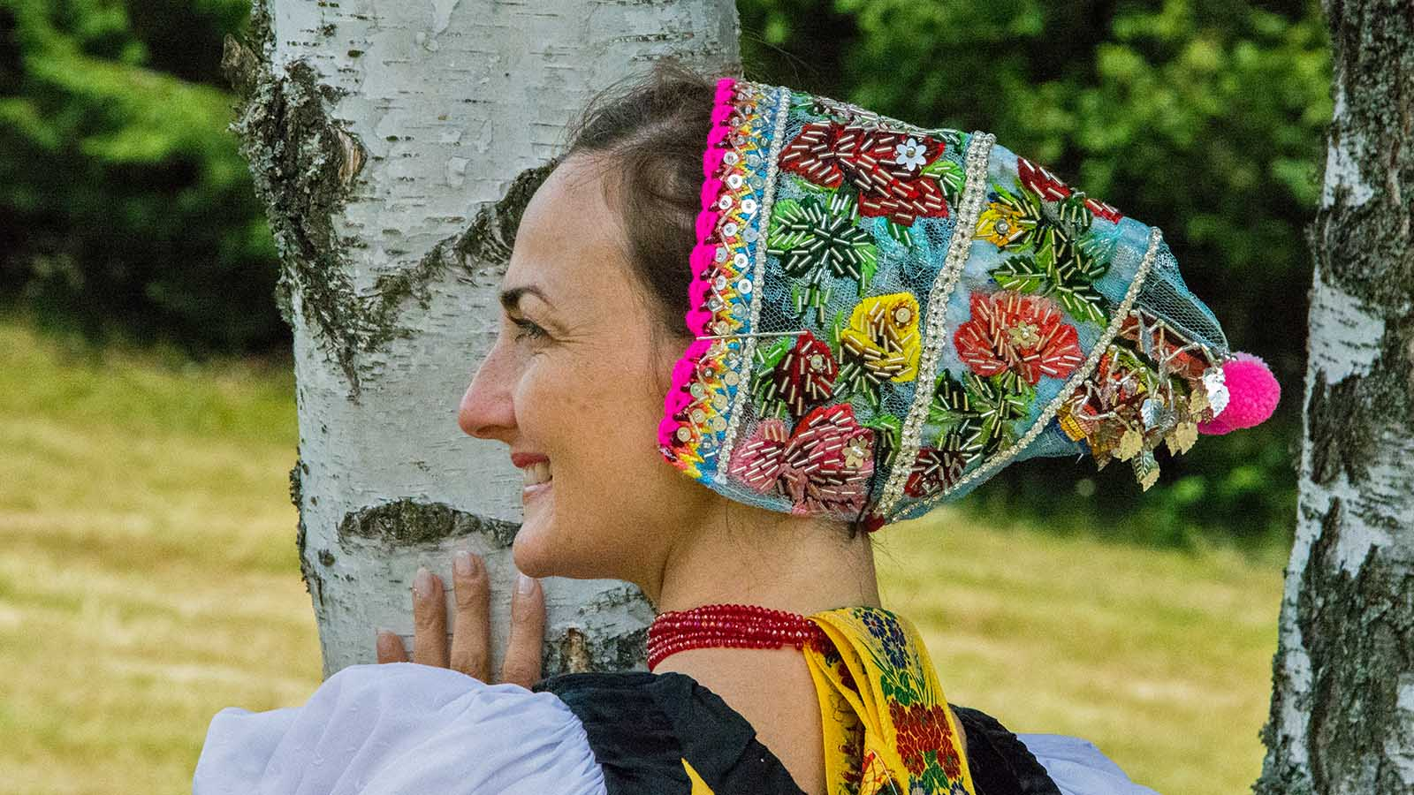
Photo © Hudec Ivan

Slide 16
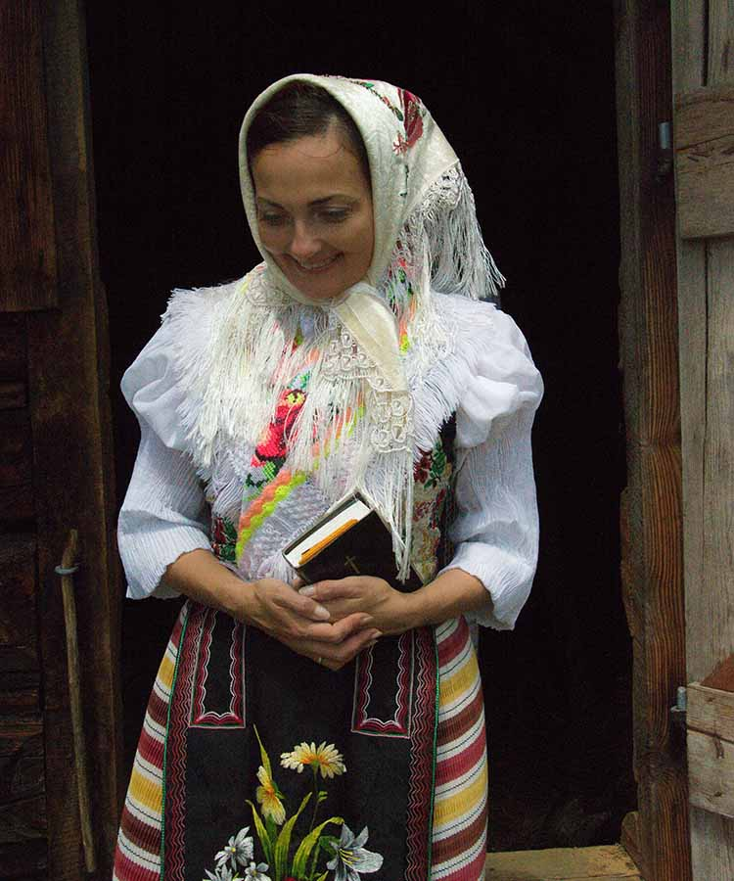
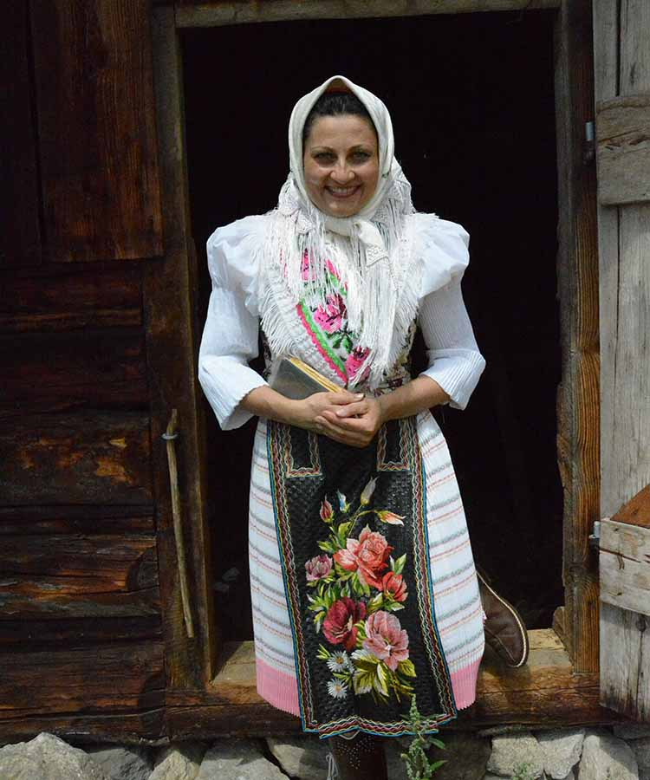
Photo © Hudec Ivan
Photo © Hudec Ivan

Slide 17
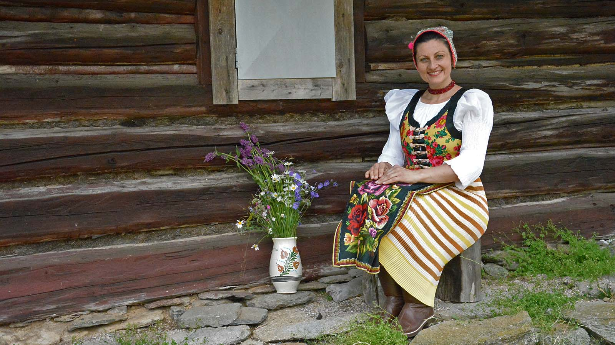
Photo © Hudec Ivan

Slide 18
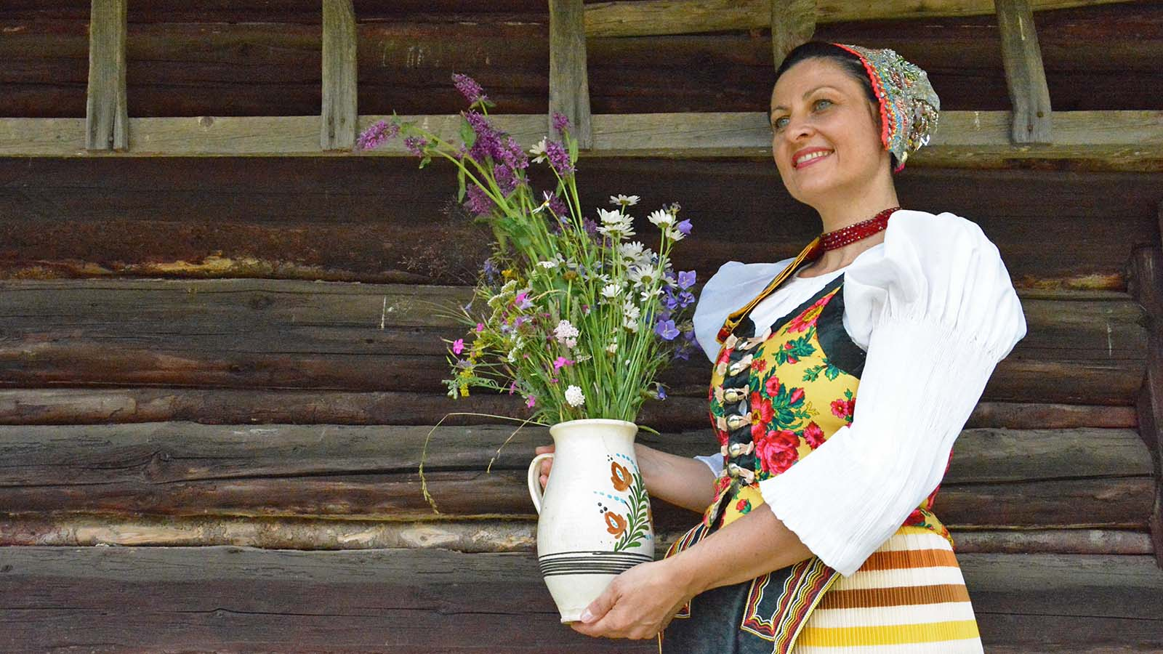
Photo © Hudec Ivan

Slide 19
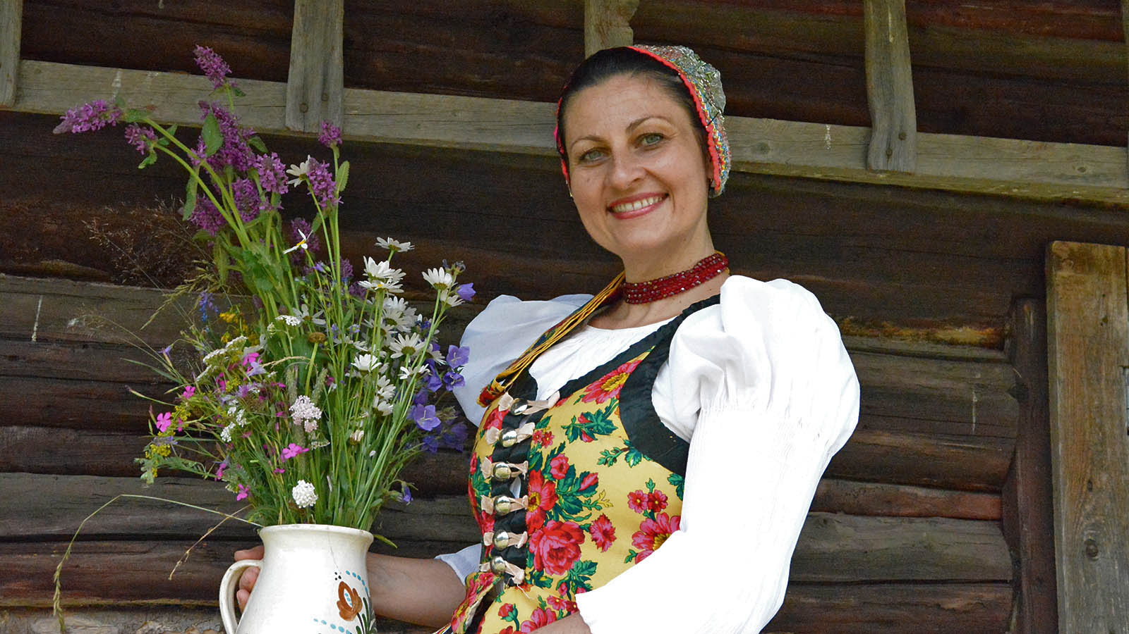
Photo © Hudec Ivan

Slide 20
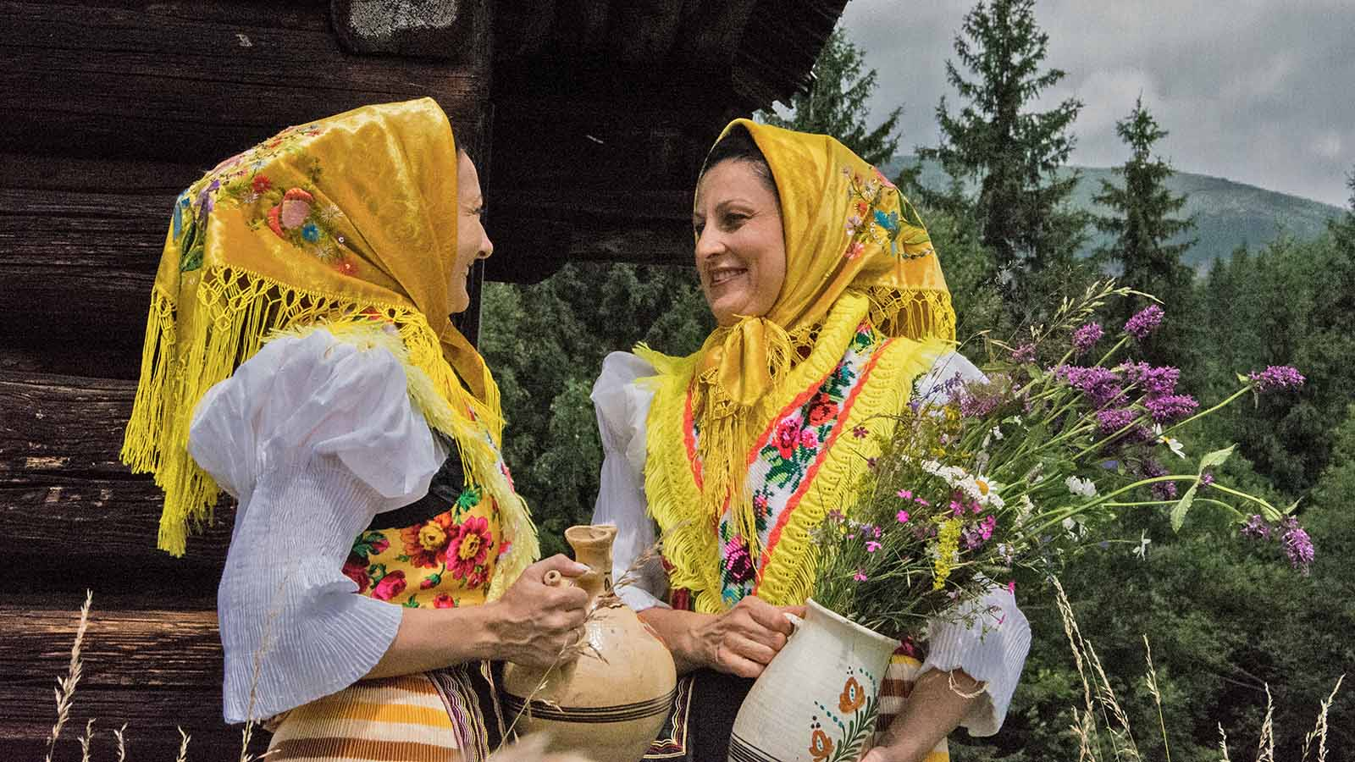
Photo © Hudec Ivan

Slide 21
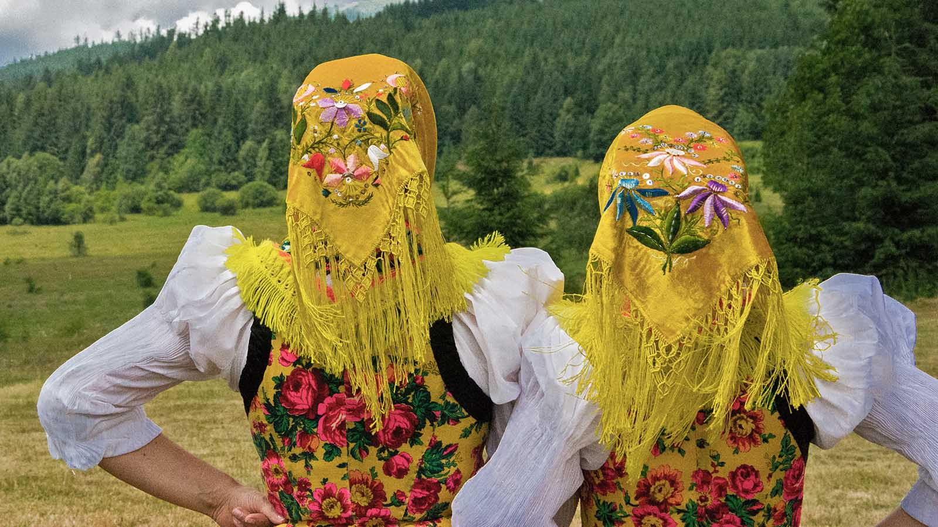
Photo © Hudec Ivan

Slide 22
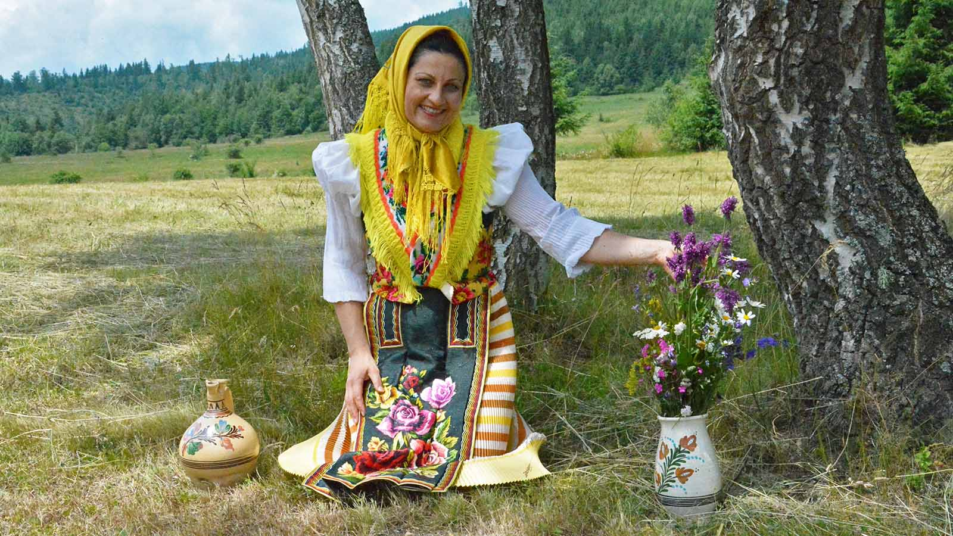
Photo © Hudec Ivan

Slide 23
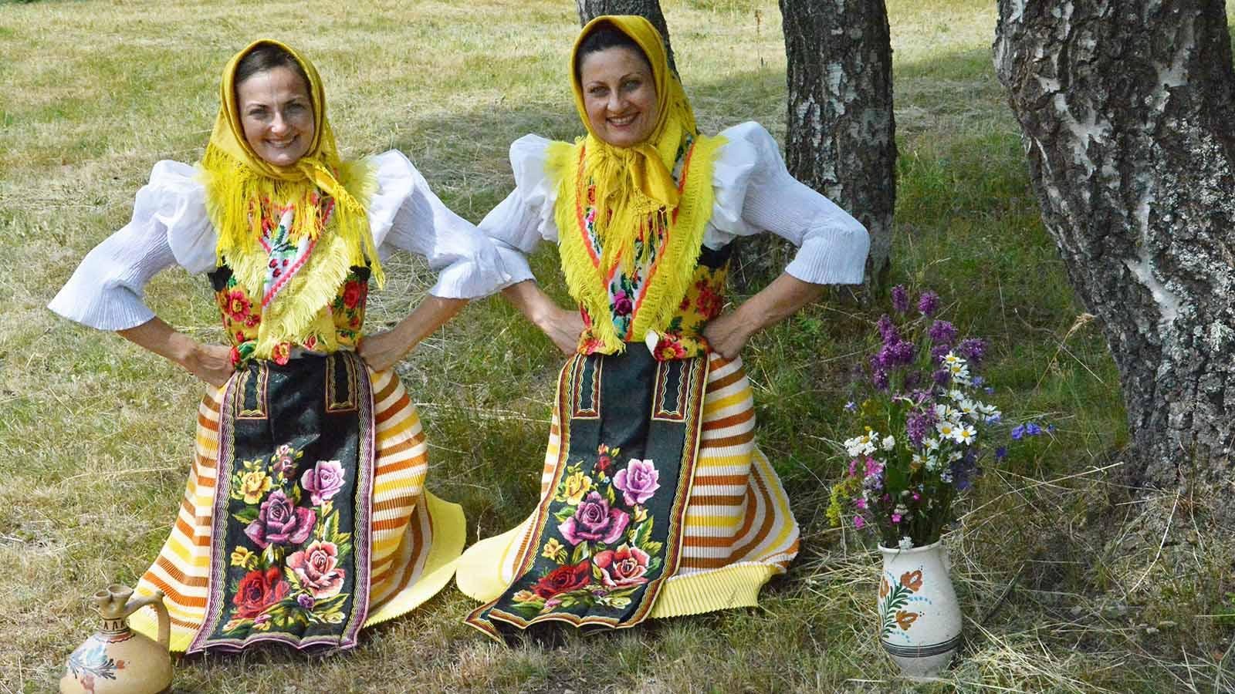
Photo © Hudec Ivan

Slide 24
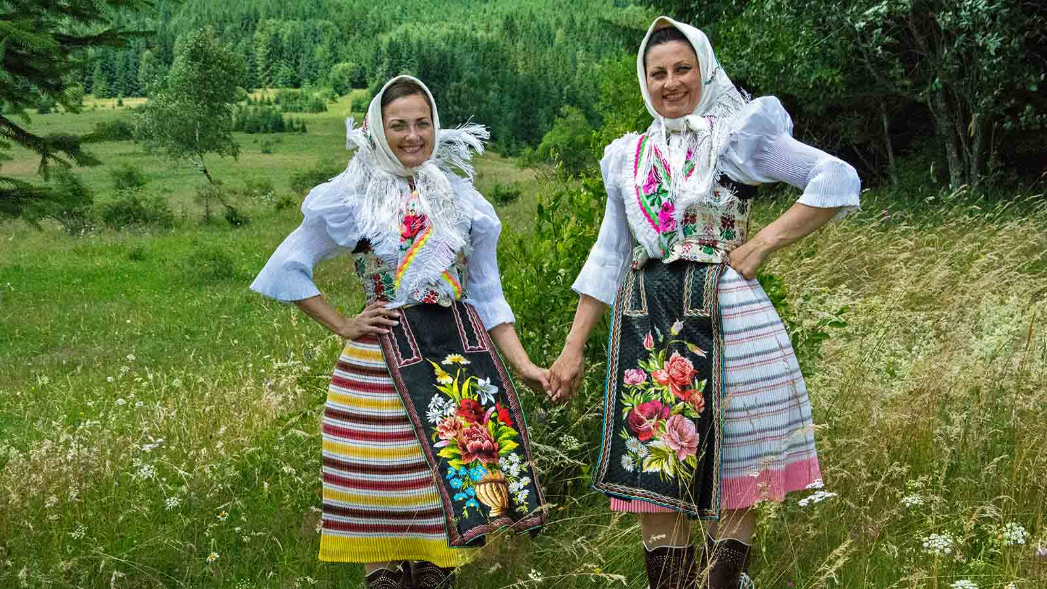
Photo © Hudec Ivan

Slide 25
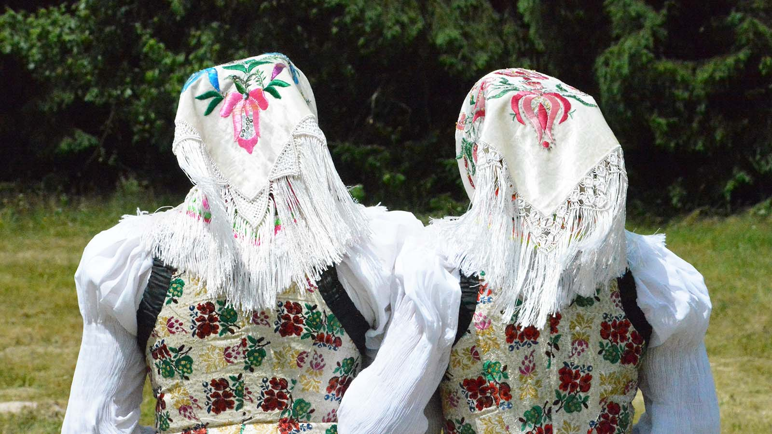
Photo © Hudec Ivan

Slide 26
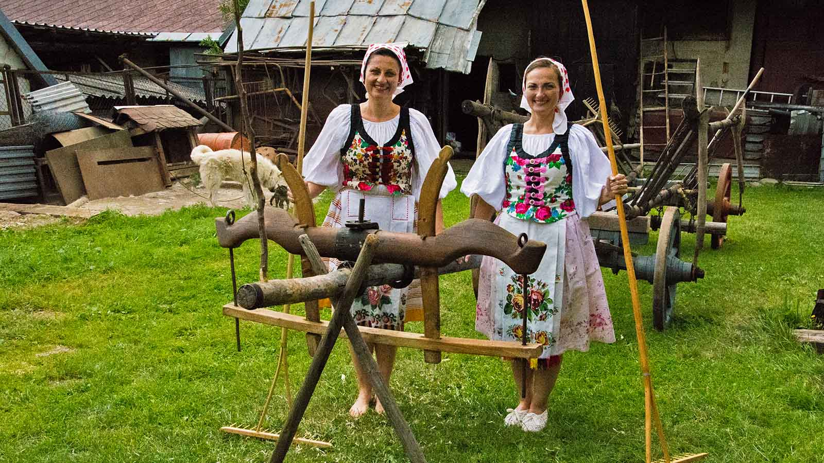
Photo © Hudec Ivan

Slide 27
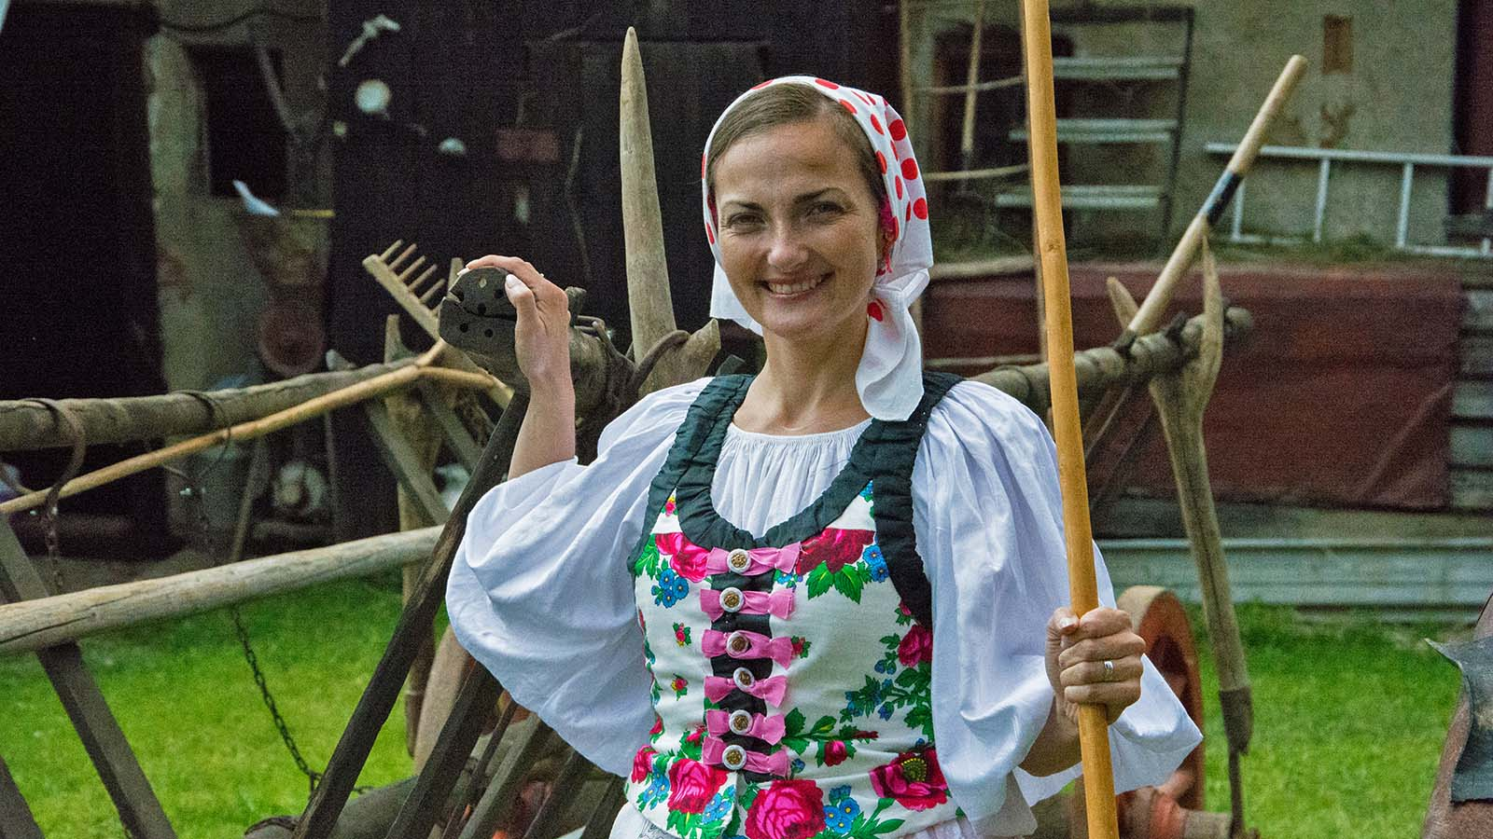
Photo © Hudec Ivan

Slide 28
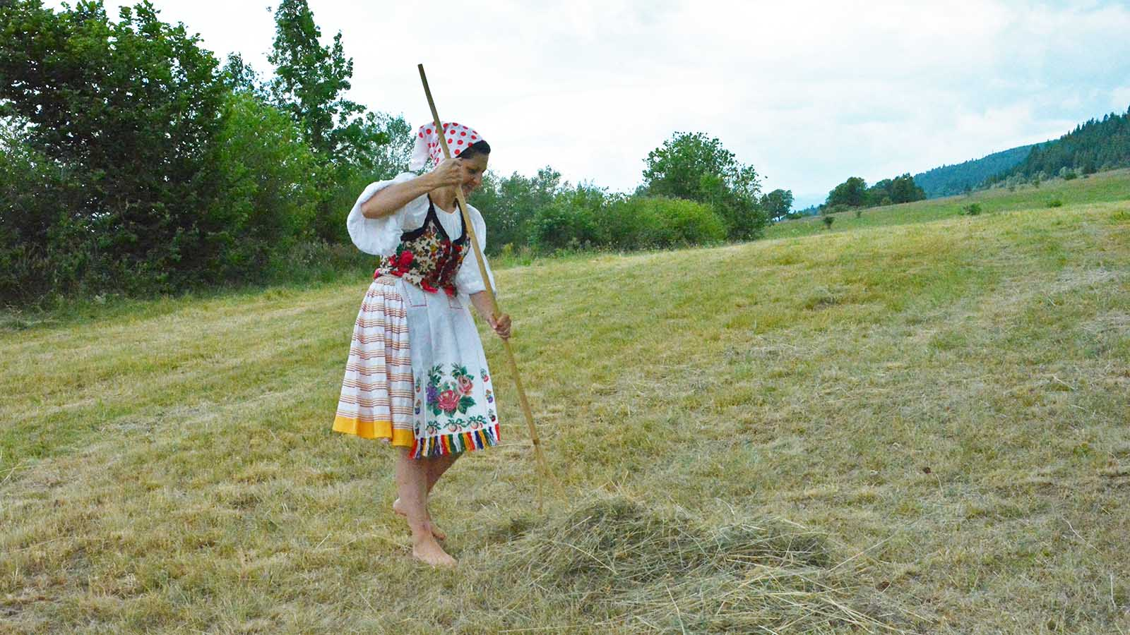
Photo © Hudec Ivan

Slide 29
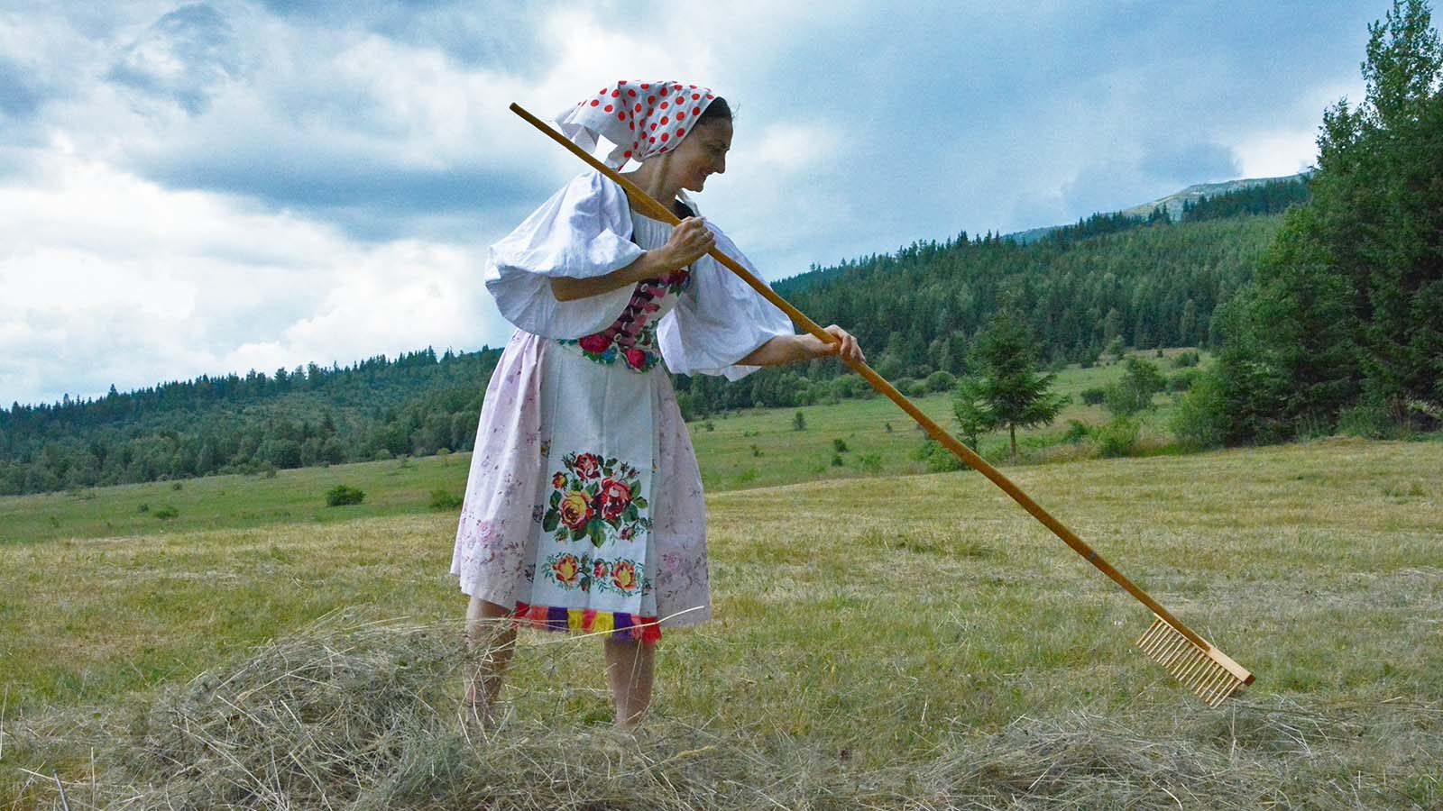
Photo © Hudec Ivan

Slide 30
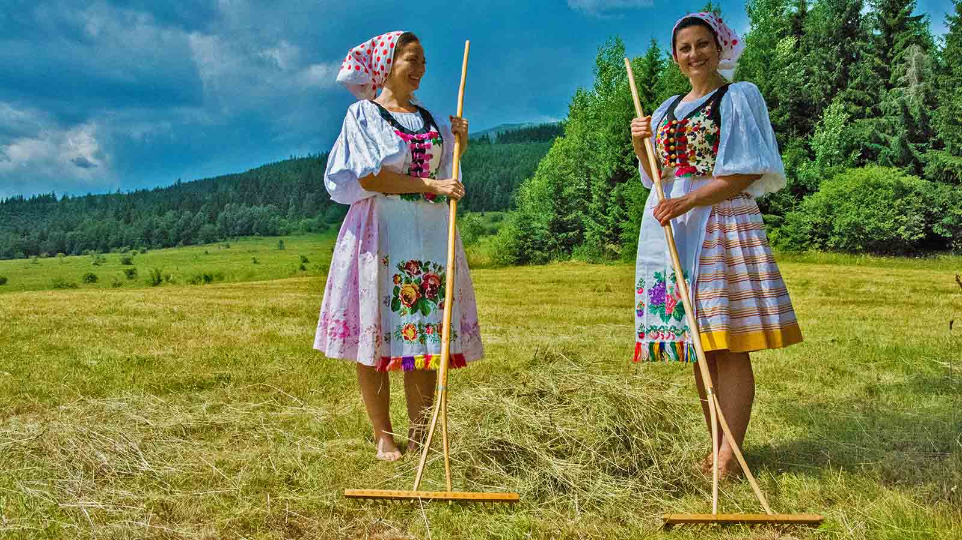
Photo © Hudec Ivan

Slide 31
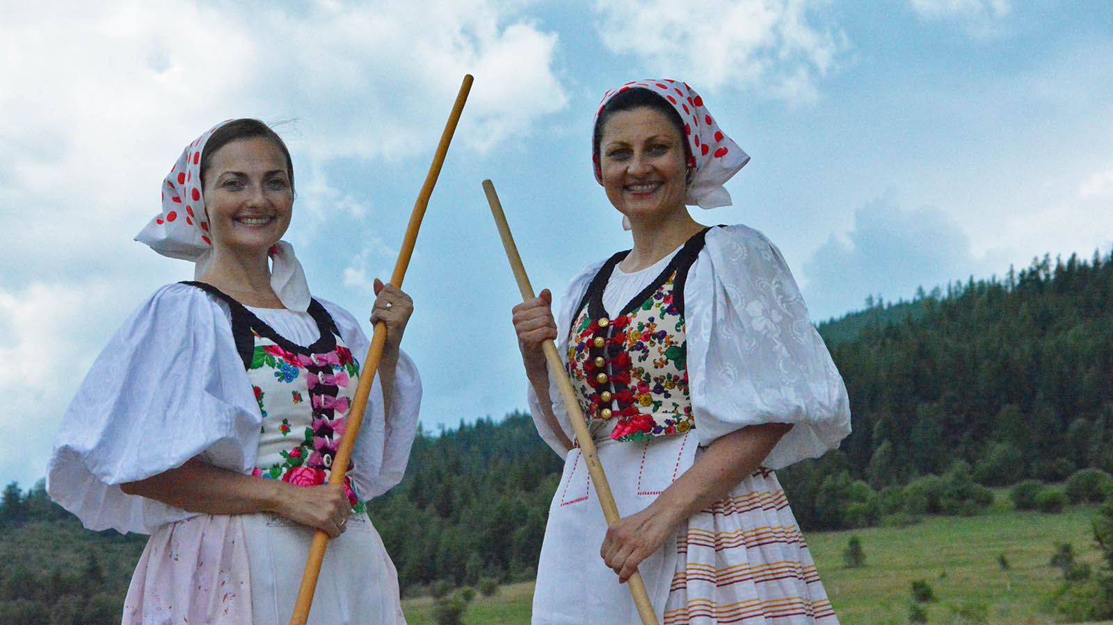
Photo © Hudec Ivan

Slide 32
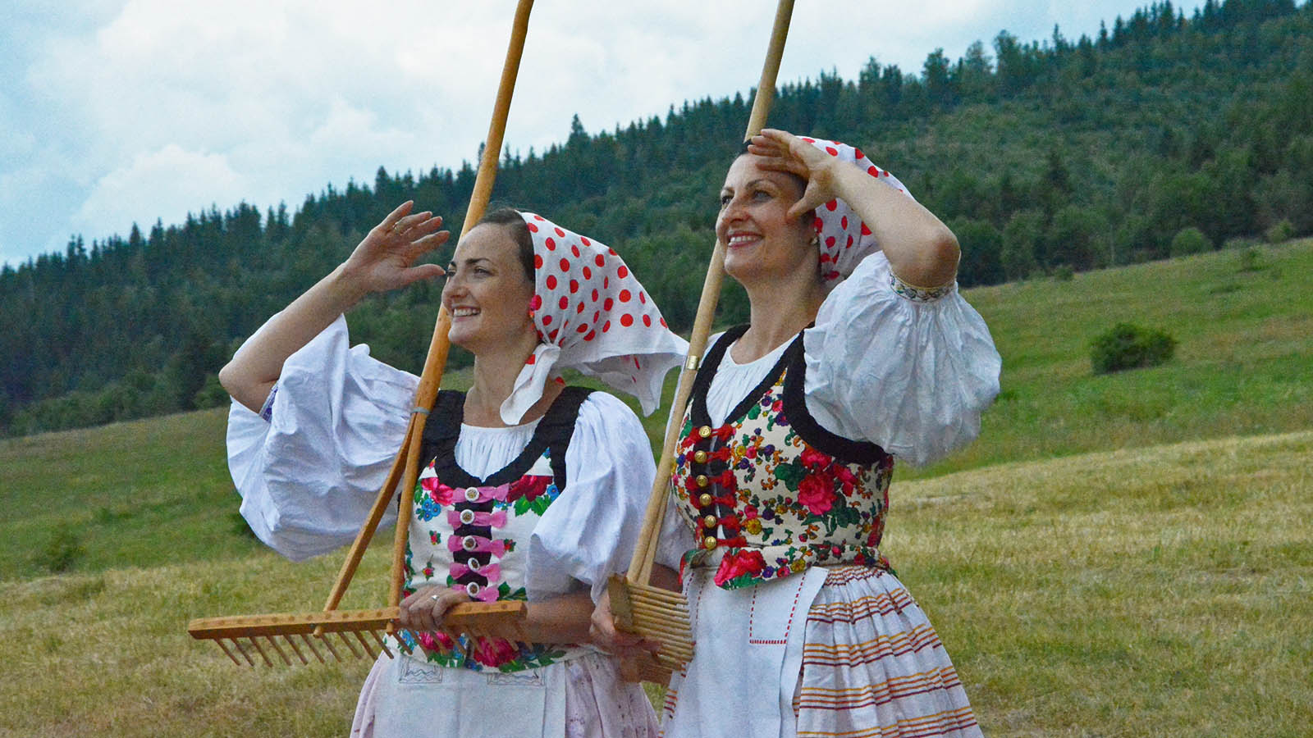
Photo © Hudec Ivan

Slide 33
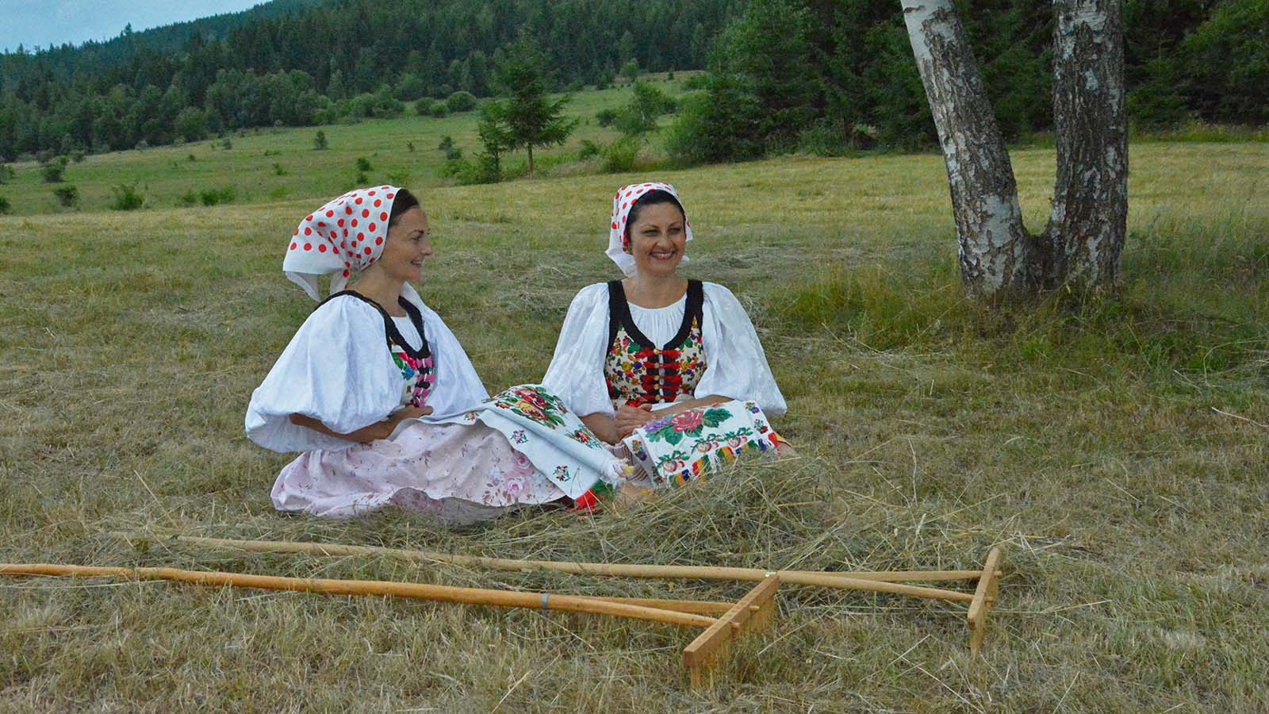
Photo © Hudec Ivan

Slide 34
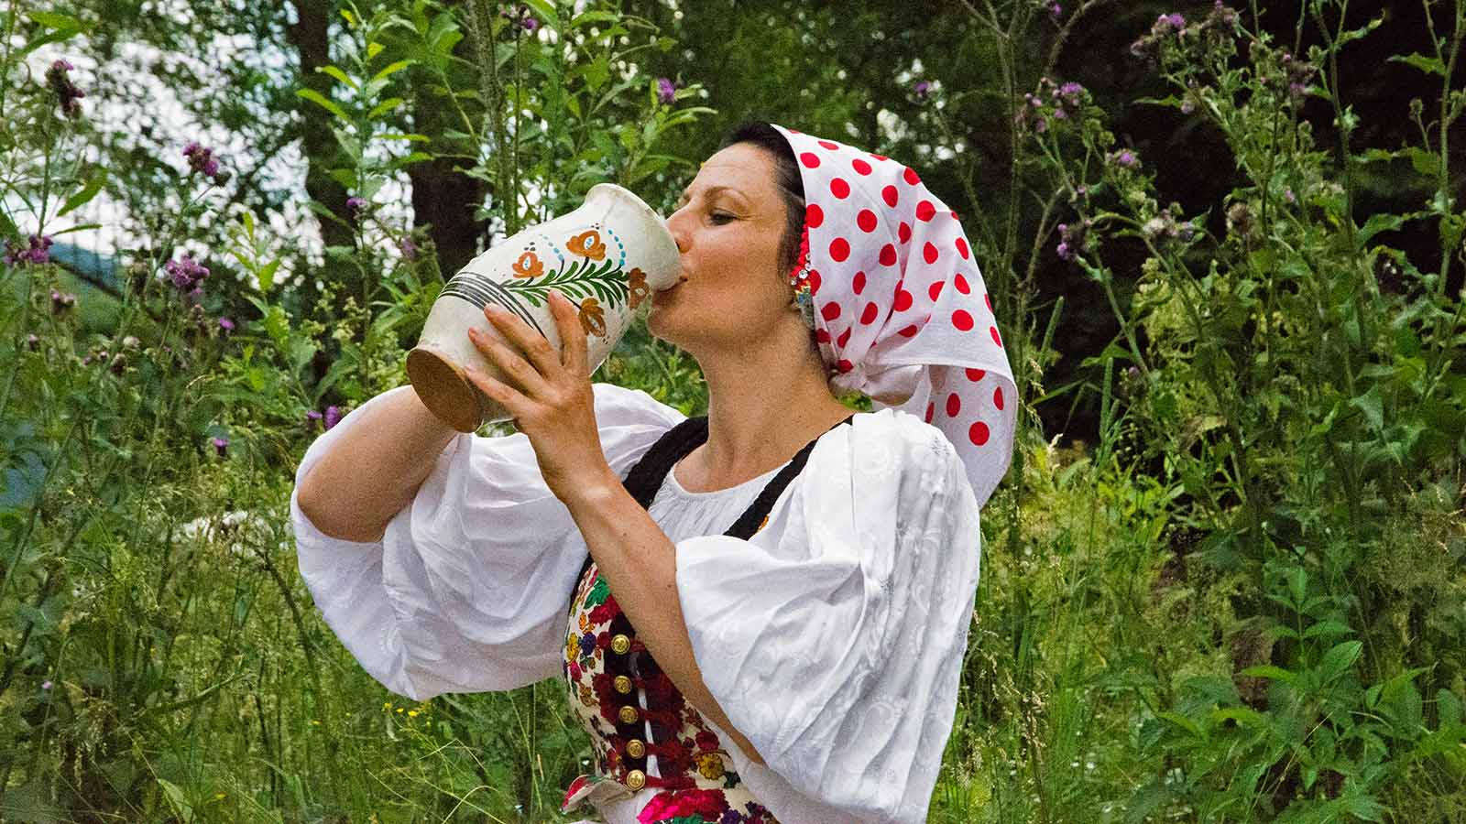
Photo © Hudec Ivan

Slide 35
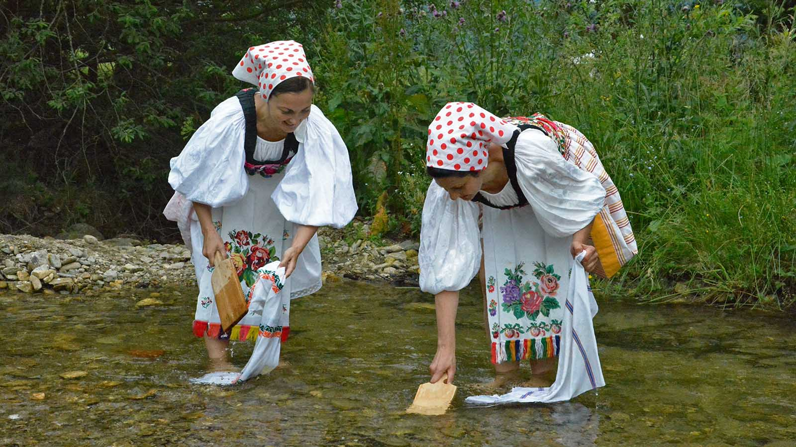
Photo © Hudec Ivan

Slide 36
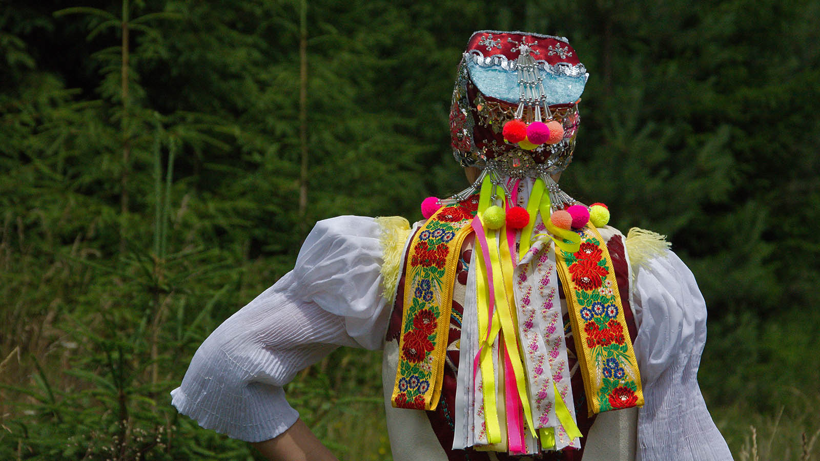
Photo © Hudec Ivan

Slide 37
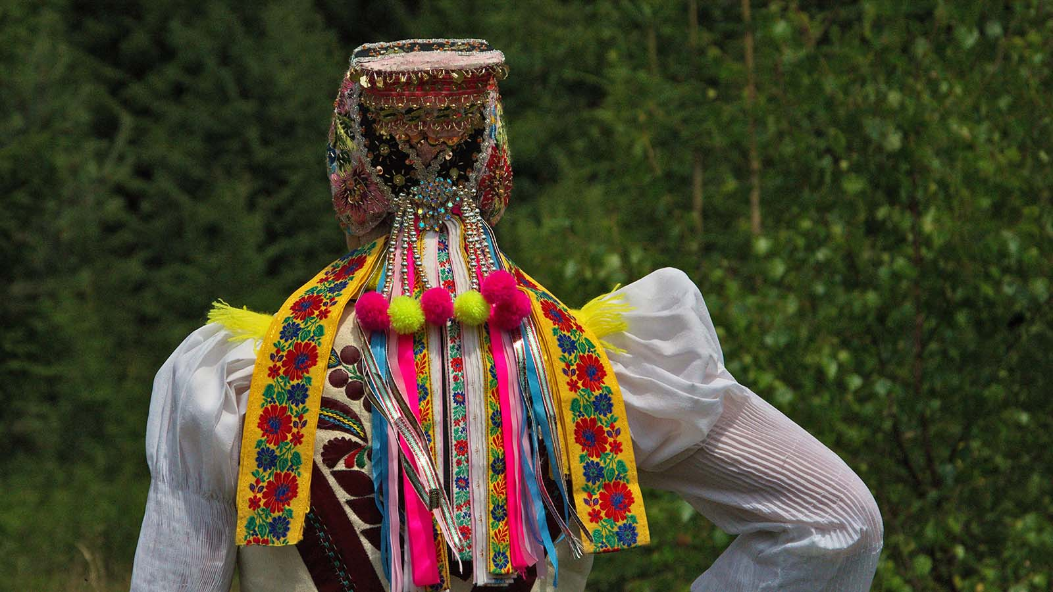
Photo © Hudec Ivan

Slide 38




Year - 2019
Photos - Hudec Ivan
Compilation - Rumpler Štefan
Music - Čardáše z Horehronia
Contact - pista2011@gmail.com

