Slide 1

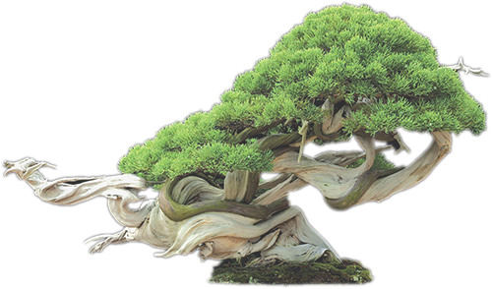
Magical gardens
of
JAPAN

Slide 2

Traditional Japanese gardens are famous the world over. These gardens highlight the beauty of nature, avoiding artificial, man-made components wherever possible. The first of these gardens began to be built on the island of Honshu around 600 A.D.
Japanese gardens also capture aspects of the traditional Shinto religion,
as well as Taoism and Buddhism. The gardens speak of the unstoppable
march of time, natural aspects of the Japanese landscape, such as its
volcanic peaks, and often include replicas of the legendary Mount
Horai.
A special compilation by Tony Chacko

Slide 3
We’ve selected some of the best gardens in Japan
for the globe trotter and adventure tourists
Kenroku-en (Kanazawa)
Koraku-en (Okayama)
Kairaku-en (Mito)
The Katsura Imperial Villa, Kyoto
The Kokedera, or Moss Temple Garden
The Ryoan-ji Temple, Kyoto
Gardens surrounding the Adachi Museum of Art
Koishikawa Korakuen Garden, Tokyo
Rikugean Garden, Tokyo
The Shinjuku Gyoen, Tokyo
Japanese Tea House at the Shinjuku Gyoen Park
The Imperial Palace East Gardens, Tokyo
Ritsurin Koen in Takamatsu, Kagawa Prefecture
Showa Kinen Koen (Showa Memorial Park)
Saika no Sato - Sasaki Farm at Hokkaido
Furano Lavender Flower-fields of Hokkaido
The Fujikawa International School of Bonsai, located in Ikeda City
The Byodo-In Temple of Hawaii
The famous Sakura in Tokyo.
The oldest Wisteria Tree of over 140 years in Japan
Takinoue Park
Kiso Sansen Park
Wisteria Tunnel of Kawachi Fuji Garden in Kitakyushu

Slide 4
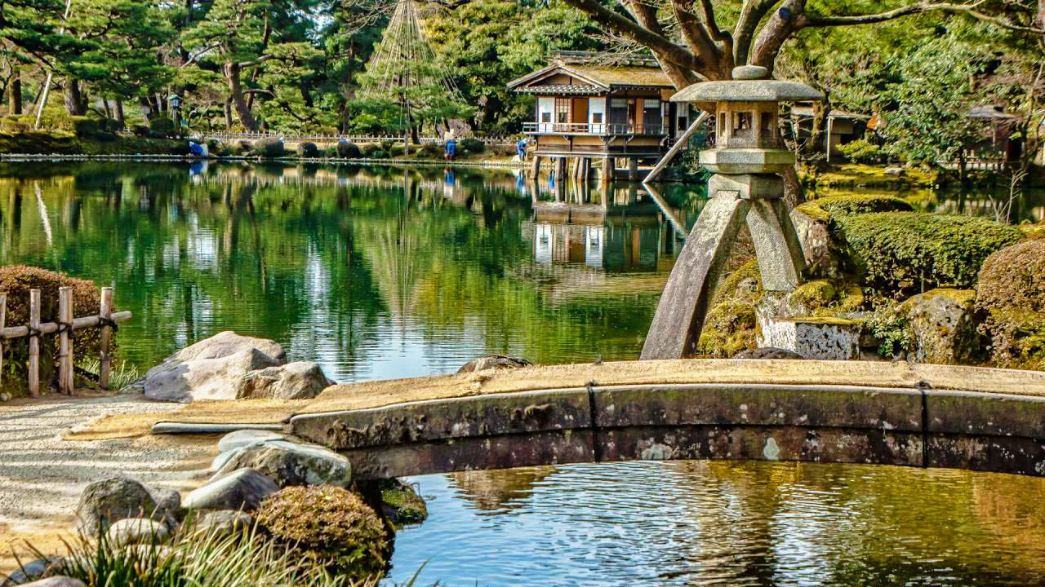
Kenroku-en Garden at Kanazawa, Japan, is an old private garden. Along with Kairaku-en and Kōraku-en, Kenroku-en is one of the Three Great Gardens of Japan.

Slide 5
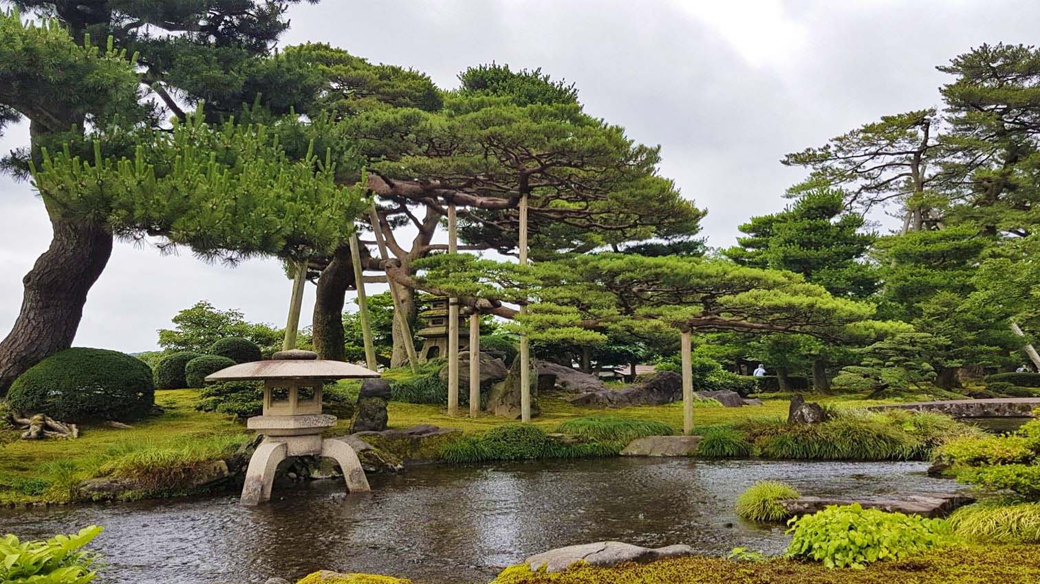
Kenroku-en Garden at Kanazawa, Ishikawa Japan

Slide 6
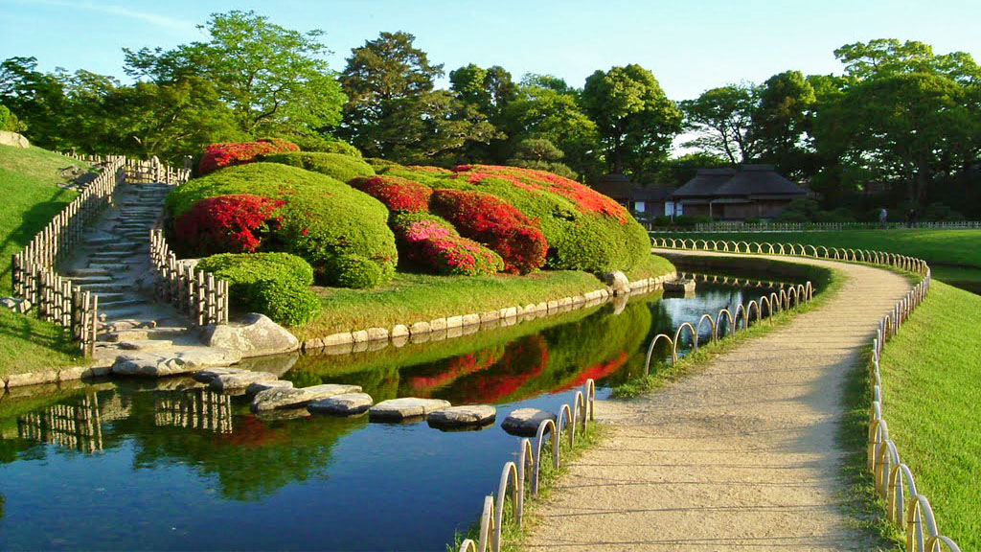
Koraku-en Garden at Okayama - one amongst the Three Great Japanese gardens.

Slide 7
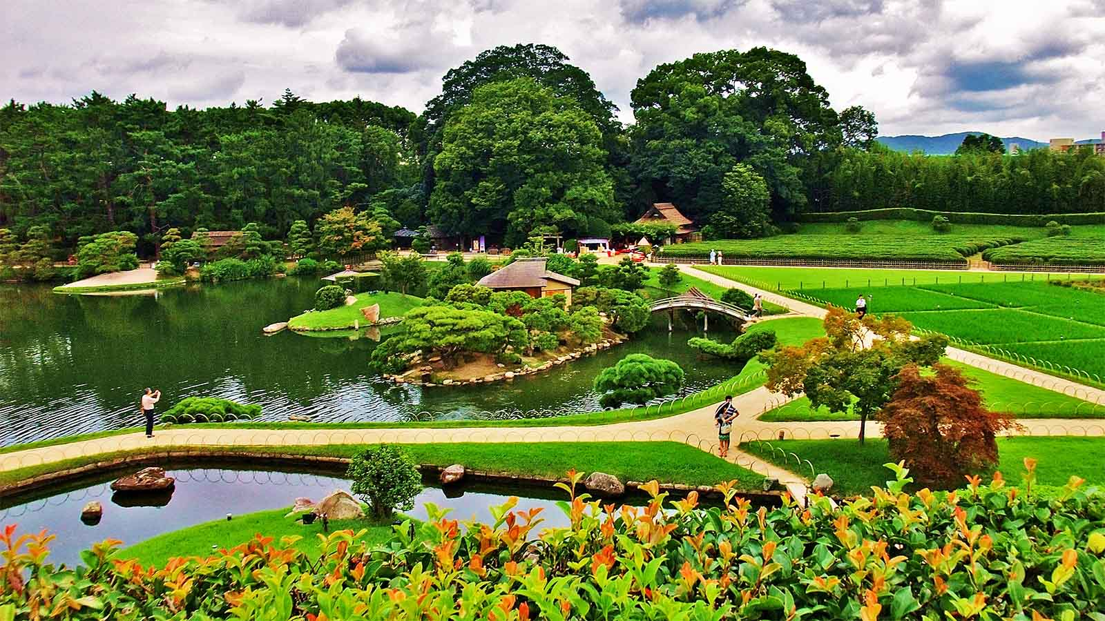
Koraku-en Garden at Okayama

Slide 8
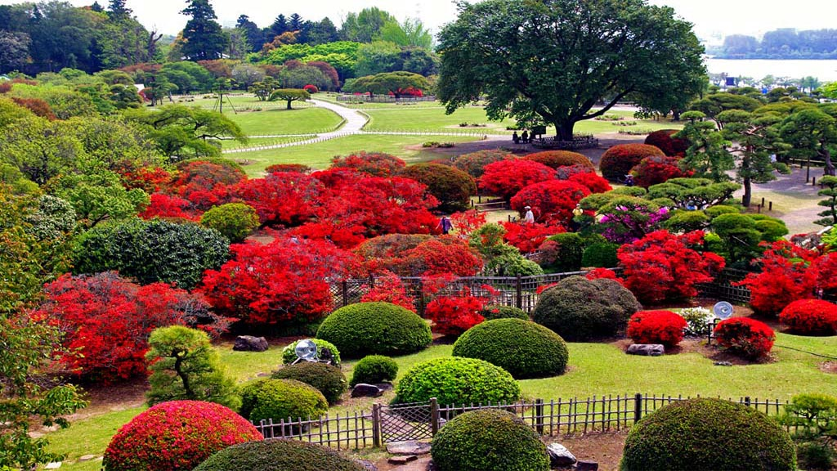
Kairaku-en Garden at Mito, Ibaraki, Japan and is part of the Three Great Gardens of Japan

Slide 9
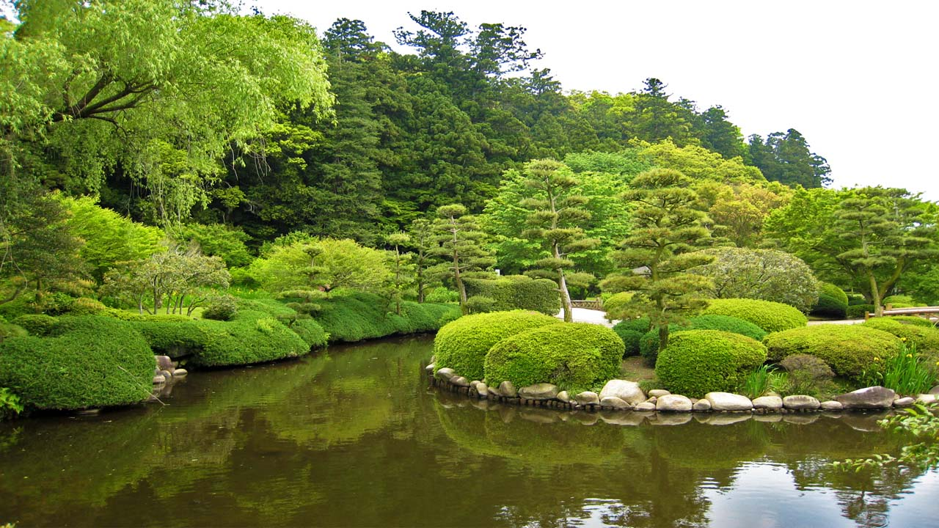
Kairaku-en Garden at Mito

Slide 10
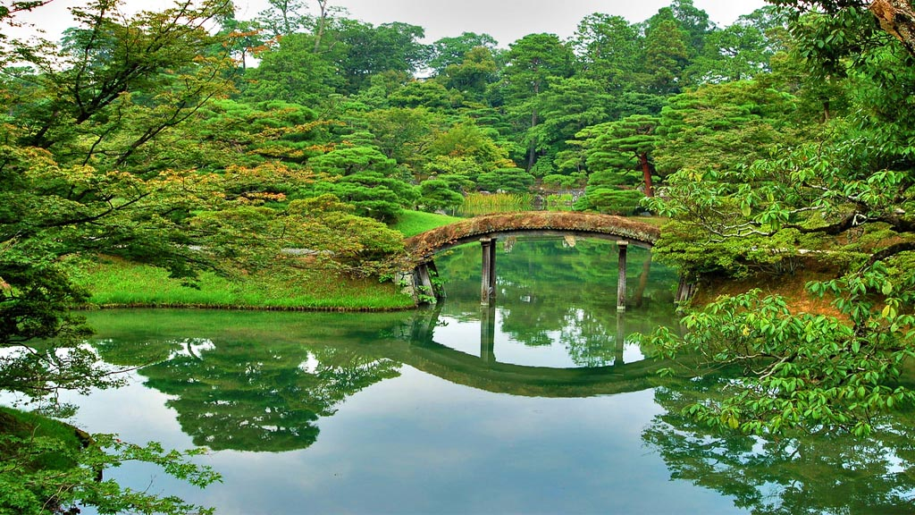
The Katsura Imperial Villa Gardens, is a villa with associated gardens and outbuildings in the western suburbs of Kyoto, Japan (in Nishikyō-ku, separate from the Kyoto Imperial Palace). It is one of Japan's most important large-scale cultural treasures.

Slide 11
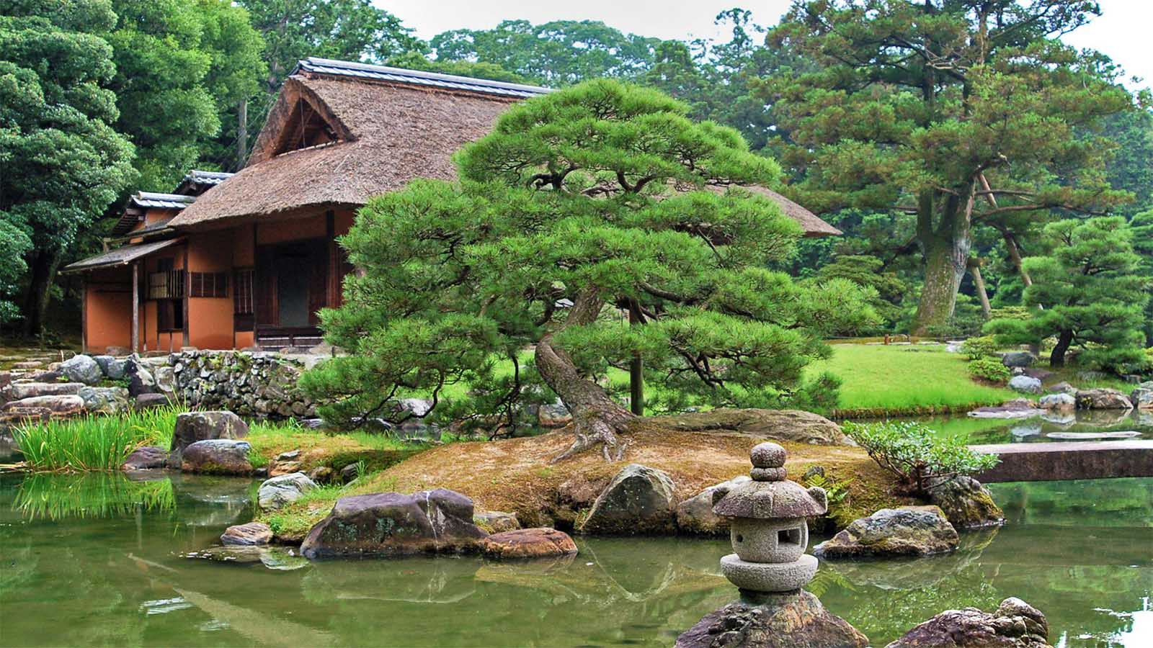
The Katsura Imperial Villa Gardens, Kyoto

Slide 12
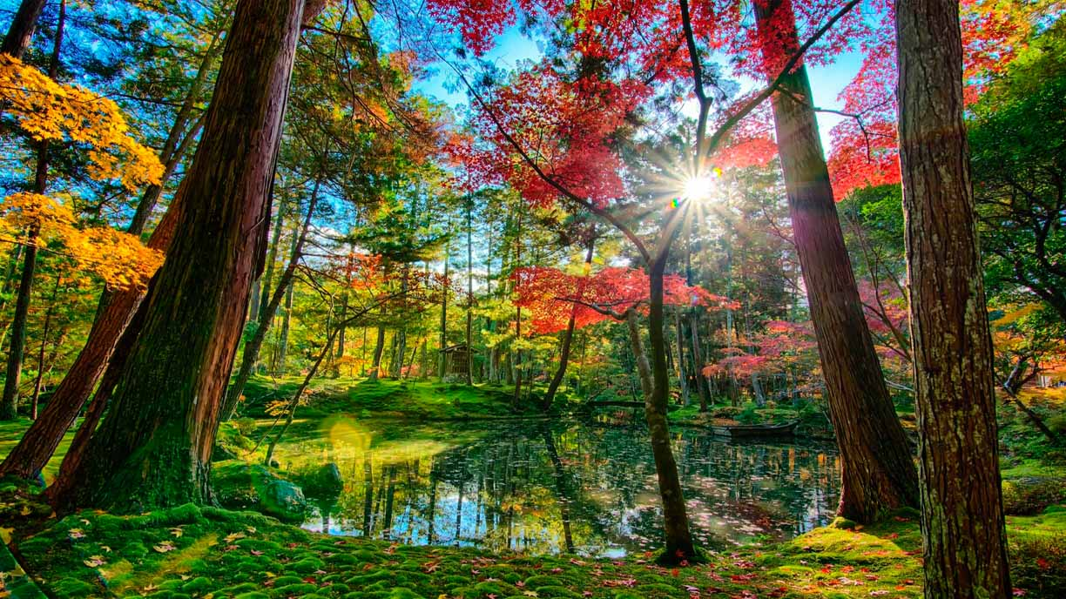
Saihō-ji is a Rinzai Zen Buddhist temple located in Matsuo, Nishikyō Ward, Kyoto, Japan. It’s garden the Kokedera, or Moss Temple Garden is the most beautiful Japanese garden to visit. (It is called as the moss temple). Entrance is only granted through written application and permission.

Slide 13
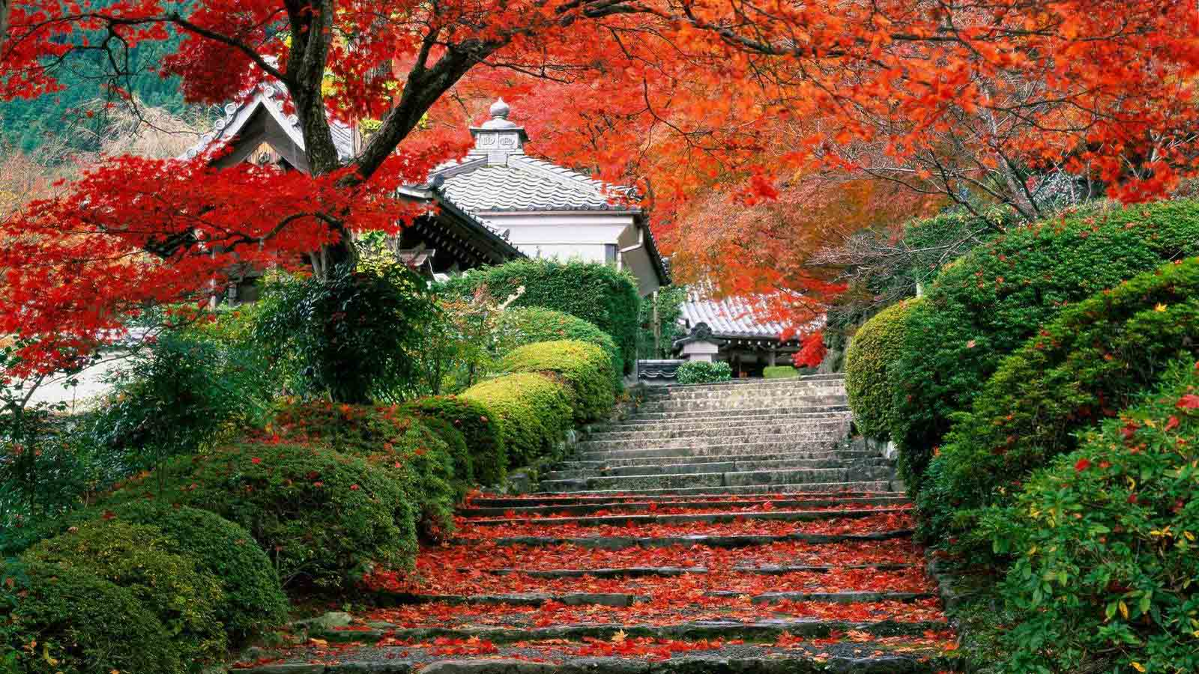
The Kokedera, or Moss Temple Garden

Slide 14
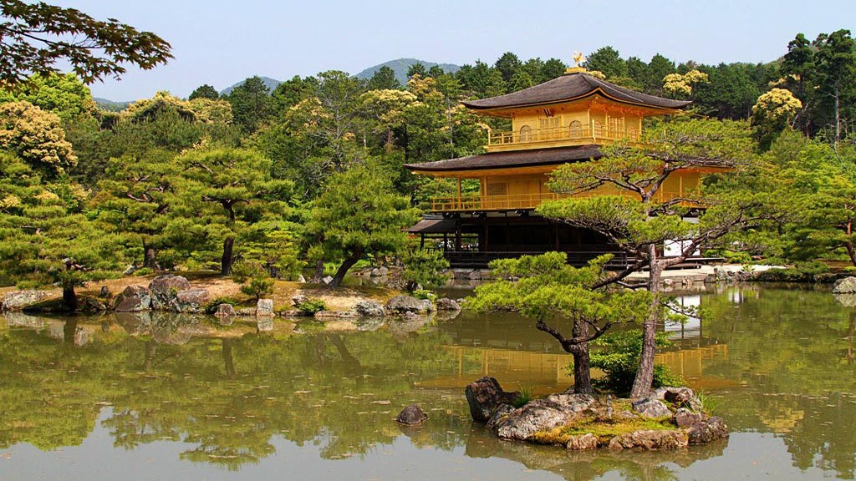
The Ryoan-ji Temple with it’s Golden Pavilion, Kyoto

Slide 15
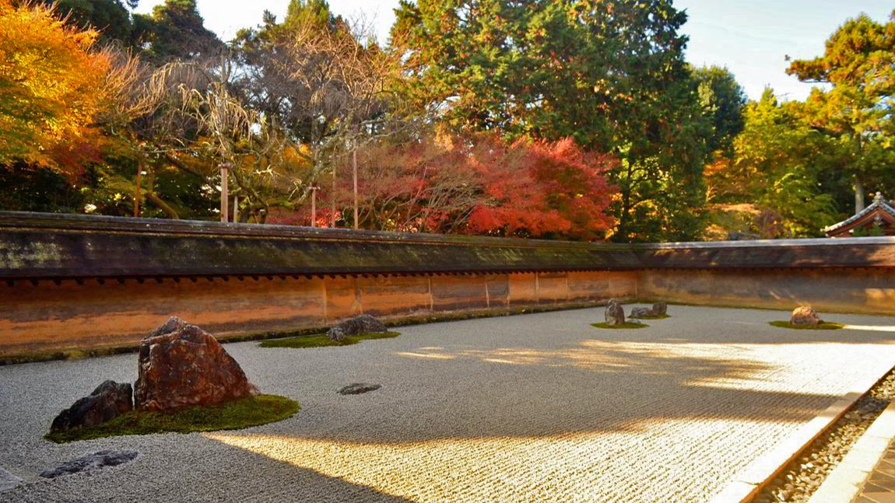
The Ryoan-ji Temple’s pebbles and stone laid meditation area.

Slide 16
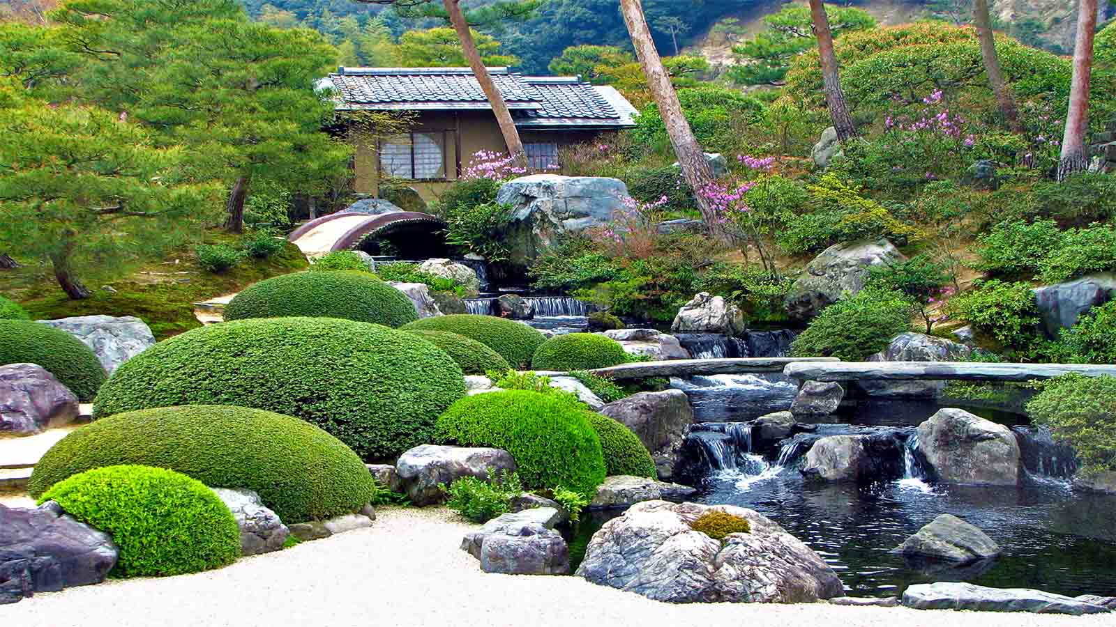
Adachi Museum of Art is an art museum located in Yasugi city, Shimane prefecture. It was founded in 1970 by Zenko Adachi who was passionate about Japanese art and gardens. There are several gardens around the museum. The main garden is the Dry Landscape Garden, but we can also find the Moss Garden, the Tea Garden, the Pond Garden, which is the oldest garden on the grounds, and the White Gravel and Pine garden, a tribute to works of Yokoyama Taikan.

Slide 17
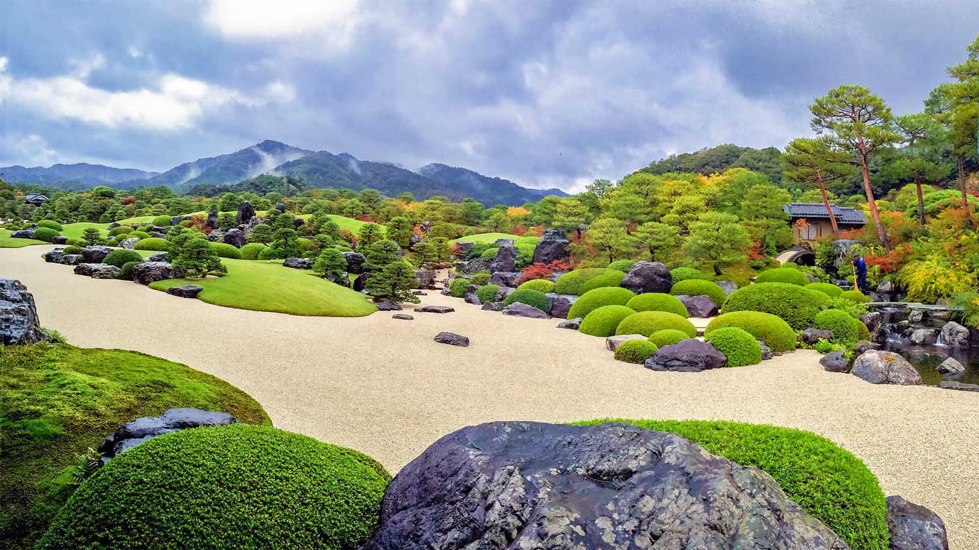
Gardens surrounding the Adachi Museum of Art

Slide 18
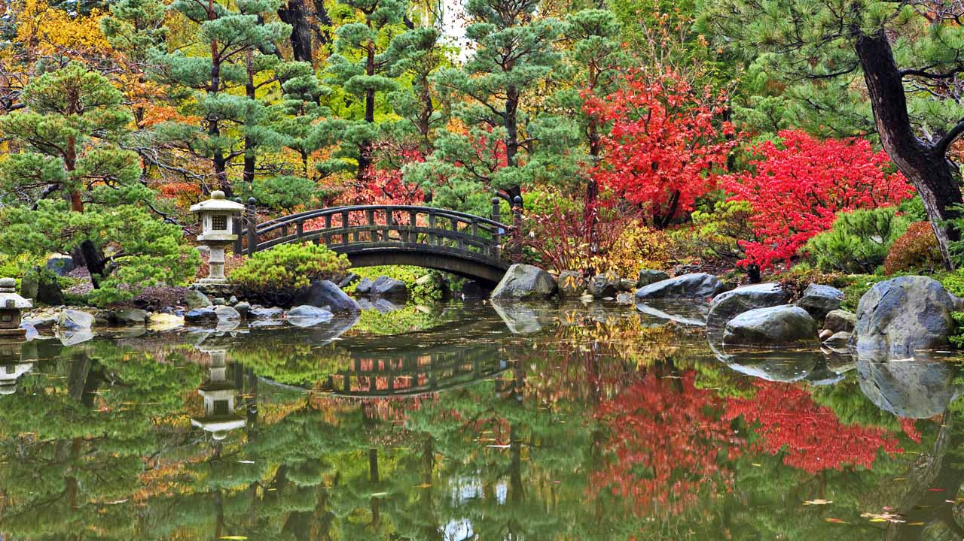
A wonderful Japanese Nature Garden for ideal relaxing of the mind.

Slide 19
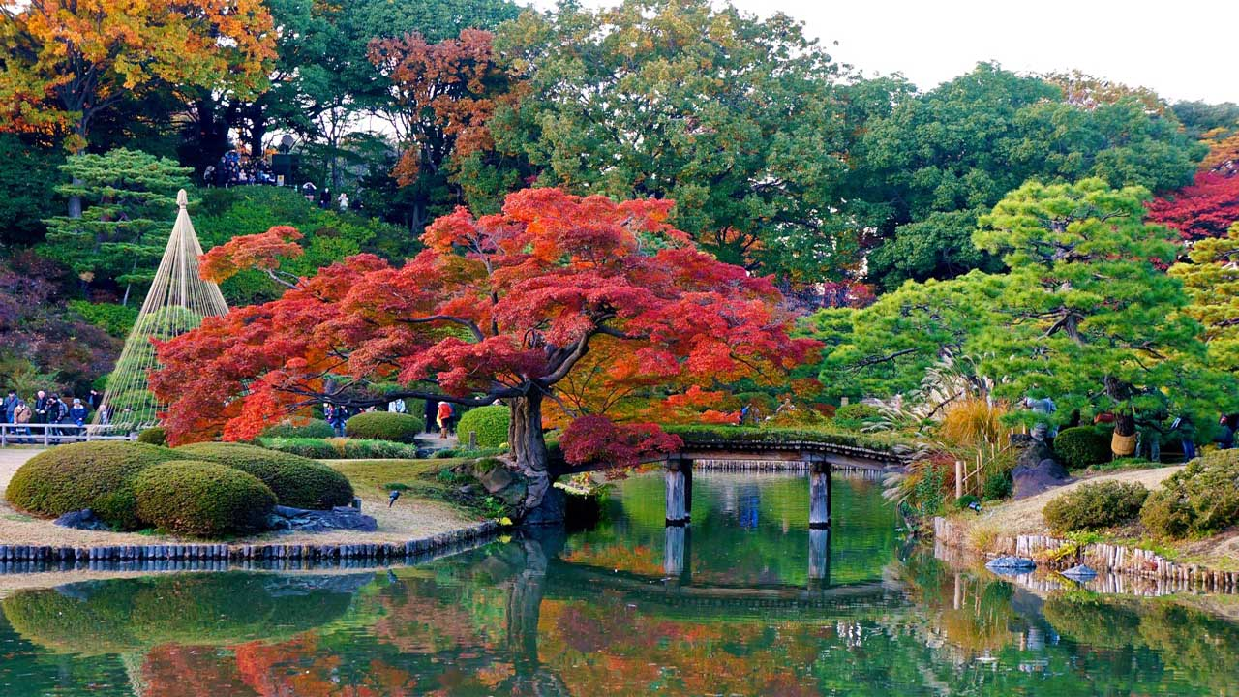
Koishikawa-Kōrakuen is a seventeenth-century garden in Koishikawa, Bunkyō, Tokyo. It incorporates elements of both Chinese and Japanese tastes of garden design.

Slide 20
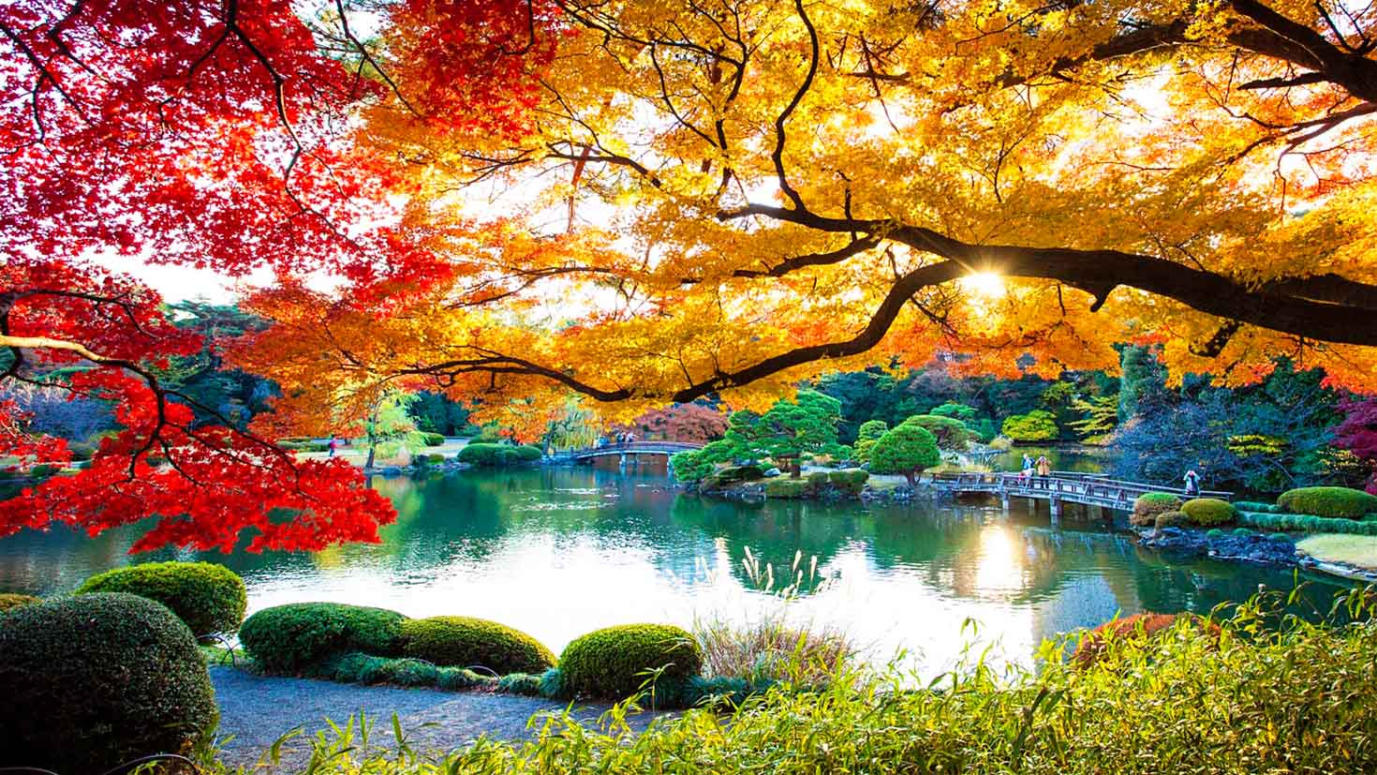
The Shinjuku Gyoen Garden, Tokyo

Slide 21
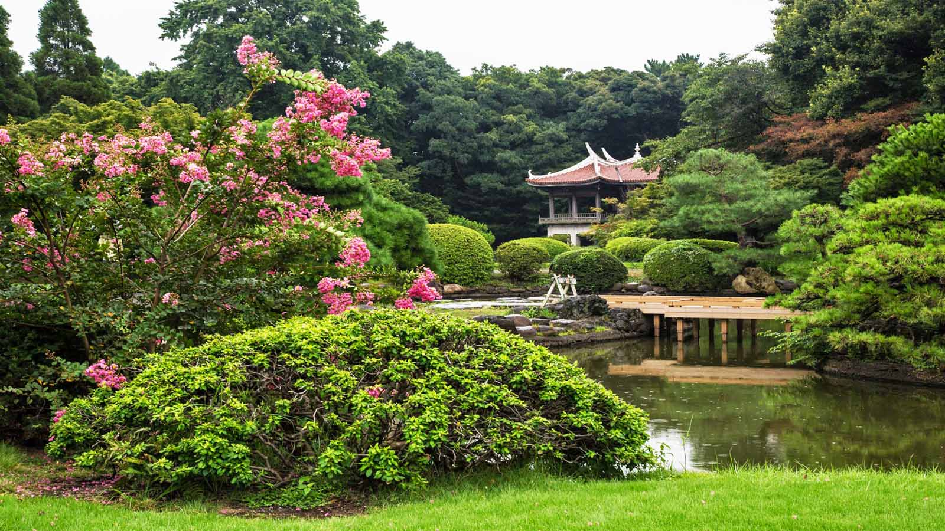
Japanese Tea House at the Shinjuku Gyoen Park

Slide 22
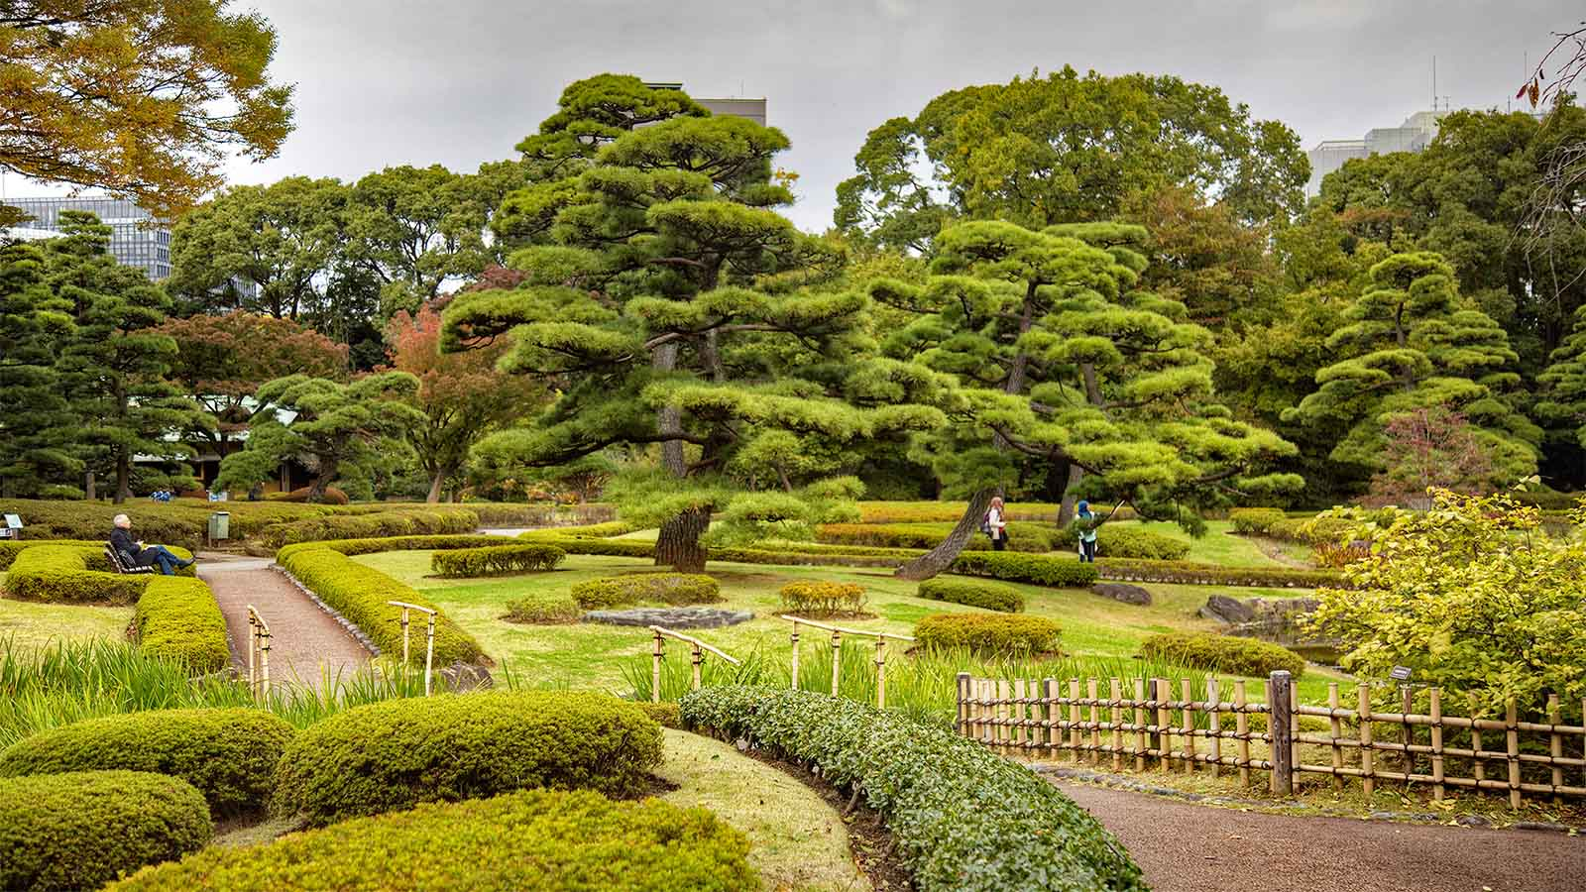
The Imperial Palace East Gardens, Tokyo

Slide 23
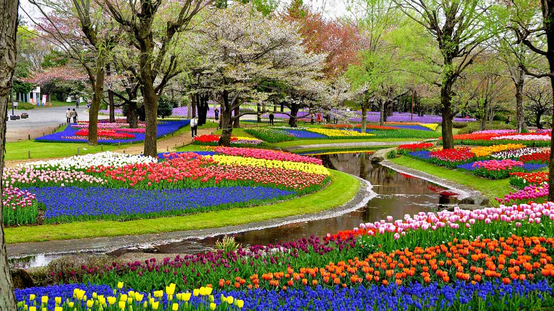
Showa Kinen Koen (Showa Memorial Park) of Tokyo

Slide 24
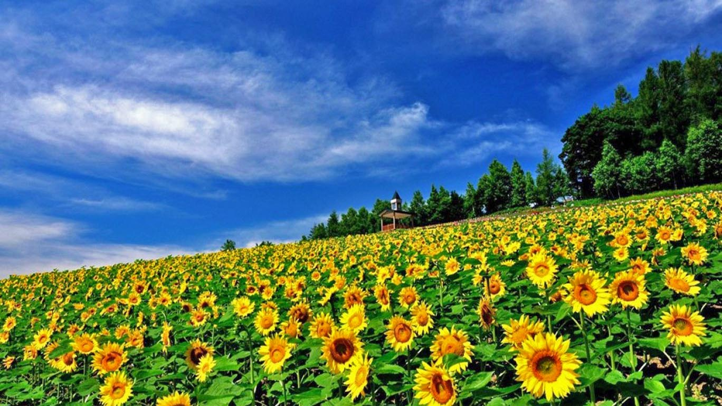
Saika no Sato - Sasaki Sunflower farm at Hokkaido

Slide 25
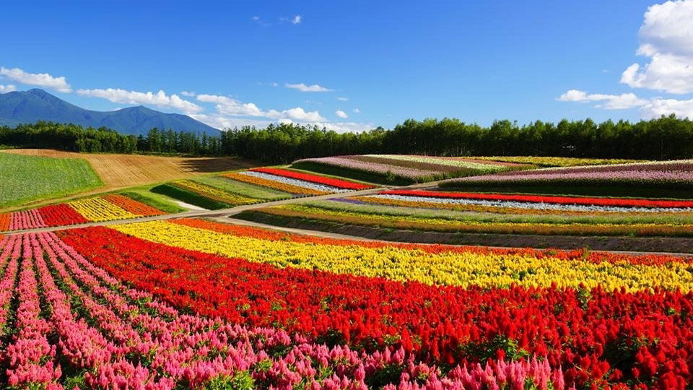
Furano Lavender Flowerfields of Hokkaido. This is one place you must visit! This is where lavender has been produced since 1958. It is currently a traditional lavender field.

Slide 26
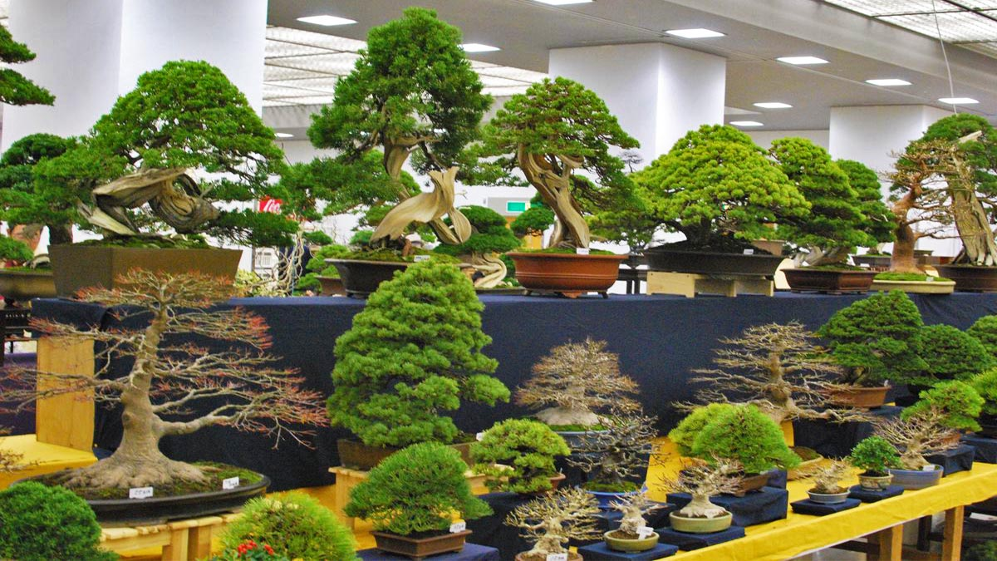
The Fujikawa International School of Bonsai. Located in Ikeda City (Osaka), Japan with it’s display of miniature potted trees.

Slide 27
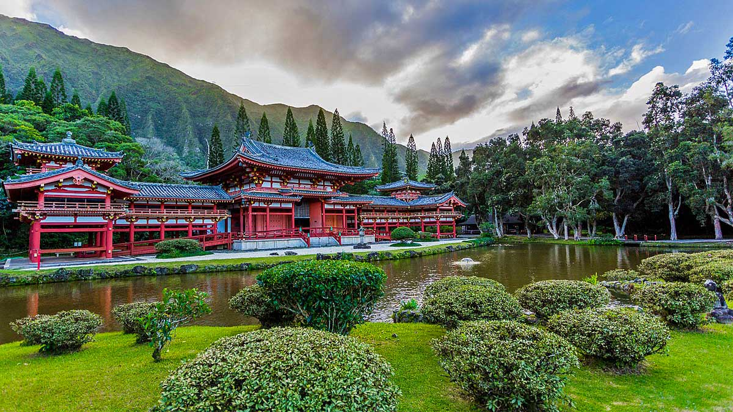
The Byodo-In Temple of Hawaii. Commemorated to the first migration of Japanese to Hawaii

Slide 28
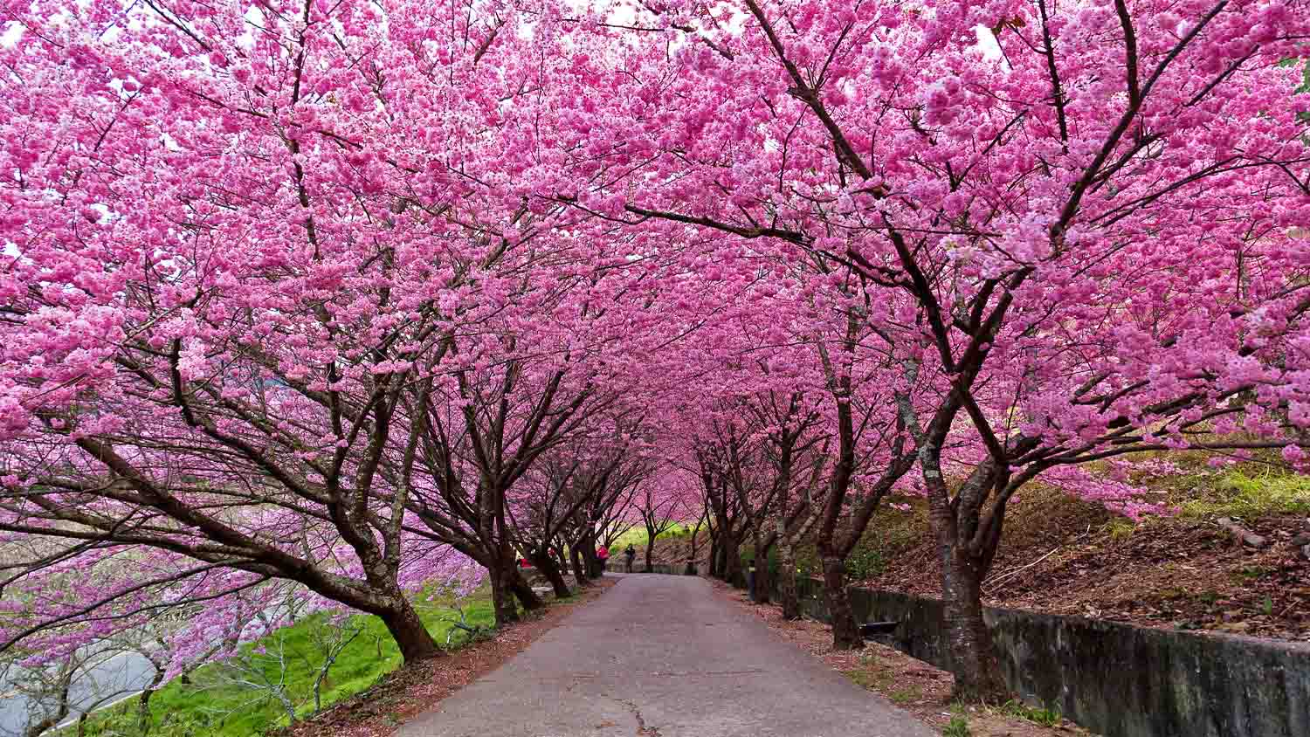
A japanese Garden with Cherry Blossom Trees lining the walkway.

Slide 29
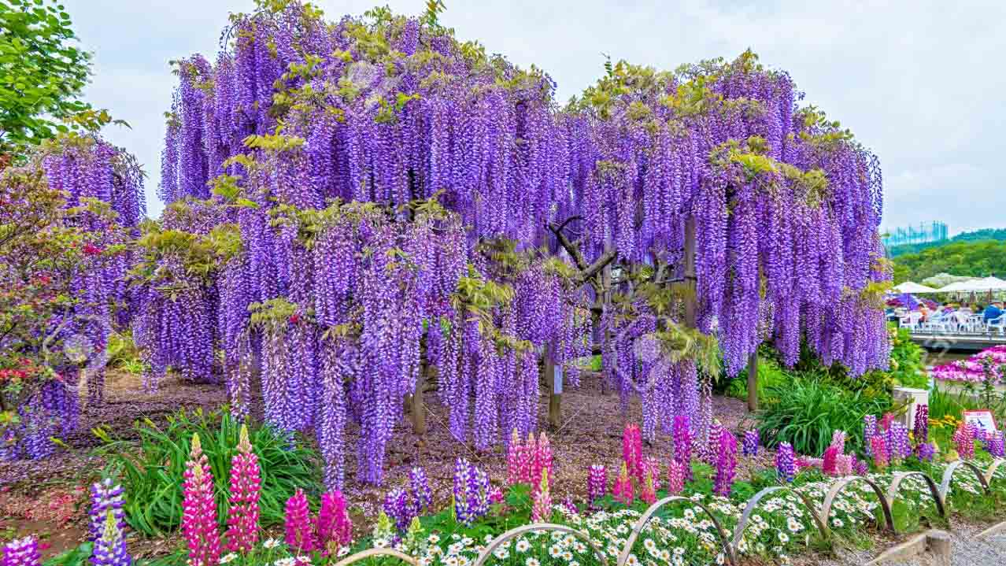
The best places to view fuji flowers (wisteria) is the Ashikaga Flower Park in Ashikaga City, Tochigi Prefecture. Ashikaga Flower Park features lots of blue, white and pink fuji as well as yellow laburnum (Japanese: kingusari) that look like yellow colored fuji.

Slide 30
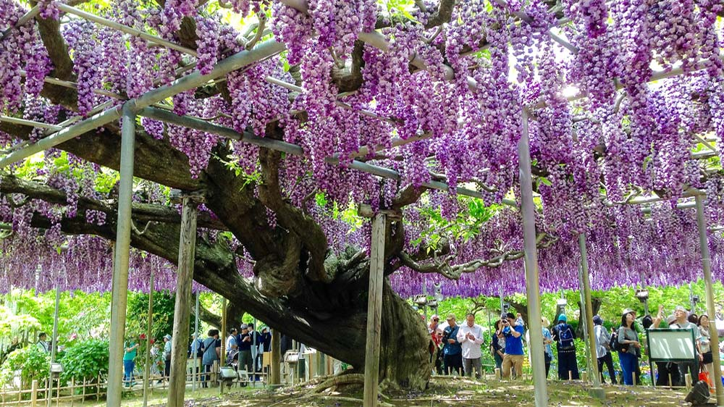
This 148 year old Wisteria Tree, located in Ashikaga Flower Park, Tochigi in Japan, though not the largest in the world, it still comes in at an impressive 1,990 square meters (or half an acre) and dates back to around 1870.

Slide 31
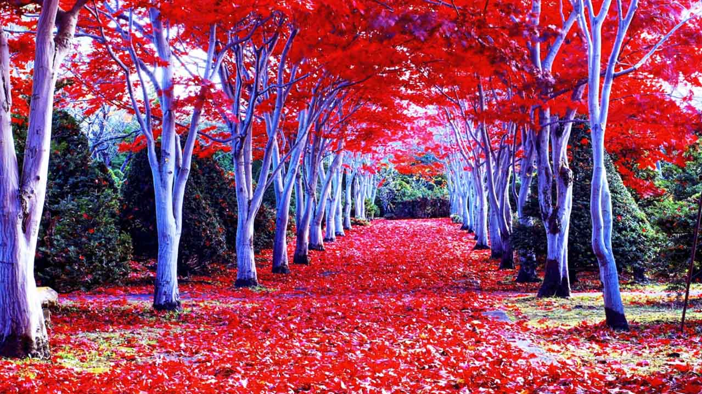
Autumn in Hokkaido (North Japan) with lined Maple Trees at Hiraoka Jugei Center

Slide 32
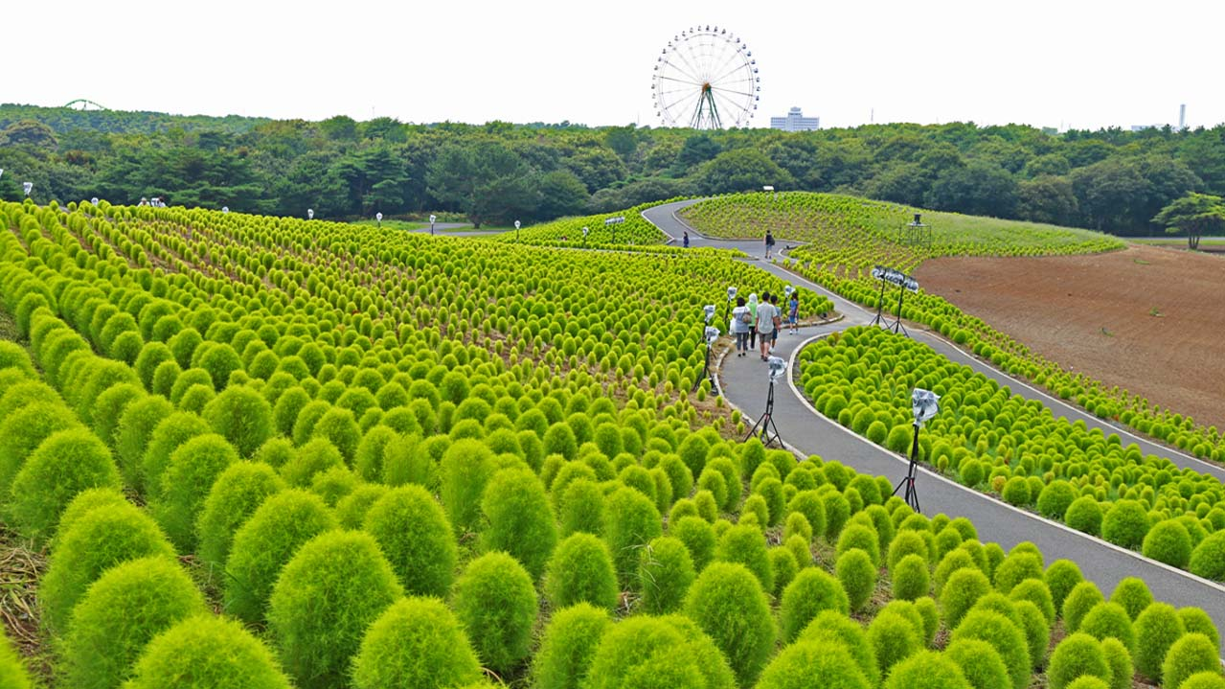
Hitachi Seaside Park covering an area of 190 hectares, features blooming flowers around the year. It has become known for its baby blue-eyes flowers, with the blooming of 4.5 million of the translucent-petaled blue flowers in the spring drawing tourists. In addition to the annual "Nemophila Harmony", the park features a million daffodils, 170 varieties of tulips, and many other flowers.

Slide 33
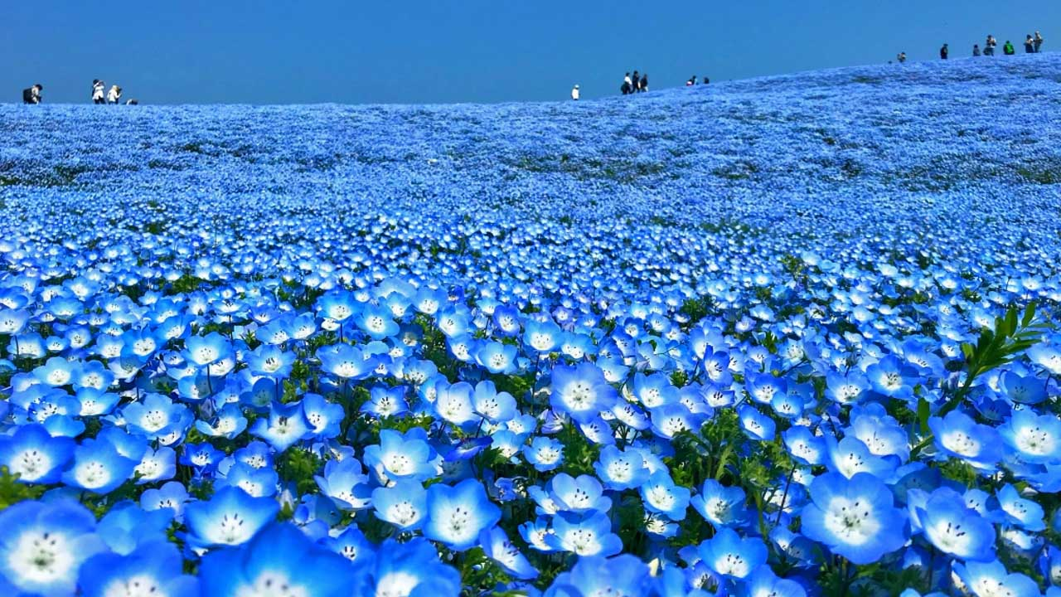
Nemophila flower field at Hitachi Seaside Park

Slide 34
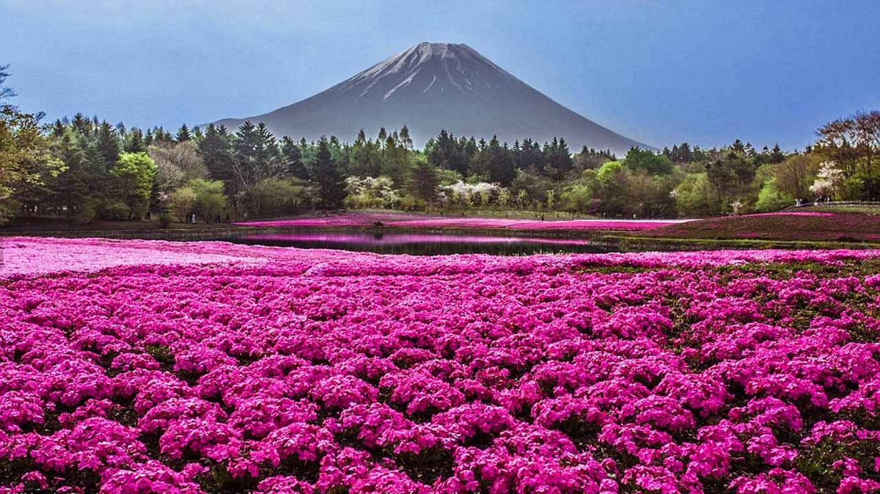
After Sakura season is over, the Shibazakura (Moss Pink or Phlox Subulata) season reaches its peak. This is Hitsujiyama Park, one of the most popular Shibazakura viewing spots in Japan. For people who likes flowers, this place is a must see place.

Slide 35
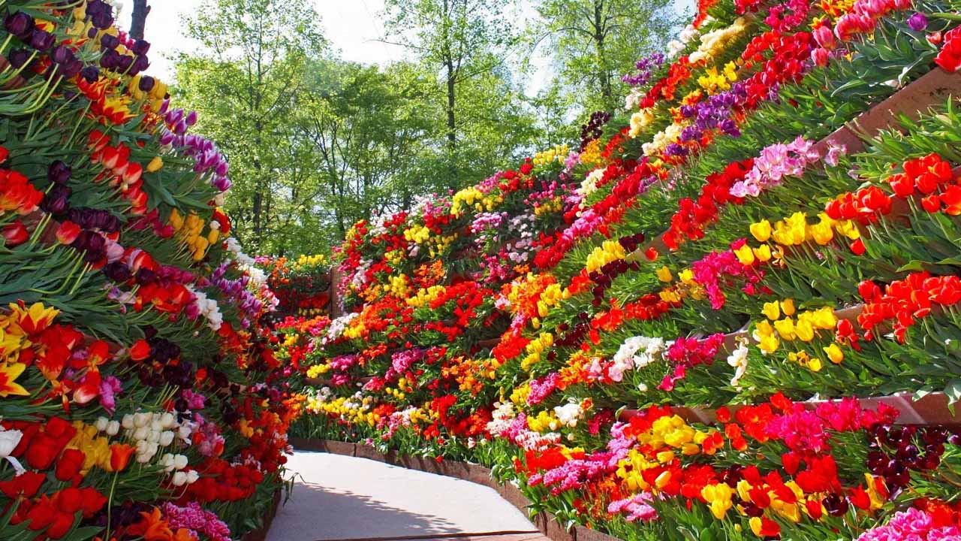
There is a tulip park in Tonami in Toyama Prefecture, as well as a nationally recognized tulip festival that is held every year. There is a windmill transferred by the Netherlands, inscribed "DE VRIENDSCHAP" (friendship). The Tonami tulip festival has over 600 different kinds of tulips, and more than 2.5 million tulips in recent years.

Slide 36
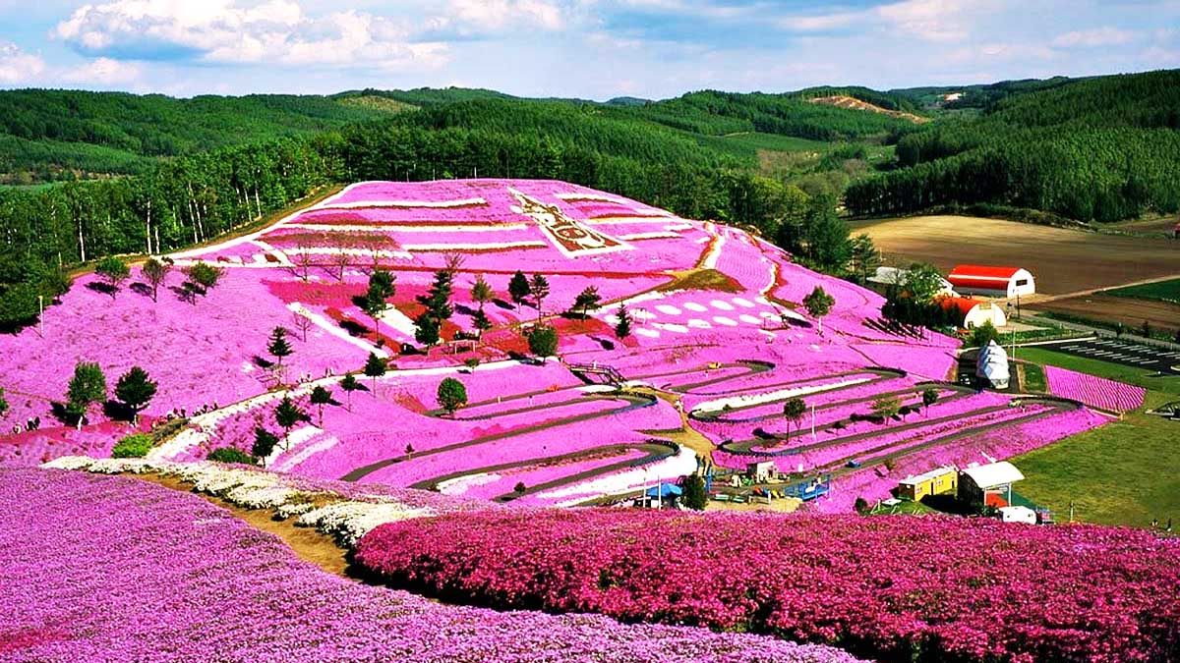
Takinoue Park, located in Okhotsk Sub-prefecture, Hokkaido is famous for Shibazakura or Pink Moss. The 10,000 m² park attracts thousands of visitors every year between May and June when the flowers are in full bloom.

Slide 37
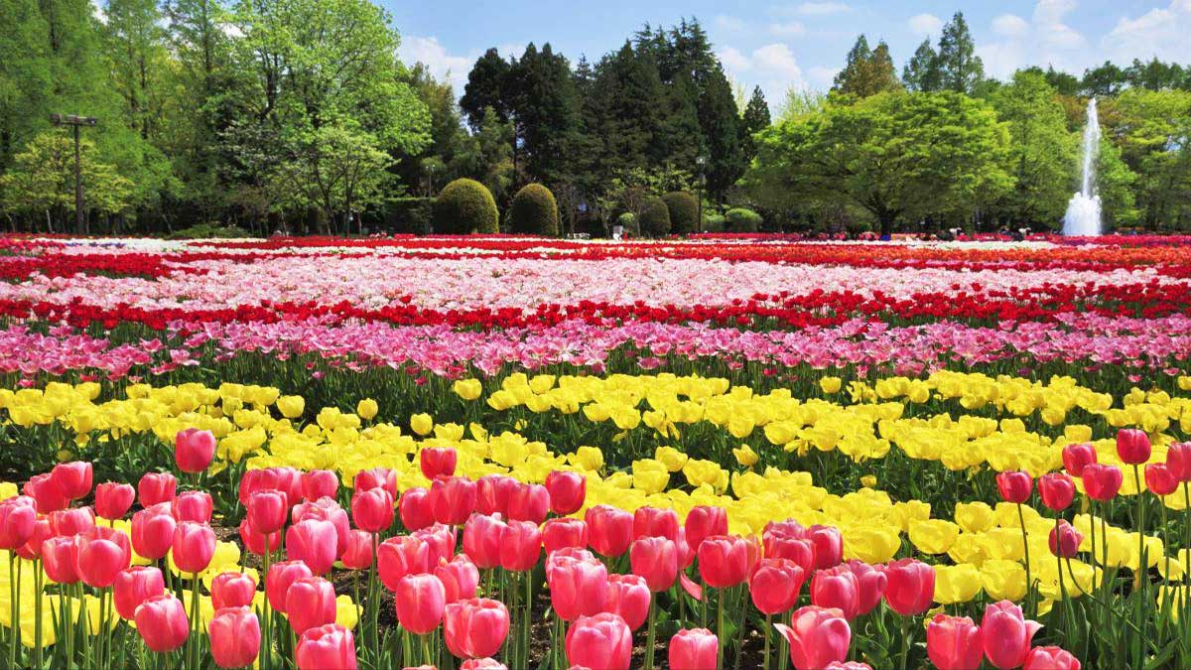
Kiso Sansen Park located in Kaizu City, Gifu Prefecture, is the largest government park in Japan and is home to Japan's famous Tulip Festival.

Slide 38
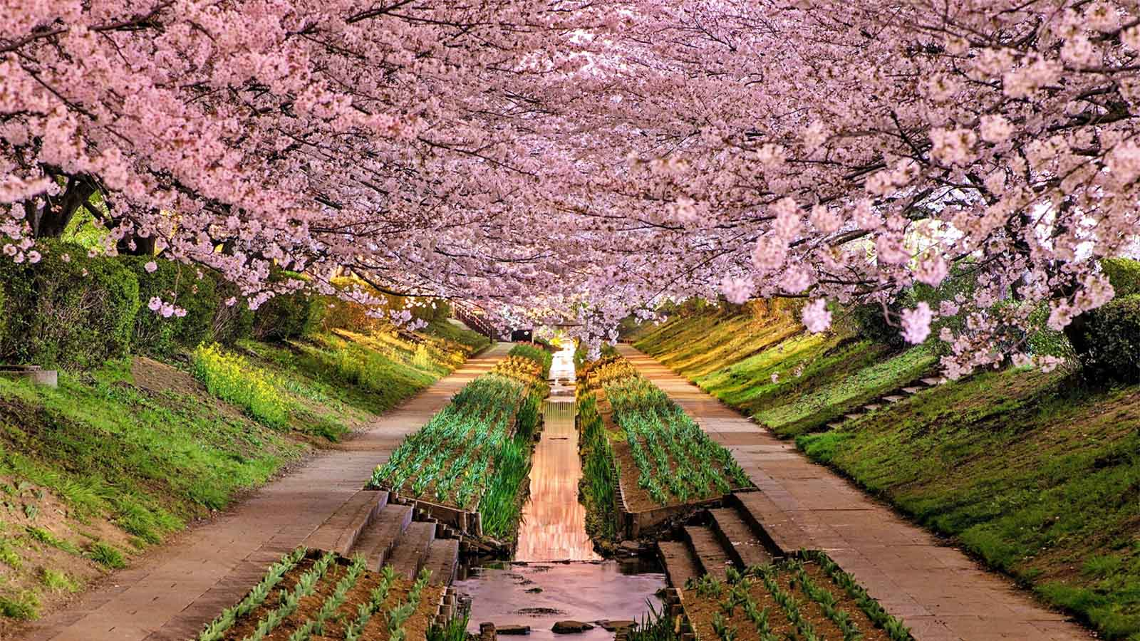
The famous Wisteria Tunnel of Kawachi Fuji Garden in Kitakyushu, Fukuoka Prefecture, Hokkaido.

Slide 39

The End
Hope you liked these gardens from the best natural garden makers of the world - "The Japanese“.
Viewers opinions and comments are most welcome.
Tony Chacko
(tonychacko2000@gmail.com)
Steve Rumpler
(pista2011@gmail.com)

