Slide 1
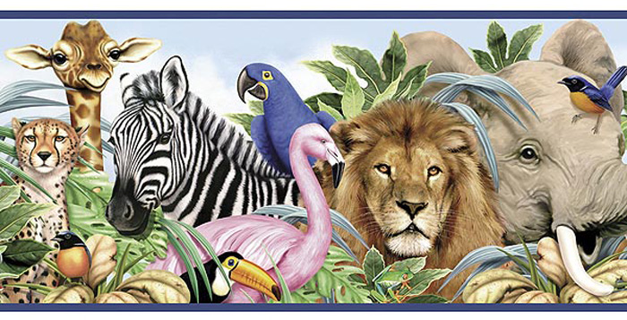
What can animals do?

Slide 2
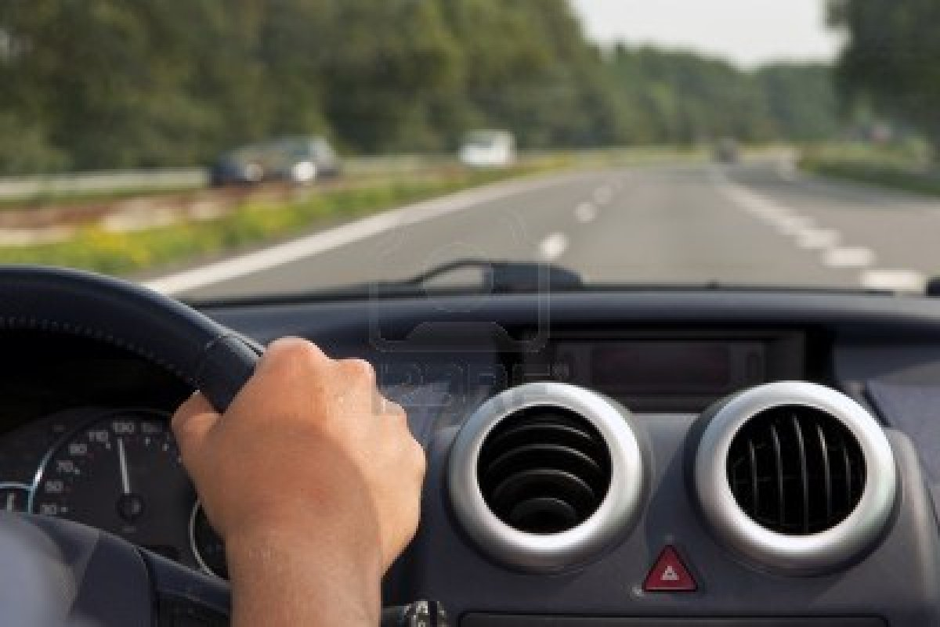
Can animals drive a car?

Slide 3
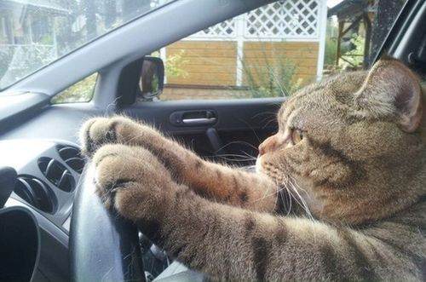
Yes, they can. ☺

Slide 4
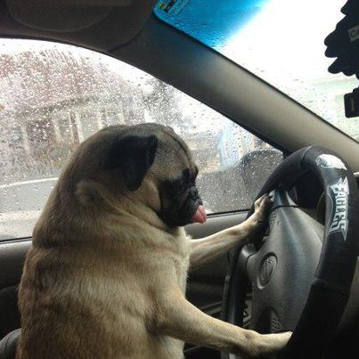
Yes, they can. ☺

Slide 5
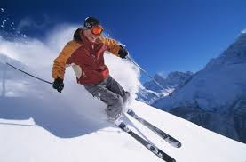
Can a dog ski?

Slide 6
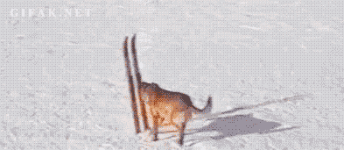
Yes, it can. ☺

Slide 7
Can a dog ride a Jet ski?

Slide 8
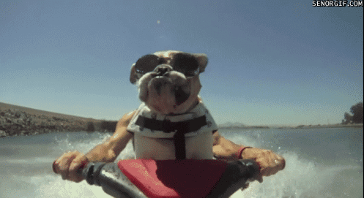

Slide 9
Can a panda climb a tree?

Slide 10
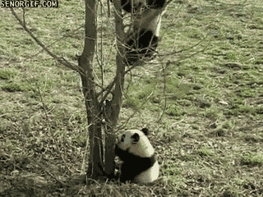

Slide 11

Can a dog cook?

Slide 12
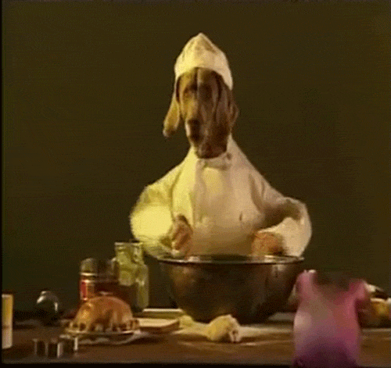

Slide 13
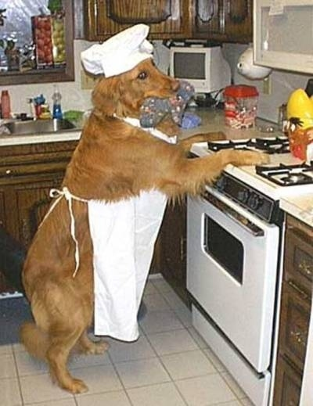

Slide 14

Can animals play an instrument?

Slide 15
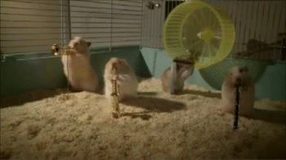

Slide 16


Slide 17
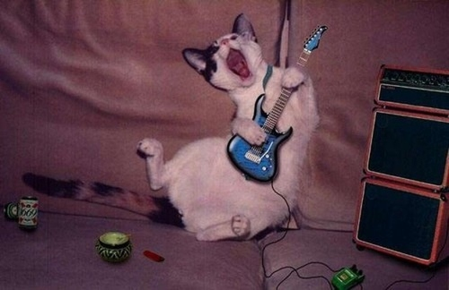

Slide 18
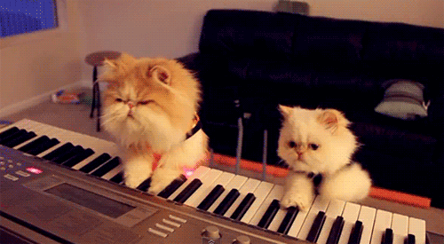

Slide 19
Can a cat wear boots?

Slide 20
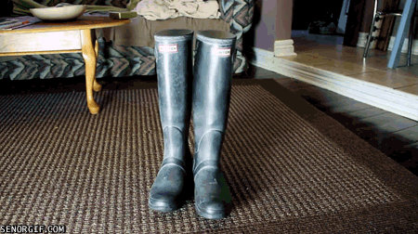

Slide 21
Can a dog play basketball?

Slide 22
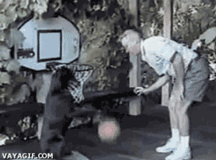

Slide 23

Can animals dance?

Slide 24
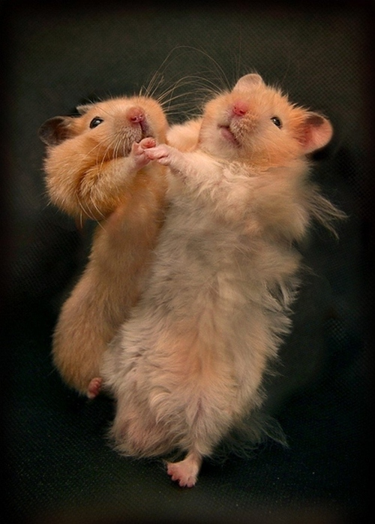

Slide 25


Slide 26

Can animals do exercises?

Slide 27
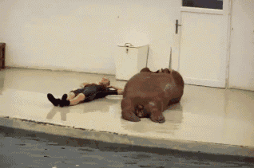

Slide 28
Can a dog ride a bike?

Slide 29
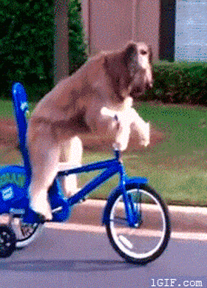

Slide 30
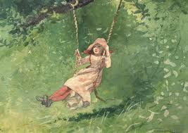
Can a dog swing?

Slide 31
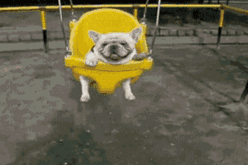

Slide 32
Can elephants swim?

Slide 33
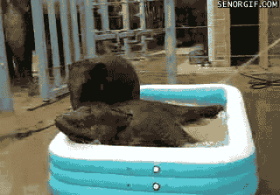

Slide 34
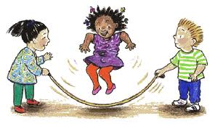
Can animals skip?

Slide 35
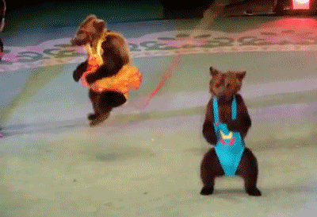

Slide 36
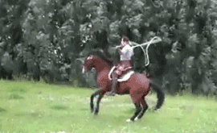

Slide 37
Can elephants play football?

Slide 38
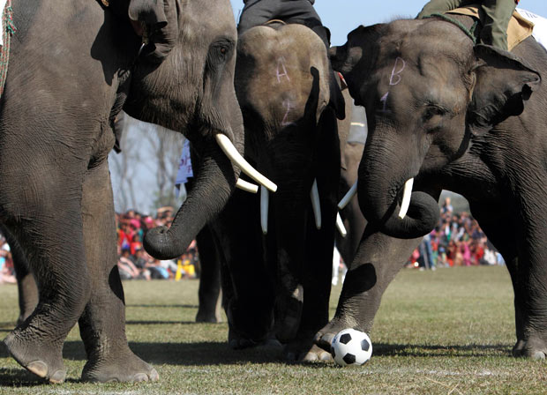

Slide 39
Can cats read a book?

Slide 40


Slide 41
Can a hamster swim?

Slide 42
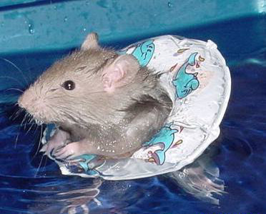

Slide 43
Can a cat make music?

Slide 44


Slide 45
Can a turtle fly?

Slide 46
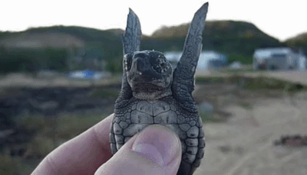

Slide 47
Can a rabbit eat an ice-cream?

Slide 48
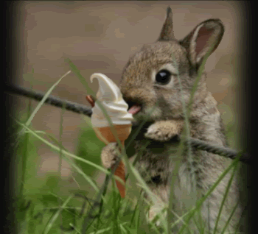

Slide 49
The end ☺

Slide 50


