Slide 1

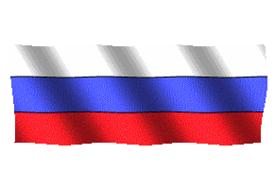

Russian
Federation
2
2017
Compiled by - Tony and Steve

Slide 2

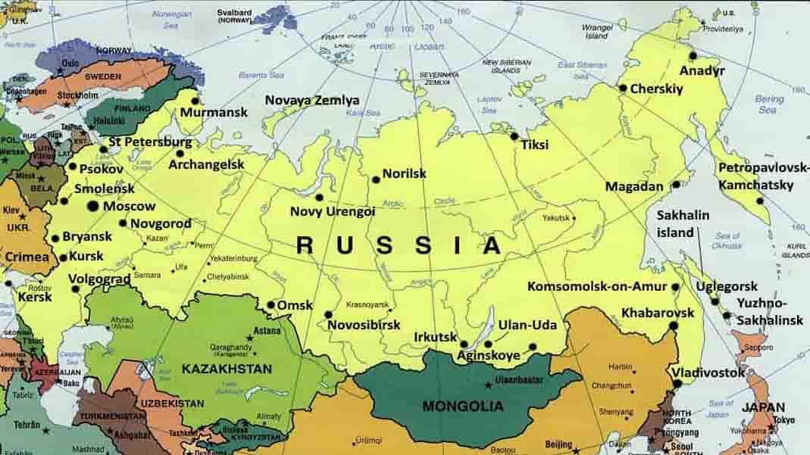

General Geographic Map of Russia

Slide 3
Russia
Russia - is a country that is mostly in Asia and partly in Eastern Europe. It is the largest country in the world, covering more than one-eighth of the Earth's inhabited land area.There are indeed many interesting tourist attractions in Russia and here are some highlighted places.
The federal subjects of Russia are the constituent entities of Russia. It consists of republics, krais, oblasts, cities of federal importance, an autonomous oblast, and autonomous okrugs, all of which are equal subjects of the Russian Federation. The Russian Federation constitutionally consists of 83 (2008) federal subjects..
Russia's capital and the biggest city is Moscow. The second biggest city is Saint Petersburg, which was the capital of Russia in the 18th and 19th centuries.
Area : 17,075 million km²
Population : 144.5 million (2015)
Ethnic groups (2010) : Russian (80,9 %), Tatar (3,9 %), Ukrainian (1,4 %), Bashkirs (1,2 %), Chuvash (1,1 %),
Chechen (1,0 %), Armenians (0,9 %), other / unspecified (9,8 %)
Wikipedia

Slide 4

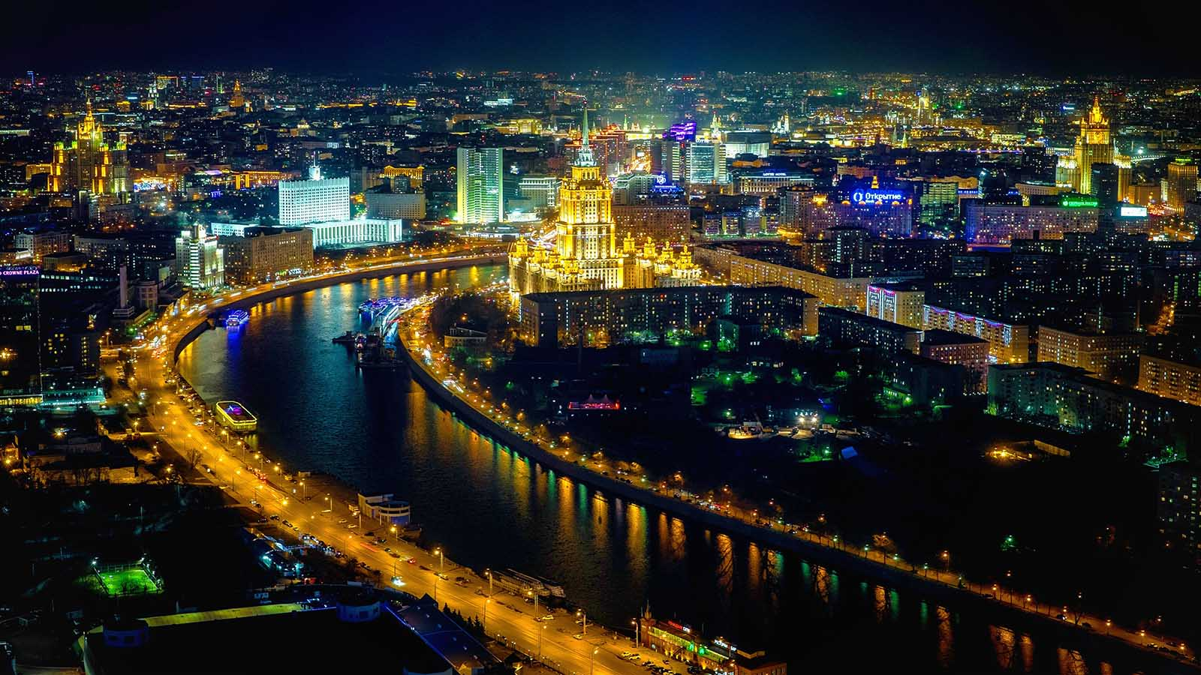
Moscow

Slide 5
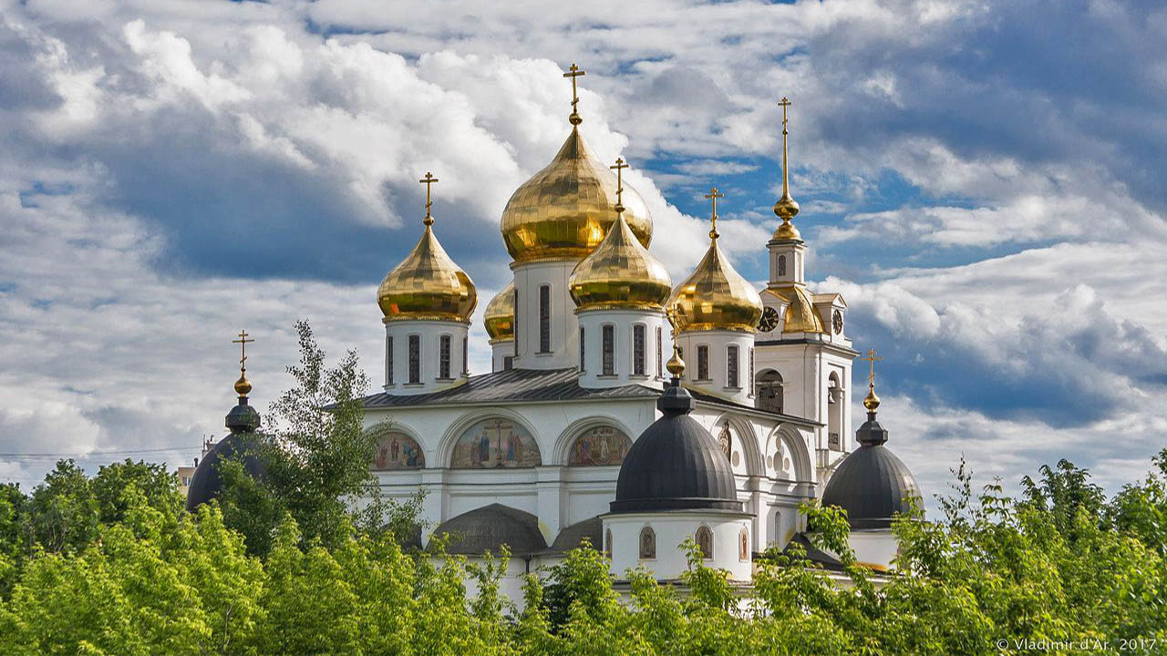
Dmitrov

Slide 6
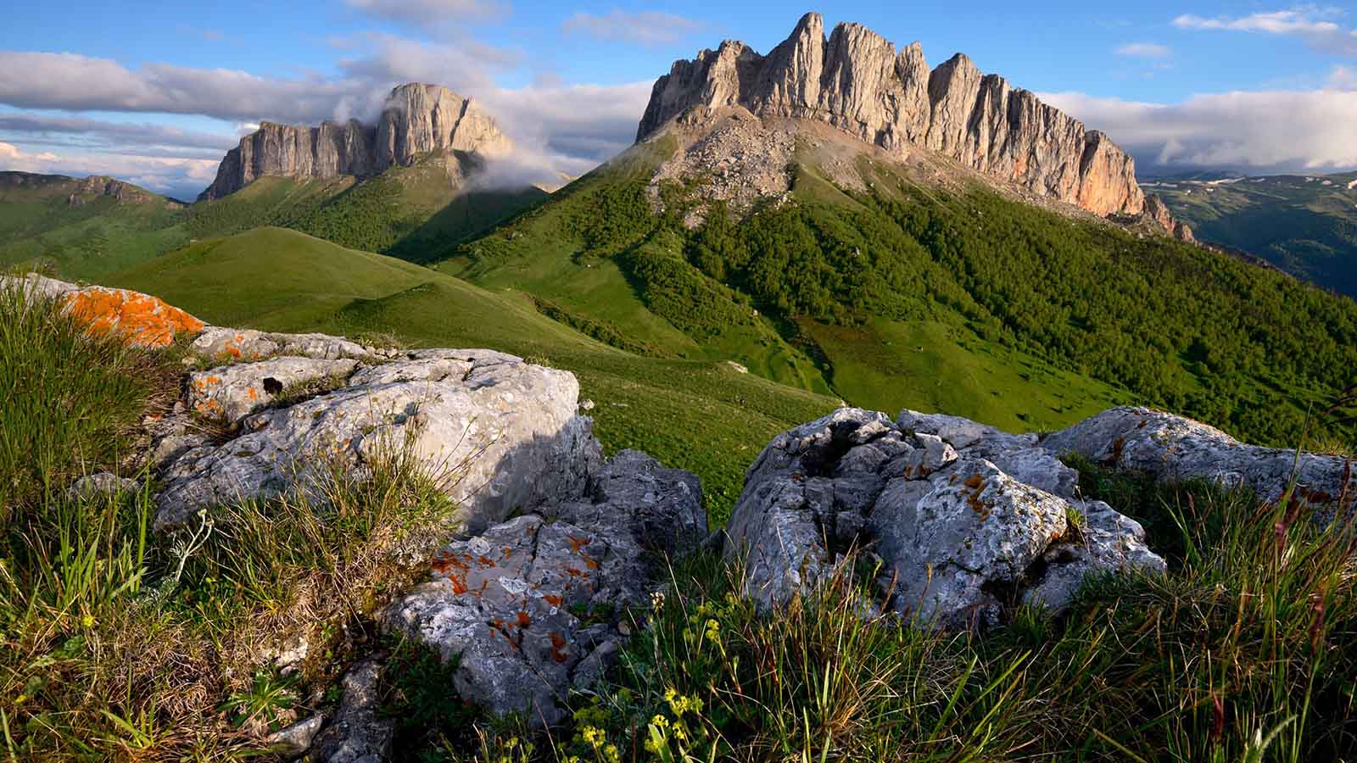
Adygea Rep.

Slide 7
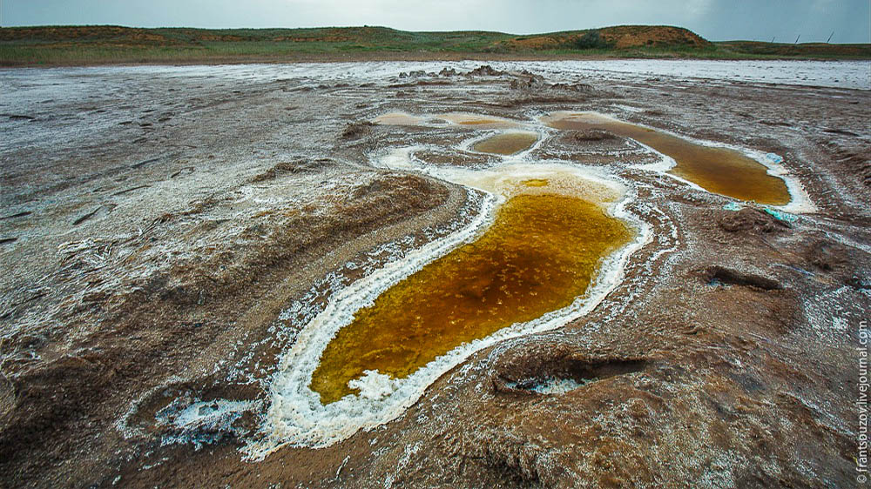
Salt Lake, Baskunchak (Astrakhan)

Slide 8
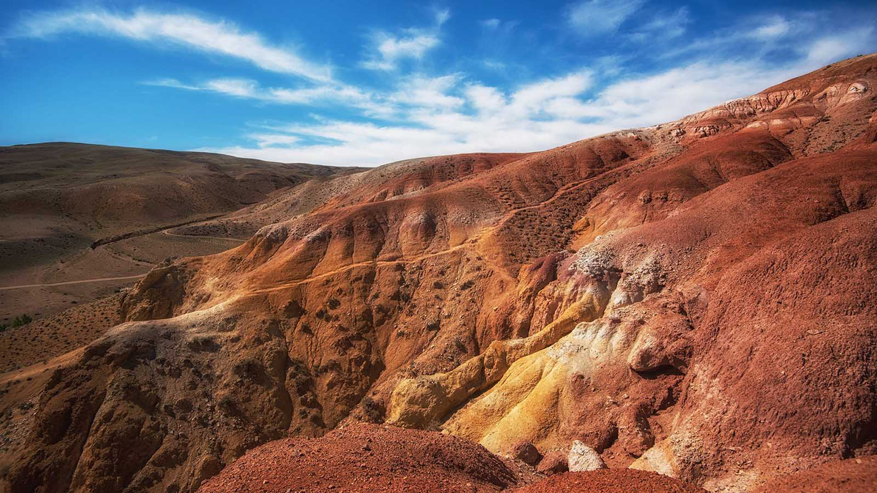
Altai Mountains

Slide 9
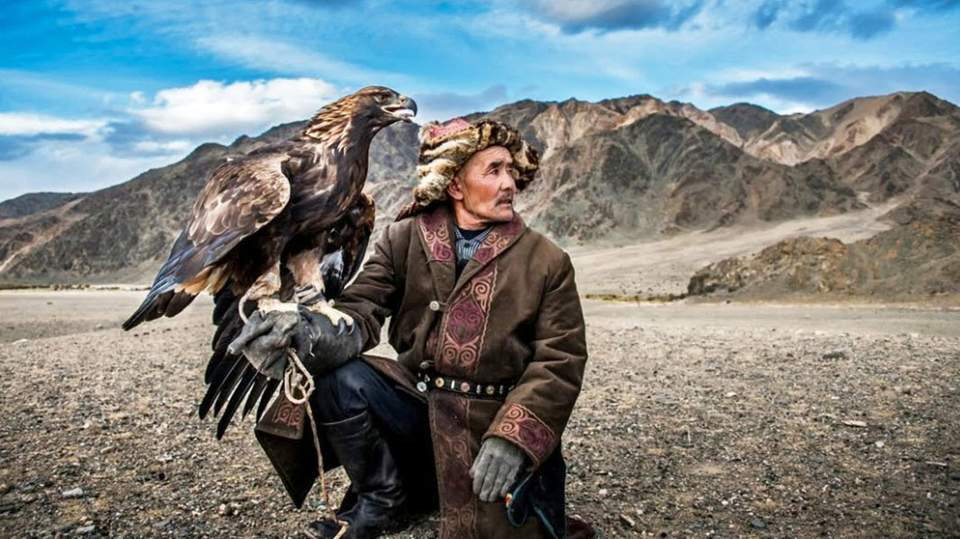
Altai people

Slide 10
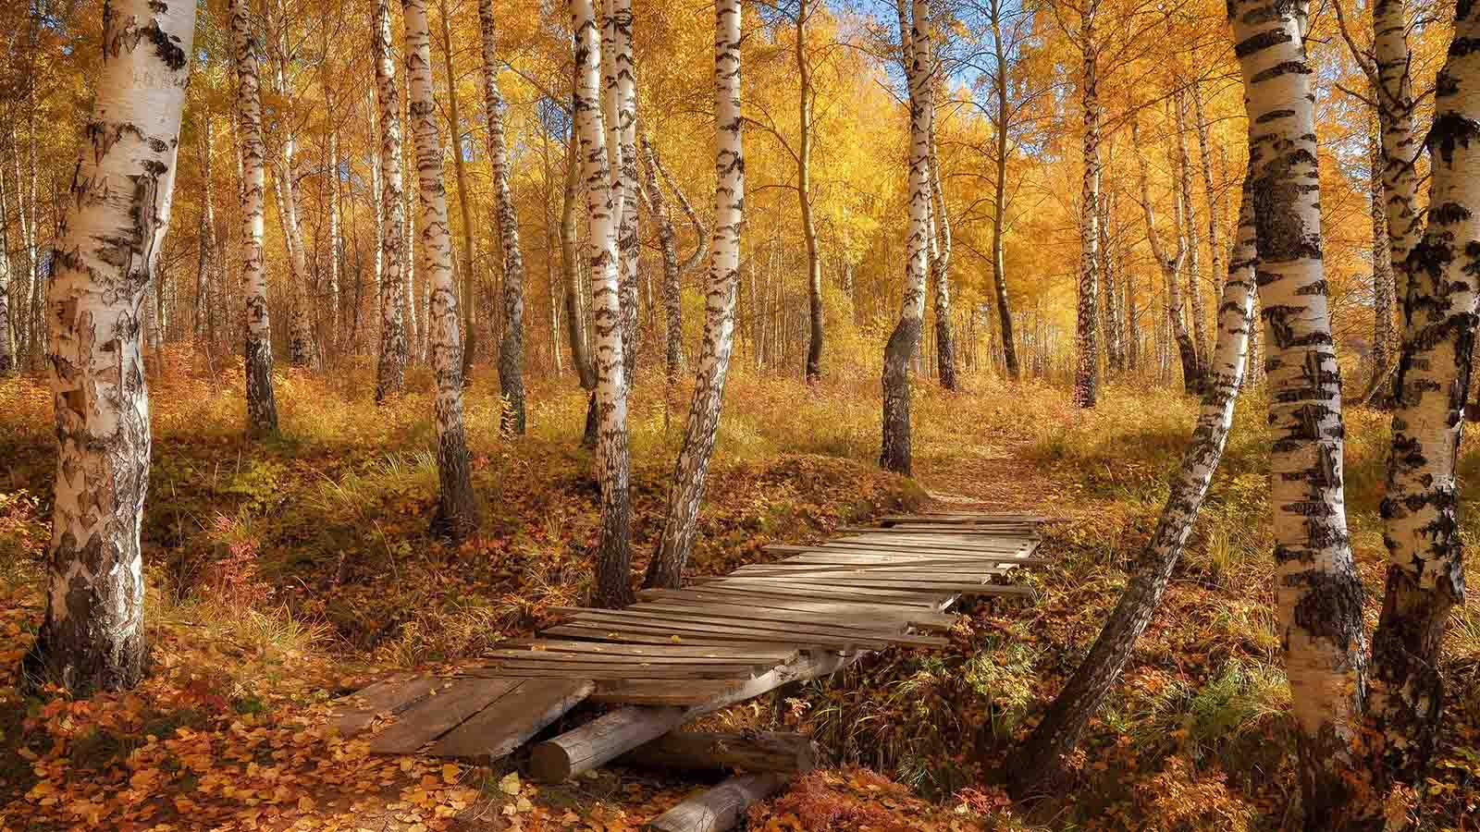
Forest of birches

Slide 11
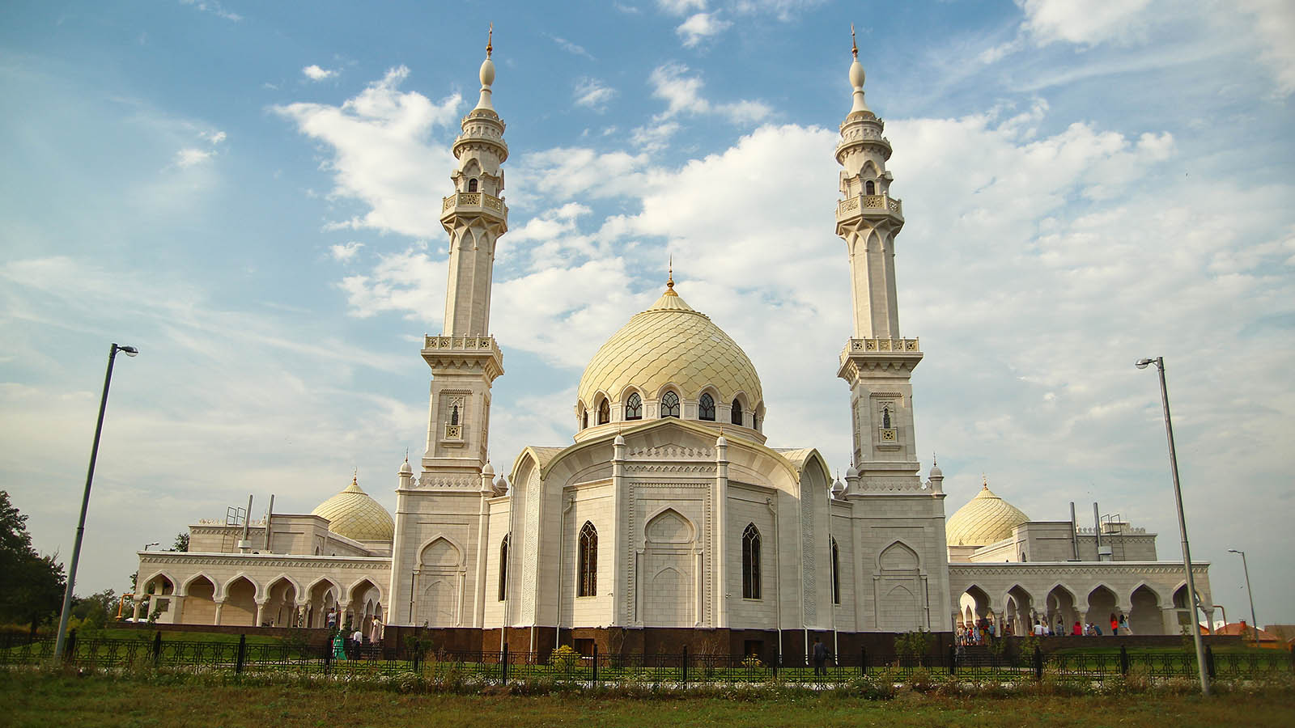
Bolgar (Tatarstan)

Slide 12
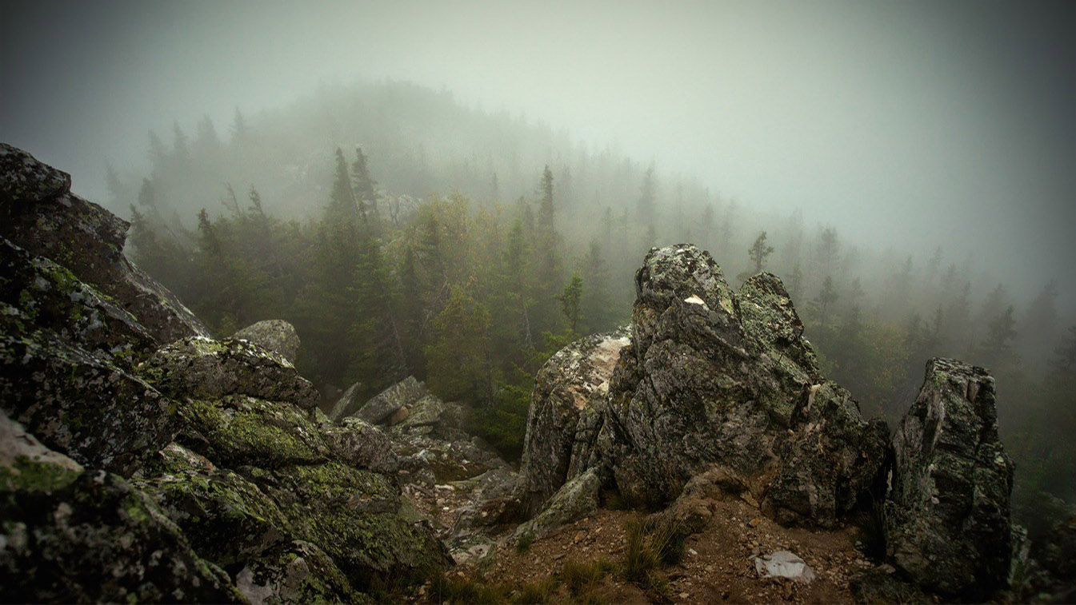
Dombai (North Caucasus)

Slide 13
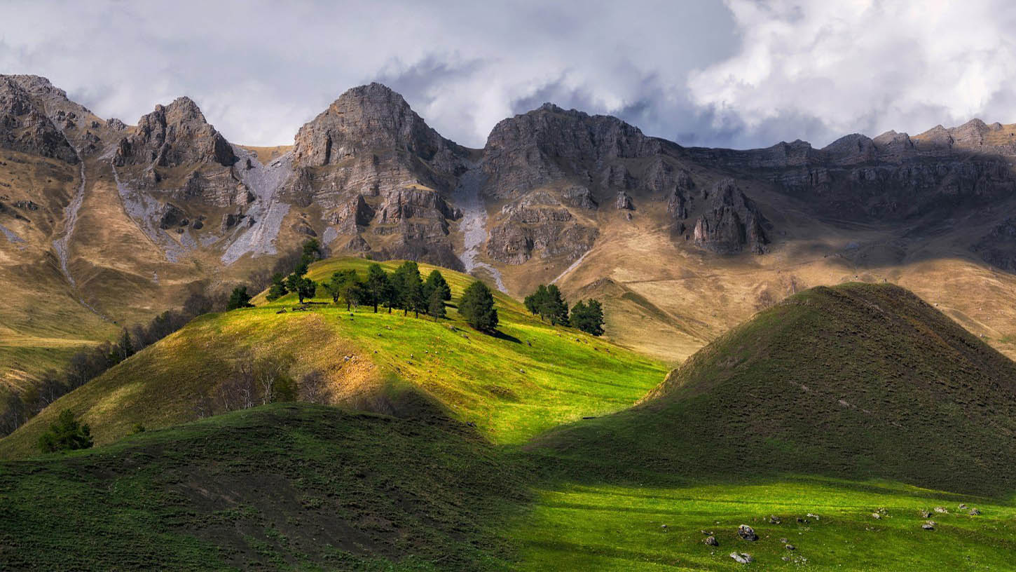
Erzi (Ingushetia)

Slide 14
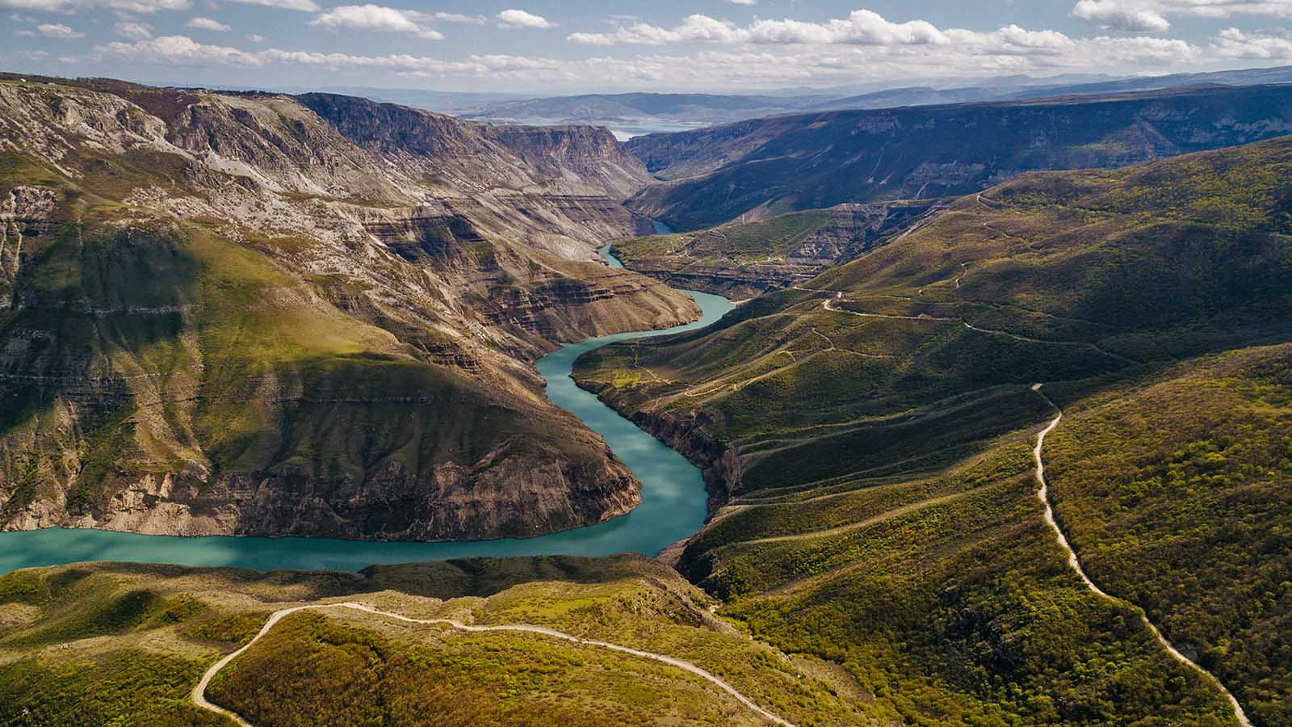
Dagestan

Slide 15
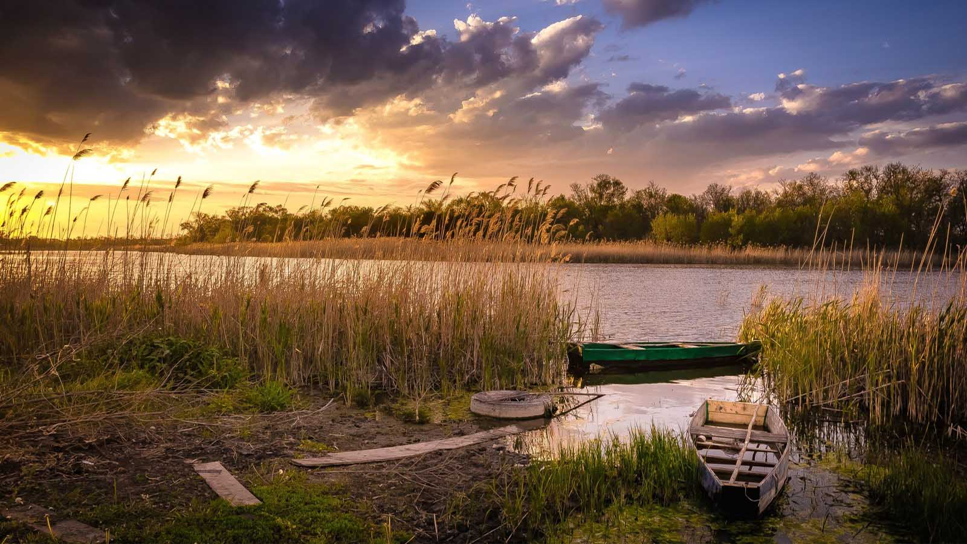
Bitchevaia Balka (Khabarovsk)

Slide 16
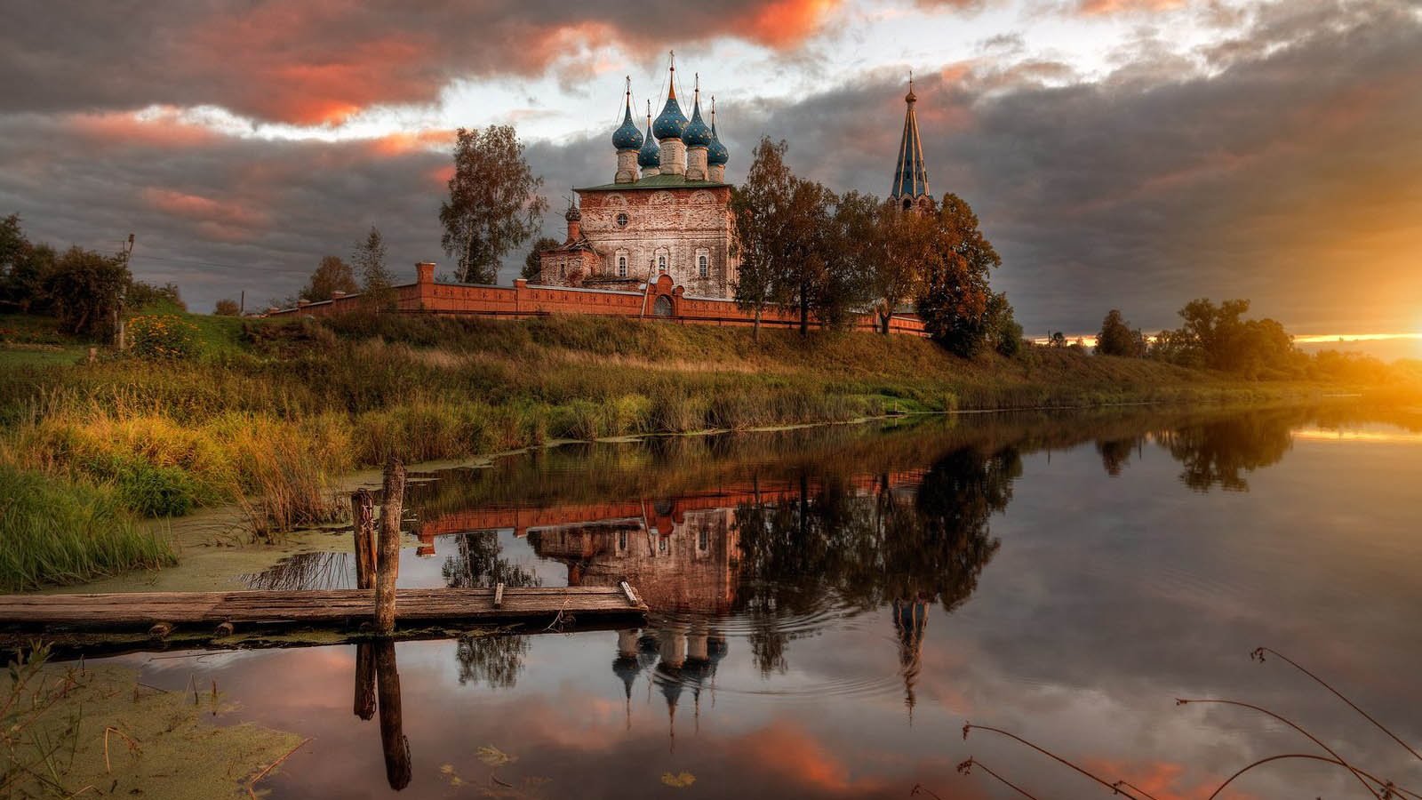
Ivanovskaia Obl.

Slide 17
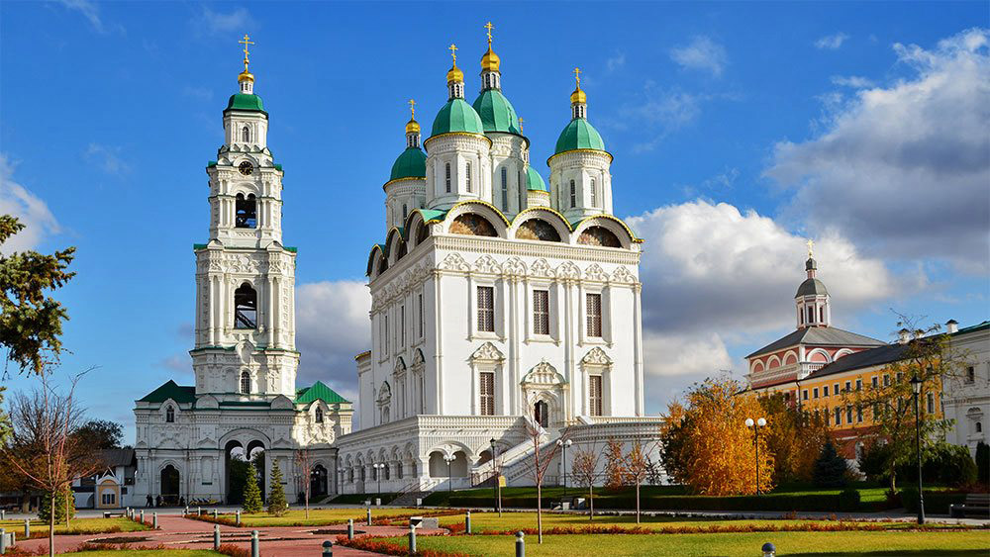
Astrakhan

Slide 18
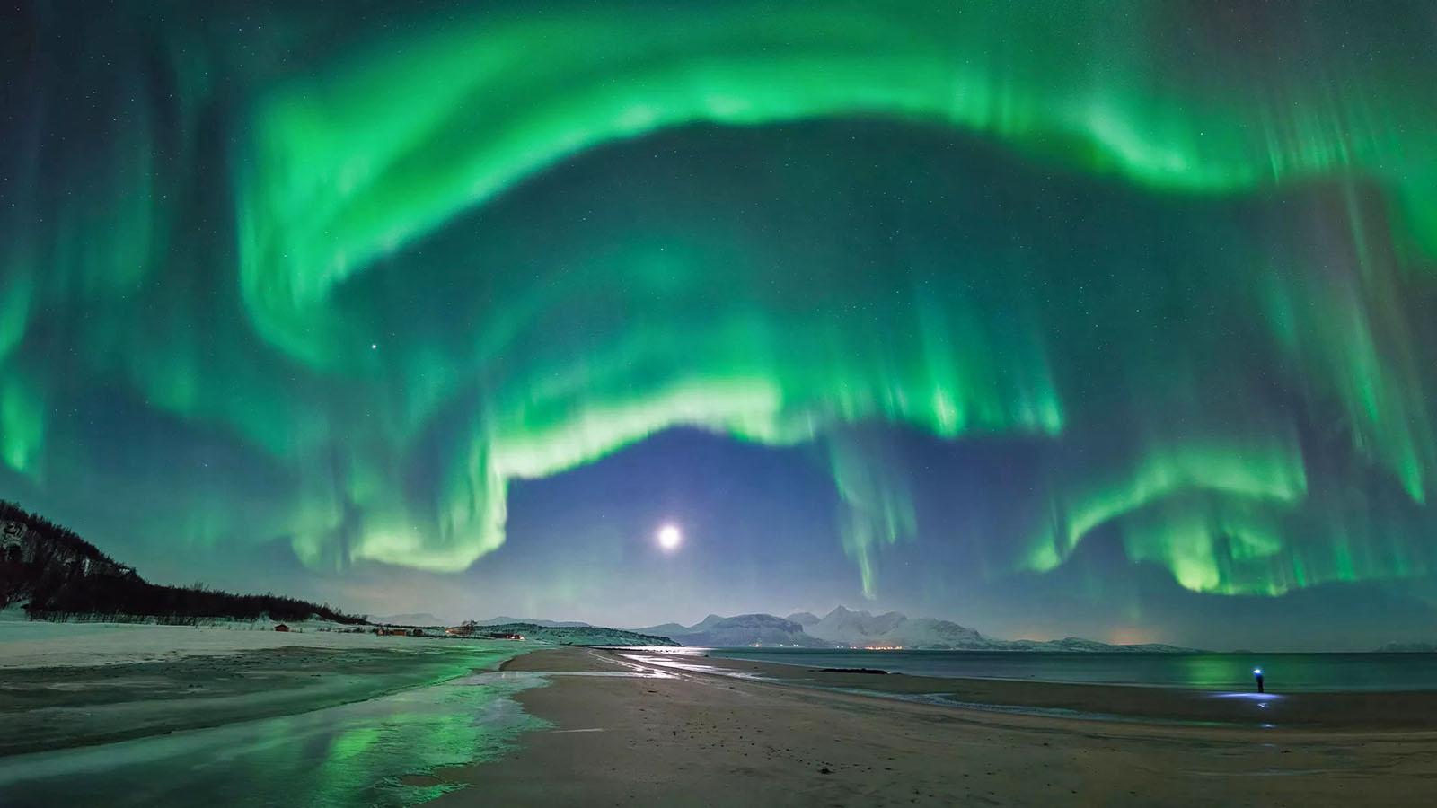
Aurora Borealis

Slide 19
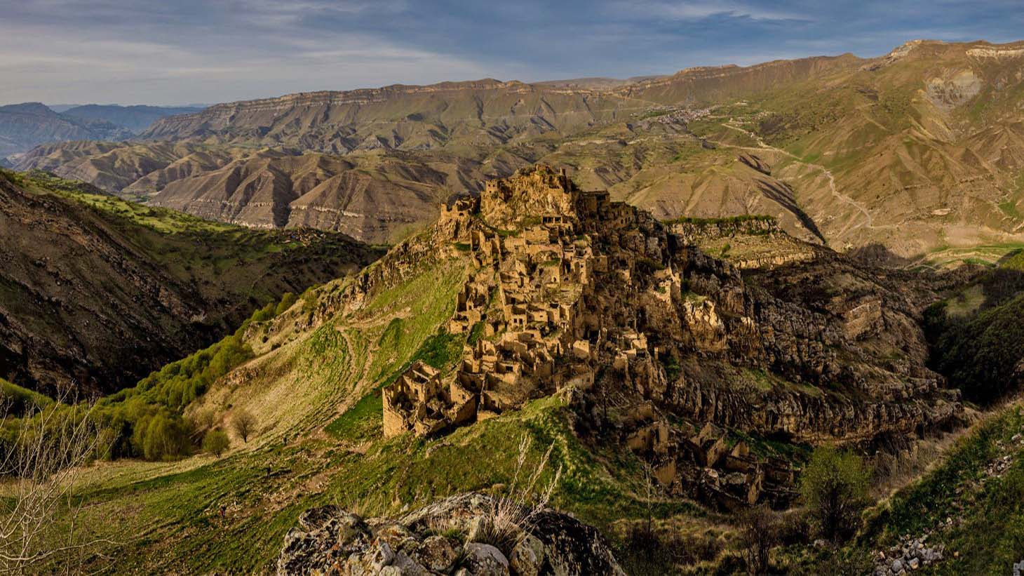
Gamsuti (Dagestan)

Slide 20
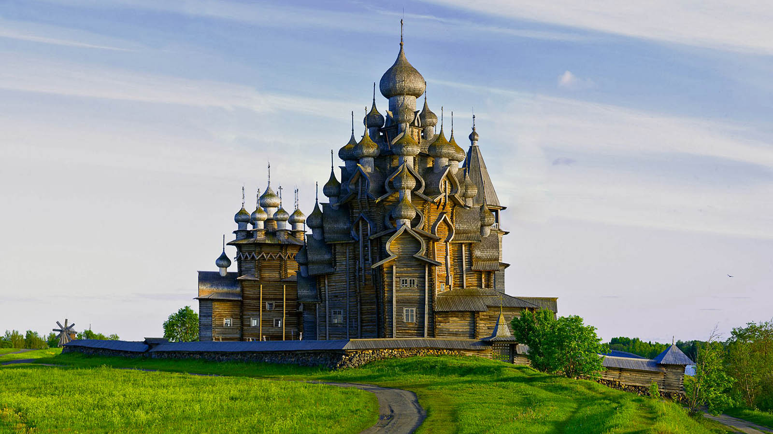
Kizhi Island (Karelia)

Slide 21
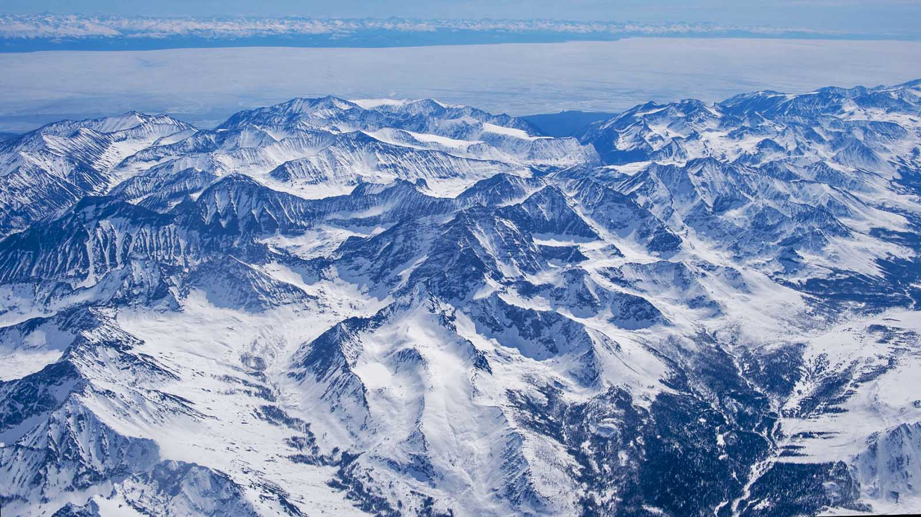
Chersky Mountain (Buryatia)

Slide 22
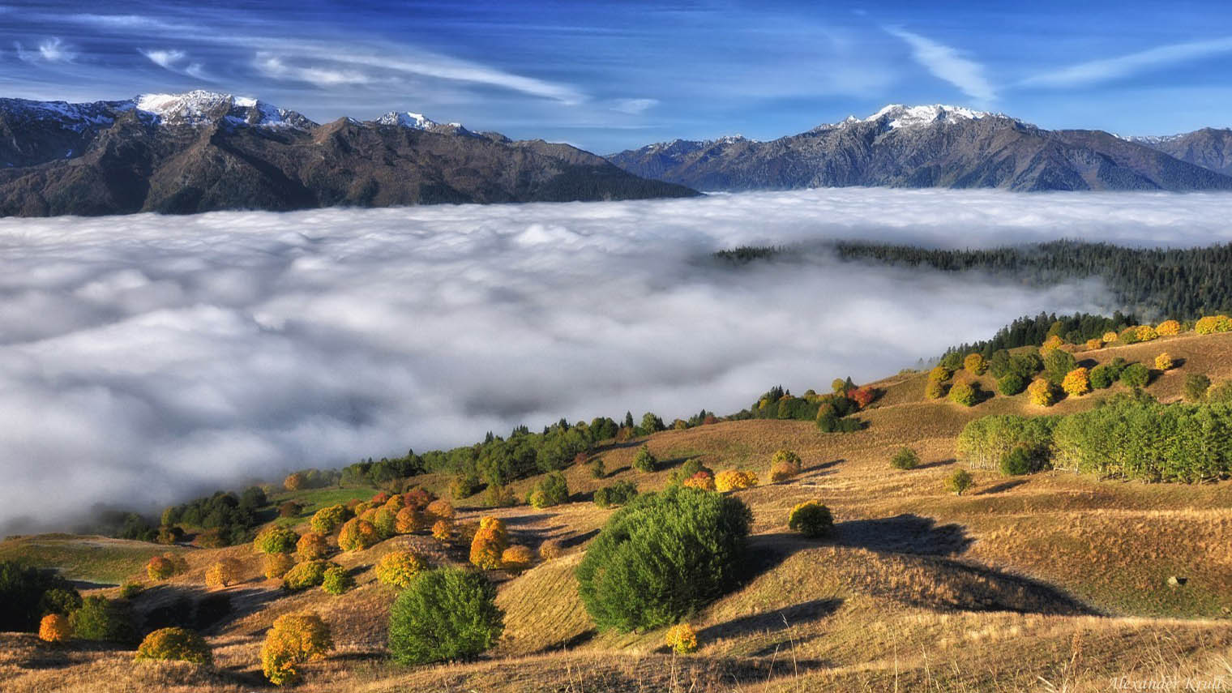
Cherkessia Rep.

Slide 23
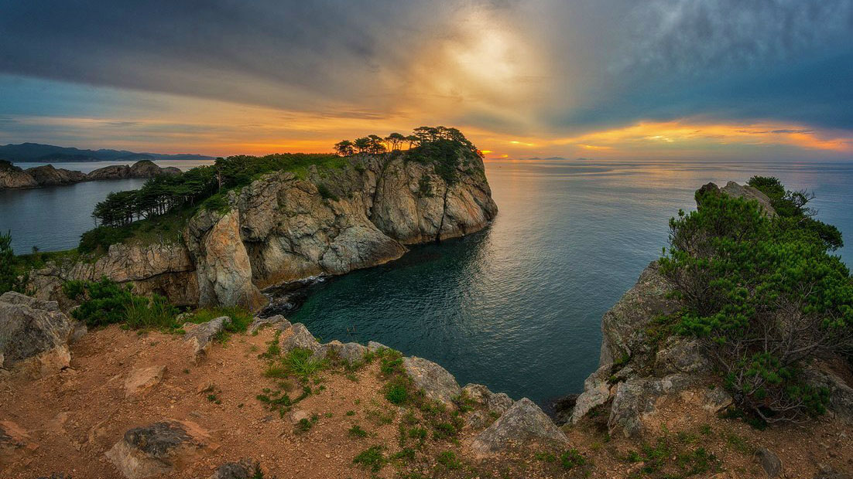
Japan Sea

Slide 24
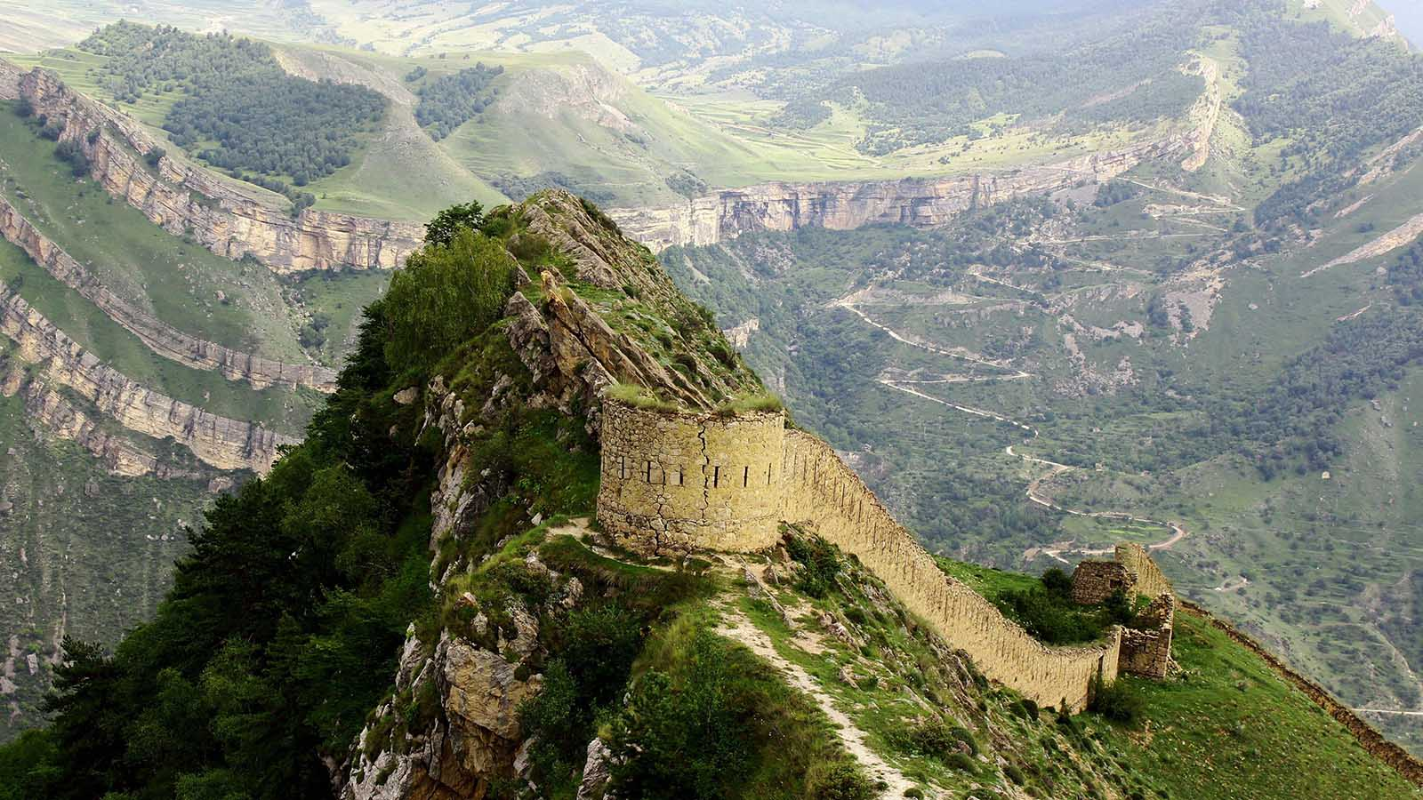
Gunib (Dagestan)

Slide 25
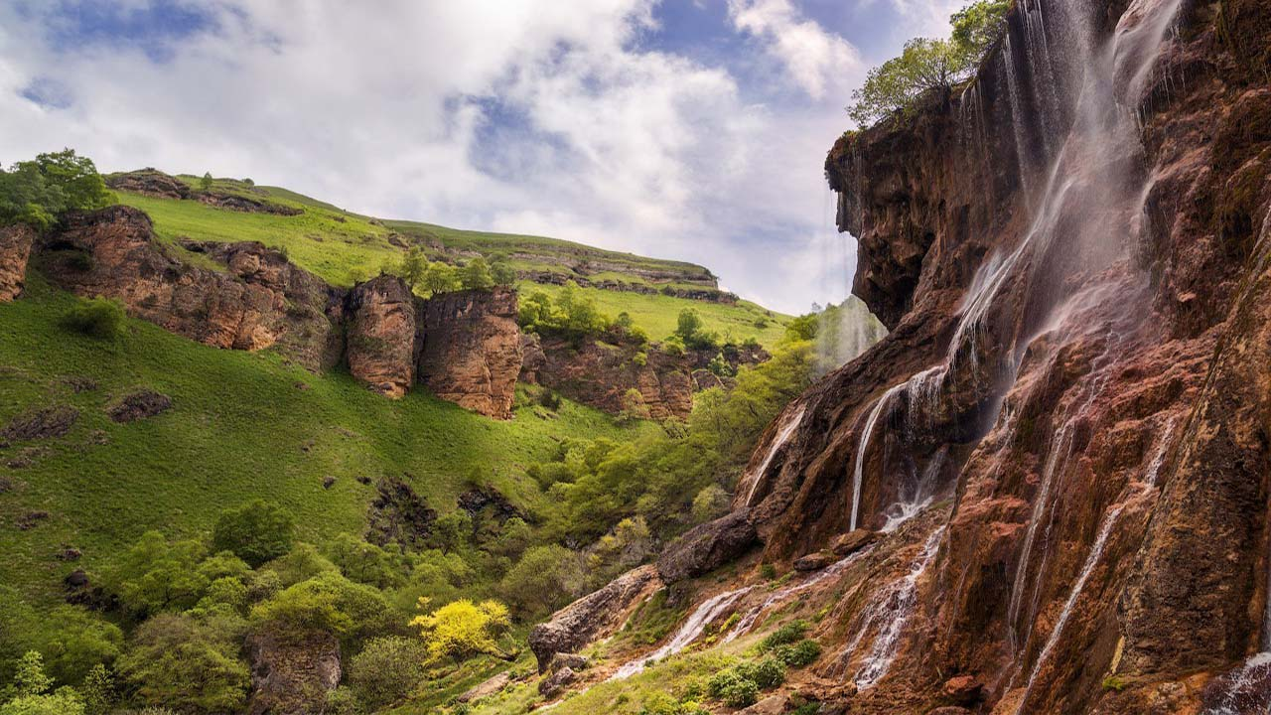
Kabardino-Balkaria Rep.

Slide 26
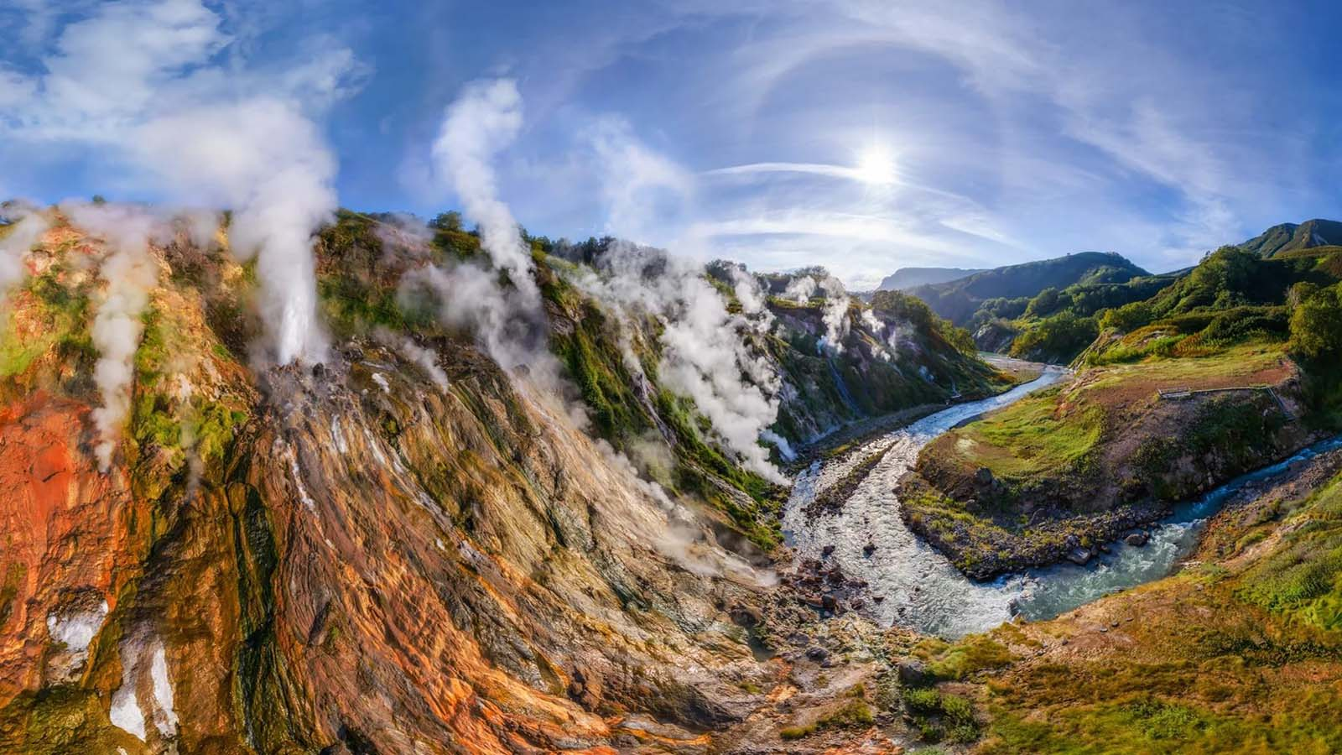
Valley of Geysers (Kamchatka)

Slide 27
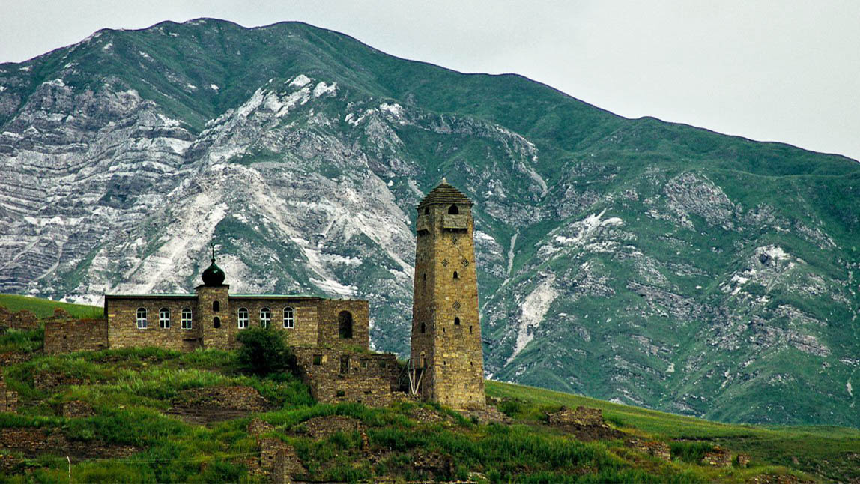
Sharoy (Chechnia)

Slide 28
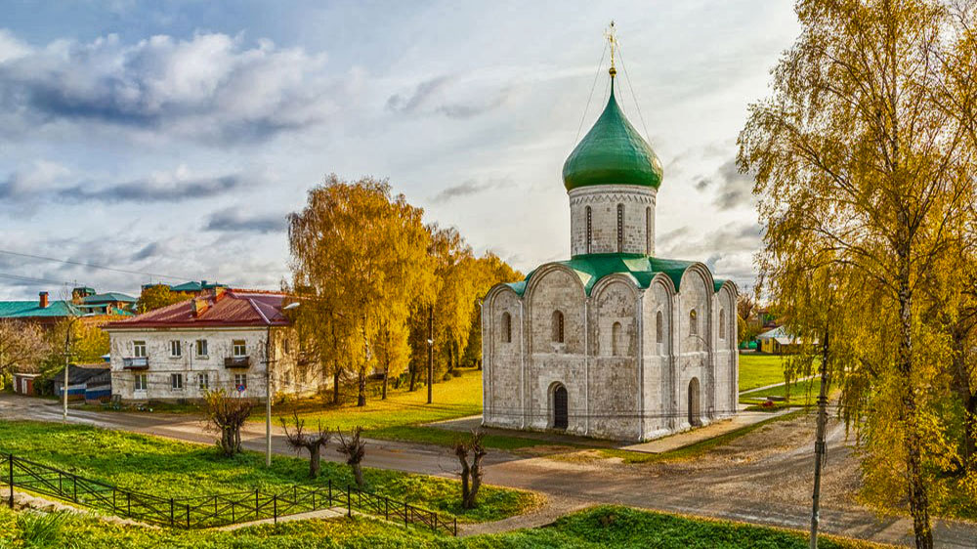
Pereslavl-Zalessky (Yaroslavl)

Slide 29
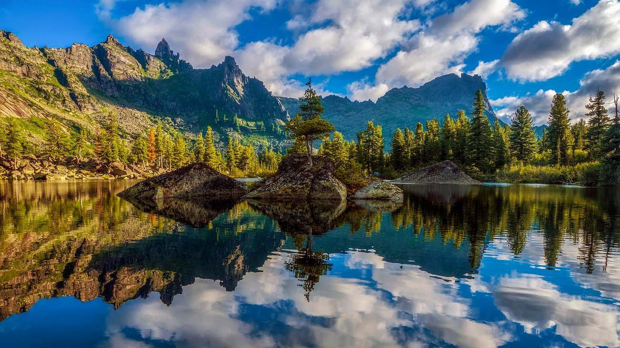
Krasnojarsk

Slide 30
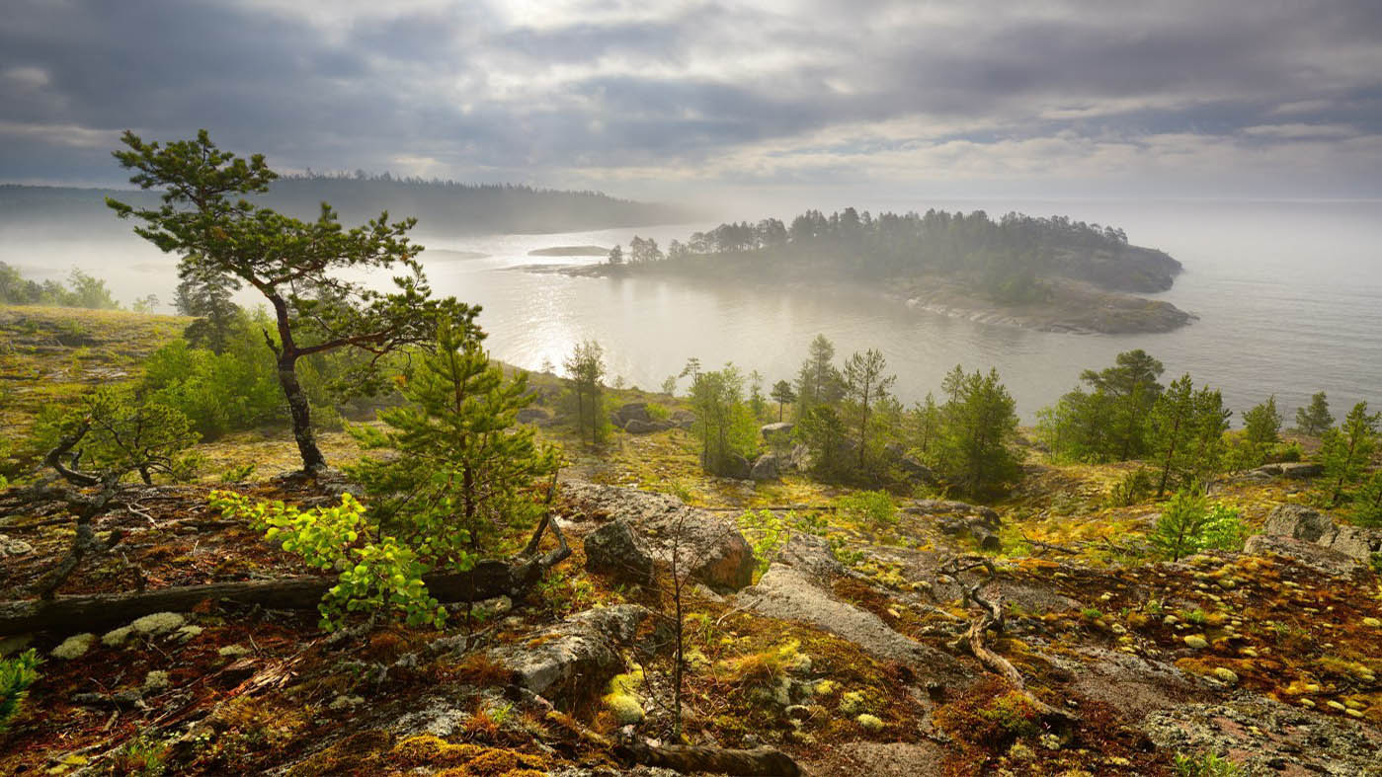
Lake Ladoga (Karelia)

Slide 31
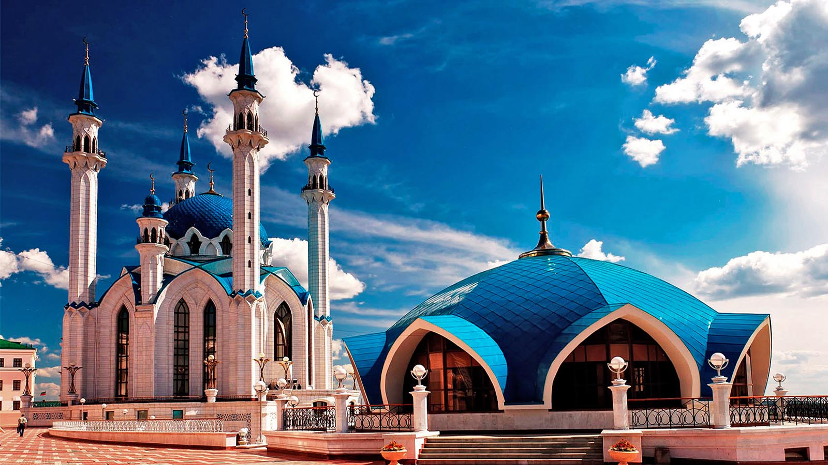
Kazan (Tatarstan)

Slide 32
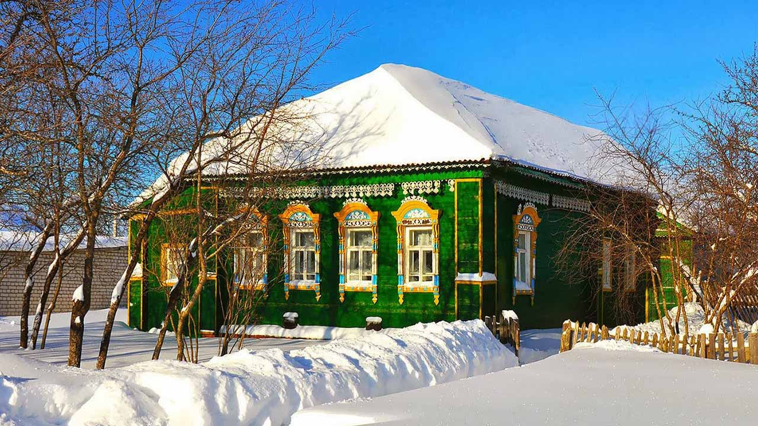
Russian village

Slide 33
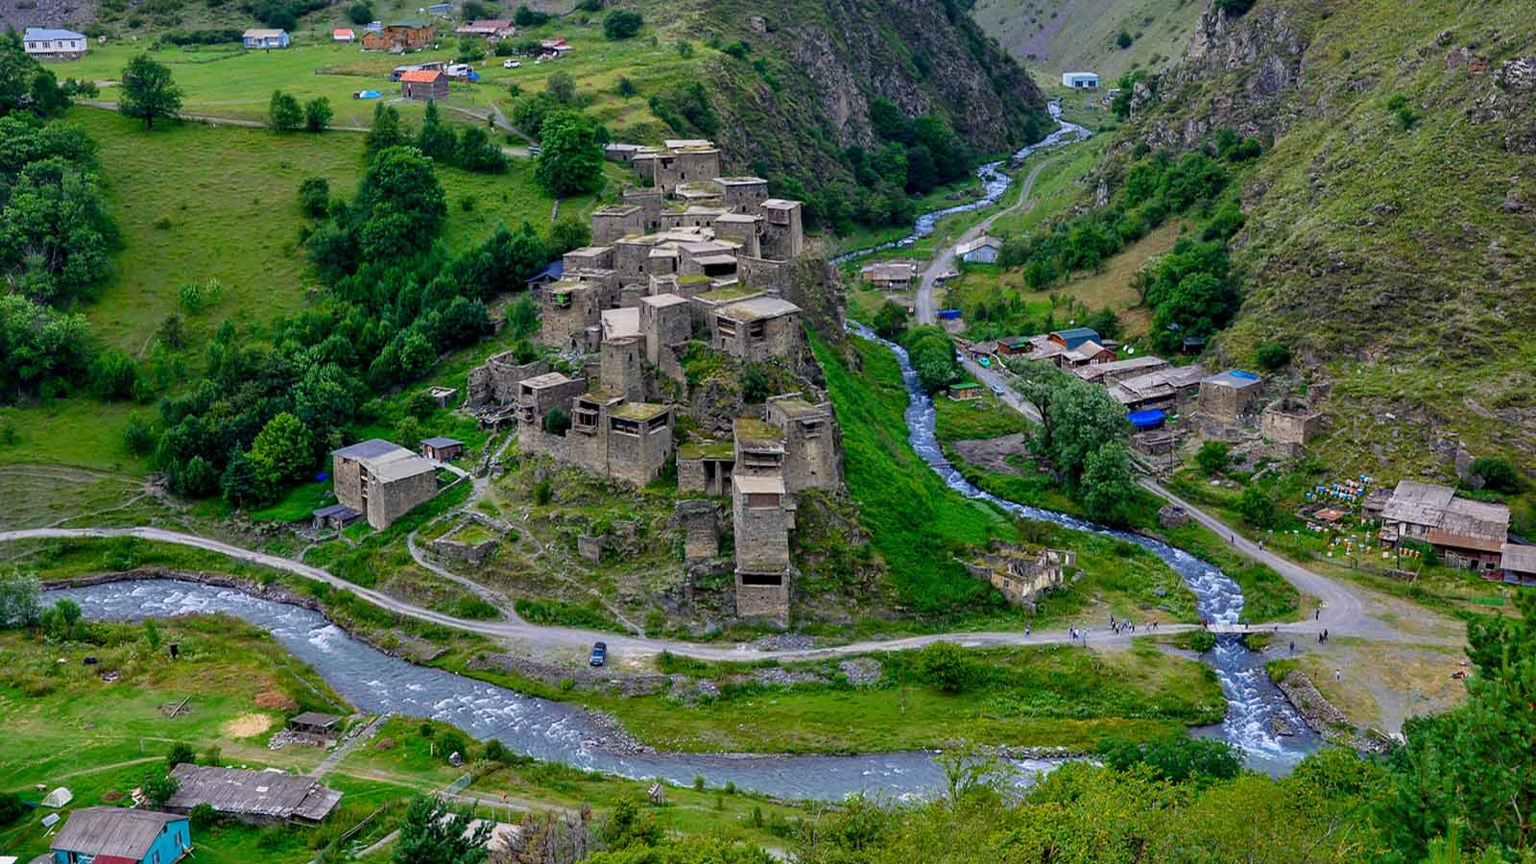
Khevsureti Shatili (Georgia)

Slide 34
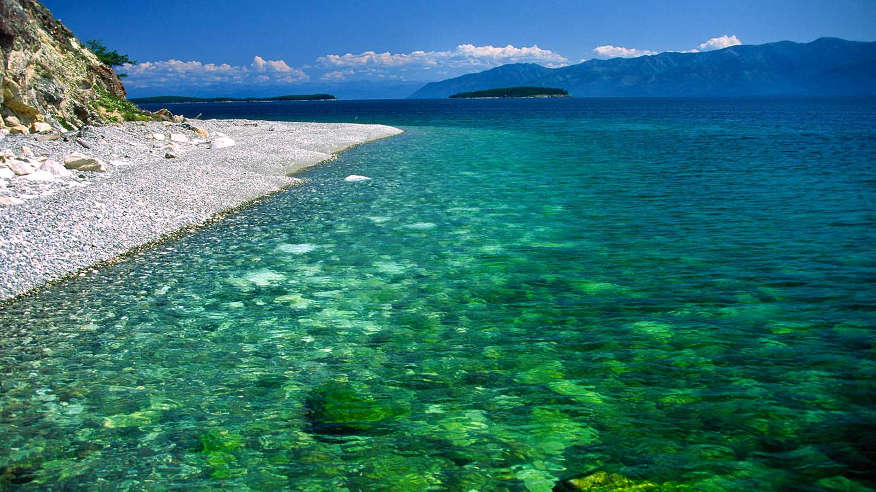
Lake Baikal

Slide 35
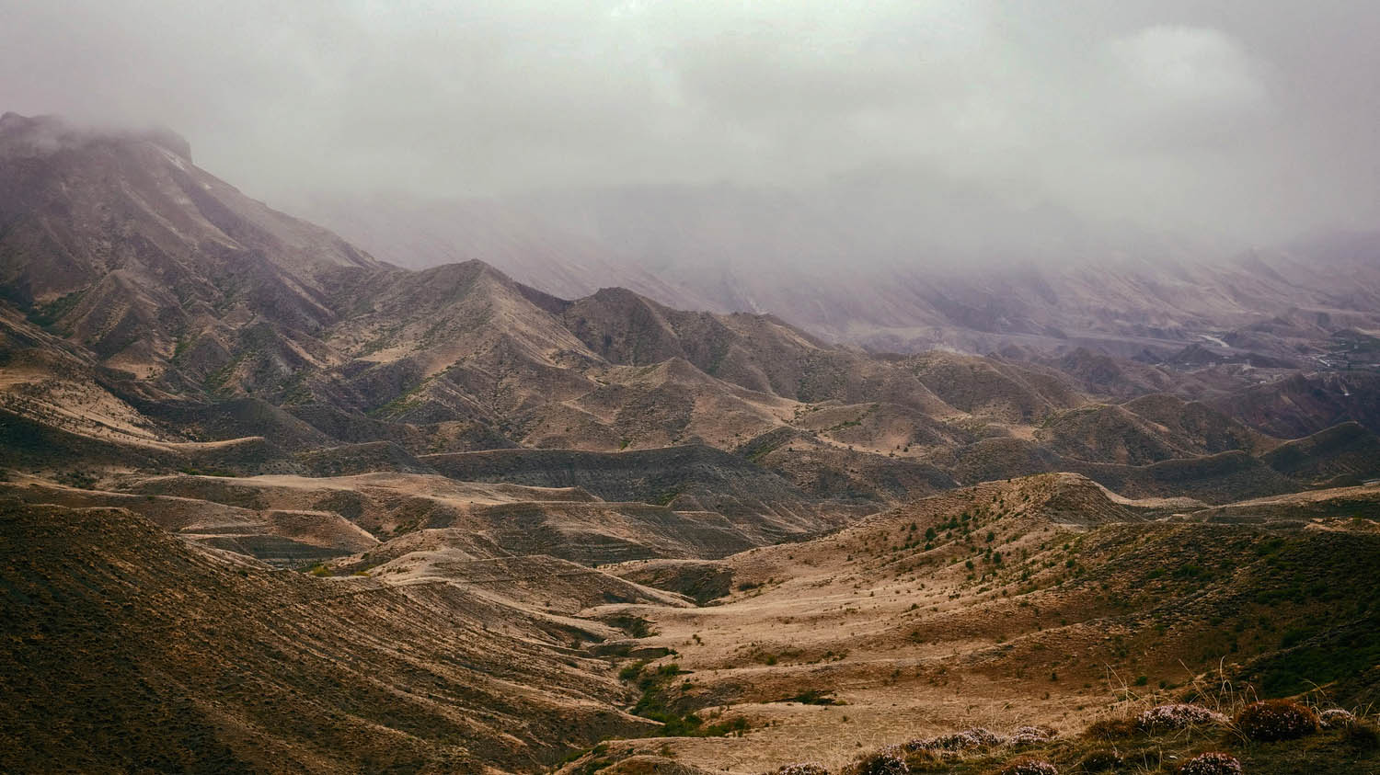
North Caucazus

Slide 36
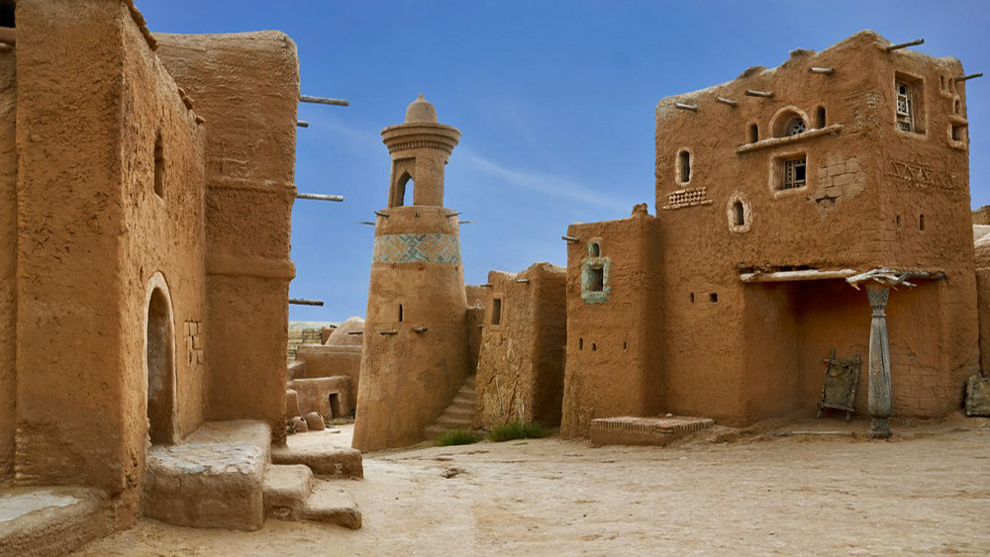
Sarai Batu (Astrakhan)

Slide 37
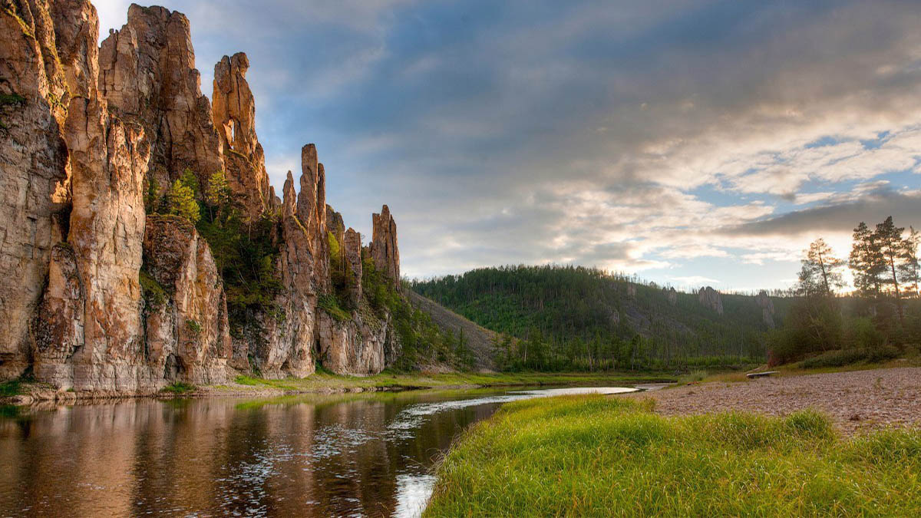
Sinyaya River (Pskov)

Slide 38
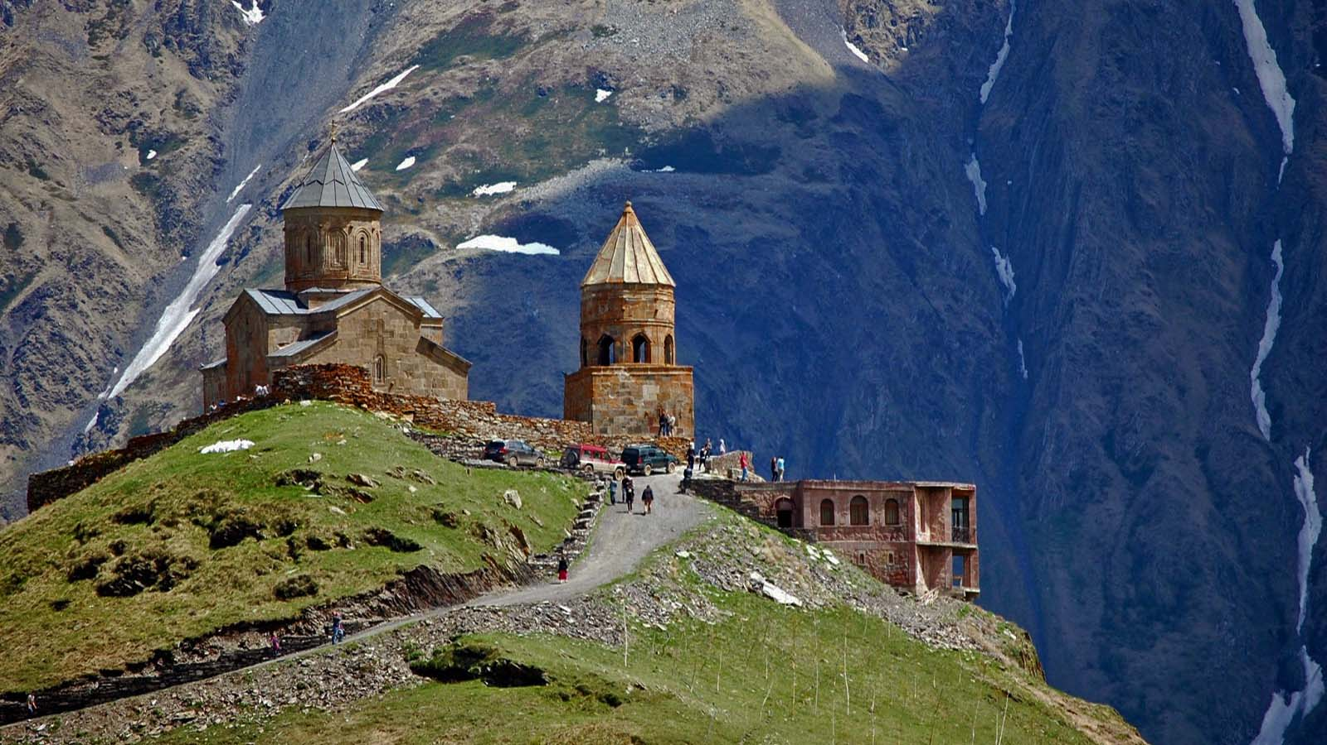
Vladikavkaz (North Ossetia)

Slide 39
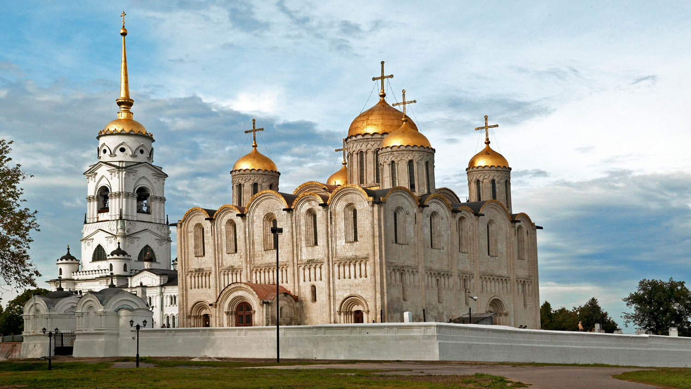
Vladimir

Slide 40
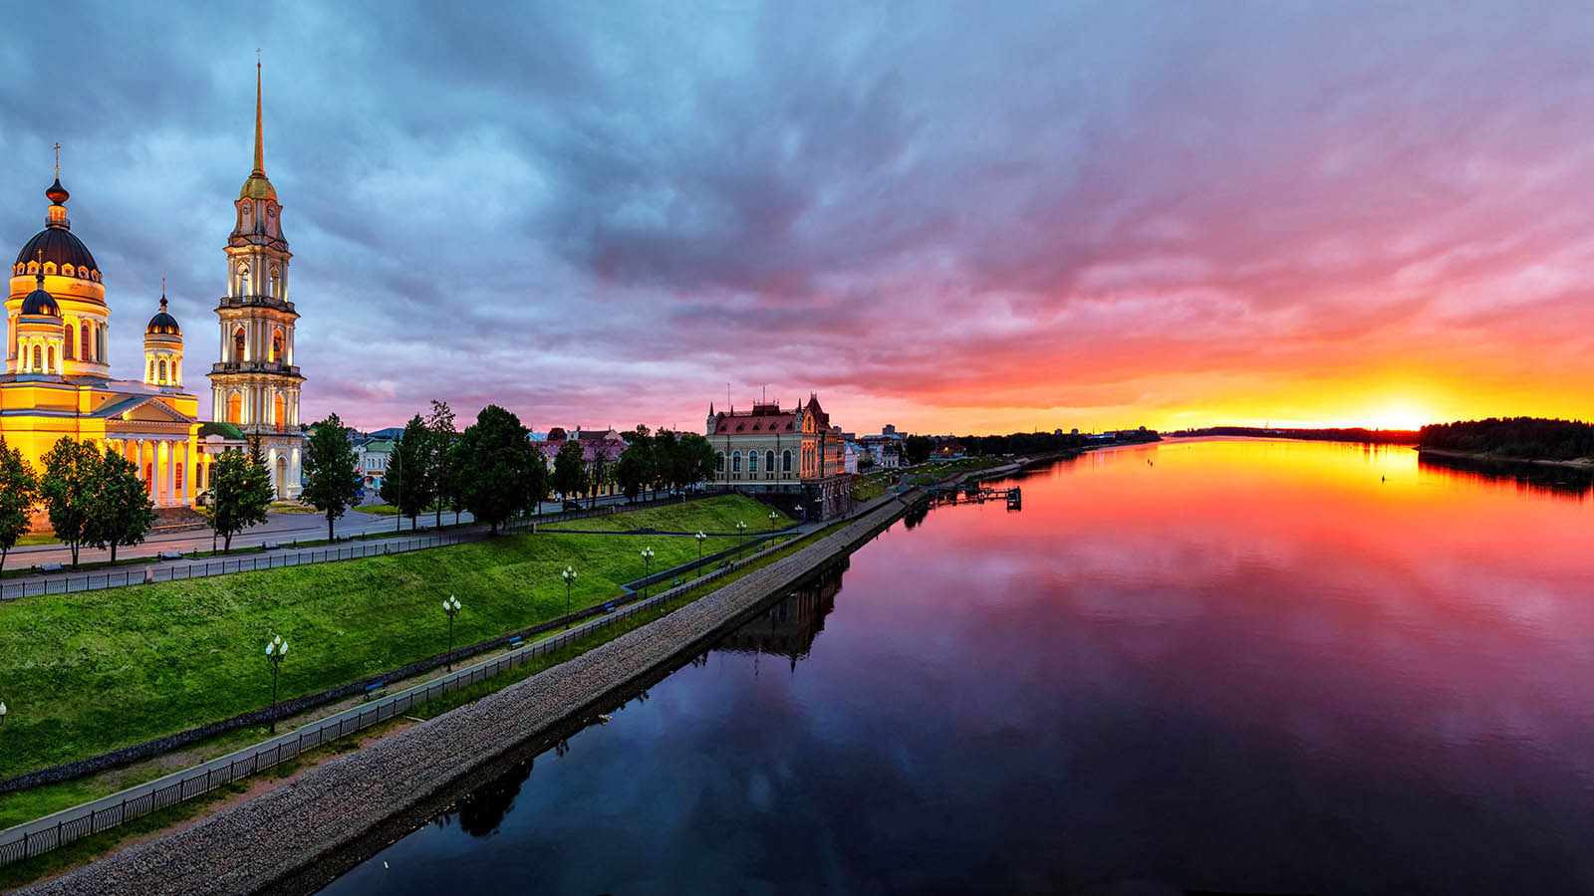
Volga River, Rybinsk

Slide 41
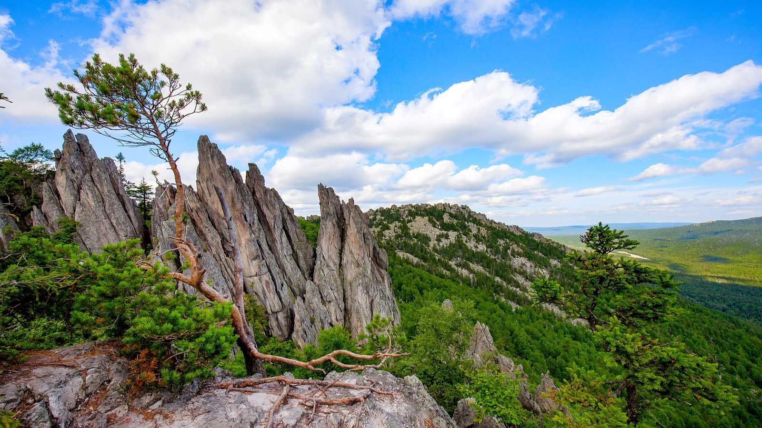
Southern Ural Mountains

Slide 42
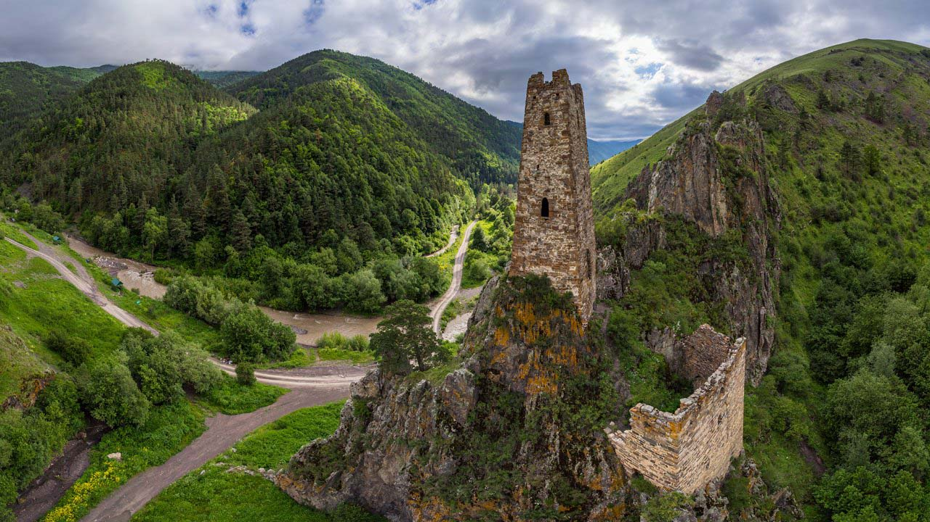
Watch Towers (Ingushetia)

Slide 43
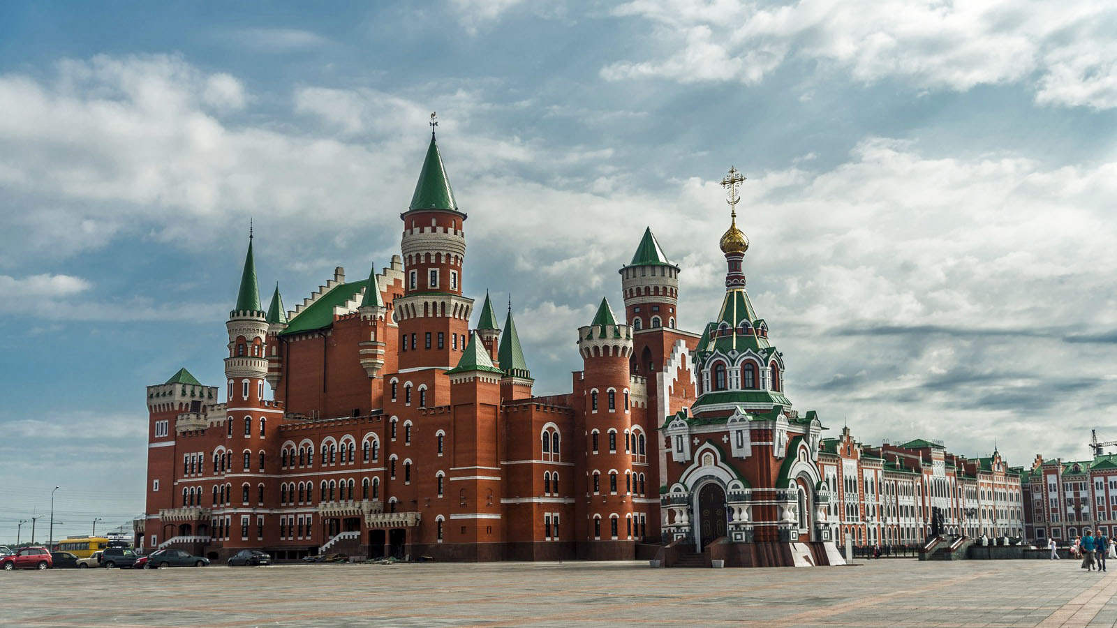
Yoshkar-ola (Rep. of Mari El)

Slide 44
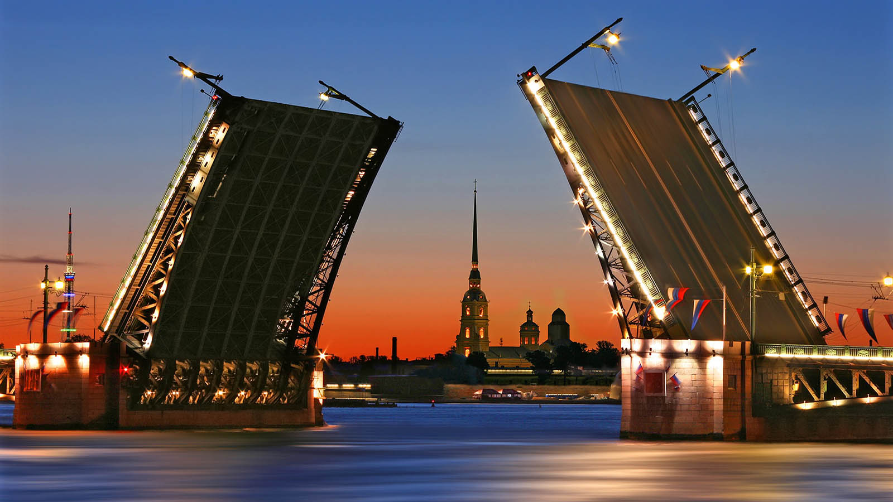
St.Petersburg

Slide 45
Hope you have enjoyed viewing this presentation
Have a nice day
With regards - Tony Chacko and Steve Rumpler
tonychacko2000@gmail.com pista2011@gmail.com
Music : Franz Lambert - Summer Roses
2017

