Slide 1

Beautiful
MEANDERING RIVERS
of the World

Slide 2
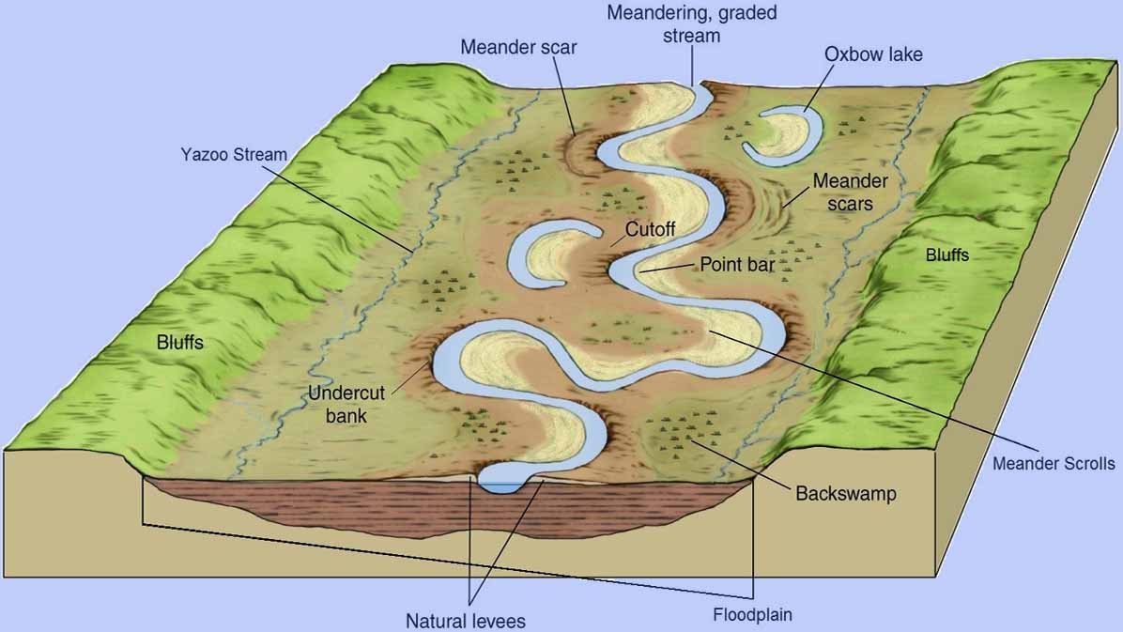


Slide 3
I stand by the river and I know that it has been here yesterday and will be here tomorrow and that therefore, since I am part of its pattern today, I also belong to all its yesterdays and will be a part of all its tomorrows. This is a kind of earthly immortality, a kinship with rivers and hills and rocks, with all things and all creatures that have ever lived or ever will live or have their being on the earth. It is my assurance of an orderly continuity in the great design of the universe.
(Virginia Eifert)
Compiled by - TONY CHACKO and STEVE RUMPLER

Slide 4
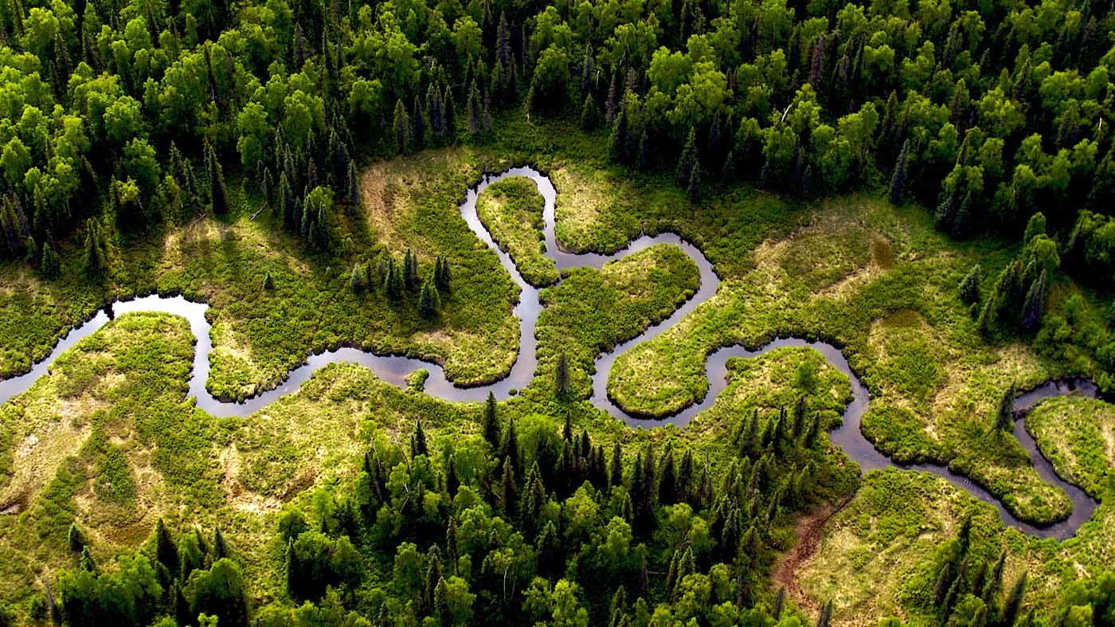
Meandering river (Germany)

Slide 5
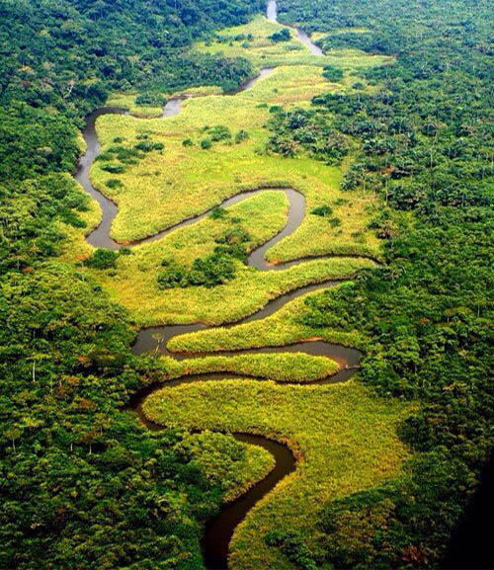
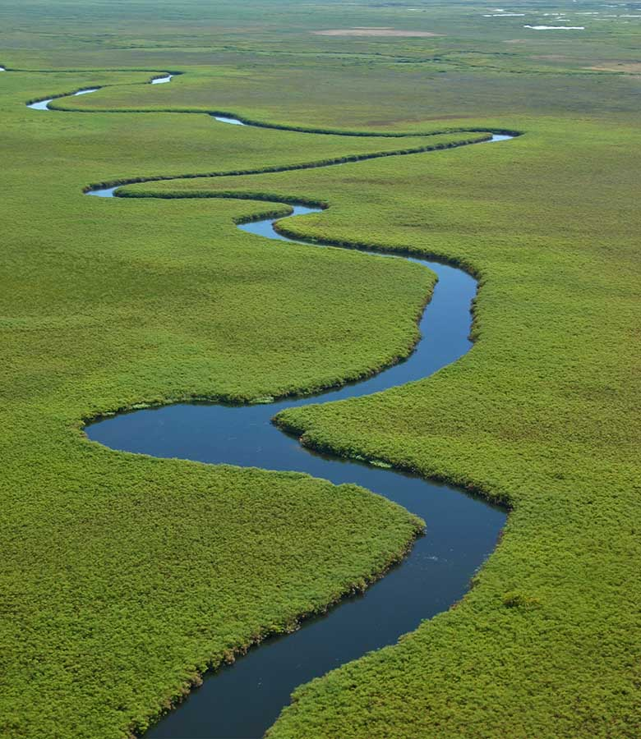
Momboyo River (D.R. of Kongo)
Okavango River (Botswana)

Slide 6
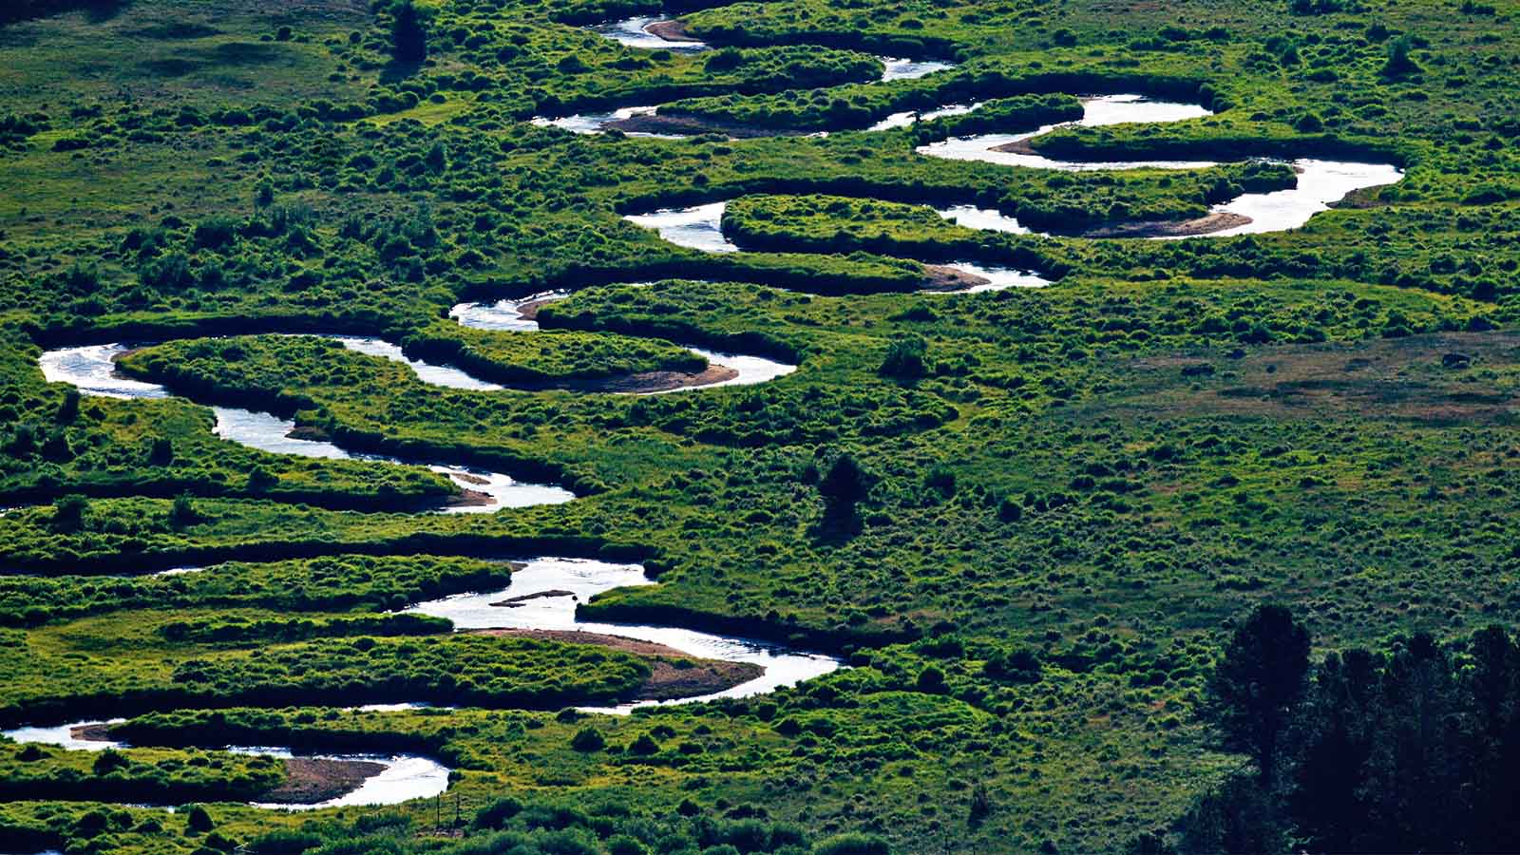
Rocky Mountain, Colorado (USA)

Slide 7
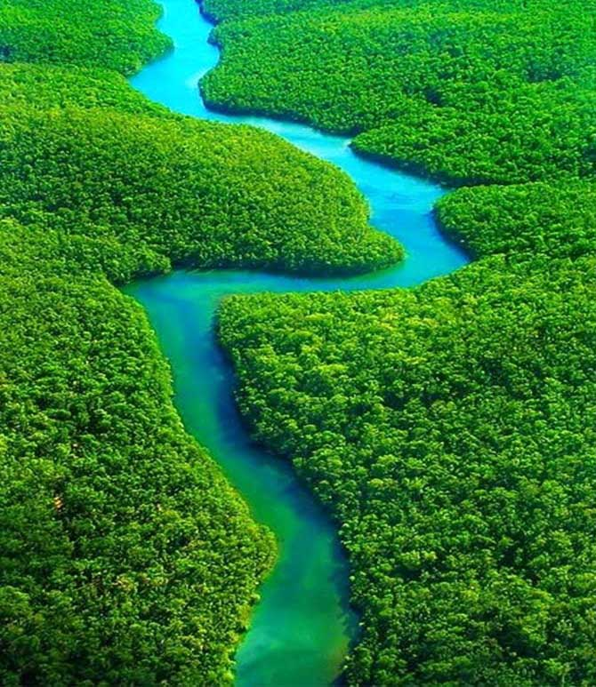
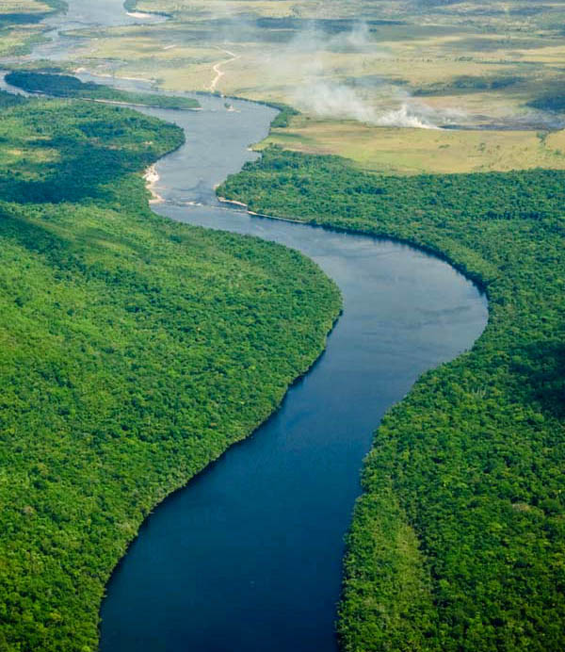
Amazon River (Peru)
Meandering river (Venezuela)

Slide 8
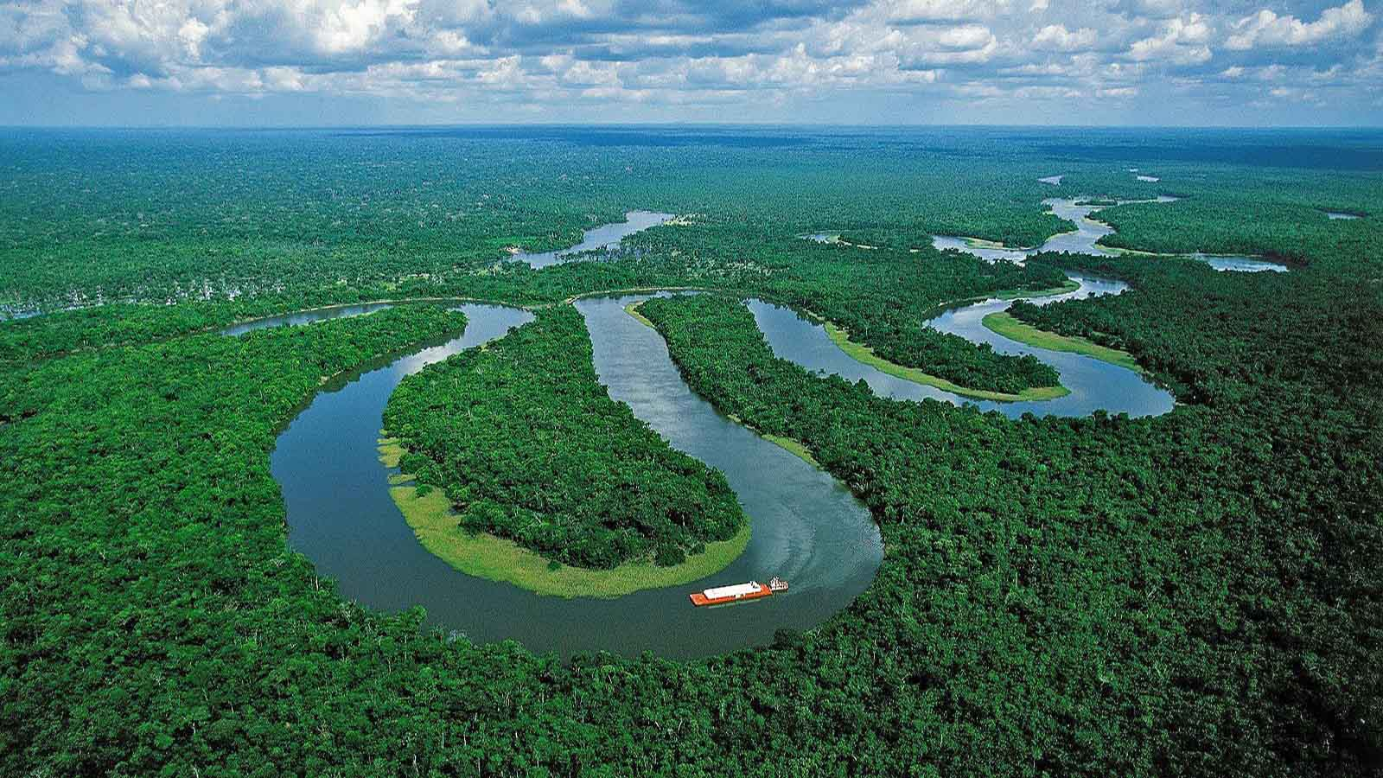
Amazon River (Peru)

Slide 9
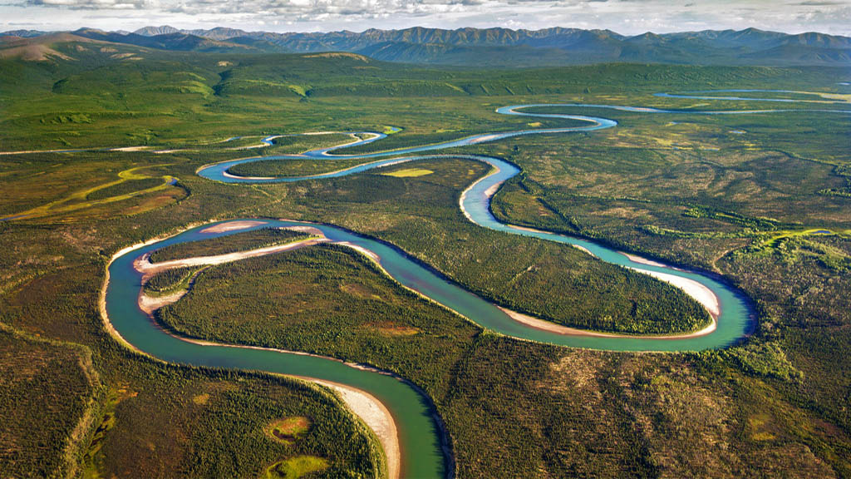
Noatak River, Alaska (USA)

Slide 10
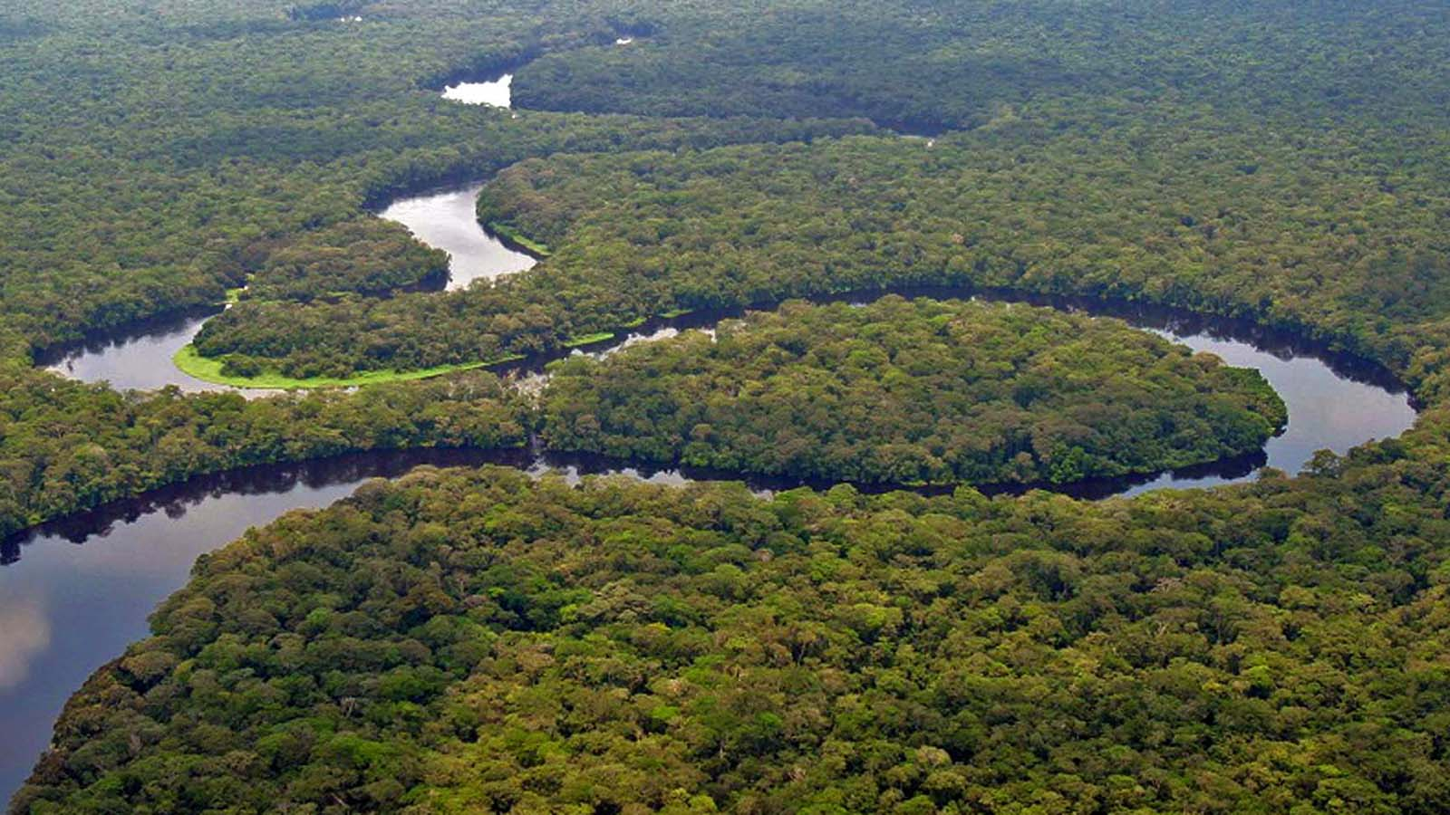
Congo River (Central Africa)

Slide 11
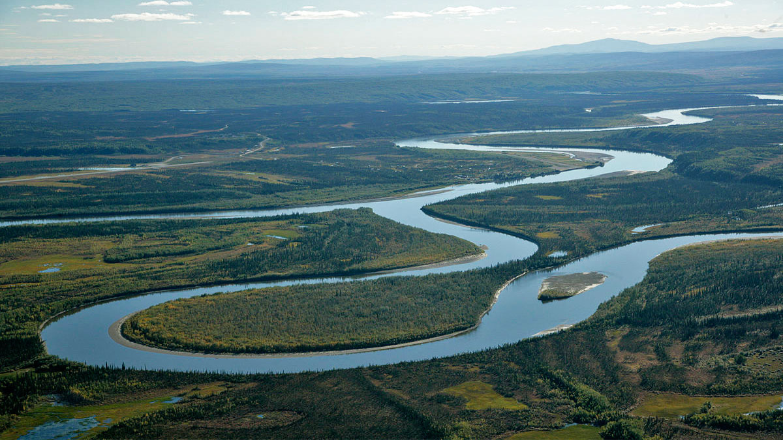
Alatna River, Alaska (USA)

Slide 12
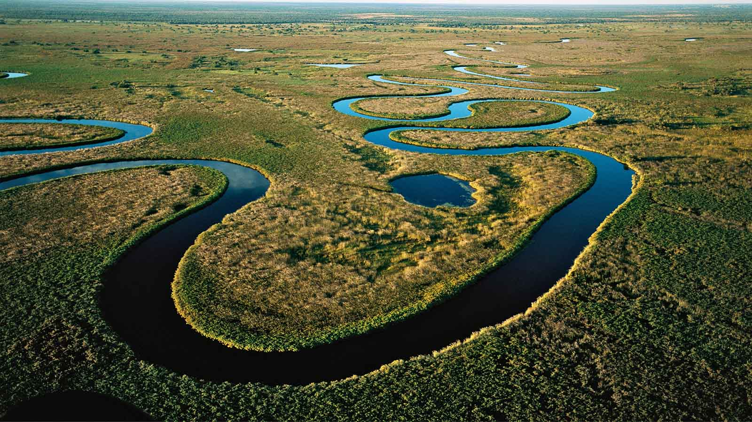
Okavango River (Botswana)

Slide 13
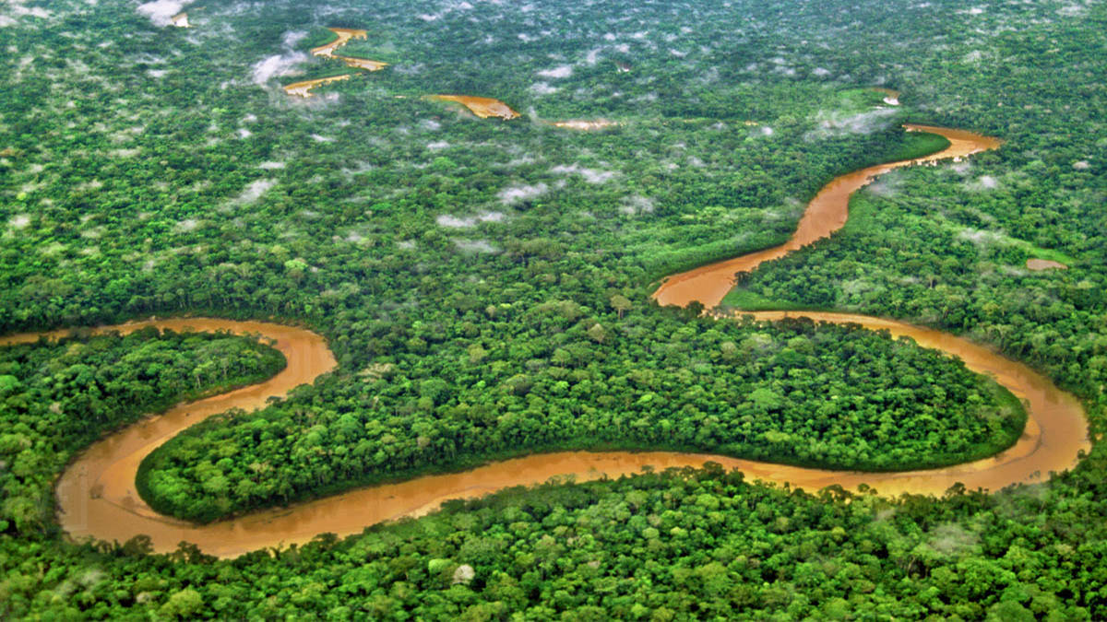
Tambopata River (Peru)

Slide 14
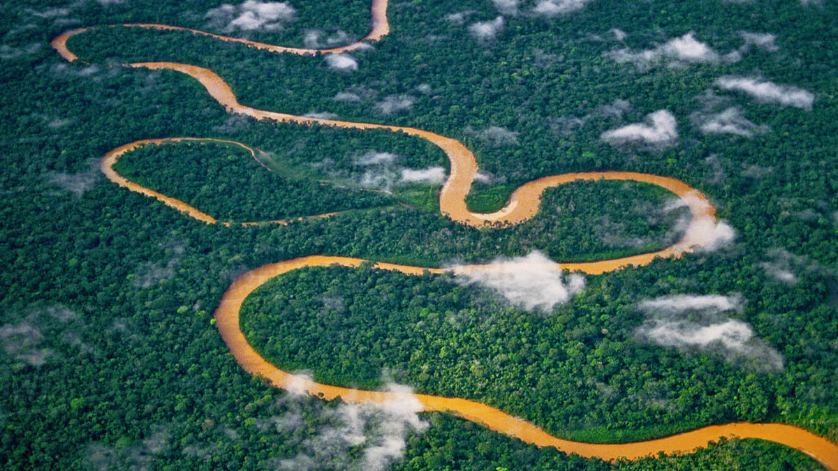
Tambopata River (Peru)

Slide 15
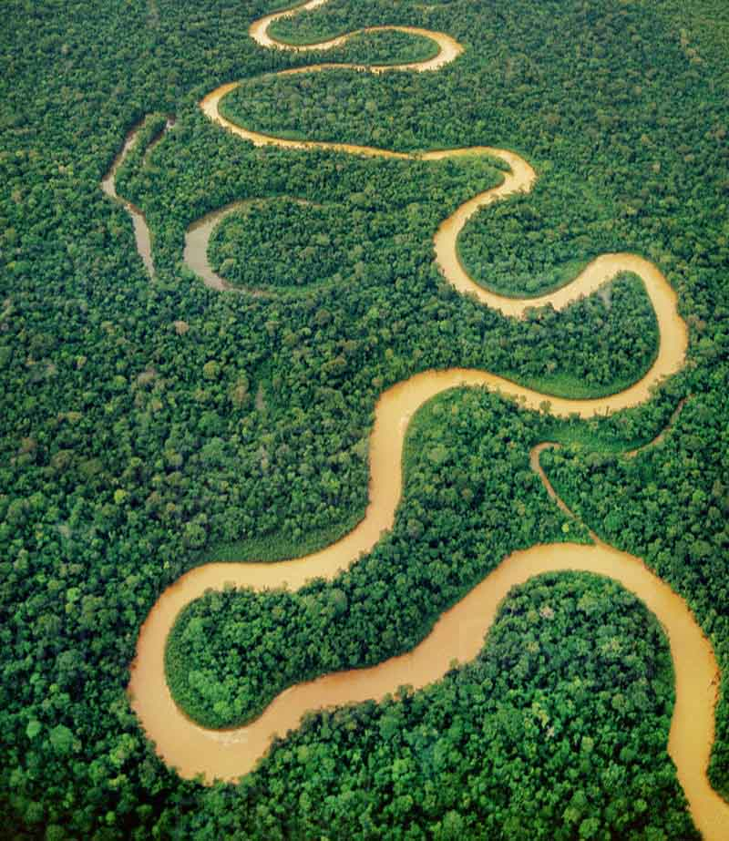
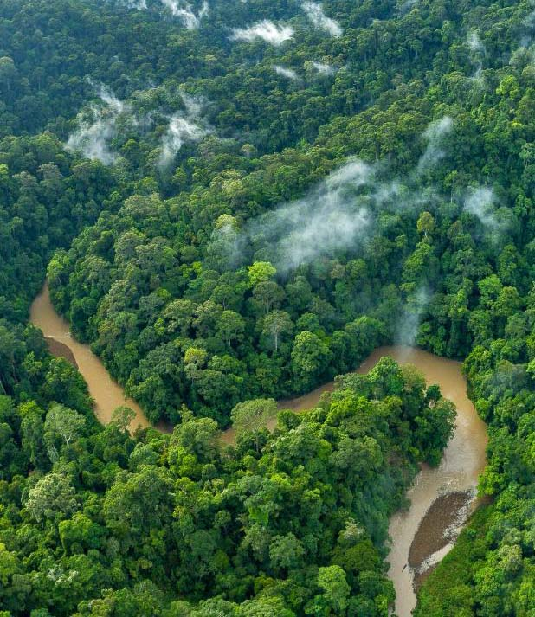
Tambopata River (Peru)
Temburong River (Brunei)

Slide 16
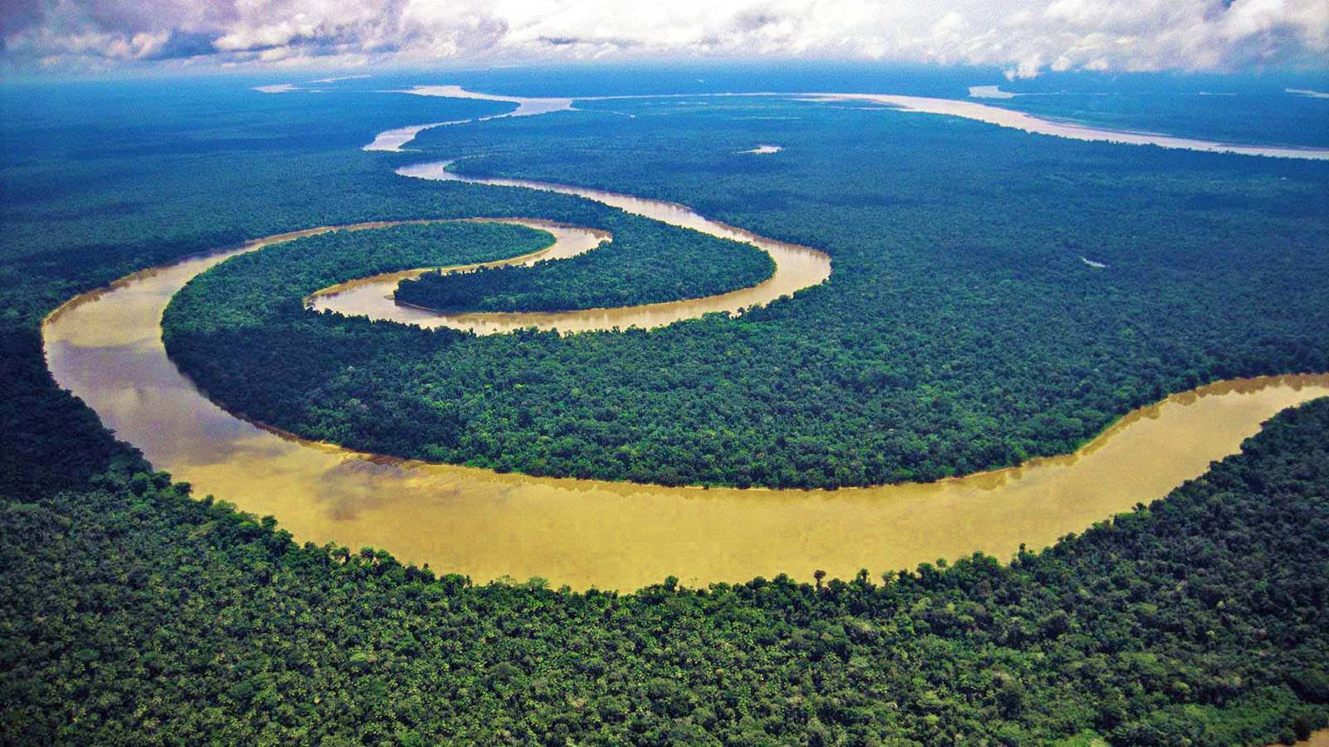
Amazon River (Peru)

Slide 17
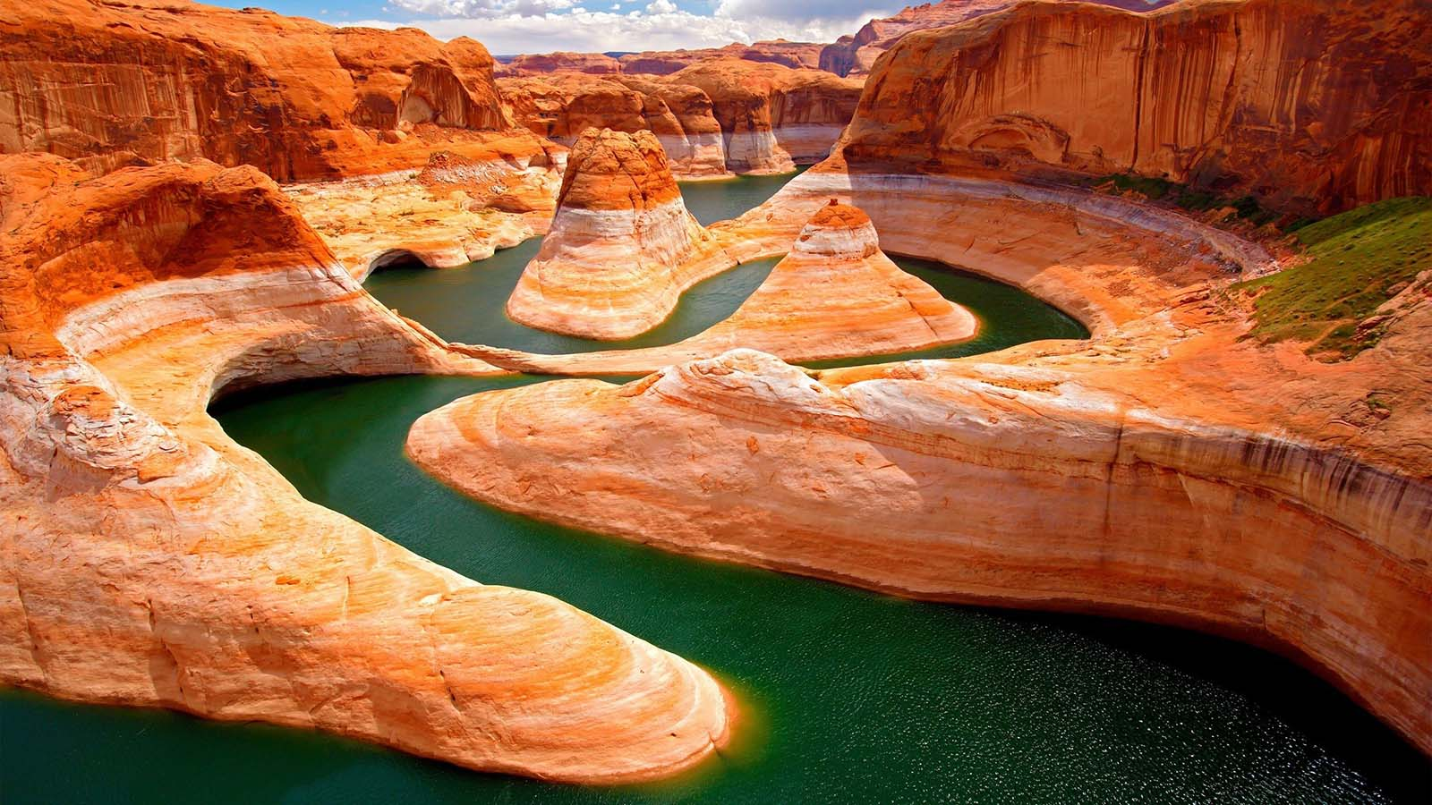
Colorado River, Arizona (USA)

Slide 18
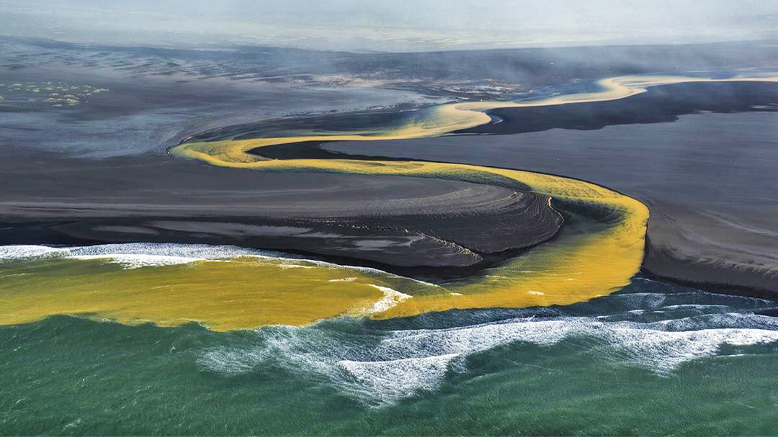
Meandering river (Island)

Slide 19
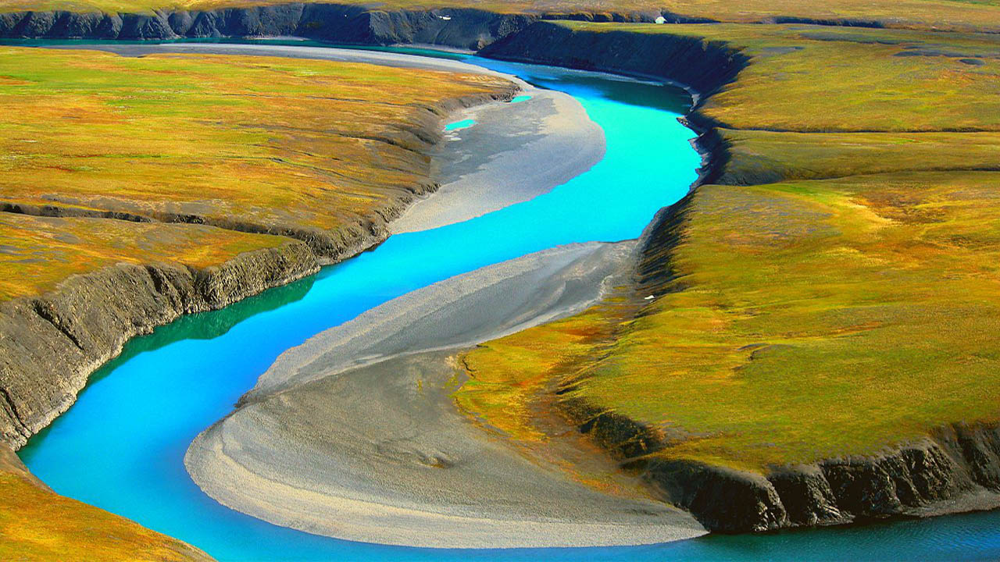
Meandering river, Novaya Zemlya (Russia)

Slide 20
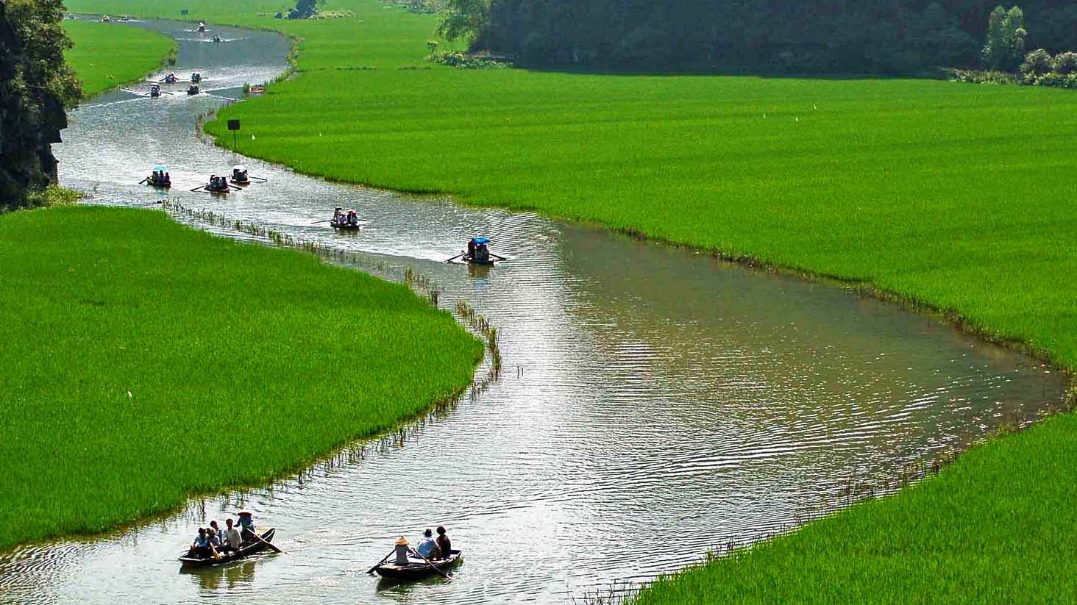
Meandering river (Vietnam)

Slide 21
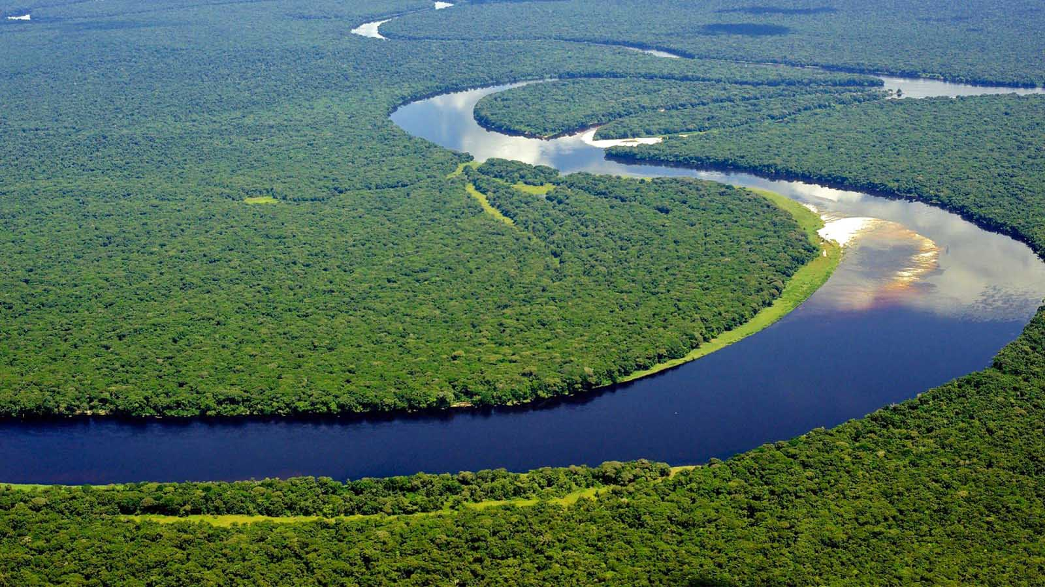
Congo River (Central Africa)

Slide 22
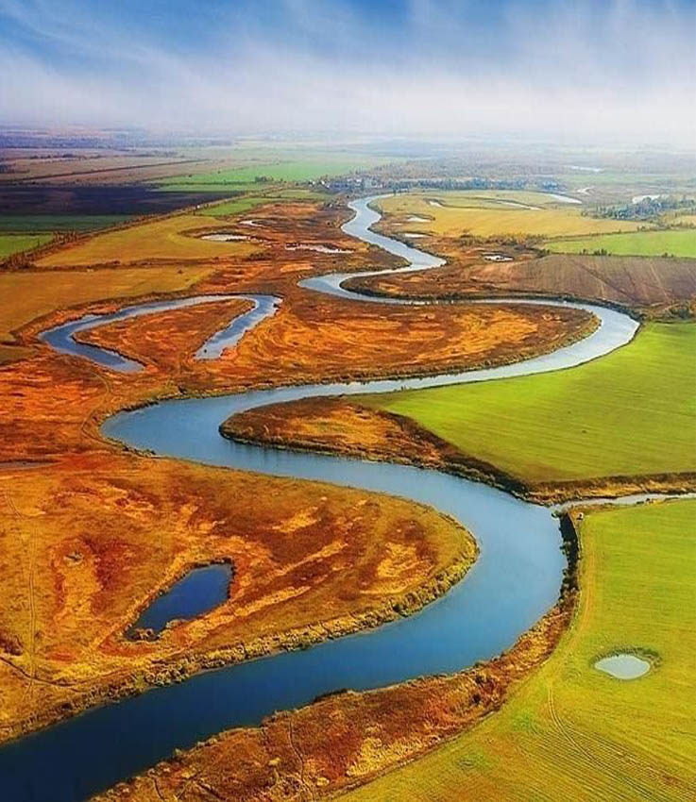
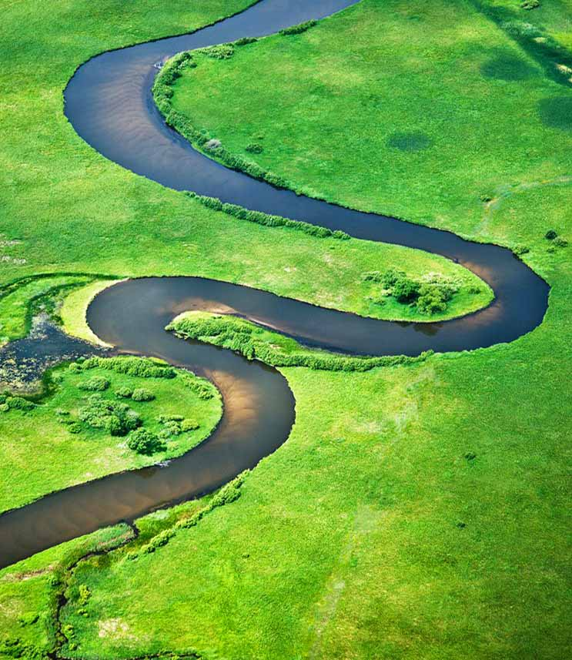
North Platte, Nebraska (USA)
Pere Marquette River, Michigan (USA)

Slide 23
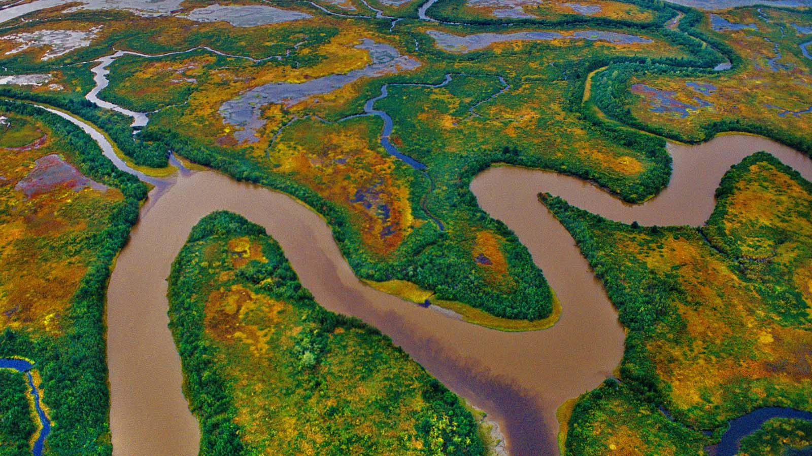
Copper River, Alaska (USA)

Slide 24
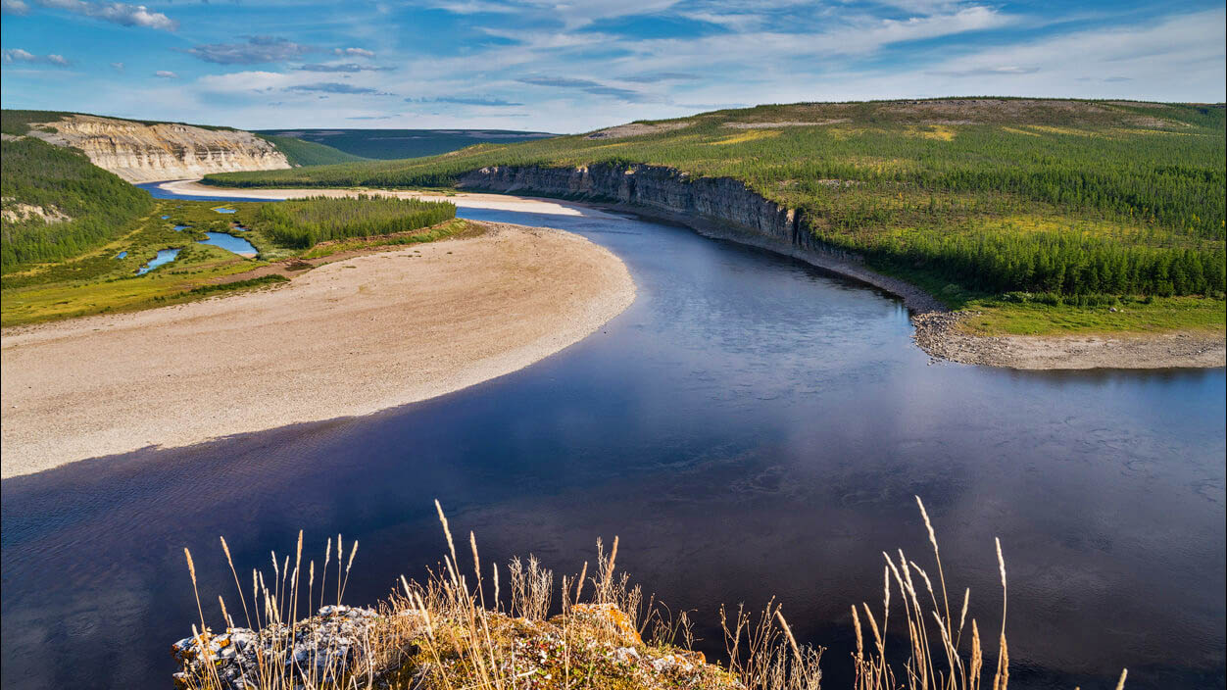
Kotui River (Russia)

Slide 25
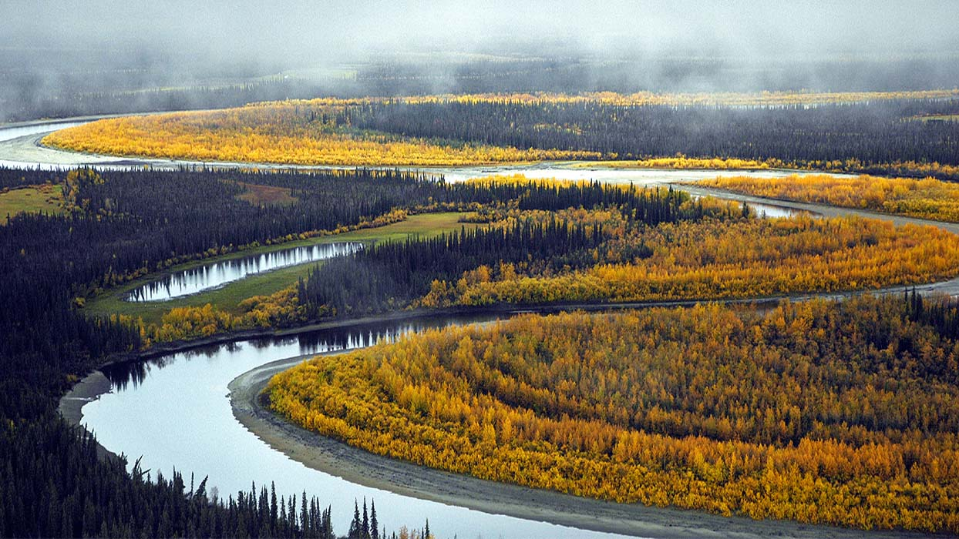
Koyukuk River, Yukon (USA)

Slide 26
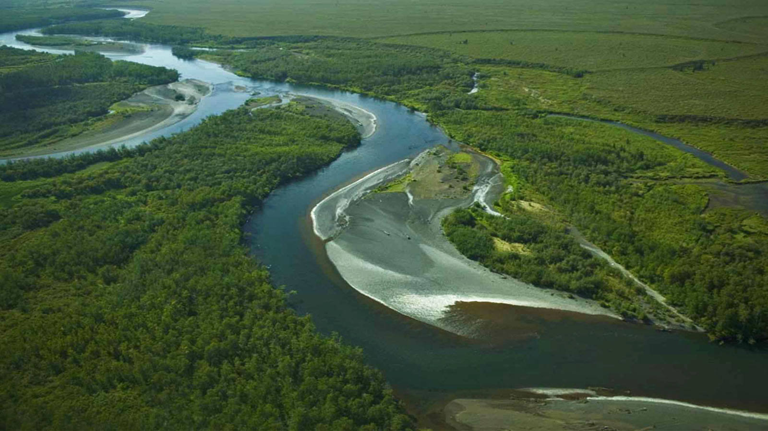
Toglak River, Alaska (USA)

Slide 27
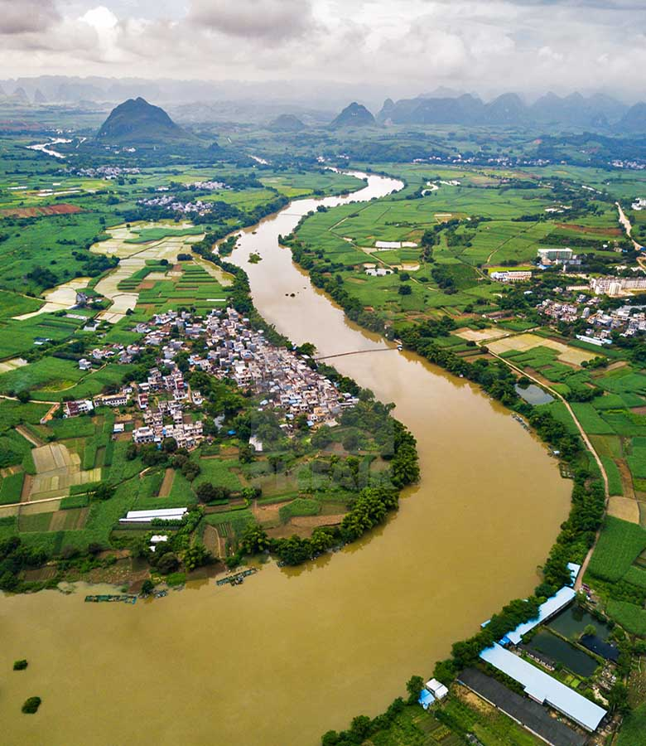
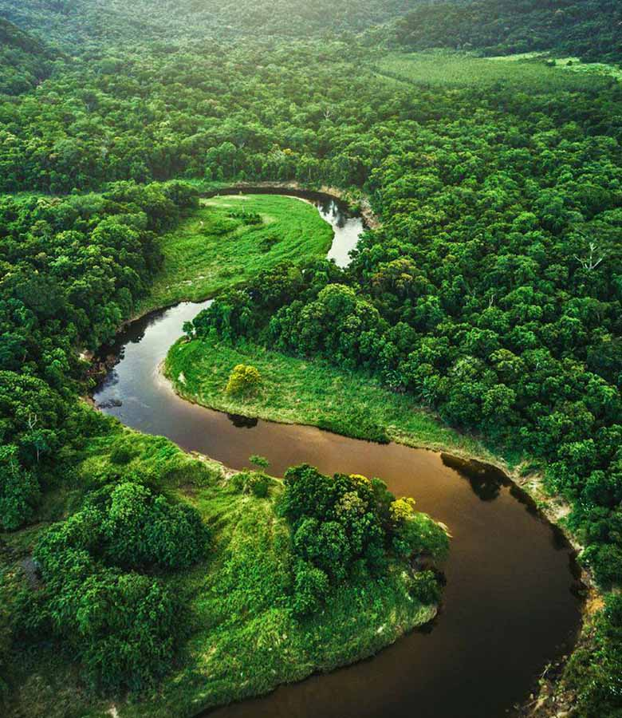
Lijang River (China)
Meandering river (Austria)

Slide 28
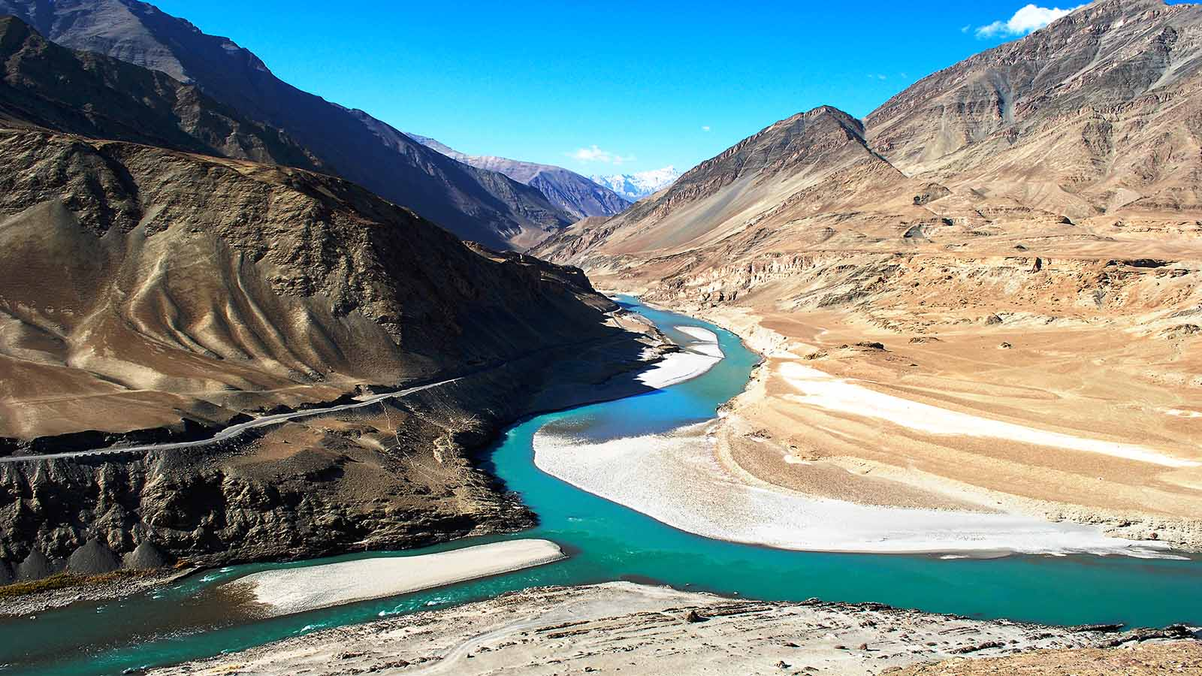
Indus River (India)

Slide 29
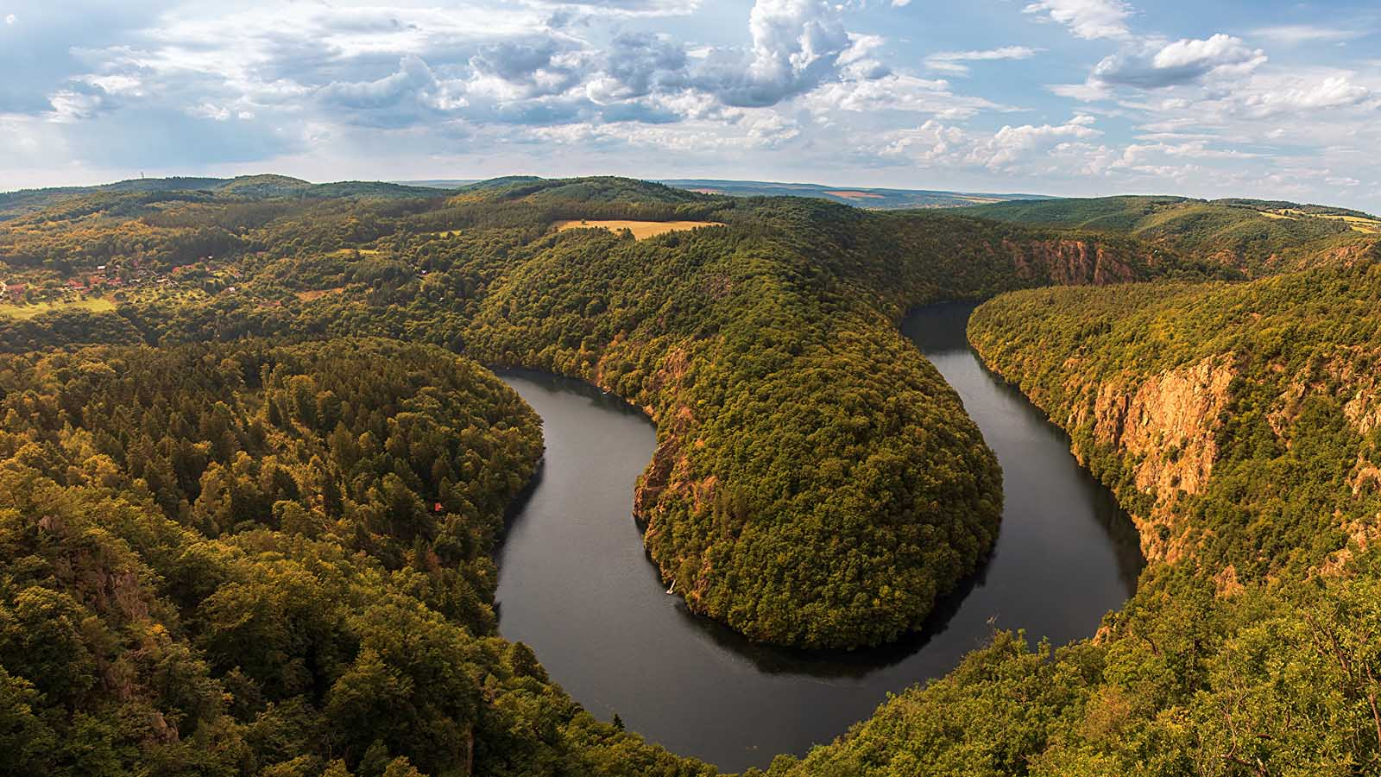
Vltava River (Czech Rep.)

Slide 30
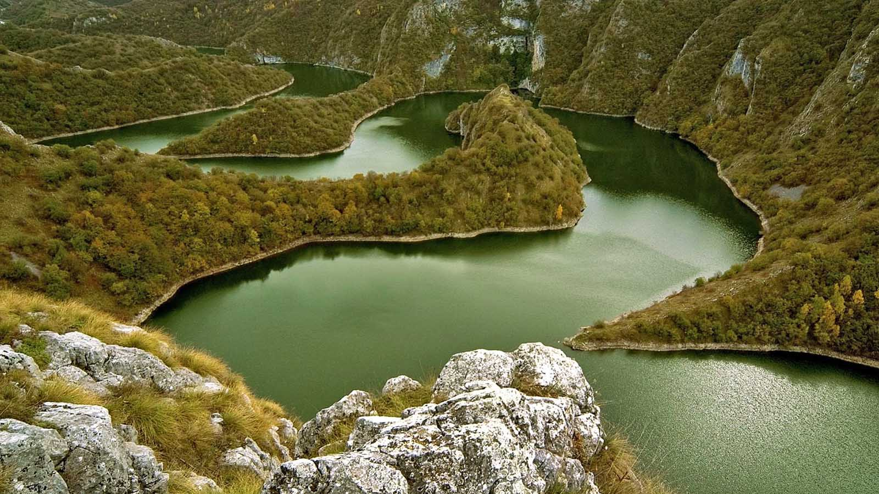
Uvac River (Serbia)

Slide 31
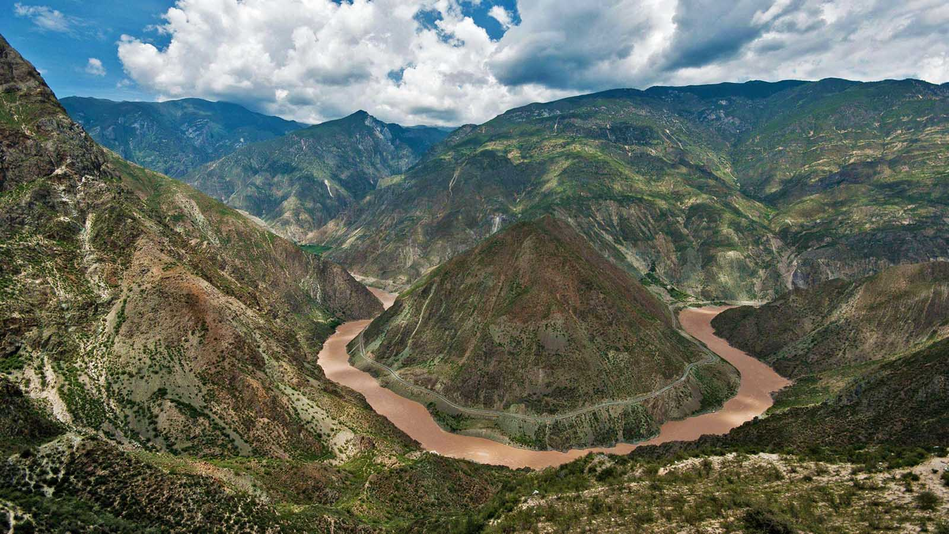
Yangtze River (China)

Slide 32
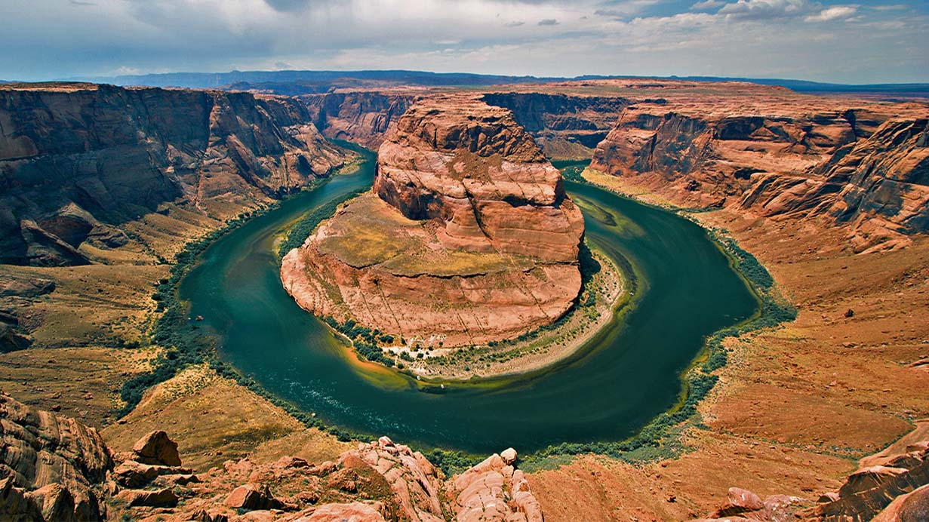
Colorado River, Arizona (USA)

Slide 33
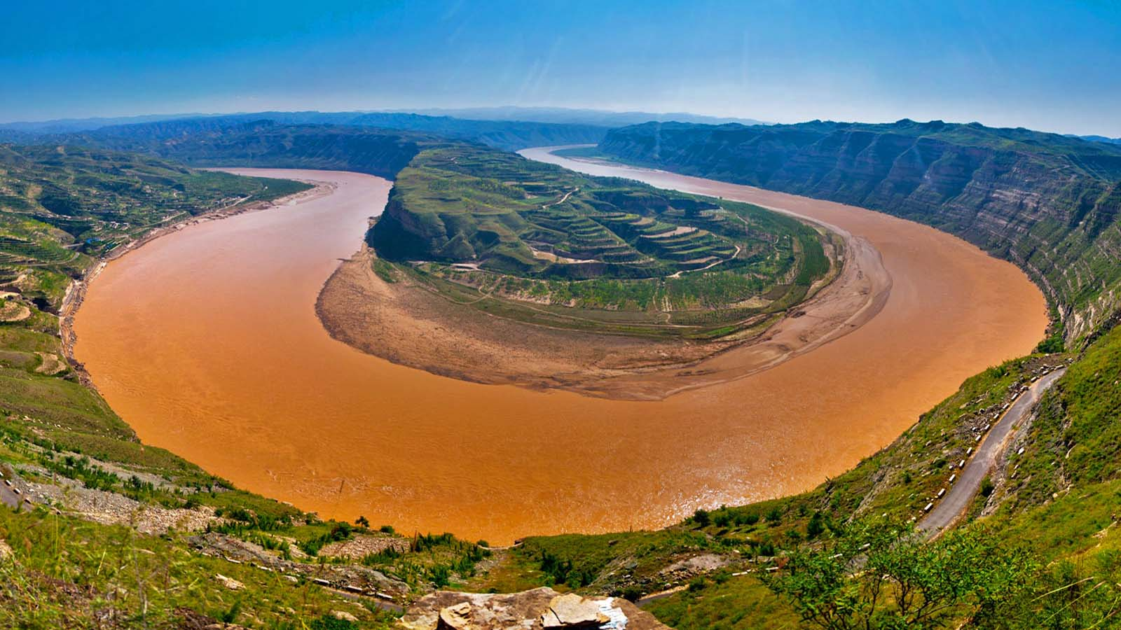
Yellow River (China)

Slide 34
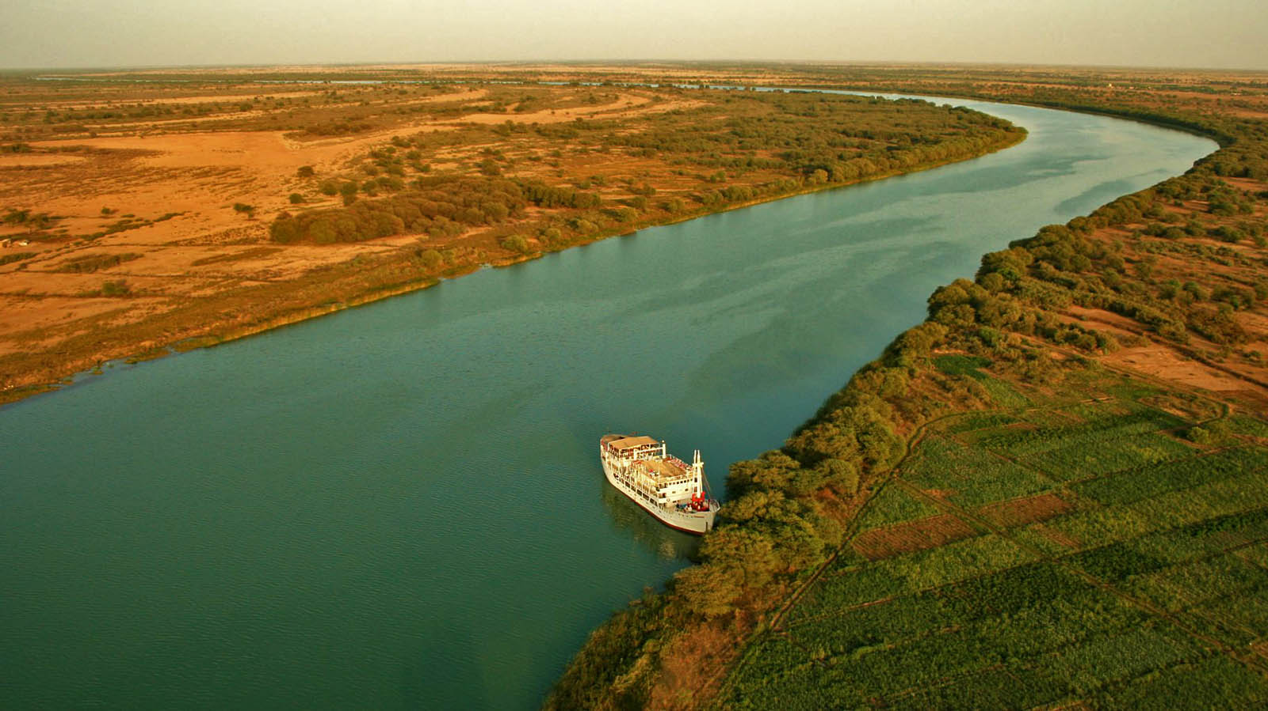
Bou el Mogdad River (Senegal)

Slide 35
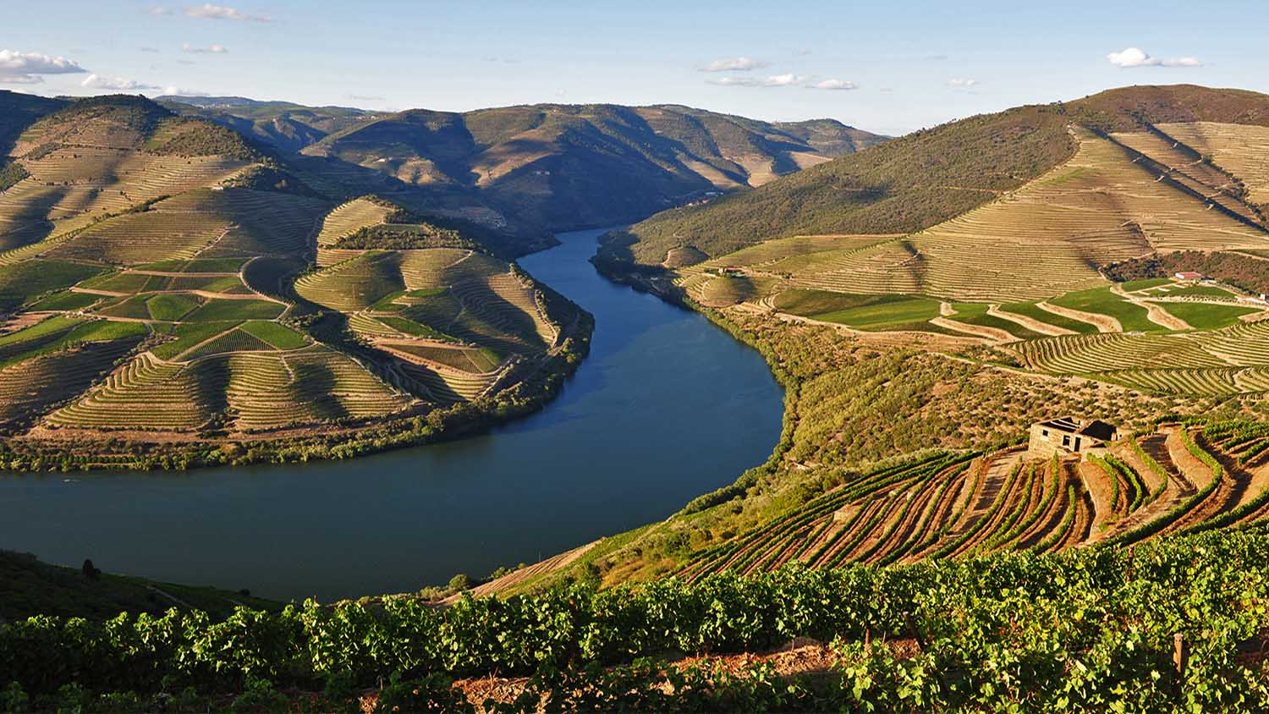
Douro River (Portugal)

Slide 36
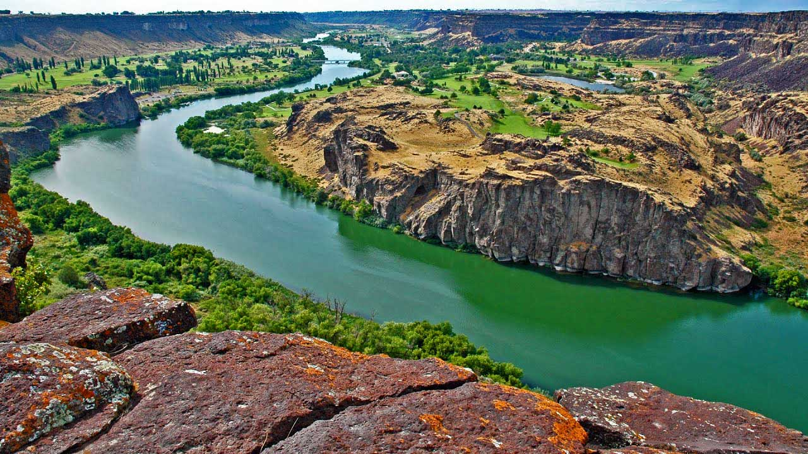
Snake River (USA)

Slide 37
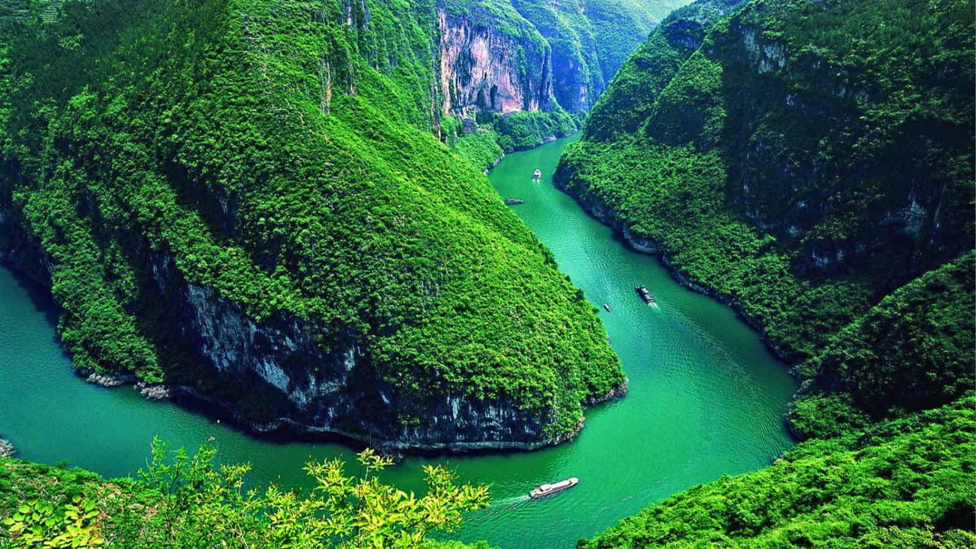
Yangtze River (China)

Slide 38
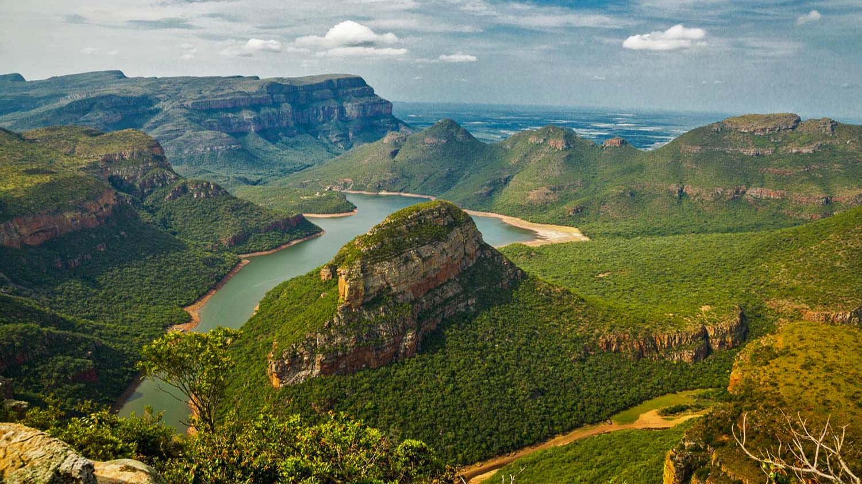
Blyde River (South Africa)

Slide 39
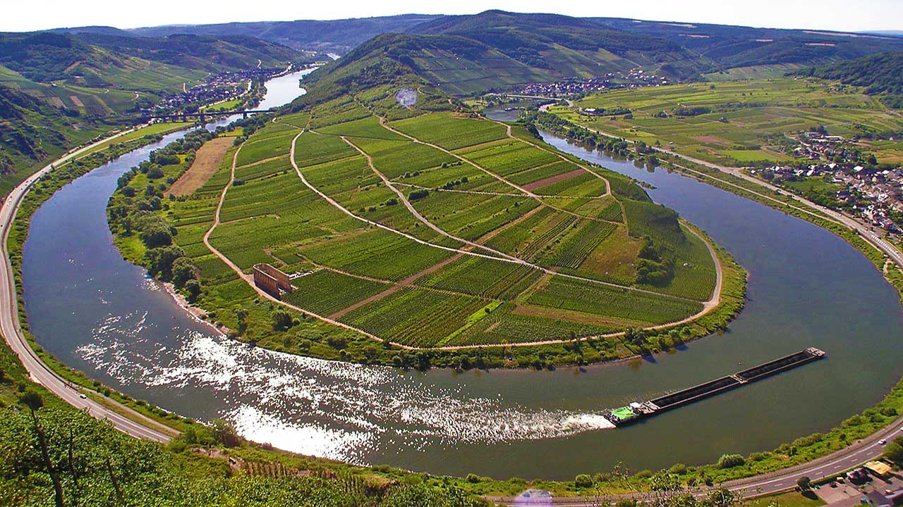
Mosel River (Germany)

Slide 40
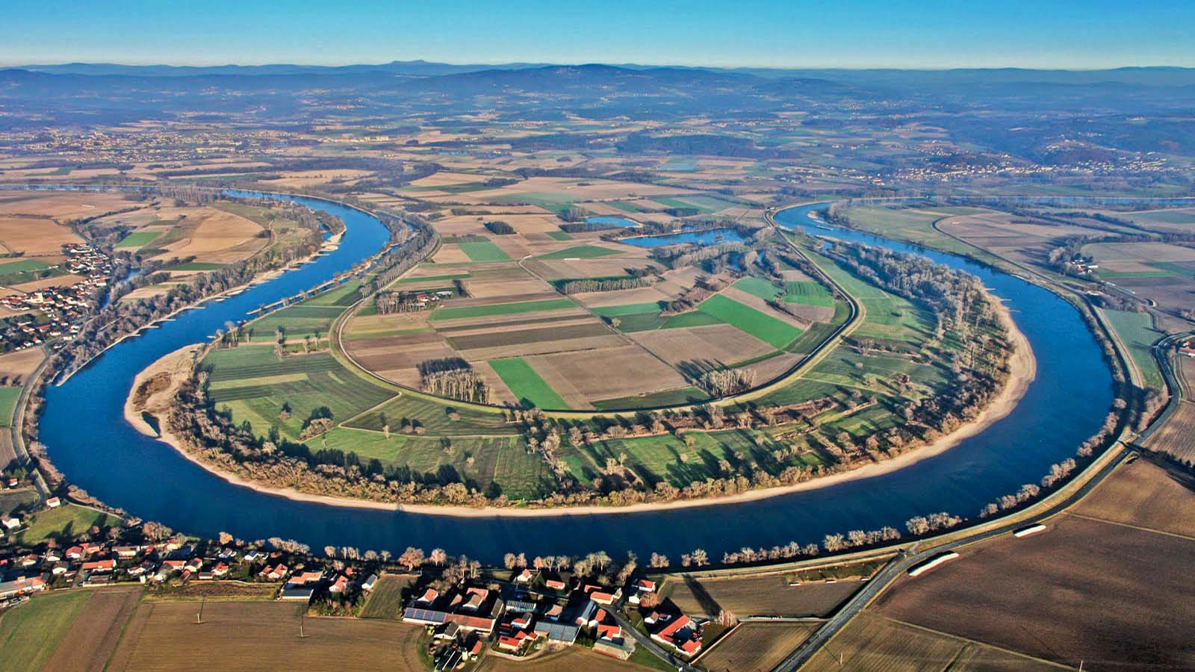
Danube River (Germany)

Slide 41
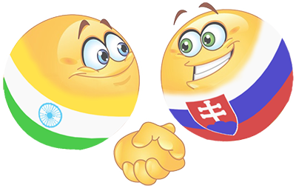
Thank you for a viewing the presentation.
Tony Chacko and Steve Rumpler
TONY
STEVE
tonychacko2000@gmail.com
pista2011@gmail.com
The Indo-Slovakian friendship

