Slide 1

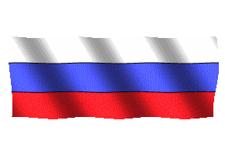
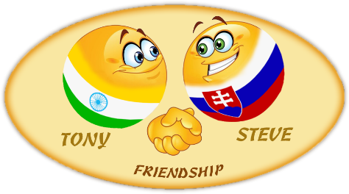
Russian
Federation
1
Compiled by - Tony and Steve
2017

Slide 2

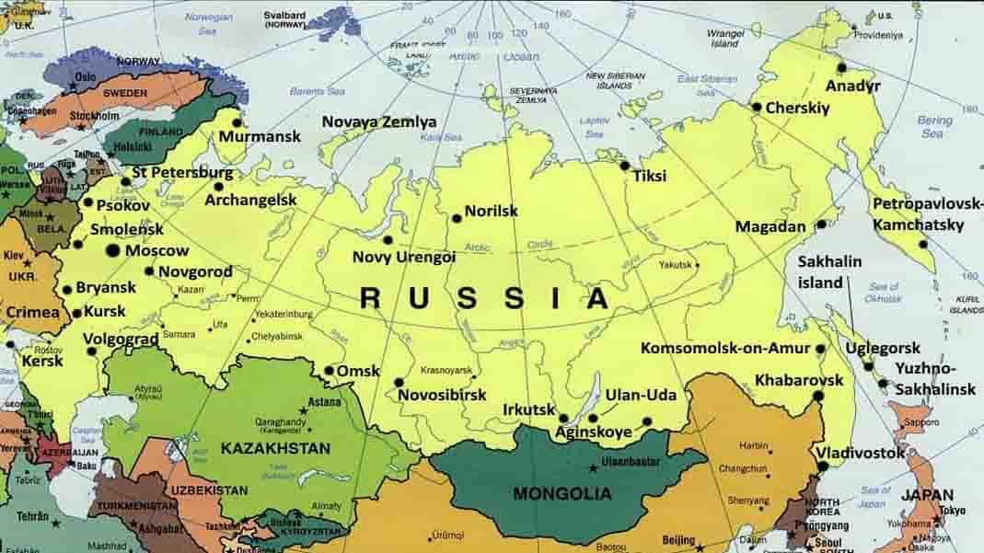

General Geographic Map of Russia

Slide 3
Russia
Russia - is a country that is mostly in Asia and partly in Eastern Europe. It is the largest country in the world, covering more than one-eighth of the Earth's inhabited land area.There are indeed many interesting tourist attractions in Russia and here are some highlighted places.
The federal subjects of Russia are the constituent entities of Russia. It consists of republics, krais, oblasts, cities of federal importance, an autonomous oblast, and autonomous okrugs, all of which are equal subjects of the Russian Federation. The Russian Federation constitutionally consists of 83 (2008) federal subjects..
Russia's capital and the biggest city is Moscow. The second biggest city is Saint Petersburg, which was the capital of Russia in the 18th and 19th centuries.
Area : 17,075 million km²
Population : 144.5 million (2015)
Ethnic groups (2010) : Russian (80,9 %), Tatar (3,9 %), Ukrainian (1,4 %), Bashkirs (1,2 %), Chuvash (1,1 %),
Chechen (1,0 %), Armenians (0,9 %), other / unspecified (9,8 %)
Wikipedia

Slide 4
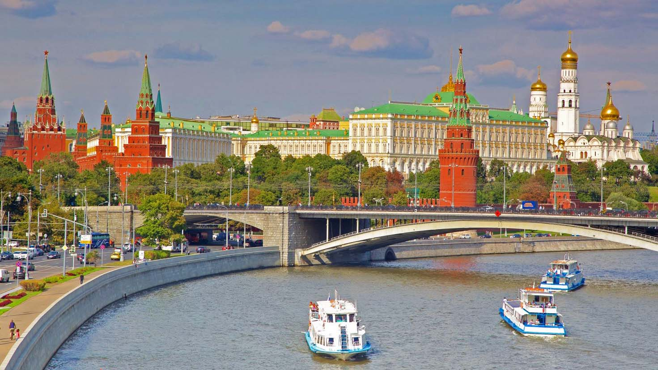

Moscow Kremlin

Slide 5
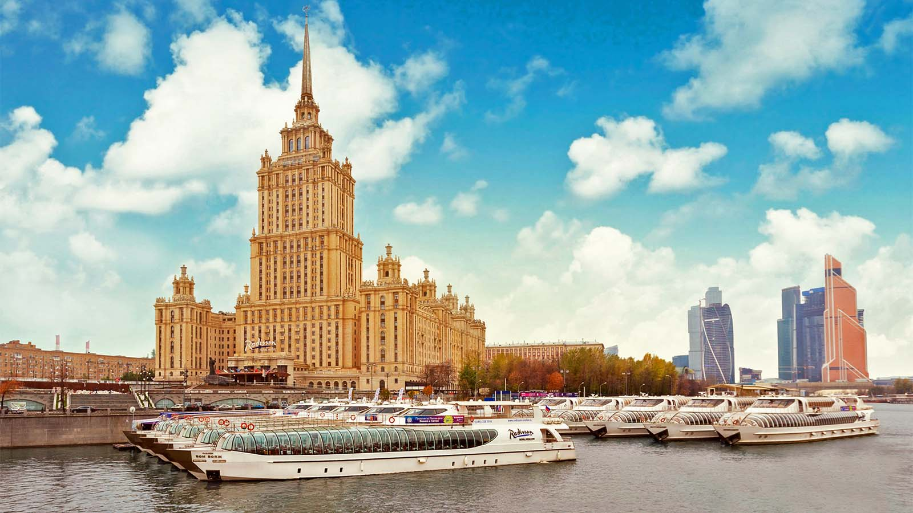
Raddison Hotel, Moscow

Slide 6
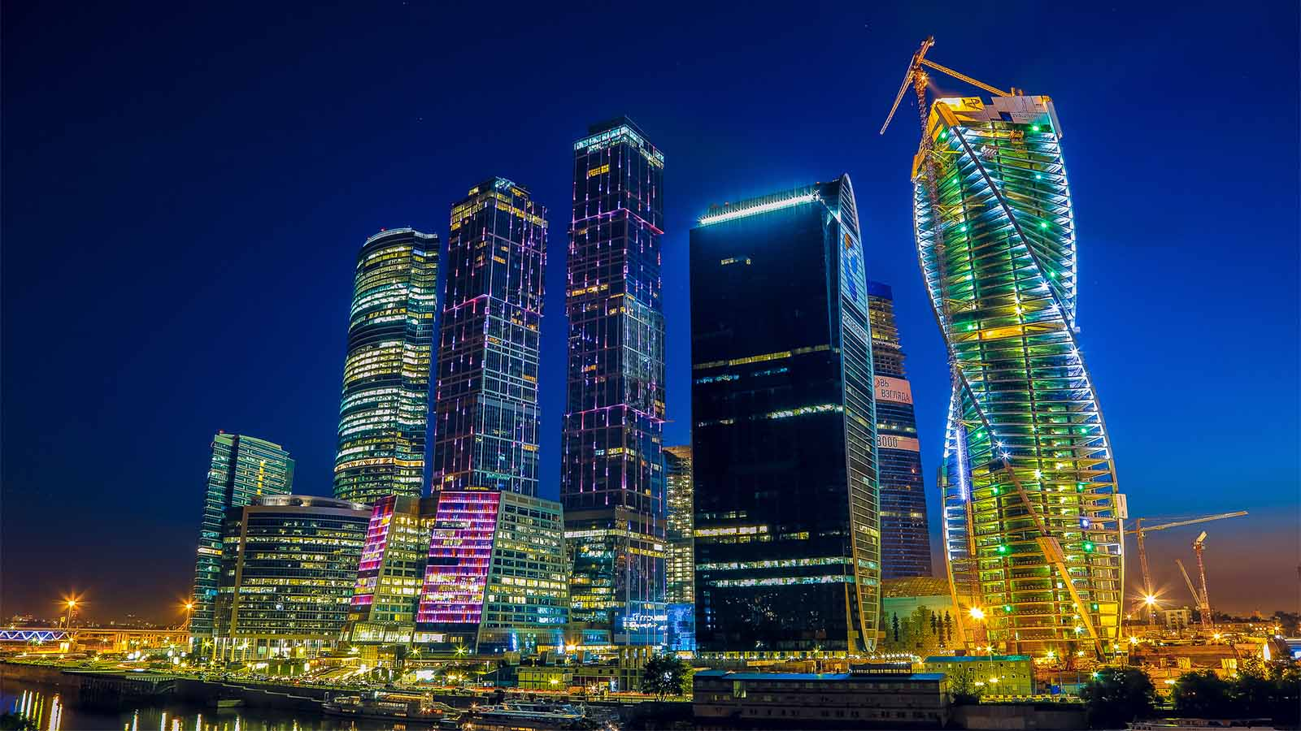
Moscow

Slide 7
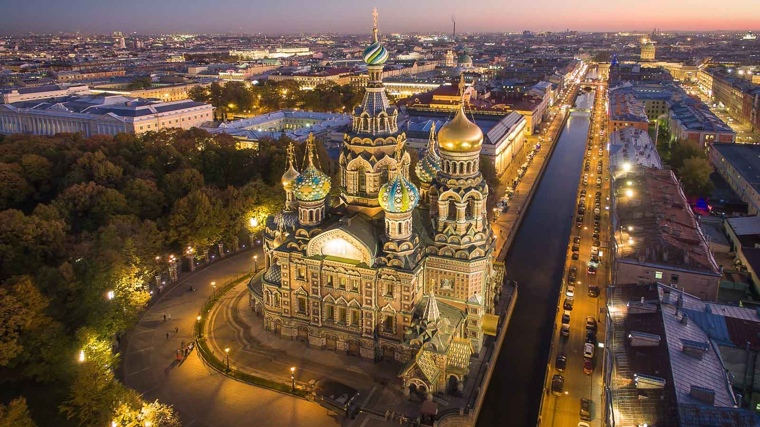
St.Petersburg

Slide 8
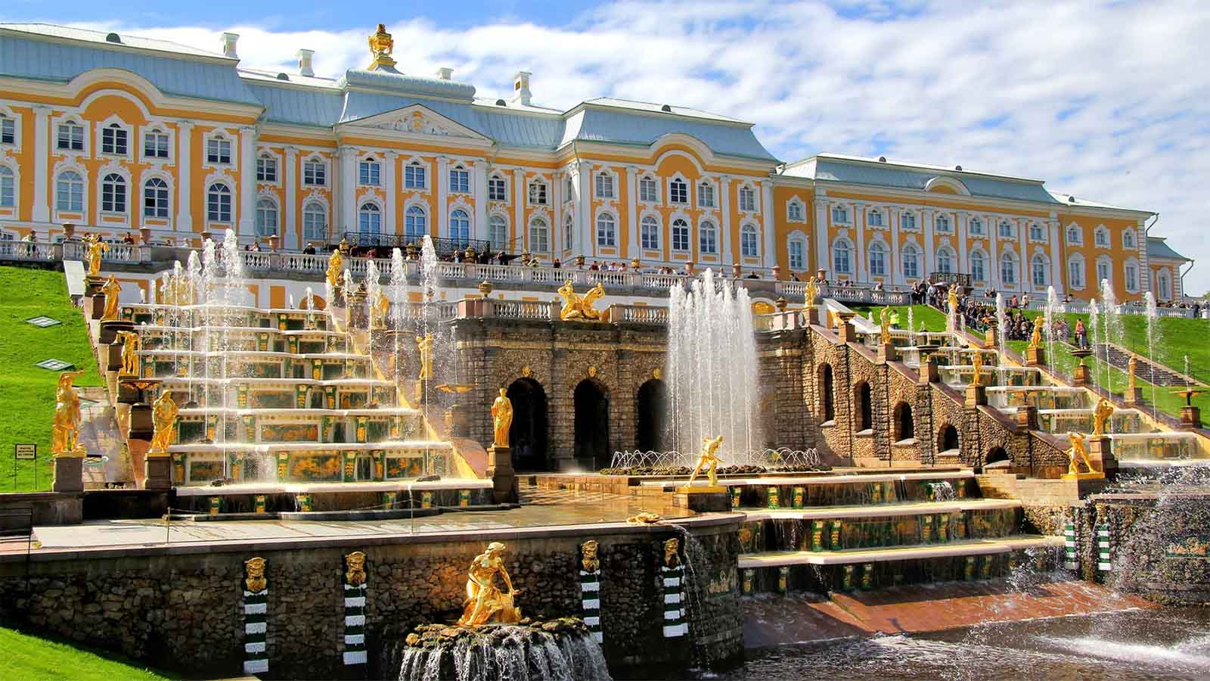
Peterhof Palace, St.Petersburg

Slide 9
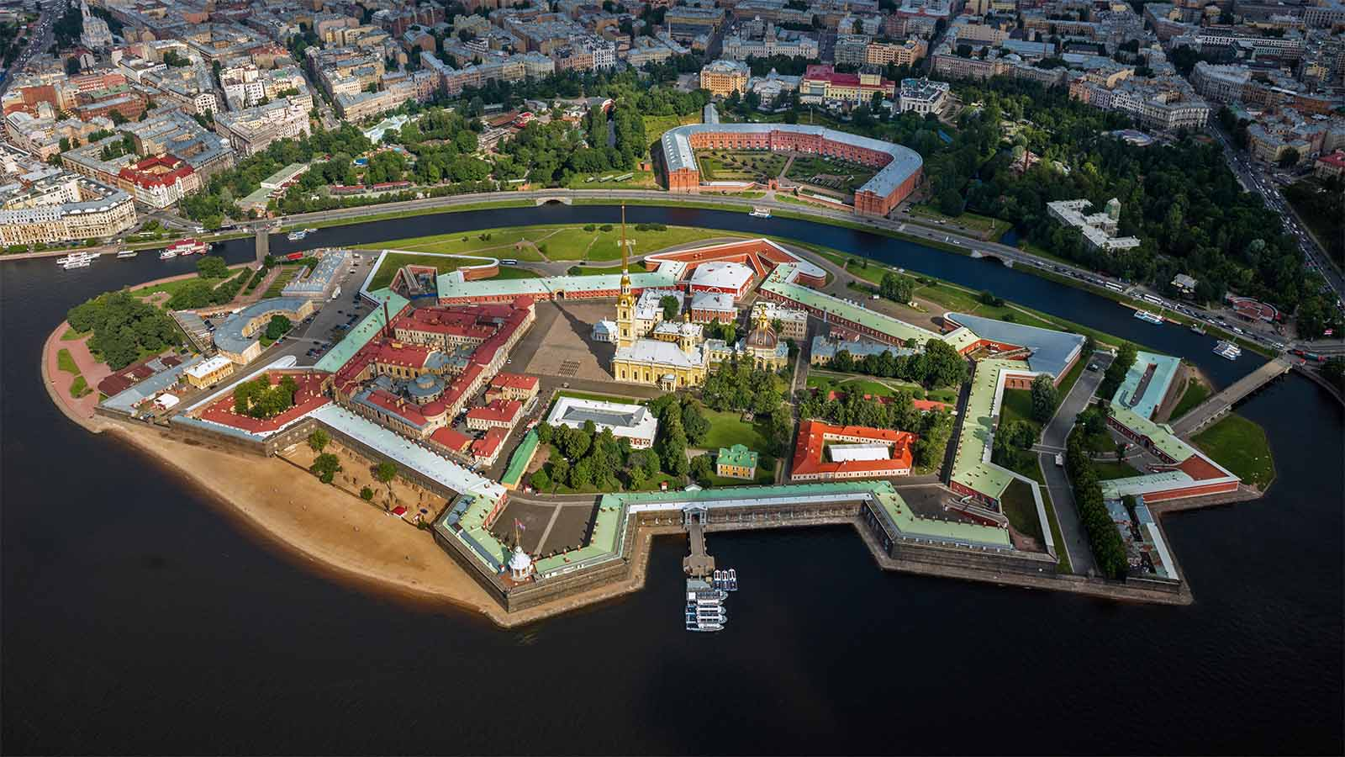
Peter and Paul Fortress, St.Petersburg

Slide 10
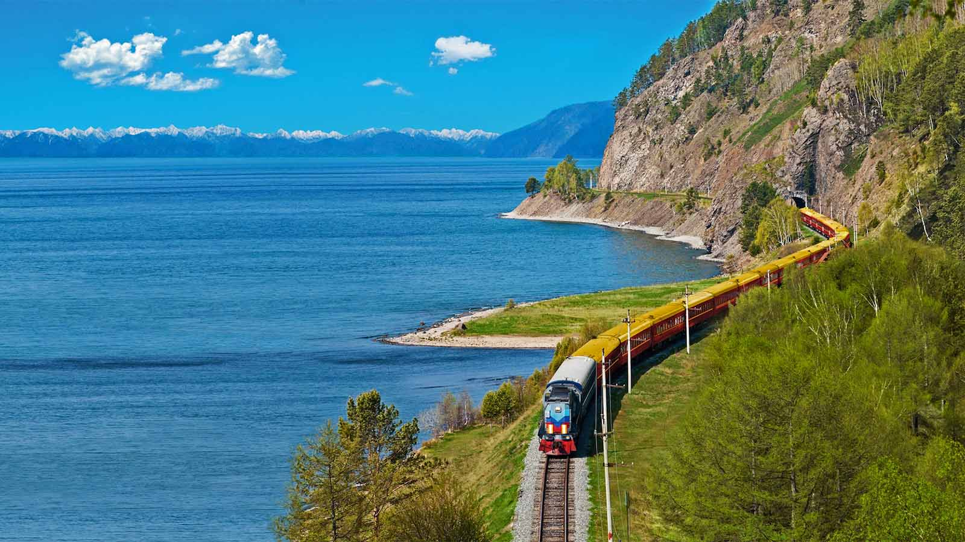
Trans-Siberian Railway

Slide 11
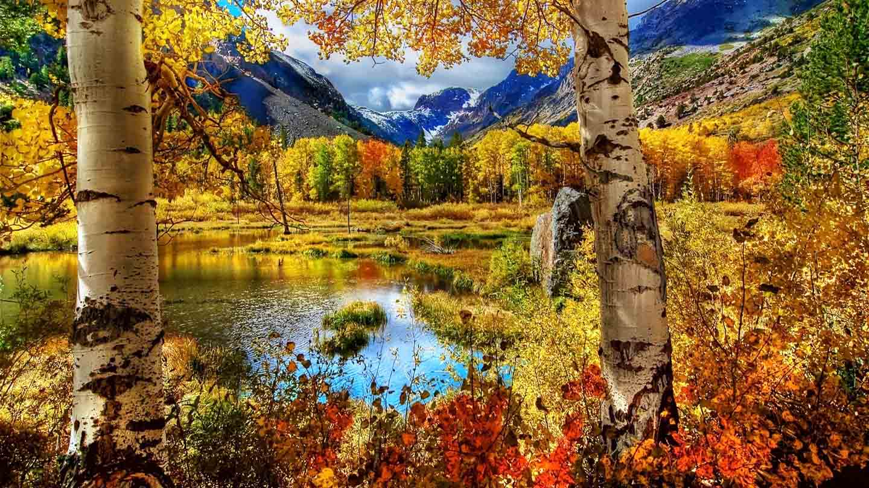
Russian countryside

Slide 12
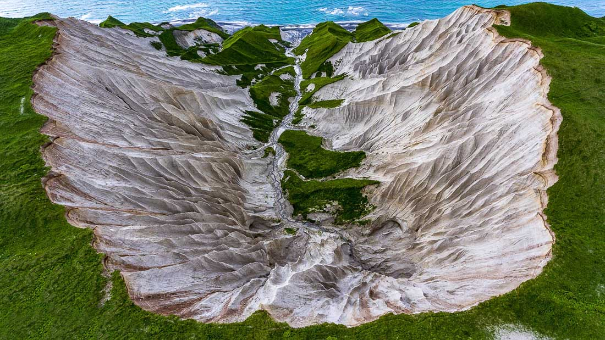
Iturup, Kuril Islands

Slide 13
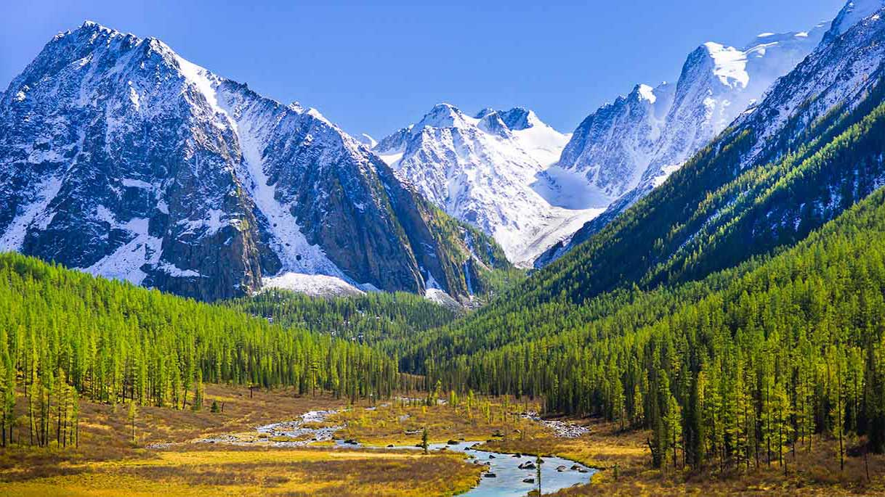
Altai Mountains

Slide 14
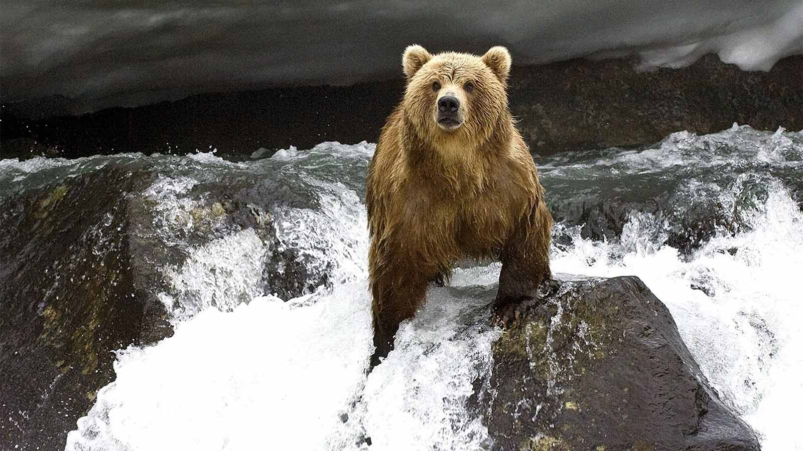
Kamchatka Peninsula

Slide 15
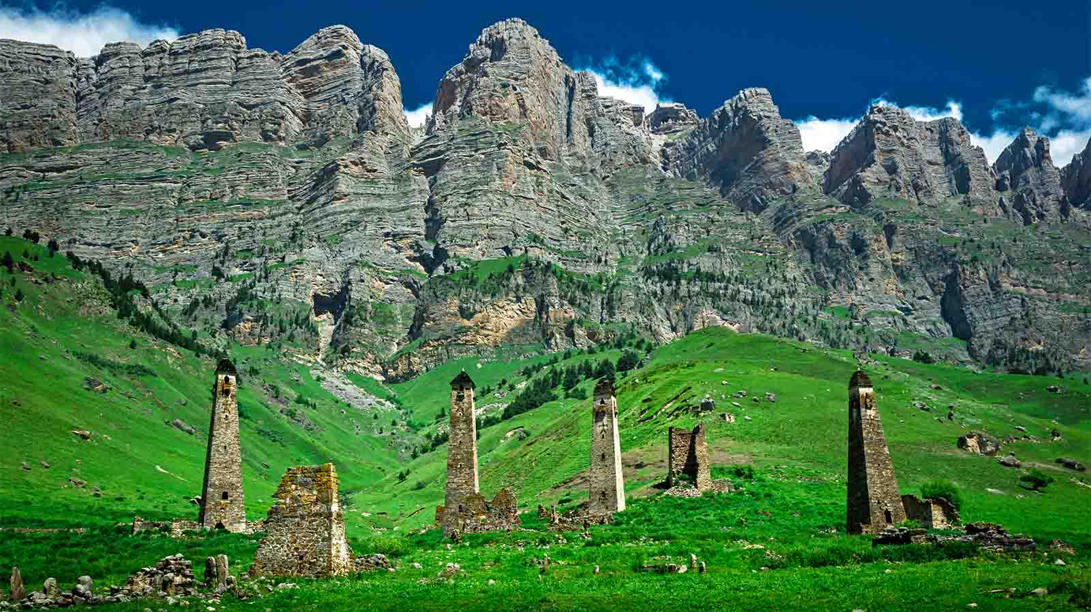
Watchtowers, Ingushetia

Slide 16
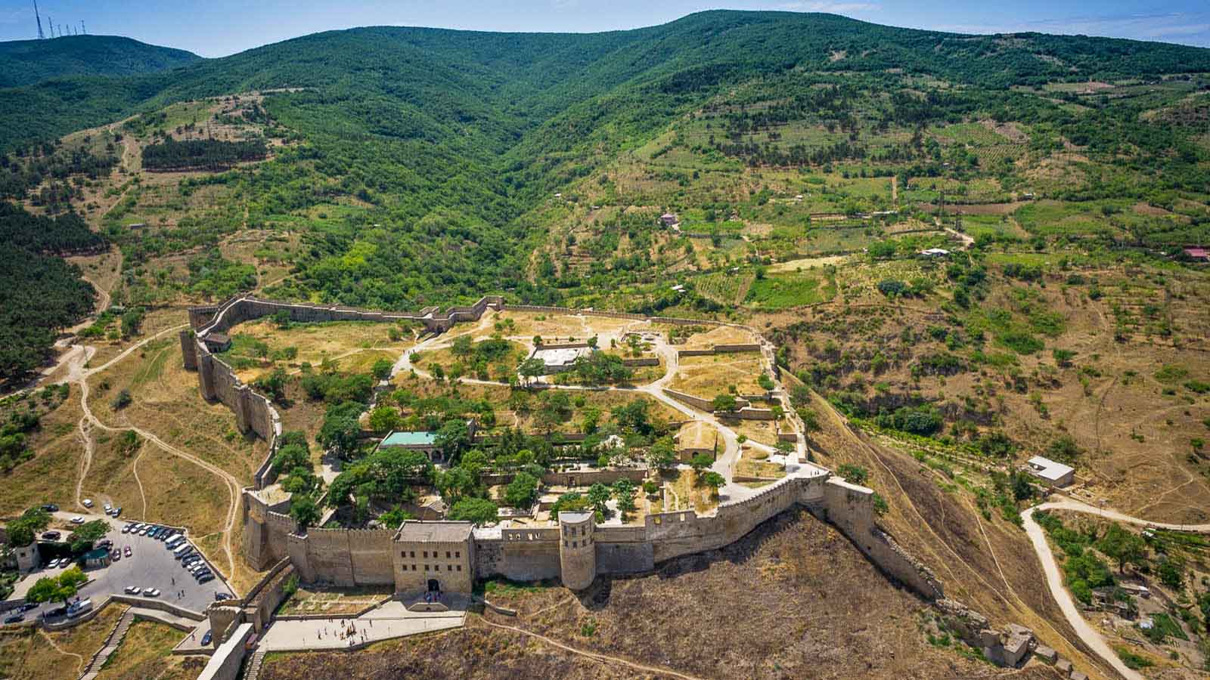
Fort Narin' Kala, Dagestan

Slide 17
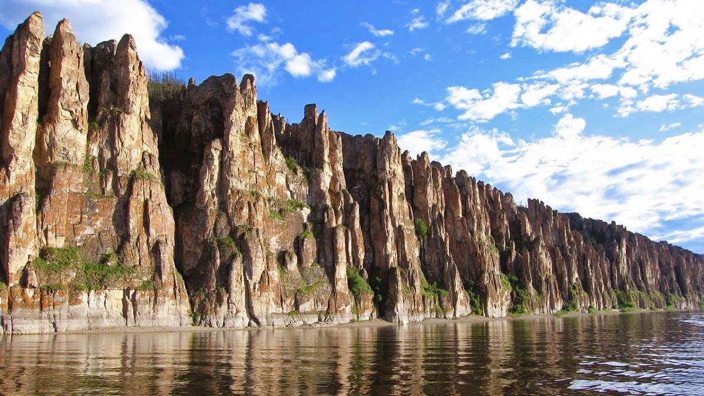
Lena Pillars,Yakutia

Slide 18
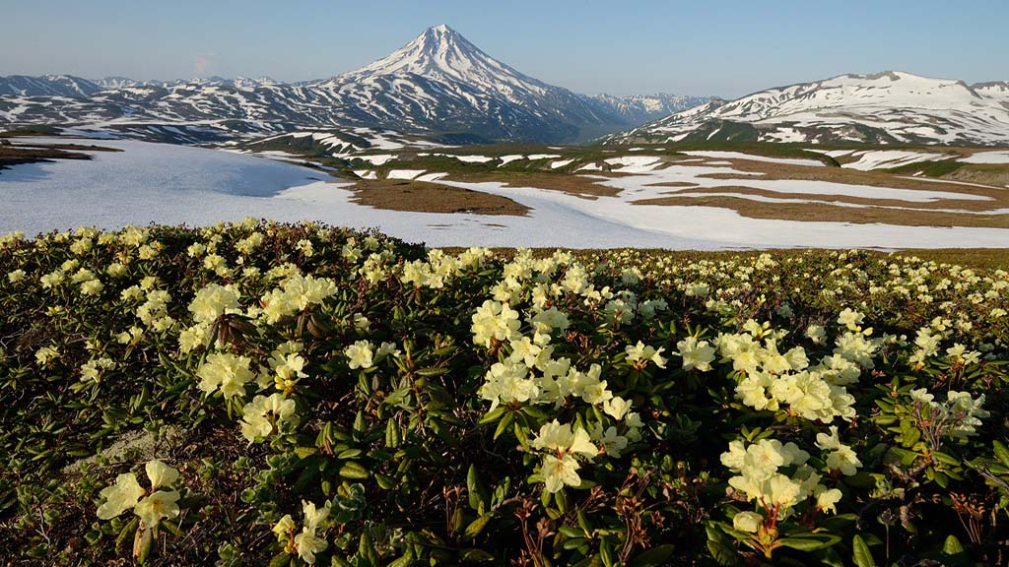
Kamchatka countryside

Slide 19
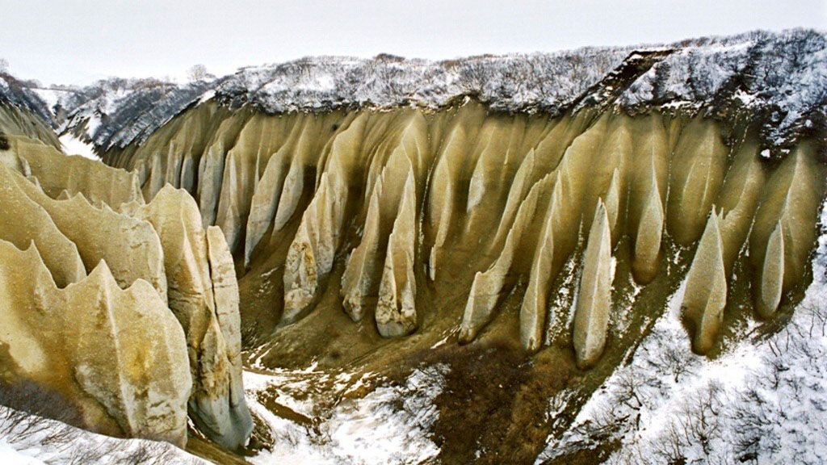
Kutkhiny Baty, Kamchatka Peninsula

Slide 20
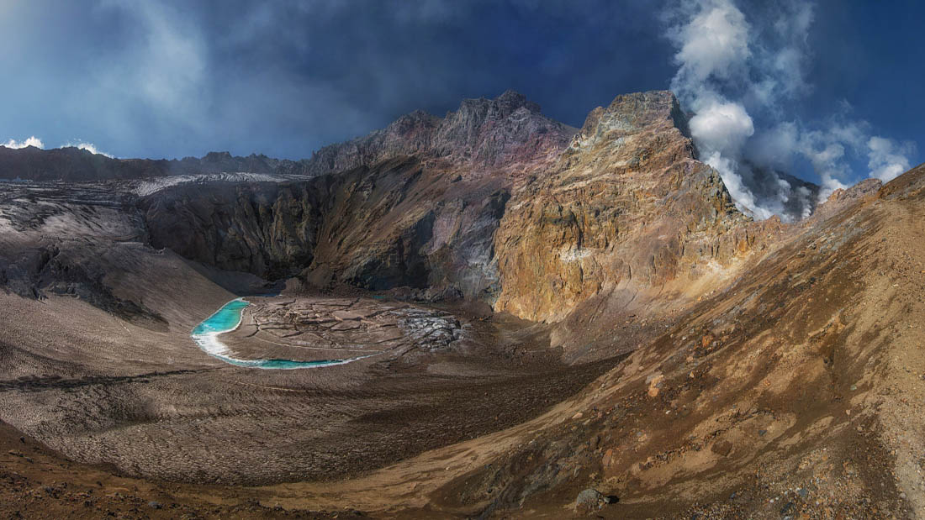
Mutnovsky Volcano, Kamchatka

Slide 21
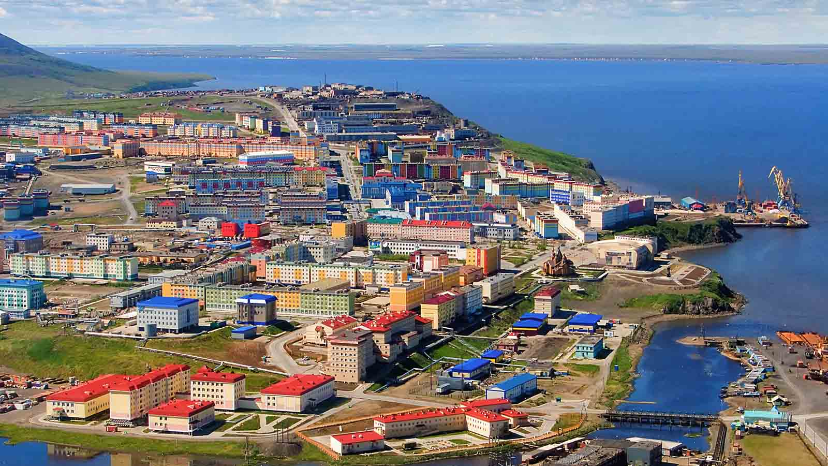
Anadyr, the easternmost town in Russia

Slide 22
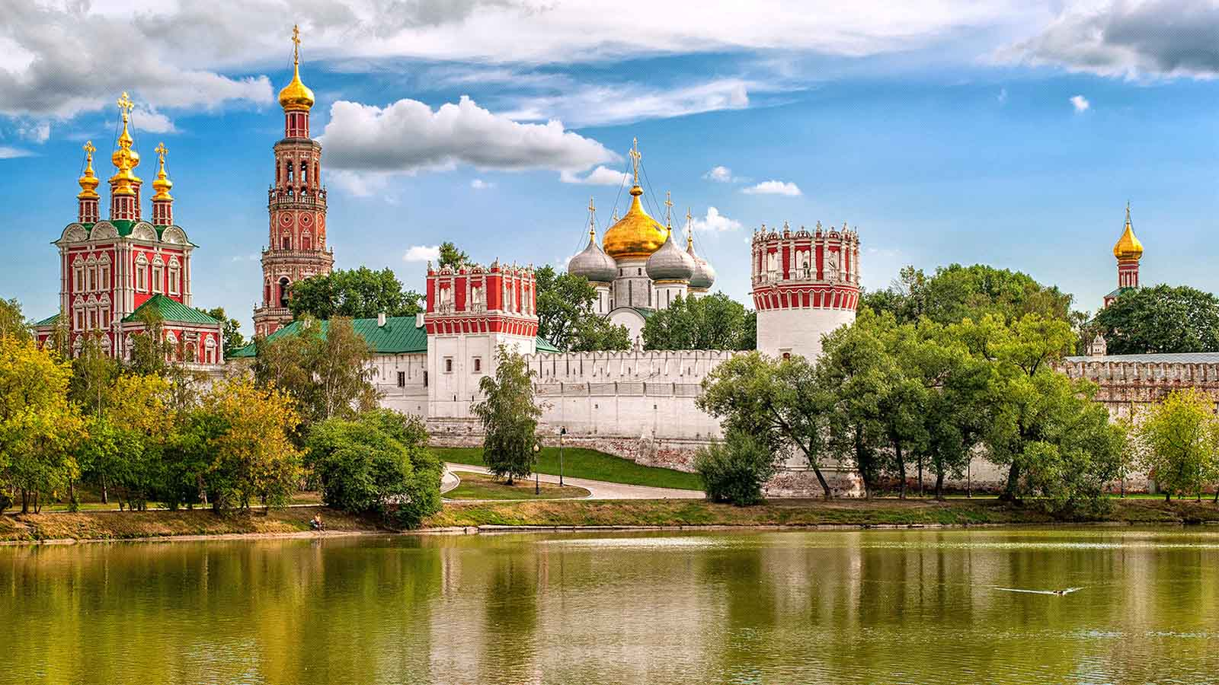
Bryansk

Slide 23
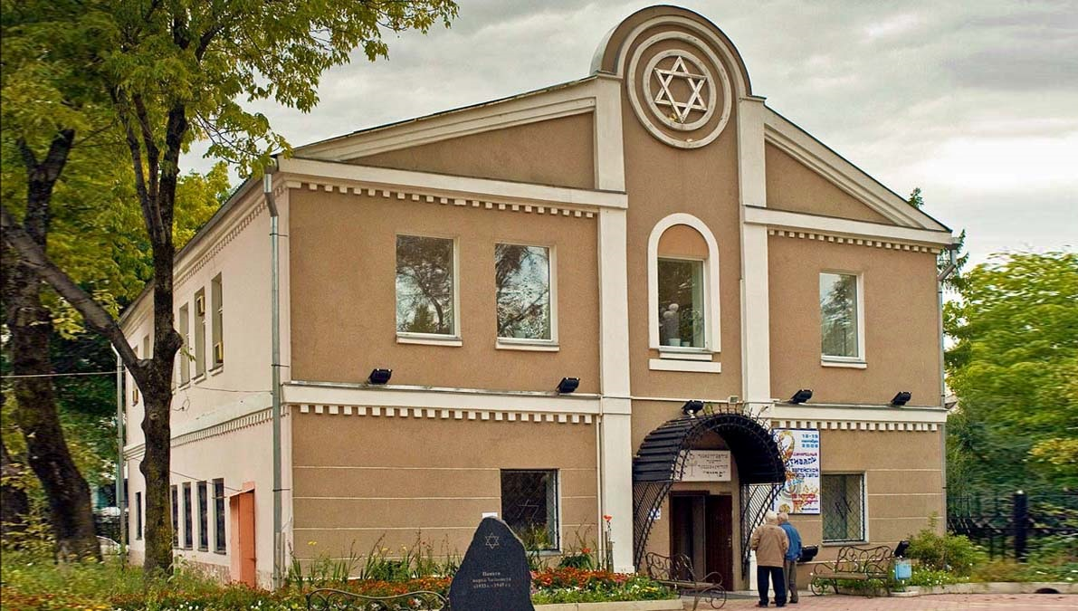
Birobidjan, Jewish Oblast

Slide 24
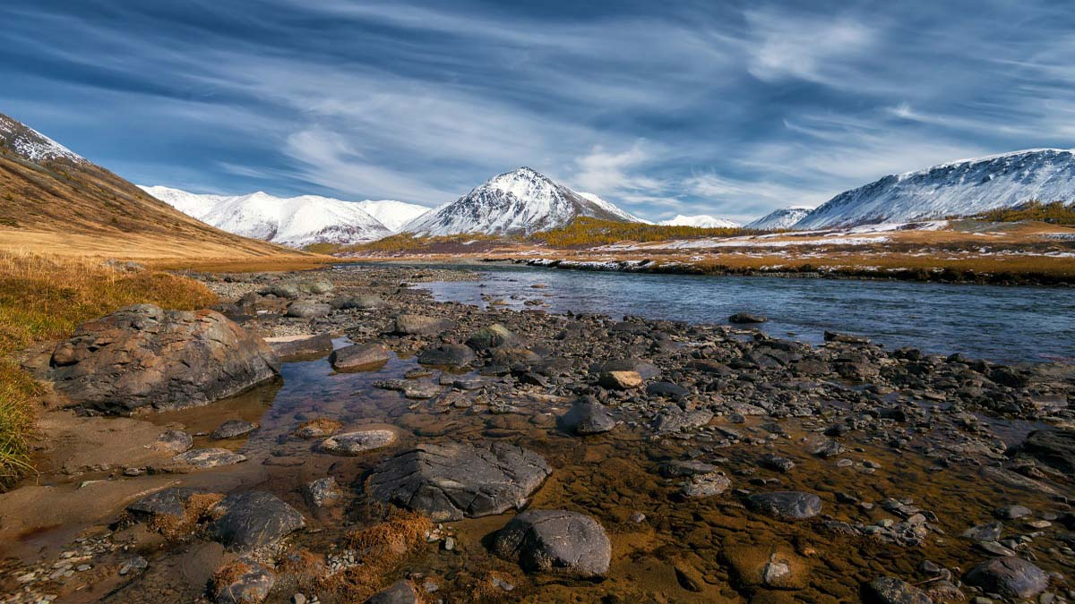
Altai Mountains

Slide 25
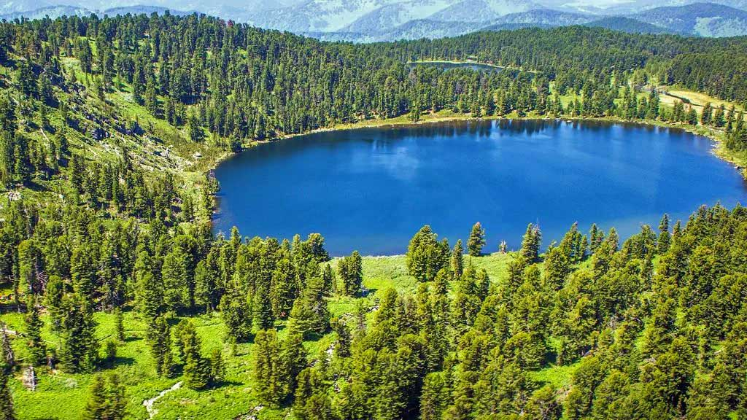
Lake Karakol, Altai

Slide 26
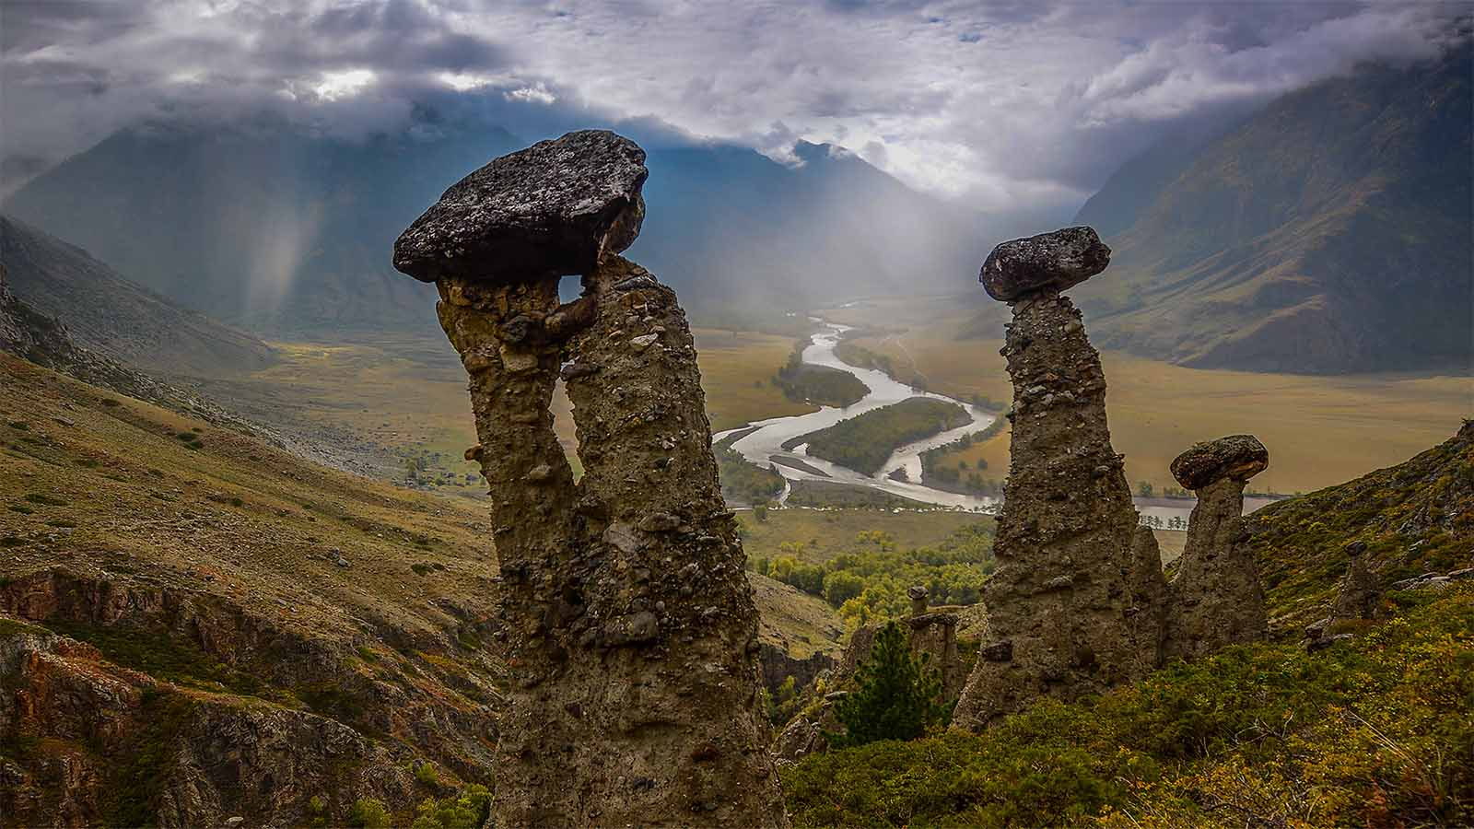
Stone Mushrooms, Altai

Slide 27
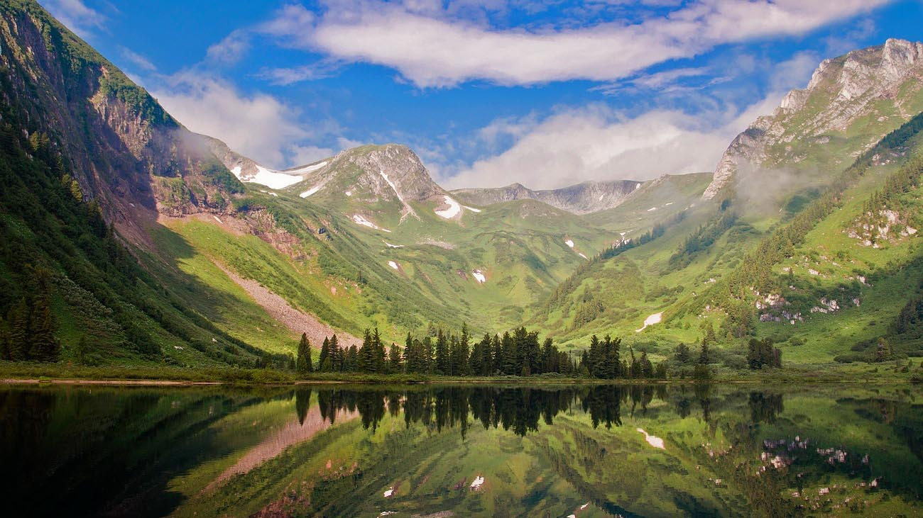
Medvejie Lake, Krasnoyarsk

Slide 28
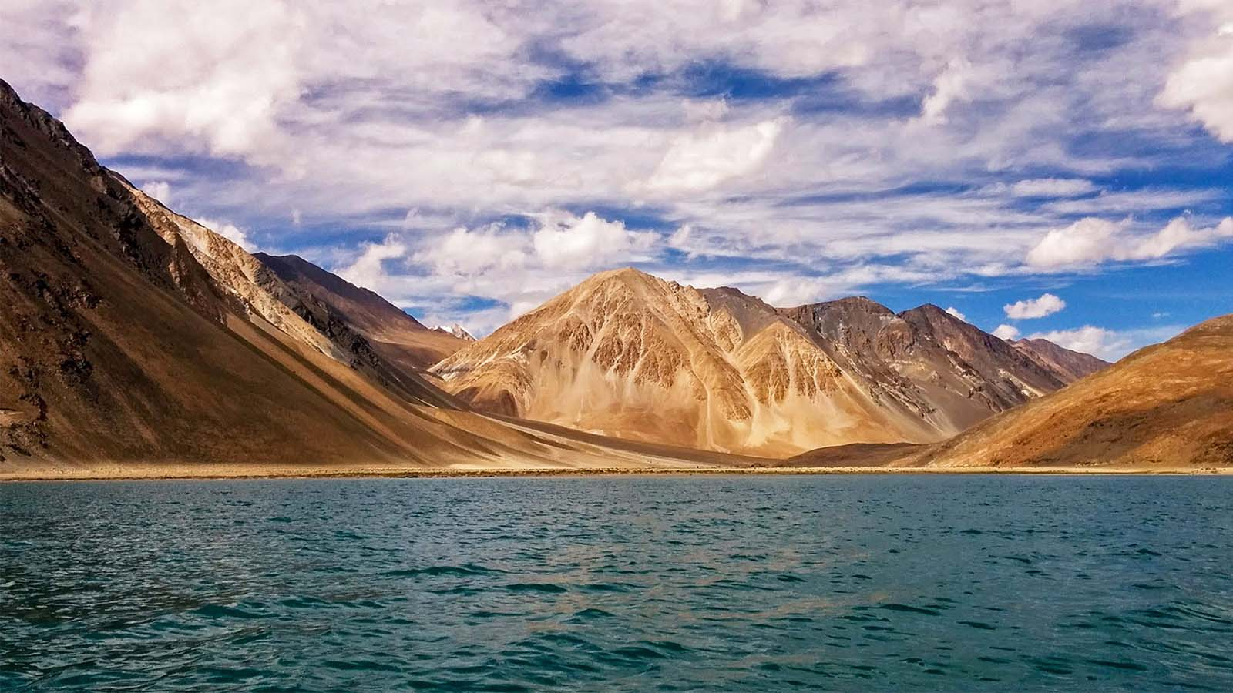
Putorana Plateau, Siberia

Slide 29
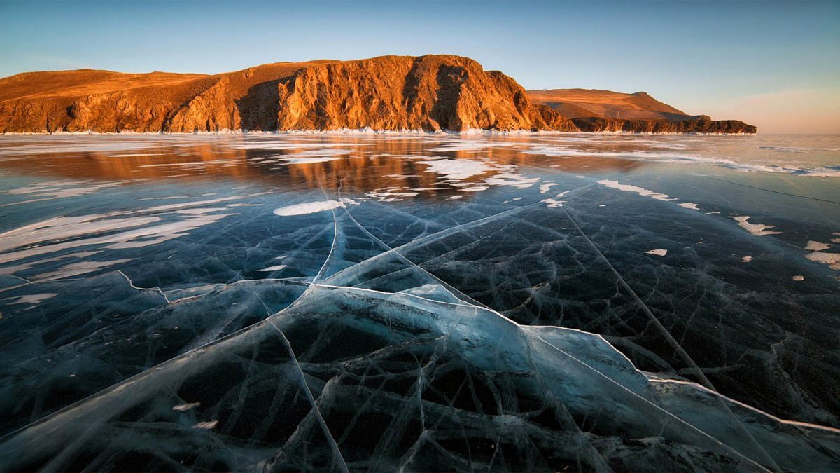
Lake Baikal, Siberia

Slide 30
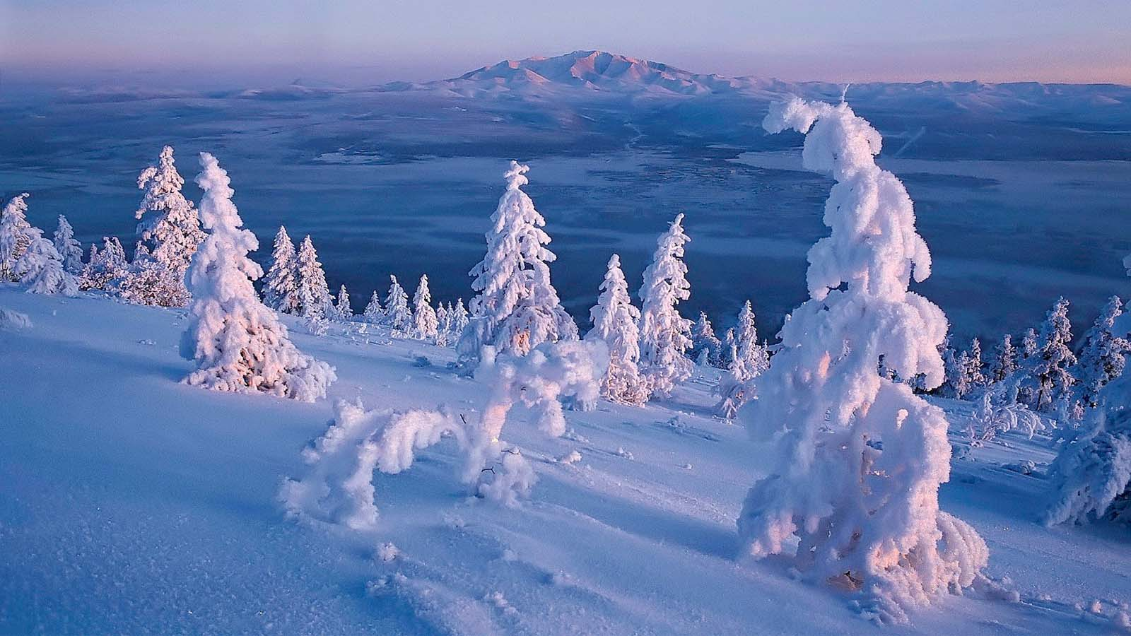
Sakha, Yakutia

Slide 31
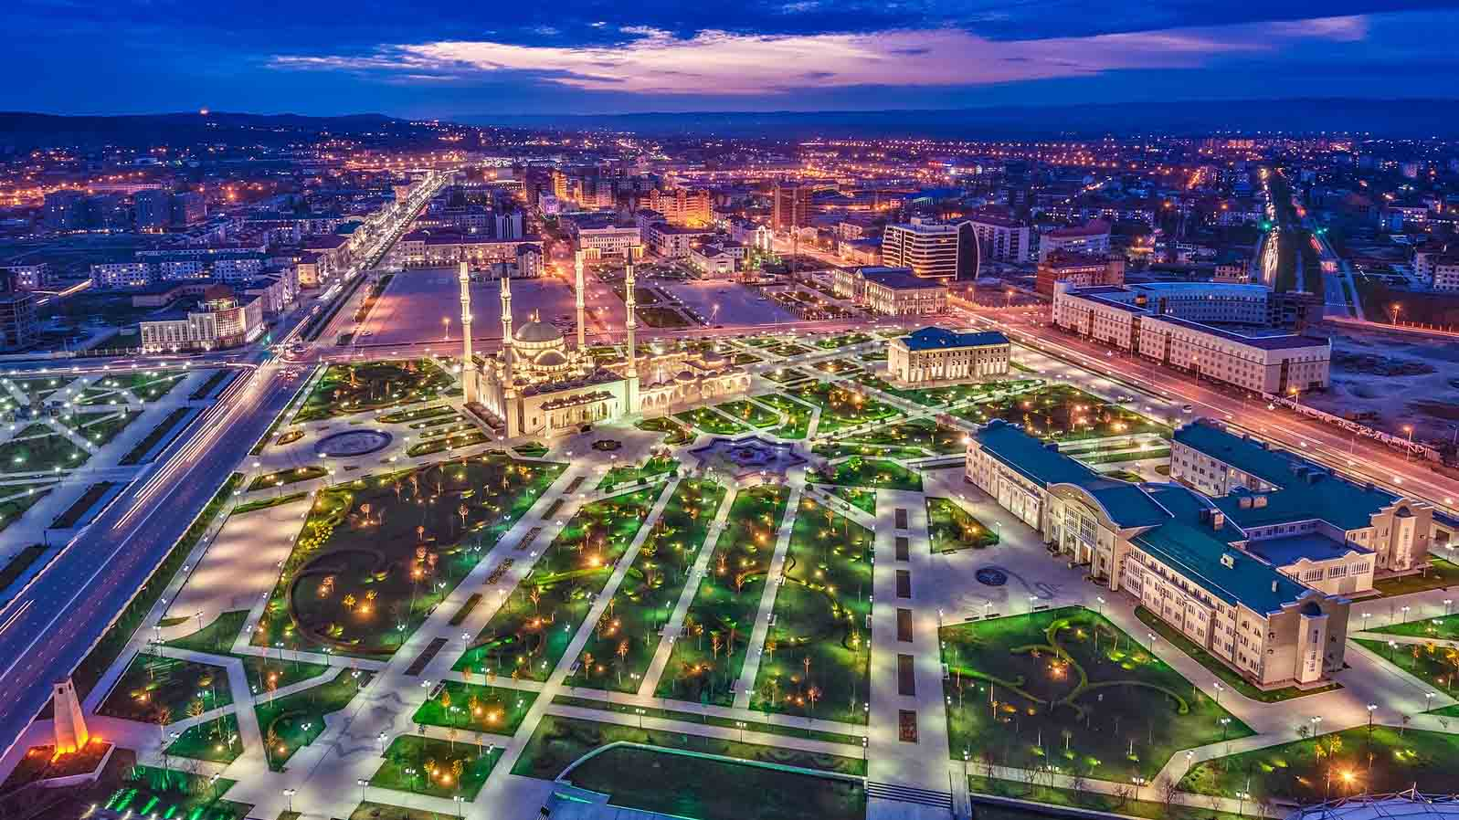
Grozny, Chechnia

Slide 32
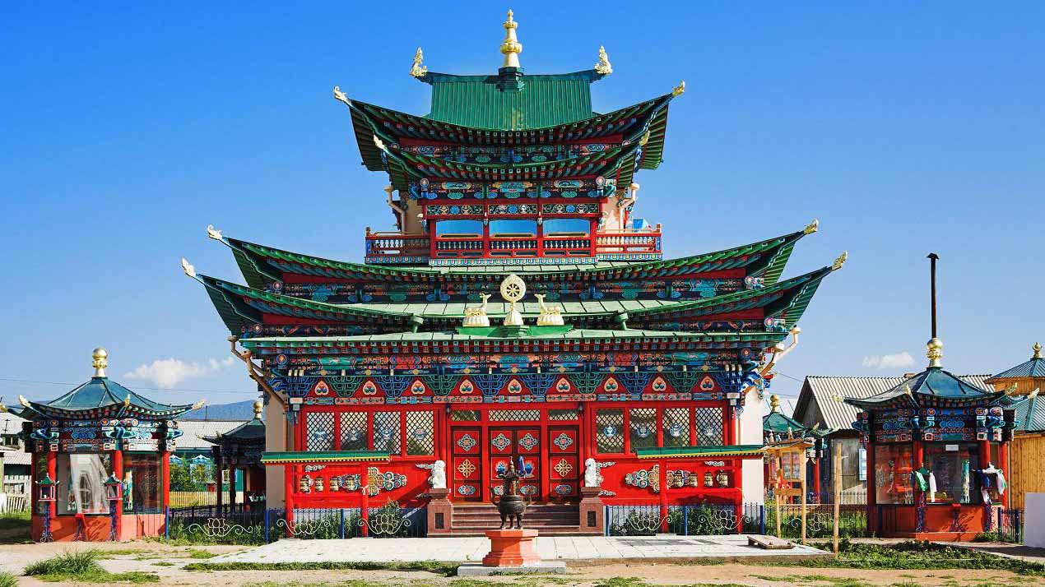
Ulan-Ude, Buryatia

Slide 33
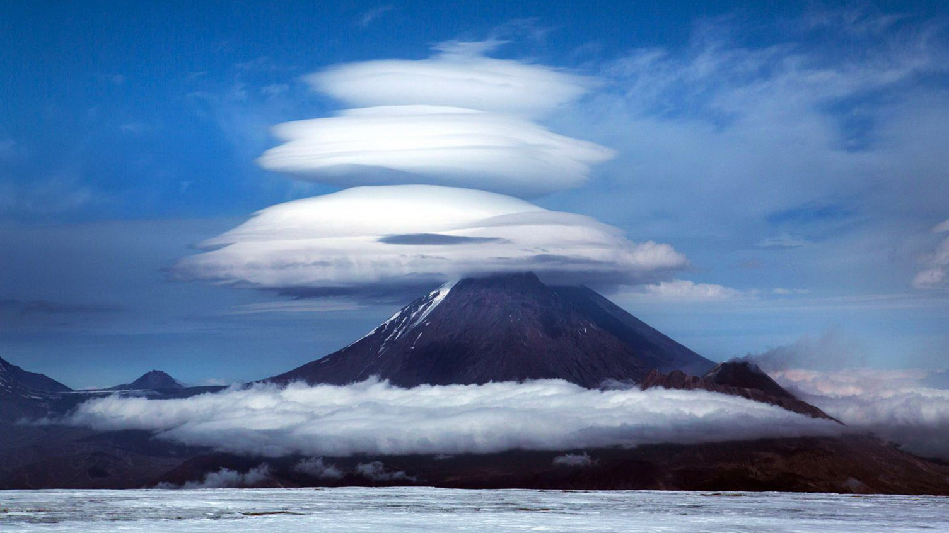
Kamchatka Peninsula

Slide 34
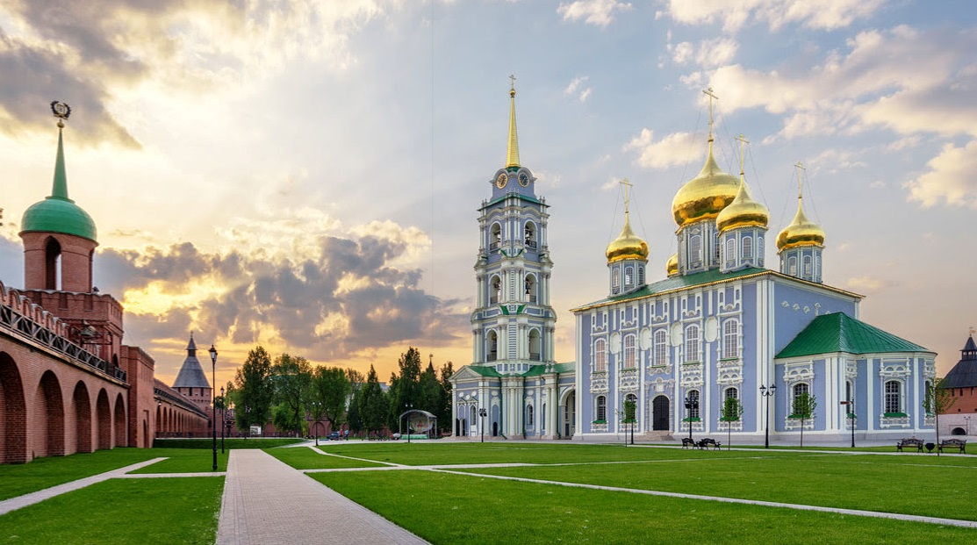
Uspensky Convent, Tula

Slide 35
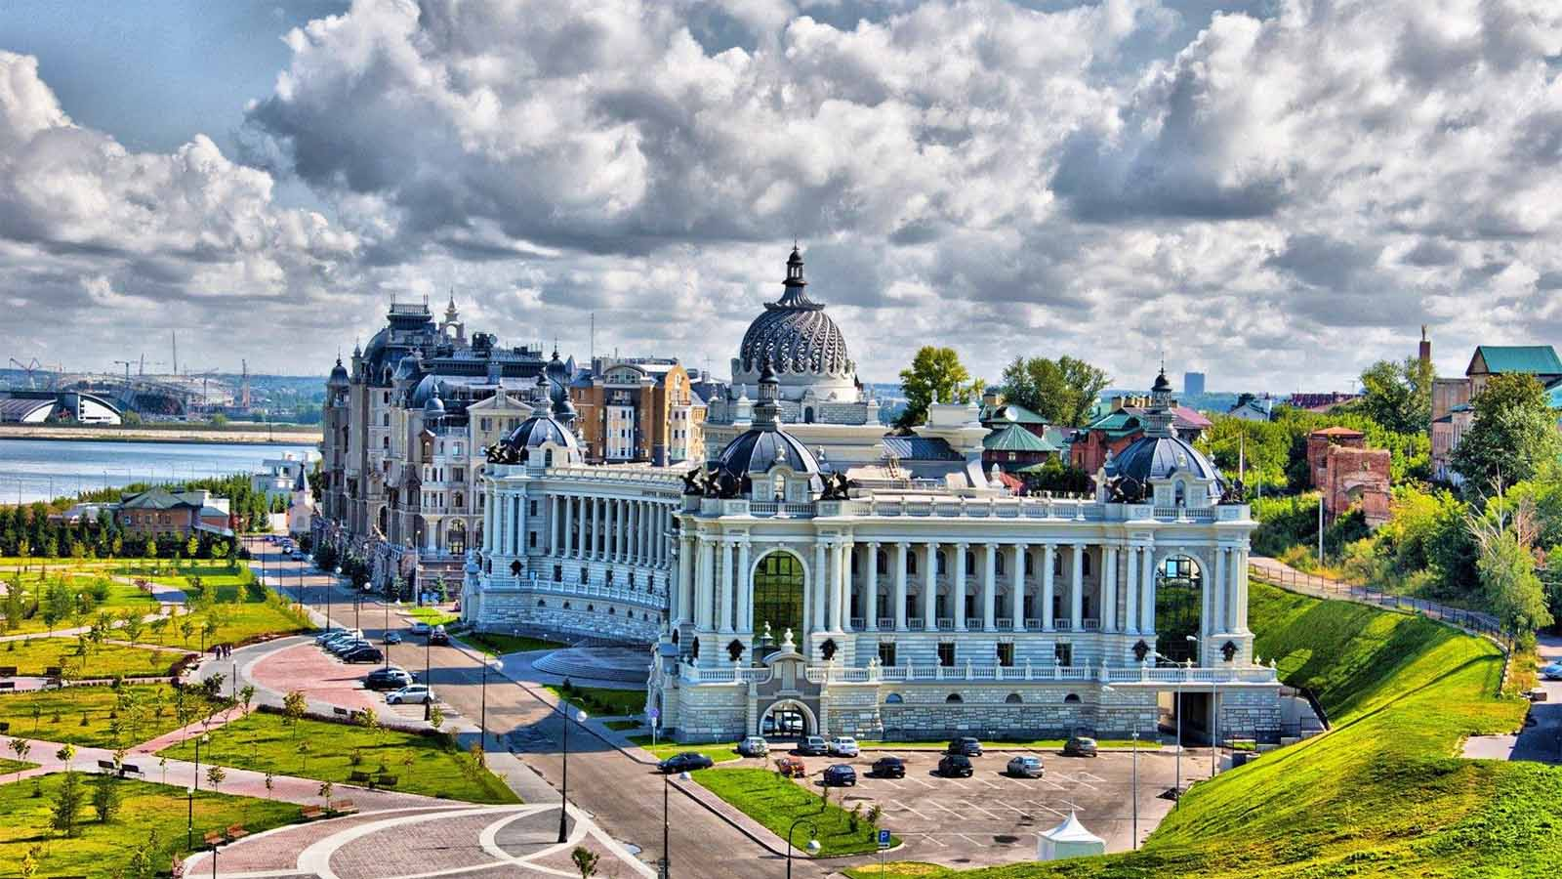
Kazan, Tatarstan

Slide 36
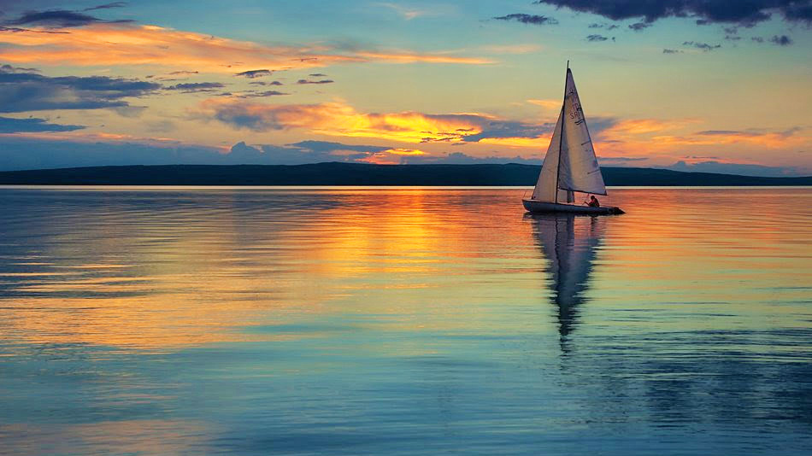
Lake Shira, Khakassia

Slide 37
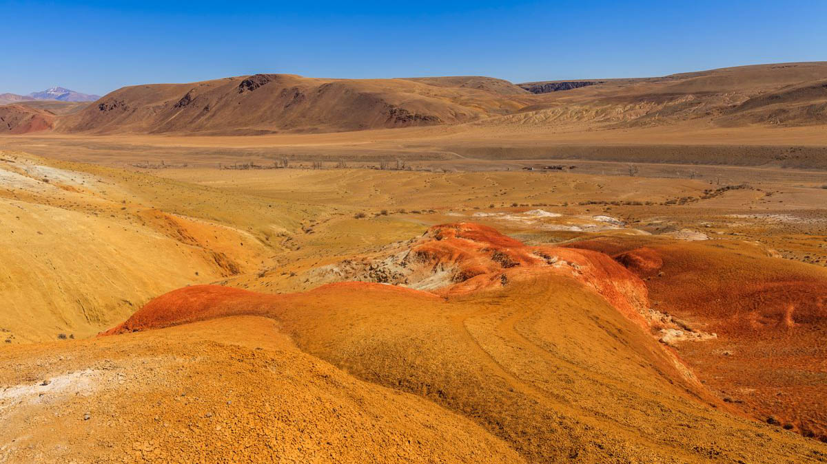
Altai Mountains

Slide 38
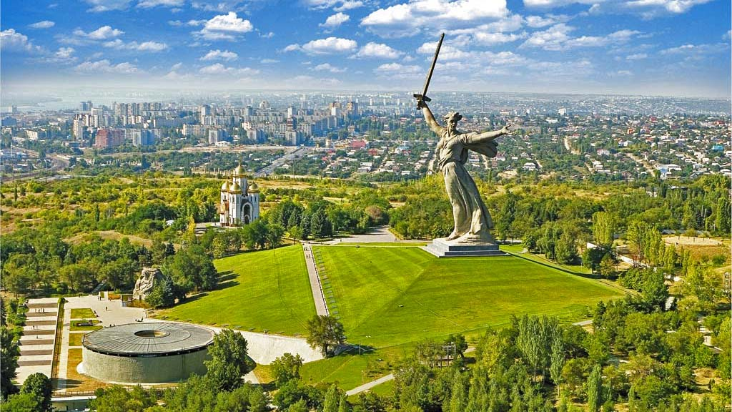
The Motherland Calls, Volgograd

Slide 39
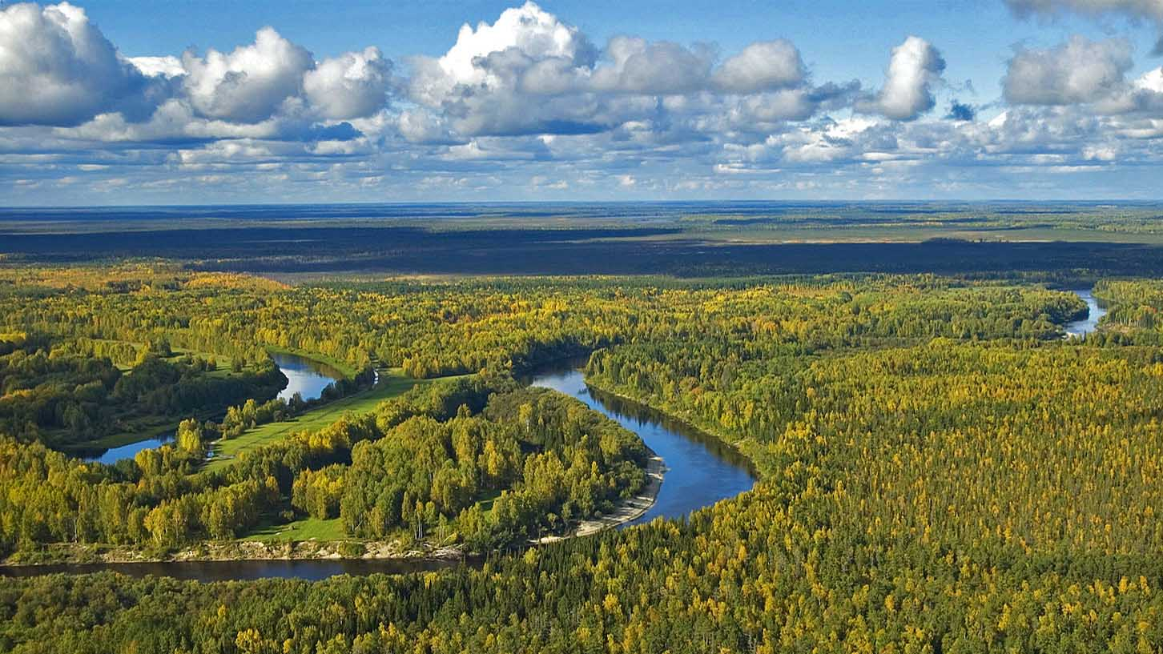
Siberian tajga

Slide 40
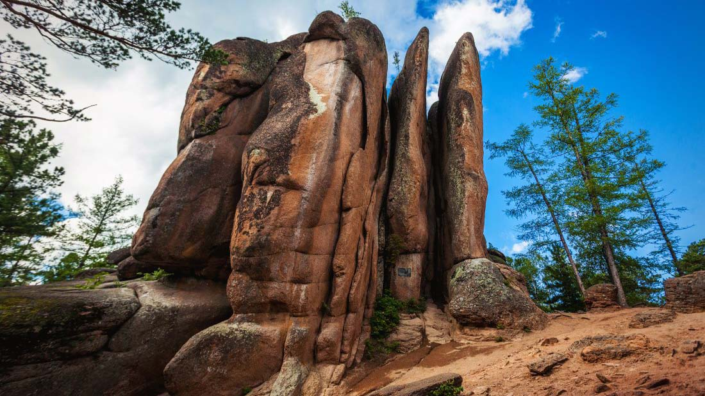
Stolby Natur Reserve, Krasnoyarsk

Slide 41
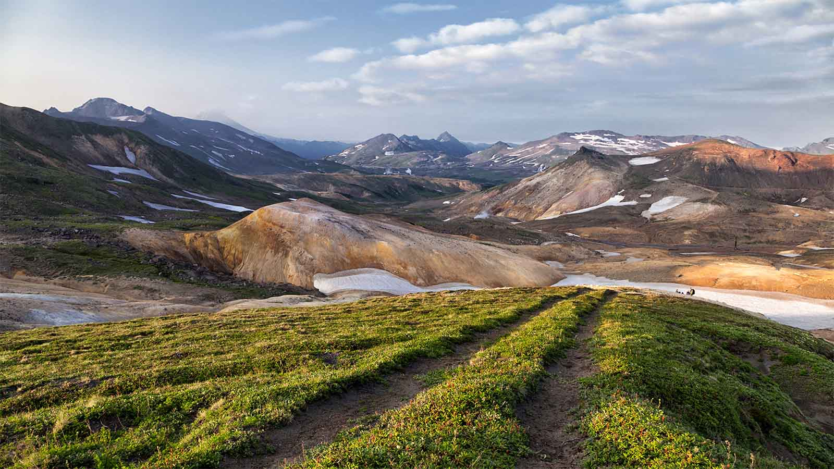
Kamchatka countryside

Slide 42
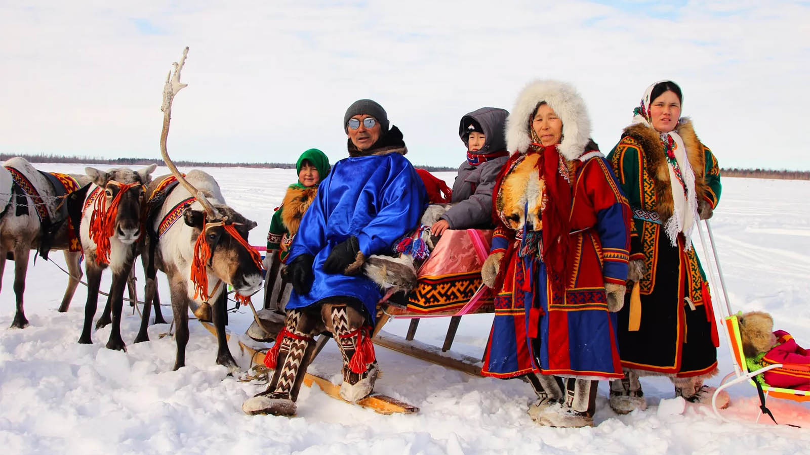
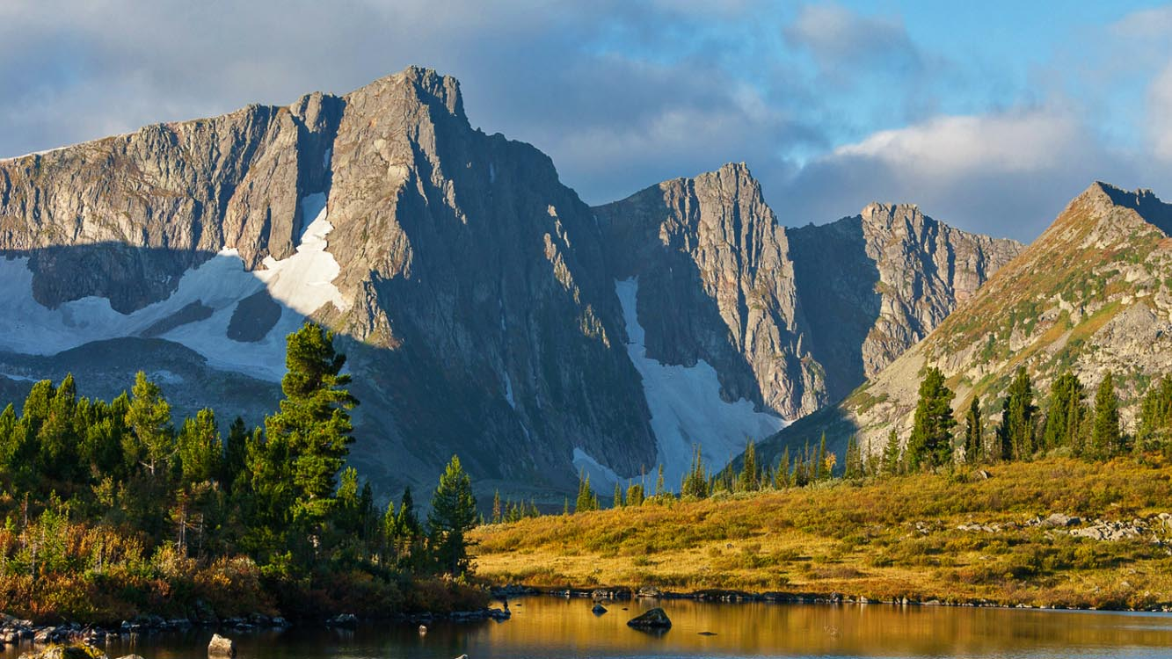
Kemerovo Obl.

Slide 43
People in Siberia

Slide 44
Hope you have enjoyed viewing this presentation
Have a nice day
With regards - Tony Chacko and Steve Rumpler
tonychacko2000@gmail.com pista2011@gmail.com
Music : Didula - Way to Home
2017

