Slide 1

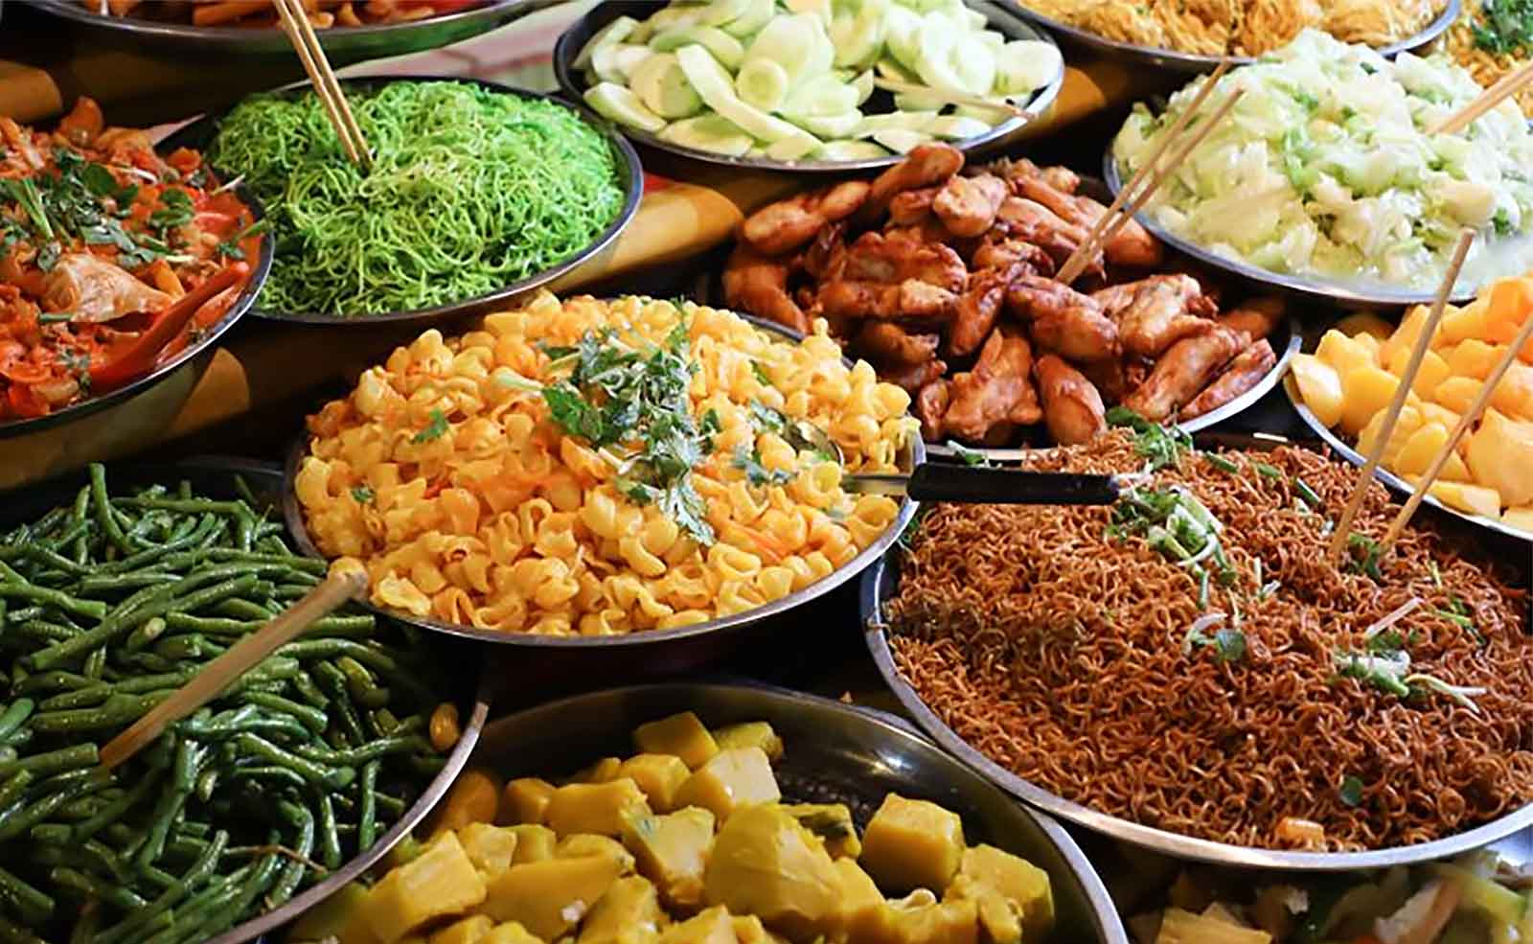

The Best of
South-East Asian food
Southeast Asia is home to an incredibly rich food history. From French colonial-inspired bánh mì to Singapore's iconic chicken rice to creamy Thai tom yam kung soup, this is one cuisine that embraces enough flavors to satisfy any palate. Then there are the frier items like Satays and Barbeques. Here are some great recipes to get you started!
(A presentation by Tony Chacko)

Slide 2
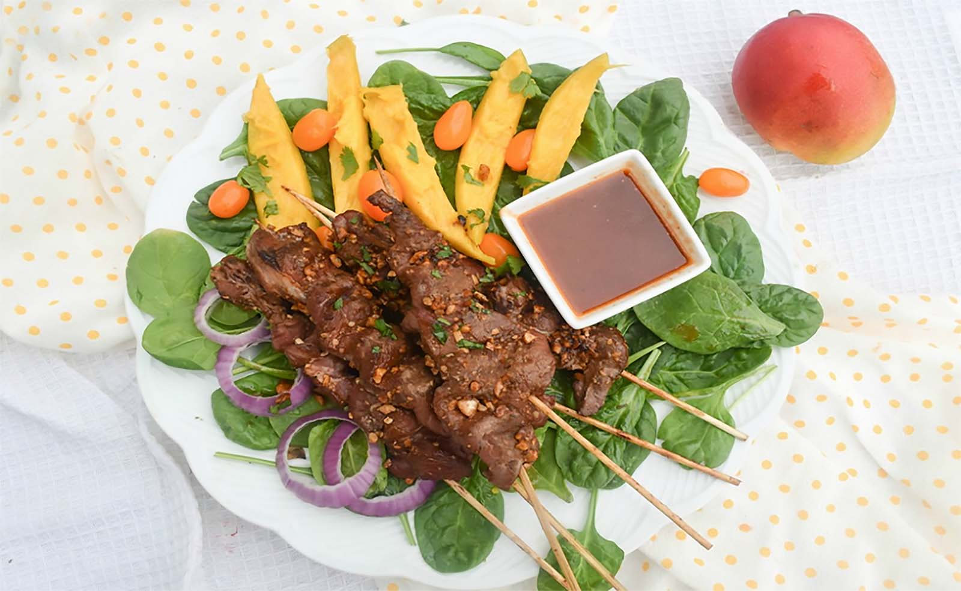
Beef Satay

Slide 3
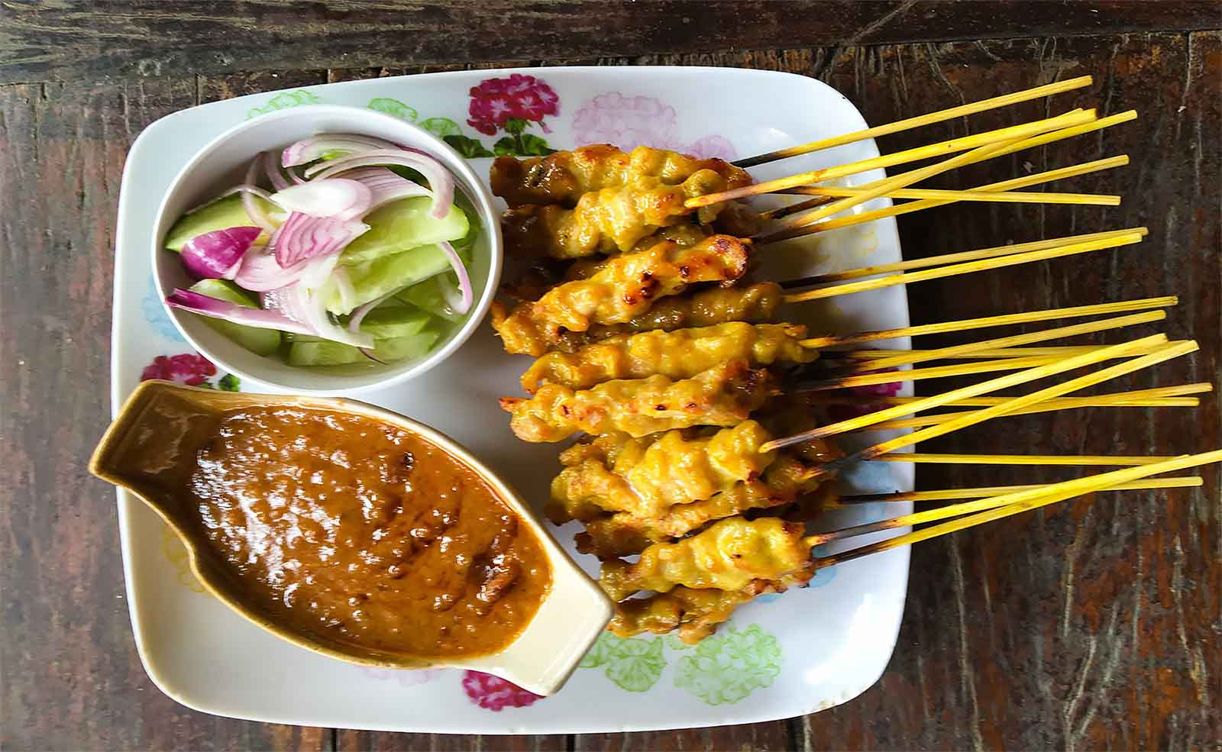
Chicken Satay with Peanut Sauce and Cucumber Salad

Slide 4
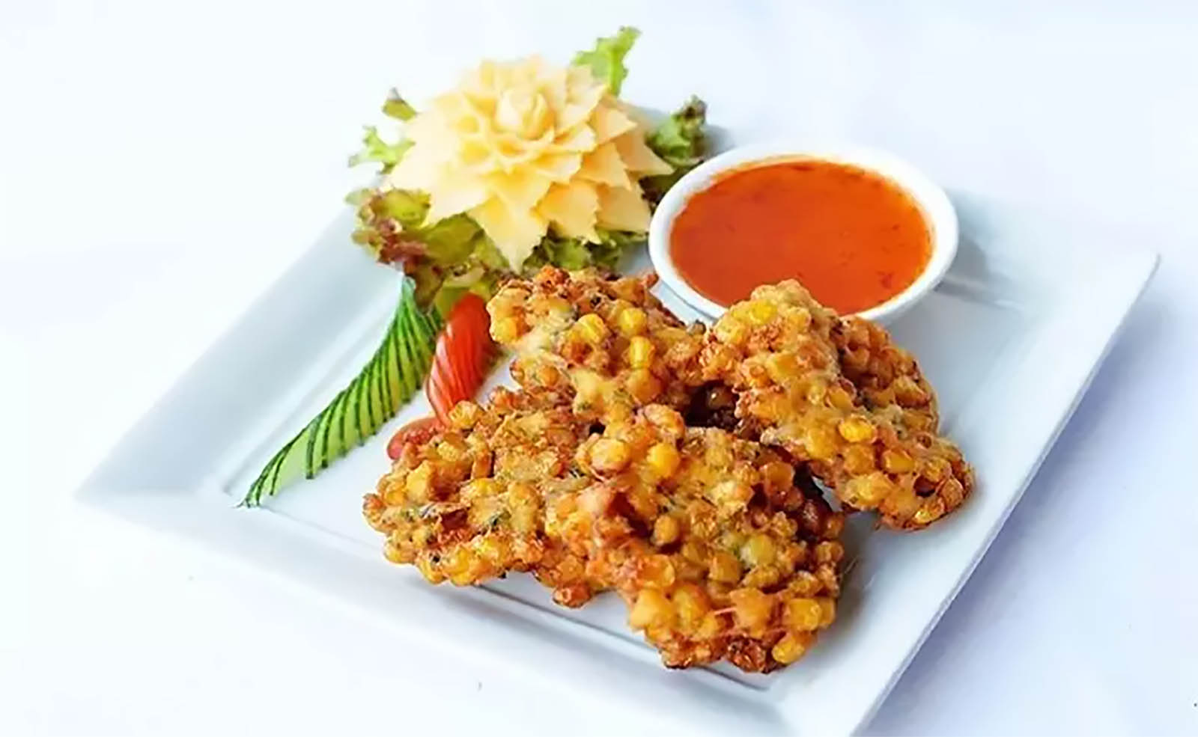
Thai Corn Fritters (Tod Man Khao Pod)

Slide 5
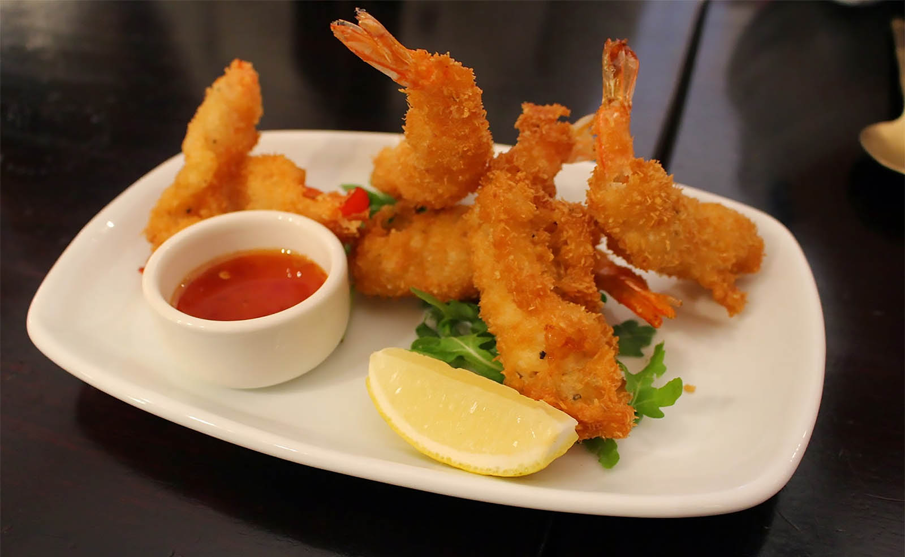
Tempura Prawns with Chilli Dip Sauce

Slide 6
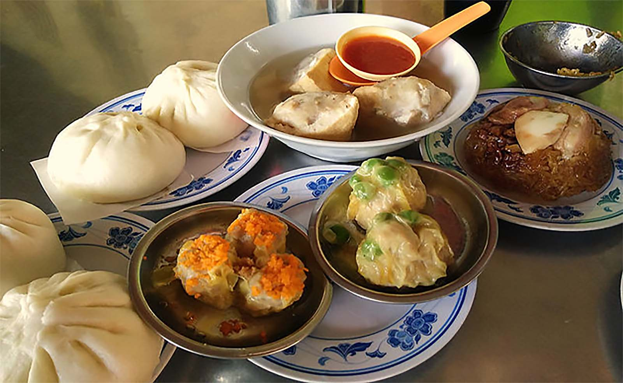
Char Siew Pau (Steamed BBQ Pork in Bun)

Slide 7
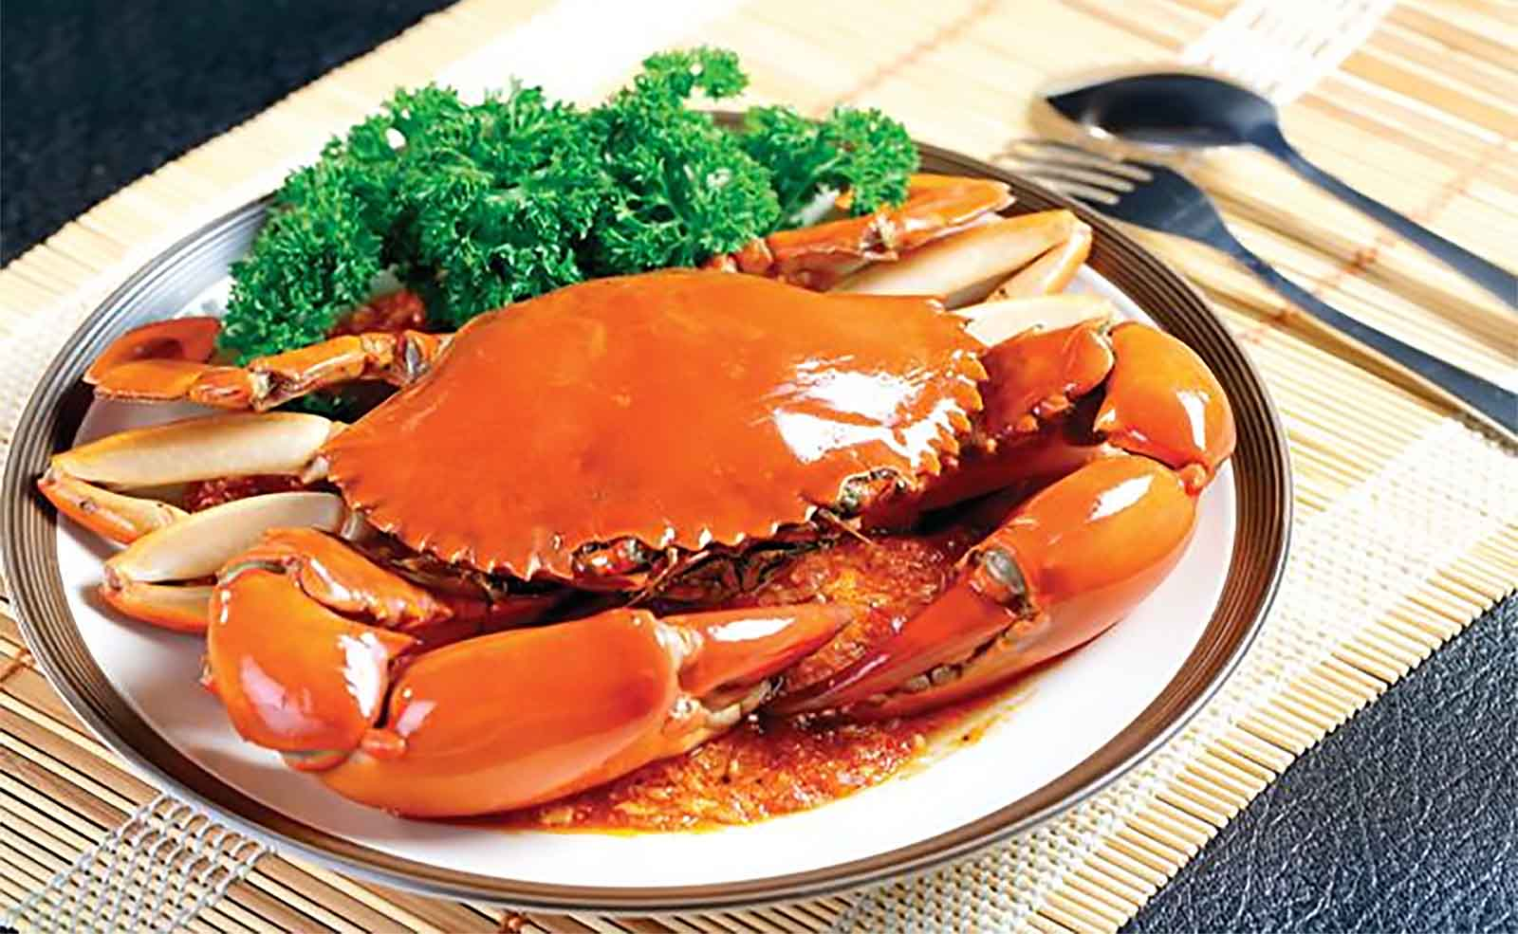
Singapore's Chilli Crab

Slide 8
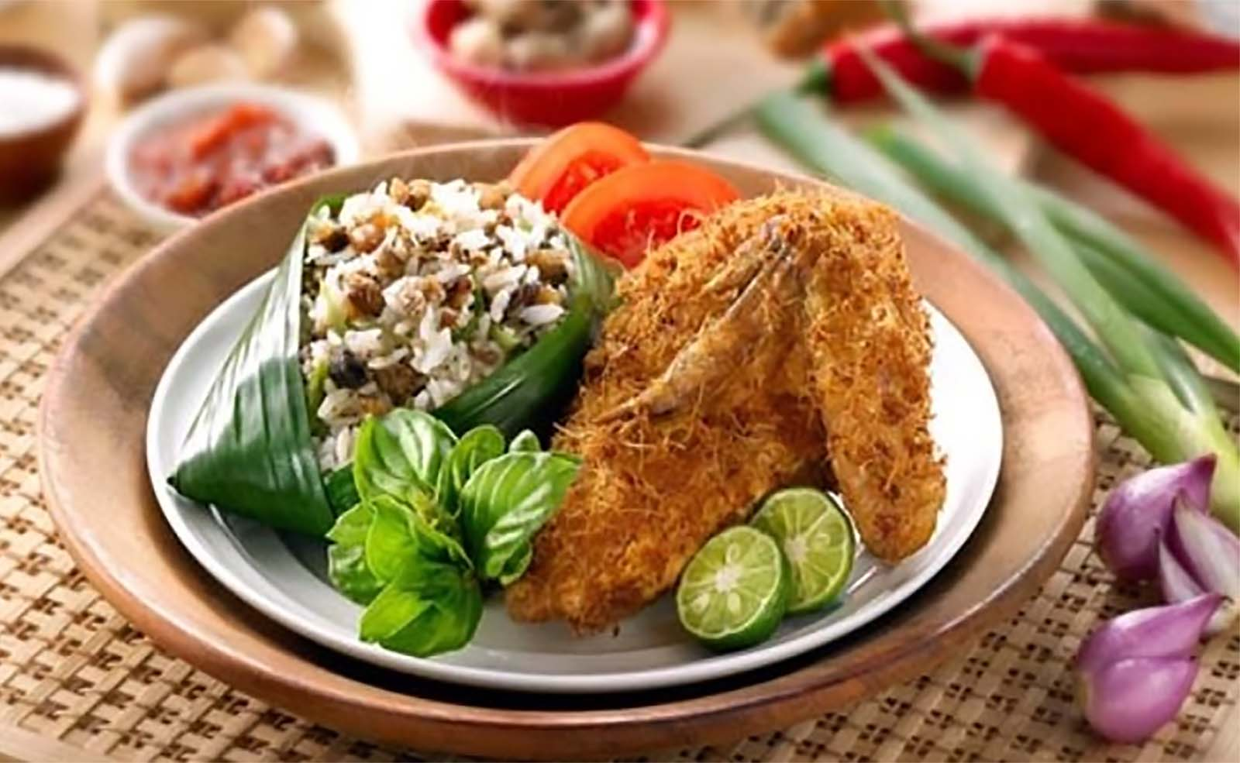
Indonesian Ayam Goreng and Nasi Tutug (Fried Chicken and Tutug Rice in Banana Leaf)

Slide 9
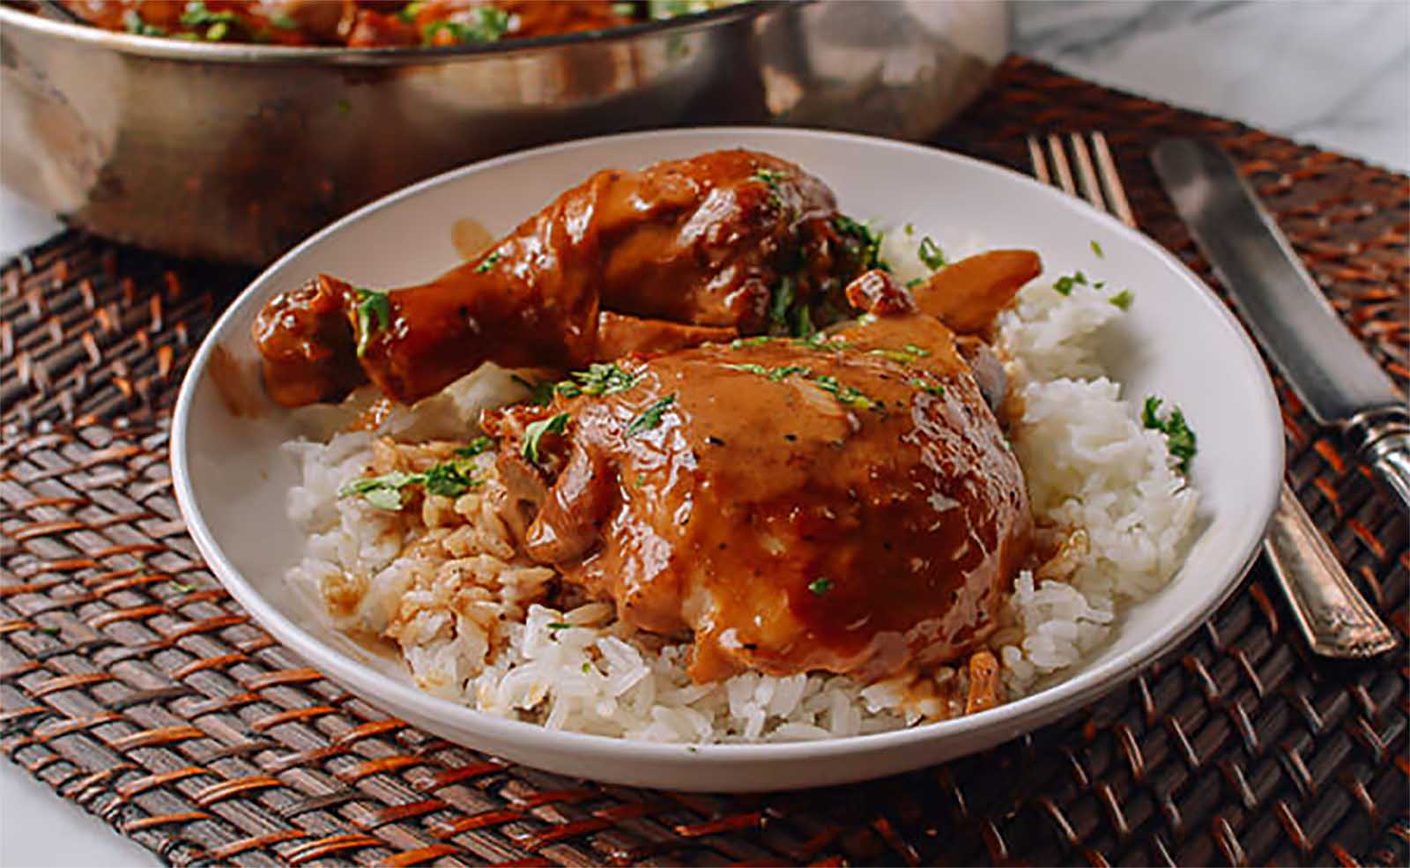
Chicken Adobe (Philippines)

Slide 10
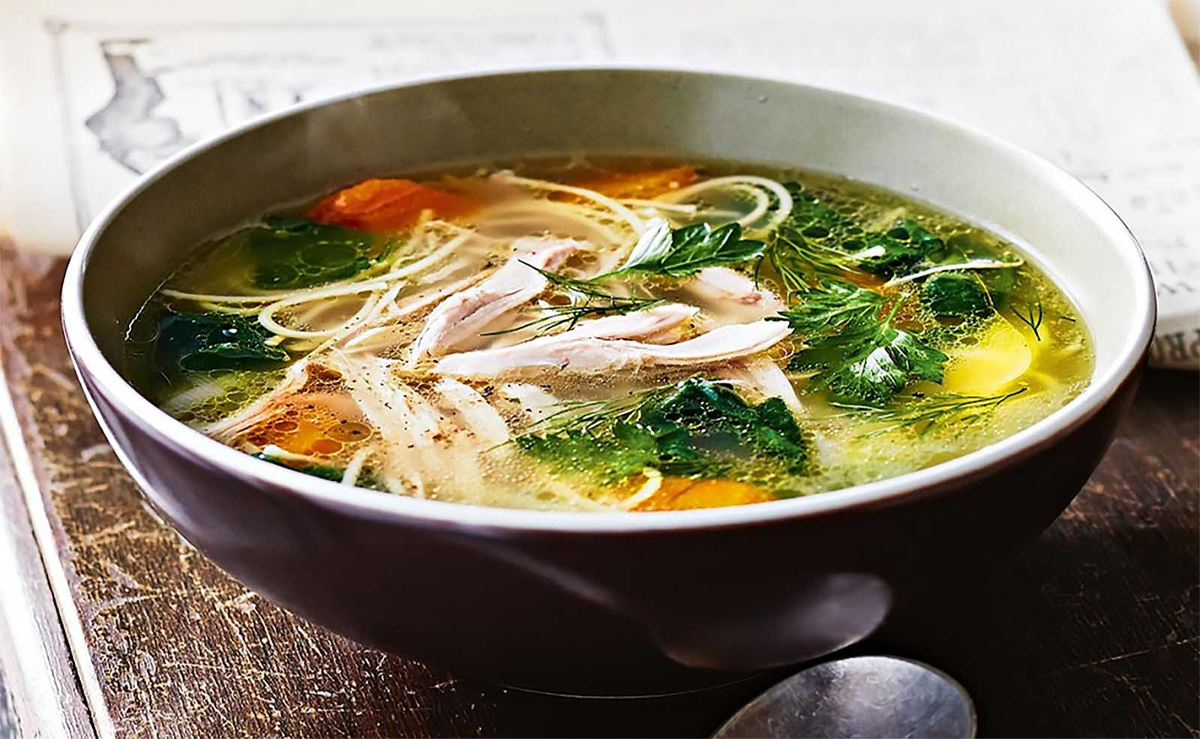
Chicken Noodle Soup

Slide 11
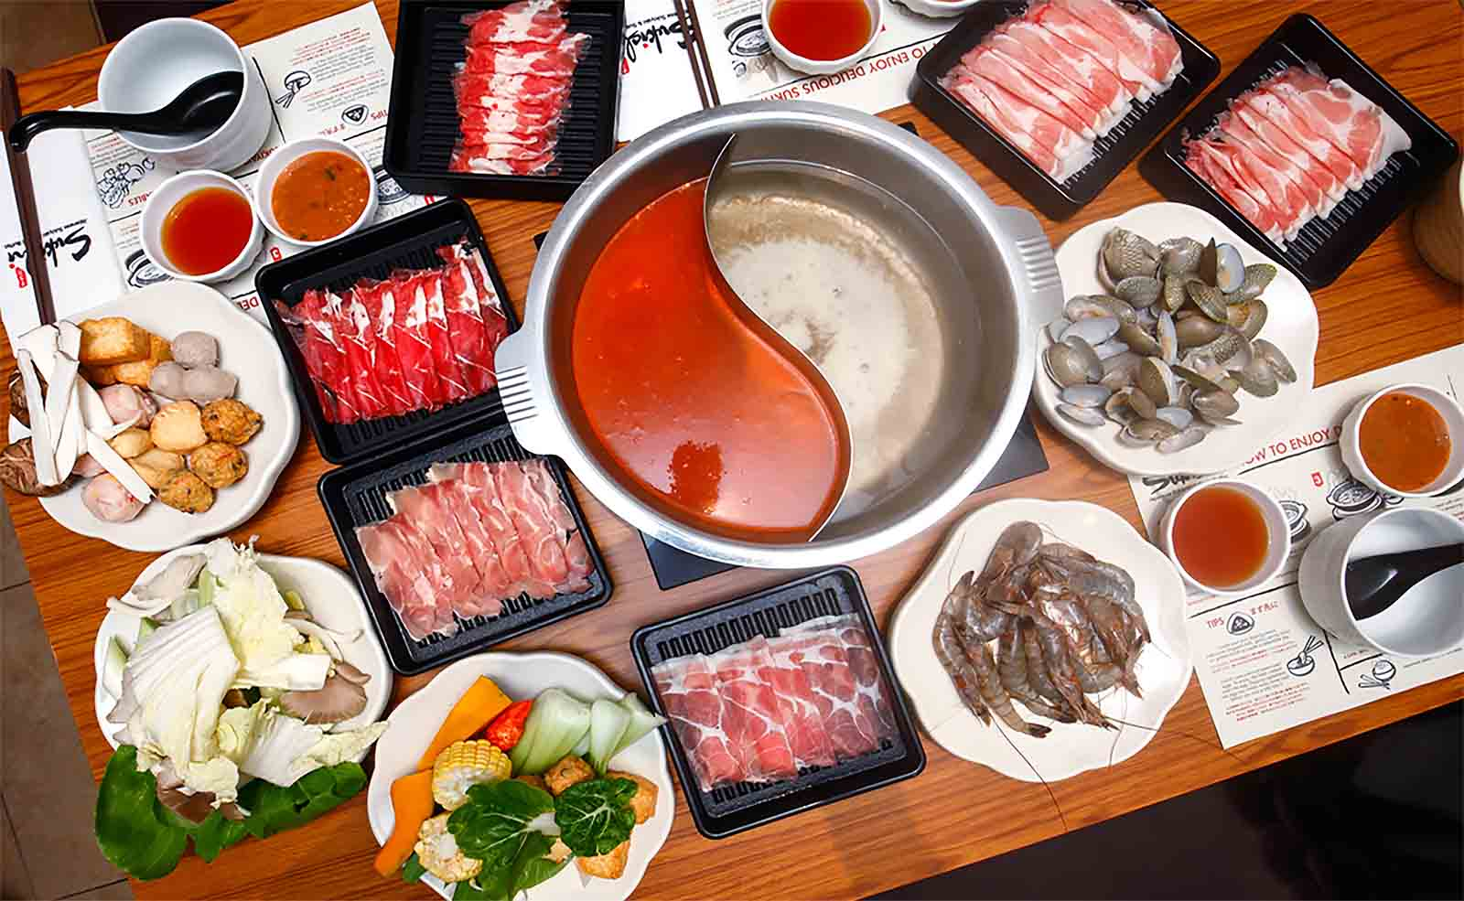
Sukiyaki is a Japanese dish that is prepared and served in the nabemono (Japanese hot pot) style. It consists of meat (usually thinly sliced beef) which is slowly cooked or simmered at the table, alongside vegetables and other ingredients, in a shallow iron pot in a mixture of soy sauce, sugar, and mirin. Though a speciality food, non-Chinese people refrain eating this dish as all these non-veg items are served raw.

Slide 12
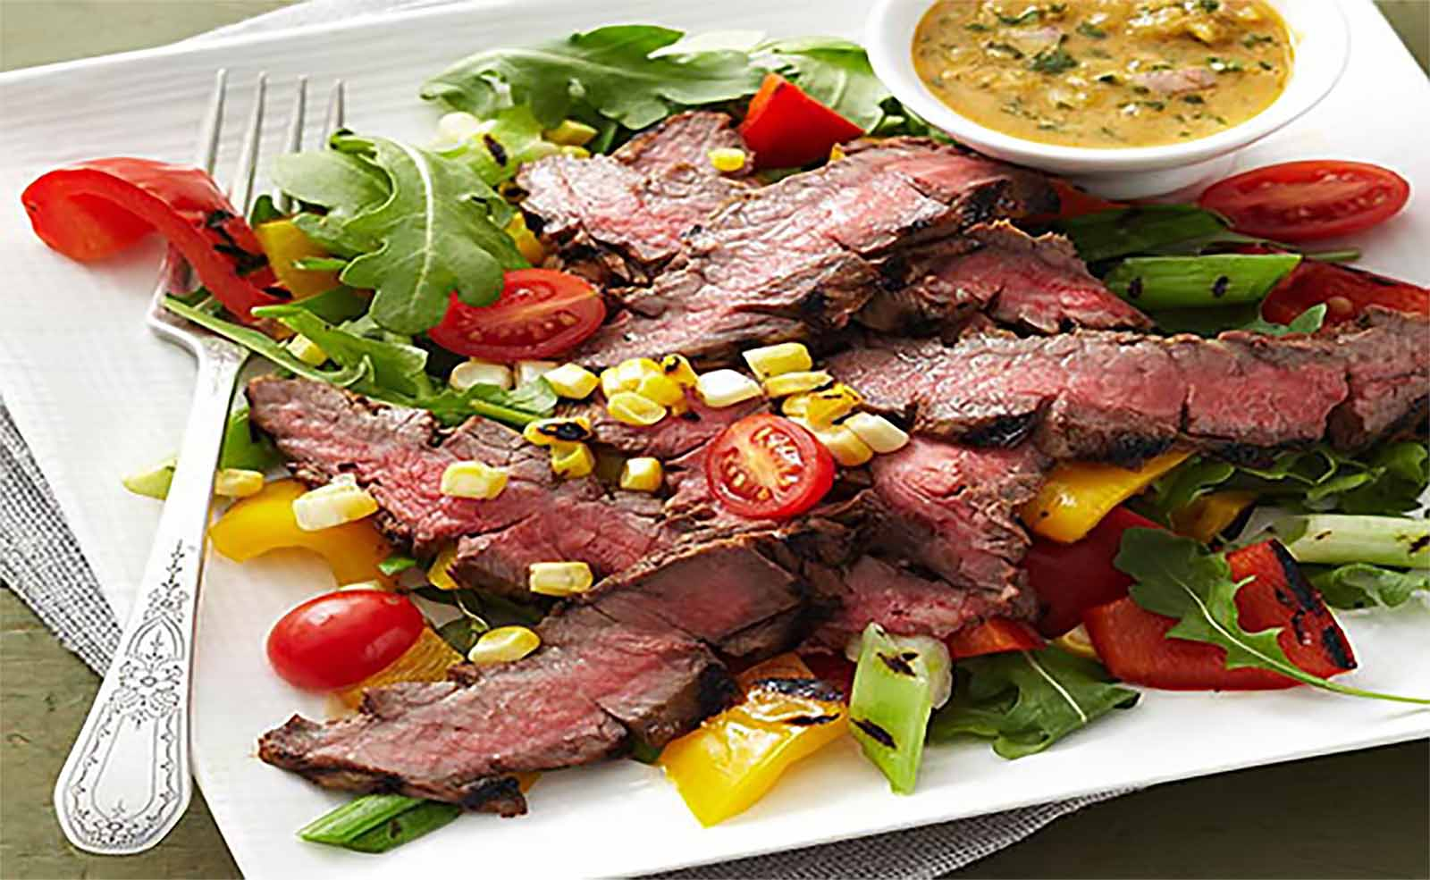
Thai-Style Marinated Flank Steak and Herb Salad

Slide 13
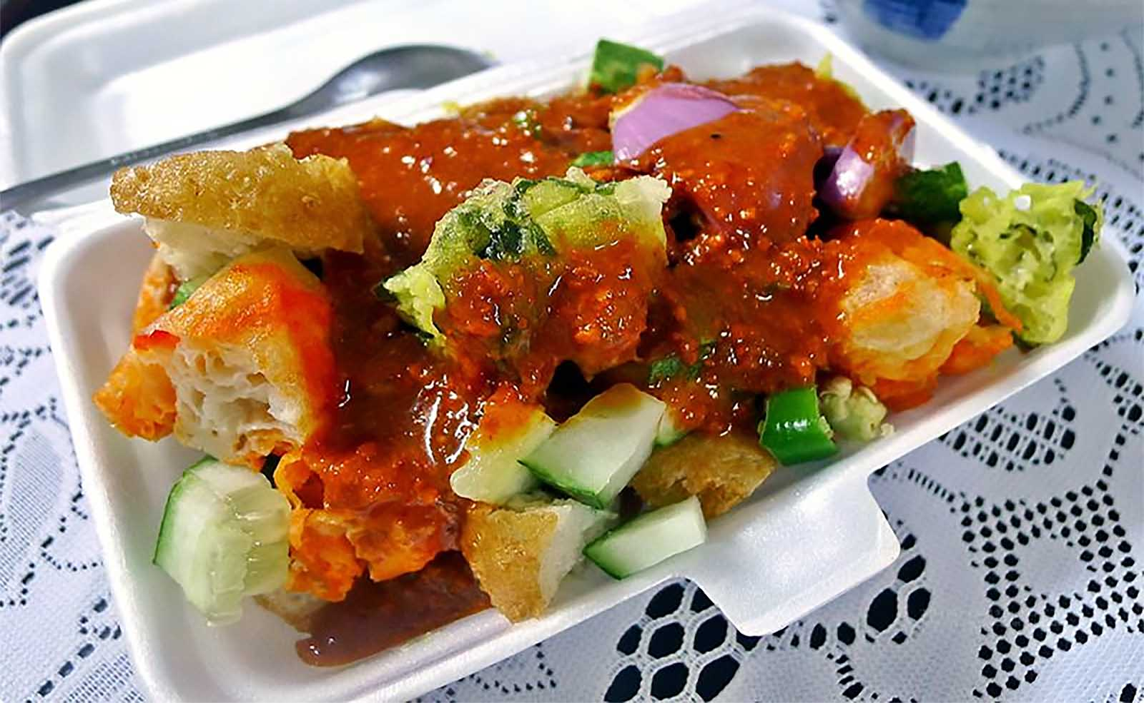
Rojak or Rujak is a traditional fruit and vegetable salad dish commonly found in Indonesia, Malaysia and Singapore. Rojak in Malaysia and Singapore, however, is mostly of Indian influence, mixed with fried tofu, cracker, cruller, meat and seafood fritter.

Slide 14
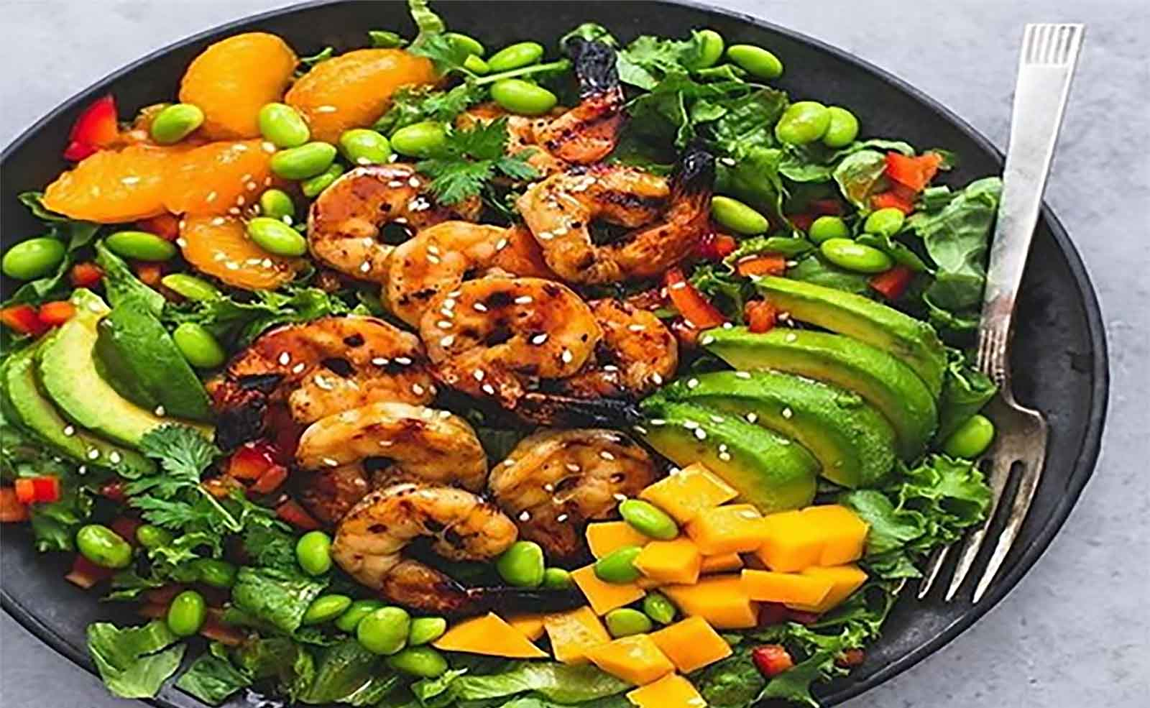
Mango Mandarin Sesame Shrimp Salad

Slide 15
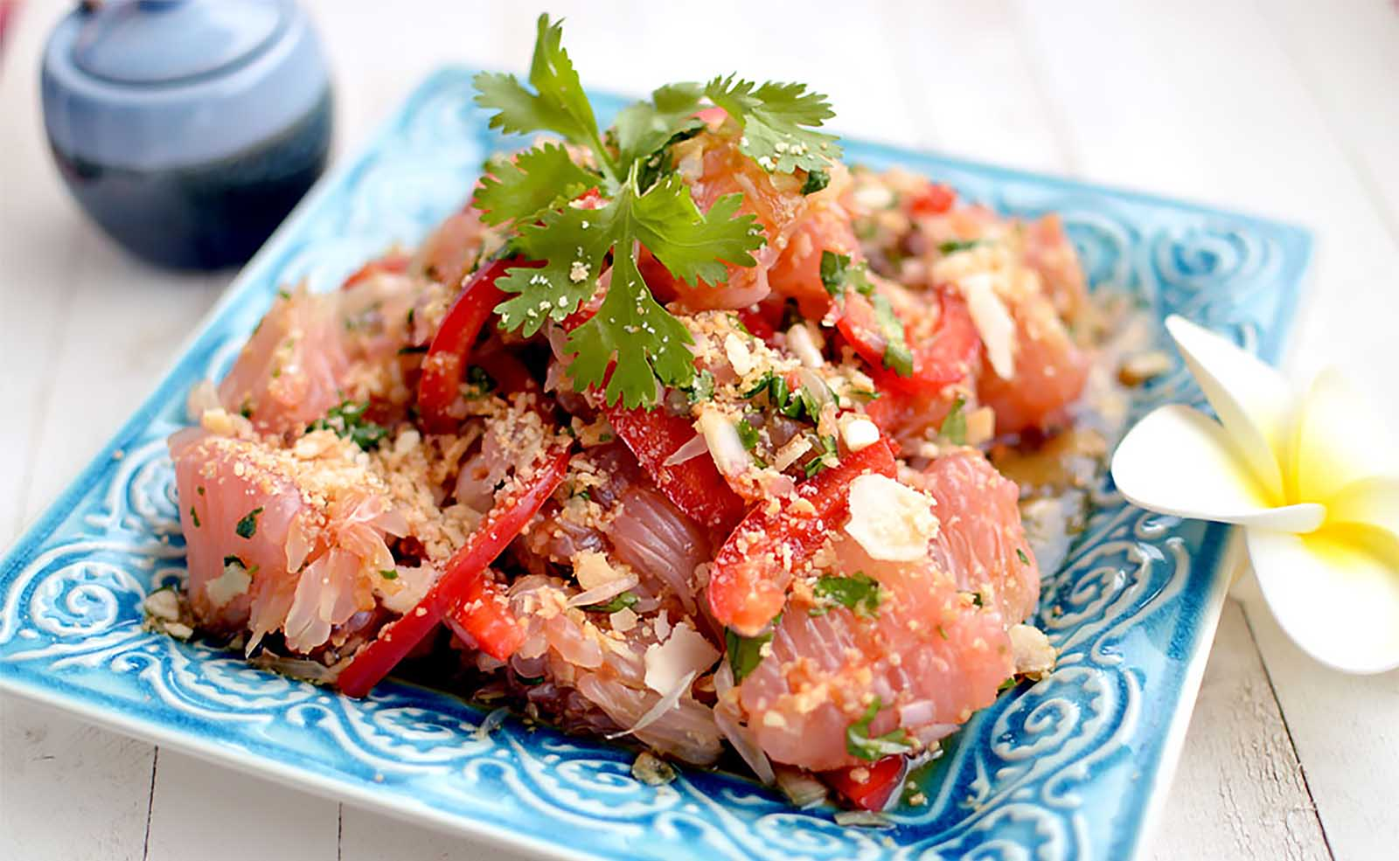
Jicama and Pomelo Salad with Spicy Thai Dressing (Vegan)

Slide 16
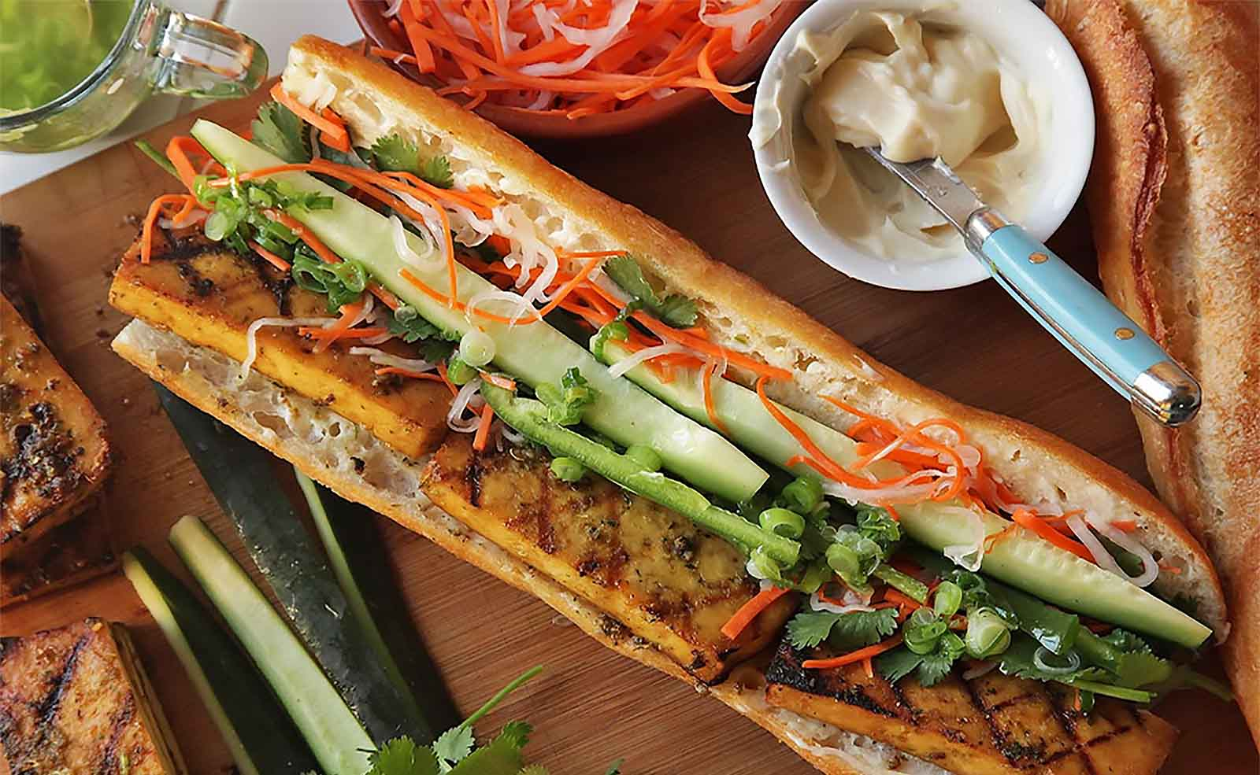
Vietnamese Sandwiches with Tempura Sweet Potato and Avocado (Vegan Banh Mì)

Slide 17
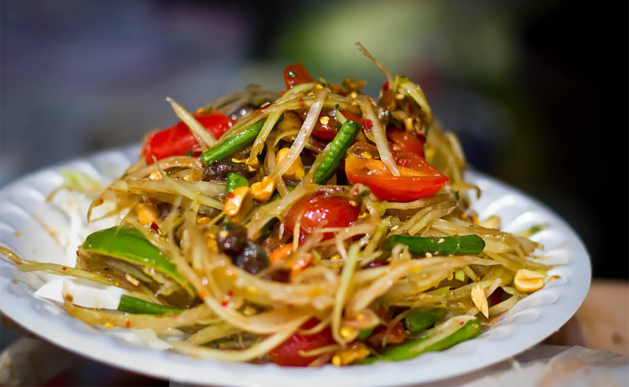
Laotian Papaya Salad

Slide 18
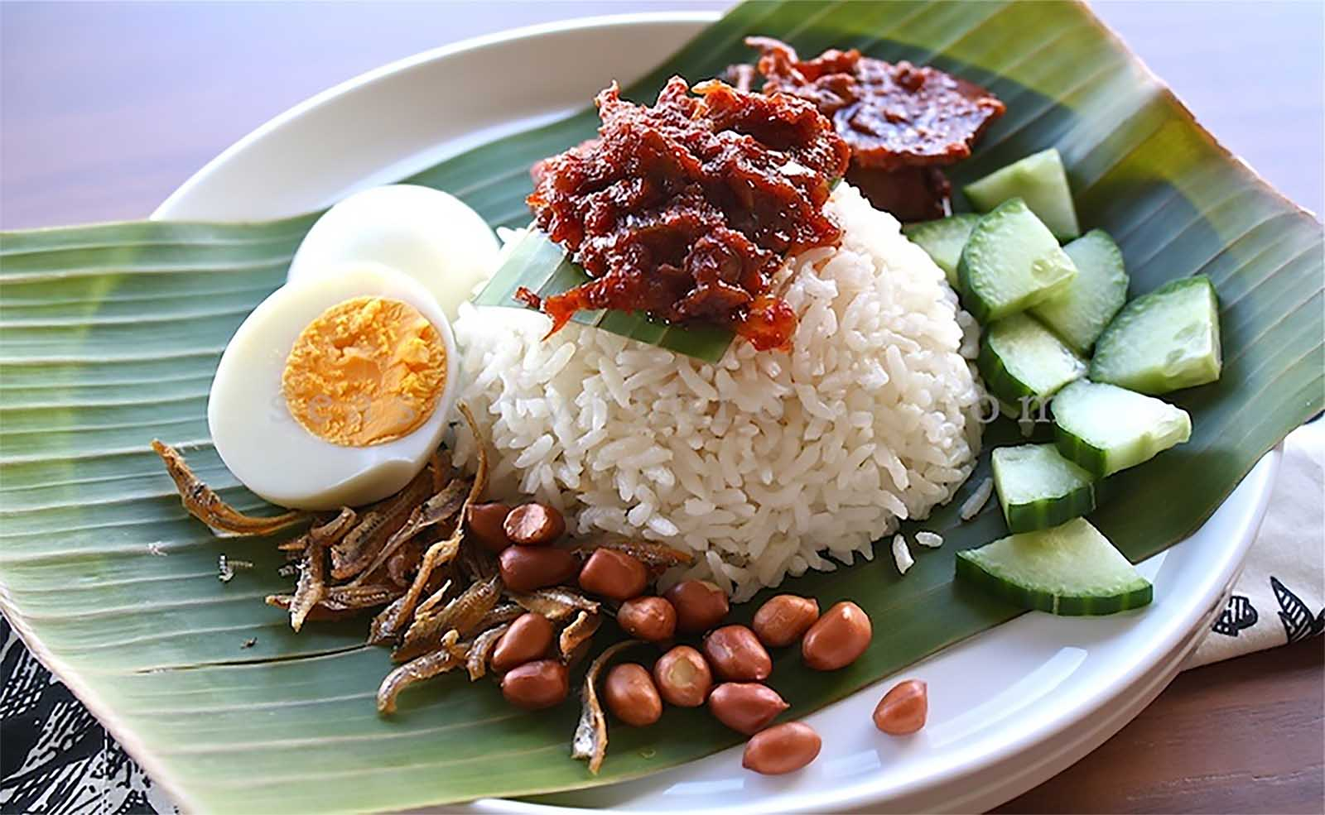
Nasi Lemak and Sambal : Rice and spicy fried anchovies gravy (or fried prawn gravy).

Slide 19
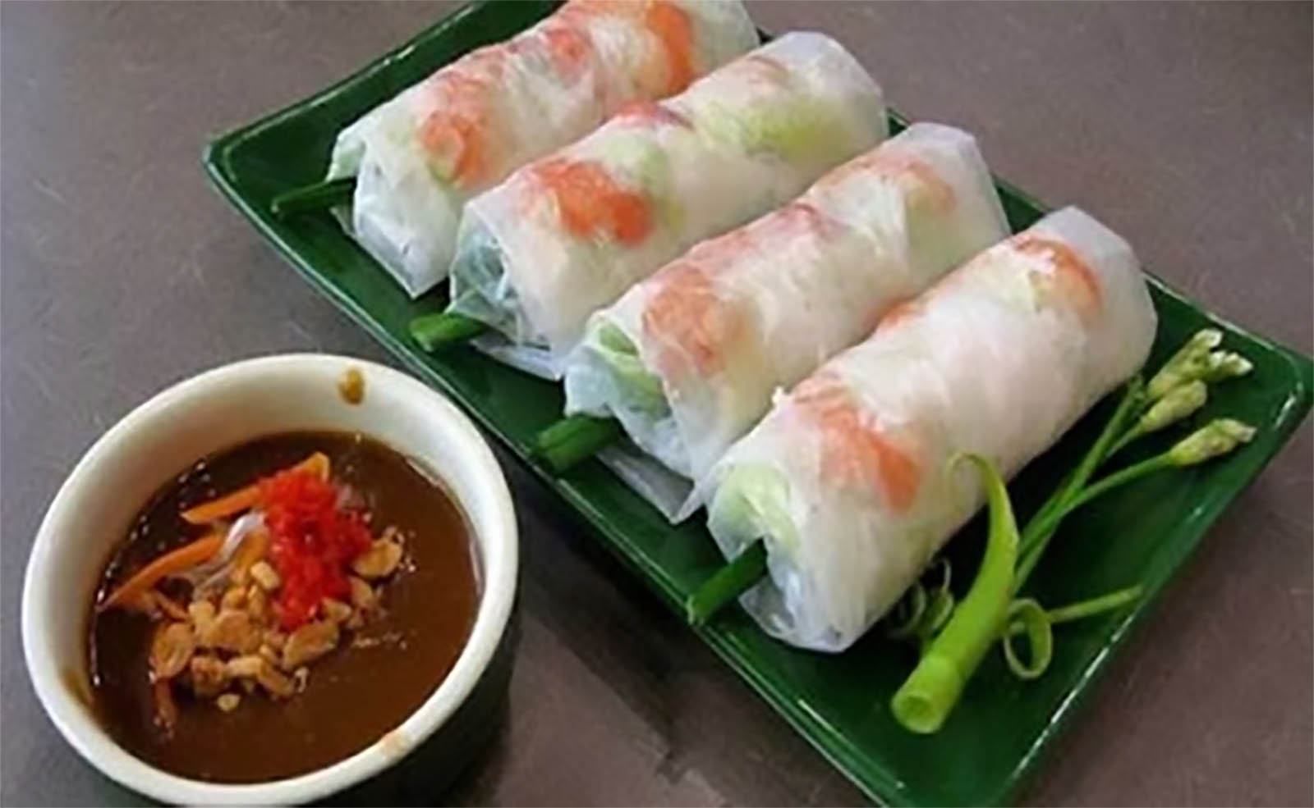
Goi Cuon (Vietnamese Spring Roll)

Slide 20
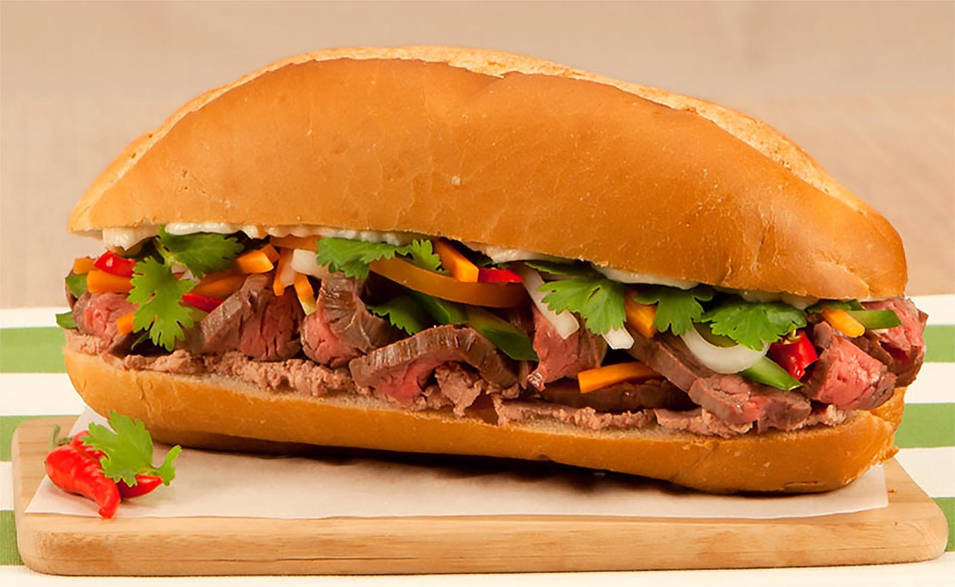
Bánh mì (Bacon or Beef) are crusty French-style buns stuffed with a classic explosion of Vietnamese flavours and textures - sweet and sour, crunchy and soft.

Slide 21
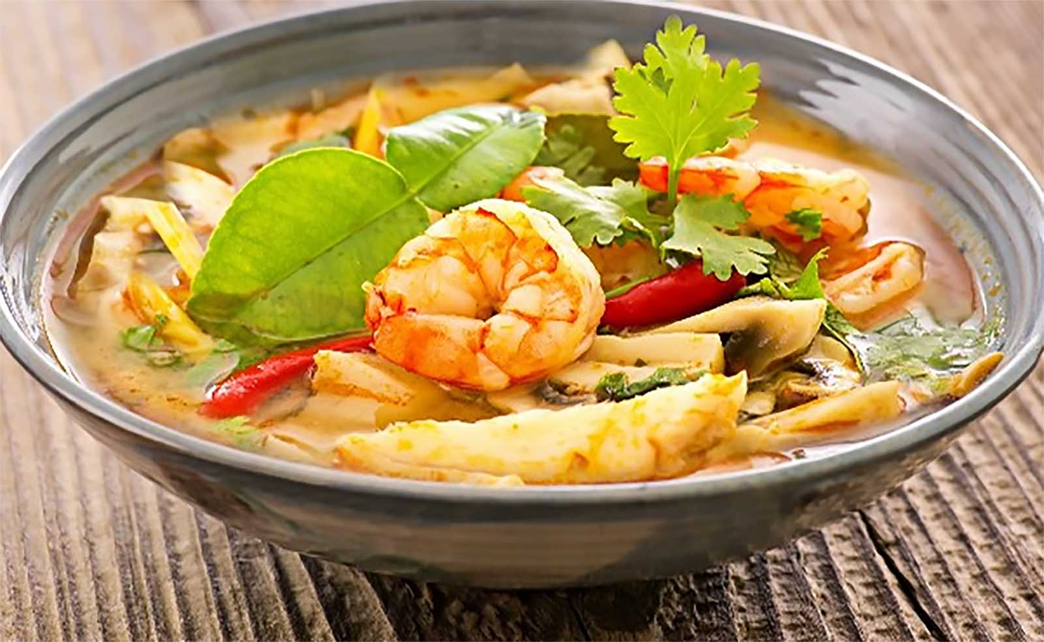
Tom Yum Gung : Hot and Sour Thai Soup

Slide 22
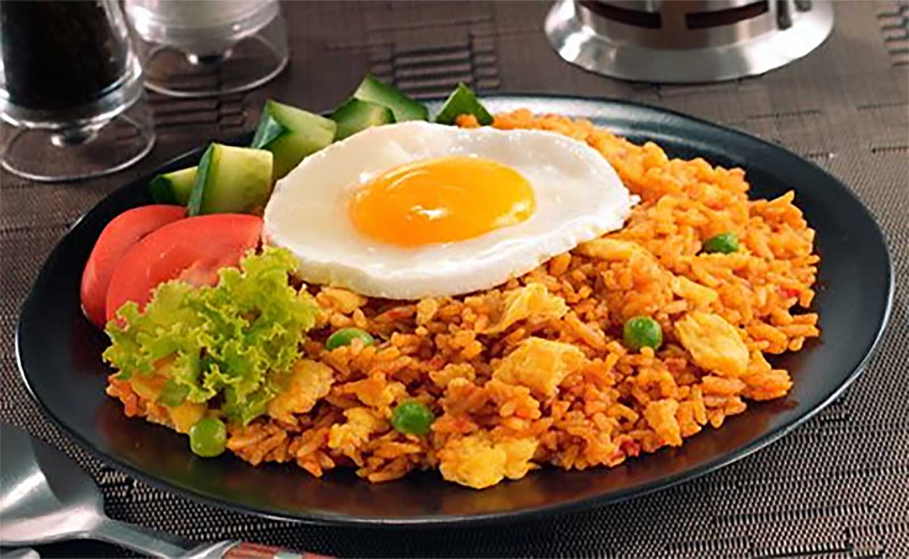
Nasi Goreng (Indonesian / Malaysian Fried Rice)

Slide 23
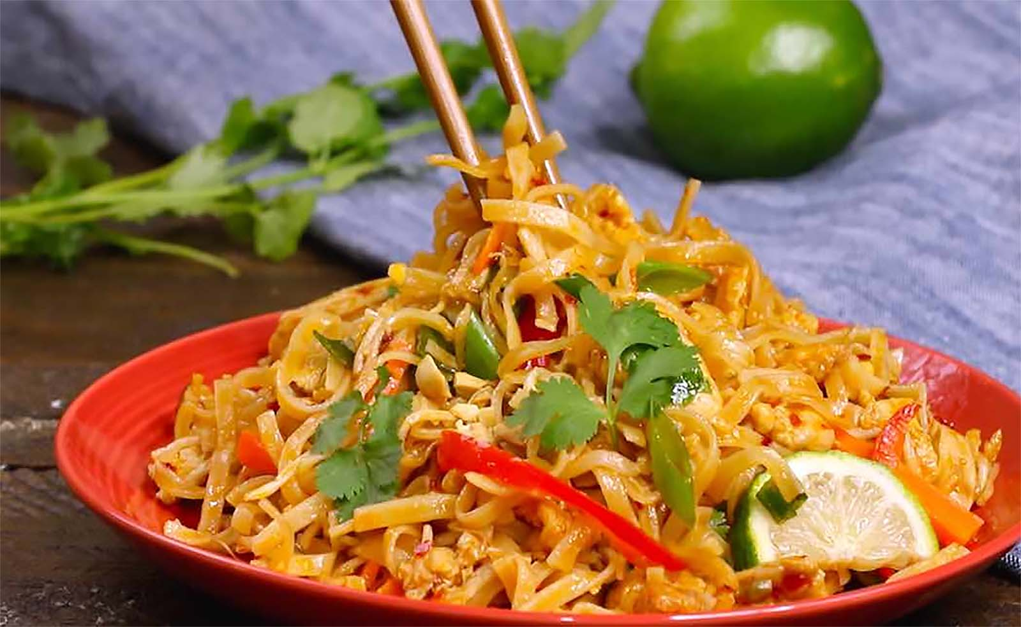
Chicken Pad Thai

Slide 24
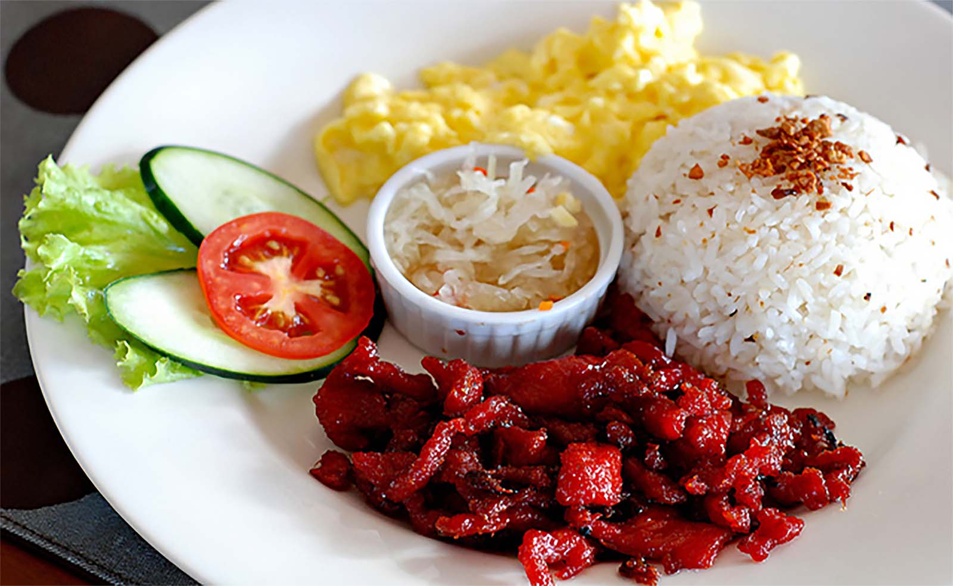
Tocino (Sweet Cured Pork) with garlic rice, scrambled egg and salad - Philippino Breakfast

Slide 25
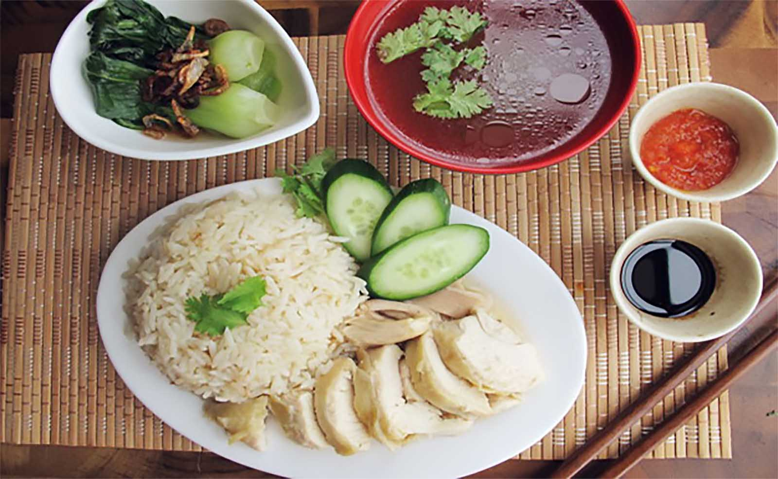
Hainanese Chicken Rice Set

Slide 26
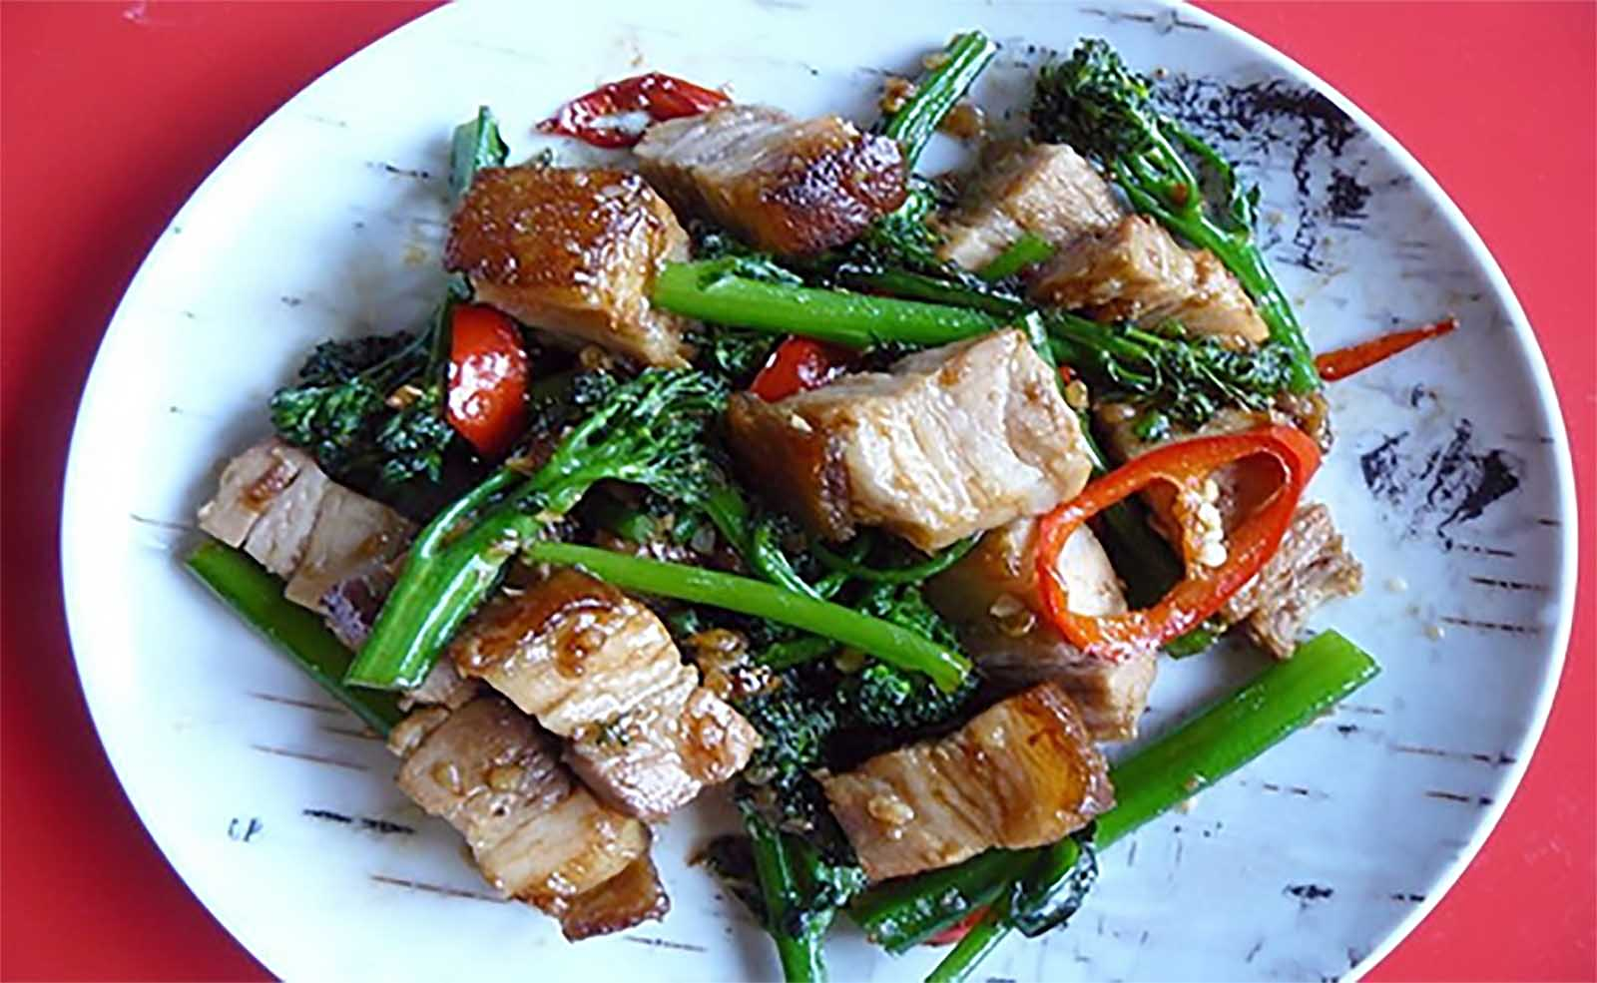
Stir-Fried Chinese Broccoli with Crispy Pork Belly (Khana Mu Krop)

Slide 27
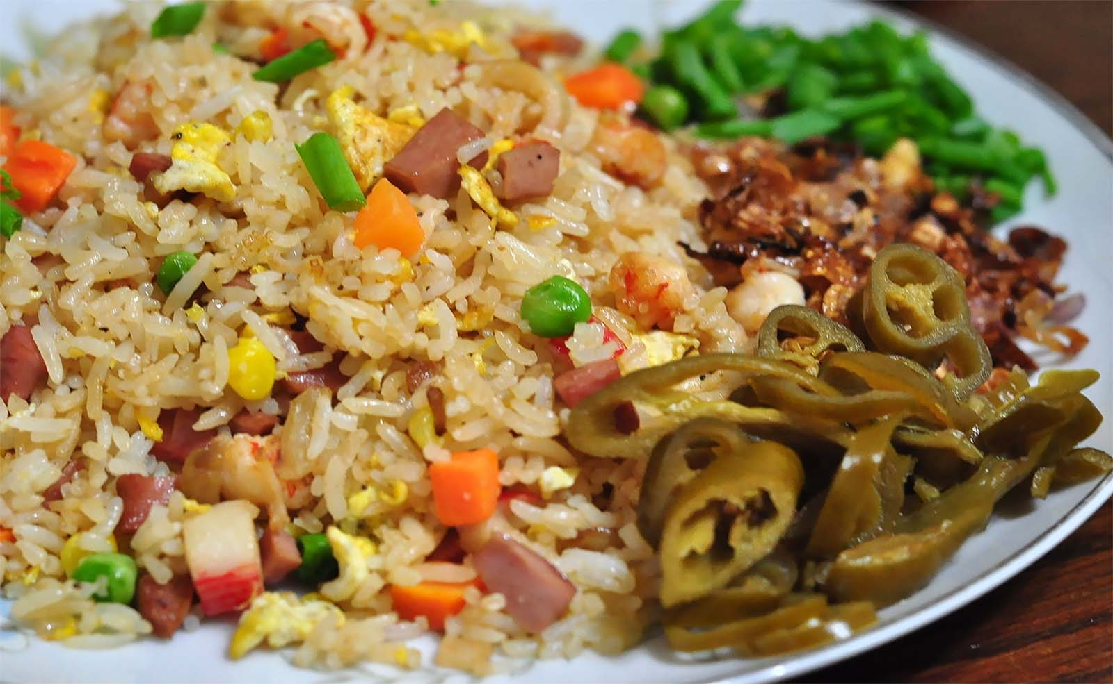
Yang Chow Mixed Fried Rice

Slide 28
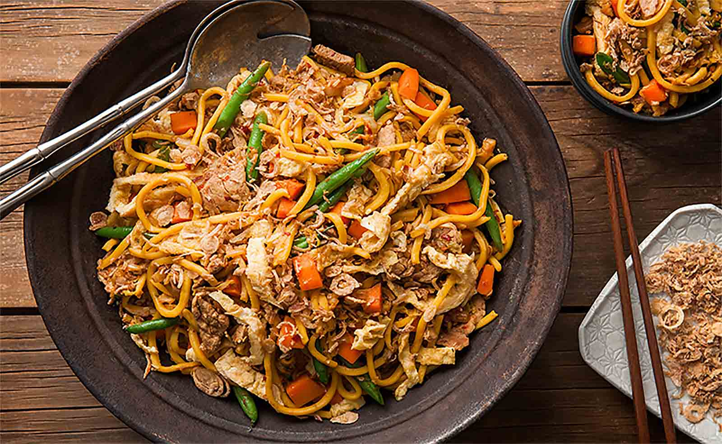
Mee Goreng; (meaning "fried noodles"), also known as bakmi goreng, is a flavourful and often spicy fried noodle dish common in Indonesia, Malaysia, Brunei Darussalam and Singapore.

Slide 29
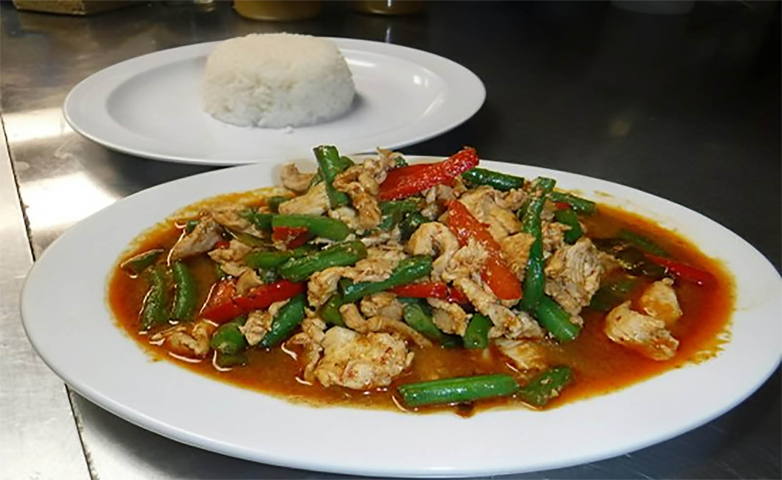
Chicken Red Curry Stir-Fry with Green Beans (Pad Prik King Chicken)

Slide 30
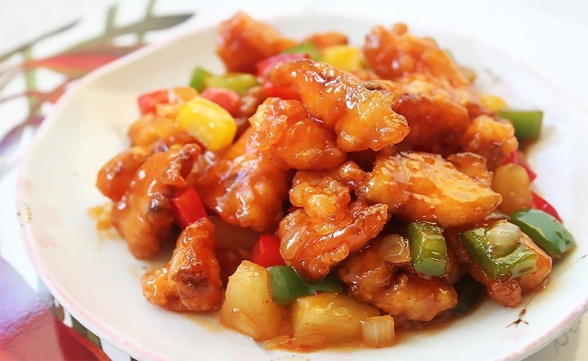
Sweet and Sour Fish

Slide 31
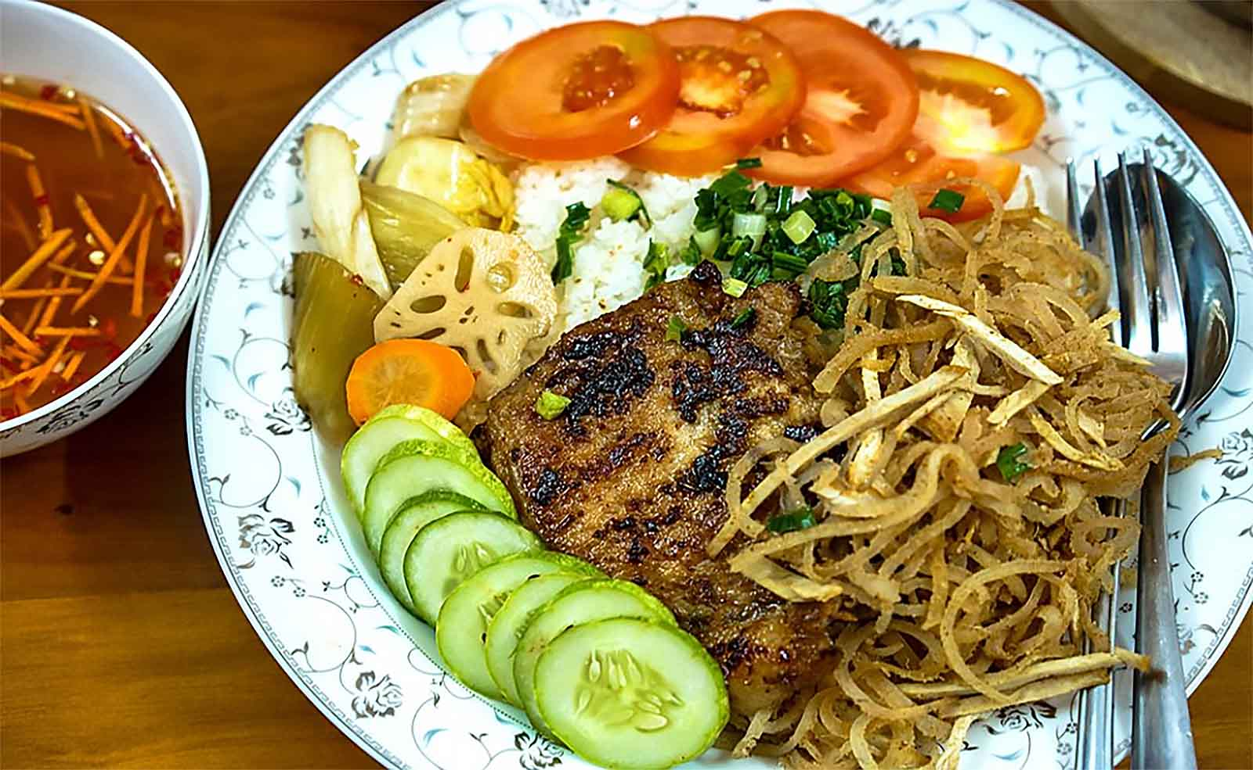
Bai Sach Chrouk - a Cambodian Pork and Rice Breakfast Dish

Slide 32
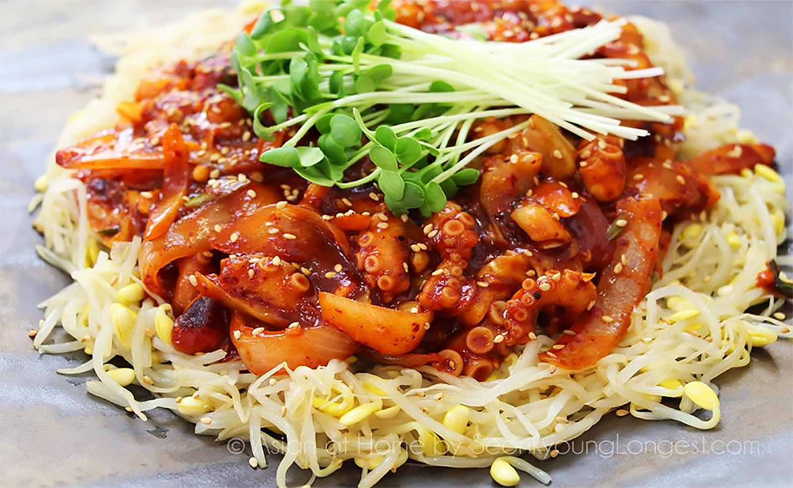
Spicy Stir-Fried Squid (Korean Dish)

Slide 33
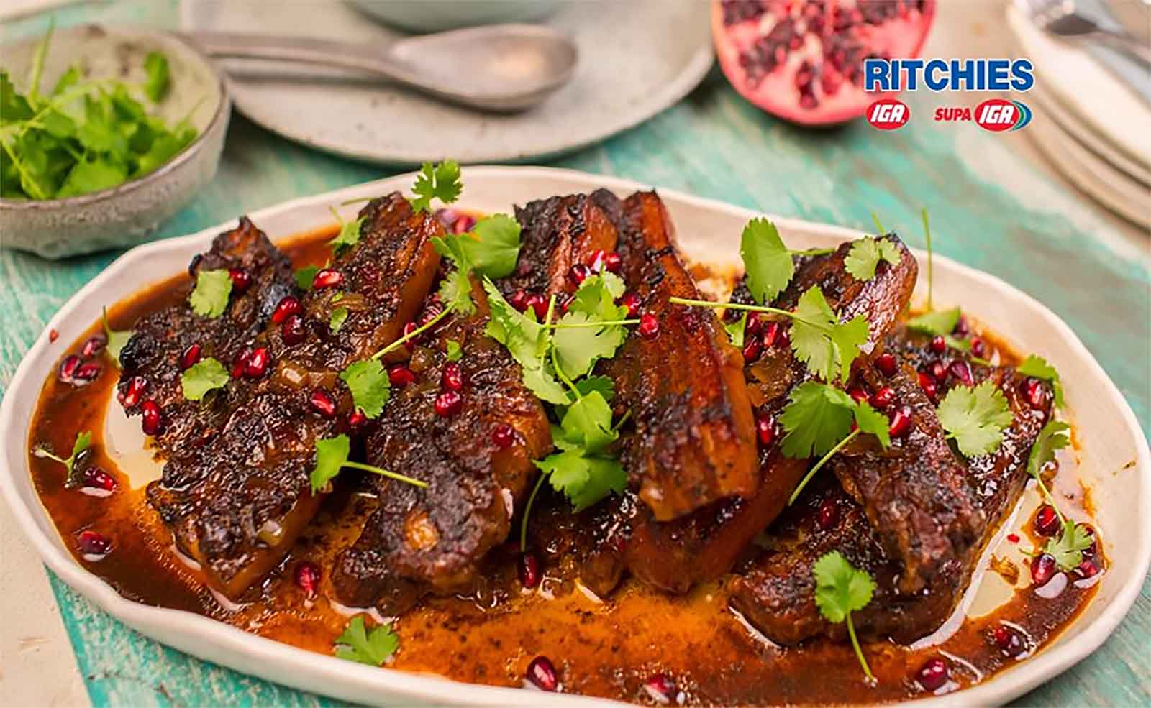
Pomegranate Braised Pork Spare Ribs

Slide 34
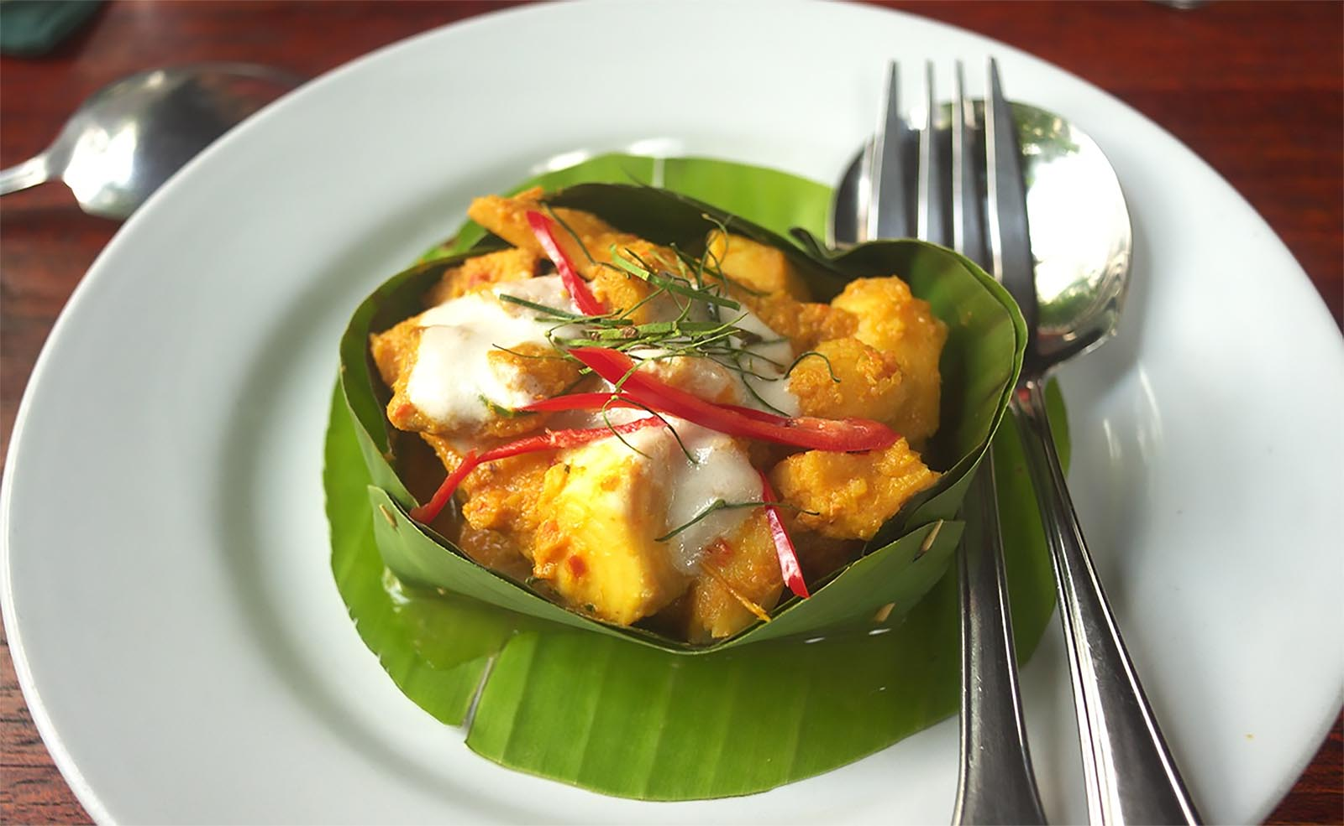
Fish Amok is a classic Khmer dish. It's usually steamed and served in a banana leaf with a little coconut cream on top.

Slide 35
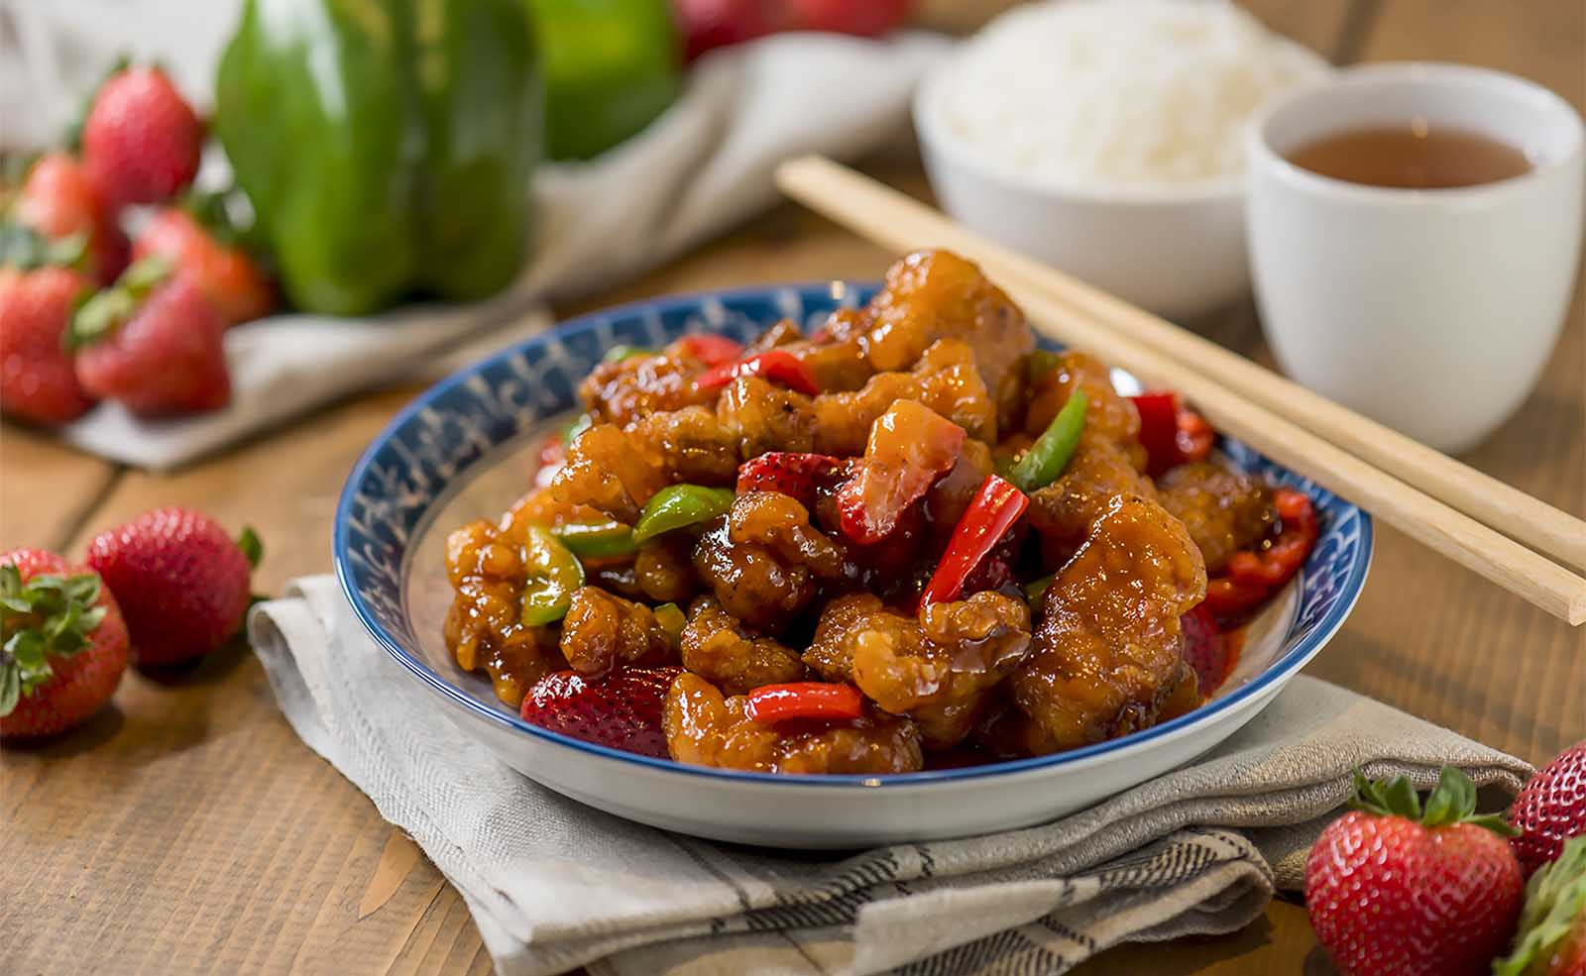
Sweet and Sour Pork

Slide 36
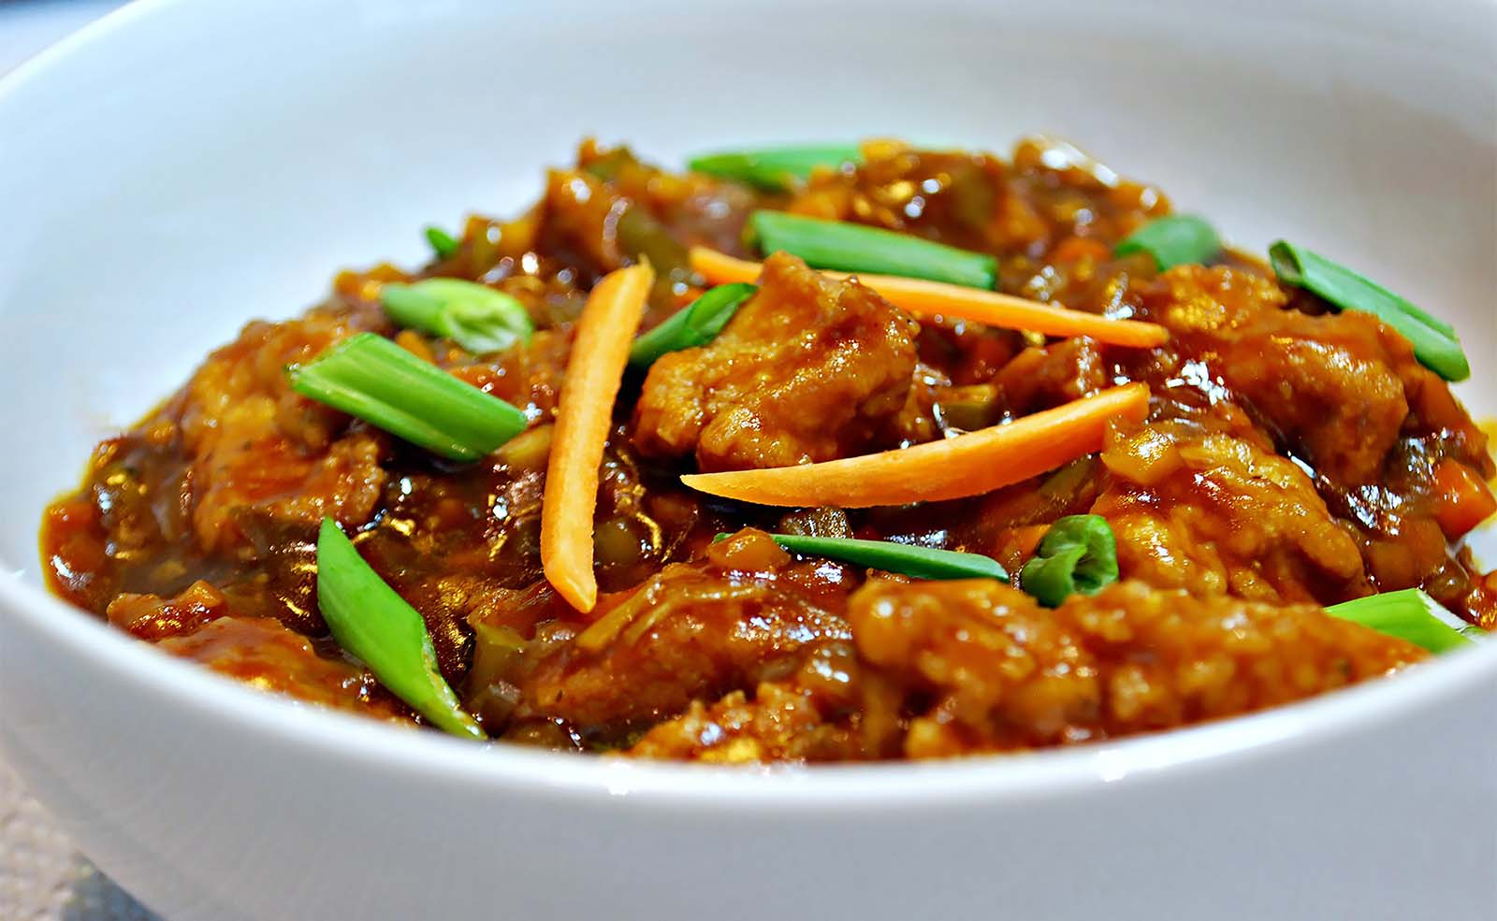
Manchurian Chicken

Slide 37
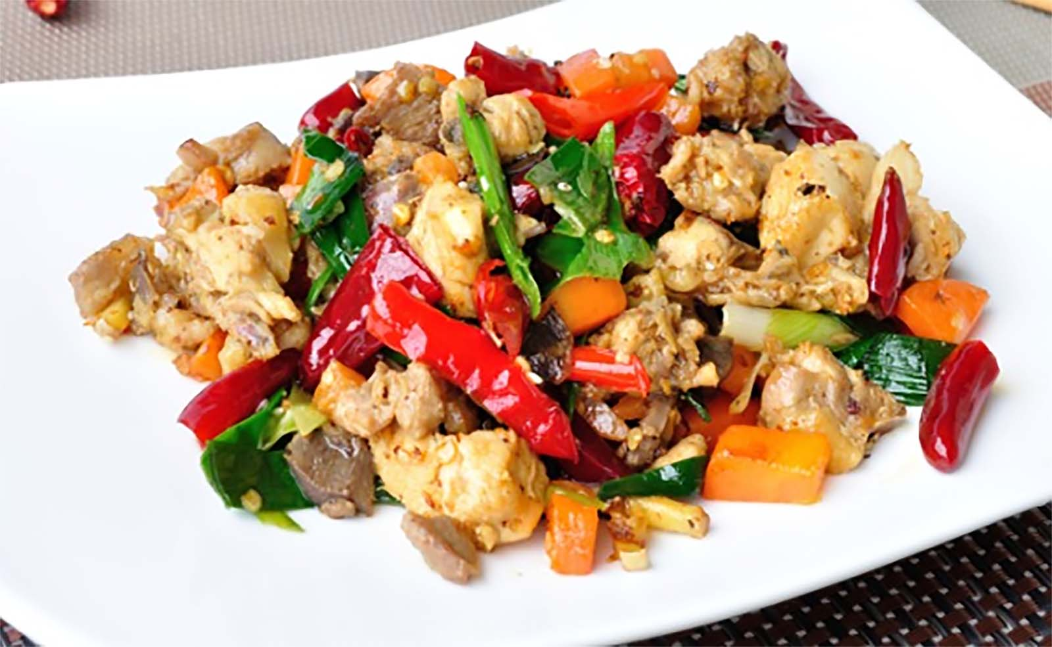
Szechuan (Sichuan) Chilli Chicken

Slide 38
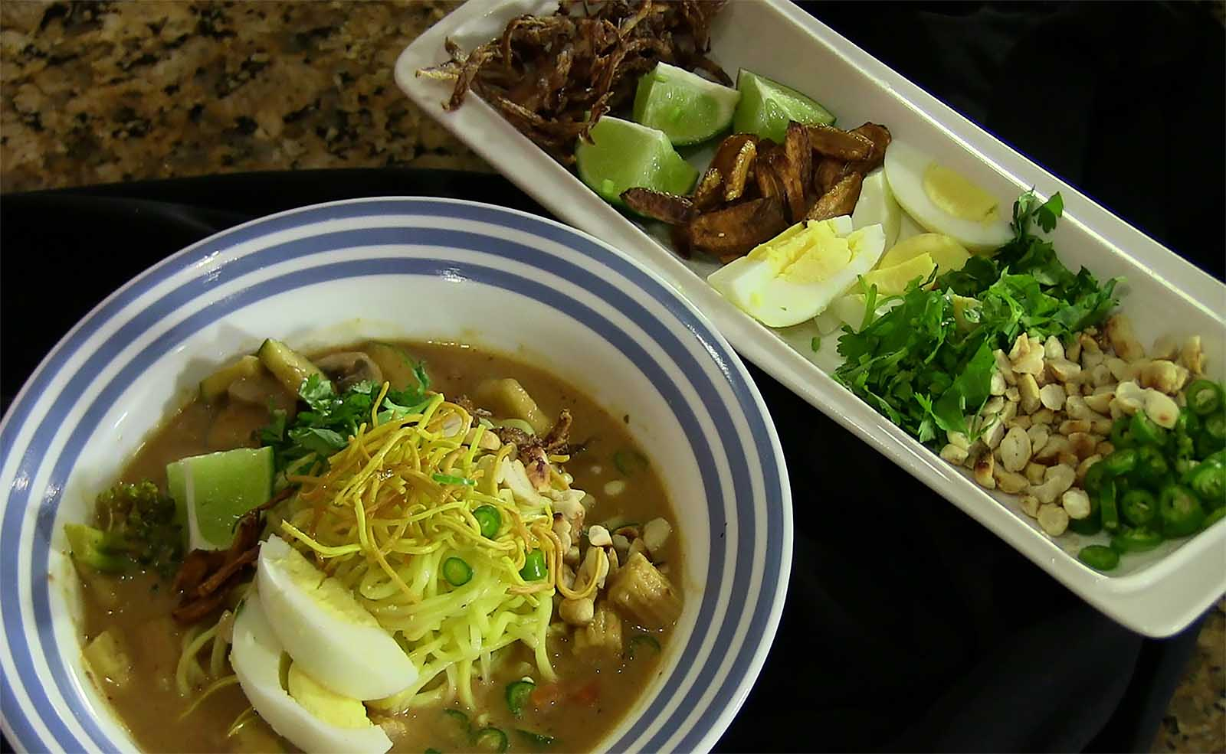
Burmese Khao Suey (Curried Noodles and Entrees)

Slide 39
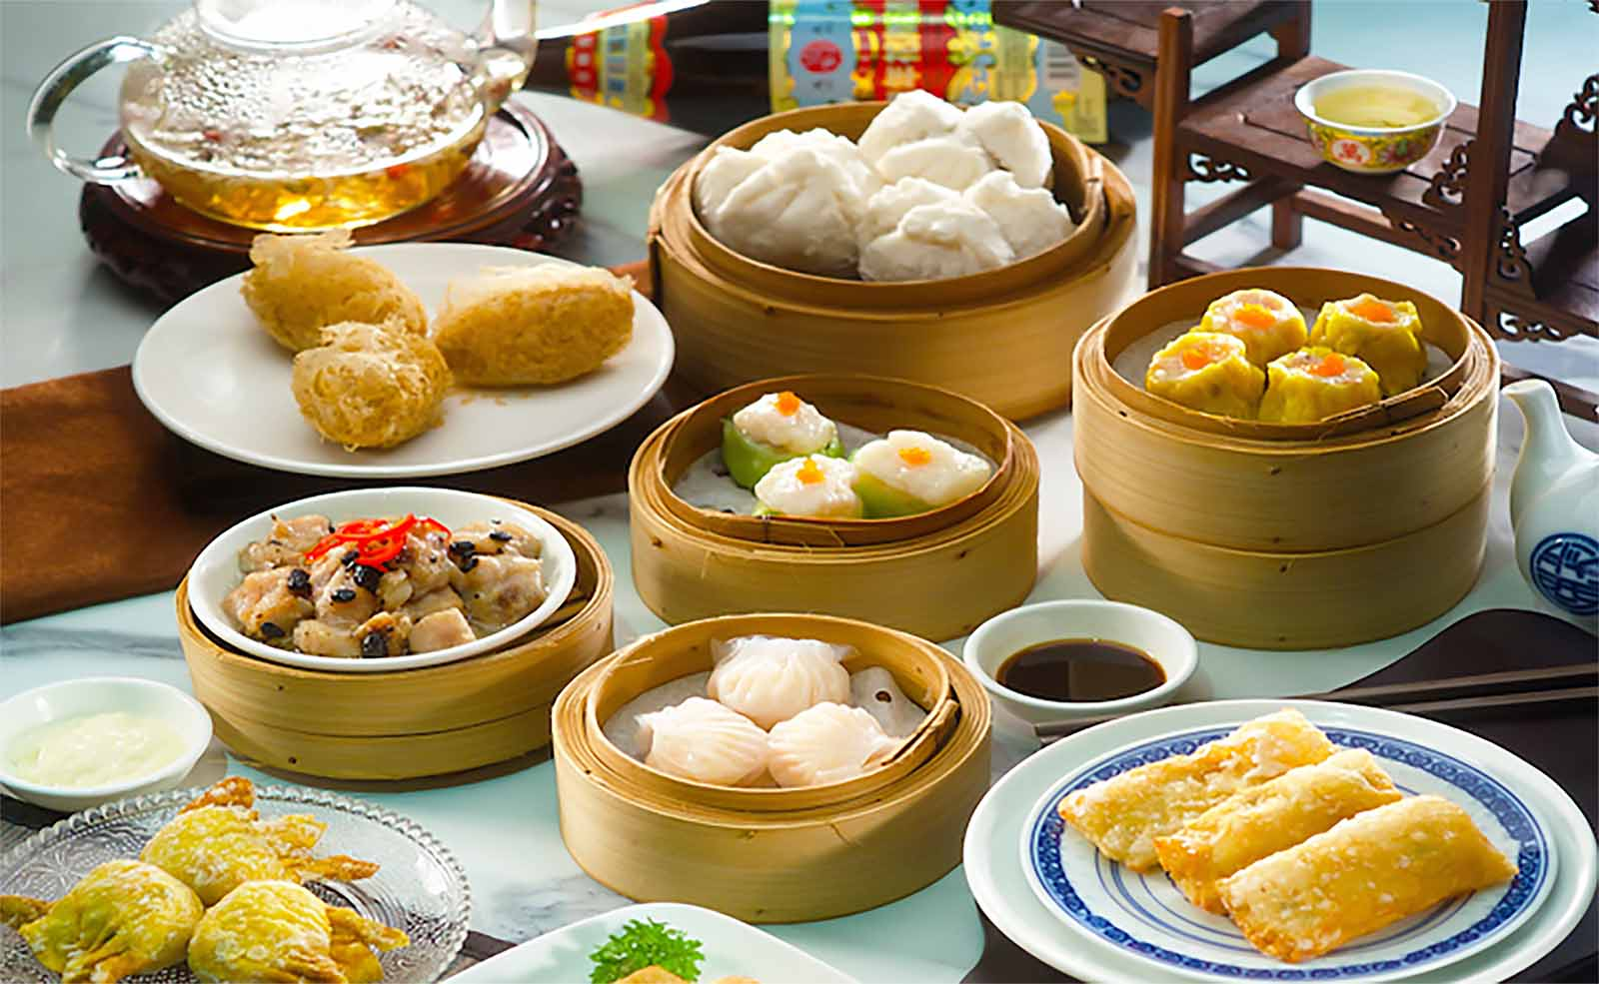
Dim sum. It is a style of Chinese cuisine prepared as small bite-sized portions of food served in small steamer baskets or on small plates. They are usually served with tea and together form a full tea brunch. Dim sum traditionally are served as fully cooked, ready-to-serve dishes.

Slide 40
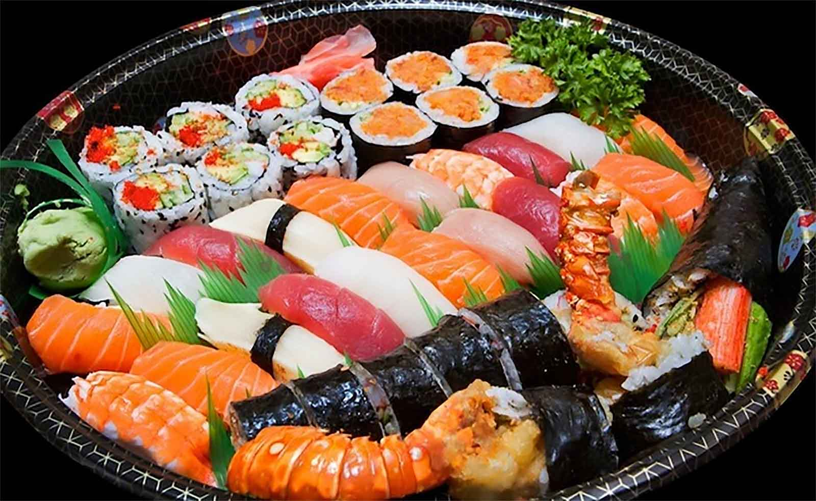
Sushi is a Japanese dish of specially prepared vinegared rice pastry (sushi-meshi), usually with some sugar and salt, combined with a variety of ingredients, such as seafood vegetables, and occasionally tropical fruits. They are made into rolls filled with seafood and meat items.

Slide 41
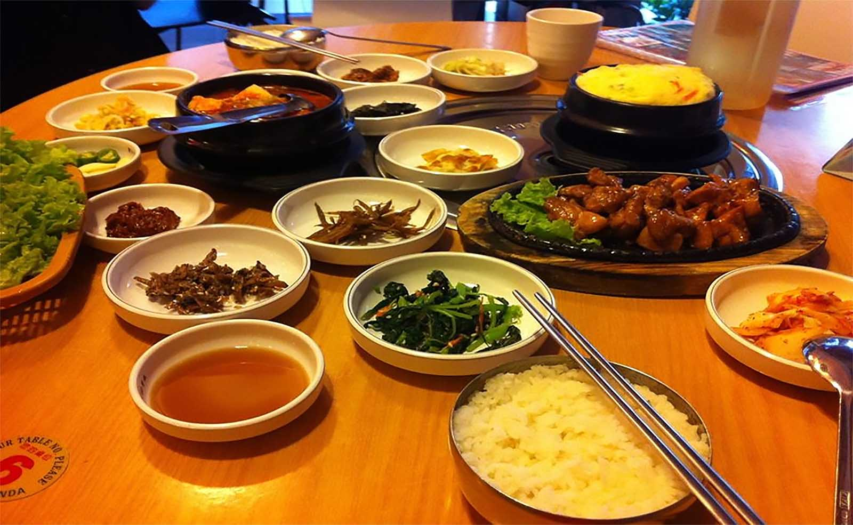
Bulgogi (Korean Barbequed Meat) is the most popular variety of Korean barbecue. Before cooking, the meat is marinated with a mixture of soy sauce, sugar, sesame oil, garlic and pepper. It is traditionally cooked using gridirons or perforated dome griddles that sit on braziers, but pan cooking has become common as well.

Slide 42
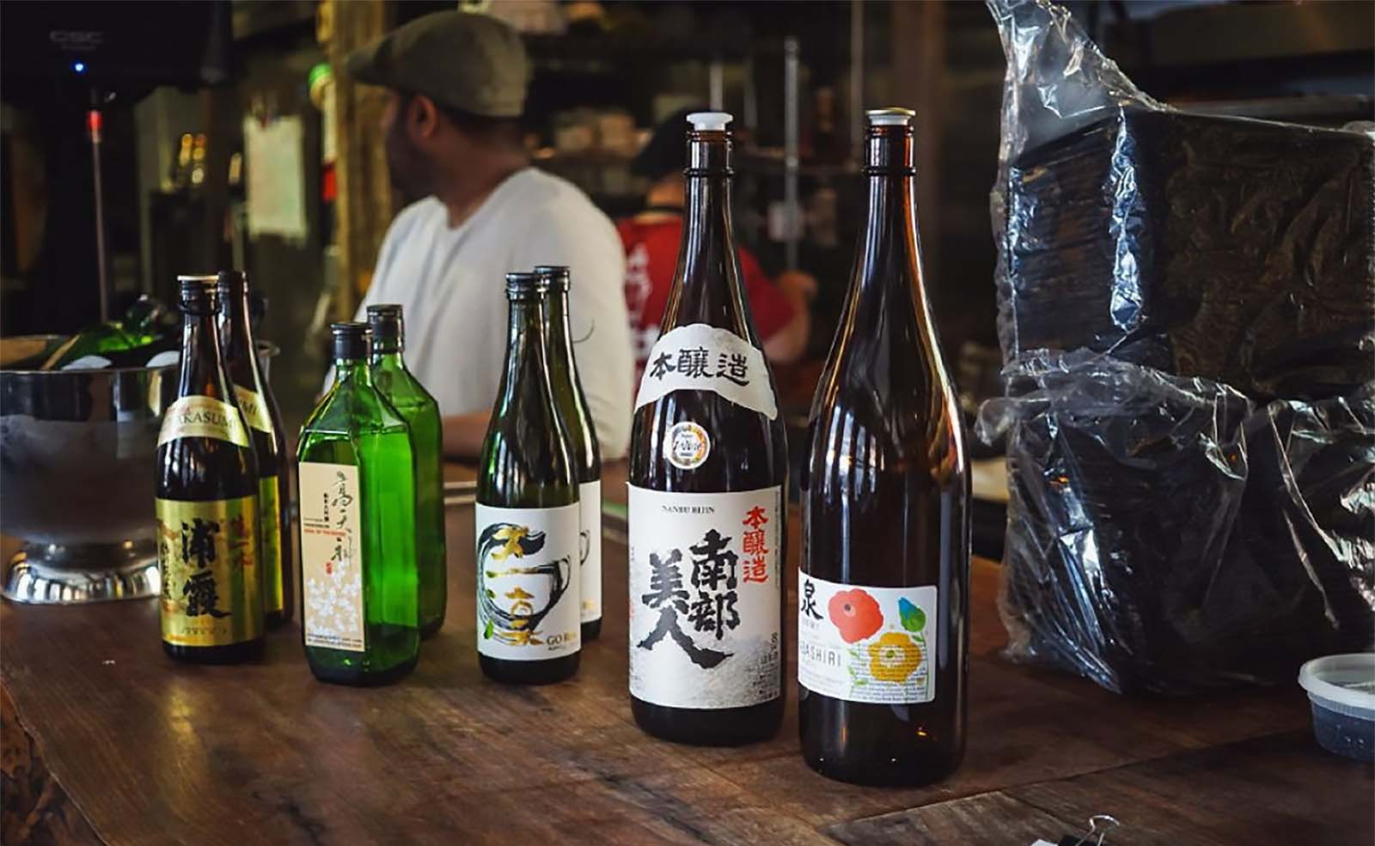
Sake, the Japanese Rice Wine. A toast to all of you friends. Have a nice Asian tour and let me know if you have enjoyed all these Asian Food Delicacies.
Tony Chacko (tonychacko2000@gmail.com)

Slide 43





Hope you have enjoyed viewing this presentation
Have a nice day
Music : Konstantin Klashtorni - Evening Sun
With regards - Tony Chacko and Steve Rumpler
(tonychacko2000@gmail.com / pista2011@gmail.com)

