Slide 1
Culture Quiz #8
Thanksgiving

Slide 2
Question #1
On the 4th Thursday of November.

Slide 3
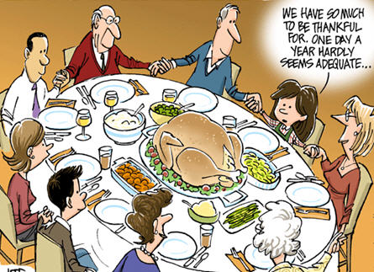
Question #2
Thanksgiving Day is a national holiday to give thanks for the
blessings of the harvest and of the preceding year.

Slide 4
Question #3
1621

Slide 5
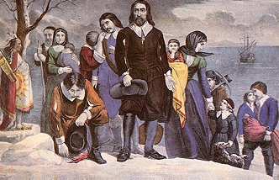
Question #4
The Pilgrim Fathers

Slide 6
Question #5
They didn’t agree with the religious teachings
of the Church of England. They left England in search
of a safe place to practice their religion.

Slide 7
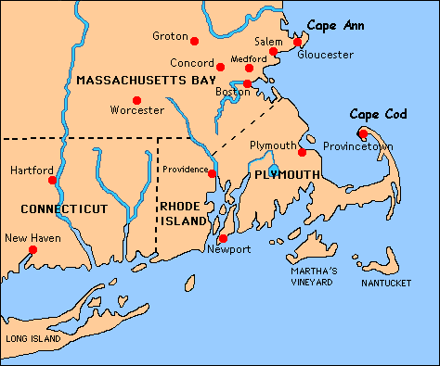
Question #6
In Plymouth,
Massachusetts.

Slide 8
Question #7
The Mayflower

Slide 9
Question #8
102 passengers

Slide 10
Question #9
The Mayflower departed Plymouth, England
on September 6th 1620 and arrived at Cape Cod
on November 1620, after a 66-day journey.

Slide 11
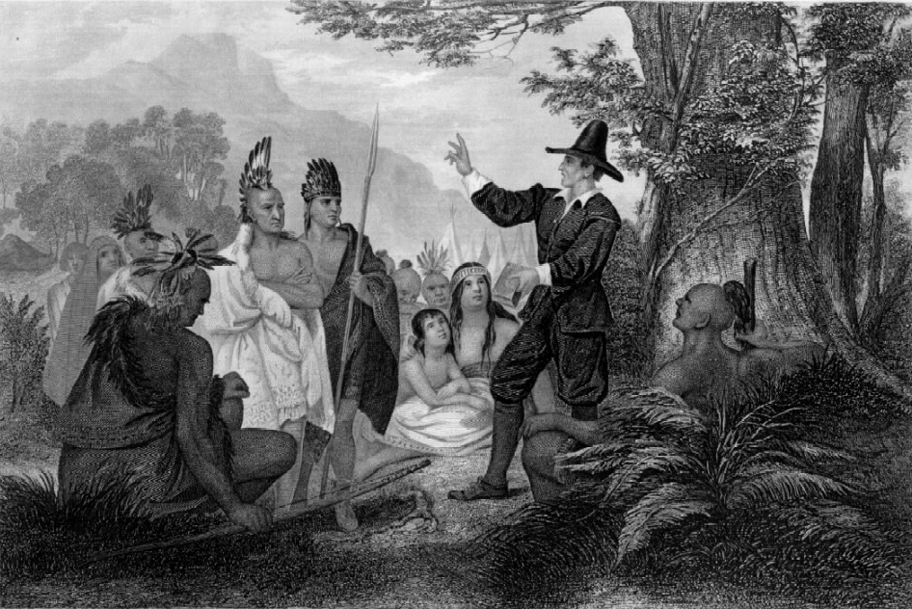
Question #10
The Wampanoag

Slide 12
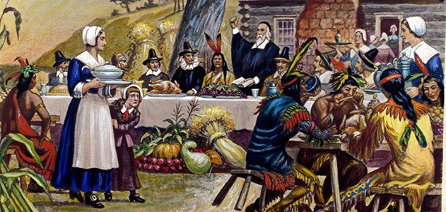
Question #11
The Pilgrims and the Wanpanoag celebrated
the first Thanksgiving together to say thank you
for their first successful harvest.

Slide 13
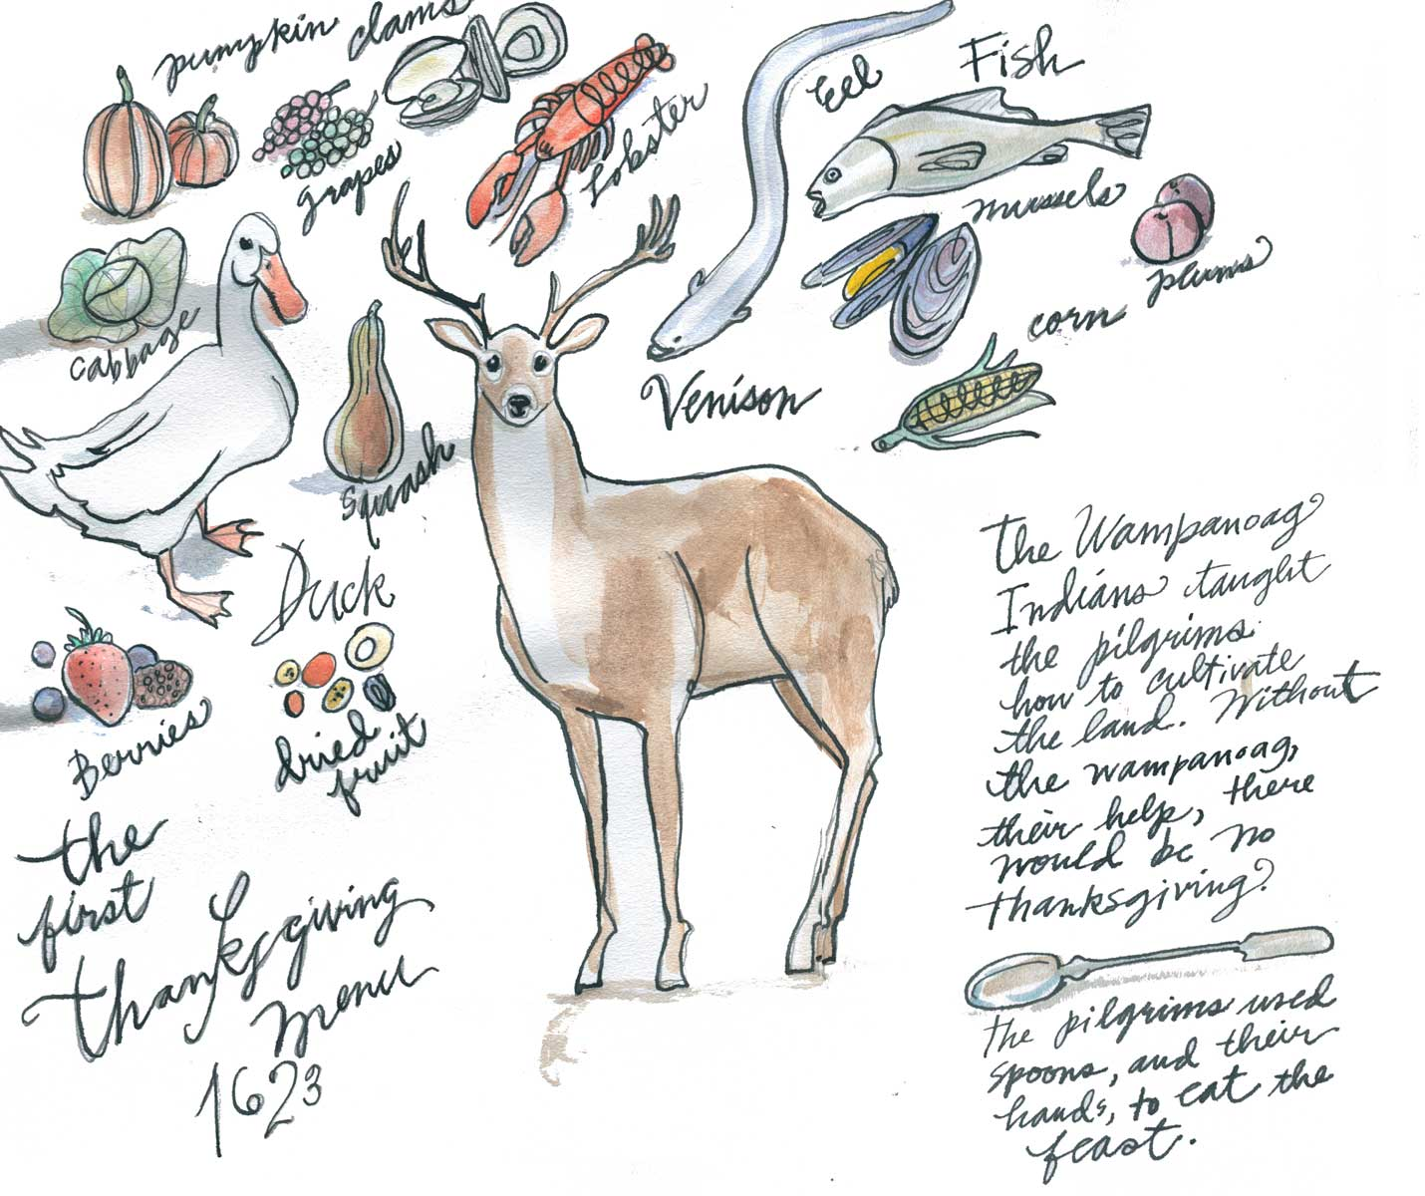
Question #12
Wild fowl, corn, porridge and venison.

Slide 14
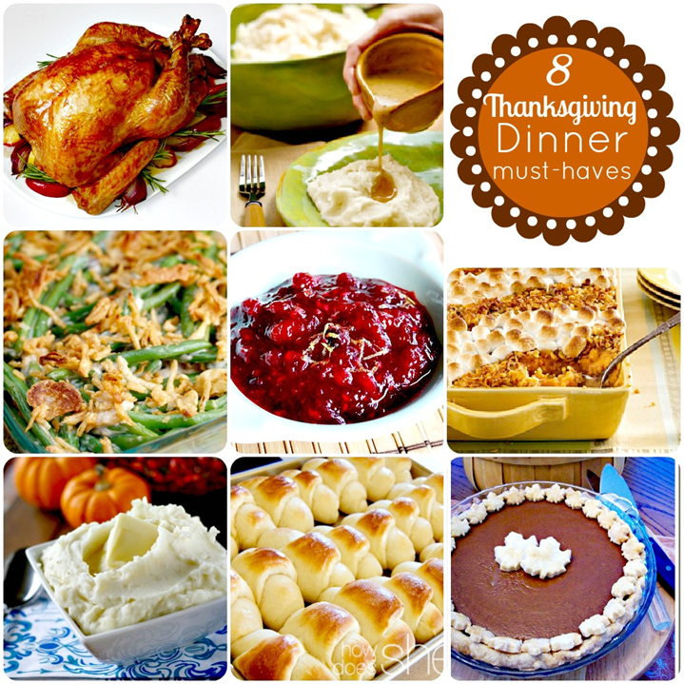
Question #13
Roasted turkey, stuffing, cranberry sauce, gravy, mashed potatoes, sweet corn,apple pie and pumpkin pie.
(and sometimes sweet potatoes with marshmallows)

Slide 15
Question #14
While the Wampanoag welcomed the Pilgrims
and helped them ensure a successful first harvest,
they were nearly wiped out by warfare
and diseases that arrived with the settlers.

Slide 16
Question #15
President Trump is going to pardon a turkey,
in other words to spare its life.
https://www.youtube.com/watch?v=Y-ESYUls2Pk

Slide 17
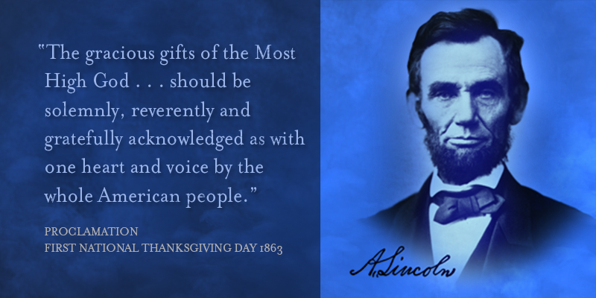
Question #16
Abraham Lincoln

Slide 18
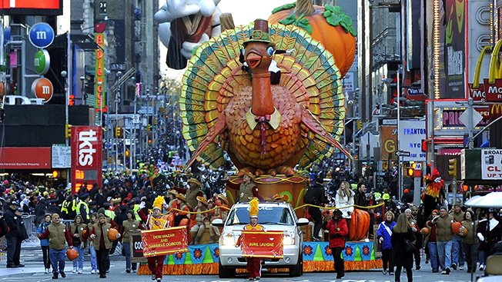
Question #17
Macy’s is the biggest department store in New York City.

Slide 19
Question #18
« Freedom from want » is the right not to live in poverty.
The painting depicts three generations of a family around a table at Thanksgiving. The father is standing at the head of the table as the mother is about to place a large turkey in front of him.
The opulence of the turkey is counterbalanced by the relative scarcity of other foods on the table.
America was involved in World War 2,
and the painting is intended to show that
despite the difficulties the country was facing,
traditional American family values were still highly important.
http://totallyhistory.com/wp-content/uploads/2013/01/Norman-Rockwell-Freedom-from-Want-1943.jpg

Slide 20
Question #19
Black Friday. It is the day after Thanksgiving Day.
It is one of the busiest shopping days in the USA.
Some people use it to start their Christmas shopping.

Slide 21

Question #20
Cyber Monday is a marketing term
for the Monday after the Thanksgiving holiday.
It is one of the biggest online shopping days of the year.

Slide 22
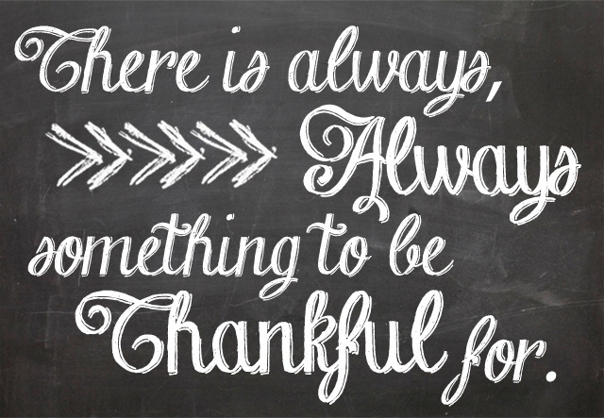

Slide 23


Slide 24
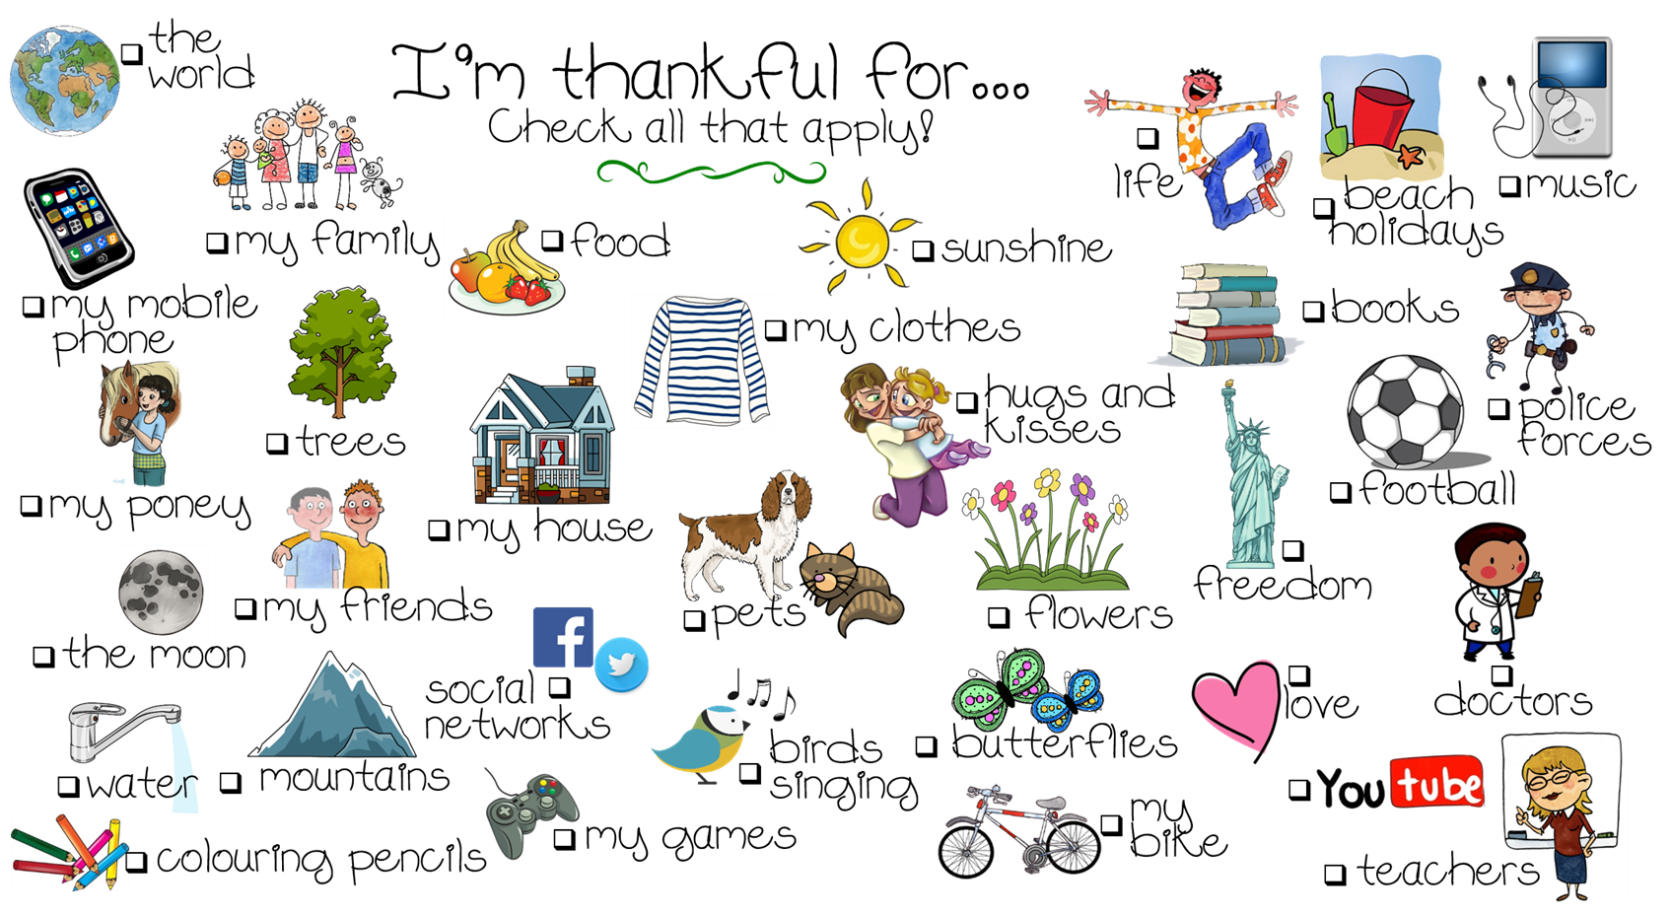

Slide 25
