Slide 1
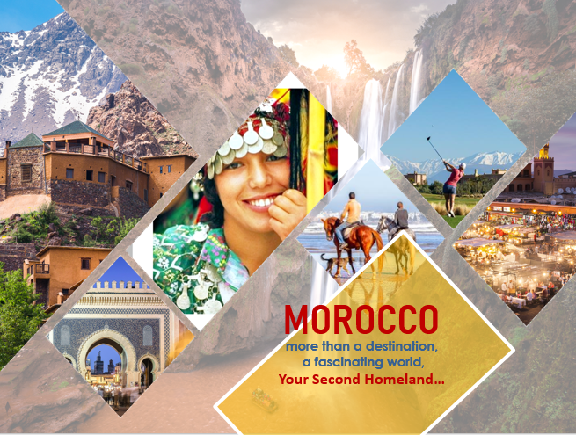

Slide 2
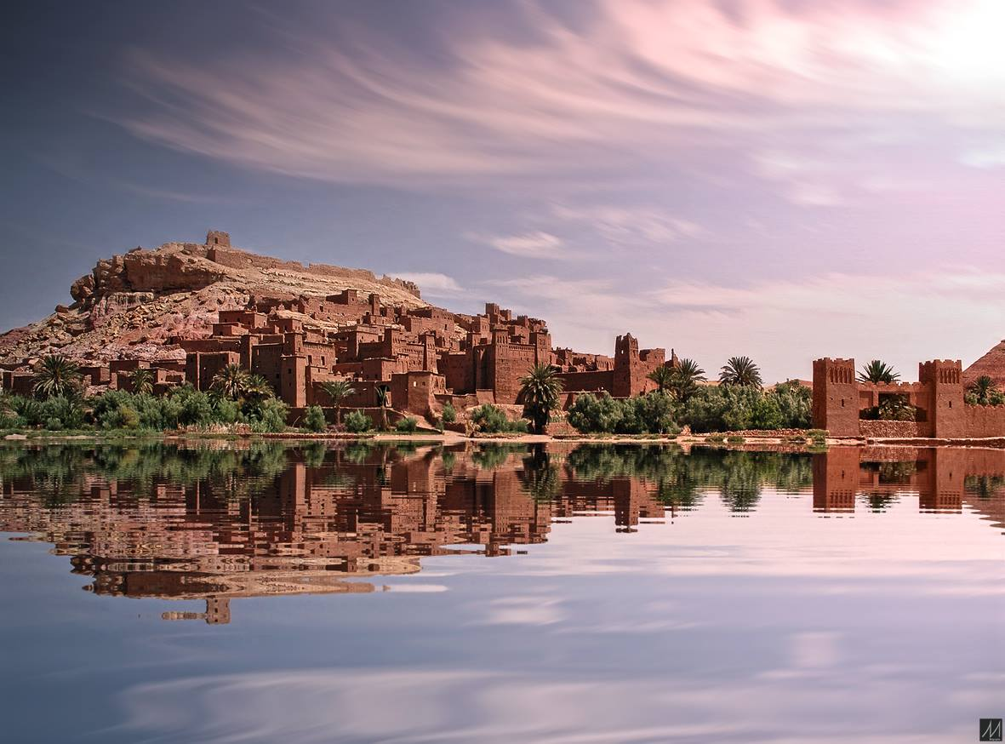


Slide 3


Slide 4

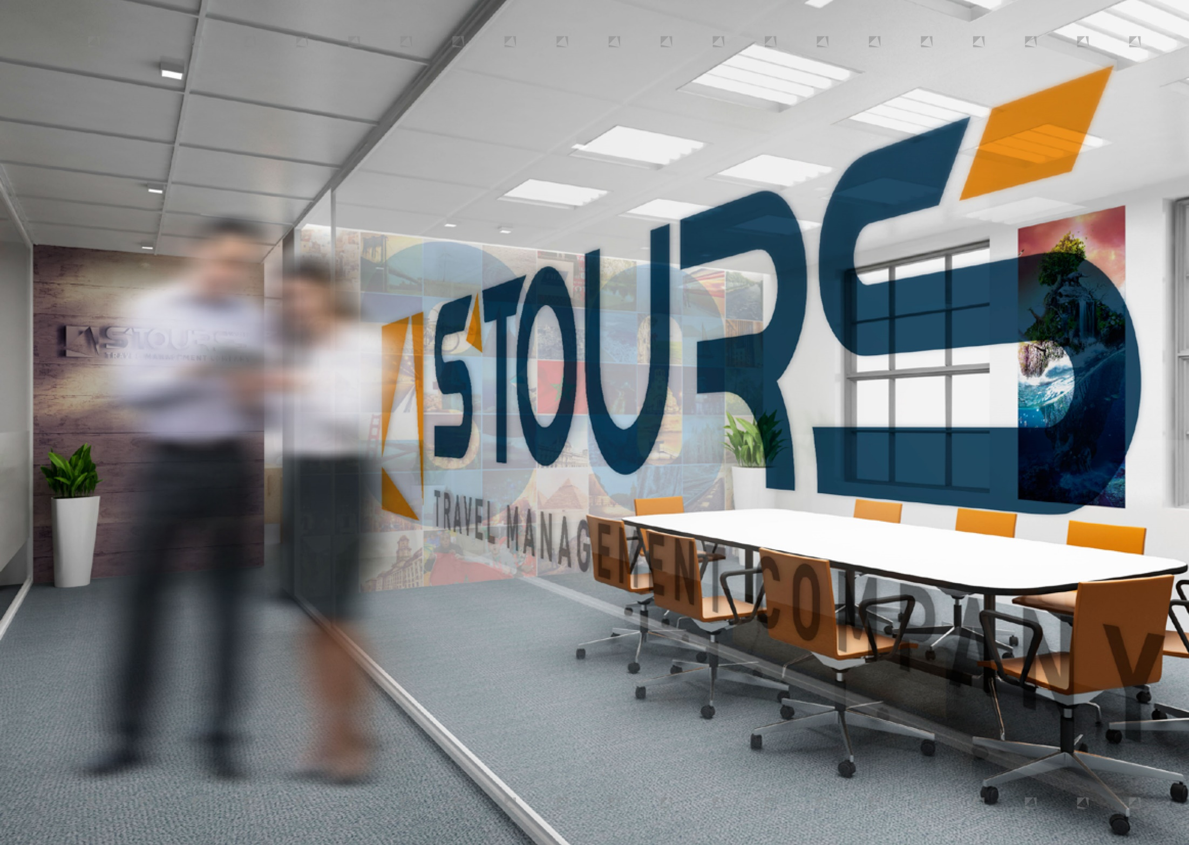




KEY FIGURES
35
50
1 OFFICE IN
CASABLANCA
SIX SPOKEN
1 OFFICE IN
LANGUAGES
MARRAKECH
1 OFFICE IN
FRENCH
GERMAN
SPANISH
ENGLISH
ITALIAN
ARABIC
AGADIR
YEARS OF EXPERIENCE
EXPERTS
1 OFFICE IN
TUNIS
+ 200
+ 2 500
+ 50 000
Events Per Year
Corporate Clients
People Catered Per Year
2017 TURNOVER
18 MILLION €

Slide 5



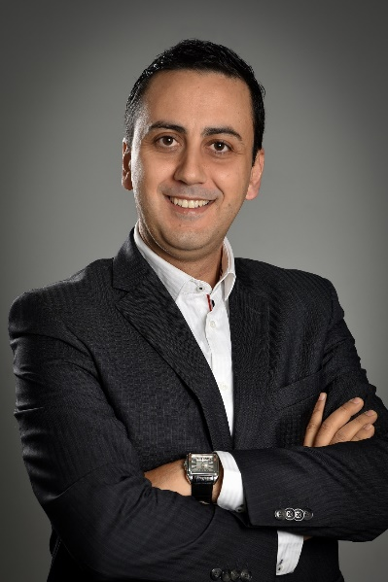
CHOOSE THE LEADER, CHOOSE MOROCCO
With us, there's no double speak or beating around the bush! And that's the key to our success. When our clients are travelling for business, they need everything to be perfect. From their timetable and transport to their equipment, meals and safety, everything needs to run smoothly – and they are also looking for pleasure, satisfaction, discovery and memories.
We rise to these challenges every day, working tirelessly and with confidence for our clients. Of course, the perfect world doesn't exist (occasionally, even Agadir has a few clouds in its sky ☺), and that's why, to guarantee the very best quality, we have committed to the ISO 9001 - v2008 standard. Promises are only words. The facts are the best proof of our leadership.
So, whether you want to organize a week-long team-building trekk for managers or you'd like to hold a two-day seminar for 500 people, you can be sure that S'TOURS and Morocco are the best choice you can make.
Now, I'll just let you imagine what we can do when it comes to organizing a trip for private individuals!
Rigor, efficiency, beauty and sunshine are, for me, the best words to sum up the key benefits of our organization and our country
Mr. Hicham BELHADFA
Managing Director

Slide 6


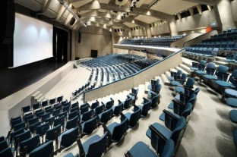
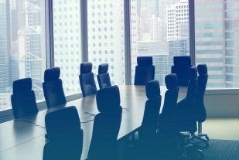
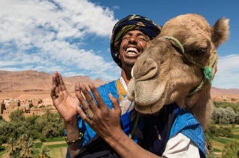
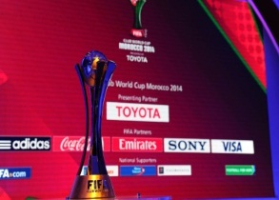
FOUR CORE SPECIALITIES
S’TOURS quickly structured itself into 4 specialist departments to provide quality services to all its different clients. This organization allows our experts to develop their know-how through internal processes focused on excellence.
This organization works thanks to the creativity of the S'TOURS teams and the fact that our departments work hand in hand to deliver global offers. We don't only create made-to-measure trips; we also ensure they run perfectly to plan –which is why we decided to invest in our own fleet of vehicles.
Our expertise covers every step of your stay, and this 360° approach ensures peace of mind and cost control when we're putting together your travel projects.
BUSINESS
TRAVEL
EVENTS
MEETING
CONGRESSES
INCENTIVE
TOUR
OPERATING
SPORTING
EVENTS
+ TRANSPORTATION

Slide 7
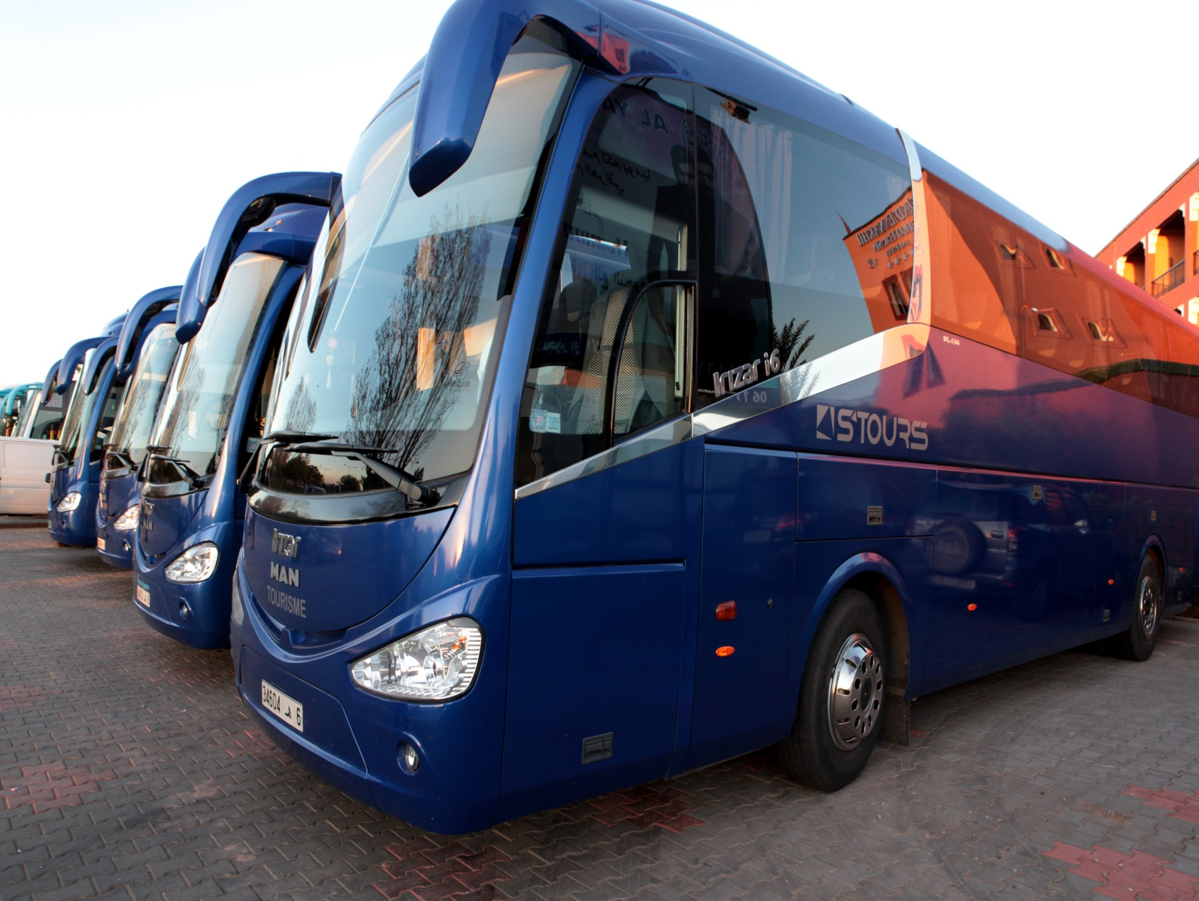
TRANSPORTATION
TRAVEL IS ALL ABOUT IT
Our objective is to ensure the well-being of our clients. That's why we developed our own fleet of vehicles to guarantee travelers' comfort.
While the vehicle is important, the driver is essential! For this reason, S'TOURS has a rigorous selection process for staff in charge of transporting passengers. Our drivers always wear a suit and tie and speak several languages.
Our vehicles are serviced every day and, before every trip, we check the route, parking and logistics.
The pillars of our transport offer are peace of mind, safety and comfort, and today we have a fleet of more than 25 vehicles.

Slide 8
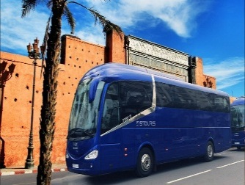
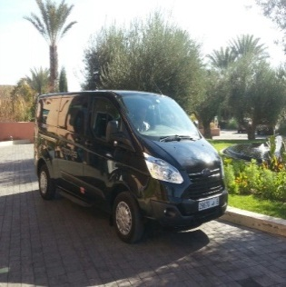
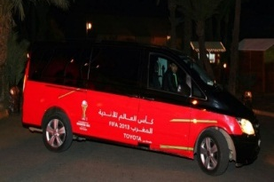
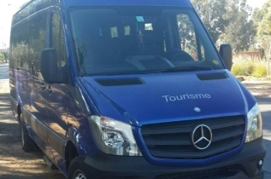
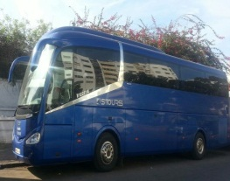
OUR FLEET, YOUR GUESTS WELLBEING
MAN
BUS
Our fleet is made up of high-end vehicles that can be repackaged in the colours of your company or event.
Our vehicles:
MAN bus or similar, 48 seats/40 places with air conditioning, microphone, video and radio.
Hyundai minibus or similar, 6 places with air conditioning, microphone, video and radio.
48 SEATS
MINI BUS
06
SEATS
MOTORCOACH
15 SEATS
NEWEST FLEET
MAN BUS
- 2 YEARS OLD
40 SEATS

Slide 9




S’TOURS VOYAGES
LEADERSHIP IN MOTION
SINCE 1983, S’TOURS HAS MADE
EVERY EFFORT TO ENSURE
ITS CLIENTS’ COMFORT
BY INSISTING THAT MADE-TO-MEASURE SERVICES ARE THE ONLY SOLUTION POSSIBLE
BY INVESTING IN TEAMS WHOSE EXPERTISE MAKES THE GROUP A LEADER
BY MOVING BEYOND THE MOROCCAN BORDER AND CONQUERING NEW REGIONS

Slide 10
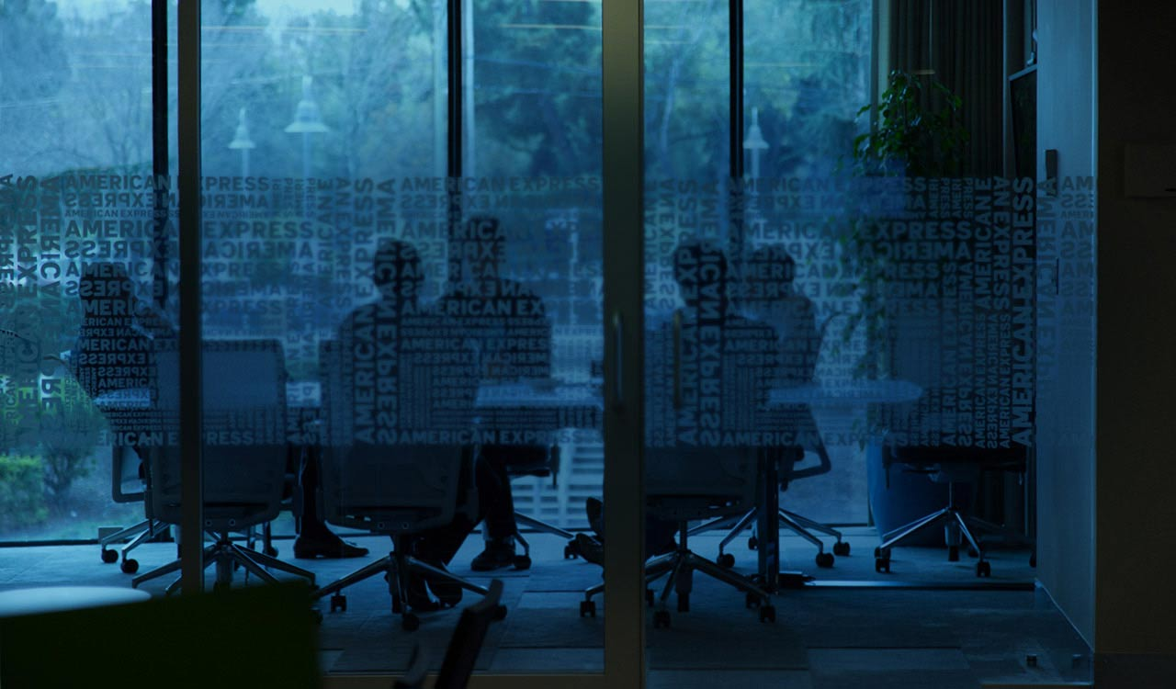

S’TOURS VOYAGES
INTERNATIONAL RECOGNITION
IN 2005, S’TOURS BECAME THE OFFICIAL AMERICAN EXPRESS GLOBAL BUSINESS TRAVEL REPRESENTATIVE FOR MOROCCO.
This prestigious title was awarded thanks to 10 years of consistently excellent services.
Every year, S’TOURS caters for international companies with one thing in common: they all have extremely high standards.
GLOBAL BUSINESS TRAVEL

Slide 11

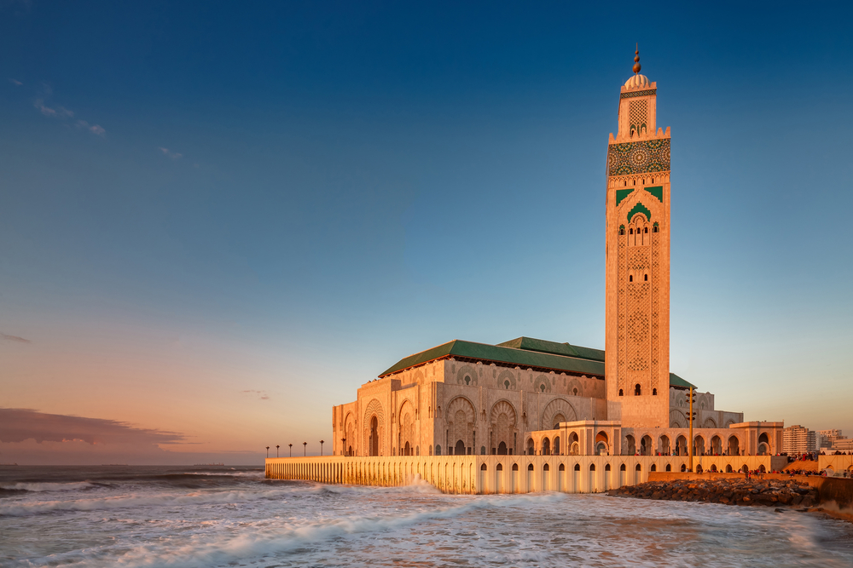

Welcome to Our Fascinating
MOROCCO

Slide 12
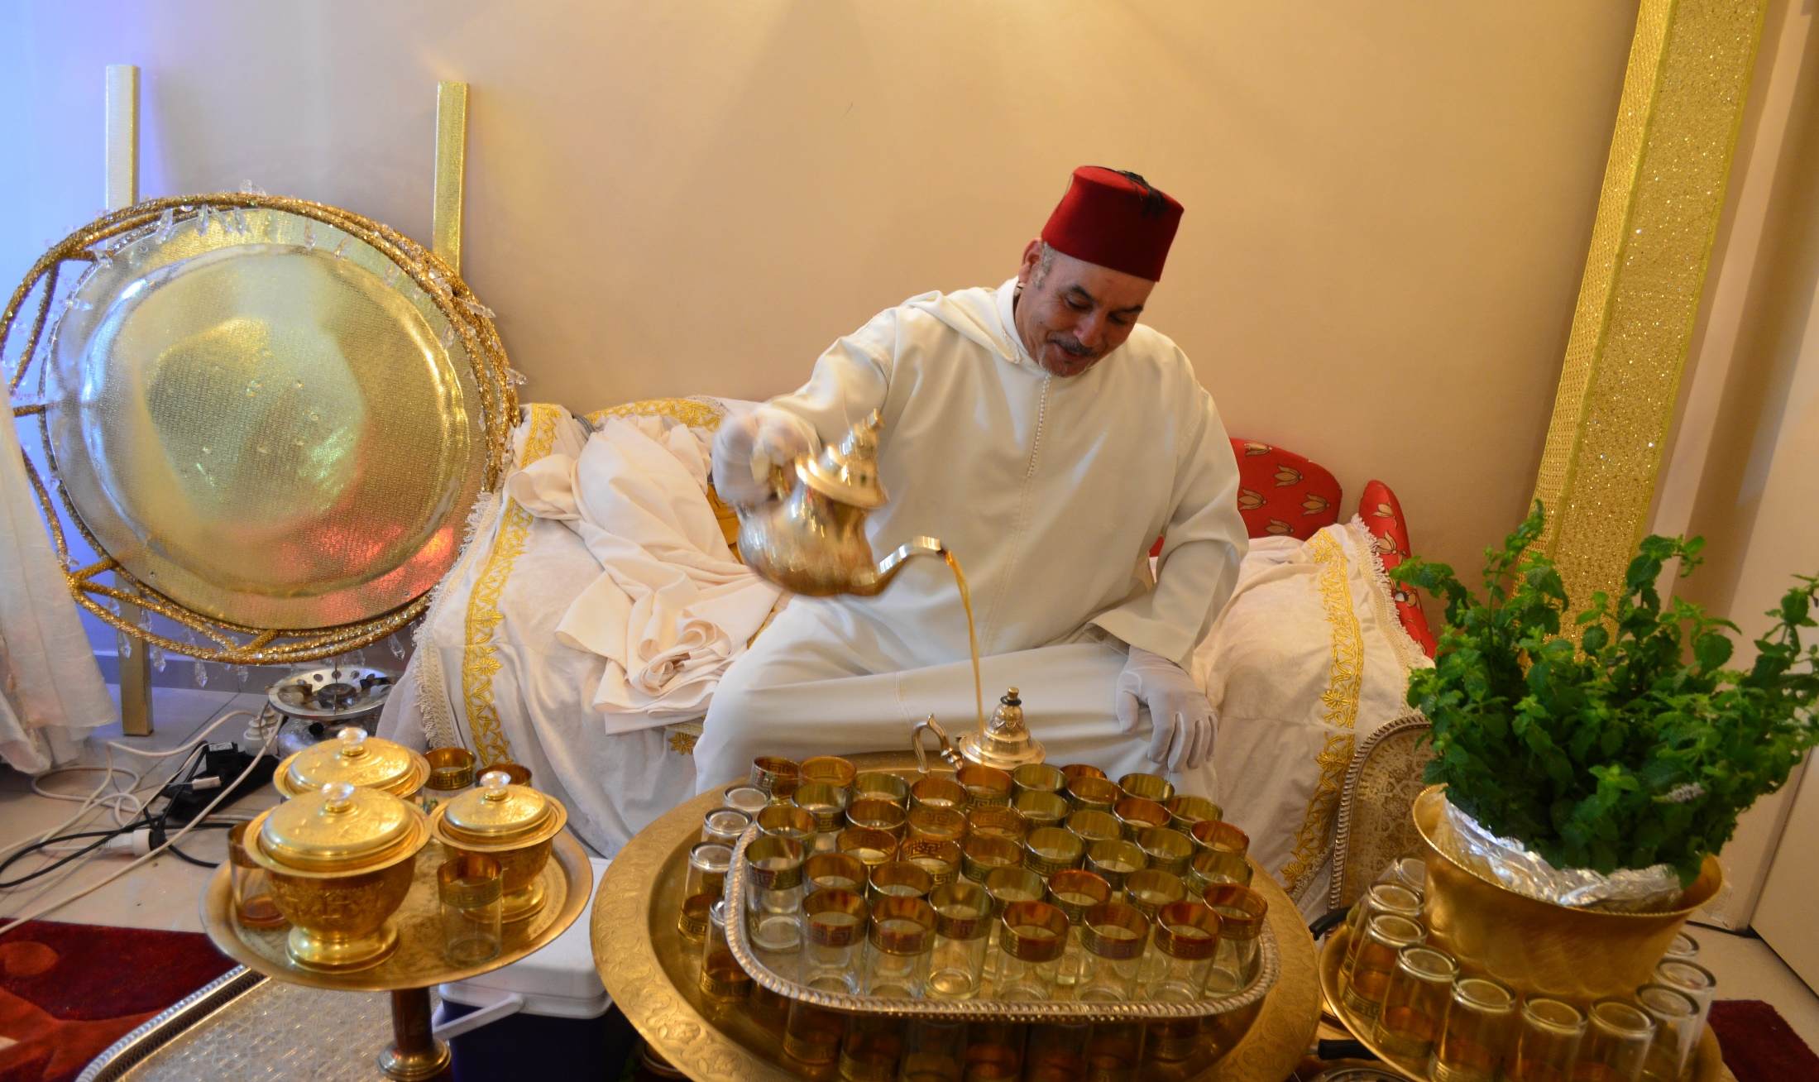
WELCOMING MINT TEA

Slide 13
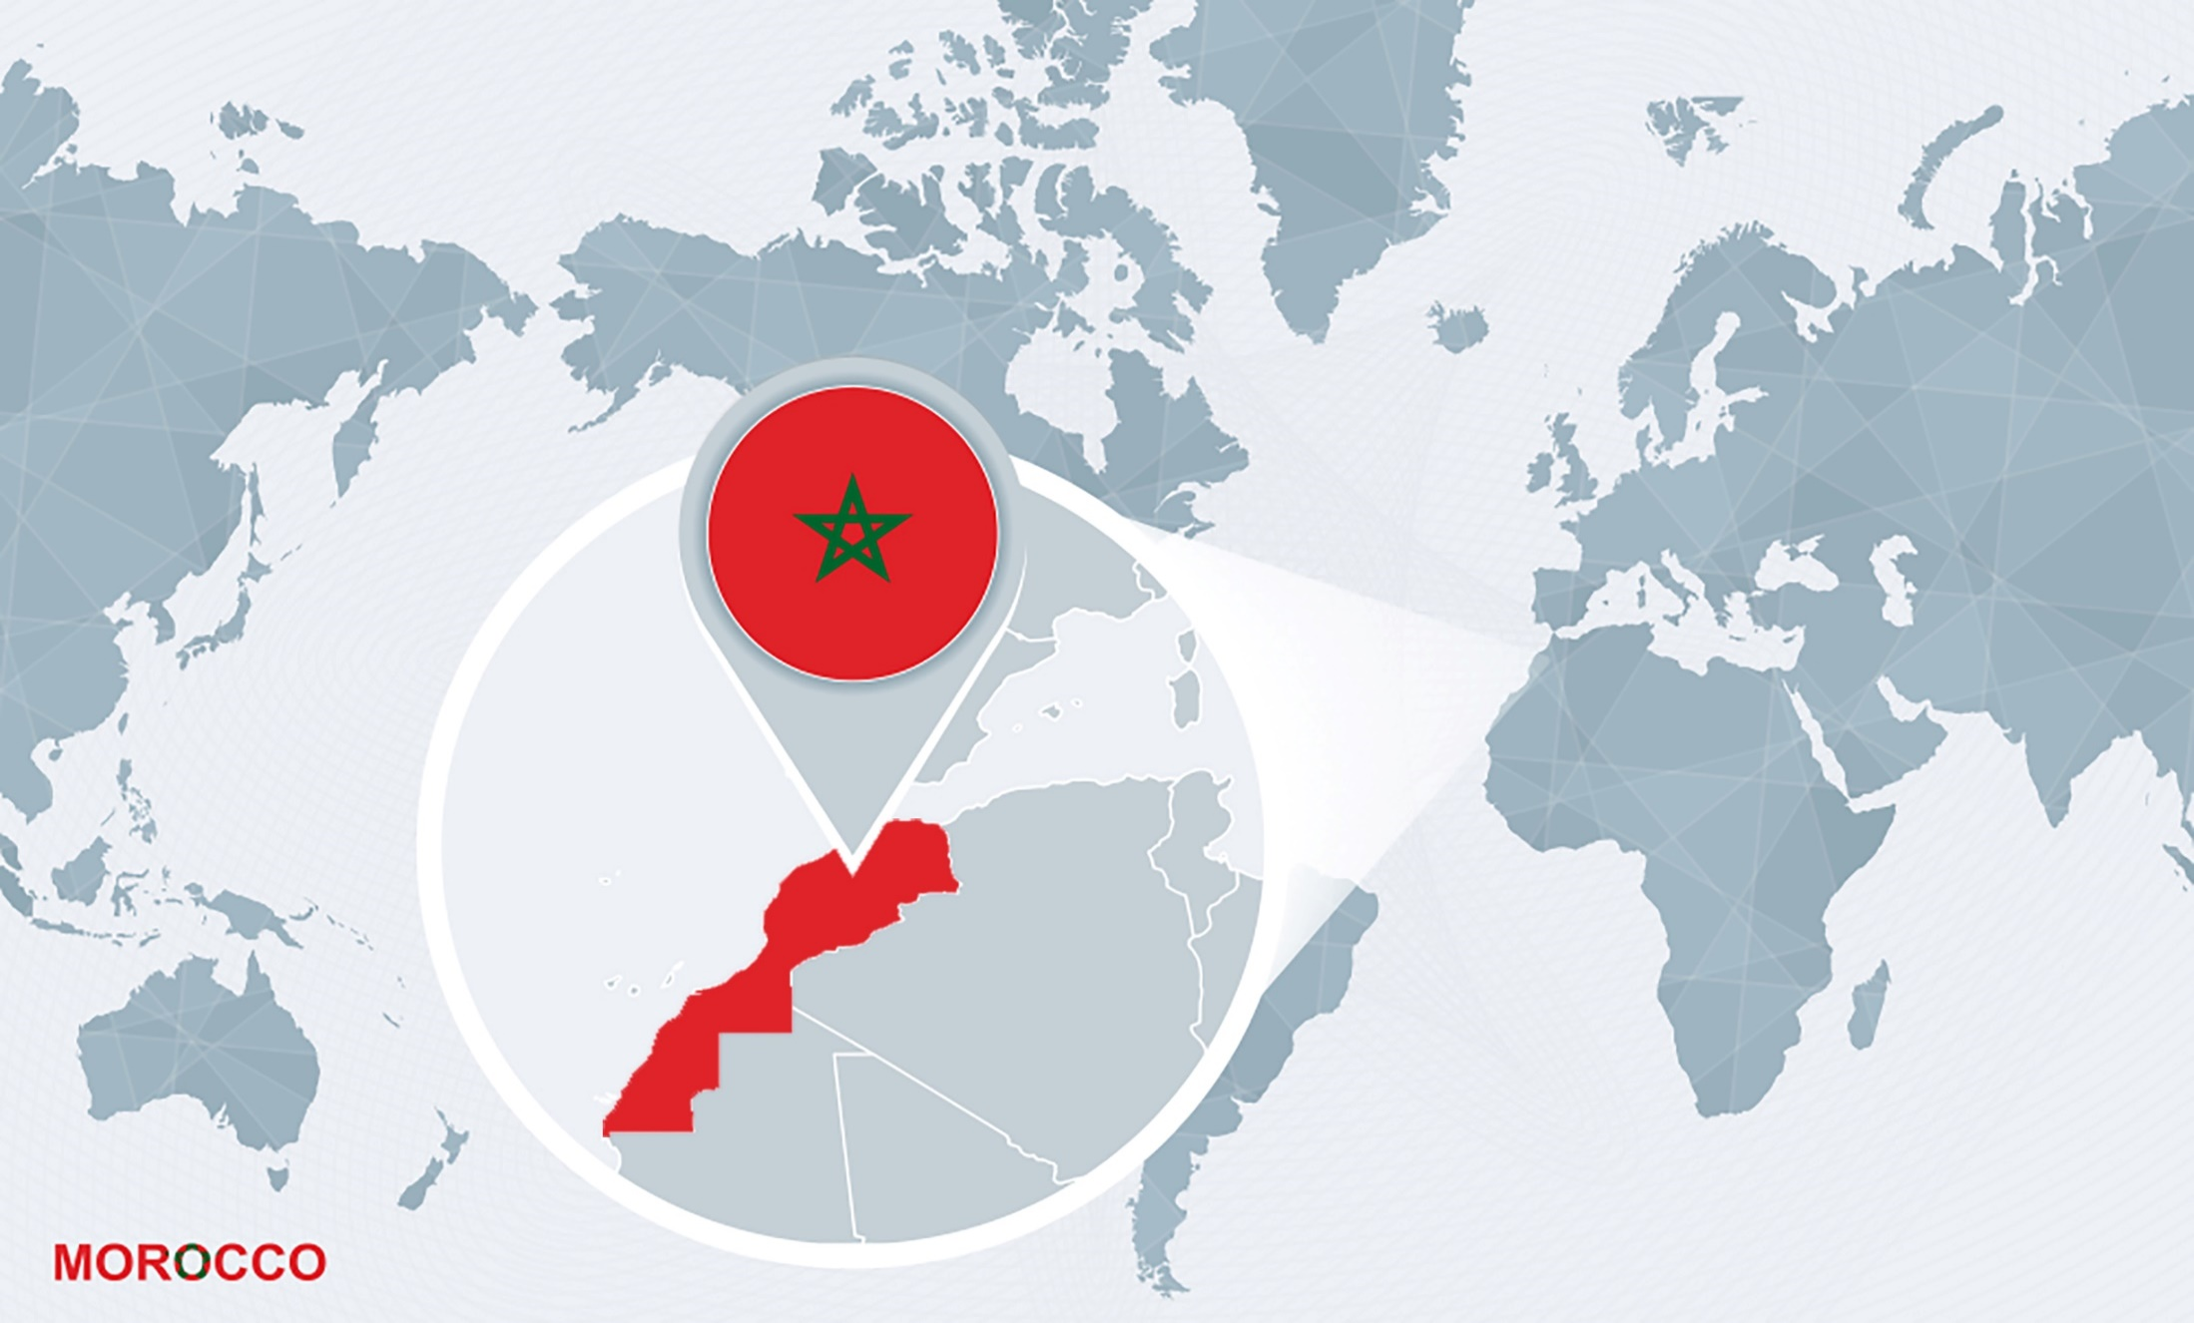
GEOGRAPHY
Morocco is located at the northwest of Africa. It is bordered in the north by the Strait of Gibraltar and the Mediterranean Sea; to the south by Mauritania; to the east by Algeria and to the west by the Atlantic Ocean. The Moroccan coast extends over 3,500 km.
Land Area: 710,850 Km².
Two coastlines: the Atlantic: 2,934Km and the Mediterranean: 512Km.
Physically, the country predominantly is open to the sea, with 2500 km of Atlantic shores and 500 km of Mediterranean shores .

Slide 14


MAIN CITIES
TANGIER
FEZ
Famous and renowned spa resort.
Spiritual and cultural capital, the oldest imperial city.
RABAT
MEKNES
Capital of the Kingdom of Morocco. One of the imperial cities.
Imperial city, with an attractive countryside.
CASABLANCA
MARRAKECH
Big trade and industry center, economic capital.
Southern capital, with a big tourism potential.
OUARZAZATE
A beautiful southern city, with a local charm famous for its amazing countryside .
AGADIR
Famous and renowned spa resort.

Slide 15
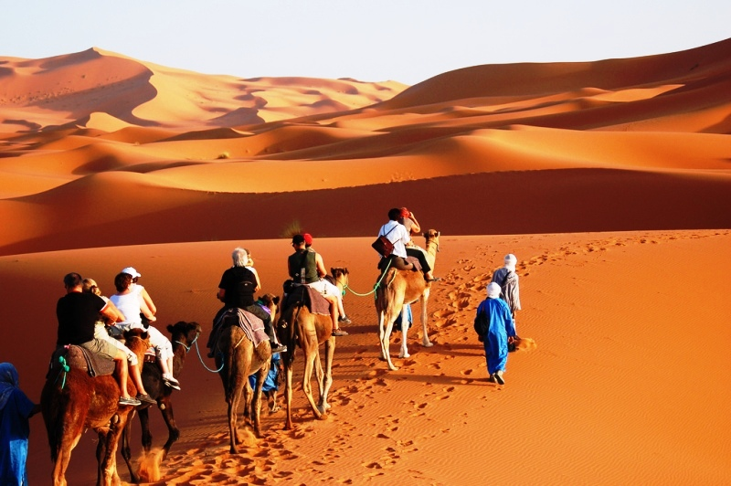
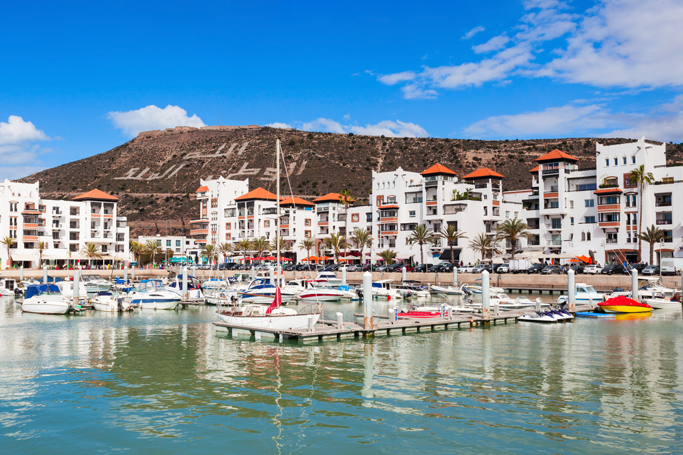
GEOGRAPHY
Morocco enjoys an infinite variety of landscapes and territories. Mountains, coastline, desert, each site has its own charm and a unique natural wealth.
As seen from the air, Morocco is set between the Mediterranean Sea and the Atlantic Ocean, and a long mountain strip expands from east to west to disappear in the sand at the south border with Mauritania.
The landscapes are varied and stunning: the breathtaking snow-capped peaks of the High Atlas Mountains and Rif Mountains, dense forests of oaks and cedars of the central plateau, fertile plains of the Meseta, arid lands of the high plateau, semi-desert steppes and luxurious oases of the Souss basin, and the Sahara’s sand dunes

Slide 16
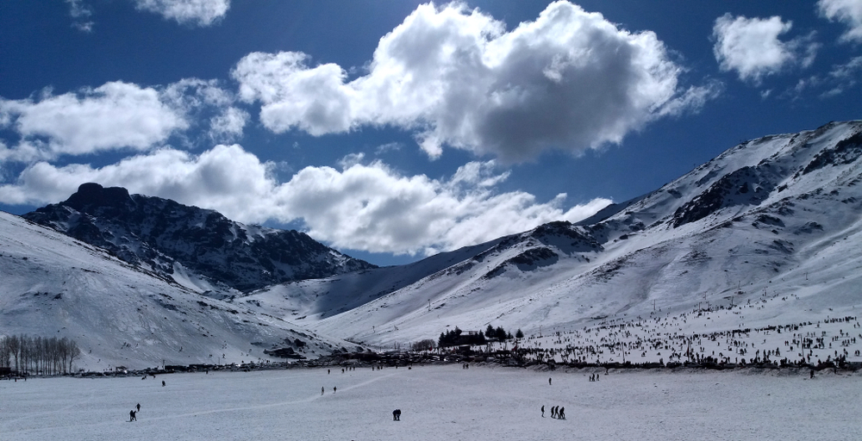
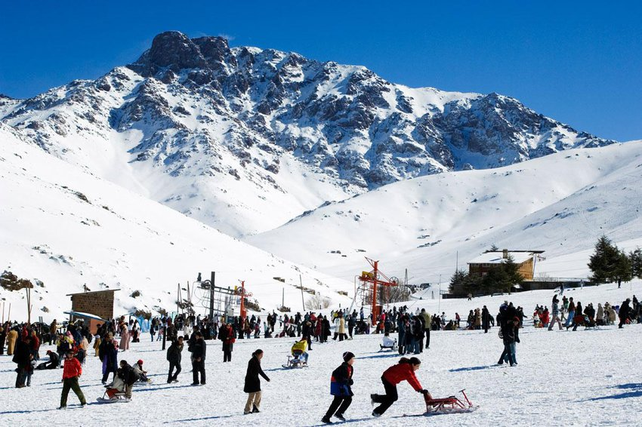
FLORA & FAUNA
The flora and fauna vary according to the diversity of regions and areas. Morocco provides such geographical diversity, that in the morning, you can go to the beautiful beaches of Agadir, and then in the afternoon be at ski resort of Oukaimden, before returning to enjoy a quiet evening at the palm gardens in Marrakech.

Slide 17
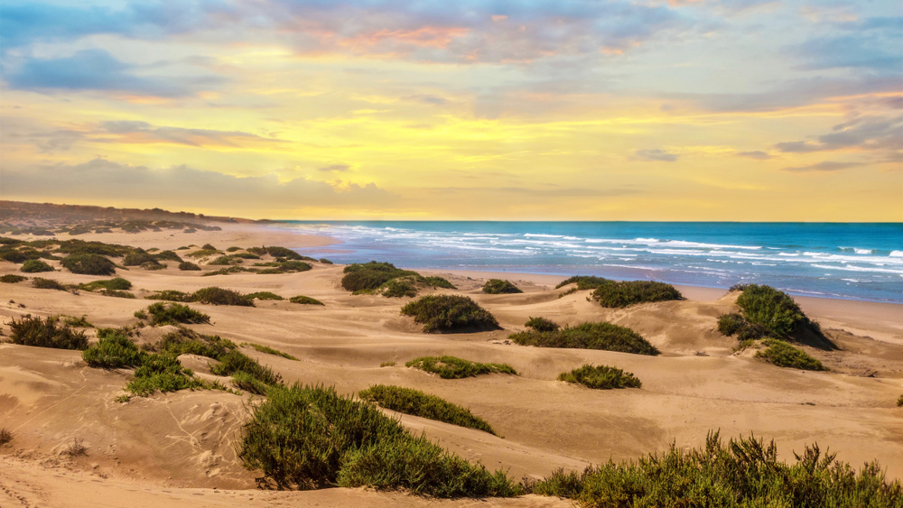
Morocco is a subtropical country at the western edge of Africa. In summer, it undergoes hot arid zone conditions, while in winter the climate is cool and humid.
Precipitations:
Average annual precipitation varies between:
* 500 to 2,000 mm, in the wettest area in the Northwest under the influence of the Atlantic Ocean;
* 200 to 1,000 mm, in the West and the Center under the influence of the Atlantic Ocean;
* 100 to 200 mm, in the East of the country;
* Less than 100 mm, in the South of the country.
CLIMATE

Slide 18
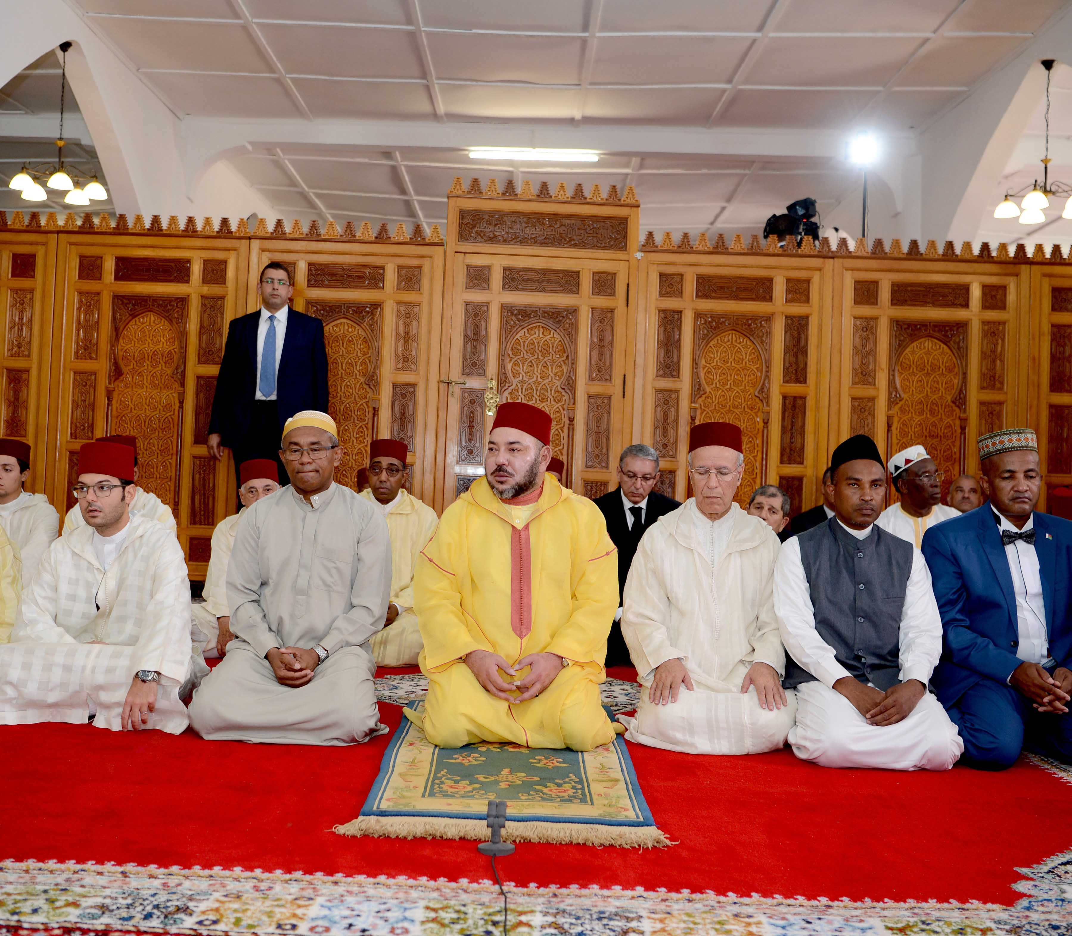
LANGUAGE AND RELIGION
Religion: Islam is the established state religion of Morocco. Almost the entire population is Sunni Muslim. The Monarch is the supreme Muslim authority in the country. He is also the Commander of the believers. The Moroccan constitution garantees the freedom of worship.
Language: The official languages are Arabic and Amazigh. French is the dominant foreign language in the country. Spanish is often spoken in the northern and southern provinces. English is fairly widely spoken.

Slide 19
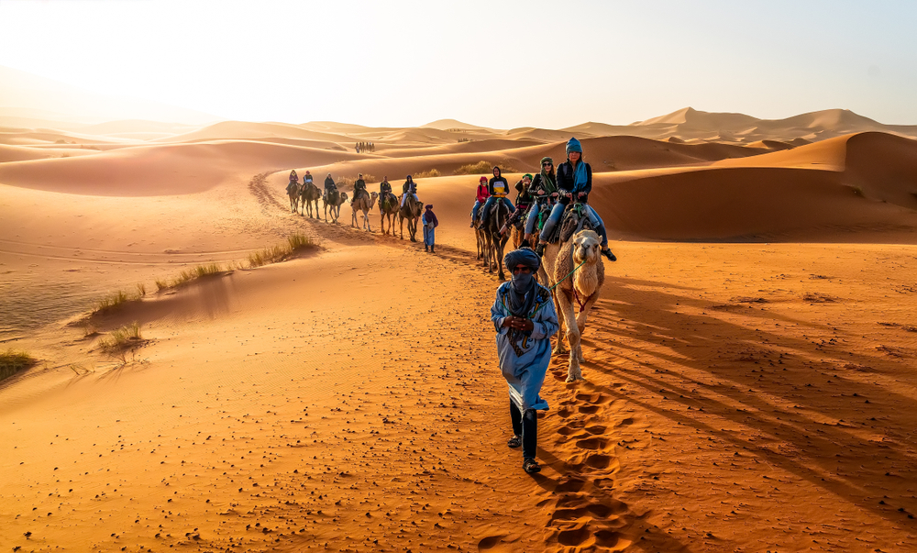
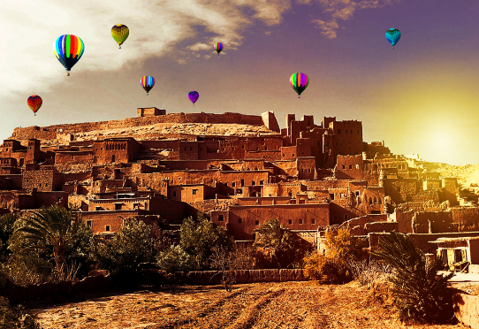
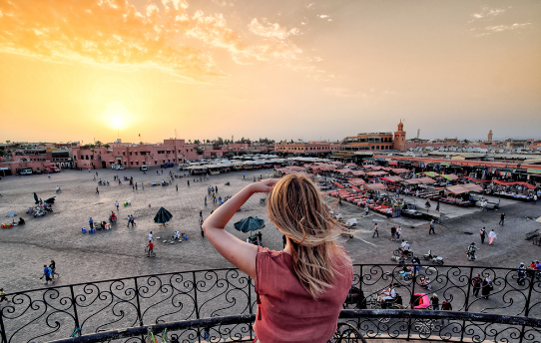
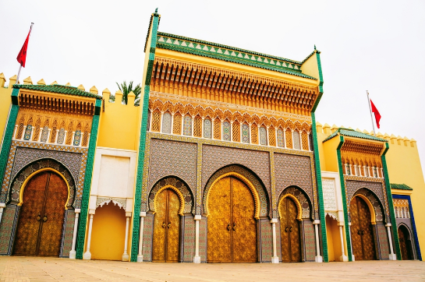
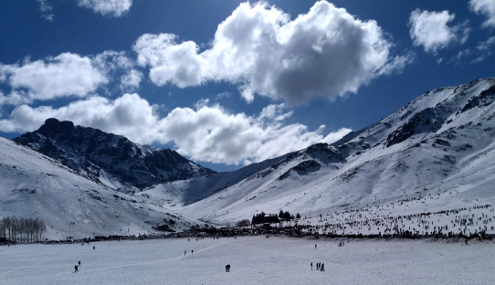
MOROCCO
more than a destination, a fascinating world,
Your Second Homeland…

Slide 20
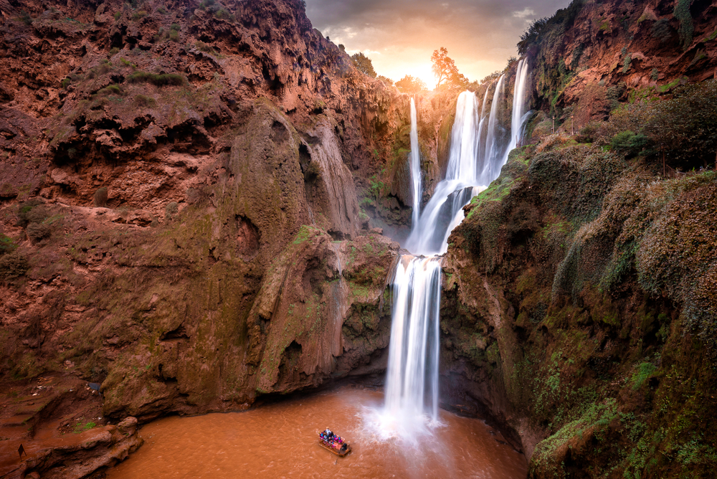
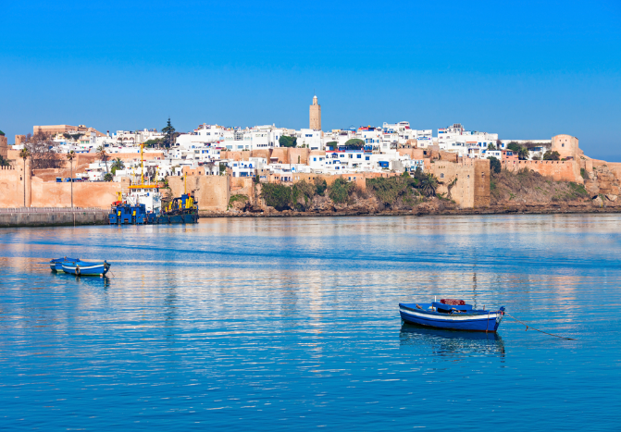
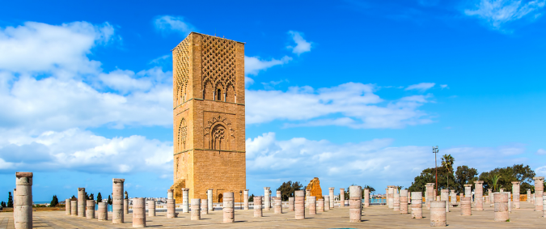
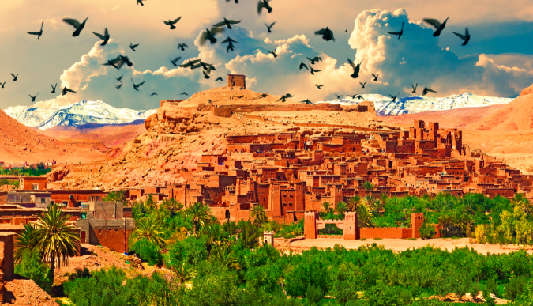
OUR MOROCCO
A country that makes everyone of you feel special and unique, the land that shares with you its beauty and tradition, but as well proud to show you how modernity and progress have fitted with our traditions.
You will experience a truly professional and friendly attention anywhere your steps will take you.

Slide 21
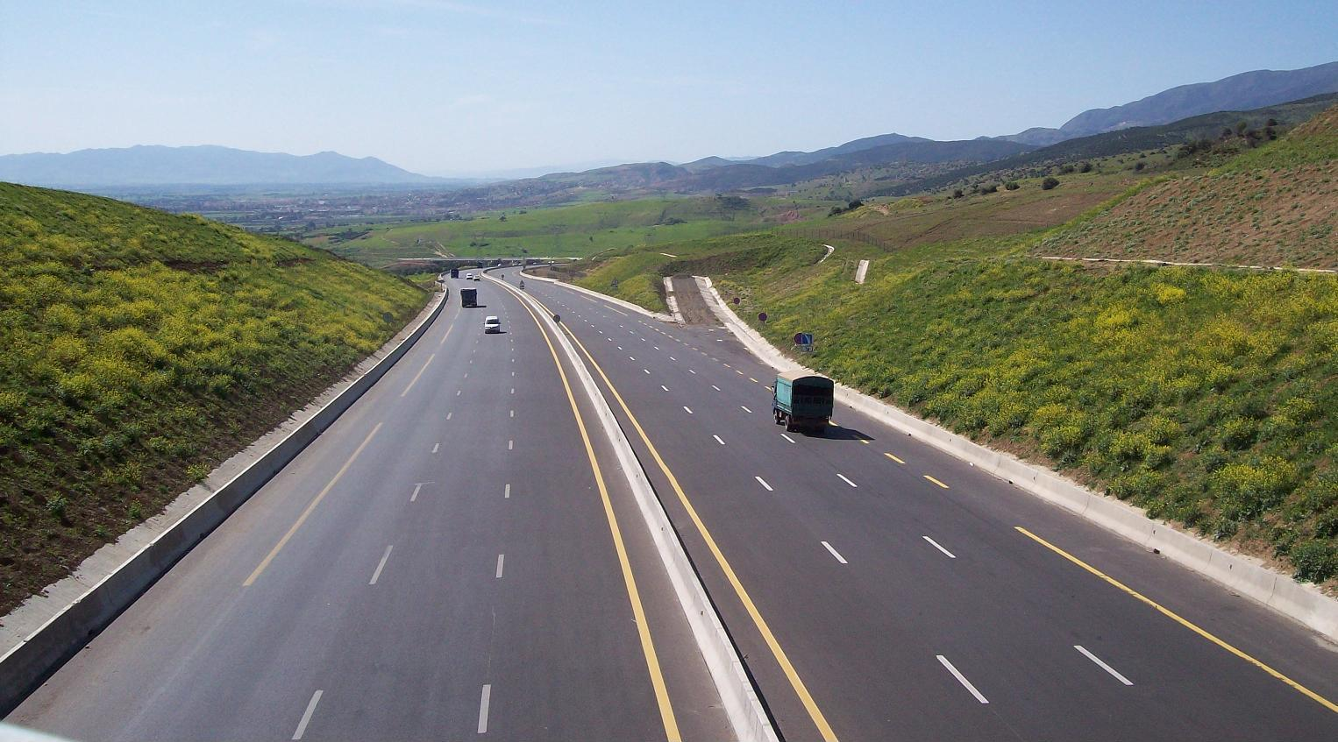
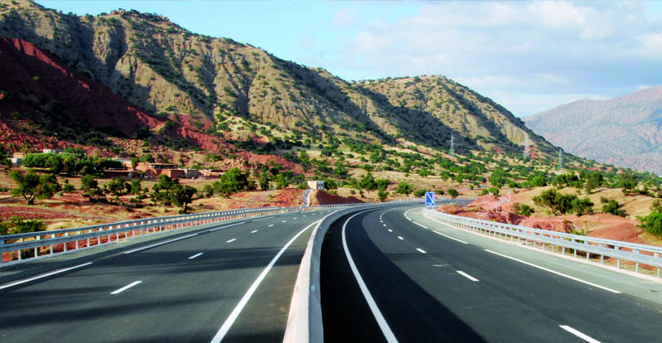
INFRASTRUCTURE

Slide 22
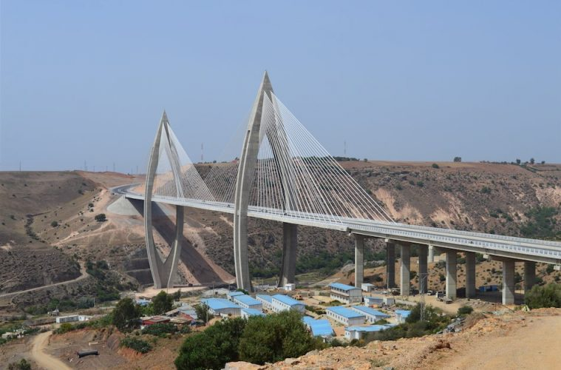
INFRASTRUCTURE
There are around 56,986 km of roads In addition to 1,808 km of highways

Slide 23
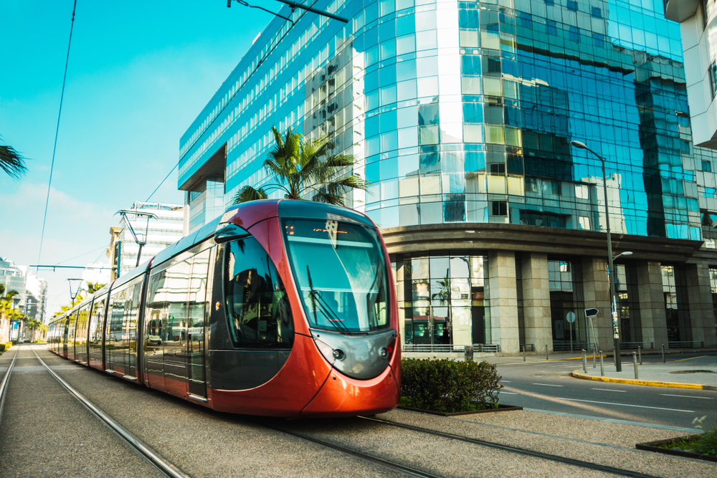
INFRASTRUCTURE
TRAMWAY

Slide 24
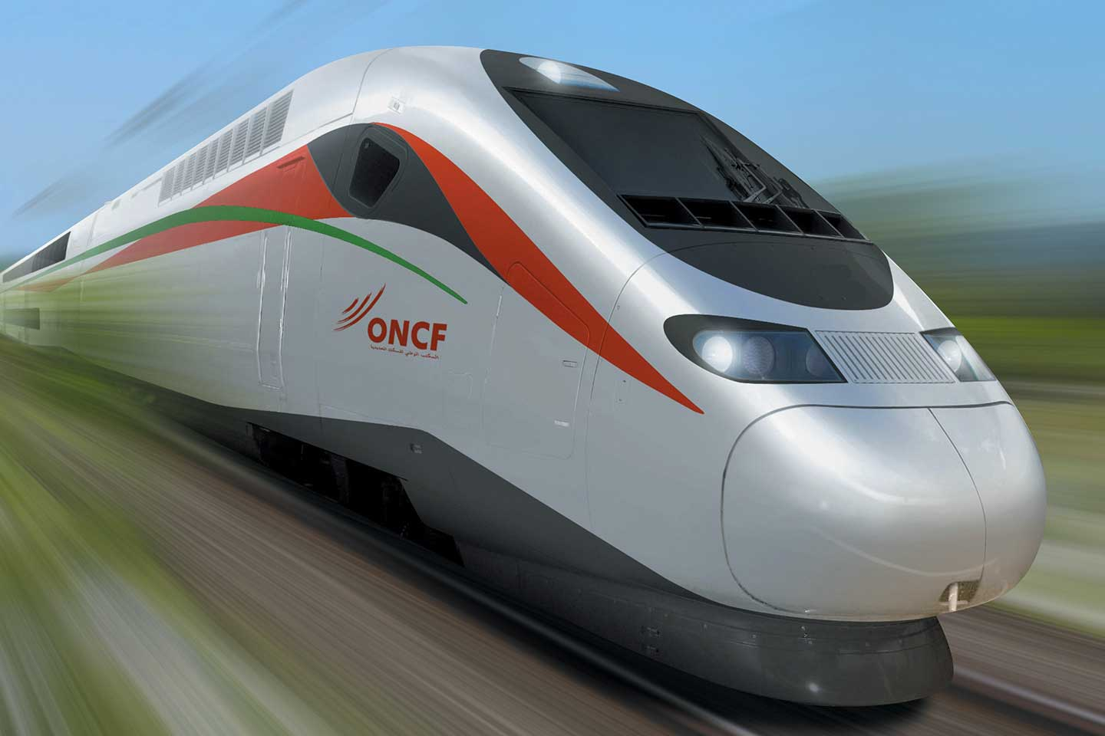
INFRASTRUCTURE
Rail network

Slide 25
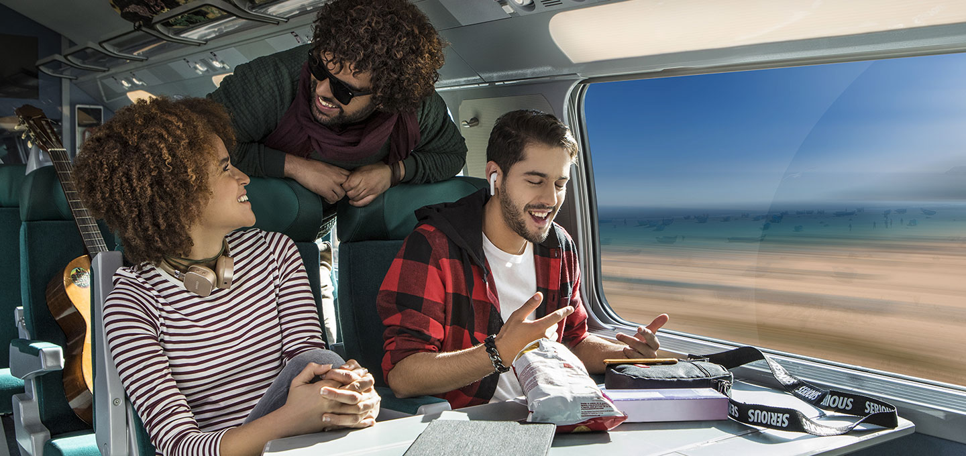
INFRASTRUCTURE
Rail network
Passenger transport
3815 km of railroad tracks
585 passenger wagons
64 % of lines electrified
5 498 merchandise carriages
35 million passengers
204 trains a day
137 railroad stations
105 609 seats available/day

Slide 26
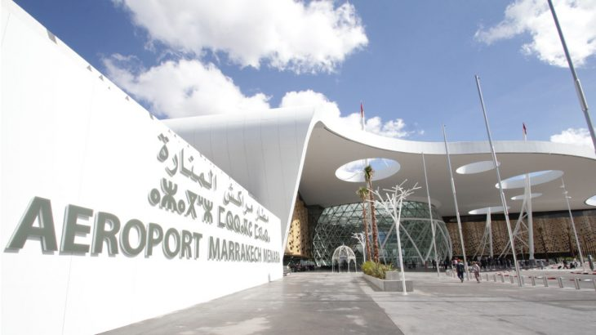
INFRASTRUCTURE

Slide 27
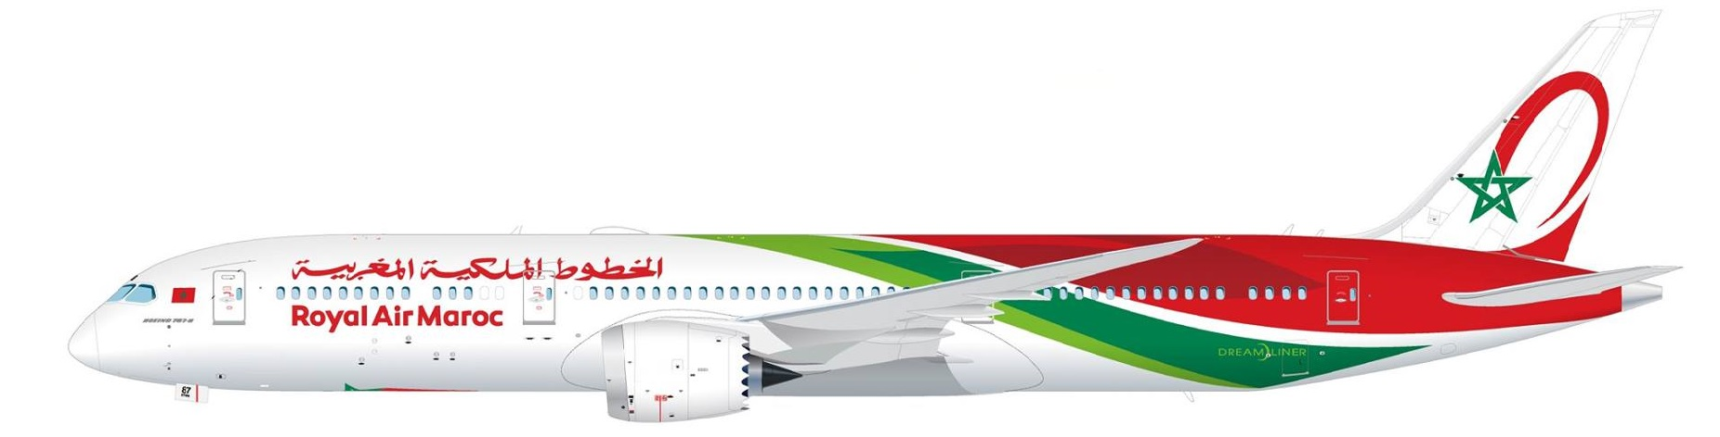
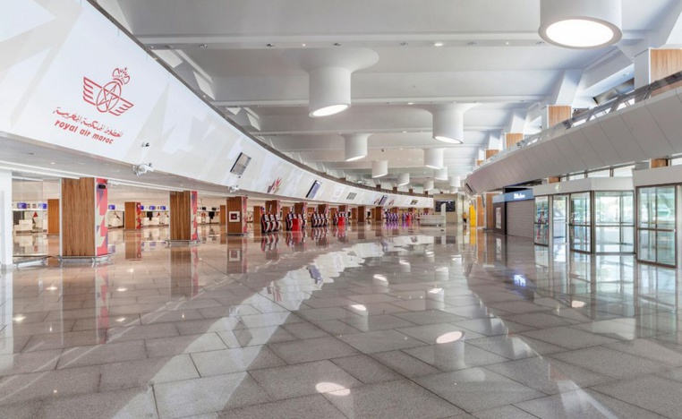
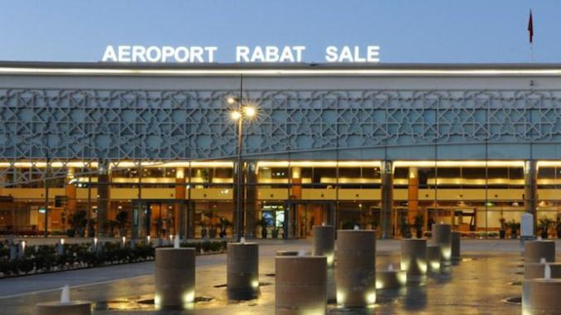
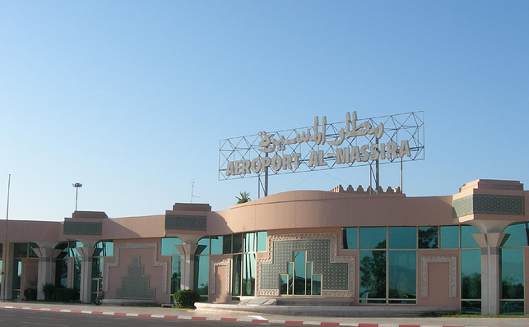
18 AEROPORTS
INFRASTRUCTURE

Slide 28
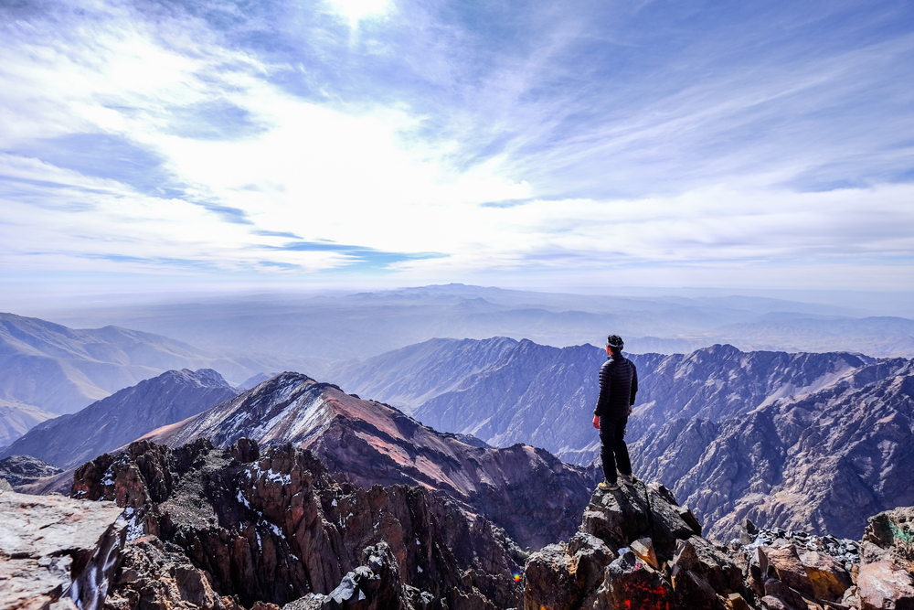
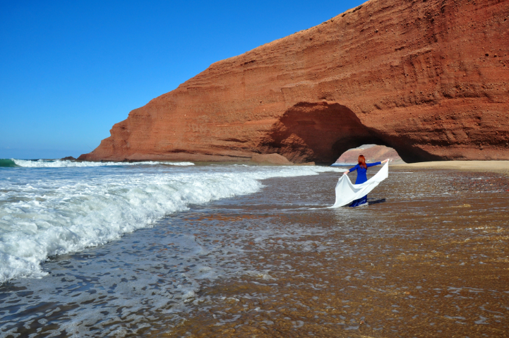
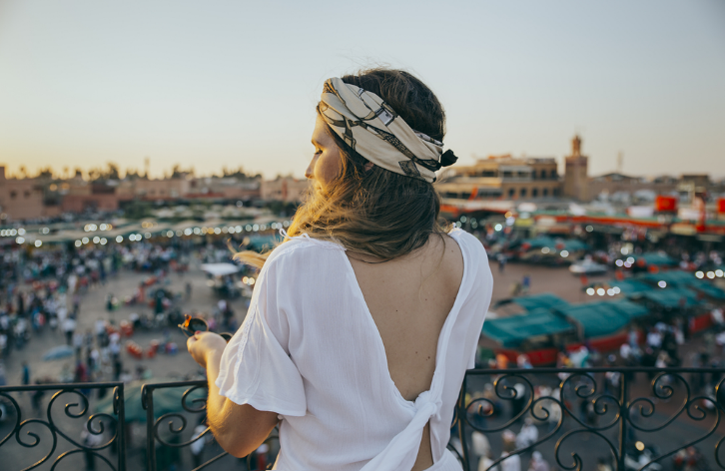

TOURISM
The accommodation capacity in Morocco is quite good and respects the standard norms of quality.
Total capacity is about 100.000 Beds.
Hotels offer convenient and basic services respecting norms of safety and hygiene.

Slide 29
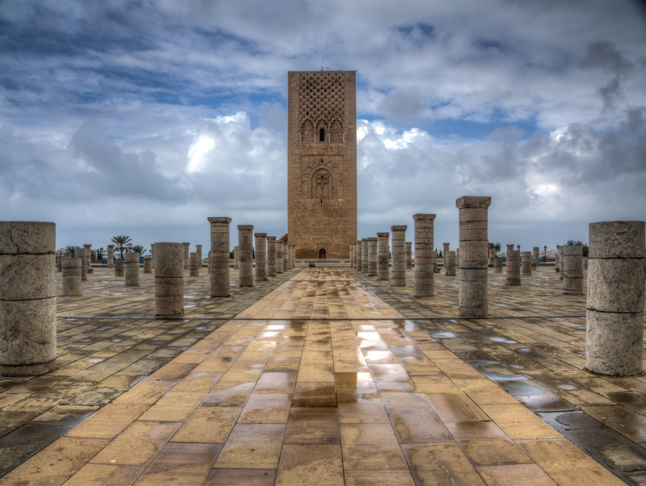
WELCOME TO RABAT

Slide 30
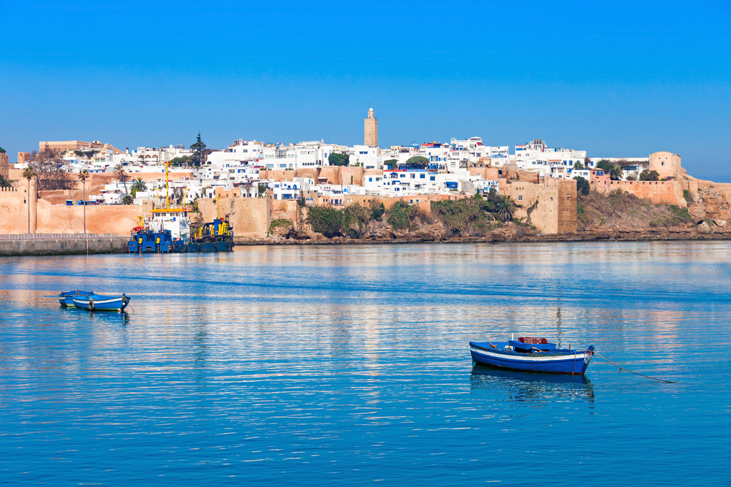
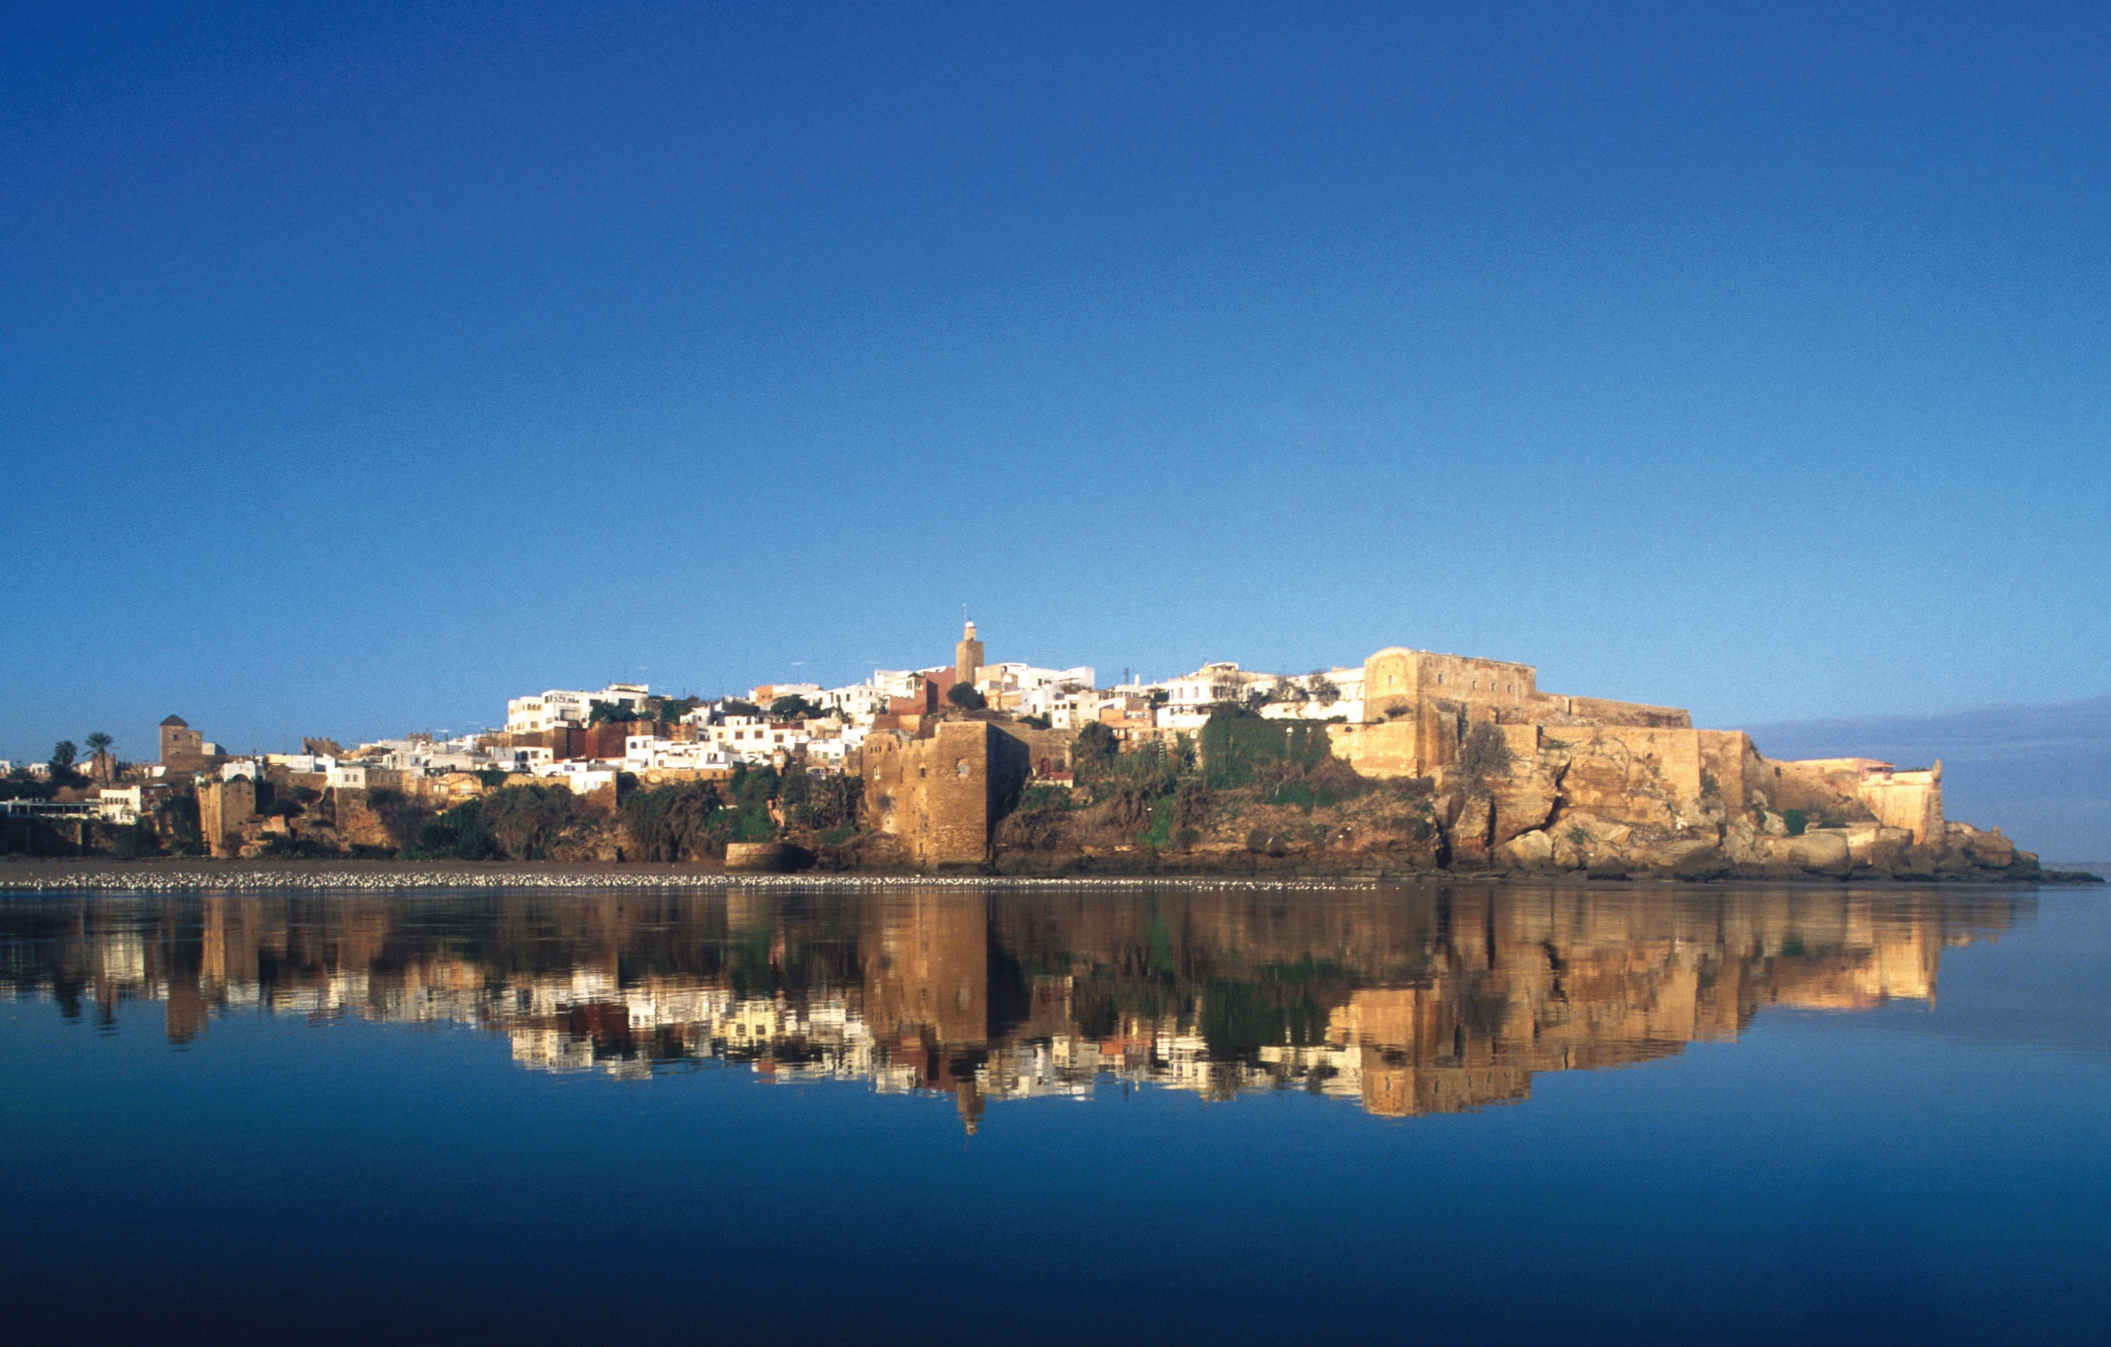
WELCOME TO RABAT

Slide 31

WELCOME TO RABAT

Slide 32

WELCOME TO AGADIR

Slide 33
WELCOME TO AGADIR

Slide 34


WELCOME TO AGADIR

Slide 35


WELCOME TO CASABLANCA

Slide 36

WELCOME TO CASABLANCA

Slide 37

WELCOME TO CASABLANCA

Slide 38

WELCOME TO MARRAKECH

Slide 39

WELCOME TO MARRAKECH

Slide 40

WELCOME TO MARRAKECH

Slide 41

WELCOME TO MARRAKECH

Slide 42




WELCOME TO ESSAOUIRA

Slide 43

WELCOME TO ESSAOUIRA

Slide 44

WELCOME TO FEZ

Slide 45

WELCOME TO FEZ

Slide 46

WELCOME TO MEKNES

Slide 47

WELCOME TO MEKNES

Slide 48


WELCOME TO MEKNES

Slide 49


WELCOME TO TANGIER

Slide 50


WELCOME TO TANGIER

Slide 51



WELCOME TO OUARZAZATE

Slide 52



WELCOME TO OUARZAZATE

Slide 53


THE BIG SOUTH OF MOROCCO
SAHARA
THE BIG SOUTH OF MOROCCO
CAMEL RIDE

Slide 54
THE BIG SOUTH OF MOROCCO
CAMEL RIDE

Slide 55


BIVOUAC
THE BIG SOUTH OF MOROCCO

Slide 56




BIVOUAC
THE BIG SOUTH OF MOROCCO

Slide 57

MOROCCAN HANDICRAFT

Slide 58



MOROCCAN HANDICRAFT

Slide 59



MOROCCAN HANDICRAFT

Slide 60

MOROCCAN MINT TEA

Slide 61


Atlas Golf Resort Marrakech

Slide 62





GOLF SAMANAH

Slide 63



GOLF SAMANAH

Slide 64

GOLF ASSOUFID

Slide 65




GOLF ASSOUFID

Slide 66



Golf Noria Marrakech

Slide 67


Air Balloon Flight Hot

Slide 68


Air Balloon Flight Hot

Slide 69



Air Balloon Flight Hot Marrakech
Take a relaxing flight through the Moroccan sky in a hot air balloon. Enjoy breathtaking views of Marrakesh and the beautiful nearby countryside. If you choose to follow your flight by a camel ride.

Slide 70



TRANSPORTATION

Slide 71

Motorcoaches : 48 Seats
Brand Man & Irizar

Slide 72

Motorcoaches : 15 Seats
Brand MERCEDES

Slide 73

Motorcoaches : 5 Seats
Brand Hyundai & Ford

Slide 74


Please, Be Our Guests To our Wonderful Morocco

