Slide 1


Slide 2
How everything begun
In 1997 we started to introduce Orec to our dealers
At that time the main market was sickle bar mowers and brush cutters!
Nobody knew or understood the concept of the RM „Ride On“ brushcutter
and only a few dealers knew similar machines such as „SH mowers“
Other brands at that time which had a similar concept like SH were:
Brummi, AS Motor, Kiva, Roques Lecouer etc.
The sales have been quite slow at the beginning and we figured out
that we need a good strategy to be successful in the future

Slide 3


The strategy
Marketing strategy
Dealer demos
Product comparison
End-User demos
Market analysis
Dealer education

Slide 4
Marketing strategy
Dealer strategy
After we persuade our dealers through the demos and presentation we have made,
we convince them to buy a first batch of different machines.
By buying those machines, we give the dealers the following support:
We buy all possible target addresses of users in his region + his customer addresses
We send out a professional video incl. a brochure to all his target end-users
Inviting them to our dealers for a professional demo-day „high-grass-day“
Using a telemarketing strategy to support the invitation
Support our dealers with our sales-reps during the demo-day „high-grass-day“
Advertisement campaigns in the local newspaper of the dealer

Slide 5
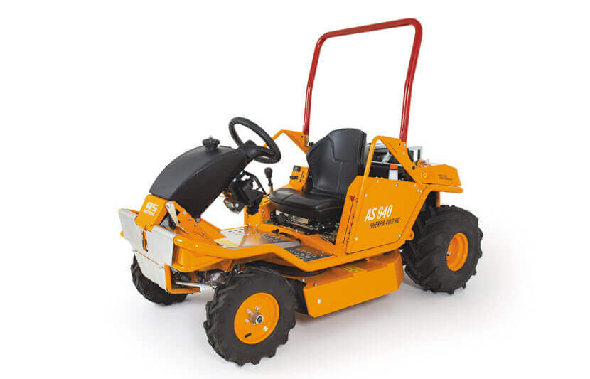
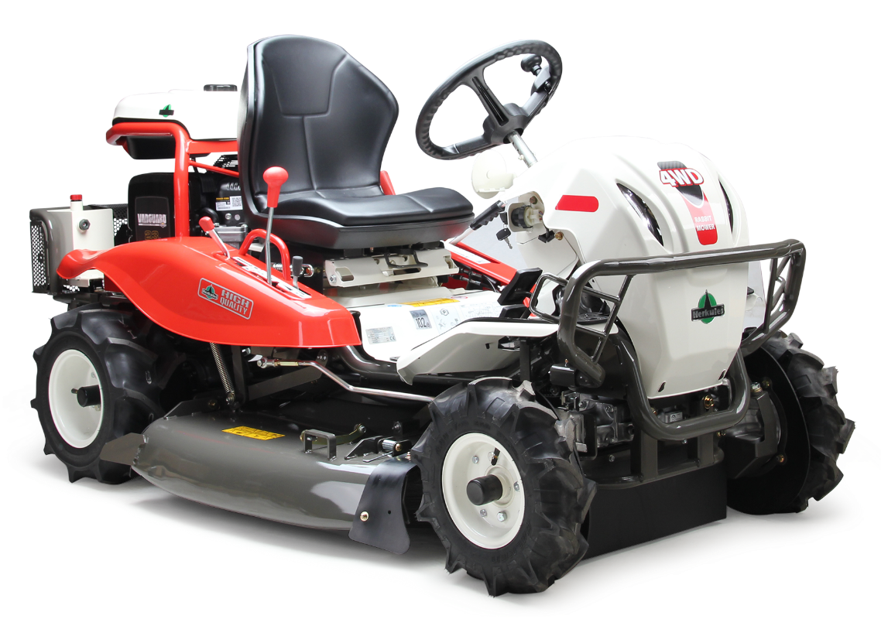
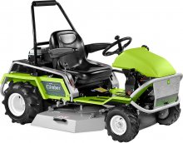
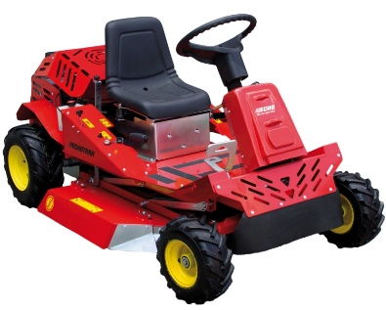
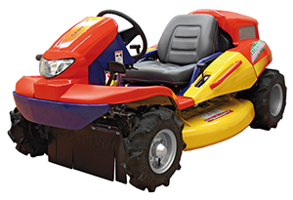
Market analysis
Ride on
Original
vs.
Copy

Slide 6
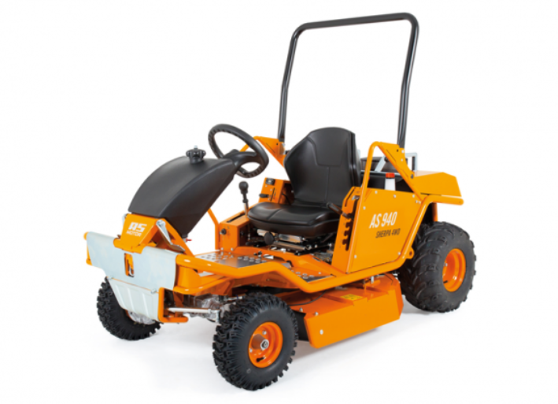
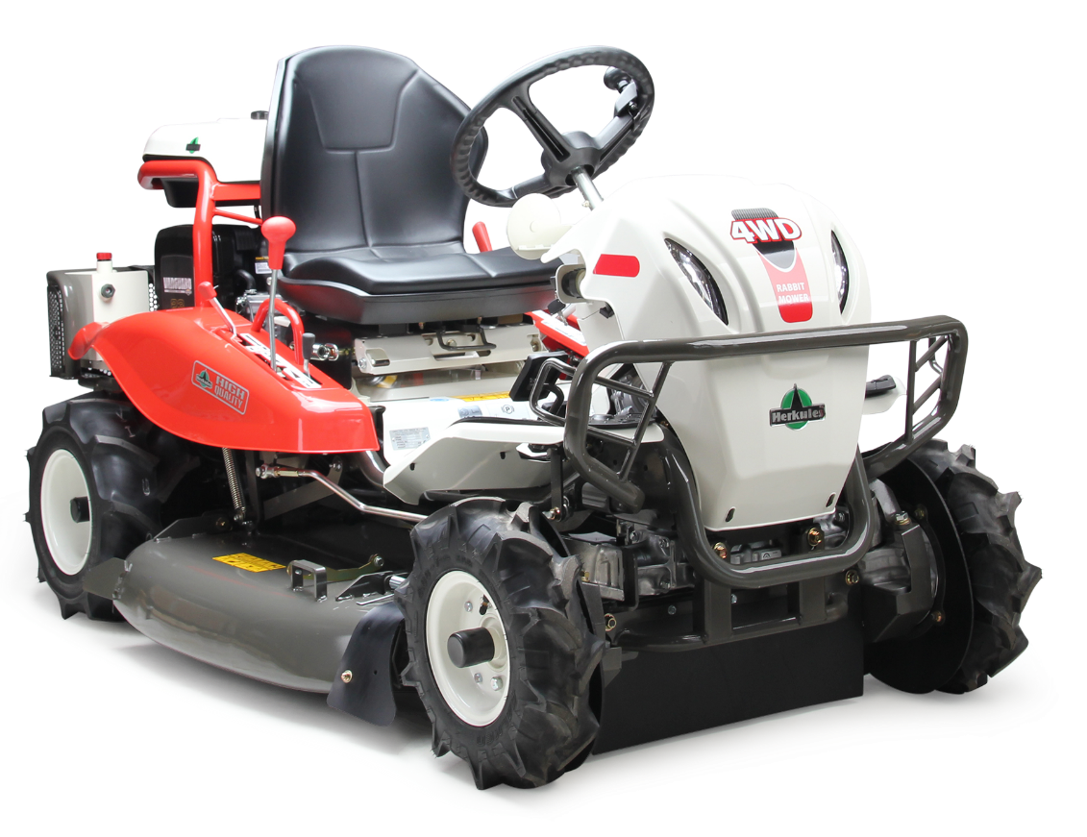
RM 982F 4WD vs. AS Scherpa

Slide 7
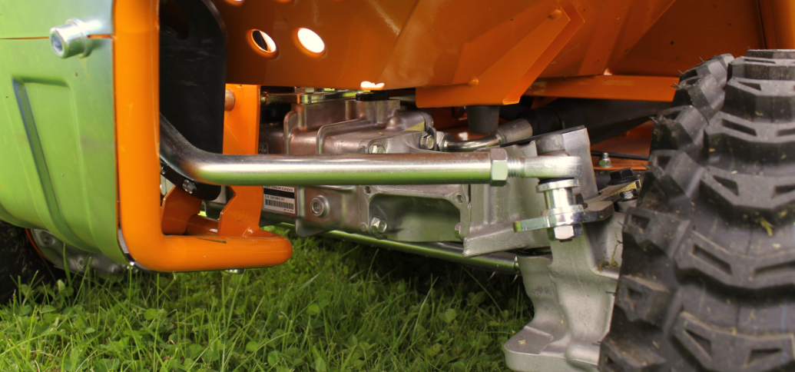
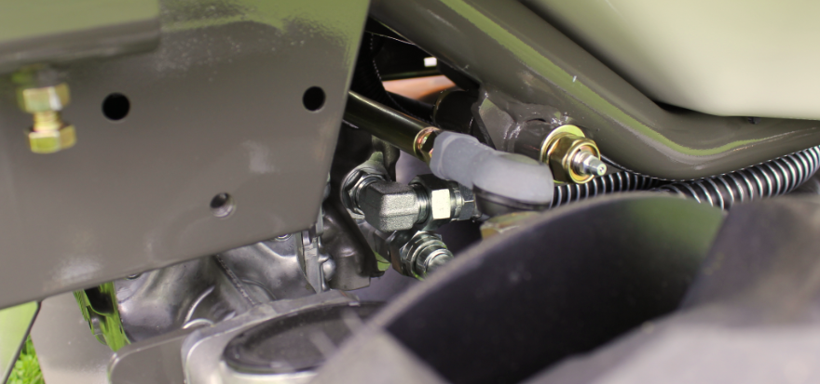
RM 982F 4WD vs. AS Scherpa
AS: Steering linkage is in front of axle not
protected against shocks
Orec: Steering linkage is behind the axle
and thus protected against shocks

Slide 8
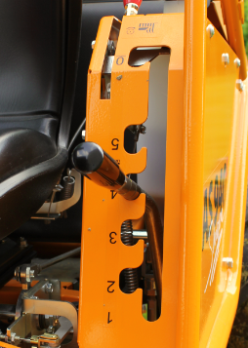
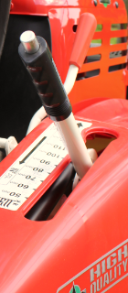
RM 982F 4WD vs. AS Scherpa
AS: Cutting height adjustment 5 - fold
Difficult to use arrangement
uncomfortable
Orec: Cutting height adjustment by
a gas spring supports infinitely
positioned comfortably

Slide 9
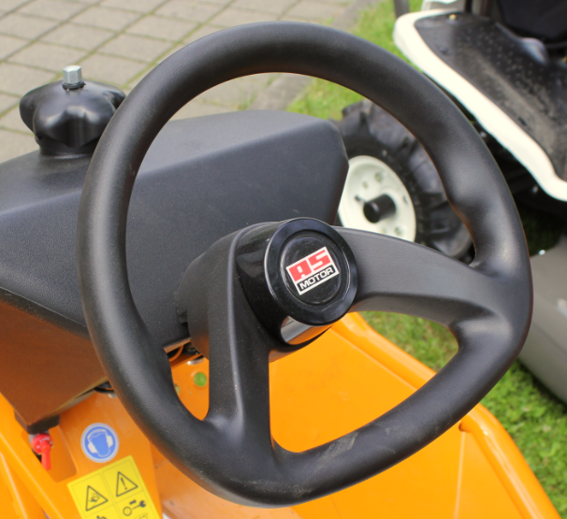
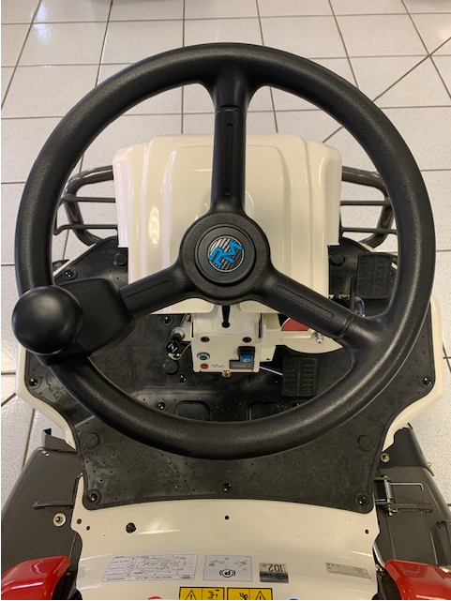
RM 982F 4WD vs. AS Scherpa
AS: The steering wheel look good! To
Quick maneuver you needs both
Hands.
Orec: Steering wheel adjustable in height.
the steering knob of the RM can be easily
control with one hand

Slide 10
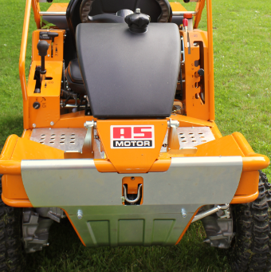
RM 982F 4WD vs. AS Scherpa
AS: No Head-lamp
Orec: Head-lamp

Slide 11
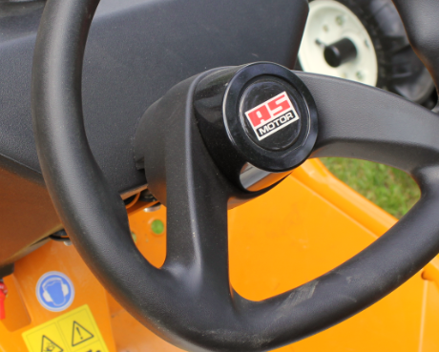
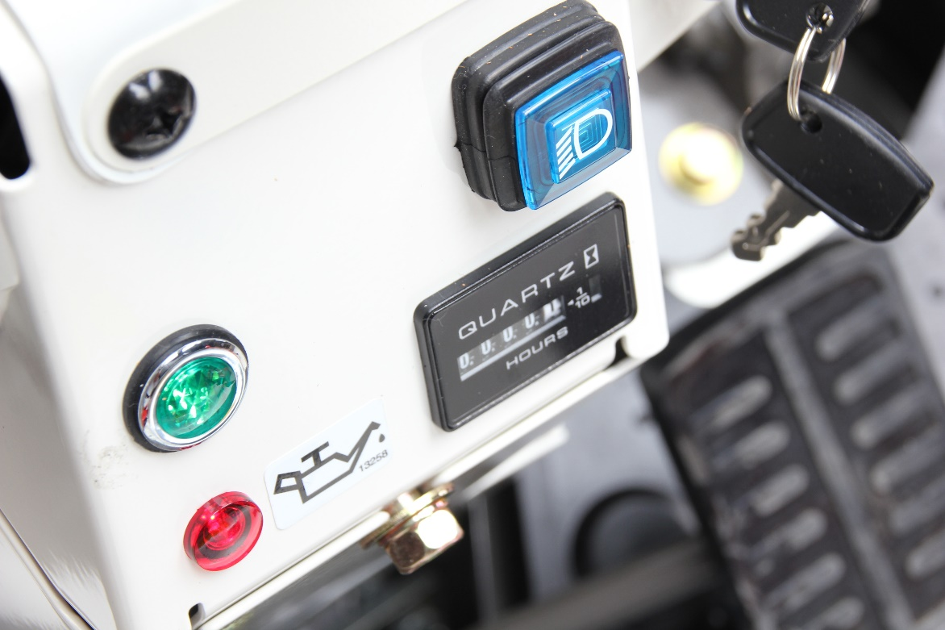
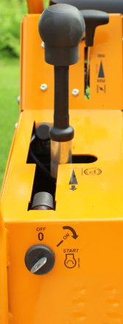
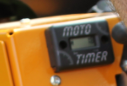
RM 982F 4WD vs. AS Scherpa
AS: Operating hours counter Joke
Ignition key to the steering wheel no
tank indicator
Orec: Hour meter, Joke,
tank indicator ignition key everything in the
cockpit good to see and reach

Slide 12
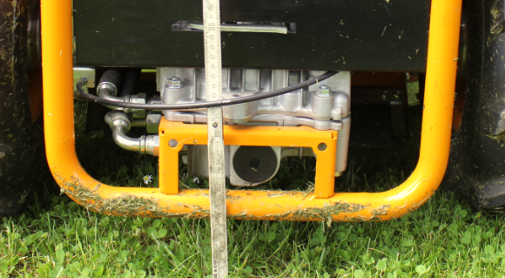
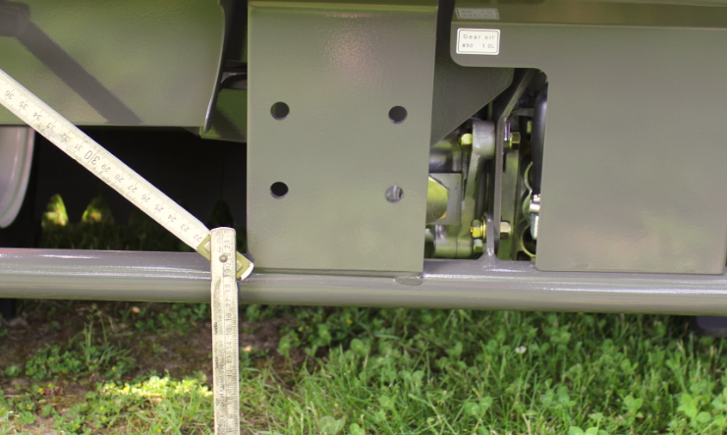
RM 982F 4WD vs. AS Scherpa
AS: Ground clearance is about 7 cm.
The Hydrostat attached to the rear frame
(no bumper) beats by acting go directly to the hydrochloride and the axles
Orec: Ground clearance is about 17 cm
Hydrostat is protected to shocks

Slide 13
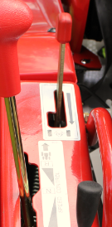
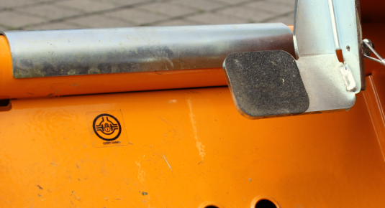
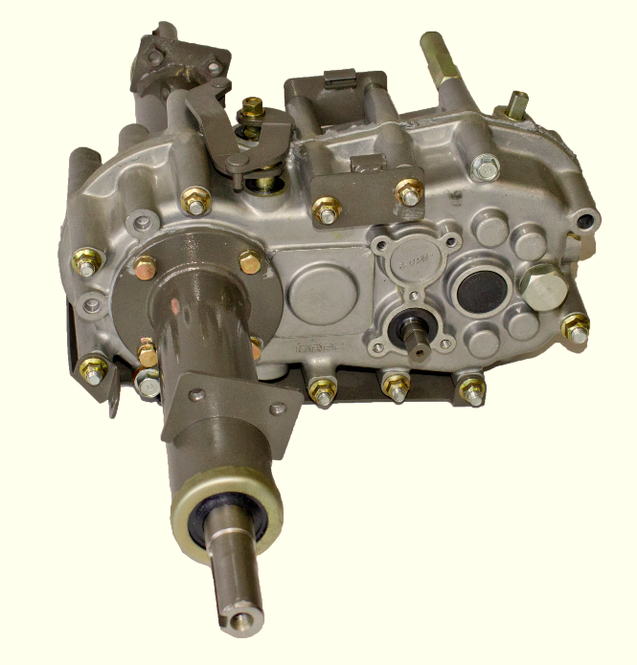

RM 982F 4WD vs. AS Scherpa
AS: Mechanical differential lock
The foot pedal can not be locked
Orec: lockable differential gear

Slide 14
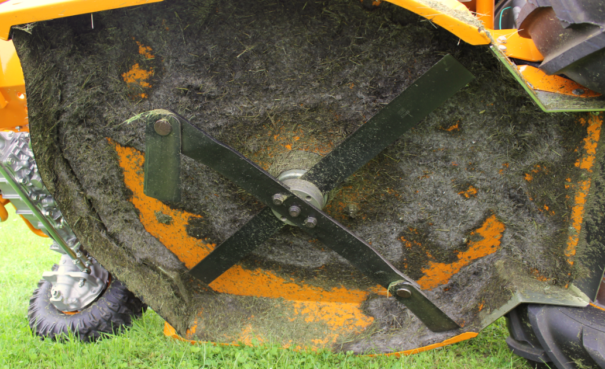
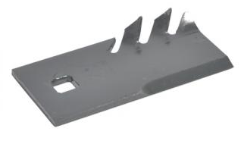
RM 982F 4WD vs. AS Scherpa
AS: through the cross blade is a good
Cutting performance ! With 27 hp B & S engine the AS is very quickly on his power limit
Orec: To have also a nice cutting
Performanc we have to use te Mulching Knife.
(now included)

Slide 15
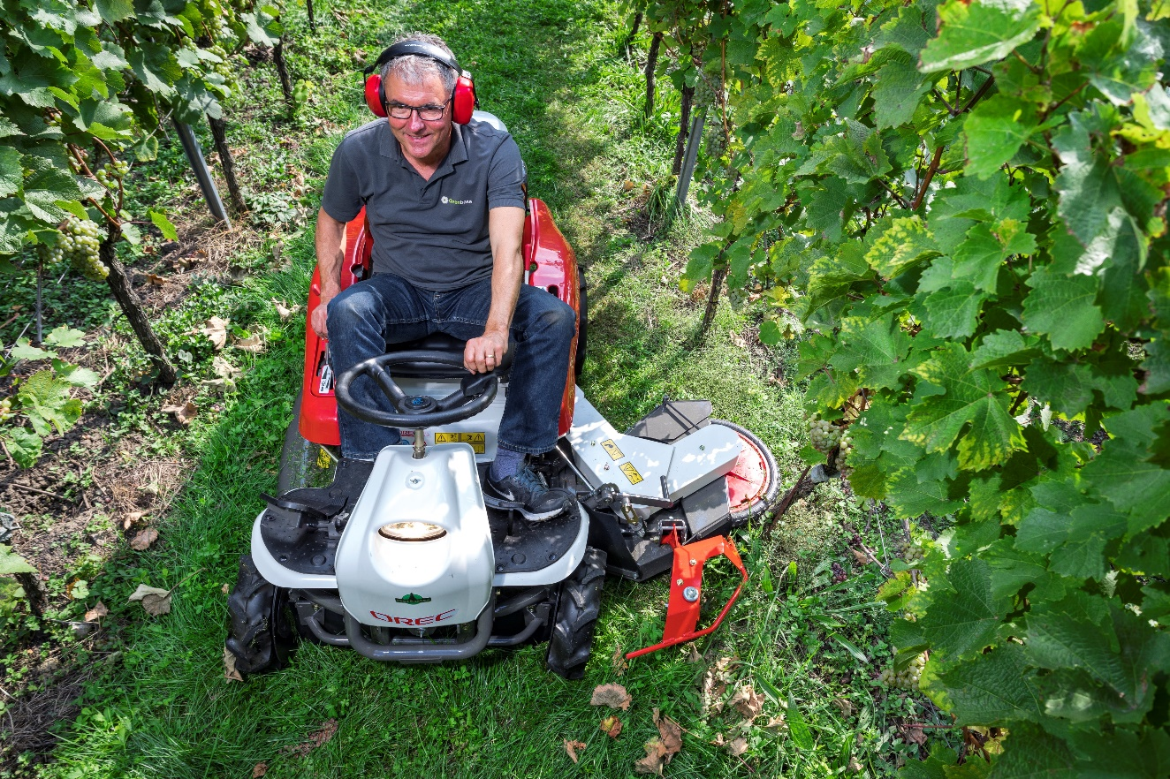
Marketing strategy
Identifying the target customer
Farmers
Municipalities
Wine farmers
Tree plantations
Landscapers
Industrial companies
Fruit farmers
X-Mas tree plantations
Hunters
Owners of a summer house
Etc.

Slide 16
DEMO = SALES

Slide 17



