Slide 1
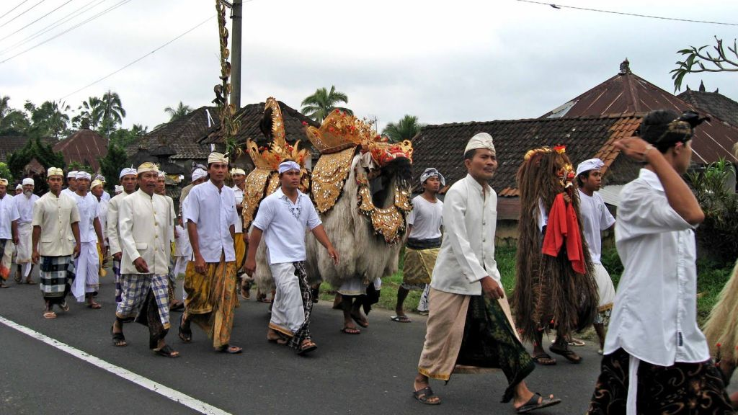

Bali: Barong & Gamelan
http://www.authorstream.com/Presentation/michaelasanda-1531373-bali1-barong-gamelan/
Notes:
Ulun Danu Beratan Temple is consisted of 4 temples complex that are:
The Shrine of Lingga Petak It is a meru - 3 superimposed roofs shrine - located at the most eastern side, reachable by canoe. The shrine has 4 doors for 4 directions. According to the record the shrine was renovated in 1968, and in the foundation were found 3 long round stones each had red, white, and black color. The white stone was in the middle and was believed to be a " lingga " the symbol of god Shiva. It is very probable that this temple got the name from the white lingga ( Petak means white ). Until now the local religious leader still dedicate this temple as the worship of Shiwa. It is also called " the abode of Ulun Danu god " as the symbol of fertility. It is already known that the Shiwa - Lingga devotee put strong emphasize on the worship of fertility ( influence of Tantric school ). At most ancient sites found to preserve this symbol it is normally consist of 2 parts. The base and the round up-right stone. The base is called " Yoni " and the up-right is called " lingga ". This thought was probably inspired by the atheistic thinking of Shamkya philosophy about the creation or as mentioned above from Trantric school. That is the meeting between " Purusa " or the male element with the "Pradhana " the female element will result the creation. The distribution of this thought in Bali was almost all over the island. This is the prove that Shivaitic sectarianism had wide followers. The practice of this sect later influenced very much by the practice of Tantrayana, a left hand path of Buddhism.

Slide 2
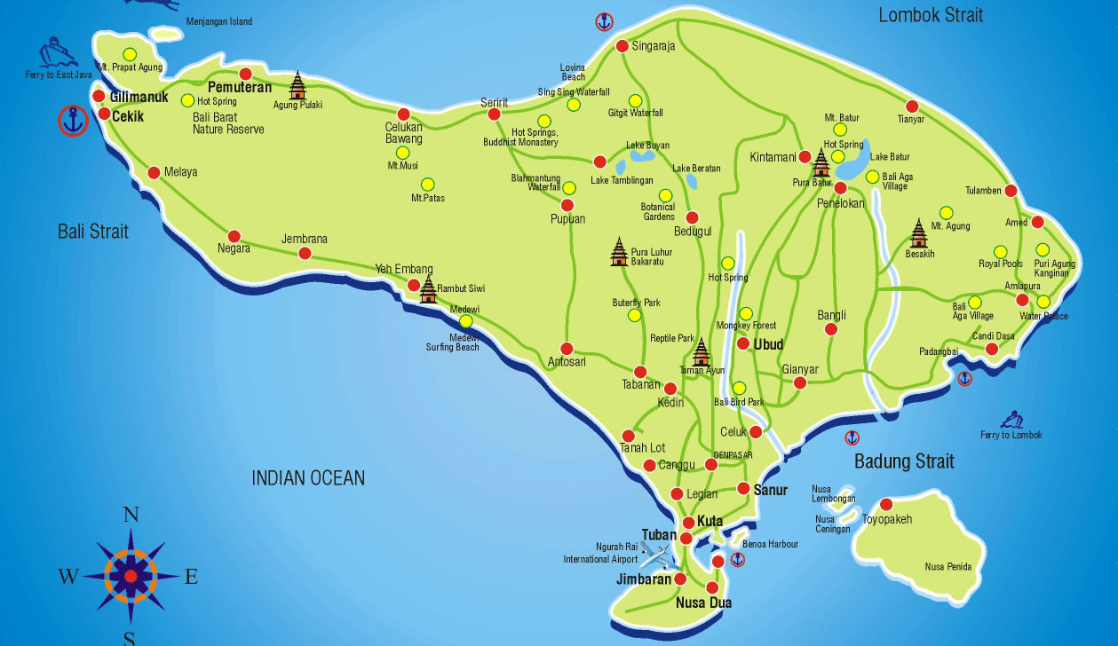
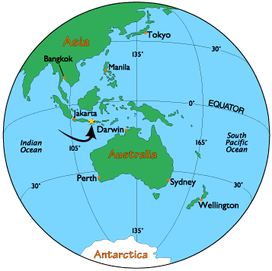
1
Bali
Notes:
The Shrines for temporary abode of god in Mount Mangu The location is just on he west side of Lingga Petak, reachable by wooden bridge. The shrines are a11-superimposed merus. Who was considered to abode Mt. Mangu? This is a story from a manuscript called " Babad Usana Bali" on which various directions in Bali with the temple name and the above are mentioned. Mount Mangu is mentioned as the abode of the power of Wisnu or Dewi Danu. It is hard to understand why for the god Wishnu the shrine is bigger while at that time Shiwa-Lingga was preponderant.
Shrines of Teratai Bang It is also called Pura Penataran Agung. This complex is consist of 3 yards as the common structure of temple in Bali. Here 22 shrines and pavilions standing for various dedication. From the name of spirits worshipped here there are very clear the mixed spirits between ancestor's spirits and the worship of the god power. Local ritual leaders consider that the main shrine is the 7-roofed meru as the abode of god Brahma.
Pura Dalem Purwa, the complex has 3 pavilions for worshipping the power of god Shiwa in the form of Bhagawati goddess, the symbol of wealthiness.

Slide 3
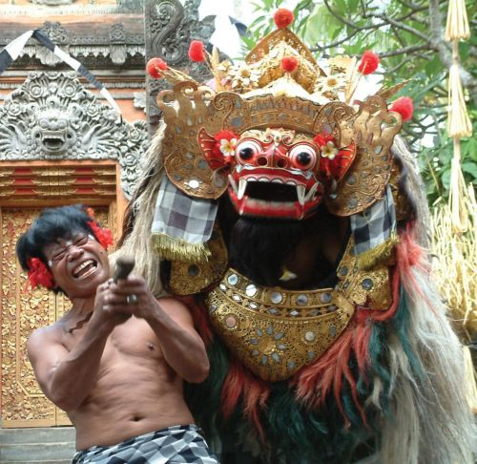
Barong is probably the most well known dance. It is also another story telling dance, narrating the fight between good and evil. This dance is the classic example of Balinese way of acting out mythology, resulting in myth and history being blended into one reality.
In Balinese mythology, the good spirit is identified as Banas Pati Raja. Banas Pati Raja is the fourth "brother" or spirit child that accompanies a child throughout their life, which is a similar concept to guardian angels. Banas Pati Raja is the spirit which animates Barong. A protector spirit, he is often represented as a lion. The Barong is often portrayed accompanied by two monkeys. Barong is portrayed as a lion with red head, covered in white thick fur, and wearing gilded jewelry adorned with pieces of mirrors. The shape of lion Barong is somewhat similar to a Pekingese dog
Dansul Barong este expresia luptei eterne dintre spiritele bune şi cele rele, de fapt reprezentarea luptei dintre forţele haosului şi distrugerii (Rangda) şi cele ale ordinii (Barong). În mitologia balineză, spiritul bun este identificat ca Banas Pati Raja. Banas Pati Raja este al patrulea „frate" sau spiritul care însoţeşte un copil de-a lungul vieţii lui, un concept similar cu îngerul păzitor. Banas Pati Raja este spiritul care îl animă pe Barong, şi el un spirit protector, adesea reprezentat ca un leu.
Notes:
Buddhist Temple
The existence of Ulun Danu Temple reminds that The Balinese Hindu live tolerantly with other people outside of Hindu like Buddha. It is signified by the existence of Buddhist Temple located outside of temple area. This temple building look very beautiful with Buddha Monk Statues put surround the temple. These Buddhist Temples are strategically situated in the lush tropical garden with cool atmosphere surround it. In this page, we present one of Buddhist Temples in Bedugul Bali.

Slide 4
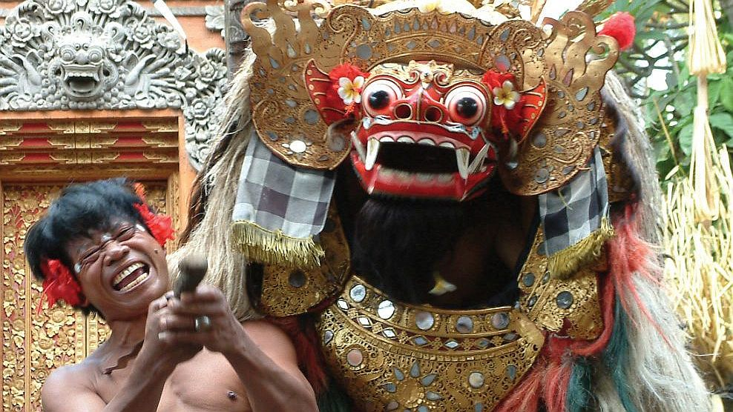

Slide 5
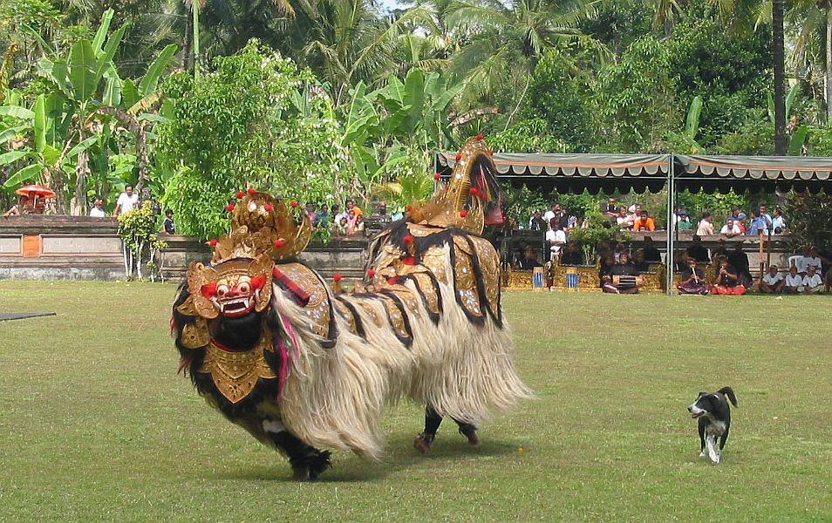
The story goes that Rangda, the mother of Erlangga, the King of Bali in the tenth century, was condemned by Erlangga's father because she practiced black magic. After she became a widow, she summoned all the evil spirits in the jungle, the leaks and the demons, to come after Erlangga. A fight occurred, but she and her black magic troops were too strong that Erlangga had to ask for the help of Barong. Barong came with Erlangga's soldiers, and fight ensued. Rangda casted a spell that made Erlangga soldiers all wanted to kill themselves, pointing their poisoned keris into their own stomachs and chests. Barong casted a spell that turned their body resistant to the sharp keris. At the end, Barong won, and Rangda ran away.
Legenda spune că Rangda, mama regelui din Bali în secolul al X-lea, Erlangga, a fost condamnată de soţul său deoarece practica magia neagră. După ce a devenit văduvă, ea a chemat toate spiritele rele din junglă şi demonii, să vină după Erlangga. A avut loc o luptă dar ea şi forţele de magie neagră erau prea puternice iar Erlangga a trebuit să ceară ajutorul lui Barong. Barong a venit cu soldaţii lui Erlangga şi în lupta care a urmat Rangda a făcut o vrajă care i-a făcut pe soldaţi să se omoare cu propriile pumnale otrăvite. Barong a făcut şi el o vrajă prin care pumnalele ascuţite nu mai puteau străpunge corpurile soldaţilor. Până la sfârşit Barong a câştigat, şi Rangda a fugit.

Slide 6
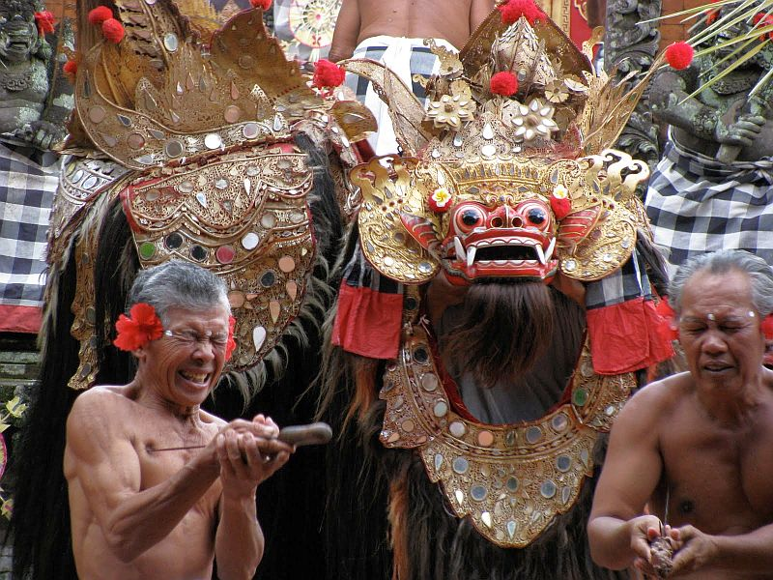
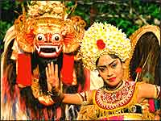
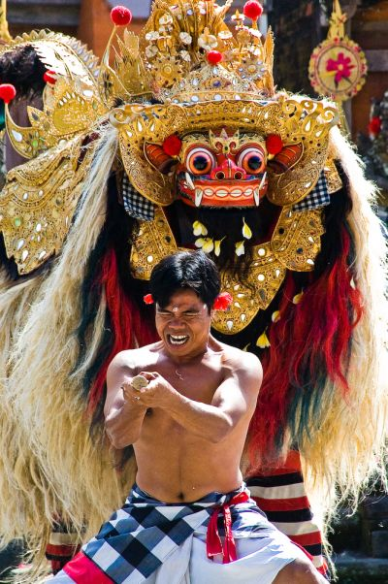

Slide 7
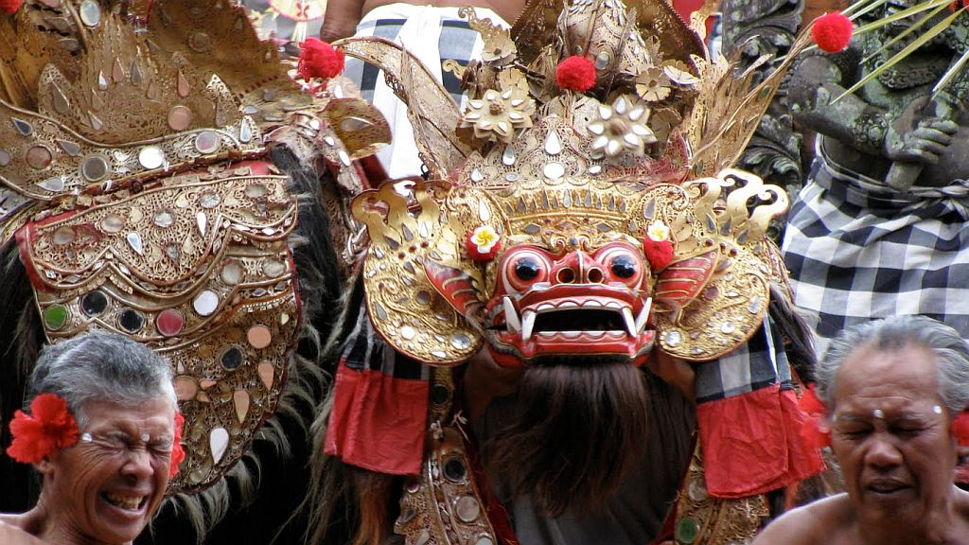

Slide 8
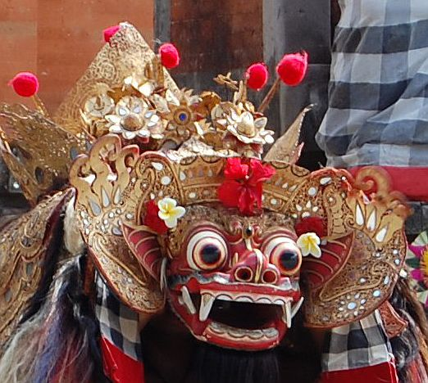

Slide 9
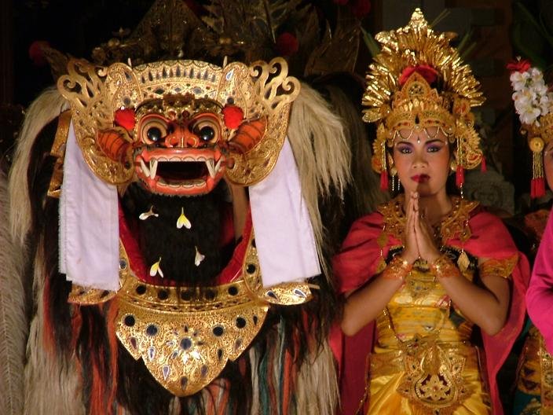
Somebody can die or get seriously injured in a Barong dance. It is said that if Rangda's spell is too strong, a weak soldier may not be able to resist it, even with the help of Barong. He may end up hurting himself with his own keris.
Cineva poate muri sau se poate răni grav într-un dans Barong. Se spune că dacă vraja Rangda este prea puternică, un soldat slab nu poate fi capabil să reziste, nici chiar cu ajutorul lui Barong. El poate ajunge să se rănească cu propriul pumnal (keris).

Slide 10
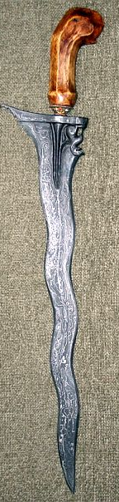
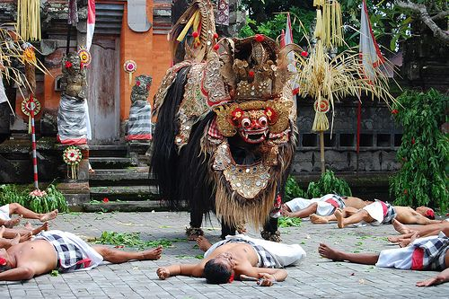
Kris
Bali

Slide 11
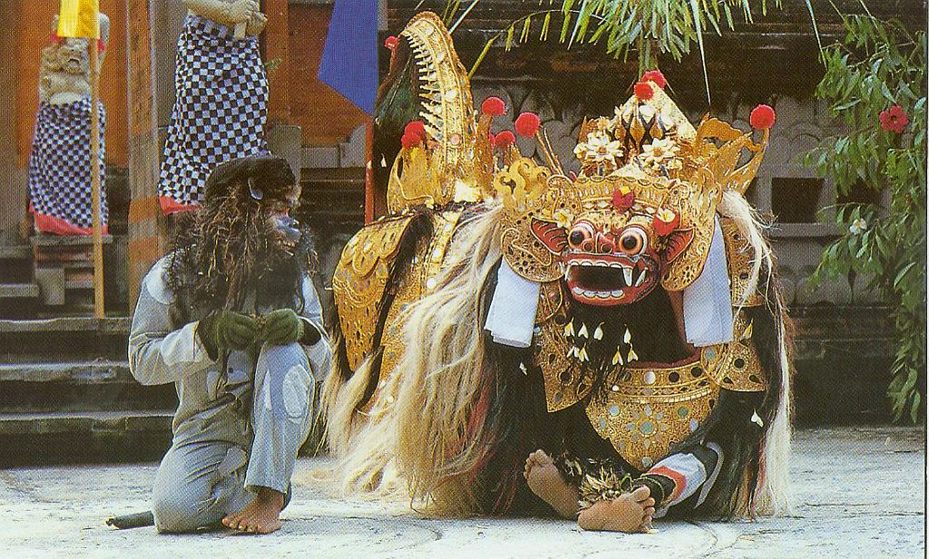

Slide 12
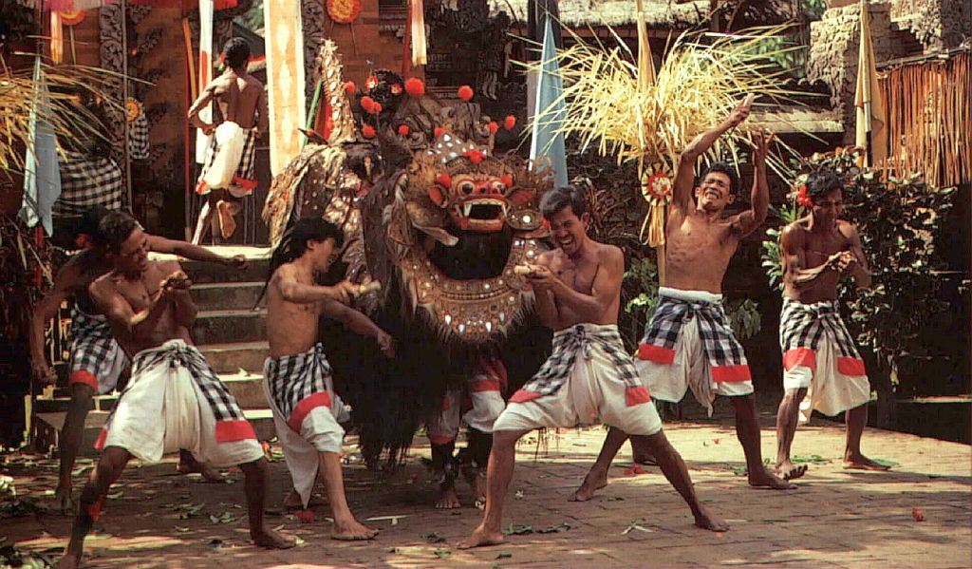

Slide 13
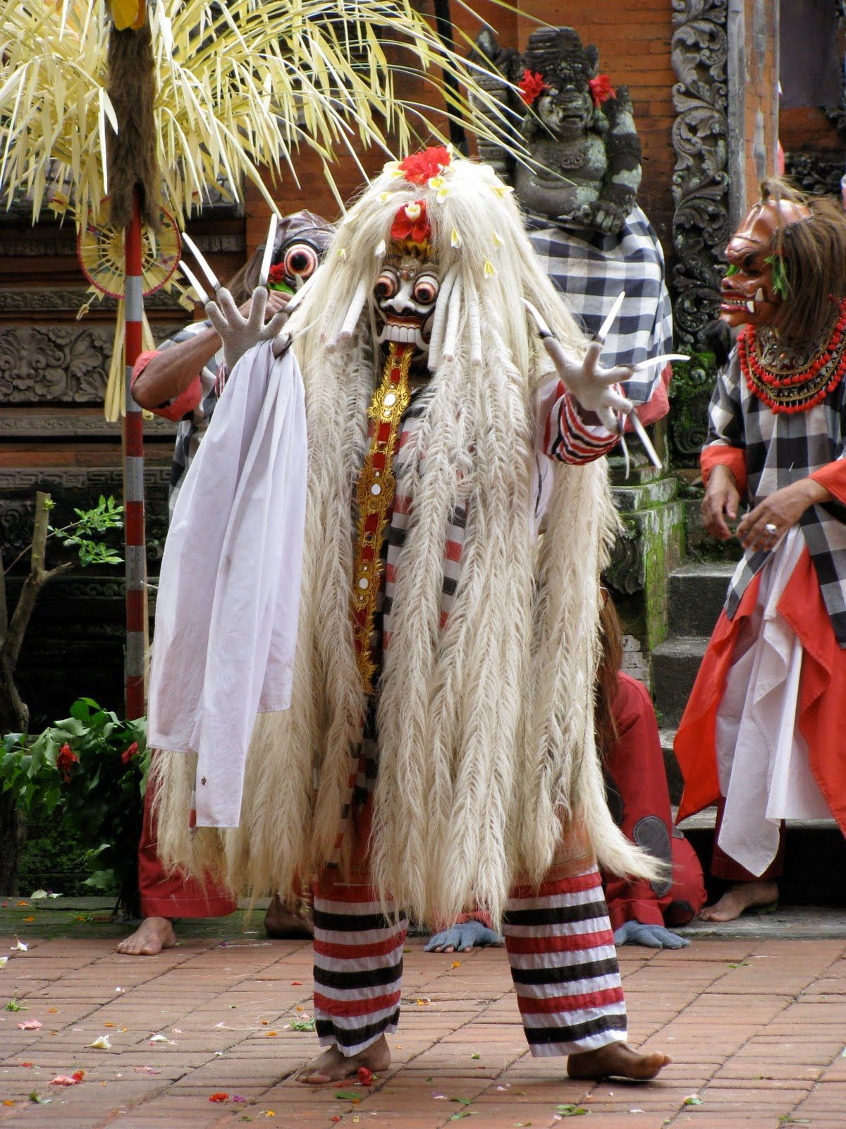
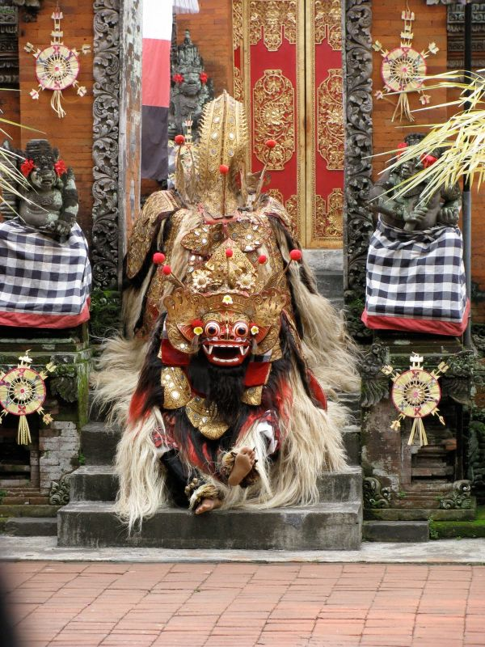
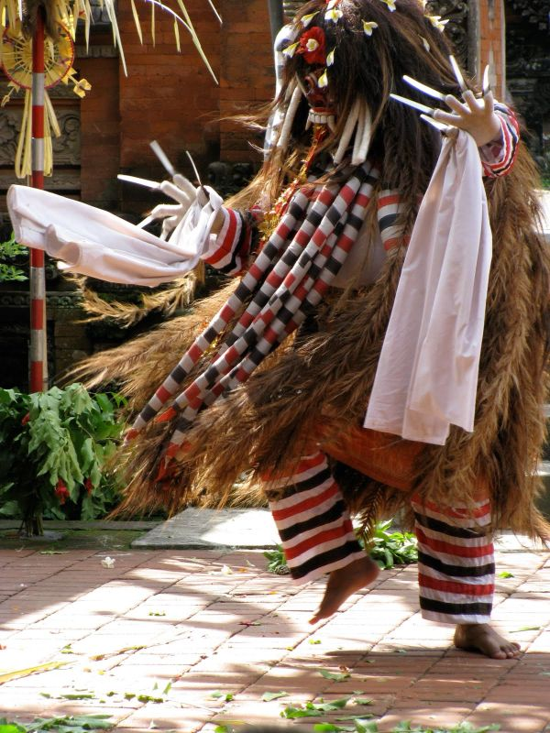
Rangda
Barong

Slide 14
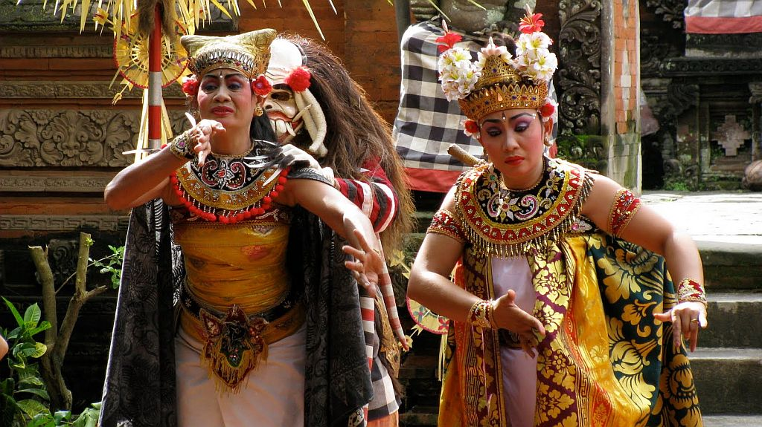

Slide 15
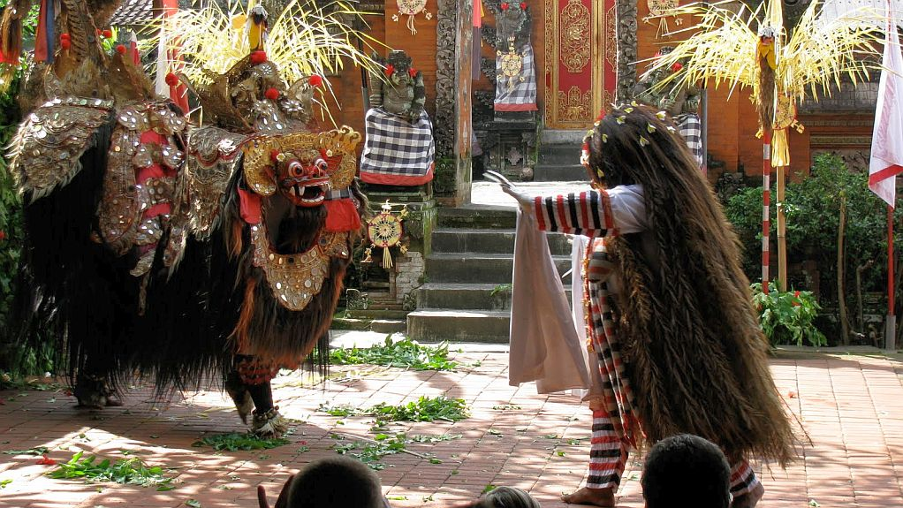

Slide 16
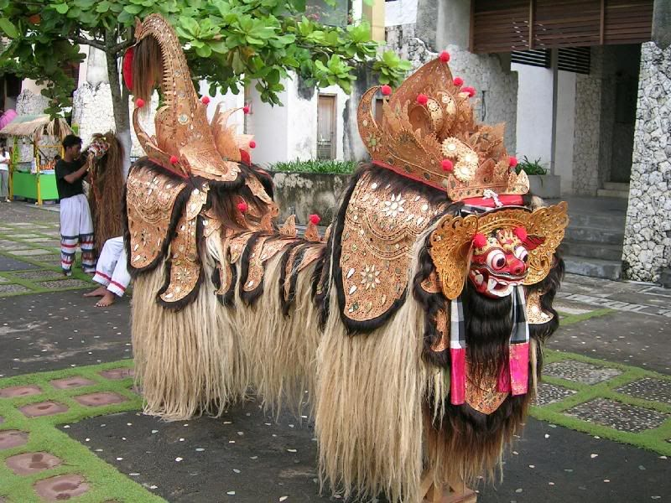
The masks of Barong and Rangda are considered sacred items, and before they are brought out, a priest must be present to offer blessings by sprinkling them with holy water taken from Mount Agung, and offerrings must be presented.
Măştile de Barong şi Rangda sunt considerate obiecte sacre, şi înainte de a fi scoase afară, un preot trebuie să fie prezent pentru a le binecuvânta prin stropirea cu apă sfinţită luată de la Muntele Agung, şi trebuie aduse ofrande.

Slide 17
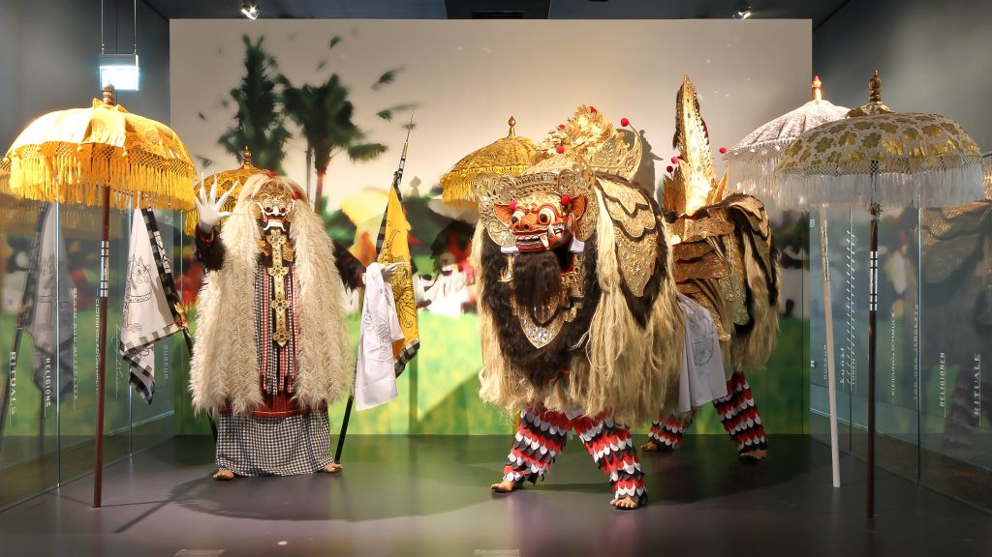

Slide 18
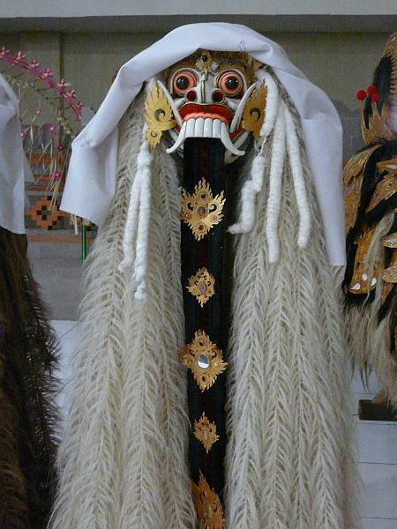
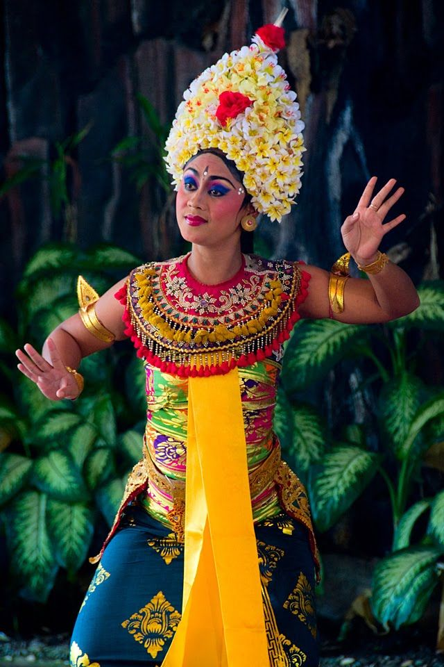
Rangda

Slide 19
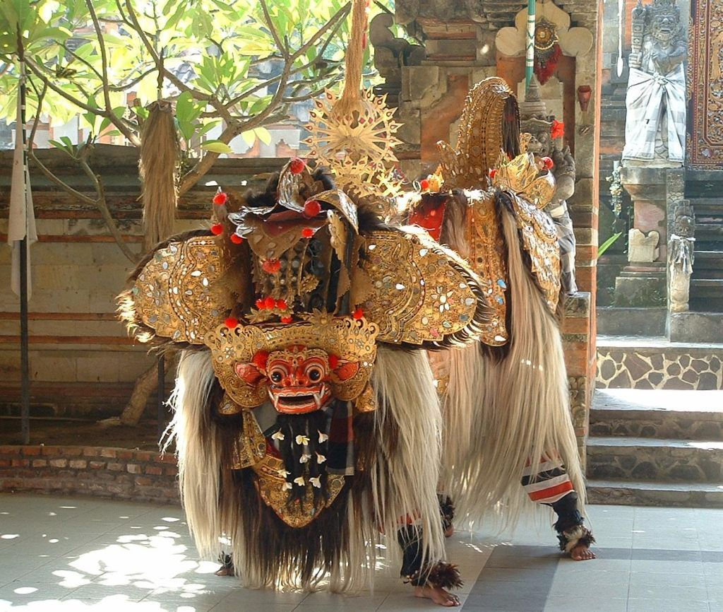
Barong is a lion-like creature and character in the mythology of Bali, Indonesia. He is the king of the spirits, leader of the hosts of good, and enemy of Rangda, the demon queen and mother of all spirit guarders in the mythological traditions of Bali. The battle between Barong and Rangda is featured in Barong dance to represent the eternal battle between good and evil
Barong este o creatură mitologică balineză asemănătoare unui leu. El este regele spiritelor, şeful forţelor binelui, şi duşmanul lui Rangda, regina demon şi mama tuturor duhurilor rele din tradiţiile mitologice din Bali. Lupta dintre Barong şi Rangda este prezentată în dansul Barong pentru a ilustra lupta eternă dintre bine şi rău

Slide 20
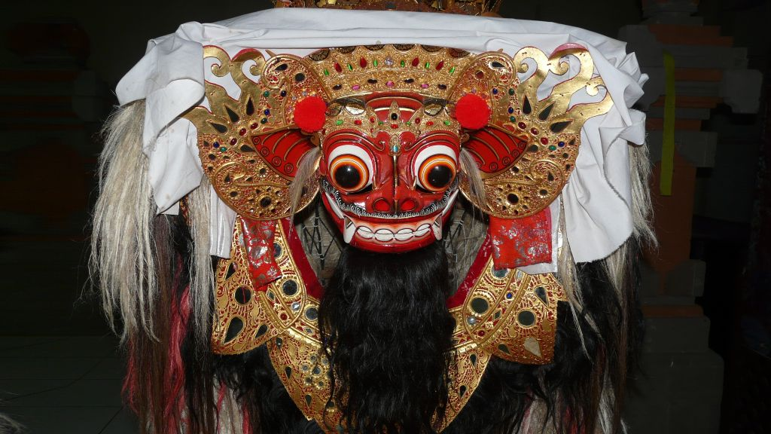
Barong

Slide 21
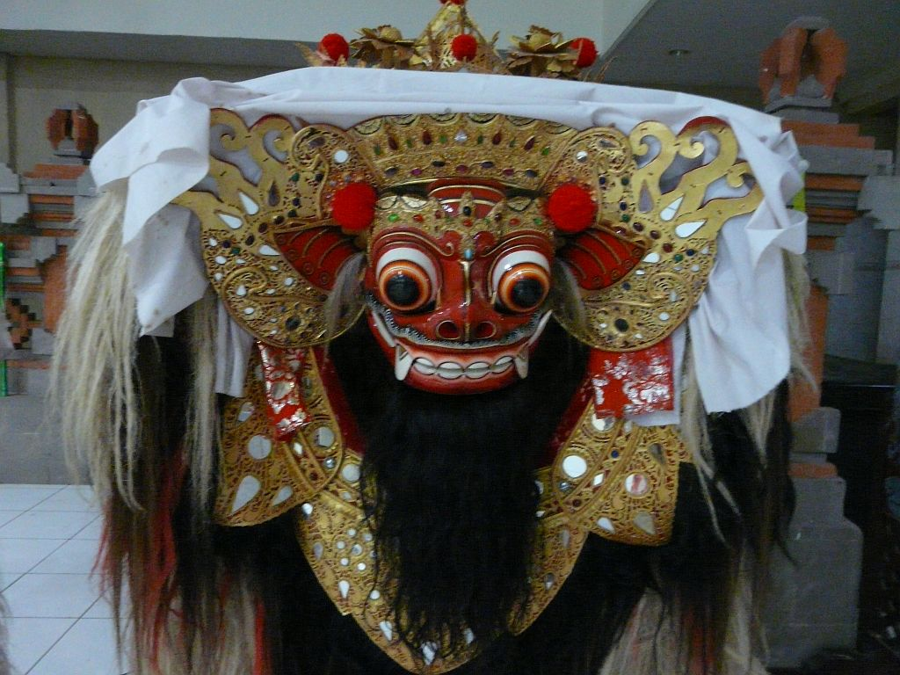
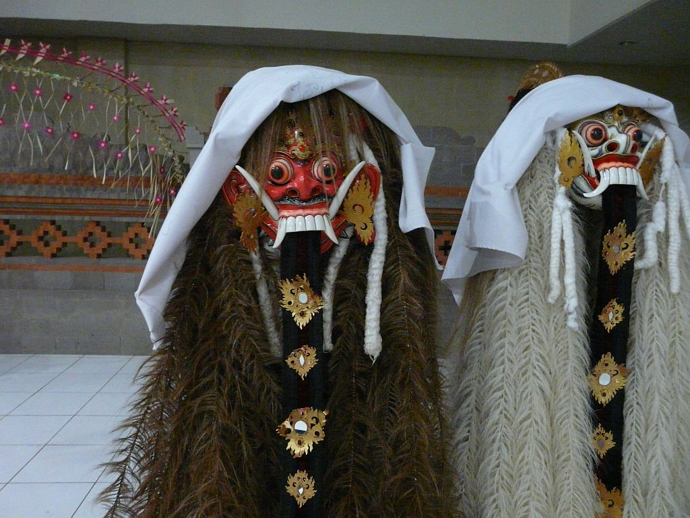
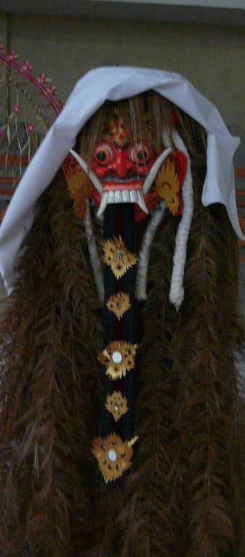

Slide 22
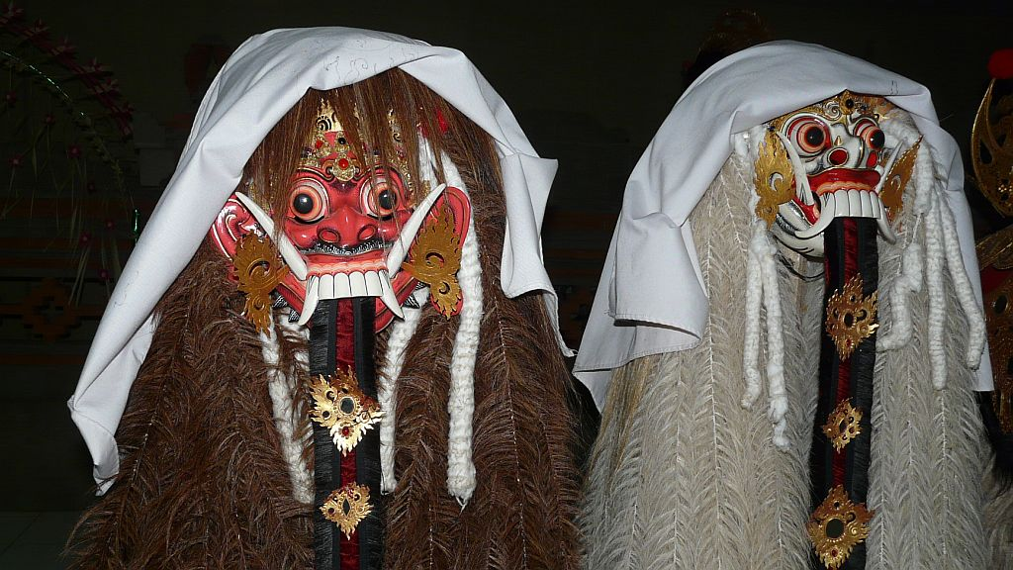

Slide 23
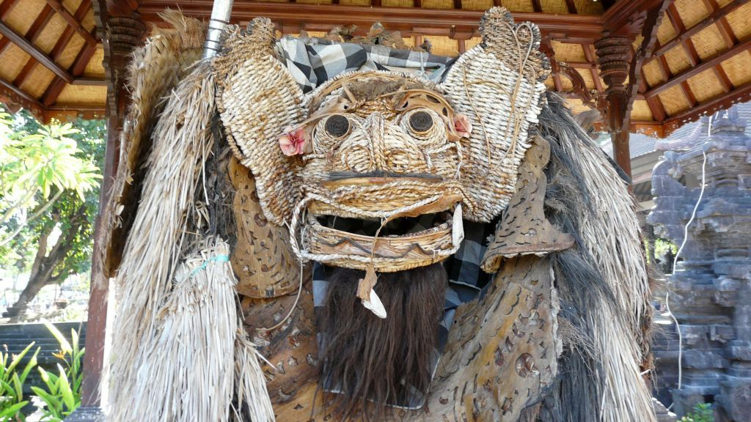

Slide 24
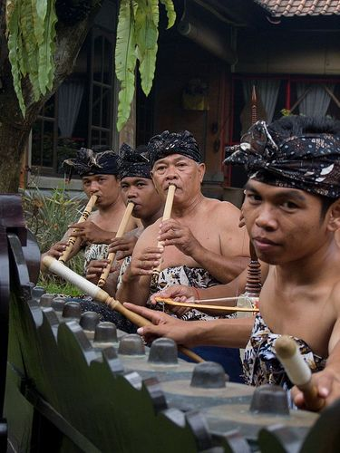
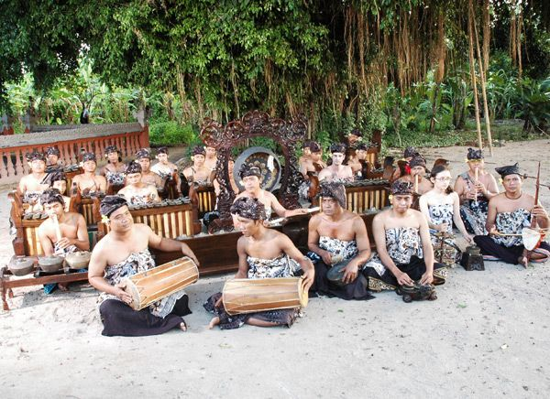
Cuvântul Gamelan defineşte orchestrele tradiţionale din Indonezia. În general cea mai mare parte a instrumentelor din componenţa lor sunt instrumente de percuţie precum cele asemănătoare xilofonului/marimbafonului sau vibrafonului. Uneori în componenţa acestor orchestra se găsesc şi cântăreţi

Slide 25
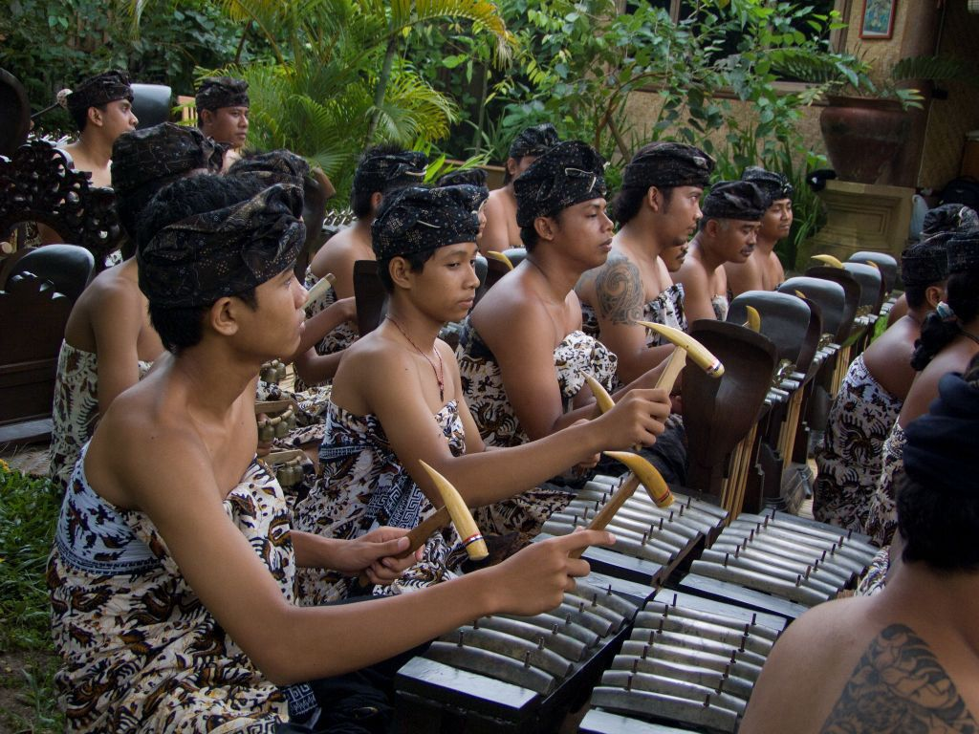
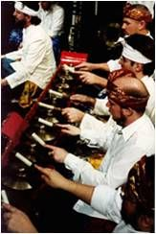
A gamelan is a musical ensemble from Indonesia, typically from the islands of Bali or Java, featuring a variety of instruments such as metallophones, drums and xylophones, gongs; bamboo flutes, bowed and plucked strings. Vocalists may also be included.

Slide 26
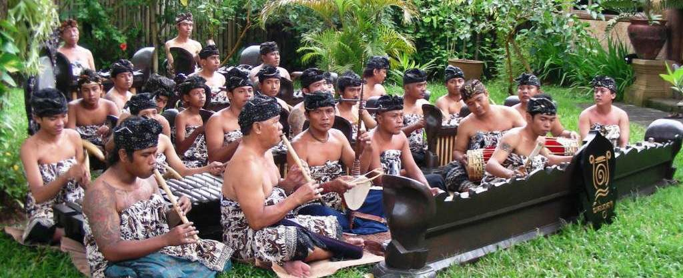

Slide 27
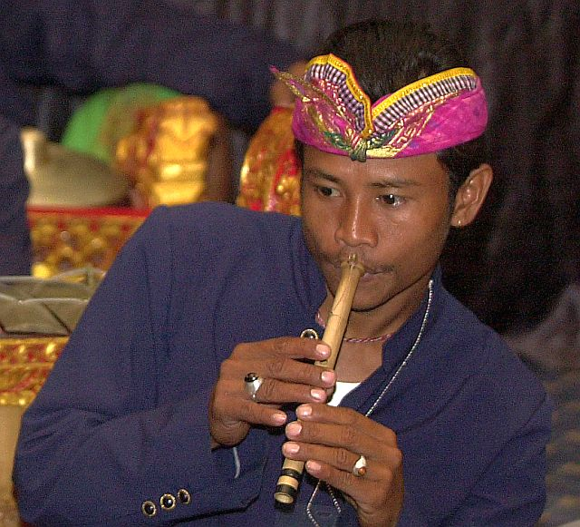
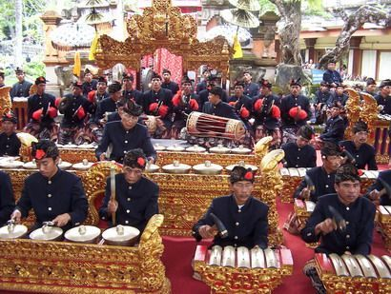
The term gamelan refers more to the set of instruments than to the players of those instruments. A gamelan is a set of instruments as a distinct entity, built and tuned to stay together — instruments from different gamelan are generally not interchangeable.

Slide 28
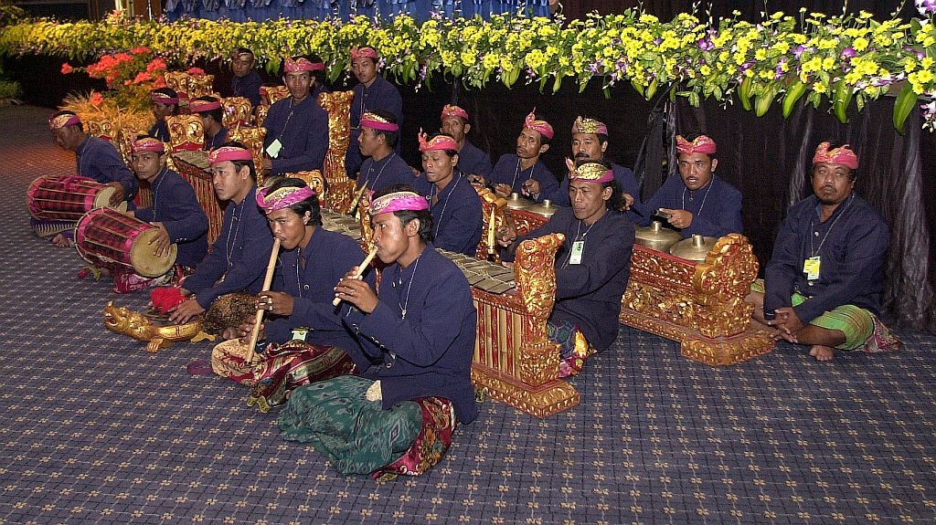

Slide 29
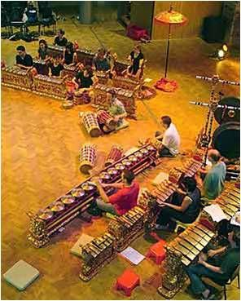
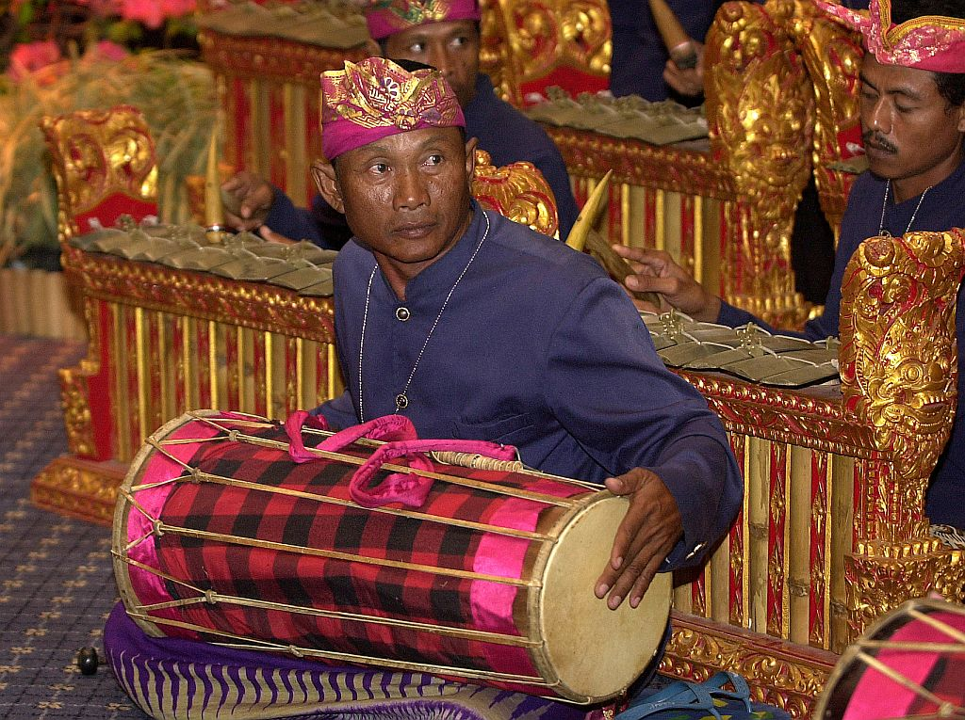
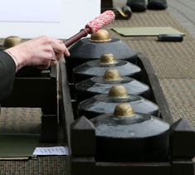

Slide 30
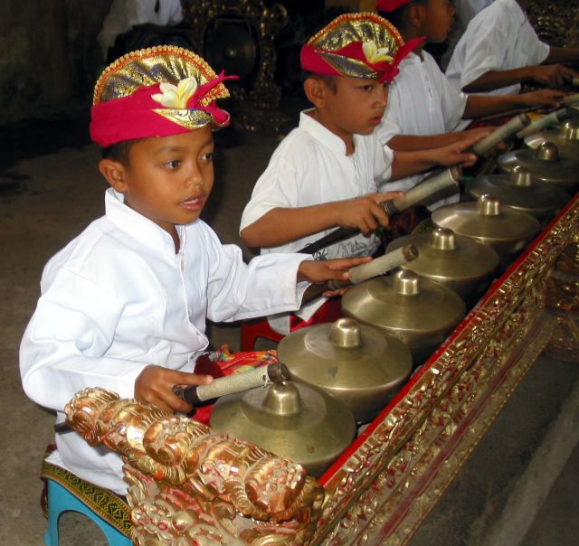
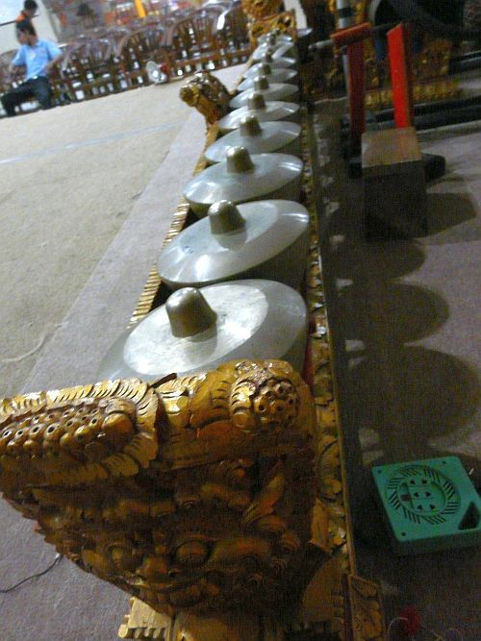

Slide 31
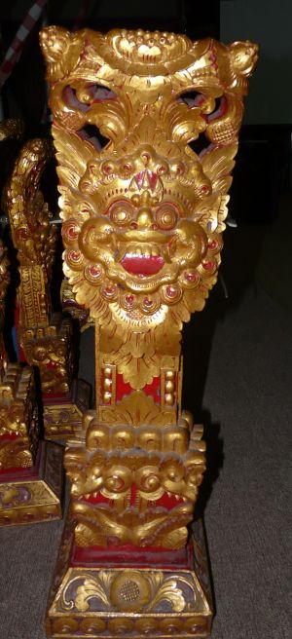
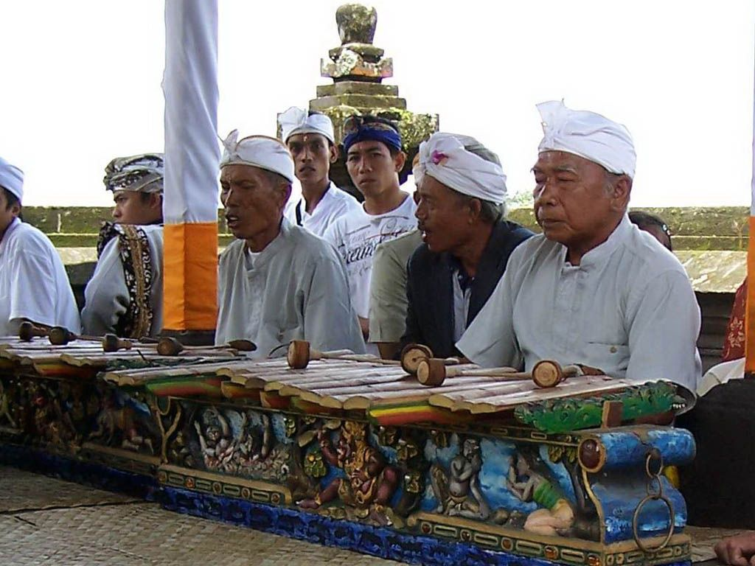

Slide 32
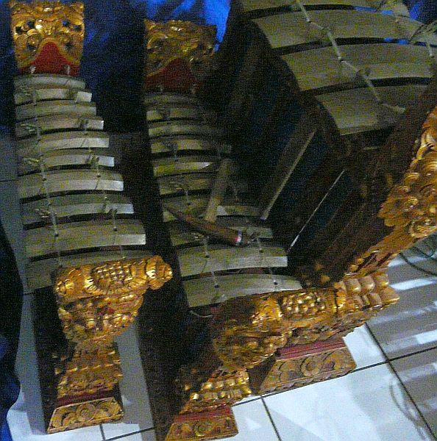
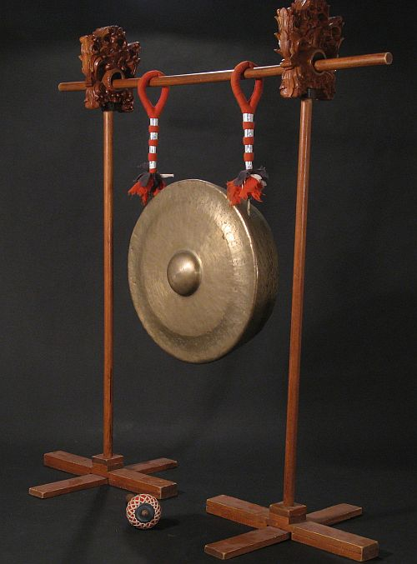

Slide 33
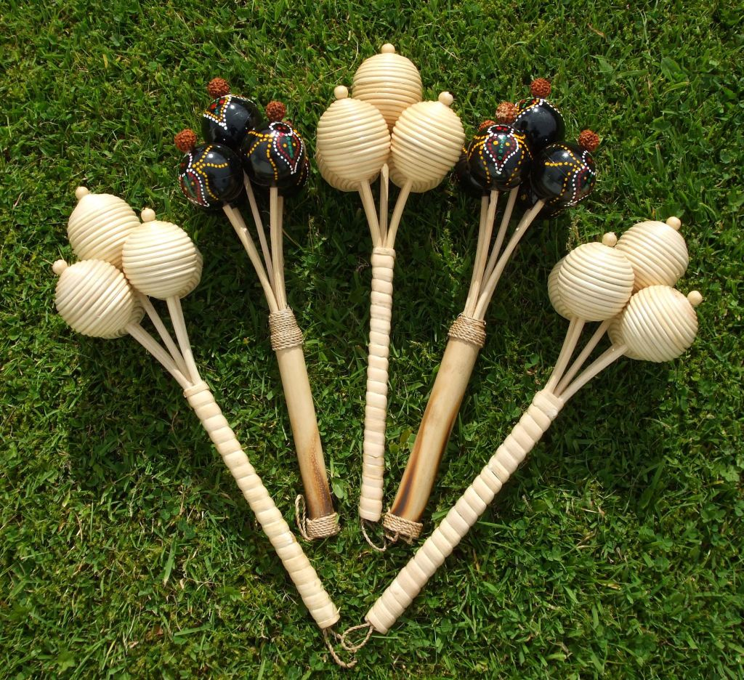
In Bali, the Gamelan instruments are all kept together in the balai banjar, a community meeting hall which has a large open space with a roof over top of it with several open sides. The instruments are all kept here together because they believe that all of the instruments belong to the community as a whole and no one person has ownership over an instrument. Not only is this where the instruments are stored, but this is also the practice space for the Gamelan orchestra. (sekaha). The open walls allow for the music to flow out into the community where the rest of the people can enjoy it.
Rattan '5-Ball' Rattles from Bali

Slide 34



The sekaha is led by a single instructor whose job it is in the community to lead this group and to come up with new songs.

Slide 35


When they are working on a new song, the instructor will lead the group in practice and help the group form the new piece of music as they are practicing. When the instructor creates a new song, he leaves enough open for interpretation that the group can improvise and as a group they will be writing the music as they are practicing it.

Slide 36


The Balinese Gamelan groups are constantly changing their music by taking older pieces they know and mixing them together as well as trying new variations on their music.

Slide 37


Their music is always constantly changing because they believe that music should grow and change; the only exception to this is with their most sacred songs which they will not change. A single new piece of music can take several months before it is completed.

Slide 38


Men and women usually perform in separate groups, with the exception of the pesindhen, the female singer who performs with male groups.

Slide 39



Slide 40


Slide 41


Gamelan's role in rituals is so important that there is a Javanese saying that "It's not official until the gong is hung.”
In Bali, almost all religious rituals include gamelan performance.

Slide 42


The word "gamelan" comes from the Javanese word "gamel", meaning to strike or hammer, and the suffix "an", which makes the root a collective noun. Real hammers are not used to play these instruments as heavy iron hammers would break the delicate instruments.

Slide 43



Bali
Text : Internet
Pictures: Internet & Nicoleta Leu
Copyright: All the images belong to their authors
Arangement: Sanda Foişoreanu
www.slideshare.net/michaelasanda
Sound: Ensemble instrumental Seka Balaganjur - Balaganjuran
Notes:
bali-tanah-lot-7 mamadou

