Slide 1
Cultural difference in business
Thibault AUGER – Maxime CRESPIN – Julie POULAILLON – Laurie Vaugeois

Slide 2
QUESTION 1
Is Schneider Electric a multinational company ?
What are Schneider Electric’s motivations for being in Russia ?

Slide 3
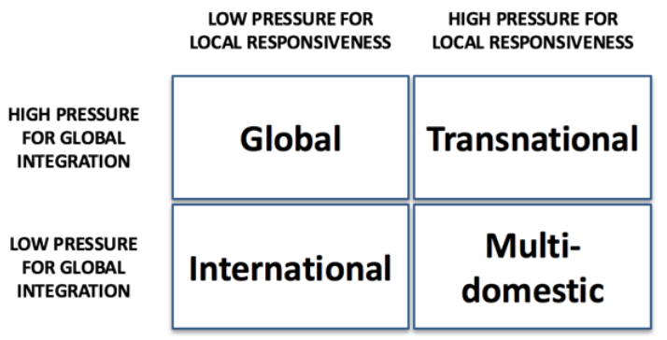
1. Is Schneider Electric a multinational company ?
Bartlett & Ghoshal model
Notes:
Julie

Slide 4
1. Is Schneider Electric a multinational company ?
Why is Schneider Electric Transnational ?
High pressure for local responsiveness:
Do customers in each country expect the product to be adapted to meet local requirements?
➔ Different plants producing various products corresponding to the Russian market.
➔ Present all around the world (every continent).
Do local (domestic competitors) have an advantage based on their ability to be more responsive?
➔ SE needs to be very responsive in emerging markets for example, to be competitive.
Notes:
Julie

Slide 5
1. Is Schneider Electric a multinational company ?
Why is Schneider Electric Transnational ?
High pressure for global integration:
How important is standardisation of the product in order to operate efficiently (e.g. economies of scale)?
➔ Standardization of procceses and some products.
➔ Diversification in some markets, to meet specific customer needs.
Notes:
Laurie

Slide 6

1. Is Schneider Electric a multinational company ?
Why is Schneider Electric Transnational ?
High pressure for global integration:
Is consistent global branding required in order to achieve international success?
➔ Even if SE is around the world, this company is using the cultural differences as a strength to create a global identity.
Notes:
Laurie

Slide 7
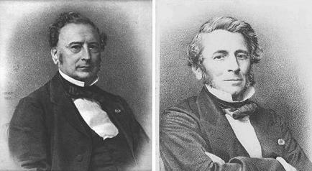
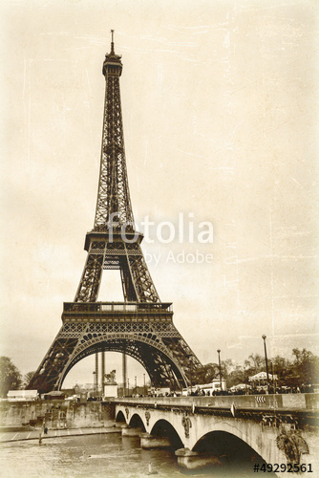
1. The national origin of Schneider Electric
Why can we consider that the national origin of SE is French ?
SE has been created in 1836 by French (the Schneider brothers) in France
➔ The headquarter of SE is located in Reuil-Malmaison (close to Paris)

Slide 8
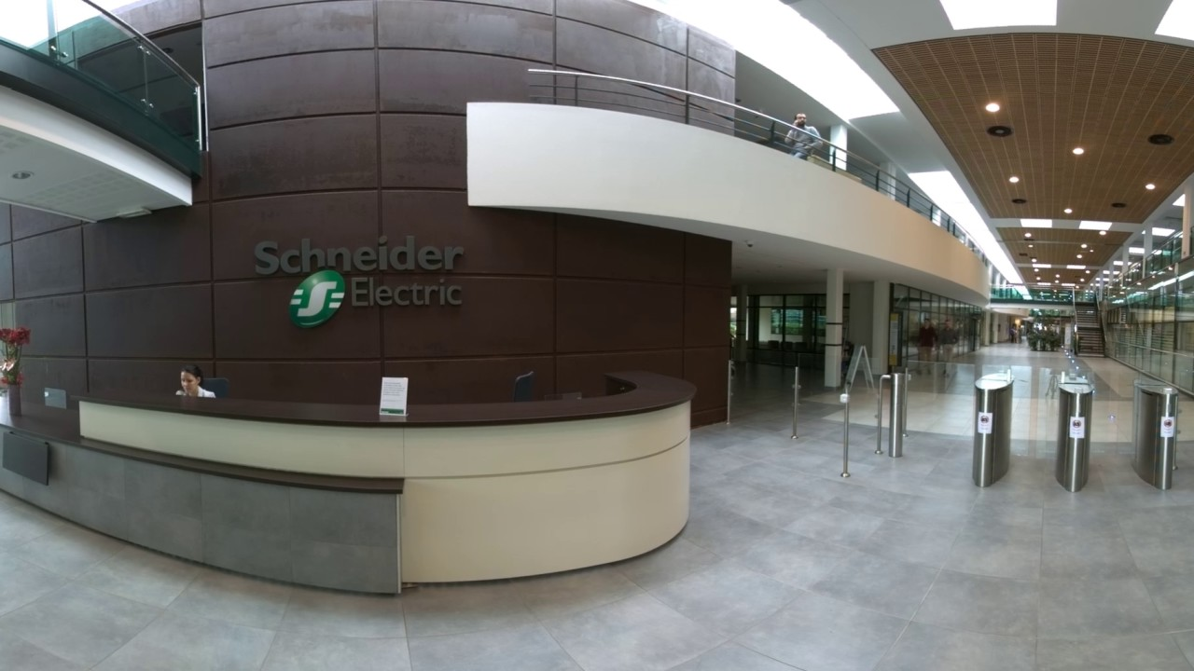
1. The national origin of Schneider Electric
Why can we consider that the national origin of SE is French ?
Schneider Electric is still having very important activities in France such as:
The main R&D center (Electropole) is located in France (in Grenoble).
The capital of SE is mainly in France (31,6% in France)

Slide 9
2. What are Schneider Electric’s motivations to be in Russia ?
They want to develop their market in Russia:
Russia has an enormous internal market that is not fully saturated (5th biggest market).
➔ Schneider Electric wants to be close to their customers
Russians intend to implement long-term modernization and development programs (so a lot to do for SE)

Slide 10
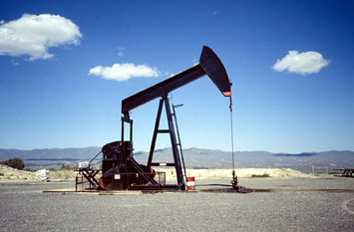
2. What are Schneider Electric’s motivations to be in Russia ?
They are interested in the Russian raw materials
Russia has got a lot of raw materials and mainly oil and gas
➔ As part of their strategy, Schneider Electric has decided to go deeply into utilities in oil and gas. In Russia they will be closer to their suppliers

Slide 11

2. What are Schneider Electric’s motivations to be in Russia ?
They have the capacities to go in Russia
Schneider Electric has the knowledges to work in Russia
They have a very good brand image (for their quality of products and services)

Slide 12
Thank you for your attention !

