Slide 1
Antoni Gaudí i Cornet
1852 - 1926

Slide 2
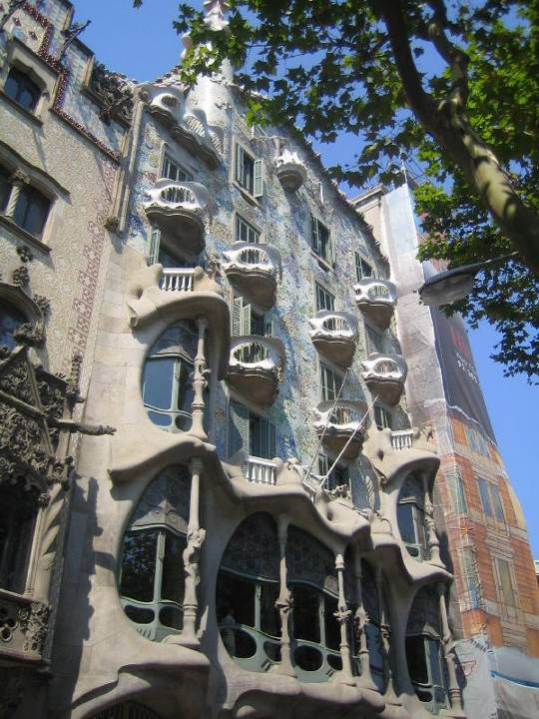
A Gaudi building

Slide 3
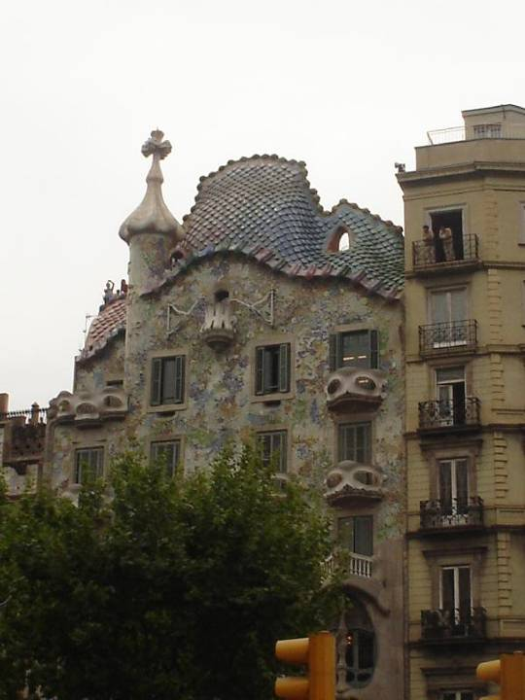
Another Gaudi house

Slide 4
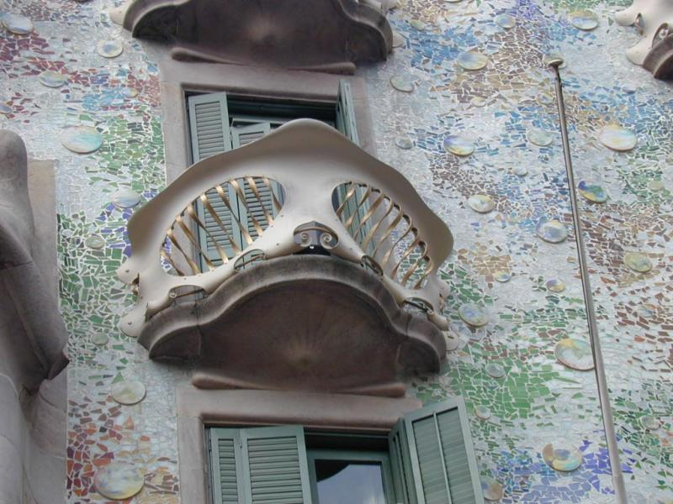
Balcony of Batlo house by Gaudi

Slide 5
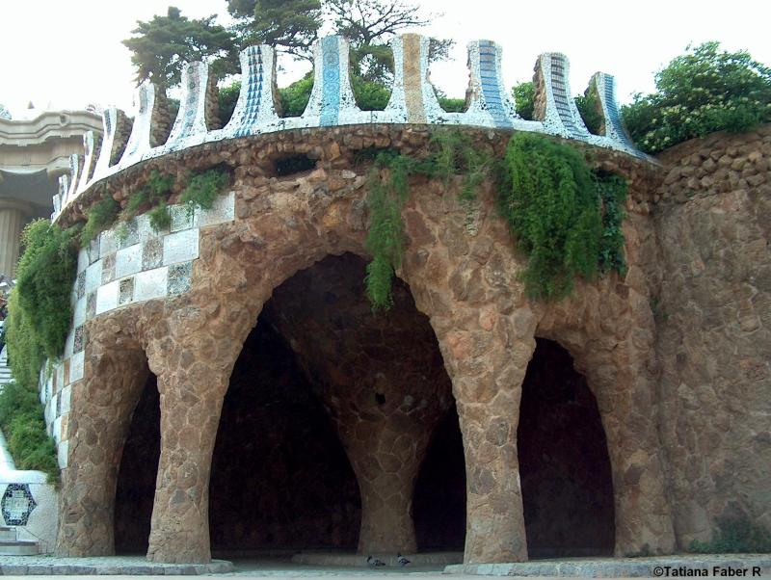
Barcelona, Parque Güell

Slide 6
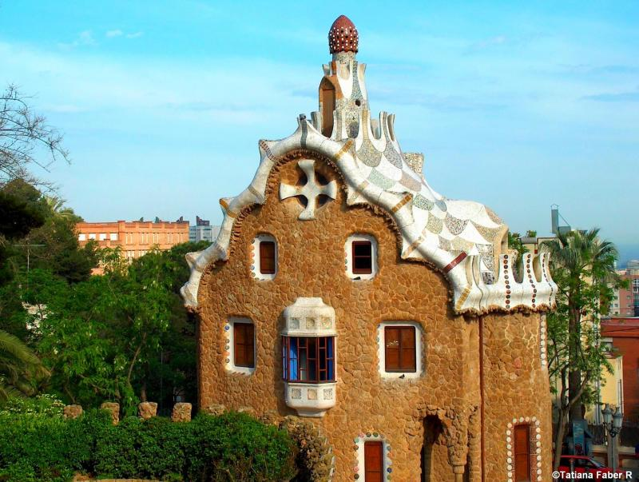
Barcelona, Entrance Building at Park by Gaudi

Slide 7
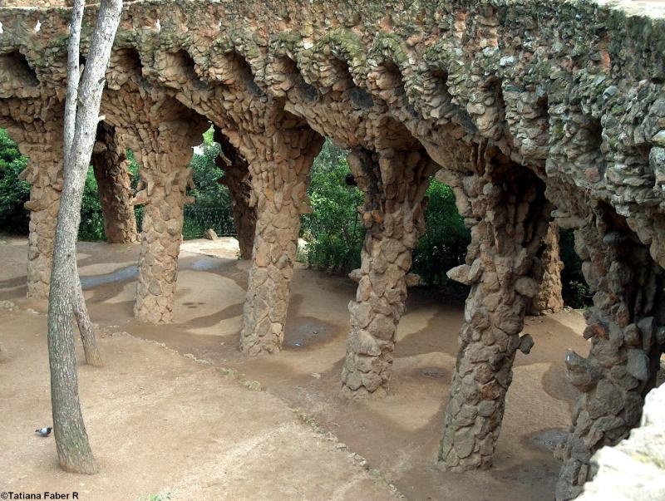
Barcelona Parque Güell

Slide 8
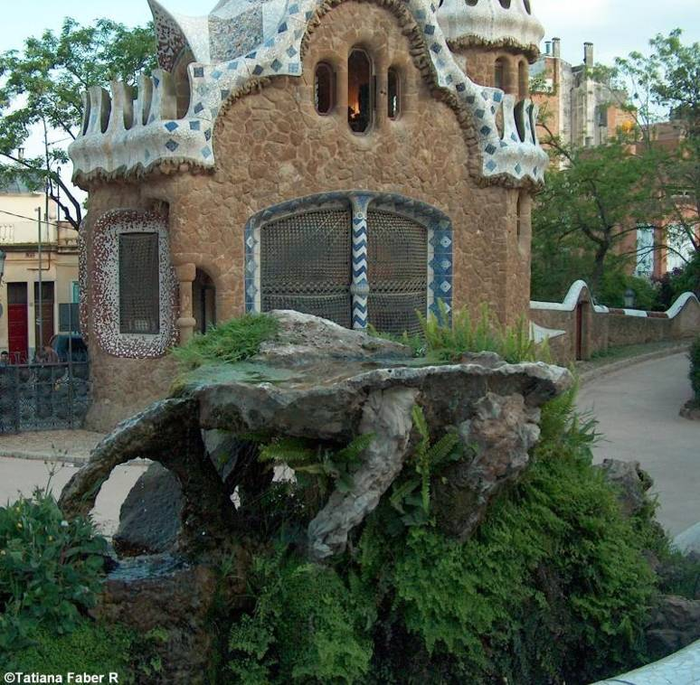
Barcelona,
Fountain at
entrance
of Park Guell

Slide 9
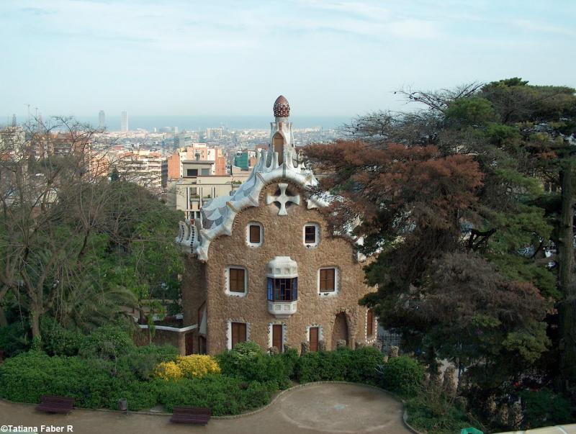
Barcelona, La casita de golosinas y chocolate de la bruja

Slide 10
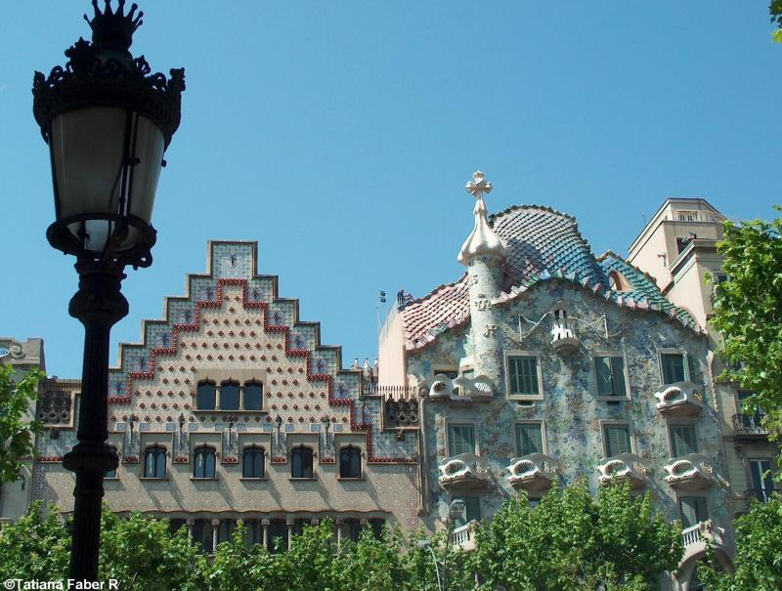
Casa Amatller & Casa Batllo

Slide 11
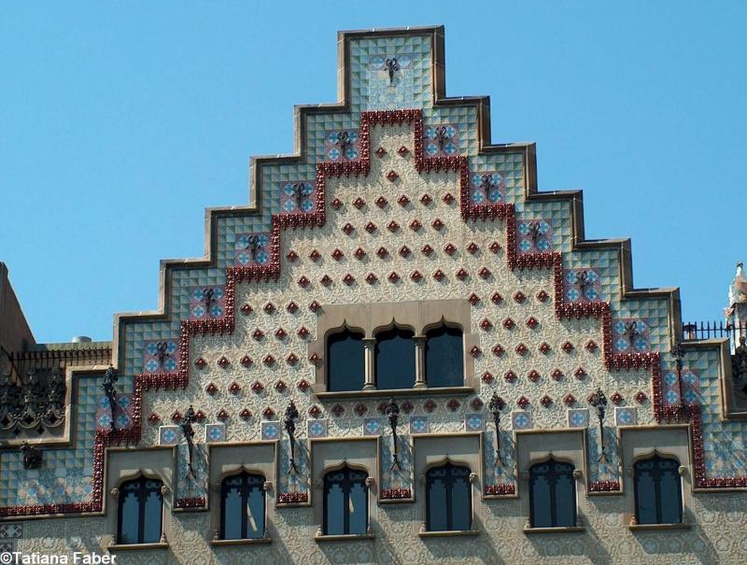
Casa Ametller

Slide 12
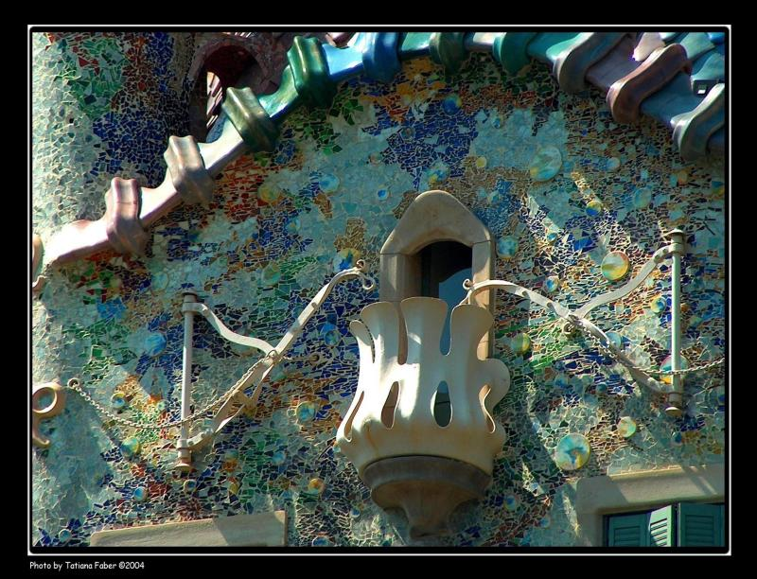
Casa Batllo

Slide 13
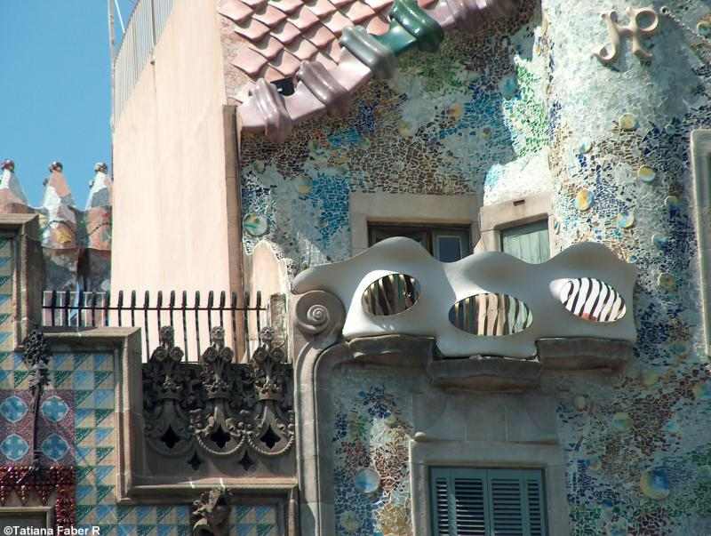
Casa Batllo

Slide 14
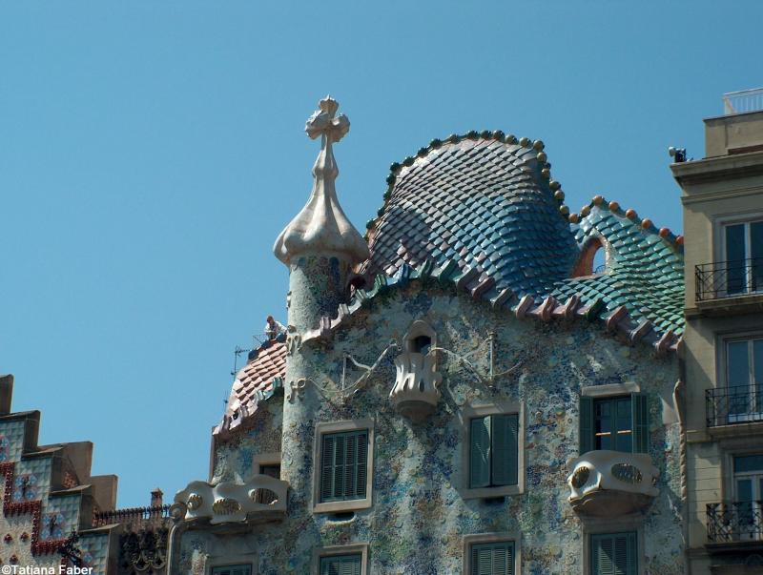
Casa Batllo

Slide 15
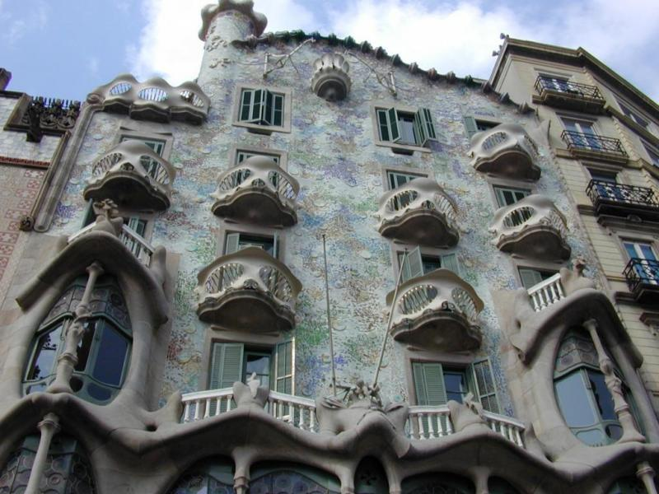
Casa Batlo de Gaudi

Slide 16
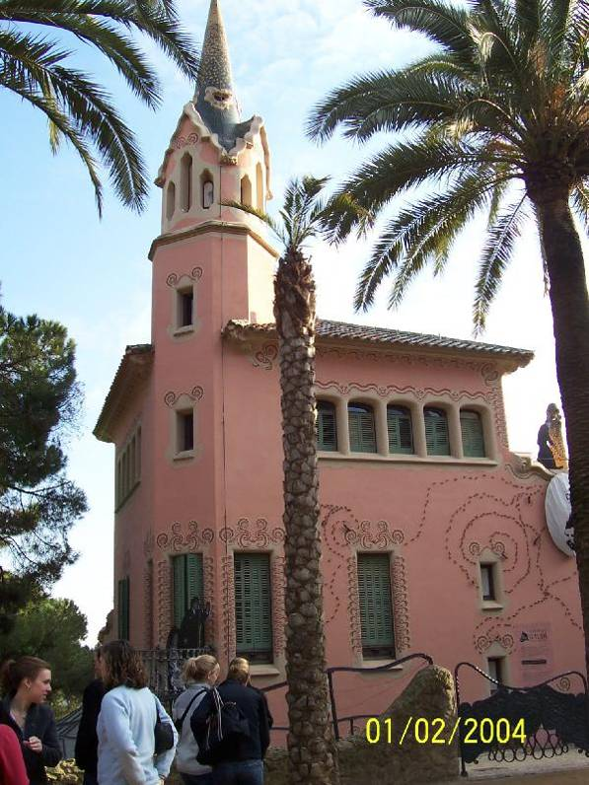
Casa-Museu Gaudi in
Park Guell designed by
Gaudi to be a garden
city for the elite

Slide 17
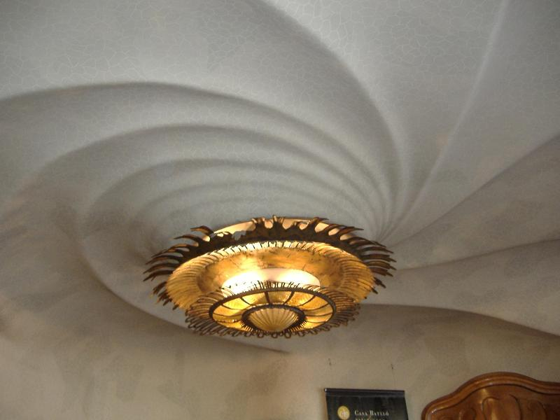
Ceiling inside Gaudi House (Gaudi's Casa Batllo)

Slide 18
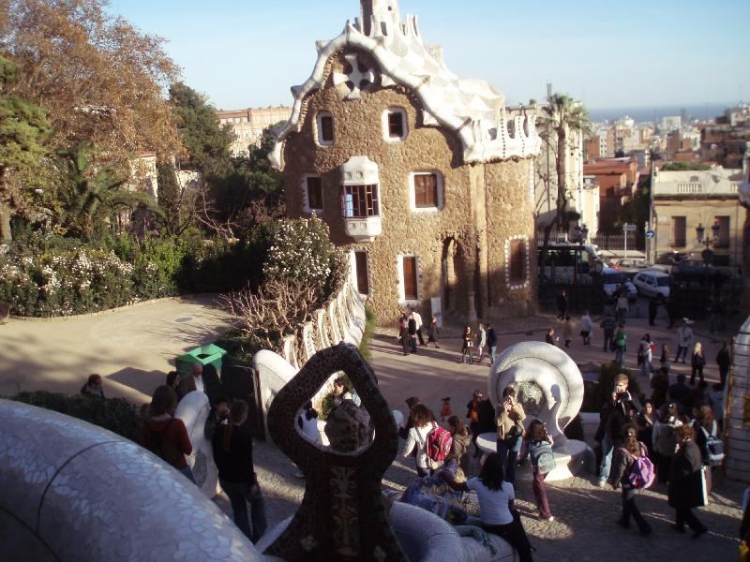
Barcelona, Entrance Building at Park by Gaudi

Slide 19
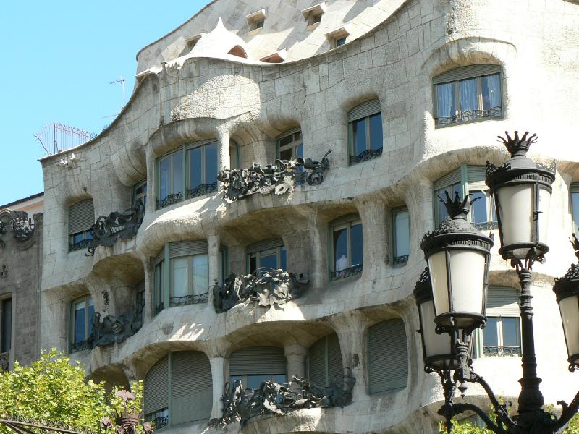
Gaudi and more Gaudi

Slide 20
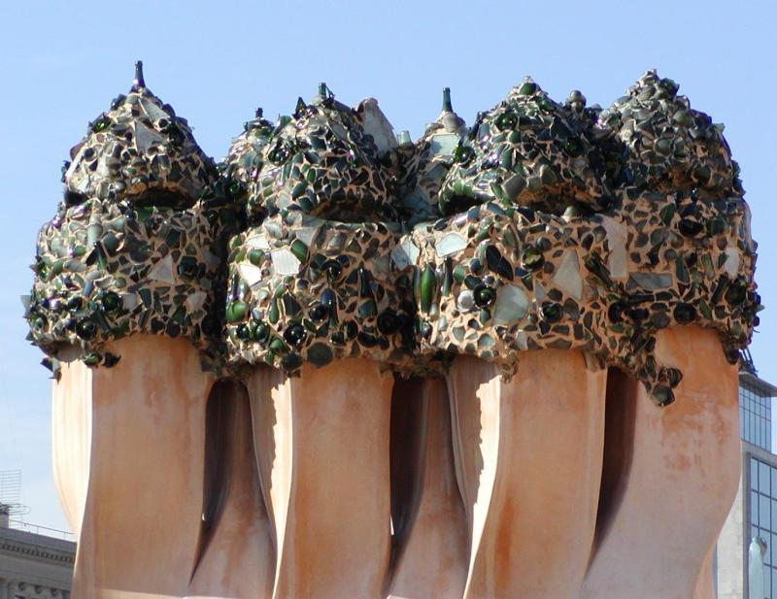
Gaudi chimneys

Slide 21
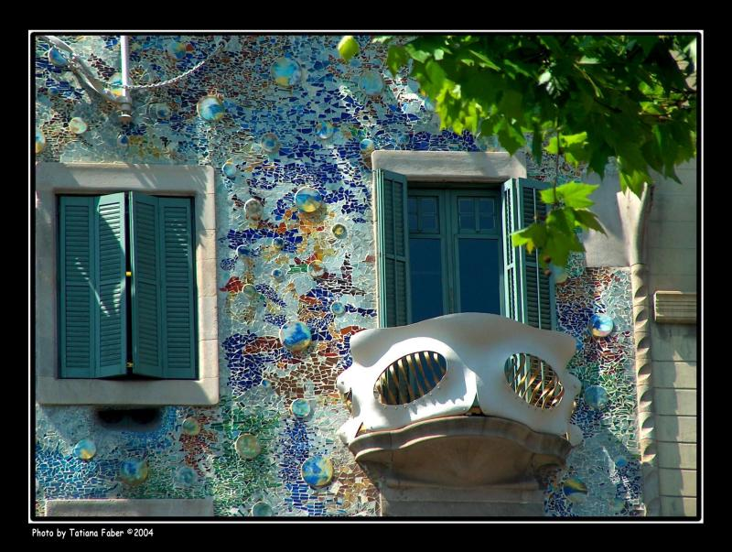
Gaudi Creation (1904-1906)

Slide 22
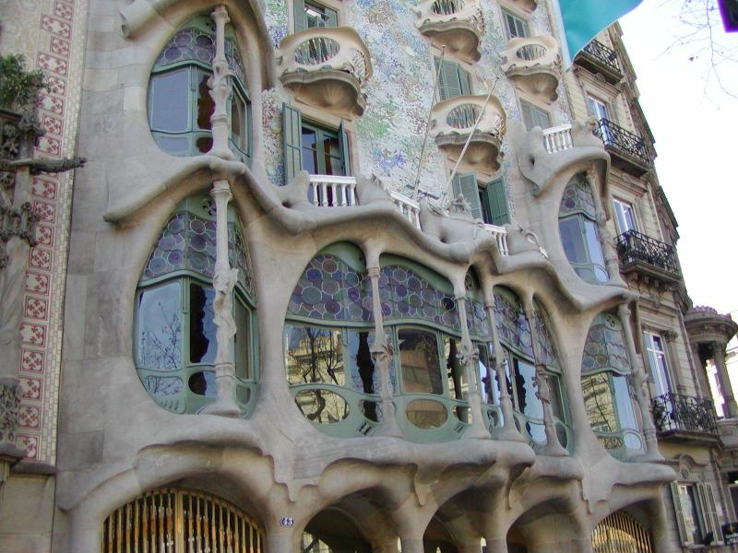
Gaudi house

Slide 23
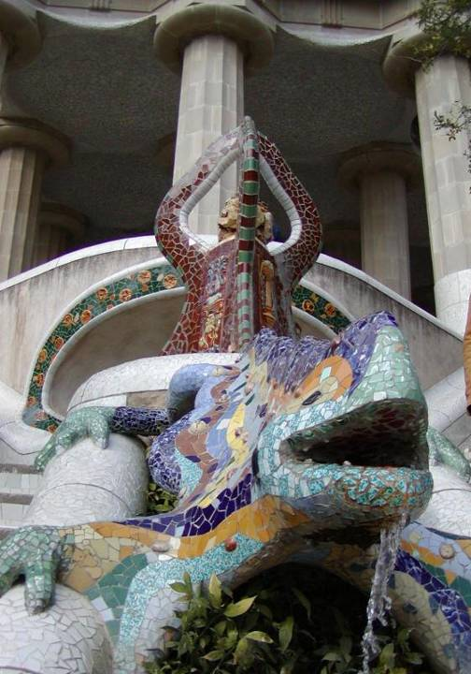
Gaudi lizard

Slide 24
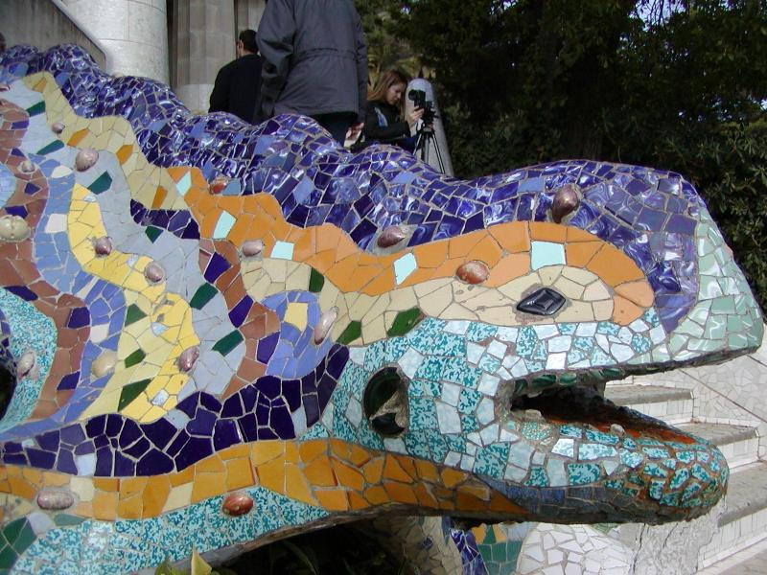
Gaudi lizard

Slide 25
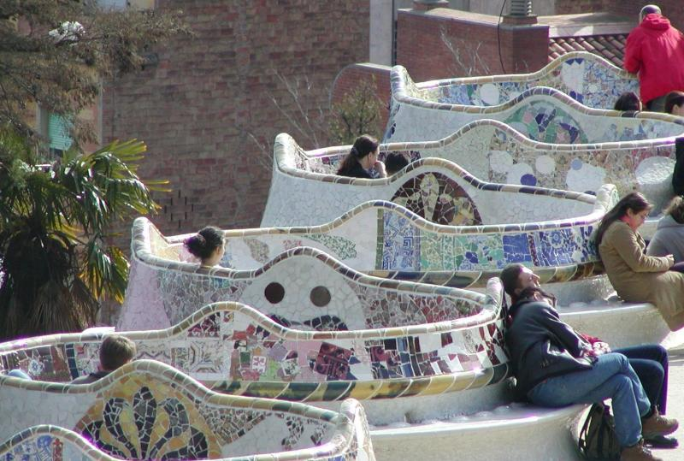
Gaudi parc seats

Slide 26
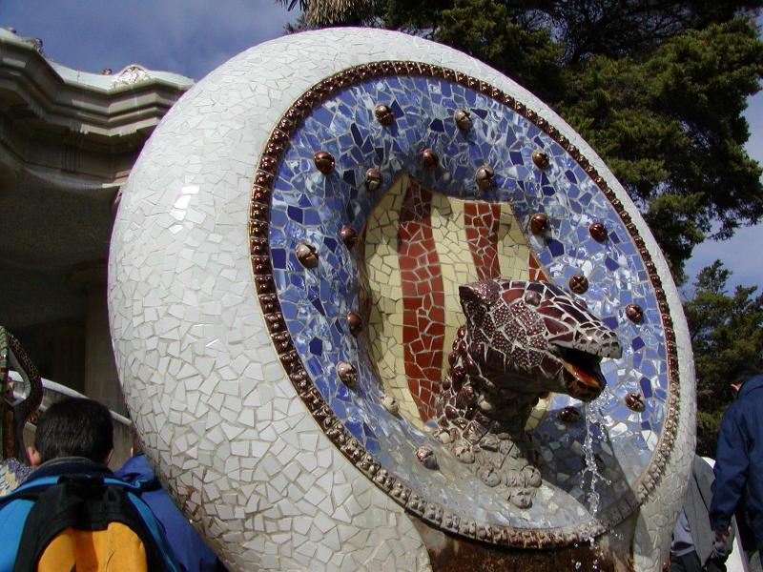
Gaudi spout.

Slide 27
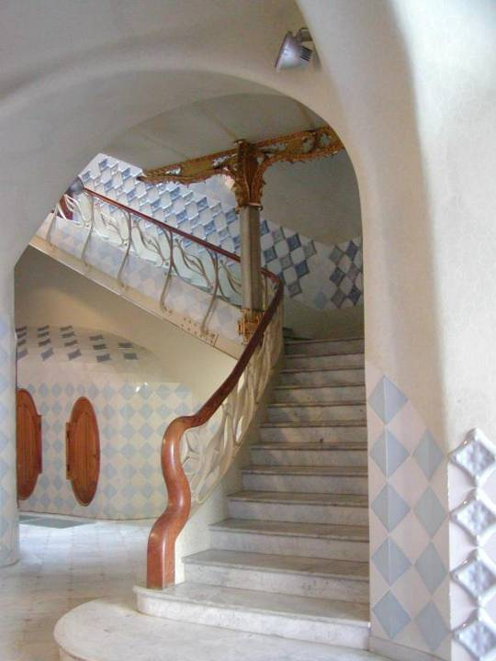
Gaudi staircase

Slide 28
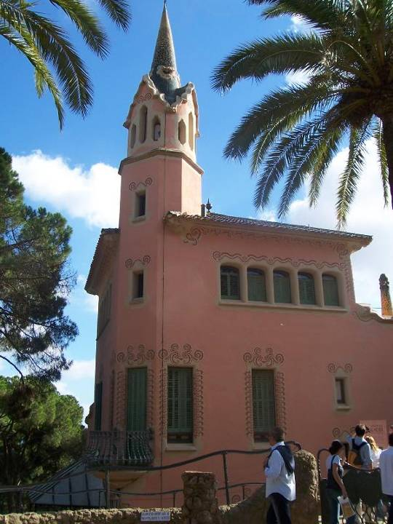
Gaudi, Casa Gaudi
1906-1926

Slide 29
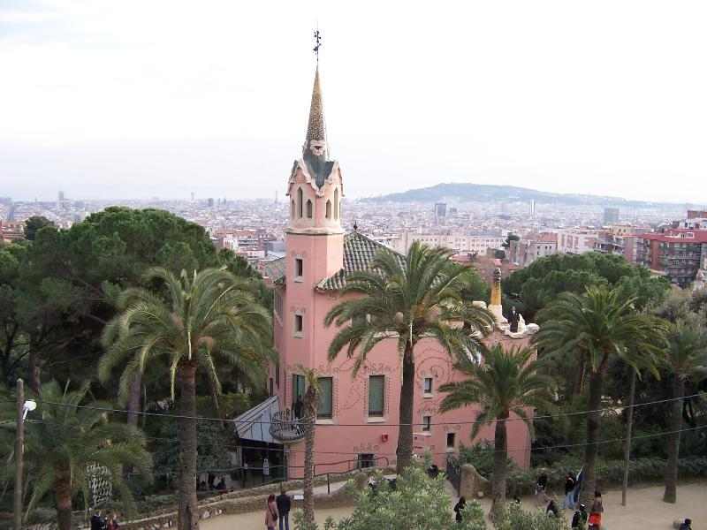
Gaudis house in Gaudi park

Slide 30
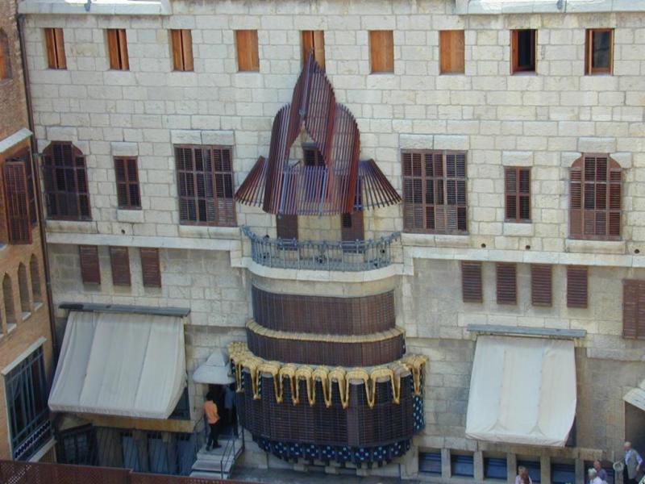
Güell house is the first important building of Gaudi in
the city of Barcelona

Slide 31
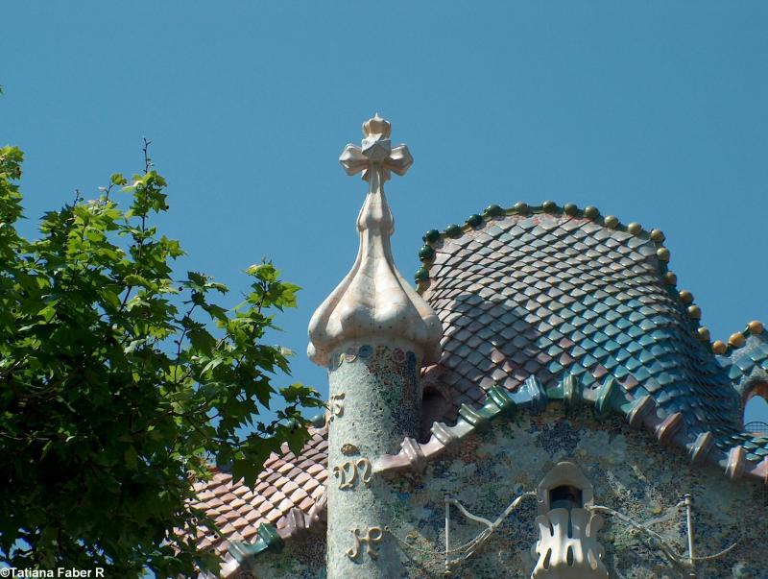
La Casa Batllo

Slide 32
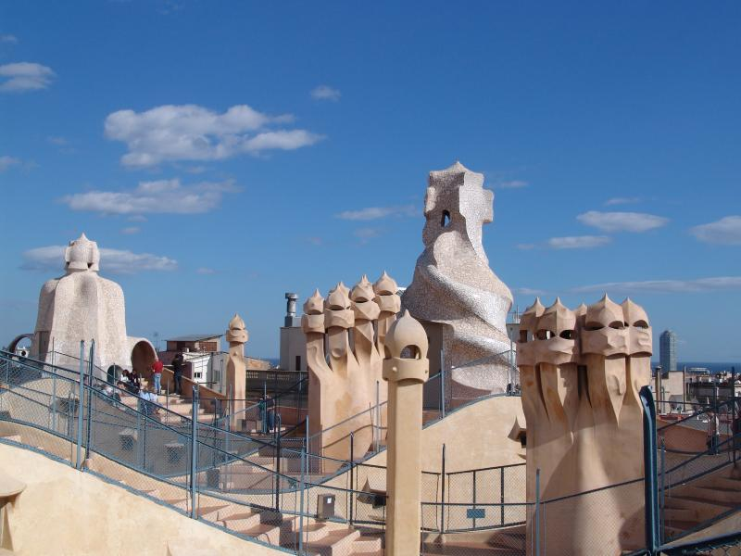
Gaudi Archtectural landmark

Slide 33
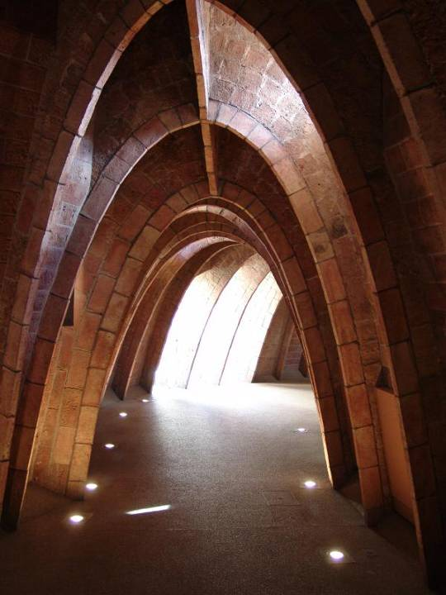
The Casas Mila, built 1908

Slide 34
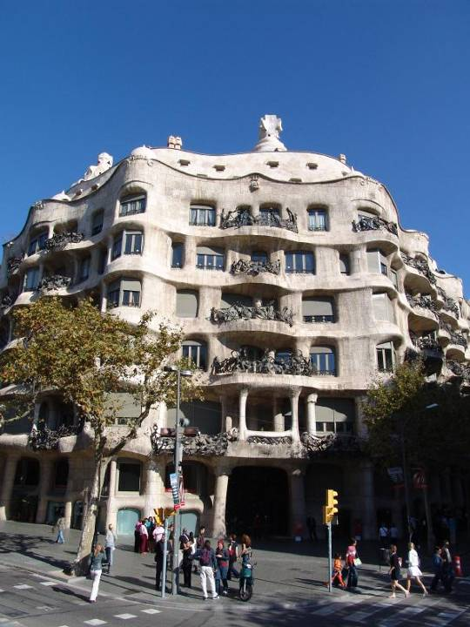
Gaudi Archtectural

Slide 35
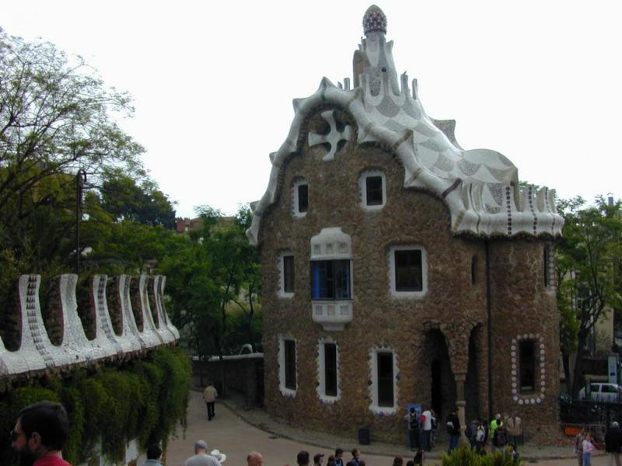
Management building of Güell park by Gaudi

Slide 36
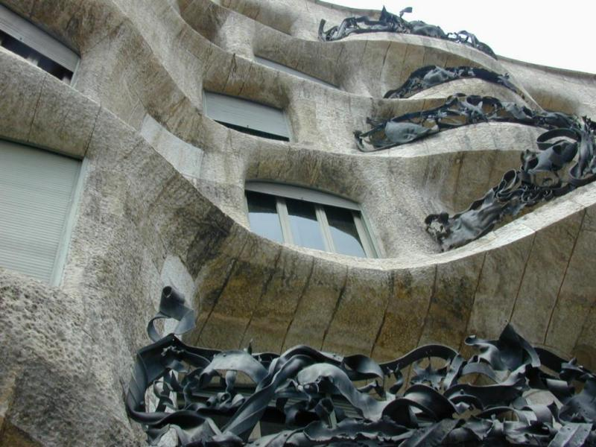
Mila House is the most important contribution
by Gaudi to civil architecture

Slide 37
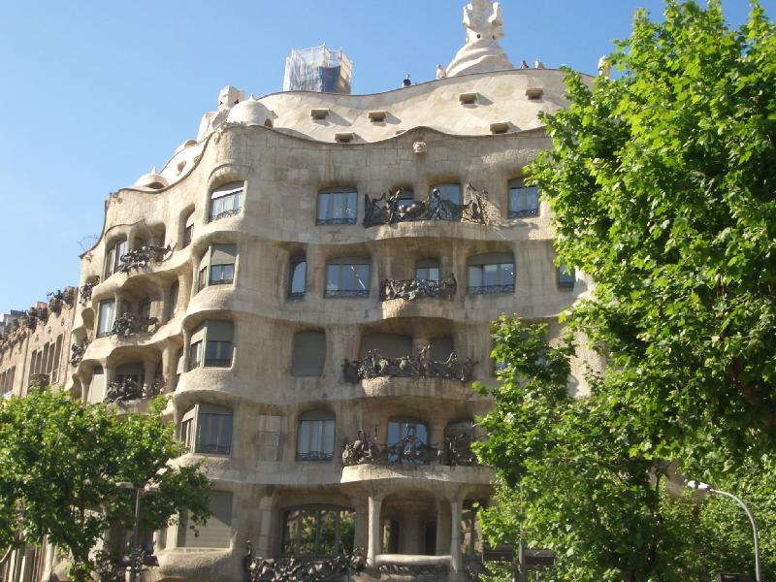
More Gaudi artowrk

Slide 38
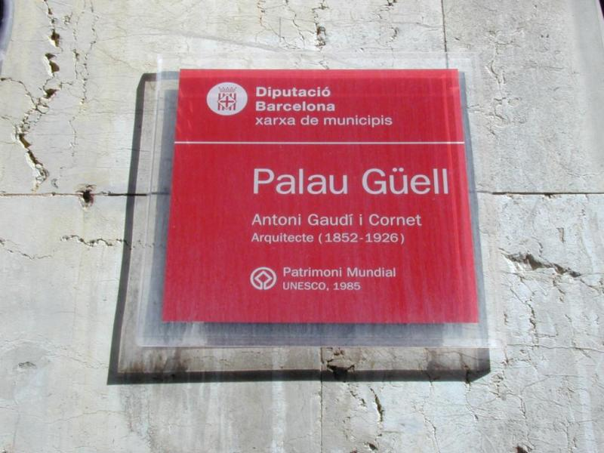
Palau Güell, el primer edificio importante de Gaudi en la ciudad.

Slide 39
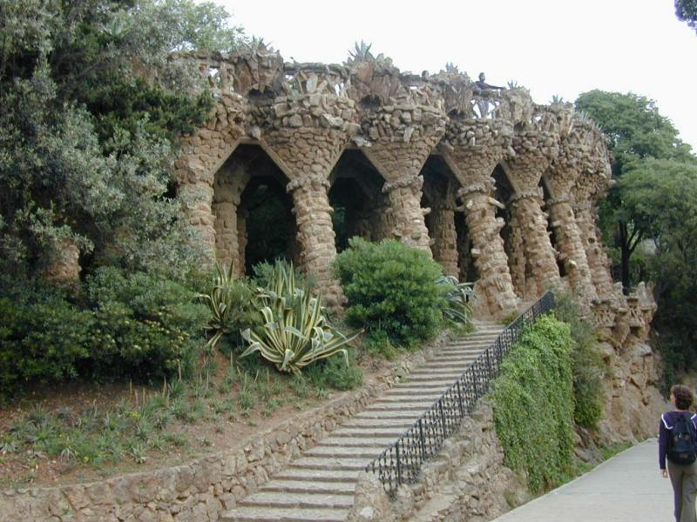
Parc Güell de Gaudi

Slide 40
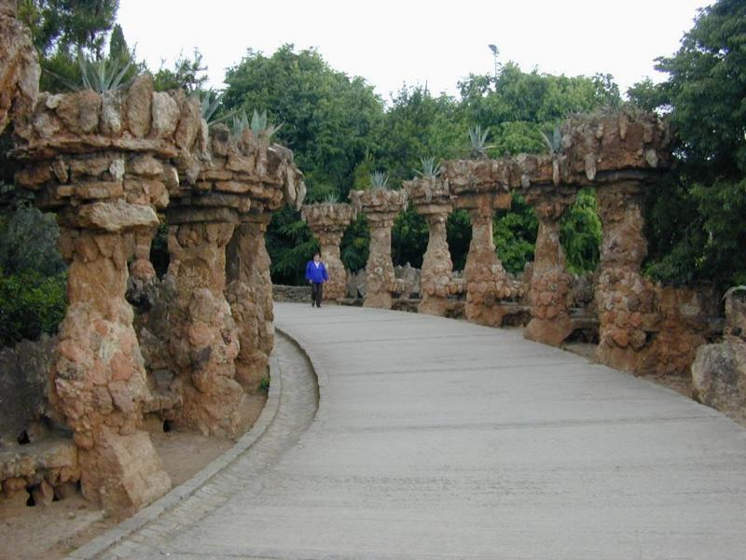
Parc Güell de Gaudi

Slide 41
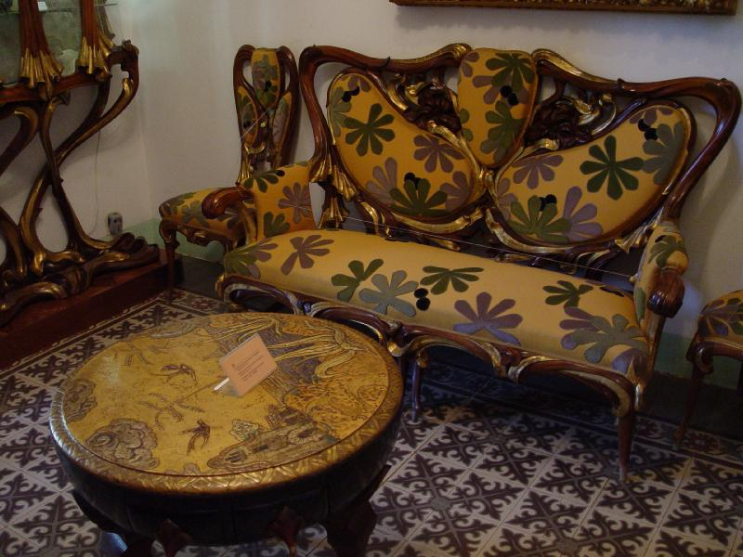
Gaudi's estate - home - his own designs

Slide 42
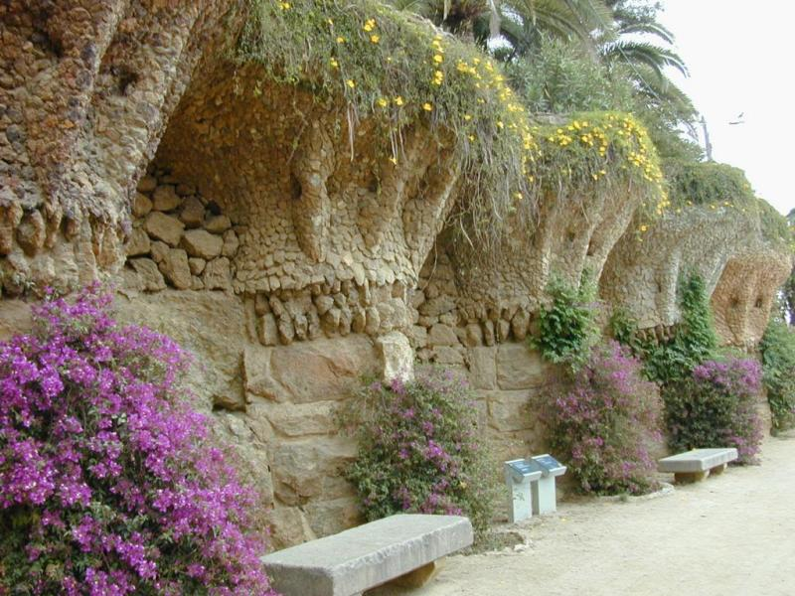
Parc Güell de Gaudi

Slide 43
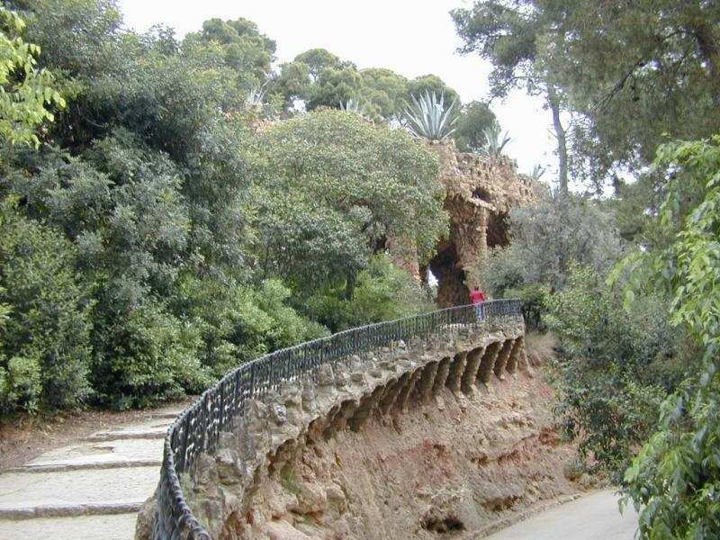
Parc Güell de Gaudi

Slide 44
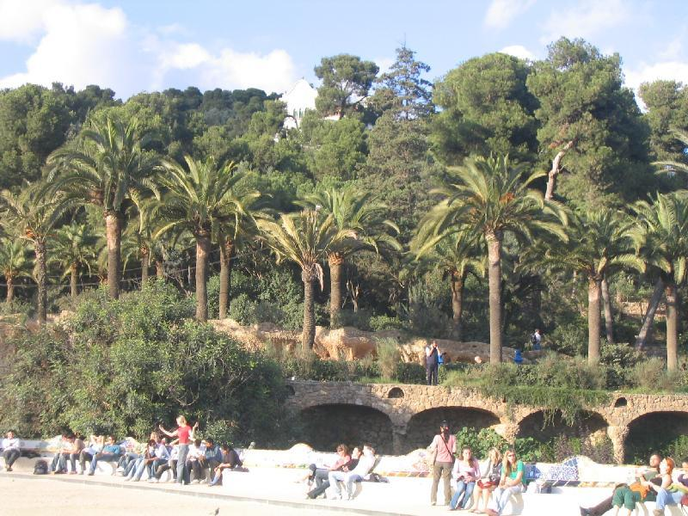
Parc Guell ... Gaudis park

Slide 45
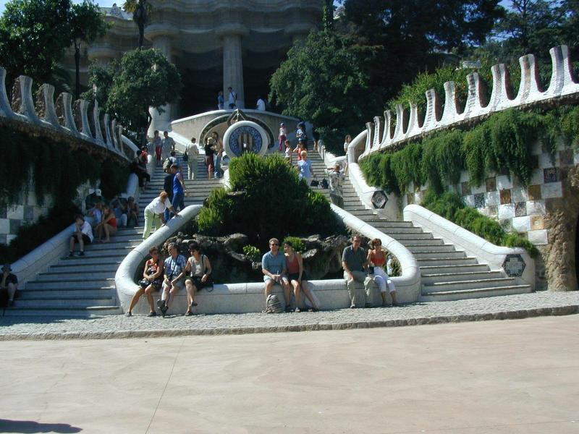
Park Guell (Gaudi's Design)

Slide 46
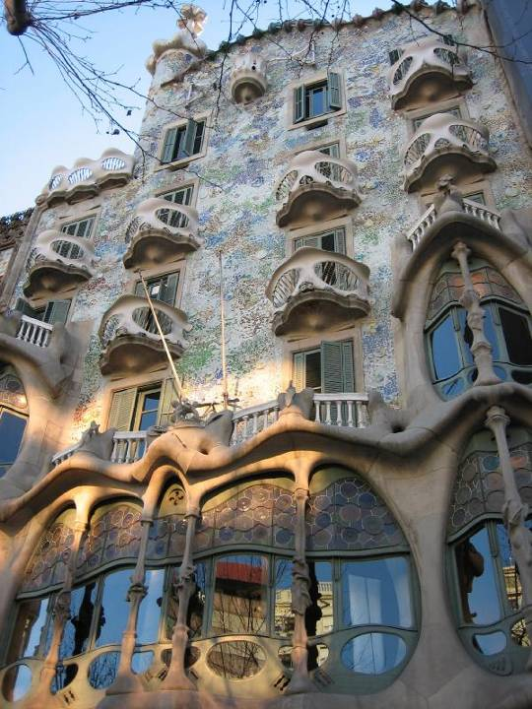
Second Gaudi house

Slide 47
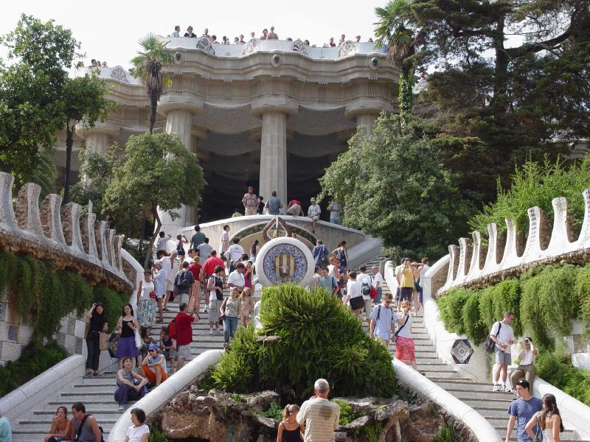
The grand entrance to Gaudi's estate

Slide 48
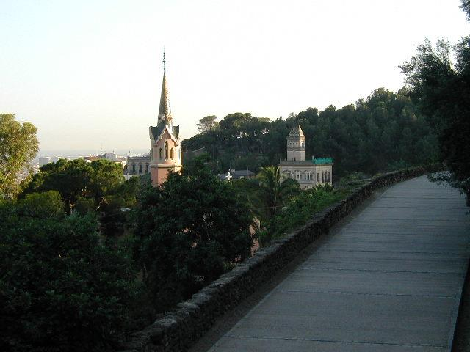
Tower on Museu Guell where Gaudy resided until his death

Slide 49
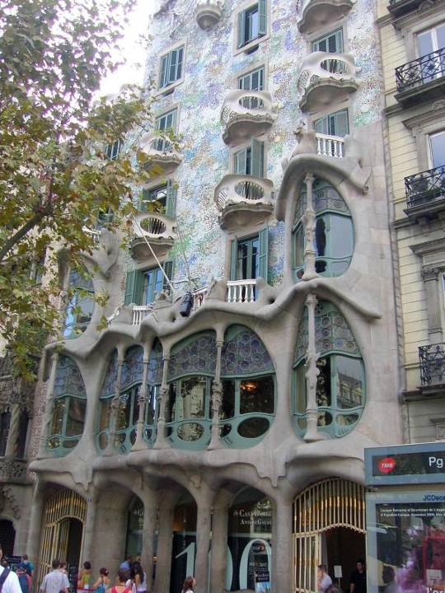
Second Gaudi house

Slide 50
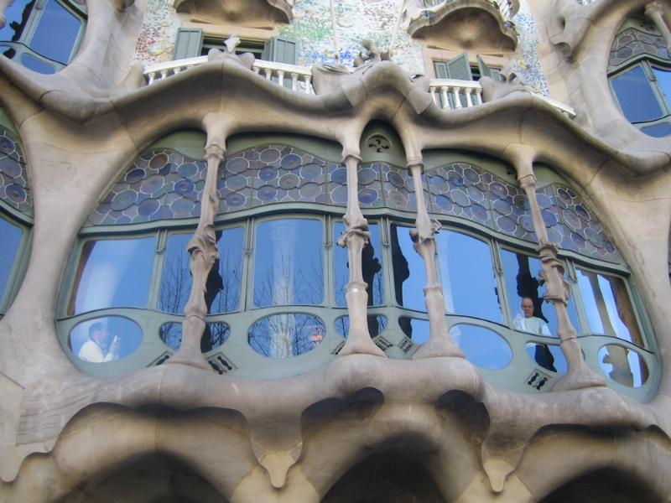

Slide 51
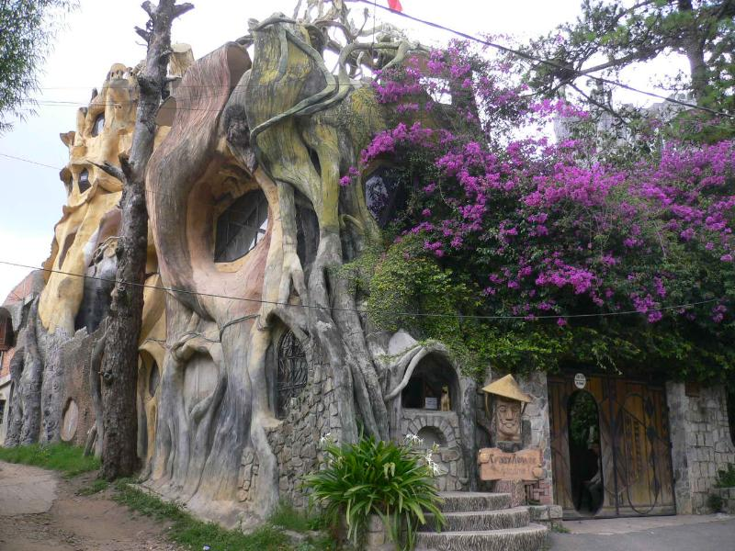

Slide 52

La Sagrada Familia - Gaudi's
most famous work, it
remains unfinished

Slide 53

Gaudi's masterpiece

Slide 54

La Sagrada Familia

Slide 55

La Sagrada Familia

Slide 56

La Sagrada Familia

Slide 57

Gaudi Cathedral

Slide 58

La Sagrada Familia

Slide 59
THE END

