Slide 1


CHRISTMAS SEASON
AND THE FESTIVE DECORATIONS
IN Europe and North America
The Christmas season, also called as the festive season, or the holiday season (mainly in the U.S. and Canada; often simply called the holidays), is an annually recurring period recognized in many Western and Western-influenced countries that is generally considered to run from late November to early January. It is defined as incorporating at least Christmas, and usually New Year, and sometimes various other holidays and festivals. It also is associated with a period of shopping which comprises a peak season for the retail sector (the "Christmas or holiday shopping season"), and a period of sales at the end of the season (the "January sales"). Christmas window displays and Christmas tree lighting ceremonies when trees decorated with ornaments and light bulbs are illuminated, are traditions in many areas. Here is a presentation of all decorations and lighted decorations in important Western Cities and North America.
Both - Tony and Steve dedicate this presentation to their strong bond of friendship. We wish all readers a Happy Christmas and a Prosperous New Year 2019.
Compiled by : Tony CHACKO (tonychacko2000@gmail.com)
Technical and Art creator : Steve RUMPLER (pista2011@gmail.com)

Slide 2
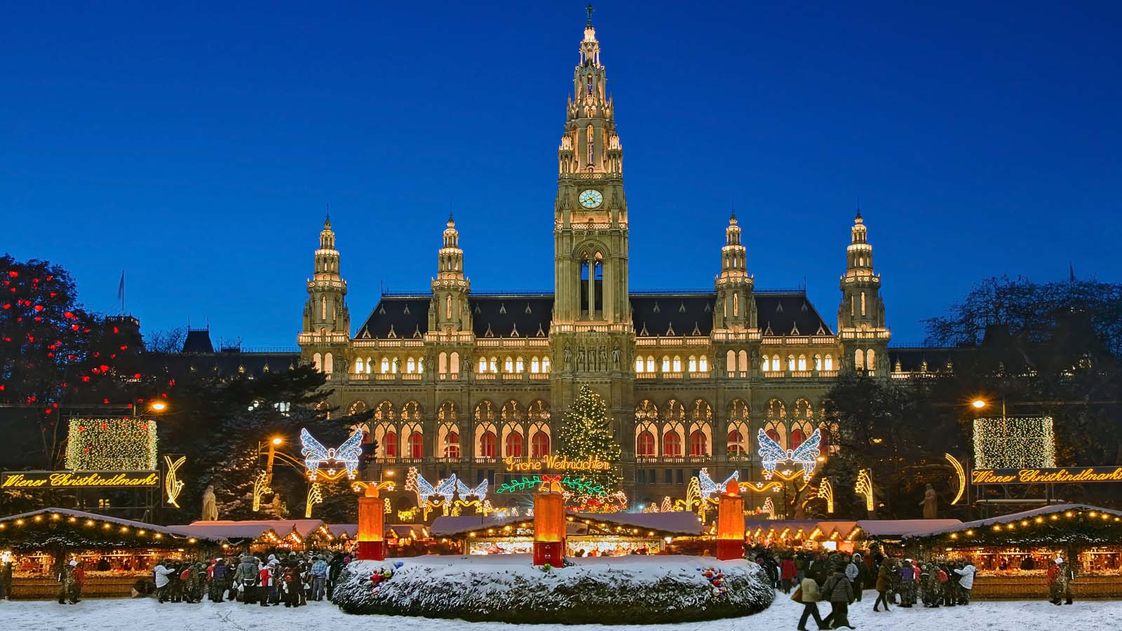

Vienna, Austria

Slide 3
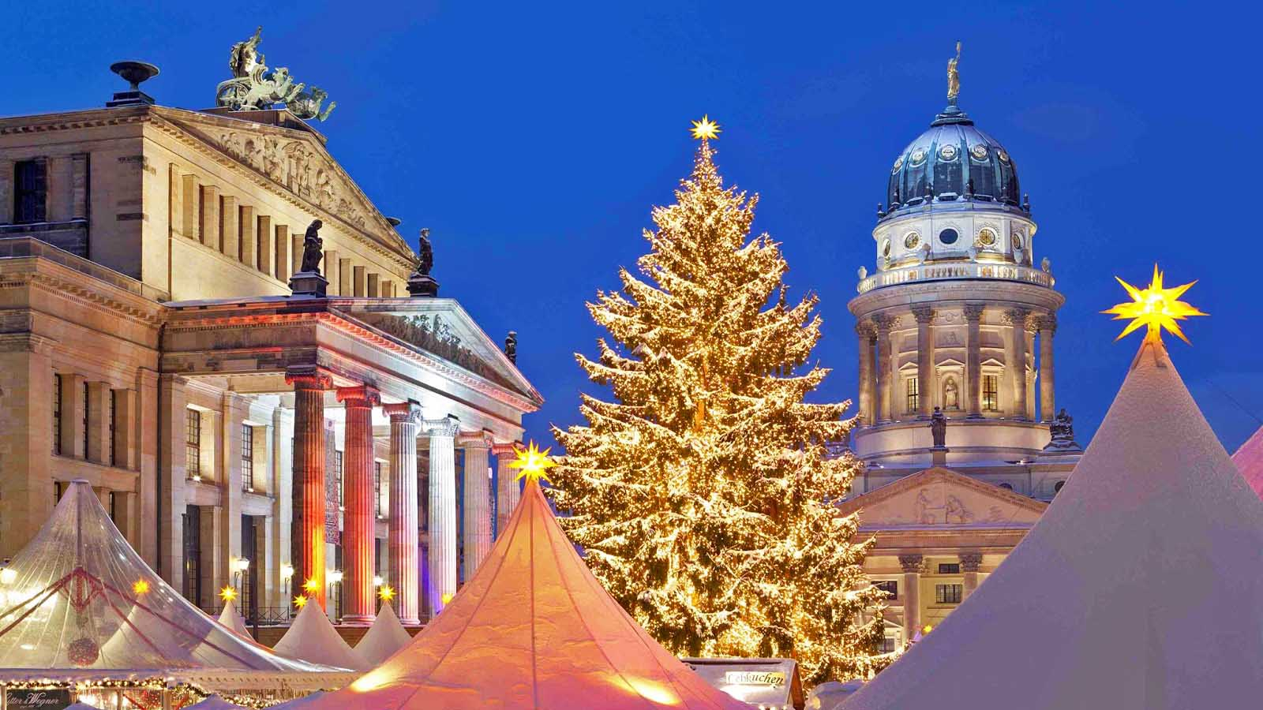
Berlin, Germany

Slide 4
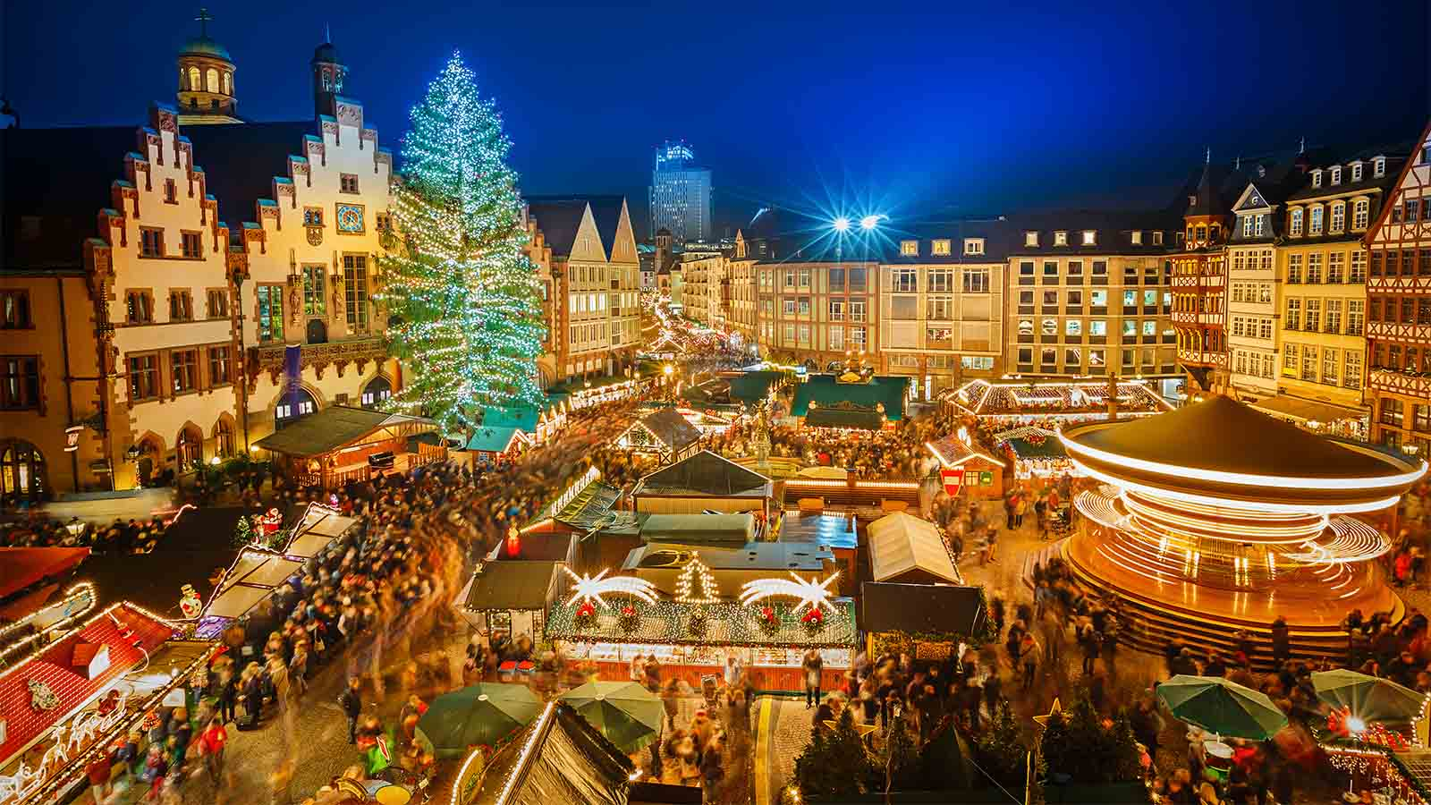
Frankfurt, Germany

Slide 5
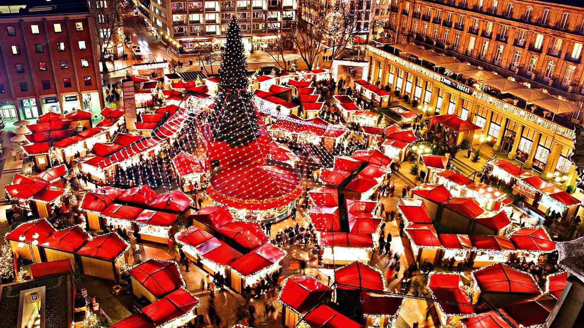
Cologne, Germany

Slide 6
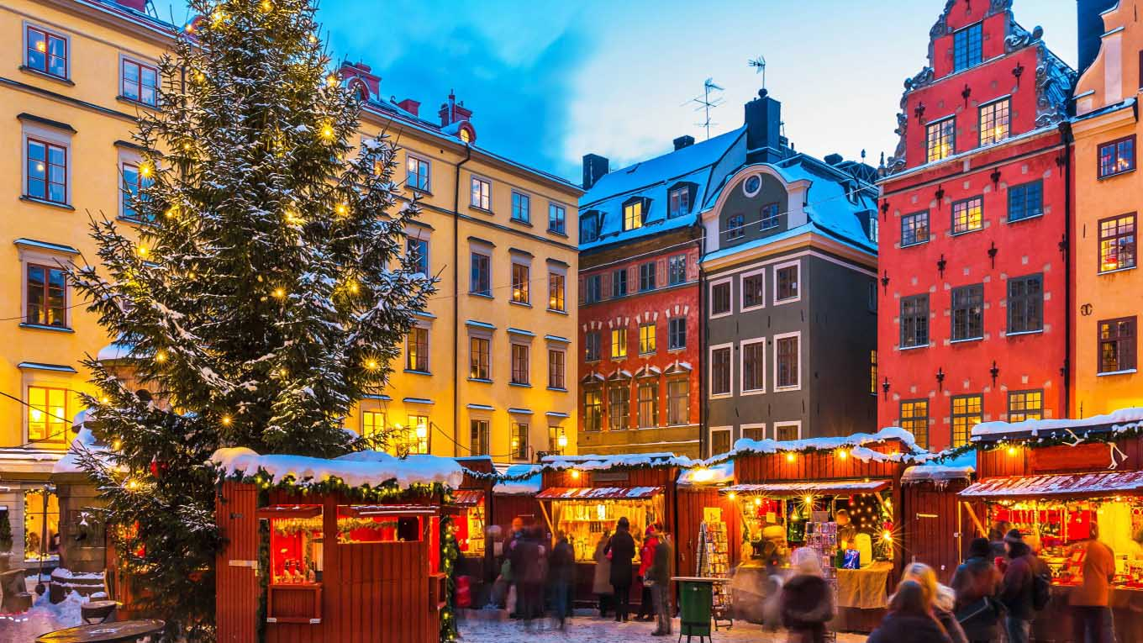
Stockholm, Sweden

Slide 7
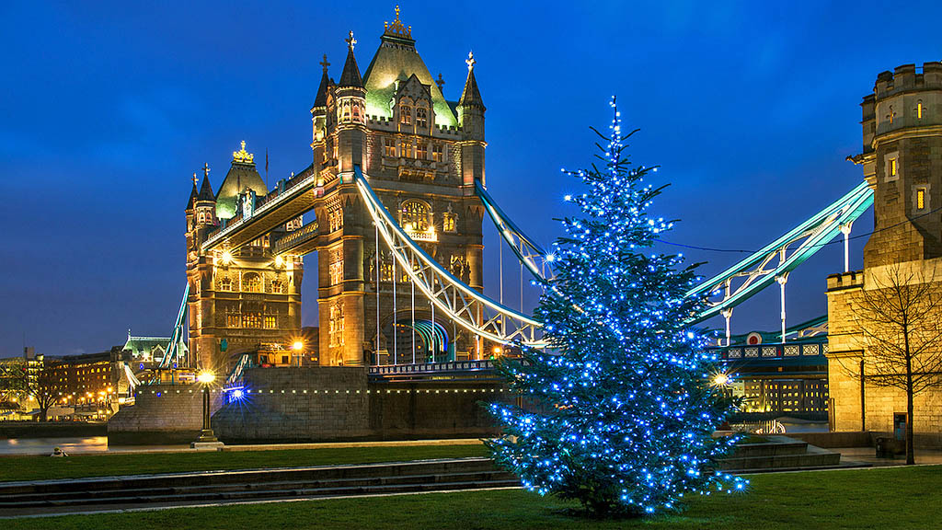
London, U.K.

Slide 8
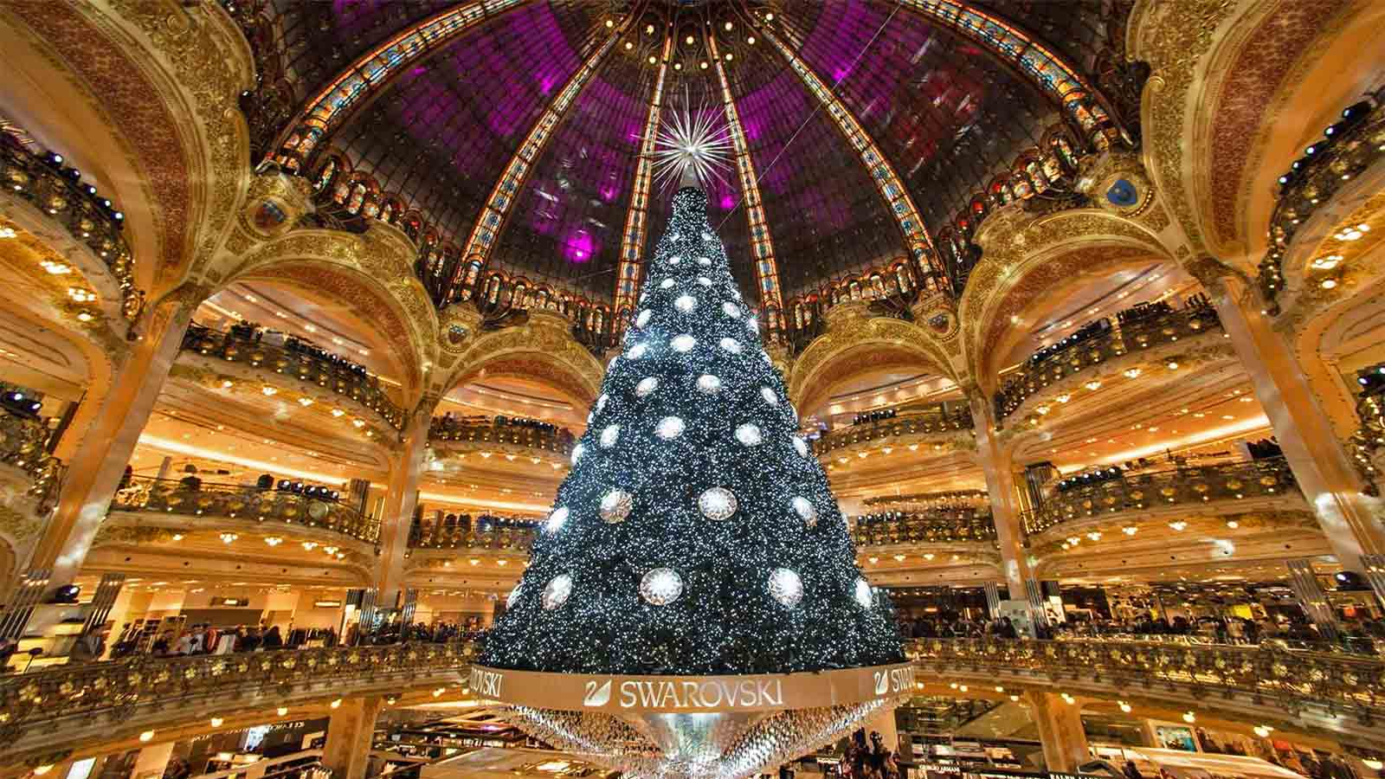
Paris, France

Slide 9
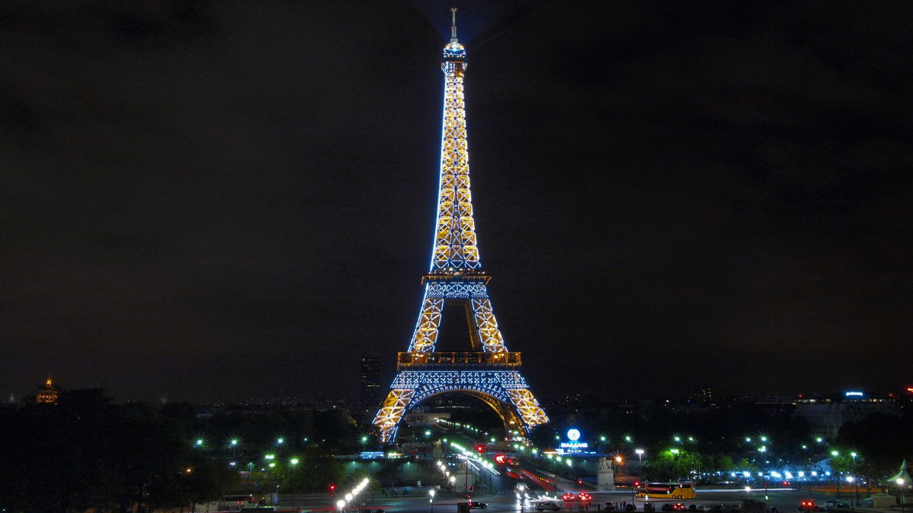
Paris, France

Slide 10
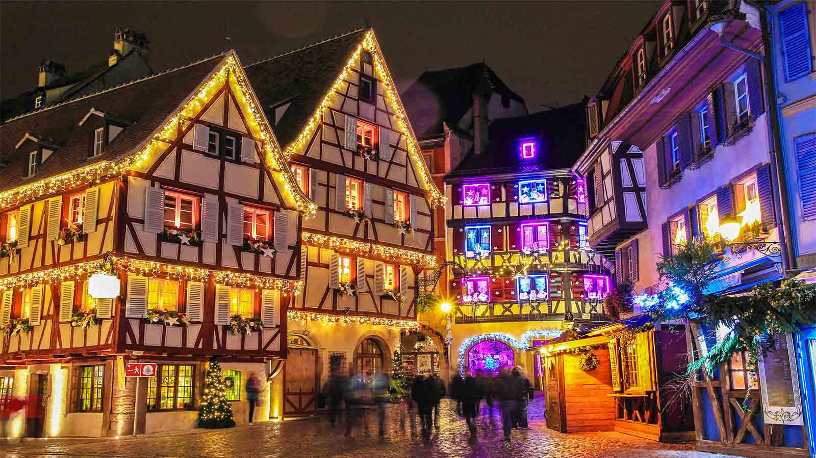
Colmar, France

Slide 11
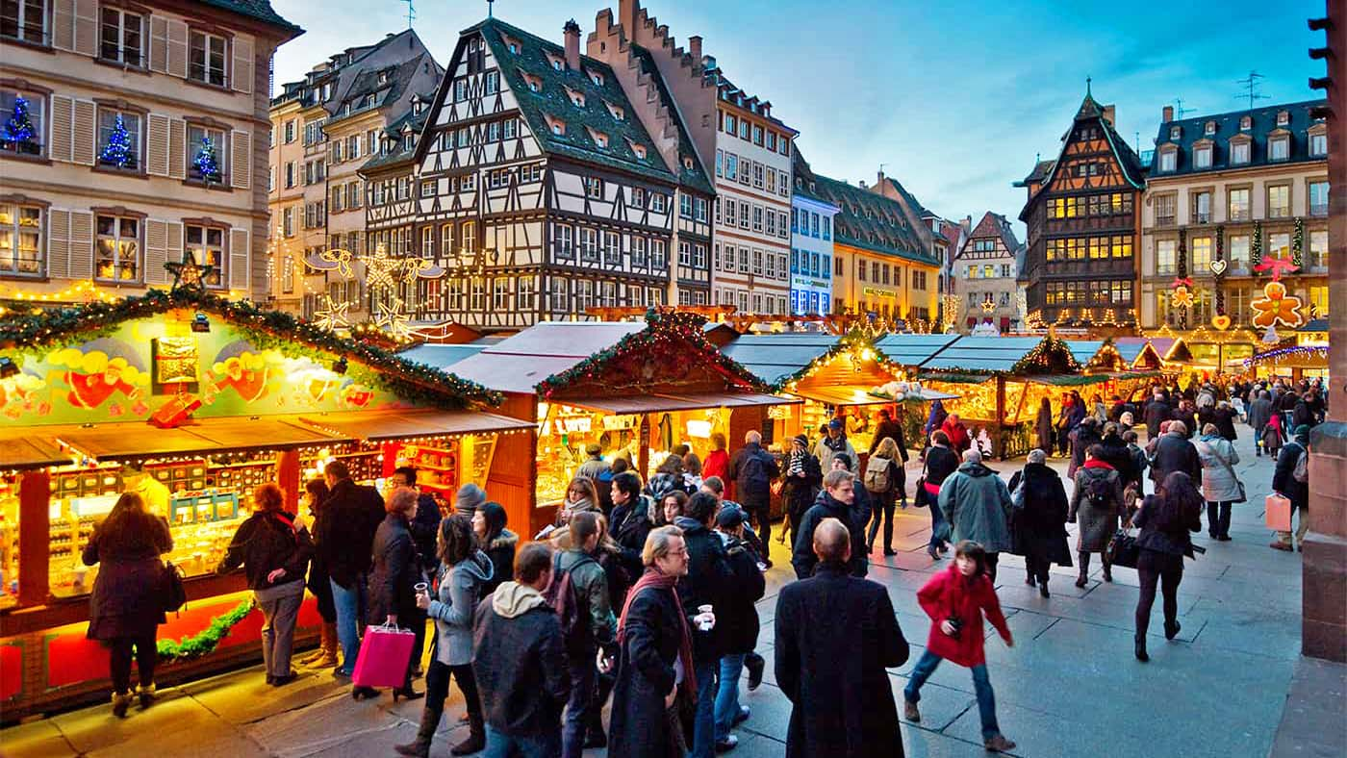
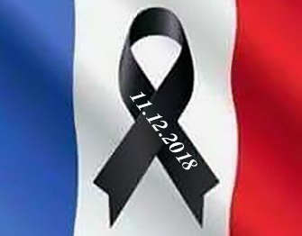
Strasburg, France

Slide 12
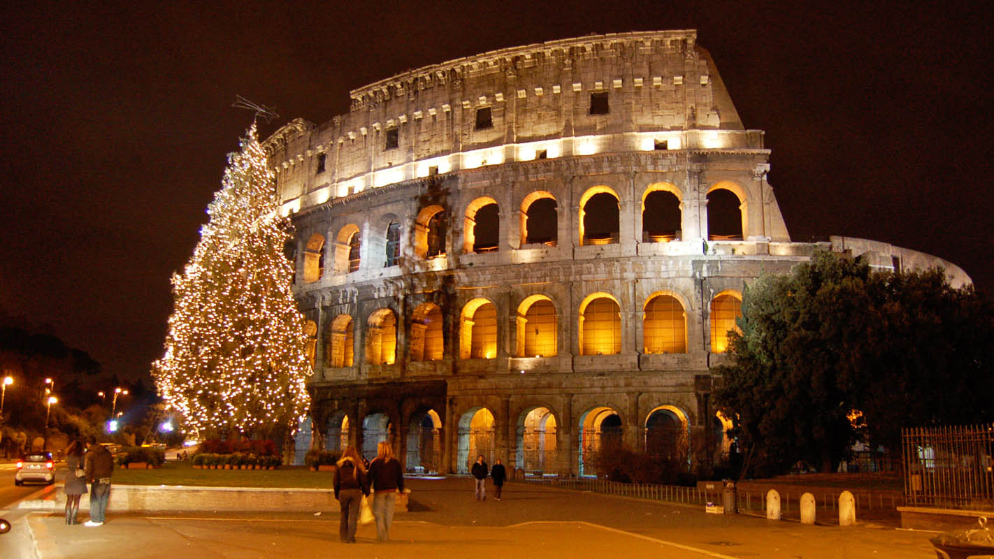
Rome, Italy

Slide 13
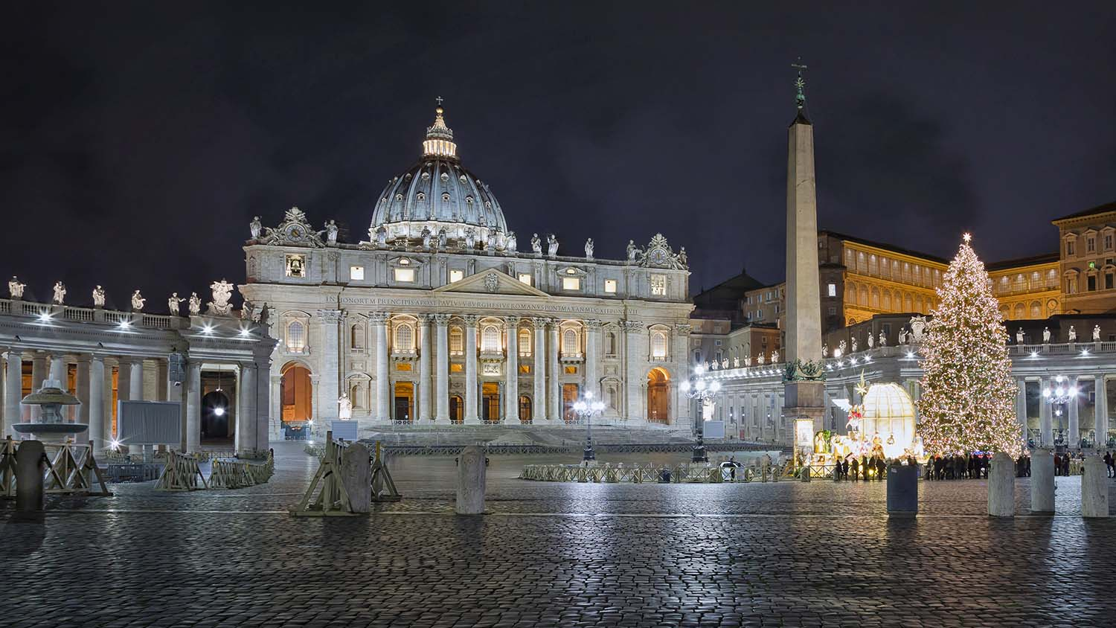
Vatican City State

Slide 14
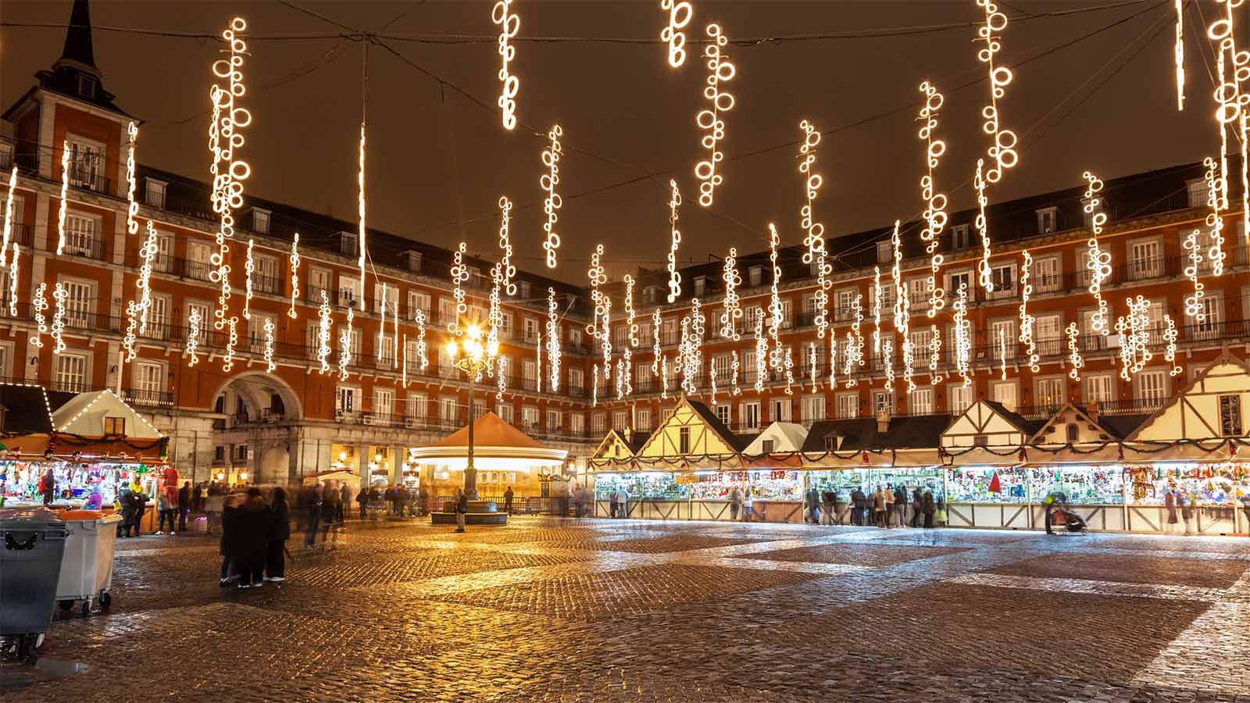
Madrid, Spain

Slide 15
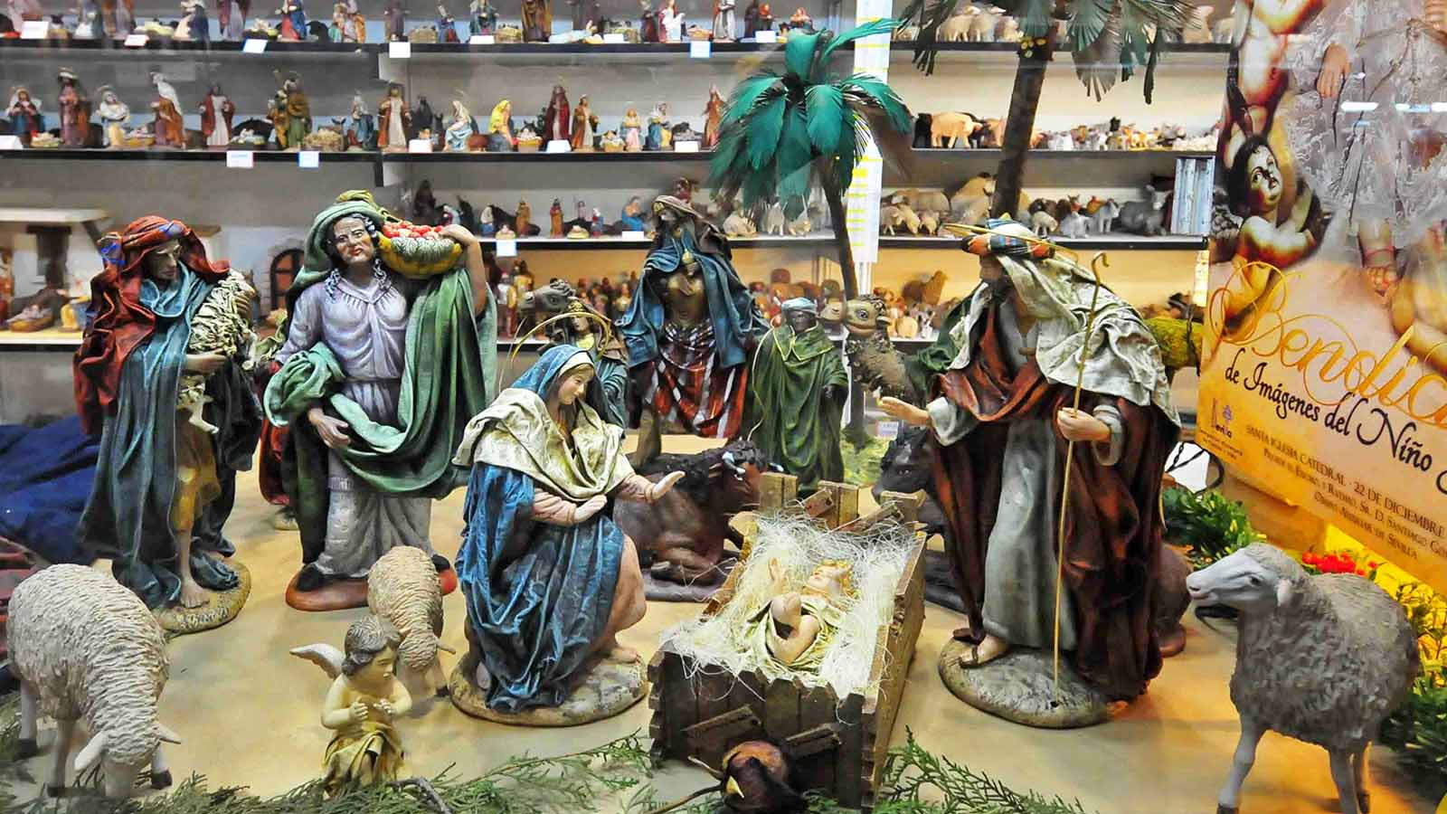
Seville, Spain

Slide 16
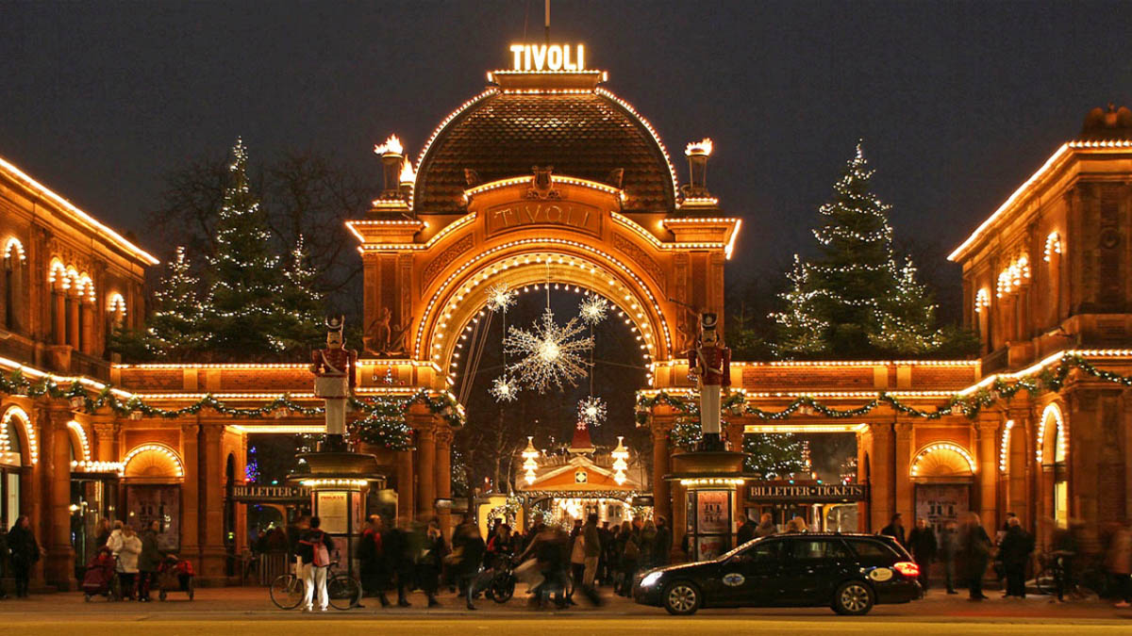
Copenhagen, Denmark

Slide 17
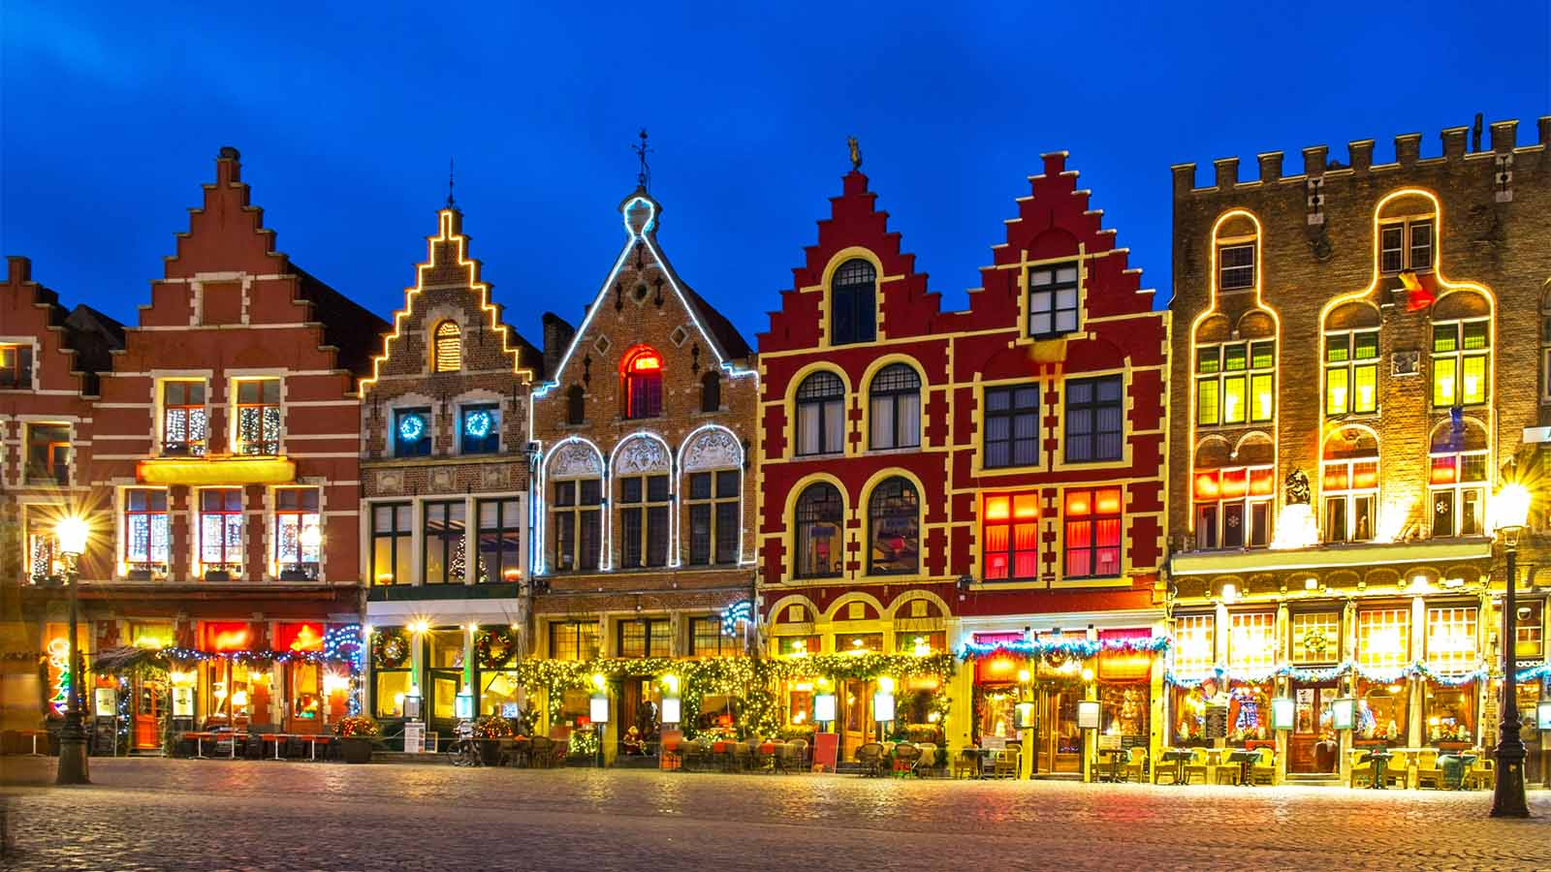
Bruges, Belgium

Slide 18
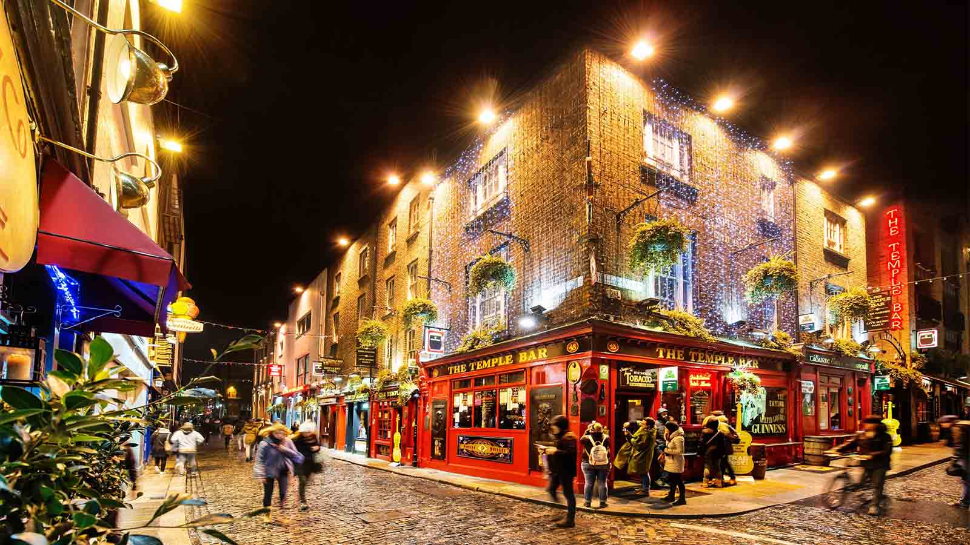
Dublin, Ireland

Slide 19
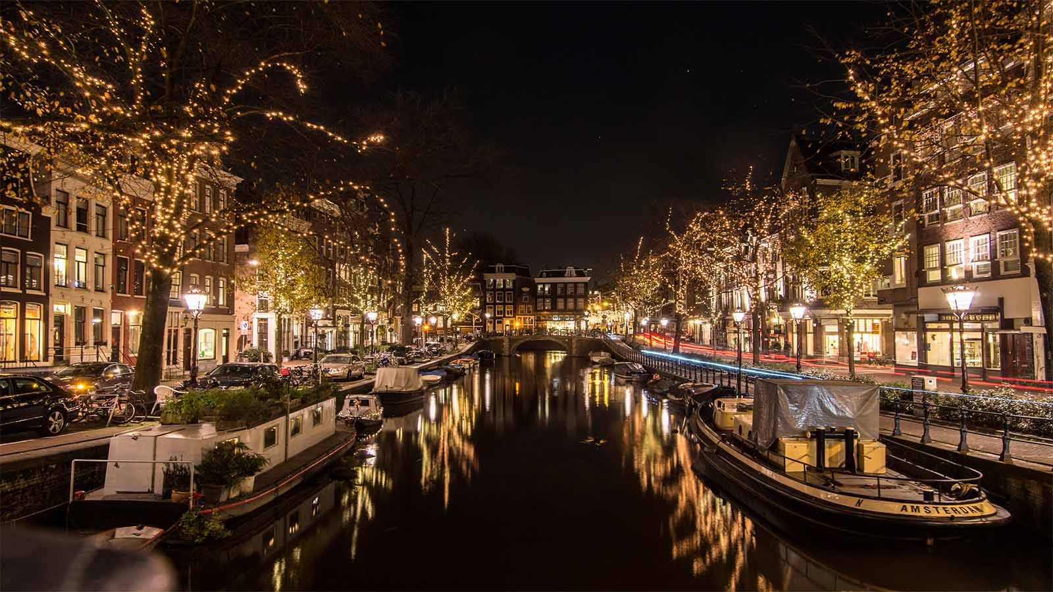
Amsterdam, Netherlands

Slide 20
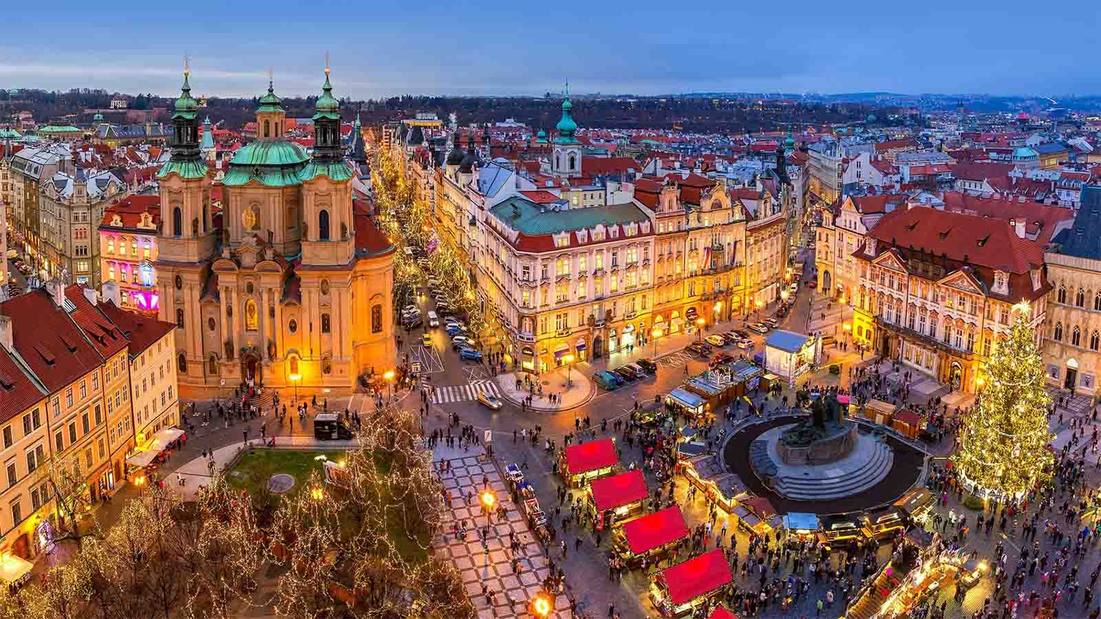
Prague, Czech Republic

Slide 21
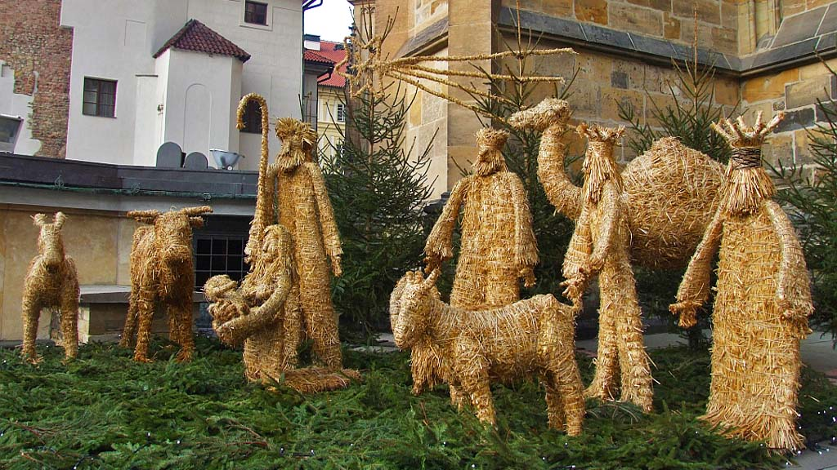
Prague, Czech Republic

Slide 22
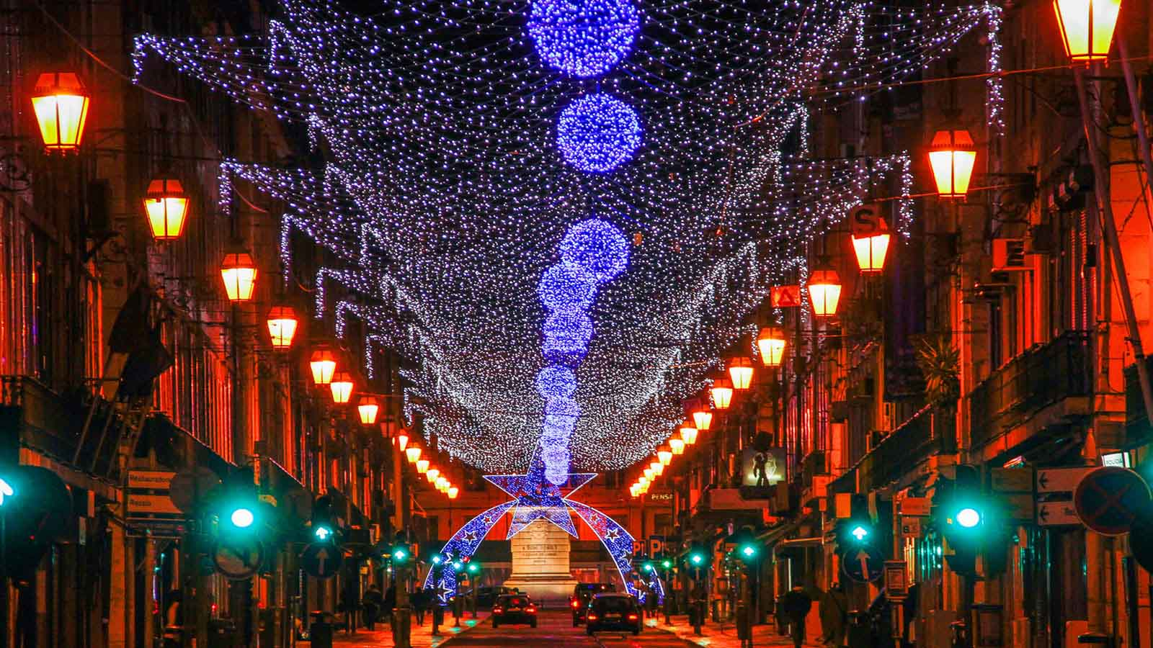
Lisbon, Portugal

Slide 23
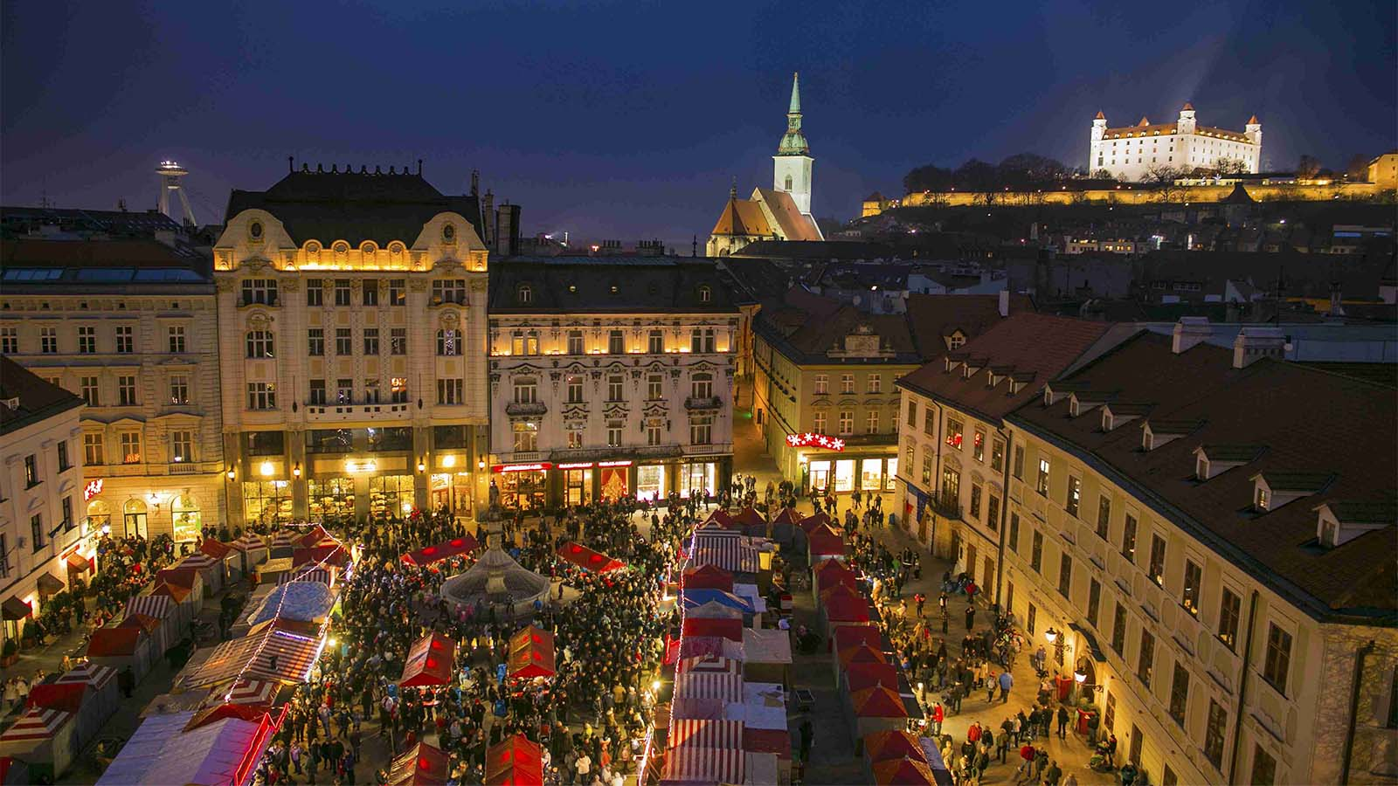
Bratislava, Slovakia

Slide 24
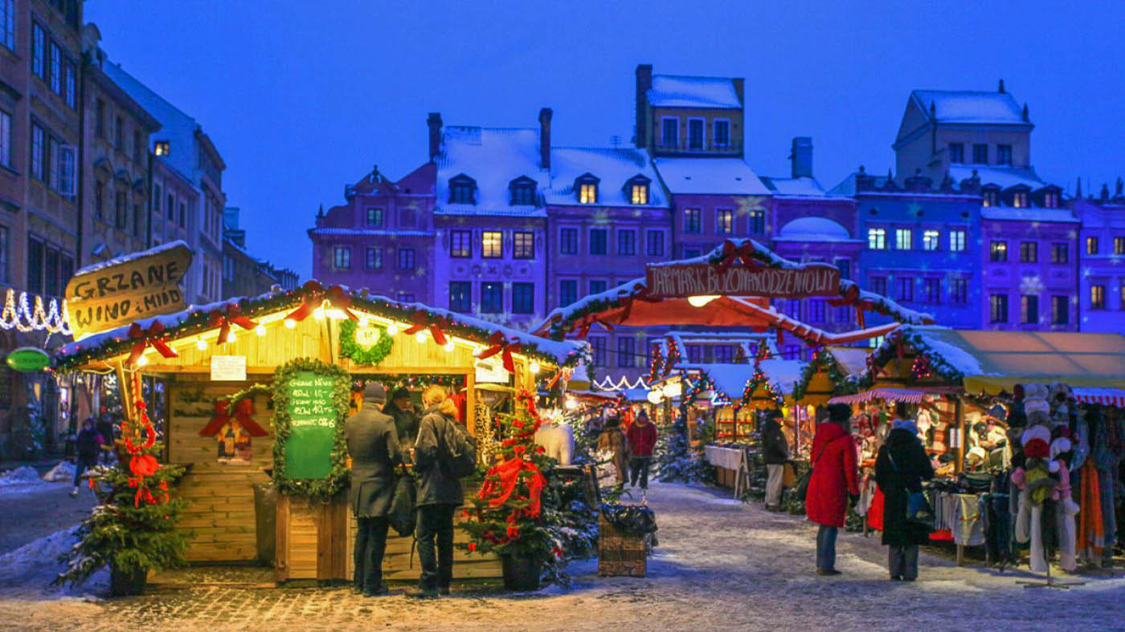
Warsaw, Poland

Slide 25
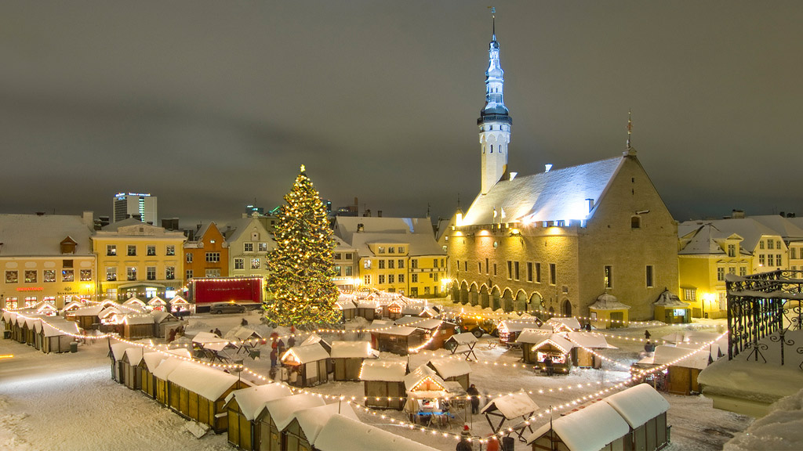
Tallin, Estonia

Slide 26
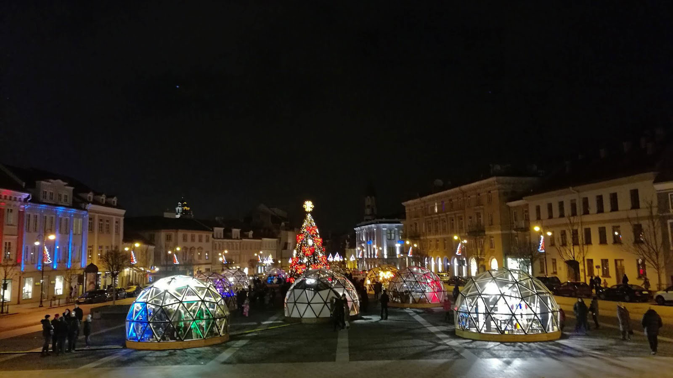
Vilnius, Lithuania

Slide 27
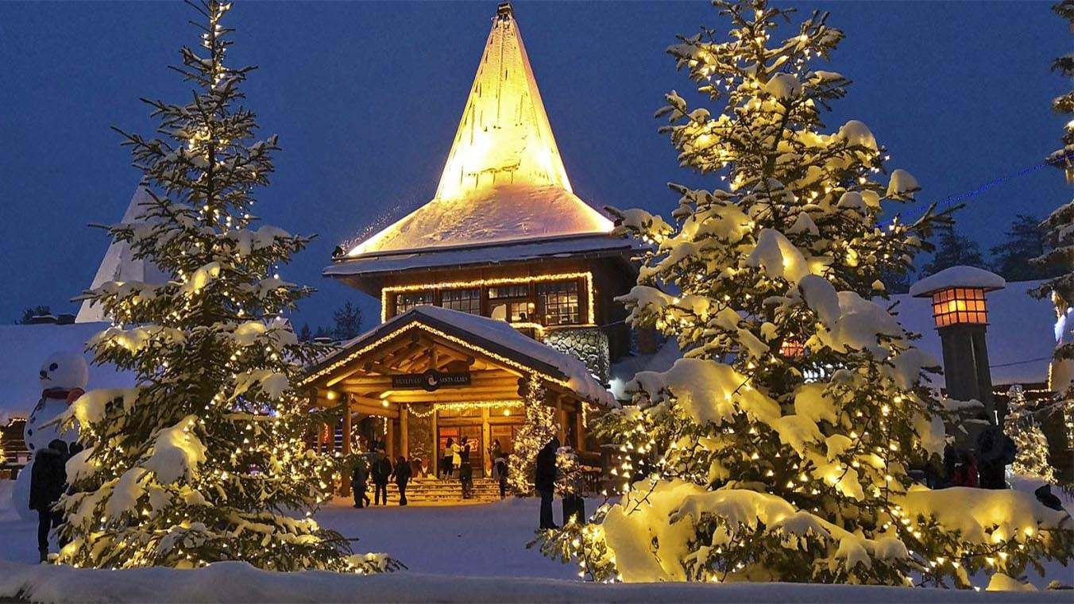
Rovaniemi (Santa Klaus Village) in Lapland, Finland

Slide 28
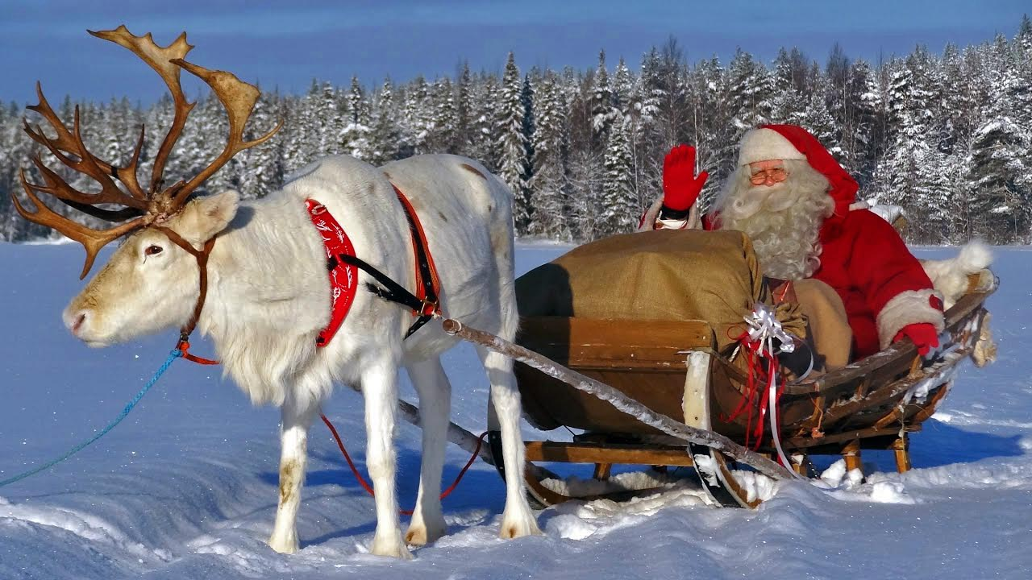
Real-time Santa doing his rounds

Slide 29
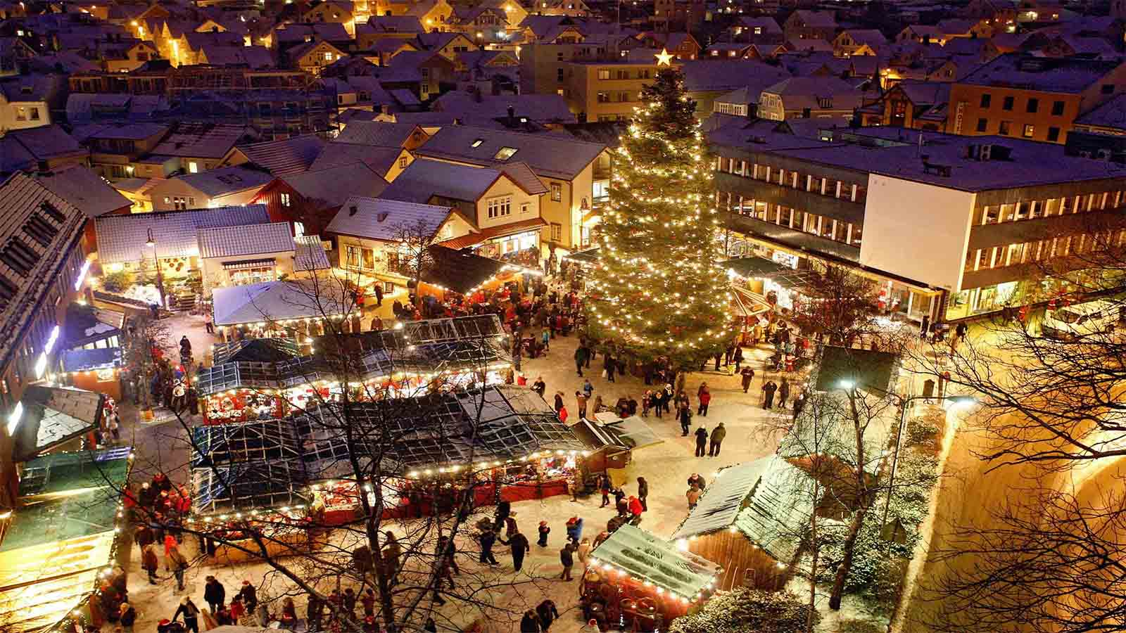
Trondheim, Norway

Slide 30
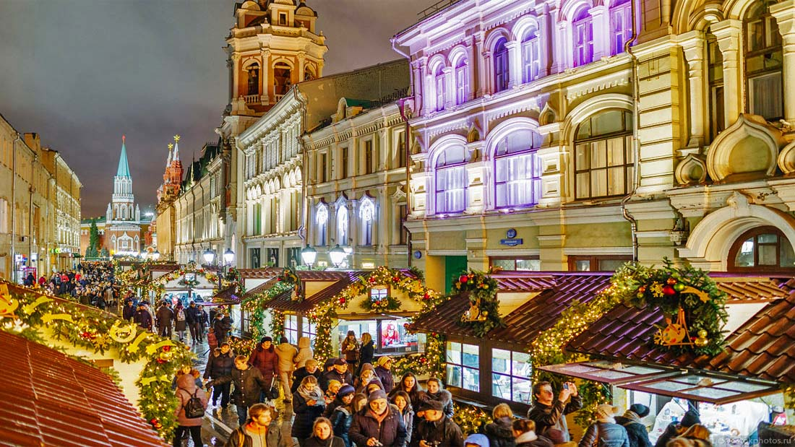
Moscow, Russia

Slide 31
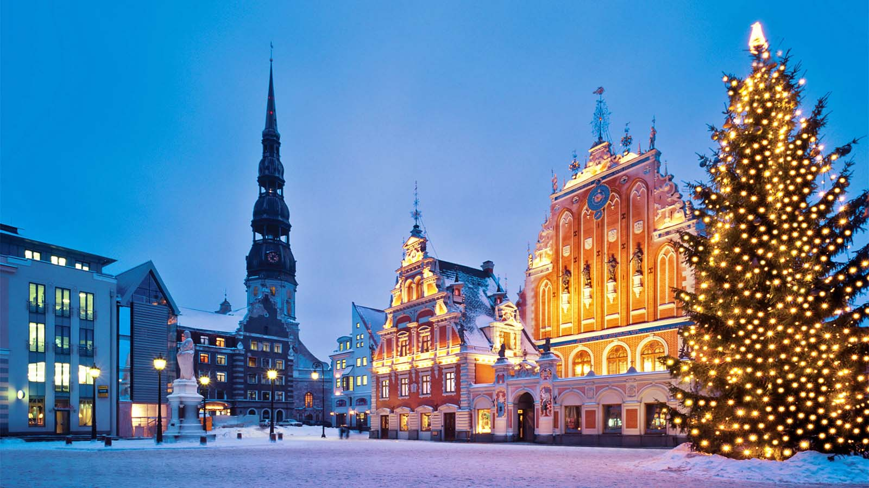
Lviv, Ukraine

Slide 32
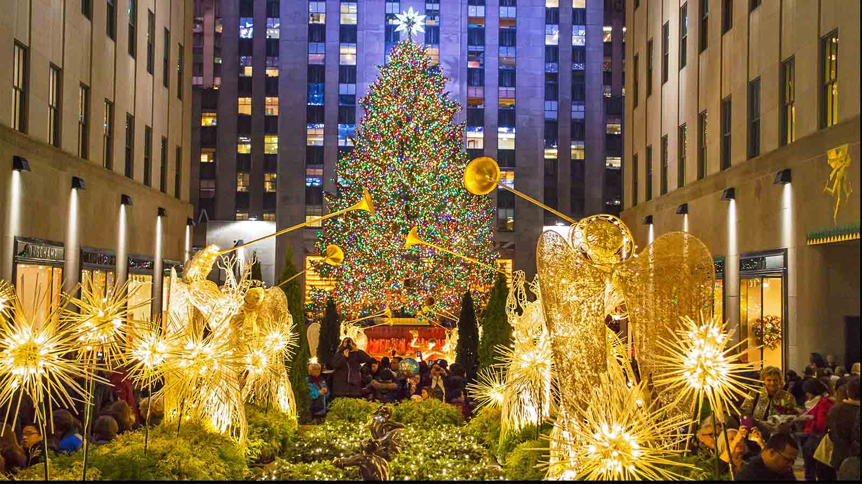
New York, USA

Slide 33
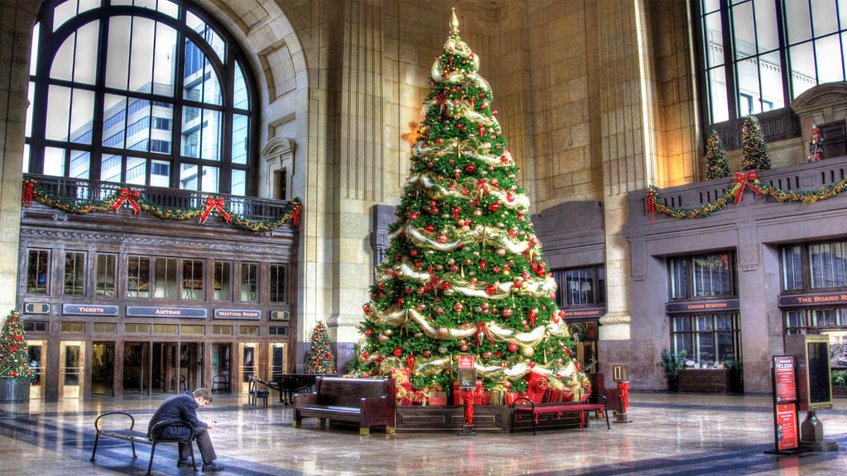
Kansas City, USA

Slide 34
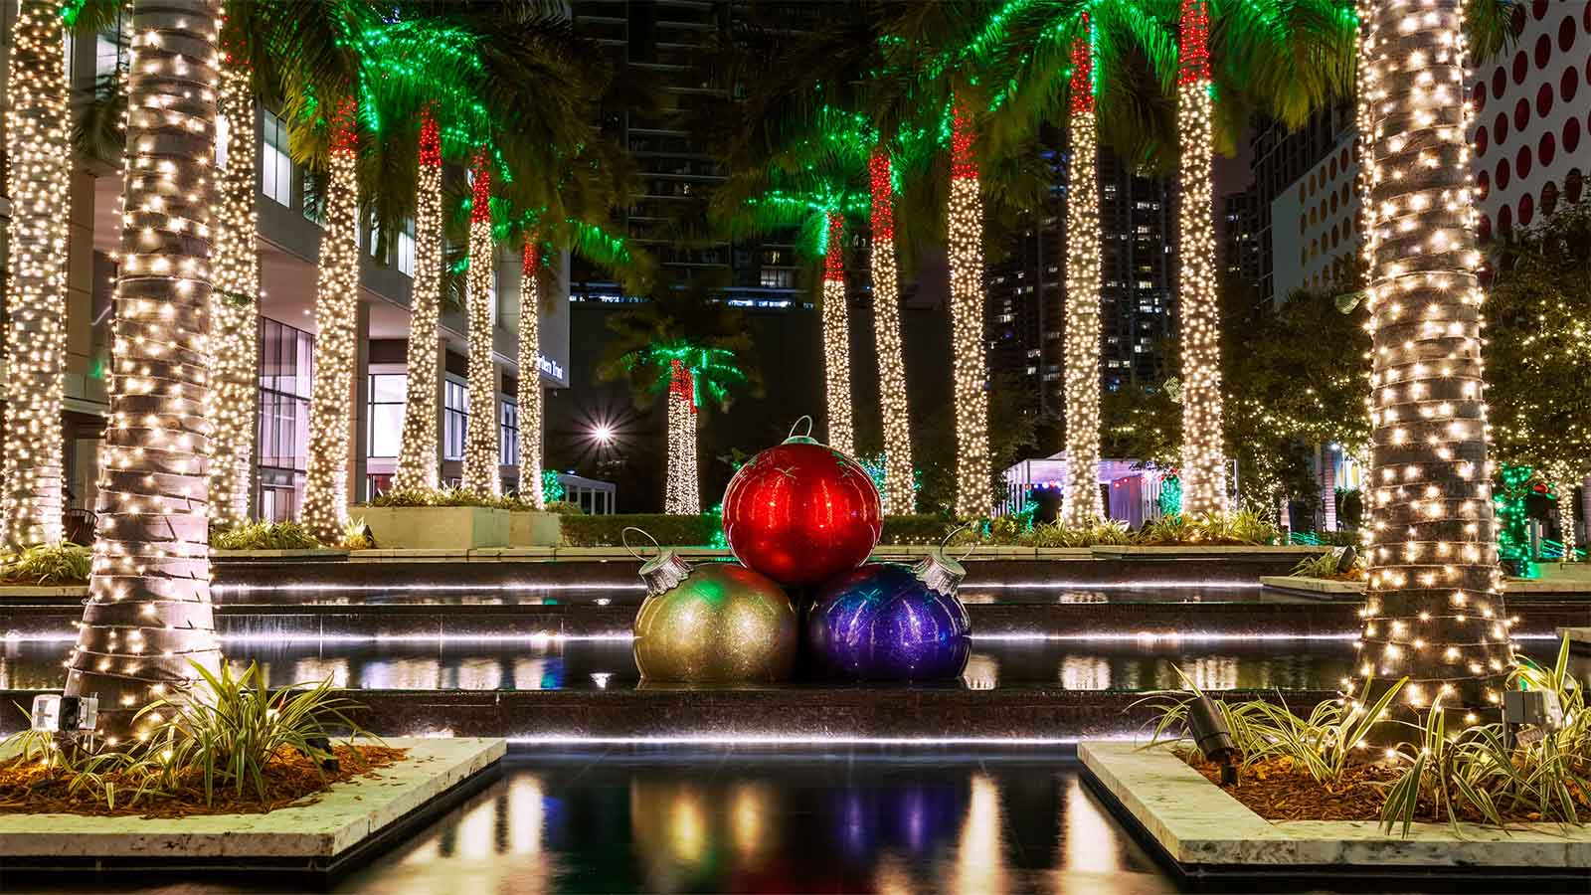
Miami, USA

Slide 35
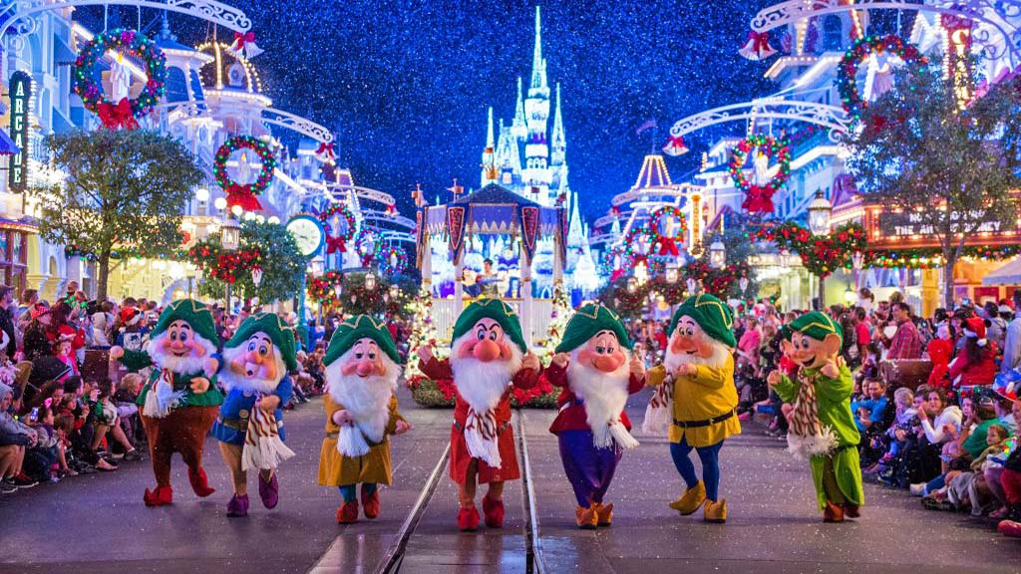
Disney World in Los Angeles, USA

Slide 36
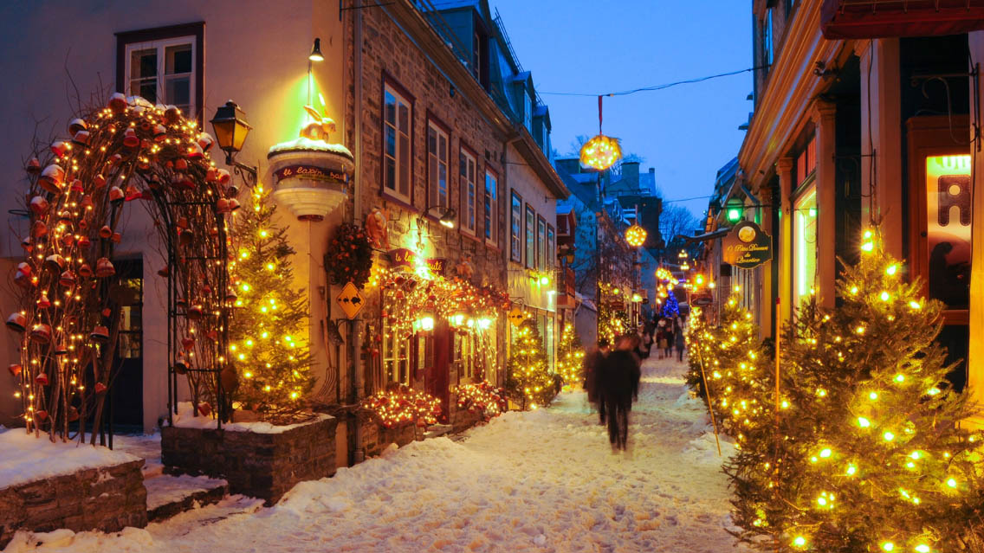
Quebeck City, Canada

Slide 37
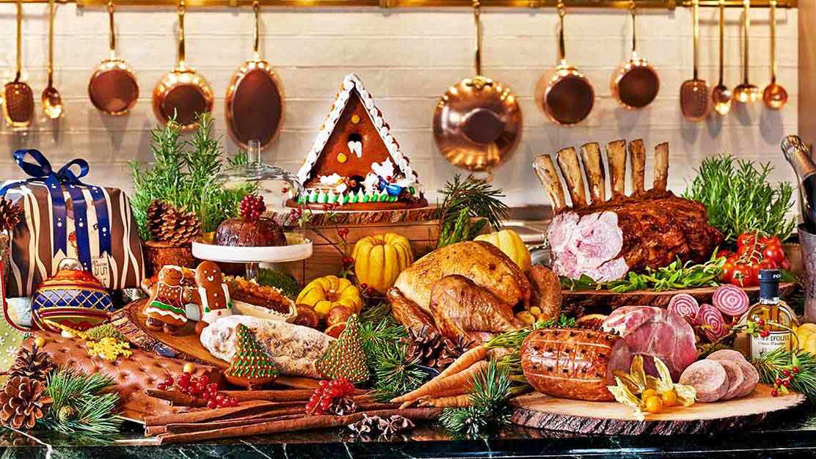
Okay friends, let’s have some aesthetic Christmas dinner...

Slide 38

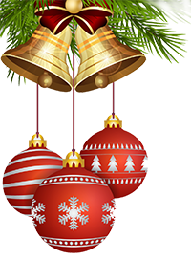

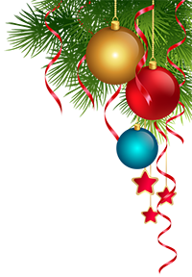

Hope you have enjoyed viewing this presentation
Have a nice Christmas Time
Music : The Nazarene - Michael Card
With regards - Tony Chacko and Steve Rumpler
(tonychacko2000@gmail.com / pista2011@gmail.com)

