Slide 1
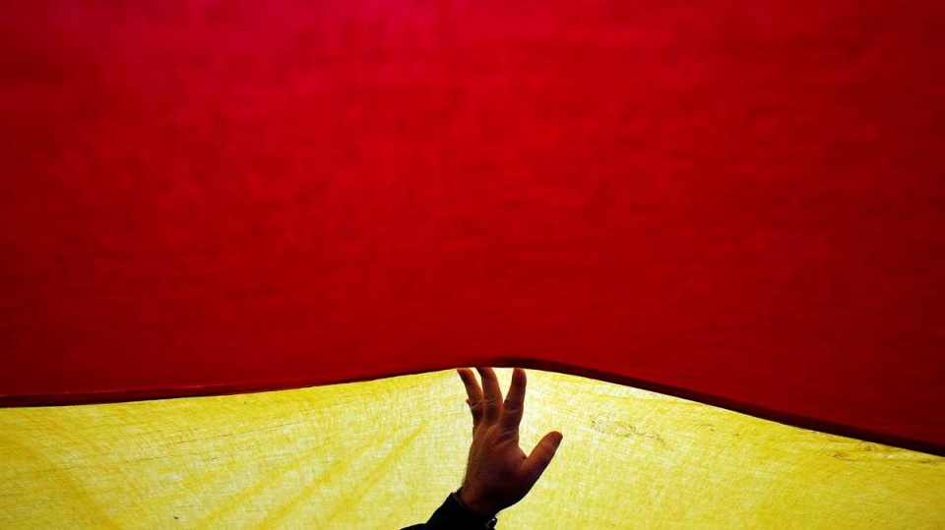

World Diary 121209 地球日誌
By Eddie 12/29/2012

Slide 2
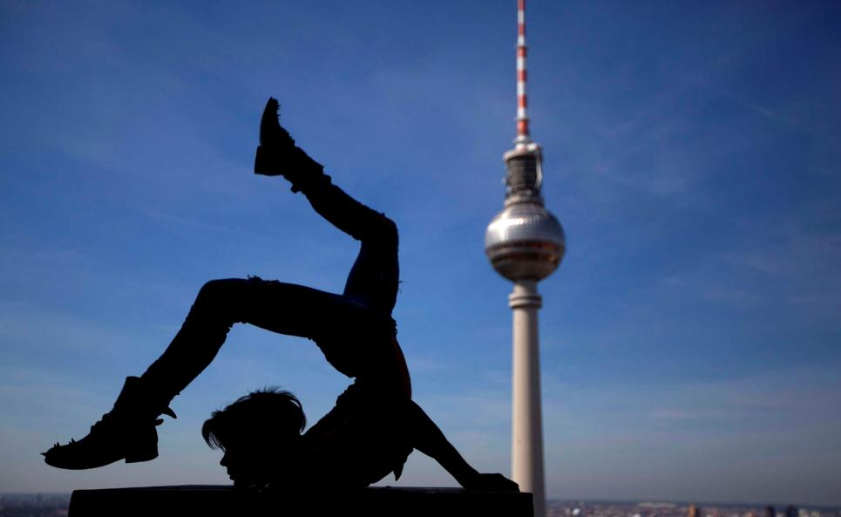
The story of the Spaniards.
西班牙人的故事

Slide 3
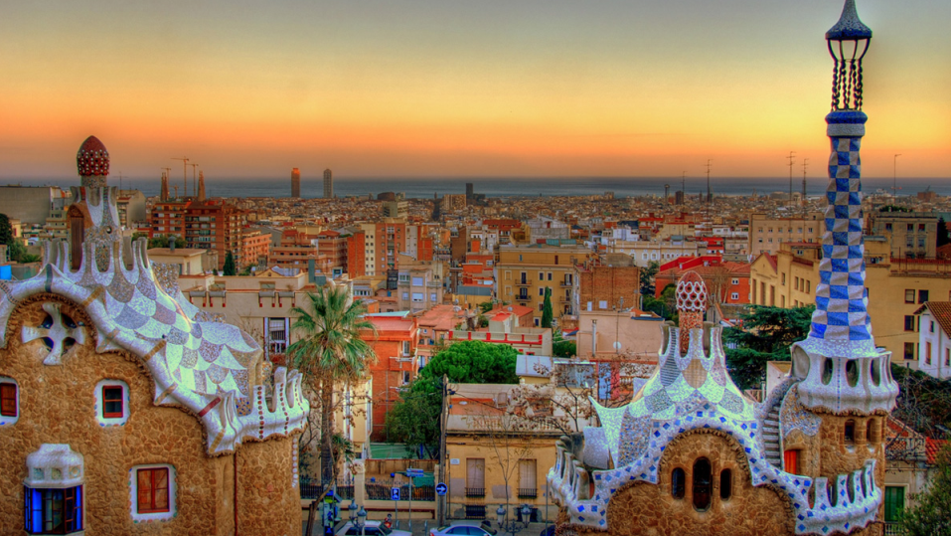
Great architecture 偉大的建築

Slide 4
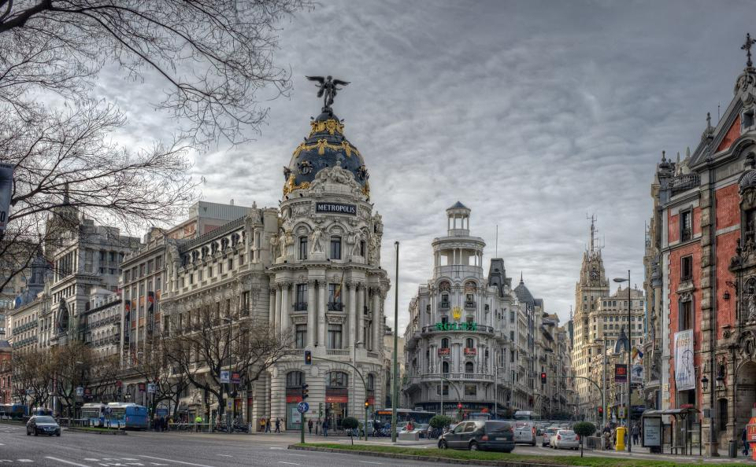

Slide 5
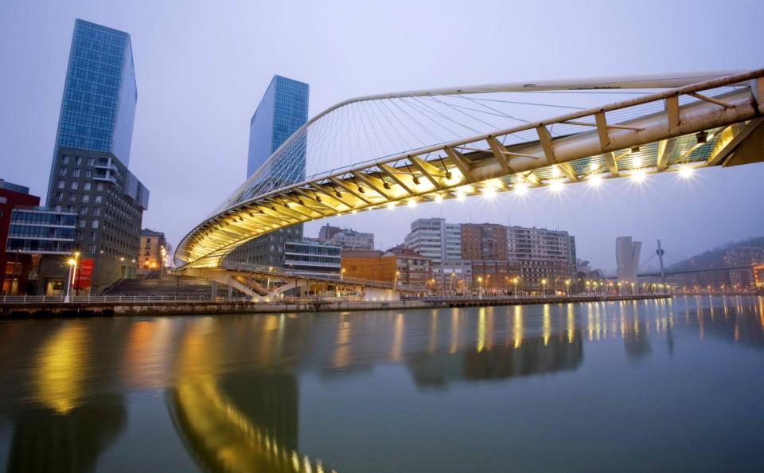

Slide 6
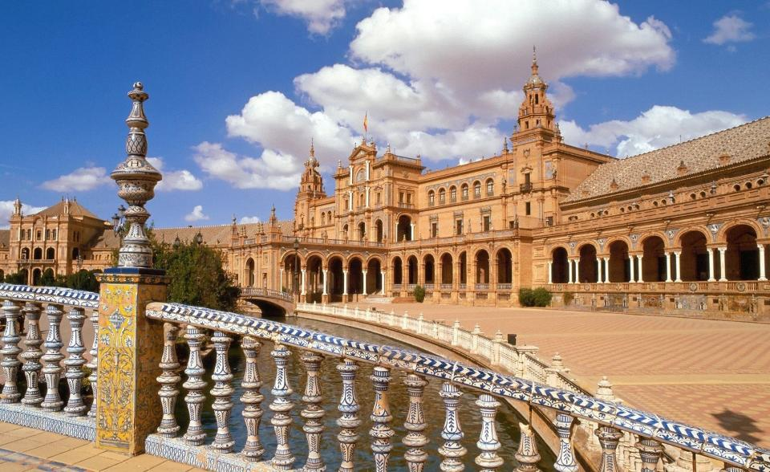

Slide 7
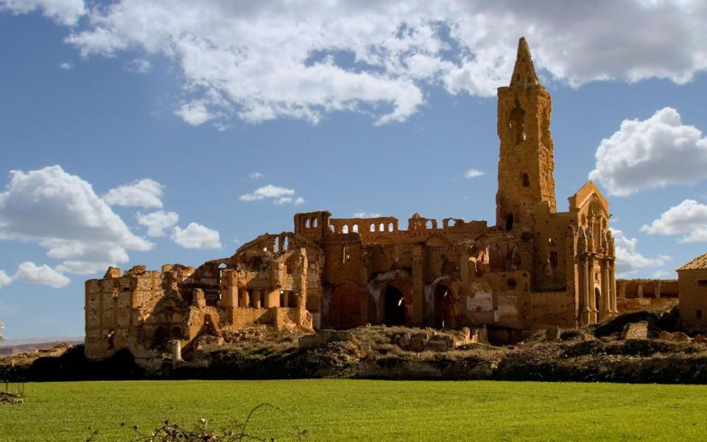

Slide 8
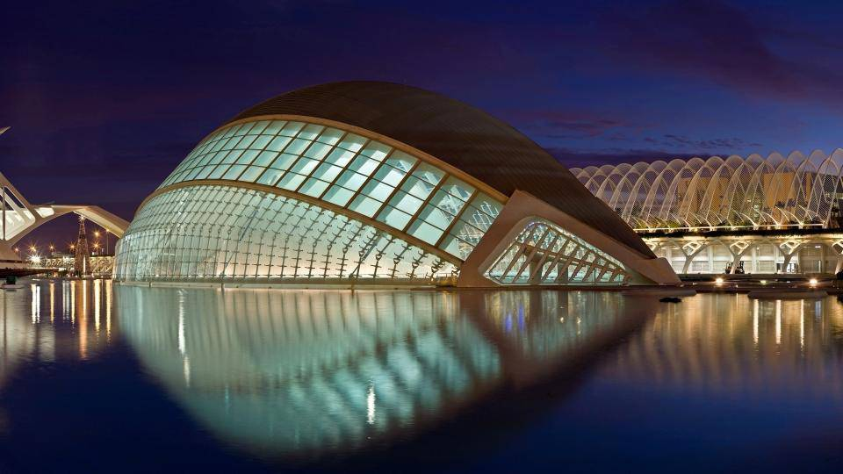

Slide 9
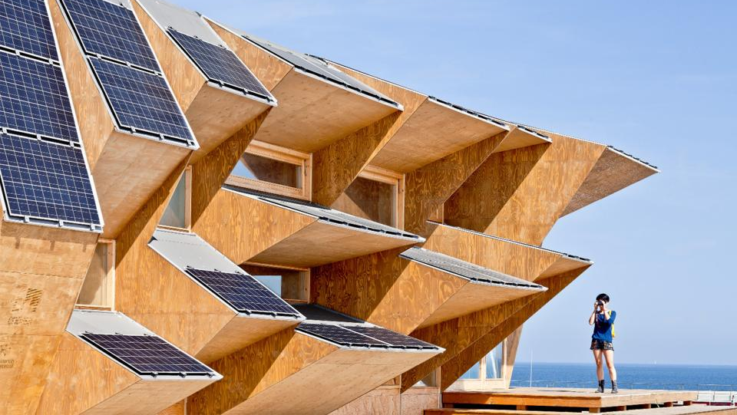

Slide 10
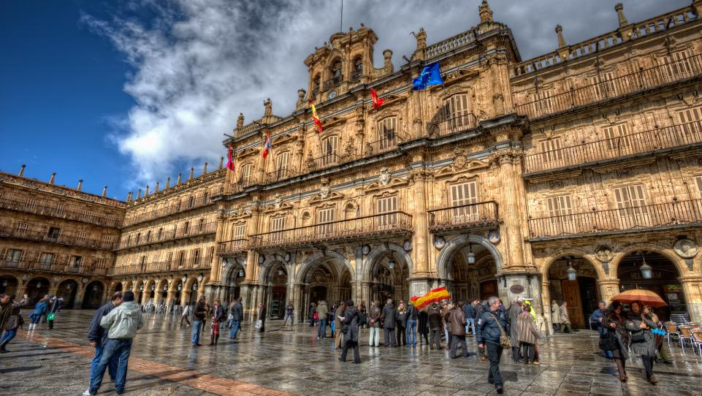

Slide 11
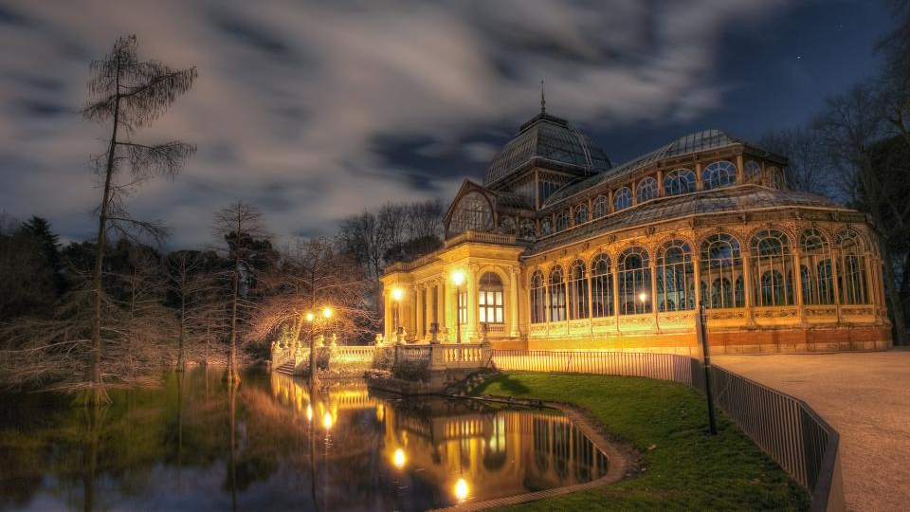

Slide 12
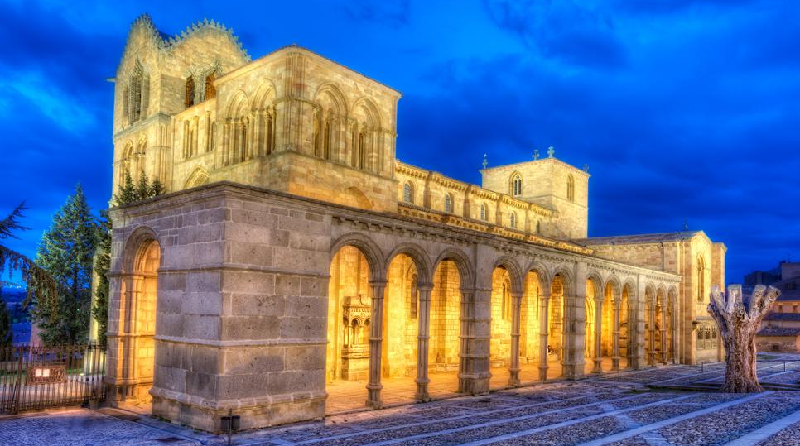

Slide 13


Slide 14
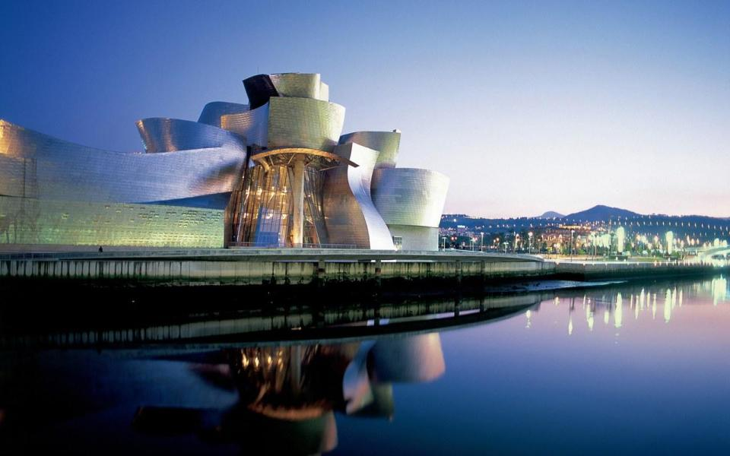

Slide 15
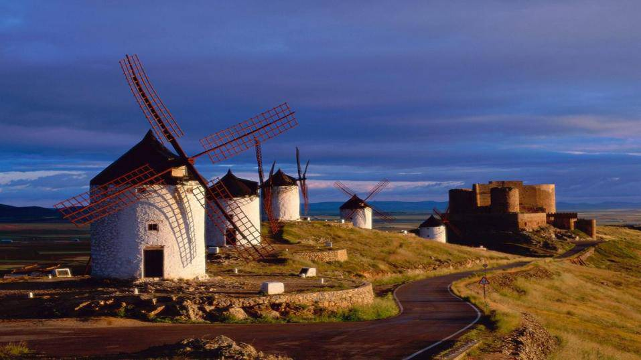

Slide 16
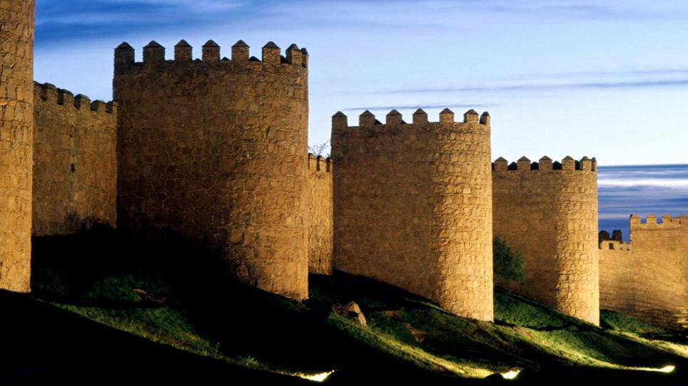

Slide 17
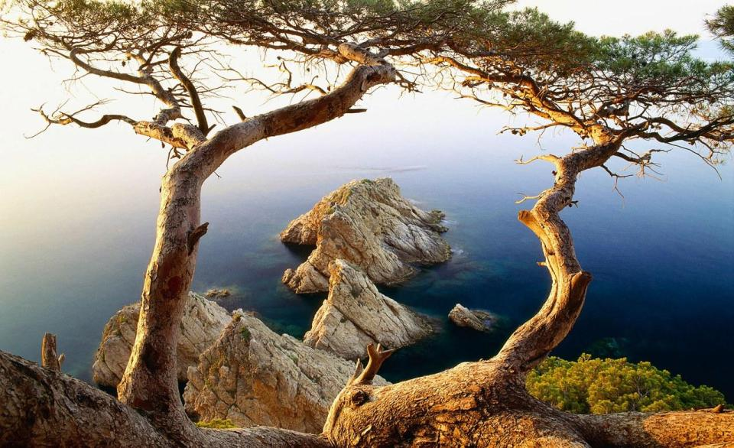
Beautiful landscape
美麗的風景

Slide 18
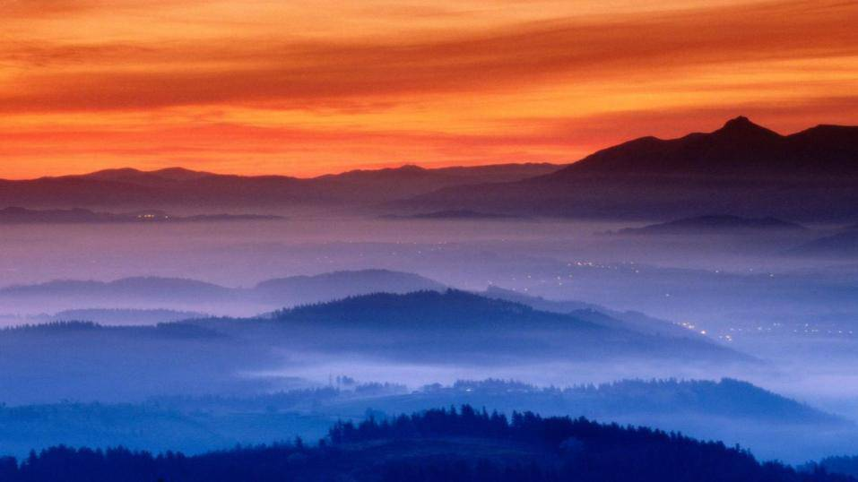

Slide 19
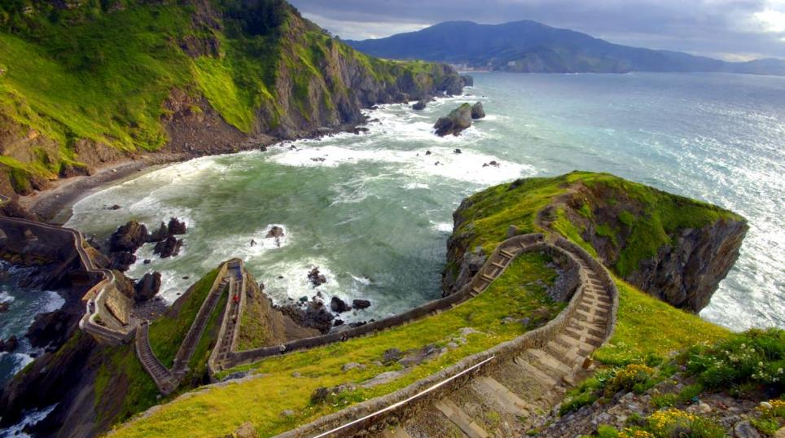

Slide 20
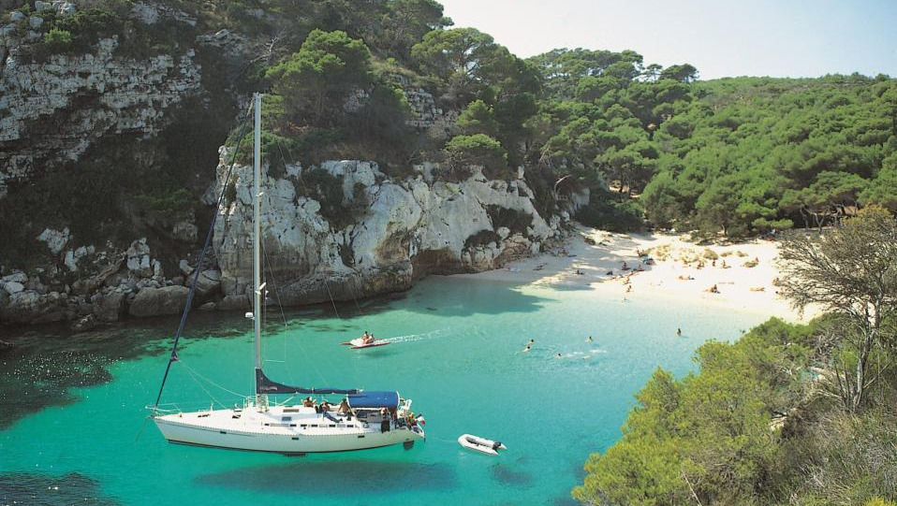

Slide 21
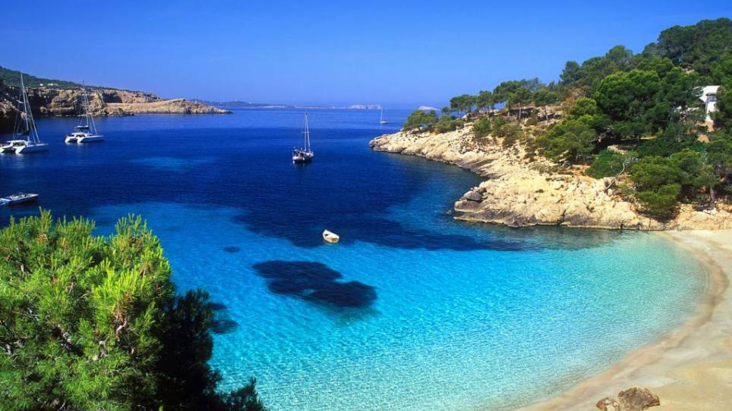

Slide 22
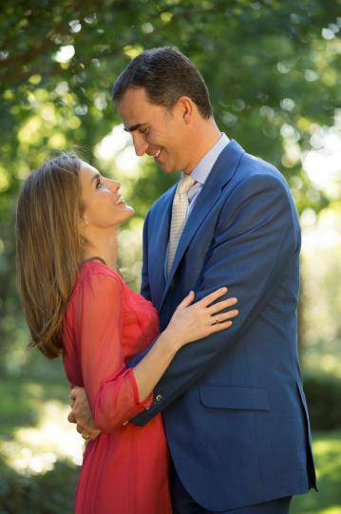
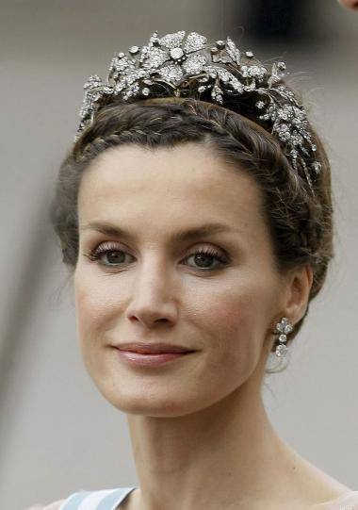
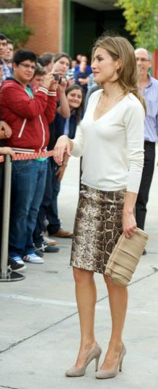
Spanish prince and princess
西班牙太子與太子妃

Slide 23
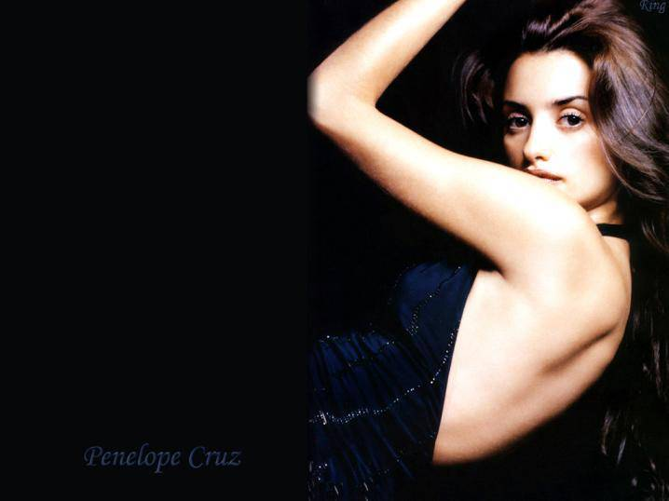

Spanish eyes

Slide 24


Spanish beauties

Slide 25



Spanish eyes
西班牙人的眼睛

Slide 26

Wedding 婚禮

Slide 27
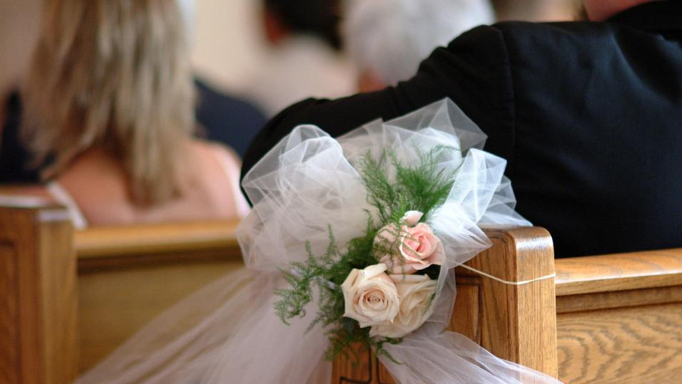

Slide 28
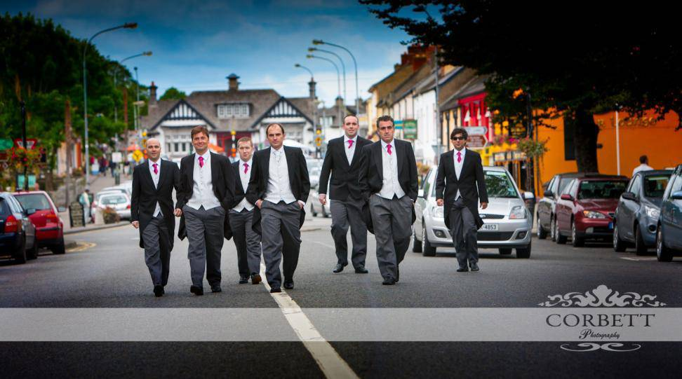

Slide 29
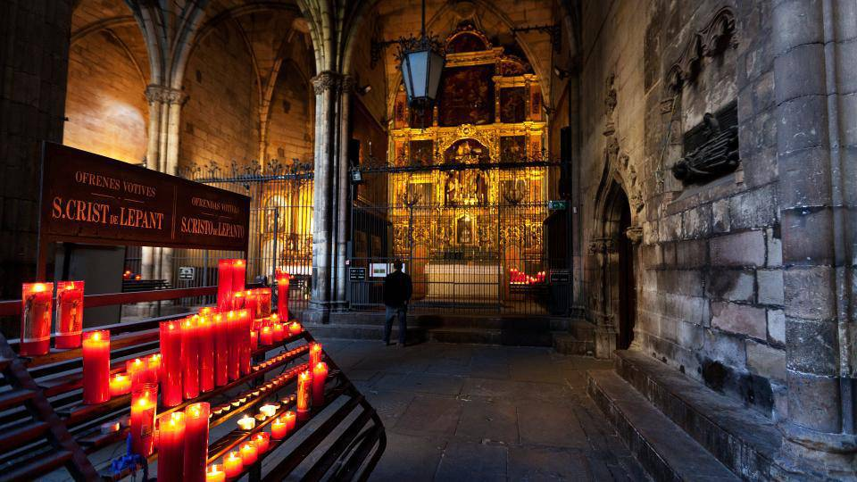

Slide 30
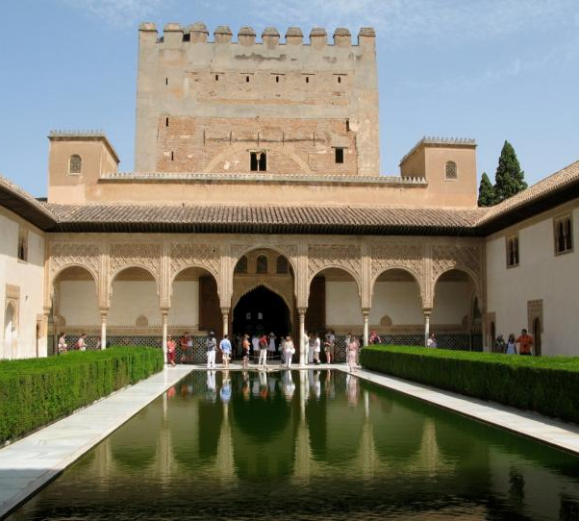
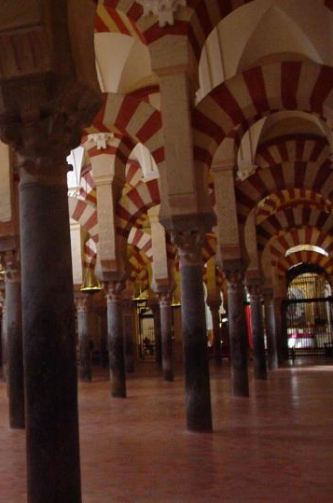
History 歷史
Spain was conquered by Moorish invaders for hundreds years. The Moorish left behind some buildings.
西班牙曾經被北非的摩爾人佔領過好幾百年，他們留下了這些建築。

Slide 31
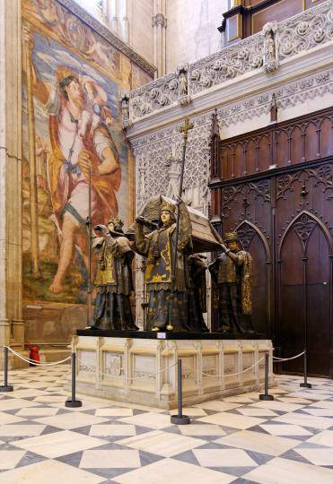
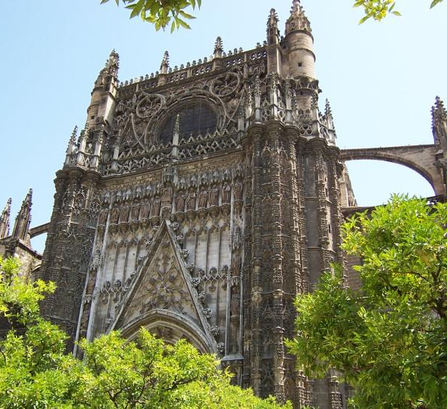
Columbus' Tomb was placed in this church--Seville Cathedral
哥倫布的靈柩置放於此教堂

Slide 32
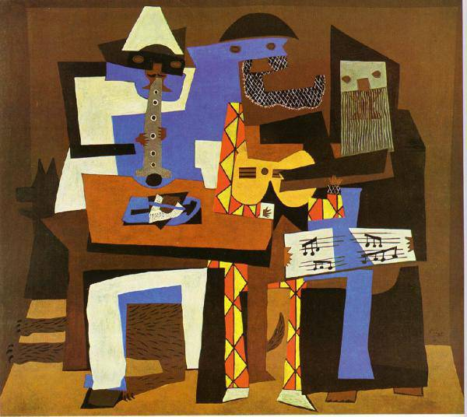
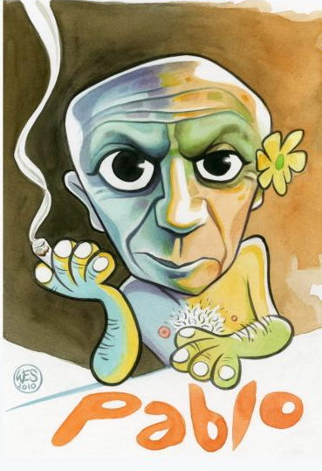
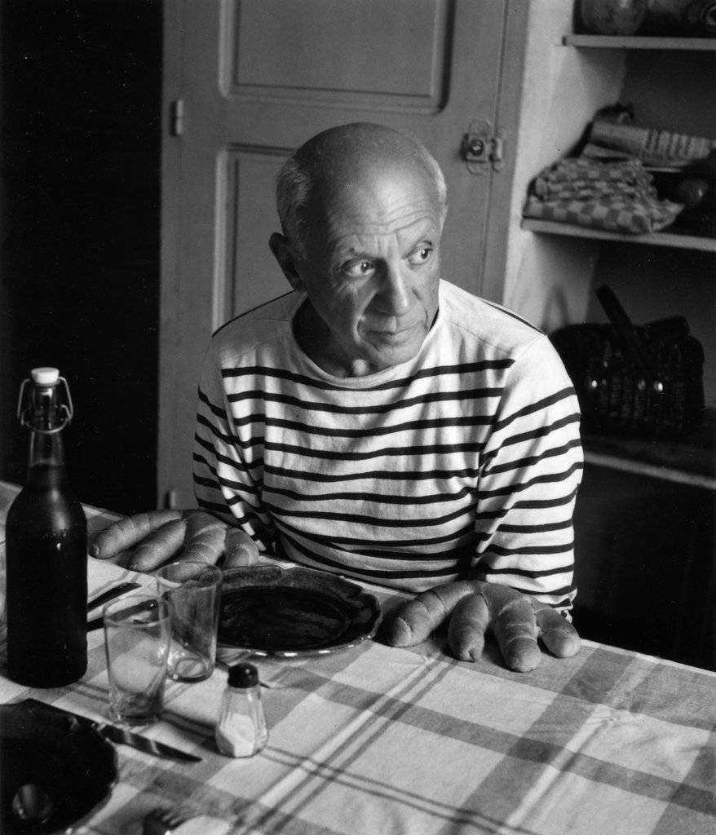
Picasso

Slide 33
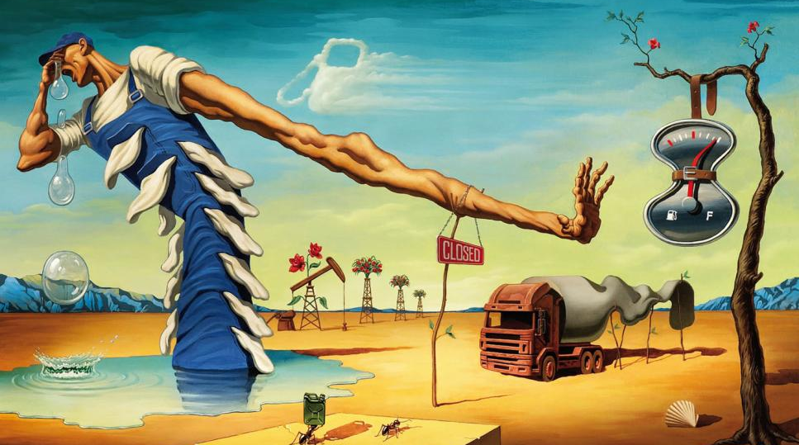
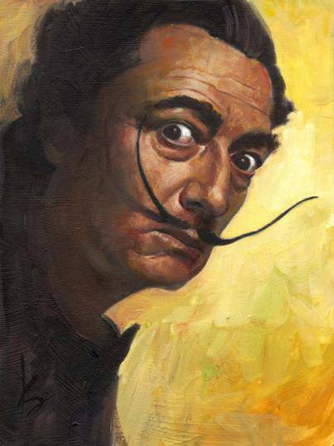
Salvador Dali

Slide 34


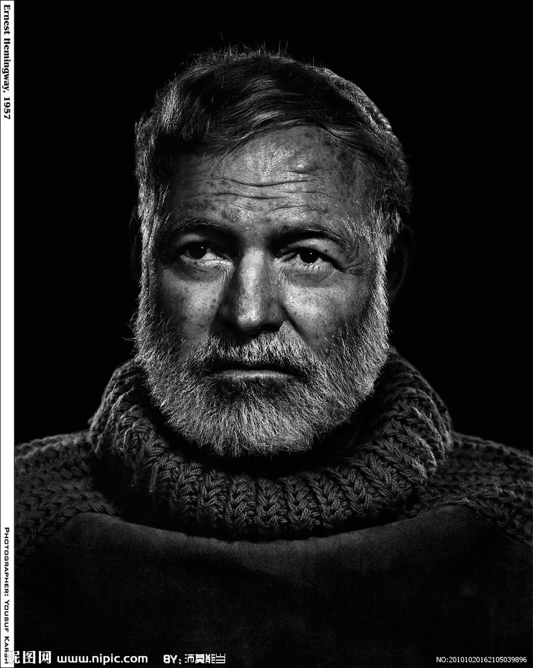
Hemingway once took part in this war.
海明威曾經參加了這場戰爭。

Slide 35
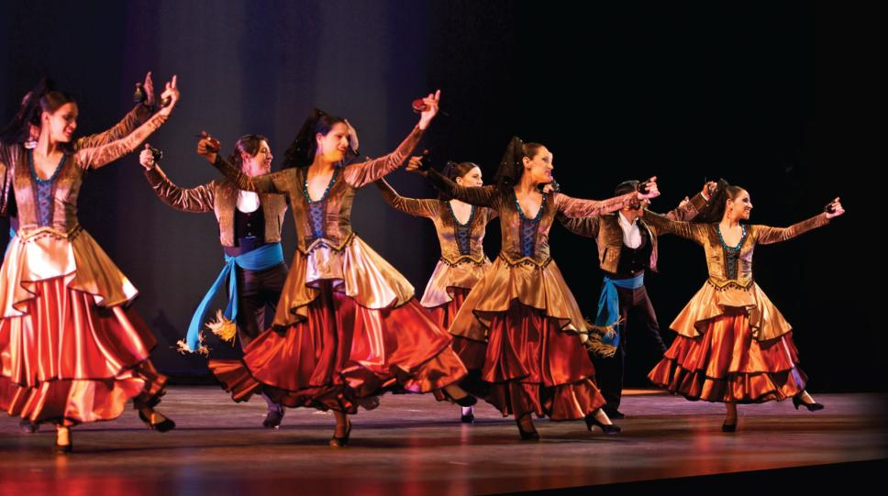
Dancing 舞蹈

Slide 36
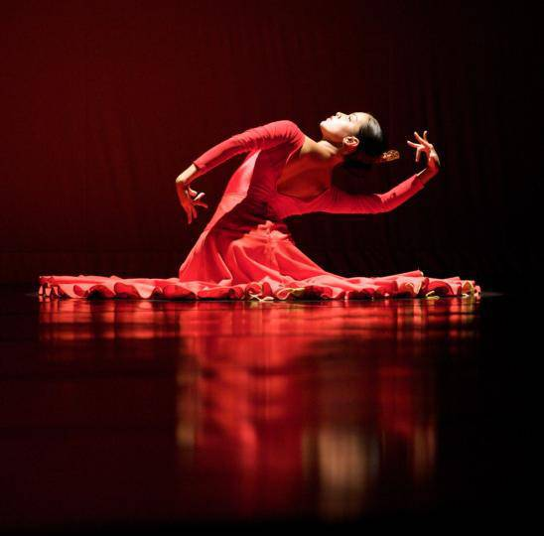
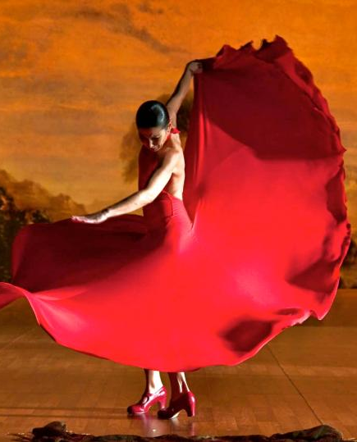

Slide 37
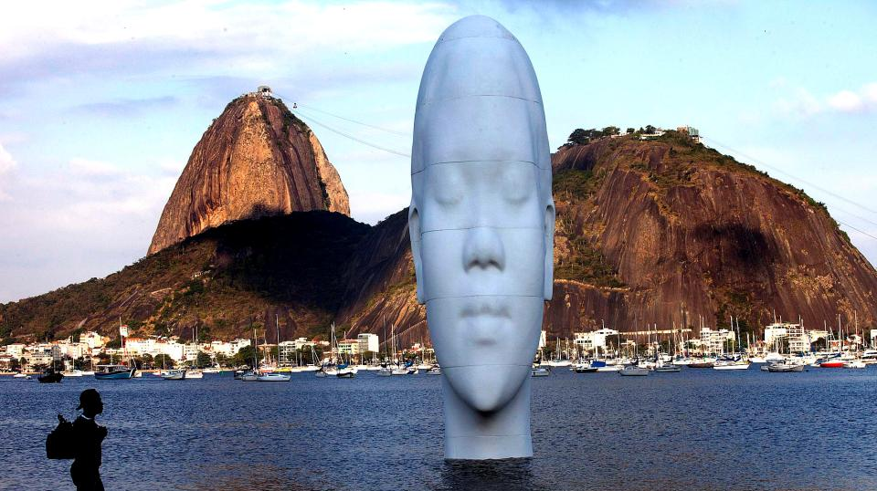
Art 藝術

Slide 38
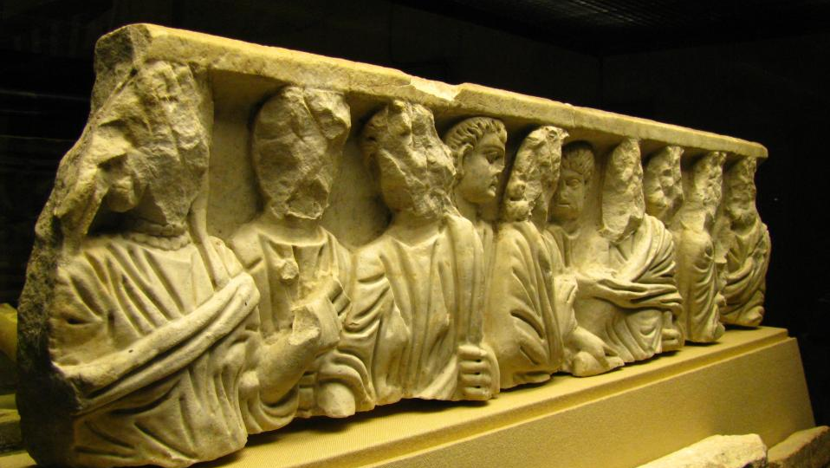
Antiquities. 古物

Slide 39

Spanish Navy 西班牙海軍

Slide 40
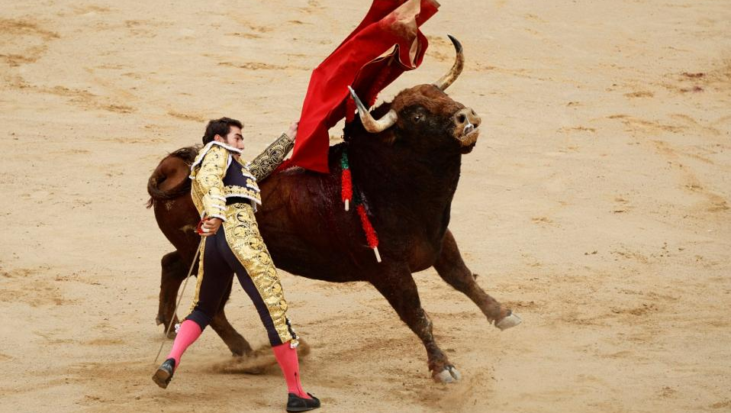
Bullfighting 鬥牛

Slide 41
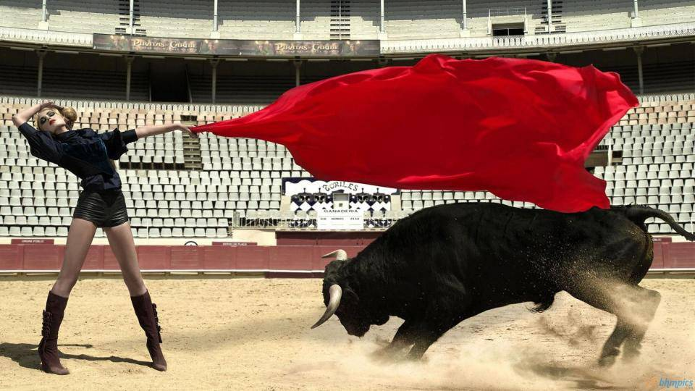

Slide 42
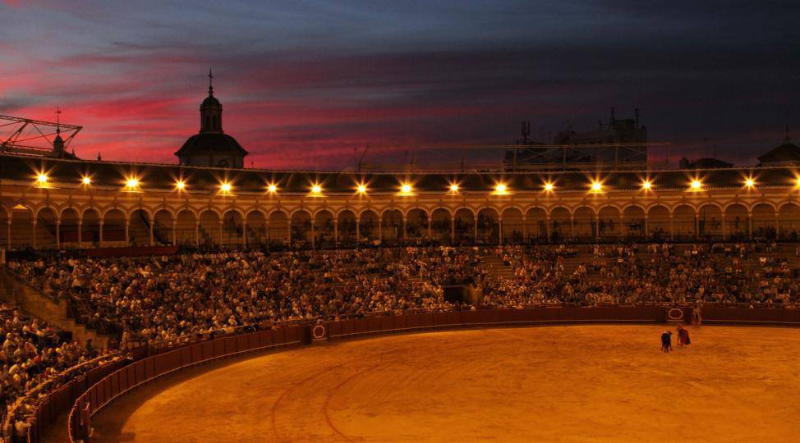

Slide 43
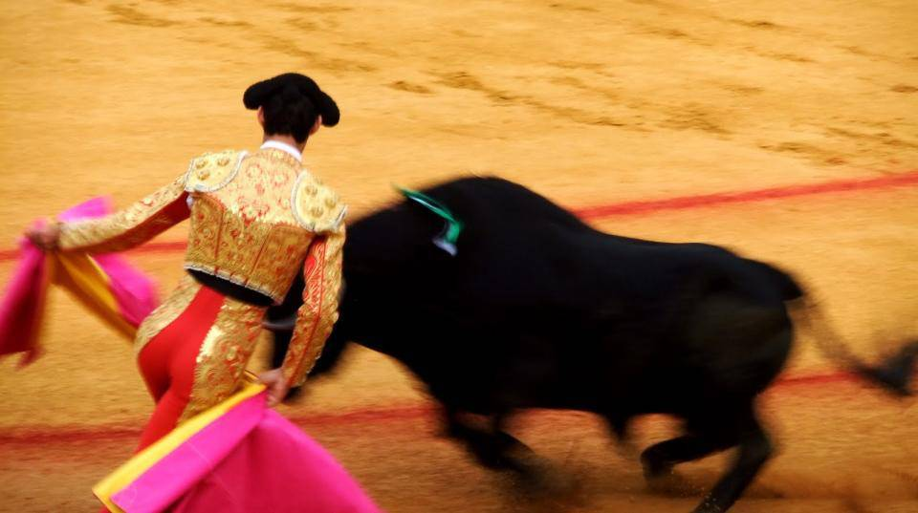

Slide 44
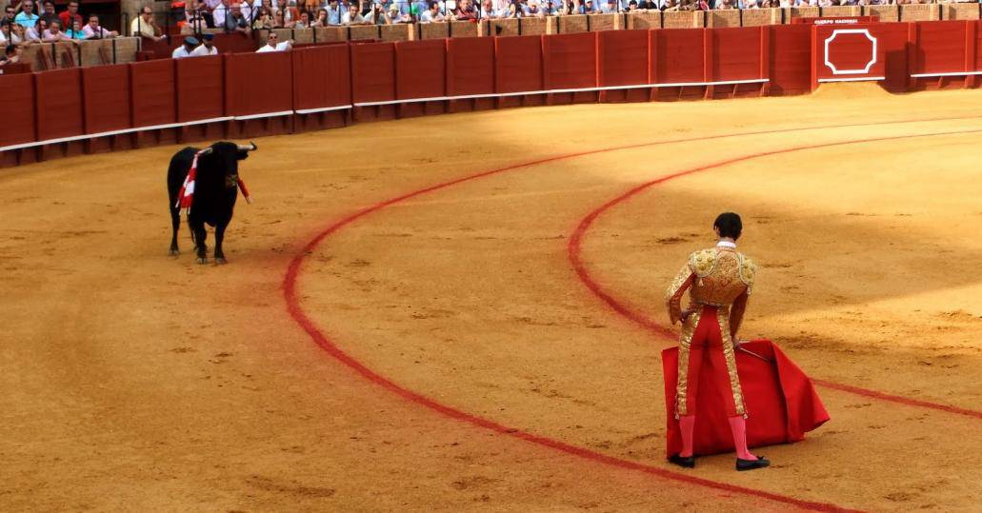

Slide 45
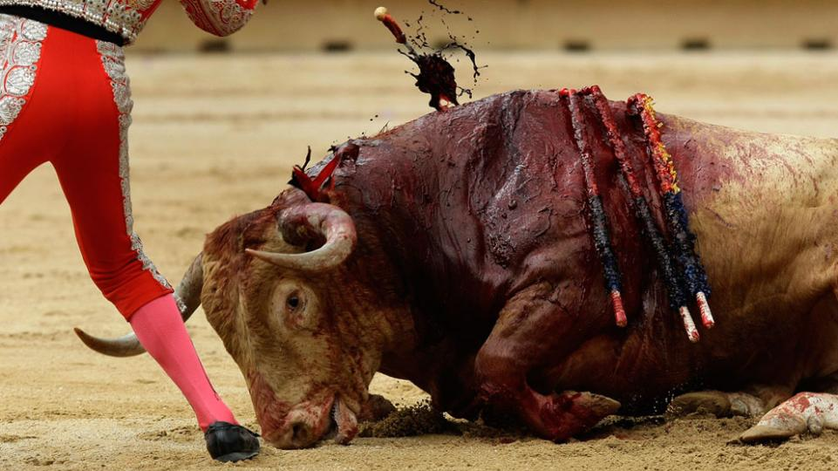

Slide 46
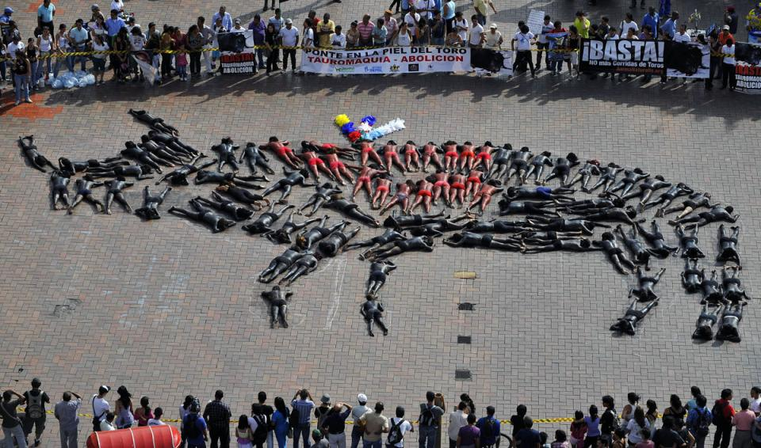
Against bullfighting.
反對鬥牛

Slide 47
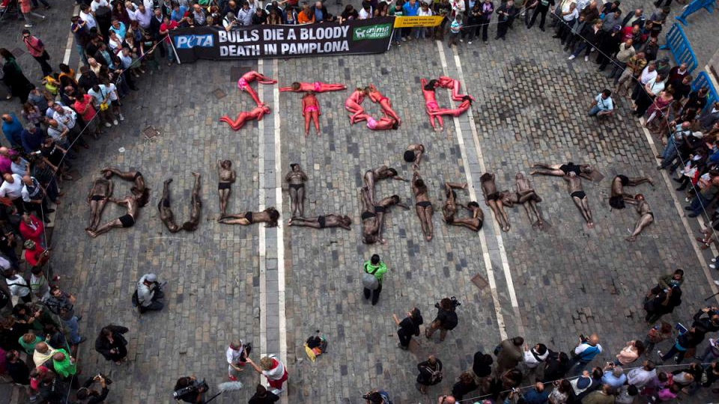

Slide 48

Against bullfighting.
反對鬥牛

Slide 49



Slide 50

The Festival of San Fermin
The Running of the Bulls
奔牛節

Slide 51


Slide 52


Slide 53


Slide 54


Slide 55


Slide 56


Slide 57


Slide 58

Tomato Festival
番茄(西紅柿)大戰

Slide 59


Slide 60


Slide 61


Slide 62

Pretty Gypsy Beggar, Barcelona (Old Town).
巴塞隆納的吉普賽乞丐

Slide 63

Football game 足球運動

Slide 64

Football fan 足球迷

Slide 65



Slide 66

西班牙的經濟大危機

Slide 67

Riot for economic crisis
憤怒的西班牙人抗議節衣縮食

Slide 68


Slide 69



Slide 70



Slide 71


Slide 72



Slide 73


Slide 74


They have to face this problem.
他們必須面對這個無奈又嚴肅的問題。

Slide 75


Slide 76



Slide 77

Where are their hopes?
李常生 Eddie Lee 12/28/2012 Taipei,
All photos from est 100, internet….
Leechangsheng6666@gmail.com

