Slide 1
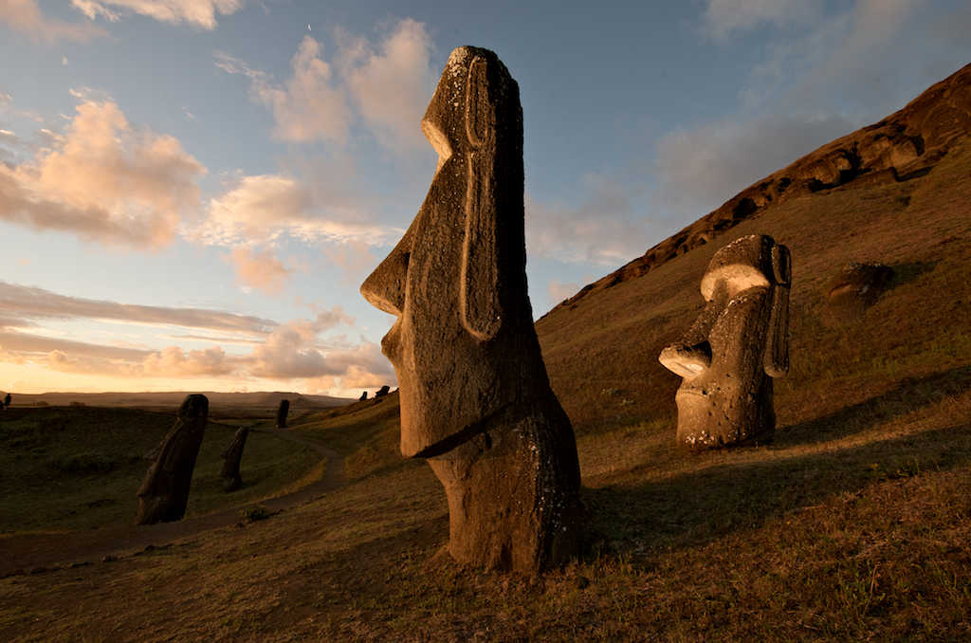
Chile
Helga design

Slide 2
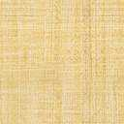
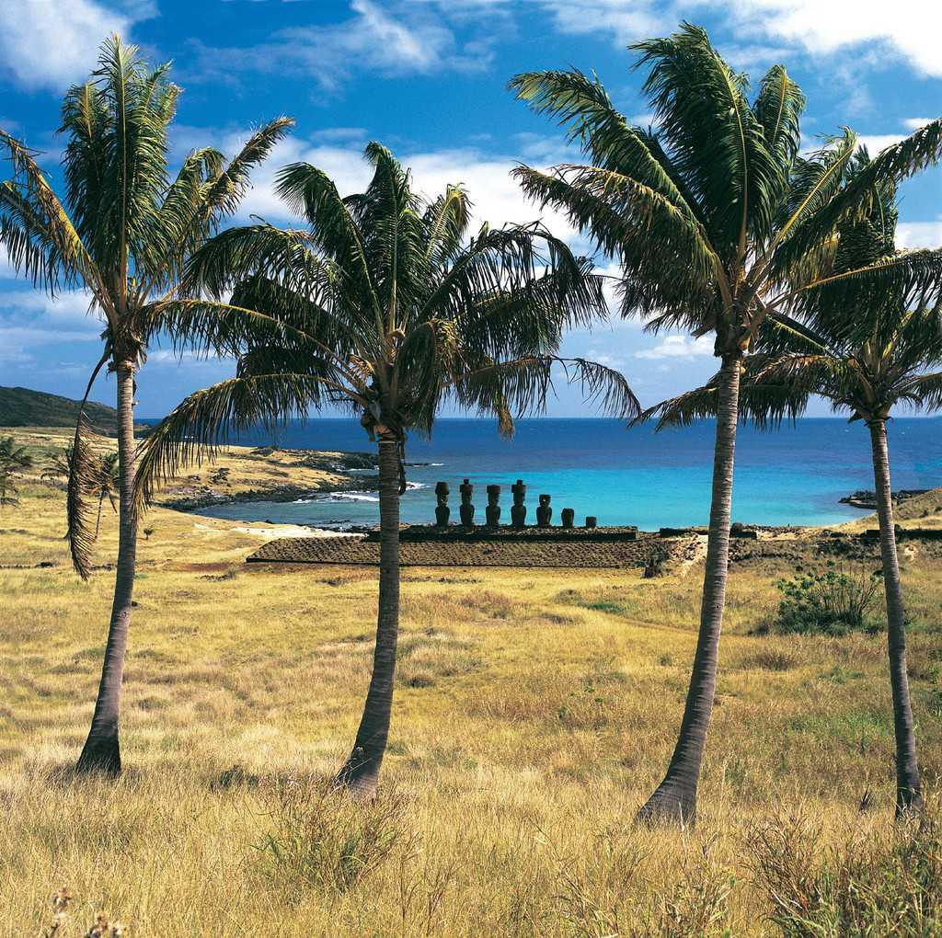
Isla de Pascua- Rapanui

Slide 3
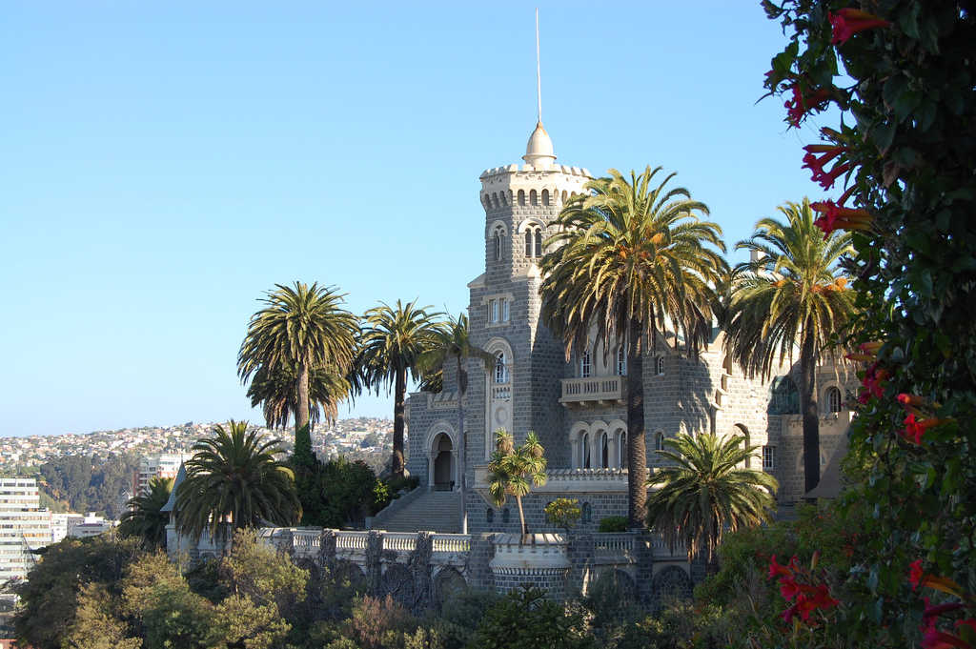
Castillo Brunet, en Viña del Mar

Slide 4
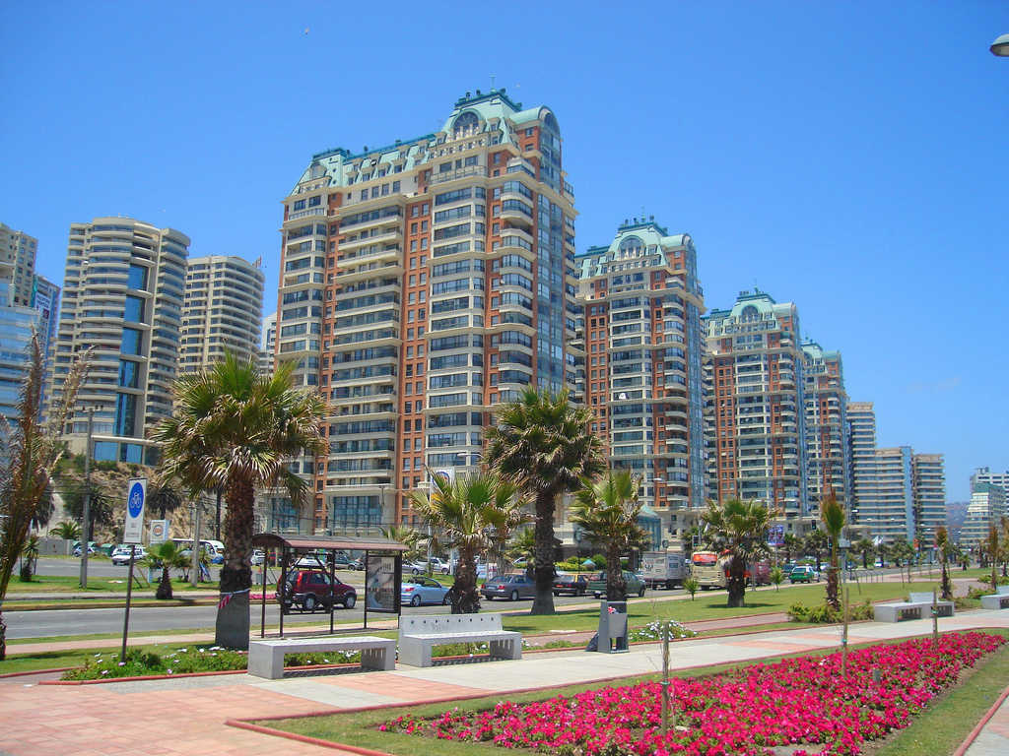
Viña del Mar

Slide 5
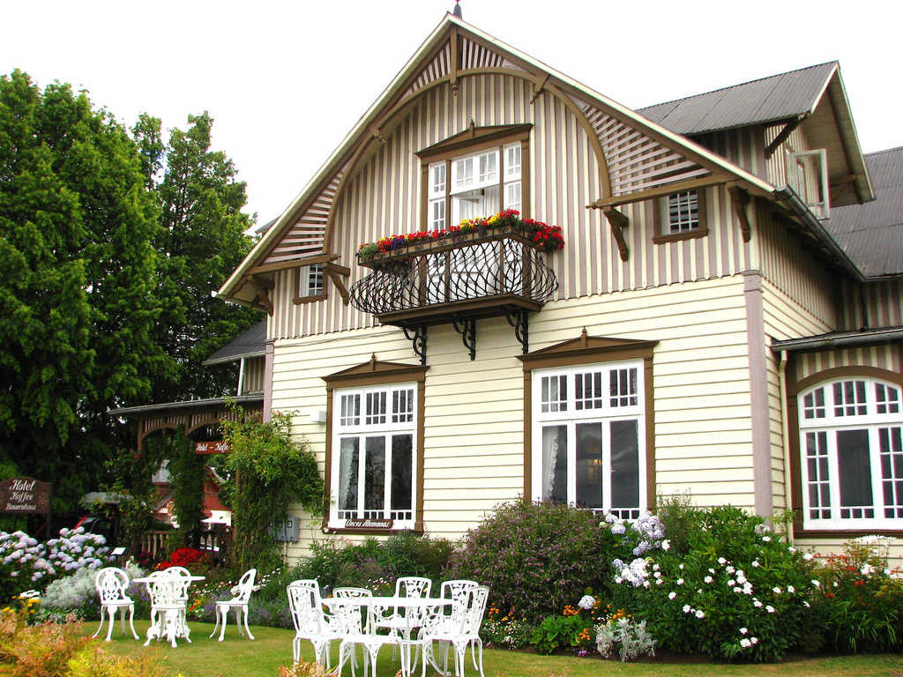

Hotel Kaffe Bauernhaus

Slide 6
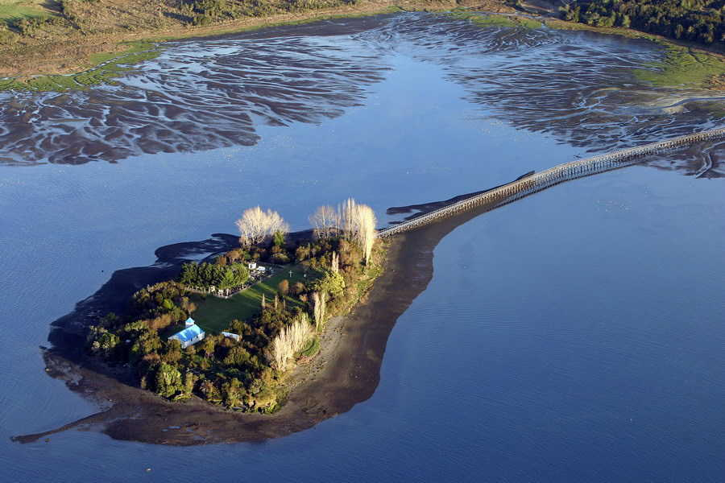
Isla en Chiloé

Slide 7
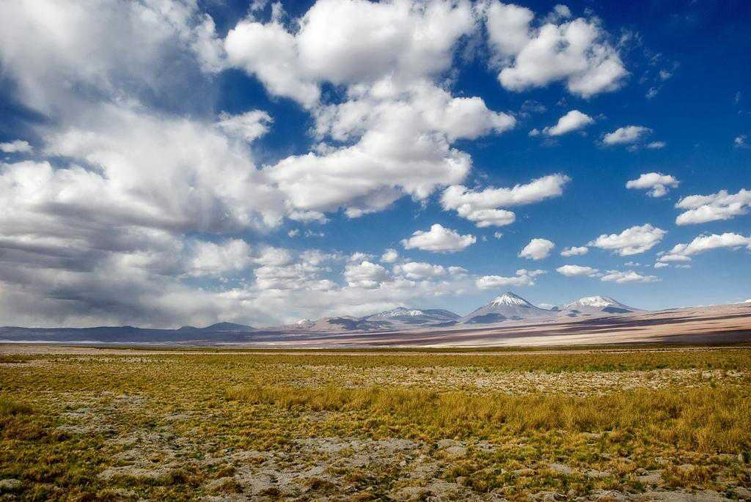
Desierto de Atacama

Slide 8
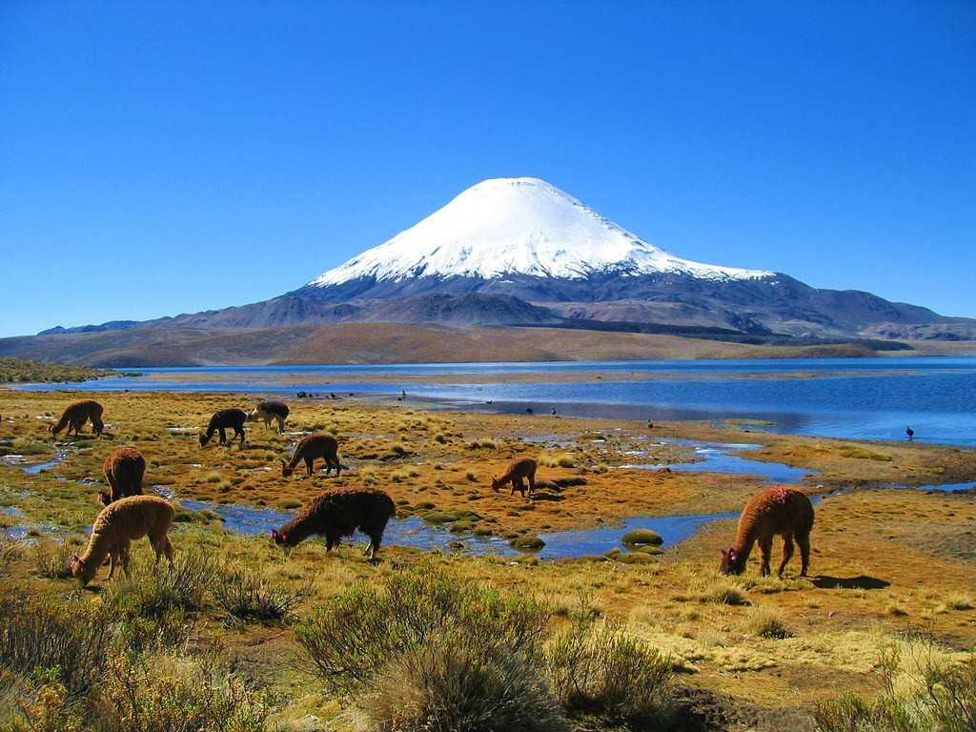
Lago Chungará

Slide 9
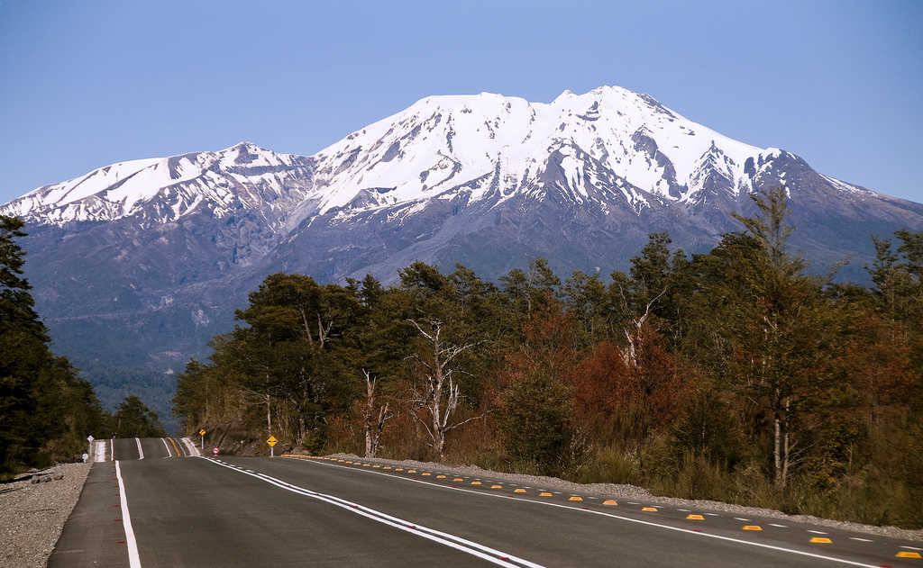
Calbuco

Slide 10
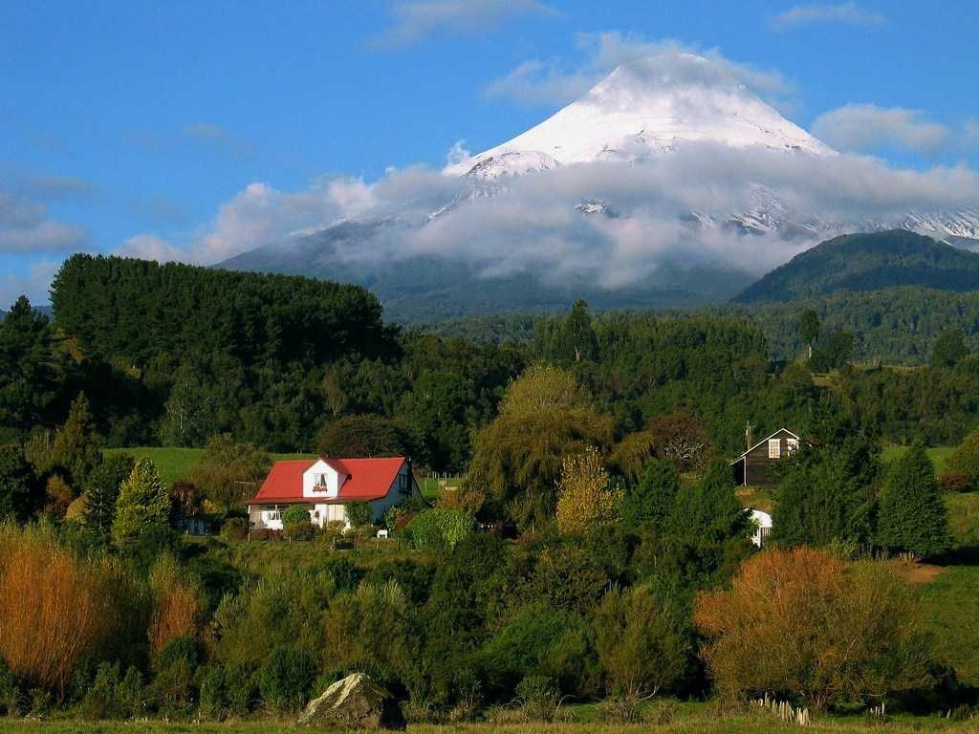
Volcán Osorno

Slide 11
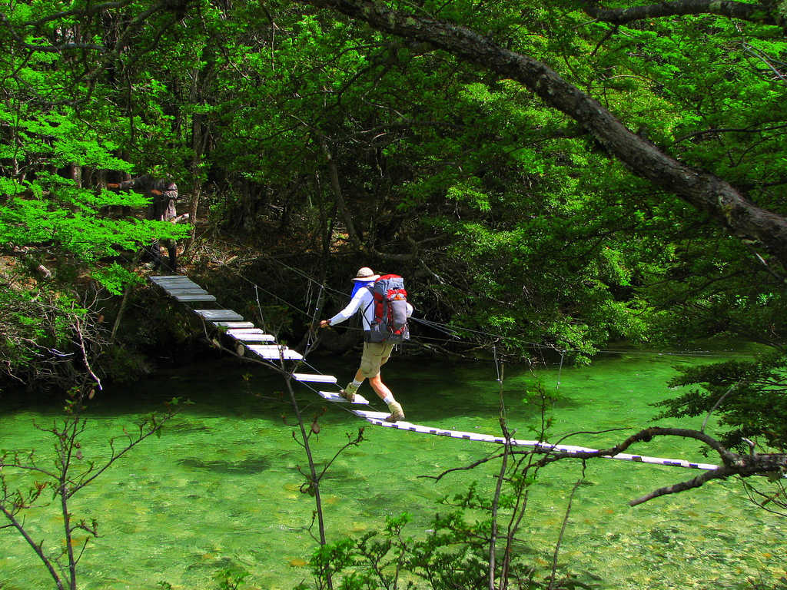
Trekking en la Patagonia

Slide 12
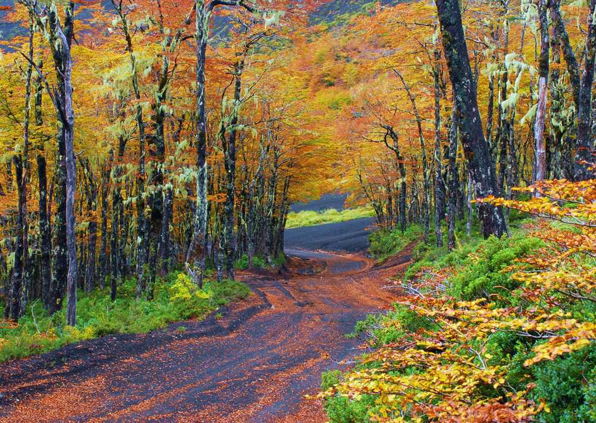
Antillanca

Slide 13
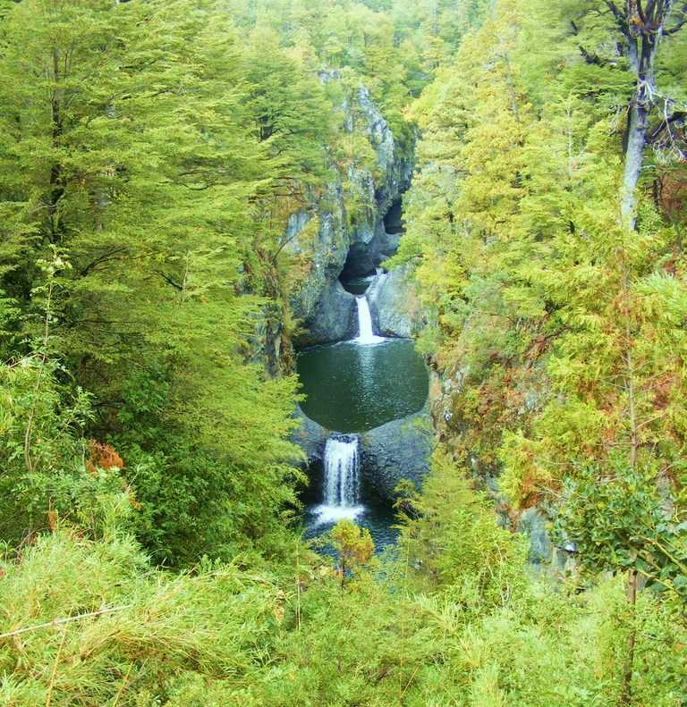
7 Tazas

Slide 14
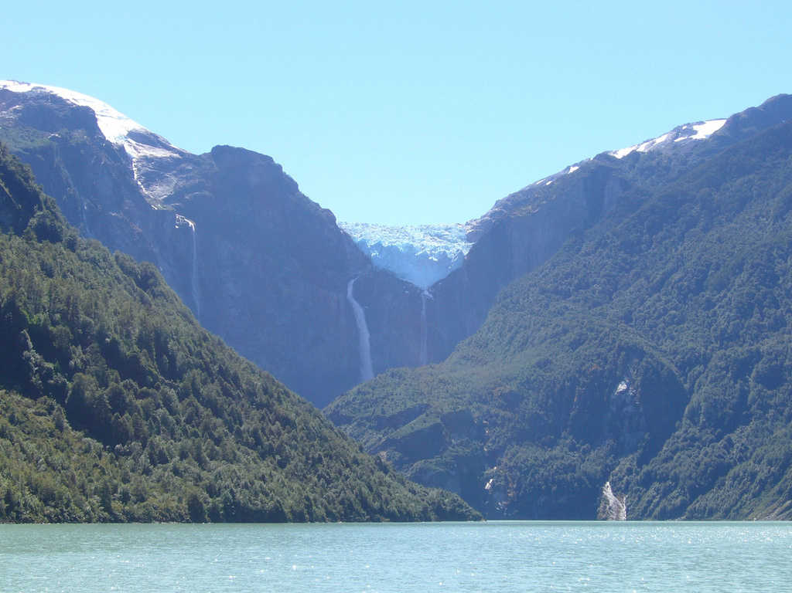
Glaciar Colgante Queulat

Slide 15
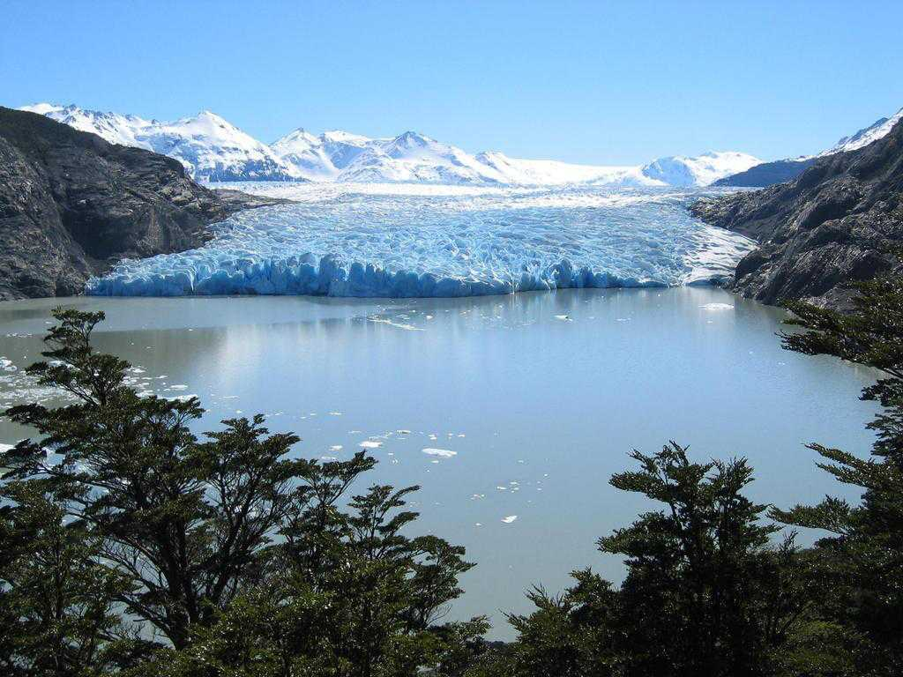
Glaciar Grey

Slide 16
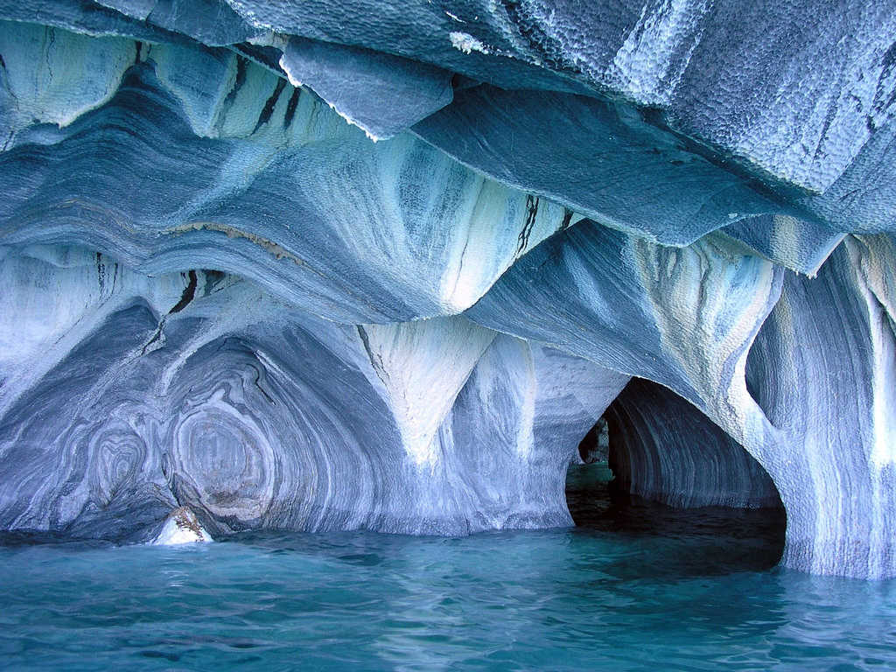
Catedral de Marmol

Slide 17
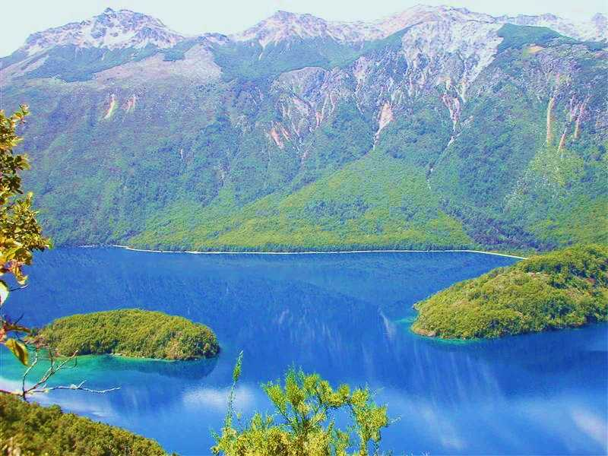
Lago Azul

Slide 18
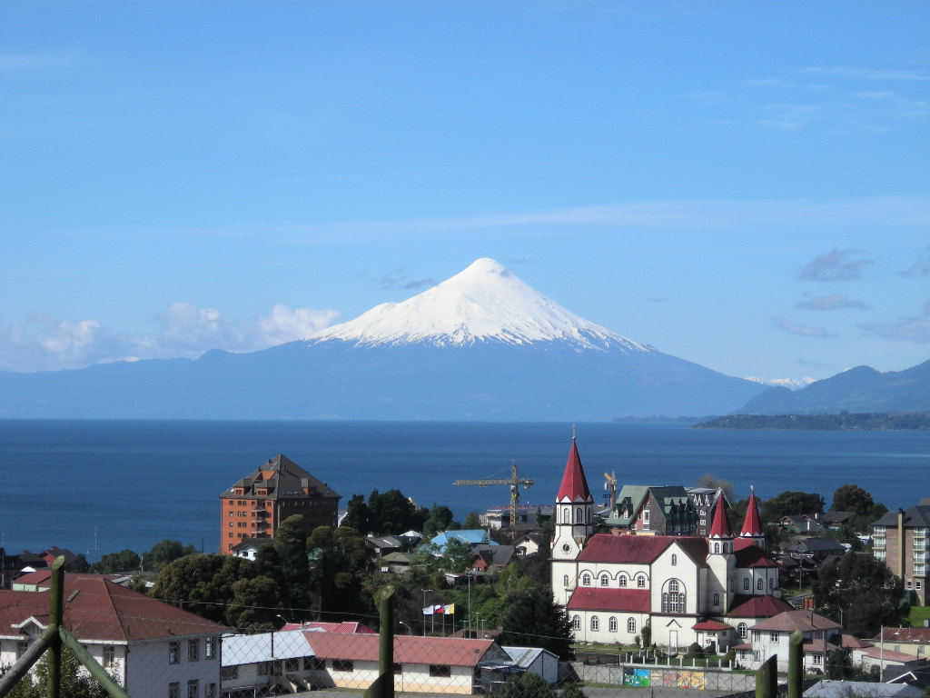
Puerto Varas

Slide 19
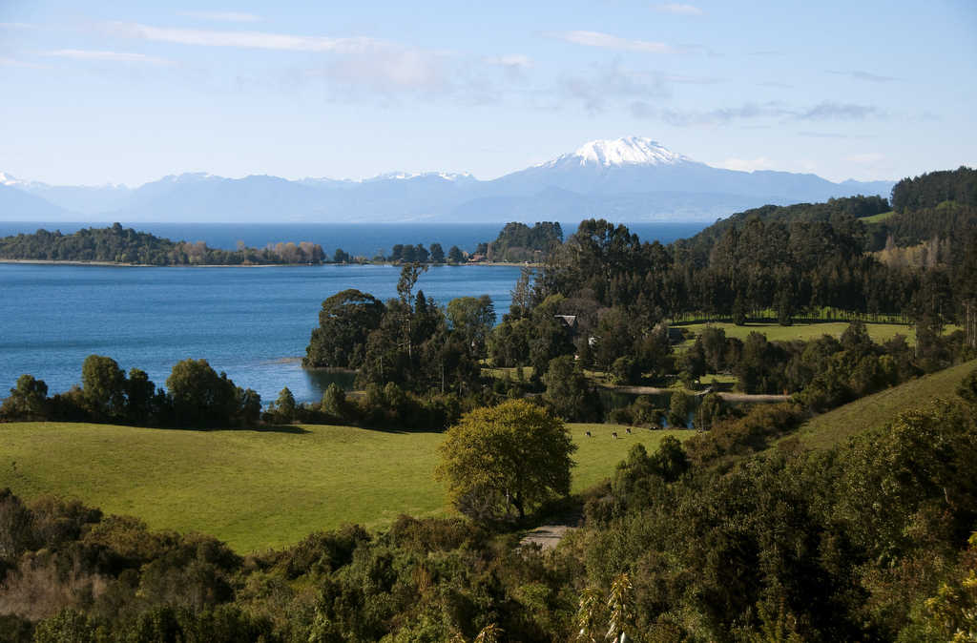
Volcán Osorno

Slide 20
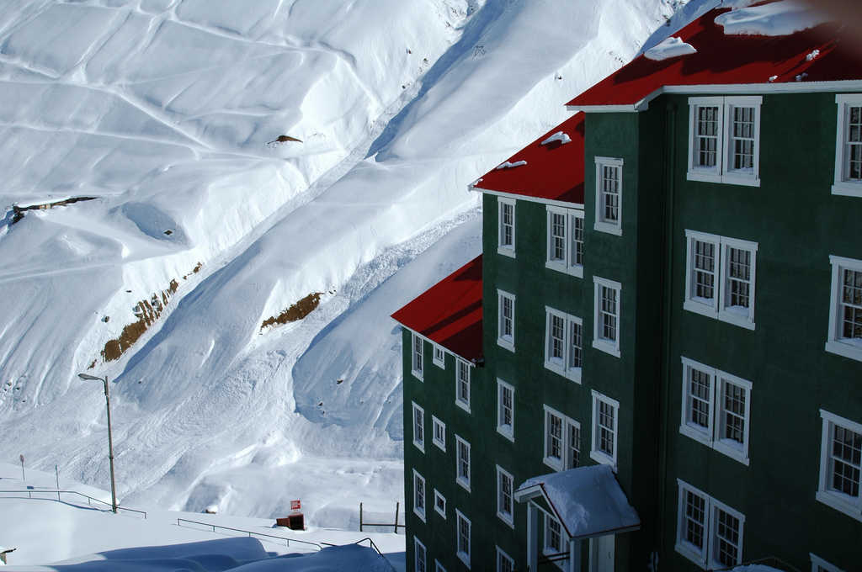
Sewell

Slide 21
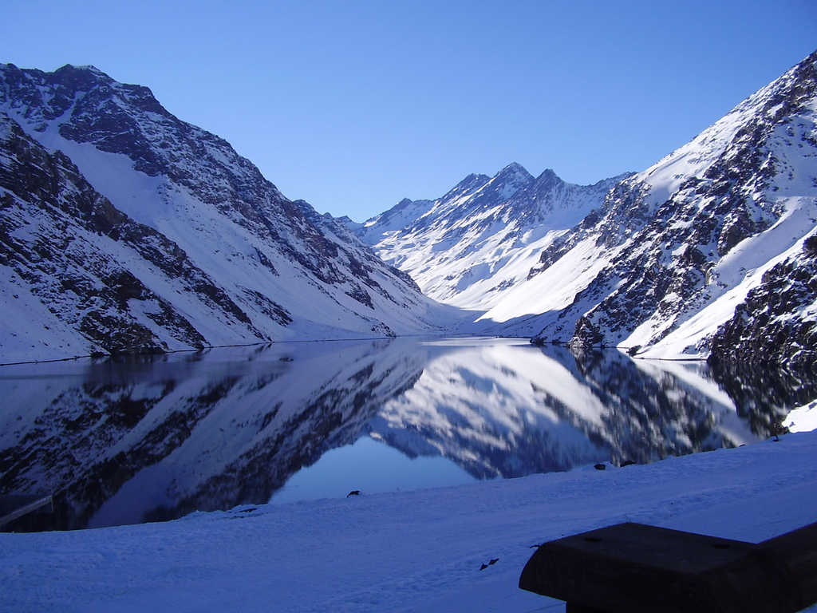
Laguna del Inca

Slide 22
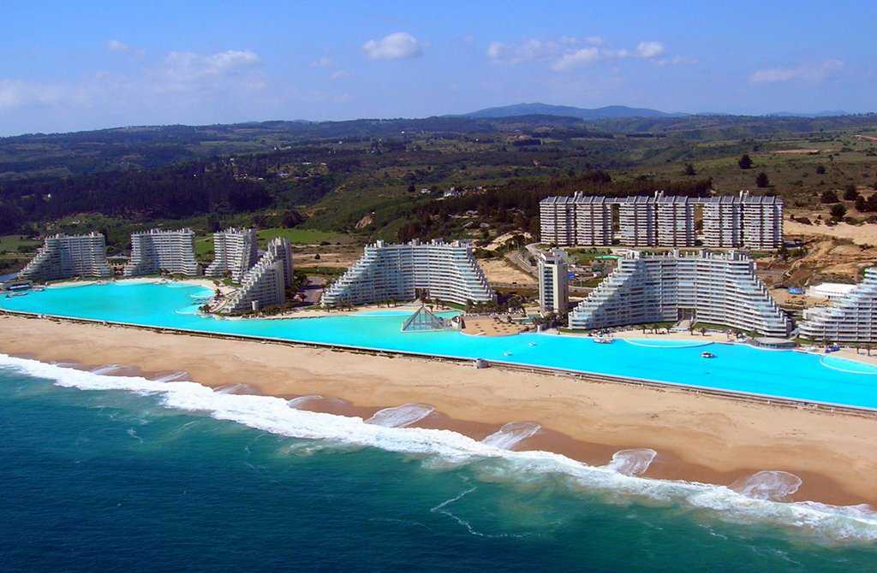
San Alfonso del Mar

Slide 23
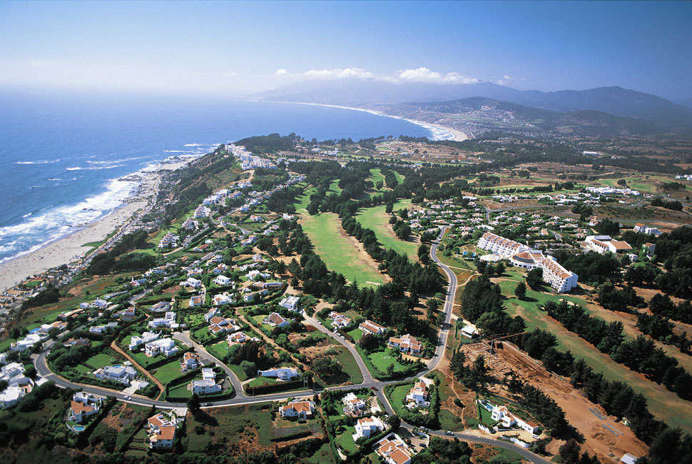
Marbella

Slide 24
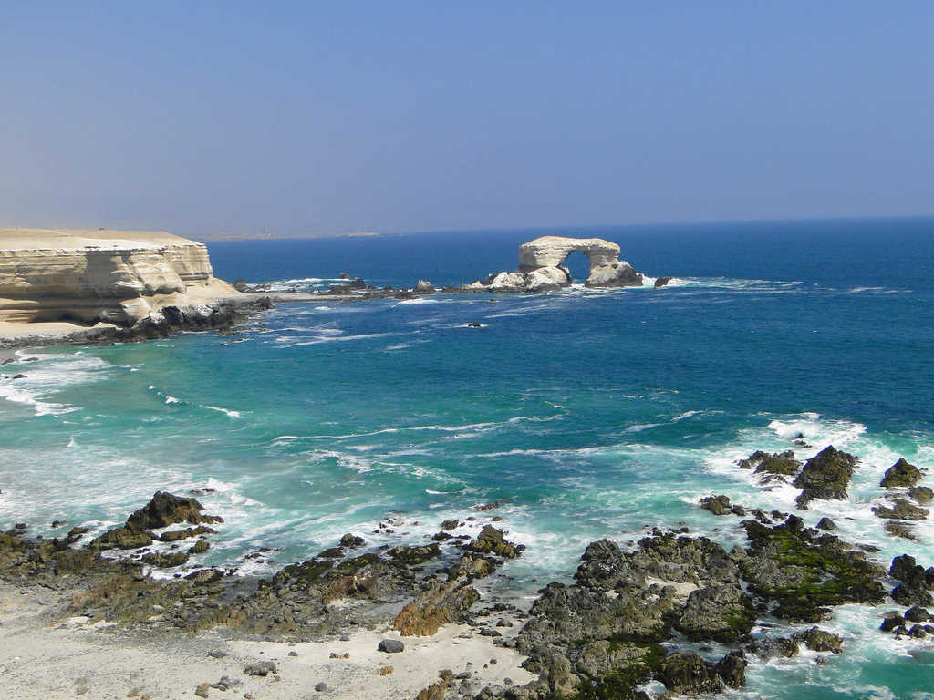
Portada de Antofagasta

Slide 25
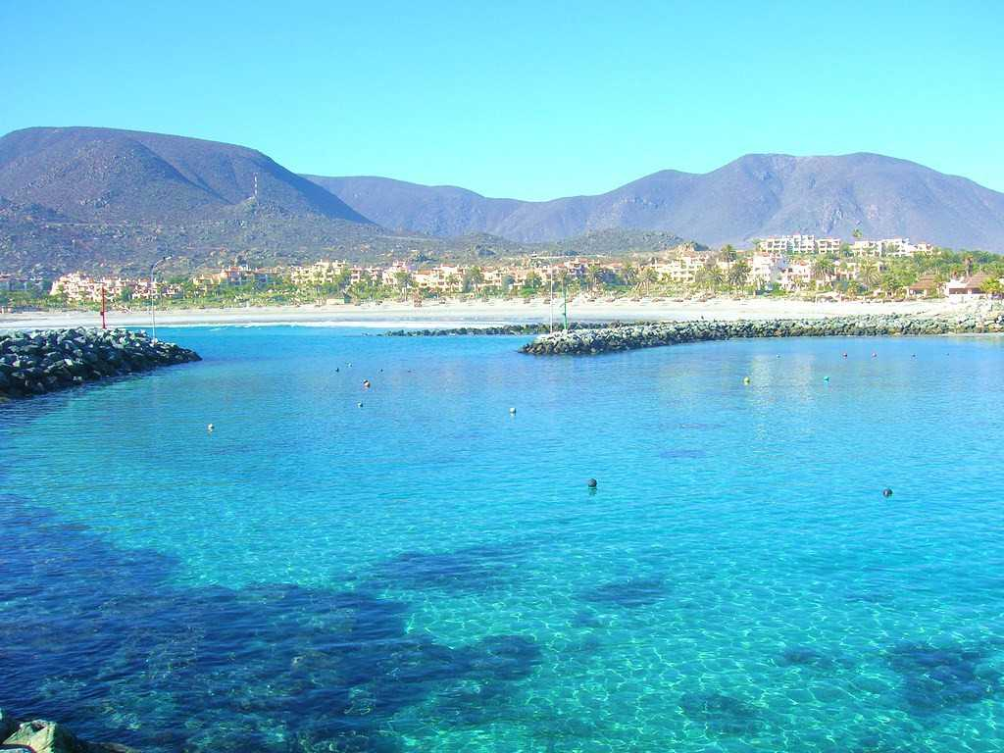
Las Tacas

Slide 26
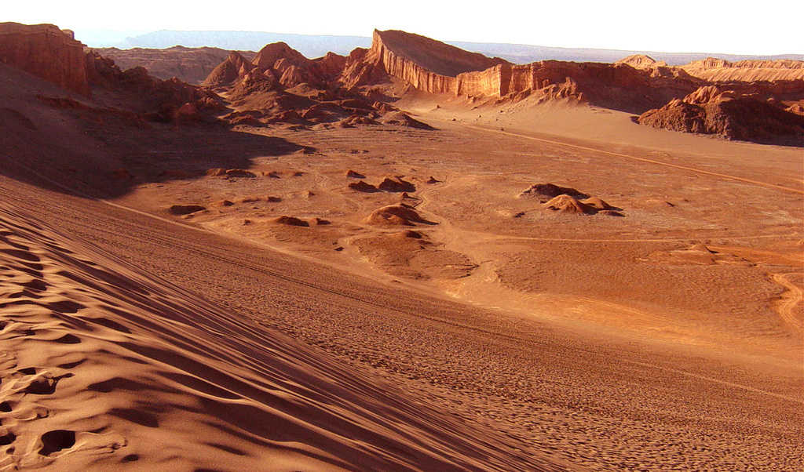
Valle de la Luna

Slide 27
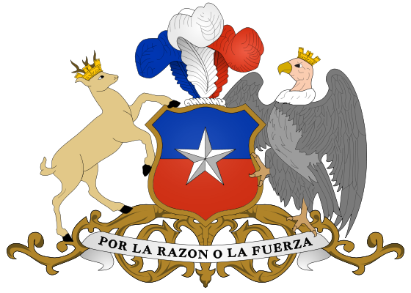
Chile officially the Republic of Chile, is a country in South America occupying a long, narrow coastal strip between the Andes mountains to the east and the Pacific Ocean to the west. It borders Peru to the north, Bolivia to the northeast, Argentina to the east, and the Drake Passage in the far south. Along with Ecuador, it is one of two countries in South America that do not border Brazil.
The Pacific coastline of Chile is 6,435 kilometres (4000 mi)
Chilean territory includes the Pacific islands of Juan Fernández, Salas y Gómez, Desventuradas and Easter Island. Chile also claims about 1,250,000 square kilometres (480,000 sq mi)
of Antarctica.

Slide 28
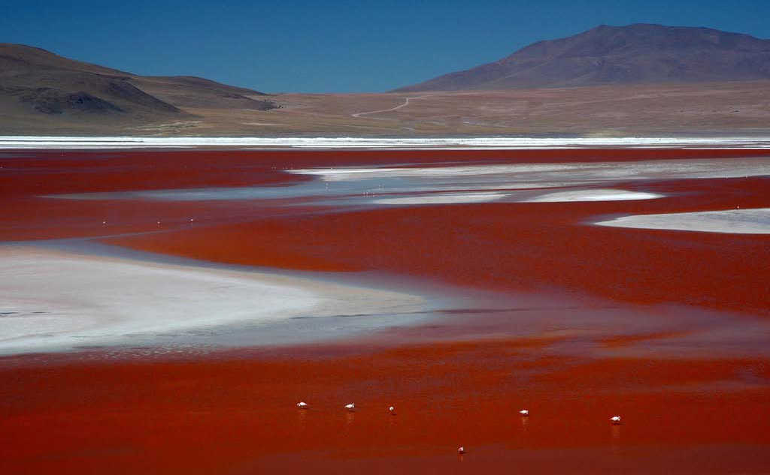
Laguna Colorada

Slide 29
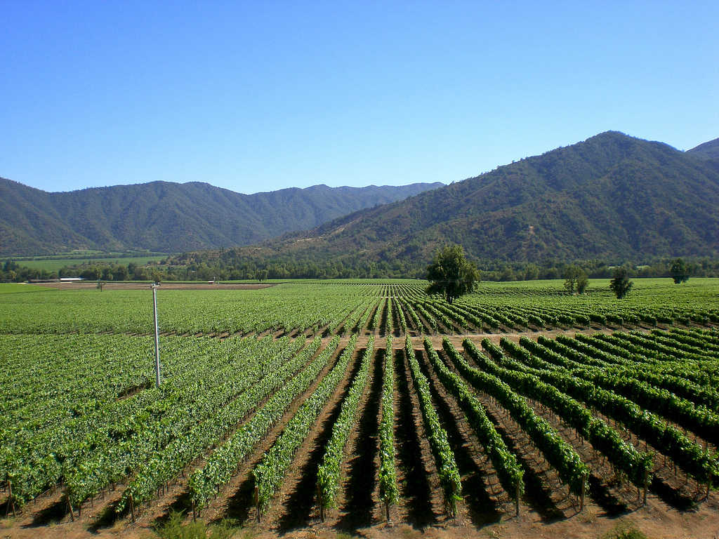
Valle del Maipo

Slide 30
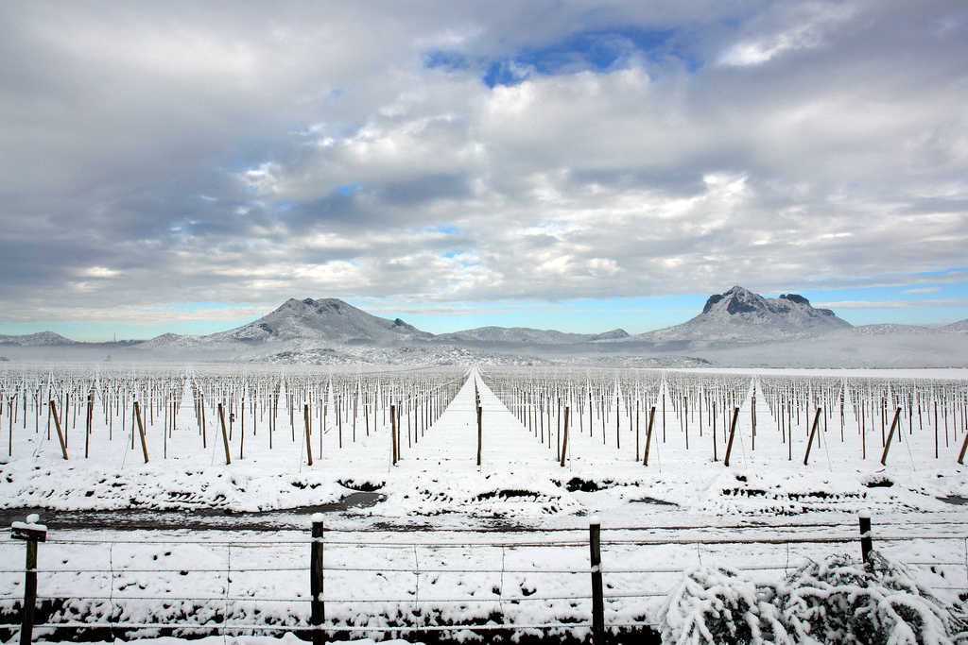

Viñas bajo la nieve

